Slide 1

Two electrons source, for two different projects at CERN
Dr Kévin Pepitone

Slide 2
Outline
AWAKE
  Electron beam line and electron source
  Beam instrumentation (BPM, Faraday Cup, PepperPot)
  Booster structure
  Klystron and modulator
CLIC
  Layout
  Electron source
  Cathode and connector
  Experimental results
  Simulations
  Comparison experiments/simulations
  Emittance estimation
Conclusions

Slide 3
Outline
AWAKE
  Electron beam line and electron source
  Beam instrumentation (BPM, PepperPot)
  Booster structure
  Klystron and modulator
CLIC
  Layout
  Electron source
  Cathode and connector
  Experimental results
  Simulations
  Comparison experiments/simulations
  Emittance estimation
Conclusions

Slide 4

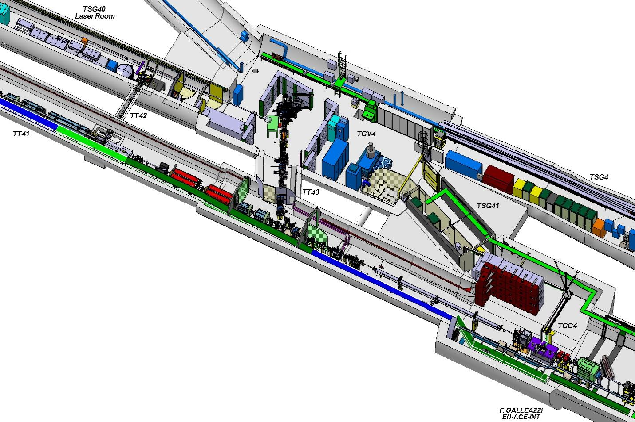
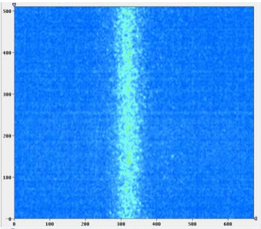
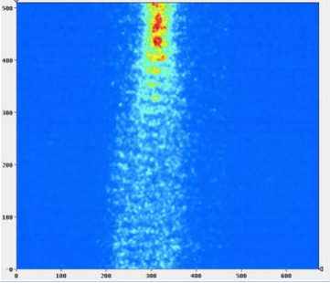
AWAKE - Introduction
Comparison to the proton bunch longitudinal profile (left, no plasma) with the profile for a bunch passing through the plasma (right). The strong modulation of the bunch is clearly seen

Slide 5
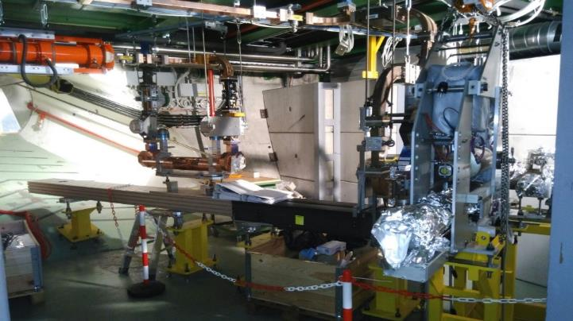
AWAKE – Electron source
Parameters | Phase 1
Beam energy | 16 MeV
Relative energy spread | Dp/p = 0.5%
Bunch Length | σ_{z} = 4 ps (1.2 mm)
Bunch size at focus | σ*_{x,y} = 250 um
Normalized Emittance | 2 mm.mrad
Electrons/bunch (bunch charge) | 1.25E9 (0.2 nC)

Slide 6
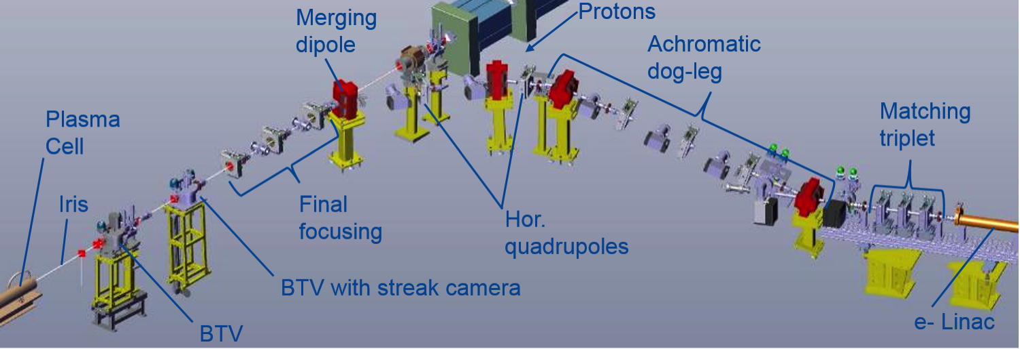
AWAKE – Electron transfer line layout

Slide 7
AWAKE – Beam instrumentation
Instrument | How many | Resolution | Who
BPMs | 3 | 50 um | Triumf, new
Fast current transformer | 1 | 10 pC | CERN, existing
Faraday cup | 1 | 10 pC | Triumf, new
Screens | 3 | ~ 20 um | CERN, partly existing
Multi slit (emittance) | 1 | < mm mrad | University of Manchester
Quad scan (emittance) | 1 | < mm mrad | CERN
Spectrometer | 1 | 10 keV | CERN
Klystron from CTF3
Laser +Diagnostics
Spectrometer
MTV
Matching triplet
FCT
Emittance
MS
Accelerator
FC
BPM
BPM
RF GUN
VPI
MTV, Emittance
Corrector

Slide 8

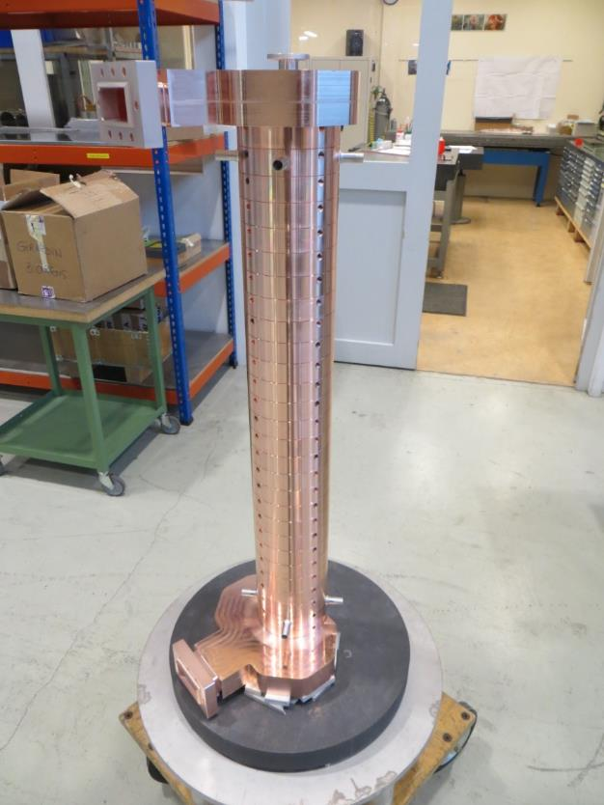
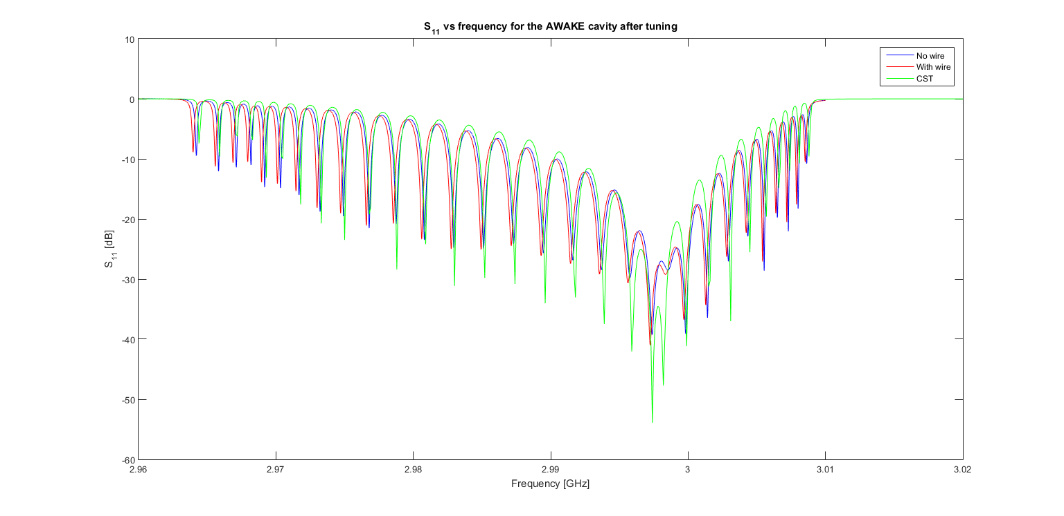
AWAKE – Booster structure fabrication and tuning

Slide 9

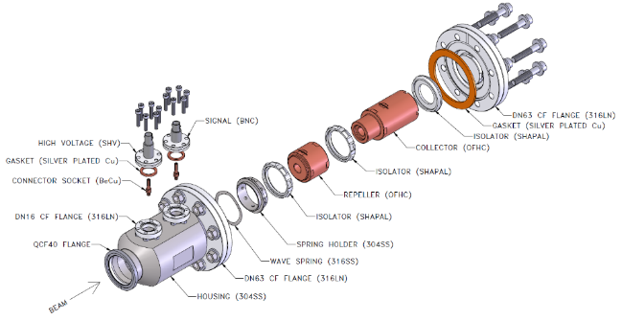
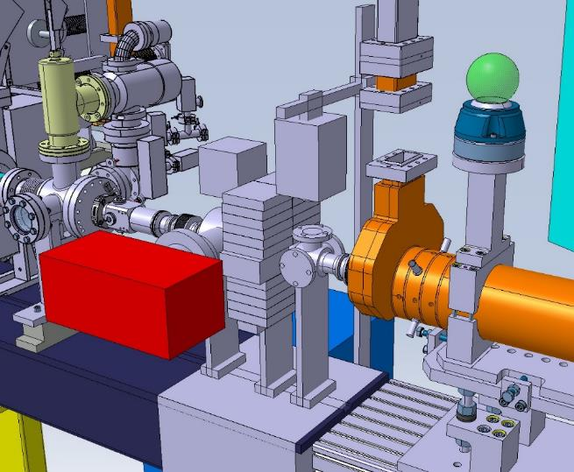
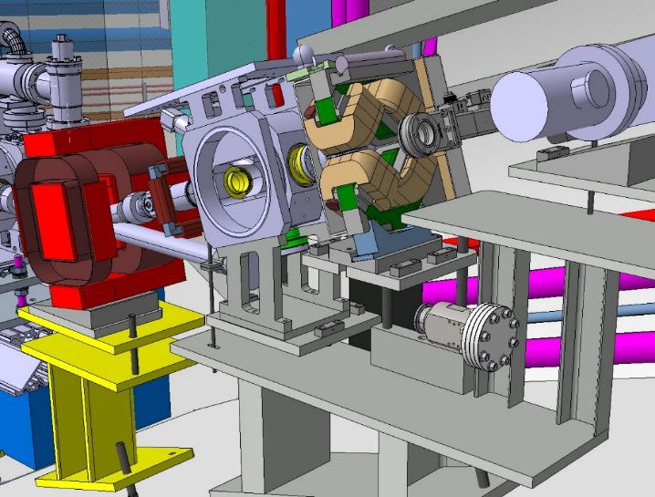
AWAKE – BPM and Faraday Cup

Slide 10

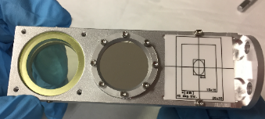

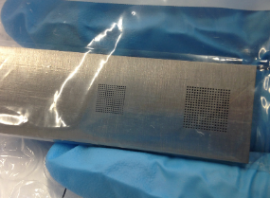
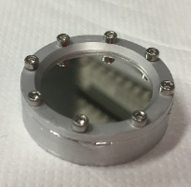
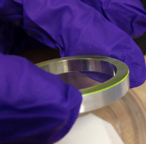
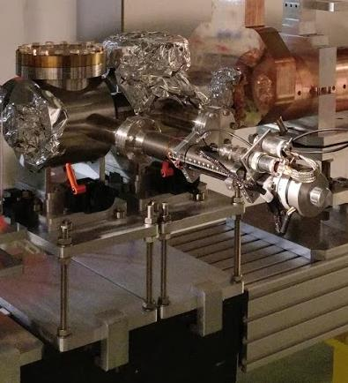
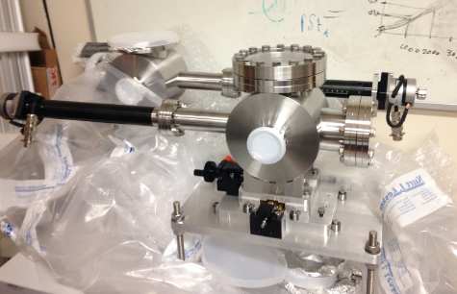
AWAKE – Pepper pot
Calibration screen.
Pepper Pot has been delivered at CERN and installed
OTR
Mask
YAG:Ce

Slide 11
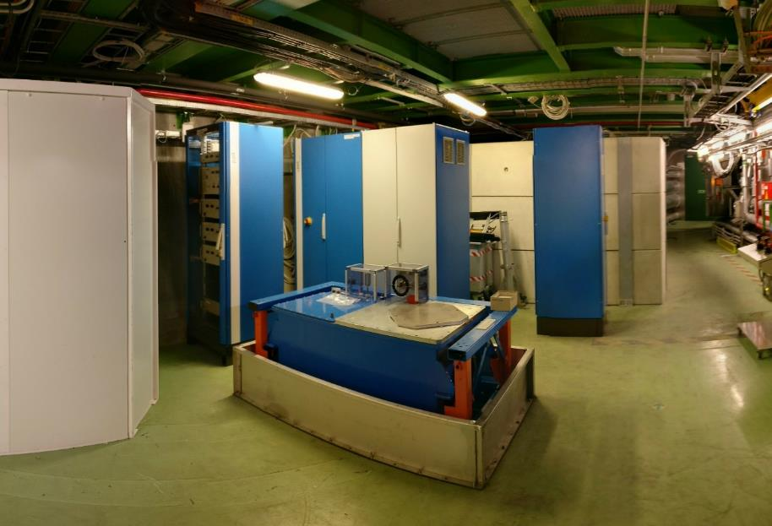
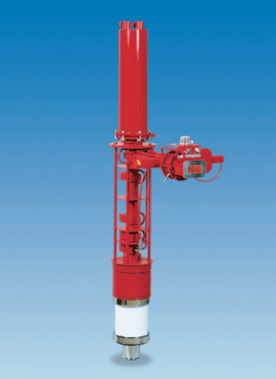
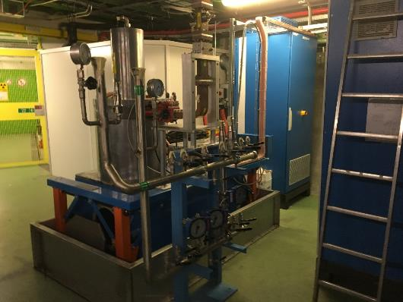
AWAKE – Klystron and modulator
Thales TH2100
Modulator
Power
supplies
Control
Parameters | Specifications
RF frequency | 2998.5 MHz
Peak RF power | 45 MW
RF gain | 54 dB
Efficiency | 43 %
Anode voltage | 307 kV
Beam current | 340 A
High voltage pulse length @75% | 7.6 us Needed : 1-2 us
Total height | 1.7 m
Klystron tank and
retention box

Slide 12
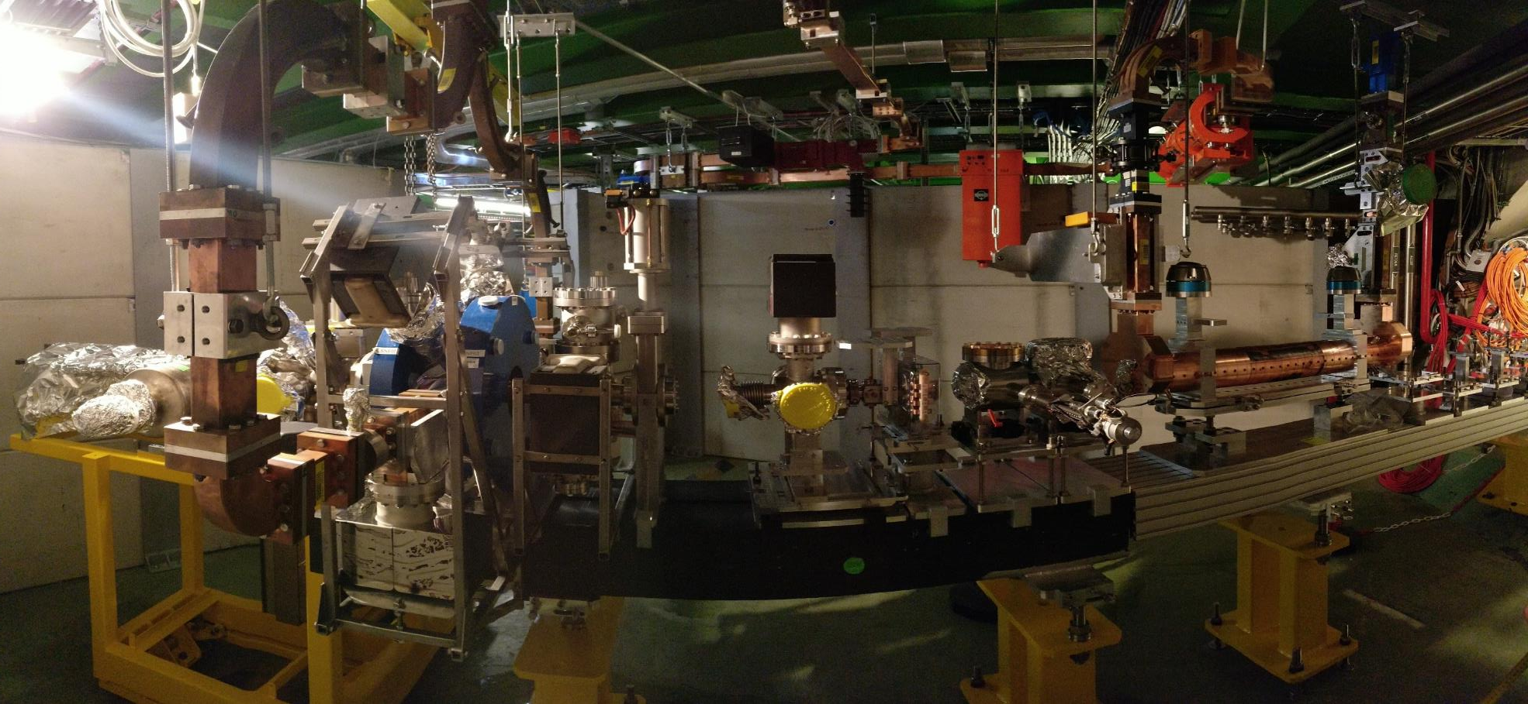
AWAKE – Picture

Slide 13
Outline
AWAKE
  Electron beam line and electron source
  Beam instrumentation (BPM, PepperPot)
  Booster structure
  Klystron and modulator
CLIC
  Layout
  Electron source
  Cathode and connector
  Experimental results
  Simulations
  Comparison experiments/simulations
  Emittance estimation
Conclusions

Slide 14

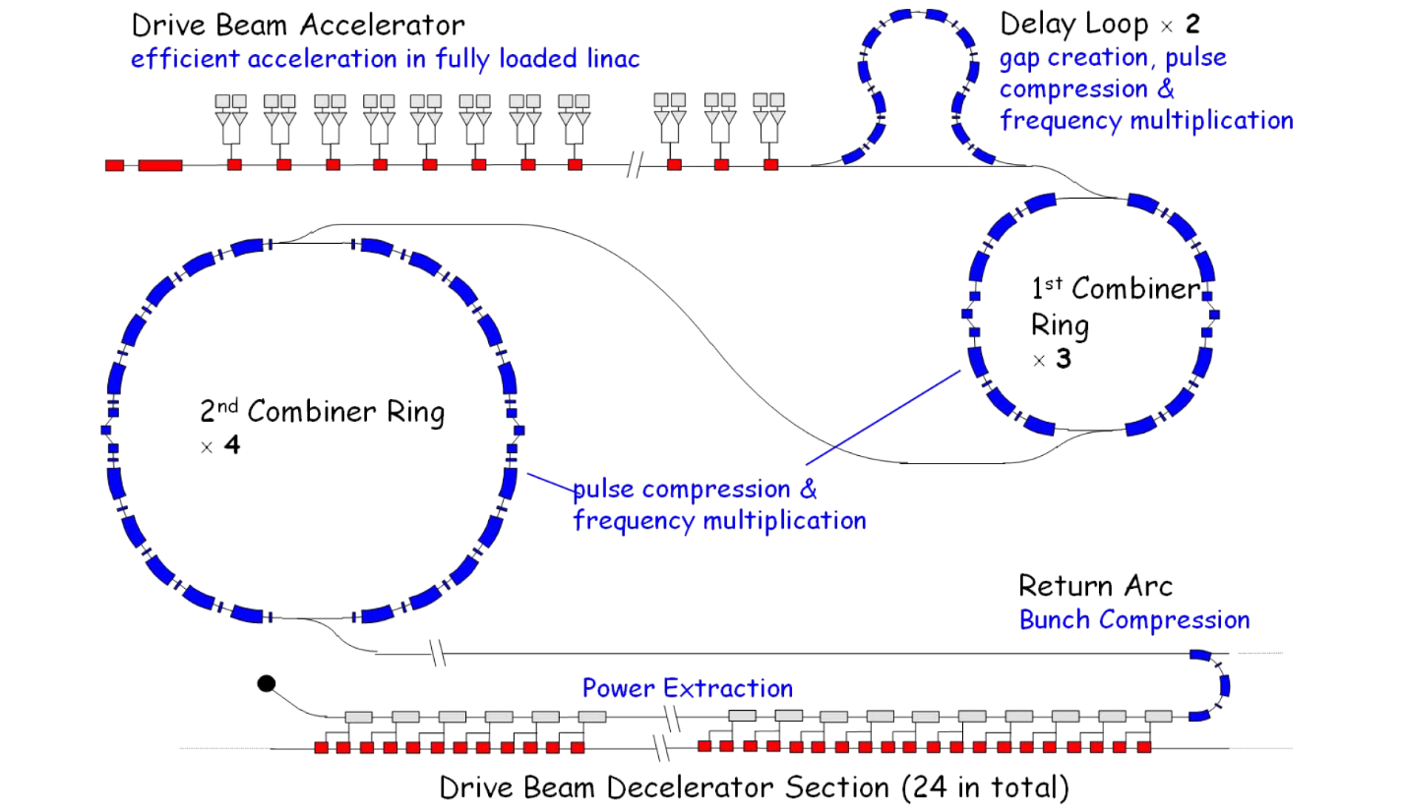
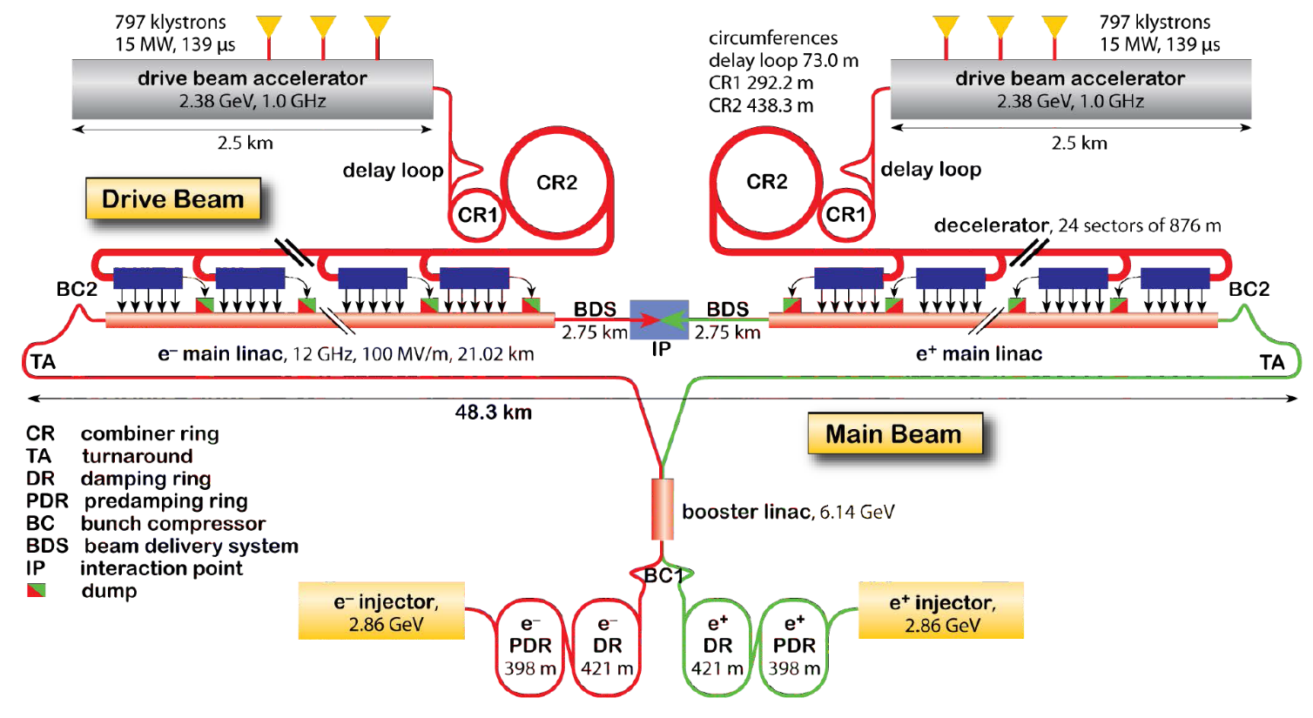
LEETCHI – Electron source and beam parameters
Conceptual design report (EDMS 1234244)

Slide 15
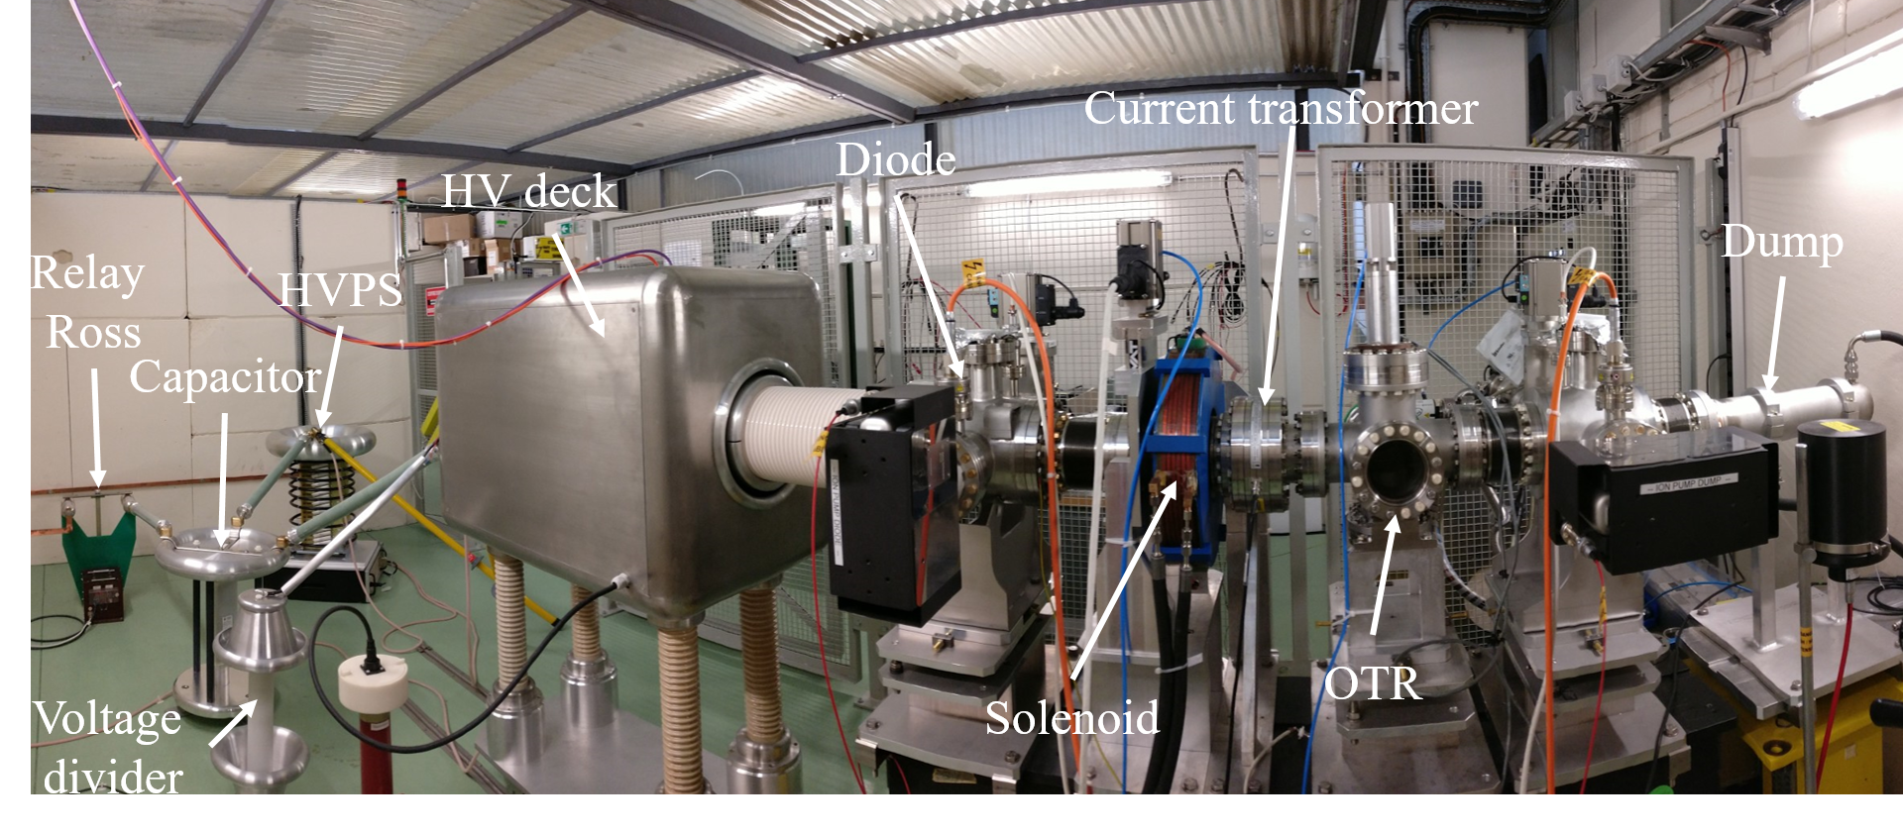
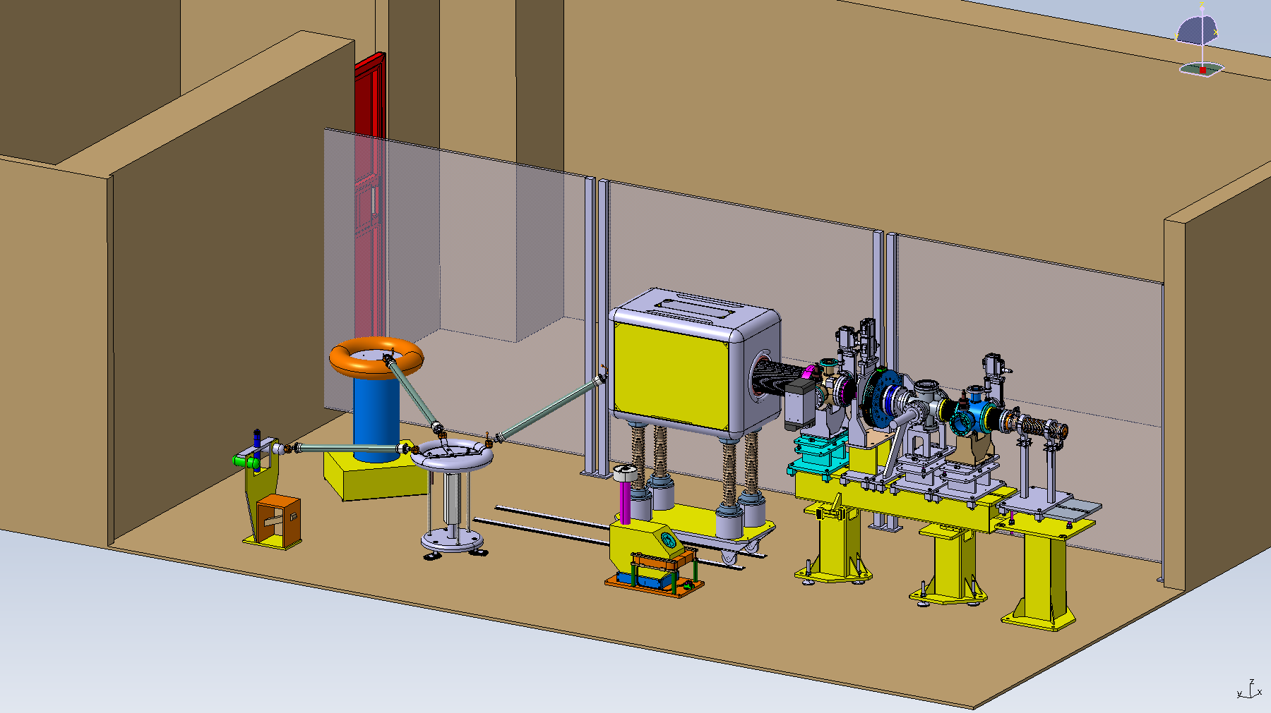
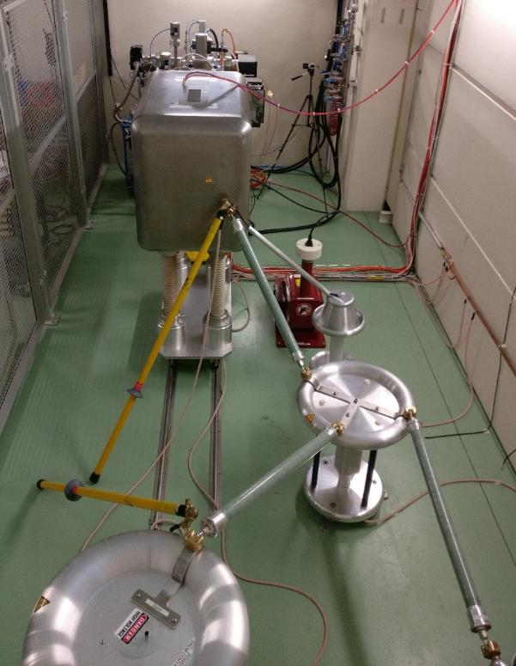
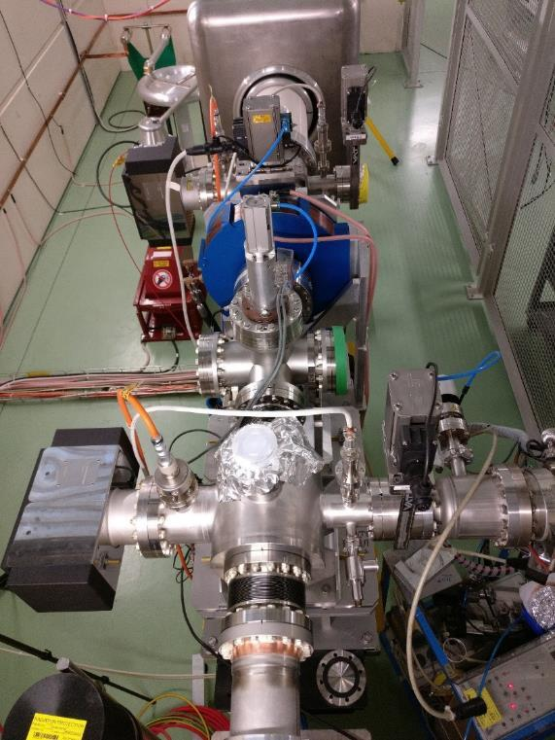
LEETCHI – Electron source and beam parameters
LEETCHI
Parameters | Baseline
Beam energy | 140 keV
Beam current | 5 to 7 A
Pulse length | 140 µs
Emittance (RMS) | < 20 mm mrad
Repetition rate | 50 Hz
Beam power | 4,9 to 6,9 kW
Shot to shot charge variation | 0.1 %
Flat top charge variation | 0.1 % after correction

Slide 16
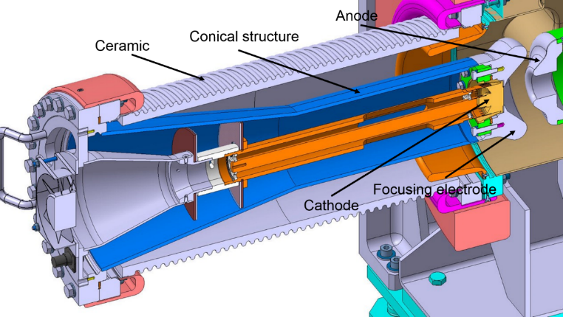
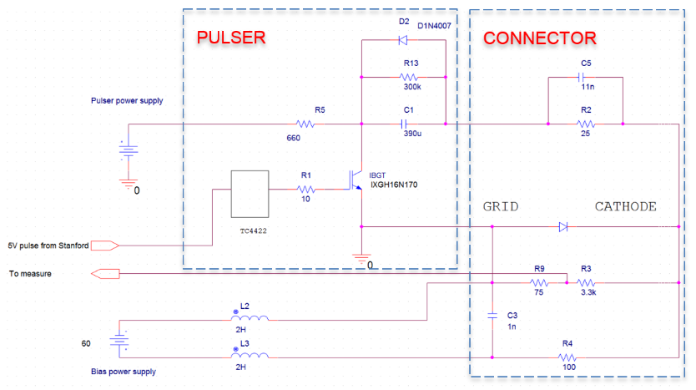
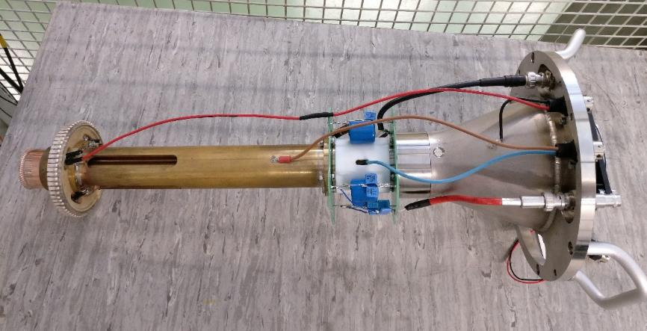
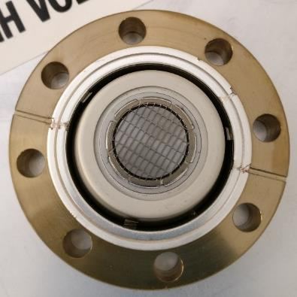
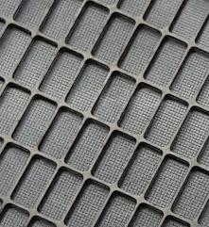
LEETCHI – Cathode and connector
CPI YU-156

Slide 17
LEETCHI – Experimental results
Pulse to pulse current stability
1000 shots @ 50 Hz, extracted from 180 000 shots (1 hour @ 50 Hz)
V_{HV} = 140 kV ; t = 8 µs ; I_{B} = 4.5 A
Measured pulse to pulse stability on beam current: 0.3-0.4 %
Allan Standard Deviation = A metric for stability = Two-sample Standard Deviation taken over variable interval of time or variable interval of pulses

Slide 18
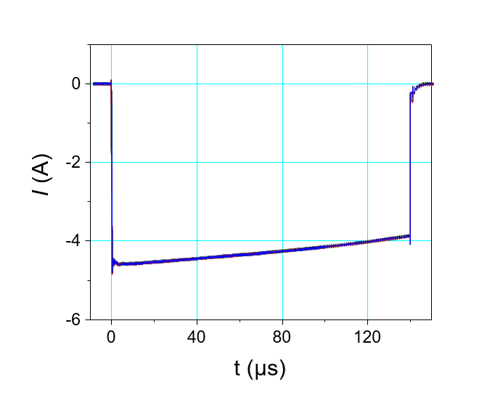
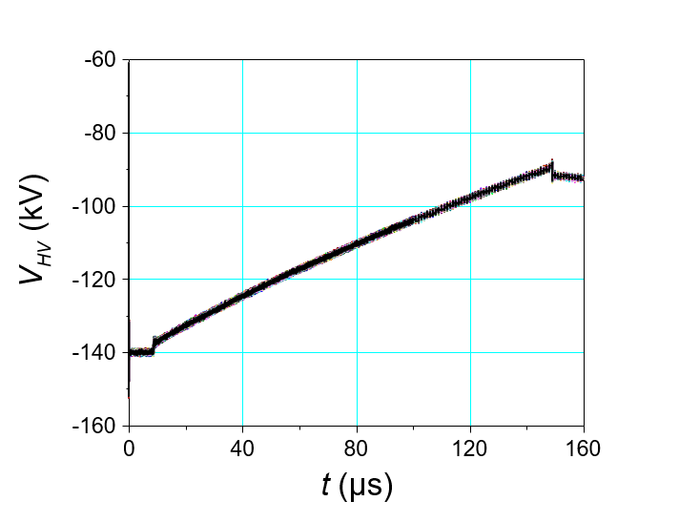

Experimental results
Beam stability from the electrical results
300 shots @ 6 Hz, extracted from 1800 shots (5 minutes @ 6 Hz)
V_{HV} = 140 kV ; t = 140 µs ; I_{B} = 4.5 A
Measured pulse to pulse stability on beam current: 0.3-0.4 %
Flat top current stability 10 %
New
Modulator
The grid of the cathode resists to 4.5 A (mean current) during 140 µs
Capacitor discharge during the pulse, the energy of electrons decreases during the pulse (140 keV to 90 keV)

Slide 19
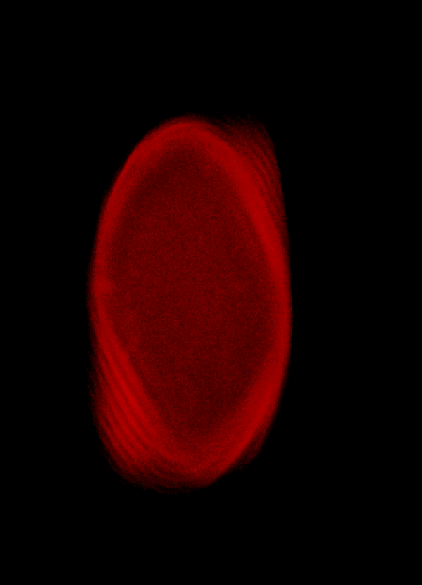
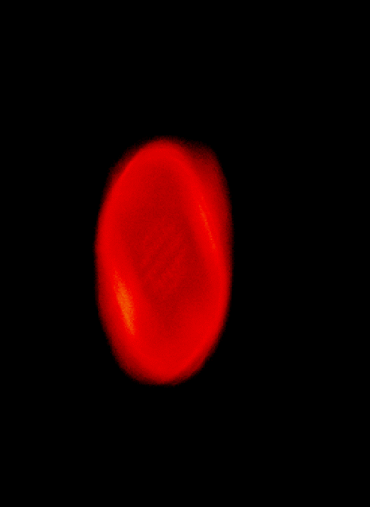
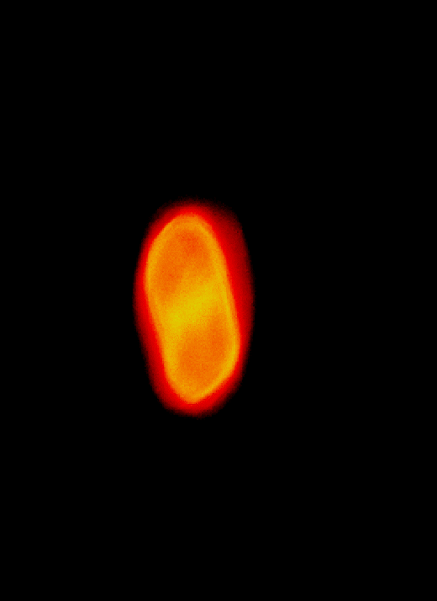
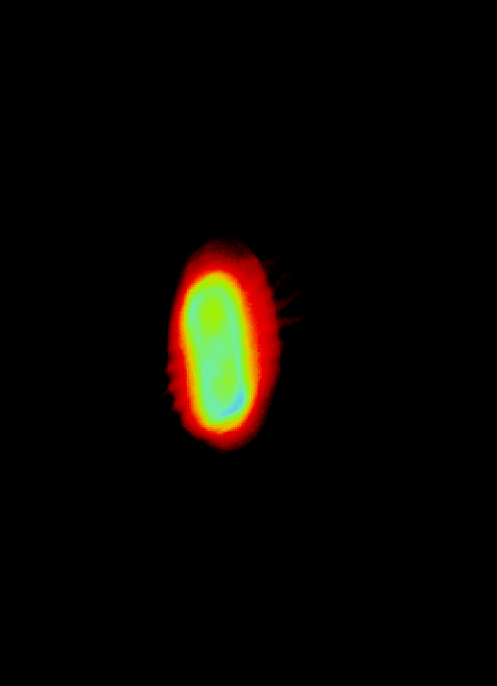

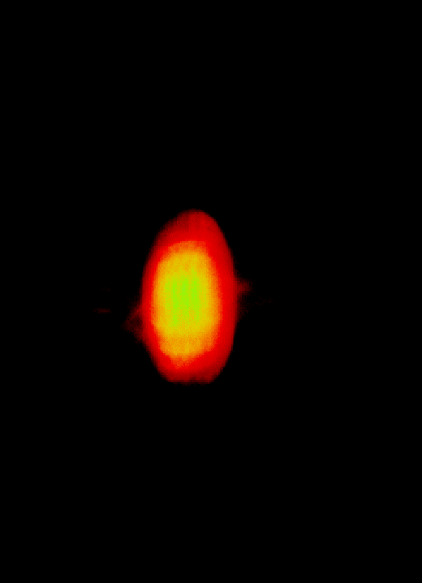
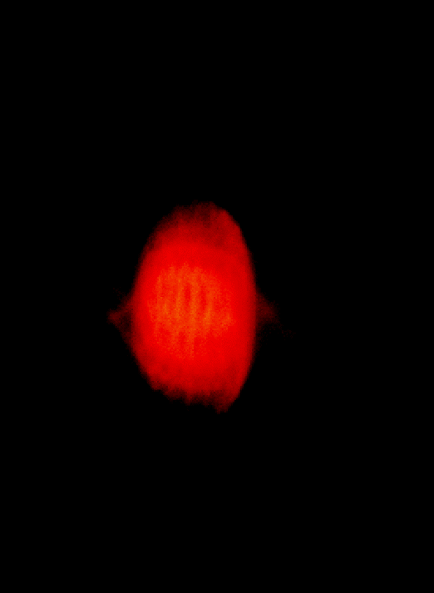
LEETCHI – Experimental results
RMS radius from OTR images
t = 5 µs, I_{beam} = 4.5 A, E = 140 keV
r_{rms} = 9.8 mm
r_{rms} = 5.9 mm
r_{rms} = 11.3 mm
r_{rms} = 13.5 mm
r_{rms} = 6.8 mm
r_{rms} = 8.2 mm
r_{rms} = 12.6 mm
I_{solenoid} = 5.0 A
I_{solenoid} = 6.0 A
I_{solenoid} = 7.0 A
I_{solenoid} = 8.0 A
I_{solenoid} = 5.5 A
I_{solenoid} = 6.5 A
I_{solenoid} = 7.5 A

Slide 20
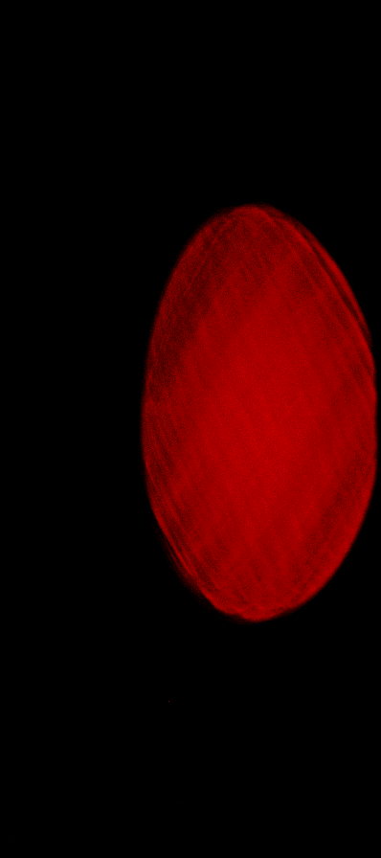
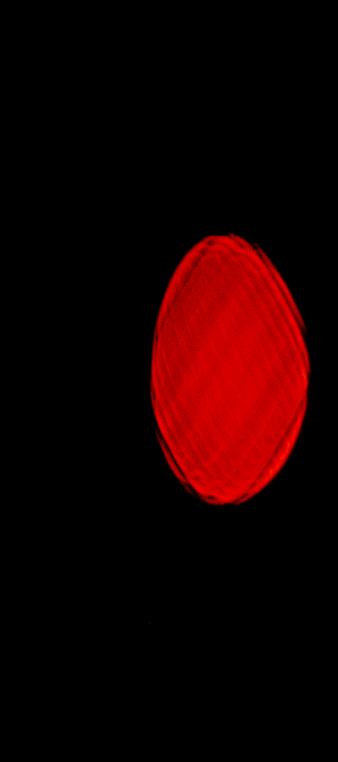
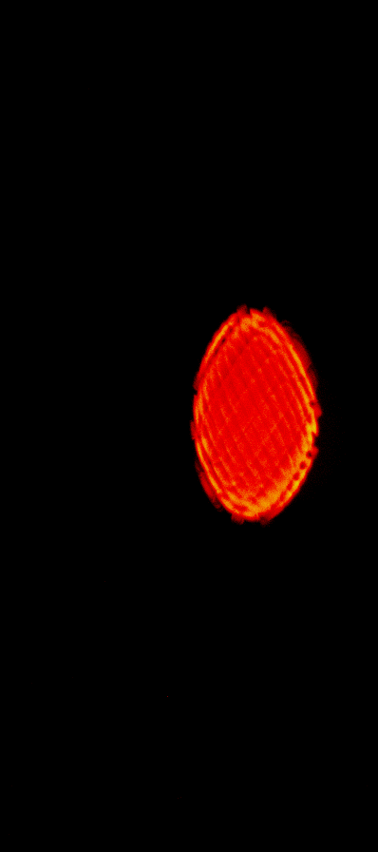
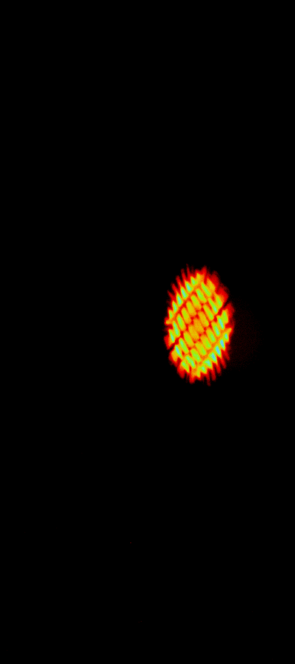

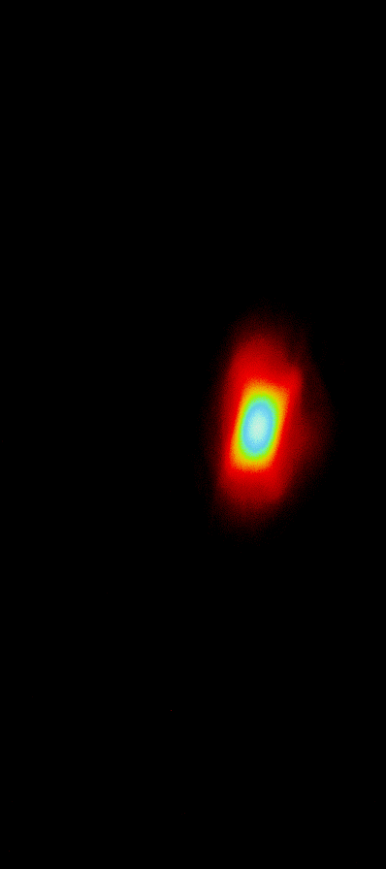

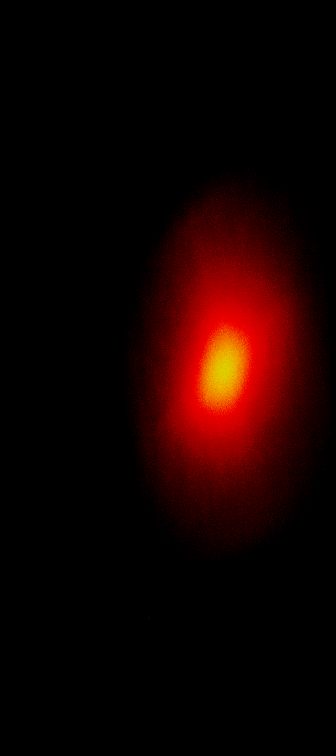
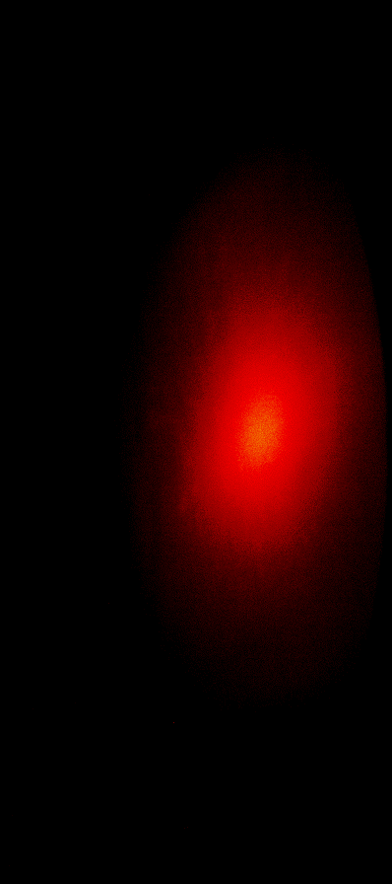
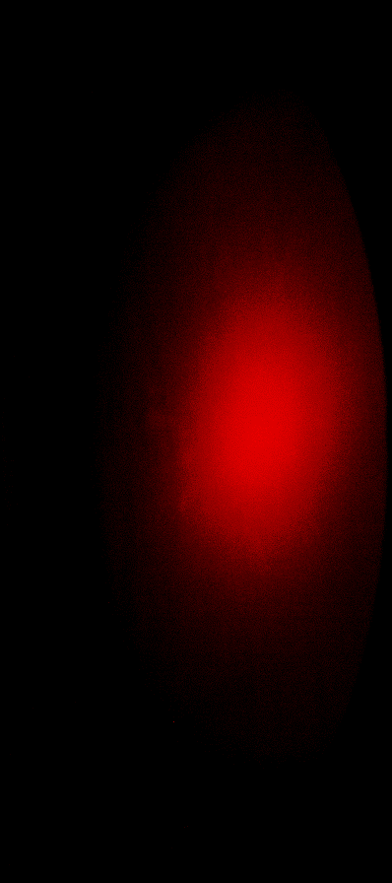
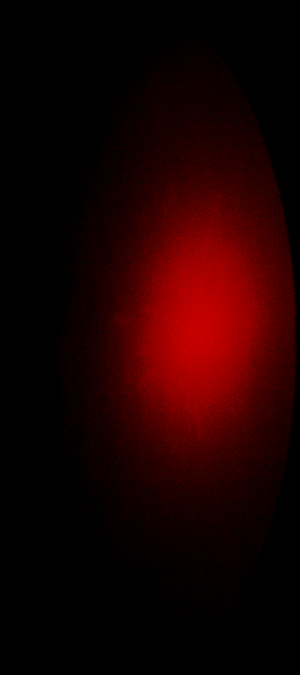
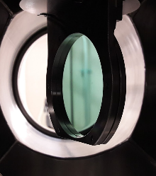
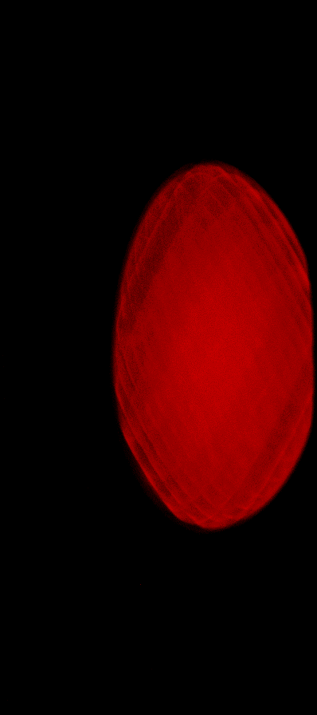


























LEETCHI – Experimental results
OTR images
t = 5 µs, E = 140 keV
I_{beam}
0.5 A
1 A
4.5 A
5 5.2 5.4 5.6 5.8 6 6.2 6.4 6.6 6.8 7 7.2 7.4 7.6 7.8 8
I_{Solenoid} (A)

Slide 21



LEETCHI – CST layout

Slide 22




LEETCHI – Micro focalization
X-Z plane
E field
Y-Z plane
Pierce geometry
Anode
Second grid

Slide 23


LEETCHI – Comparison experiments / simulations
t = 5 µs, E = 140 keV
The emittance calculation will be performed by a comparison between experimental results and CST, Magic simulations for different value of the solenoid and beam currents.
The minimal radius at waist is linked to
the space charge and to the emittance

Slide 24



LEETCHI – Emittance
Emittance formulas (Lapostolle and Lee, Cooper)
$\left\langle ε_{x}\right\rangle =4.0\sqrt{\left\langle x^{2}\right\rangle \left\langle {x′}^{2}\right\rangle −{\left\langle xx′\right\rangle }^{2}}$ and $\left\langle ε_{r}\right\rangle =2.0\sqrt{\left\langle r^{2}\right\rangle \left[{\left\langle {p_{r}}/{p_{z}}\right\rangle }^{2}+{\left\langle {p_{θ}}/{p_{z}}\right\rangle }^{2}\right]−{\left\langle {{rp}_{r}}/{p_{z}}\right\rangle }^{2}−{\left\langle {{rp}_{θ}}/{p_{z}}\right\rangle }^{2}}$
$x^{′}= {d_{x}}/{d_{z}} , r=\sqrt{x^{2}+y²}$, $p_{r}=p_{x}\cos{θ}+p_{y}\sin{θ}$, $p_{θ}=−p_{x}\sin{θ}+p_{y}\cos{θ}$
CST-Tracking emittances calculations (with and without cathode grids)
MAGIC-2D PIC, CST-PIC, CST-Tracking comparison (without cathode grids)
Third grid
Second grid

Slide 25
Outline
AWAKE
  Electron beam line and electron source
  Beam instrumentation (BPM, PepperPot)
  Booster structure
  Klystron and modulator
CLIC
  Layout
  Electron source
  Cathode and connector
  Experimental results
  Simulations
  Comparison experiments/simulations
  Emittance estimation
Conclusions

Slide 26
Conclusions
AWAKE
  AWAKE is working with the laser, the plasma cell and the proton beam
  Klystron, modulator and waveguides installed
  The installation of the laser line is ongoing
  Electron line installed and leak tied
  Installation of diagnostics ongoing
  Beams requirements are clearly defined
  Tests of AWAKE with the electron beam in 2018
LEETCHI
  Perfectly working at 140 kV
  The mean current is 4.5 A @ 140 µs
  Repetition rate is 6 Hz @ 140 µs and 50 Hz @ 8 µs (vacuum limitation)
  Shot to short variation of the order of 0.1 %
  The grid of the cathode resists to the current
  Simulations are in a well advanced phase

Slide 27






Thank you for your attention

