Slide 1
UPPSALA UNIVERSITY_GERSEMI PROJECT
Project follow-up
Manufacturing and planning follow-up
Lery, 06-07/07/2017

Slide 2
Contents
Planning
Deviation from initial planning
Critical paths
Manufacturing follow-up
Progress
Issues
Actions

Slide 3
Planning: deviation from initial planning
 | 2016 |  |  |  |  |  |  |  |  |  |  |  |  |  |  |  |  |  |  |  |  |  |  |  |  |  |  |  |  |  |  |  |  |  |  |  |  |  |  |  |  |  |  |  |  |  |  |  |  |  |  |  | 2017 |  |  |  |  |  |  |  |  |  |  |  |  |  |  |  |  |  |  |  |  |  |  |  |  |  |  |  |  |  |  |  |  |  |  |  |  |  |  |  |  |  |  |  |  |  |  |  |  |  |  |  | 2018
 | January |  |  |  | February |  |  |  | March |  |  |  |  | April |  |  |  | May |  |  |  | June |  |  |  |  | July |  |  |  | August |  |  |  | Septembre |  |  |  |  | October |  |  |  | November |  |  |  |  | December |  |  |  | January |  |  |  | February |  |  |  | March |  |  |  |  | April |  |  |  | May |  |  |  | June |  |  |  |  | July |  |  |  | August |  |  |  |  | September |  |  |  | October |  |  |  | November |  |  |  |  | December |  |  |  | January |  |  |  | February |  |  |  | March
 | 1 | 2 | 3 | 4 | 5 | 6 | 7 | 8 | 9 | 10 | 11 | 12 | 13 | 14 | 15 | 16 | 17 | 18 | 19 | 20 | 21 | 22 | 23 | 24 | 25 | 26 | 27 | 28 | 29 | 30 | 31 | 32 | 33 | 34 | 35 | 36 | 37 | 38 | 39 | 40 | 41 | 42 | 43 | 44 | 45 | 46 | 47 | 48 | 49 | 50 | 51 | 52 | 1 | 2 | 3 | 4 | 5 | 6 | 7 | 8 | 9 | 10 | 11 | 12 | 13 | 14 | 15 | 16 | 17 | 18 | 19 | 20 | 21 | 22 | 23 | 24 | 25 | 26 | 27 | 28 | 29 | 30 | 31 | 32 | 33 | 34 | 35 | 36 | 37 | 38 | 39 | 40 | 41 | 42 | 43 | 44 | 45 | 46 | 47 | 48 | 49 | 50 | 51 | 52 | 1 | 2 | 3 | 4 | 5 | 6 | 7 | 8 | 9 | 10 | 11 | 12 | 13
Order reception
Kick-off preparation
Kick-off meeting
Design clarification by CERN
Design update by ACS
Double heater W580
Cryostat GERSEMI
Magnet insert
Bath insert
Valve box GERSEMI
Transfer lines design&manufacturing
Simulator box
Control system design
Control system procurement
Sensors, internal actuators and feethrough cabling
Workshop pre-assembly
Worshop pre-cabling and electrical tests
workshop test VB with Simulator
Manufacturing file edition
Packing and delivery
Assembly and onsite tests

Slide 4
Planning: critical paths
Valve box
Impact of procurement (bended pipes) delay?
Simulator box
Manufacturing start?
Milestones:
Assembly and pre cabling in workshop in September
Test of VB with simulator in October

Slide 5
Manufacturing follow-up
Double Heater W580
Manufacturing and commissioning done in January 2017, send to UU
Cryostat GERSEMI
Vacuum vessel commissioning and delivery to CD done in May 2017
20170502_VV_control report: helium leak test control report
Pressure vessel welding ongoing
Neck cooling system welded
Lack of solder on one side of the tubes
Addition of solder required to improve thermal contact
Stiffeners welded
Welding of the top lid on the pressure vessel ongoing

Slide 6
Manufacturing follow-up
Cryostat GERSEMI
Thermal shield manufacturing ongoing
Reinforcements required to avoid deformation during handling
Issues with piping supplier for the cooling system (required tubes not in stock and can’t be produced, alternative tubes don’t meet specification)
New supplier found (tubes are standard for faster procurement but will require machining to obtain omega shape)

Slide 7
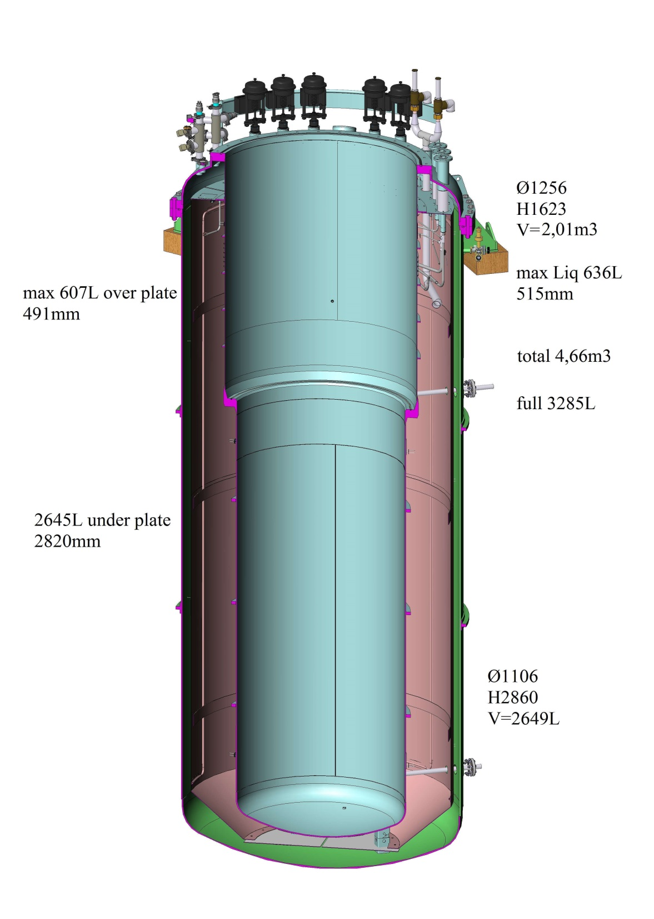
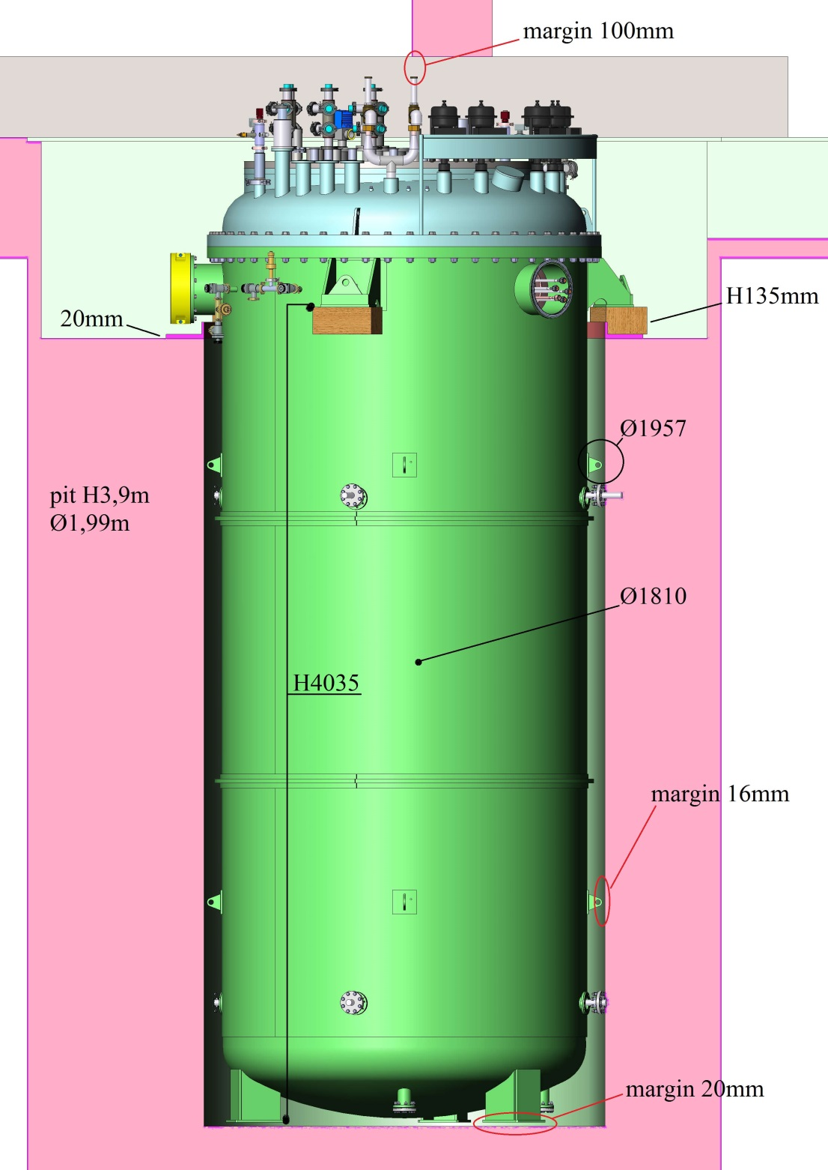
Manufacturing follow-up
Flanges still too long !!
Ø2,04m

Slide 8
Manufacturing follow-up
Magnet insert
Design reviewed by ACS
Manufacturing drawing will be send to UU for validation
Heat exchanger Lambda HX683 design review
Waiting for procurement specification from subcontractor, Pro Beam
Procurement and manufacturing
Current lead specification required to define associated components (heaters, sensors)
UU should send the current lead characteristics
Liquid insert
Manufacturing done
Waiting for instrumentation
Cabling will be done in parallel of other system cabling in the workshop

Slide 9
Manufacturing follow-up
Valve box GERSEMI
Assembly ongoing (heat exchanger, tank installed)
Top lid flanges welded
Thermal shield welding ongoing
Delay on piping procurement
Partial delivery to continue assembly
Transfer lines
Multiline: procurement ongoing, manufacturing start
Single line: drawing send to UU for validation
Assembly in workshop with other systems (VC, VB) to control the correct assembly (procedures and interfaces)

Slide 10
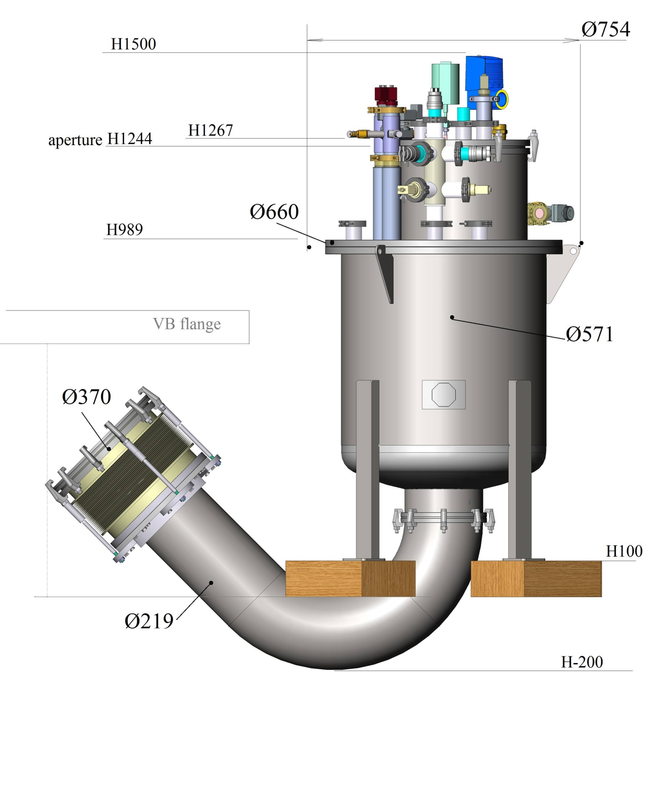
Manufacturing follow-up
Simulator box
Vacuum vessel drawings received
General nomenclature received
to be finalized with CD these days
Detailed and assembly drawings
to be received from ACS
250kG

Slide 11
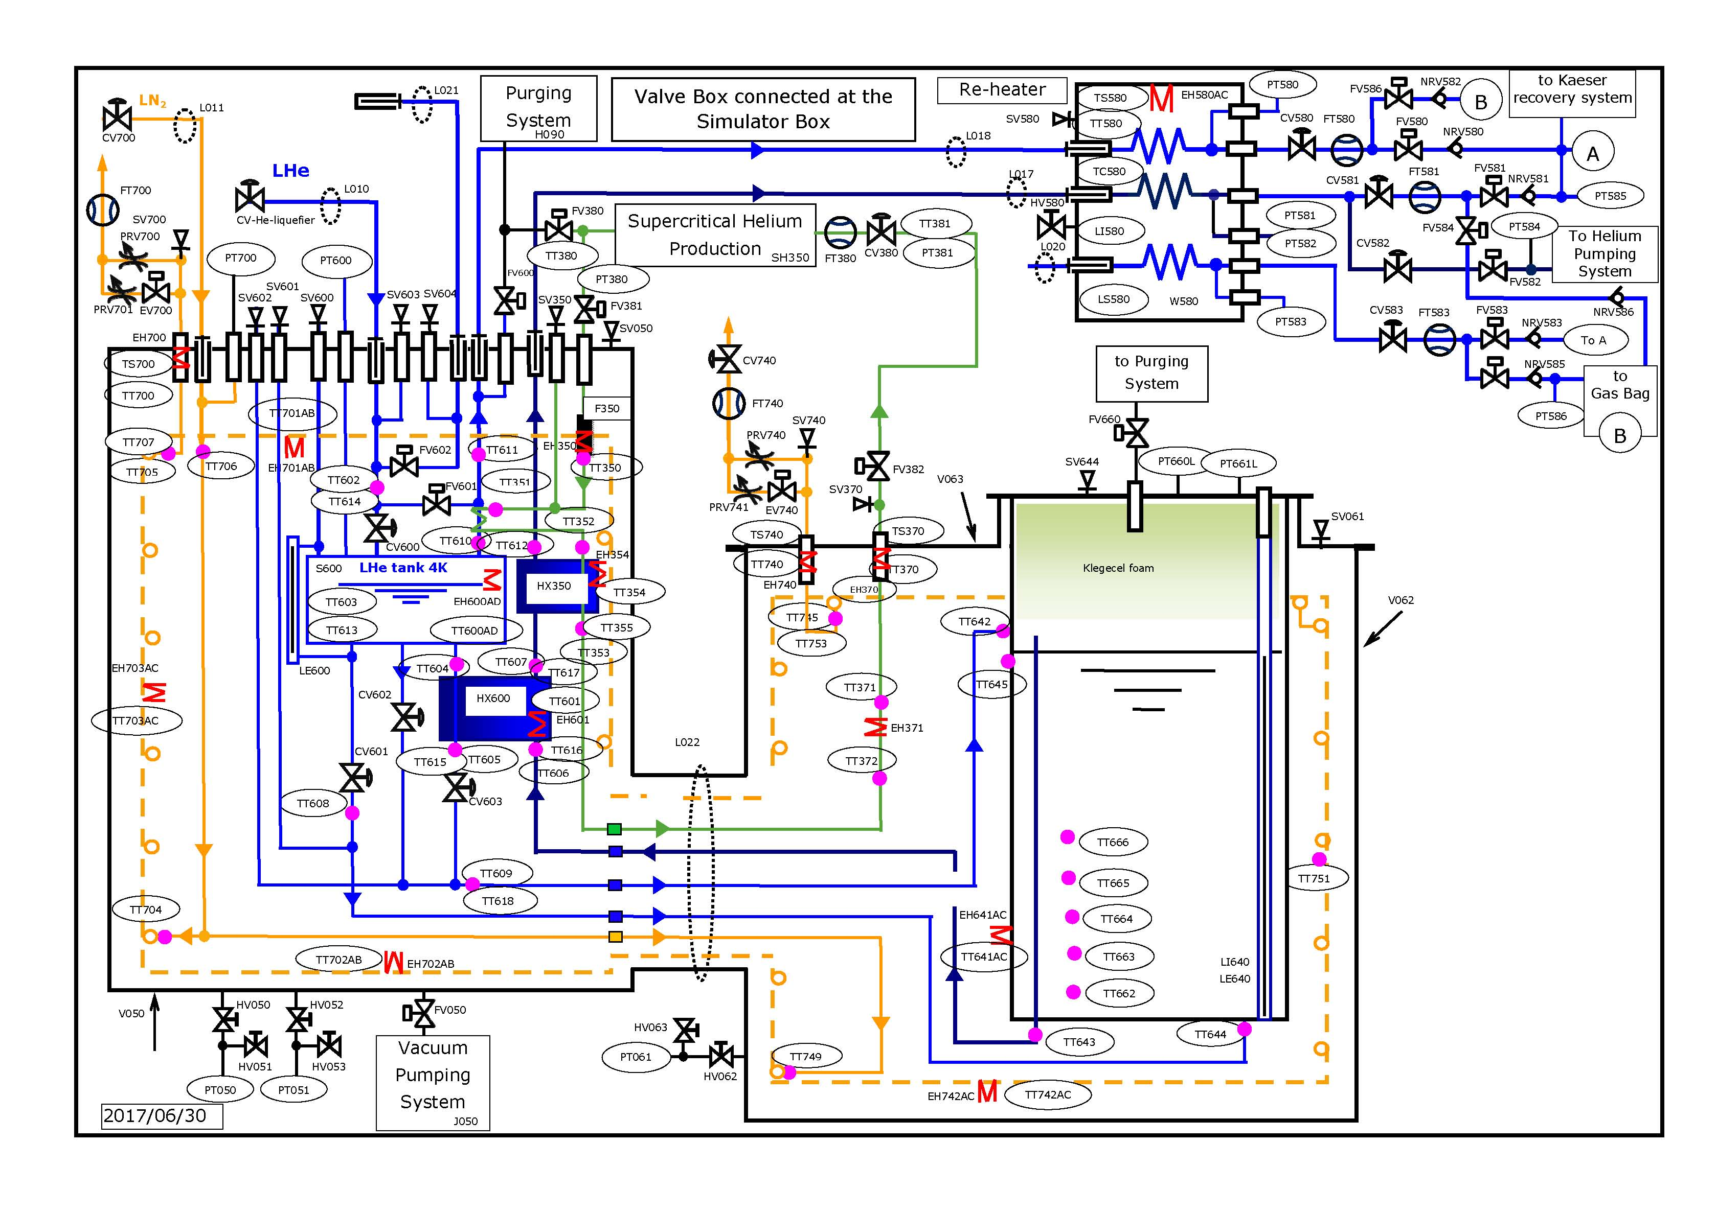

Slide 12
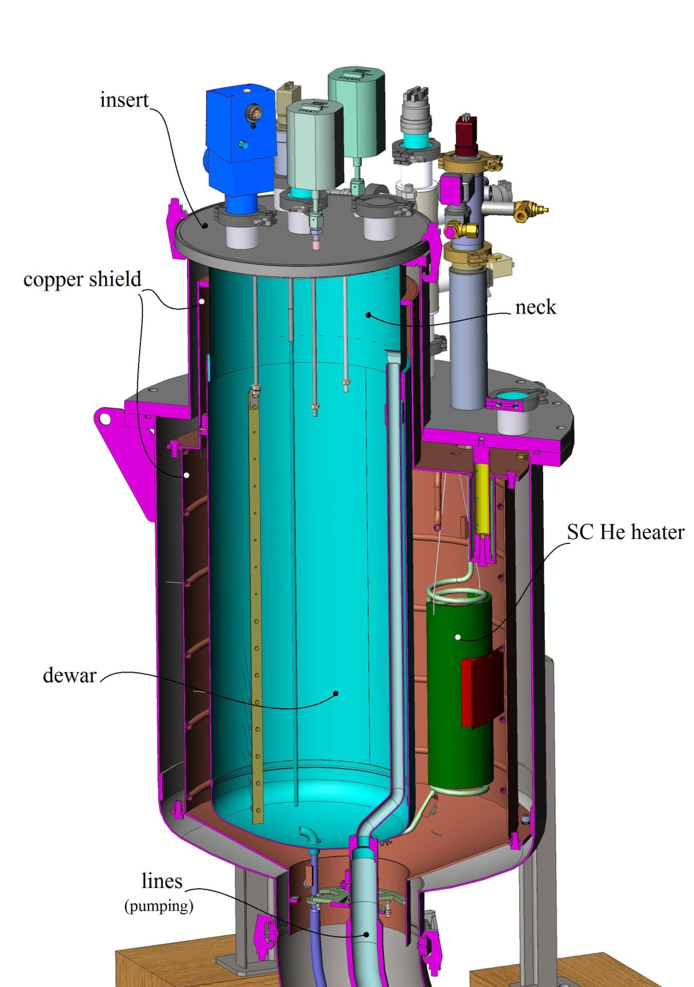
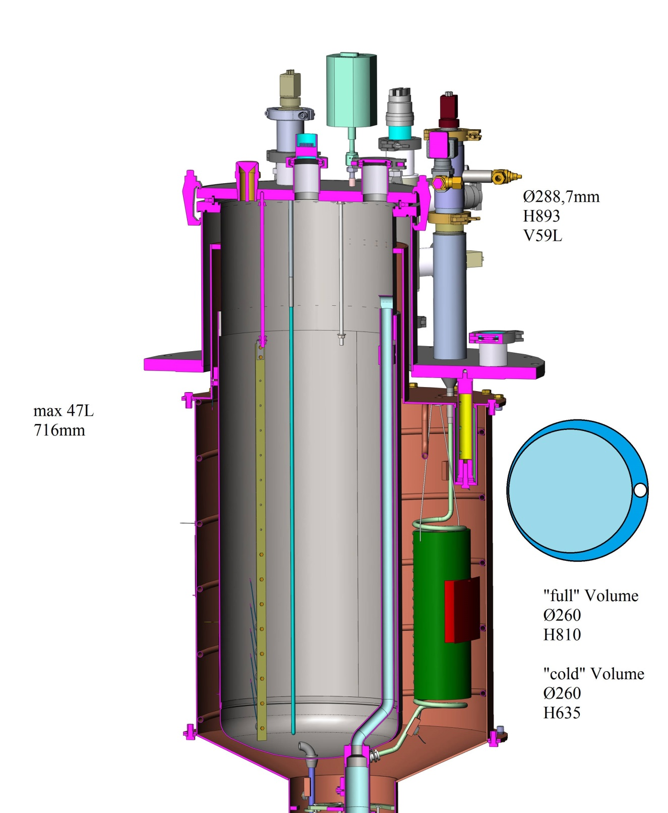
Manufacturing follow-up

