Slide 1
Uppsala University Contract UH2015/09 - UA2016/05 Job nr. 5973/7200
Vertical Cryostat GERSEMI
4th follow-up meeting
06/07/2017

Slide 2
JOB STATUS
General planning
Cryostat
Previous target: 27/06
New target: 19/07
Valves Box
Previous target: 28/06
New target: 03/08
Simulator box
Previous target: 19/07
New target: 20/09
Workshop tests
Previous target: 22/09
New target: 15/11
Onsite tests
New target: November 2017 to March 2018

Slide 3
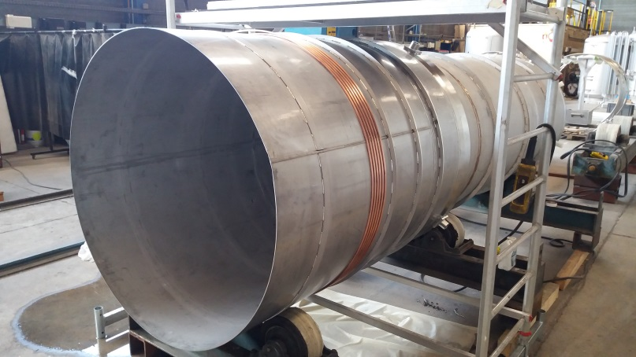
JOB STATUS
WP2: cryostat status
Issues:
Trouble with cooling circuits
Mitigation:
Design update to use another cooling circuit type

Slide 4
JOB STATUS
WP3: magnet insert
Issues:
Copper heat exchanger manufacturing
Current lead still not defined

Slide 5
JOB STATUS
WP5: valves box
Issues:
Resources and tooling difficulties on some very complex bending
Mitigation:
Qualification of new subcontractor for 3D bending

Slide 6
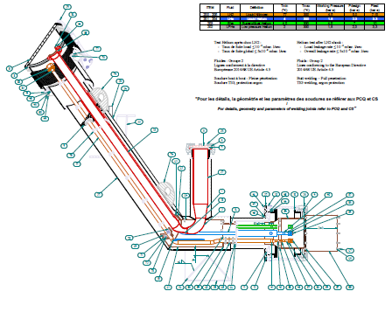
JOB STATUS
WP6: transfer lines
Multiline procurement almost completed
Multiline manufacturing file released to the workshop
Next step single lines and general integration of the GERSEMI Project in FREIA Hall:
Needs definition of current leads to define the last components
Needs to check the 3D model of the water heat exchanger compared with the already built one

Slide 7
JOB STATUS
Procurement issues:
Cernox: calibrating machine is in repair by IPNO
Electrical studies are hold to JB decision
Some components are not defined (needs current lead design to be finished

