Slide 1

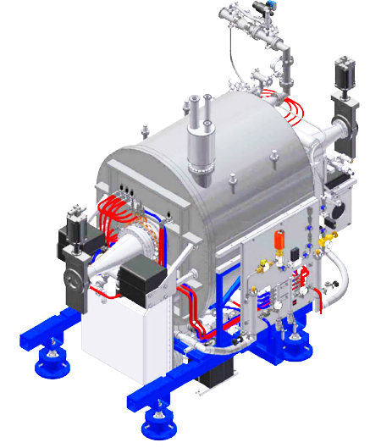
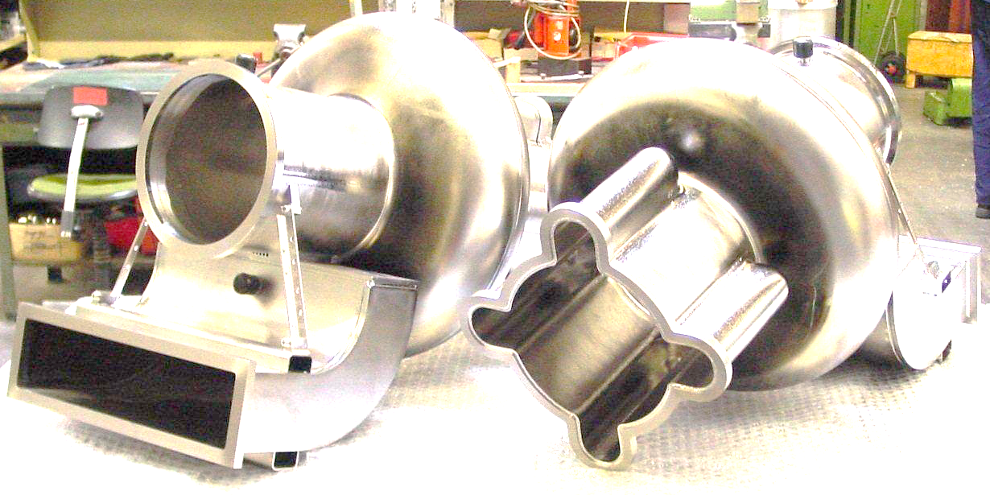
Introduction of PAL and
Activities in Superconducting RF
Younguk Sohn
@RREIA, Uppsala University
September 11, 2017

Slide 2
Topics
Introduction of PAL
Experience and Activities in SRF

Slide 3
What’s PAL ?
Pohang Accelerator Laboratory is belonged to POSTECH (Pohang University of Science & Technology). Private Institute supported by Korean government.
POSTECH, founded by Pohang Steel Company (POSCO) in 1986
PAL operates
PLS-II (3rd generation synchrotron): superconducting RF
PAL-XFEL (4th Gen. Syn.): normal conducting RF
Pohang is one of industrial & Science cities in Korea.

Slide 4
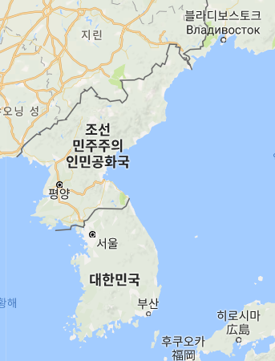
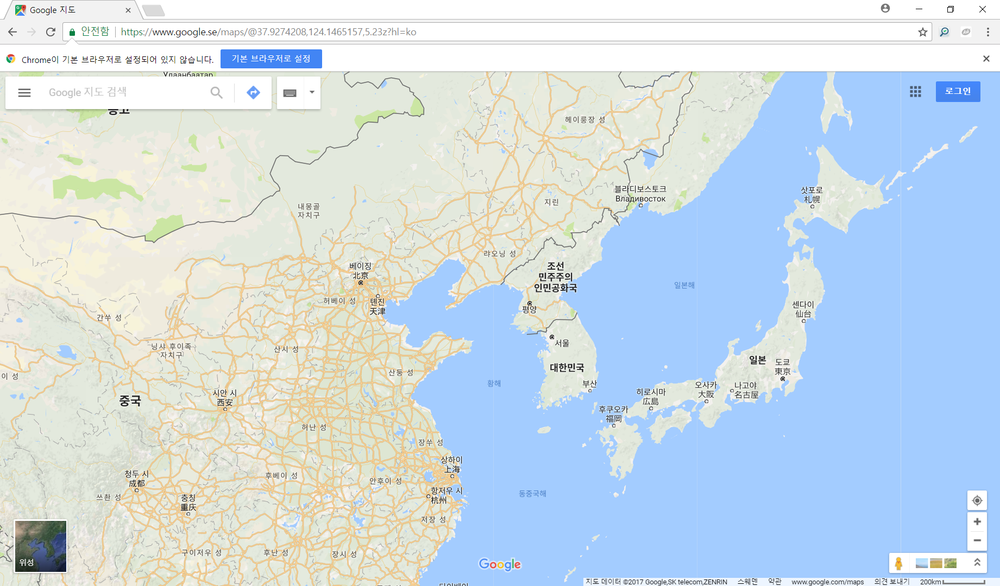
We are here
East Asia
Seoul
Russia
Pohang
Japan
Korea
China
USA

Slide 5
Younguk Sohn
(孫 永旭, 손영욱)
Nuclear power plant for 2 years
In accelerator for 26 years
- Magnet (especially superconducting) design
- Beamline (synchrotron light) design
- Superconducting system

Slide 6
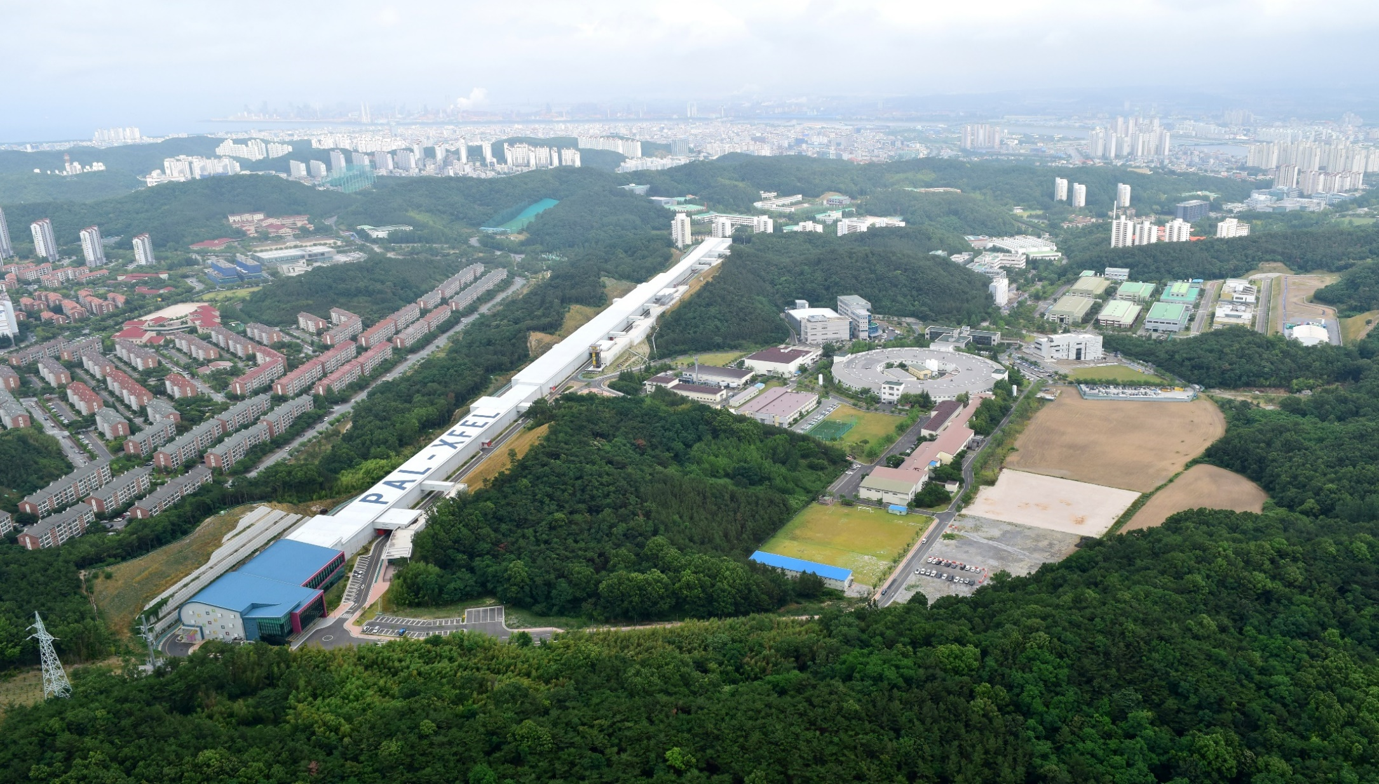
Bird View of PAL Site
PAL-XFEL, 2 km long
PLS-II, 286 m circumference

Slide 7
PAL-XFEL Parameters
30A
2 ps
300A
200fs
3kA
22fs
Hard X-ray
8
12
Und.
7 und.
Soft X-ray
2130 m
  Main parameters
  e⁻ Energy 10 GeV
  e⁻ Bunch charge 20-200 pC
  Slice emittance 0.5 mm mrad
  Repetition rate 60 Hz
  Pulse duration 10 fs – 100 fs
  Peak current 3 kA
  SX line switching DC (Phase-1)
  Kicker (Phase-2)
Undulator Line | HX1 | SX1
Wavelength [nm] | 0.1 ~ 0.6 | 1 ~ 4.5
Beam Energy [GeV] | 4 ~ 10 | 3.15
Wavelength Tuning [nm] | 0.6 ~ 0.1 (energy or gap) | 4.5 ~ 3 (energy) 3 ~ 1 (gap)
Undulator Type | Planar, out-vac. | Planar
Undulator Period / Gap [mm] | 26 / 8.3 | 35 / 8.3

Slide 8
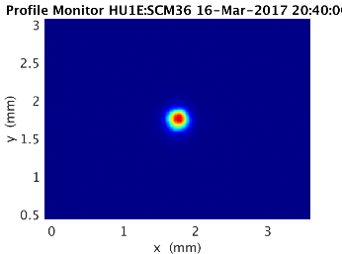
Milestone PAL-XFEL
2002 ~ Studying and persuading government
Apr. 2011 PAL-XFEL project started
Jun. 2012 Ground-breaking
Apr. 2016 Commissioning started
Jun. 2017 User-service started
14 Jun. 2016 First SASE lasing at 0.5 nm
28 Oct. 2016 Lasing at 0.15 nm
27 Nov. 2016 Saturation of 0.15 nm
16 Mar. 2017 Saturation of 0.1 nm: Goal
0.1 nm

Slide 9
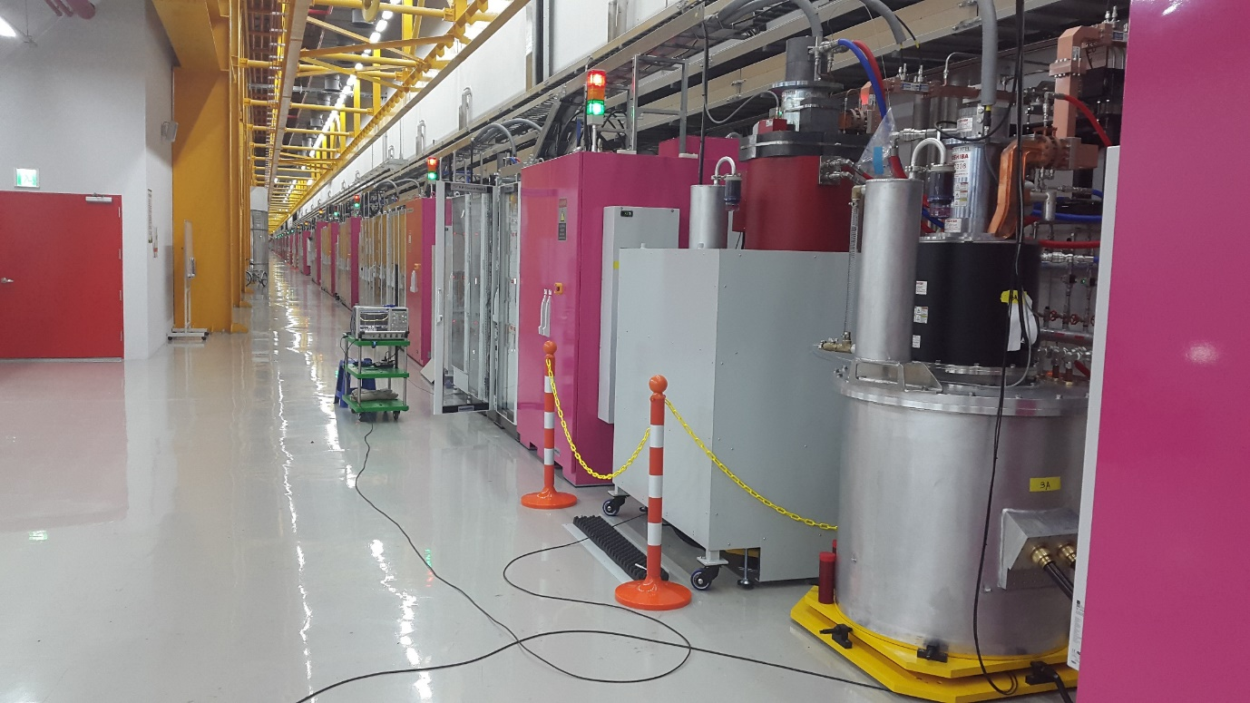
Klystron Gallery - PAL-XFEL

Slide 10
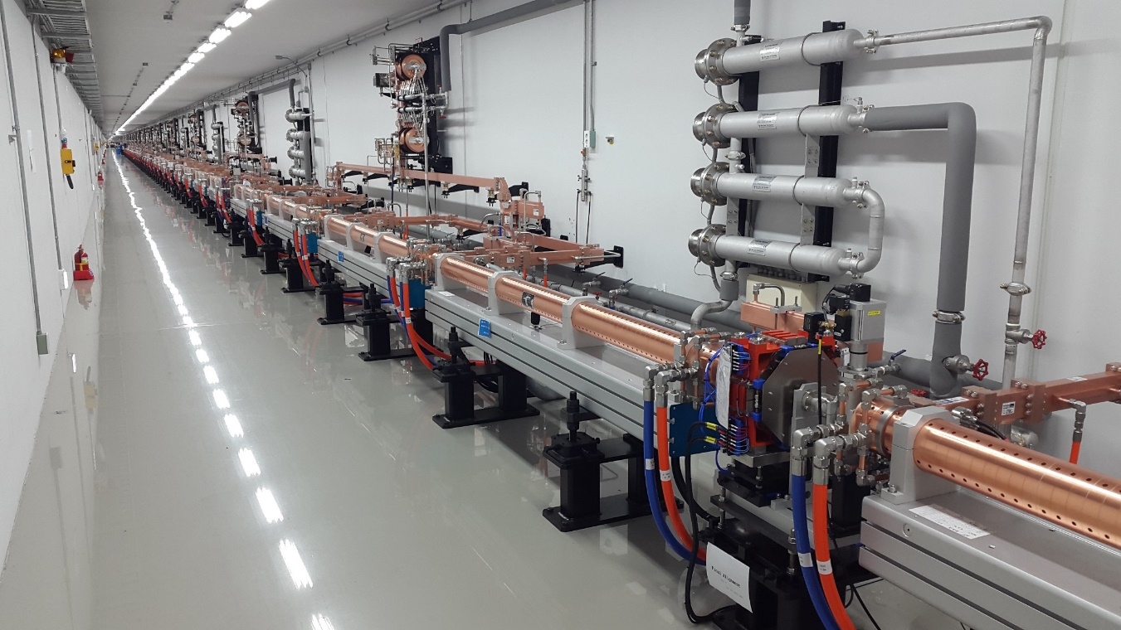
Linac Tunnel - PAL-XFEL

Slide 11
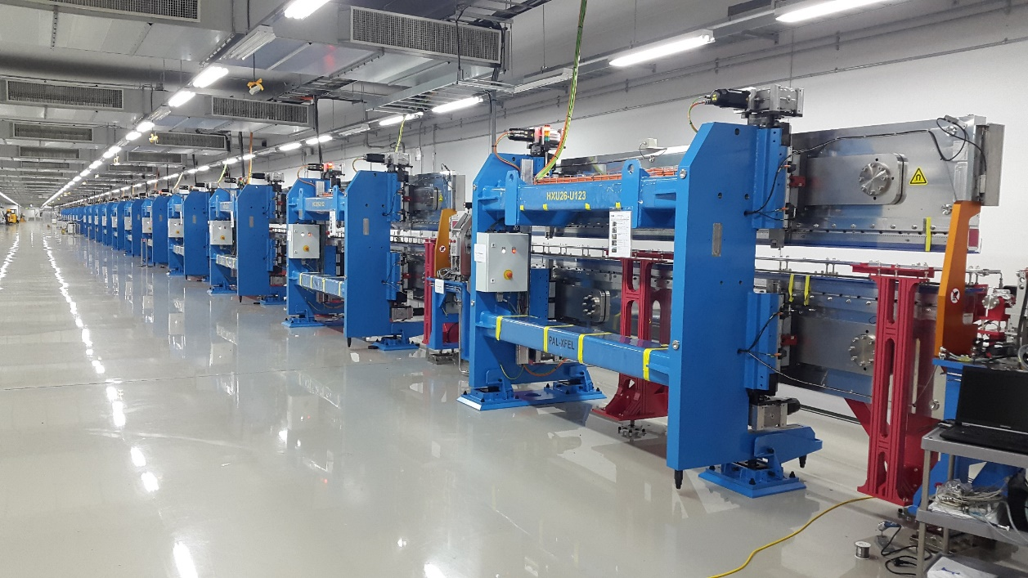
Undulator Hall - PAL-XFEL

Slide 12
Storage Ring, PLS-II
Parameters | Values
Energy [GeV] | 3
Current [mA] | 400
Emittance [nm-rad] | 5.9
Harmonic number | 470
No. of Insertion Devices | 20
Electron energy loss / turn [KeV] | 1242
RF frequency [MHz] | 499.973
Number of RF cavity | 3
Accelerating Voltage [MV] | 4.5
RF Voltage per cavity [MV] | 1.5 (5 MV/m)
Klystron amplifier [kW/each] | 300
Cryogenic Cooling Capacity @4.5 K [w] | 700
※ PLS-II has 32 beamlines (16 ID and 16 BM)

Slide 13
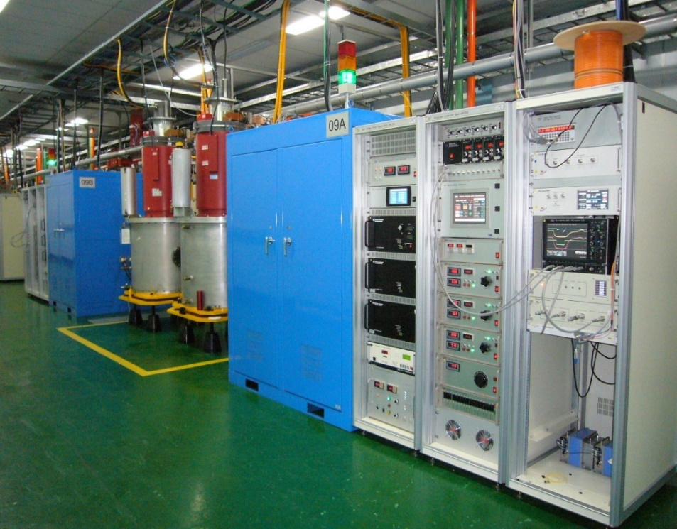
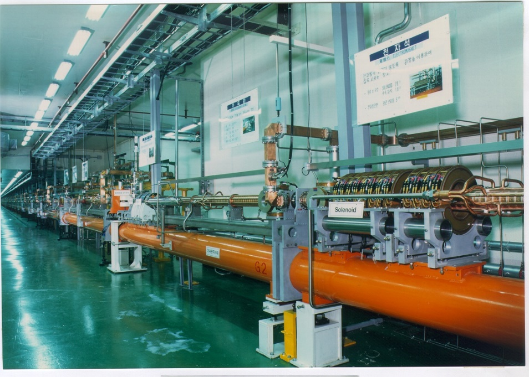
LINAC (3 GeV) as Injector
Injector LINAC
Length = 170m
3.0 GeV, full energy injection
2,856 MHz (S-band)
10Hz, 1.5 ns, 1Å pulsed beam
Norm. emmittance : 150µmrad
Gallery
Thermionic Electron Gun
16 Pulse Modulators (200MW, 7.5µs)
16 Klystrons (80 MW, 4µs)
15 Energy Doublers (gain=1.5)
46 Accelerating Sections
Tunnel

Slide 14
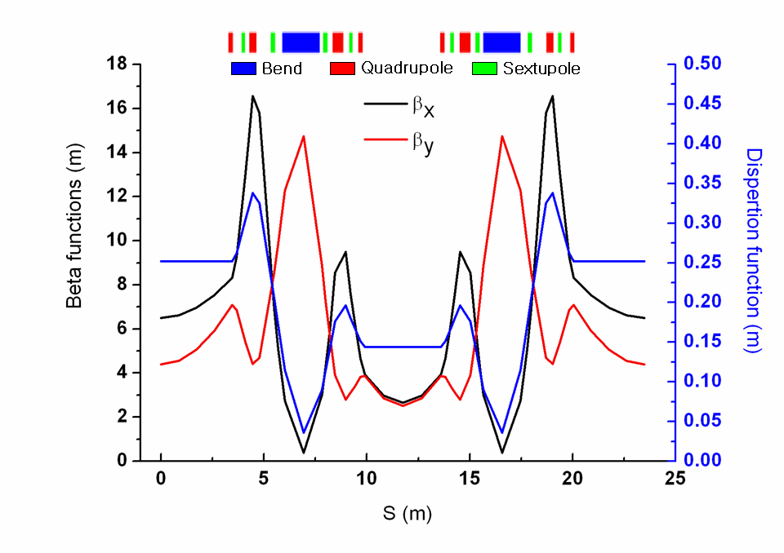
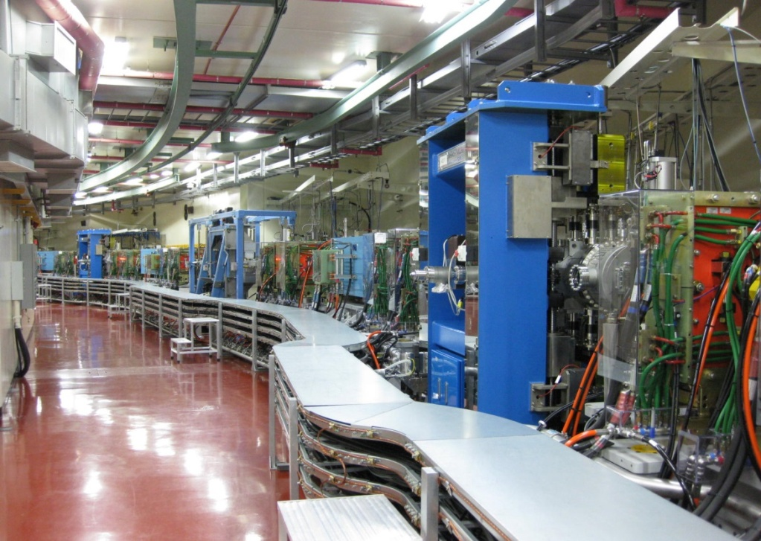
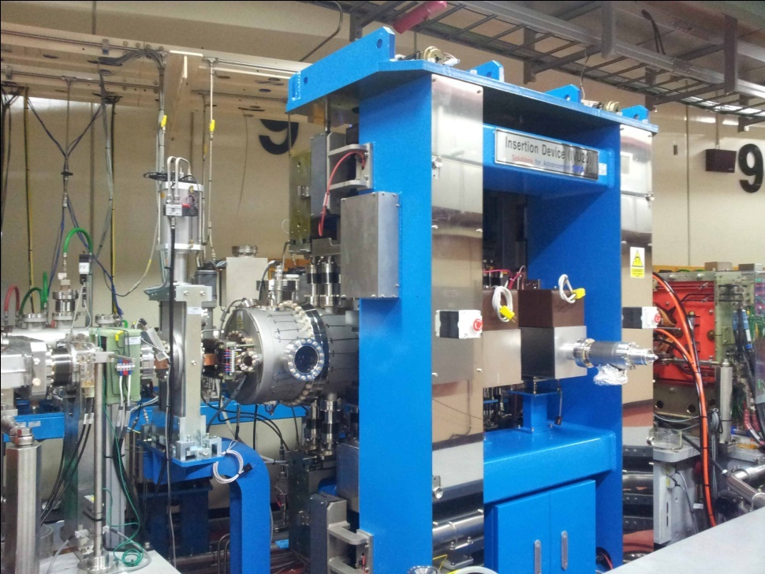
PLS-II Storage Ring
Beam Energy 3.0GeV
Beam Current 400mA
Lattice DBA
Superperiods 12
Emittance 5.8 nm∙rad
Tune 15.37 / 9.15
RF Frequency 499.97 MHz
Circumference 281 m

Slide 15
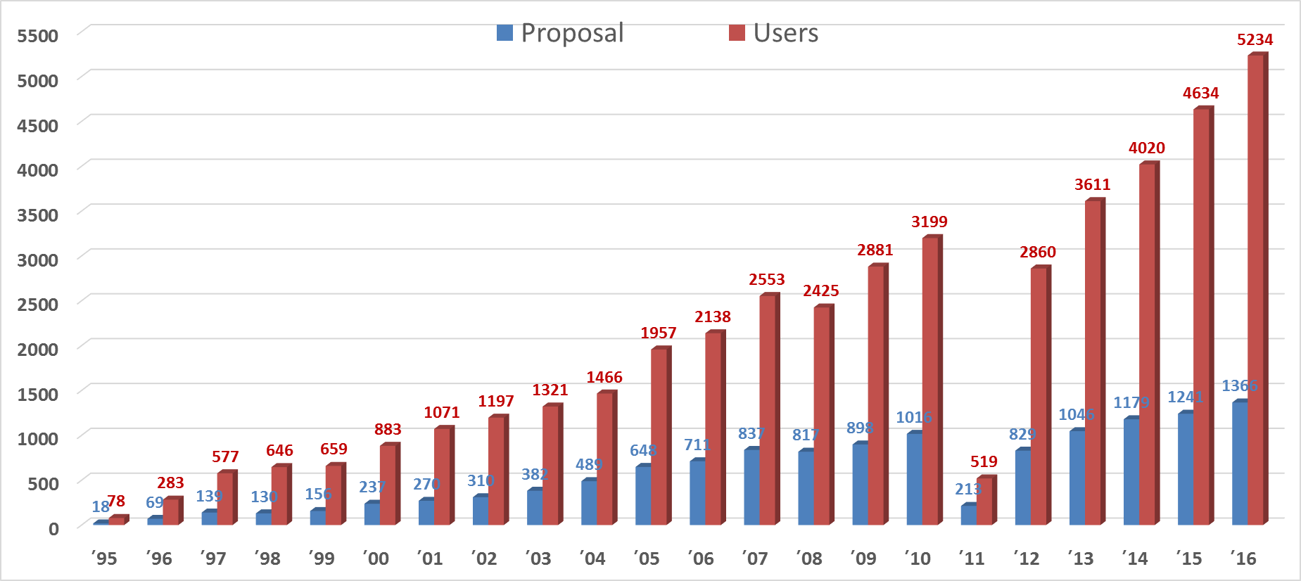
User Statistics
1366 experiments
5234 by users

Slide 16
Introduction
Superconducting RF System in PLS-II

Slide 17
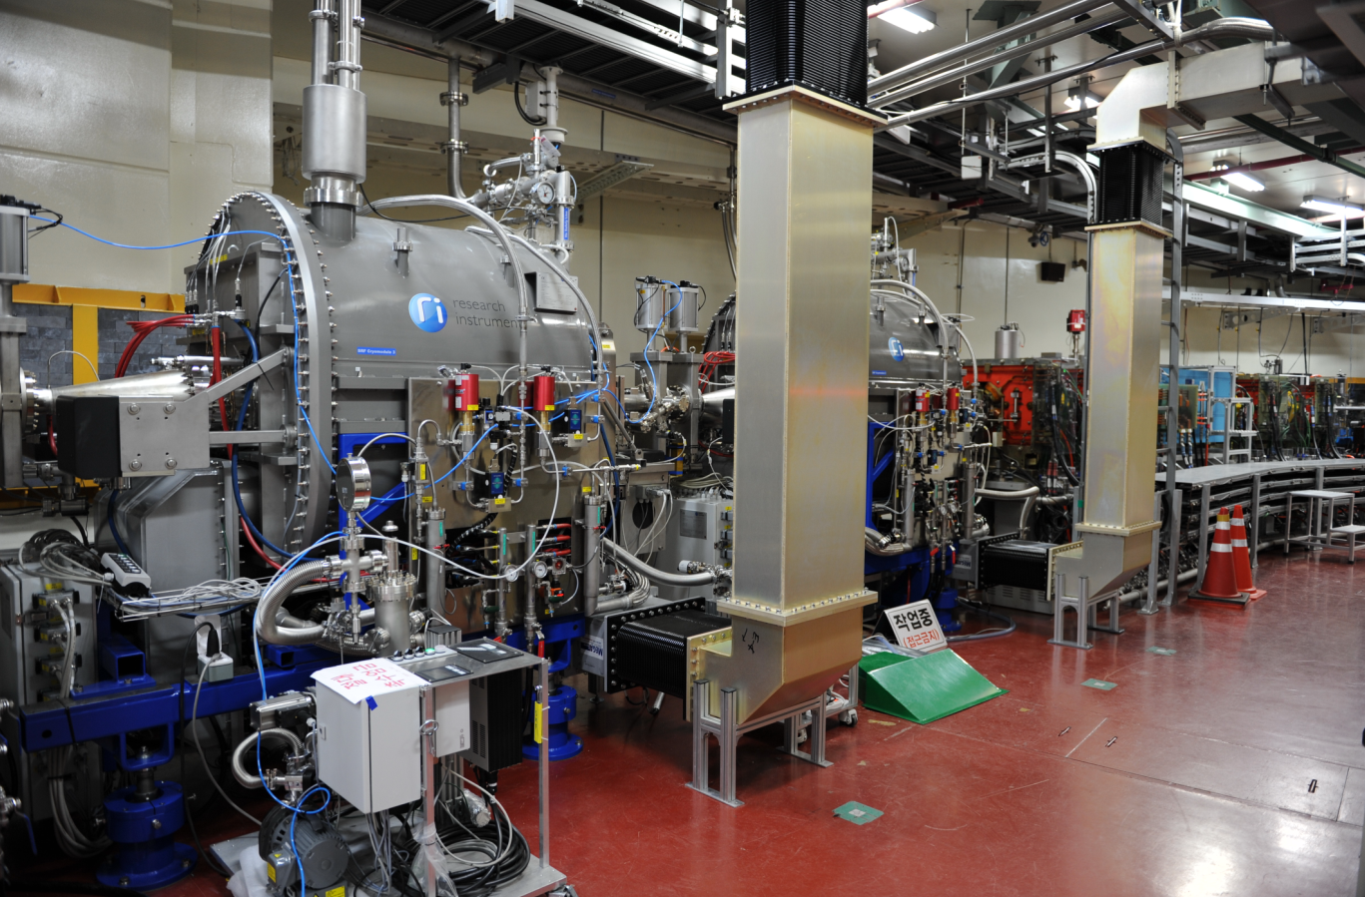
3 SRF Modules @Tunnel
SRF module 2
SRF module 3

Slide 18
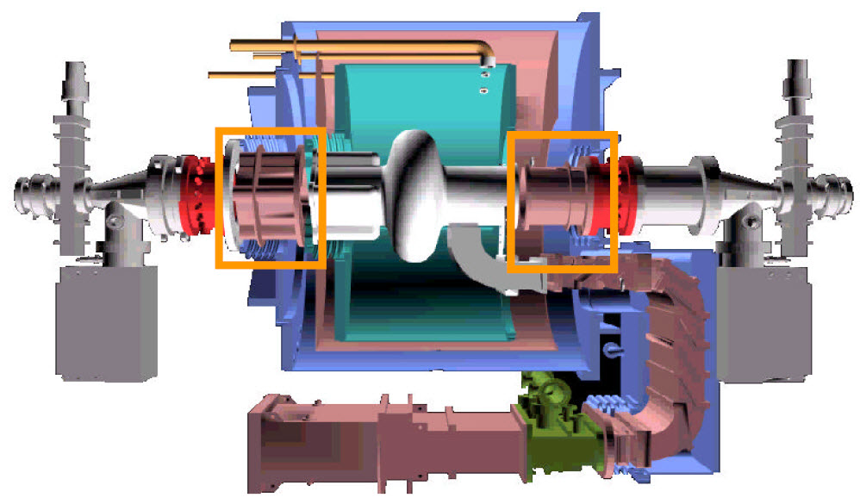
LHe Vessel
70K Thermal Shield
Vacuum Vessel
Thermal Transition
HOM Absorber
E-beam
Wave-guide
RF Window
CESR-3 Cryomodule, Designed by Cornell University

Slide 19
PLS-II, SRF 500 MHz Cavities
Orbit stability @ high beam current to 400 mA
High beam power W/ 20 insertion devices
Higher synchrotron radiation brightness,
order of 2 (100 times) compared to PLS
→
PLS-II operated with 380mA topup mode,
But, nominal is 400 mA.

Slide 20
Specifications of SRF System
Specification
Resonant frequency [MHz] | 499.973
R/Q [Ω] | 89
Q₀ | >1×10^{9 @} Vacc ≤ 2.0 MV (~7 MV/m)
Q_{e} | 1.37E5 +/- 0.2E5
Frequency tuning range (step-motor) | ±150 kHz with resolution of 10 Hz
Operating Temperature [K] | 4.4
Accelerating Voltage / Cavity [MV] | 1.3 – 2.5 (4.5 – 8.5 MV/m)
Max. RF Power(CW) / Cavity [kW] | 300 (operation < 200 kW)
HOM Removal | Ferrite Absorber
Input power coupler | Waveguide
Window | 300 kW in TW cw 150 kW SW cw at full reflection

Slide 21
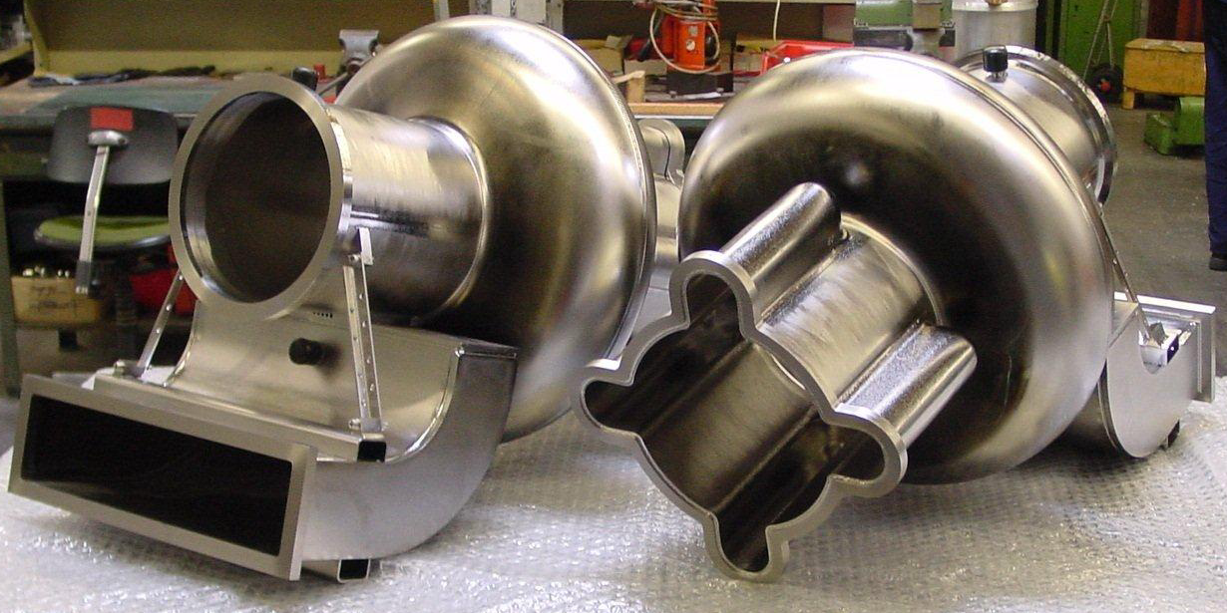
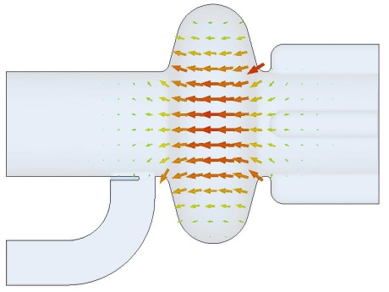
Superconducting 500 MHz RF Cavities
CESR Type

Slide 22
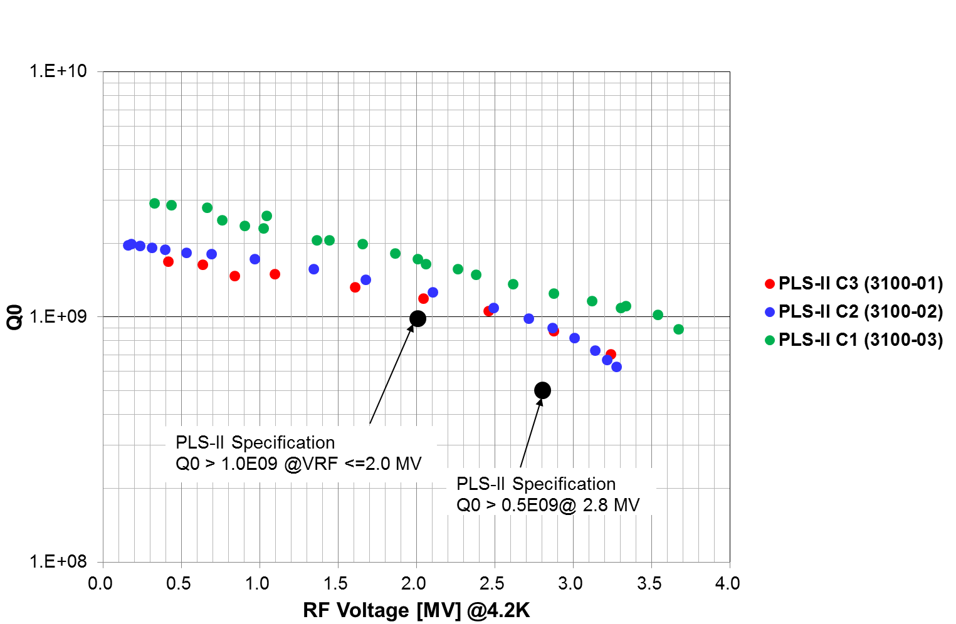
Accelerating Voltages @ Bare Cavity
@cryomodule test
@vertical test

Slide 23
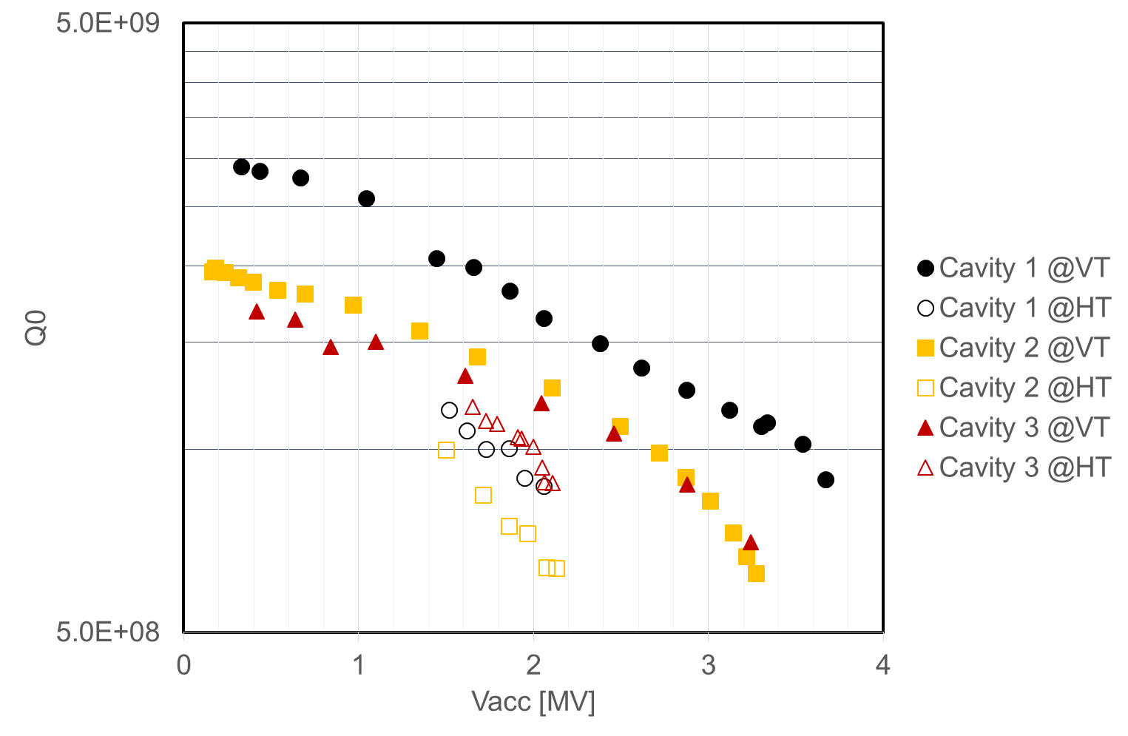
Q0 Degradation, VT vs HT (SAT)
1.0E+09
※ Cavity 2 was less Q0 than spec. 1.0E9 @2 MV/m

Slide 24
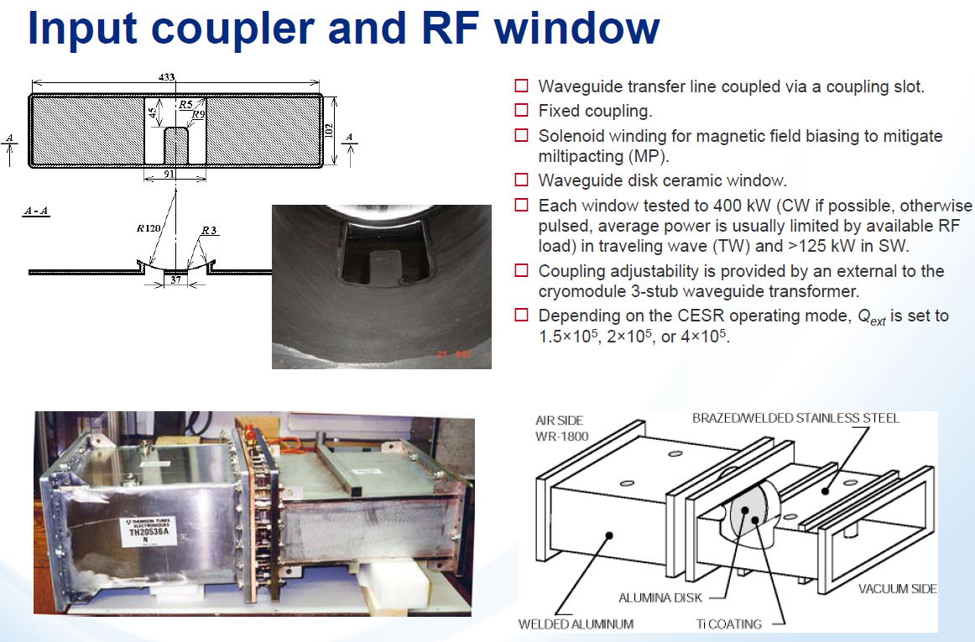

Slide 25
Window Conditioning & Test
9 days (~10 hours/day) for conditioning and test of RF window at Test Stand @warm temperature
Travelling Wave Mode; Spec.
- 8 hours @300 kW CW
- Max △T=29 C (<60 C)
- Vacuum pressure: 2.9~4.9E-9 mbar, no trip (<1E-7)
Standing Wave Mode; Spec.
- 4 hours @150 kW CW
- Max △T=47 C (#24), 56.5C (#25)
- Vacuum pressure: 1.2E-8 ~ 5.9E-9 mbar, no trip

Slide 26
Site Acceptance Test (SAT) @PLS-II
Leak Check: Cavity from atmosphere and He vessel
Spec. (@warm & cold temp.) < 2e-10 mbar l/s
Window & cavity conditioning
On-resonance and off-resonance
Pulse conditioning: 1, 2, 5, 10, 20, 50 msec and CW mode
Repetition rate: primarily 10 Hz with 1, 2, 5 Hz
RF Voltage (Vacc) and Q0 Measurement
Long term operation: 2.03 MV, Q0=6.8e8 (Spec: >5.0e8)
Maximum Vacc: 2.5 MV (8.5 MV/m), Q0=6.4e8
Q external: 1.65E5
Tuner performance test: stroke > +/- 150 kHz, resolution <10Hz

Slide 27
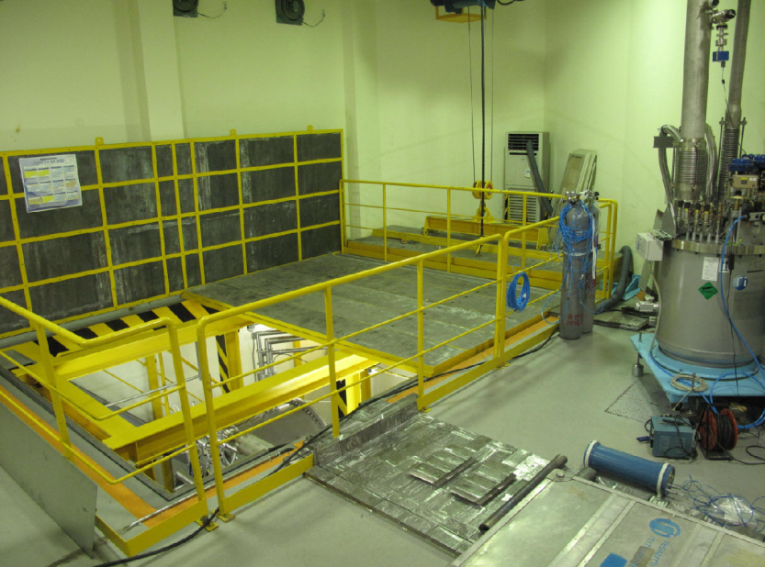
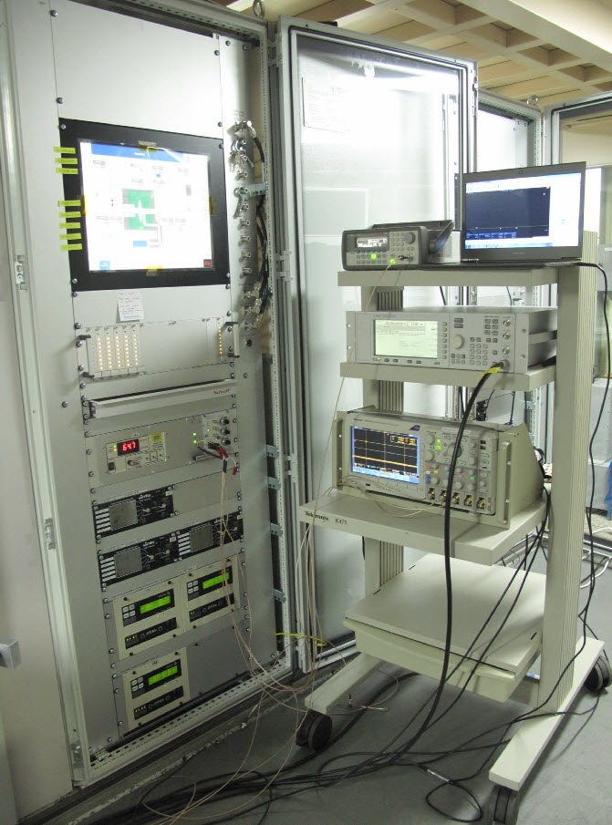
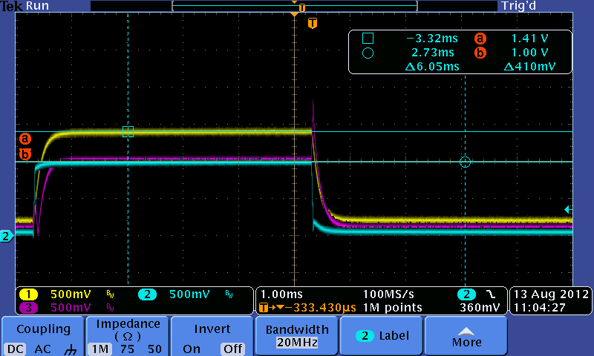
Site Acceptance Test
Test-pit With radiation shield
Cryomodule control system
Pulse-1,2,5,10,20,50 &100 msec

Slide 28
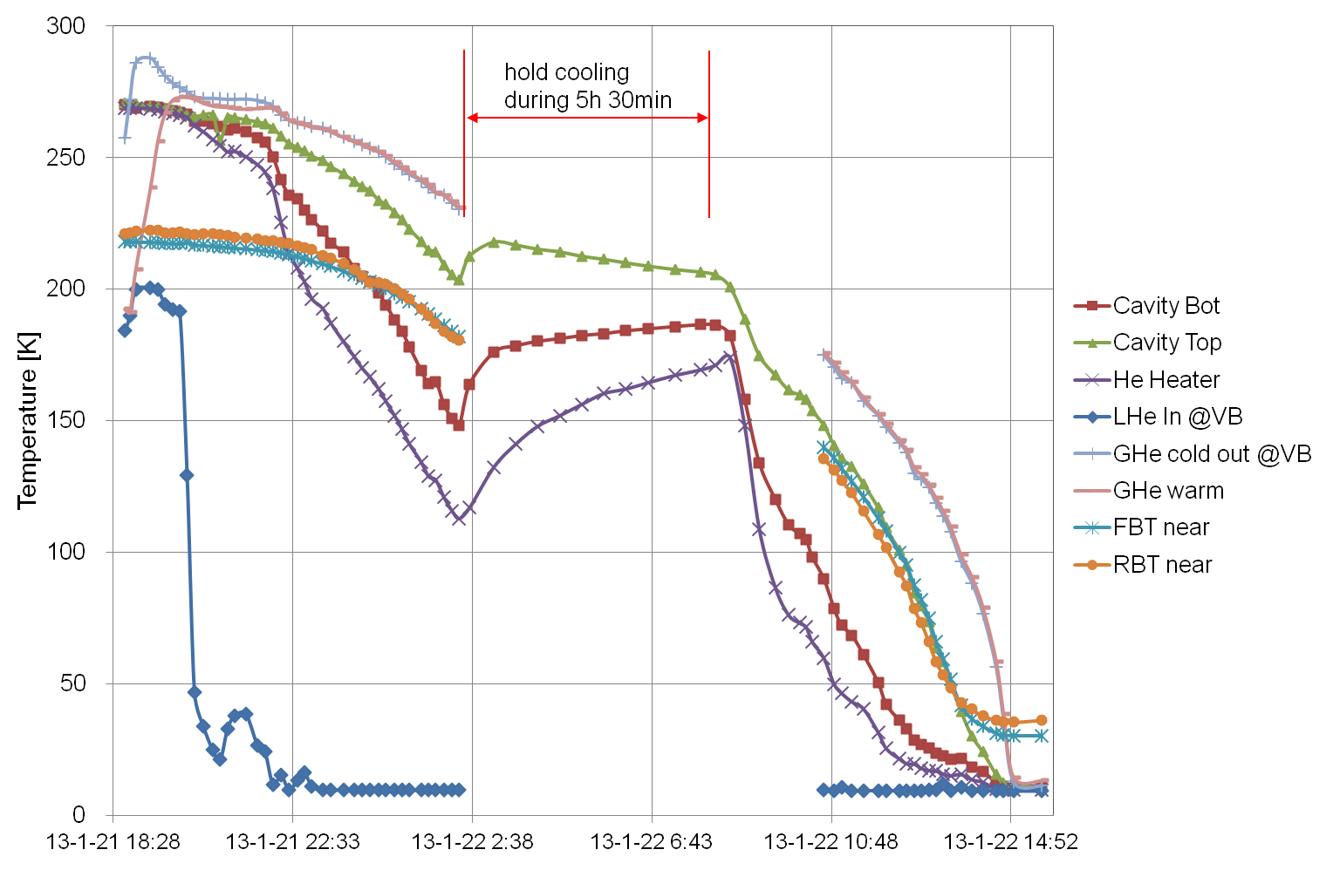
Cooling with Liquid He
~15 hours: room temp. to 4.4 k

Slide 29
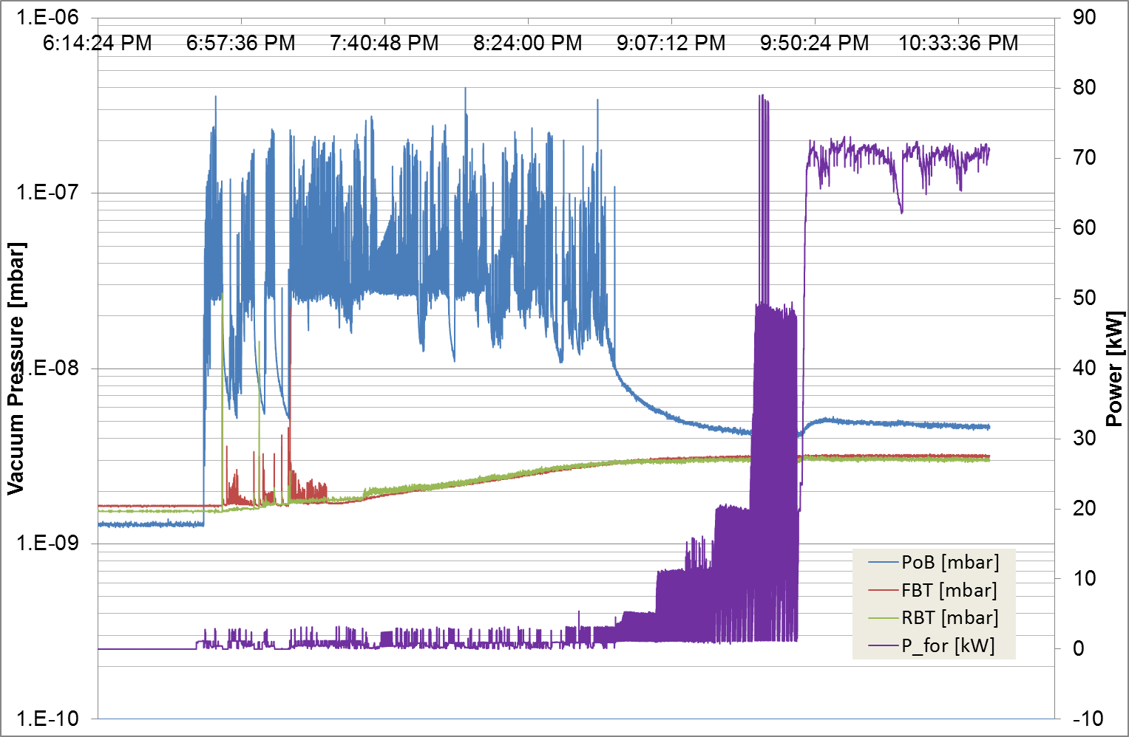
Conditioning Window & Cavity
Last 16 hours
Aug. 14, 2012
CW mode
Window Vacuum
Window Vacuum Pressure
2.03 MV !!
50 msec
Cavity Vacuum
20 msec
10 msec
1 msec
2 msec
5 msec

Slide 30
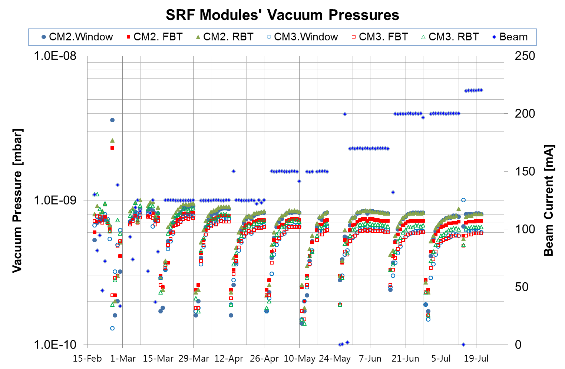

Management, Cavity & Window Vacuum
Partial warming-up cavity up to 40K
Threshold pressure vacuum bursts >1 x 10⁹ mbar

Slide 31
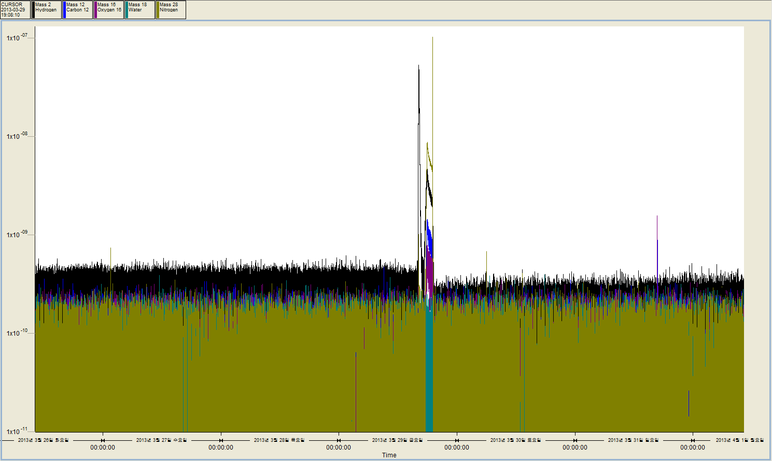
Partial Warmup & Cooldown
Mass-Spectrometer (RGA)
4 days before partial warmup, and 3 days after re-cooldown
Partial warmup
Before partial warmup
After re-cooldown
Partial Pressure of Hydrogen (Black)

Slide 32
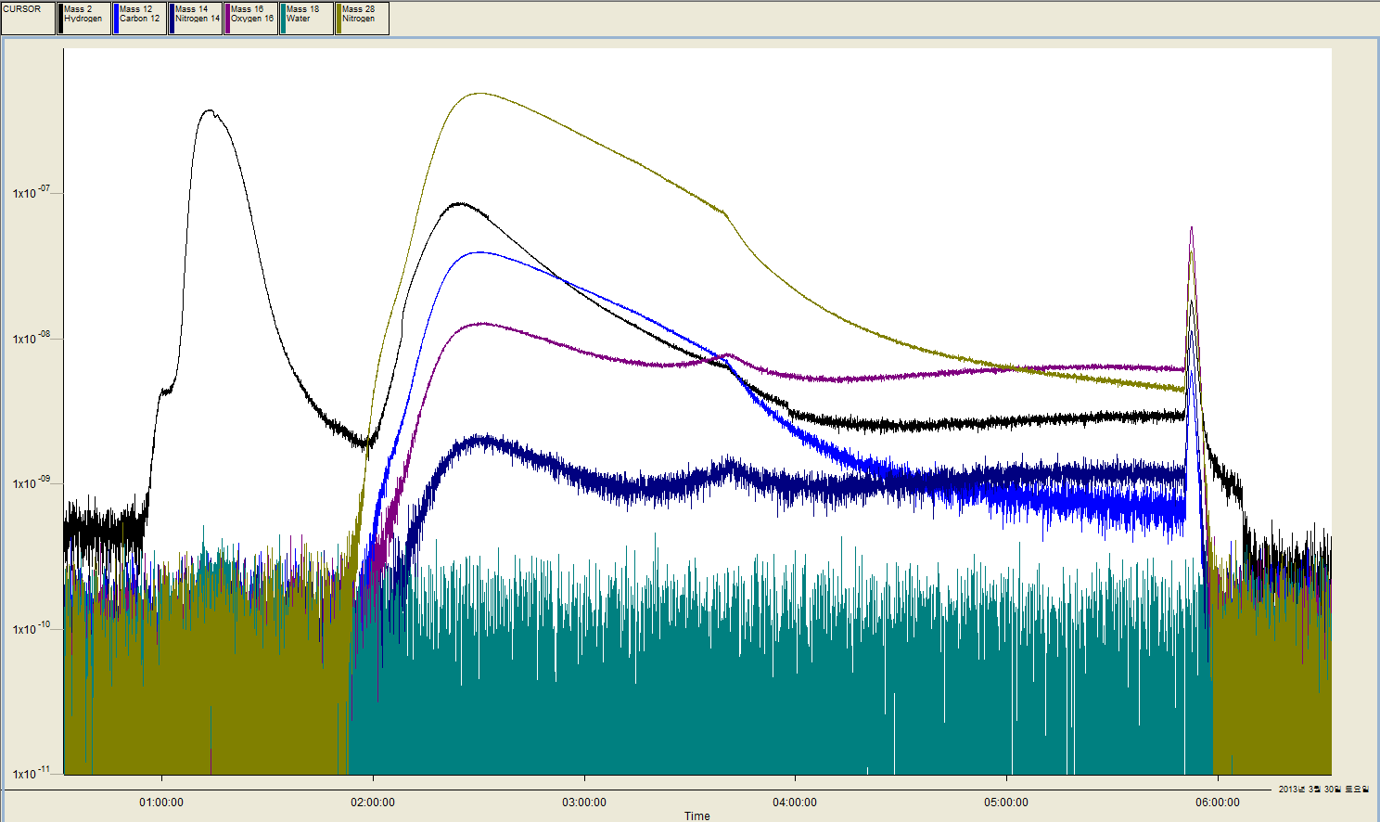
Partial Warmup & Cooldown
During partial warmup & cooldown with TMP operation
~22K
N2: Mass 28
1 Ion pump @window on by mistake
(03:40)
H: Mass 2
TMP on
1.4e-8 mbar
(01:00)
C, Mass 12
All Ion pump on
TMP off
Cavity top:43K
Cavity bottom: 31K
(06:07), 2.9e-9 mbar
Ion pump off
(00:28)
O:Mass 16
N:Mass 14
~15K
~26K

Slide 33
3rd Harmonic Cavity for PLS
(Mar. 2004 – Dec. 2007)
For;
Increase beam lifetime by lengthening e-beam bunches
Reduce coupled-bunch instabilities from higher order mode (HOM)

Slide 34
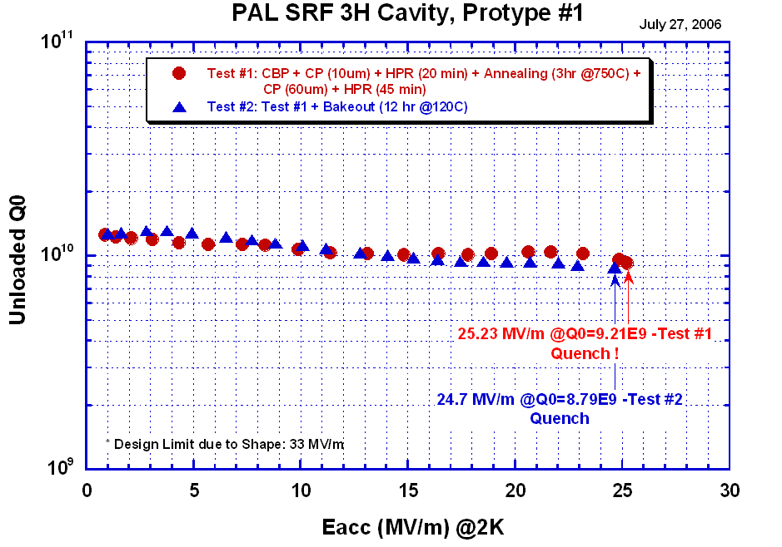
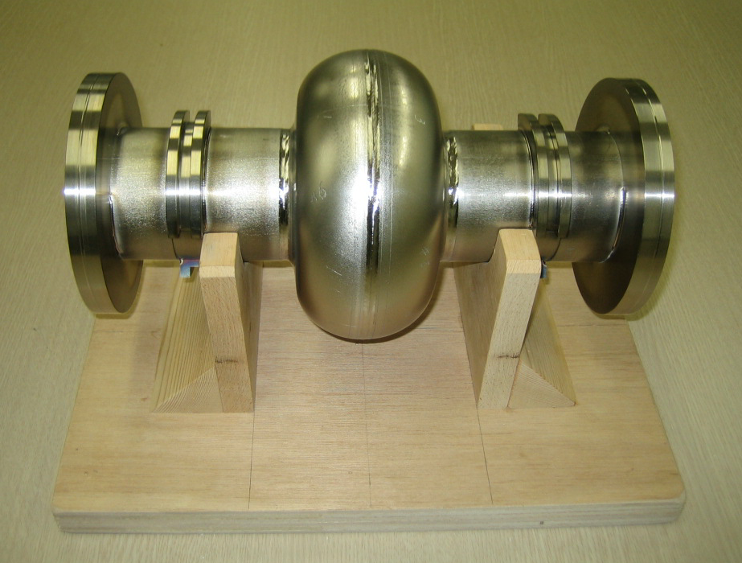
Prototype 3rd Harmonic SRF Cavity for PLS
Prototype 3rd H Cavity
Cavity Performance from vertical test
Design/fabrication @ PAL, surface preparation @KEK, vertical test @Jlab.
First SRF Cavity developed in Korea !!

Slide 35
R&D for ILC SRF
  Cavity (KEK-Low loss) design by K. Saito
  Design/Fabricating dies, jigs & fixtures by PAL
  Fabricating two 9-cell cavities with simple straight beam pipe
  Surface preparation and vertical test at KEK, Japan

Slide 36
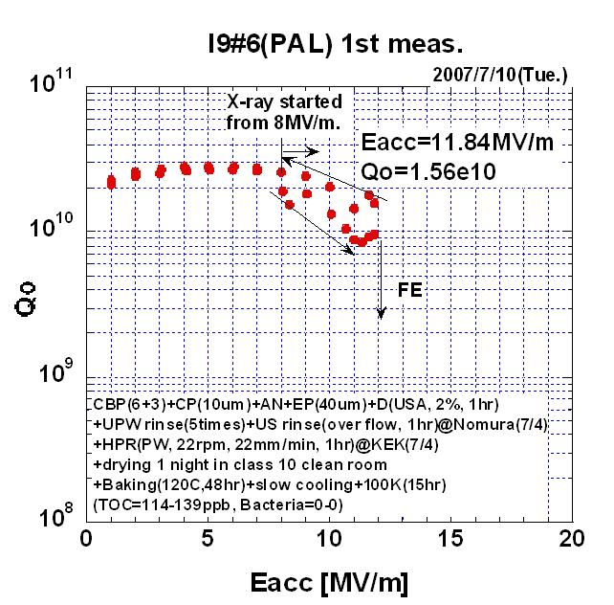
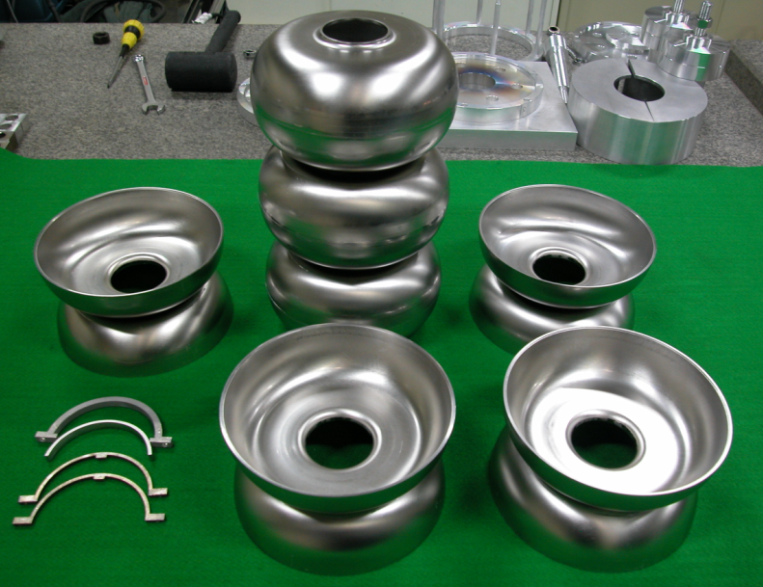
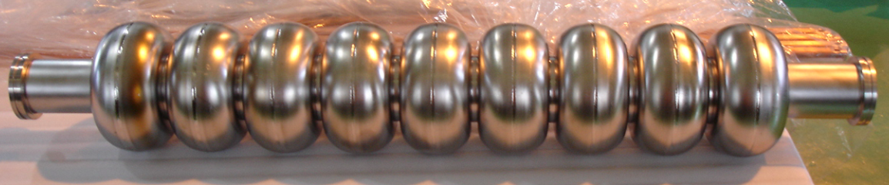
Fabrication of 9-cell Cavity - PAL #1 and 2
3 Measurements of Eacc
- Average Eacc = 23.0 MV/m
- Max. Eacc = 27.2 MV/m

Slide 37
Results of Vertical Test for 9-cell Cavity
3 Measurements of Eacc
- Average Eacc = 23.0 MV/m
- Max. Eacc = 27.2 MV/m

Slide 38
Tack !
감사합니다 !
(Gam-Sa hap-ni-da !)

