Slide 1
Quench Protection
Younguk Sohn
FREIA, Meeting for H-β Elliptical cavity test, October 3, 2017

Slide 2
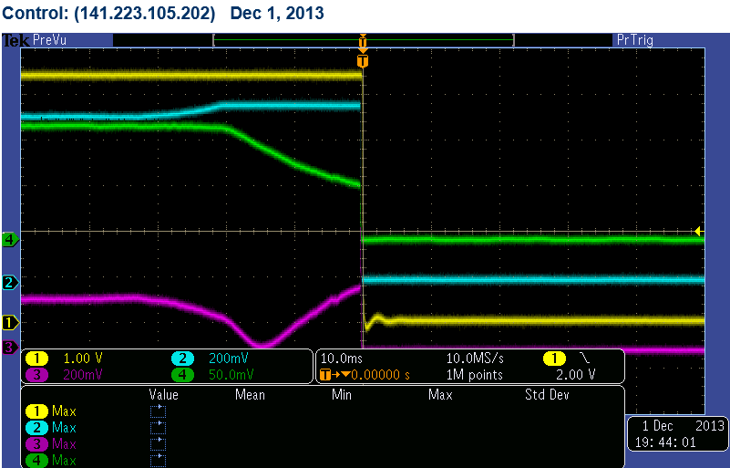
Beam Dump by Quench 2013/12/01/19:17
Beam current
P_for
P_tran: Vacc
P_ref
Reflected power (Pref) decreased, forward power (Pfor) increased slightly, but accelerating voltage (Vacc) decreased. Then it was typical quench !!

Slide 3
Stored Energy in 500 MHz Cavity , PLS-II

Slide 4
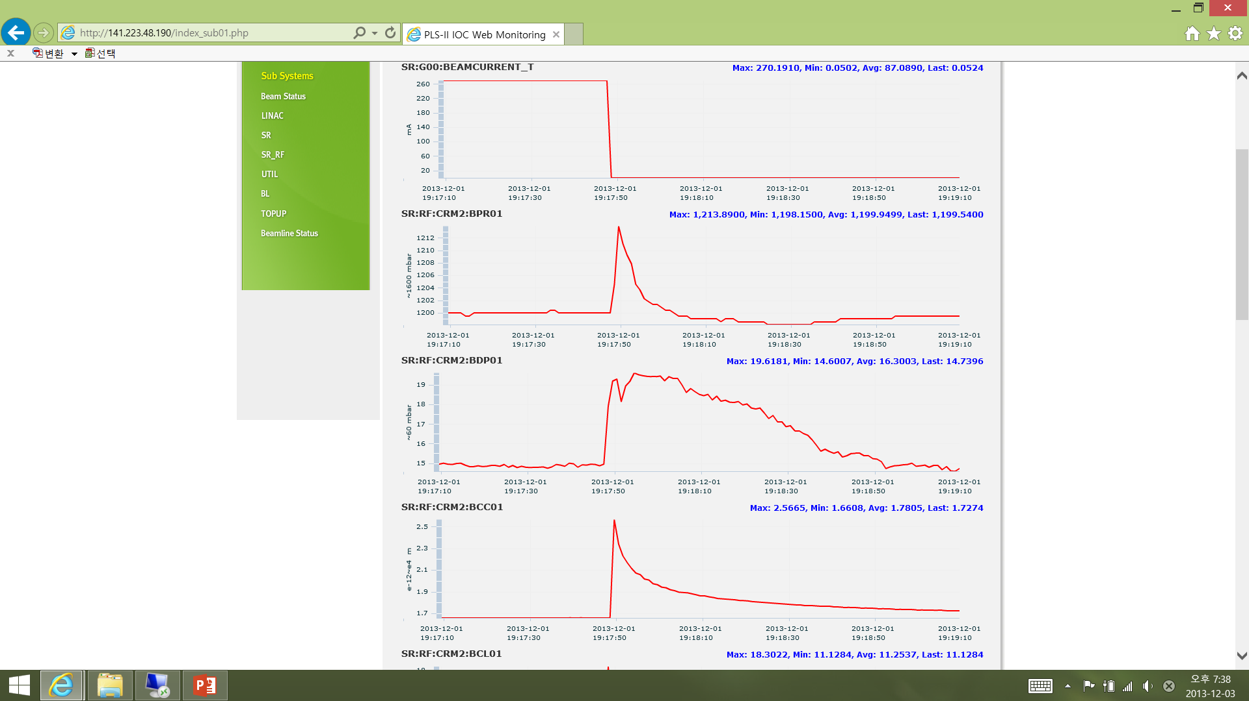
Beam Dump 2013/12/01/19:17
Beam current
Quench is happened, then
→ All RF power is reflected to load and transferred to beam
→ Only stored energy in cavity is dumped to normal zone
(~ ten Jules)
→ Cavity temperature increases
→ LHe evaporation rate increases
And cavity vacuum become bad
Pressure @He vessel
LHe evaporation rate
Cavity vacuum pressure

Slide 5
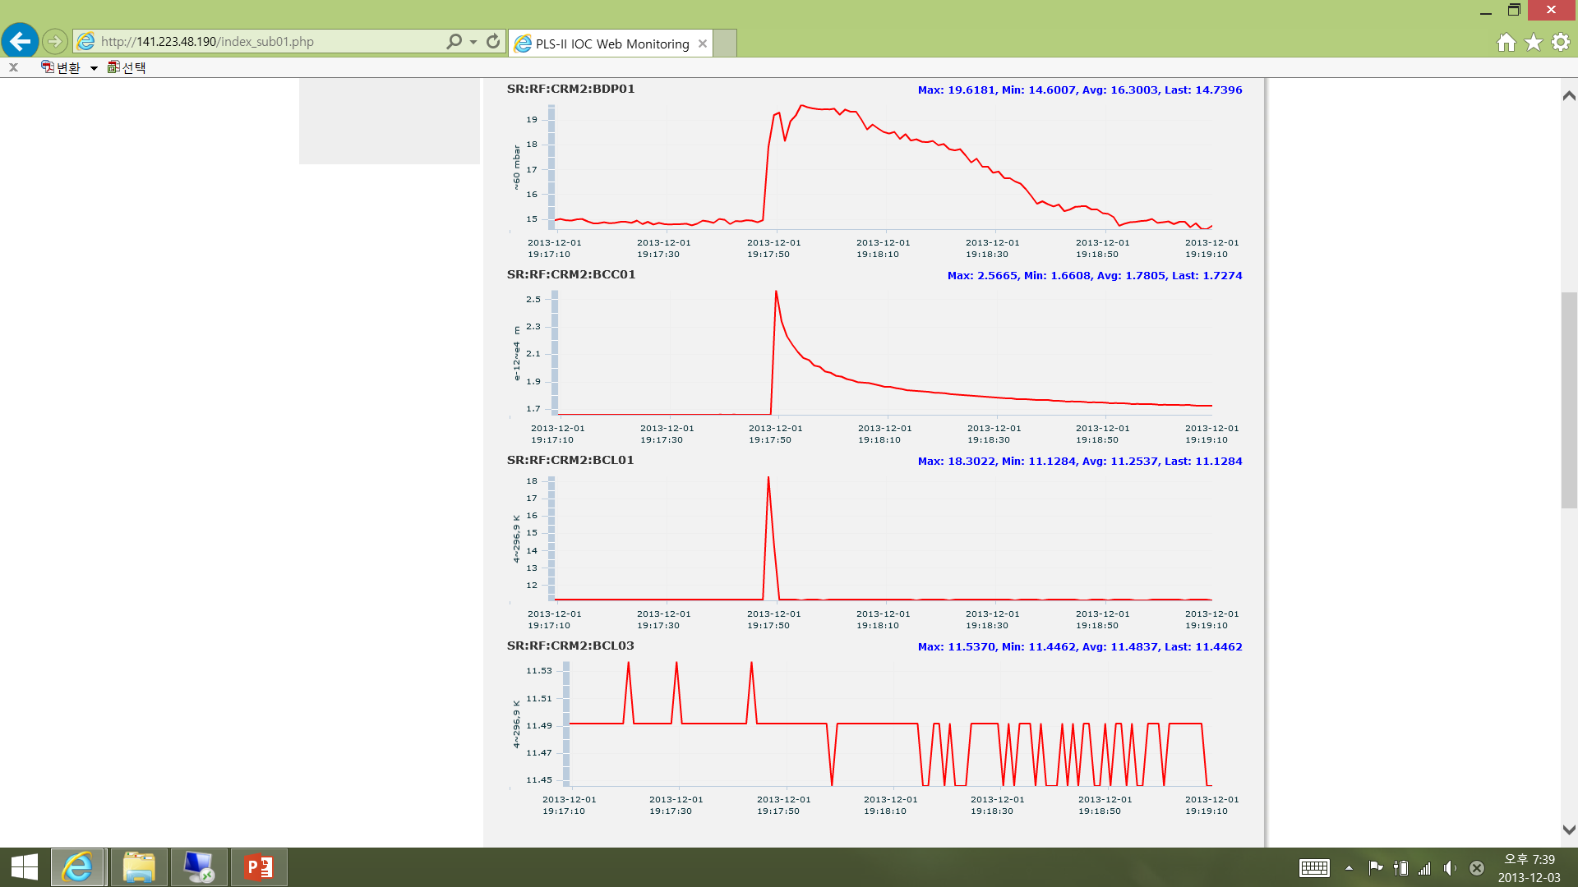
Beam Dump 2013/12/01/19:17
Temperature @cavity bottom
Temperature @cavity top

Slide 6
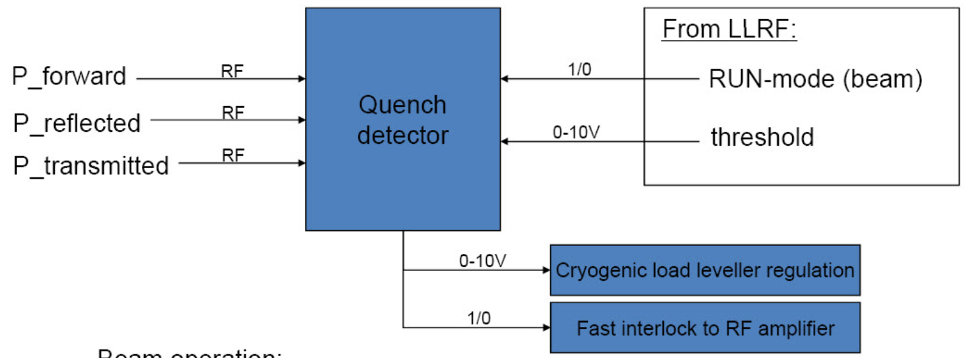
Algorism of Quench Protection
LLRF
Run mode (beam): 1
Processing mode: 0
Forward power limit
Processing mode :
V_{reflected} - f_{reflected} (%) * V_{forward} < 0 (if P_reflected decreases)
where f_{reflected} (%) is set value, the higher the faster response.
Run mode (Beam operation):
V_{prove} - f_{prove} (%) * V_{set} < 0 (If Vacc decreases)
V_{reflected} - f_{reflected} (%) * V_{forward} < 0
Forward power limit
- V_{forward} > V_{limit}
where V_{limit} is set value
Quench trigger time is dependent on quench intensity, fastest time is < 3μs
※ V??? is direct signal from power meter

