Slide 1
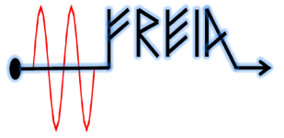
Test plan of ESS HB elliptical cavity
Han Li
On behalf of FREIA team
FREIA Laboratory, Uppsala University
3rd of Oct. 2017

Slide 2
The list of tests in some order of priority
Central cavity frequency and spectrum of higher-order modes (HOM) +
Loaded Q (basically measurement of the 3 dB bandwidth) +
Q0 (calorimetric measurement) +
Max gradient +
Tuning range of the slow step tuner +
Stabilization of the cavity field with LLRF using only RF compensation - +
Dynamic Lorentz force detuning (change in the cavity frequency during the RF pulse) - +
Compensation for the dynamic Lorentz force detuning with the fast piezo tuner -
Stabilization of the cavity field with LLRF using both RF and piezo tuner compensation -
Onset and level of field emission +
Sensitivity to helium pressure fluctuations +
Multipacting +
Cryo related test both at 4 K and 2 K +
Overall test of electronics. - +

Slide 3
Warm test | Cool down | Cold test | Warm up
Central cavity frequency and spectrum of HOM Qe | Frequency shift due to cool down | Coupler cold conditioning | Frequency shift vs. T
 |  | Cavity conditioning
 |  | Central frequency and HOM Loaded Q and Qe
Coupler warm conditioning
 |  | Cavity level profile: let the LHe evaporate to low levels Effect of CV105 in heat load Cavity's power limit Effect of different FPC cooling temperatures in heat load Max load on the 2K pumps
 |  | Q0 Dynamic heat load Max gradient Dynamic Lorentz force detuning
 |  | Stabilization of the cavity field with LLRF using only RF compensation Dynamic Lorentz force detuning Tuning range of the slow step tuner
 |  | Tuner related testing
CRYO
VNA
SGD
signal
generator driven
SEL
Lund system
Lund university

Slide 4
Warm test detail
Process or check item | Work Description | Team | Loop and special device | Power
Build loop and cabling | Build SEL | RF |  | Low power
instrumentation check | validation of instruments SEL, FPGA software debuging | RF | SEL: Copper cavity, SEL, FPGA, interlock switch, RF switch and RF station
 |  |  | SGD: Signal generater driven system, interlock system, coupler vacuum, RF station, conditioning software
 |  |  | VNA: VNA, frequency auto checking software
S parameter measurement | Get central cavity frequency | RF | VNA
Qe | Simply estimate the coupling factor and Qe | RF | VNA

Slide 5
Warm test detail
Process or check item | Work Description | Team | Loop and special device | Power
preparing of Interlock system | Validation of software Set related parameters in the software and vacuum interlock thredshold | CTRL RF | SGD: software, RF station, | Low power
Coupler warm conditioning | Ramp up forward power to 1.1 MW during filling time Increase pulse width to 3.5ms Get an optimal procedure for RF conditioning | CTRL RF | SGD: RF station, FREIA software | High power

Slide 6
Cool down test detail
Process or check item | Work Description | Team | Loop and special device
Frequency shift vs. T | Frequency shift due to cool down | RF | VNA, frequency auto checking software
Cool down to 4 K |  | CRYO
Cavity level profile | let the LHe evaporate to low levels (below 30%) | CRYO
Frequency shift vs. Pressure | Frequency shift due to pressure | RF | VNA, frequency auto checking software
Cool down to 2 K |  | CRYO
Static heat loads | Effect of CV105 in heat load Cavity's power limit: apply heat power until the level and/or the pressure in the cavity shows instabilities Effect of different FPC cooling temperatures in heat load | CRYO
Max. 2K pumps capacity at 2K | Max. 2K pumps capacity at 2K (theoretically at 90W) | CRYO

Slide 7
Cold test detail (I)
Process or check item | Work Description | Team | Loop and special device | Power
Coupler Cold conditioning | Conditioning coupler with detuned cavity or with a frequency outside the cavity bandwidth Ramp up forward power to 1MW during filling time Increase pulse width to 3.6ms | RF CTRL | SGD: RF station, FREIA software Data acquisition system Personal safty system | High power
Dressed cavity packet cold conditioning | Conditioning coupler and cavity at resonant frequency Ramp up forward power to 232KW or less Increase pulse width to 3.5ms | RF CTRL | SEL: RF station FPGA, Interlock system, RF switch Data acquisition system Personal safty system
Central frequency and HOM Loaded Q and Qe | Get central cavity frequency and high order mode Loaded Q and -3dB bandwidth Qe | RF | VNA | Low power

Slide 8
Cold test detail (II)
Process or check item | Work Description | Team | Loop and special device | Power
Q0 Dynamic heat load Max gradient Dynamic Lorentz force detuning | Runing pulse SEL from low power with 3.5ms, 14Hz forward pulse Get average Q0 value as a function of average gradient Checking the radiation Increas the forward power until reaching the nominal gradient Measure dynamic heat load at different power level Use I/Q meadth to check the frequency shit during the pulse | RF CRYO | SEL: SEL, FPGA, RF station Interlock system, RF switch, Helium gas flowmeter, Data acquisition system, Personal safty system | High Power
Dynamic Lorentz force detuning | Use Lund system to generator step pulse input Use FPGA to check the frequency shit during the pulse | RF | Lund system , FPGA, RF station Data acquisition system, Personal safty system

Slide 9
Cold test detail (III)
Process or check item | Work Description | Team | Loop and special device | Power
Stabilization of the cavity field with LLRF using only RF compensation | Use Lund system to produce input pulse Ramp up power level from low power to 232KW Stay at nomial gradient for a certain time to confirm the stabilization of the cavity field | CRYO RF | Lund system RF station Data acquisition system, Personal safty system | High power
Tuning range of the slow step tuner | Slow tuning control by lund system Slow tuning control by IPNO software ? | CRYO RF | Lund system Data acquisition system, | Low power
Tuner related testing | Test that lund university are interested ? | CTRL Lund | Lund university

Slide 10
Warm up test detail
Process or check item | Work Description | Team | Loop and special device
Frequency shift vs. Pressure | Frequency shift due to pressure | RF | VNA
Warm up to 4 K |  | CRYO
Frequency shift vs. T | Frequency shift due to warm up | RF | VNA
Warm up to 300 K |  | CRYO

Slide 11
Current progress
704 MHz SEL>
Hardware:
SEL box is under design and will be finished at the end of Oct.
---key people: Tord, Tor and Han
Software:
SEL Labview interface will be modified next week
---key people: Han and Tor
Temperature sensors
Temperature sensors location of interested.
---key people: Rocio, Magnus, Younguk and Han
Four wire heater for power calibration
Wiers extending of hearter;
One current meter is need to connect in the loop.
---key people: Rocio

Slide 12
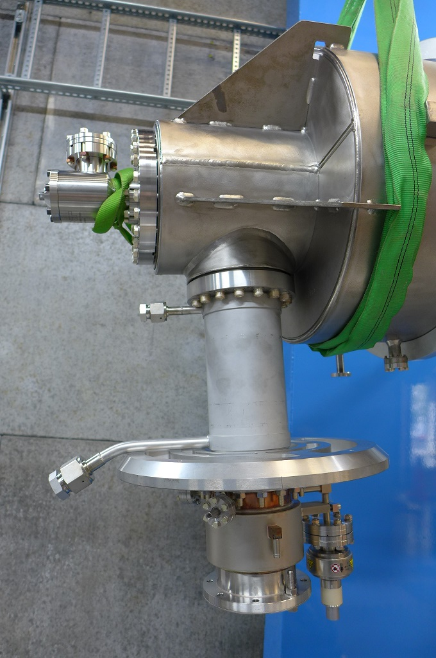
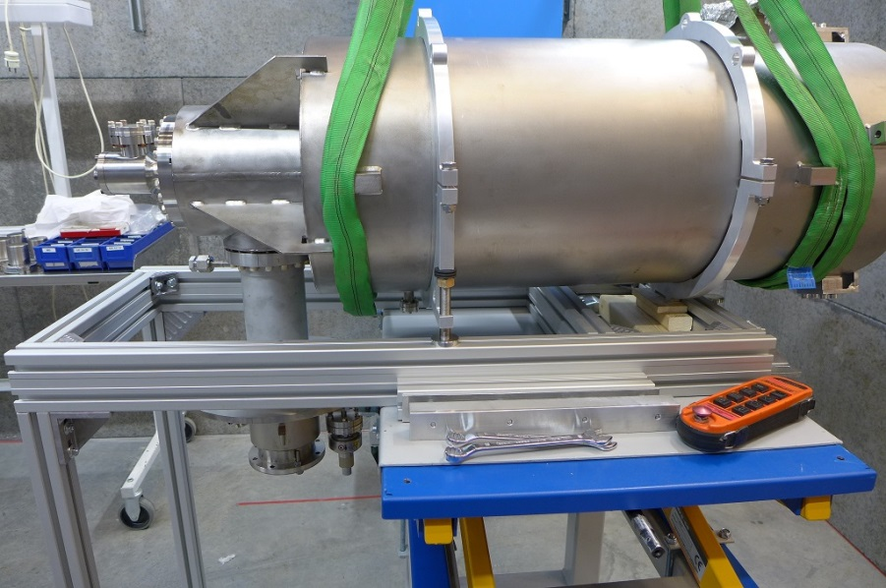
FPC temperature sensors positions
Cernox
Pt 100
Minco Heater (thin film)
Cavity-Antenna interface
Cavity-FPC interface
Cooling (TT104)
Inlet ScHe (TT303)
Pt100 (TT147)
TT117
TT125
FPC Midsection
EH103C (TT143C)
TT115
EH103A (TT143A)
Outlet ScHe (TT305)

Slide 13
To do list
704 MHz Conditioning system
Hardware: Validation of Interlocks
---key people: Konrad and Kjell
Power limitation and interlock
---key people: Magnus, Konrad and Han
Software: SEL Labview interface will be modified next week
---key people: Han and Tor
Pressure gauge test
Find out the reason of the step-wise reading and how ti improve it?
---key people: Rocio, Konrad and Han

Slide 14
questions
Do we need to consider quench or not ? Which signal should we use for Quech detection? What is the way to hook up this signal into interlock system?

Slide 15
Parameter for HB elliptical cavity
main parameter of ESS high Beta elliptical cavity
$V_{0}=E_{acc}×L_{eff}=5$,751 MV
$L_{eff }$=0,92 m
$\frac{R}{Q }$ = 435 Ω
$Q_{L }$=7,6e5
$$f_{0}=704,42 MHz at 2 K$$
$$P_{f_max}=\frac{{{(E}_{acc_peak_Pf}×L_{eff})}^{2}}{4×R/Q×Q_{L}}$$
231 kW at 19.9 MV/m
189 kW at 18 MV/m
Q0 for SC cavity: ⪸ 10e9
Q0 for NC cavity: ≈ 10e4

