Slide 1
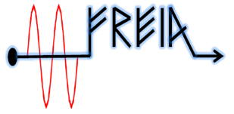
Test plan of ESS HB elliptical cavity
Han Li
On behalf of FREIA team
FREIA Laboratory, Uppsala University
10th of Oct. 2017

Slide 2
Current progress
704 MHz SEL>
Hardware:
SEL box is under design and will be finished at the end of Oct.
---key people: Tord, Tor and Han
Software:
SEL Labview interface will be modified next week
---key people: Han and Tor
Temperature sensors
Temperature sensors location of interested.
---key people: Rocio, Magnus, Younguk and Han
Four wire heater for power calibration
Wiers extending of hearter;
One current meter is need to connect in the loop.
---key people: Rocio

Slide 3
Current progress (cnt.)
Quench detection>
Simulation:
cavity quench profile simulation
Quech detection analog loop simulation
Hardware: component order and board solder
---key people: Magnus, Tord Peterson and Han
Coupler conditioning factor>
FPC conditioning | Source frequncy | cavity frequency
Warm | 704.42MHz | ?
Cold | 704.42MHz | 704.0947MHz

Slide 4
To do list
704 MHz Conditioning system
Hardware: Validation of Interlocks
---key people: Konrad and Kjell
Power limitation and interlock
---key people: Magnus, Konrad and Han
Software: SEL Labview interface will be modified next week
---key people: Han and Tor
Quench detection
Simulation of cavity profile during MP and using this profile to test our quech detector design
---key people: Magnus and Han
Pressure gauge test
Find out the reason of the step-wise reading and how ti improve it?
---key people: Rocio, Konrad and Han

