Slide 1
Processing Against Cavity Limits
Younguk Sohn
FREIA Seminar, 2 November, 2017

Slide 2
Topics
Work process of cavity, design to beam commissioning in an accelerator – page 3
Cavity cooling rate – page 8
Acceptance criteria, cavity and cryomodule – page 14
Happenings during vertical test, module test, beam operation and coupler conditioning – page 23
Main Power Coupler Problem – page 45

Slide 3
1. Work Process of Cavity for Accelerator

Slide 4
Work Process of Cavity for Accelerator
Physics Design
Beam dynamics
RF simulation by computer codes
RF specification
Proper design to avoid multipacting
In cavity and coupler
MP
Engineering Design
Drawings
Engineering & specification of each material, element and part
VC
QH
Less chance of vacuum leakage
Interface between other materials
Materials
Cavity & beam tube, He vessel
(Nb, Ti, SUS, …)
Material inspection
Defect from material (Nb, ceramic and coating)
QH
MP
FE
Machining
Welding
(light) Chemical cleaning
Measuring dimension and frequency
Tuning each half-cell and whole cells
Inspection, (and if necessary grinding)
Assembling He vessel (after cavity tuning)
Less dimensional deviation
No incursion of foreign materials
Uniformity between cells
Cavity Fabrication
QH

Slide 5
Work Process of Cavity for Accelerator
Primary polishing (~200 um ±α, BCP or EP)
Inspection inside
Heat treatment (high temperature)
Tuning (for field flatness and frequency)
High pressure water rinsing (HPR)
Massage polishing (~20 um ±β, BCP or EP)
Primary (final) HPR
Assembling accessary (HOM, pickup antenna, flange)
Heat treatment (low temperature, baking)
QH
MP
FE
VC
QD
Go to He jacket assembly
Surface Preparation
After He jacket assembly
Most careful process
Less contamination chance
Well-defined recipe, facility and operators
Cable calibration and measuring RF parameters at warm temperature
Cool down (4K) and measuring Eacc vs Q0
Measuring BCS resistance (4→2K cooling) by RF power supplying
Cable calibration and measuring RF parameters including HOMs at 2K
Measuring Eacc vs Q0 at 2K
Warm up
Vertical Test
For cavity R&D or
For acceptance test

Slide 6
Work Process of Cavity for Accelerator
Coupler preparation (with warm conditioning)
Tuner preparation
Cavity string
Thermal shield, magnetic shield, cryogenic parts, vacuum parts, sensors, MLI,…
QH
MP
FE
VC
Assembling Cryomdule
High chance of cavity & coupler contamination
※ FAT is usually for points of dimension, vacuum, cryogenics and tuner function.
Leak check (cavity vacuum, insulation vacuum)
Cable calibration and measuring RF parameters
Coupler conditioning
Functional test of tuner, cryogenic control system and interlock system
At warm temp
Cool down (4K then 2K) and monitoring frequency
Leak check
Functional tests of tuner, cryogenic control system and interlock system
Coupler conditioning & cavity conditioning (measuring Eacc)
Cable calibration and measuring RF parameters including HOMs at 2K
Measuring dynamic heat loss (Q0) with Eacc
Tuner test
Frequency sensitivity against pressure change
Long term stability at Nominal Eacc (4 hours ?)
Warm up
At cold temp
Module Test (FAT, SAT)
f0, Eacc, Q0 (dynamic heat loss), static heat loss, Qexternal, HOM frequency, tuner characteristics, pressure sensitivity, (onset of FE), filling time, max Eacc …

Slide 7
Work Process of Cavity for Accelerator
On-site Movement
Connection, vacuum part, utility, RF & control part
Connection, cryogenic part
Alignment for connection and for right beam position
Leak check
QH
MP
FE
VC
Installation in an Accelerator
Same procedure as module test, without beam
Long-term operateablity of whole system, without beam
Calibration of pickup signal to P_{transmitted}
RF power characteristics (I_{beam} vs P_{forward}, P_{reflect}, P_{transmitted}) of each cavity, with beam
Phase tuning between cavities and also between modules, with beam
Recovering time after faults
Commissioning w/o and W/ beam
Operation

Slide 8
2. Cavity Cooling Rate

Slide 9
Cooldown Rate – XFEL @DESY
300 K → 100 K
12 hours, ~18 K/hr
4-5 hours at 100 K
100 K → 4 K
~1.25 hours ~76 K/hr
~ 18K/min at 9.2 K
Maximum local temp. gradient
~ 40 K between both cavity ends
4 K → 2 K
~ 30 mK/min
data: arXiv:1609.06503v4 [physics.acc-ph] 13 Sep 2017

Slide 10
Cooldown Rate – XFEL @DESY
~18 K/hr
Plot: Temporal temp. gradient
10 mK/s = 36 K/hr
Plot: Local temp. gradient
10 mK/mm = 10 K/across cavity (~1 m)
※ In case of PLS-II, <60 K/hr and < 60 K/across cavity

Slide 11
Cooldown Rate
In point of Q0 improvement (Cornell Uni, Fermilab)
With nitrogen doped cavities, the faster cooldown rate (> few K/min), the better Q0 from study
The larger local temperature gradient, the higher Q0
Q0 effectiveness of local temp. gradient is bigger than that of cooling rate
Local temp. gradient would give less chance to trap magnetic flux near critical temp. (Dan Gonnella, Proceedings of LINAC2014, Geneva, Switzerland)
In point of mechanical safety
mechanical failures such as vacuum leakage (indium gasket) in NSLS-II, DLS
ferrite tile (HOM removal) detached in Cornell Uni.

Slide 12
Cooldown Speed
Fast: 50 min 300-4.2 K, 5.3 K/min
N2 doped 9-cell cavity for LCLS-II
Fine grain, EP single-cell cavity

Slide 13
Cooldown Speed
Conclusion
With nitrogen doped cavities, the faster cooldown is helpful also with 9-cell LCLS-II cavity (Alexander Romanenko, SRF 2015)
Effects both of from 300 K and 20 K looks nearly same.
Cavities from usual preparation (no Nitrogen doped), less sensitive
Recommendation: normal cooling speed until ~20 K, then fast cooldown
Don’t worry H-disease with normal cooling speed around 110 ~ 60 K
Probable mechanism: A. Romanenko, et al, Journal of Applied Physics 115, 184903 (2014)

Slide 14
3. Acceptance Criteria
A lots of specification must be qualified during;
Material preparation: defect free
Cavity fabrication: dimension, frequency
Surface preparation: field flatness (85~90 % cell to cell)
Vertical test: Eacc, Q0, frequency, radiation (MP, FE)
Module test (FAT & SAT): leak rate <1E-10 mbar l/s, Eacc, Q0, frequency, HOM frequency, Qexternal, radiation (MP, FE)

Slide 15
Acceptance Criteria – Experience in XFEL
Data: D. Reschke, et al., PHYS. REV. ACCEL. BEAMS 20, 042004 (2017)
Vertical test
831 cavities in vertical test
816 cavities in 102 cryomodules
15 cavities, used in studies of facility and procedure
Maximum achievement gradient: E_{max}
Maximum E_{acc} , recorded independent on the cause like quench, MP, FE and administrative power limit
Usable gradient: E_{usable}
Quench limit (E_{quench} – 1 MV/m)
Q0 limit, Q0 ≥ 10¹⁰
X-ray limit (field emission threshold, < 10 μSv/min) in beam axis
※ CEBAF upgrade < 167 μSv/min

Slide 16
Acceptance Criteria – Experience in XFEL
Usable gradient (acceptance criteria for VT)
≥ 26 MV/m (at beginning): ~10% higher than nominal E_{acc} 23.6 MV/m
≥ 20 MV/m (after 270 VTs): because expectation of higher average Eacc than 23.6 MV/m
If E_{usable} < 20 MV/m, rejected to re-treatment
Statistics of vertical test
Total 1340 VTs with 831 cavities, →1.48 times VT each cavity, average
28% of cavities with more than 2 times VT as passed incoming inspection
Average E_{max} 31.4 MV/m (rms dev 6.8 MV/m)
Average E_{usable} 27.7 MV/m (Q0 ≥ 10¹⁰, rms dev 7.2 MV/m)

Slide 17
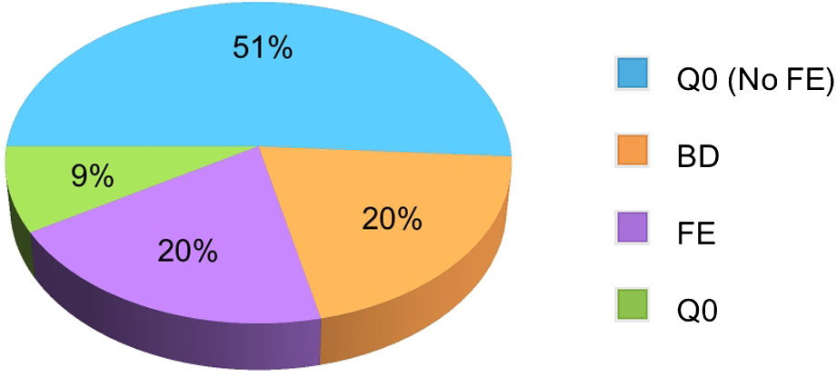
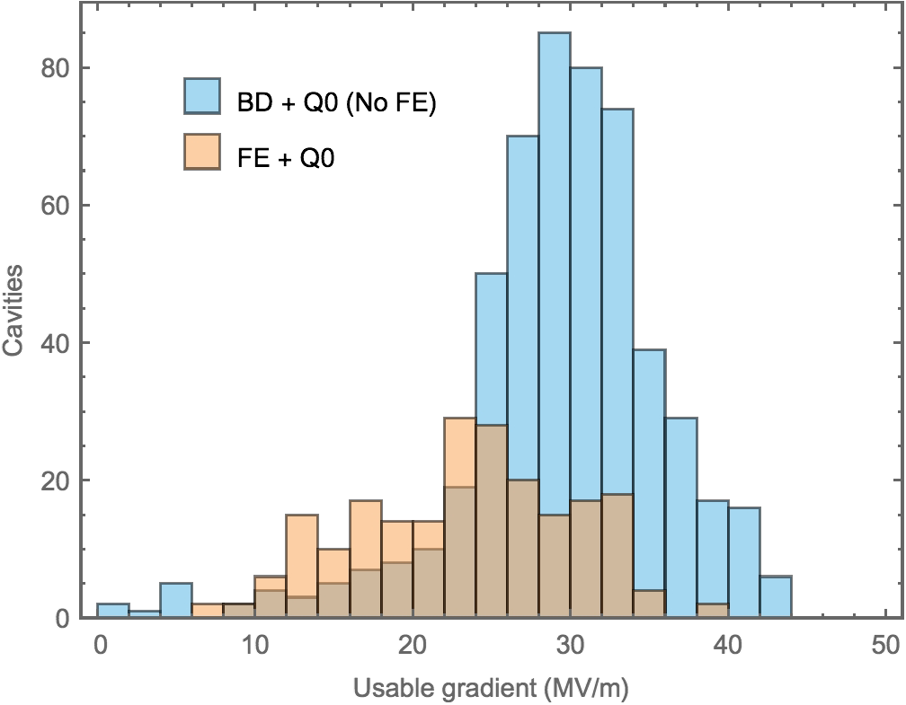
Acceptance Criteria – Experience in XFEL
Nominal Eacc
high Q-slop
1st rejected
Q0 with FE
quench
Field emission
2nd rejected
Cavities in categorized with limiting phenomena during VT
Usable Eacc distribution
※ 10% of cavities were rejected to send to re-treatment, before VT, remaining 90% are as “received cavity”

Slide 18
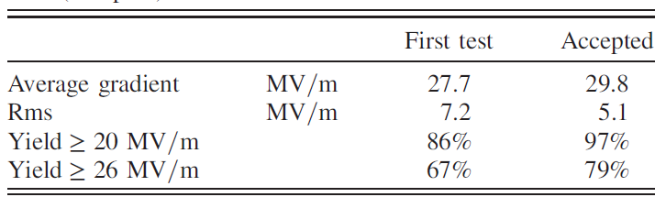
Vertical Test Summary
E_{usable}
Condition with
Q0 ≥ 10¹⁰
During the acceptance vertical test
No curing process such as high power pulse conditioning and He processing against MP and field emission
But re-treatment and retest were done.

Slide 19
FXFEL Summary
E_{usable}
Criteria for VT and module test
E_{usable} ≥ 20 MV/m
Q0 ≥ 10¹⁰
Xray (FE) < 10 μSv/min

Slide 20
Acceptance Criteria – ESS Preliminary (?)
 | Spokes | Medium -β | High β
Number of modules | 13 | 9 | 21
Type of cavity | spoke | elliptical | elliptical
Cavities per module | 2 | 4 | 4
Spokes / cells | 2 | 6 | 5
Frequency [MHz] | 352.2 | 704.4 | 704.4
Geom. b | 0.5 | 0.67 | 0.86
R/Q [Ω/m] | 427 | 367 | 435
Nominal E_{acc} [MV/m] | 9 | 16.7 | 19.9
Q0 at nominal Eacc | 1.5 x 10⁹ | 5 x 10⁹ | 5 x 10⁹
Acceptance from vertical test, [MV/m] | > 8.1~10 Q0 ≥ 1.3 x 10⁹ | 15~18.4 Q0 ≥ 4.3 x 10⁹ | 17.9~21.89 Q0 ≥ 4.3 x 10⁹
Acceptance from module test [MV/m] | 8 | 15 | 17.9
±10% E_{nominal}
+15% heat loss

Slide 21
Acceptance Criteria – ESS Preliminary (?)
ESS criteria looks easy apparently, based on those of XFEL, CEBAF Upgrade and LCLS-II
But, it seems more hard compared to others, because
Primary surface polishing of XFEL and CEBAF were “Electropolishing” of which roughness would be ≤ ~10 μm and suitable for high Eacc (≥ 20 MV/m) & Q0 cavity
ESS polishing recipe is “Buffer chemical polishing” of which roughness would be ≥ ~10 μm and suitable for ≤ 20 MV/m cavity
Eacc,18-20 MV/m would be marginal between BCP and EP !

Slide 22
Acceptance Criteria – ESS Preliminary (?)
BCP
EP
C. Xu, C. E. Reece and M. J. Kelley, "Simulation of non-linear SRF losses derived from characteristic Nb topography: comparison of etched and electropolished surfaces," http://arxiv.org/abs/1406.7276, 2014.

Slide 23
4. Limitations during vertical test, module test, beam operation and coupler conditioning

Slide 24
Limitations during Cavity & Module Test
Cavity quenching – by poor polishing, defect
Multipacting (MP) in coupler and cavity, resonant phenomena, produce multiple collisions
Field emissioning (FE) in coupler and cavity
High field Q- disease, by hydrogen
Immature quenching and/or Q- disease
Vacuum leakage (rate > 1e-10 mbar l/m)
Tuner sticking – reliability of passive unengaging system
Tuner limitation for moving
Thermal breakdown

Slide 25
Limitations during Cavity & Module Test
Cavity contamination during pump connection and pumping & purging
→ automatic P&P system, using in-vacuum particle counter and RGA
Operation error from LLRF & control system during system tuning and power calibration, with real power
Unintended overpower during conditioning of coupler and cavity at the transient periods
→ set “forward power limit” from interlock system
Vacuum spike with unknown cause
→ diagnostic system (maybe oscilloscope - monitoring signals such as forward & reflect powers, RF pickup from cavity and coupler, cavity & coupler vacuums)

Slide 26
Multipacting (MP)
MP is a resonant electron discharge, produced by the synchronization of emitted electrons with the RF fields and by the electron multiplication at the impact point with the surface of the structure. Then often plaguing radiofrequency structures.
The discharge is mainly encountered in RF accelerating structures where the combination of RF fields and clean surfaces of high secondary yield metals like copper, aluminium, or niobium will enhance the electron multiplication of the electrons at each impact.
Encountered at the interface between vacuum and dielectrics such as RF windows in waveguides or ceramic feed-through in power devices such as RF couplers for accelerating cavities or broadcasting power tubes and devices.
Reference: R. Parodi, INFN-Genova, Genoa, Italy
https://arxiv.org/ftp/arxiv/papers/1112/1112.2176.pdf

Slide 27
Multipacting
To have multipacting you need the occurrence of two conditions:
electron synchronization with the RF fields
electron multiplication via secondary electron re-emission.
Both conditions need to be met by the electron clouds trapped in the RF fields, to produce a real MP barrier.
MP electrons
Absorb RF energy → low Q0
Produce x-ray
Can be evolved to thermal breakdown → quench

Slide 28
How to Avoid MP
There are two ways to avoid or reduce the possibility of MP:
reduce electron multiplication (by material selection)
avoid spatial focusing of electrons in critical regions to break time focusing and RF (by geometric design)
To kill the electron multiplication using materials with secondary emission coefficient lower than one. Exponential decrease of reemitted electrons, unable to self-sustain. Unfortunately.

Slide 29
Field Emission (FE)
Electrons in local points of cavity surface absorbs RF power by surface-electric field, then electrons escape to cavity space. FE scales exponentially with the electric field and is capable of consuming inordinate amounts of power.
FE is characterized by an exponential drop of the Q0 versus Eacc curve and x rays production.
The escaped electrons impact the cavity walls, producing heat and bremsstrahlung x rays. The heating can be so severe that a quench results.
Detected with electron-pickup probe in the cavity and an x-ray detector outside the cryostat (for bremsstrahlung x rays). Both are useful for detecting the onset of FE and to measure the emitter strength

Slide 30
Field Emission
Geometric field enhancement contributes FE. Sharp tip of metal would give field enhancement, but round tip would mitigate field enhancement.
Field enhancement is due to a combination of geometric field enhancement and effects involving adsorbates or the interface (something foreign particles - contamination).
FE can be developed to arcing and/or quenching, basically with radiation

Slide 31
Avoiding and Mitigating FE
The most of the field emitters are either foreign particles or protrusions on the surface such as scratches.
Careful surface polishing
Cleanliness
High power processing: when the field emitter particle is heated up by a short pulse with very high RF power to the temperature of evaporation.
He processing
Plasma processing (SNS)

Slide 32
Quench
Due to the superconducting nature of niobium, when the maximum bearable field is reached with a certain reason the sudden increase of the surface resistance consumes all the rf energy stored in the cavity causing the so-called quench. All RF forward is reflected to outside of cavity !!
the fundamental limitation introduced by the overcoming of the field of first penetration - field at which vortexes can penetrate the superconductor,
non-fundamental, by the presence of limiting factors such as defects at the rf surface or associated to phenomena such as multipacting or field emission.
Initiated at a small area due to heating up above the critical temperature (Tc), or due to the local field of first penetration being exceeded.

Slide 33
Quench
At initiating quench,
the reflected power ⇓ with constant forward power, without beam
the reflected power ⇓ with constant (or slight higher) forward power and/or the transmitted power ⇓ , with beam
At both cases, local heating and vacuum spike are happened !! (< 30 K from PLS-II experience)
→ Some power would be consumed from somewhere
(from experience) ~30 msec quench from initiation to RF switch off, superconductivity recovered after 2-3 seconds (in point of temperature)
Recovery time: He pressure ~80 sec, cavity vacuum ~ 90 sec
Intensity of He pressure spike dependent on quench time, especially how fast RF switch off !!

Slide 34
(High Power) RF Processing
Despite all precautions, some particulate contamination is unavoidable.
The cavity is pulsed with high power. In some cases continuous wave (cw), low-power operation.
The plasma, produced by a discharge during the explosion of the emitter, removes surface adsorbates, thereby creating a ”dark" area of reduced secondary-electron-emission coefficient.
It’s not from Joule heating.
The pulse properties are dependent on each cavity or coupler. In some case power up to 1MW with 1 msec pulse length.

Slide 35
RF Processing
“Starbursts”
(a)
(b)
Exploded emitter in a 5.8-GHz \mushroom" cavity. (a)
Low-magnification picture, (b) magnified view of the framed region (J. Knobloch)

Slide 36
Helium Processing – JLab.
He processing is similar to RF processing, except supplying pure He.
The admission of small amounts of He to the cavity, while applying rf power, can precipitate the extinction of emitters.
erosion and blunting of FE tips by sputtering,
alteration of the surface composition by ion implantation,
desorption of adsorbates by impacting ions.
He processing have implemented mainly with CEBAF cavities in JLab.

Slide 37
Helium Processing
The benefit from the reduction of FE would be
reduction in the rate of window arcing: FE in the cavity causes electrostatic charging of the cold RF window which, in turn, causes periodic arcing. The arcing rate is directly related to the magnitude of FE
reduction in the dynamic heat load for a given cavity.
Reduction in the level of radiation, which mitigates the damaging neighboring components and then allows the cryomodules to operate at higher gradients.

Slide 38
Helium Processing - Station
Pumping cart located in the tunnel adjacent to the cryomodule, to safely introduce and monitor gas He into the cavity vacuum of cold cryomodule
99.9999% pure He, a 0.003 μm filter and a variable leak metering valve
A residual gas analyzer (RGA) for measuring the partial pressure of He and full range vacuum gauge
A turbo pump for pumping out He at the end of the processing
Control and data acquisition station in the service building.
A PC running Windows and Labview, communicates with a Field Control Chassis (FCC), power meters, a frequency counter, and the accelerator control system (EPICS).
Radiation monitoring (detection), connected with data acquisition, then can be monitored via EPICS

Slide 39
Pumping Cart for SAT at Test Stand
Additional Recommended Devices
Rare gas analyzer
N2 (He) venting system, with leakage control valve
In-vacuum particle counter (information from KEK)

Slide 40
Helium Processing - Procedure
(JLab recipe, M. Drury†, F. Humphry Jr., L. King, M. McCaughan, A. Solopova, Proceedings of NA-PAC2016, Chicago, IL, USA)
Measuring and analyzing field emission characteristics. Data from the Radiation monitors and RF power system while ramping up the cavity gradient until a fault condition, such as a quench, was reached.
He introduction into cavity vacuum. He partial pressure ~mid 1 x 10⁻⁵ torr range. Process of reaching a stable target pressure, take as long as 8 hours. Very slow filling ! (maybe vacuum pump off ?)
After a pressure stabilization, processing can begin. Gradient establishment in cavity up to a target gradient for processing. Processing stopping until no further improvements in radiation.
After processing completed, a partial warm up of cryomodule cavity vacuum open to turbo pump. This was done to remove He. Cavity temperatures reaches 30 – 40 K. The temperature cycle takes approximately 24 hours
Measuring radiation in order to confirm improvement

Slide 41
Helium Processing – Happening and Result
(JLab recipe, M. Drury†, F. Humphry Jr., L. King, M. McCaughan, A. Solopova, Proceedings of NA-PAC2016, Chicago, IL, USA)
He processing is possible with leakage free cavity !!
Several events out of 314 cavities led to cessation of processing. A quench by a dramatic increase in FE and a new, much lower, maximum gradient. These were most likely the creation of a new FE site in cavity. Until now, cause is unknown even with analysis !
Improvements in FE onset gradient, FE magnitude and, most importantly resulting improvement in energy reach of the accelerator.
They are happy with He Processing !!

Slide 42
Helium Processing - Result
(JLab recipe, M. Drury†, F. Humphry Jr., L. King, M. McCaughan, A. Solopova, Proceedings of NA-PAC2016, Chicago, IL, USA)
FE onset improvement
Radiation reduction

Slide 43
Effect of Thermal Cycle
axial RF coupler, (Qe: 9 × 10¹⁰)
Q0 using two ports
RF coupler, (Qe: 4.6 × 10⁷)
Q0 Cryogenic heat load
(for Cornell ERL 1.3 GH 9-cell cavity)
- Usual preparation (BCP – high T Heat treatment – BCP – HPR – baking – VT)
- Assembled with He jacket and axial RF coupler, (Qext = 9 × 10¹⁰)
⇒ Horizontal test - Slow cooldown 300 to 1.8 K
N. Valles (Cornell), Proceedings of SRF2013
The Q0 increased by ∼50% after thermally cycling to low temperatures.
Both spatial and temporal gradients across cavity, reducing flux pinning
The most benefit after the first 15 K thermal cycle.
No Q0 degradation between VT an HT (both cases with weak power)

Slide 44
5. Main Power Coupler Problem

Slide 45
RF Power Coupler Failures
Typical coupler failures & performance degradation:
Cracked windows due to mechanical stresses
Cracked windows due to thermal stresses – cooling/warmup speed
Punctured windows due to electron activities
Leaking brazes and welds
Leaking flanges
Burned bellows
Cracked bellows
Increased heating – well-prepare conditioning procedure
Increased arcing – well-prepare conditioning procedure
Re-activation of MP barriers – well-prepare conditioning procedure

Slide 46
RF Power Coupler Failures
Causes of failures & performance degradation:
Beam-induced higher-order modes
Transient effects
Harmonics from RF source
Gas condensation on cold surfaces – Rare gas analyzer ?
Sputtering due to intense MP or arcing
Insufficient thermal margin in design
Inadequate mechanical design margin
Inadequate vacuum pumping – additional pumping ?
Poor quality control during fabrication
Window metallization

Slide 47
RF Power Coupler Failures – Experiences @SNS
Multipacting: As the beam power is increased, the MP purely in the FPC in several cavities is observed. DC biasing helps to suppress MPs
Coupler outer conductor cooling circuit
Difficult adjustment of helium flow under changing average power
Cross-interactions between cavities in a cryomodule
Cold cathode gauge (interlock to protect coupler window): sleeping and wake-up with erratic signals, then moving towards interlocking on electron probe signals
Cavity-coupler interaction: Electron current at the full traveling wave, then radiation spikes. It causes MP.
Belomestnykh, SRF 2013, Paris

Slide 48
Multipacting (MP) in Couplers
Nearly most part of couplers have experienced electron MP, especially in coaxial couplers.
Geometrical environment, easily to generate MP. standing, traveling and mixed wave pattern can exist depending upon the load conditions.
Complex MP in a coupler
Most cases require extensive “conditioning”
MP always occurs close to the electric field maximum and close to zero in magnetic field
Different Trajectories of MP electrons in SW and TW: stationary in SW, traveling with wave in TW.
MP may appear in entire line in TW, only at discreet points in SW
MP power bands occur at 4 times higher power levels than in SW case
P (TW) = ~4 P (SW)

Slide 49
Multipacting (MP) in Couplers
In design phase, Multipacting mitigation must be considered
Geometrical configuration
Lower secondary emission coefficient material, maybe coating on ceramic surface Ti or TiN
Bias electric field and/or magnetic field

Slide 50
Coupler Conditioning – Recommendation @FREIA
During the warm conditioning of coupler, the cavity contamination from outgassing from coupler is afraid. So an additional pumping port would be considered.
With cavity & coupler package, conditioning with travelling wave (cavity & coupler) first, then standing wave
If the tuner is available, frequency swapping would touch more wide area in coupler
Swapping pulse repetition rate, 1, 2,4,8,10 and to 14 Hz
In case the coupler conditioning at cold temperature seems not satisfied, the thermal cycle up to 40 K is recommended.
TAK

