Slide 1
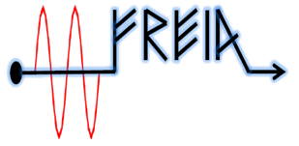
Test plan of ESS HB elliptical cavity
Han Li
On behalf of FREIA team
FREIA Laboratory, Uppsala University
31th of Oct. 2017

Slide 2
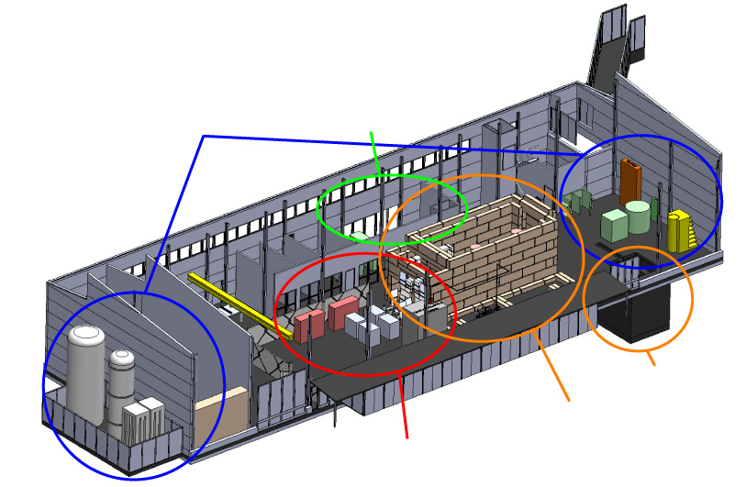
FREIA Laboratory - infrastructure
LHe cryo-plant
The bunker
Two 352 MHz 400 kW RF amplifiers
RF switchboard, transfer lines, circulators, loads, etc.
Horizontal cryostat (HNOSS)
Deionized cooling water system
Radiation monitoring system
Oxygen deficiency detectors
RF leakage detectors
Weather station (temperature, humidity, pressure in the hall)

Slide 3
Prepare at FREIA
Question mark means need to check with CEA colleague
1.RF source:
Modulator : reach full power, full pulse length and 14 Hz repetition rate
RF circulator: will be tested with the klystron
RF directional coupler: coupling factor (60dB) Directivity(40 and 30 dB)
RF distribution: need doornob
Klystron:will be shipped to FREIA early 2018
2. Cryogenic:
Cooling capacity: 140W at 4K and 90W at 1,8 K
LN₂ cooldown: around 21.5 hrs at last run
LHe cooldown: 4.48K/min at last run (?)
System static heat load(without cavity and related piping): 1W
Pressure sensor: two pressure sensors to cross-check at 2 K tank
Temperature sensors location: ?
Heater location on the flange:?
Filling rate:?
Temperature gradient tracing:?

Slide 4
3. LLRF:
All subsystems connected to EPICS
PLC for slow control (water, vacuum, interlocks, radiation protection)
µTCA LLRF and timing (LU)
cRIO for fast interlocks (programmed in LabVIEW)
Almost all data archived using archive appliance (and CS-Studio archiver as backup)
CS-Studio BEAST alarm server
CS-Studio BOY as a primary user interface
Lund LLRF system:
Different runing modes have been tested
Different rising time (within 300us) and pulse length is available
Different repetition rate is available
Tuner feedback system is not available currently
SEL:
A pulse mode test at high power level has been tested at last run
Developed digital phase shifter and gain-controller
Base on LabView: connect most of the laboratory instruments (oscilloscopes, signal generators, spectrum analyzers, power meters, vector network analyzer)
NI PXIe fast data acquisition (10 channels, 250 Ms/s, input bandwidth 800 Mhz, Self Exited Loop)

Slide 5
4.Interlocks
Arc detectors
Multipacting detectors (threshold)
Vacuum levels (threshold/ADC)
Radiation monitors ( more monitors or test from ESS)
Quench detector
5.Software
Developed an coupler auto conditioning system in LabView.
( different pulse length, power level, repetition rate are available)
Developed SEL control and data acquisition system in LabView.
Developed frequency tracing and data acquisition system in LabView.
Developed dynamic Lorentz force detuning in LabView.

Slide 6
The list of tests in some order of priority
Central cavity frequency (warm and cold)+
Loaded Q (basically measurement of the 3 dB bandwidth) +
Q0 (calorimetric measurement) +
Max gradient +
Tuning range of the slow step tuner +
Dynamic Lorentz force detuning +
Compensation for the dynamic Lorentz force detuning with the fast piezo tuner -
Stabilization of the cavity field with LLRF using both RF and piezo tuner compensation -
Onset and level of field emission +
Sensitivity to helium pressure fluctuations +
Multipacting +
Cryo related test both at 4 K and 2 K +
Overall test of electronics. - +
Stabilization of the cavity field with LLRF using only RF compensation - +

Slide 7
Warm test | Cool down | Cold test | Warm up
Central cavity frequency and spectrum of HOM Qe | Frequency shift due to cool down | Coupler cold conditioning | Frequency shift vs. T
 |  | Cavity conditioning
 |  | Central frequency Loaded Q and Qe
Coupler warm conditioning
 |  | Cavity level profile: let the LHe evaporate to low levels Effect of CV105 in heat load Cavity's power limit Effect of different FPC cooling temperatures in heat load Max load on the 2K pumps
 |  | Q0 Dynamic heat load Max gradient Dynamic Lorentz force detuning
 |  | Stabilization of the cavity field with LLRF using only RF compensation Dynamic Lorentz force detuning Tuning range of the slow step tuner
 |  | Tuner related testing
CRYO
VNA
SGD
signal
generator driven
SEL
Lund system
Lund university

Slide 8
Questions to be discussed
1.What is the frequency tracking range for tuner test at warm ? Full range or just tuner function validation? Limitation for testing slow motor (max tuning range, tuninng sensitivity,ratio between tuner and cavity, speed, maximum time, temperature, runing current .... )
2. Coupler conditioning parameter? If the pulse repetition rate start from 1Hz is manditory? (we now can chang system repetition rate from 1,2 3.5,7 and 14 Hz)
Parameter | value
Loop control time (s) | 1
Pulse repeat rate (Hz) | 14?
Vacuum upper limit (mbar) | 1e-6 ?
Vacuum lower limit (mbar) | 5e-7 ?
RF upper limit (KW) | 1000 ?
RF lower limit (KW) | 0,1 ?
Initial pulse length (µs) | 20 ?
pulse length step | 20 µs, 50 µs, 100µs, 200 µs, 500 µs, 1 ms, 1.5 ms, 2 ms, 2.5 ms, 2.86 ms

Slide 9
3. The sequence of RF Conditioning:
FPC warm conditioning cavity package cold conditioning (on resonance)
Coupler cold conditioning (off resonance)
4. Different system for cavity package cold conditioning?There will be a drop at field with Lund system. There could be a flattop with SEL.
5. The maximun transmitted power during the FPC warm conditioning and coupler cold conditioning (off resonance)?
6.Use 14 Hz repetition rate pulse mode @ 3.5 ms duration and up to 250 kW for the Q0 factor and dynamic heat load measurement.
If the klrstron and handle full power, 3.5 ms duration at lower repetition rate, then we can measure filling time and dynamic lorentz detuning.
If the klystron can handle low power but much longer pulse length in oder to test the mechanical mode of cavity package?
7. Should we go to the maximun Eacc ? Quench? Or set a gradiant limit?
8. Any cooldown rate limitation? Temperature sensors location?Heater location on the flange?Filling rate?Temperature gradient tracing?

Slide 10
Any other interest?

