Slide 1




AMICI
WP1 – Management, coordination and dissemination
Sylvie Leray, deputy-coordinator
CEA/Irfu

Slide 2
WP1 Objectives
  Objectives:
  Overall management of the project in order to ensure the achievement of the project objectives and the coordination of the work done in the different WPs. Specific objectives are:
      Relations with EC including progress and financial reporting,
      Exchange of information between the partners and with industry,
      External dissemination of the project results
      Communication and outreach activities.
  Since one of the goals of the project is to establish strong relations with industry, one of the first tasks consisted in defining how industry, from large enterprises to SMEs, will be associated to the project and their role in the different WPs.

Slide 3
WP1 tasks
  WP1.1: Project management (CEA)
  WP1.2: Organization of the participation of industry (INFN, CEA, IFJ PAN)
  WP 1.3: Administrative and financial project management (CEA)
  WP1.4: Communication and outreach activities (IFJ PAN, CEA)

Slide 4

WP1.1: Project management
  The project management is ensured by the Project Coordination Team (PCT) under the supervision of the Steering Committee, composed of the PCT and WP leaders
  The Advisory Group has been installed and is consulted periodically on the general strategy of the project: KoM, annual meetings
  The PCT is in charge of the dissemination of the results of the project to the whole community of accelerator and SC magnets, to industry with the help of ILOs, and to national and European stakeholders:
    Content of the website
    Participation to conferences, workshops and information meetings: LCSW 2017 Industry Forum (Strasbourg), co-innovation workshop (February 2018, Brussels), BSBF 2018 (February 2018, Copenhagen)

Slide 5
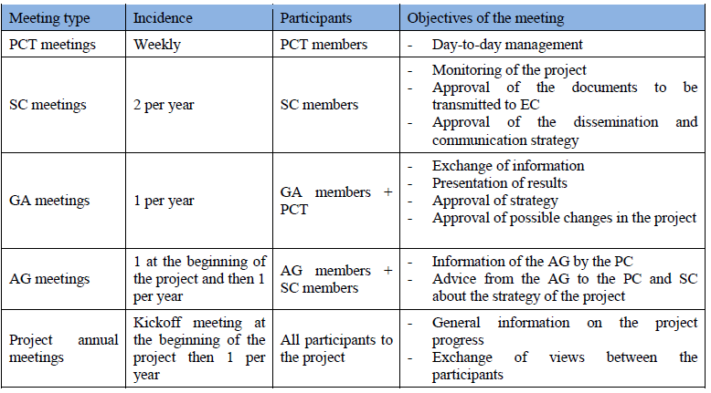
Exchange of information
Actually, 10 since the beginning

Slide 6

WP1.2: Organization of the participation of industry
  the framework for industry participation will be defined in collaboration with ILO's/TT offices and industries they are in consultations with
  a “Partner and Industry Days for Scientific Technological Infrastructures” will be organized to present and discuss the proposal of the activities and the underlying collaboration framework
  the availability of enterprises to participate in the activities will be collected and, wherever necessary, the representative ones on a geographical, topical or other basis identified.

Slide 7

Achievements of the ‘Industry Days’
Total Participation: 83 individuals, including one ILO (Spain/F4E)
Industry Participation: 33 individuals from 29 companies, including Spanish and Danish companies
Survey Participation: 20 companies + Spanish ILO

Slide 8
Achievements of the ‘Industry Days’
Survey Participation:
20 companies + Spain ILO
Task Leaders have been informed and have been invited to start their Work
Since June 4, 2017.

Slide 9

Accelerator-Industry Co-Innovation Workshop
  Organisers: TIARA Consortium of European Research Institutions, ARIES Integrating Activity for particle accelerator R&D, AMICI Coordination and Support Action for accelerator and magnet technological infrastructures.
  Objective: Find tools and strategies to enhance industry-academia cooperation in the particle accelerator community by:
  fostering discussion on most effective ways to develop co-innovation with industry in Europe.
  identifying sustainable structures, possible funding schemes and financing mechanisms.
  contributing to the definition of new EC instruments to boost co-innovation.
  providing a communication platform to all relevant stakeholders: policy makers, academia, industry and scientific management.

Slide 10
Accelerator-Industry Co-Innovation Workshop
  https://indico.cern.ch/event/682411/
  92 participants of which 1/3 from industry, 8 from EC.
  Presentations from scientific institutions of TIARA, ARIES, AMICI
  Presentations by EC of the existing instruments related to co-innovation
  Views from companies on the existing schemes of co-innovation
  B2B meetings
  Panel discussion:
    What prevents industry from participating in R&D with the academic world?
    Are the present instruments and schemes sufficient for doing R&D in collaboration between academia and industry?
    What structures and instruments do we need to improve co-innovation in our community?

Slide 11
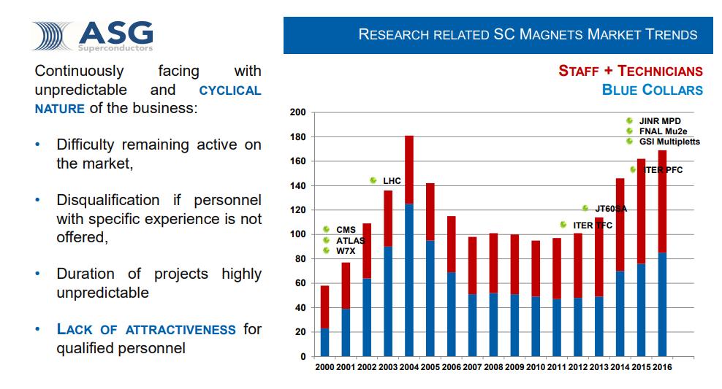
Accelerator-Industry Co-Innovation Workshop
  Issues related to what we do in AMICI:
  Importance of defining a clear technological roadmap
  Subsidiarity between academic laboratories and industry
  Intellectual property
  Gaps in the demand / sustainability
A. Pellecchia

Slide 12
WP1.3: Administrative and financial project management
  The PCT
  handles the relations with EC and be responsible for the accounting and distribution of the budget;
  prepares of the Consortium Agreement, Grant Agreement, and periodic progress and financial reporting to EC;
    First reporting after 18 months (June 2018)
  organizes the meetings of the Steering Committee, General Assembly and Advisory Group.

Slide 13

WP1.4 Communication and outreach activities
Public website for internal and external communication:
      Internal website providing access to an internal project document base, information about meetings and any event related to the project, dedicated tool to follow up milestones and deliverables.
      Open website ensuring the dissemination of the progress results, information for the all actors working in the domain of accelerators and magnets, communication to public at large.
  Dissemination to the relevant European and the Worldwide scientific communities as well as to the general public in EU through participation to major conferences, workshops, colloquia or dedicated seminars.

Slide 14
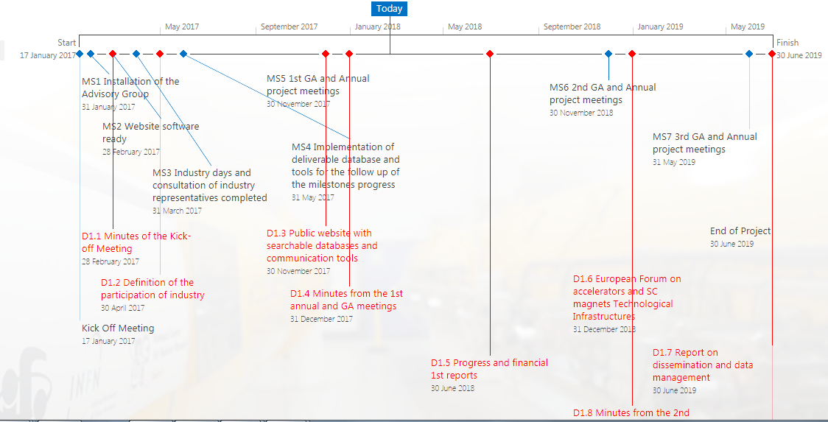
WP1.4 Communication and outreach activities
      Internal website providing access to an internal project document base: WP documents, Deliverables, Milestones, Minutes of meetings, communication documents, …

Slide 15

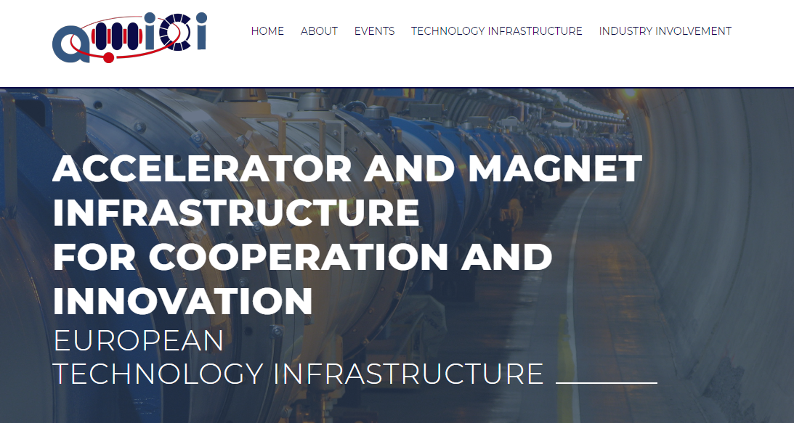
WP1.4 Communication and outreach activities
  Public website for internal and external communication:
  http://eu-amici.eu/

Slide 16
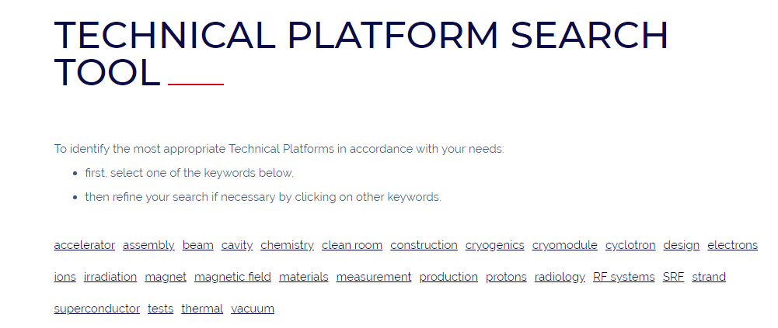
WP1.4 Communication and outreach activities
  Public website for internal and external communication:
  http://eu-amici.eu/
Calls for tender: http://eu-amici.eu/industry_involvement/tendering

Slide 17
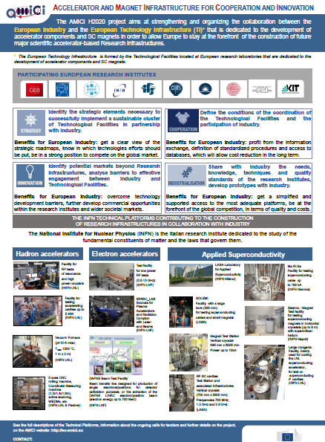
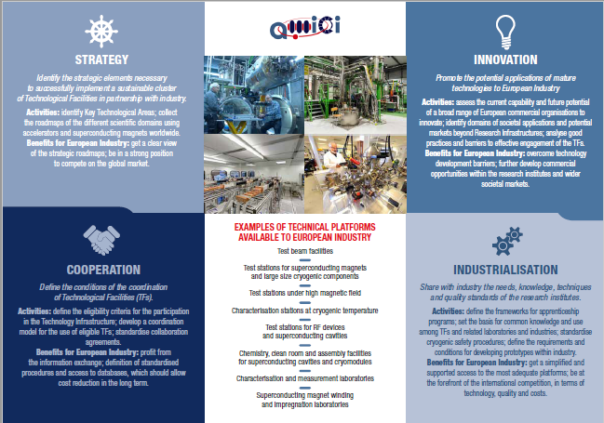
WP1.4 Communication and outreach activities
  Dissemination through participation to conferences, workshops, colloquia or dedicated seminars: flyer, posters
Poster for BSBF: Italian ILO booth
AMICI flyer

Slide 18
WP1 Deliverables
  D1.1: Minutes of the Kick-off Meeting (CEA) M2
  D1.2: Definition of the participation of industry (INFN) M4
  D1.3: Public website with searchable databases and communication tools (IFJ PAN) M11
  D1.4: Minutes from the 1st annual and GA meetings (CEA) M12
  D1.5: Progress and financial 1st reports (CEA) M18
  D1.6: European Forum on accelerators and SC magnets Technological Infrastructures (INFN) M24
  D1.7: Report on dissemination and data management (IFJ PAN) M30
  D1.8: Minutes from the 2nd annual and GA meetings (CEA) M24
  D1.9: Minutes from the 3rd annual (final) and GA meetings (CEA) M30
  D1.10: Progress and financial 2nd reports (CEA) M30

Slide 19
WP1 Milestones
  MS1: Installation of the Advisory Group (CEA) M1
  MS2: Website software ready (IFJ PAN) M2
  MS3: Industry days and consultation of industry representatives completed (INFN) M3
  MS4: Implementation of deliverable database and tools for the follow up of the milestones progress (IFJ PAN) M5
  MS5: 1st GA and Annual project meetings (CEA) M11
  MS6: 2nd GA and Annual project meetings (CEA) M23
  MS7: 3rd GA and Annual project meetings (CEA) M29

