Slide 1
AMICI WP5 INDUSTRIALIZATION
Report of activities

Slide 2
Objectives of AMICI WP5- Industrialization:
Industry for Research’s benefit
The overall goal of this Work Package is to sensitize and train the industrial companies in the needs, the knowledge (know-how), the techniques, the methods and the quality standards involved in the accelerator and superconducting magnet technologies developed in the Research Institutes.
We should allow the industries to be able to develop and construct, also independently, accelerators (or components of accelerators) and sc magnets for research projects (industrialization) and, possibly, applications beyond RI interests (innovation) and to placing European Industries in position to participate in the construction of new Research Infrastructures in Europe and worldwide.

Slide 3
Our reference scheme
MARKET

Slide 4
WP5 is organised in 4 Tasks
T5.1 Professional training and apprenticeship
Task Leader: C Madec
T5.2 Harmonization- Material and Component References
Task Leader: M.Fouaidy
T5.3 Harmonization - Cryogenic Safety Procedures
Task Leader: S.Grohman (A. Henriques)
T5.4 Requirements and conditions for developing prototypes with the industry
Task Leader: M.Michelato (F.Broggi)

Slide 5
T5.1 Professional training and apprenticeship
Promoting professional skills training and cross improvement between research laboratories and industry
Training and apprenticeship in TI. Defining the conditions and setting the basis for an apprenticeship program, where professional technicians and young engineers from relevant industrial partners would be trained by hands-on fabrication, assembly or test of accelerator and magnet equipment and by exercising key techniques
Training and apprenticeship in industry. The engagement in industrial R&D activities and in services to the industry aimed at innovating their products and processes would benefit from the secondments of researchers and technical personnel within the companies themselves.

Slide 6
T5.1 Activities of the first year
After the Industry day in Padova, a working group with industry was formed (40-30, Elytt and Alsyom) and meetings were held. In particular a meeting a last December with participation of other Task (5.2 and 5.4)
Survey of the practice in RI in training and apprenticeship
Survey of the practice in Industry in training and apprenticeship

Slide 7
T5.1 Results from surveys in institutes
1) Contract from institutes to companies included practice and training for companies technical staff. The contract included the obligation to make the industrialization study technical report public, in such a way that the rules of fair competition are not biased.
2) Companies pay institutes to provide consultancy for example on clean room assembly on the companies premises, in the framework of the execution of a company outside contract.
3) Institutes provide training on the operation and qualification to institute standards to industry. The financial aspect are institutes and project dependant.
4) Institutes offered training to other institutes staff on their premises on string assembly (part of the same institution)

Slide 8
T5.1 Results from surveys in industry
Companies have to face irregular work load. They keep a core team with core skills and competences and hire short term people that are trained by co-workers.
Companies had contracted institutes to learn specific techniques or exchange information with institutes and experts communicate on their experience but not trainings
The need of a training could be :
Quick when company has a activity peak consecutive to contract award
On the long range, the company is also interested in increasing their knowledge (know-hows)
Companies are financing the trainings on its own money

Slide 9
T5.1 What else we have learnt
Trainees are technicians and/or engineers.
In order to attest that a company had followed a training, a formal document shall be produced and could be used at the call for tender or as a proof of knowledge.
E-learning : start to learn , interesting before a real training
On-line learning : with the teacherin front of the computer and the trainees in front of the computer at a different place. Need a real training afterward
Trainings should be dedicated to specific topic. On-hands trainings are preferred. The need is on short (1 to 2 days) trainings with some theoretical background (1/2 day) and practical experiments.
The problem of the language : technicians may understand English but may not speak it fluently

Slide 10
T5.1 Questions and ongoing activities
How to finance the training :
Can a training be given in a country different from the trainee company country be included in the state law financing?
A EC “Framework for state aid for research and development and innovation” ref SWD(2014) 163}-{SWD(2014) 164} exists and needs to be read and thought through.
The next steps :
There is a need of a list of skills that companies should have or should develop in the field of accelerators and magnets.
Survey of training/learning needed by industry
Could we create a « fund » with the contribution of interested companies and practice the training?
Creating a consortium of infrastructures and companies in order to train/learn when contracts for next accelerators or magnets construction are issued or ….

Slide 11
T5.2 Harmonization- Material and Component References
As stated in the AMICI proposal:
“Establish a common knowledge, background and use among Technological Infrastructures and related laboratories and industries in relation to material and components involved in accelerator and large superconducting magnets. “
Main idea:
Accelerator performances are based not only on accelerator systems design but also on material or component choice and specifications.
Data and characteristics of these are not easy to find in papers and knowledge sharing is more commonly done with private communications.
Even on raw materials, non-standard use in an accelerator environment (radiation, cold temperature…) add difficulties to find corresponding data.
Main outcome:
Create a reference database for material/component used in accelerators (accelerating structures, magnets, diagnostics, ancillaries…) and start to fill it with relevant data.

Slide 12
T5.2 What shoud be included into the database
1. MATERIAL
Some examples:
Raw material, as used to fabricate accelerator systems
Niobium, Nb3Sn, NbTi, Stainless steel, Titanium,…
Ceramics (power couplers)
Magnetic material (µmetal ,co-netic, …)
…
Material as used during processing/preparation
Chemical etching mixture
Ultra-pure water
Media for mechanical polishing
…

Slide 13
T5.2 What shoud be included into the database
2. COMPONENT
Some examples:
Ancillaries, as used to implement accelerator systems
Cables,
RF feedthrough, HV feedthrough
Screws, bolts
Gaskets
…
Sensors/Instrumentation as used in accelerator environment ? Specially when they are very specific
Temperature sensors
Piezoelectric actuators
Vacuum gages
…

Slide 14
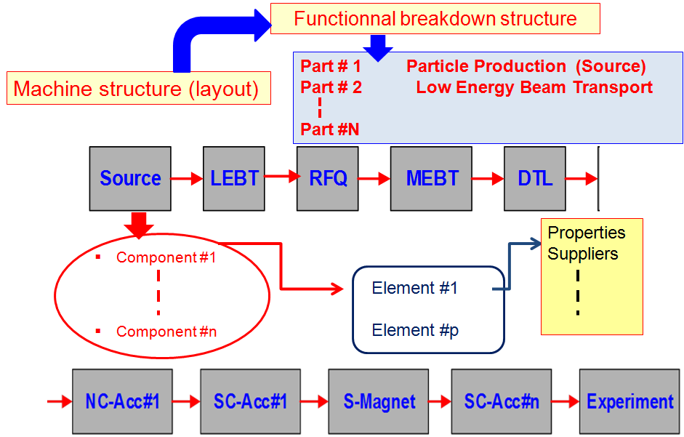
Database structure based on the main parts functions

Slide 15
T5.2 Who is working

Slide 16
Status of WP5.2
Working group created (WG) CNRS-CEA WP5.2: M. Fouaidy (IPNO/CNRS), M. El Khaldi (LAL/CNRS), F. Rondeaux (IRFU/CEA)
Participation of Desy to WP5.2: experts to be contacted via Hans Weise when needed (example: SRF photo-injector)
4 WG meetings- Minutes reports
4 progress reports for AMICI SC
Participation to all meetings (WP 5 and/or AMICI meetings)
Round table Institutes/Industry at AMICI Partner and Industry Days
Mailing industry (4 positive reply) for active participation to WP5.2
Database structure in progress
Collecting Material data Bibliography & collection of papers
Meeting with FuSuMaTech on November 2017: we will share the Work for Superconducting magnets (Avoid double job!)

Slide 17
T5.3 Harmonization - Cryogenic Safety Procedures
WP 5.3 members
Motivation and Objectives (recall)
Milestones
Status of the European standardization project (CEN/TC 268 WG 6)
Status of Deliverable D5.3

Slide 18
WP 5.3 members
Steffen Grohmann (KIT) – Task leader
Andre Henriques (CERN)
Eric Ercolani (CEA)
Jean-Marc Poncet (CEA)
Roser Vallcorba (CEA)
Philippe Bredy (CEA)
Christina Weber (KIT)

Slide 19
T5.3 General Objectives
“Beyond the actual state-of-the art, this task will collect and assess available modelling codes, which are able to consider and analyse the process dynamics of cryogenic incidents. In addition, the task will define the scope of future experiments and model developments required to consolidate and evolve the proposed common methodologies. This concerns specifically the experimental basis required for the implementation of dynamic models in a common standard, as well as performance data of pressure relief devices under cryogenic conditions.”
Scope beyond the European standardization project (which will reflect the state-of-the-art)
Definition of the roadmap / pre-conditions for a future upgrade of methodologies in the new European standard on safety of liquid helium cryostats

Slide 20
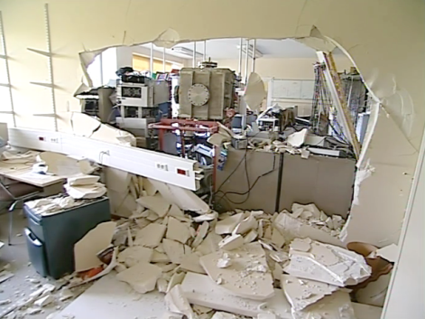
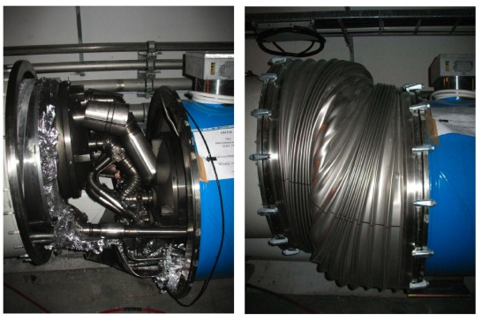
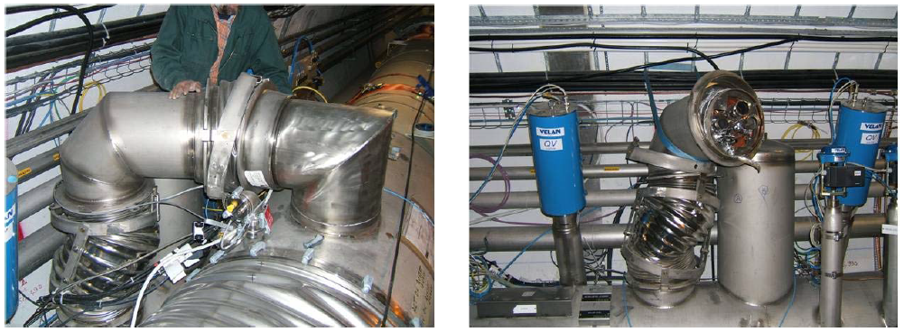
T5.3 Objectives - Cryostats

Slide 21
T5.3 Milestones
“General” scenario to cope with the n possible faults

Slide 22
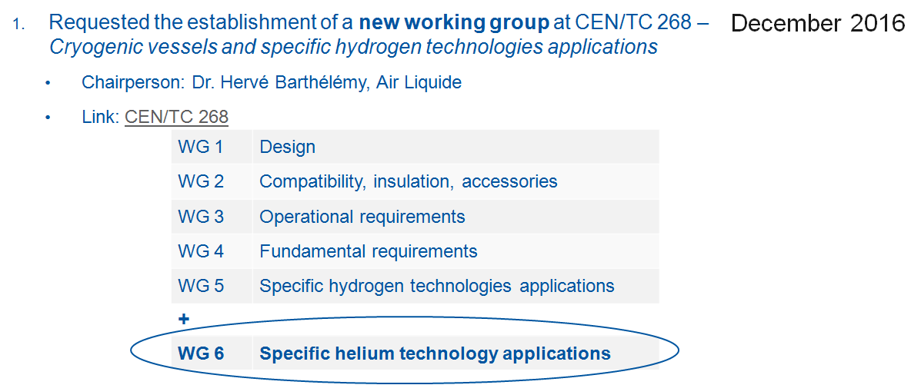
T5.3 Status of CEN/TC 268 WG 6

Slide 23
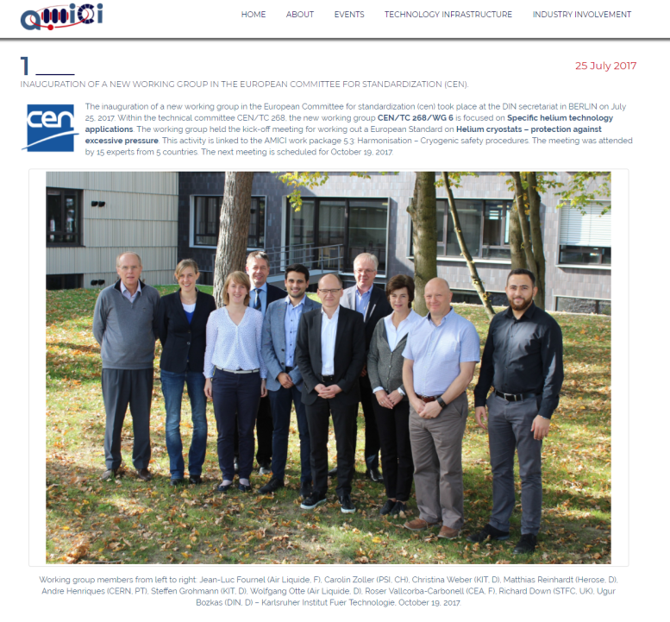
T5.3 Status of CEN/TC 268 WG 6

Slide 24
T5.3 Status of milestones

Slide 25
T5.4 Requirements and conditions for developing prototypes with the industry
The basic idea behind this task is that taking a leading role in the construction of prototypes for the Technological Infrastructures, can represent for industry a very effective way to acquire first-hand knowledge of cutting-edge technologies and to provide feedback on engineering aspects that are important for the following industrialization process.
Such early involvement can foster both the opportunities for industry to promote the development of new products and to test new/alternative solutions for mature technologies.

Slide 26
T5.4 Two scenarios
Two scenarios were taken into considerations.
The industry develops prototypes in the facilities of the TI in close collaboration with TI personnel.
The industry develops prototypes in their facilities taking advantage of existing tool or other technical infrastructure not available in the TI.
In both scenarios the prototype development could contribute in taking active large tooling or facilities developed for past projects and marginally or not involved at all after the project conclusion.

Slide 27
T5.4 - Questionnaire for the companies of the working group
Presently 6 companies are actively working with T5.4: ASG Superconductors (Italy), ANTEC Magnets,S.L.U. (Spain), Babcock Noell GmbH (Germany), ELYTT ENERGY/NEUREUS TECHNOLOGIES (Spain), Zanon (Italy) , Sigmaphi (France).
A series of advantages and disadvantages have been envisaged regarding various possibilities for TI-Industry collaboration in prototype developments. The industrial partners are asked to comment the different scenarios by assigning a rank to the entity of the advantage or disadvantage (High, Medium, Low and Negligible) and possibly commenting and adding further pros or cons.
This questionnaire was considered a practice way for starting the Working Group 5.4 activities. To be noted that the legal frameworks (constituting potential limitations) are not yet part of the discussion. We are trying to preliminary understand how much appealing is the collaboration Industry TI in prototype development

Slide 28
T5.4 - Questionnaire example (in case Industriy develops prototypes at the TI / RI)
Advantages for Industry | Advantages for RI / TI
Gain more money | More qualified manpower
Knowledge growing | Gain experience from industry (project management)
Access to first hand and extremely high quality know how | Gain money (?)
Access to already available high cost tooling / technologies not available in the industry due to high cost / high risk in buying and doing investment, in particular for small and medium-sized enterprises | Technological transfer to the industry for future project
Limited economical investment / low risk | Use / maintain live high cost tooling / plants that are not often used or developed for past projects
More updated perception of future possible markets (general and accelerator fields) | …
… | …

Slide 29
T5.4 - Ongoing discussion
The construction of prototype with industry has been debated in two recent meetings of the T5.4 Working Group in Milano and Bruxelles. Main outcomes:
For many industries the cost is not the most relevant parameter. The interest of the industry is to participate since the beginning to the design of a prototype rather than have a restrict role in the manufacturing of the prototype.
Industry can invest significant amount of money on R&D if there is large enough potential business. In the field of scientific activities, the ‘’large enough business’’ cannot be linked to the size of the market for one given product

Slide 30
T5.4 - Ongoing discussion (cont’)
In general the industries expressed their preference to develop the prototype in their facilities rather than moving personnel in RI/TI laboratories. The main reason seems to be a better and more synergic use of the personnel with their facility (better allocation of human resources). However if the development requires big investments in equipment and if this equipment is available in the RI/TI laboratories, it would be more convenient to perform the construction of the prototype in the RI/TI
Industry should like that a subsidiary principle is introduced: if industry is interested and at the same time has the technical capacity for developing a prototype, this should be pushed and supported; TI/RI should be involved only if industry is not available or cannot do it

Slide 31
T5.4 - Points to be better investigated
Legal Framework
a) The EU PCP (Pre Commercial Procurement) seems a model preferred the industry for developing prototype.
b) The industry seems to be interested in a model following the USA SBIR
c) Partnership for Innovations, EU or Regional project...?
2. Intellectual property handling.
Next meetings this year for answering these questions and, may be, envisaging temporary industries- Ti consortia for dedicated developments(producing innovations) with EU support.

Slide 32
WP5 working plan
WP5.1
MS19 : Preliminary report on the required condition (April 18)
MS20 : Preliminary report on the required conditions for apprenticeships program in industries for apprenticeships program in TI (June 18)
Prepare the list of skills
Questionnaire on the training companies interested in
WP5.2
Meeting with industry at Orsay (April or May)
Progress report (end of June 2018)
WP5.3
Meeting in UK with CEN members (April 2018)
Preparation of the roadmap for future research
WP5.4 Meeting on Intellectual property with industry

