Slide 1


Overview of the AMICI Strategy for Consolidating the Exploitation of the European Technology Infrastructure
Olivier Napoly, coordinator
CEA/Irfu

Slide 2
From Science to Innovation: Technology
The scientific quest for fundamental discoveries is a progress force for our societies. Through Technology, it carries an indirect societal influence via Innovation.
“Large-scale science projects address fundamental questions at the forefront of science and technology.
These projects require large and sustained infrastructures and a good collaboration on long time scales.
In turn, such projects provide unique equipment, challenging request for high technology and innovation, stimulating ideas that attract good people, and offer the occasion to bring people closer together.”
Rolf Heuer, The Role of Big Laboratories,
Phys. Scr. T158 (2013)

Slide 3
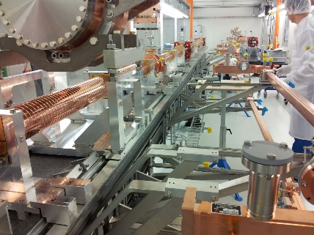
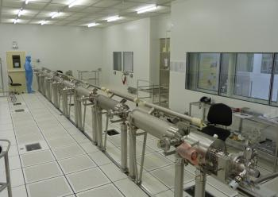
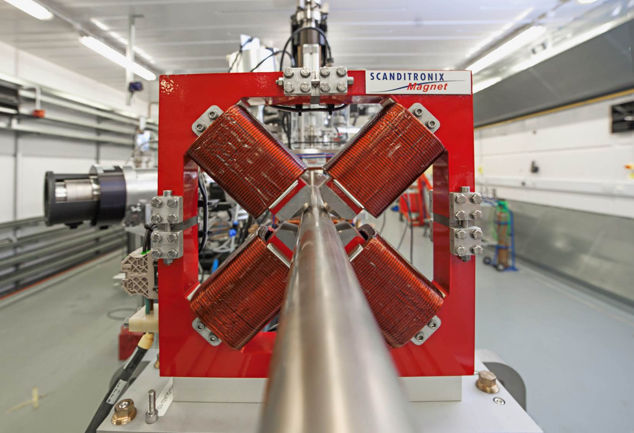
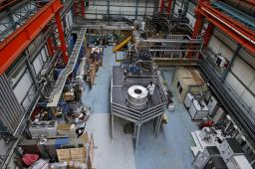
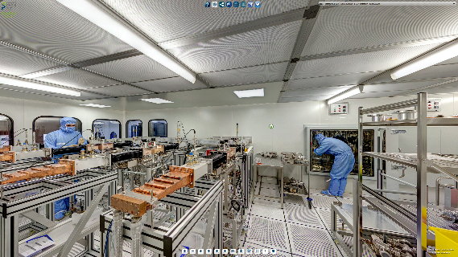
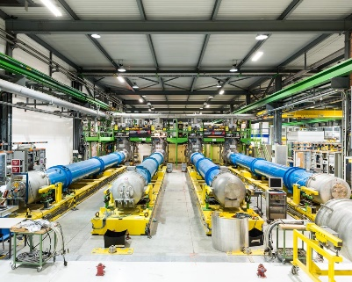
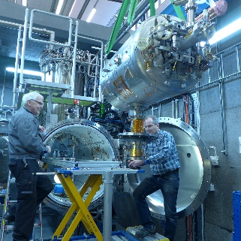
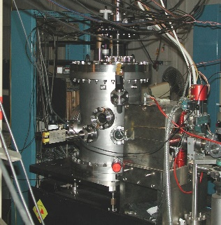
European Technology Infrastructure
The Technology Infrastructure is the basement of any future large-scale accelerator and SC magnet projects, spanning activities
from Design to Construction and Operation
R&D
Prototyping
Assembly
Verification
Installation
Support
It spans the whole TRL spectrum, from R&D to fabrication, with an emphasis on the Preparation and Construction phases, corresponding to Prototyping (3-5) and Industrial Production (>5) of components.

Slide 4


ESS LINAC Work Matrix
 |  | Germany | France |  | Italy |  | Poland | Spain | Sweden |  | UK
 | CERN | DESY | CEA | CNRS | Elettra | INFN | IFJ-PAN | ESS-Bilbao | ESS | Uppsala | STFC
R&D Phase
Linac Components
RF systems
LLRF
Cryomodules
SRF cavities
Powers Couplers
Frequency Tuners
Cold vacuum
Module Assembly
Test Infrastructures
RF cavities/ couplers
RF cryomodules

Slide 5










H2020 Consortium: a Community

Slide 6
ESS LINAC Work Matrix
 | Germany | France |  | Italy |  | Poland | Spain | Sweden |  | UK
 | DESY | CEA | CNRS | Elettra | INFN | IFJ-PAN | ESS-Bilbao | ESS | Uppsala | STFC
Linac Components
RF systems
LLRF
Cryomodules
SRF cavities
Powers Couplers
Frequency Tuners
Cold vacuum
Module Assembly
Test Infrastructures
RF cavities / couplers
RF cryomodules

Slide 7
AMICI: Political Perspective
Year 2: ‘Projection Phase’ goals
Laying down an organization for the Technology Infrastructure
Elaborating the Accelerator and SC Magnet Technological Roadmap
Identifying the existing barriers and recommend actions to simplify and support the access of Industry to the Technology Infrastructure
Articulating the needs for Co-Innovation technical platforms
Last Semester: ‘Proposition / Persuasion Phase’
Gaining the support of the EC and Agencies to our findings and proposals
Beyond 2019: ‘TI-AMO’ (or ‘AMICI-2’)
Transversality of Accelerator and SC Magnet Technology through communities and applications is a key beneficial factor for success and progress.
Option 1: The European TI is included in the ESFRI List
  Access to EC support programme for ‘preparation phase’
  Access to EC support programme for ‘implementation phase’
Option 2: bid to the ‘Pilot Co-Innovation’ programme in 2020
  ‘La porte étroite’ is quite crowded !

Slide 8
Questions to the Advisory Group
WP2) Strategy: expectations on the content of the Accelerator and SC Magnet ‘Technological Roadmap’
WP3) Cooperation: expectations about the mode of association of Industry or Companies to a future Accelerator and SC Magnet ‘Technology Infrastructure’
WP4) Innovation: expectations about the ongoing market survey processes
WP5) Industrialization:
  a. validity and scope of the Academia-Industry ‘subsidiarity’ principle (e.g. prototyping in Industry rather that at Institutes).
  b. Opportunities and incentives for co-innovation at the Technology Infrastructure platforms

Slide 9
WP2: Strategy
Budget breadown versus Component Breakdown
CEPC in China
Total Cost ~ 5 B-Currency
PIP-II in USA
Total Cost ~ 720 M$
Major Systems Requirements:
Superconducting Cavities Types: 5
Superconducting Cavity Frequencies: 162.5, 325, 650 MHz
Superconducting Cavities: 116
Superconducting Cryomodules: 25
RF Amplifiers (CW):
162.5 MHz (3 kW): 8
325 MHz (7-20 kW): 51
650 MHz (40-70 kW): 57
Superconducting Solenoids: 37
Normal Conducting Quadrupoles: 83
Normal Conducting Dipoles: 32
Correction Dipoles: 83
Magnet Power Supplies:
< 15 A: 150
< 500 A: 2
Which is the most useful presentation ?

Slide 10
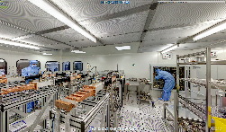
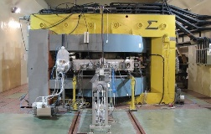
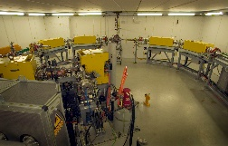
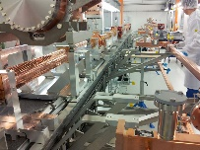
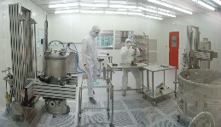
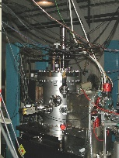
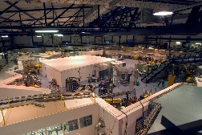
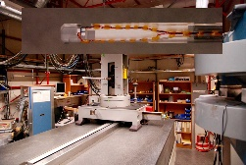
Co-Innovation @ Technology Infrastructure
WP3: Cooperation
Technological
facility @
Industry n°2
Technological
facility @
Industry n°1
Technological
facility @ PSI
Technological
facility @ KIT
Technological
facility @ IFJ PAN
Technological
facility @ CNRS
Technology Infrastructure
Scheme n°1: Industry in TI
Technical platform n°1
Technical platform n°1
Technical platform n°1
Technical platform n°1
Technical platform n°2
Technical platform n°2
Technical platform n°2
Technical platform n°2
The form of Industry-Academia partnership is under evaluation.
Co-Innovation is favored by the adequacy of the TI platforms to high-TRL advanced components.
Scheme n°2: TI as a node

Slide 11
2020: post-AMICI Horizon
AMICI is only a first step towards a European Technology Infrastructure Organization
AMICI partners are working on defining its statuses and functioning and networking rules.
This European Technology Infrastructure Organization will not be restricted to the current AMICI partners.
The case for European TI Organization will require the understanding and the support from the EC and from Industry

