Slide 1
Detection and Analysis of Uncontrolled Beam Loss in the High Luminosity LHC
Björn Lindström
CERN and Uppsala University
With input from L. Bortot, A. Fernandez Navarro, M. Valette, V. Raginel, D. Wollmann
28th November 2017
Notes:
Hello and thank you for coming. I’m going to give a brief summary of my PhD project with the preliminary title “Detection and analysis of uncontrolled beam loss in the High Luminosity LHC”.

Slide 2
Scope of project
Study of uncontrolled beam loss scenarios
How failure occurs
Effect on the beam
Subsequent beam losses (intensity, location)
Time scales
Detection of failures
How to limit time between detection of failure and beam dump
Mitigation of or protection against failures
Simulations (mainly beam tracking and optics calculations)
Experiments (using very fast diamond beam loss monitors)
Also important to protect beam from unnecessary dumps!
Notes:
The scope of my project can be summarized by, study of uncontrolled beam loss scenarios, involves how a failure occurs, its effect on beam and the losses it leads to, and also the time scales of the failure.
The detection of failures, how to limit time between detection of failure and beam dump.
Mitigation of or protection against failures.
These studies are mainly done using simulations, involving beam tracking and optics calculations, as well as experiments. It is also important to remember to proect the beam from unnecessary dumps.
Next I will show you some examples of what can go wrong...

Slide 3
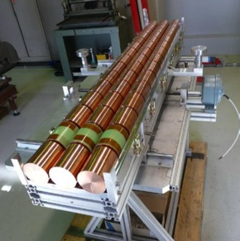
Beam induced damage
SPS beam shot at copper cylinders
1.5e11 protons per bunch @ 440 GeV
Target 3
144b
σ = 0.2mm
Target 2
108b
σ = 0.2mm
Target 1
144b
σ = 2mm
Courtesy of F.Burkart
Notes:
This was an experiment using the SPS beam, by shooting it at these copper cylinders you can see in the photo. The bunch intensity was 1.5e11 protons, with energy of 440 GeV. A total of 144 bunches maximum per shot.

Slide 4
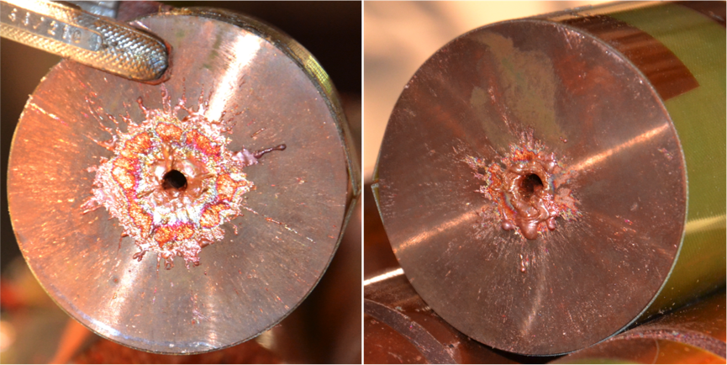
Beam induced damage
144 bunches of 1.5e11 protons per bunch, 440 GeV
Courtesy of F.Burkart
Notes:
This is the aftermath, the beam drilled a hole through the length of the cylinders. From simulations it has been estimated that the nominal LHC beam could fully penetrate through over 20 meters of solid copper.

Slide 5
LHC Injection Failure
Before LHC commissioning, SPS beam hit aperture in LHC injection transfer line
3.4e13 protons @ 450 GeV
Required changing chamber and a quadrupole
JAS14, Beam Transfer and Machine Protection, V. Kain
Notes:
This is an example of an actual failure, which happened while the transfer line to the LHC was tested before its commissioning. The beam was missteered and hit the aperture, drilling a hole in the chamber. This required changing both the chamber and a quadrupole.

Slide 6
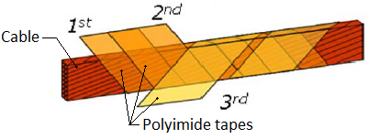
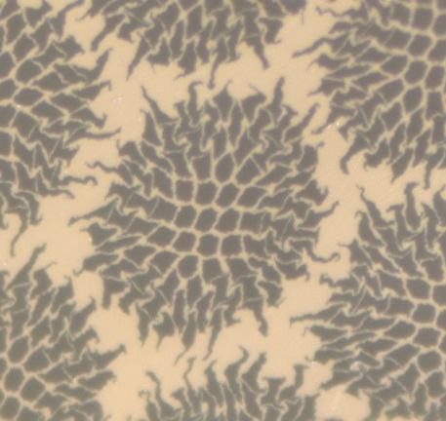
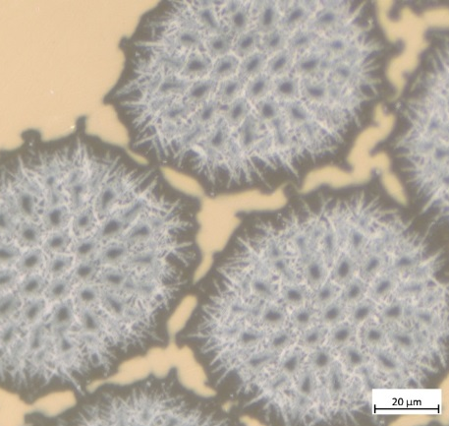
Magnet damage
Decomposition of insulation
=> short circuit
Decomposition of superconducting strands
=> degradation of superconducting properties
Need replace magnet
=> min. downtime ~3 months
Ref
1157 K
Courtesy of V.Raginel
Notes:
Yet another example, concerning the magnets. If hit by too much beam, the insulation between cables can decompose leading to short circuits. Furthermore, if you look in this photo, on the left you see a normal wire with superconducting strands embedded in a copper matrix. After a severe heating the superconducting material diffuses out into the copper and the superconducting properties are degraded. In either of these cases, the magnet would need replacing, meaning a downtime of at least 3 months.

Slide 7
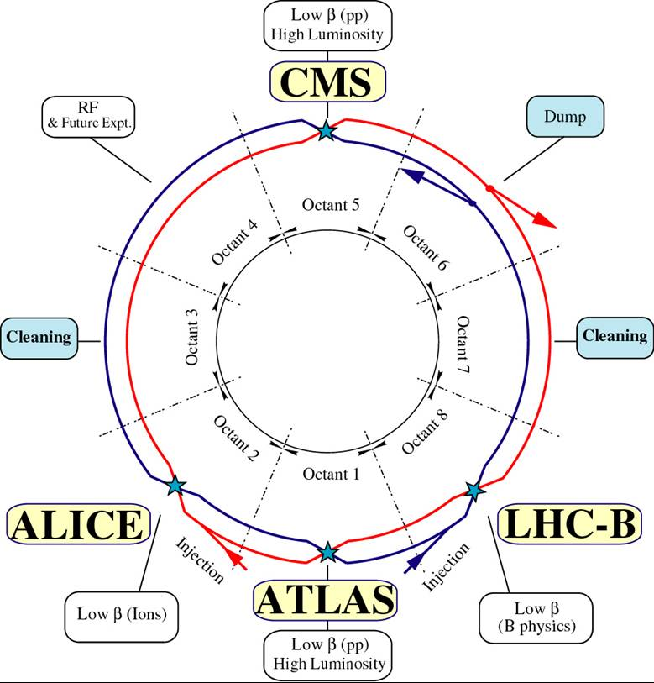
LHC overview
Most of ring – periodic lattice of FODO cells
Around interaction points, matching section
Triplet quadrupoles (Q1,Q2,Q3) – very large beta functions
Separation and recombination dipoles (D1 and D2)
Notes:
To give you a quick reminder of what the LHC looks like, you can see this schematic. The interaction points ATLAS, ALICE, CMS and LHC-B, there are two collimation regions to remove particles with non-nominal parameters, the dump region and the RF acceleration. Most of the LHC consists of a periodic lattice, but around the interaction points there is a so called Matching section, where the magnets of main concern for Machine protection are the so called triplet quadrupoles, Q1Q2 Q3, as well as the separation and recombination dipoles D1 and D2. These are important due to the very large beta functions and the high strengths.

Slide 8
High Luminosity LHC (HL-LHC) changes
To attain higher luminosity, higher bunch intensity and smaller β* (bunch size in collision point)
Many changes in layout (e.g. Triplet quadrupoles, crab cavities ... )
 | LHC | HL-LHC
# bunches | 2808 | 2808
Bunch intensity [protons per bunch] | 1.15e11 | 2.2e11
β* [cm] | 55 | 15
Stored Beam energy (@ 7 TeV) [MJ] | 362 | 693

Slide 9
Failure Classifications
Slow failures (> 1 s)
Cryogenics, failure of orbit/tune feedback...
Manual intervention possible
Fast failures (> 15 ms)
Trip of RF system, superconducting circuit/magnet power problem
Protection by multiple systems
Very fast failures(> 3 LHC turns, 270 µs)
UFOs (macroparticles entering beam), resistive magnet power problem, transverse damper failure, crab cavity failure
Protection by fastest systems
Ultrafast failures(< 3 turns)
Injection/extraction failure, loss of beam-beam kick, quench heaters
Protection dump not possible (rely on passive protection)
Notes:
Failures are usually classified by their time scales. Slow failures are over more than a second, and are usually slow enough that manual intervention is enough. Fast failures are more than 15 ms, and are easily protected for by the automatic systems.
Very fast failures are classified as more than 3 LHC turns. The reason for this is that 3 turns is the normal maximum time it takes to dump the beam after detecting a failure. Any failure faster than this is called ultrafast and one can only rely on passive protection for these.

Slide 10
Accelerator Physics – some basic concepts
Beta function describes the oscillation of off-center particles, a function of the quadrupoles
Beta function is also related to the beam size
Transverse bunch particle distribution can be modelled as sum of two 2d-Gaussians (beam core + beam halo)
1 σ [m] ~ 1 standard deviation/width of distribution
$σ(s)=\sqrt{β(s)ε}$
$s :longitudinal distance$
$ε :emittance, average transverse spread in phase space$
Off-center particles remain at constant radius in phase space
Normalized to beam σ – convenient unit
Phase must be taken into account for very fast failures
Notes:
I’m not sure exactly how much everyone knows about accelerator physics, so I will give a very brief summary of some important keywords.
The beta function describes the oscillation that off-center particles undergo around the reference orbit, and this is mainly a function of the quadrupoles. The beta function is therefore also related to the beam size.
The distribution of particles in a bunch can be modelled as a sum of two 2d-Gaussians, with the beam core plus the beam halo.
A beam sigma is a measure of how wide the particle distribution, or the bunch, is. One can show that the beam sigma at a position s in the machine equals the squareroot of the beta function at that position times the emittance, where the emittance is the average transverse spread in phsase space of the particles.
Normalizing parameters to units of beam sigma is very convenient since an offset in phase space in units of sigma remains constant.

Slide 11
Collimation system overview
Smallest aperture bottleneck
Designed to clean off-center particles
First elements to intercept the beam for most failures
Consists of three sets
Primary collimators (TCP, ~5.5 σ aperture, ~2 mm)
Carbon
Diffuses protons
Secondary
Carbon
Shower creation
Tertiary
Tungsten
Absorbs showers
Orbit excursion of ~3 σ at 7 TeV enough to damage
Notes:
The collimation system in IR7 is the smallest aperture bottleneck and is designed to clean off-center particles. They are therefore also the first elements to intercept the beam for most failures. For the most part, it consists of three sets of collimators, the Primary collimators made of carbon which diffuses protons. The secondary collimators where the main shower production starts and the tertiary collimators made of tungsten to absorb the showers. The TCPs are nominally set at 5.5 sigma, which corresponds to roughly 2 mm (about the size of France on a euro coin). To damage the collimator system at top energy, it is enough with as little as a 2.5 sigma orbit excursion.

Slide 12
Damage limits
Collimator system
288 nominal bunches (one SPS beam) at 450 GeV
8 nominal bunches at 7 TeV
~Half this for HL-LHC
Magnets
Quench limit: ~1e9 protons @ 450 GeV, ~1e7 protons @ 7 TeV
Damage limit: 1e12 protons @ 450 GeV, 1.e11 protons @ 7 TeV

Slide 13
Magnet protection
When a quench occurs
Usually localized
Must be spread quickly (~100 ms) to diffuse the resistive current loss throughout the magnet
Quench heaters: resistive plates attached to magnet (current system)
A new system for heating whole magnet at once in development – explained further down
Both types induce magnetic field in beam area
Affects the beam!
Notes:
Next I will mention a bit of magnet protection and its effects on the beam. When a quench occurs, it is usually very localized, so in order not to damage the magnet the quench must be spread quickly such that the current is deposited throughout the whole mass of the magnet. To achieve this quench heaters are installed on all superconducting magnets in the LHC. These consist of resistive plates in which a capacitor is discharged when a quench is detected. There is also a new system for heating the magnets which I will describe later. Both of these types of quench heaters induce a magnetic field in the beam area and thus affect the beam.

Slide 14
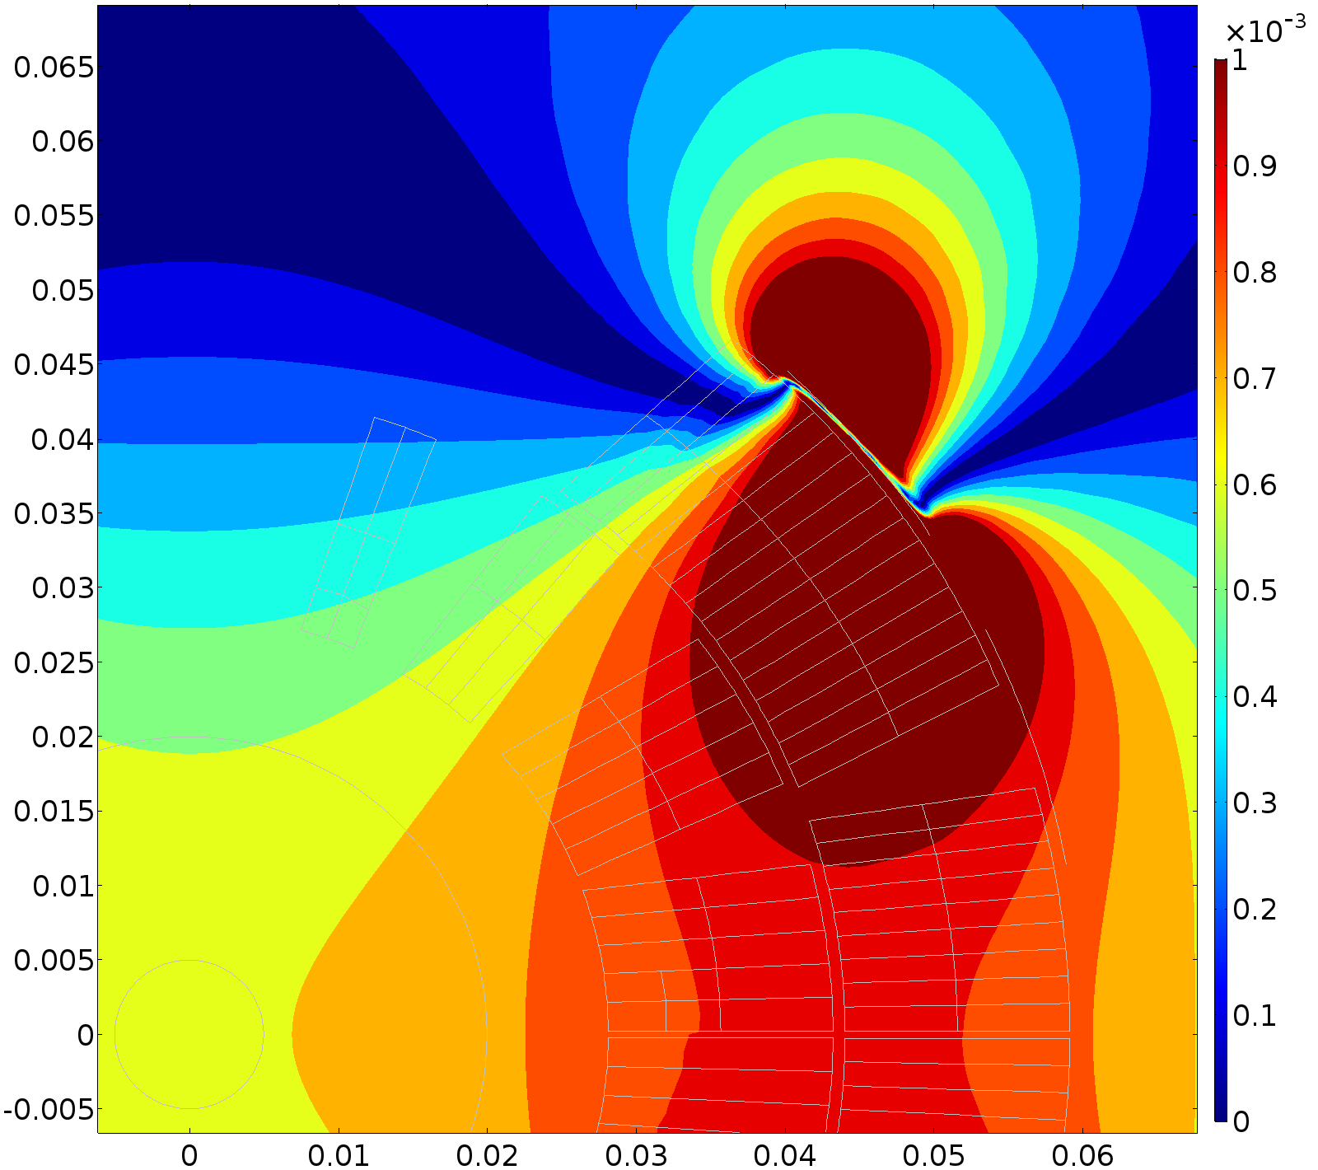
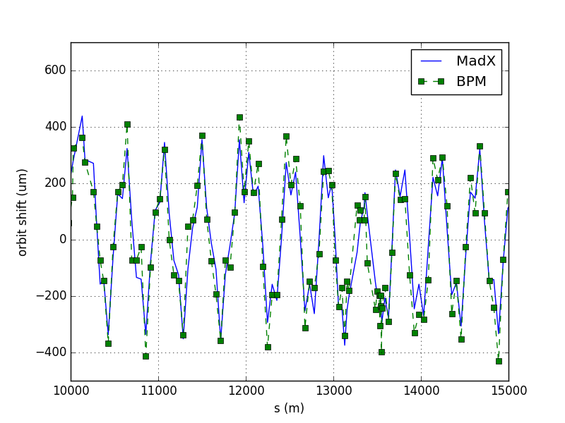
Quench heaters in Dipoles
QH induced magnetic field
(T)
From simulations: the QH cause a 0.7 mT field in the beam area
Associated orbit change: +/- 400 µm, confirmed experimentally
A delay of up to 3 ms (35 turns) between QH firing and dump
In HL-LHC triplet quadrupole, up to 52 σ kick
Imperative to dump first
Measured and simulated orbit change
Notes:
As an example of a quench heater I show here the magnetic field of one fired in a normal dipole magnet. If you look in this plot, you can see the quench heater here, sitting outside the magnet coils here, with the beam area in the corner. This induces about 0.7 mT in the beam area. The orbit change from this is about 400 µm, and as you can see in this plot here comparing simulations to an actual measurement, with the blue being the simulation from MAD-X and green the beam position monitors, it agrees very well.
In the current implementation in LHC it happens that there is a delay between firing of the quench heaters and the actual beam dump. In HiLumi LHC, if the quench heaters in the triplet quadrupoles fires with beam in the machine, it would give a kick of 52 sigmas to the beam. It is thus imperative to dump first.

Slide 15
CLIQ – Coupling Loss Induced Quench
CLIQ – a new type of quench protection system
Capacitor discharges current in magnet circuit
2 kA of current going into the magnet coils – imperative to study its criticality
Poles P3 and P1 see lower current
Poles P4 and P2 see higher current
Heat is deposited in the copper matrix via inter-filament and inter-strand coupling losses, causing a quench
Q2 current – CLIQ discharge
CLIQ
current in poles
I_CLIQ
CLIQ current
Magnet Poles
I_nominal
Notes:
The CLIQ, or coupling loss induced quench, is a new quench protection system currently being developed. It consists of a capacitor discharging about 2 kA directly into the magnet coils, which is a considerable fraction of the nominal current in the magnets.
If you look in this schematic of the Q2 quadrupole, you can see the CLIQ unit attached here between the four poles of the magnet. The nominal current goes like this and the CLIQ current goes like this. The result is thus that the poles P3 and P1 see a lower current, while P4 and P2 see a higher current, changing the magnetic field in the beam area.
The actual heat is deposited in the copper matrix via inter-filament and inter-strand coupling losses, due to the changing current in the coils.

Slide 16
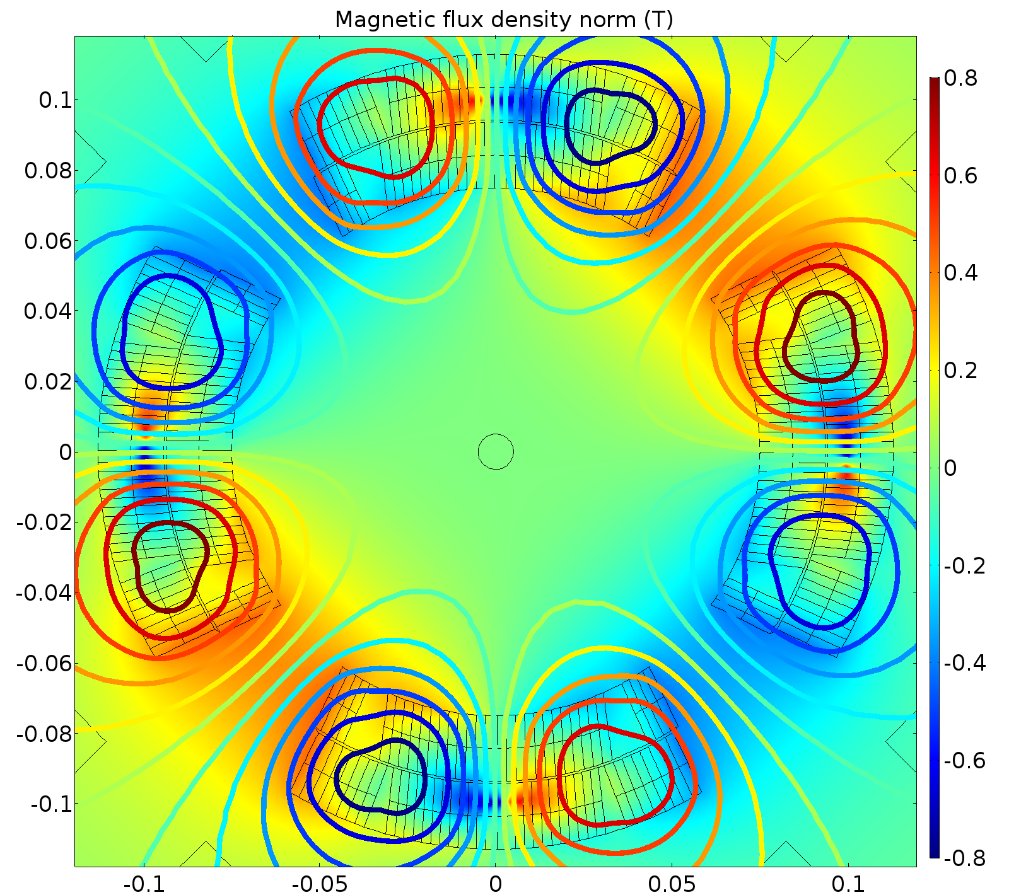
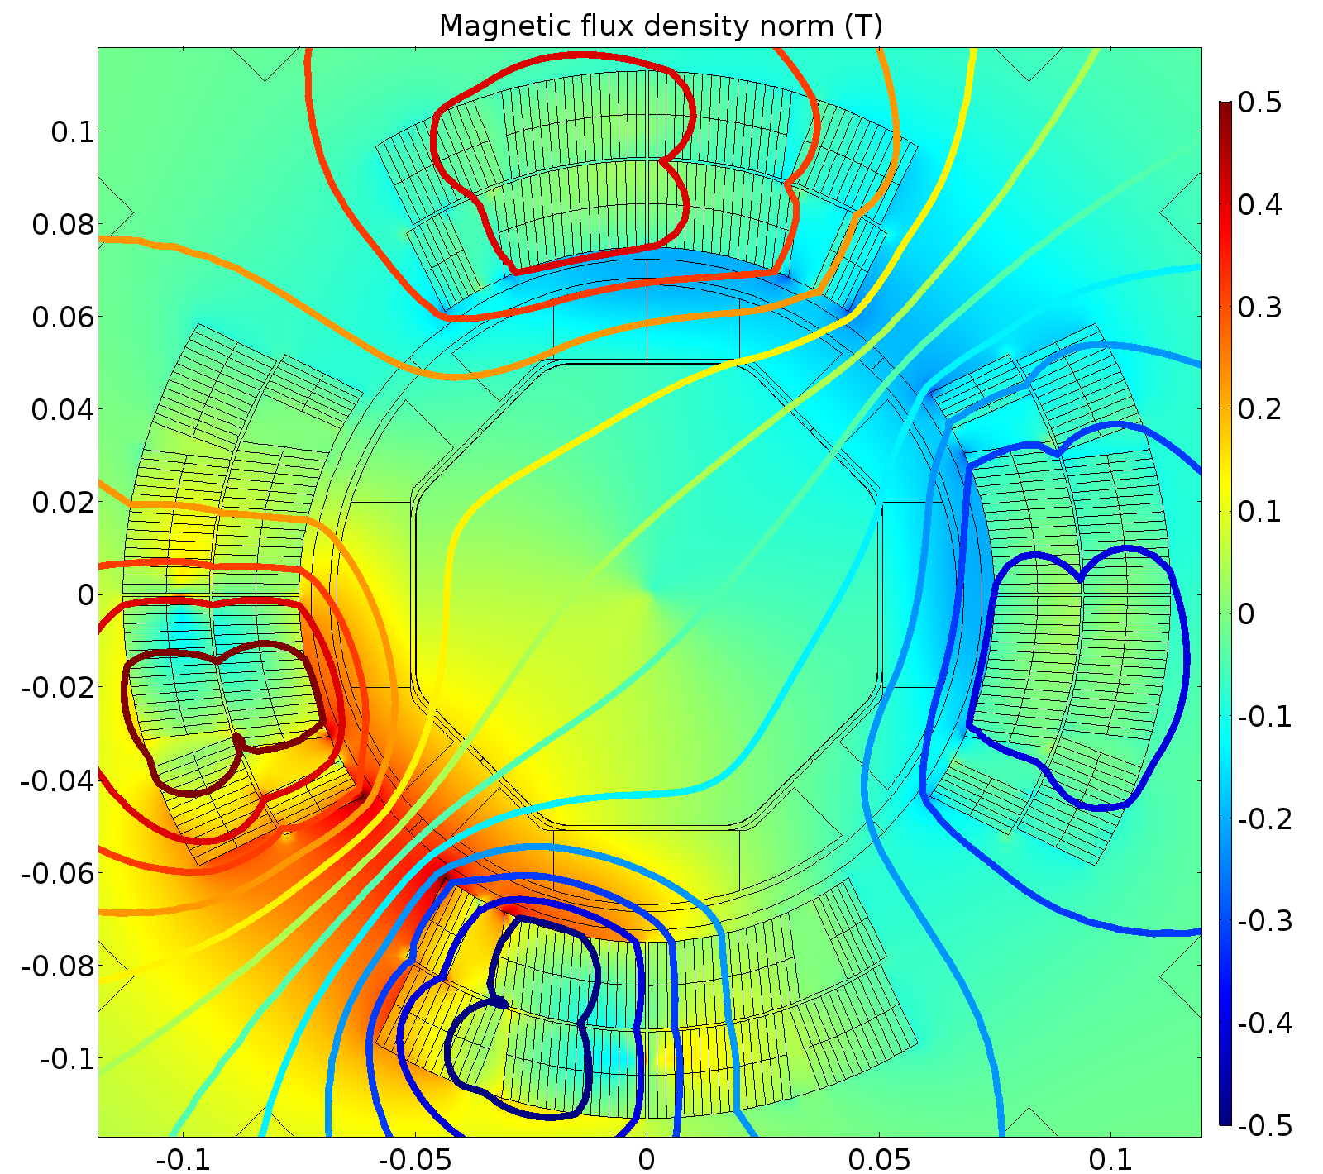
CLIQ in Triplet (Q2 and Q3)
Differences in connection, different magnetic fields.
Q1 electrically same as Q3
From optics, Q3 has larger beta function, and is thus more critical
Q2: Symmetric discharge -> Quadrupolar field -> beta beating
Q1/Q3: Asymmetric discharge -> Skew dipolar field -> orbit excursion
Q2, peak field (12 ms)
Q3, peak field (20 ms)
Notes:
Here you can see the change in the magnetic field. In Q2 to the left, you can see that there is mainly a quadrupolar component, whereas in Q3, and also Q1, the result is a dipolar field. In Q2 there will thus be a change in the focusing of the magnet, giving rise to a change of the beta function, knows as beta beating. In the Q3, we instead get an orbit excursion of the beam.

Slide 17
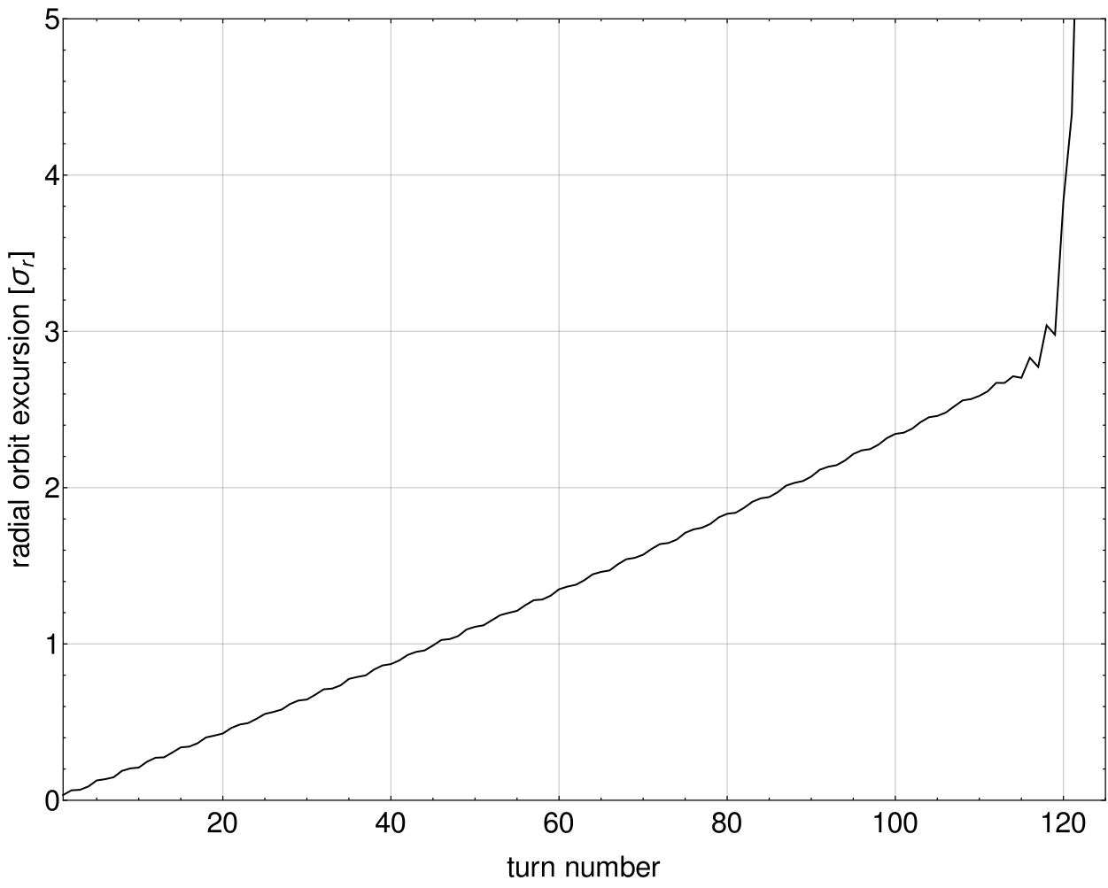
Q3 – orbit excursion
Beam lost shortly after LHC turn 100
Normal LHC – D1 failure
1 σ – 4 ms
Notes:
Here you can see the simulated orbit excursion in units of beam sigma, over time in units of LHC turns. After about 100 turns the beam would be lost completely. 1 sigma is reached after about 4 ms. This failure is slow enough that a fast current change monitor can detect it and dump in time. In comparison you can see the D1 power failure, which is currently considered one of the worst failures.

Slide 18
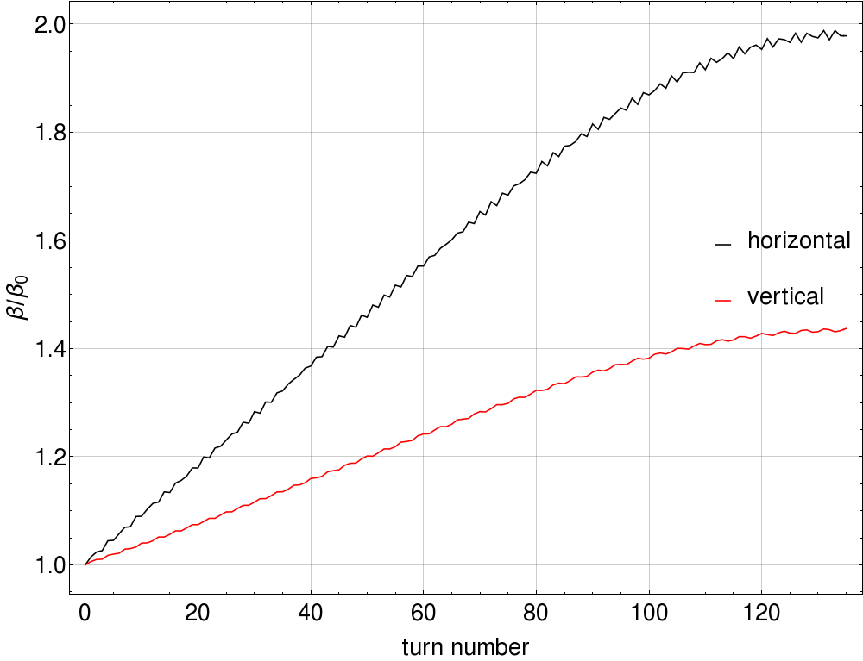
Q2 – Beta Beating
Beta beating of up to 100 % at the TCPs
Beam size changes -> losses at TCPs
Notes:
For the Q2 we instead get a beta beating due to the change in focusing gradient. In the plot you can see beta over beta nominal, plotted over time in units of LHC turns. You can see that at the maximum the beta beating reaches 100 %, which means a change in beam size of a factor 1.4. What this means in practice is that we will start seeing losses at the TCPs.

Slide 19
Crab Cavities
In HiLumi LHC, due to smaller β* and to limit beam-beam effects the crossing angle will be increased
⇾ Lower luminosity:
Piwinski Reduction (Geometric) Factor
 | 2012 LHC | 2015 LHC | HL-LHC
 | 313 | 290 | 590
 | 0.88 | 0.85 | 0.31
Geometric Factor
Notes:
Another important element to consider for HiLumi LHC are the crab cavities. In HiLumi LHC, the crossing angle will be increased due to the smaller beta star, that is, beta in the middle of the interaction point, and also to limit the beam-beam effects. However, increasing the crossing angle lowers the luminosity. In the formula for luminosity there is a geometric, or a Piwinski reduction, factor. In current LHC it is about 0.85, but for HiLumi it will be 0.31, considerably lowering the luminosity production.
The reason for this lowering can be explained by this schematic. You can see the two beams here, moving in oppostive directions. In the collision point, the overlap is not very good. To correct for this, the crab cavities will be installed.

Slide 20
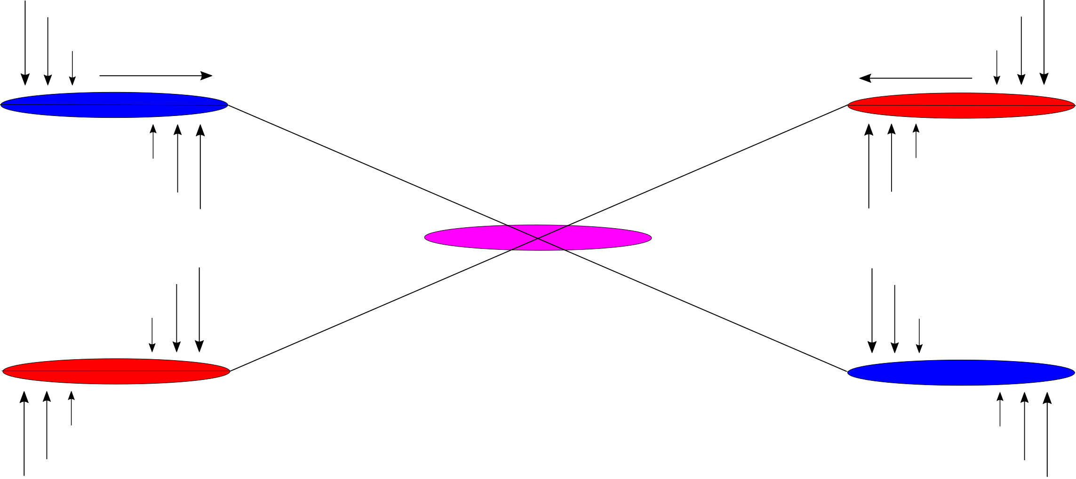
Crab Cavities
Cavity with sinusoidal transverse kick - bunch is tilted - better overlap at crossing point
E
180° - x’ set to 0 with same voltage
0° - kick in x’
90° - max offset in x
Phase advance:
Notes:
The crab cavities apply a sinusoidal transverse kick to the bunches, as you can see here. The center of the bunch will be untouched, while the sides get a kick in opposite direction. In the interaction points, you will then get a better overlap and more luminosity. On the other side of the IP, the sinusoidal kick is applied again in the same way to stop any residual crabbing from getting out of the IP.

Slide 21
Crab Cavities – failure modes
Voltage drop (~4 LHC turns)
Residual crabbing outside Interaction Point large
Phase change (must be driven by the RF control)
Kicks beam core out of orbit
Quench (combination of the above)
Notes:
The failure modes considered for these crab cavities are Voltage failures, which means that there would be residual crabbing outside of the Ips
Phase change, which must be driven by the RF control. This kicks the beam core out of orbit. And lastly a quench, which would act somewhat like a combination of the other two.

Slide 22
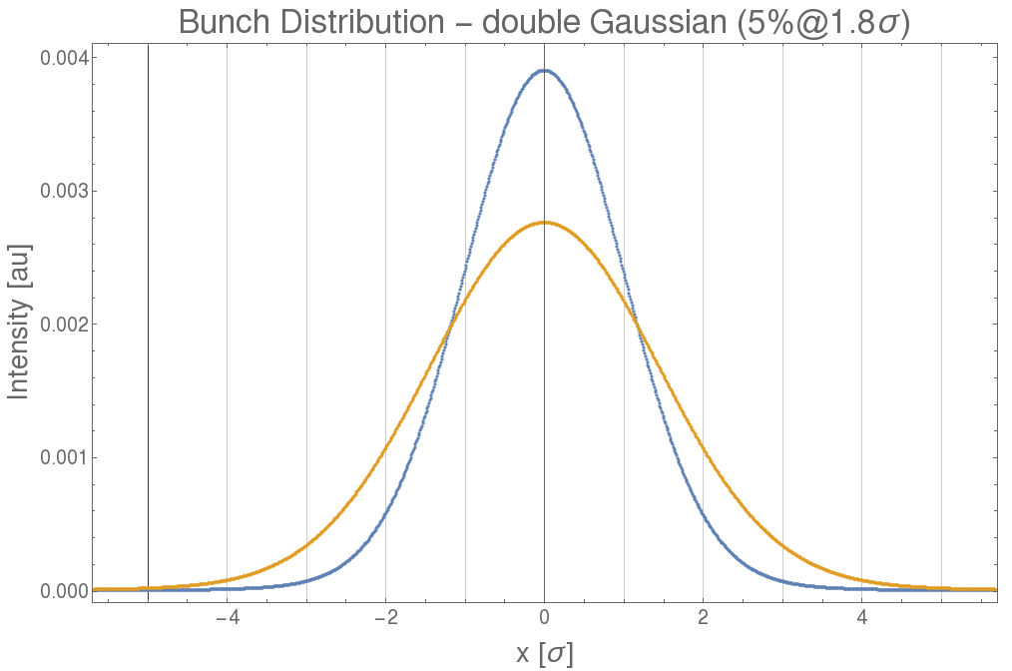
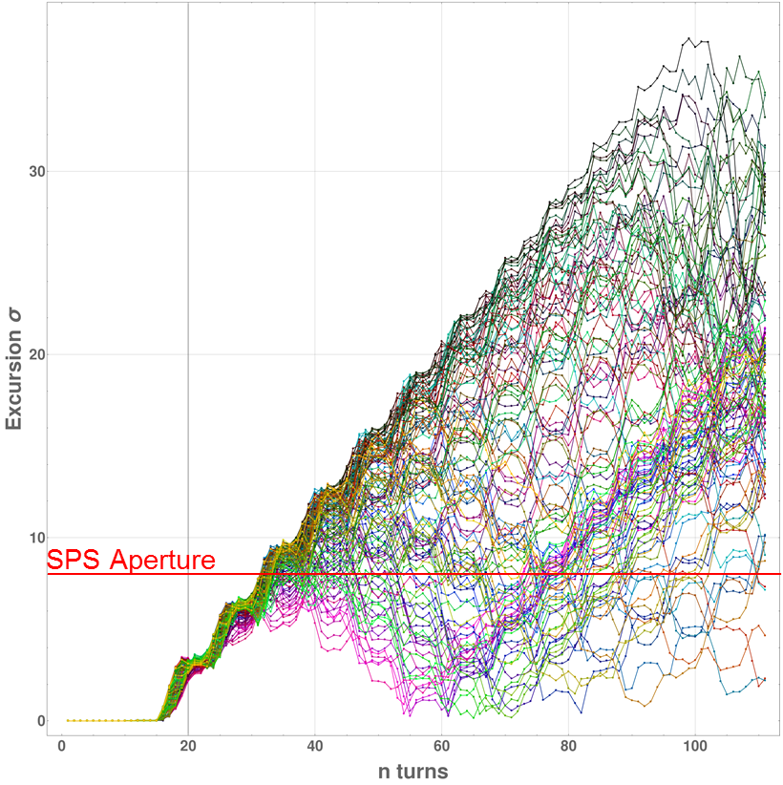
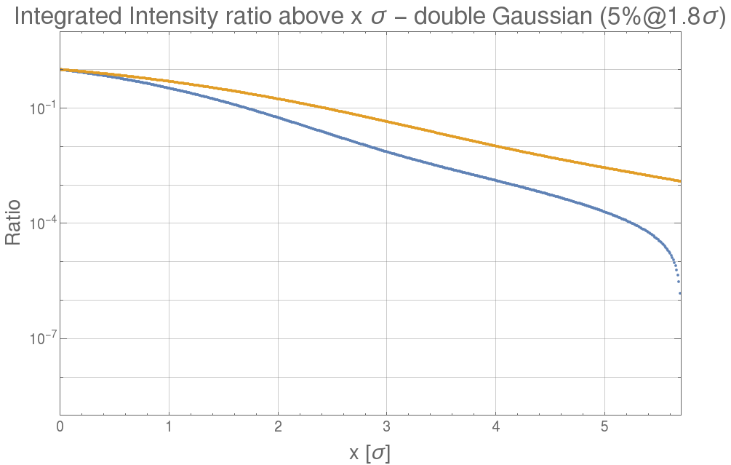
Consequences of CC failure
If crabbing not compensated (e.g. voltage drop), transverse beam distribution wider - increases hazard of other failures
Phase shift causes beam core to be transversally kicked - can give fast beam loss
Nominal
180 µrad tilt
Notes:
For the phase shift, the beam gets kicked transversally which can give rise to fast beam losses, especially if the phase shift per turn is in resonance with the tune of the optics. In the example here you can see the effect of this on the beam in the SPS, and the aperture is hit after roughly 20 turns.
For the voltage drop, we instead have residual crabbing outside of the Ips. This means that the transverse beam distribution becomes wider. If you look in this plot, you can see the nominal distribution in blue, after the crabbing, the projection of the beam distribution onto the transverse plane is then wider. This could increase the hazard of other failures, since you have more particles outside a certain nominal beam sigma. In this plot you can compare the integrated intensity ratio above a certain number of sigmas for the two different cases.
For example in the nominal case, an orbit excursion of 3 sigma would damage the collimator system, which if you look here in the plot corresponds to about 0.2 % of the ratio of the full beam. For the orange curve however, this limit has moved here, meaning the margin has lowered by about one sigma.

Slide 23
Combined failures – beam beam effect
The two beams interact with each other electromagnetically in crossing points
Transverse kick (orbit change, main issue)
Emittance growth
Tune spread
...
Dumping one beam gives sudden loss of beam-beam kick
After a given failure, beams will always be dumped
-> this type of combined failure must thus always be considered
Notes:
I will briefly mention the beam beam effect. When you have two counter-rotating beam passing each other in the Ips, they interact with each other electromagnetically. The main effect of this is a transverse kick, giving an orbit change. When one beam is dumped, the other beam will thus suddenly lose this beam beam kick, which gives a large orbit excursion. After a given failure, a dump will always occur, and the beams are usually not synchronized to the turn in the dumping. This menas that you can get an extra orbit excursion on top of another failure and is a combined failure that must always be considered.

Slide 24
Current work...
Experiment on Thursday
Studying UFO dynamics using diamond beam loss monitors
Two IPAC papers (preliminary titles)
Results of UFO dynamics studies with beam in the LHC
Crab cavity failures combined with loss of beam-beam effect in the HL-LHC
Article on ”Fast failures in the LHC and HL-LHC”
First draft by end of this year...
Notes:
I will conclude with the main points of my current work. On Thursday I will have an experiment studying UFO dynamics using diamond beam loss monitors. I also have two upcoming IPAC papers, one on UFO dynamics which will be based on this experiment and one we had during the summer, as well as one of combined failures between crab cavities and loss of beam-beam kick.
Lastly I am also preparing an article on fast failures in the LHC and HL-LHC to summarize what I have done during my first year.

Slide 25
Thank you!

Slide 26
Introduction
16L2 refers to loss events in an interconnection in LHC sector 16L2
Three types:
Steady state losses (resolved)
UFO-like losses causing beam instability (fast loss rise, beam dump, quench)
UFO-like losses not causing instabilities (do not dump)
Courtesy of A.Lechner

Slide 27
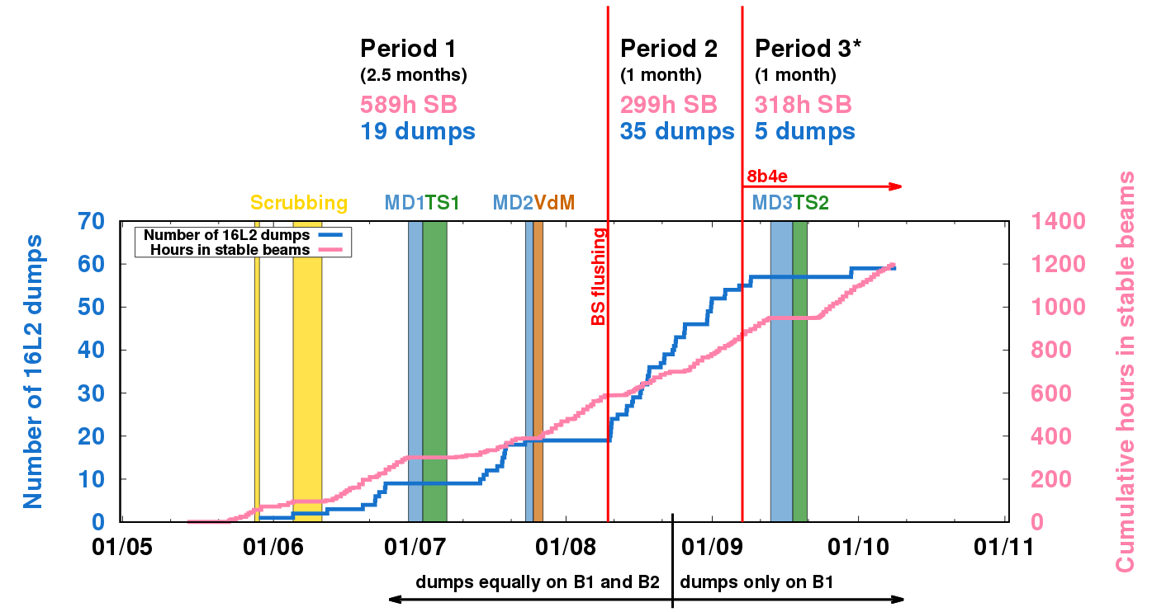
Introduction
61 dumps since May until 25th Oct (7 more until 28th Nov)
294 dumps due to faults, 64 due to beam losses (incl 16L2)
Courtesy of A.Lechner

Slide 28
Observables and Goals
Hypothesis:
Solid macro-particle enters beam -> gives UFO-like losses
Macro-particle evaporates -> charged particle cloud -> beam instability -> losses in TCPs
Local dBLM: direct losses from 16L2 interaction (relatively low signal)
IR7 dBLM: losses due to build-up of instabilities
From local data, study the UFO dynamics
Bunch blow-up in H or V
Displacement of bunches in H,V or diagonally
-> Tells us which direction the UFO is coming from (see MD on UFO dynamics with wirescanner)
From IR7 data, study how the instability develops
Fastest losses observed in the LHC

Slide 29
16L2 Machine Development test (MD)
Unique opportunity with UFOs on demand
High bunch intensity, many bunches and high energy seems to trigger them
Foreseen to conduct MD before end of this run
Various combinations of blown up and displaced bunches
-> study UFO dynamics as shown by previous MD2036 using wirescanner
-> understand 16L2 in case it reoccurs
Challenges for dBLM part:
Optimize signal
Use many bunches with set properties for better statistics
How many bunches required will be an outcome of current analysis
From understanding the histogram
How to combine signals from the different bunches to draw conclusions
Increasing statistics without destroying relevant data

Slide 30
16L2 Machine Development test (MD)
Unique opportunity with UFOs on demand
High bunch intensity, many bunches and high energy seems to trigger them
Foreseen to conduct MD before end of this run
Various combinations of blown up and displaced bunches
-> study UFO dynamics as shown by previous MD2036 using wirescanner
-> understand 16L2 in case it reoccurs
Challenges for dBLM part:
Optimize signal
Use many bunches with set properties for better statistics
How many bunches required will be an outcome of current analysis
From understanding the histogram
How to combine signals from the different bunches to draw conclusions
Increasing statistics without destroying relevant data

