Slide 1
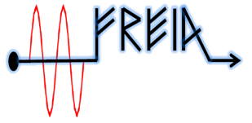
Test plan of ESS HB elliptical cavity
Han Li
On behalf of FREIA team
FREIA Laboratory, Uppsala University
14th of Nov. 2017

Slide 2
Discussion with CEA
Only motor movement checking at room temperature.
Full tuner test at cold:
Tuning range of step motor: 600 kHz
Cavity resonant frequency at 2 K without tuner: 704,094684 MHz
Tuning range of piezo: 800 Hz (for MB elliptical cavity)
Max turns of tuner at one go: 20
Tuning sensitivity: 217 kHz/mm
Try the full tuning range at cold.
Contorller from ESS or CEA will be discussed. If from CEA, they will support FREIA with hardware and Labview software. But we have no access to their variables.

Slide 3
2. Coupler conditioning parameters will be provide by CEA.
Conditioning frequency of 704.42 MHz
Peak power up to 1.1 MW within 500 µs
Peak power up to 300 kW for any pulse longer than 500 µs
Conditioning pulse length can up to 3.6 ms
Coupler vacuum threshold should lower than 10⁻⁷ mbar
Parameter | value
Loop control time (s) | 1
Pulse repeat rate (Hz) | 1Hz, 14Hz
Vacuum upper limit (mbar) | Provided by CEA
Vacuum lower limit (mbar) | Provided by CEA
RF upper limit (KW) | 1.1 MW
RF lower limit (KW) | 0,1
Initial pulse length (µs) | 20
pulse length step | Provided by CEA
1100kW
300kW
500µs
3.6 ms

Slide 4
3. The sequence of RF Conditioning:
FPC warm conditioning Coupler cold conditioning (off resonance)
cavity package cold conditioning (on resonance)
No field in the cavity before checking coupler is clean.
MP regions in TW
100 kW
300 kW
Around 900 kW
MP regions in SW
25 kW
75 kW
Around 250 kW
In our case

Slide 5
4. The maximun transmitted power during the FPC warm conditioning and coupler cold conditioning (off resonance)?
Detect radiation level, can not have radiation in the cavity
Cavity voltage should be less than 10 kV.

Slide 6
Questions to be discussed
5. Different system for cavity package cold conditioning?There will be a drop at field with Lund system. There could be a flattop with SEL.
6.Use 14 Hz repetition rate pulse mode @ 3.5 ms duration and up to 250 kW for the Q0 factor and dynamic heat load measurement.
If the klrstron and handle full power, 3.5 ms duration at lower repetition rate, then we can measure filling time and dynamic lorentz detuning.
If the klystron can handle low power but much longer pulse length in oder to test the mechanical mode of cavity package?
7. Should we go to the maximun Eacc ? Quench? Or set a gradiant limit?
8. Any cooldown rate limitation? Temperature sensors location?Heater location on the flange?Filling rate?Temperature gradient tracing?

Slide 7
Qe of FPC
Eacc=19.9MV/m

Slide 8
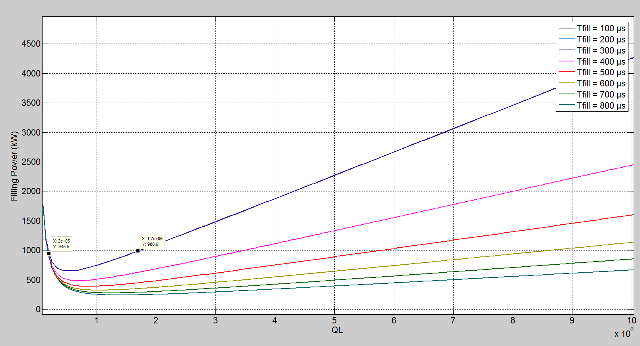
Eacc=19.9MV/m
Qe=2E5
Qe=1.7E6
If the Q0 for room temperature is 1.4-1.9 E4, Then the SWR should be in the regin of 10-100

Slide 9
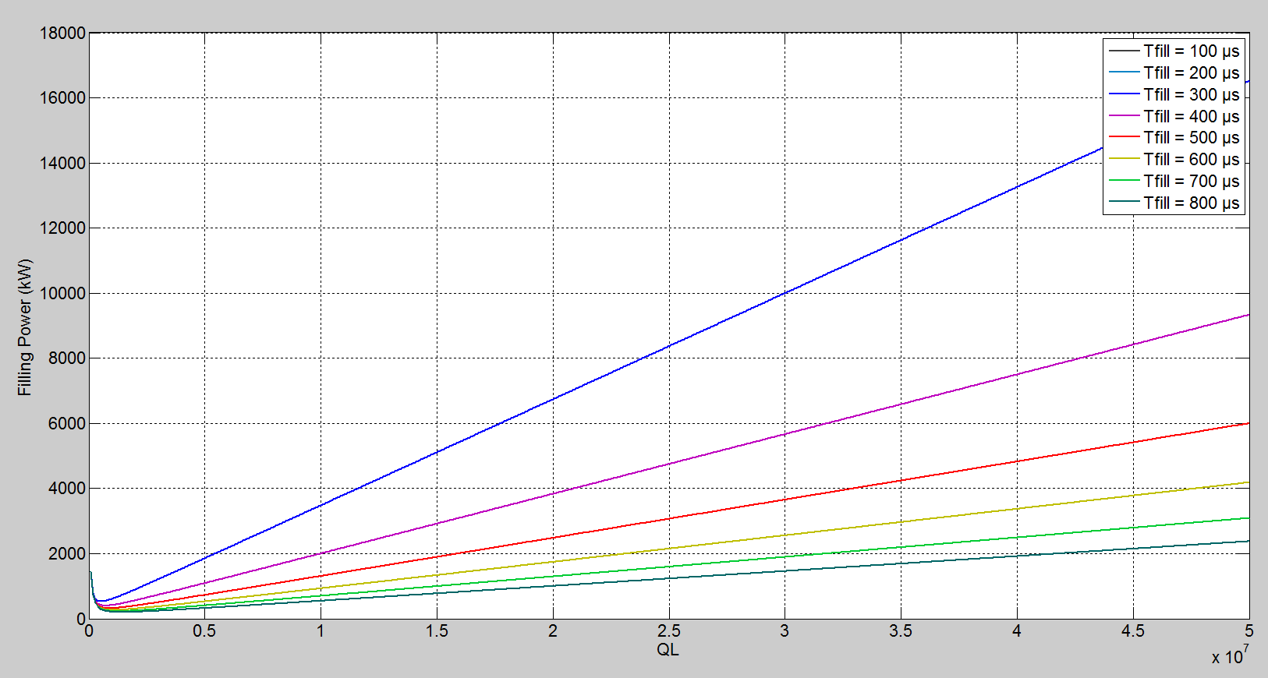
Eacc=18MV/m

Slide 10
Eacc=18MV/m
Qe=2.3E6
Qe=1.5E5
If the Q0 for room temperature is 1.4-1.9 E4, Then the SWR should be in the regin of 10-100

Slide 11
Eacc=18MV/m

