Slide 1
RF R&D at CERN
Seminar at Uppsala University December 2017

Slide 2
Outline
RF R&D at the existing CERN accelerator complex
  PSB Finemet® based wideband system
  PSB controlled longitudinal emittance low-up
  PS new beam gymnastics
  PS transversely biased ferrite tuner
  SPS wideband transverse kicker
  High-power RF going solid-state (ex. SPS)
  LHC full detuning
Preparing the future
  CLIC
  High efficiency klystron research
  SRF Technology
    HL-LHC Crab Cavities
    HIE-ISOLDE cavities
    Nb₃Sn thin film technology R&D
Summary

Slide 3
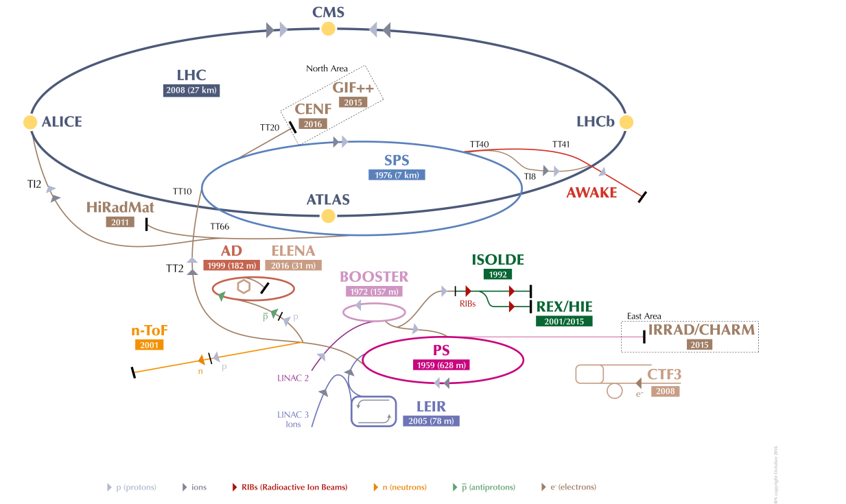
CERN Accelerator complex
LHC Large Hadron Collider
SPS Super Proton Synchrotron
PS Proton Synchrotron
AD Antiproton Decelerator
CTF3 CLIC Test Facility
AWAKE Advanced WAKefield Experiment
ISOLDE Isotope Separator OnLine
REX Radioactive EXperiment
HIE-ISOLDE High Intensity and Energy ISOLDE
LEIR Low Energy Ion Ring
LINAC LINear ACcelerator
n-TOF Neutrons Time Of Flight
HiRadMat High-Radiation to Materials
CHARM CERN High Energy AcceleRator Mixed field facility
IRRAD proton IRRADiation facility
GIF++ Gamma Irradiation Facility
CENF CErn Neutrino platForm

Slide 4
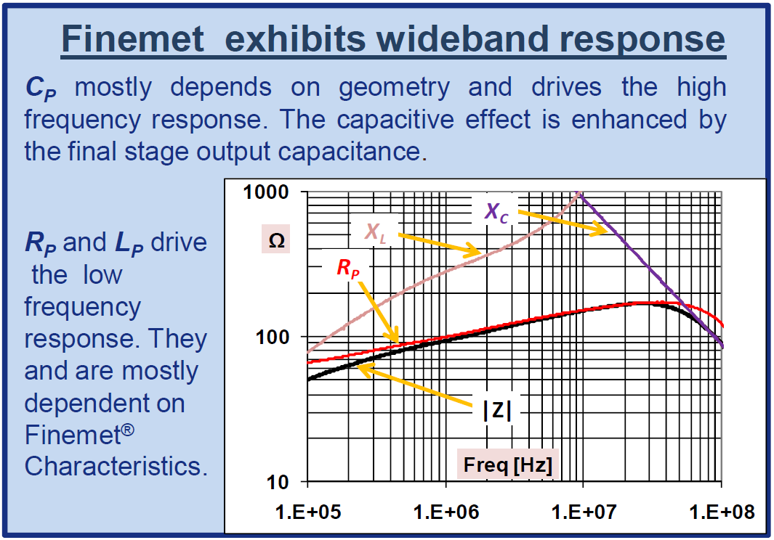
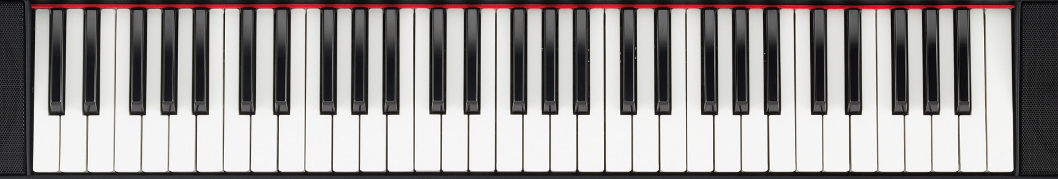

PSB Finemet® System
Finemet® is a composite magnetic material, developed and commercialized by Hitachi Metals, Japan.
It allows to build a “cavity” without a resonance, with a flat frequency response covering $\left(0.6…18\right) MHz$ without any
tuner. (almost 5 octaves!)
M. Paoluzzi

Slide 5
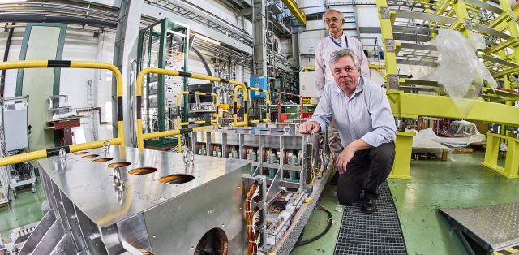
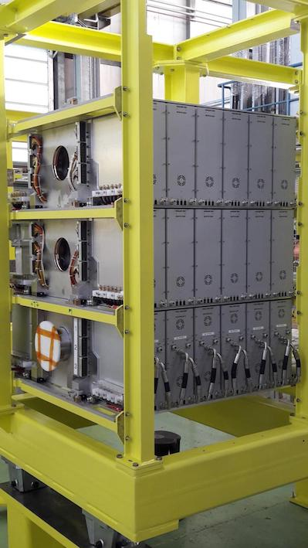
PSB RF SYSTEM – fabrication completed
New PSB RF System, working between 0.5 and 20 MHz without tuning, to be operational after LS2.
27 cavities assembled, 24 will be installed. Collaboration work with KEK - Japan
M. Paoluzzi et al.

Slide 6
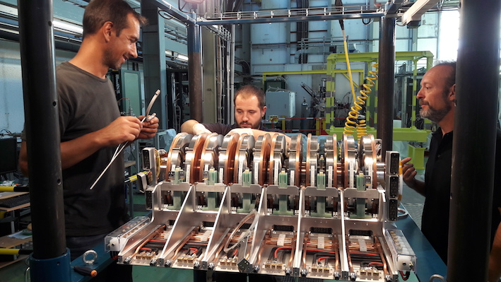
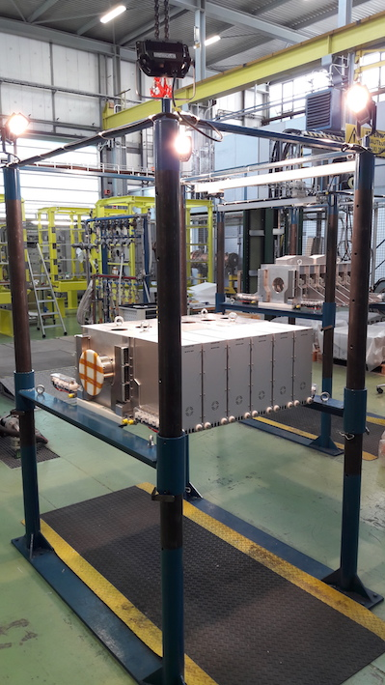
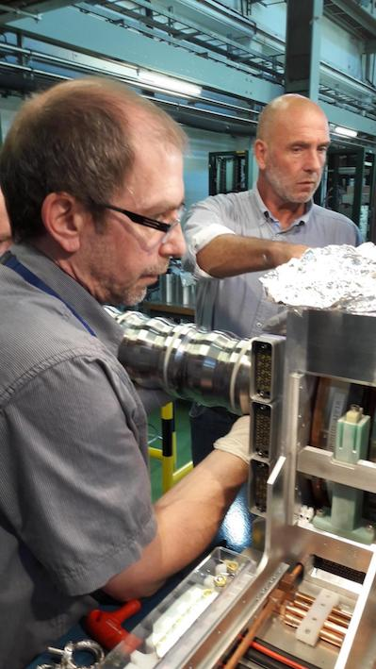
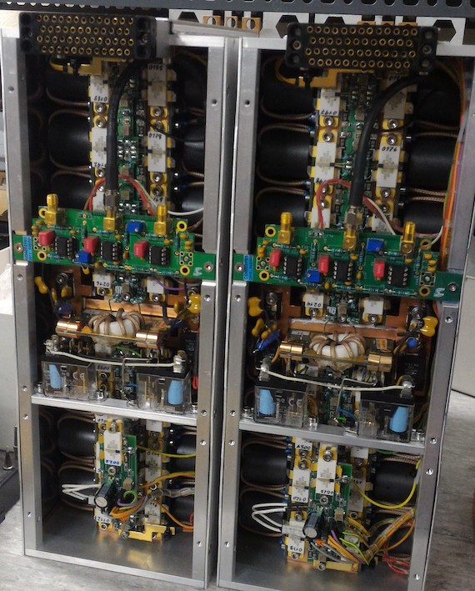
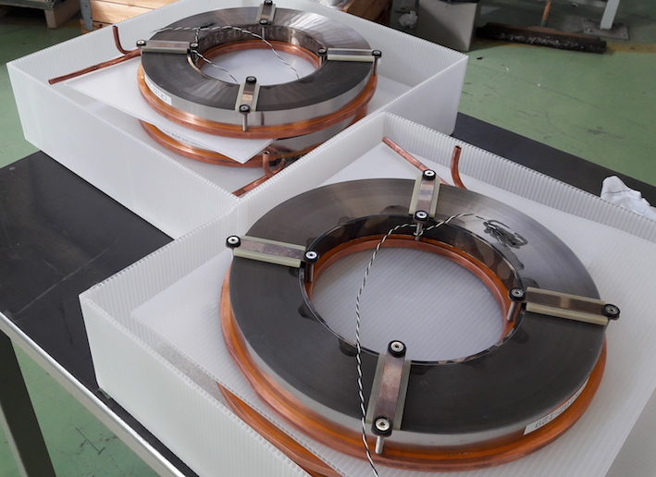
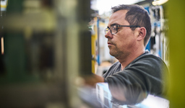
PSB RF SYSTEM – fabrication completed
Most of fabrication, complete assembly and cabling performed at the RF workshop

Slide 7
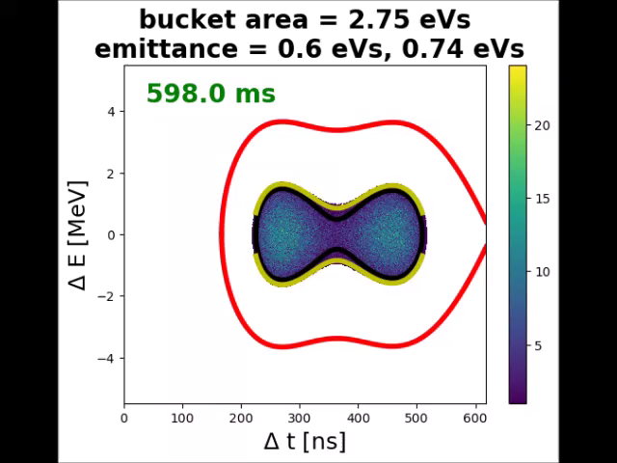
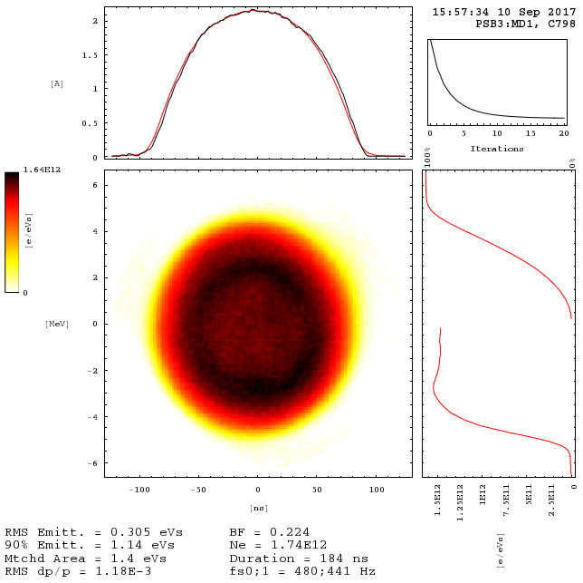
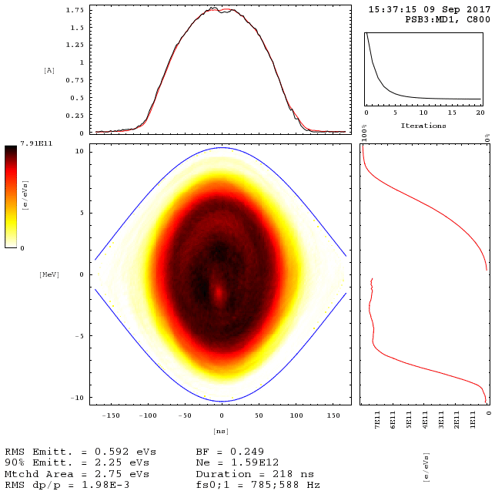
PSB: new controlled longitudinal emittance blow-up
Controlled longitudinal emittance blow-up is performed in present operation using
phase modulation of high harmonic RF system C16
in MDs and probably in future operation → band-limited phase noise in main RF C02
Stable and
reproducible
bunches at
PSB extraction
1.4 - 2.8 eVs
MOVIE: emittance blow-up during ramp
S. Albright et al.

Slide 8
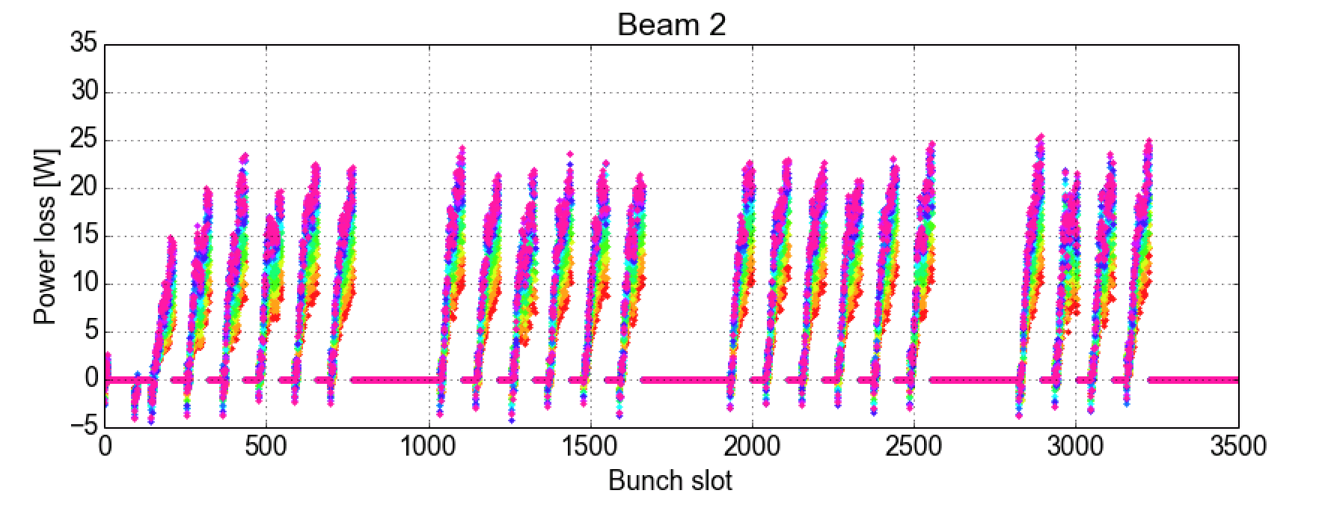
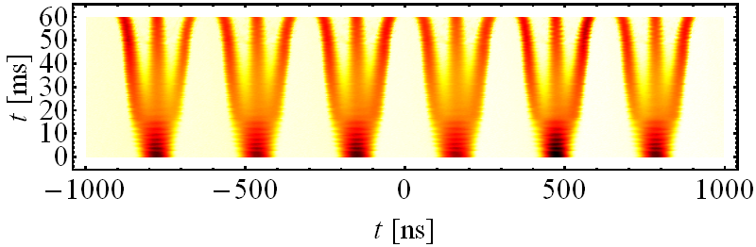
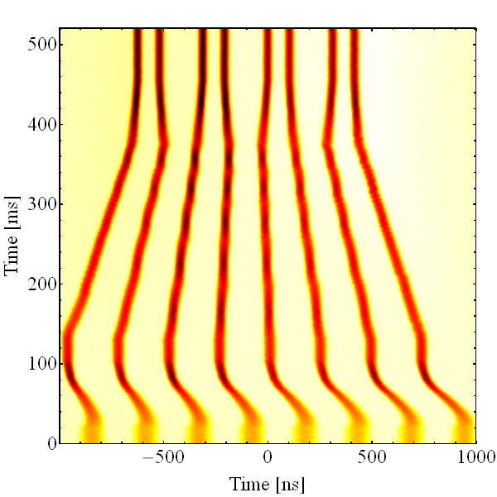
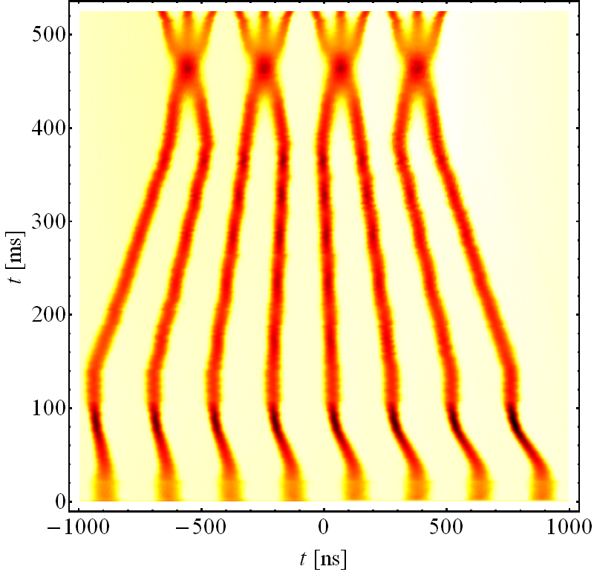
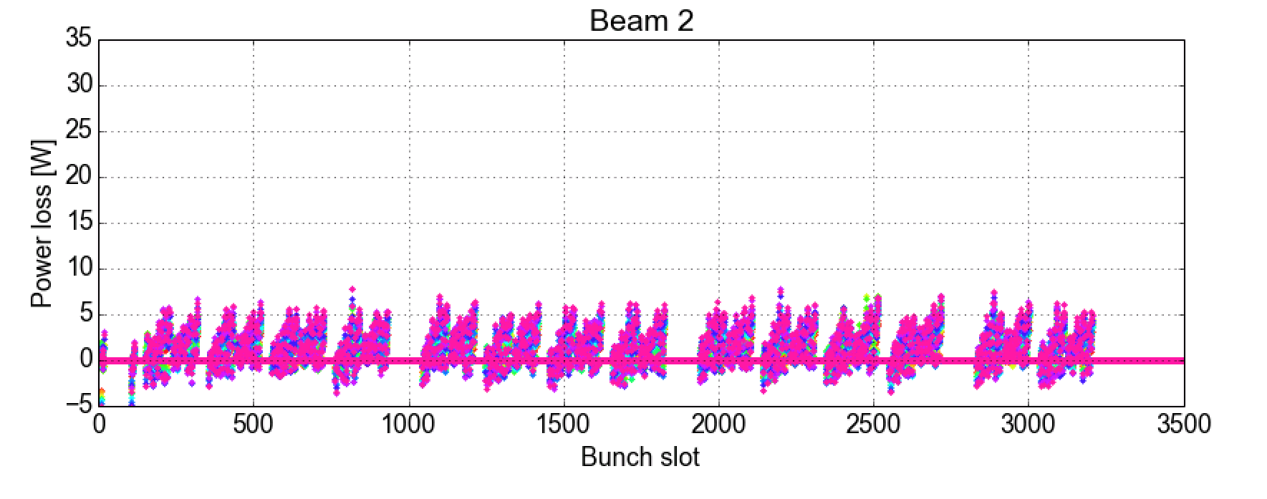
PS Beam manipulations from nominal to 8b4e BCS: mitigating e-cloud in LHC
Nominal scheme: 6 PSB bunches →18 → 36 → 72
BCMS 25 ns: 8 PSB bunches → 4 → 12 → 24 → 48
BCS 8b4e: 8 PSB bunches → 16 → 32
Record luminosity in LHC with BCS 8b4e: > 2x10³⁴ cm-²s⁻¹
Standard 25 ns beam
1600b.
standard 72b
BCS 32b 8b4e
“8b+4e” beam
1600b.
BCMS 48b
power loss from stable phase measurement

Slide 9
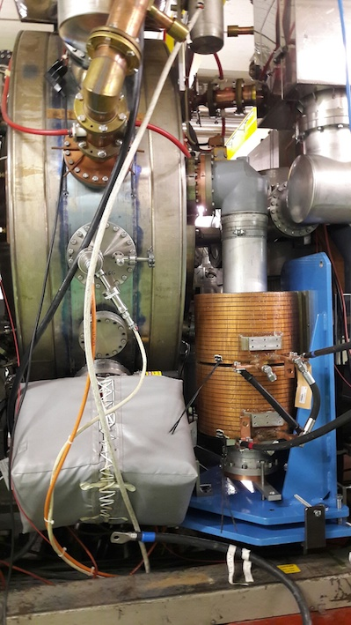
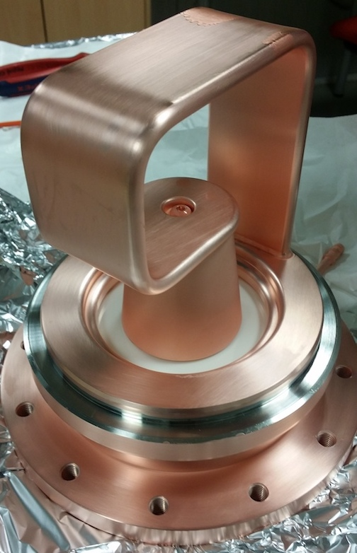
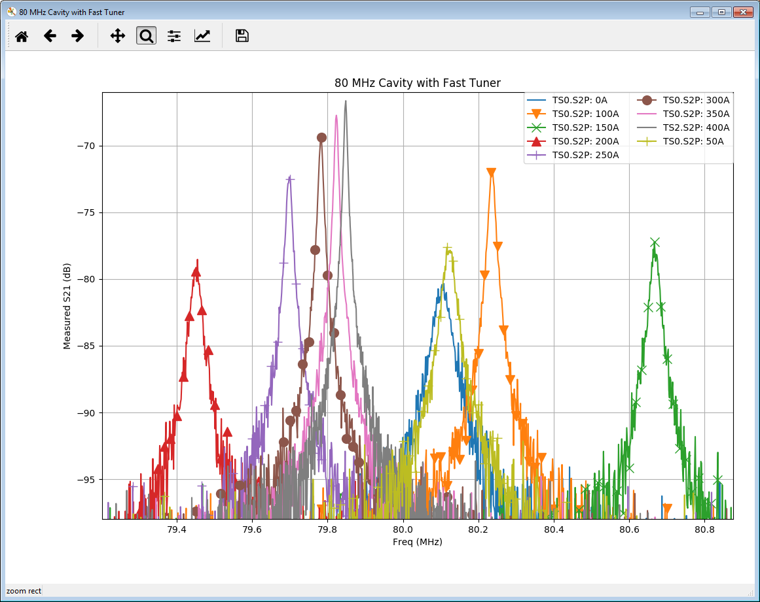
PS 80 MHz Fast Tuner – R&D work in progress
The prototype of 80 MHz fast tuner was installed in the PS during EYETS, however preliminary measurements performed under a tight schedule were not able to indicate a usable working point for the device.
C. Vollinger et al.

Slide 10
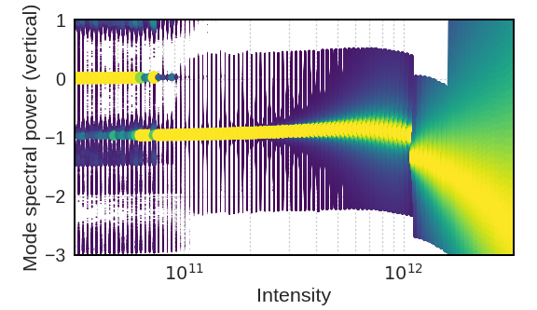
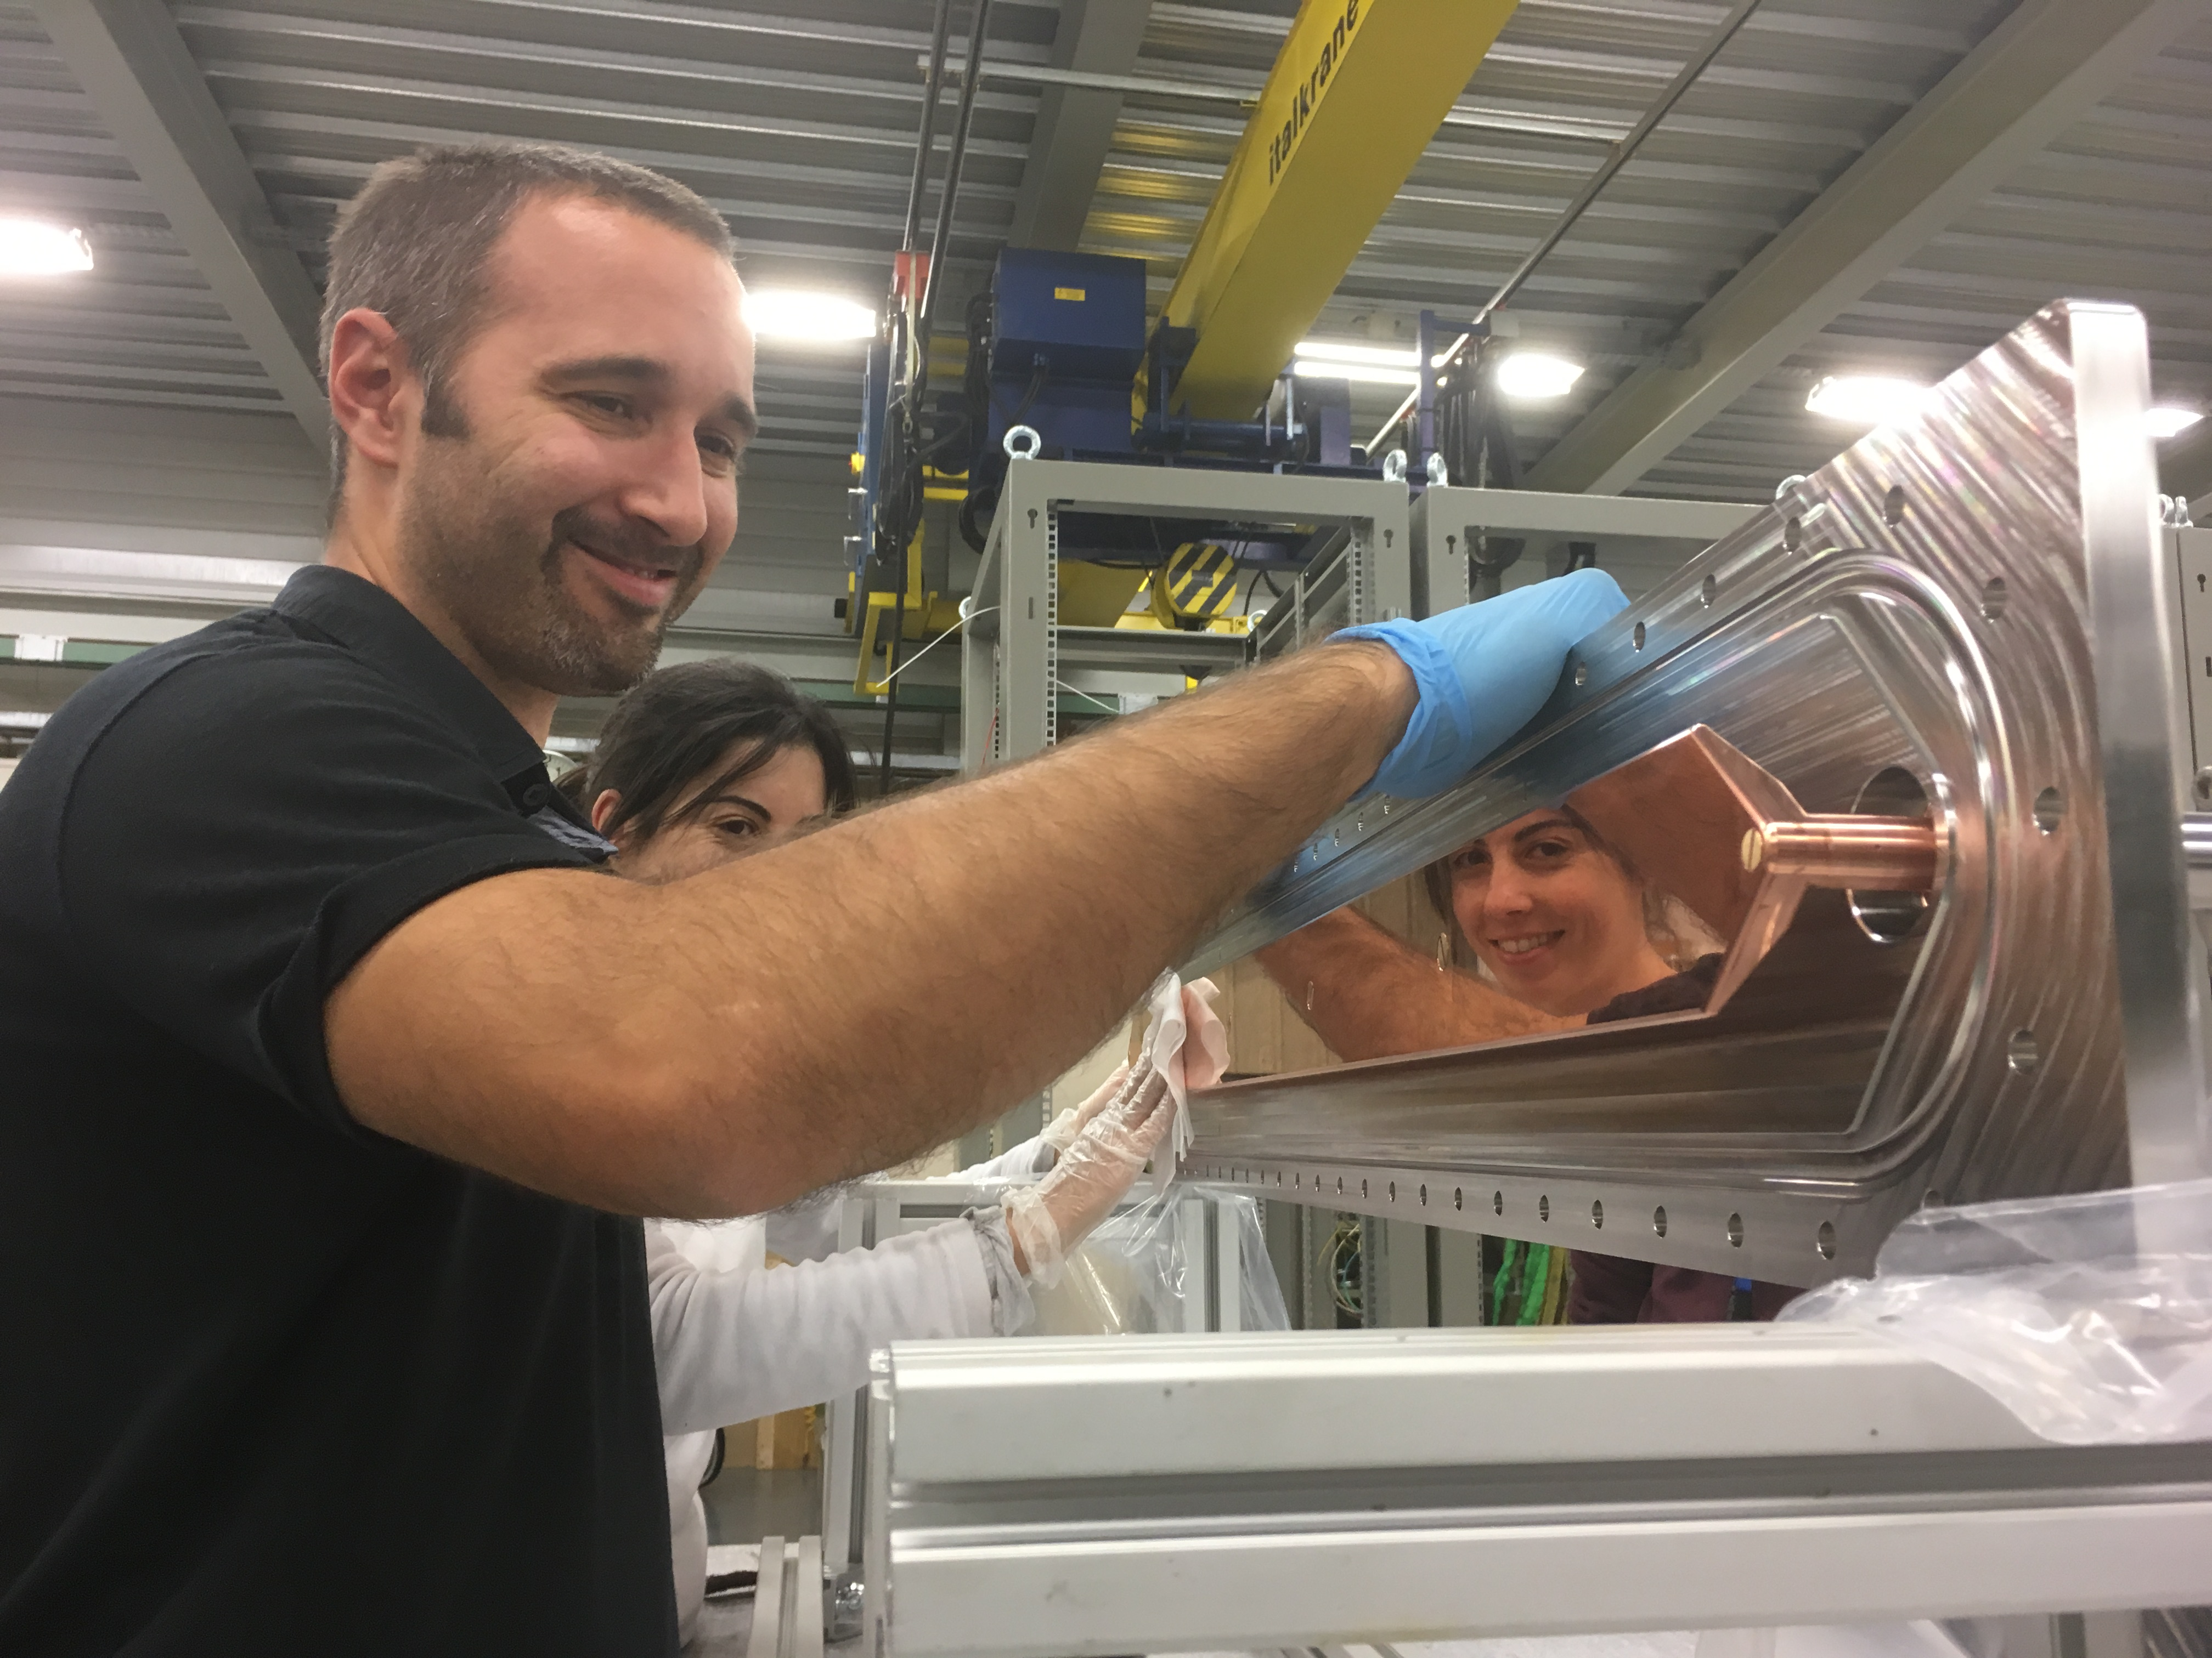
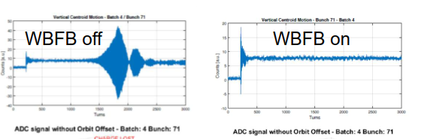
SPS: R&D for wideband transverse feedbacks
GHz wideband transverse feedback (WBTF) for SPS
Study for FCC transverse feedbacks with head-tail code simulations
Implementation of signal processing for PSB and PS transverse feedback upgrades
The new WBTF slot line kicker is made from two half cells, laser soldered, each having its own cover with its copper electrode
single bunch in 25 ns train, Q2O optics
W. Hofle, G. Kotzian, D. Valuch, E. Montesinos, S. Calvo et al.

Slide 11
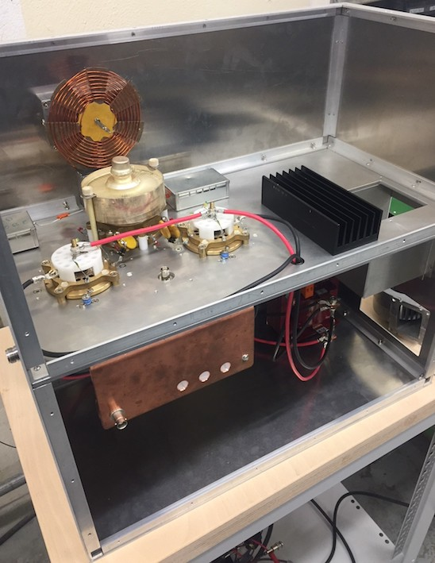
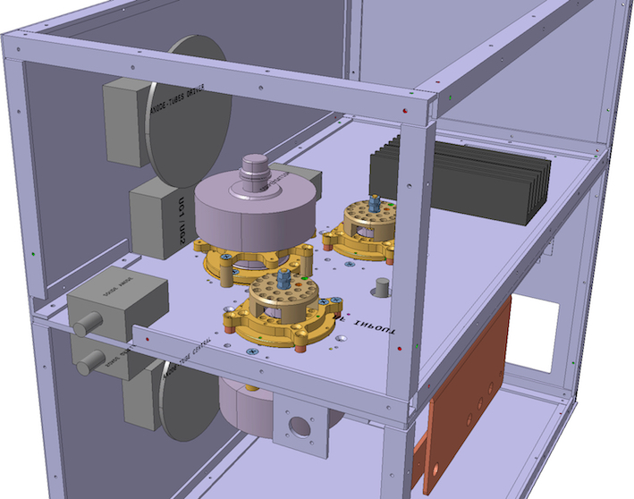
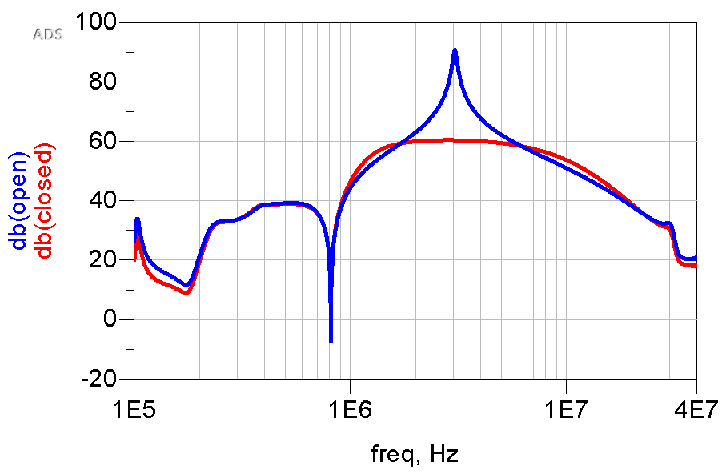
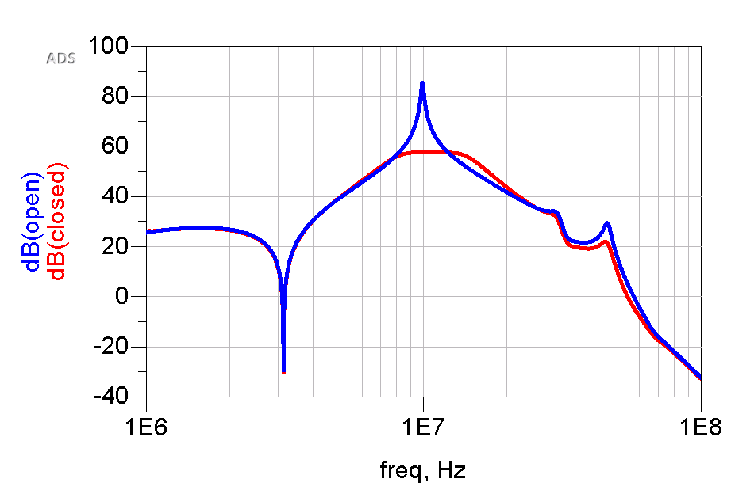
LIU-PS 10 MHz Upgrade
The final prototype of the upgraded feedback amplifier is getting ready to be installed in the PS during the next YETS.
3 MHz
A more advanced option, based on solid state amplifiers, is also being developed, preliminary simulations show promising results.
10 MHz
G. Favia, M. Morvillo, C. Rossi et al.

Slide 12
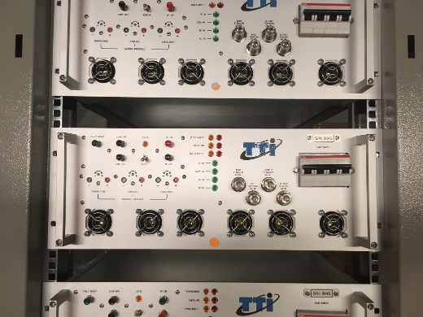
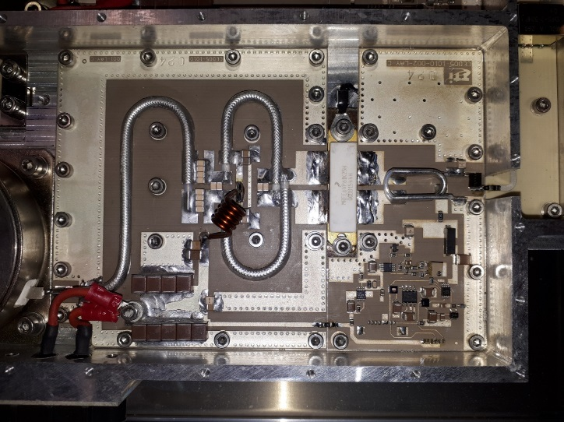
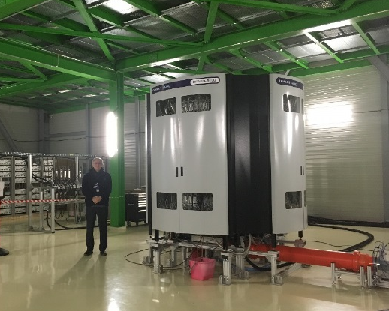
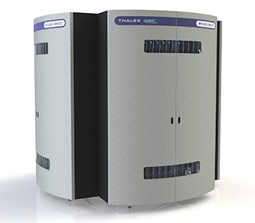
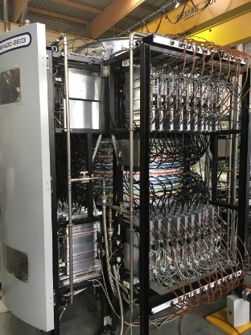

LIU-SPS-RF turning solid-state
SPS 200 MHz, 1250 Wp 5 seconds – 700 W CW Solid State Power Amplifiers from TTi Norte (Spain)
In operation since beginning 2017
SPS 200 MHz, 144 kWp 5 seconds – 72 kW CW Solid State Power Amplifiers from Thales (France)
Still under (difficult) qualification
E. Montesinos et al.

Slide 13
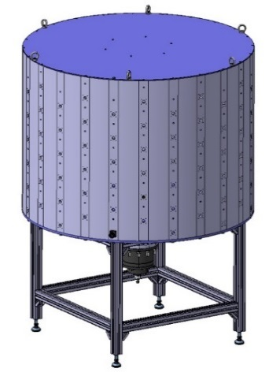
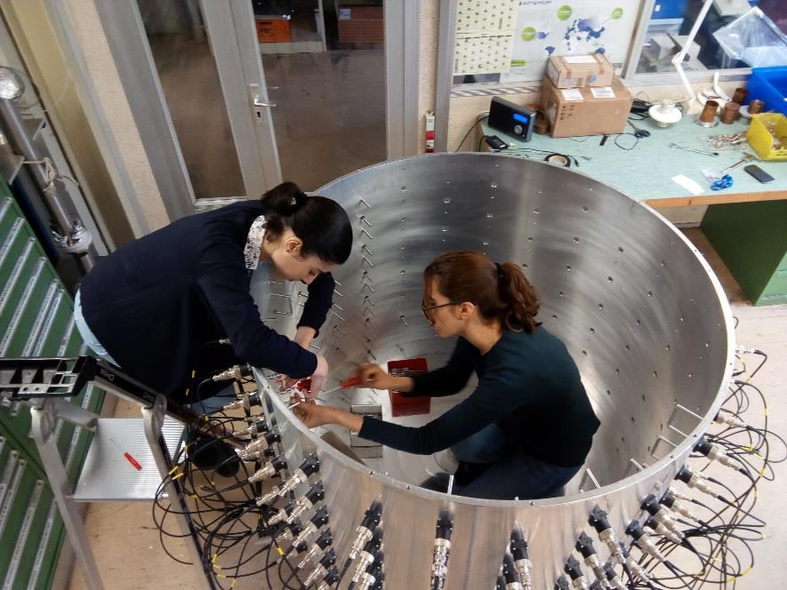
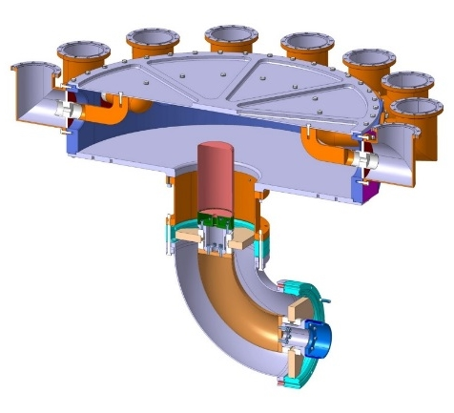
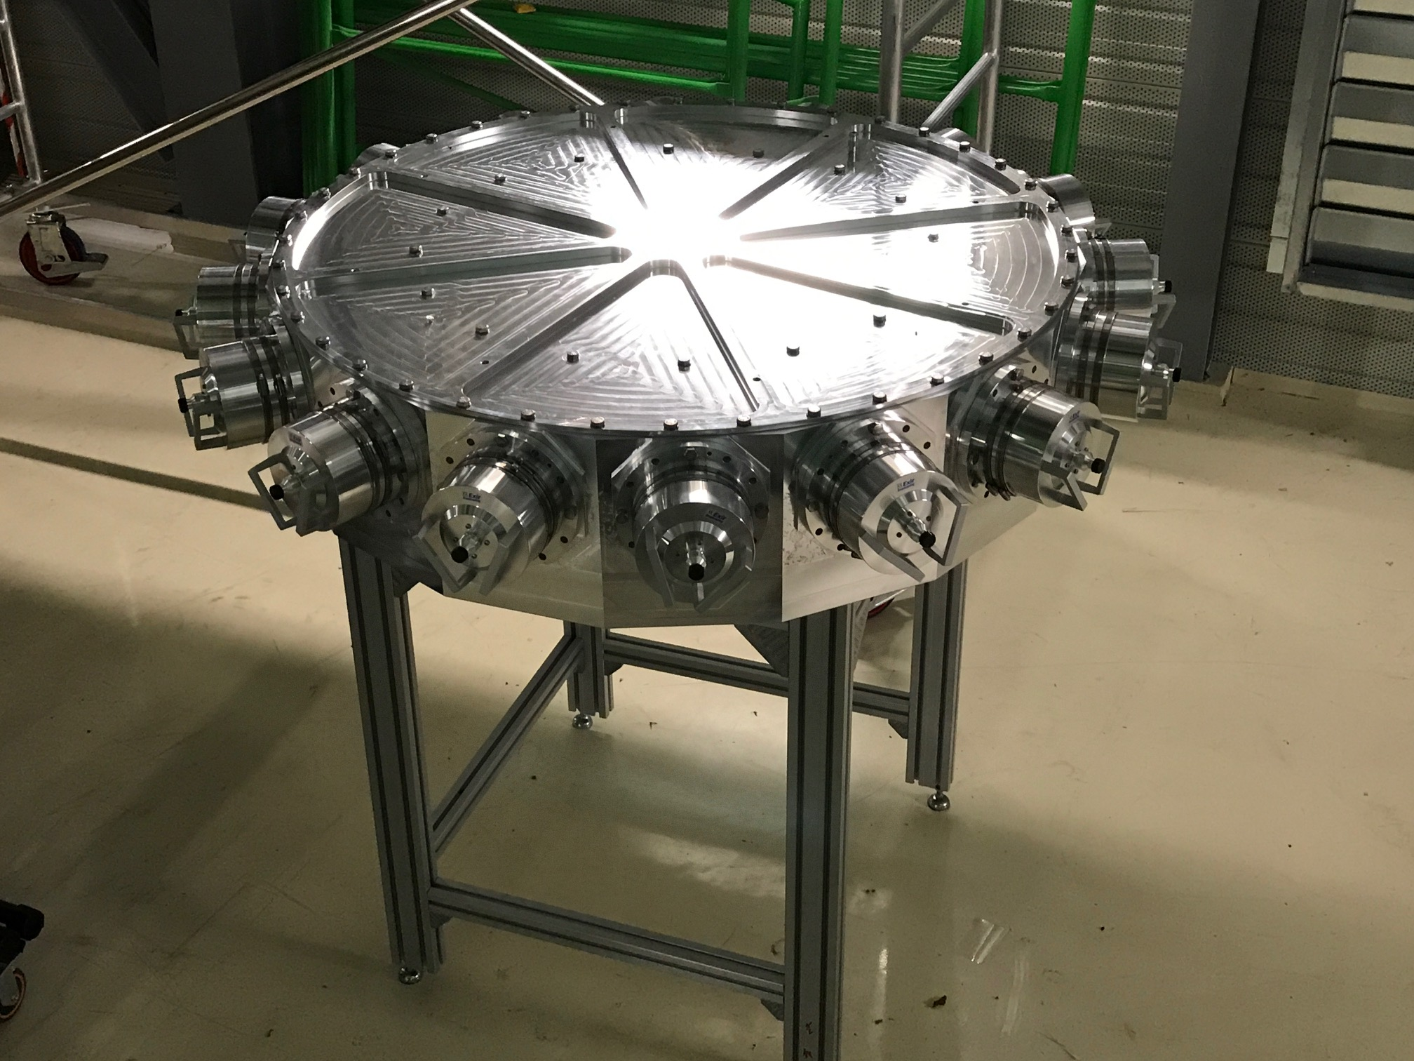
Power combiners
Key to go to solid-state!
We validated several cavity combiners, for the MB-IOT and the LIU-SPS-RF, including a VHPCC (Very High Power Cavity Combiner)
This is very important as opening the doors of the high power levels (MW) to the SSPA based amplifiers
CERN 144:1 cavity combiner 144 kW @ 200 MHz
Calculations by ESRF, construction by CERN
CERN 16:1 radial cavity combiner 2.4 MW CW @ 200 MHz,
Still to be power tested, validated at VNA level
with only -0.2dB insertion losses
Machined by EN-MME in-house from a massive block of aluminium
E. Montesinos et al.

Slide 14
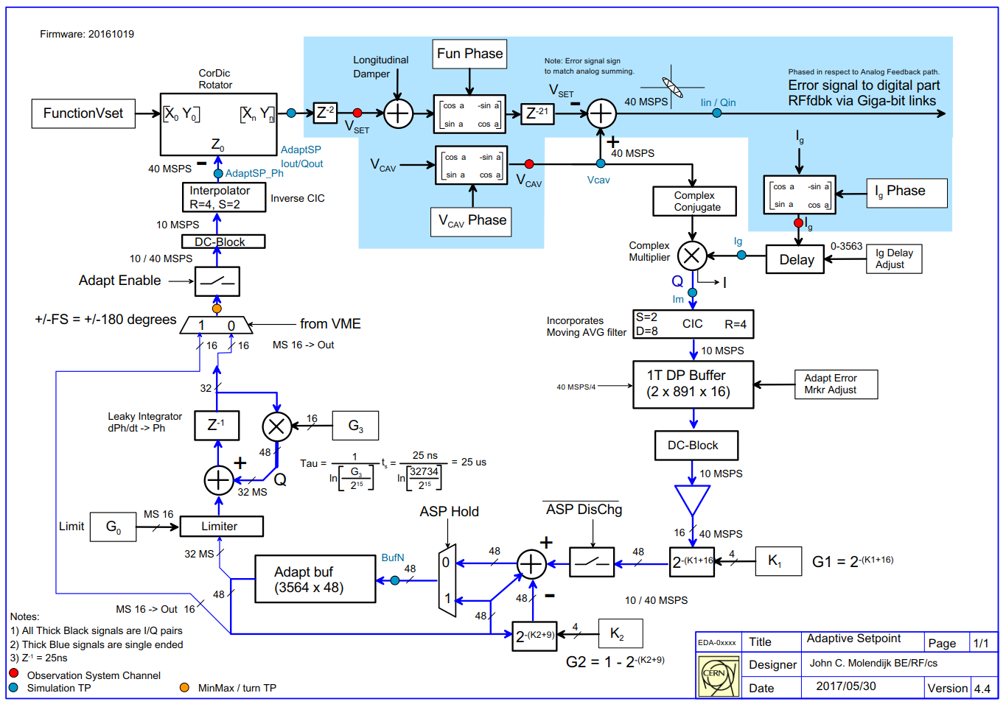
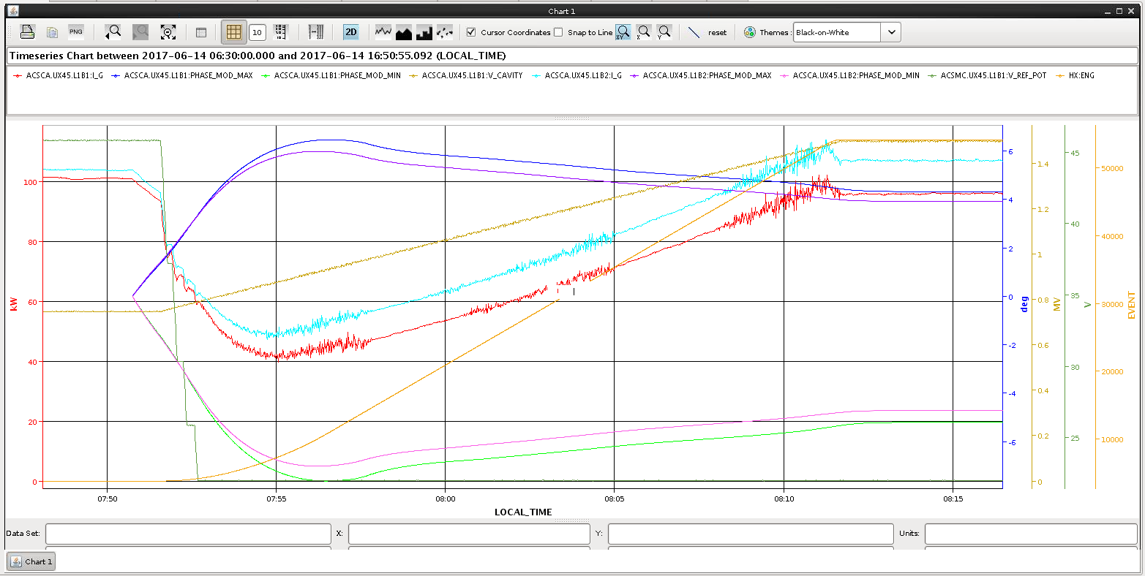
LHC Adaptive Set-point (Full Detuning)
Klystron power
Phase modulation
Algorithm switched ON before start of ramp
FPGA implementation of adaptive setpoint algorithm in SetPoint VME module
Operational in LHC in 2017: achieves a factor 2 reduction in klystron power
Power and phase modulation during LHC ramp
P. Baudrenghien, G. Hagmann, T. Mastoridis, O. Brunner et al.
Notes:
Algorithm developed by Themis and Philippe enabling ‘full detuning’ operation of the LHC cavities was implemented in FPGA by John Molendijk.
The algorithm is switched on at the end of filling and before the start of the ramp. The phase modulation takes a few minutes to settle, during which time we see the klystron power reduce. The power then increases through the ramp due to the increase in cavity voltage. At flat top the power along 1 turn is < half of what would previously be necessary.
Demonstrates the flexibility of digital LLRF with programmable logic: can survive a complete paradigm change!

Slide 15
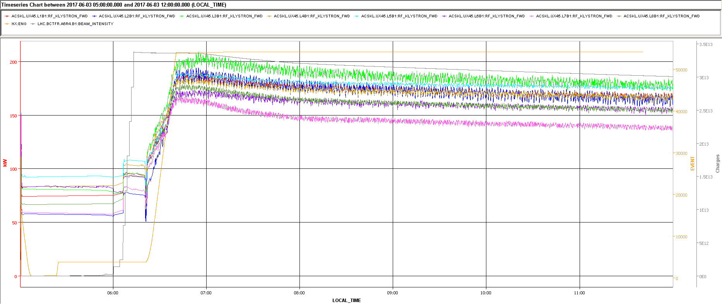
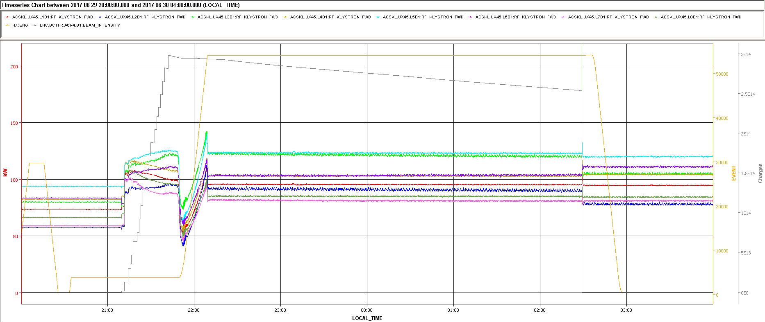
LHC: Phase modulation in production
Fill 5737
  old scheme
  power increases during ramp
  noise ripples caused by the beam/no beam transients
  power scales as beam current → 190 kW at 1.5 MV, 0.5 A DC
Fill 5887 (→ summer 2017 onwards)
  new scheme
  power independent of beam current
  very small power change following beam dump
  power scales quadratic with beam voltage → 104 kW at 1.5 MV, Q_{L}=60k
Beam gone..
Minimal change in power
Minimizes power required from klystron

Slide 16
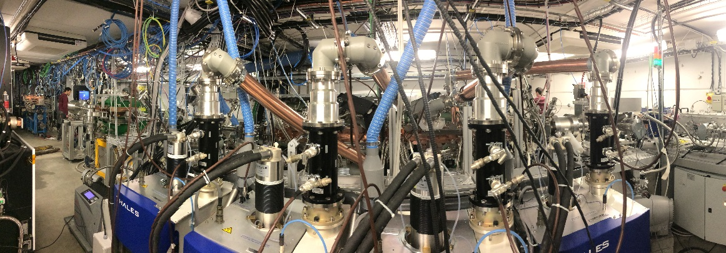
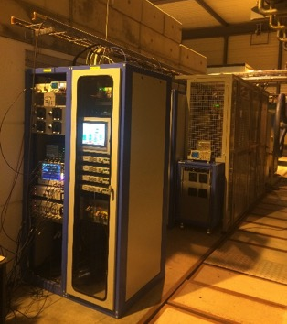
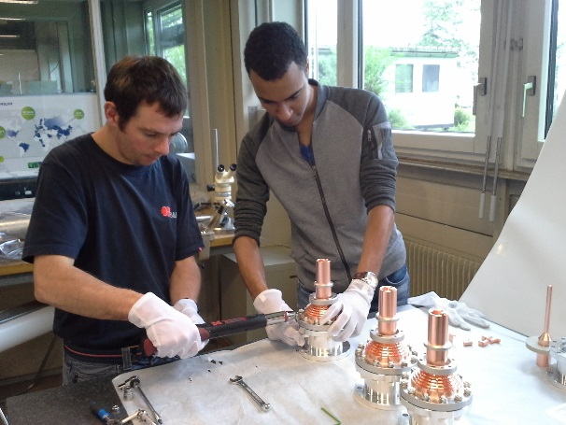
Medical RFQ amplifiers
Construction of the HPRF,
i.e. 4 * 100 kW IOT 20 µs - 200 Hz
@ 750 MHz
  Capacity charger and capacitor, HV cage, Grid – Focus – Ion pump supplies, RF drivers, PLC + Fast interlock, RFQ Conditioning system, Instrumentation, Four IOT and trolleys, RF lines, FPC
Started in March 2016, fully delivered to in June 2017, property transfer to ADAM in October 2017
The four IOT + RF lines + air cooling + FPC connected to the RFQ
The compact FPC with PEEK windows
The SSPA Drivers + HVPS + controls
E. Montesinos et al.

Slide 17
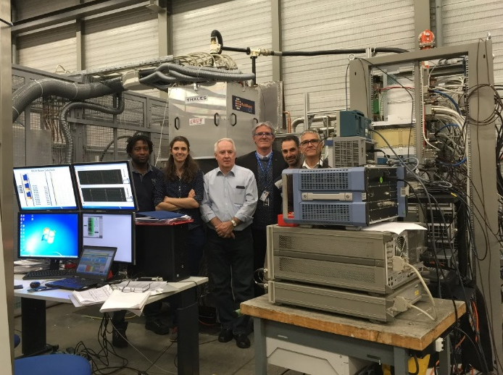
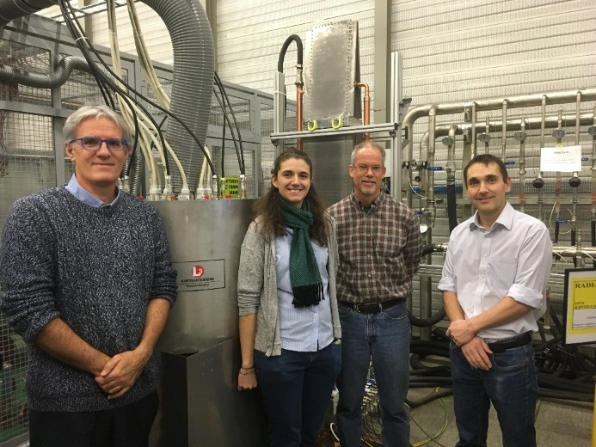
Multi Beam IOT (work for ESS)
CPI-Thales MB-IOT has performed 1.2 MW 4 ms – 14 Hz for few seconds before an output line vacuum internal default stopped the tests, it is under repair
The proof of feasibility has been made
Test bench completed in 2017, including
  Capacity charger, HV Capacitors 80 µF, HV cage, Grid – Focus – Ion pump supplies, LEP crowbar, RF drivers + cavity combiners, PLC + Fast interlock, Compact RIO, Instrumentation
CPI-Thales tube tested in June up to 1.2 MW 4 ms 14 Hz @ 704 MHz (tube failure after 1 hour, being repaired, test to restart soon)
L3 com tube tested in October up to 1.1 MW 4ms 14 Hz @ 704 MHz (Limited by Drivers and tube internal crowbar, test to restart soon)
L3 MB-IOT has performed 1.1 MW 4 ms – 14 Hz for an hour before a strong crowbar stopped the tests, Drivers have been damaged and are under repair, tests to restart soon
The proof of feasibility has been made
E. Montesinos et al.

Slide 18
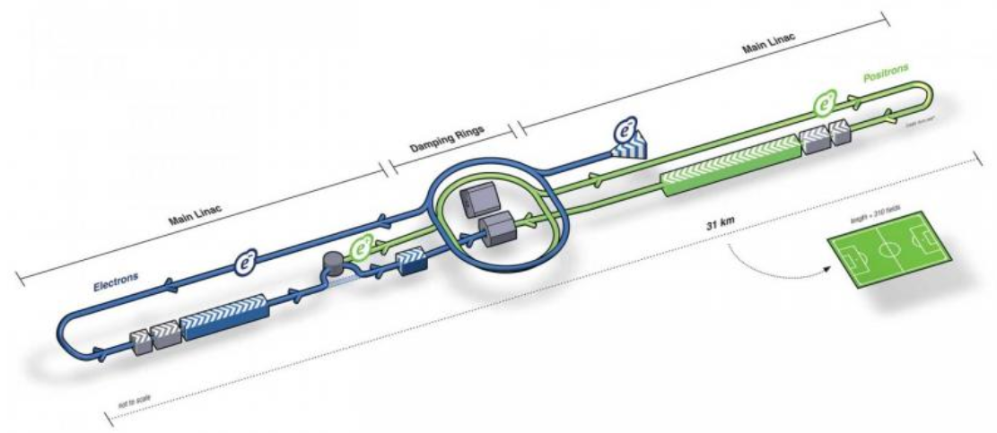
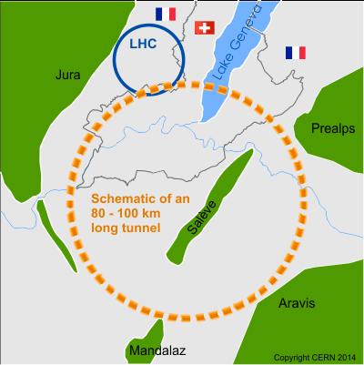
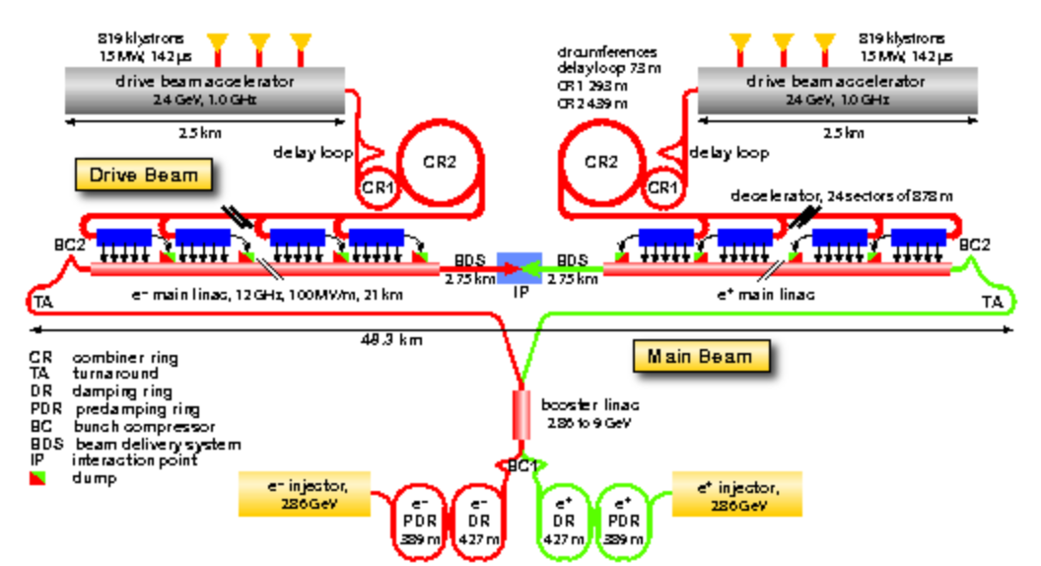
R&D to prepare the future of CERN some possible future colliders
0.5 TeV
ILC ^{e+e-}: Pulsed, 1.3 GHz, 500 GeV
3.0 TeV
FCC ^{ee}: CW, 0.4 & 0.8 GHz, up to 350 GeV
FCC ^{hh}: 0.4 GHz, 100 TeV!
CLIC ^{e+e-}: Pulsed, 1.0 GHz, 3 TeV

Slide 19
CLIC
Features:
High-gradient, 100 MV/m, acceleration for a shorter, less expensive linac
Nano-meter sized beams at the interaction for high luminosity
Two-beam rf power generation for efficient high peak power

Slide 20

3 TeV version of CLIC

Slide 21



Two 380 GeV versions: drive beam or klystrons

Slide 22



CLIC baseline accelerating structure
11.994 GHz X-band
100 MV/m
Input power ≈50 MW
Pulse length ≈200 ns
Repetition rate 50 Hz
HOM damping
waveguide
Micron–precision disk
25 cm
6 mm diameter beam aperture
W. Wuensch et al.

Slide 23


Prototype testing X-band - XBoxes
W. Wuensch et al.

Slide 24




X-band
Manufacturing ongoing
New CLIC improved prototype in productionTD26CC_R1 (4)
CLIC 380GeV prototype under fabrication TD31CC (4)
New company qualification and technology transfer with T24(2) and TD26CC_R1(1)
Crab cavity and deflectors for collaborations
VACUUM FLANGE
ALIGNMENT PIN
New designs for improved assembly
Cold copper halves design
Compact damping waveguides in rectangular disks
Improved components
Xboxes supports and modifications
Tooling, measurements etc.
COVER
HALF
COOLING CHANNEL
COOLING FITTING
WAVEGUIDE
W. Wuensch et al.

Slide 25

High-field vacuum arcs understanding the physics
Vacuum arcs – the formation of plasma accompanied by large electron currents - occur in many devices and applications.
What’s so special about us?
Very high surface electric fields, over 200 MV/m
Opportunity to test over 20 rf structures and over 40 pulsed dc electrodes combined with significant theoretical and simulation effort.
We believe that we see processes which give fundamental field limits for copper.
Data from T. Higo
ArcPIC simulations, K. Sjoebaek

Slide 26



Breakdown rate dependence on parameters – a physical model
Regularly observed dependence:
$$BDR∝E^{30}τ^{5}$$
Physical model based on defect formation
$$BDR∝\exp\left(\frac{−E_{f}+ε_{0}E^{2}ΔV}{k_{B}T}\right)$$
$$E_{f}≈0.8 eV$$
$$ΔV≈0.8×{10}^{−24} m^{3}$$
K. Nordlund, F. Djurabekova, Defect model for the dependence of breakdown rate on external electric fields, Phys. Rev. ST Accel. Beams 15, 071002 (2012)
Data taken in XBox-2 with TD26CC structure, T. Lucas
W. Wuensch, MeVArc 17

Slide 27



Breakdown rate understanding the physics
We operate a pulsed system, CLIC is 50 Hz, and the breakdown rate must be of the order 10⁻⁷ in the collider.
$$BDR∝E^{30}τ^{5}$$
Data from T. Higo
W. Wuensch, MeVArc 17

Slide 28

Recent test results
W. Wuensch, MeVArc 17

Slide 29



CLIC Technology – applications overview
Beam manipulation and diagnostics:
Energy spread linearizers and deflectors
Thompson/Compton scattering source
XFEL
Medical
Advanced acceleration
W. Wuensch et al.

Slide 30

High efficiency klystron research
Collaborative effort guided and coordinated by I. Syratchev
High Efficiency International klystron activity ²
2
J. CAI, CERN
C. Marrelli, ESS
A. Baikov, MUFA
D. Constable, Lancaster U
V. Hill, Lancaster U
G. Burt, Lancaster U
R. Kowalczyk, SLAC
Since 2013
I. Syratchev et al.

Slide 31




High efficiency! How high it could/should be!?
Igor’s outlook and challenges in efficiency reach with single beam klystron amplifiers.
We still might do it?
difficulty
New bunching technology
Common tubes, 95% of the market
Ultimate(space charge – free) limit
Reducing perveance
‘best’ existing tube
MBK
Depressed collector
Efficiency, %
Complementary technologies
Multi Beam technology. Reduced voltage and perveance. Cost and efficiency.
Gated Cathode (triode gun). No HV switches. Modulator cost and efficiency.
SC or PPM solenoid. Overall efficiency.
I. Syratchev et al.

Slide 32




High efficiency! How high it could/should be!?
Efficiency impact on operation cost
FCC ^{e+e-} at 50 Euro/MWh and 5000 hours/year:
1 year
Pulsed, 0.7 GHz,
92 MW
-10.7 M€
Excessive electricity bill, M€
-9.3 M€
37 MW, more than twice the overall cryogenic power needs
Efficiency, %
I. Syratchev et al.

Slide 33


CLIC 20 MW L-band Multi-beam pulsed klystron.
20 MW, 50 Hz, 150 sec
150 kW
180 kV
Modulator (η=0.9)
Energy storage
HV transformer
η_{Total} = 0.62
switch
Cathode
RF circuit (η=0.7)
Collector
60 KW
150 kW + 88 kW
Solenoid 4 KW
Lower (<60kV) voltage:
- 40 mini-cathodes
No oil tank (cost)
Shorter tube (cost)
Faster switching (efficiency/cost)
Permanent Magnets:
- No power consumption
- Potential cost reduction
Vs. SC solenoid:
- More expensive solution
Depressed collector (η=0.5)
New klystron RF circuit (η=0.9)
(+) Reduced Collector dissipation (16 kW)
New/advanced technology
Gated mini-cathode:
No switches (cost)
Modulator efficiency ~1.0
(+) Improved stability
η_{Total} = 0.95
Power from grid:
290 190 MW
I. Syratchev et al.

Slide 34







State of the art.
Commercial MBK (low perveance) tubes with high efficiency.
After many decades of development the klystron technology was considered to be saturated. The experimental results from hundred’s of different devices have shown that higher efficiency is associated with lower perveance. Accounting for technological and cost reasons (μK>0.2), the 75% efficiency was expected to be the utmost limit.
MBK TH1803
10 beams
21 MW
1.0 GHz
Klystron efficiency vs. perveance
73.5%
Optimised at CERN
23.04.2017
Recommended by industry
RF measurements with directional coupler.
I. Syratchev et al.

Slide 35


COM tubes with different numbers of stages:
Bunch saturation issues.
Optimised by 1D code KlypWin
Reaching high efficiency requires that ALL the electrons entering the output cavity should populate the bunch (useful part of RF period) leaving anti-bunch empty.
K=0.26
bunch
anti-bunch
To saturate the bunch, peripheral electrons should receive much stronger relative phase shift than the core electrons: non monotonic bunching. In the COM method the Core of the bunch experiences periodical Oscillations due to the space charge forces, whilst the peripherals approach the bunch centre monotonically. COM method requires very long length to achieve full bunch saturation.
I. Syratchev et al.

Slide 36



Bunch saturation issues.
Example of the ‘fully’ saturated bunch in COM tube (Tesla 2D code)
I. Syratchev et al.

Slide 37


















High efficiency klystrons.
New bunching technologies on one slide.
Core Oscillations Method (5.75 m)
Bunching Alignment Collecting, 2.44 m
133.8 kV, 12.55 A, 1.4 MW at 0.8 GHz, 80(+)%
COM
Core Stabilization Method
BAC
High Efficiency International klystron Activity
CSM_2L3B3, 1.88 m
CSM
igor.syratchev@cern.ch
CSM_23B1, 1.72 m
I. Syratchev et al.

Slide 38






Power conversion efficiency issues.
From the klystron text book:
“For the bunch entering output cavity, the good bunching (i.e., a high fundamental harmonic of the beam current) can only yield high conversion efficiency when the energy spread in stream is small.”
Example: power extraction efficiency from the bunched beam with I₁/I₀=1.75 and E _{min}=E₀ (monochromatic bunch) at the output cavity entrance. The beam and cavity parameters were taken from FCC COM tube.
$=\frac{1}{2}\frac{I_{1}}{I_{0}}{\left(\frac{E_{min}}{E_{0}}\right)}^{1/2}$ (1)
Output cavity F/Q _{Loaded} phase space. Fully saturated bunch 1D simulations with CERN in-house code (J. Cai)
Unstable area: bouncing/ reflected electrons
Zoom
85.3%
Equation (1)
F₀
Power conversion efficiency
Bunch deceleration in the output cavity F=1.00025xF₀
Fully saturated bunch
Simulations (J. Cai)
83.3%
85.3%
accelerated electrons
Modulation depth, I₁/I₀
In a ‘classical’ approach, the highest power conversion efficiency with fully saturated bunch does not exceed 87%.
Ez in the cavity
Gaussian ‘classical’ bunch
Fully saturated ‘rectangular’ bunch
I. Syratchev et al.

Slide 39



Power conversion efficiency issues.
quick optimisation
89.4%
I₁/I₀=1.75
Ultimate high power conversion efficiency conditions:
To avoid migration of the electrons from bunch to anti-bunch during deceleration in the output cavity, the incoming bunch with non-zero length should have certain velocity dispersion: Congregated Bunch, when the leading electrons are slower than the tailing ones.
For the full deceleration, the congregated bunch should be gradually transformed at the cavity exit into monochromatic bunch with least velocity.
bouncing electrons
Equation (1)
congregated
Power conversion efficiency
saturated
‘classical’
Modulation depth, I₁/I₀
I. Syratchev et al.

Slide 40









Power conversion efficiency. Limiting factors.
Example of HE CSM tube (full 3D CST simulations).
Bunch Radial Stratification
Efficiency 80%
BRS is an effect when the bunch length shows radial dependence.
It appears as a result of intrinsic radial imbalance between cavities RF impedance and the space charge forces of the beam.
In 2D simulations this effect is the major source of reflected electrons generation that are not predicted in 1D simulations.
We are not inefficient (2D vs. 1D), we simply cannot go higher – the reflected electrons collapse power generation.
Bouncing (re-accelerated) electrons
Harmonic current (bunch length) at different radii.
Applegate diagrams for the electrons emitted at different radius:
r=0
r=0.5 R _{beam}
r=0.9 R _{beam}
I. Syratchev et al.

Slide 41







COM tube. 8_04_XX series of 10 optimised tubes.
Frequencies scattering
MAGIC (PIC)
8_04_08; Eff. = 84.62%
Klys2D (Thales), 81.6%
Drifts scattering
Cavity 7 Volts
Replacing cylindrical beam by hollow beam efficiency is further increased up to 86%
Cavity 8 Volts
08_04_08
BRS effect is almost mitigated!
08_04
I. Syratchev et al.

Slide 42






CSM tube. Second Generation. Tube length 1.72 m at 0.8 GHz.
Saturation curve (MAGIC 2D)
85.7%
I. Syratchev et al.

Slide 43




We have developed special procedure (GSP/PSP) which allows to scale the frequency, power, perveance, voltage, number of beams etc., and to preserve the bunching quality of the original tube:
GSP/PSP
0.8 GHz, 133.9 kV, 12.551 A, K=0.263
0.704 GHz, 110 kV, 15.272 A, K=0.42
Length 1.72 m
Length 1.4 m
Expected efficiency reduction (AJDisk) 1.9%.
I. Syratchev et al.

Slide 44






HL-LHC: Crab Cavities for SPS test
R. Calaga, A. Macpherson et multi al.
2017, A year of milestones
  2 bare cavities: Processed & RF validated at 2K
  2 dressed cavities: Preparation & cleanroom assembly
  Cold test of dressed cavity at 2K
  Cleanroom string assembly of 2 dressed cavities
  Crab LLRF functionality: Validation at 2K with BE-RF-FB
  Complete refurbishment of SM18_M7 test bunker
  Cold test of SPS cryomodule in M7 (with limited RF)

Slide 45





HL-LHC: Crab Cavities for SPS
R. Calaga, A. Macpherson et multi al.
Bare Cavity Validation
String Assembly
Preparation
Dressed Cavity Testing
Cryomodule Cold Test

Slide 46




HIE ISOLDE cavities, cryomodules and linac commissioning for 2017 physics run
Breakthrough! Seamless Cavities
W. Venturini, K. Schirm et al.
CM4 assembled and ready for installation in HIE ISOLDE
HIE ISOLDE 2017
physics run with 3 CM
Courtesy BE-OP
12 RIB experiments done
8 MeV/u achieved
Excellent SRF availability
20 QWR produced, qualified and installed in the 4 HIE ISOLDE CMs

Slide 47
Nb₃Sn sputtered films for SRF
Advantages
Challenges
High critical temperature
Low BCS resistance
Stoichiometry control (Sn At% 19-26 %) [1]
Requires high temperature treatment
Limited range of annealing temperatures
Substrate importance
Tc | Nb₃Sn ~ 18.3 K
 | Nb ~ 9.3 K
R_{BCS} @ 4.2K and 500MHz | Nb₃Sn ~ 0.4 nΩ
 | Nb ~ 45 nΩ
[1] J. Charlesworth, I. MacPhail, and P. Madsen, J. Mater. Sci. 5, 580 (1970).
K. Ilyina et al.

Slide 48








Coating by magnetron sputtering
Reacted After Coating
Reacted After Coating
Reacted After Coating
Reacted During Coating
Reacted During Coating
Reacted During Coating
Coating parameters:
Coating gas: Ar or Kr
Coating pressures:
7·10⁻⁴ mbar … 5·10⁻² mbar
Composition:
Sn 20 At% to 27 At%,
07-Dec-2017
07-Dec-2017
Annealing temperatures | 600 - 800ºC
Annealing time | 24 h… 72 h
Coating temperatures | 600 - 735ºC
Alternative Additional Annealing | 24 h… 72 h
48
K. Ilyina et al.

Slide 49




Results: films reacted after coating
A15 phase formation. XRD analysis & Morphology
A15 phase confirmed by the presence of Nb₃Sn characteristic peaks of (200), (210), (211) … (332)
Absence of non-superconducting phases NbSn₂, Nb₆Sn₅
100 nm
100 nm
K. Ilyina et al.

Slide 50


Results: films reacted during coating
A15 phase confirmed by the presence of Nb₃Sn characteristic peaks of (200), (210), (211) … (332)
Absence of non-superconducting phases NbSn₂, Nb₆Sn₅
FIB
Pt
SEM
Nb₃Sn
200 nm
Cu
100 nm
K. Ilyina et al.

Slide 51

Results: Critical temperature
How to increase $T_{c}$?
Composition
Films of Nb₃Sn on copper substrate
Reacting AFTER /DURING coating
High temperature treatment duration
Additional Annealing
[2] A. Godeke. Supercond. Sci. Technol., 19 (2006) R68-R80
K. Ilyina et al.

Slide 52

Proposed improvement: intermediate layer
Idea:
Works as “buffer” layer to reduce residual stresses in the films (to solve cracking problem
for the films reacted AFTER the coating)
Decrease lattice mismatch, i.e. improving crystalline lattice order (to avoid $T_{c}$ depression) [4]
Diffusion barrier layer (to prevent copper interdiffusion into Nb₃Sn layer)
Possible candidates – Nb, Ta, Al₂O₃
[4] Hein. The A15 story. The Science and Technology of Superconductivity, pp 333-372
K. Ilyina et al.

Slide 53
Preliminary results with Ta layer: encouraging
K. Ilyina et al.

Slide 54
Summary
The RF R&D at CERN is very diverse
A large part reflects the necessity to go beyond present-day performance of existing accelerators – for the LHC and its injectors in particular this means larger intensity to reach higher luminosity.
There is a clear trend visible to replace vacuum tubes by solid-state wherever possible.
Preparing the future of accelerator-driven High-Energy Physics requires intensive R&D on new technologies (CLIC technology for high-gradient normal-conducting linacs operating in pulsed mode, superconducting RF for circular colliders running in continuous mode)
Thank you very much!

