Slide 1

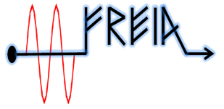
Test plan of
ESS HB elliptical cavity
Han Li
On behalf of FREIA team
FREIA Laboratory, Uppsala University
31th of Dec. 2017

Slide 2
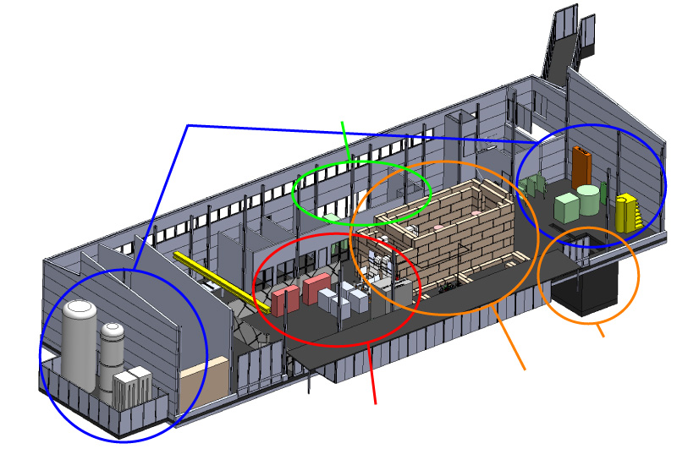
FREIA Infrastructure
LHe cryo-plant
The bunker
704 MHz klystron
PPT modulator
RF switchboard, transfer lines, circulators, loads, etc.
Horizontal cryostat (HNOSS)
Deionized cooling water system
Radiation monitoring system
Oxygen deficiency detectors
RF leakage detectors
Weather station (temperature, humidity, pressure in the hall)

Slide 3
Prepare at FREIA
1.RF source:
Modulator : reach full power, full pulse length and 14 Hz repetition rate （change to PPT ）
RF circulator: will be tested with the klystron
RF directional coupler: coupling factor (60dB) Directivity(40 and 30 dB)
RF distribution: doornob will be installed soon
Klystron:will be shipped to FREIA in Januanry 2018
2. Cryogenic:
Cooling capacity: 140W at 4K and 90W at 1,8 K
LN₂ cooldown: around 21.5 hrs at last run
LHe cooldown: 4.48K/min at last run (as fast as possible from CEA suggestion )
System static heat load(without cavity and related piping): 1W
Pressure sensor: two pressure sensors used to cross-check at 2 K tank
Temperature sensors location: 8 sensors is connated with the cavity

Slide 4
3. LLRF:
  All subsystems connected to EPICS
  PLC for slow control (water, vacuum, interlocks, radiation protection)
  µTCA LLRF and timing (LU)
  cRIO for fast interlocks (programmed in LabVIEW)
  Almost all data archived using archive appliance (and CS-Studio archiver as backup)
  CS-Studio BEAST alarm server
  CS-Studio BOY as a primary user interface
Lund LLRF system:
  Different runing modes have been tested
  Different rising time (within 300us) and pulse length is available
  Different repetition rate is available
  Tuner feedback system is not available currently
  SEL:
  A pulse mode at high power level has been tested at last run
  Developed digital phase shifter and gain-controller
  Base on LabView: connect most of the laboratory instruments (oscilloscopes, signal generators, spectrum analyzers, power meters, vector network analyzer)
  NI PXIe fast data acquisition (10 channels, 250 Ms/s, input bandwidth 800 Mhz, Self Exited Loop)

Slide 5
  4.Interlocks
    Arc detectors
    Multipacting detectors (threshold)
    Vacuum levels (threshold/ADC)
    Radiation monitors ( more monitors or test from ESS)
    Quench detector
  5.Software
    Developed an coupler auto conditioning system in LabView.
    ( different pulse length, power level and repetition rates are available)
    Developed SEL control and data acquisition system in LabView.
    Developed frequency tracing and data acquisition system in LabView.
    Developed dynamic Lorentz force detuning in LabView.

Slide 6
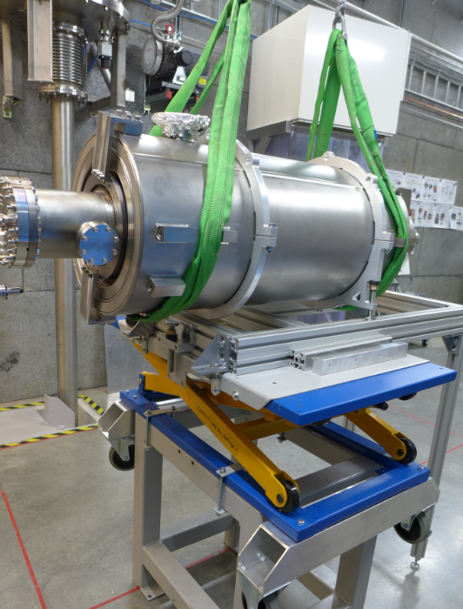
RF Test Goals
The test of HB elliptical cavity has the following goals:
  verify cooling procedures,
  verify power coupler conditioning procedure, coupler ability and performance,
  verify cavity intrinsic ability, accelerating performance, mechanical behaviour,
  verify LLRF ability and performance,
  verify the high power RF amplifier ability and performance in combination with the cavity and LLRF,
  verify cold tuning system (CTS) ability and performance,
  achieve nominal RF pulse.
Typical measurements:
  RF behaviour during cool down,
  Coupler conditioning and cavity package conditioning,
  Achieve maximum gradient,
  Cryogenic heat loads,
  Loaded Q-factor, eigen and external Q, Q₀ = f(E) curve,
  Dynamic Lorentz detuning and mechanical modes,
  Field emission onset and multipacting barriers,
  Sensitivity to helium pressure fluctuations,
  Tuning sensitiviy.

Slide 7
The list of tests
( in some order of priority )
Central cavity frequency (warm and cold)+
Loaded Q (basically measurement of the 3 dB bandwidth) +
Q0 (calorimetric measurement) +
Max gradient +
Dynamic Lorentz force detuning +
Tuning range of the slow step tuner +
Compensation for the dynamic Lorentz force detuning with the fast piezo tuner -
Stabilization of the cavity field with LLRF using both RF and piezo tuner compensation -
Onset and level of field emission +
Sensitivity to helium pressure fluctuations +
Multipacting +
Cryo related test both at 4 K and 2 K +
Overall test of electronics. - +
Stabilization of the cavity field with LLRF using only RF compensation - +

Slide 8
Warm test | Cool down | Cold test | Warm up
Central cavity frequency and spectrum of HOM Qe | Frequency shift due to cool down | Coupler cold conditioning | Frequency shift vs. T
 |  | Cavity conditioning
 |  | Central frequency Loaded Q and Qe
Coupler warm conditioning
 |  | Cavity level profile: let the LHe evaporate to low levels Effect of CV105 in heat load Cavity's power limit Effect of different FPC cooling temperatures in heat load Max load on the 2K pumps
 |  | Q0 Dynamic heat load Max gradient Dynamic Lorentz force detuning
 |  | Stabilization of the cavity field with LLRF using only RF compensation Dynamic Lorentz force detuning Tuning range of the slow step tuner
 |  | Tuner related testing
CRYO
VNA
SGD
signal
generator driven
SEL
Lund system
Lund university

Slide 9
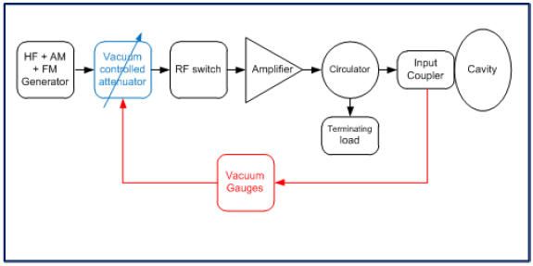
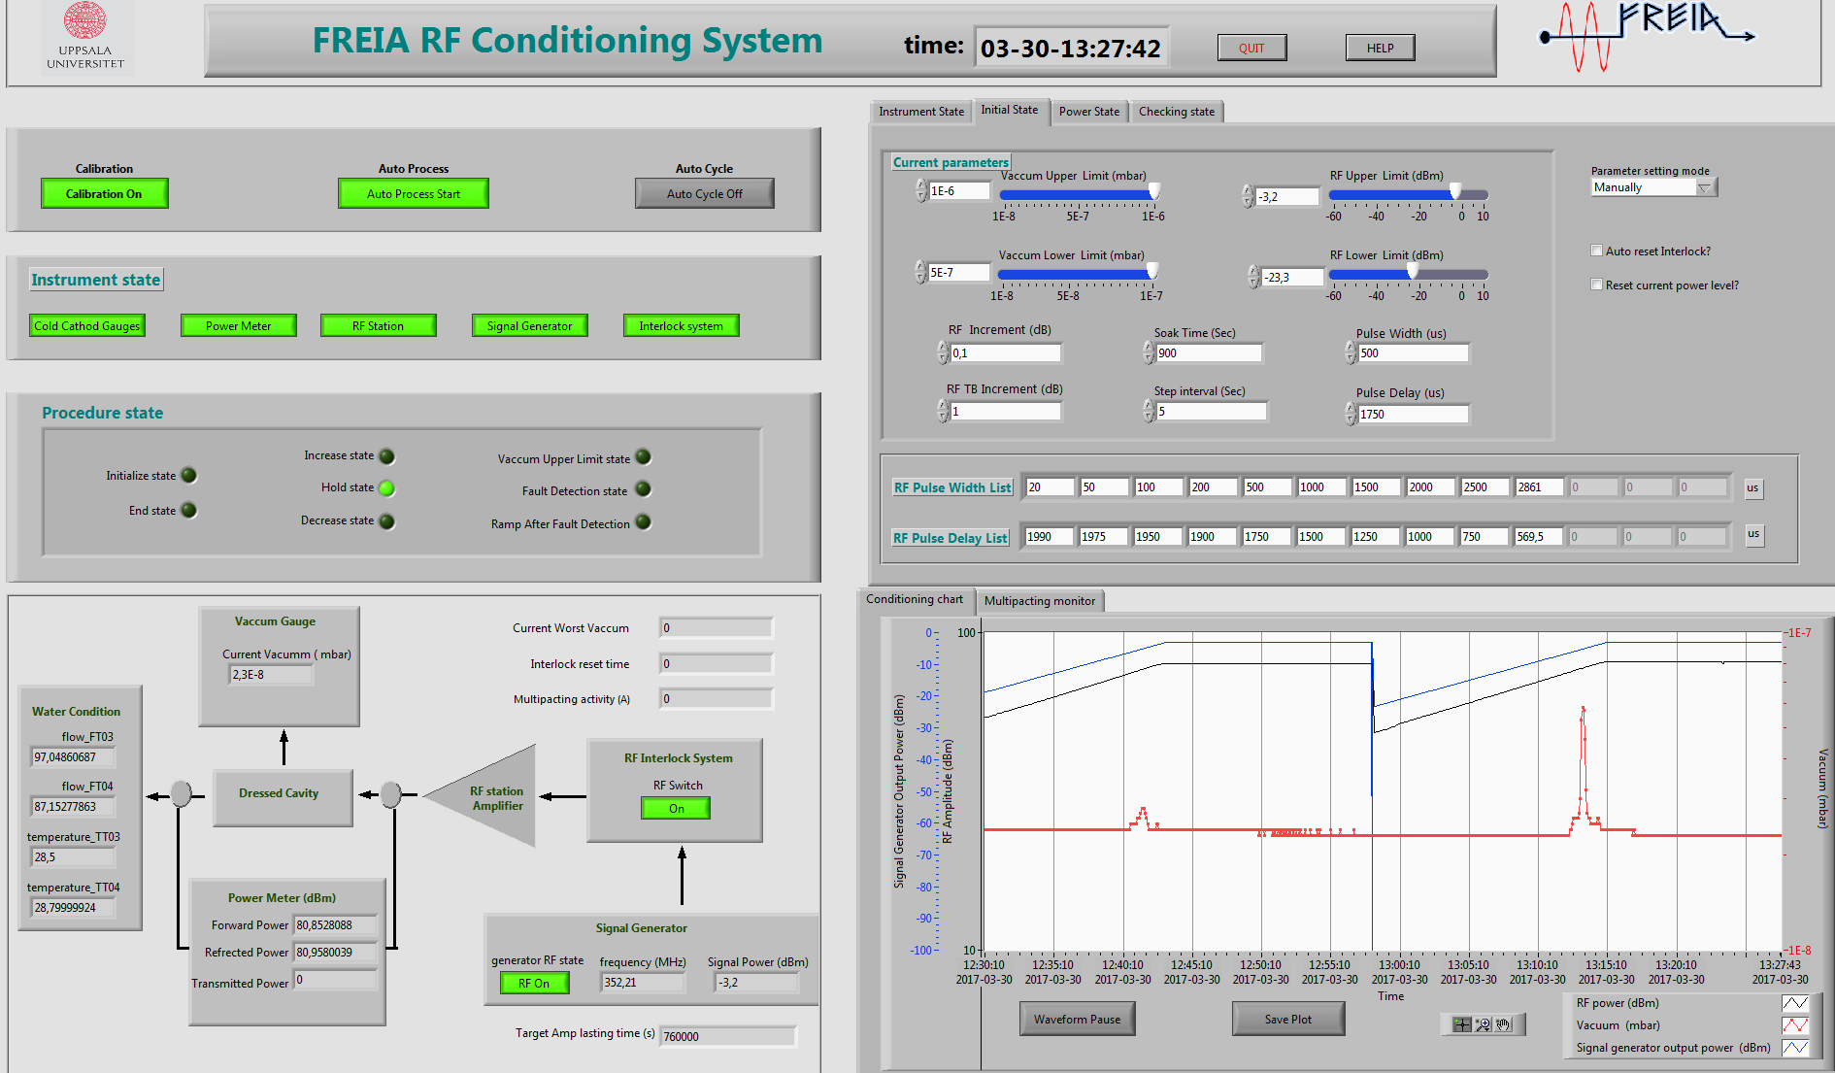
FPC conditioning
FREIA conditioning program
  Conditioning software has been tested with ESS spoke cavity
  Several repetition rates are available
  (1Hz, 2Hz, 3.5Hz, 7Hz, 14Hz,)
  Key paremeters setting are following CEA’s suggestion, like interlock thresholds and vacuum thresholds.
Parameter | value
Loop control time (s) | 1
Pulse repeat rate (Hz) | 1,14
Vacuum upper limit (mbar) | 1e-6 ?
Vacuum lower limit (mbar) | 5e-7 ?
RF upper limit (KW) | 1000 ?
RF lower limit (KW) | 0,1 ?
Initial pulse length (µs) | 20 ?
pulse length step | 20 µs, 50 µs, 100µs, 200 µs, 500 µs, 1 ms, 1.5 ms, 2 ms, 2.5 ms, 2.86 ms

Slide 10

Conditioning procedure
1. RF Calibration
• Time Domain Reflectometer (TDR) cables check
• Directional Couplers/ Circulators: get calibration data
• Calibrate RF power measurement cables/devices at 704.42MHz
• Make RF calibration summary table
2. Technical Interlock/Sensors
•Check the sensors (vacuum, arc detector, electron detector ,water flow, temperature, etc)
• Validation of RF switch
• Set the hardware interlock thresholds
• Set the forward power hardware limite /interlock if need
3. RF source/Waveguides/LLRF
• RF station (Klystron)/LLRF check on the load
• Waveguides visual check
• System check check at low power
4. Conditioning software
• Validation of software arithmetic
• Validation of the communication between EPICS and Labview
• Set conditioning initial parameters
• Validation of data aquisition

Slide 11
Conditioning procedure (cnt.)
5. Coupler conditioning at warm
• Start with low pulse duration
• Start with low RF amplitude
• Auto cycle at the nominal power length and amplitude
• Monitor the field in the cavity
6. Cooldown to 2 K
7. Cryo check
• Check and monitor the helium flow for the coupler cooling
8. Coupler conditioning at cold (on/off resonance)
• Tune/detune the cavity. Frequncy sweeping around the resonant frequency at low power first ( only for ”on resonance conditioning”).
• Start with low pulse duration
• Start with low RF amplitude
• Auto cycle at the nominal power length and amplitude
• Continiuelly running on the nominal pulse length and amplitude for several hours.

Slide 12
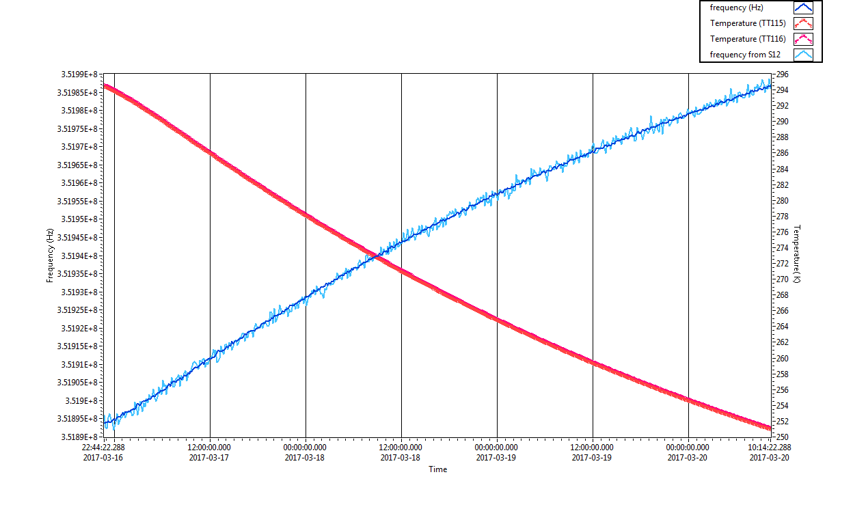
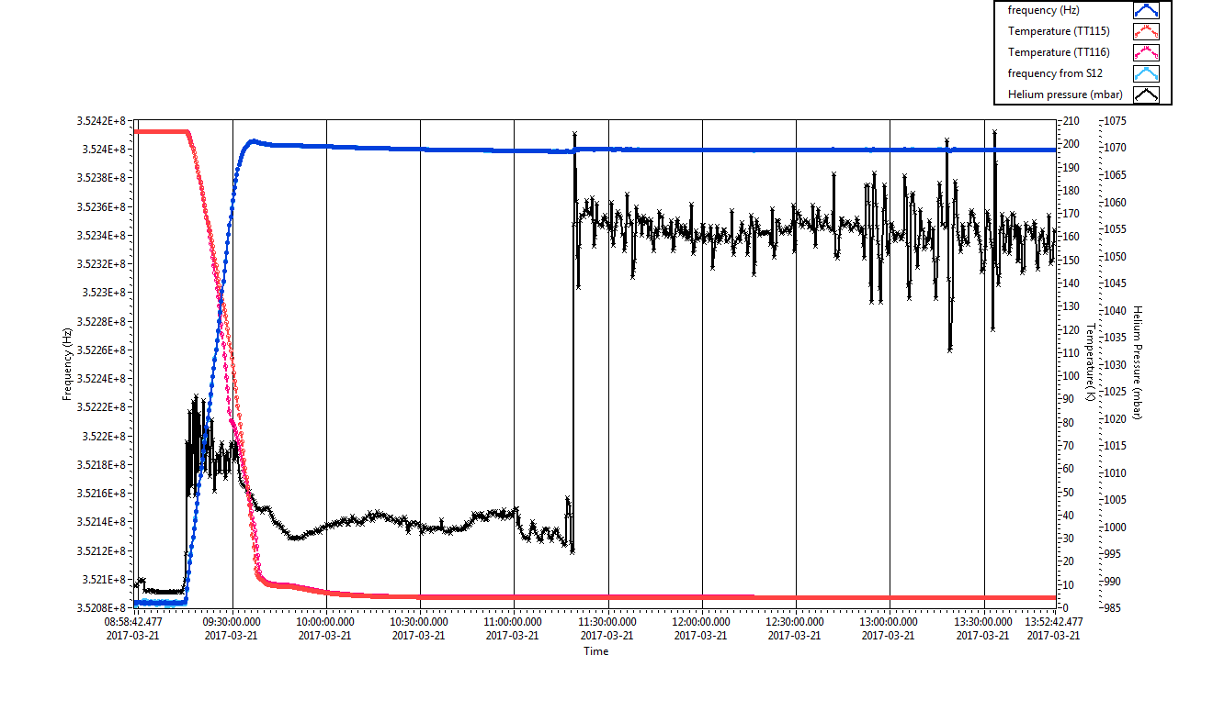
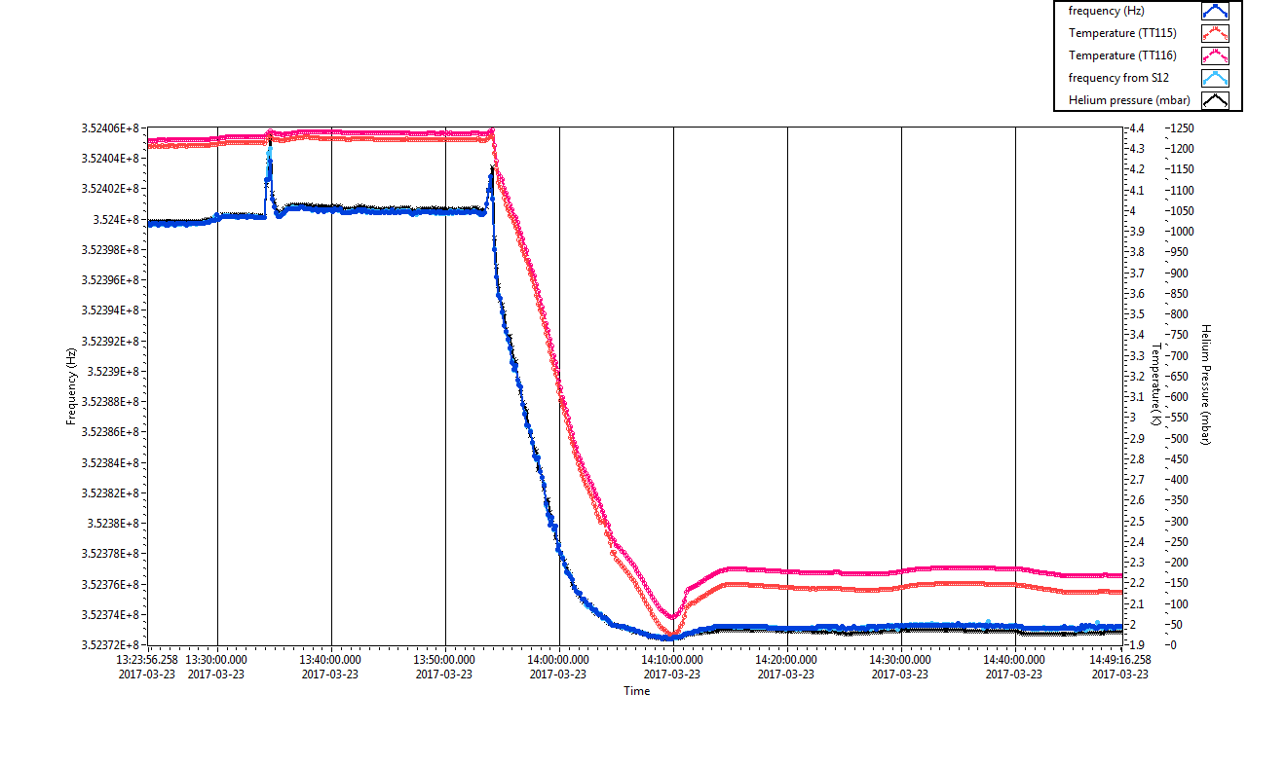
Frequency checking
Frequency checking during cool down to study the cavity behavior
  Key frequencies at certain temperature
  Frequency shift
  Pressure sensitivity.

Slide 13
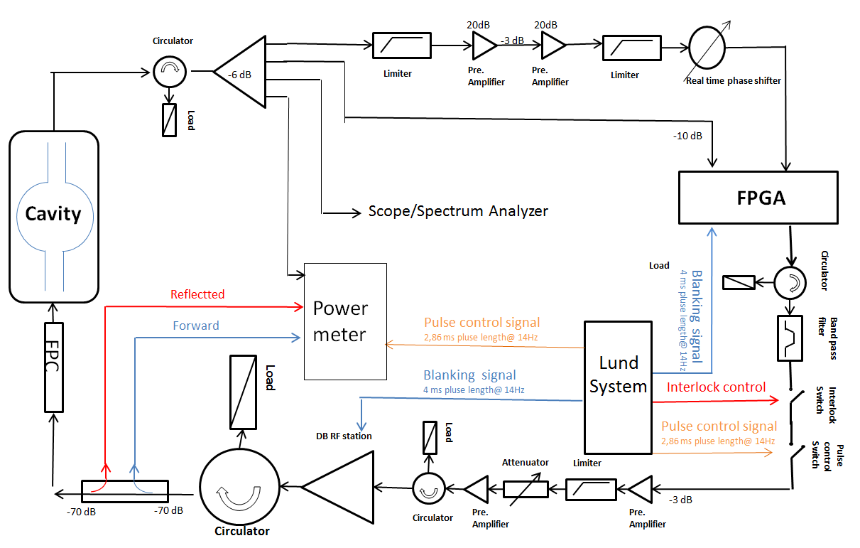
The Self-excited Loop Test Stand (I)
FREIA developed a test stand based on SEL for superconducting cavities under a pulse mode test at high power level.
Help with the determination of cavity performance without tuner feedback system.
FREIA SEL block diagram

Slide 14
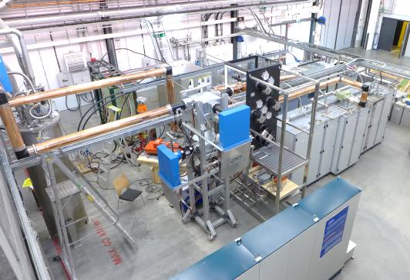
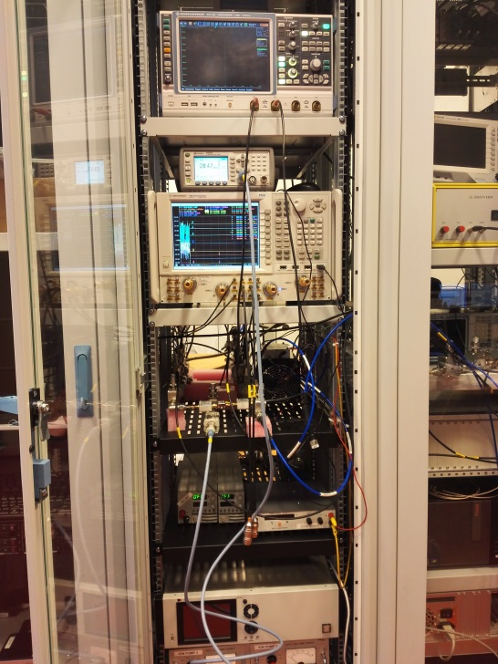
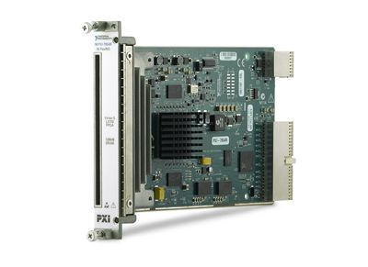
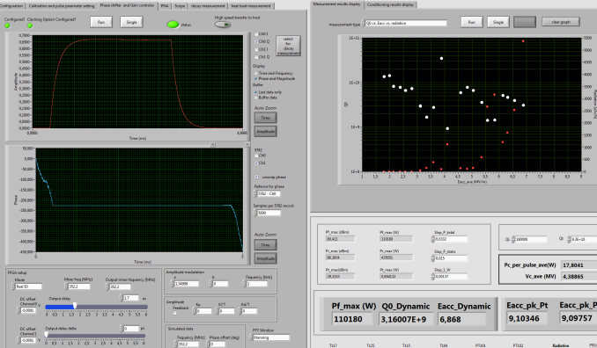
The Self-excited Loop Test Stand (II)
Developed digital phase shifter and gain-controller.
Introduce interlock system for safety consideration.
Introduce RF switch in order to manage a pulse operation mode.
Developed SEL control and data acquisition system in LabView.
Interlock and RF switch
RF station
SEL loop installed into a cabinet
FPGA
FREIA Labview SEL control system

Slide 15
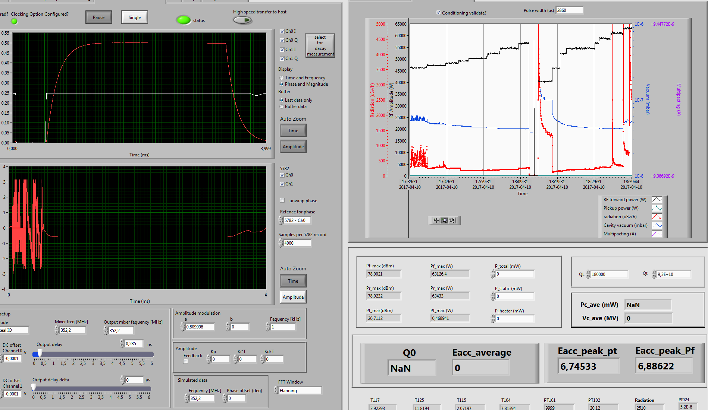
Cavity conditioning
Cavity package conditioning will use FREIA pulse SEL,
Auto conditioning program base on Labview will be applied, which has sucessfully implemented in the conditioning of spoke packege,
2.86 ? ms pulse with 1 and 14Hz repetition rate will be used,
Major multipacting regions and FE regions will be found
Contorl screem of pulse SEL at FREIA

Slide 16
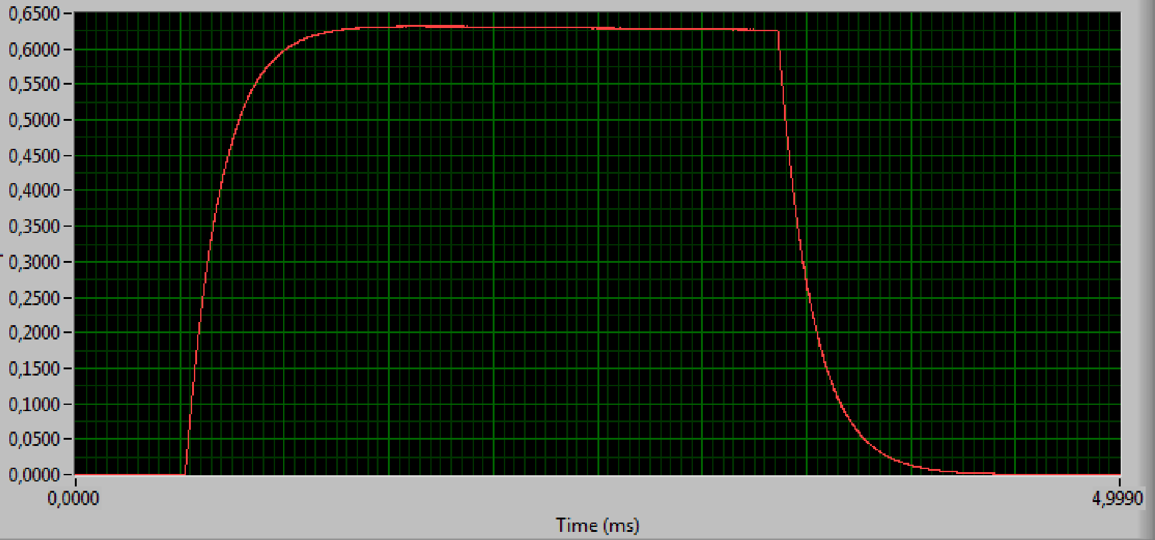

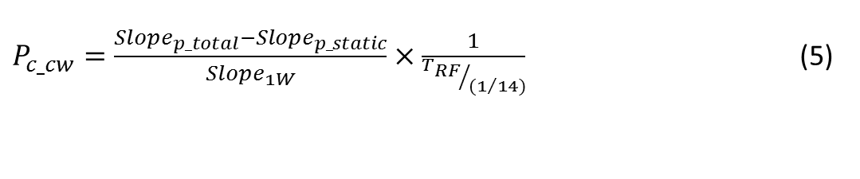


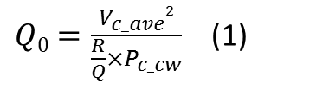
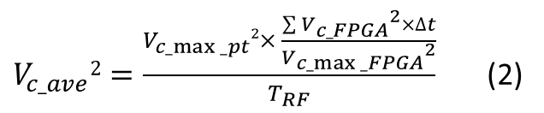
Q0 measurement (I)
Q factor measurement
$$2,86 ms$$
$Q0=\frac{V_{c_ave}2}{\frac{R}{Q}×P_{c_cw}}$ (1)
$\frac{R}{Q }$ = 435 Ω
$V_{c_ave}2=\frac{V_{c_max⁡_pt}2× \frac{\sum{{V_{c_FPGA}}^{2}}×∆t}{{V_{c_max⁡_FPGA}}^{2}}}{T_{RF}}$ (2)
$$T_{RF}$$
$V_{c_max⁡_pt}2$ $=$ R/Q$×Q_{t}×P_{t_max}$ (3)
$$T_{RF}=2,86 ms (4)$$
$P_{c_cw}=\frac{{Slope}_{p_total}−{Slope}_{p_static}}{{Slope}_{1W}}×\frac{1}{{T_{RF}}/{{(1}/{14)}}}$ (5)
$P_{c_dynamic}=\frac{{Slope}_{p_total}−{Slope}_{p_static}}{{Slope}_{1W}}$ (6)

Slide 17
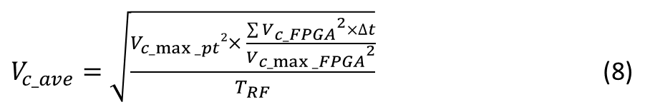

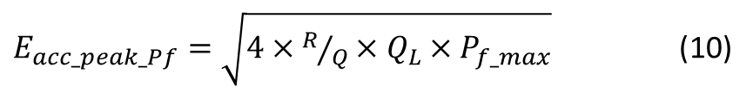
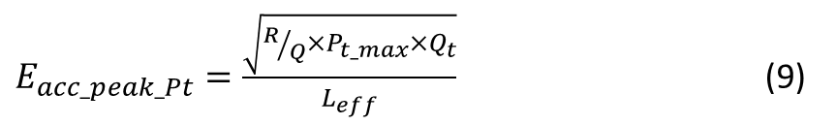

Q0 measurement (II)
Gradient measurement
$E_{acc_ave}=\frac{V_{c_ave}}{L_{eff}}$ (7)
$L_{eff }$=0,915 m
The limit gradient could be set to 15 MV/m for all tests. Once all tests are done, it might be possible to increase the gradient up to the quench
$V_{c_ave}=\sqrt{\frac{V_{c_max⁡_pt}2× \frac{\sum{{V_{c_FPGA}}^{2}}×∆t}{{V_{c_max⁡_FPGA}}^{2}}}{T_{RF}}}$ (8)
$E_{acc_peak_Pt}=\frac{\sqrt{{{R/Q×P}_{t_max}×Q}_{t}}}{L_{eff}}$ (9)
$E_{acc_peak_Pf}=\sqrt{4×R/Q×Q_{L}×P_{f_max}}$ (10)

Slide 18
Dynamic heat load
Two different methods of dynamic heat load measurements to cross check the cavity performance:
  liquid helium evaporation
  (measured via the flowmeter placed after the sub-atmospheric pumps)
  the pressure rise method
The cavity package dynamic dissipated power at 15 MV/m with 4% duty cycle first.
Eacc (MV/m) | dynamic RF load (W) | Test run | Test method
9 | 10.71 | 1st run 2017-4-13 | Flowmeter
8.98 | 13.16 | 2nd run 2017-4-25 | Flowmeter
8.98 | 13.35 | 2nd run 2017-4-25 | Pressure rise
9.1 | 11.74 | 3rd run 2017-4-26 | Pressure rise
(Comparison of dynamic heat with two different methods ,Romea, 2017)

Slide 19
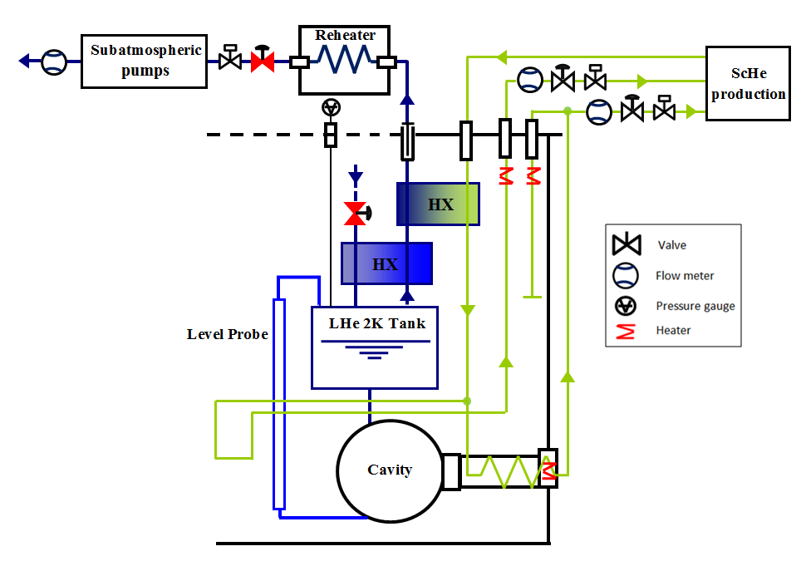
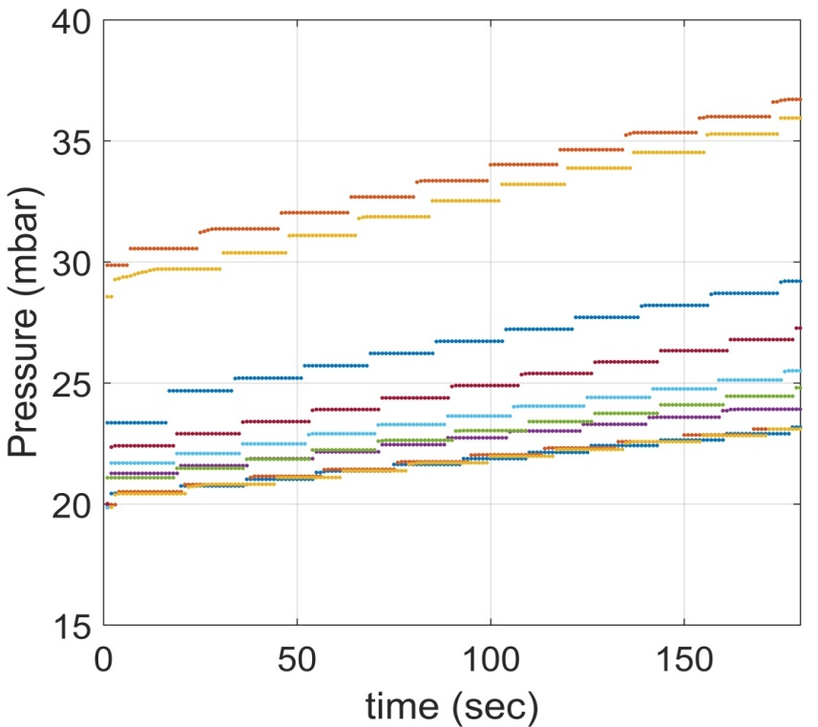
Q₀ measurement (I)
Calorimetrical measurement of Q₀
  The level in the 2K tank was kept between 60% and 80%
  Apply a known amount of resistive heat to the helium
  Close inlet and outlet valves of the cryostat
  Record the pressure as a function of time for three (3) minutes
LHe inlet
LHe outlet
Cavity
Heater
Pressure curve vs Applied Power for spoke

Slide 20
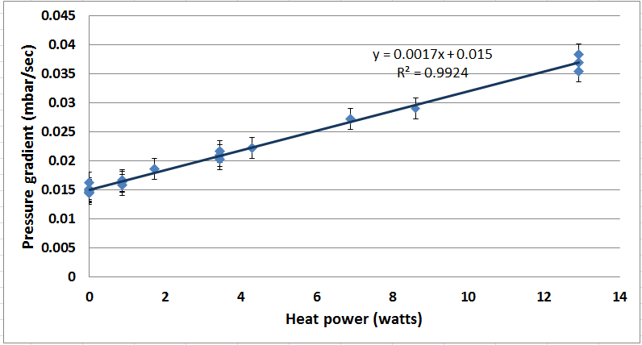
Q₀ measurement (II)
Calorimetrical measurement of Q₀ cont.
  Build the calibration curve: the rate of pressure rise vs. heat
  Load apply RF to the cavity and the system was left to stabilise only in pressure, record the pressure rise
  Calculate the dynamic RF load using the calibration curve
P_{m} = m*W+c
Dissipate power calibration curve

Slide 21
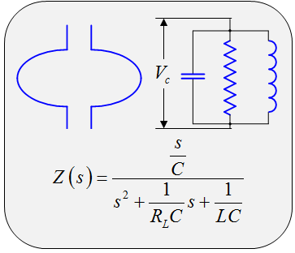
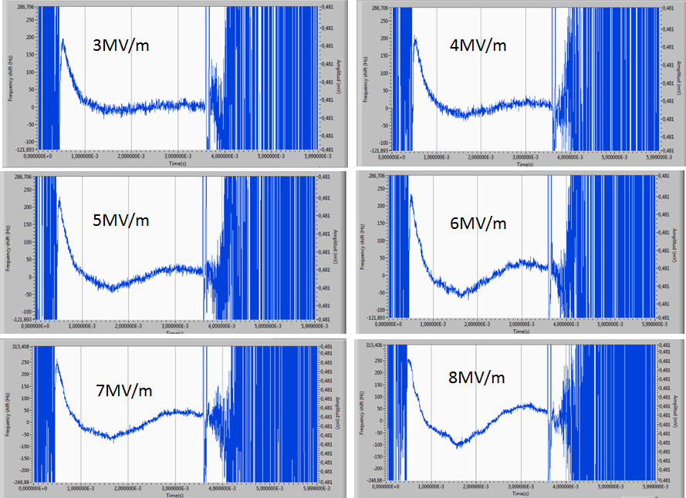
Dynamic Lorentz Force detuning (I)
Monitoring and manipulating the complex signal from cavity during the pulse, dynamic Lorentz force detuning at different gradient could be studied.
state space equation

Slide 22
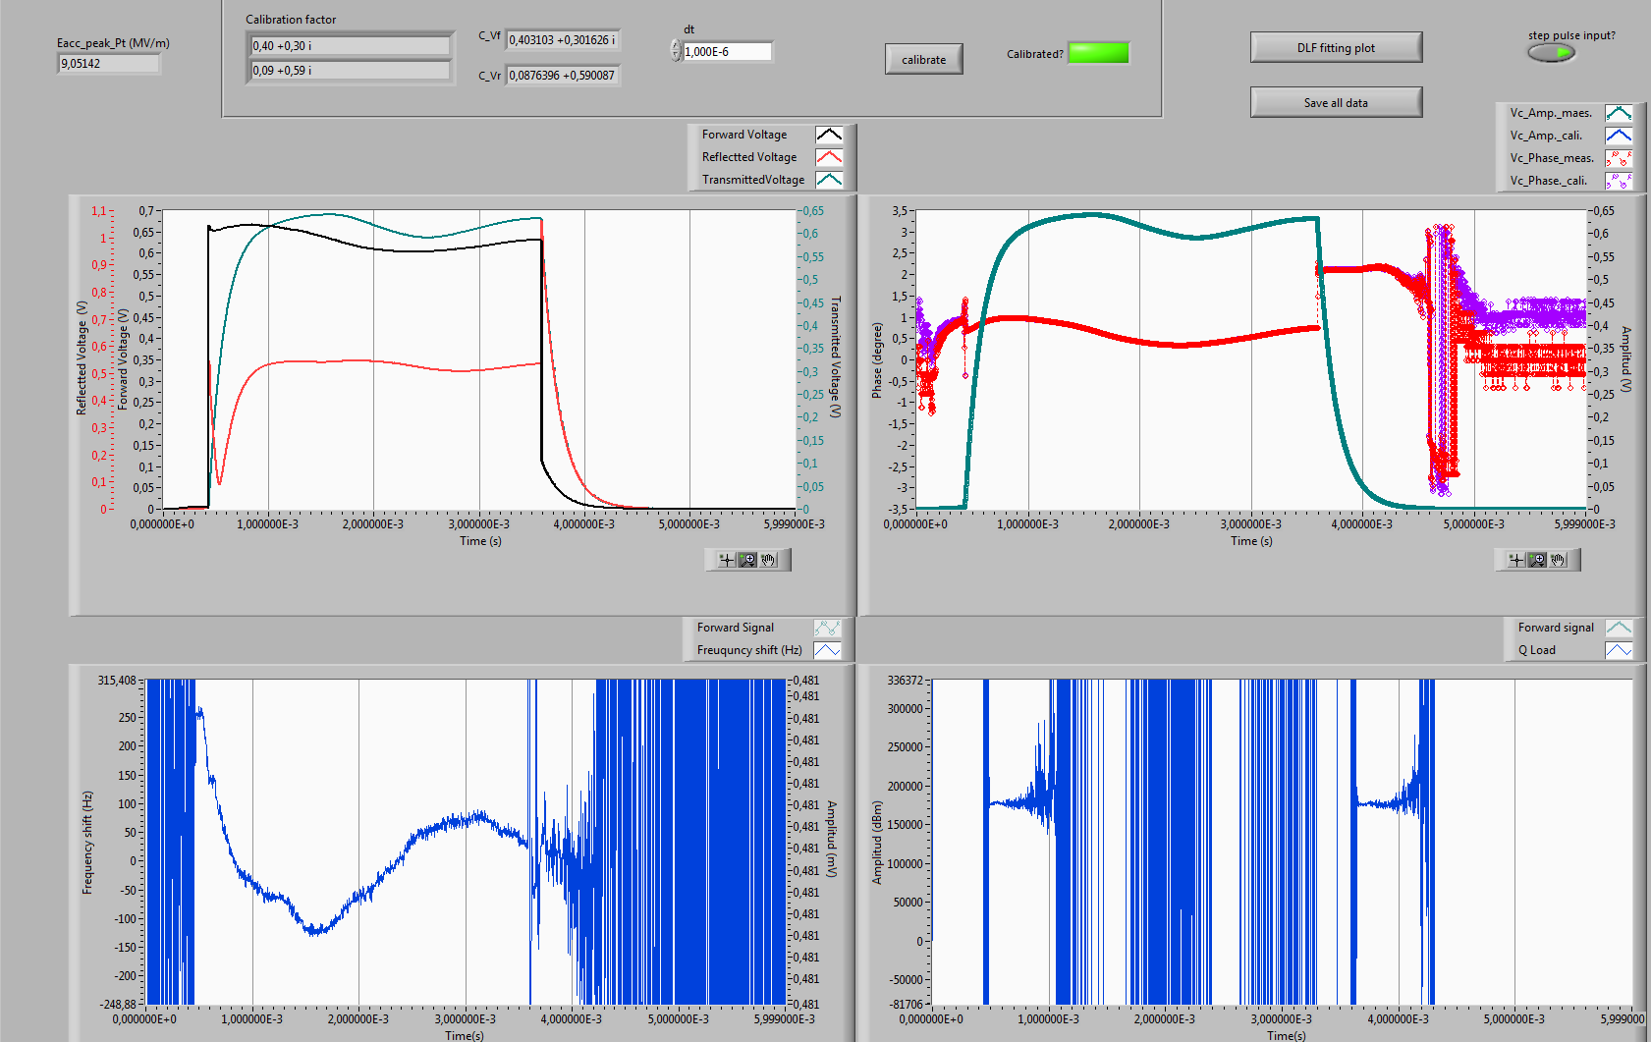


Dynamic Lorentz Force detuning (II)
Developed an FPGA-based LabView program for dynamic Lorentz force detuning.
Dynamic Lorentz Force detuning will be tested at the maximum accelerating gradient.
A Loaded Q value from state space equation caculation could be cross check with the VNA measurement.
$$∆f=400Hz$$
$$QL=1.8×105$$

Slide 23
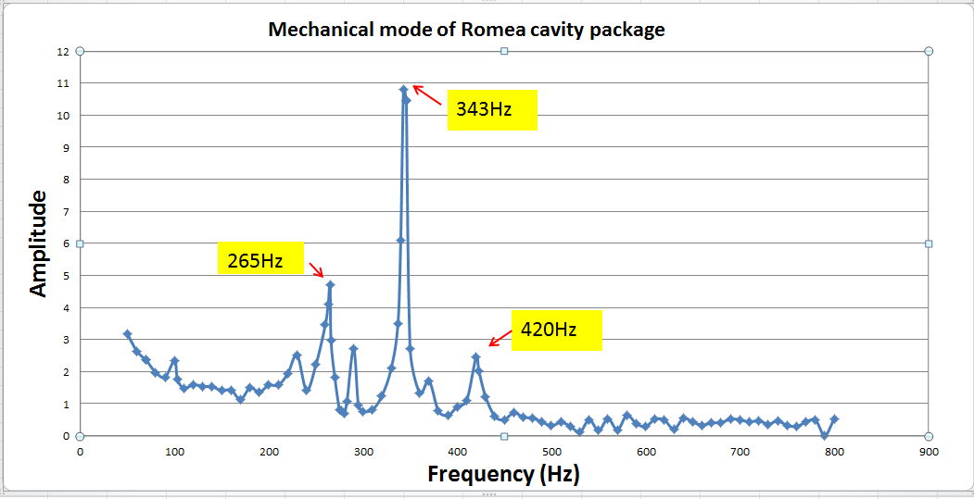
Mechanical Modes
Stimulate the cavity by amplitude modulation .
By sweeping the modulation frequency up to 800 Hz, the fit of mechanical modes could be studied.
Slow tuner will be in fixed position .
Simulation from IPNO
N° | Frequency
1 & 2 | 212 Hz
3 & 4 | 265 Hz & 275 Hz
5 & 6 | 285 Hz
7 | 313 Hz
8 to 11 | 315 Hz to 365 Hz
12 | 396 Hz

Slide 24
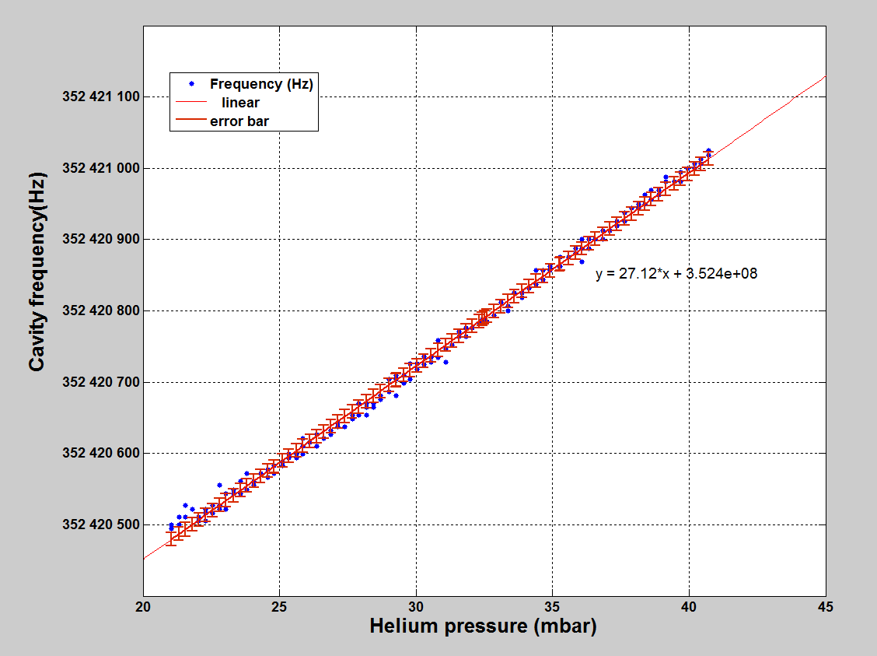
Frequency Sensitivity to Pressure
By closing both the inlet and outlet of the cryostat, checking the cavity frequency shift as a function of helium pressure from 20 to 40 mbar.
Frequensy sensitivity test rerult of Spoke package
frequency shift measured during cool down from 4.2 K (~1030mbar) to 2 K (~20mbar) is another method of measurement .

Slide 25
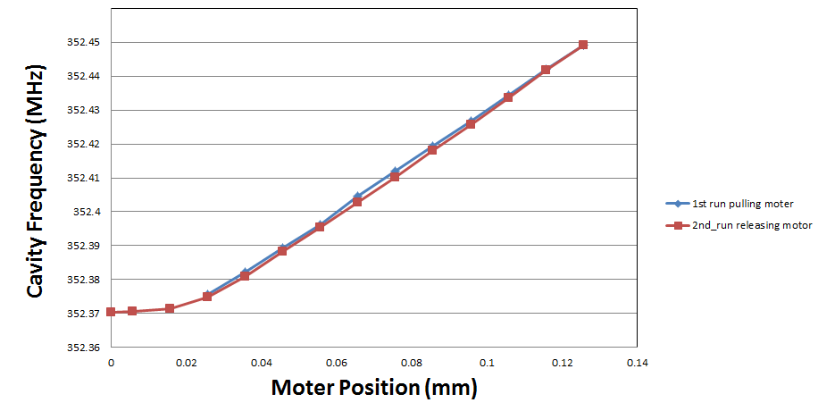
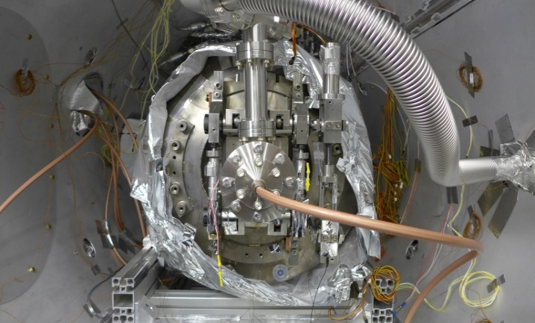
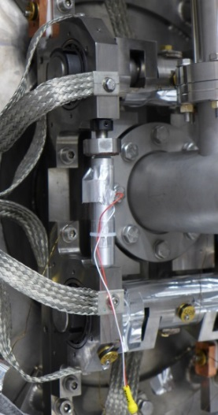
Tuner Sensitivity
Slow tuner is controlled by Lund system.
Tuning sensitivity will be studied at 2K.
Tuner sensitivity test result of spoke cavity

Slide 26
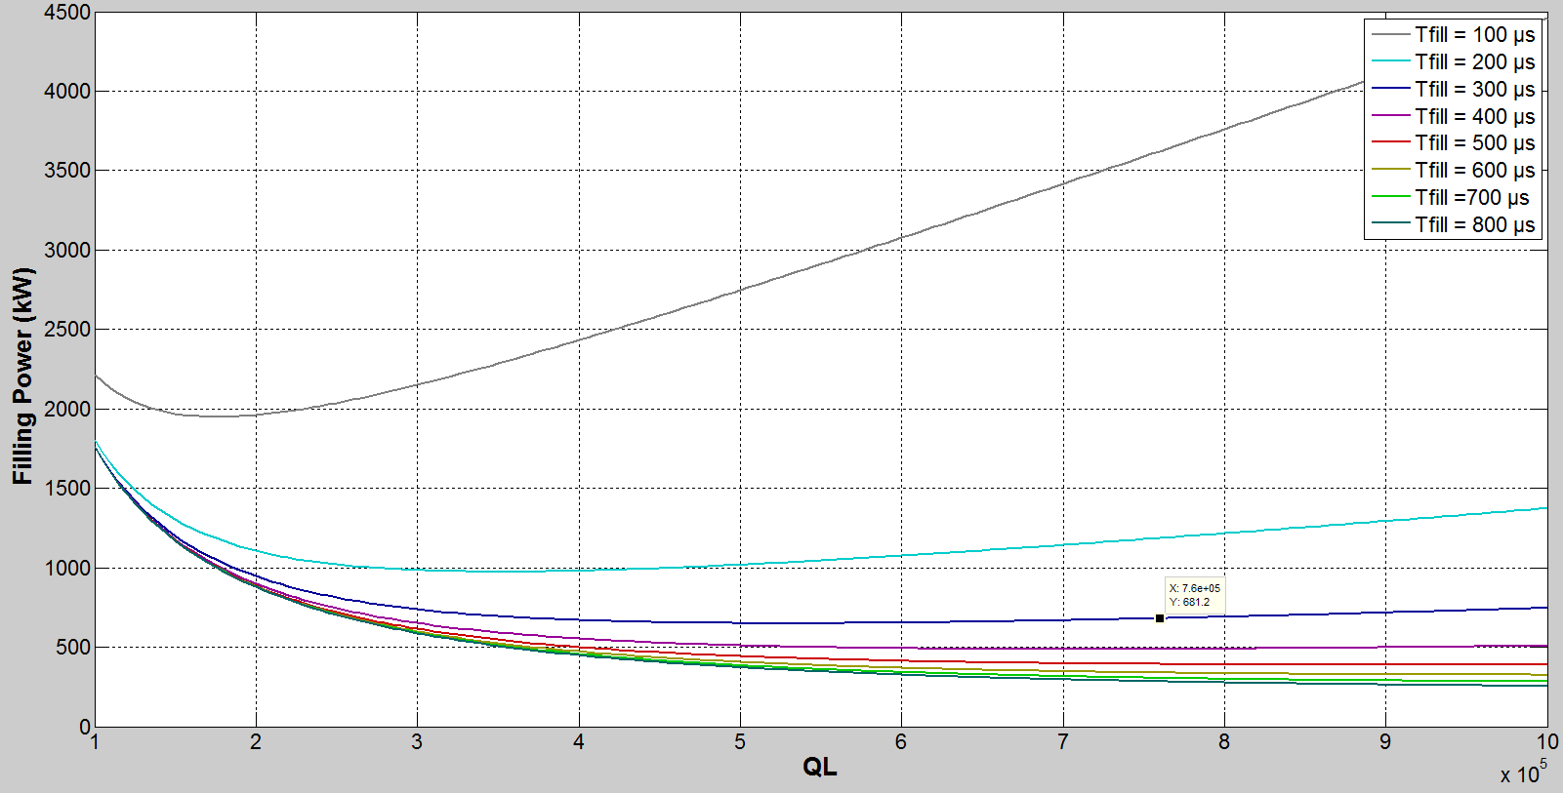
High Beta elliptical cavity
Cavity Voltage =$18.308$MV
Detuning = 0Hz
681kW@QL=7.6E5
Enough RF power for us to try the charging time experiment !

Slide 27
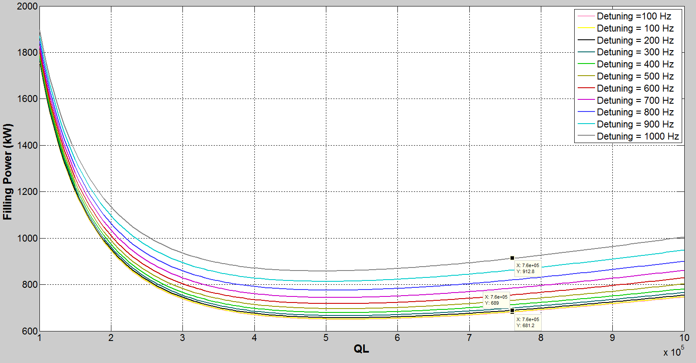
When QL = 7.6e5
1% more filling power is required for 200Hz detuning
50% more filling power is required for 1000Hz detuning

Slide 28
Different filling method
For steps filling:
681kw
1100kw
231kw
231kw
300µs
2.86 ms
211µs
2.86 ms
(a)
(b)

Slide 29
Conclution
Hardwares are in place.
Software have been tested and are ready for running.
Test technologe has been checked in privious tests.
Experience from the test of spoke packege will be helpful in the test of HB elliptical cavity.

