Slide 1
Progress of the
European Spallation Source
Roger Ruber
Uppsala University
Thanks to all colleagues for materials
Jülich, 1 February 2018

Slide 2
Presentation Outline
Reminder of neutron science
Overview of the ESS machine
Technical highlights
  Science instruments
  Target system
  Accelerator
Outlook
  Fundamental physics at ESS
  Financing and time schedule

Slide 3

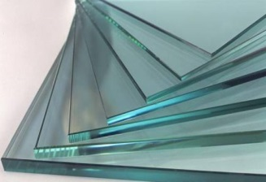
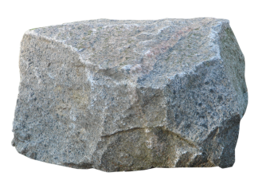
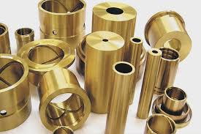
Material Science & Innovation
“The Stone Age didn’t end for lack of stone”
Ahmed Zaki Yamani
Society’s progress has been determined by the development of new materials
Wood, glass, stone, bronze, iron, steel, concrete, plastics, silicon…
ferroelectrics, superionic conductors, giant magnetoresistance, semiconductors, liquid crystals, fullerenes carbon allotropes, high Tc superconductors and more…
We have to build the best facilities
with the best instruments
if we are to develop, understand, and harness New Materials

Slide 4
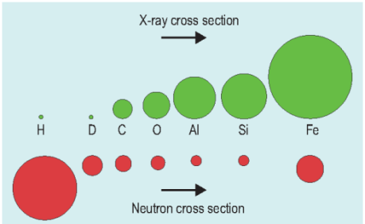
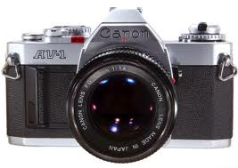
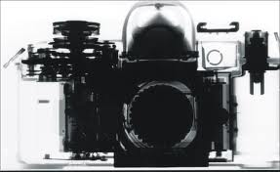
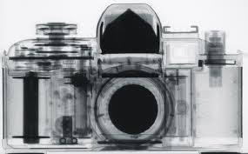
Why to use neutrons?
Neutral charge
  deeply penetrating except for some isotopes
Nuclear interaction:
  cross section depending on isotope (not Z),
  sensitive to light elements.
Spin S = 1/2
  probing magnetism
  unstable n → p + e + νe with
  life time τ ~ 900s , I = I0 e^{- t/τ}
Thermal energies result in non-relativistic velocities
  mass: n ~p; E = 293 K = 25 meV, v = 2196 m/s , λ = 1.8 Å
Light
X-rays
Neutrons
Light
X-rays
Neutrons

Slide 5
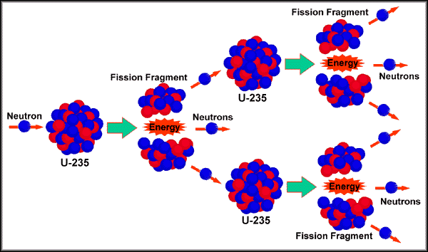
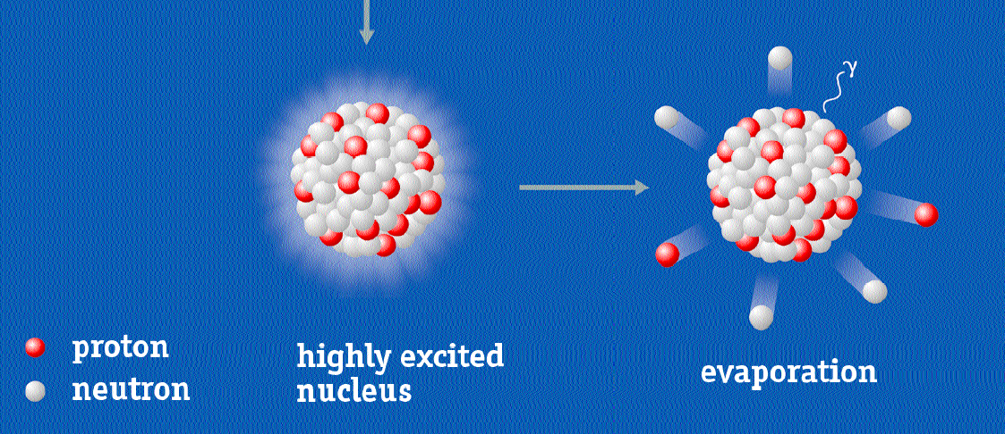


How to produce neutrons
Nuclear Spallation
→ accelerator
Nuclear Fission
→ reactor

Slide 6
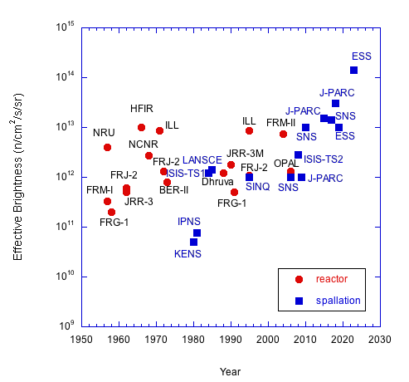
Usable Neutron Brightness
Spallation
4 x per decade
Fission
1.2 x per decade

Slide 7
Long Pulse Performance
15
x10¹³
ESS 5 MW
2015 design
λ = 5 Å
Possibilities of pulse shaping
10
Brightness (n/cm²/s/sr/Å)
ESS 2 MW
2015 design
5
JPARC
0.3-1 MW
SNS
1-2 MW
ISIS TS1
128 kW
ISIS TS2
32 kW
ILL 57 MW
0
time (ms)
1
2
3
4

Slide 8
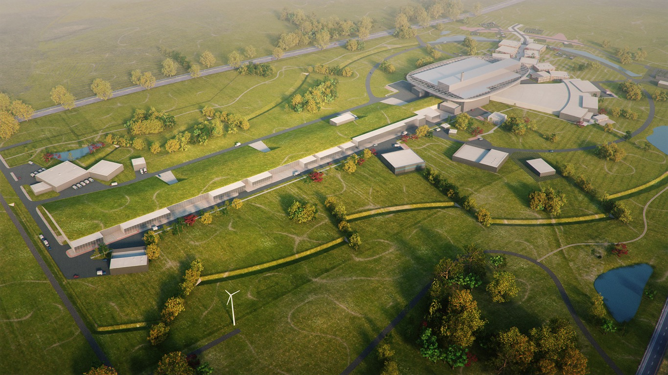
ESS Basic Design Principles
High Power Accelerator
Ultimate energy: 2 GeV
Repetition rate: 14 Hz
Pulse length: 2.89 ms
Peak power: 125 MW
Target Station
Ultimate power: 5 MW
He-gas cooled
Rotating W-target
42 Beam ports
Instruments
15-22 Instruments in construction budget
(depending on scenario)
Ion Source
Protons
Current: 62.5 mA

Slide 9
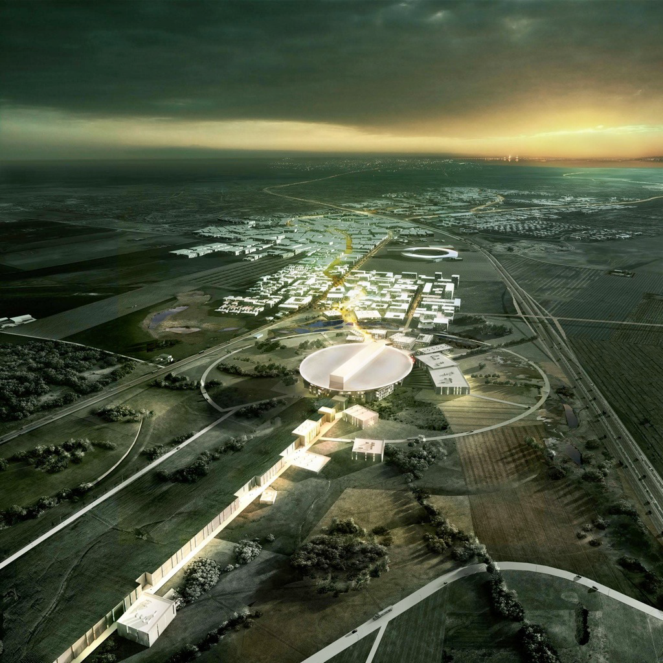
European Spallation Source (ESS)
2025
Construction complete
2023
Start of user program
2020
First beam on target
First neutrons
2014
Construction starts
2012
Design update completed
2009
Decision that ESS will be build in Lund
30 years !
2003
First European design effort completed
1993
Proposal for a European spallation source

Slide 10
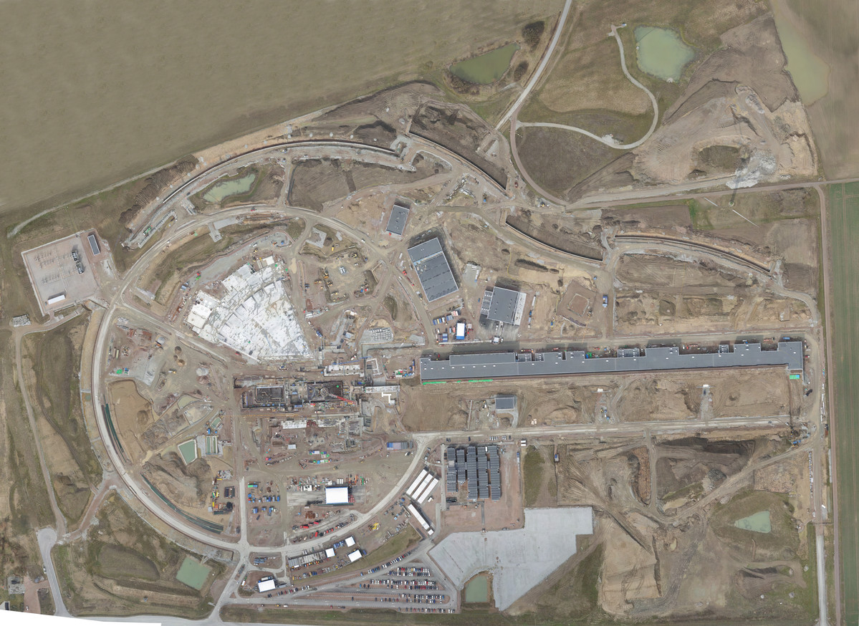

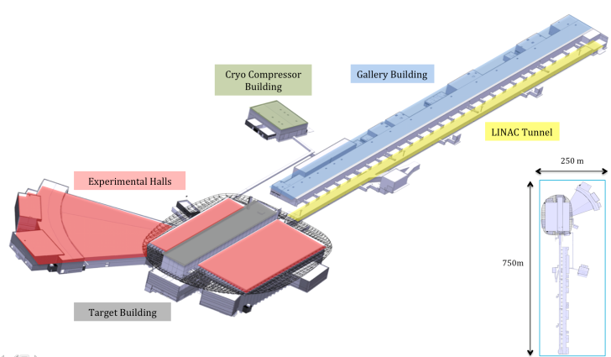
Distribution
Substation
Primary
Substation
Central Utility
Building
April 2017
Exp. Hall
E01
Cryo Compressor
Building
Klystron Gallery
Front End
Building
Active
Cells
Target
Monolith
High Energy
Loading Bay

Slide 11
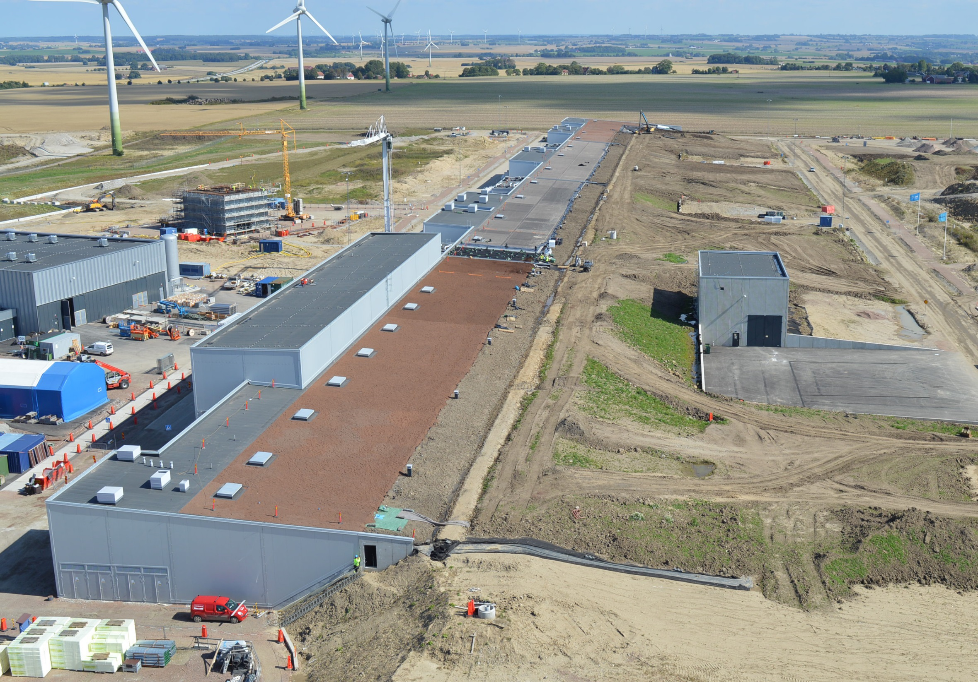
Accelerator and Klystron Gallery
Accelerator Tunnel and
Klystron Gallery

Slide 12
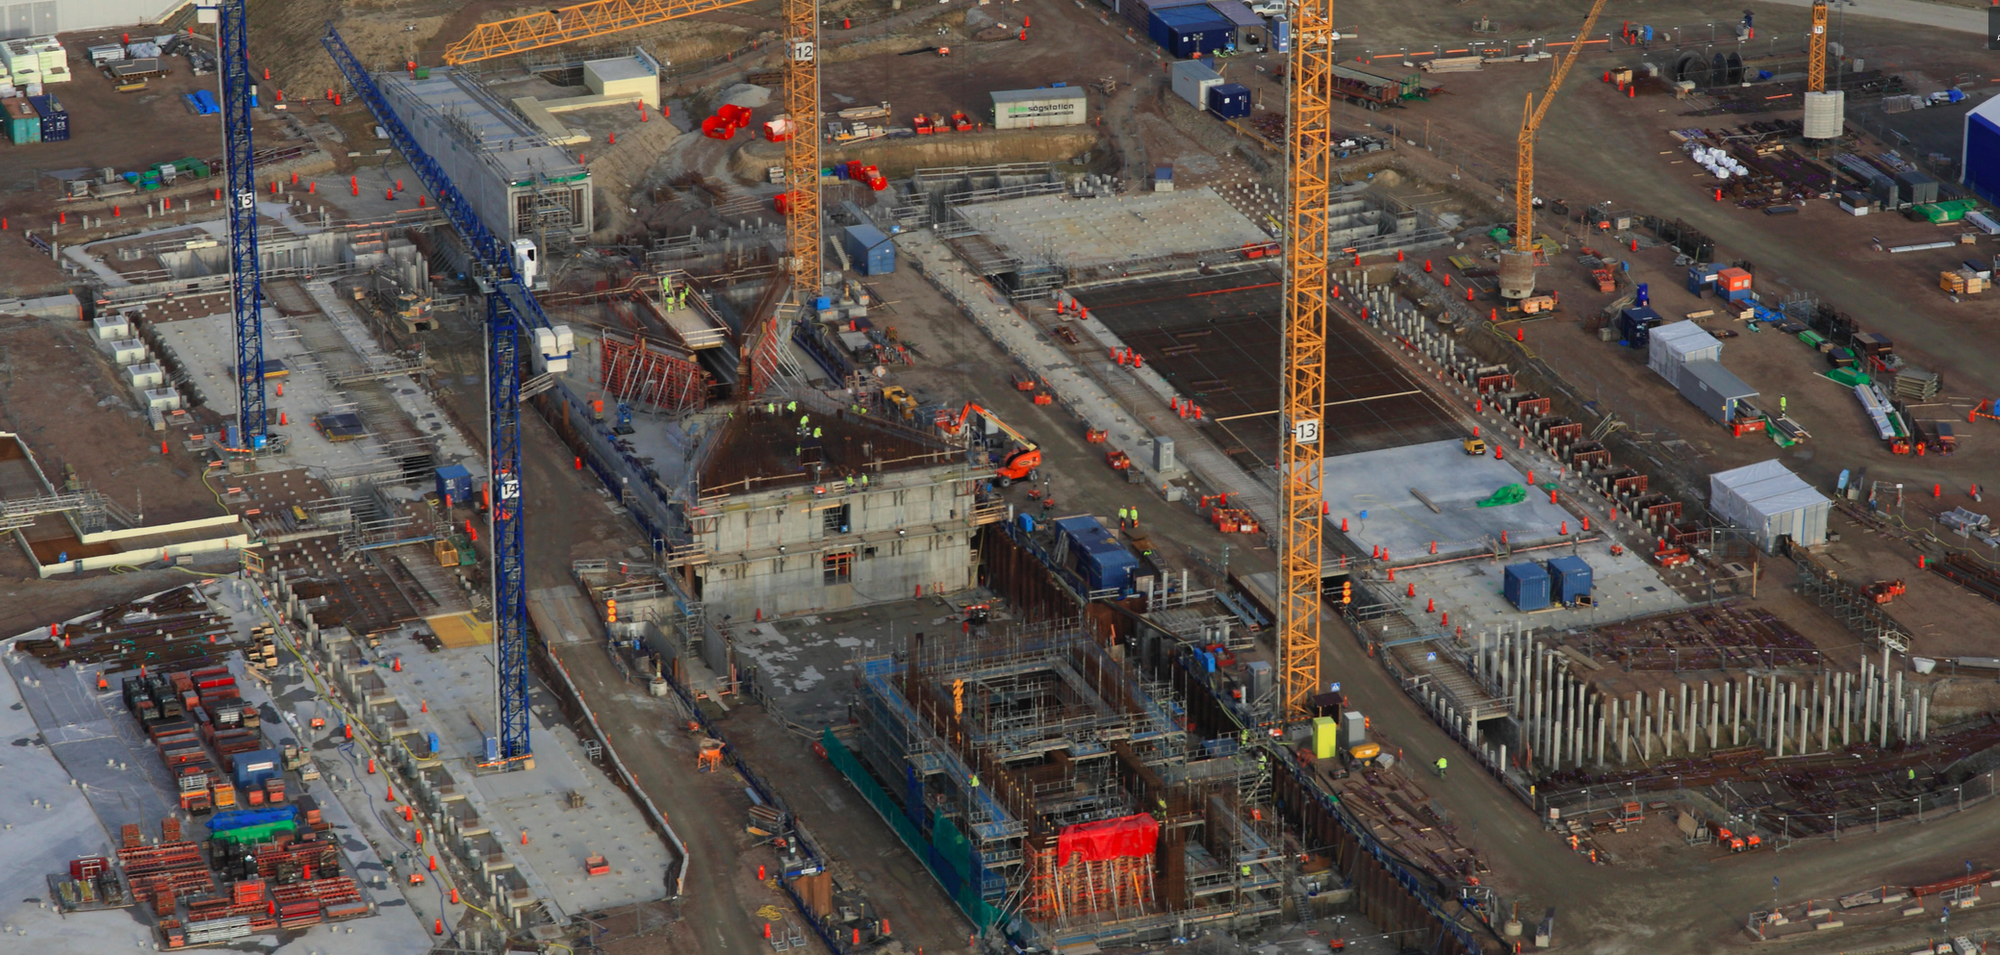
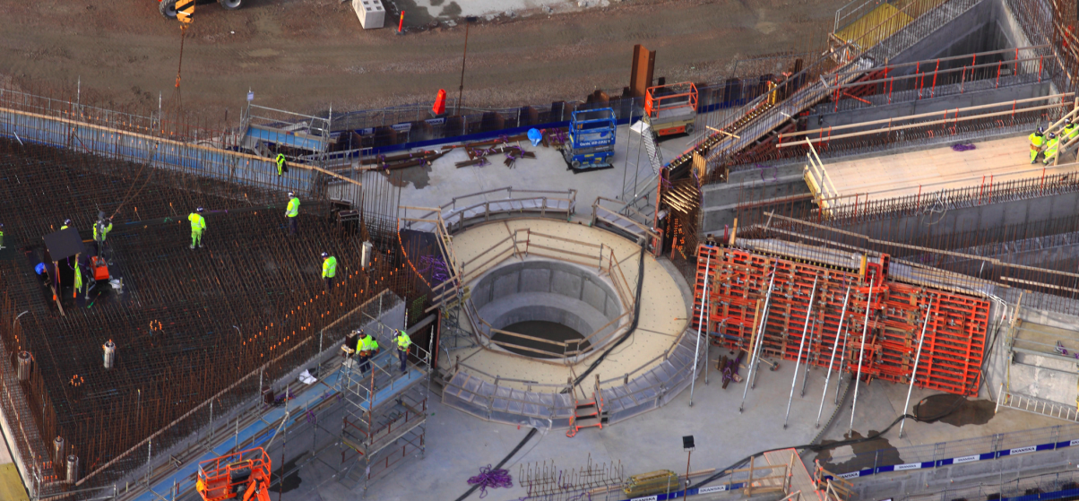
Target Buildings

Slide 13
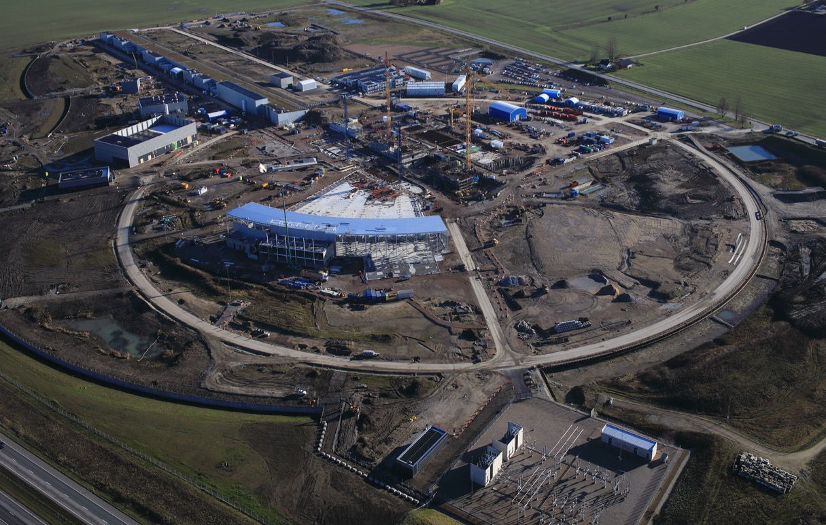
Experiment Hall
December 2017

Slide 14

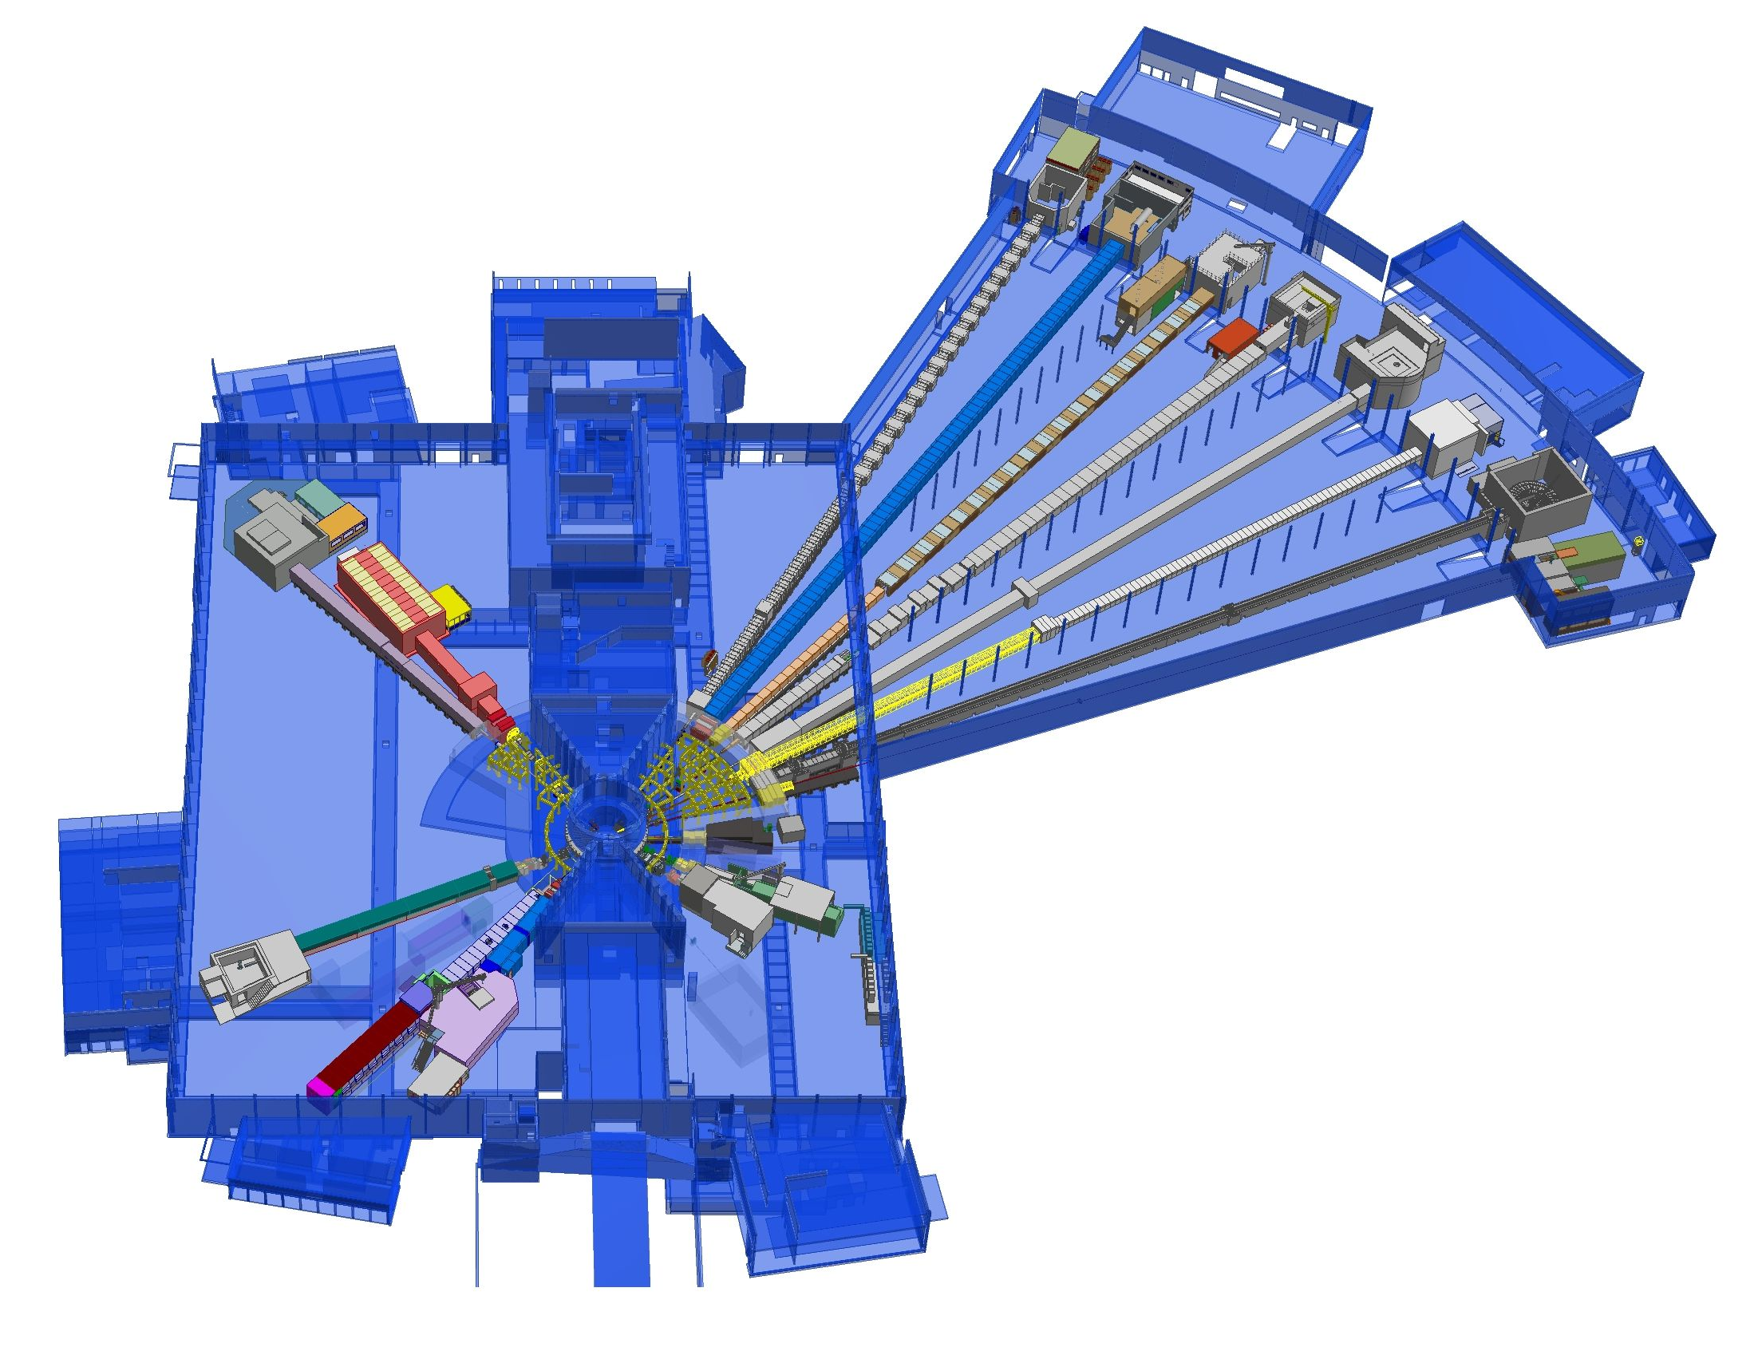











First 15 Neutron Science Instruments
Neutron beam extraction
Offers 42 neutron beam ports
Allows instruments to view either
upper or lower moderator position
+
Nuclear Physics Institute
NMX
+
BEER
Monolith
C-SPEC
BIFROST
MIRACLES
MAGIC
ODIN
T-REX
DREAM
HEIMDAL
Test Beam Line
VESPA
LOKI
FREIA
SKADI
ESTIA
ESS In-Kind Partners also collaborate on sample environment, data management systems etc.
+
ESS Instrument Layout (September 2017)

Slide 15
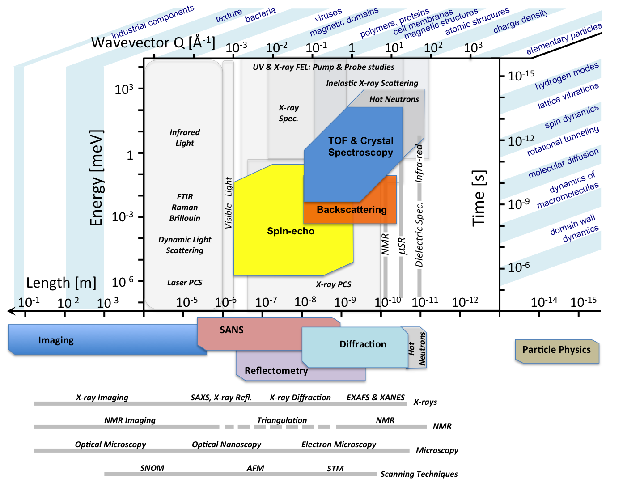
Length and Energy Scales
SANS = small angle neutron scattering
Notes:
Small-angle neutron scattering (SANS): uses elastic neutron scattering at small scattering angles to investigate the structure of various substances at a mesoscopic scale of about 1–100 nm.
Neutron reflectometry is a neutron diffraction technique for measuring the structure of thin films.
Neutron diffraction or elastic neutron scattering is the application of neutron scattering to the determination of the atomic and/or magnetic structure of a material.

Slide 16
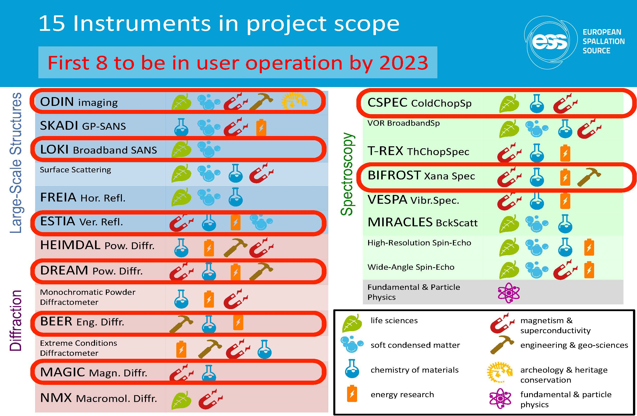

Slide 17
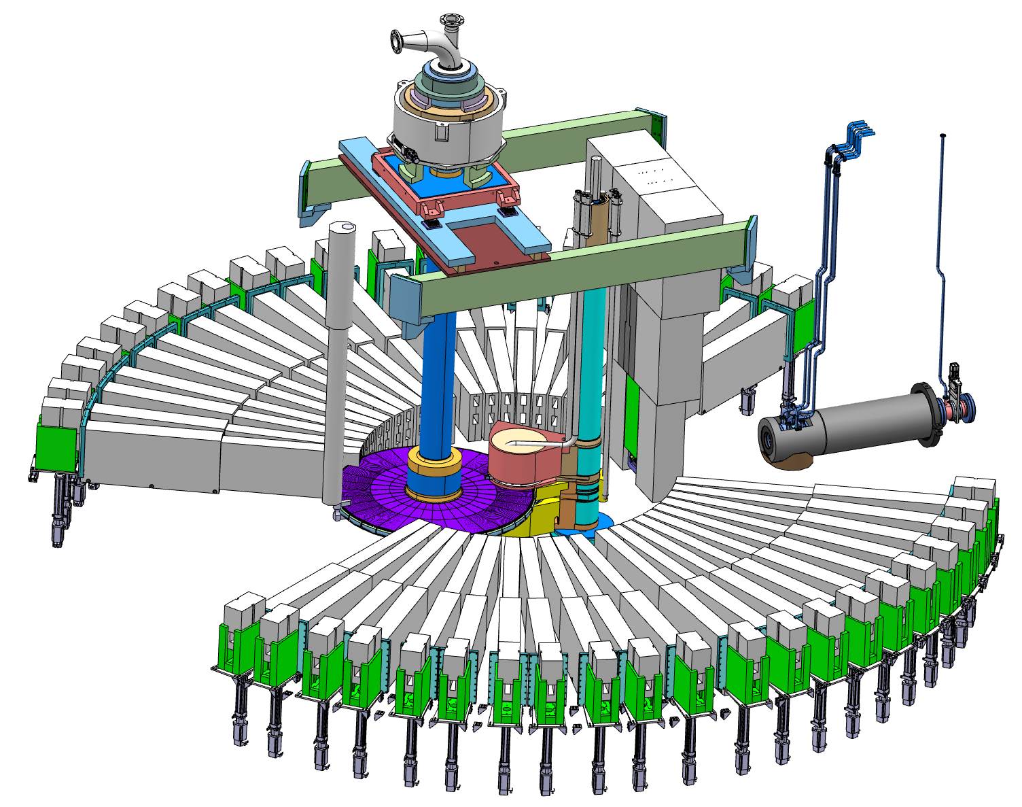
The ESS Target
Moderator and reflector plugs
Proton beam window
Target wheel

Slide 18
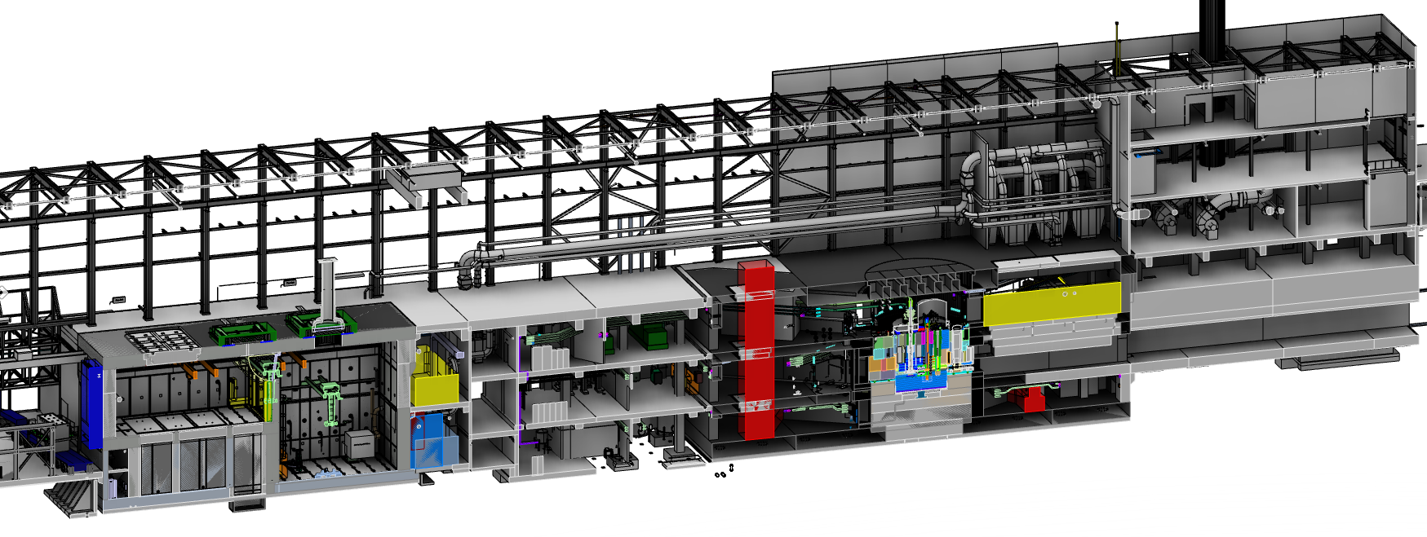
The Target Building
Utilities and cooling plant
Helium cooling of target wheel
Water cooling of moderators, plugs and shielding
Intermediate water loops between primary circuits and conventional facility utilities
Helium cryoplant for refrigeration of cold moderator system
Nuclear grade HVAC system
Remote handling systems
Large active cells for safe storage and processing of spent radioactive target components
Shielded casks for transfer of spent components from monolith to active cells
High bay
22 m
130 m
Transport hall
37 m
Active cells
Utilities block
Target
monolith
Beam expander hall

Slide 19
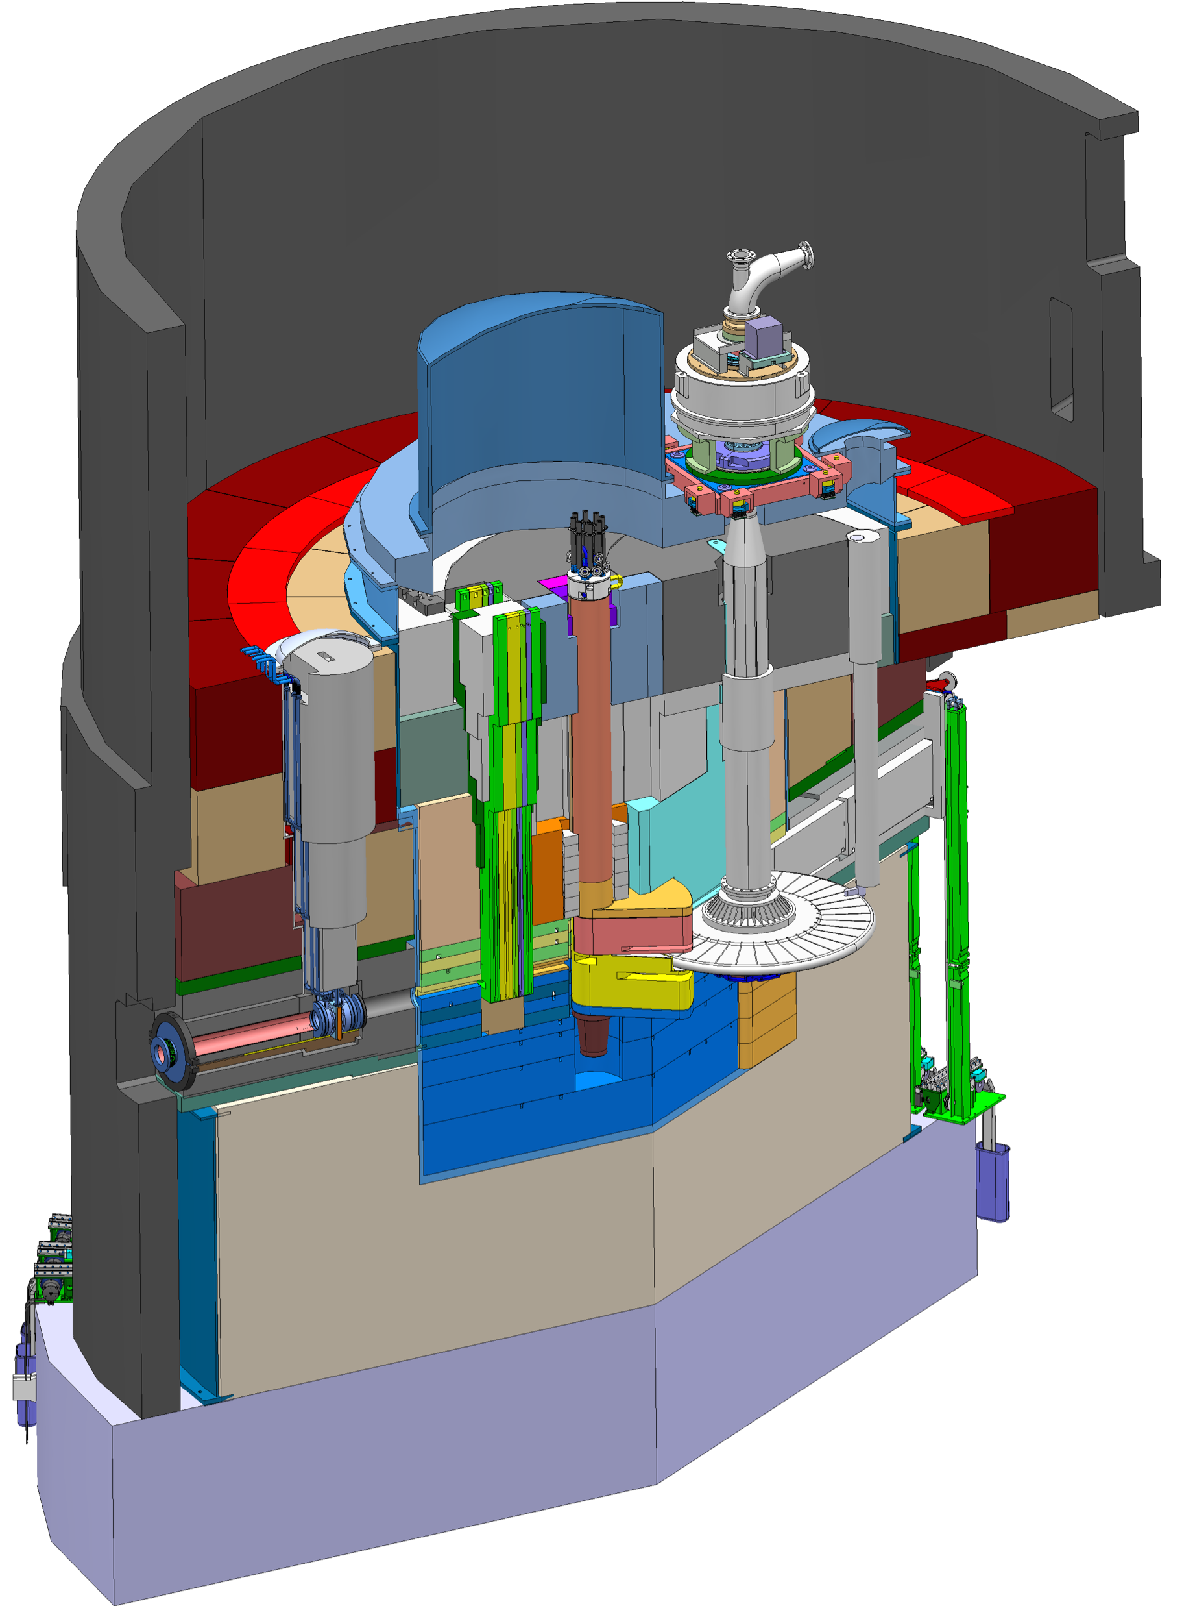
The Target Station
Target Safety System
Monitors target coolant flow, pressure and temperature, monolith pressure,
& target wheel rotation
Prohibit beam on target if parameters are outside specified limits
Helium cooling of target material
Mass flow 3 kg/s
Pressure 11 bar
Temperature inlet/outlet 40 °C/240 °C
Moderator and reflector
proton beam instrumentation plug
monolith vessel
neutron beam extraction port
Rotating solid tungsten target
36 sectors
Mass, total 11 tonnes, whereof 3 tonnes of W
Rotates 23.3 rpm, synchronized with pulsed proton beam 14 Hz
proton
beam
target wheel
target monitoring plug
proton
beam window
Diagnostics and instrumentation
Controlled and integrated commissioning and operation of the accelerator and target
Fluorescent coating of PBW and target front face
Optical paths, grid profile monitor, aperture monitor
Wheel monitoring including position, temperature, vibration, as well as internal structure
Moderators
Provisional locations of moderators above and beneath the target wheel, i.e. monolith centre
1st MR plug exploits the upper space, offering:
  Cold, 30 mm high, liquid H₂ moderators, 17 K
  Thermal, 30 mm high, H₂O moderator, 300 K

Slide 20

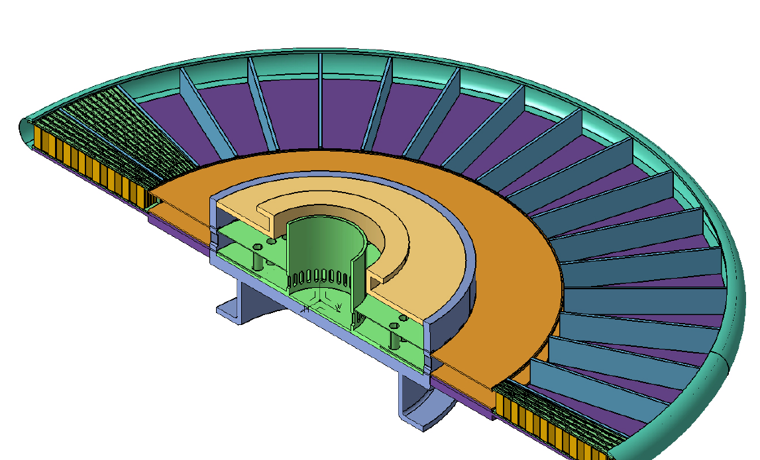
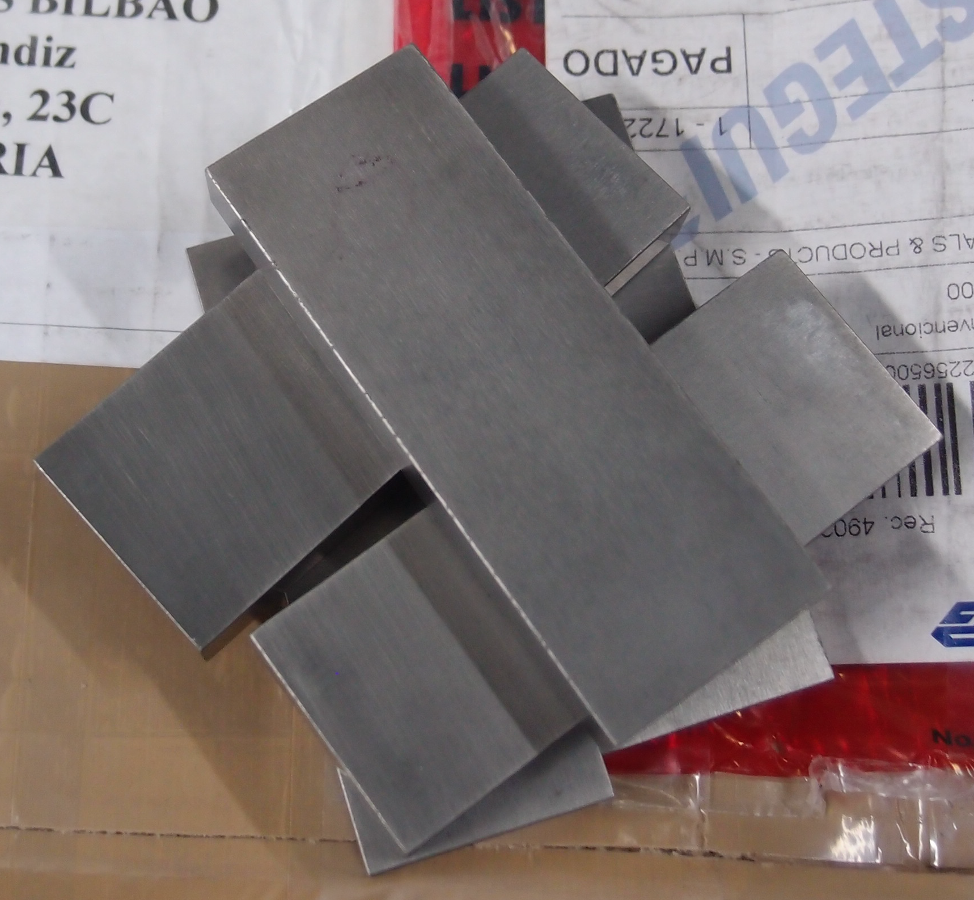
The Target Wheel
proton
beam
48 cm
Each 10° sector is loaded with a tungsten-filled cassette
Tungsten depth in proton beam direction is 45 cm
The range of a 2-GeV proton in tungsten is 74 cm
Brick dimensions: 10 W x 30 D x 80 H mm3
190 bricks per sector, 6840 bricks in total
Helium flows
  radially outward above and below the cassette,
  reverses direction at the wheel rim,
  and returns through the tungsten
Tungsten bricks
20
Cassette

Slide 21
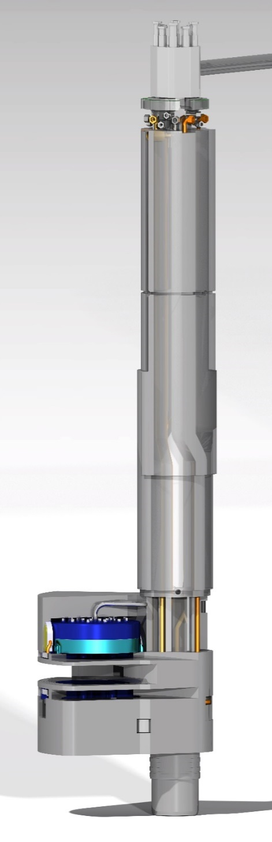
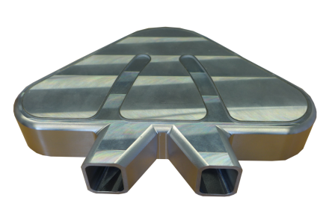
Moderator and Reflector Systems
Moderate neutrons to low energies, thermal and cold,
  useful for the neutron scattering
Cooling the radiation heat in liquids and solid metal bodies

Slide 22
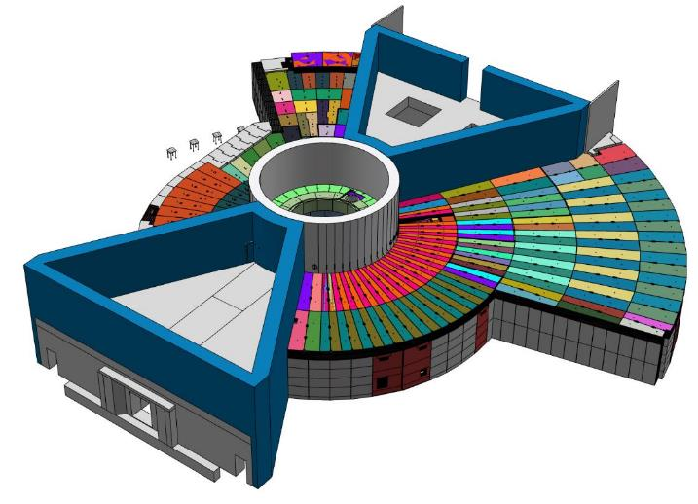
The Bunker Design
~ 7000t of steel
~ 300t of Borated HDPE
~ 750t of virgin HDPE/LDPE
~ 620t of concrete
~ 970t of heavy concrete
~200t of construction steel
Each bunker side measures approx. 40m long x 26m wide x 5m high
~ 10,000 tones total mass
~1400 wall & roof blocks

Slide 23
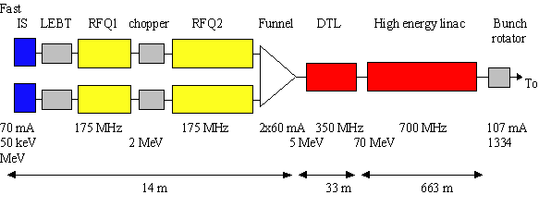
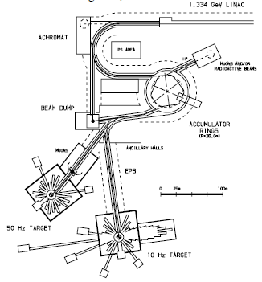
1996 ESS Design: Feasibility Study
5 MW beam power
1.334 GeV H⁻ Linac
  synchrotron option discarded
    to complex for E <3GeV
  normal conducting linac
    SC linac under consideration
  6% duty cycle
  107 mA, 0.6 ms pulse
  2 x 70 mA sources
    not yet achieved at time of proposal
2 accumulator rings → 2 targets
  1 µs pulse compression (from 2 injection pulses)
  10 Hz and 50 Hz target operation
coupled cavity
PAC97 - 9W013: Status of the European Spallation Source Design Study
ESS A Next Generation Neutron Source for Europe, Volume 3, The ESS Feasibility Study, March 1997.

Slide 24
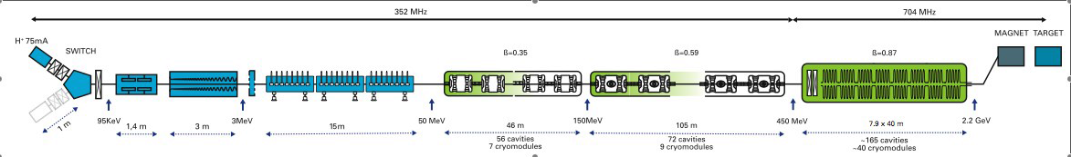
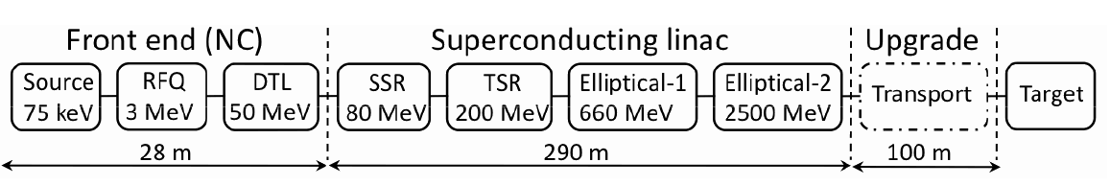
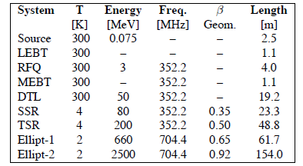
2009 ESS Accelerator Design Update
SC linac option (5 MW)
  1 GeV, 150 mA, 16⅔ Hz
Simplify the linac design and increase reliability
  proton pulse length ≥ 1 µs, energy ≥ 1 GeV (and ≤ 3 GeV)
  synergies with CERN Linac4 + SPL development work
  decrease the current to 75 mA
    single source
    can increase cavity gradient to 15 MV/m
  increase the energy from 1 to 2.2 GeV
  increase the repetition rate to 20 Hz
  decrease pulse length to 1.5 ms from 2 ms
PAC09 - TU6PFP083: Conceptual Design of the ESS-Scandinavia

Slide 25
2013 ESS Accelerator Design
Design Drivers:
High Average Beam Power
  5 MW
High Peak Beam Power
  125 MW
High Availability
Key parameters:
2.86 ms pulses
2 GeV
62.5 mA peak
14 Hz
Protons (H+)
Low losses
Minimize energy use
Flexible design for mitigation and future upgrades
352.21 MHz
704.42 MHz
2.4 m
4.6 m
3.8 m
39 m
56 m
77 m
179 m
Target
Source
LEBT
RFQ
MEBT
DTL
Spokes
Medium β
High β
HEBT & Contingency
75 keV
3.6 MeV
90 MeV
216 MeV
571 MeV
2000 MeV
First beam
  90 MeV during Summer 2019
  571 MeV during Fall 2020
5 MW capacity after 2025
RF sources for HB part are
scope contingency for accelerator
IPAC13 - THPWO072: Design Options of the ESS Linac

Slide 26
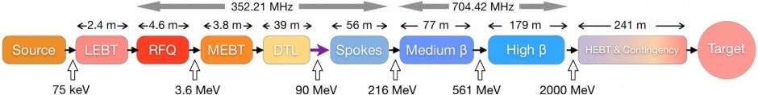
The ESS Accelerator
 | Length [m] | No. Cavities | β | No. Magnets | No. Steerers | No. Sections | Power [kW]
LEBT | 2.38 |  |  | 2 Solenoid | 2 x 2 | 1
RFQ | 4.6 | 1 |  |  |  | 1 | 1600
MEBT | 3.83 | 3 |  | 11 Quad | 10 x 2 | 1 | 15
DTL | 38.9 | 5 |  | PM-Quads | 15 x 2 | 5 | 2200
LEBT + Spoke | 55.9 | 26 | 0.50 | 26 Quad | 26 | 13 | 330
Medium Beta | 76.7 | 36 | 0.67 | 18 Quad | 18 | 9 | 870
High Beta | 178.9 | 84 | 0.86 | 42 Quad | 42 | 21 | 1100
HEBT | 130.4 |  | (0.86) | 32 Quad | 32 | 15
DogLeg | 66.2 |  |  | 12 Quad + 2D | 14
A2T | 46.4 |  |  | 6 Quad + 8 Raster
 | 604.21 | 155

Slide 27






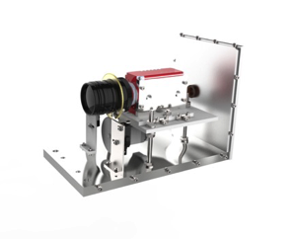
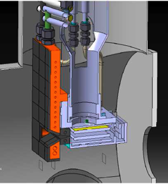
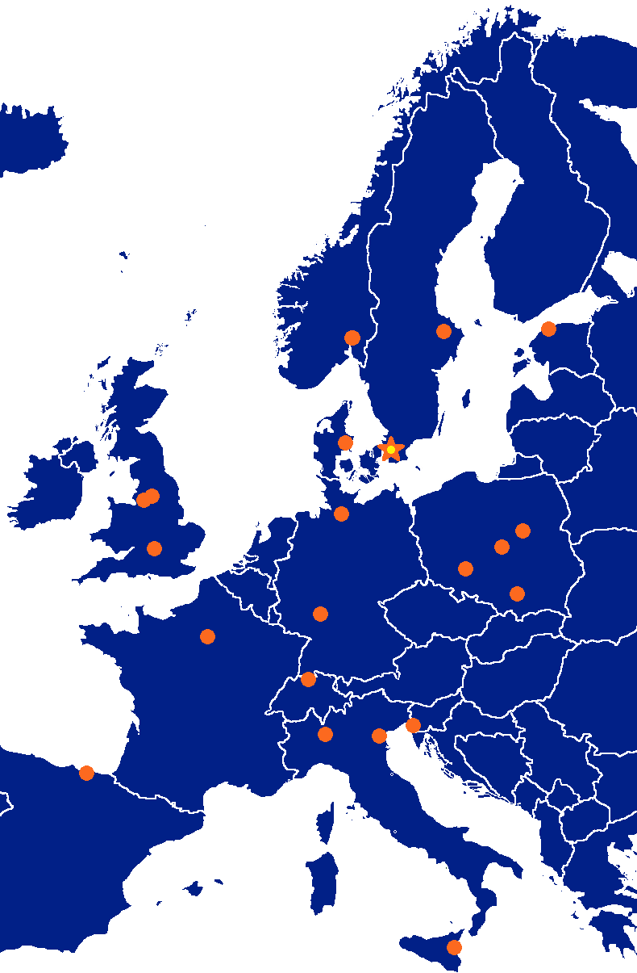




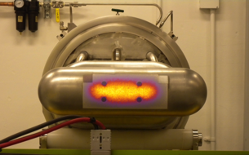

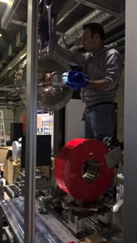

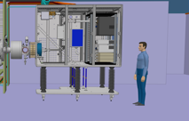

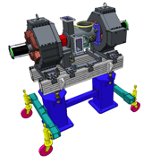




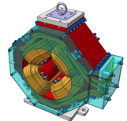


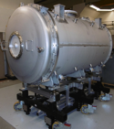
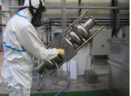
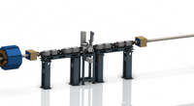



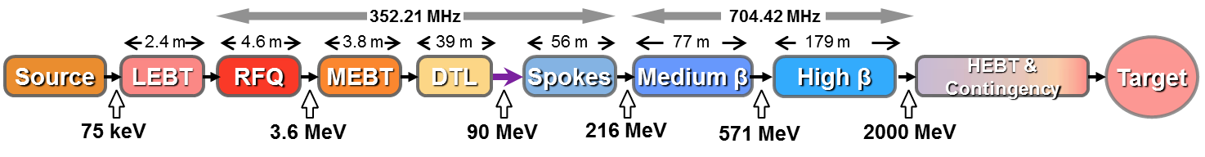








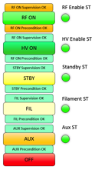


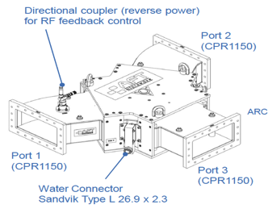
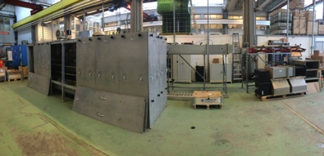


















ESS Accelerator Collaboration
27

Slide 28







Ion Source & Low Energy Beam Transport
Nominal performance achieved in INFN-Catania.
Start installation in January 2018.
First Plasma from the ESS Ion Source
M. Lindroos, TAC 14, Oct. 2016
CERN Courier, May 2006
ESS Ion Source
M. Lindroos, TAC 14, Oct. 2016

Slide 29








Double Spoke Resonators
DOUBLE-SPOKE CAVITY
Frequency [MHz] | 352.21
Beta_optimum | 0.50
Operating gradient [MV/m] | 9.0 (8.8)
Temperature (K) | 2
Bpk [mT] | 61
Epk [MV/m] | 38
G [Ohm] | 133
r/Q [Ohm] | 427
Lacc (=beta optimal x nb of gaps x λ /2) [m] | 0.639
Bpk/Eacc [mT/MV/m] | 6.8
Epk/Eacc | 4.3
P max [kW] | 335

Slide 30


Medium & High Beta Elliptical Cavities
 | MEDIUM-β | HIGH-β
β | 0.67 | 0.86
# cells/cavity | 6 | 5
# CM | 9 | 21
Cav. /CM | 4 | 4
# Cav. | 36 | 84
CM L [m] | 6.584 | 6.584
Sector L [m] | 77 | 179
Medium-β prototypes
P. Michelato et al, IPAC2017 & SRF2017
Prototype cryomodule with 4 medium β 6 cell elliptical sc cavities in CEA (Saclay) test place
Notes:
All cavities chemically treated with BCP
Three cavities reach the ESS specification
Very good Q0 at low field for CEA cavities, very good accelerating gradient for LASA cavity
Origin of this Q drop is not fully understood, but probably due to field emission and secondary emission effect inside inner cells (triggered by surface quality obtained after chemical treatment)

Slide 31



Beam Raster Scanning on Target
Raster system sweeping beam in 2D pattern @ target
8 colinear magnets, individually powered
Crosshatch pattern (f_{x}/f_{y}, ϕ_{xy}, a_{x}, a_{y}) within 2.86 ms pulse
5:4 pattern

Slide 32
outlook
Overview of the ESS organization, time schedule and ideas for the future

Slide 33


Fundamental Physics at ESS
Four proposals
ANNI
  precise measurements of
    neutron beta decay,
    hadronic weak interaction (input to theory),
    electromagnetic properties: dipole moment, CP-violation.
UCN
  ultra-cold neutron source
NNbar/HiBEAM
  neutron-antineutron oscillations search
    aims at least a factor of 1000 greater sensitivity to the oscillation probability than similar ILL experiment (after 3 years of operation)
ANNI
HIBEAM

Slide 34

ESSnuSB Proposal for a Neutrino Super Beam
Study neutrino oscillations (CP-violation)
  neutron program must not be affected
  if possible synergetic modifications.
Linac modifications:
  double rep. rate: 14 Hz → 28 Hz (4% to 8% duty cycle)
  add accumulator ring (Circ~400 m)
    to compress proton pulses to few μs, affordable by the
    magnetic horn (350 kA, power consumption, Joule effect)
  H- source (instead of protons)
    space charge problems to be solved.
~300 MeV neutrinos.
  target station (EUROν) & underground detector (LAGUNA)
Short pulses (~μs) allow decay-at-rest experiments using the
neutron target
EU Design Study for ESSnuSB approved by EU in December 2017
for 2018-2021

Slide 35




















Financing and In-kind Contributions
Host Countries of Sweden and Denmark
Construction 47,5%
Operations 15%
In-kind Deliverables ~ 3%
Cash Investment ~ 97%
Non Host Member Countries
Construction 52,5%
Operations 85%
In-kind Deliverables ~ 70%
Cash Investment ~ 30%

Slide 36
Partner Institutes
Aarhus University
Atomki - Institute for Nuclear Research
Agder University
Bergen University
CEA Saclay, Paris
Centre for Energy Research, Budapest
Centre for Nuclear Research, Poland, (NCBJ)
CERN, Geneva
CNR, Rome
CNRS Orsay, Paris
Cockcroft Institute, Daresbury
DESY, Hamburg
Delft University of Technology
Edinburgh University
Elettra – Sincrotrone Trieste
ESS Bilbao
Forschungszentrum Jülich
Helmholtz-Zentrum Geesthacht
Huddersfield Univesrity
IFJ PAN, Krakow
INFN, Catania
INFN, Legnaro
INFN, Milan
Institute for Energy Research (IFE)
Institut Laue-Langevin (ILL)
Rutherford-Appleton Laboratory, Oxford (ISIS)
Kopenhagen University
Laboratoire Léon Brilouin (LLB)
Lodz University of Technology
Lund University
Nuclear Physics Institute of the ASCR
Oslo University
Paul Sherrer Institute
Roskilde University
Tallinn Technical Univesrsity
Technical University of Chemnitz
Technical University of Denmark
Technical University Munich
Science and Technology Facilities Council
(STFC)
University of Tartu
Uppsala University
WIGNER Research Centre for Physics
Wroclaw Univesrity of technology
Warsaw University of Technology
Zurich University of Applied Sciences
(ZHAW)

Slide 37

Updated Schedule (Oct. 2017)

Slide 38

Civil Construction Status (Dec. 2017)

Slide 39


Slide 40
Summary
Construction is on track for the start of the user program in 2023
with 2 MW of beam power,
  the 570 MeV accelerator will start late in 2020
  instrument commissioning start in 2021
All ESS staff will move to the construction site in 2018
Thanks to all colleagues for the material
  special thanks to Colin Carlile, Roland Garoby, Mats Lindroos

