Slide 1
Teleconference ACS – FREIA 20th February 2018
Agenda:
Manufacturing follow-up
Control and command status
Planning
Commissioning tests
Installation at Uppsala

Slide 2
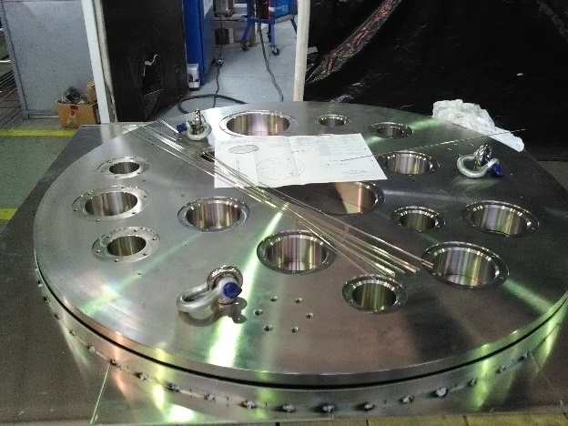
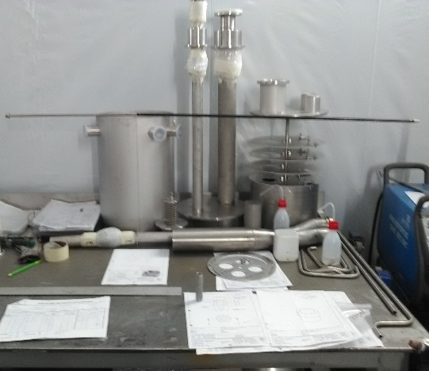
Manufacturing follow-up
Magnet insert:
Welding of the top plate
Welding of the thermal screens
Support assembly
Internal components
HX683
Issues:
Copper tube supply delayed to March
New flanges required for the vacuum box

Slide 3
Control and Command status
ISII-tech was present during the tests providing:
Formation
Technical support
Technergie still have few work to complete on the vertical cryostat
Due to the delay of the magnet insert manufacturing, ACS asked CD to send the electrical cabinet with the cryostat,
Electrical tests on the magnet insert will be done with electrical test boxes
Mechanical tests (leak test, thermal shock, vacuum) doesn’t require the electrical cabinet

Slide 4
Planning: GERSEMI
 | 2018
 | January |  |  |  | February |  |  |  | March |  |  |  |  | April |  |  |  | May |  |  |  |  | June
 | 1 | 2 | 3 | 4 | 5 | 6 | 7 | 8 | 9 | 10 | 11 | 12 | 13 | 14 | 15 | 16 | 17 | 18 | 19 | 20 | 21 | 22 | 23 | 24 | 25 | 26
magnet insert manufacturing
magnet insert mechanical testing
final electrical wiring of control cabinet & test
vertical cryostat electrical wiring repair
control cabinet & automaton test
factory acceptance test with simulator
control cabinet & automaton test with magnet insert
packing & delivery
- vertical cryostat
- valve box & simulator
- control cabinet
- magnet insert
onsite installation of project
- vertical cryostat
- valve box & simulator
- control cabinet
onsite cryogenic tests with simulator
onsite final installation of project with liquid insert
onsite acceptance tests with liquid insert
onsite acceptance tests with magnet insert

Slide 5
Planning: GERSEMI
Week 08
Monday: MLI final check
Wednesday-Thursday: carting VB + VC + simulator
Shipping : end of W08 – beginning W09
Delivery at Uppsala: early March
Ongoing tasks
Disassembly
Packaging
Listing, documentation
Additional:
VC thermal shield modification (baffle, paint)
CD preparation
List of repair (to be done after shipping)

Slide 6
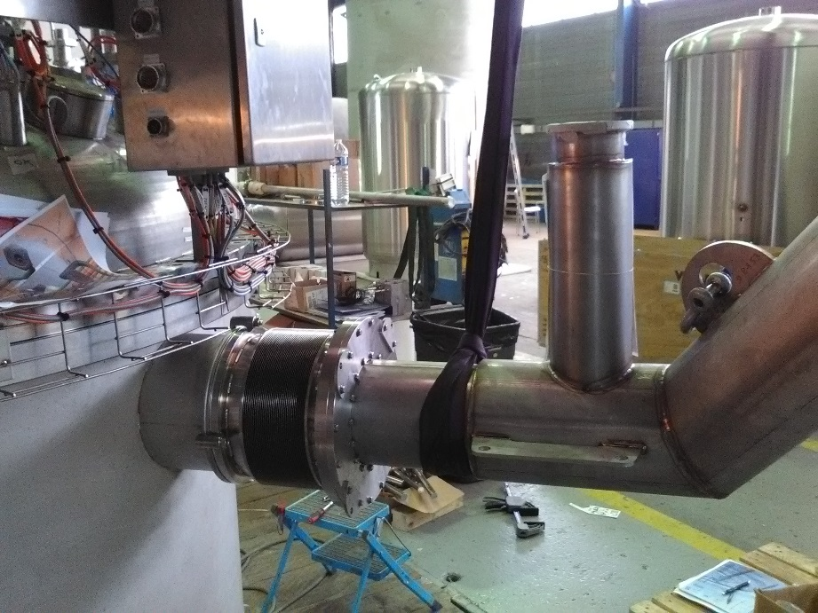
Commissioning test
Final mechanical tests:
He leak tests vessels, circuits and valves
Assembly of the multiline L012 (VC side)

Slide 7
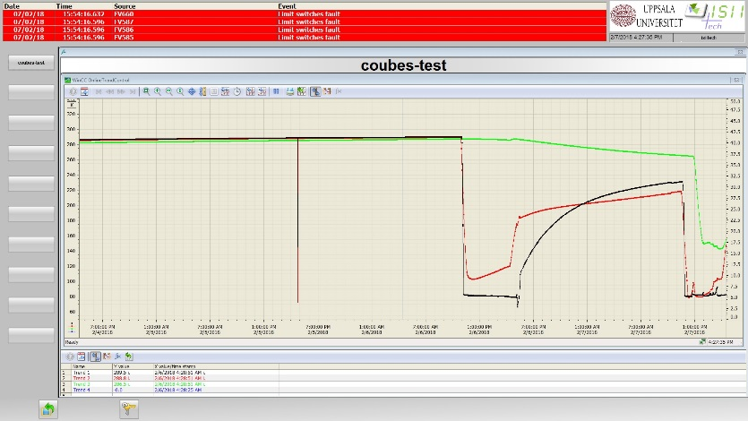
Commissioning test
Simulator allows the control of the following sequences (liquid mode):
1 VB, conditioning LHe circuit
3 VB, conditioning She circuit
5 VB thermal shield cooling
8 LHe level measurement
9 VB cooling +4K tank control level
10 cavity cooldown
12 cavity in operation @4K
14 cavity in standby @40K
21 VB warm-up
22 VC warm-up
24 VC isolated or connected to He recovery circuit
25 VB isolated or connected to He recovery circuit
Some sequences couldn’t be tested in CD workshop due to the absence of external components:
LHe production
Double reheater + recovery system

Slide 8
Installation at Uppsala
Time planned for installation?
Mechanical
Electrical connections
Transfer lines
ACS presence for:
Assembly validation
Commissioning tests

Slide 9
Thank you for your attention
Q&A

