Slide 1


Design and commissioning
of the MYRRHA RFQ
Solid State Amplifier
ARIES workshop on Energy Efficient RF Power Generation, Uppsala, Ångström Laboratory, June 20th 2019
F. Pompon, franck.pompon@sckcen.be

Slide 2
Outline
The 600 MeV MYRRHA linac
MYRRHA phase 1: MINERVA
Injector Status
RFQ SSA design overview
RFQ SSA commissioning results
Issues during commissioning
SSA ongoing procurements
Conclusions

Slide 3
The 600 MeV MYRRHA linac
176.1 MHz
80 MeV
ADS machine means extremely high availability level for the linac!
Source: SCK•CEN MYRRHA Project Team
Notes:
CW machine
Parallel & serial redundancy
SSA as a technological choice (at least up to 352 MHz)

Slide 4
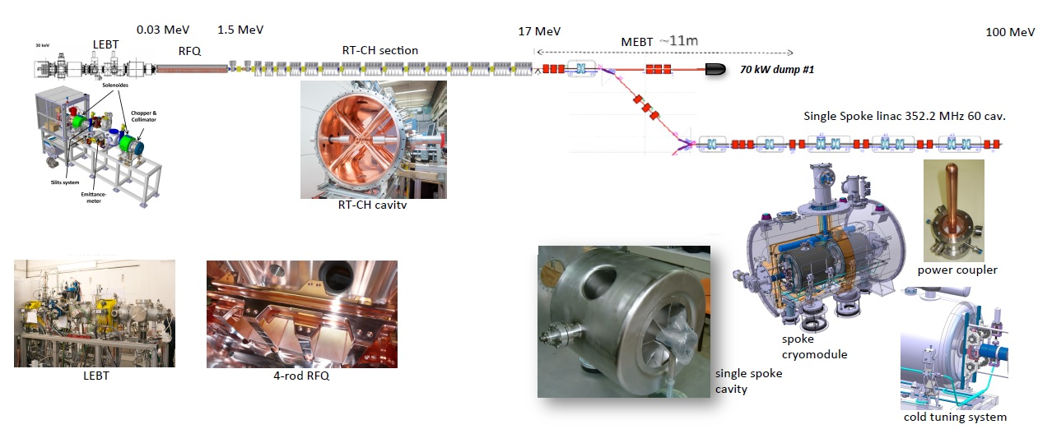
MYRRHA phase 1 = MINERVA
MINERVA = 100 MeV proton linac (4 mA) with one injector + Proton Target Facility
A fraction of the beam redirected to the PTF
Prototyping phase: Injector up to RT-CH#7 (5.9 MeV), installed at UCL-CRC (Louvain-la-Neuve)
176.1 MHz
400 kW dump
Proton
Target
Facility
Source: SCK•CEN MYRRHA Project Team

Slide 5
MYRRHA phase 1 = MINERVA
RFQ cavity: 111 kW (required) / 192 kW (installed)
SSA requirements | Injector (176 MHz) | Main linac (352 MHz) | MINERVA
Qty | 19 | 62 | 81
Required RF power (kW) | 615 | 535 | 1150
Installed RF power (kW) | 1116 | 1416 | 2532
Beam dynamics + various losses
After adding redundancy, LLRF overhead, fault tolerance
Source: SCK•CEN MYRRHA Project Team

Slide 6
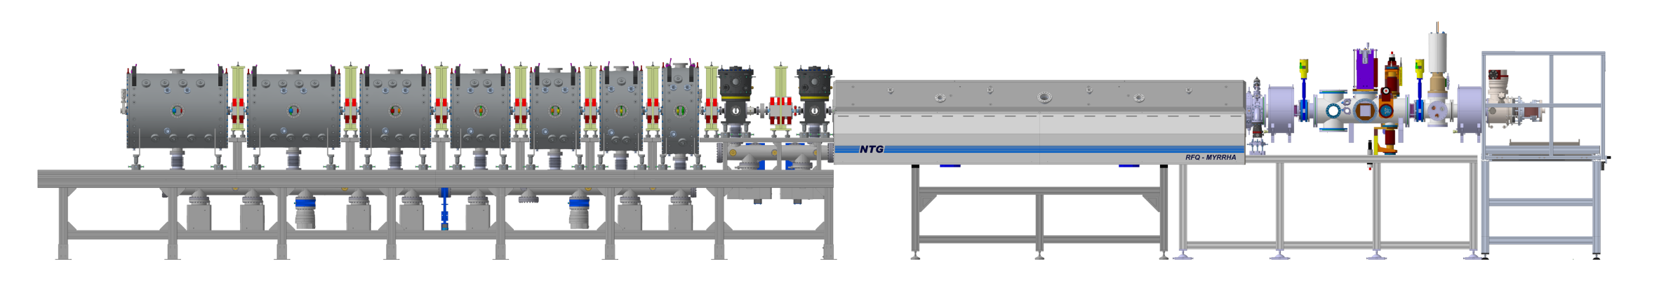
Injector Status (Prototyping phase)
Proton Source (Panteknik) & LEBT (LPSC):
Installed and under final commissioning
Quadrupoles (Scanditronics) and power supplies (JEMA):
All manufactured, factory accepted and delivered
Two quarter-wave rebunchers (IAP & Kress):
Manufactured, passed low level tests and soon under conditionning
CH1 (NTG) & CH2 (PINK) cavities (IAP):
Manufactured, passed low level tests and conditionning ongoing
RFQ cavity (IAP) and its SSA (IBA):
Installed, conditionned and waiting for LLRF operation
SSAs for all other cavities (IBA):
Almost manufactured and soon in factory acceptance
Source: SCK•CEN MYRRHA Project Team

Slide 7
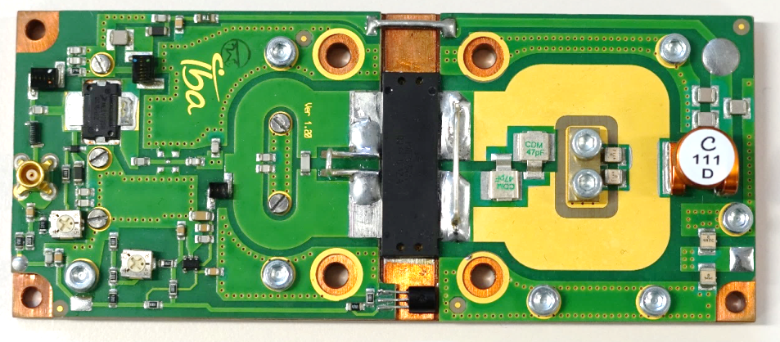
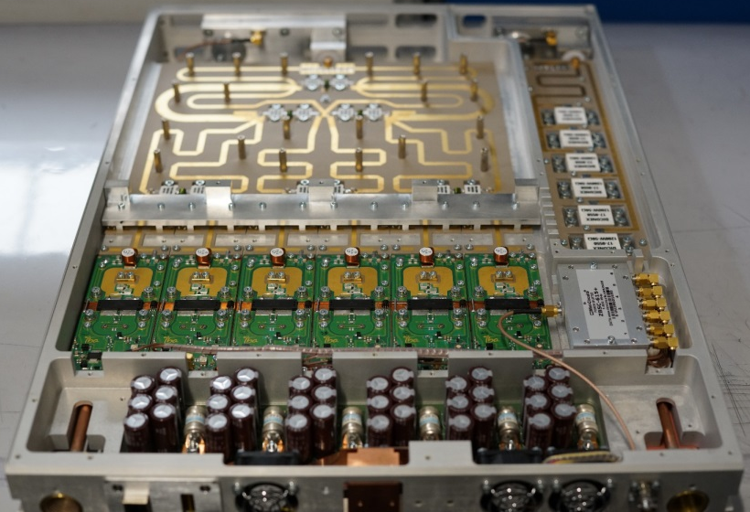
RFQ SSA design overview
MARISA Project (09/2013 -> 09/2016)
  IBA made a conceptual design of a 192 kW / 176 MHz CW Solid-State Amplifier, dedicated to RFQ
MYRTE Project (04/2015 -> 04/2019)
  IBA had the task to manufacture this first Solid-State Amplifier prototype
1 kW elementary RF pallet
  Active device: LDMOS MRF1K50N
  Including driver amplifier (> 40 dB gain)
  Planar technology for good reproducibility
  Optimized design with CST Microwave Studio
6 kW integrated module
  Customized two stages Wilkinson combiner (6 -> 3 -> 1)
  Integrated 7 kW dummy load
  Optimized design with CST Microwave Studio and Spice
  Standard 1 -> 6 splitter
  Electronics for controls, acquisitions and interlocks (back side)
  Soft + hard current interlock (< µs) -> open DC switch + auto restart
  Integrated cooling circuit
Source: SCK•CEN MYRRHA Project Team

Slide 8
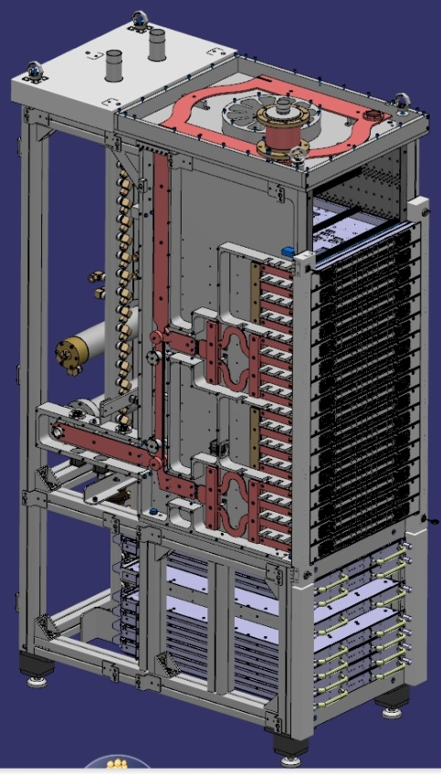
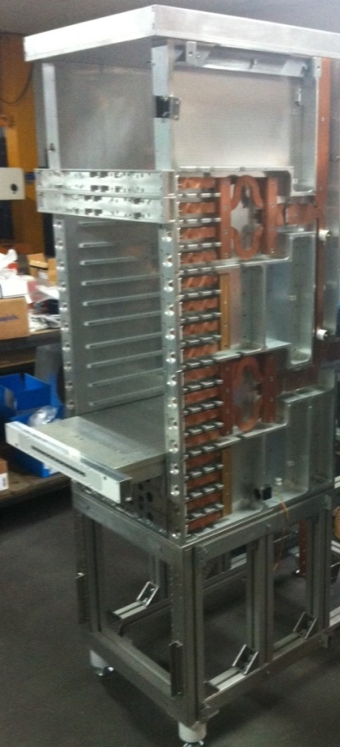
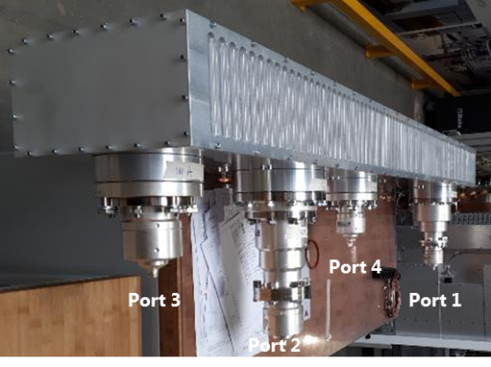
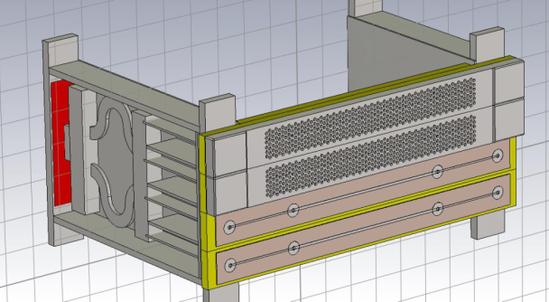
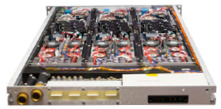
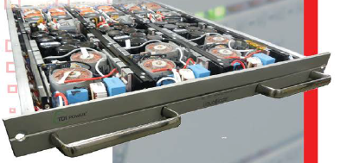
RFQ SSA design overview
Combining structure from 6 kW to 192 kW:
4 -> 1 Gysel combiner (24 kW output) using integrated 7 kW loads
Coupled line 3 dB combiner (48 kW output)
Branch type 3 dB combiner integrated in the cabinet’s roof (96 kW output)
External coupled line 3 dB combiner (192 kW output)
Innovative and compact integration
Commercial power supply unit:
LiquaBladeTM series from Astrodyne TDI
16.5 kW, 0-60 VDC, 360 A, 1U height
Water-cooled, fan-less
Power conversion efficiency > 92 %
Parallel operation (redundancy)
High reliability

Slide 9
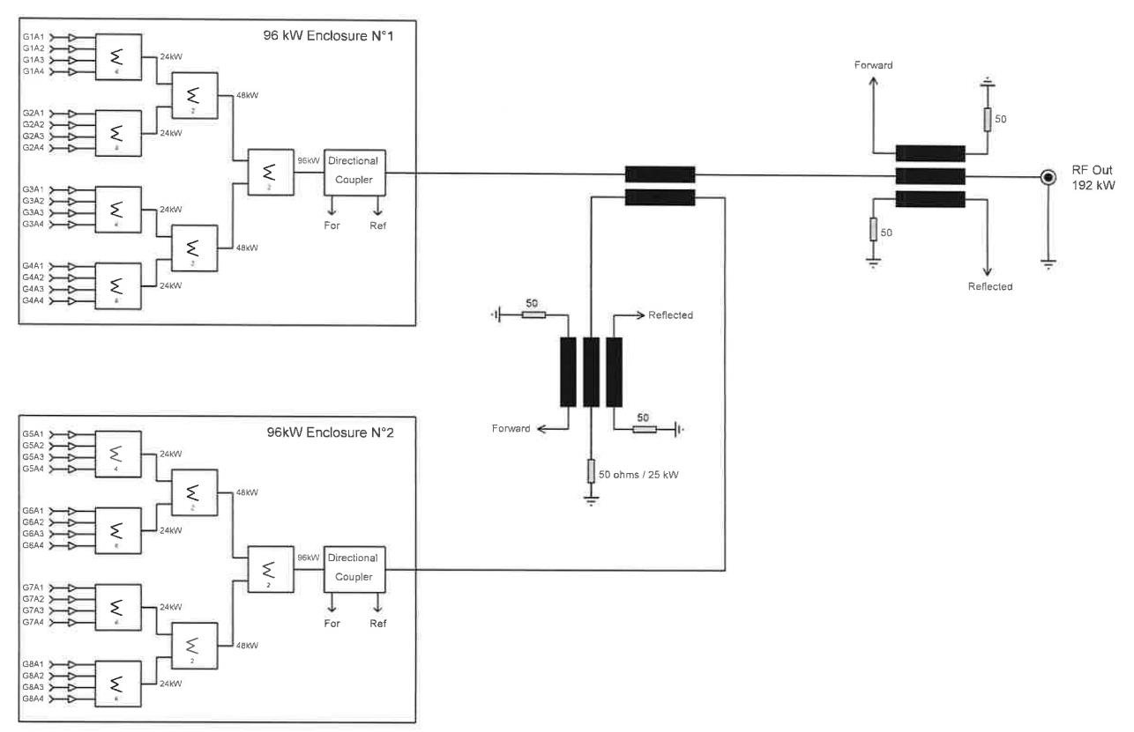
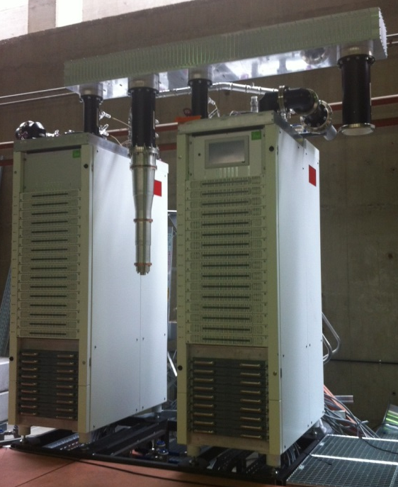
RFQ SSA design overview
Cabinet A
External combiner
Cabinet footprint (w/o electrical distribution):
620x1140 mm -> 135 kW/m²
Cabinet B
Source: SCK•CEN MYRRHA Project Team

Slide 10
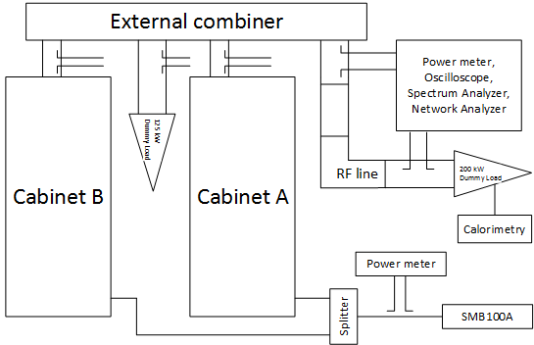
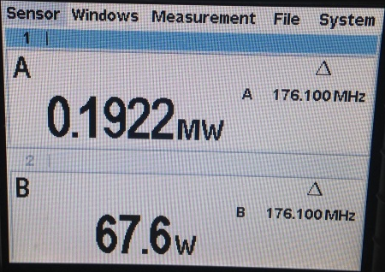
RFQ SSA Commissioning results on matched load
After few days of tuning, the design RF output power could be reached!!!
Optimized phase balance for the external combiner (~90°)

Slide 11
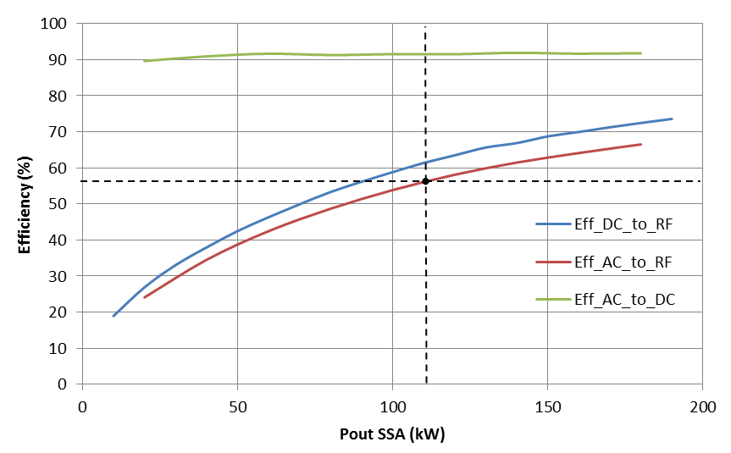
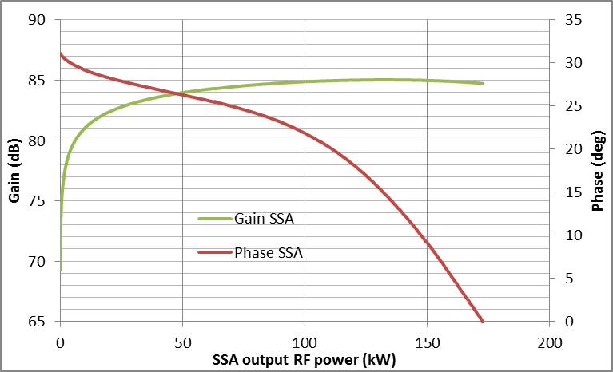
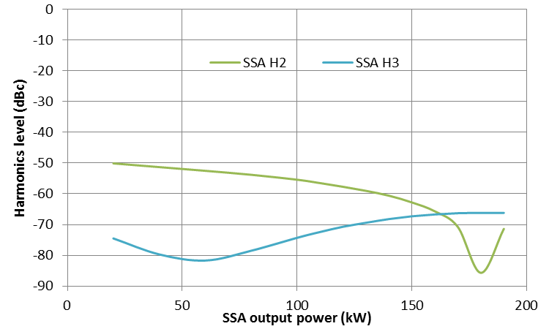
RFQ SSA Commissioning results on matched load
Main Parameters | Results | Comment
Max DC to RF efficiency | 73,6 % | Drop to 61,5 % at operating level (110 kW)
Max AC to RF efficiency | 67 % | Drop to 56 % at operating level
AC to DC efficiency | > 90 %
Harmonics level | < -50 dBc | Filtering property of combiners
Gain/phase linearity over 32% around operating level | 0,46 dB 14,5 deg | Useful for LLRF regulation
Gain/phase linearity over 20 dB range | 8 dB 20,5 deg
Gain/phase stability over 1 sec | < 0,02 dB < 0,15 deg
Rise time | 1,6 µs | Suitable for CW linac
RF voltage overshoot | < 5 %
If manual Vd adjustment (~ + 4%)

Slide 12
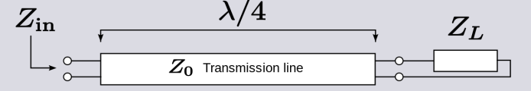
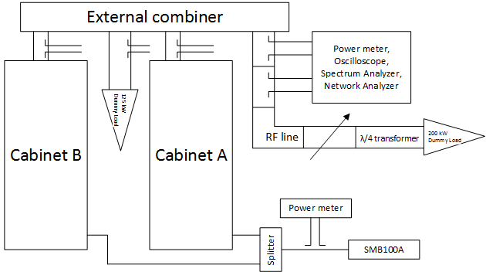
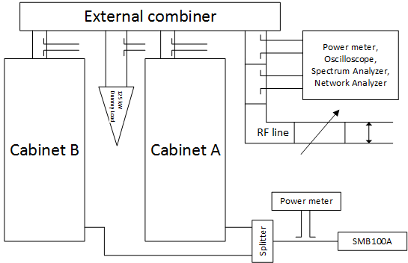
RFQ SSA commissioning results on mismatched load
On mismatched load
  With λ/4 impedance transformer providing VSWR of 2:1 or 3:1 (Z_{in} = Z₀²/Z_{L})
  Several Tx line lengthes for phase variation of Γ
On short-circuit (full reflection) - 10 ms pulse
  Several Tx line lengthes for phase variation of Γ
Source: SCK•CEN MYRRHA Project Team

Slide 13
RFQ SSA commissioning results on mismatched load
CW conditions
Pulse conditions
The maximum power corresponds to the first transistor’s current limit
The maximum forward power is softly phase dependent (averaged by phase distribution among 3 dB combiners)
The current on each pallet is strongly phase dependent (grouped by Gysel combiner = 24 pallets)
Whatever the phase of the reflection coefficient, the RFQ SSA can deliver the required forward power up to a VSWR = 2
0.33 -> VSWR 2

Slide 14
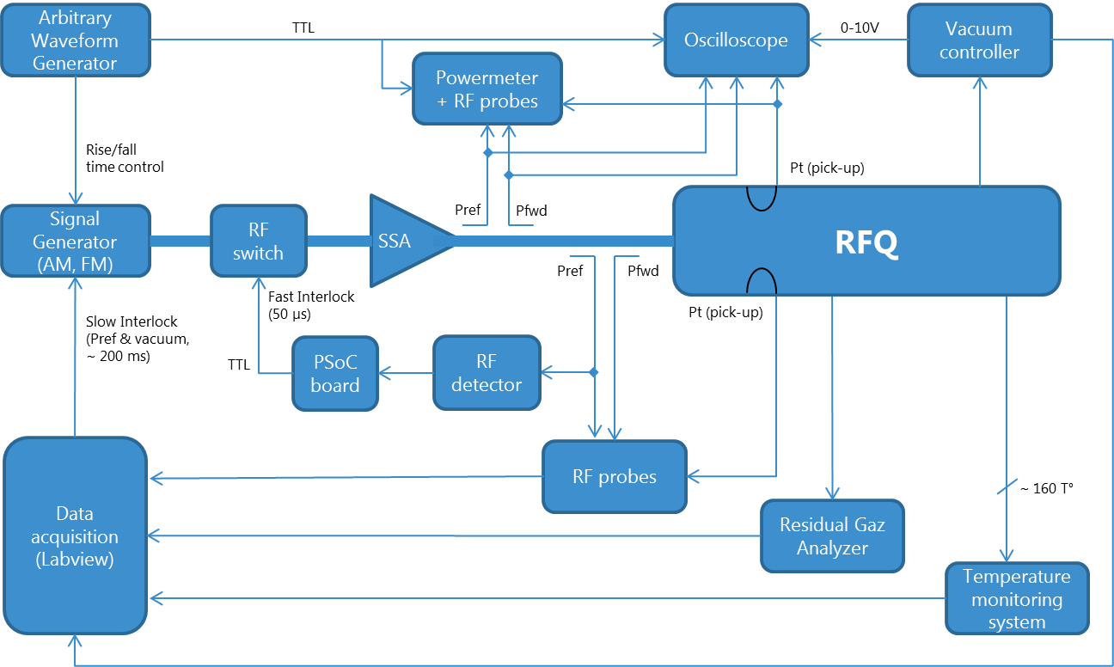
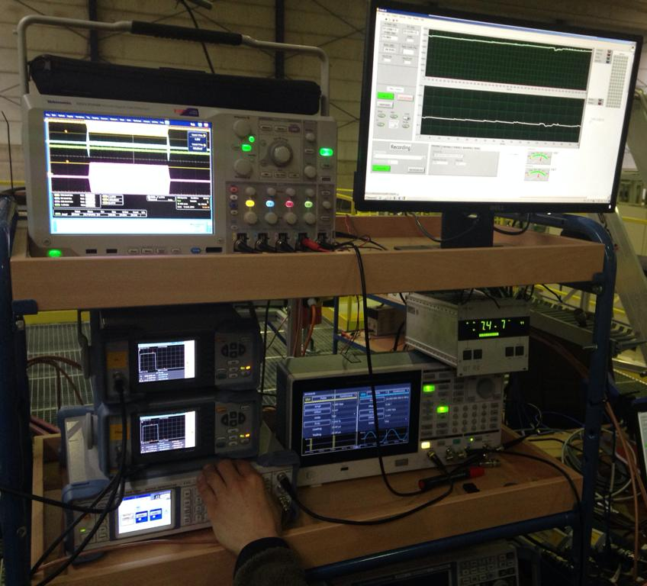
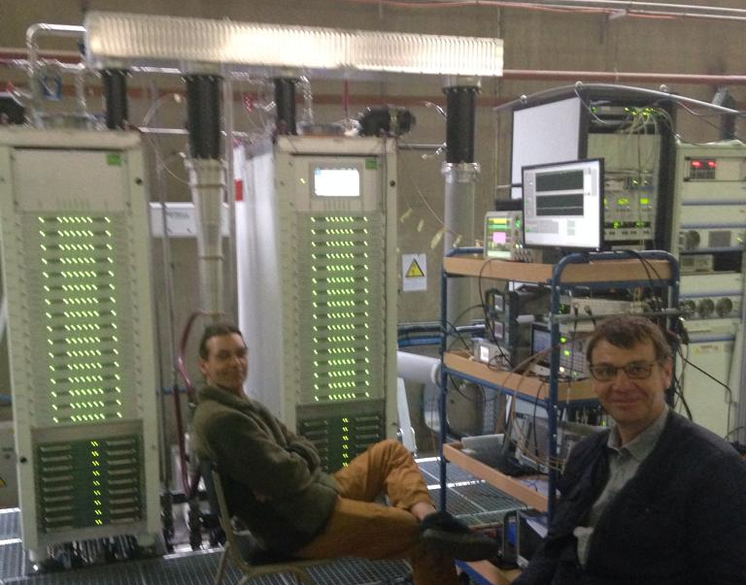
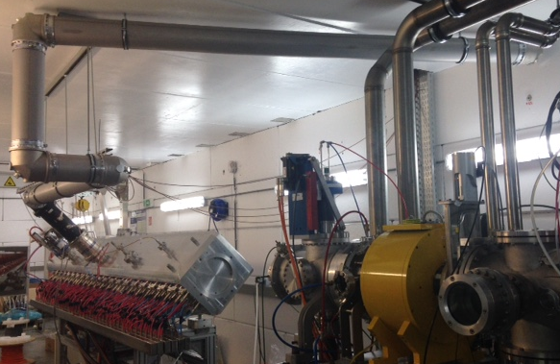
RFQ SSA commissioning results on RFQ load

Slide 15
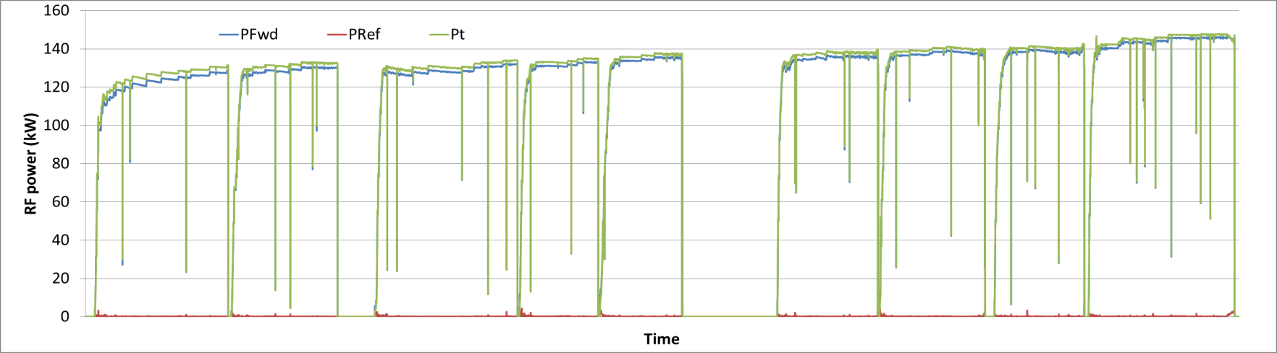
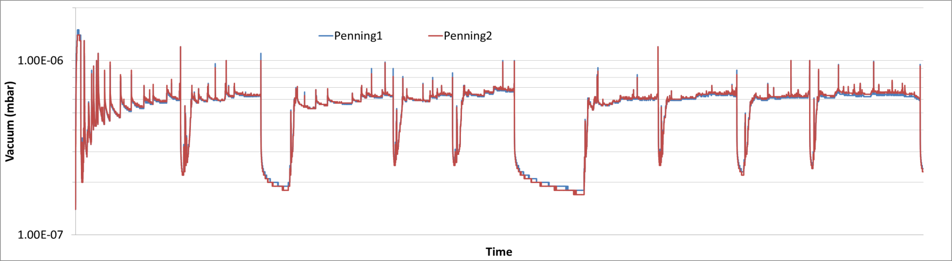
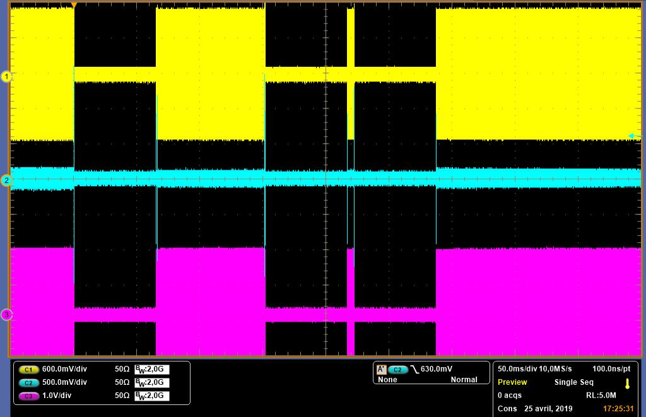
RFQ SSA commissioning results on RFQ load
7 hours duration
145 kW CW reached (110 kW CW required with beam), after 9 cumulated days of conditioning
The SSA is very stable during trips even without circulator!
RFQ Input matching at resonance is about -30 dB
Tx line (6 1/8”) temperature: ~ 60 °C (Max acceptable = 70 °C)

Slide 16
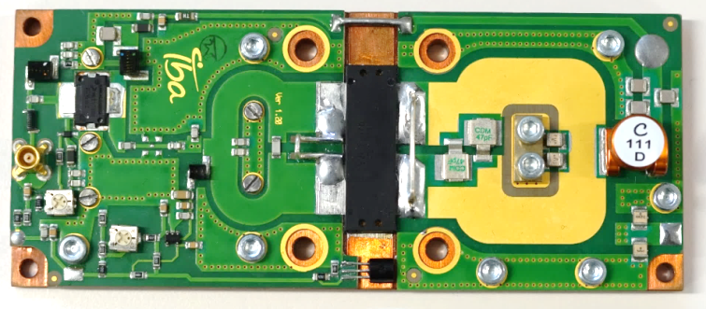
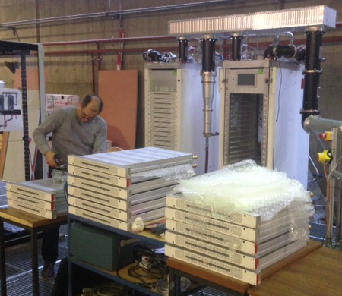
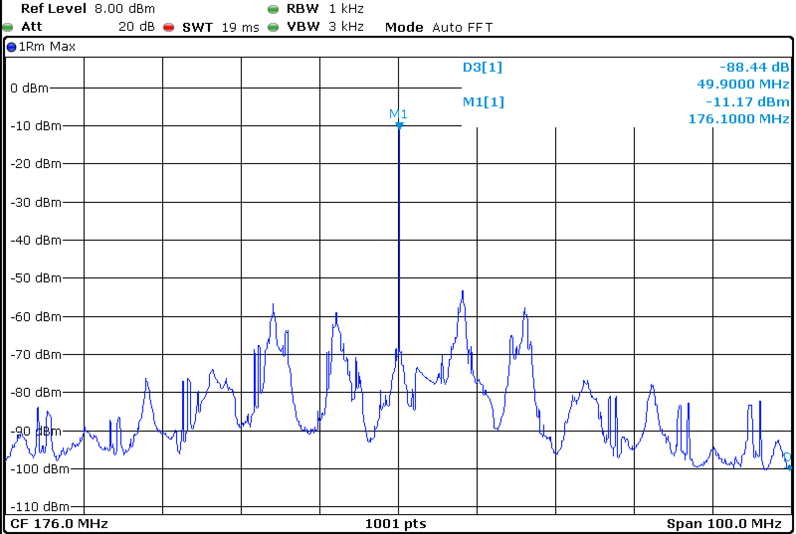
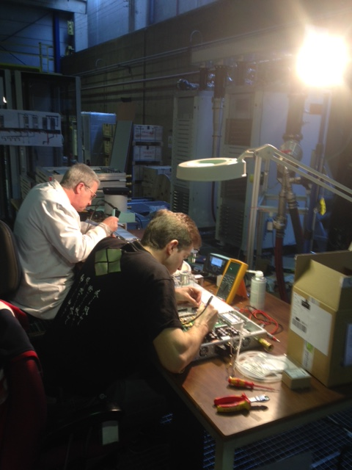
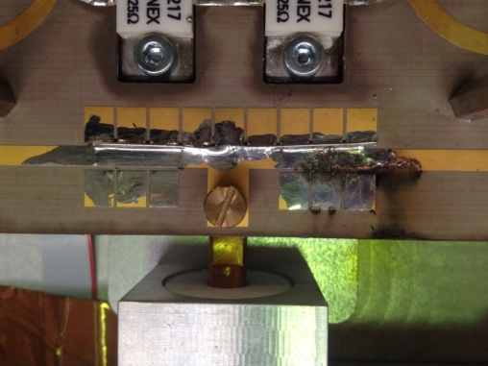
Issues during commissioning
1 Amp Fuse failure on the DC supply circuit of the 1kW pallet
Almost hundred fuses have blown up during initial commissioning
Due to a resonance, around 9 MHz, taking place in the DC supply circuit
A retrofit was done on the 192 pallets – about 120 h of manpower
No more a single fuse failure during and since the full re-commissioning
Arcing at output of a Wilkinson combiner (up to 6 kW)
Occurring at 90 kW pulse under short-circuit condition
Prototype board being used for fine tuning (isolated case)
Replaced by a standard board and working fine under same conditions!
Only one transistor death (isolated case)

Slide 17
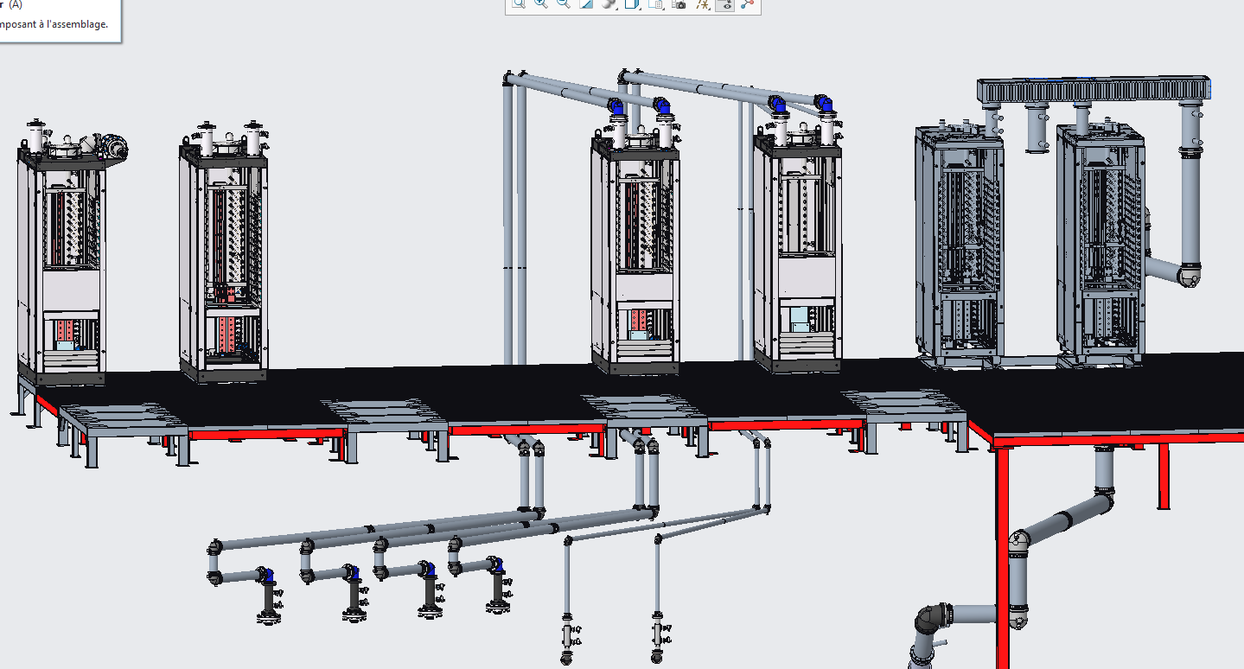
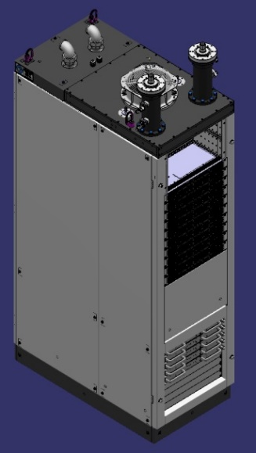
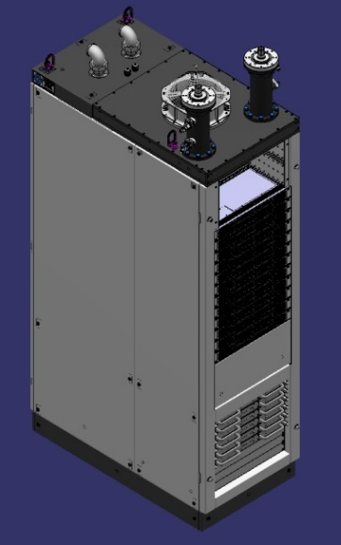
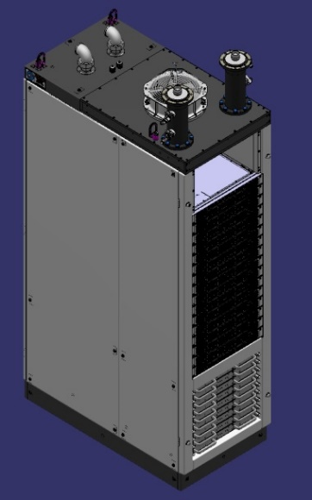
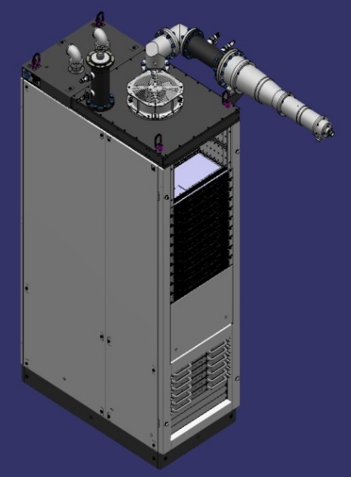
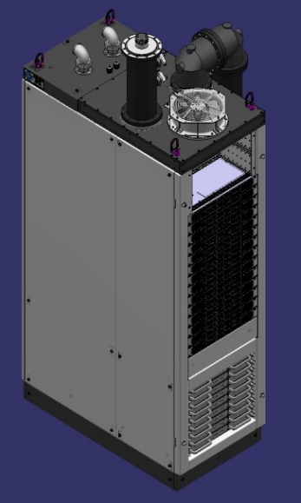
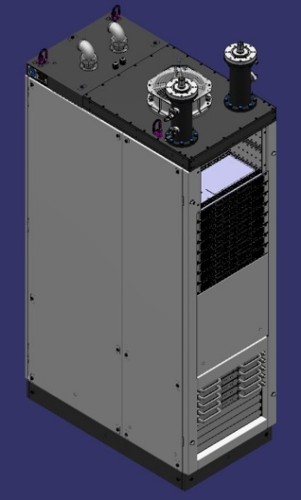
SSA ongoing procurements
Under a collaboration agreement with IBA:
12 amplifiers have been integrated among 6 cabinets
Optimized global footprint and simplified integration (electrical, cooling, control…)
Integration of these SSA is being prepared:
Electrical distribution, water cooling, mechanical support, RF lines…
The test bench will be equipped by a phase shifter, a variable stub (full coverage of Smith chart) and a dynamic short-circuit
QWR1&2 (2 x 6 kW) CH1&2 (2 x 24 kW) 176 MHz | CH3&4 (2 x 36 kW) 176 MHz | CH5&7 (2 x 48 kW) 176 MHz | CH6 (60 kW) 176 MHz | Coupler test (80 kW) 352 MHz | Cryomodule test (2 x 20 kW) 352 MHz

Slide 18
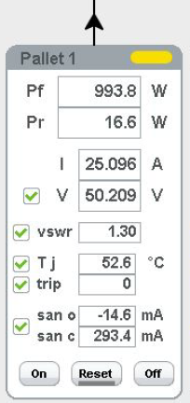
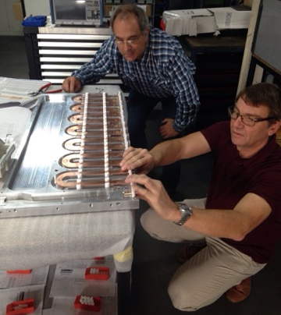
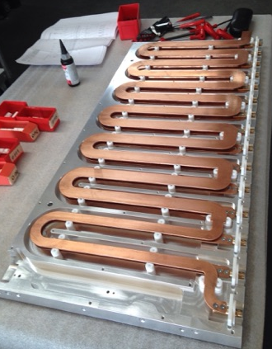
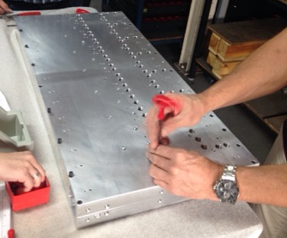
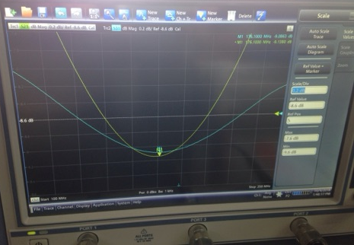
SSA ongoing procurements – New developments
Interlock on junction temperature of transistors
  Based on ANSYS real-time simulation of transistor’s junction w.r.t. dissipated power
  From dissipated power measurement, one can monitor and fast interlock (µs) the junction temperature
Progressive combiner
  Combine any number of 6 kW module
  Each port are isolated (losing a module will not affect the other modules)
  The coupling of each input is finely adjustable and progresses with the power level (1/2, 1/3, …)
  Use the integrated 7 kW loads inside modules -> no more external loads!
  Performances validated at low power and at high power

Slide 19
Conclusions
The RFQ SSA commissioning is, up to now, a success in terms of performances, compactness and robustness
As a first prototype of its kind, this SSA has required only a minor retrofit (however, many retrofits were necessary during the tests of individual components)
Importance to work closely and from the beginning with an industrial partner (design experience and tools, integration/cost optimization, industrialization view…)
The RFQ conditioning has been conducted without any trouble for the SSA even without circulator (to be confirmed with beam)
Reliability will be assessed during this prototyping phase and through a 1000 h run test, but a reliability model is required as well (from where to start?)
All SSAs required for the prototyping phase will be delivered and tested in 2019-2020!
First beam tests with the RFQ are expected for the end of the year!

Slide 20
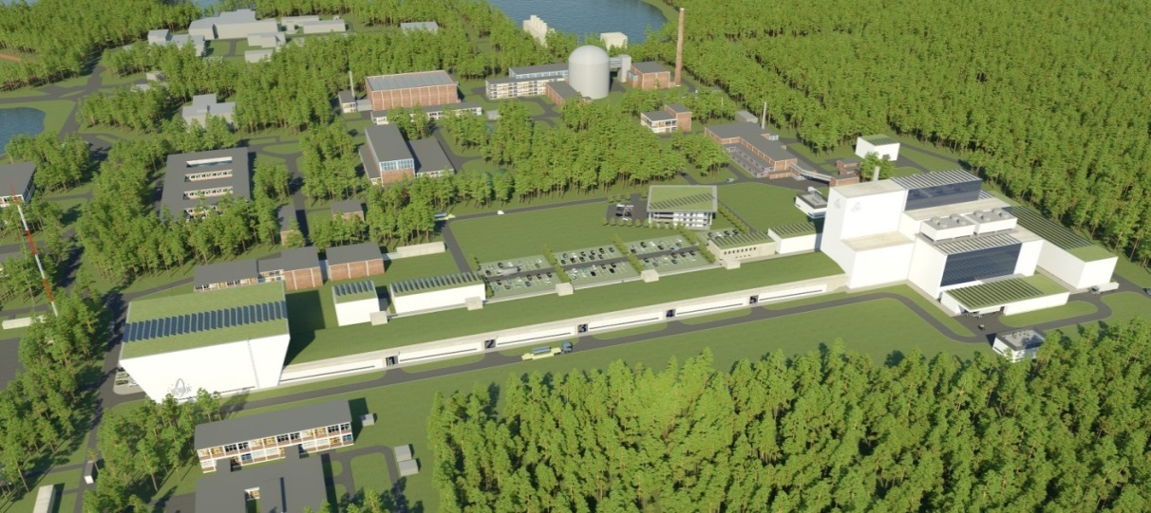
A jump in the future for innovation in Belgium

Slide 21
Copyright © 2018 - SCK•CEN
PLEASE NOTE!
This presentation contains data, information and formats for dedicated use ONLY and may not be copied, distributed or cited without the explicit permission of the SCK•CEN. If this has been obtained, please reference it as a “personal communication. By courtesy of SCK•CEN”.
SCK•CEN
Studiecentrum voor Kernenergie
Centre d'Etude de l'Energie Nucléaire
Belgian Nuclear Research Centre
Stichting van Openbaar Nut
Fondation d'Utilité Publique
Foundation of Public Utility
Registered Office: Avenue Herrmann-Debrouxlaan 40 – BE-1160 BRUSSELS
Operational Office: Boeretang 200 – BE-2400 MOL

Slide 22
BACK-UP SLIDES

Slide 23
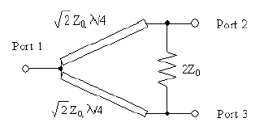
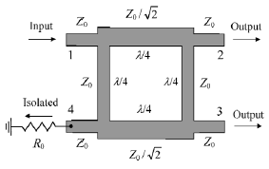
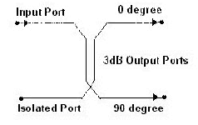
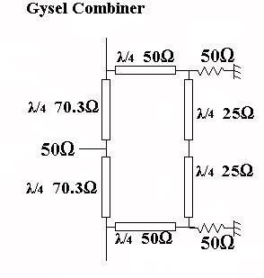
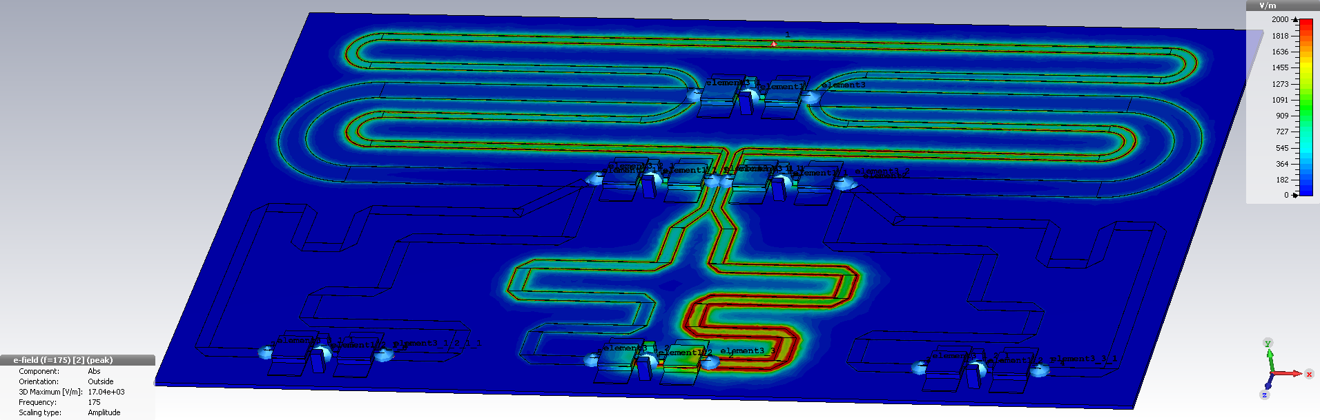
Combining structures
Wilkinson combiner
Branch-line combiner
Coupled line combiner
Wilkinson combiner 6->3->1 and input isolation simulation result (E field)
Source: SCK•CEN MYRRHA Project Team

Slide 24



Gysel combiner integration
IBA patent pending on this structure
Source: SCK•CEN MYRRHA Project Team

Slide 25

Cabinet integration
Source: SCK•CEN MYRRHA Project Team

Slide 26




Some screenshots of the local control system
Source: SCK•CEN MYRRHA Project Team

