Slide 1
Welcome
ARIES Workshop on Energy Efficient RF
Uppsala, June 11-12, 2019

Slide 2
Uppsala

Slide 3
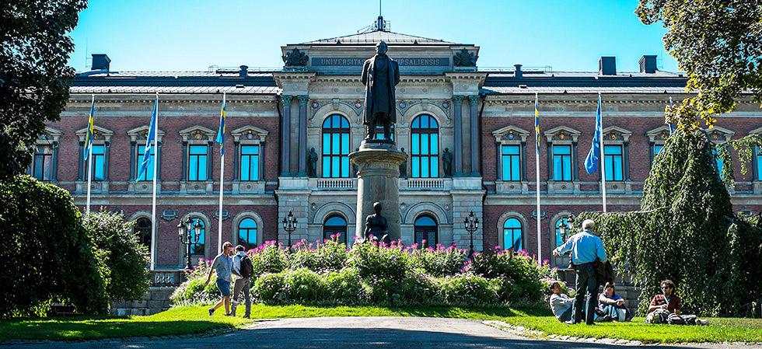
Uppsala University
Oldest university in Scandinavia (1477)
UU
40'000 students, 9'000 staff, 670 MEur annual budget
3 domains with 14 faculties:
Science and Technology
Medicine and Pharmacy
Humanities and Social Sciences
University library and hospital
Science and technology
10'000 students, 1'800 staff
Historical profiles: Linnaeus, Rudbeck, Celsius, Ångström, Siegbahn, Svedberg
R&D areas:
physics, chemistry, biology, earth sciences, engineering, mathematics, IT

Slide 4
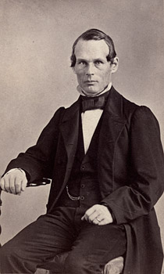
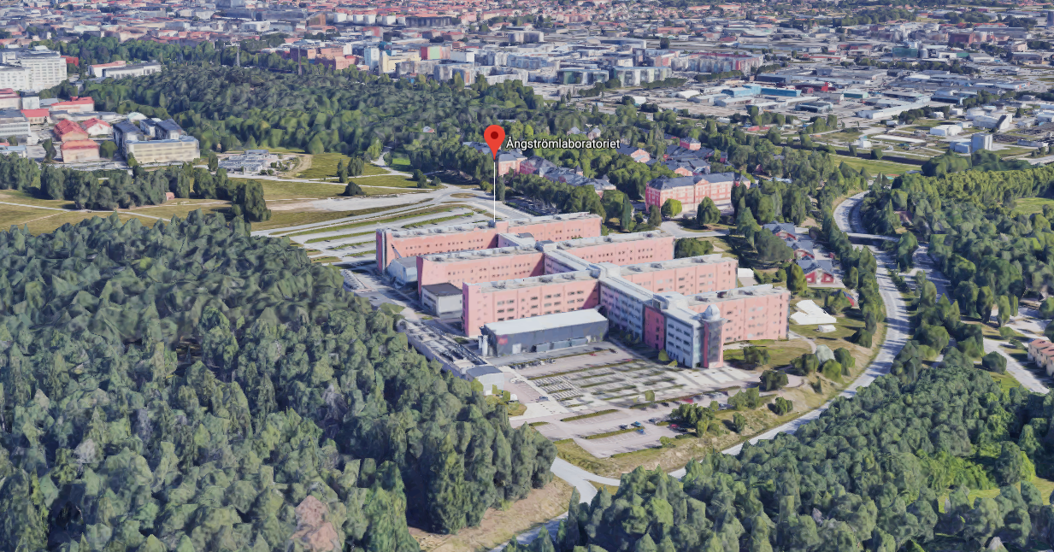
Ångström Laboratory
Departments:
Physics and Astronomy, Chemistry, Mathematics, Engineering, Sciences
Centers:
The Swedish Institute of Space Physics
The Tandem Laboratory - 5 MeV tandem accelerator and a 350 keV current ion implanter
UPPMAX/SNIC – high-performance computing centers
Ångström Microstructure Laboratory with 2000 m² cleanroom facility for microtechnology, nanoscience and characterization
Ångström Workshop - the largest university mechanical workshop in Sweden
FREIA

Slide 5
FREIA Laboratory

Slide 6
Agenda
Tuesday 18
Wednesday 19
Thursday 20
Please upload your slides to Indico
or give it to the convener before the session
Coffee breaks:
poster session
5 poster registered
visit FREIA Laboratory Wednesday afternoon
during coffee break,
before dinner

Slide 7
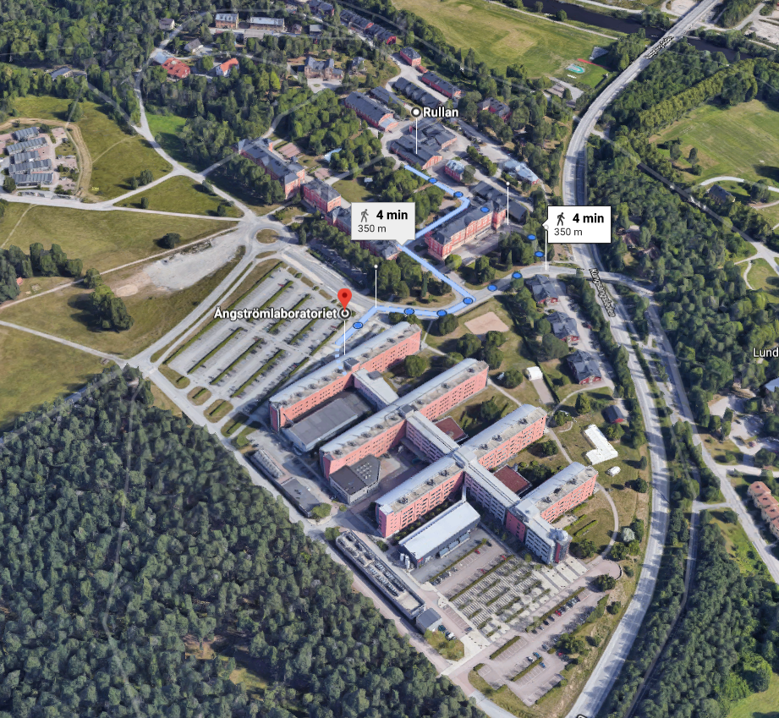
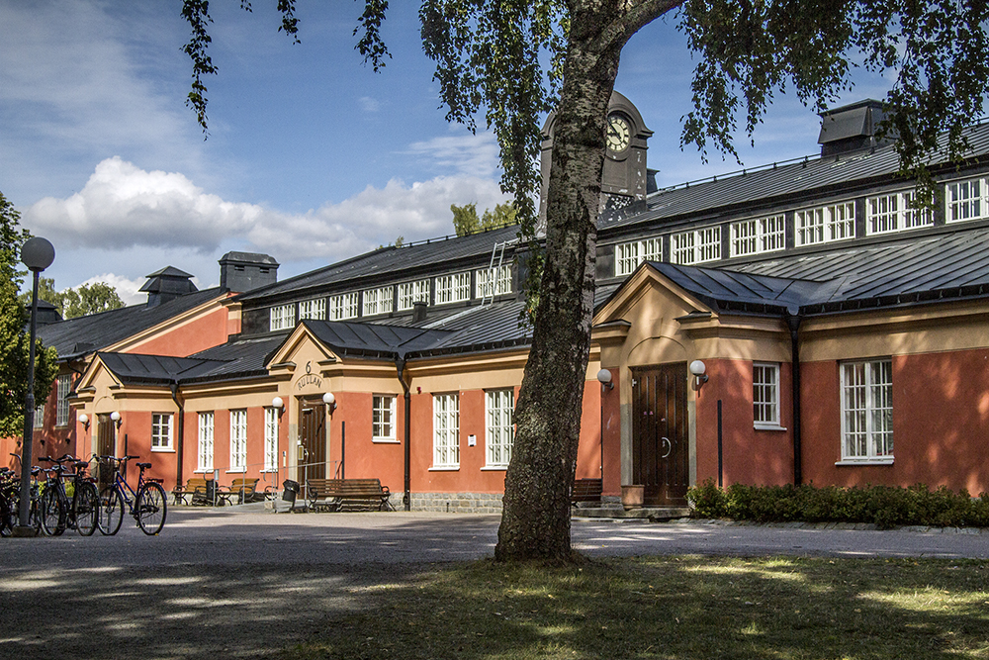
Lunch
Rullan restaurant
Lunch vouchers will be distributed.
Allergies or vegetarians, please contact us.

Slide 8
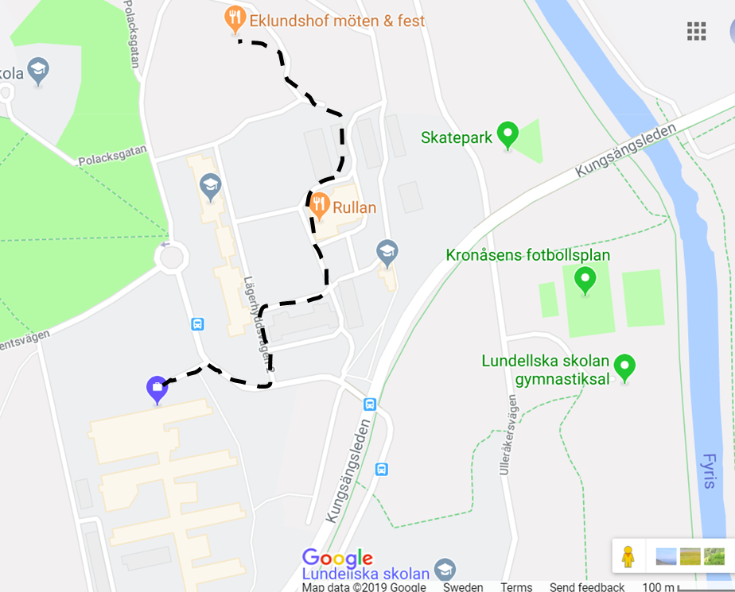
Dinner
Eklundshof
Eklundshovsvägen 7, Uppsala
Welcome drink at 19:00
Allergies or vegetarians, please contact us.

Slide 9
Aim of the Workshop
Review the status and assist the development of energy efficient RF sources
important for the future of accelerator infrastructures as energy costs have large economical and environmental impact

