Slide 1
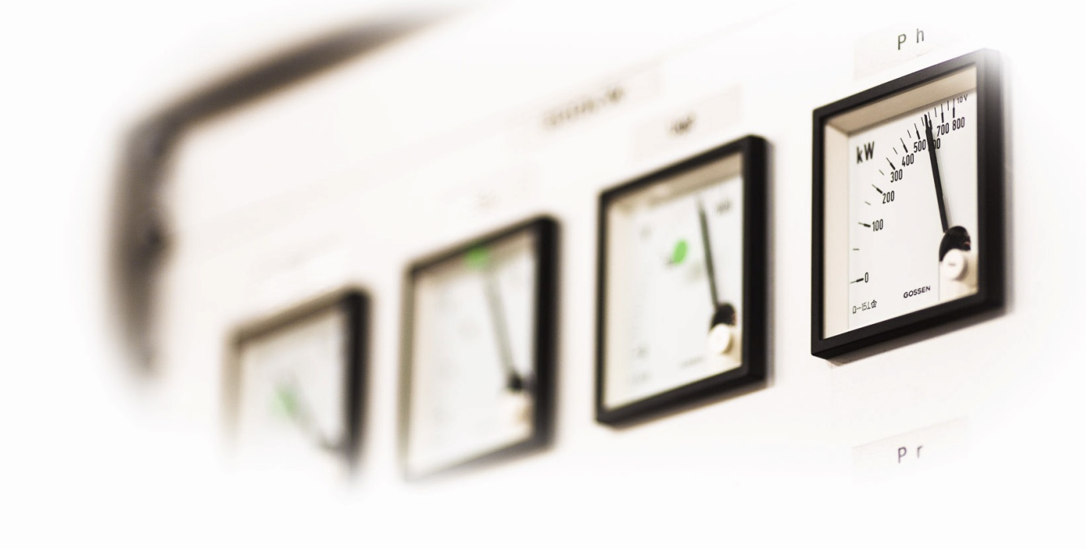

Increasing Demand for
High Efficiency RF Power Sources
Erk Jensen
CERN
ARIES Workshop on Energy Efficient RF
Ångström Laboratory, Uppsala universitet
18 – 20 June 2019 – Uppsala, Sweden

Slide 2
Outline
Introduction – global context
Definition of “Energy Efficiency”
The Demand for High Efficiency RF Power
Trends
  IOT’s
  Klystrons
  Magnetrons
  Solid State RF Power Sources
Summary

Slide 3
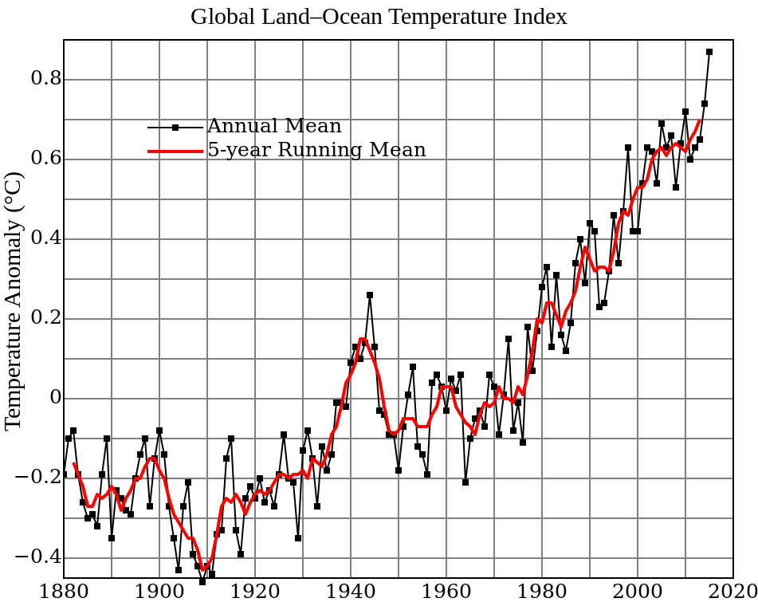
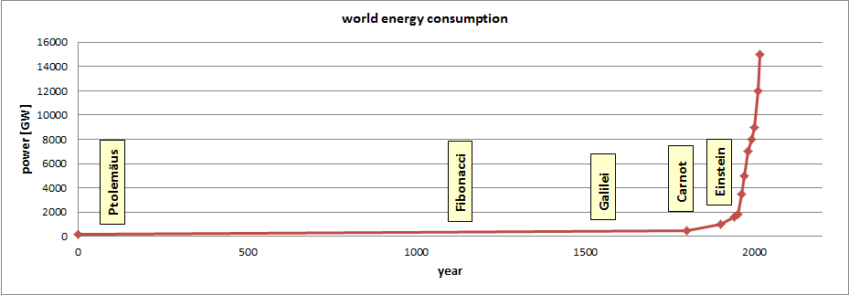
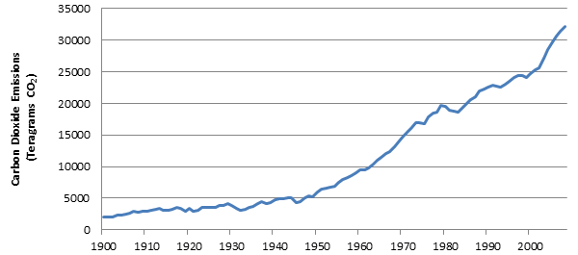
Why does energy efficiency matter?
Scarcity of fossil energy – problematic nuclear power
Volatile & unpredictable energy costs
Increasing environmental concerns (global warming, El Niño, CO₂ emission)
Awareness for 50 years (Club of Rome 1968, Oil crisis 1973)
Political – societal imperative: must go towards sustainable energy!
Also particle accelerator facilities must be conceived/built/operated with
this in mind! … in fact – they should give a good example and incite R&D!

Slide 4

Energy Efficiency and Strategy
Quote from www.iea.org:
  Energy efficiency is one of the cornerstones of any strategy to guarantee sustainable and inclusive economic growth. It remains one of the most cost-effective ways to enhance security of energy supply, to boost competitiveness and welfare, and to reduce the environmental footprint of the energy system. Not only can the growth of carbon emissions be tempered by the more efficient use of energy but energy efficiency can also improve local pollution and contribute to reducing the millions of air-pollution related premature deaths each year, and keep consumers energy bills in check.
  UN’s “Sustainable Development Goal 7.3” is the measurable improvement (decrease) of global energy density, defined as primary energy supply per GDP.
Particularly relevant since large colliders are quite gourmand for energy

Slide 5
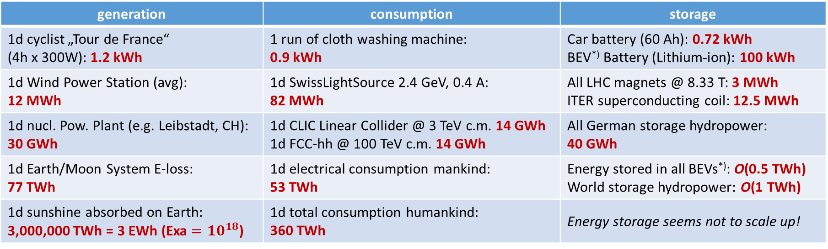
Orders of magnitude
generation | consumption | storage
1d cyclist „Tour de France“ (4h x 300W): 1.2 kWh | 1 run of cloth washing machine: 0.9 kWh | Car battery (60 Ah): 0.72 kWh BEV^{*)} Battery (Lithium-ion): 100 kWh
1d Wind Power Station (avg): 12 MWh | 1d SwissLightSource 2.4 GeV, 0.4 A: 82 MWh | All LHC magnets @ 8.33 T: 3 MWh ITER superconducting coil: 12.5 MWh
1d nucl. Pow. Plant (e.g. Leibstadt, CH): 30 GWh | 1d CLIC Linear Collider @ 3 TeV c.m. 14 GWh 1d FCC-hh @ 100 TeV c.m. 14 GWh | All German storage hydropower: 40 GWh
1d Earth/Moon System E-loss: 77 TWh | 1d electrical consumption mankind: 53 TWh | Energy stored in all BEVs^{*)}: O(0.5 TWh) World storage hydropower: O(1 TWh)
1d sunshine absorbed on Earth: 3,000,000 TWh = 3 EWh (Exa $=10^{18}$) | 1d total consumption humankind: 360 TWh | Energy storage seems not to scale up!
^{*)} Battery Electric Vehicle
Accelerators are in the range were they become relevant for society and public discussion.
Desired turn to renewables is an enormous task; storage is the problem, not production!
Fluctuations of energy availability, depending on time and weather, will be large!
M. Seidel/PSI

Slide 6
Power flow in Accelerators
Electricity grid
Accelerator
Radio Frequency
Magnets
Vacuum etc.
direct beam application:
p-therapy
Isotope production
beam
conversion to secondary radiation (beam collisions, targets, undulators …)
secondary radiation
Exotic particles, e.g. Higgs, B-mesons
Photons (synchrotron radiation)
Neutrons
Muons
Auxiliary systems
Cryogenics
Conv. cooling, AC etc.
Instruments
E.g. particle detectors
Computing
Eventually all converted to waste heat !
Possible figures of merit:
Number of physics events, secondary particles, X-rays on sample … per kWh consumed
M. Seidel/PSI

Slide 7

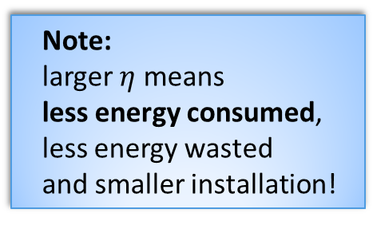


Efficiency $η$, definition
Smaller efficiency
Larger efficiency
outcome
outcome
consumed energy
useful energy
=
$η∙$ consumed energy
consumed energy
useful energy
=
$η∙$ consumed energy
rejected energy
(normally heat)
rejected energy
(normally heat)
Note:
larger $η$ means
less energy consumed,
less energy wasted
and smaller installation!
Definition as a ratio makes sense only for an energy-converting sub-system.
For an accelerator facility, we need other figures of merit!

Slide 8
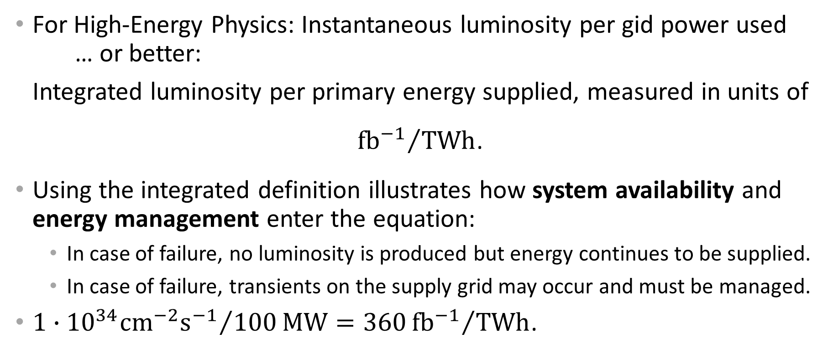
Adapted definition
For High-Energy Physics: Instantaneous luminosity per gid power used
… or better:
Integrated luminosity per primary energy supplied, measured in units of
${fb^{−1}}/{TWh}$.
Using the integrated definition illustrates how system availability and energy management enter the equation:
  In case of failure, no luminosity is produced but energy continues to be supplied.
  In case of failure, transients on the supply grid may occur and must be managed.
$1∙{{10}^{34}cm^{−2}s^{−1}}/{100}MW=360{fb^{−1}}/{TWh}$.

Slide 9
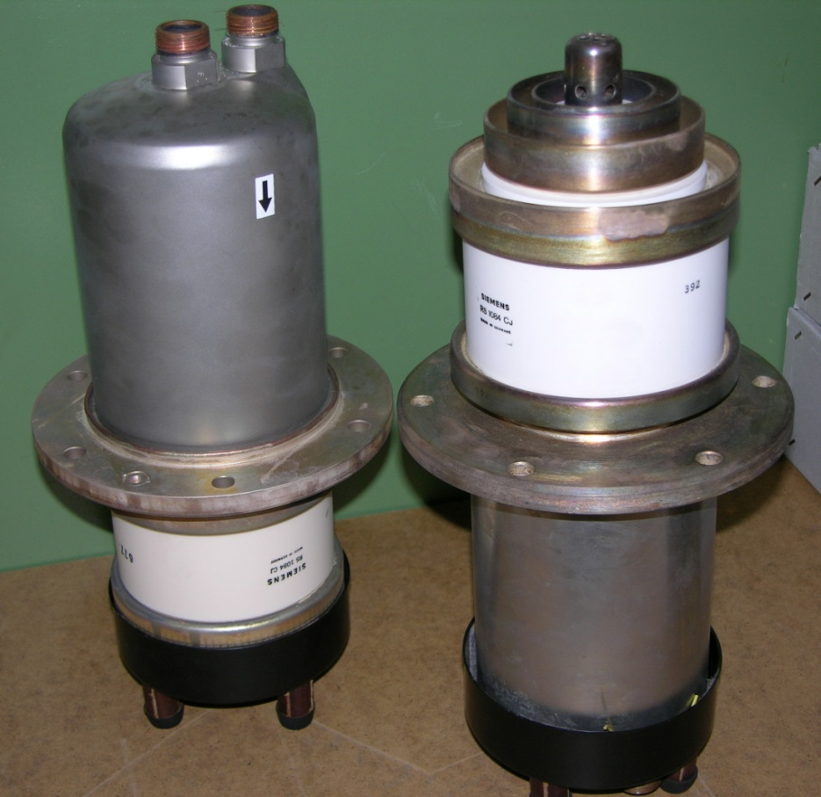
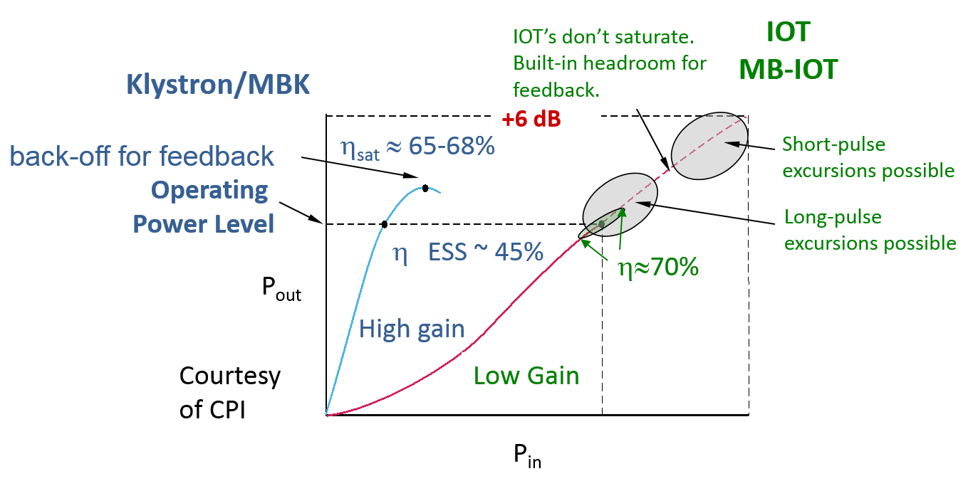
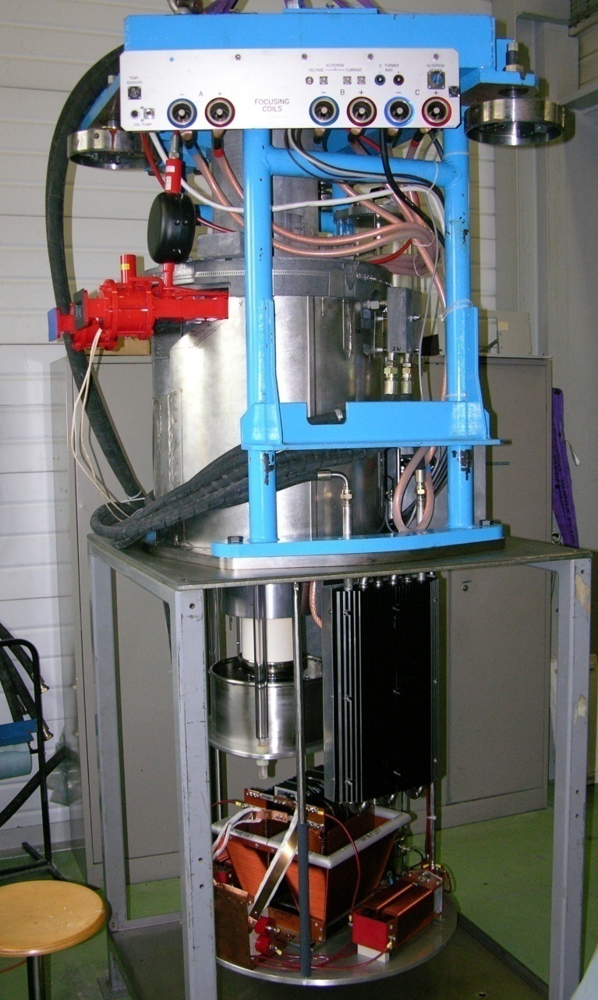
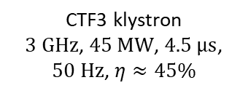
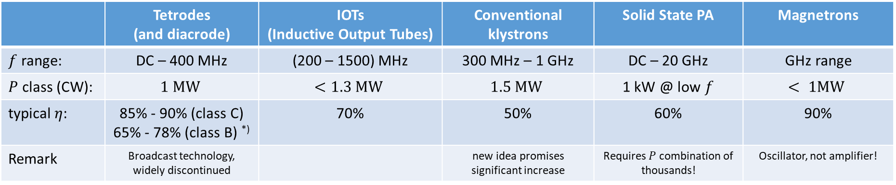
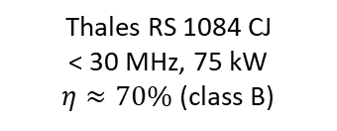
RF power generators – typical efficiencies
 | Tetrodes (and diacrode) | IOTs (Inductive Output Tubes) | Conventional klystrons | Solid State PA | Magnetrons
$f$ range: | DC – 400 MHz | (200 – 1500) MHz | 300 MHz – 1 GHz | DC – 20 GHz | GHz range
$P$ class (CW): | $$1 MW$$ | $$<1.3 MW$$ | $$1.5 MW$$ | 1 kW @ low $f$ | $$< 1MW$$
typical $η$: | 85% - 90% (class C) 65% - 78% (class B) ^{*)} | 70% | 50% | 60% | 90%
Remark | Broadcast technology, widely discontinued |  | new idea promises significant increase | Requires $P$ combination of thousands! | Oscillator, not amplifier!
^{*)} Electronic efficiency, not including heater & input power.
CTF3 klystron
$3 GHz$, $45 MW$, $4.5 μs$, $50 Hz$, $η≈45\%$
Thales RS 1084 CJ
< 30 MHz, 75 kW
$η≈70\%$ (class B)
M. Jensen: EnEfficient RF Sources, 2014, Daresbury

Slide 10




Recent Multi-beam IOT program (1/2)
In order to provide an alternative to klystrons, ESS launched a R&D program for Multi Beam IOT.
Two prototypes were delivered and tested.
The goal was 1.3 MW @ 704 MHz pulsing up to 3.5 ms – 14 Hz
CERN contributed building a test place and performing tests.
Program concluded in 2018.

Slide 11
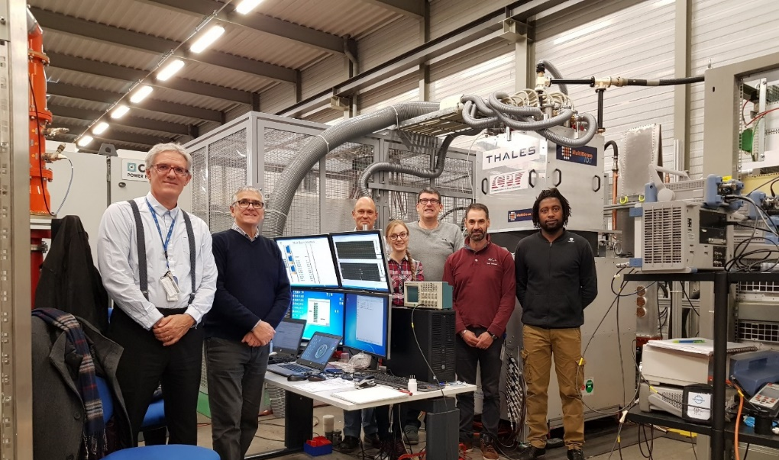
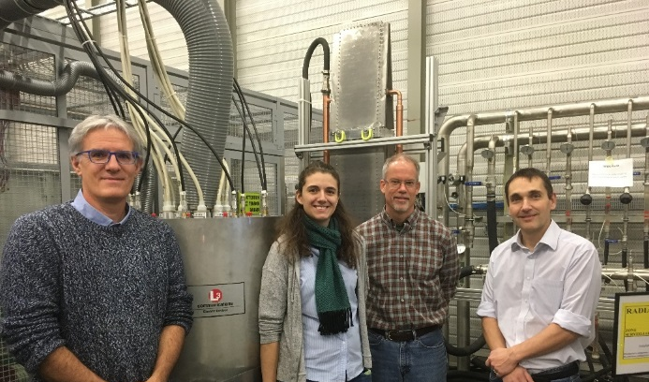











Recent Multi-beam IOT program (2/2)
$$η_{{RF}/{DC}}\left[\%\right]$$
$$η_{{RF}/{DC}}\left[\%\right]$$
Operating point
RF/DC efficiency = 72 %
Operating point
RF/DC efficiency = 70 %
$$P_{out,CW}[kW]$$
$$P_{out,CW}[kW]$$
$$1.20 MW_{peak}$$
$$1.35 MW_{peak}$$

Slide 12
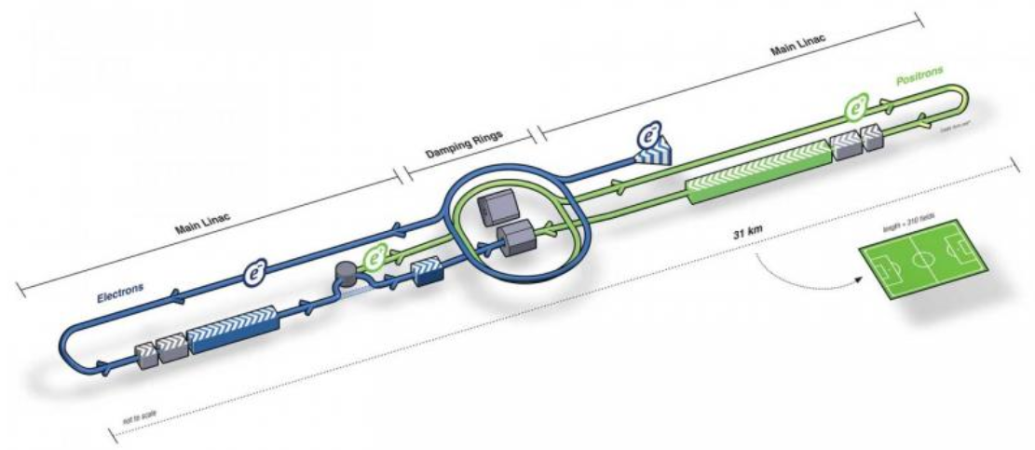
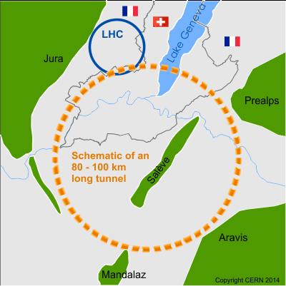
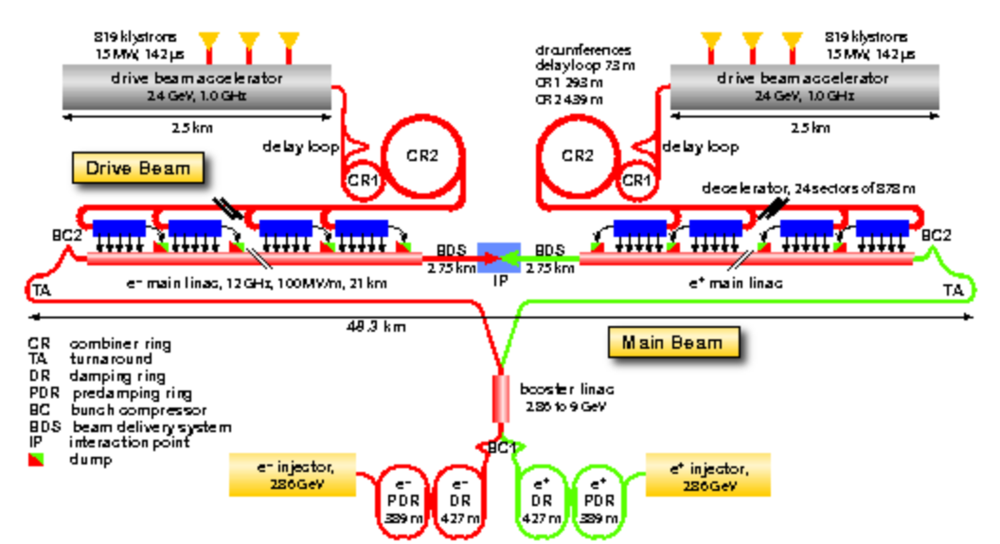

Average RF power needs of large HEP Projects
ILC 0.25 TeV: Pulsed, 1.3 GHz, $P_{RF, total}=20 MW$^{*)}
FCC-ee: CW, (0.4 & 0.8) GHz, $P_{RF, total}=105 MW$
CLIC 3 TeV: Pulsed, 1 GHz, $P_{RF, total}=180 MW$
^{*)}: Estimated value from https://arxiv.org/abs/1903.01629
TDR values for 500 GeV: (68…92) MW, depending on region.

Slide 13

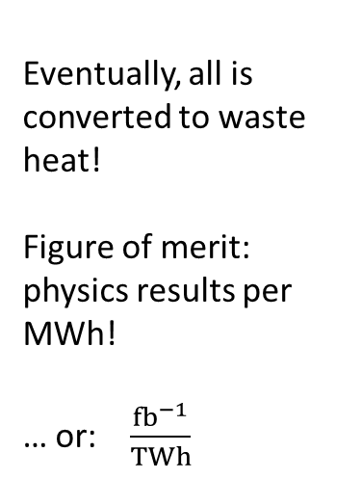
Example FCC-ee $\left(t\overline{t}\right)$: orders of magnitude
Note: largest impact by RF power generation
Grid to DC: 90%
RF power generation!
Eventually, all is converted to waste heat!
Figure of merit: physics results per MWh!
… or: $\frac{fb^{−1}}{TWh}$
RF distribution!
losses in cavities
RF to beam
P. Lebrun

Slide 14
Higher Efficiency Klystrons
… more details in following session (“Energy Efficient Vacuum Tube Devices”)

Slide 15
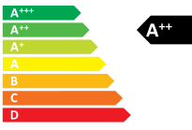
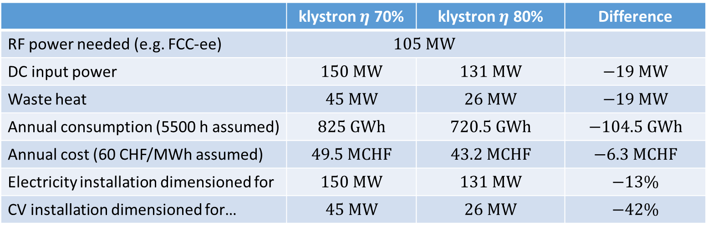

The value of increased $η$, e.g. 70% → 80%
 | klystron $η$ 70% | klystron $η$ 80% | Difference
RF power needed (e.g. FCC-ee) | $$105 MW$$
DC input power | $$150 MW$$ | $$131 MW$$ | $$−19 MW$$
Waste heat | $$45 MW$$ | $$26 MW$$ | $$−19 MW$$
Annual consumption (5500 h assumed) | $$825 GWh$$ | $$720.5 GWh$$ | $$−104.5 GWh$$
Annual cost (60 CHF/MWh assumed) | $$49.5 MCHF$$ | $$43.2 MCHF$$ | $$−6.3 MCHF$$
Electricity installation dimensioned for | $$150 MW$$ | $$131 MW$$ | $$−13\%$$
CV installation dimensioned for… | $$45 MW$$ | $$26 MW$$ | $$−42\%$$
All the above gains are significant!
R&D on increasing the useable efficiency is
worth every penny/cent invested!
Potential saving:
1.04 TWh in 10 years
63 MCHF in 10 years

Slide 16
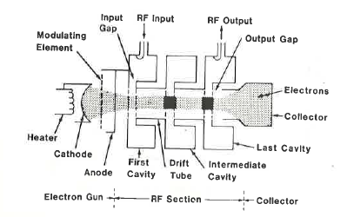
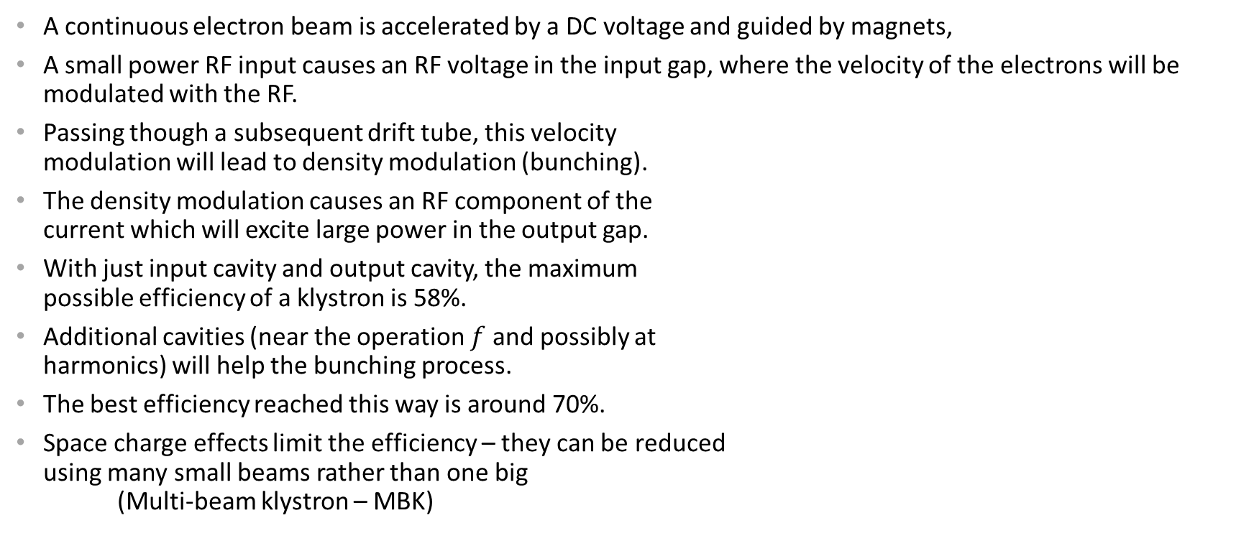
How does a klystron work?
A continuous electron beam is accelerated by a DC voltage and guided by magnets,
A small power RF input causes an RF voltage in the input gap, where the velocity of the electrons will be modulated with the RF.
Passing though a subsequent drift tube, this velocity
modulation will lead to density modulation (bunching).
The density modulation causes an RF component of the
current which will excite large power in the output gap.
With just input cavity and output cavity, the maximum
possible efficiency of a klystron is 58%.
Additional cavities (near the operation $f$ and possibly at
harmonics) will help the bunching process.
The best efficiency reached this way is around 70%.
Space charge effects limit the efficiency – they can be reduced
using many small beams rather than one big
(Multi-beam klystron – MBK)
From A.S. Gilmour, Jr. “Microwave Tubes”, Artech House 1986, who took this from Microwave Tube Manual by Varian Associates, Air Force Publication Number T.0.00-25-251, 1979

Slide 17

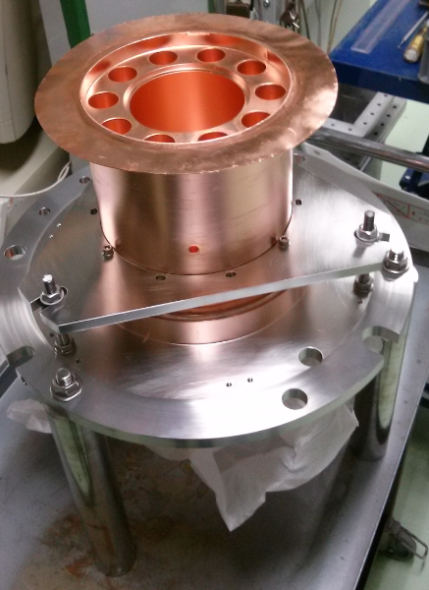
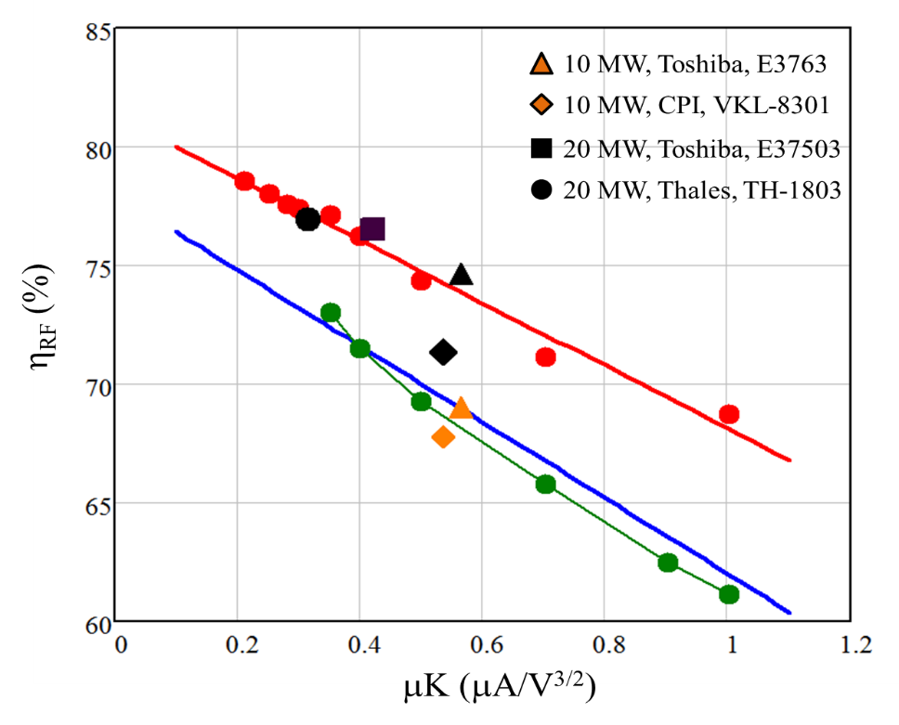
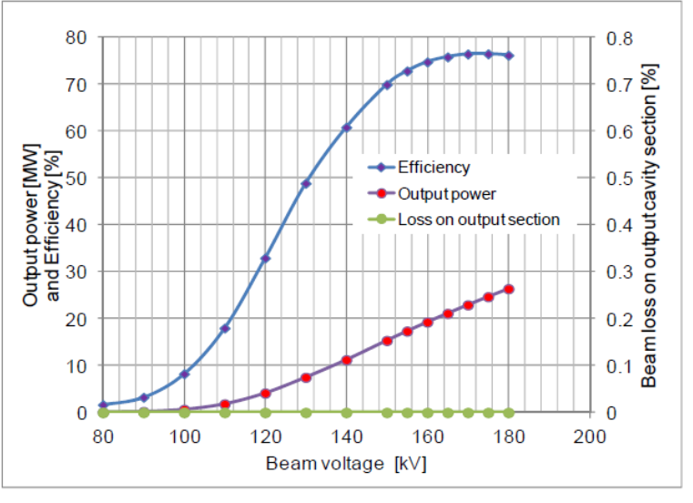
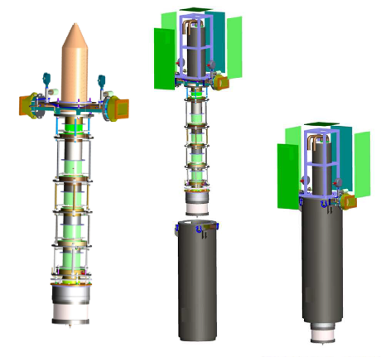

MBK developments for CLIC
Frequency: 1 GHz
Peak power: 20 MW
Pulse length: 150 μsec
Rep. rate: 50 Hz
Efficiency: >67%
Simulated klystron efficiency vs. perveance
Optimised at CERN
Recommended by industry
I Syratchev/CERN

Slide 18
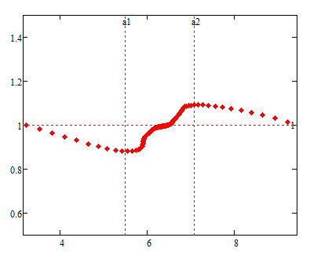
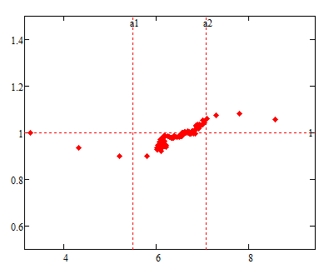
A promising new concept (2013)
2π
‘’Classical” bunching
η_{RF}=78.0%
Bunch phase
Normalised velocity
Useful RF phase
Output cavity
0
RF period, rad
New bunching with core oscillations (COM)
2π
η_{RF}=89.6%
Normalised velocity
Bunch phase
Normalised velocity
I Syratchev/CERN
Output cavity
0
http://ieeexplore.ieee.org/xpl/articleDetails.jsp?arnumber=7194781
RF period, rad

Slide 19
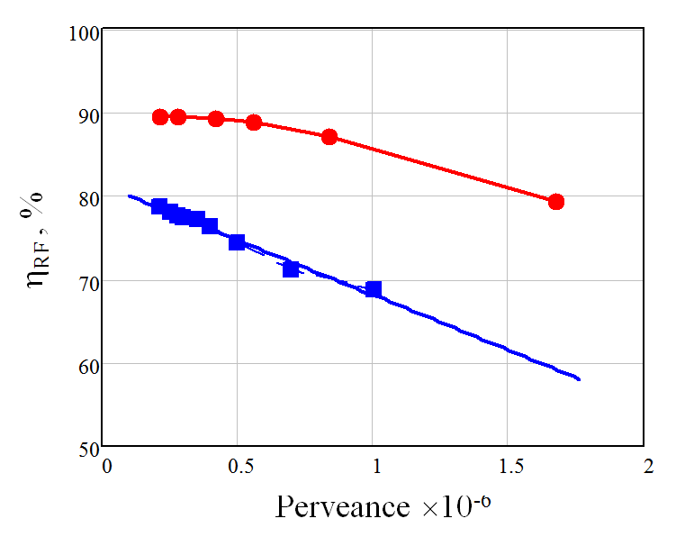
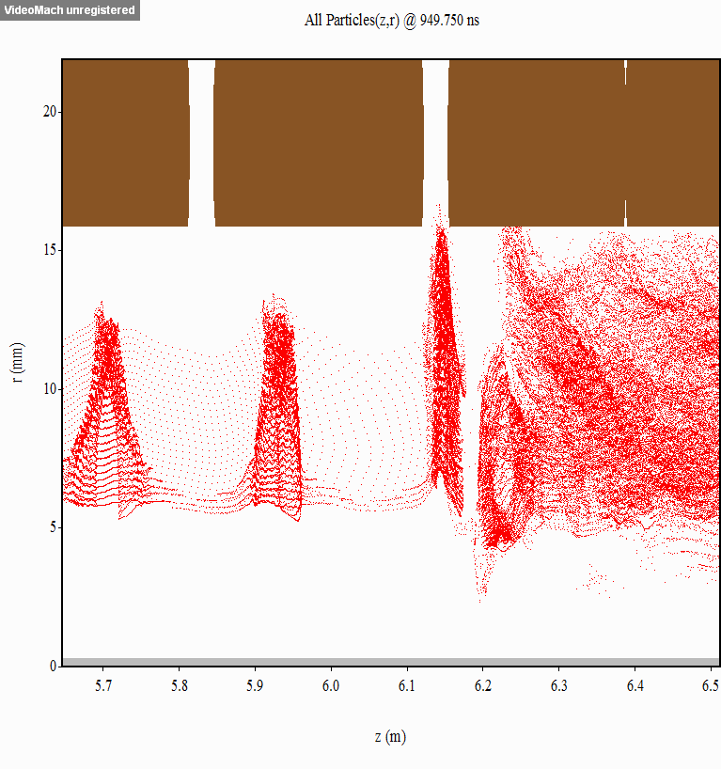
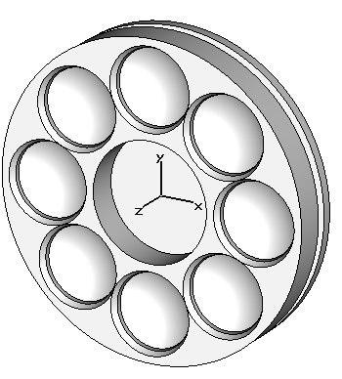
Comparison of the two bunching methods
8 beams
20 MW CLIC
COM
1 beam
20 MW CLIC
conventional
10 MW ILC
N beams = 8
V = 180 kV
I total = 128 A
RF extraction efficiency: 86.6%;
I Syratchev/CERN

Slide 20
Magnetrons

Slide 21
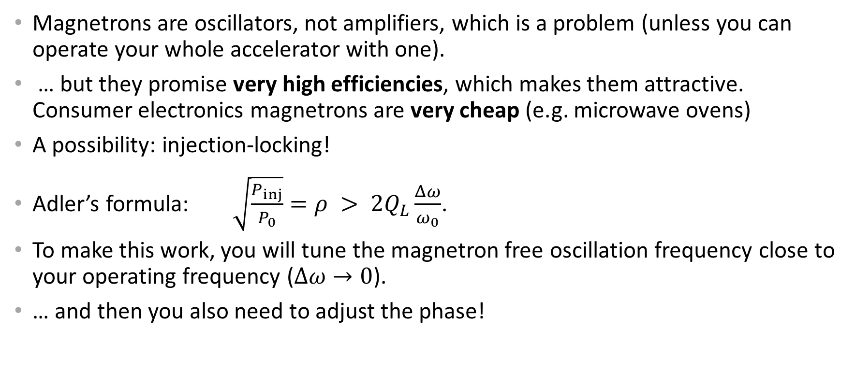
Magnetrons (?)
Magnetrons are oscillators, not amplifiers, which is a problem (unless you can operate your whole accelerator with one).
… but they promise very high efficiencies, which makes them attractive. Consumer electronics magnetrons are very cheap (e.g. microwave ovens)
A possibility: injection-locking!
Adler’s formula: $\sqrt{\frac{P_{inj}}{P_{0}}}=ρ > 2Q_{L}\frac{Δω}{ω_{0}}$.
To make this work, you will tune the magnetron free oscillation frequency close to your operating frequency ($Δω→0$).
… and then you also need to adjust the phase!
Adler, R., "A Study of Locking Phenomena in Oscillators," Proceedings of the IRE , vol.34, no.6, pp. 351-357, June 1946

Slide 22
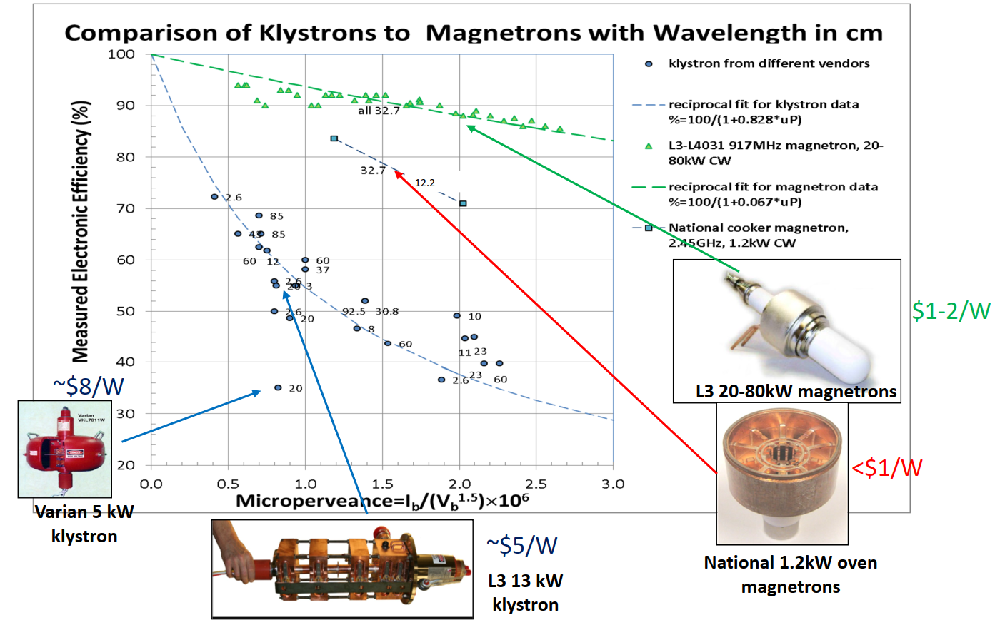
Electronic efficiency – klystrons vs. magnetrons
1.09 GHz
1.09 GHz
11.5 GHz
2.45 GHz
Magnetrons
High efficiency klystrons (I. Syratchev)
352 MHz
Klystrons
industrial empirical limit for conventional klystrons
500 MHz
1.5 GHz
H. Wang, IPAC 2019, Melbourne, WEXXPLS1

Slide 23
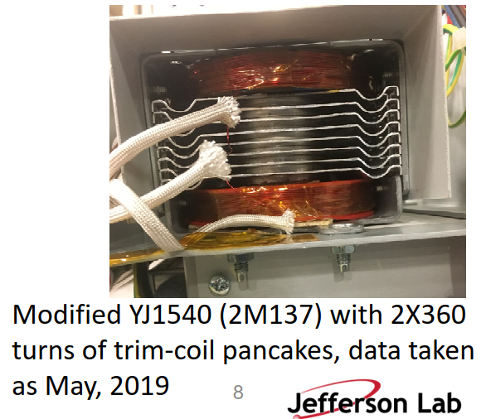
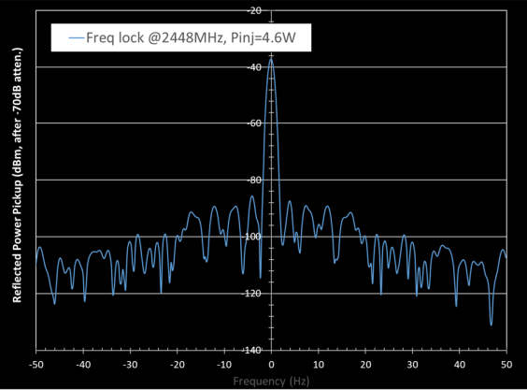

Tune by trimming the magnetic field
Trimming the field to adjust $Δω$ close to zero, an acceptable spectrum can be obtained.

Slide 24
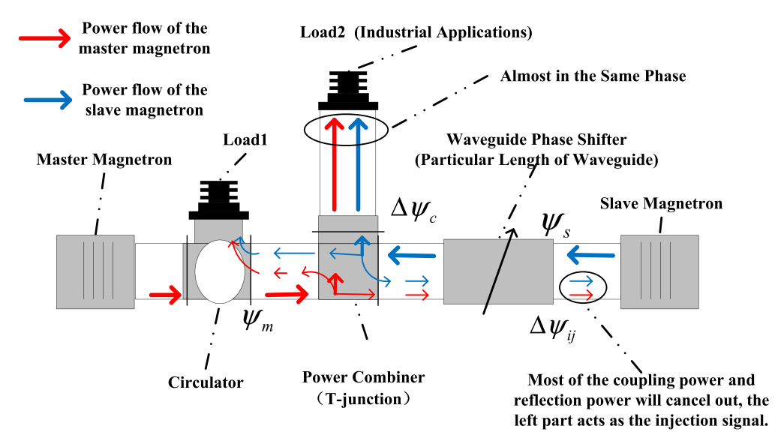
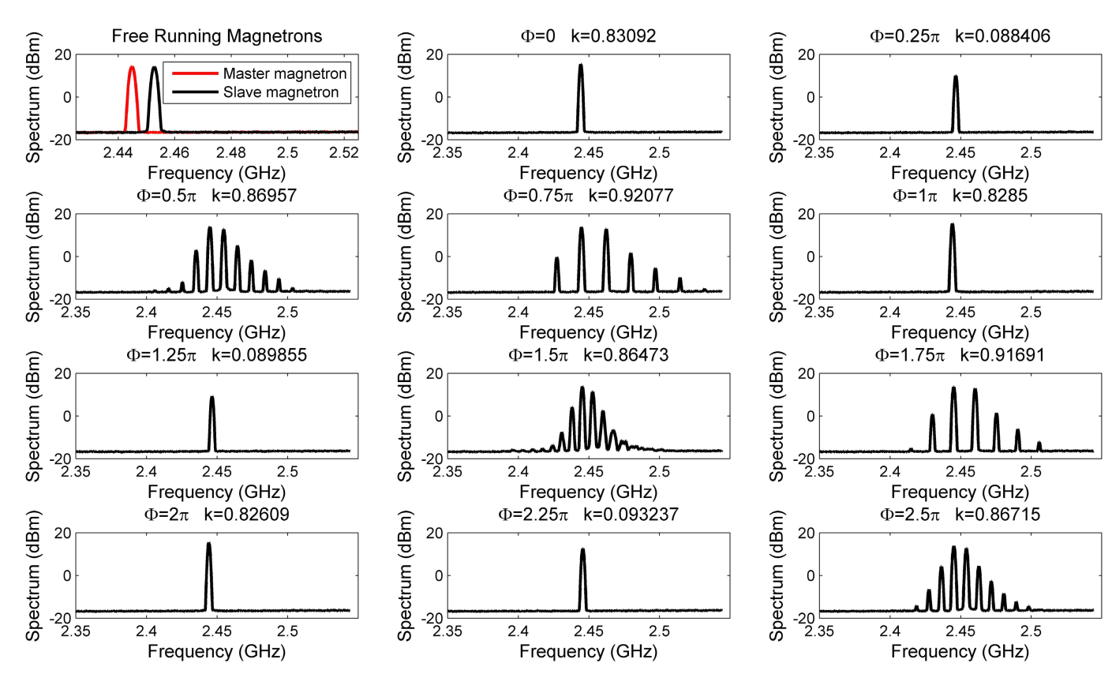
Combining the power of 2 magnetrons
Y. Zhang et al.: https://ieeexplore.ieee.org/document/8032501

Slide 25
Solid-State Power Amplifiers

Slide 26
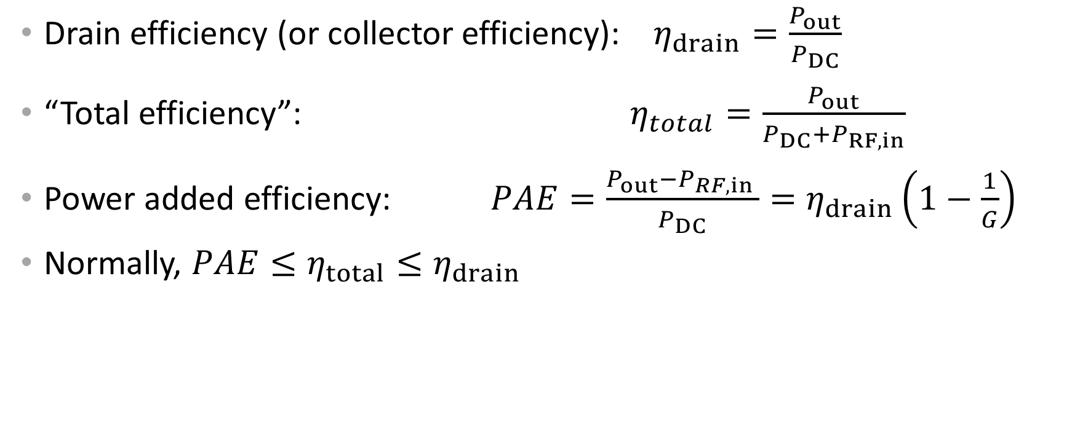
Definitions
Drain efficiency (or collector efficiency): $η_{drain}=\frac{P_{out}}{P_{DC}}$
“Total efficiency”: $η_{total}=\frac{P_{out}}{P_{DC}+P_{RF,in}}$
Power added efficiency: $PAE=\frac{P_{out}−P_{RF,in} }{P_{DC}}=η_{drain}\left(1−\frac{1}{G}\right)$
Normally, $PAE≤η_{total}≤η_{drain}$

Slide 27
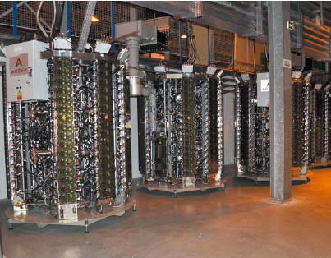
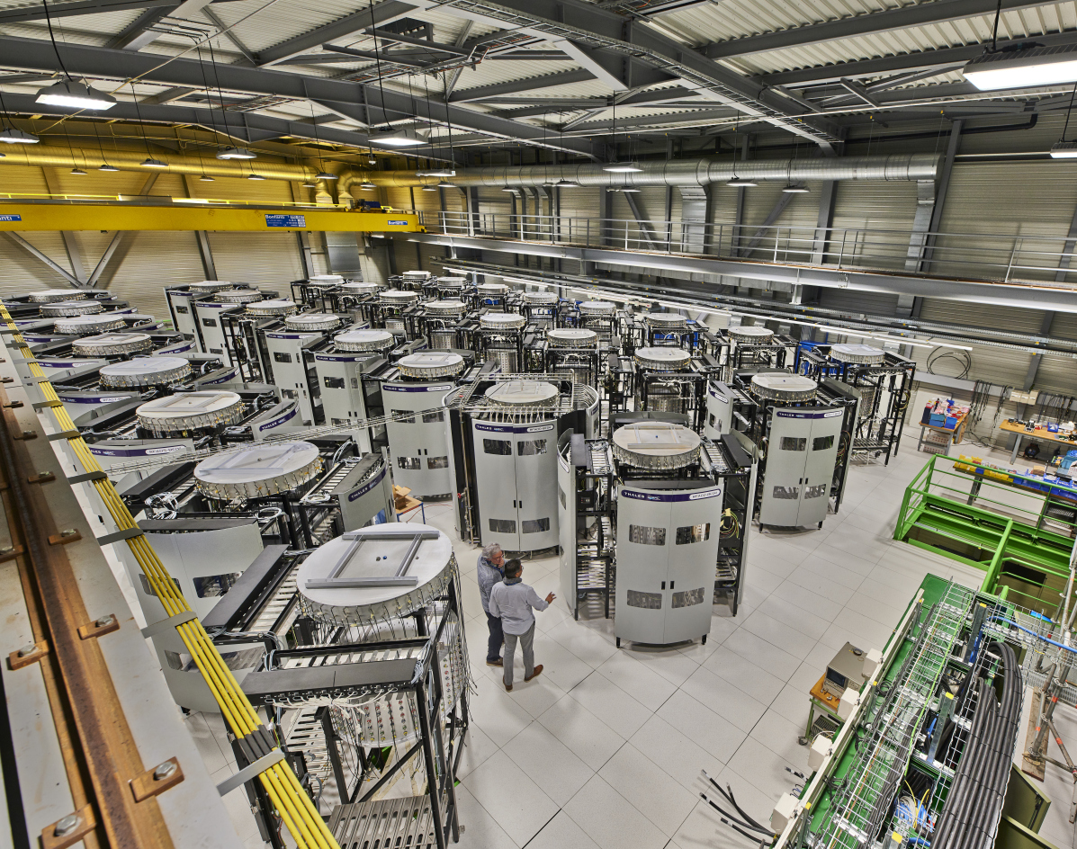
LDMOS SSPAs
LDMOS transistors have made their appearance as replacements for vacuum electronic devices, at least at the 1-kW-level.
Advantages: Operation at lower voltage, no heater, better lifetime, rugged, modularity allows system design for graceful degradation.
Disadvantages: not forgiving overdrive, modularity requires power combination of very many devices (thousands),
moderate efficiency!
Recent examples:
ESRF 350 MHz (left),
CERN 200 MHz (right).

Slide 28
Overdrive (1/3)
Operating point
RF/DC efficiency = 70 %
Possibility of short power excursions for LLRF
only for gridded tubes (possible for SSPA at a cost
of an overdesigned system)
Operating point
Including overhead
for LLRF and margin for availability
Eric Montesinos, Proton Driver Efficiency Workshop, PSI 2016

Slide 29
Overdrive (2/3)
Operating point
RF/DC efficiency = 70 %
Possibility of short power excursions for LLRF
only for gridded tubes (possible for SSPA at a cost
of an overdesigned system)
Operating point
Including overhead
for LLRF and margin for availability
klystrons saturate, but tolerate overdrive
Eric Montesinos, Proton Driver Efficiency Workshop, PSI 2016

Slide 30
Overdrive (3/3)
Operating point
RF/DC efficiency = 70 %
Possibility of short power excursions for LLRF
only for gridded tubes (possible for SSPA at a cost
of an overdesigned system)
Operating point
Including overhead
for LLRF and margin for availability
SSPAs do not tolerate overdrive!
Eric Montesinos, Proton Driver Efficiency Workshop, PSI 2016

Slide 31
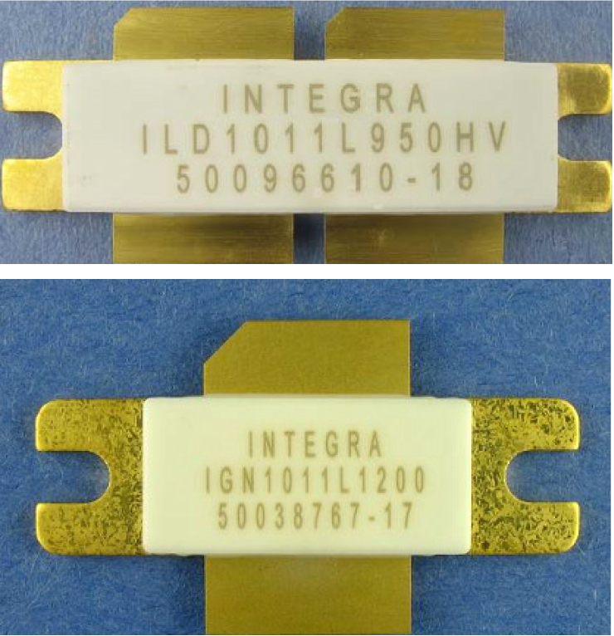
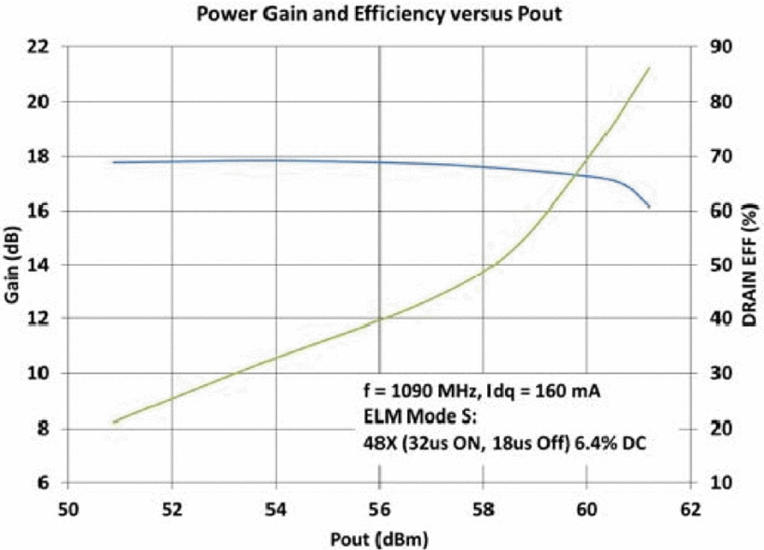

GaN SSPAs
Using gate pulsing, high efficiencies are currently possible
with 150 V GaN HEMTs (up to 85% at 1 kW, 1 GHz).
Gate pulsing implies relatively short pulses and
low duty cycles ($<10\%$).
Even without gate pulsing, efficiencies of 80% seem possible.
1 GHz Si LDMOS transistor
1 GHz GaN HEMT
J. Cluster, G. Formicone, J. Walker: https://ieeexplore.ieee.org/document/7492071 and https://ieeexplore.ieee.org/document/7777488

Slide 32
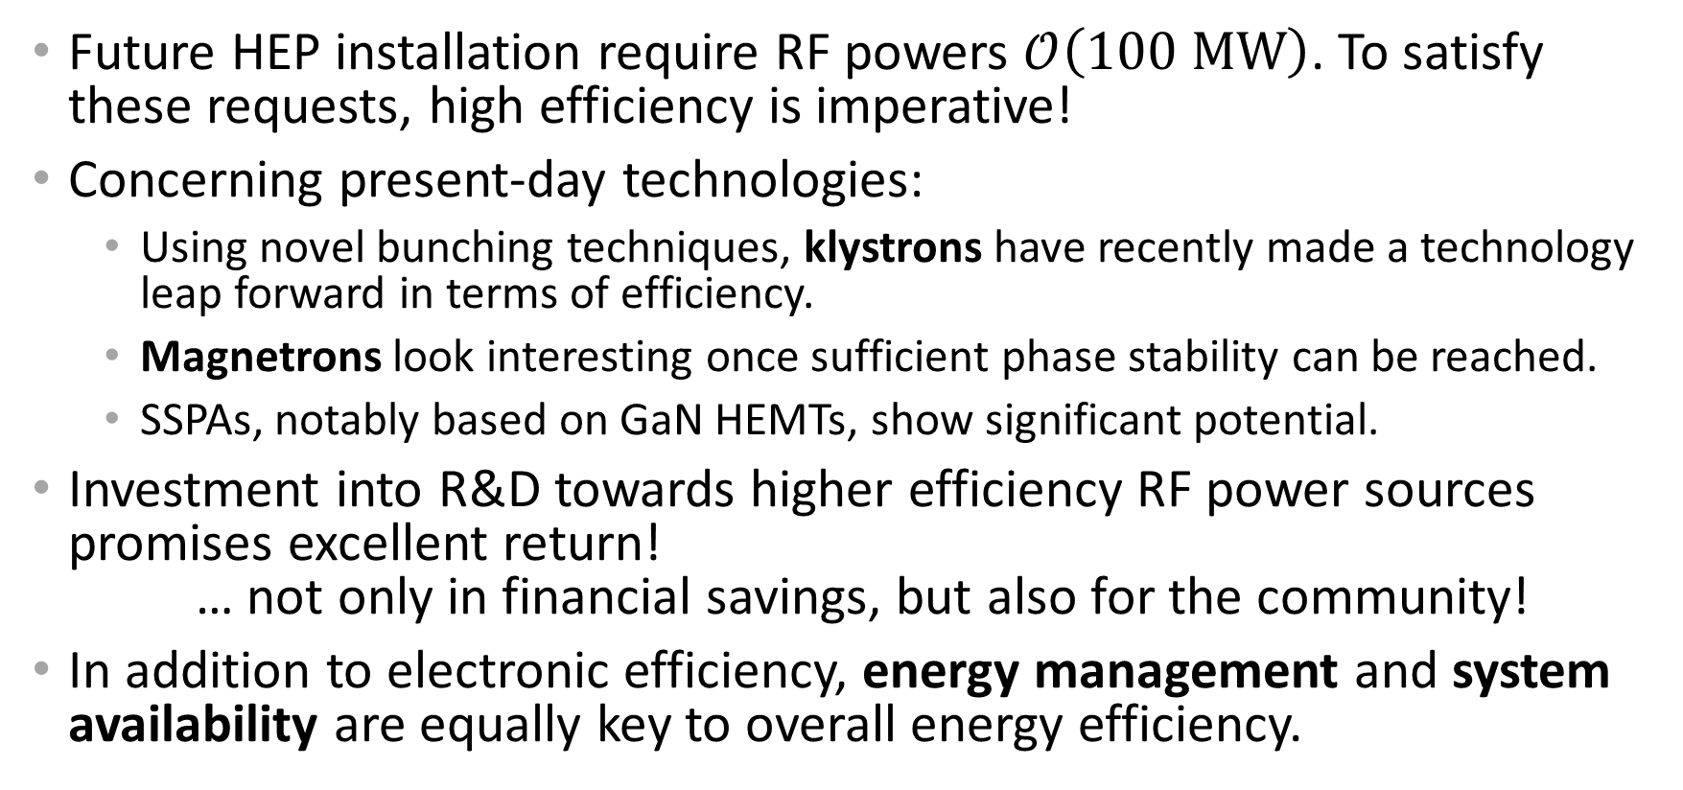
Summary
Future HEP installation require RF powers $𝒪\left(100 MW\right)$. To satisfy these requests, high efficiency is imperative!
Concerning present-day technologies:
  Using novel bunching techniques, klystrons have recently made a technology leap forward in terms of efficiency.
  Magnetrons look interesting once sufficient phase stability can be reached.
  SSPAs, notably based on GaN HEMTs, show significant potential.
Investment into R&D towards higher efficiency RF power sources promises excellent return!
… not only in financial savings, but also for the community!
In addition to electronic efficiency, energy management and system availability are equally key to overall energy efficiency.

Slide 33
Spare slides

Slide 34
Making best use of RF power

Slide 35
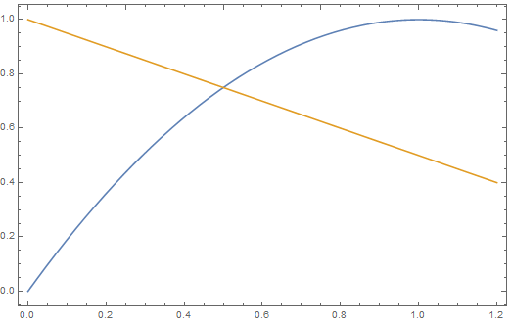




Optimum beam loading: $η$ vs. gradient
Choice for CLIC 380 GeV
Full beam loading – optimum efficiency
(operating point for CLIC drive beam)
Choice for CLIC 3 TeV
$$η$$
$η$: RF to beam efficiency
$$\frac{V_{acc}}{unloaded V_{acc}}$$

Slide 36
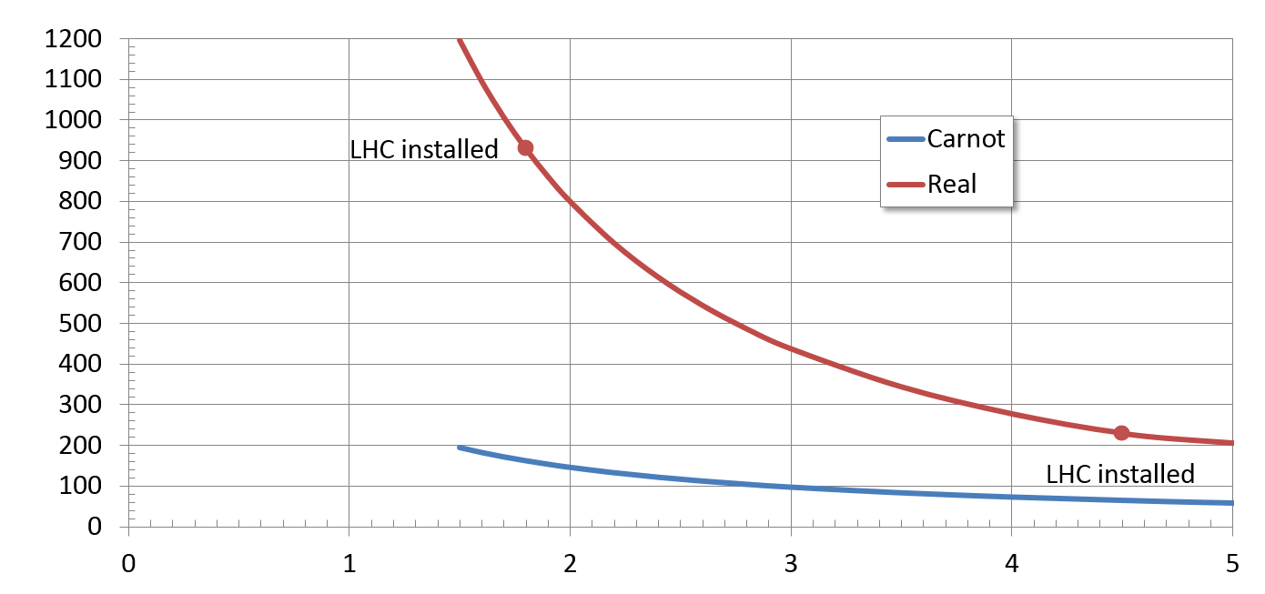




Real $COP$ of cryogenic He refrigeration
COP: Coefficient of performance: To extract $P$ at $T_{refr}$, one needs $COP∙P$ at $T_{ambient}$.
930
$$COP [W/W]$$
$$\frac{T_{ambient}}{T_{refr}}−1$$
230
P. Lebrun/CERN
$$T_{refr} [K]$$

Slide 37
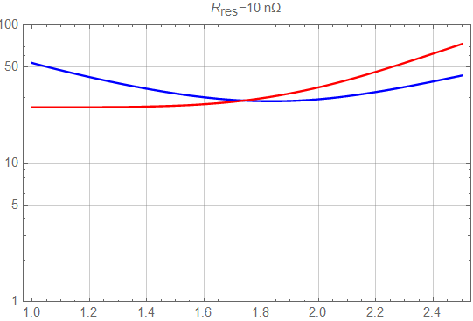
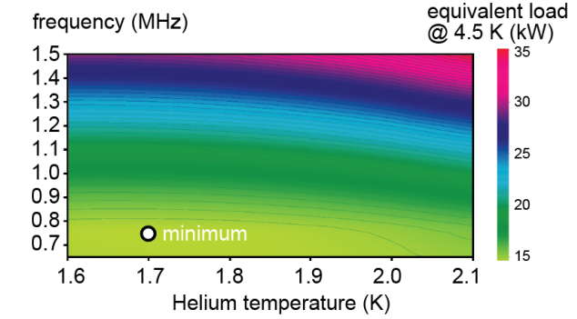






The operating $T$ for superconducting cavities
At lower $T$, the cavity $Q_{0}$ increases, so the dynamic loss decreases.
On the other hand, the cryogenic efficiency gets worse at lower $T$.
Trading these two effects off leads to an optimum operating $T$
Blue: $P_{a}[kW]$
Red: $P_{loss}[W]$
$$T \left[K\right]$$
Example: 800 MHz 5-cell cavity for 18 MV, $P_{a}$ is the cryogenic power at ambient temperature. Thanks: R. Calaga, S. Claudet, P. Lebrun!
F. Marhauser, IPAC 2014, “Cost Rationales for an SRF proton Linac”

Slide 38

State of the art: High $Q_{0}$, N₂ doping
A. Grasselino, SRF2013 & M. Liepe SRF2015

Slide 39

Recent results with Nb₃Sn coated cavities
Daniel Hall, SRF 2015, Whistler, CDN

Slide 40





Figure of merit for proposed lepton colliders
Disclaimers:
This is not the only possible figure of merit
The presented numbers have different levels of confidence/optimism; they are still subject to optimisations
$$∝{\sqrt{s}}^{−4}$$
(2 IPs)
$$ℒ/{P_{WP}} \left[\frac{{10}^{34}cm^{−2}s^{−1}}{100 MW}\right]$$
${360}/{\left(nb MWh\right)}$
$$∝{\sqrt{s}}^{2}$$
$$\sqrt{s} \left[TeV\right]$$
Numbers for baseline proposals

Slide 41

Figure of merit for proposed proton colliders
HL-LHC: $14 TeV$, $5∙{10}^{34}cm^{−2}s^{−1}$, $101 MW$
FCC-hh: $100 TeV$, $(5…30)∙{10}^{34}cm^{−2}s^{−1}$, $580 MW$

