Slide 1

Design of high efficiency klystron for ARIES WP4 task 2
Optimization of klystron based on a genetic algorithm
P. Hamel¹, C. Marchand¹, J. Plouin¹, F. Peauger²
1-CEA, France
2-BE-RF-SRF CERN, Switzerland
ARIES Workshop on Energy Efficient RF
18/06/2019
Notes:
Ajouter logo ARIES

Slide 2
SUMMARY
Introduction
Bunching circuit optimization
Multicell output cavity optimization
Integration of the output cavity into the bunching circuit
Conclusion

Slide 3
1. Introduction

Slide 4
ARIES WP 4 Task 2 objectives
This task will consist in designing a high efficiency RF source trying to push the limit above 65%. The work will include the following steps:
Define the high efficiency klystron specifications
Design and validate the design using simulation tools
Provide a 3D model
  Deliverable: Design study up to full 3D drawings
  Date due: M41 = October 2020
Notes:
Ajouter logo ARIES en haut a droite

Slide 5
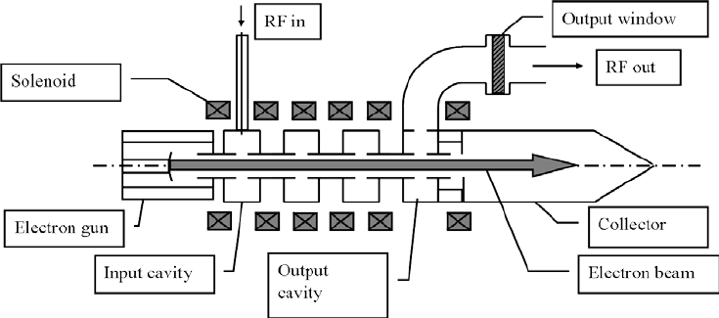

RF source : klystron
Small power
RF signal
High power
RF signal
High power
Continuous signal
Power loss
RF Amplifier
Efficiency : $η=\frac{P_{RF out}}{P_{electron beam}}$
(Neglecting the solenoid power)
Notes:
On néglige la partie du solenoide

Slide 6


Definition of the klystron specifications
2 RF sources are of interest:
Project | Frequency | Output power
CLIC | 12GHz | 50MW-70MW
Compact light | 12GHz | 10MW-30MW
A CERN-SLAC collaboration is already working on 50MW-70MW Klystrons (CAI Jinchi’s talk)
For 10MW-30MW klystrons an efficiency of 50% is achievable.
For ARIES; the klystron specifications are:
f ≈12GHz | Pout = 10-30MW | η = 70%
Notes:
Ajouter logo compact light + energie machine
Couleur/ flèche pour indiquer les projets

Slide 7

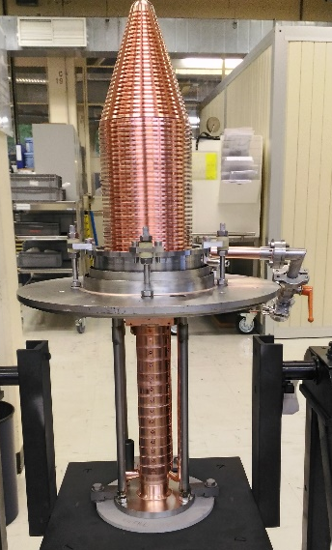
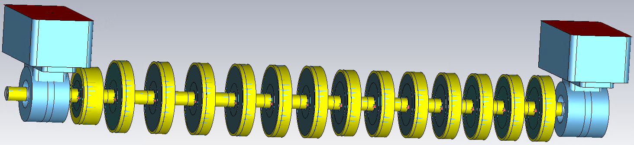
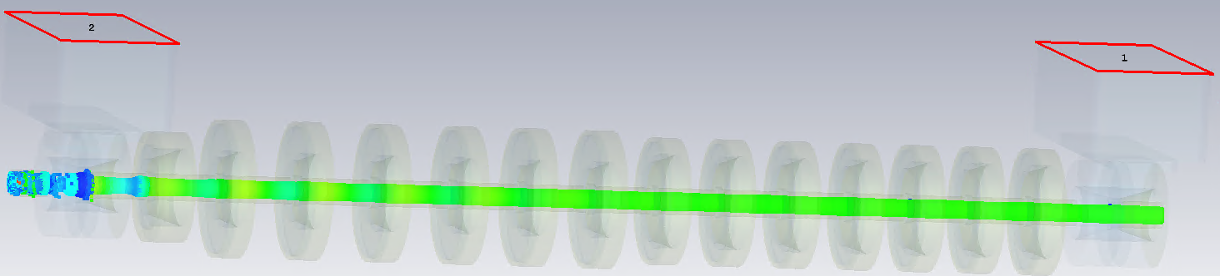
Feedback from EUCARD²
(A. Mollard PHD at CEA Paris-Saclay and THALES)
During EUCARD², a klystron operating in the C-band (TH2166 - 5 GHz) has been retrofitted and manufactured
Bunching circuit based on Adiabatic method (F. Peauger)
Its performances have been measured by the end of 2018
Because of spurious oscillations, the efficiency was lower than the expected one.
Simulations are going on for the understanding of these oscillations
Notes:
Ajouter logo THALES
+ ajouter adiabatique bunching (F. PEAUGER)
ARIES on repart d’une page blanche
Ajouter un slide pour dire qu’on sélectionne COM et adiabatique et on essaye bcp de configurations

Slide 8
From Eucar² to ARIES
For EUCARD², some parameters were limited because the structure of the TH2166 was reused. This is not the case for ARIES
 | EUCARD² | ARIES
Frequency | 4,9 GHz | 11,994 GHz
Beam parameters | Fixed | Free
Length | Fixed | Free
Bunching circuit | Adiabatic | Adiabatic + COM
Output cavity | From TH2166 | Free
Extracted power | ~55kW | 20MW
=>For the X-band klystron under design for ARIES, we are using advanced simulation tools in order to understand the cause of these oscillations and cure them in the final design.
Notes:
Ajouter logo THALES
+ ajouter adiabatique bunching (F. PEAUGER)
ARIES on repart d’une page blanche
Ajouter un slide pour dire qu’on sélectionne COM et adiabatique et on essaye bcp de configurations

Slide 9
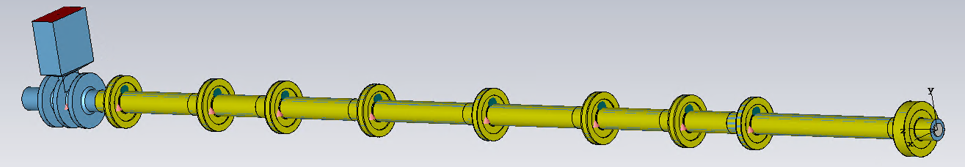
ARIES WP 4 Task 2.
Tube optimization; divided into 2 sub-problems
Bunching circuit optimization (part 2)
  Solver: AJDISK (disk-model code for klystrons simulation)
  Optimizer : GOSET (genetic algorithm on Matlab freely available)
Tube simulation (part 4)
  Klyc (code for klystron from CERN)
Multicell output cavity optimization (part 3)
  Solver: COMSOL (2D eigen mode)
  Optimizer : GOSET (genetic algorithm on Matlab freely available)

Slide 10
2. Bunching circuit optimization

Slide 11

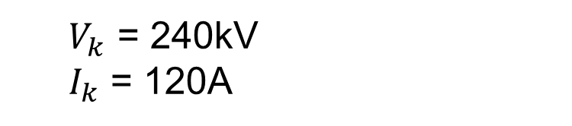
Tube characteristics
Input parameter
  X-band (CLIC, Compact Light): f=11.994GHz
  RF extracted: 20MW
  Pbeam = Vk*Ik
  µK ≈ 1 µA.V^{-1.5}
  10 cavities klystron
Goal
  Efficiency : 70%
  Small signal gain the lowest
  (to avoid instability)
$$\left\{\begin{aligned}V_{k}∗I_{k}∗0.7=20MW \\ \text{µ}\text{K}=\frac{I_{k}}{V_{k}^{1.5}}≈\text{1} \text{µ}\text{A}\text{.}\text{V}\text{−1.5} \end{aligned}\right.$$
  $V_{k}$ = 240kV
  $I_{k}$ = 120A

Slide 12
Cavity parameters
A klystron can be fully defined by 6 parameters for each cavity:
5 RF parameters: R/Q, M, Q_{ext}, Q₀, f_{CAV}.
1 geometrical parameter: the cavity position z.
For the optimization; only the frequency f_{CAV} and the position z of the cavity are optimized.
First cavity position is fixed at z=0mm
Last cavity frequency is fixed at f=11.994GHz
The constrains allow a large set of configurations (20mm<z<80mm ; 11.5GHz<f<13GHz)
For a 10 cavity klystron, 18 variables are optimized

Slide 13
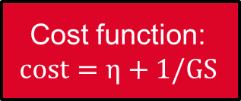
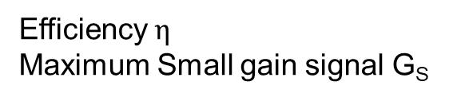
Optimization process
18 parameters
Defining klystron
Efficiency $η$
Maximum Small gain signal G_{S}
AJDISK-solver:
Klystron simulation based on disk model method
Cost function:
$$cost=η+1/GS$$
~7100
GOSET
genetic algorithm on Matlab freely available
New set of 18 parameters,
Based on configurations with the best cost function already simulated

Slide 14
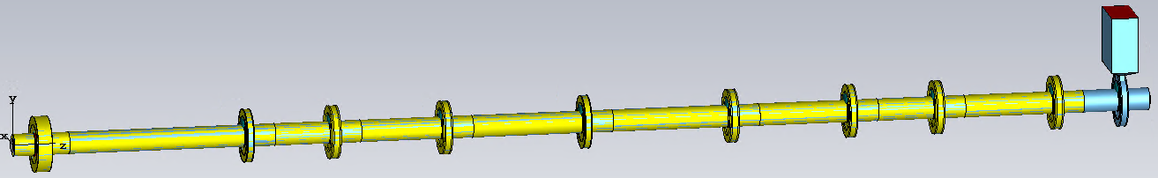
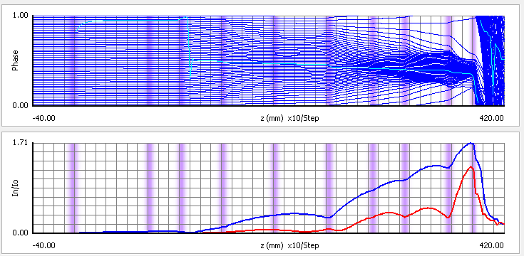
Optimal bunching circuit
Applegate diagram
Beam current modulation
$η$: 69.00 %; Maximum small signal gain 70dB

Slide 15
3. Multicell output cavity optimization

Slide 16
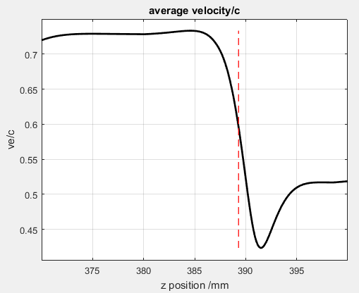
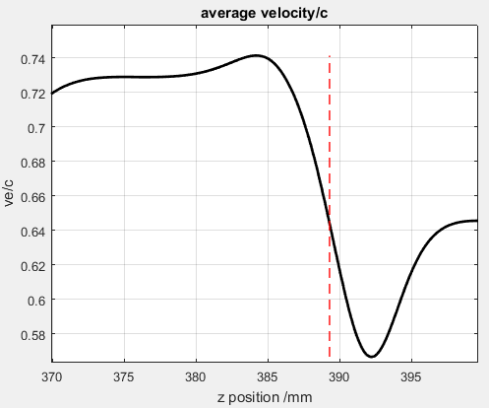
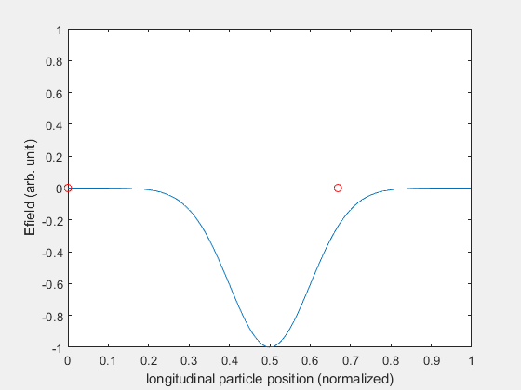
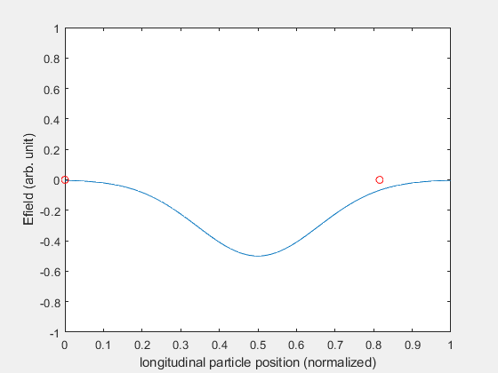
Relation between transit time factor “M” and efficiency
Transit time factor high
Transit time factor low
Lower particle velocity after the cavity with higher M
=>more RF power extracted
=>better efficiency

Slide 17
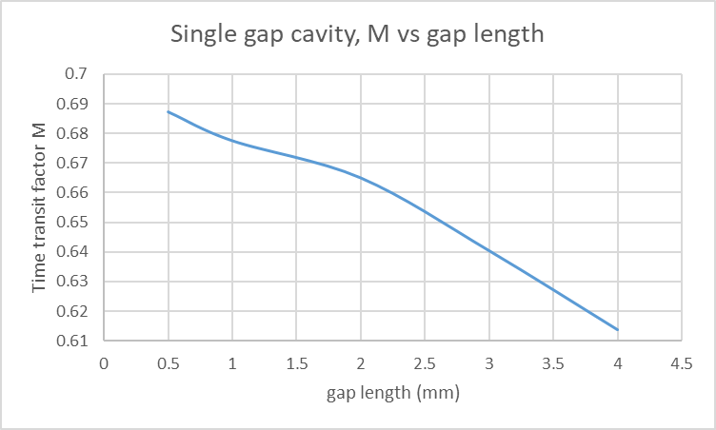
Relation between gap and transit time factor “M”
For a single gap cavity, at 11.994GHz, a very small gap is required to achieve a transit time factor M=0.8.
Transit time factor
The peak voltage on this gap would be too high
The output cavity will be a 3-cells cavity

Slide 18
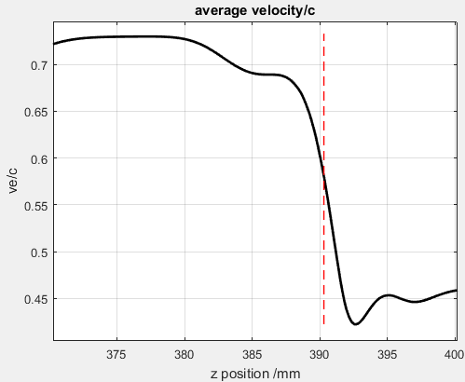
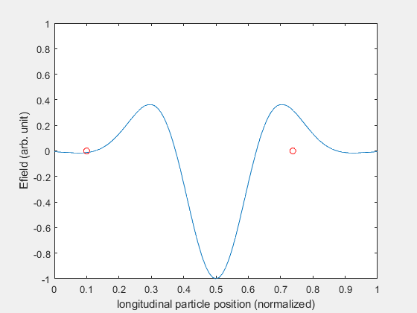
Comparison between single gap and multicell output cavity
Single gap output cavity:
M = 0.67
3-cells output cavity:
M = 0.79

Slide 19
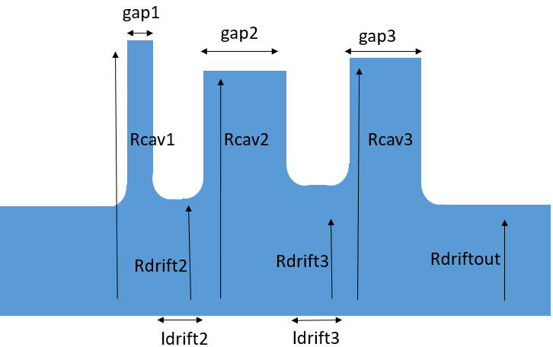
3 cells Output cavity geometry
11 geometrical variable are optimized with GOSET
Each tested geometry is computed on 2D eigensolver COMSOL
Electron beam

Slide 20
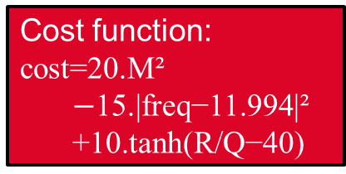
Optimization process
Transit time factor M
Resonant frequency f
R/Q parameter
11 geometrical parameters
COMSOL-solver:
2D eigenmode
Cost function:
$$\text{cost}\text{=20.}\text{M}\text{²}$$
$−\text{15.|}\text{freq}\text{−11.994|²}$
$\text{+10.}\text{tanh}\text{(}\text{R}\text{/}\text{Q}\text{−40)}$
~7100
GOSET
genetic algorithm on Matlab freely available
New set of 11 parameters,
Based on configurations with the best cost function already simulated

Slide 21
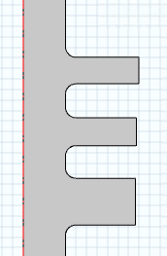
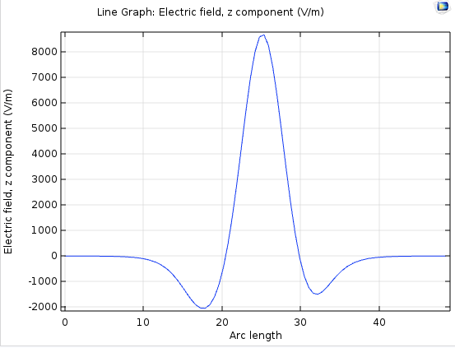
Optimal solution
Electric field on axis
f = 11.994GHz
M = 0.7914
R/Q = 44.6456

Slide 22
4. Integration of the output cavity into the bunching circuit

Slide 23

Simulation on Klyc
AJDISK
COMSOL/CST
Klyc
20MW is extracted

Slide 24
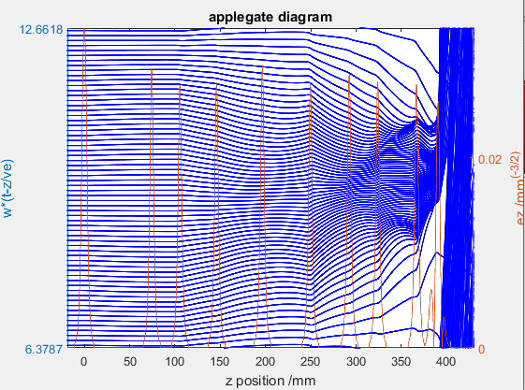
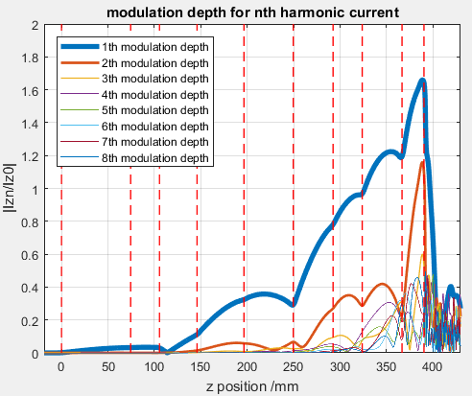
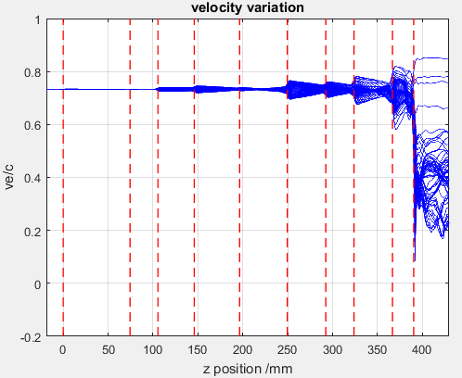
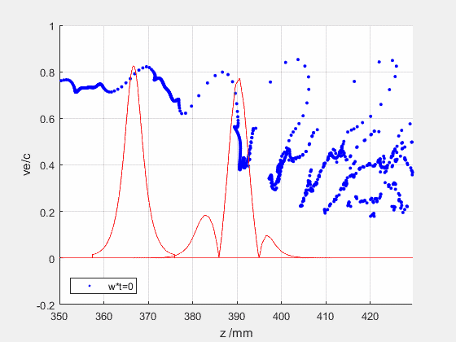
Bunching process along the tube and RF power extraction on Klyc

Slide 25
5. Conclusion

Slide 26
Conclusion
A method has been presented to maximize the klystron efficiency.
This method has been applied for a klystron:
  Operating in the X band (11.994GHz)
  1.02µK
  Beam power 30MW
  The optimization has been divided into 2 sub-problems:
  Optimization of the bunching circuit
  Optimization of the 3-cells output cavity
  The efficiency achieved by the klystron in this design reaches about 70% and 20MW RF can be extracted.

Slide 27
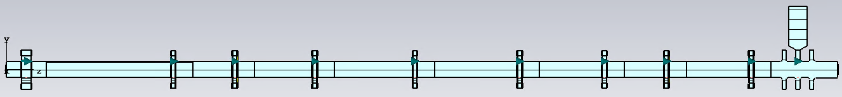
Outlook
Klyc is a preliminary design simulation tool. It is fast and provides good approximation results in steady state.
Transient state are of interest, especially to study oscillations.
Validating geometry should require simulation on 3D simulation tool.
=> Investigations are in progress on CST: 3D Particle In Cell simulation tool (in time domain).
In the current state of the design , the 3D model looks like:
Gap ~2mm

Slide 28
Thank you for your attention!

Slide 29
Spares

Slide 30
Relation between time transit factor and efficiency
The time transit factor M is a cavity parameter related to the interaction between the beam and the radiated EM field in the cavity.
The highest the time transit factor M of the last cavity, the highest is the efficiency
R/Q must be higher than 40

Slide 31
Output cavity geometry
11 geometrical variable are optimized with GOSET
Each tested geometry is computed on 2D eigensolver COMSOL
Cost function:
cost=20.M²- 15.|freq-11.994|² + 10.tanh(R/Q-40)
Coefficients can be adjusted

