Slide 1
Design study for the High Efficiency X-band Klystrons at CERN
KlyCv4
Jinchi Cai Fellow, CERN
Igor Syratchev Staff, CERN

Slide 2
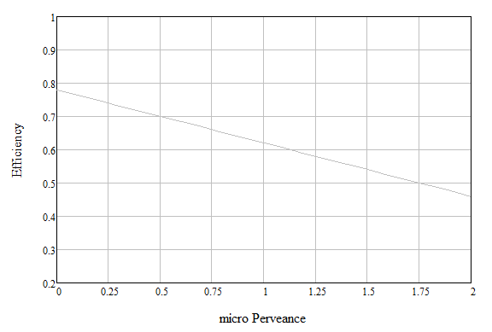
High efficiency klystron development at CERN
The new klystron bunching technologies have been established and evaluated.
The computer code KlyC/2D and special scaling procedures have been developed.
A number of high efficiency klystrons has been designed (yet on paper).
Designed at CERN (PIC & KlyC)
‘Ultimate’ technical limit (IJZ)
L-FCC
1.3 MW
UHF-LHC
0.4 MW
X-CLIC
50 MW
L-MBK CLIC
20 MW
L-MBK ILC
10 MW
UHF-LHC
0.3 MW
X-CLIC
8 MW
S-Toshiba
6 MW
XP4
75 MW
Established empirical limit
X-Toshiba
6 MW
XL5
50 MW
S-band/Industry
Industrial tubes
First HE industrial prototype (stability issues)

Slide 3
Outline
Background and design goal for 8MW Klystron
RF circuits design
Beam optics & RF launcher design
Summary & Cost effective design
Latest progress on 50MW X-band Klystron

Slide 4
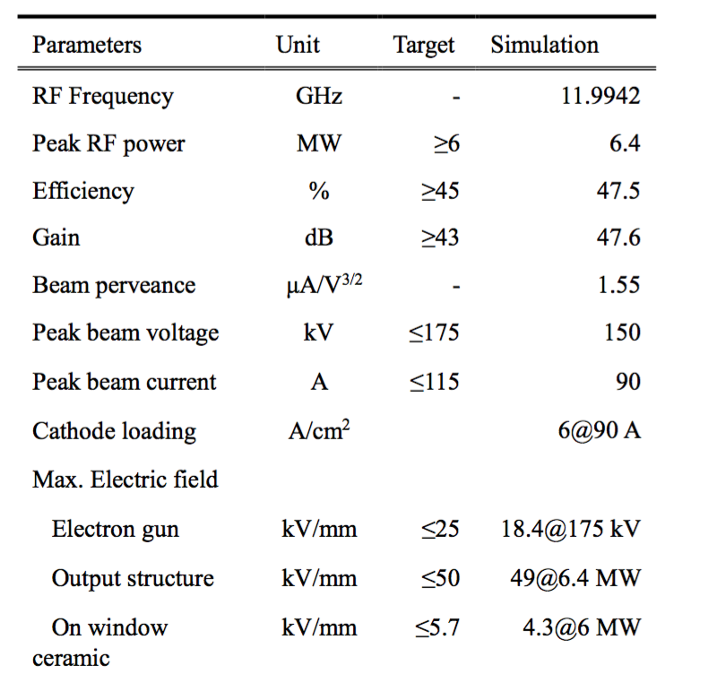
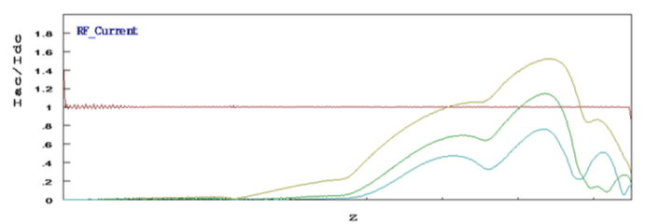
Toshiba E37113
In operation at X-box 3
As of 01.11.2018
FCI simulation: 47%, measured saturated efficiency ~43%
Large beam aperture to accommodate large current
Multiple (3) cells output coupler.
Y. Okubo, et al. Development of an X-band 6MW Pulsed Klystron

Slide 5
6 MW tube. Roadmap for the new design
Beam voltage, current are not changed. Electron gun design is preserved. (3)
COM method adopted for X band. The beam-wave interaction design should be re-done. (1)
Collector should be re-designed to accommodate the updated spent beam. (2)
Magnetic system should be adjusted to guide the beam through longer transmission. (3)
Performance evaluation of entire device. (4)

Slide 6
Outline
Background and design goal for 8MW Klystron
RF circuits design
Beam optics & RF launcher design
Summary & Efforts to improve…
Latest progress on 50MW X-band Klystron

Slide 7
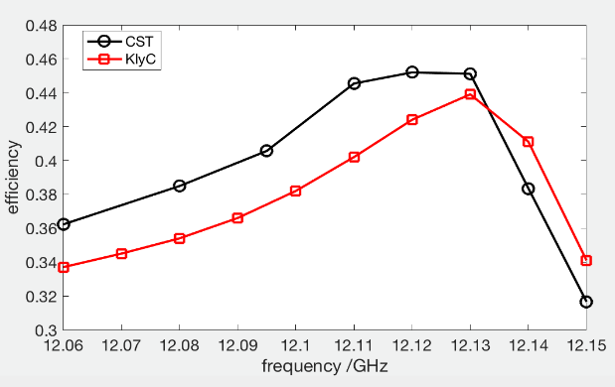
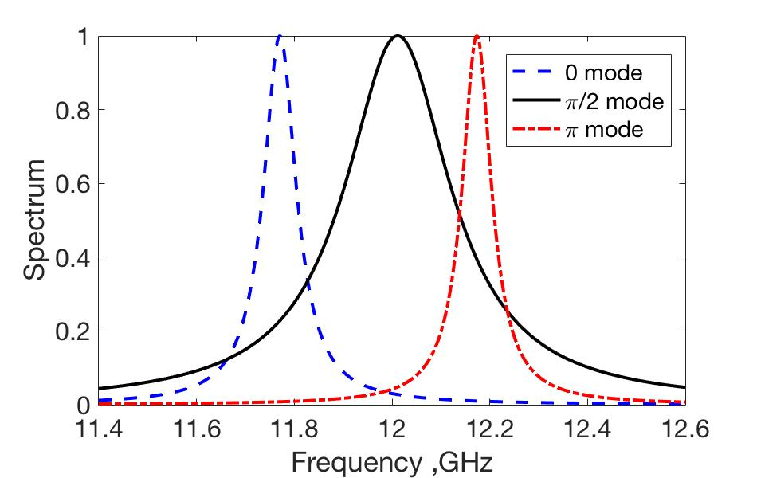
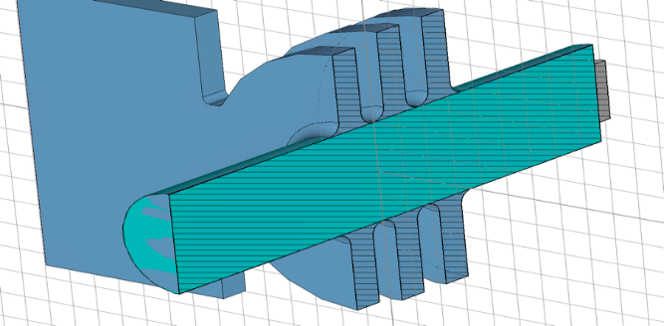
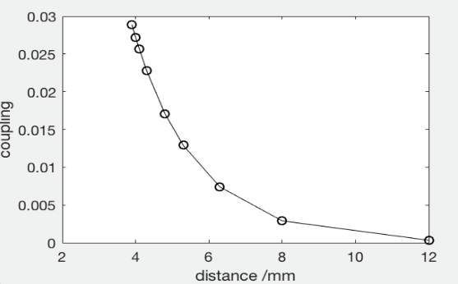
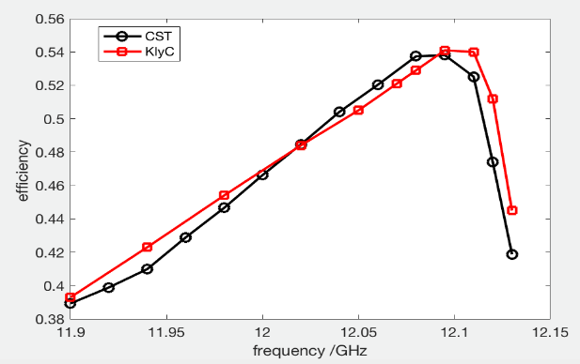
Coupled modes theory implanted into KlyC/2D
Paper submitted to IEEE TED
3
2
1
Monochromatic bunch.
 | F1 | F2 | F3
Coupled theory | 11.7704+0.0406j | 12.0114+0.1308j | 12.1735+0.0364j
HFSS eig. | 11.7710+0.0377j | 12.0051+0.1325j | 12.1722+0.0378j
CST MWS | 11.77111+0.0382j | 12.00470+0.1325j | 12.17316+0.0376j
Congregated bunch
3cells structure. KlyC vs. CST/3D benchmarking

Slide 8
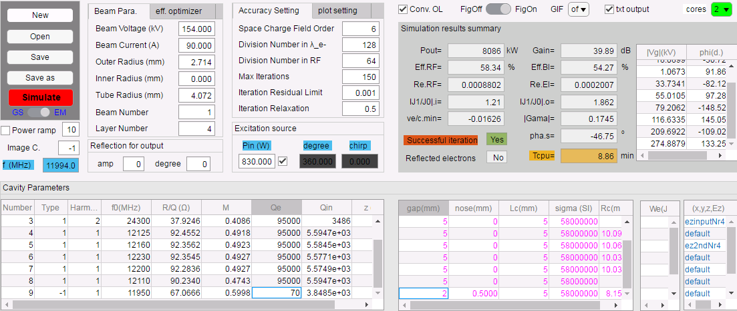
Preliminary Design Process (KlyC)
Initial opt.
1D with artificial output cavity(M=0.9): 73%
2D with artificial output cavity—64%
Check
E_{max}>200MV/m
2D with real output cavity(M=0.5): 54%
2D with real output cavity—48%
Opt.

Slide 9
Output coupler evolution
2mm
Efficiency can’t reach 60% level with a single cell design
Maximum E field is much larger than 100MV/m when eff>50%
Multiple cells structure should be adopted to increase the efficiency and to keep a reasonable surface E_{max}
eff.
E_{max}
Gap length
For the fixed gap of 2mm and period of 4mm (0.9mm fillet radius), couplers with different number of cells were analyzed. The frequencies, locations, Q_{ext} were optimized to find optimum eff. for the given bunching circuit.
Type | fake | 1cell_1mm | 1cell_2mm | 2cell | 3cell | 4cell
efficiency | 67.6% | 54.9% | 54.3% | 59.0% | 59.5% | 60.4%
Min(ve/c) | -0.23 | -0.03 | -0.02 | 0.03 | 0.03 | -0.05
E_{max}MV/m | ~ | 330MV/m | 232MV/m | 87MV/m | 80MV/m | 82MV/m
Efficiency degradation
4-cell design was benchmarked with CST; eff=58.5%

Slide 10
Optimization of the entire tube
Use max eff. as the target. Optimization is done by adjusting the frequencies and positions of all the cavities.
The maximum surface E-field is not a constraint yet in this optimization.
One more gain cavity is added to the RF circuit to increase power gain without efficiency degradation.

Slide 11
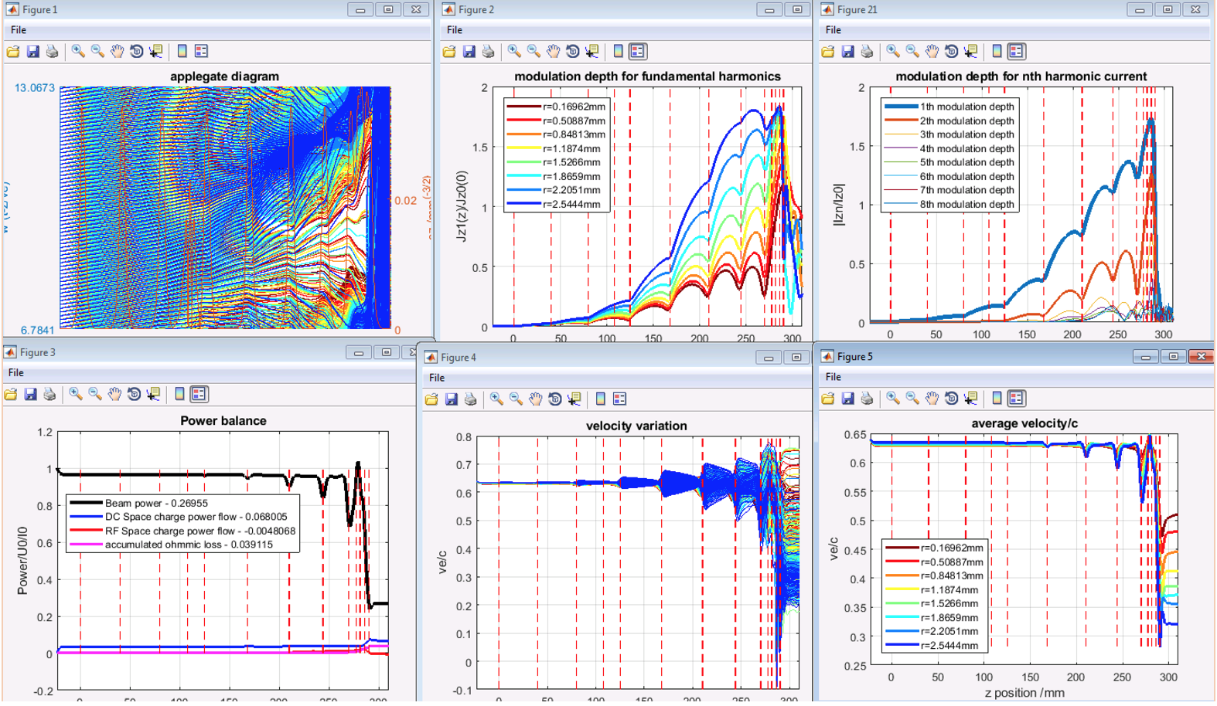
Optimized design with 4-cell coupler (KlyC)
62.8% efficiency (E_{max}=90MV/m)

Slide 12
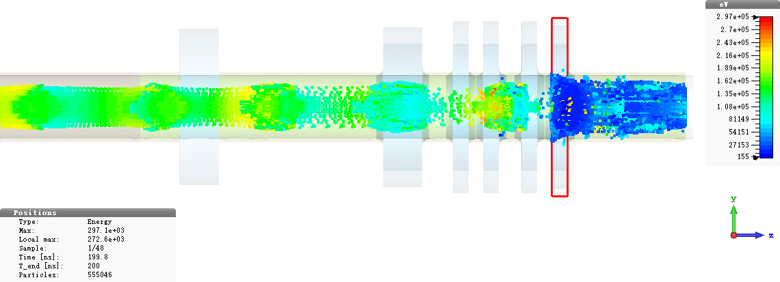
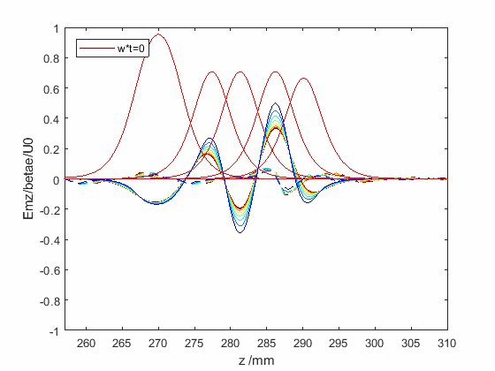
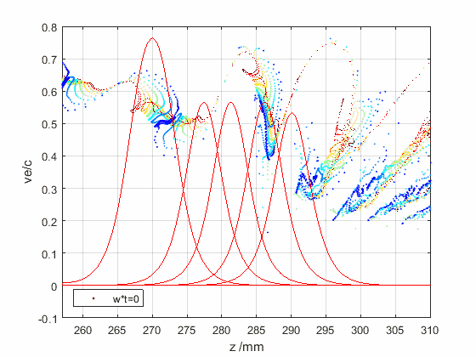
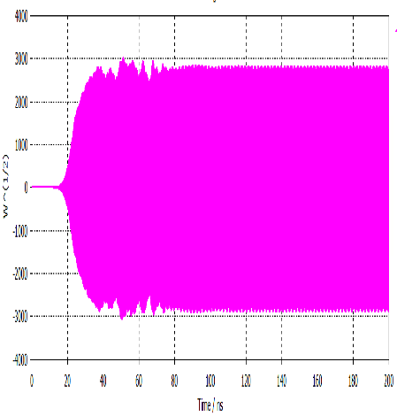
PIC CST/3D benchmarking
~0.1% beam power interception
~100MV/m
60.5% efficiency with Bz=2.5Br
Phase space movie in CST
KlyC reference
This is high efficiency design. The maximum surface field is not well addressed

Slide 13
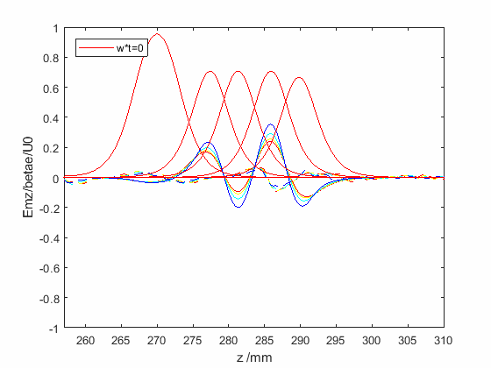
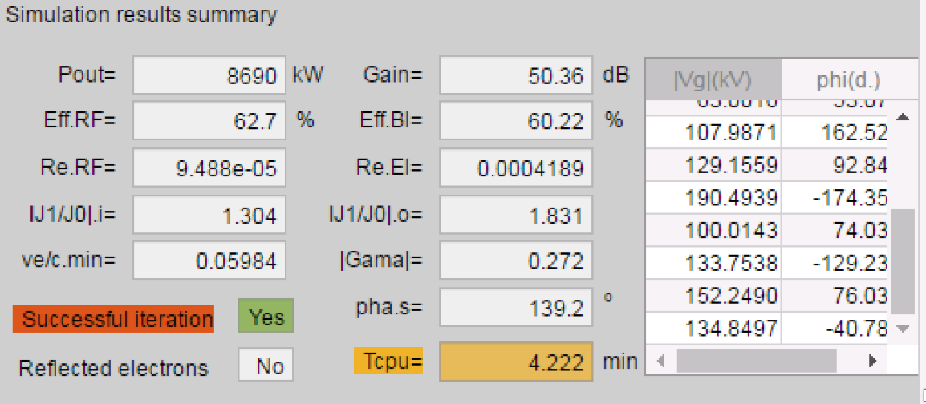
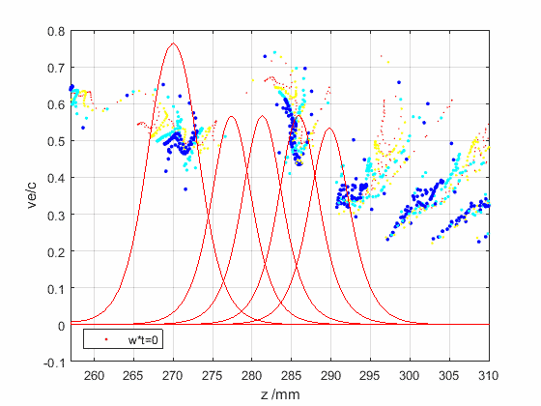
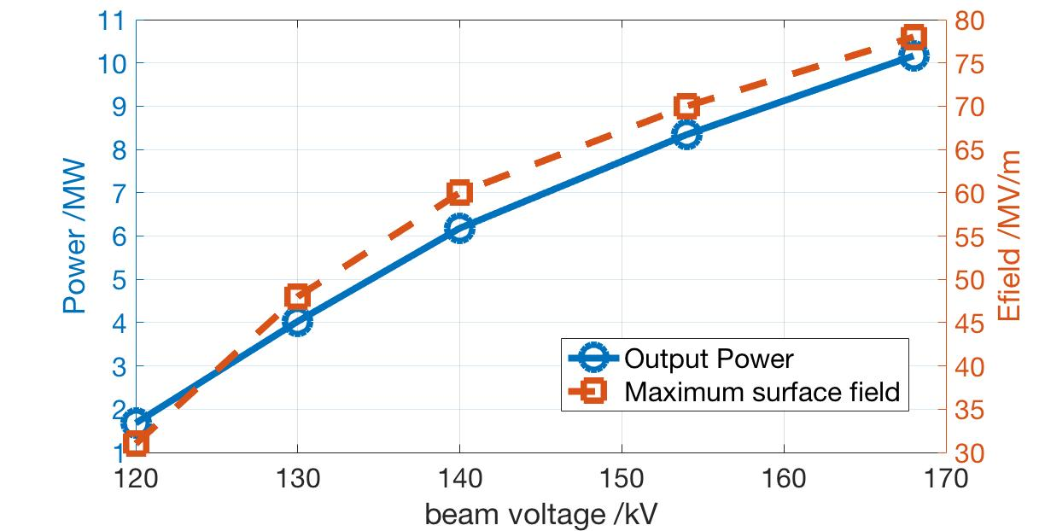
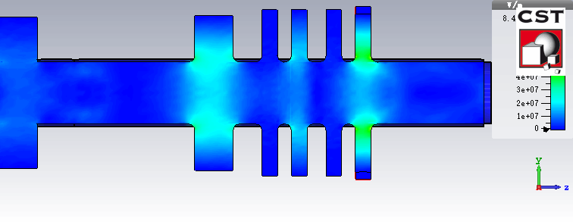
Optimization of the coupler
eff=60.2%
E_{max}=70MV/m
E_{max} reduced by 20%, eff. dropped by 2%.
The bandwidth curve and power transfer curve is almost the same
More uniform field distribution
Pin=80W
f=11.994GHz
eff.~58%, Emax~82MV/m

Slide 14
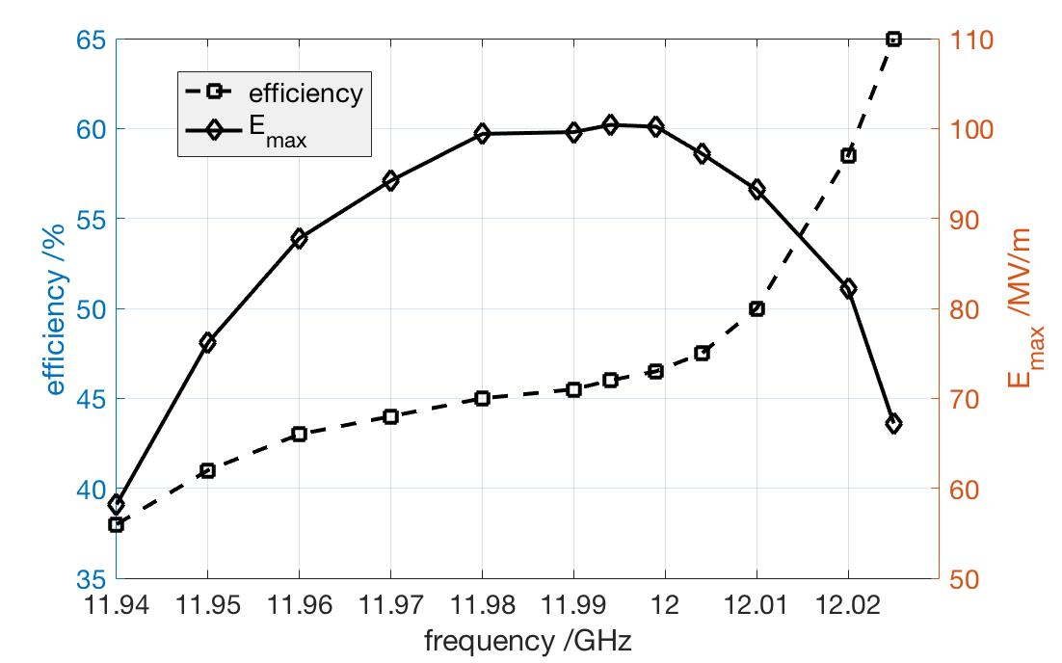
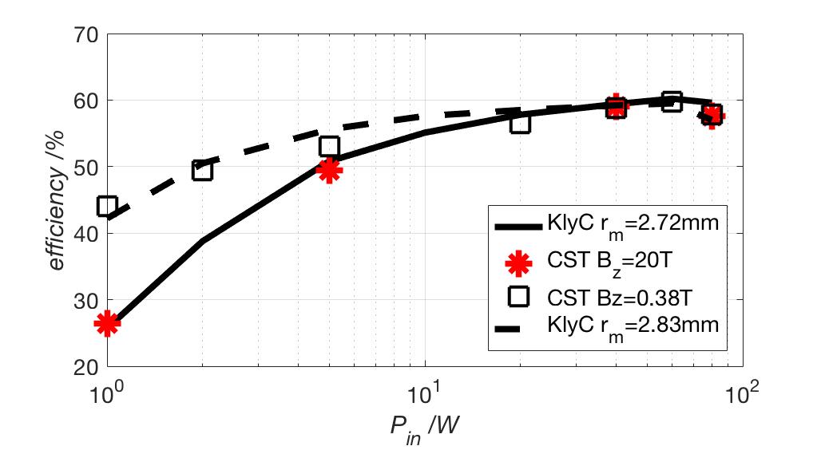
RF circuit design. Short summary.
Nominal output power=8MW
-1dB bandwidth>60MHz
Surface field E_{max} ~ 80MV/m
No instabilities observed with parameter swept
Beam radius does not affect saturation efficiency

Slide 15
Outline
Background and design goal for 8MW Klystron
RF circuits design
Beam optics & RF launcher design
Summary & Cost effective design
Latest progress on 50MW X-band Klystron

Slide 16
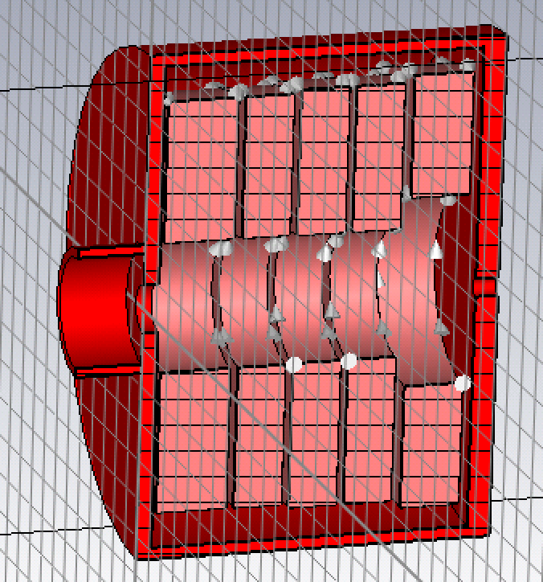
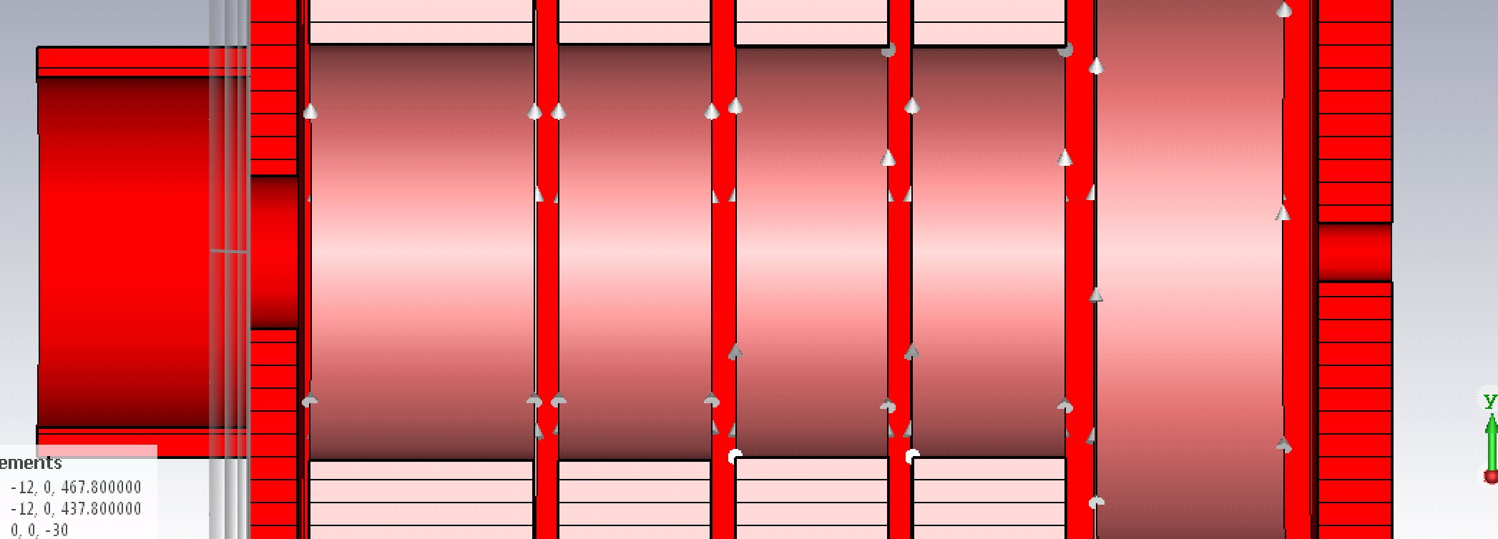
CST/3D. Solenoid design.
1.8kW to 5.9kW
0.32T to 0.38T
Bz=0.38T
150mm to 300mm
90
380
Design is scaled from the Toshiba’s original solenoid. Magnet is larger to ensure uniform 0.38T along 0.3 m section.
Magnetic field distributions near The gun and collector are not yet optimized.

Slide 17
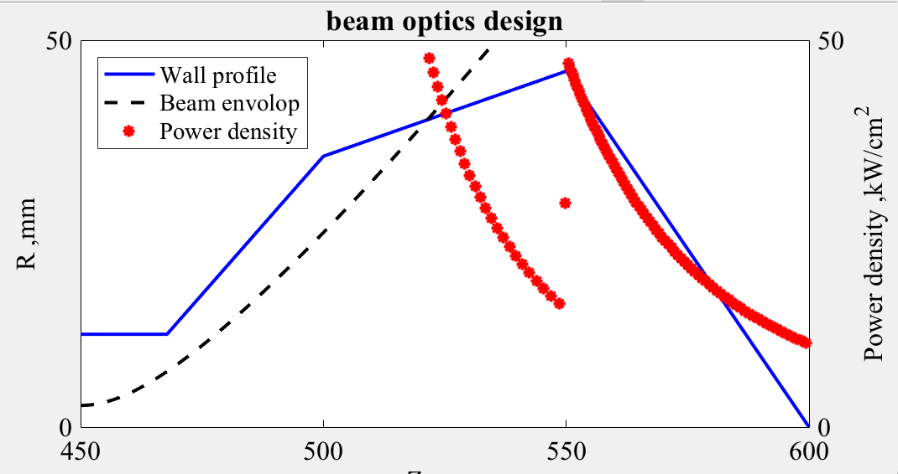
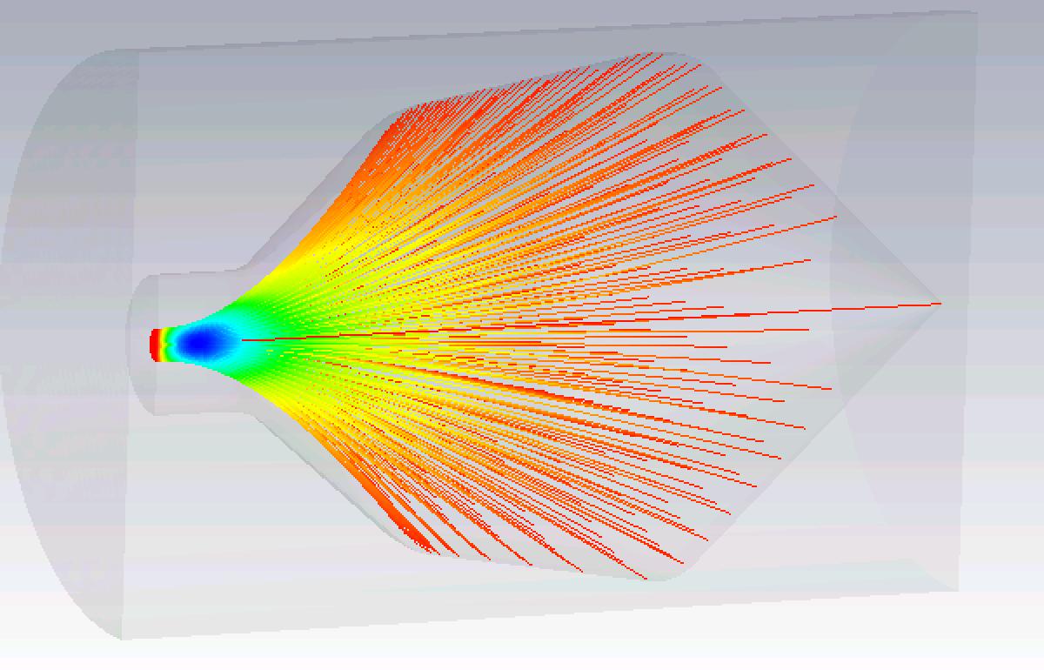
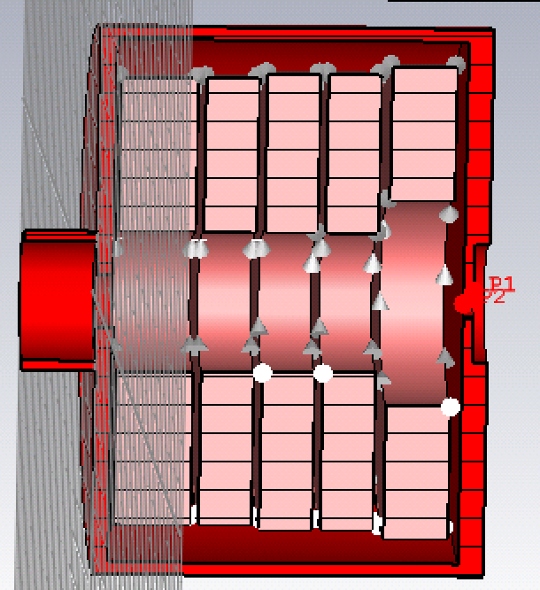
Collector design by TRK simulation
40% V_{g}
Bz=0T
Fast simulation by MATLAB code, which is benchmarked by CST TRK, dP/dS<50kW/cm²
100% V_{g}
40% V_{g}
V_{g} spread=0.4
Fake DC gap
dP/dS< 40kW/cm²; 150kW/cm² for diode mode

Slide 18
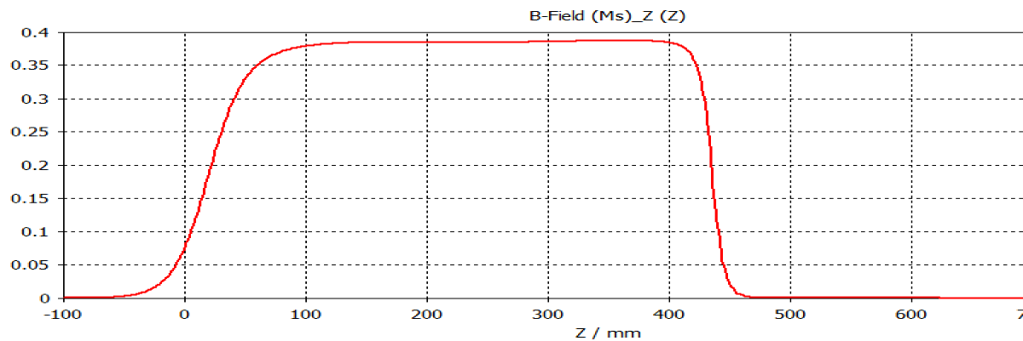
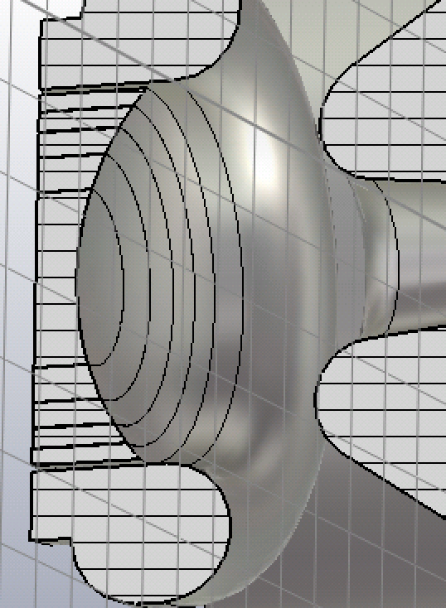
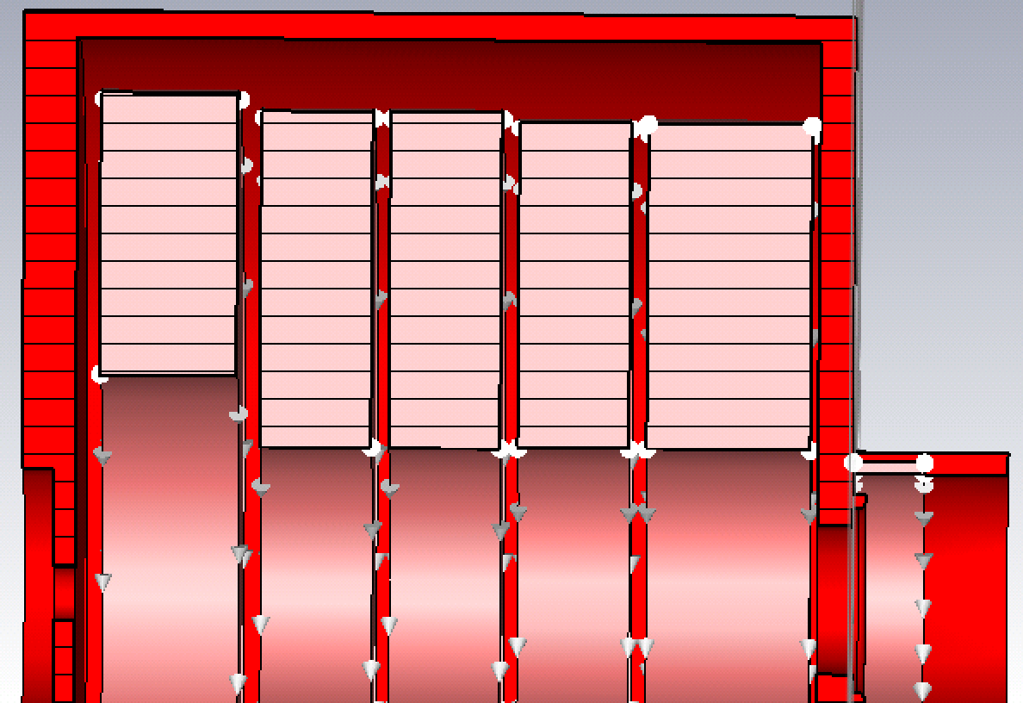
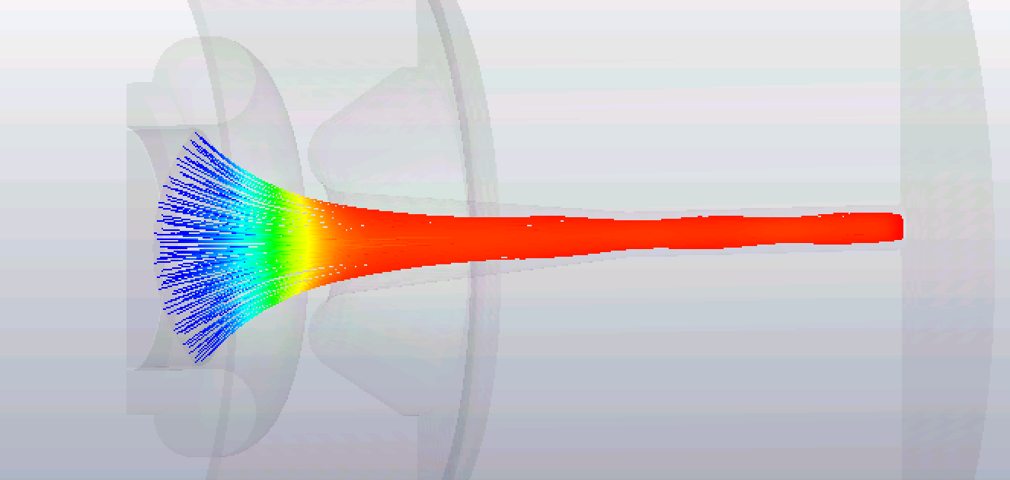
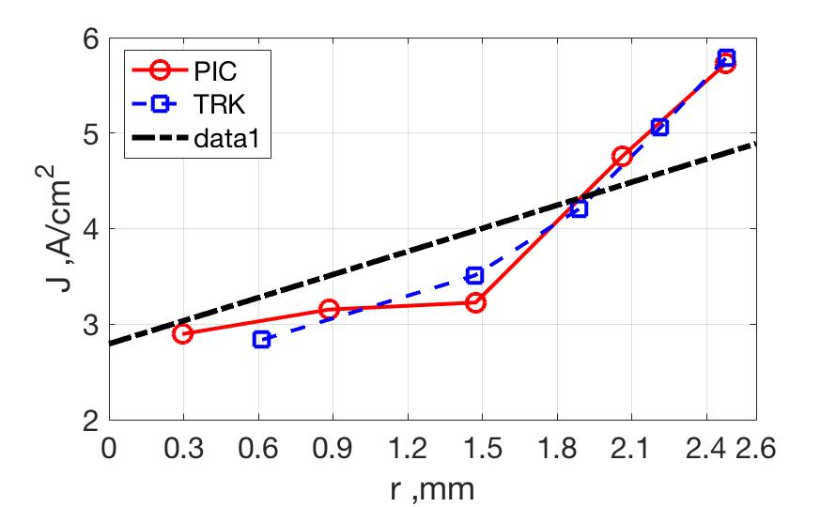
Gun Design with bucking coil (Bz=0.38T)
Geometry from Cannon
Bz profile/ Final design
PIC model
SC limit TRK model
Export/import interface

Slide 19
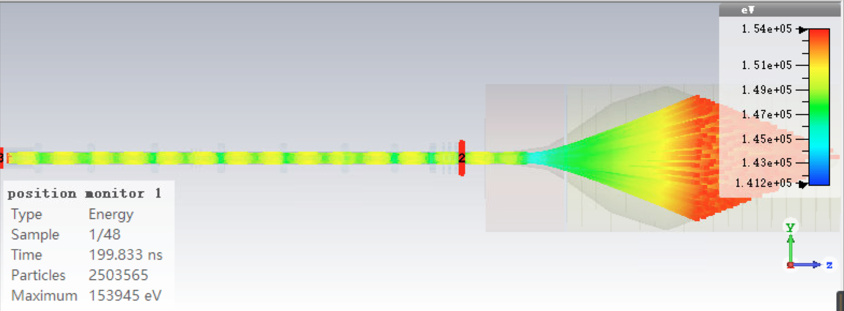
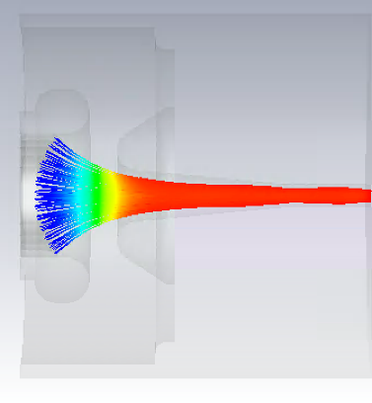
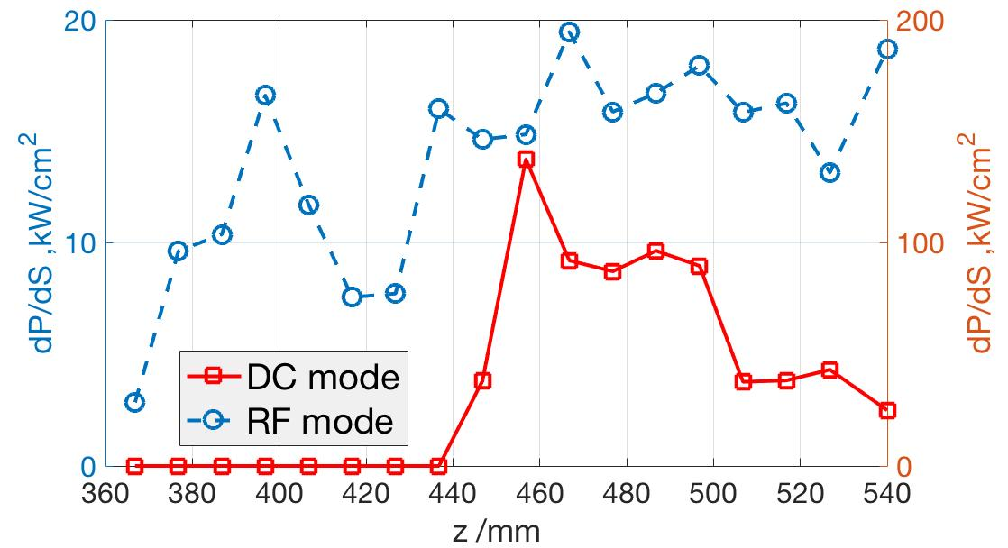
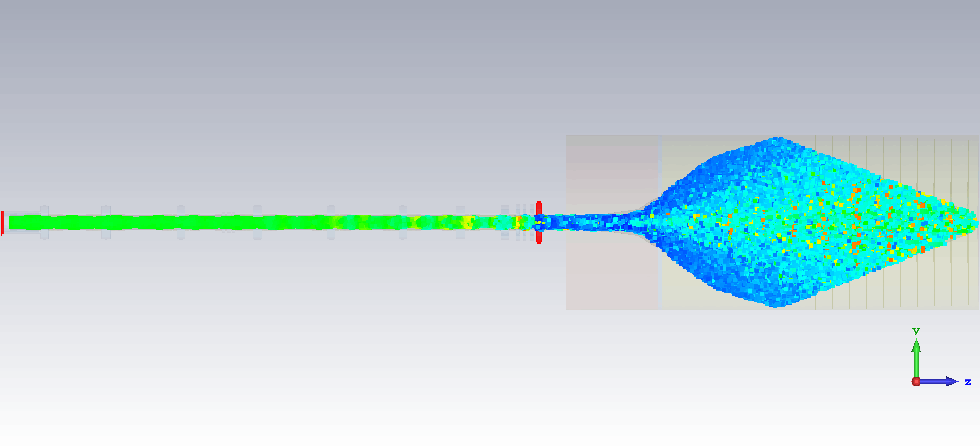
PIC RF simulation with Gun and collector
DC: stable without oscillation
Eff.=58.6%
RF: Stable amplification signal

Slide 20
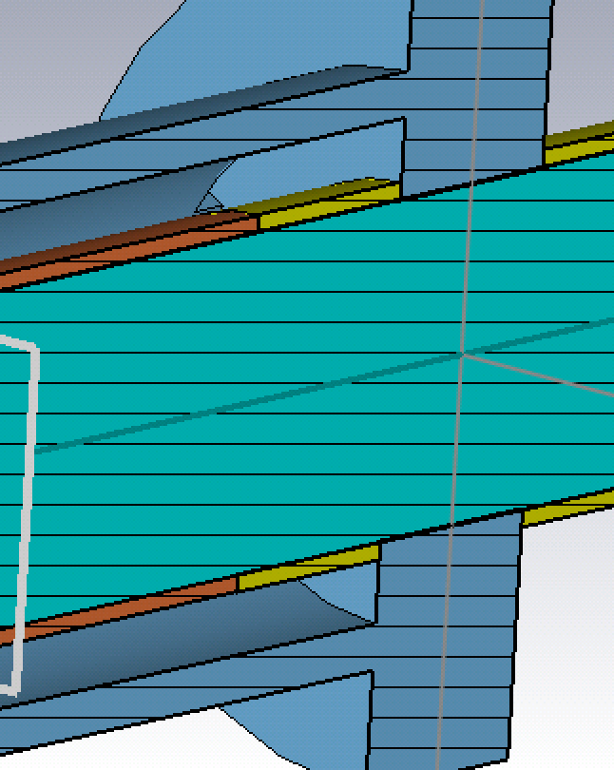
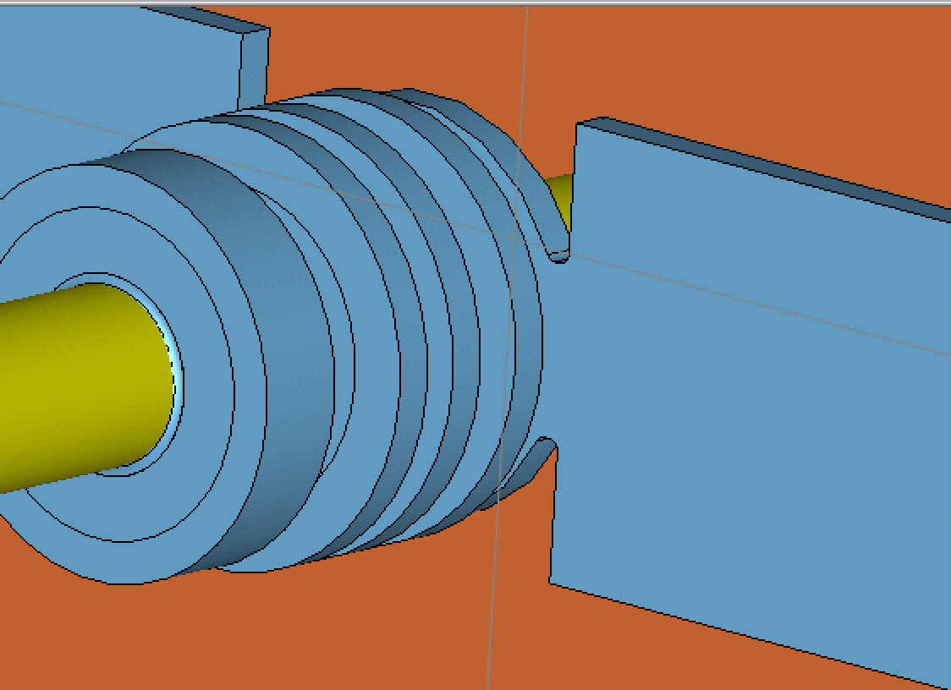
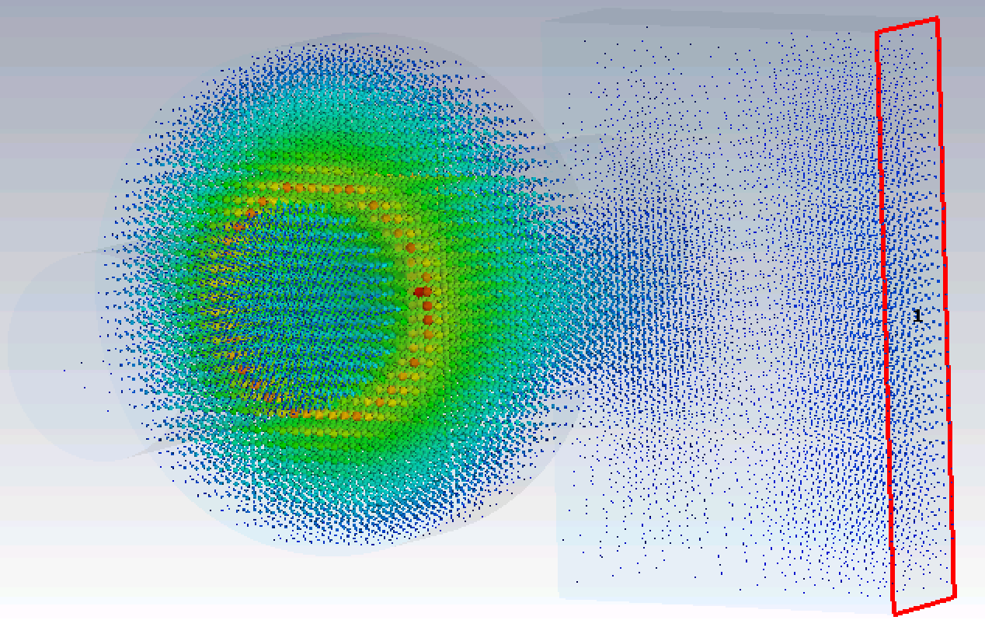
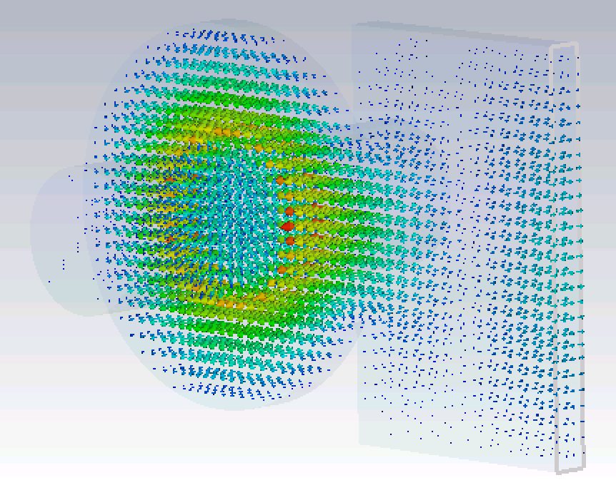
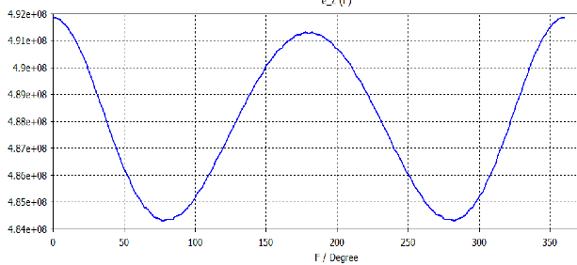
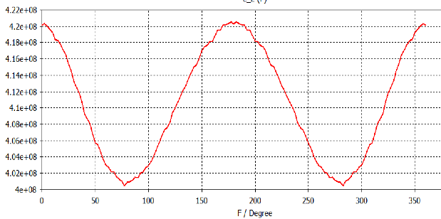
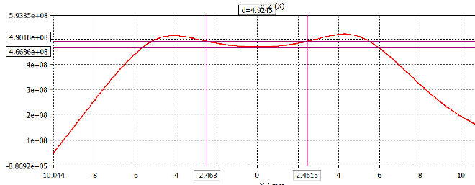
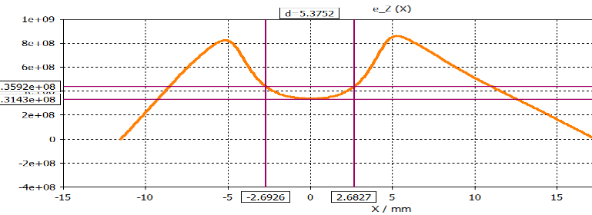
Single waveguide coupler design
1- coaxial waveguide for input
2- double WR for output
Field axial symmetric is good, but not convenient for fabrication
Single WR coupler should be substituted without much perturbation to Q_{ext} and field symmetry
1
2
0.36mm
0.64mm
R=2.5mm
(Emax-Emin)/Eaver/2=1.6%
Input cavity
Output cavity
(Emax-Emin)/Eaver/2=4.9%

Slide 21
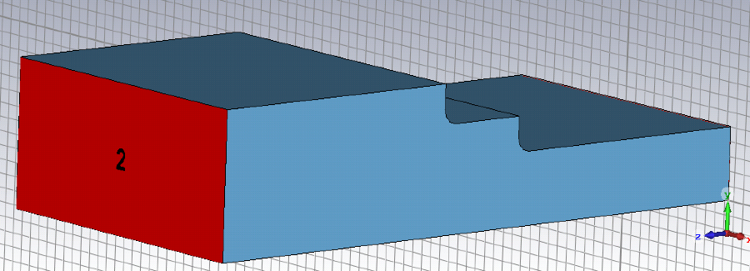
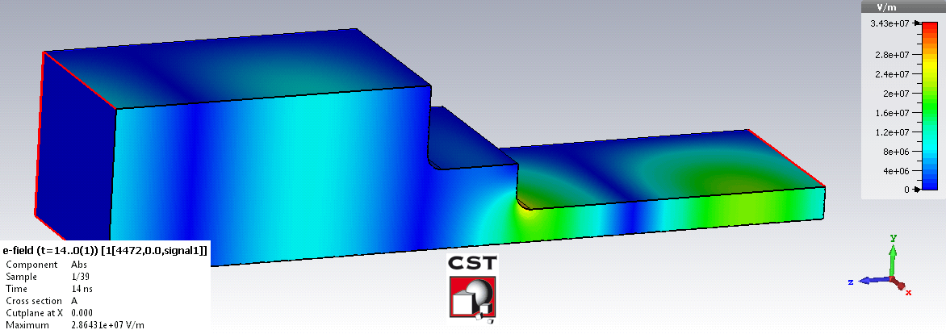
Other realistic features
100W
10MW
0.07kV/mm
34kV/mm
Coupler to WR90
Transition section guarantees the reflection less than -30dB
All the intermediate cavities are rounded by 1mm at the nose
The frequencies of all the cavities should be adjusted little a bit to compensate the lower coupling caused by rounding
KlyC simulation is done before final verification by CST PIC

Slide 22
Outline
Background and design goal for 8MW Klystron
RF circuits design
Beam optics & RF launcher design
Summary & Cost effective design…
Latest progress on 50MW X-band Klystron

Slide 23
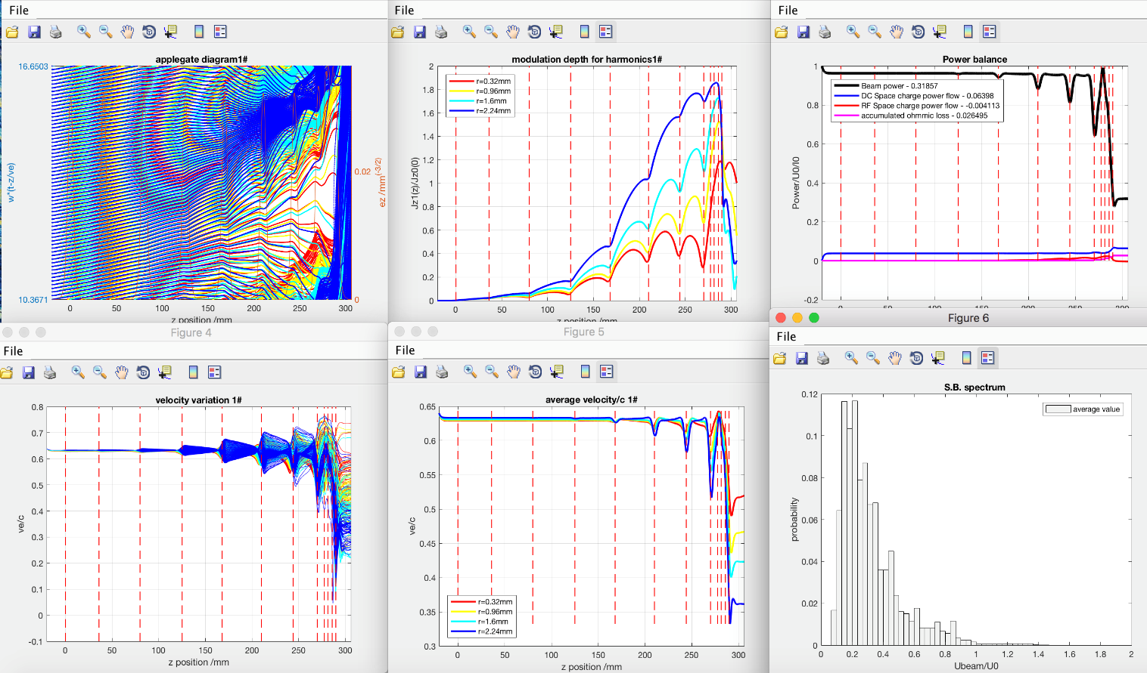
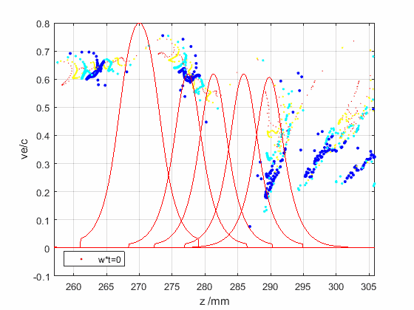
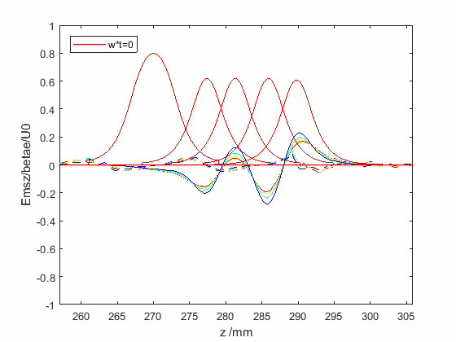
KlyC optimization is done with the field from real cavity design
Eff=58.5%
Min(ve/c)=0.045
Emax=73kV/mm
CST model is re-tuned accordingly with every feature included
SW+TW

Slide 24
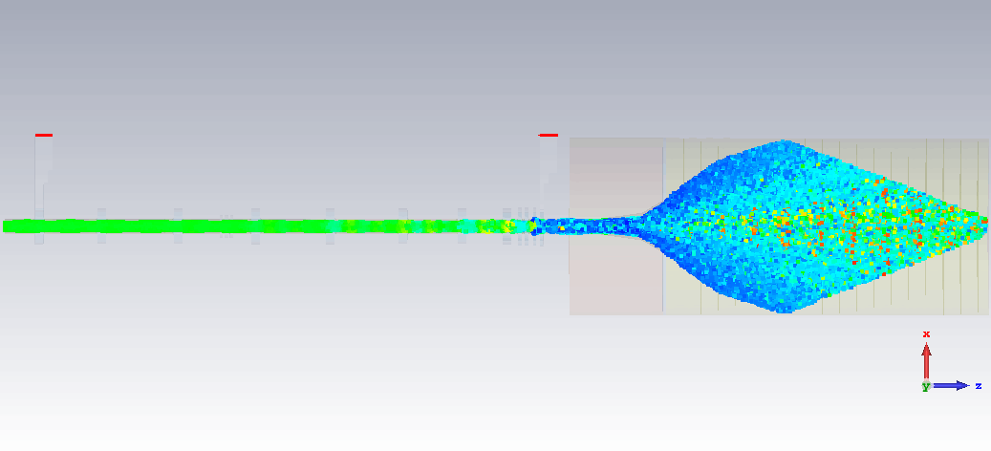
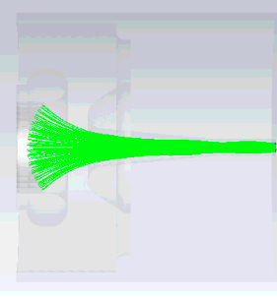
154kV,90A
All in one simulation is done in CST
22 million mesh cells
2 million particles
~ 1 day on 2-cores GPU
~1 month on CERN server
100W
8MW
B_{z} field imported from solenoid system
57dB
Eff.=58.1%
250W
Min(ve/c)=-0.059
27kW
Emax=85MV/m

Slide 25
Performance summary
60MHz
9MW Max.
Well consistent with CST

Slide 26
Cost effective design effort in collaboration with CANON
Tapering the tunnel of output cell to avoid beam interception in output gap
Optimize the output cell gap to avoid very strong surface field
Optimize of the frequencies, positions, Qext are done in KlyC
Shorter length means less solenoid power, less fabrication cost
COM for inner layer, Classic for outer layer
Whole tube optimization is done
Eff=57.5%, Emax=86kV/mm for KlyC simulation

Slide 27
Original long tube 4 cell output structure design
Updated short tube 3 cell output structure design
Eff.~58.5%
E_{max}~73kv/mm
Ve/c~-0.03
-1dB bandwidth~[-30MHz,10MHz]
Pin=130W
L~300mm
Rc after circuit~4.0mm
Eff.~57.4%
E_{max}~87kv/mm
Ve/c~-0.08
-1dB bandwidth~[-20MHz,15MHz]
Pin=80W
L~140mm
Rc after circuit~4.2mm

Slide 28
CST verification
Further polishing in PIC simulation is still necessary
Bz=0.38T
Beam interception occurs after the output structure, ~17kW
Decrease input power by 10% will lead to 6kW beam interception with 0.5% efficiency dropping down
Eff.=56.5%
Stable tube without reflected electrons
Minimal velocity is -0.071c, which is consistent with KlyC
Emax~95kV/mm
Occurs at the last but one cell
Coupled modes operated

Slide 29
Outline
Background and design goal for 8MW Klystron
RF circuits design
Beam optics & RF launcher design
Summary & Cost effective design
Latest progress on 50MW X-band Klystron
A. Jensen
B. Weatherford
J. Neilson
V. Dolgashev
I. Syratchev
J. Cai

Slide 30
50 MW HEX tube progress
Status
The 6 cell coupler was digitized for KlyC (cell frequencies, fields and coupling matrix). In KlyC, the RF power generation efficiency when excited with idealized bunched beam was 70%+ and surface E field ~90 MV/m, similar to CST/3D results.
The RF bunching circuit was scaled from 8MW HE klystron and re-optimised using artificial and efficient cavity. The 70% efficiency was predicted KlyC/2D.
Whole tube optimization (L<400mm) in KlyC is done. CST benchmark is undergoing.
Tapered 6 cell coupler
V₀=400kV, I₀=190A
Congregated bunch
Monochromatic bunch

Slide 31
Thanks! Questions?

