Slide 1
Software tools for klystron design optimization
Juliette Plouin
CEA, France
ARIES Workshop on Energy Efficient RF
18/06/2019

Slide 2
SUMMARY
How to develop a klystron design?
1D and 2D steady state code
2D and 3D Particle In Cell (PIC) codes
Codes results comparison
Conclusion

Slide 3
1. How to develop a klystron design?

Slide 4
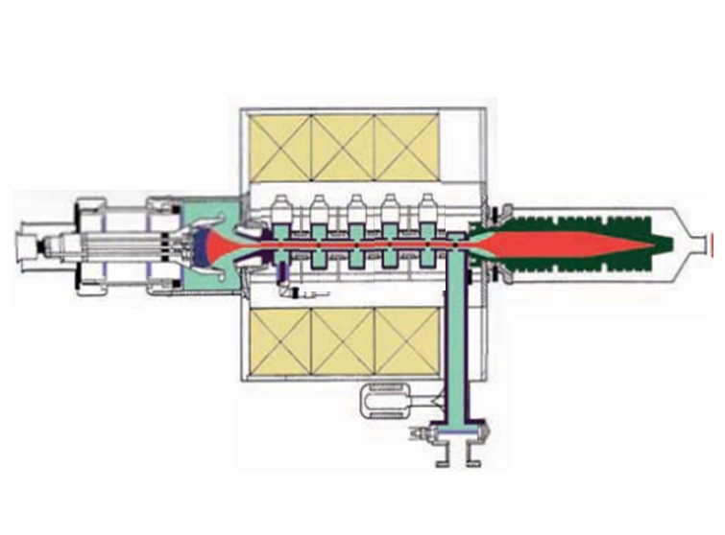
The klystron – a complicated object…
Cavities
RF propagation
RF losses
Focusing coils
magnetostatics
Electron gun
electrostatics
Collector
Beam dynamics
materials
Beam
Beam dynamics
Coupling with RF
Output wave guide
RF propagation
The design of klystrons has long been a manual process guided by experience...
 Klystrons have been developed since the 1940’s, before computers .

Slide 5
Solving equations…
From very simplified…
Small signal Two-Cavity “Bunching” Theory
“for the two-cavity klystron, without space charge and with sinusoidal voltage modulation, the maximum efficiency is 58%.”
High Power Klystrons: Theory and Practice at the SLAC, Caryotakis, 2005
…to full physics
Lorenz force on electrons
To each particule…
At each position…
At each instant…
Maxwell equations
+ Boundary conditions…+ Initial conditions

Slide 6
2. 1D and 2D steady state codes

Slide 7

1D code : ajdisk
Combination of analytical formulae and electron dynamics
Klystron cavities characterized partly by RLC circuits
⇨quick assessment of the power and efficiency
Cavities: R/Q, M, Q_{ext}, Q₀, f_{CAV}, z
Beam: V_{k}, I_{k}, r_{beam}
No magnetic field needed
Time < 1 mn
AJDISK (SLAC)
Freely available
beam
applegate
RLC circuit
modulation current
Gain and efficiency
cavity
$$\vec{E_{z}}$$
disks velocities

Slide 8
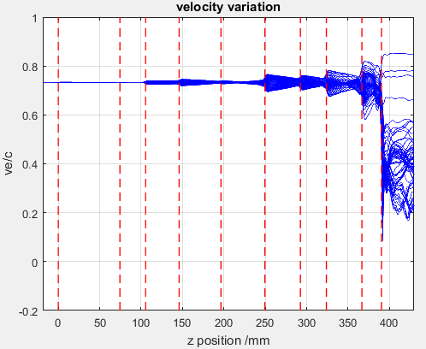
2d codes : klys2d, klyc, …
  Klystron cavities characterized by lumped circuits (f, R/Q, Q₀, Qext)
  PIC in frequency
Time ≃ 1 mn
Cavities: R/Q, M, Q_{ext}, Q₀, f_{CAV}, z and geometry (partial)
Beam: V_{k}, I_{k}, r_{beam}
Focusing mag. field : B_{z0} or B_{z}(z)
KLYS2D (Thales)
KlyC (CERN)
Klypwin
Klys2D
KlyC

Slide 9
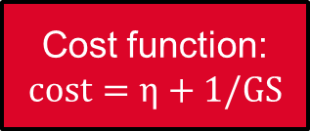
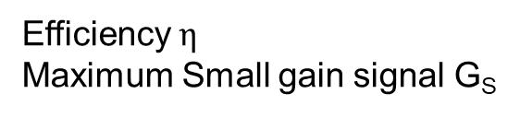
Example of optimization with genetic algorithm
18 parameters
Defining klystron
Efficiency $η$
Maximum Small gain signal G_{S}
AJDISK-solver:
Klystron simulation based on disk model method
Cost function:
$$cost=η+1/GS$$
~7100
GOSET
genetic algorithm on Matlab freely available
New set of 18 parameters,
Based on configurations with the best cost function already simulated
P. Hamel,
this workshop

Slide 10
Optimization examples
AJDISK with genetic algorithm
Simulation of High-Efficiency Klystrons with the COM and CSM bunching, Baikov et al., IVEC2019
Optimization of klystron efficiency with MOGA, Feng et al, IPAC2018

Slide 11
Conclusion on steady state codes
Why we use these codes:
They are fast, and allow optimization procedure
They are essential for the development of a klystron
Lab and companies tend to develop their own codes adapted to their specific needs.
Their limits:
They don’t take into account the whole physics and geometry of the klystron
Some of them were developed for conventional klystrons and must be adapted to be valid for new klystron types (COM, BAC, kladistron…)
They cannot predict instabilities

Slide 12
3. 2D and 3D Particle In Cell (PIC) CODES

Slide 13
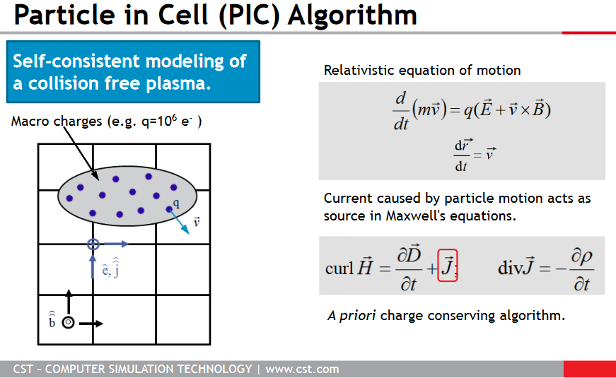
PARTICLE IN CELL CODES
The particle-in-cell (PIC) solver, which works in the time domain, can perform a fully consistent simulation of particles and electromagnetic fields
Integration of the equations of motion.
Interpolation of charge and current source terms to the field mesh.
Computation of the fields on mesh points.
Interpolation of the fields from the mesh to the particle locations

Slide 14
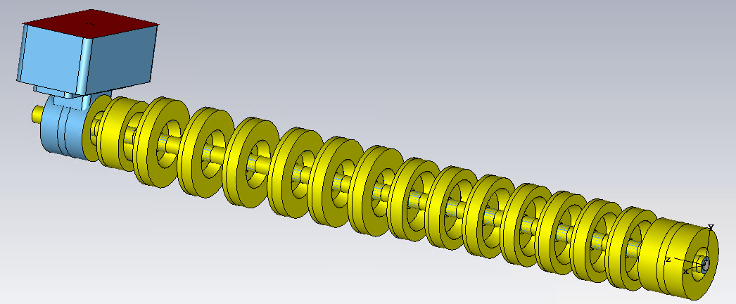
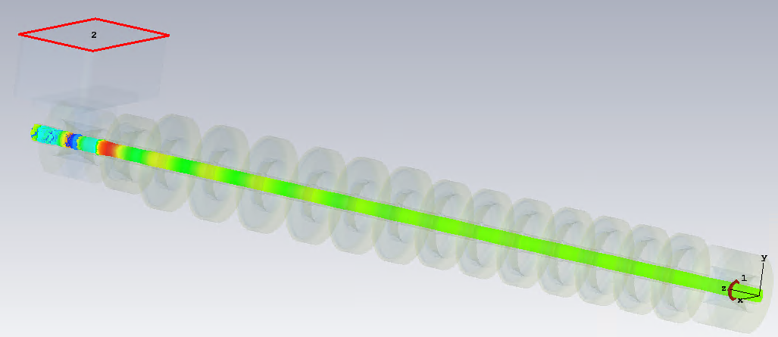
Pic codes : cst and magic
CST (Dassault Systems)
MAGIC 2D (Orbital ATK/Northrop Grumman)

Slide 15
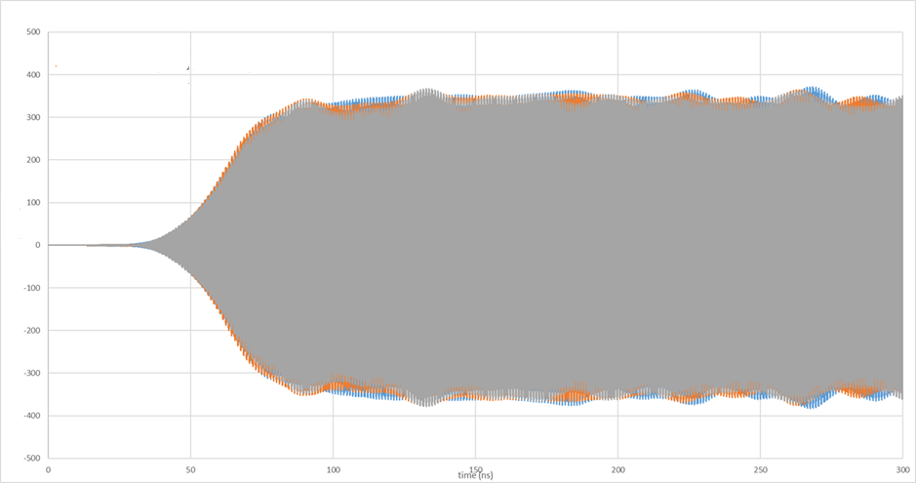
Cst example
Time: tens of hours
Amplitude
RF output power
Time
To do list
Cavity tuning to get expected frequencies
Mesh adaptation for results convergence
Numerical noise: must be damped with artificial absorption
RF signal injection: antenna, waveguide…
Find input power giving maximal efficiency
The klystron calculated performances can be very sensitive to all these parameters…

Slide 16
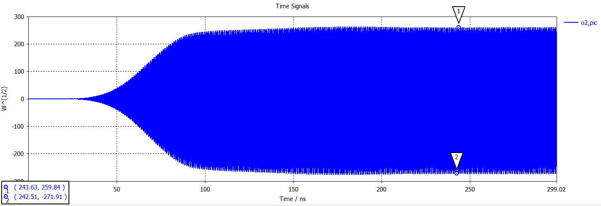
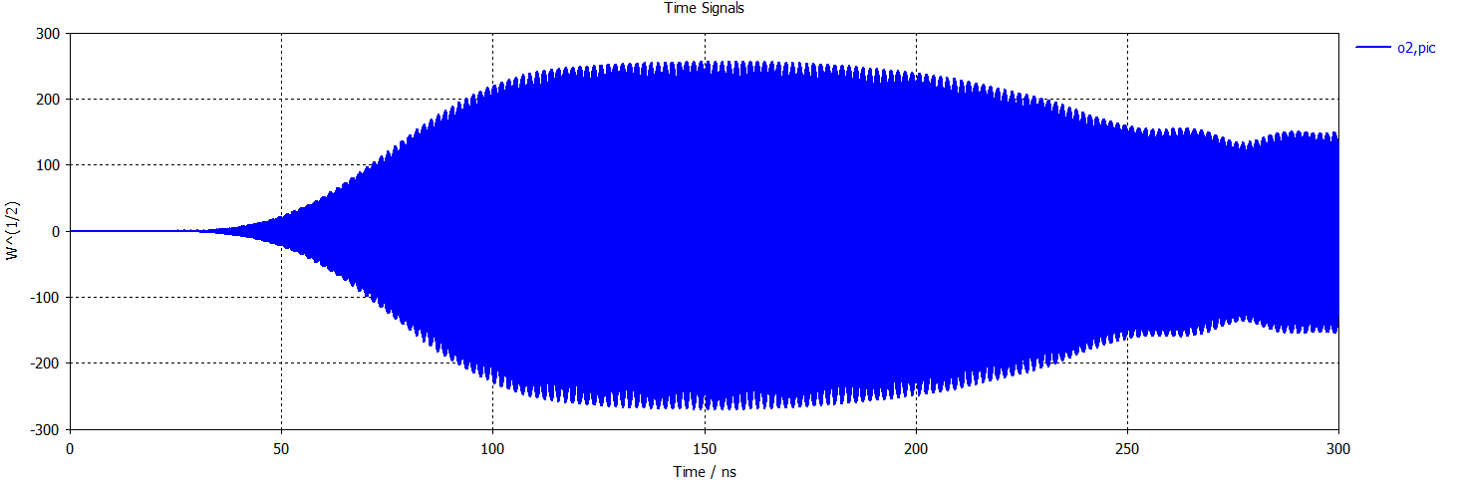
Numerical problem example with cst
RF output power
2,0x10⁶ cells
Time
Mesh size increases…
and klystron stability is lost!
This was due to a numerical problem wich as now been solved
RF output power
3,8x10⁶ cells
Time
Check and re-check the validity of your results.
Discuss with code developers!

Slide 17
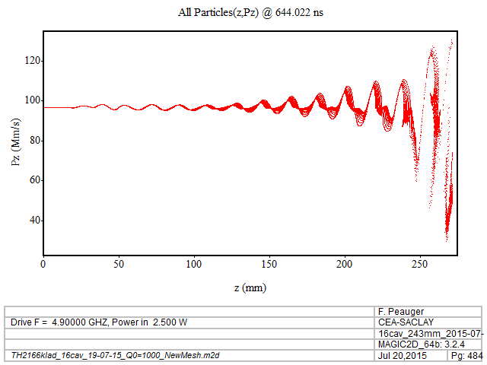
Magic 2d examples
Time: few hours
Particle velocity
Position
RF output power
Unstable klystron…
Good stability
Time
Time

Slide 18
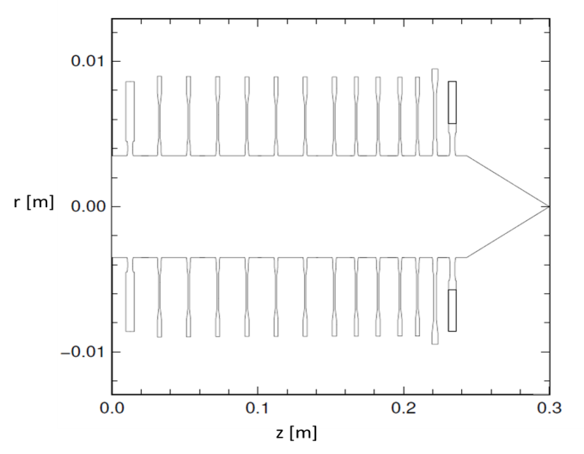
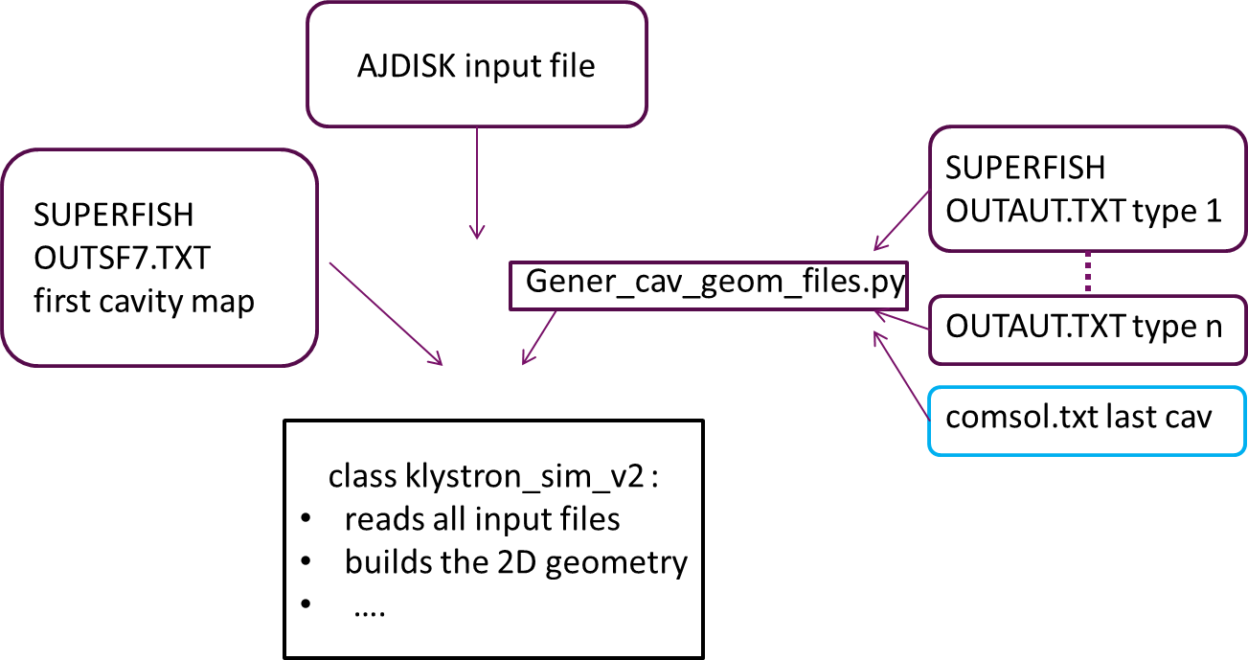
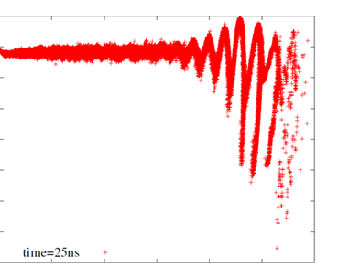
Other pic codes
GDFidL : work was done on klystron but doesn’t seem to have been continued
Warp is an extensively developed open-source PIC code designed to simulate charged particle beams with high space-charge intensity. It has been developed at Lawrence Berkeley National Laboratory, CA, USA. It’s a free and open source code.
Klystron class developed at CEA for Warp (interfaces with superfish and AJDisk)
Conclusion in 2015: “Warp shows high potentiality to simulate the klystron as built without any assumption, but a deeper knowledge of the code is still needed.”

Slide 19
Conclusions on pic codes
Why we use these codes:
Their agreement with geometry and physics of klystrons is much higher.
They allow verification of the klystron performances after optimization
These codes are developed and sold by private companies, are maintained, and propose technical support (CST people are very active in the microwave tubes community)
Their limits and difficulties:
They are time consuming, and are not fitted for optimization procedure.
They require good knowledge of their operation to avoid fake results.

Slide 20
4. Code results comparison

Slide 21
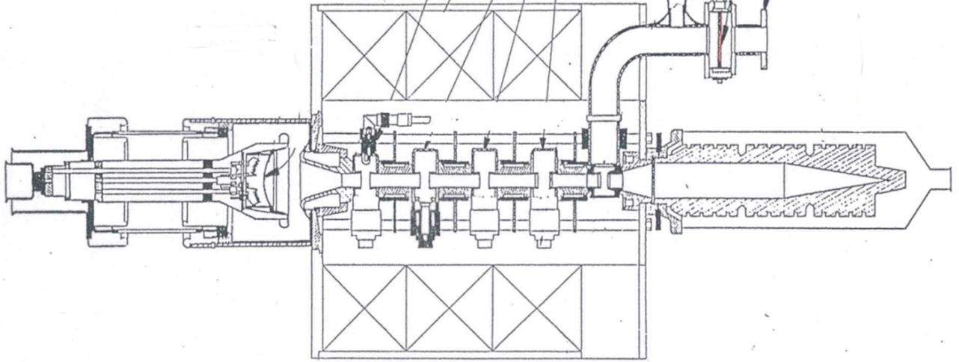
Comparison between codes - 1
Thales TH2166 klystron - 6 cavities
TH2166 intermediate cavities
input cavity
output cavity and window
  During EUCARD², a kladistron operating in the C-band (5 GHz) has been designed and manufactured, from the design of the existing Thales klystron TH2166 in view of increasing efficiency.
gun
collector
solenoid
CEA/Thales kladistron - 16 cavities
Kladistron intermediate cavities
input cavity
output cavity and window
gun
collector
Same elements
solenoid

Slide 22
Comparison between codes for th2166
Configurations | Initial beam | Magnetic field
1 | Laminary | Uniform
3 | From Optic2D (Thales code for electron gun) | Real values
A. Mollard
PhD thesis
Magnetic field
KLYS2D
MAGIC
Efficiency spread [45-55%] depending on code AND configuration

Slide 23
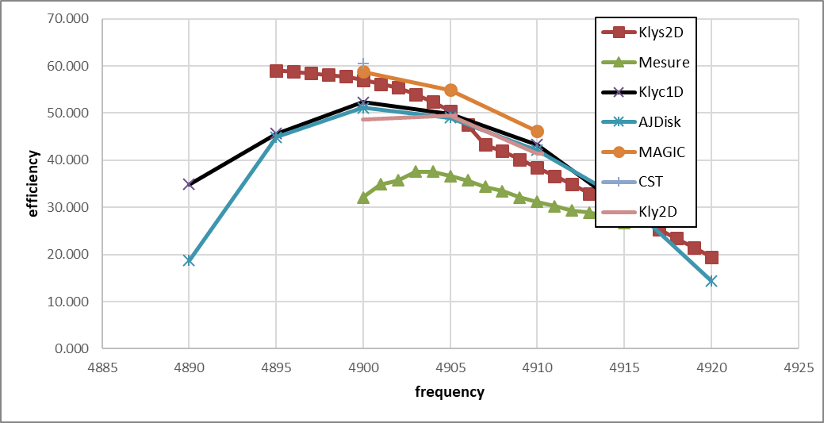
Comparison between codes - kladistron
CST
P. Hamel courtesy
Efficiency spread [50-60%] depending on code simulation
The measured efficiency is lower than expected
  this point is presently explored with retro-simulations
  spurious oscillation has been observed

Slide 24
How to predict spurious oscillation ?
Spurious oscillation in klystrons can occur when:
Backstreaming electrons turn in resonance in the interaction lines
Monotron oscillation is excited
In principle, these phenomena cannot be simulated with the steadystate codes (even if the conditions – high gain for example- can be predicted).
In principle, these phenomena can be simulated in PIC codes
However, the conditions leading to such oscillation can be very tricky
Up to now, I didn’t find a paper showing that a spurious oscillation measured in a klystron was properly generated by a PIC code. ⇨ Still this is an issue.
Example of dedicated simulations of electrons reflected from a collector, responsible of spurious oscillation
Instability caused by backstreaming electrons in klystron, Fang, APAC, 2001

Slide 25
conclusion
No code will be a perfect representation of a klystron reality, and this has never stopped the fabrication of good klystrons.
The development of codes has allowed the study of more complicated, subtle interaction lines.
Those last years, new efficient bunching methods could be developed (COM, BAC, kladistron,…) and start to give good experimental results
Systematic optimization techniques, in particular with genetic algorithms, are probably a promising tool for the future
The complete simulation of a klystron in 3D is now possible, and helps a lot for checking some issues, but is not a turnkey solution.

