Slide 1
IOT as energy efficient alternative
Chiara Marrelli, Morten Jensen
European Spallation Source ERIC
ARIES workshop on Energy Efficient RF
19/06/2019

Slide 2
Outline
IOT basics and working principles
IOTs as high efficiency power sources
IOT advantages and limitations
Multi Beam IOT for ESS: development and results
Conclusion and future perspectives

Slide 3
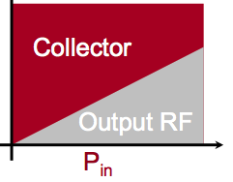

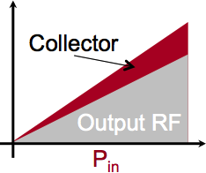
Working principles
RF input
RF output
Klystron
(Velocity modulated): class A
Cathode
(DC Beam)
Full DC input also with zero drive (and zero output)
Collector
IOT
(Density modulated): class B
RF input
No collector dissipation with zero drive
Biased Control Grid
RF output

Slide 4


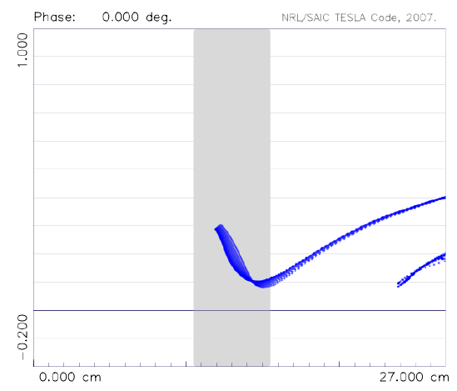
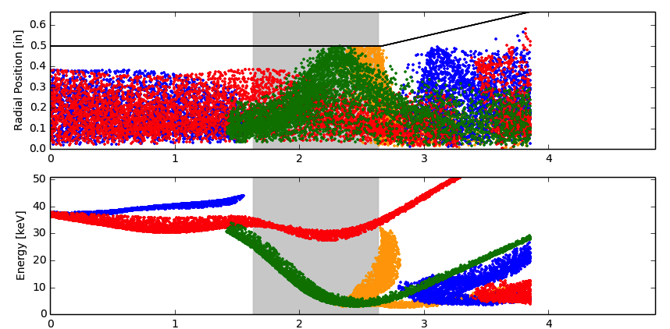

IOT as high efficiency power source
Beam comes out of the cathode-grid already bunched
Bunch saturation is 100%
There is no velocity modulation, so energy spread in the beam is very low.
No velocity modulation would be good…..if we had infinitely short bunches and no space charge. But in reality we know that we need the bunch to be congregated to achieve the maximum extraction efficiency.
Particles shown at 4 phases of an RF cycle
Extraction efficiency is tipically around 70-75%
BUT…....
L. Ives, Cal. Creek Research, “Development of a 402.5 MHz 140 kW IOT”

Slide 5
IOT Operational efficiency
We have to consider OPERATIONAL efficiency!
IOT’s don’t saturate.
Built-in headroom for feedback.
IOT
MB-IOT
The current also depends on the grid voltage.
As a result, the tube does not saturate as fast as a klystron
Efficiency at point of operation (linear region) can be as high as 70%
Efficiency drops slowly at reduced output power
Good Linearity
Short-pulse
excursions possible
Operating
Power Level
Klystron
Long-pulse
excursions possible
P_{out}
~ 70%
High gain
Low Gain
P_{in}
Courtesy of CPI

Slide 6
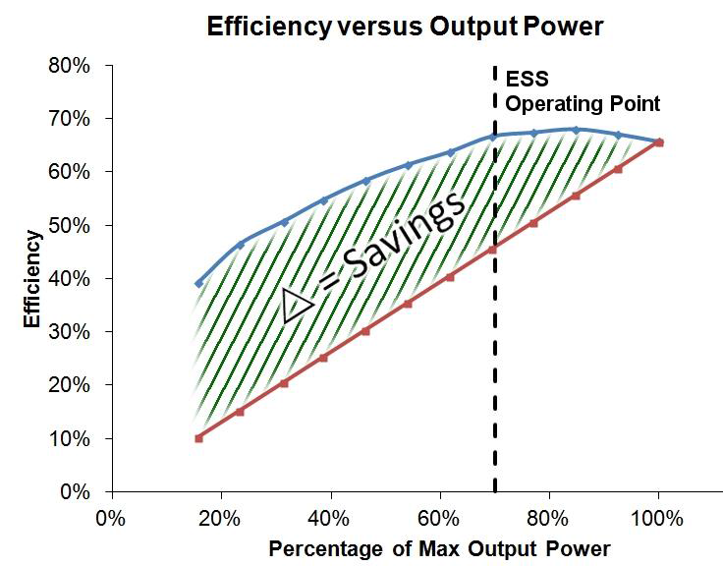
Operational efficiency IOT vs klystron
IOT measurements courtesy of M. Boyle, L3
Based on broadcast IOT L-4444
System setup limited by drive power and beam voltage
IOT setup for maximum gain (not efficiency) without breakdown
Klystron assumed to have same saturated efficiency as the IOT
No optimisation of coupling, voltages, perveance for different power levels
Good for machines which require the amplifier to operate at different power levels
  varying power loads
  Non uniform power profiles
  Margins for overhead for regulation
  One-to-one relationship with amplifier to accelerating structure
  Common HV supply to multiple power sources

Slide 7
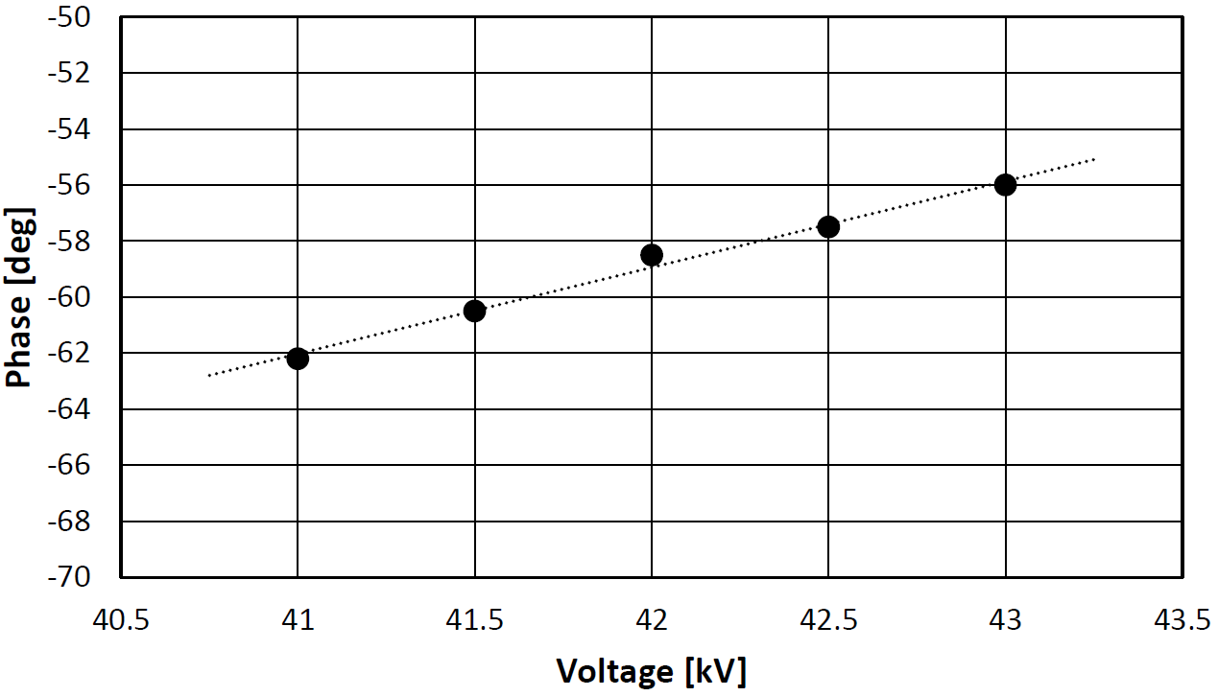
IOT as high efficiency power source
Other advantages and drawbacks
Other advantages:
Short, no gain cavities, so pushing factor is small
Solenoid power is low (0-100’s W)
Small and compact
Power is pulsed by RF instead than HV
Collector only ever handles spent RF beam (e.g. at Eff. 50% P_{Coll} = RF power)
Low power consumption in standby or for reduced output power
△ = 6 deg
△ = 2 kV
  L3 MBIOT FAT: Data taken by varying beam voltage at constant output power (1 MW)
Drawbacks: Gain is low (20-23 dB). This is a smaller problem than a few years ago thanks to the improvement in solid state technology.
Frequency upper limit: about 1.3-1.5 GHz -> limit imposed by the cathode to grid distance
Multibeam design can be complicated

Slide 8
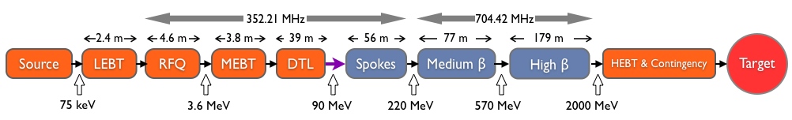
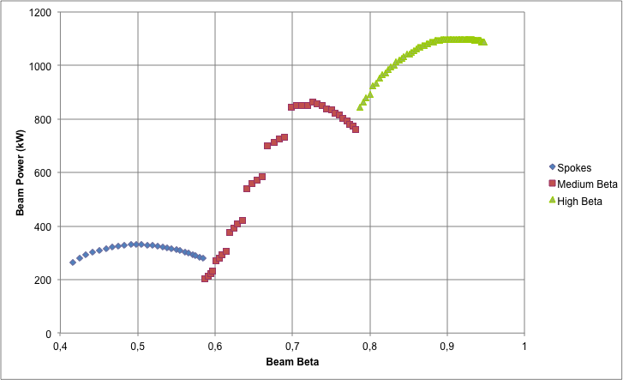
IOTs for ESS
30 kW Solid State Amplifiers
MBIOTs / 1.5 MW Klystrons
 | Frequency (MHz) | No. of Cavities | βg | Temp (°K) | RF power (kW)
Source | - | 0 | – | ~300 | –
LEBT | - | 0 | – | ~300 | –
RFQ | 352.21 | 1 | – | ~300 | 1600**
MEBT | 352.21 | 3 | – | ~300 | 20**
DTL | 352.21 | 5 | – | ~300 | 2200**
Spoke | 352.21 | 26 (2/CM) | 0.5 βopt | ~2 | 330**
Medium β | 704.42 | 36 (4/CM) | 0.67 | ~2 | 870**
High β | 704.42 | 84 (4/CM) | 0.86 | ~2 | 1100**
HEBT | – | 0 | – | ~300 | –
3 MW Klystrons
200 kW Tetrodes
1.5 MW Klystrons
Total High Power RF: 133 MW peak (4% duty) plus overhead
90 MW to High Beta Section!
** Plus overhead for control
3.3 MW estimated power reduction by using IOTs for High Beta instead than conventional klystrons
Power to
the beam for SC linac

Slide 9
Multi Beam IOT for ESS
2014 - ESS signed two contracts for two Technology Demonstrators:
L3 Electron Devices
Consortium of Thales Electron Devices (TED) and Communications & Power Industries (CPI)
Parameter
Frequency | 704.42 MHz
Output Power | ≥ 1.2 MW
RF Pulse length | Up to 3.5 ms
Duty factor | Up to 5%
Efficiency | Target > 65%
Gain | ≥ 20 dB
High Voltage | ≤ 50 kV
Design Lifetime | > 50,000 hrs
Work carried out in collaboration with CERN
ESS to procure prototypes
CERN to make space and utilities available for testing

Slide 10

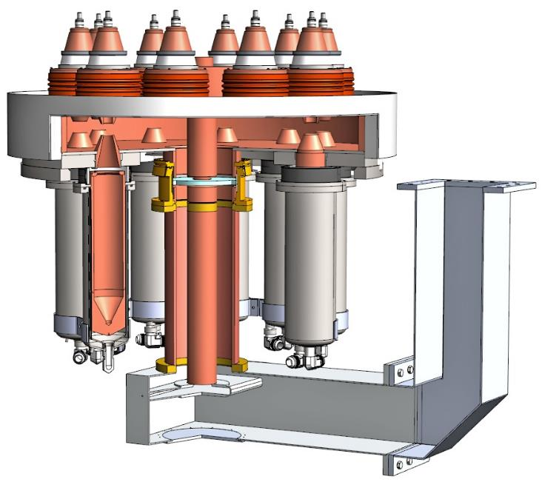
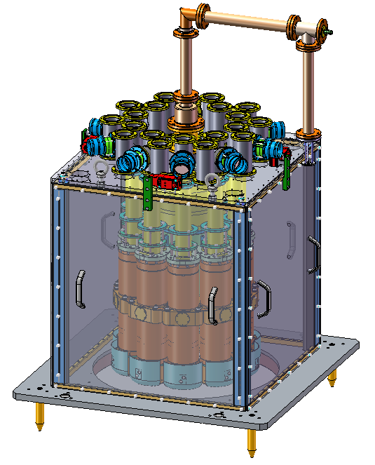
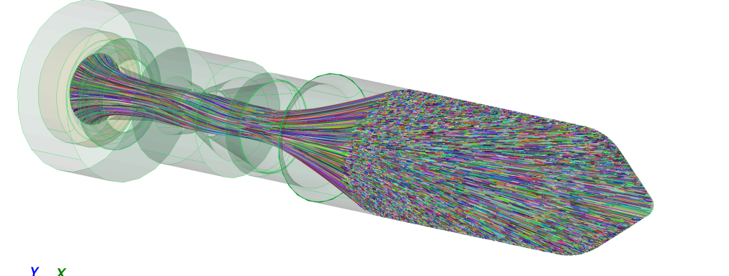
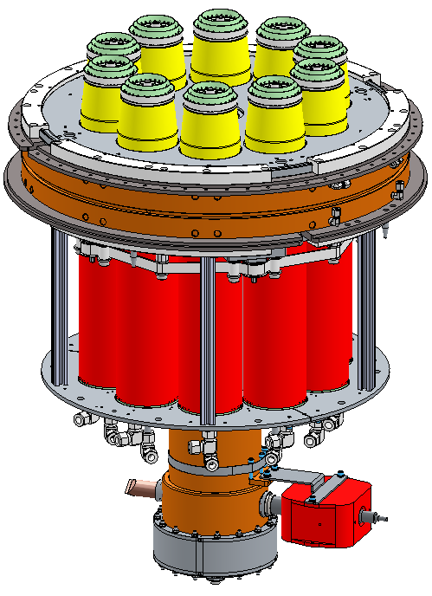
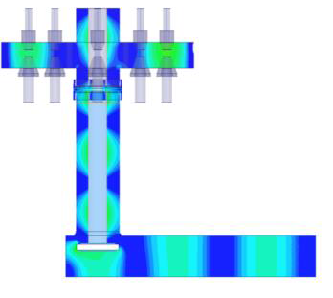
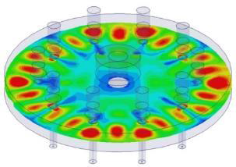
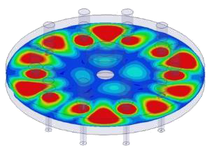
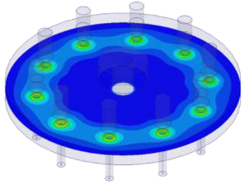


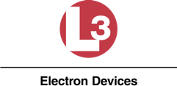
The ESS MB-IOTs
Main design features
10 Electron guns placed in a circle
Output cavity with 10 separate interaction gaps and single output
Magnetic focusing (PPM or solenoid)
Output windows based on high power klystron designs
Individual collectors
Extensive modelling and simulation by the suppliers (beam optics, mode analysis, thermal and structural analysis, innovative manufacturing, …)
Manufacturing validation through single beam prototyping and sub-assembly test vehicles, …
Design driven by reliability and efficiency
10

Slide 11
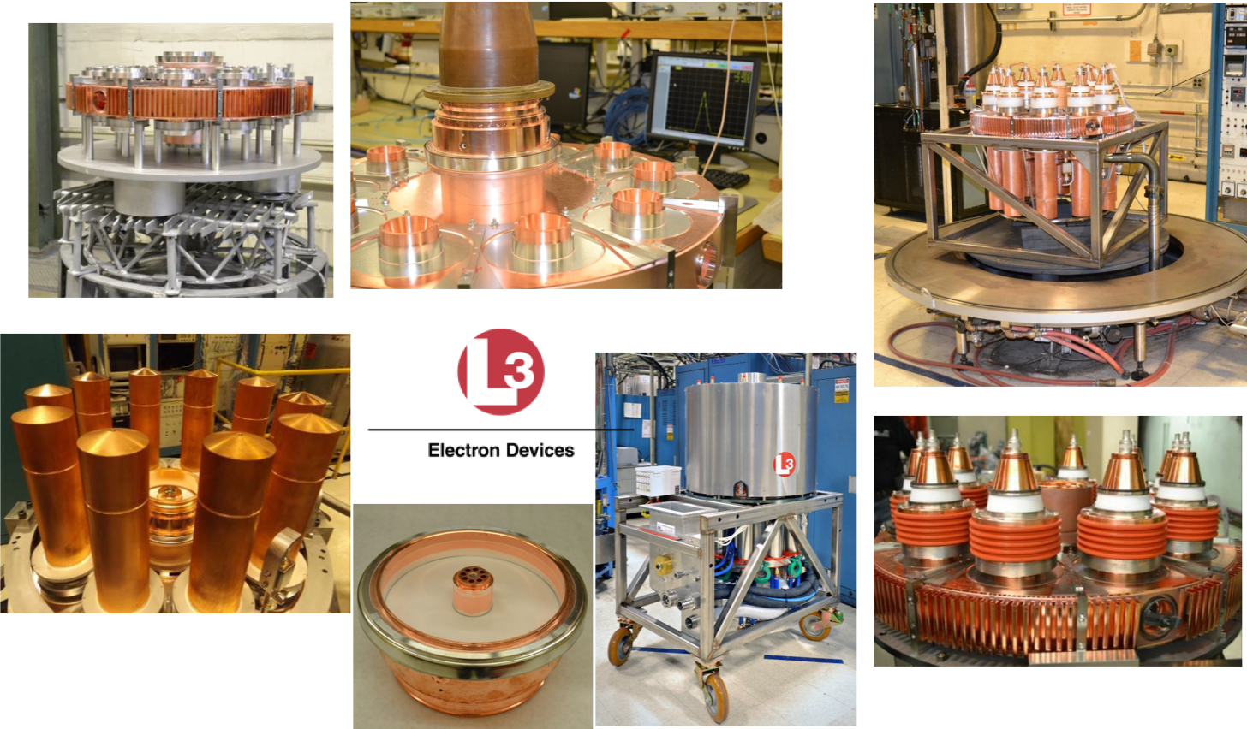
From simulations to reality: L3

Slide 12
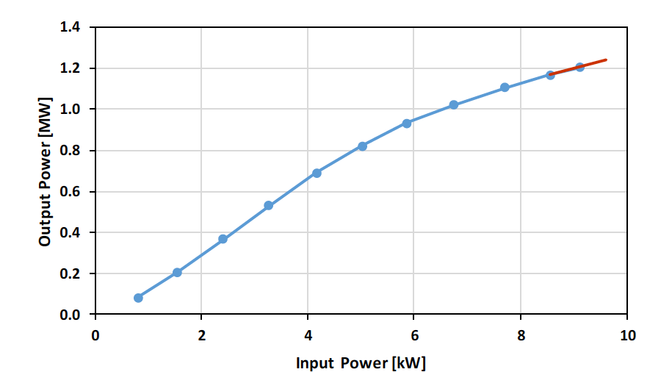
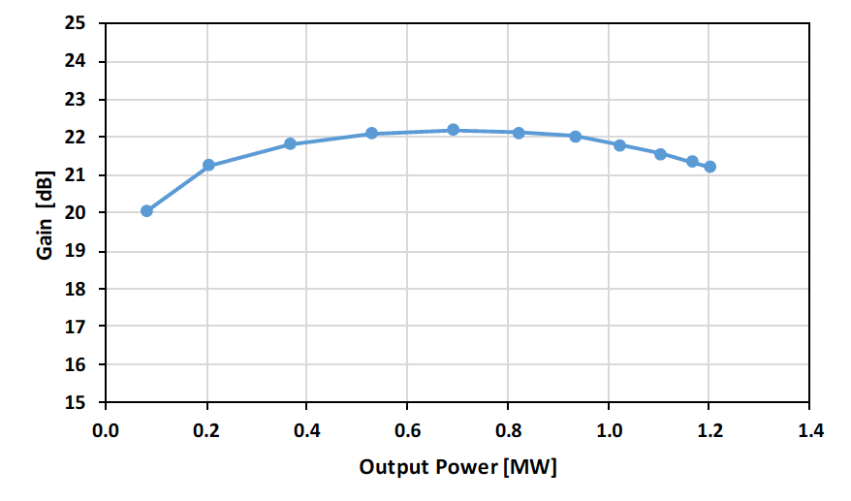
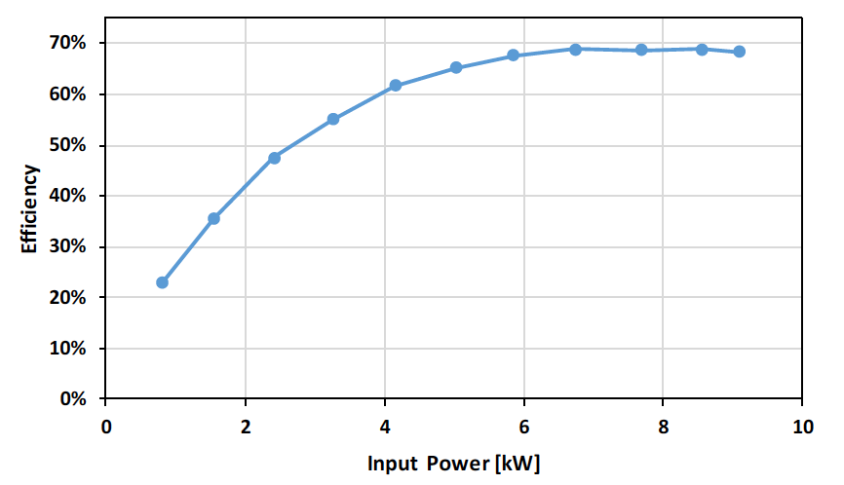
L3 MBIOT Factory Acceptance Results
Factory Acceptance test in October 2016 demonstrated the achievement of the main performances with some limitation due to the power supply at factory
Transfer curve at -43.4 kV

Slide 13
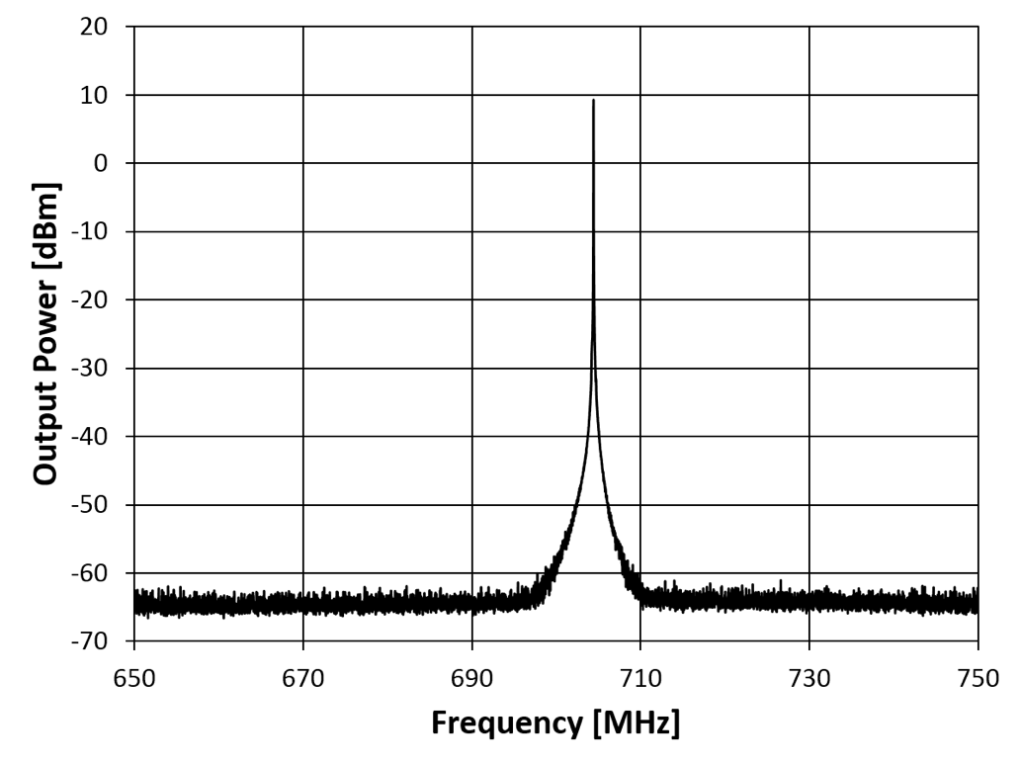
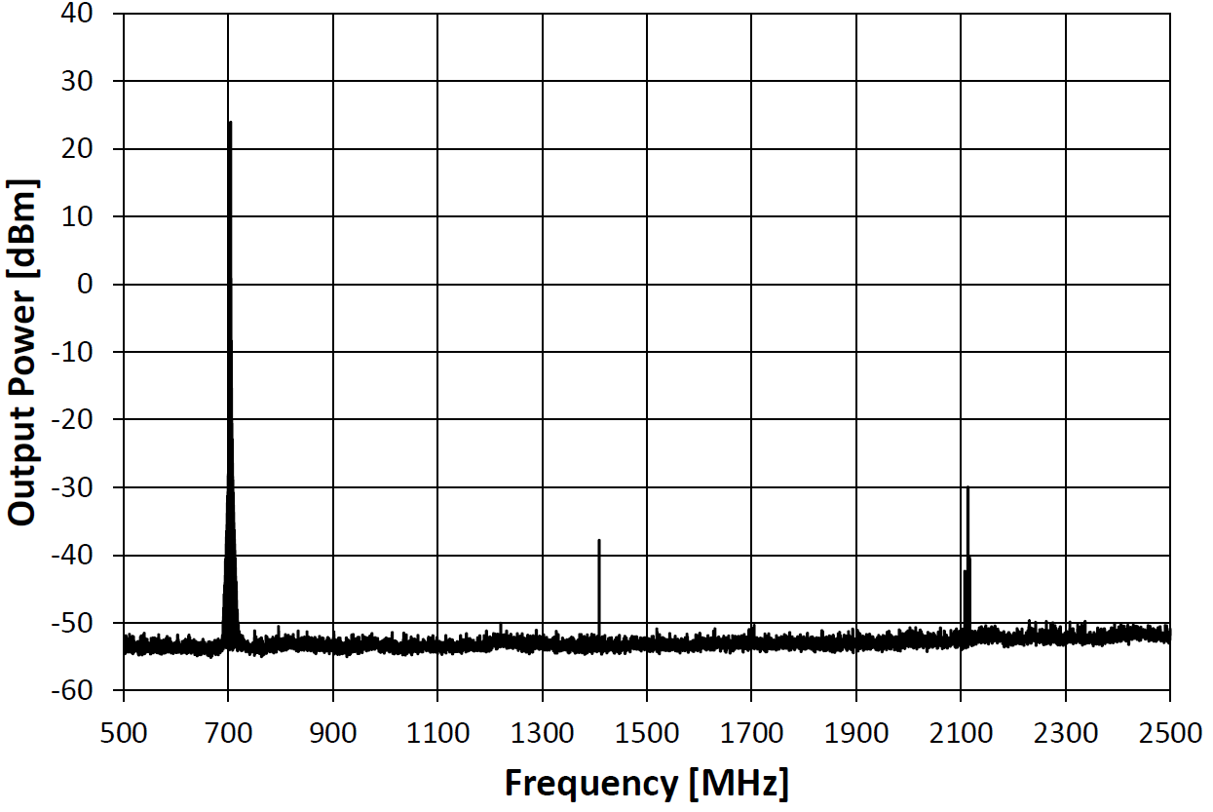
L3 MBIOT Factory Acceptance Results
Output spectrum at 1 MW
Harmonic content at 1 MW
Spurious < 60 dBc
Second Harmonic: -48 dBc (11 W)
Third Harmonic: -57 dBc (1.5 W)
(Specification < -30 dBc)
(Coupling factors calibrated at harmonics)
No power seen from harmonic cavity modes and no sign of instability

Slide 14
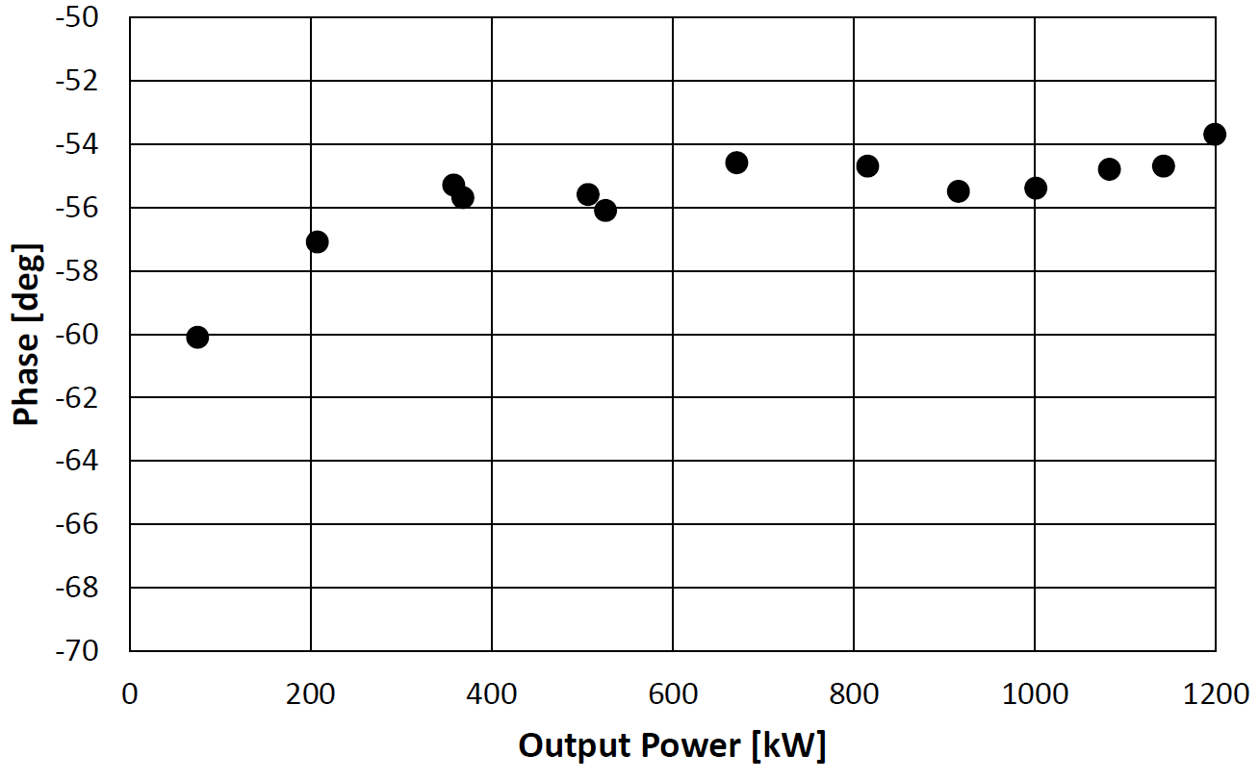
L3 MBIOT Factory Acceptance Results
Low Insertion Phase: 3 deg / kV
Linear and reduces phase variation due to HV ripple
  Data taken by varying beam voltage at constant output power (1 MW)
△ = 6 deg
△ = 2 kV
△ 4 deg
Monotonic phase shift for increasing output power
Total phase shift < 4 deg from 20% to 100% of nominal output
Measured at constant beam voltage
200 kW
1200 kW

Slide 15
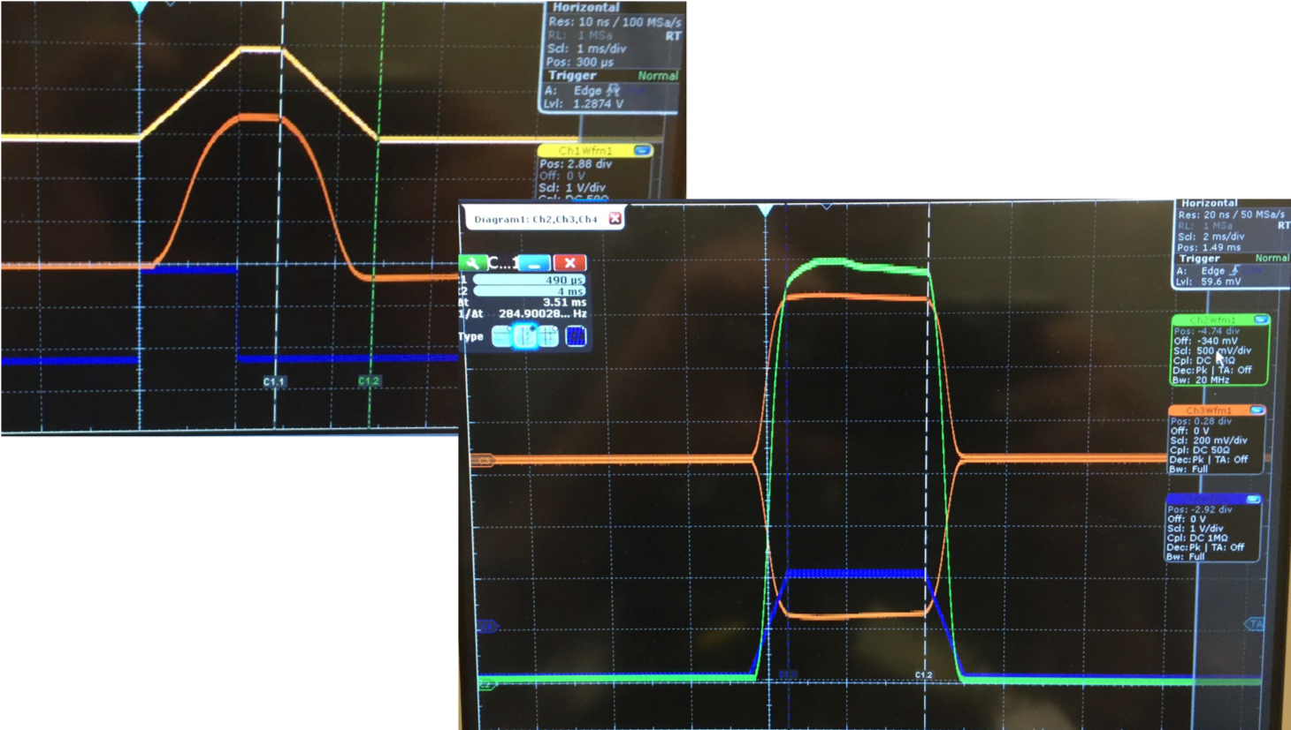
L3 MBIOT Site Acceptance Test Results
Scope capture with 400 μs flat top
Input Drive: Yellow trace
RF Output Power: Orange trace
1.2 MW output, 3.5 ms flat top
Rep. Rate = 14 Hz
Cathode current: Green trace
RF Output Power: Orange trace
Testing carried out at CERN

Slide 16
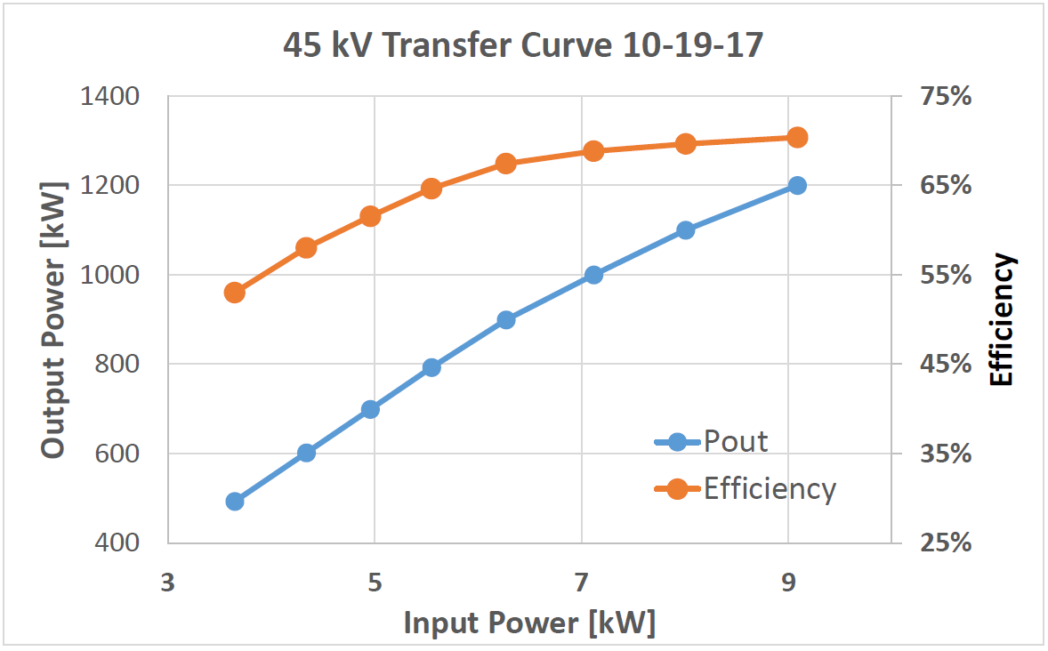
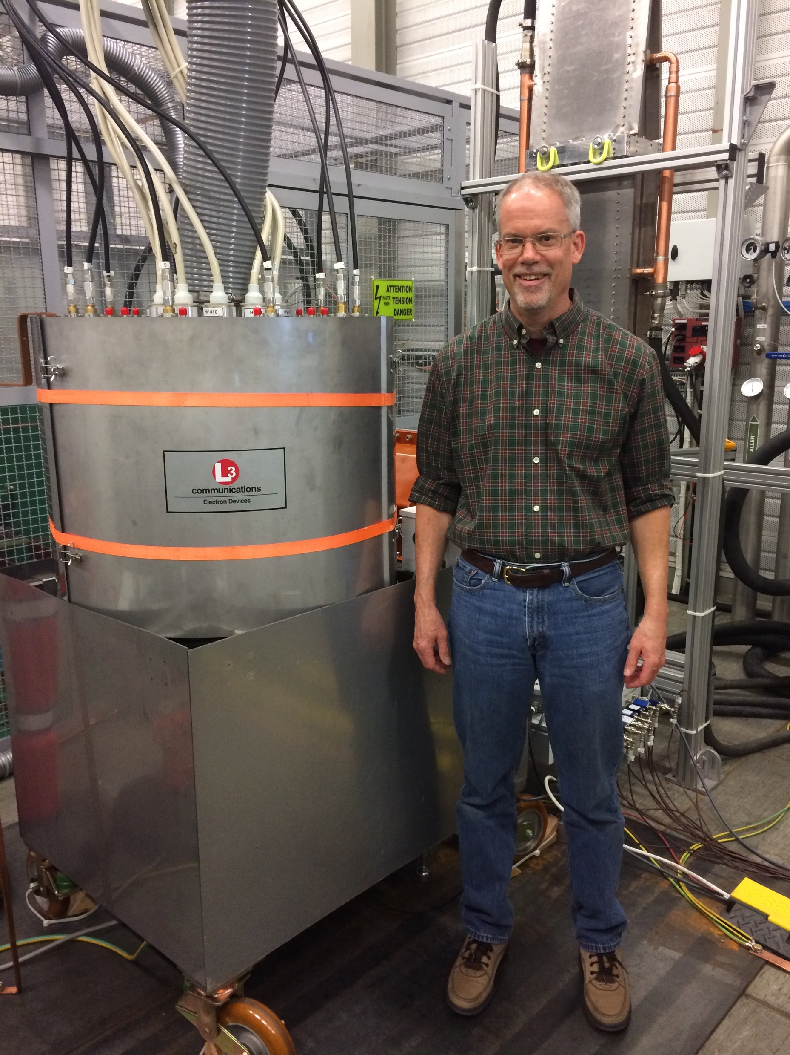
L3 MBIOT Site Acceptance Test Results
Output Power ([kW]
Efficiency
Data obtained for a 400 μs flat top
Long pulse operation:
1.2 MW achieved with 3.5 ms flat top with 1 ms ramps on leading and training edges
1.14 MW achieved at 4 ms flat top, limited by the drivers

Slide 17
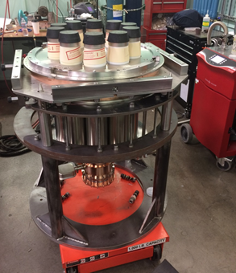
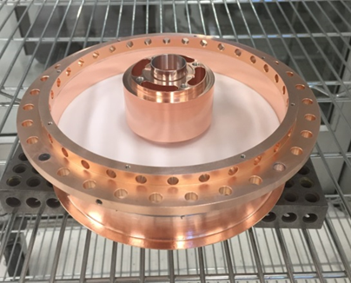
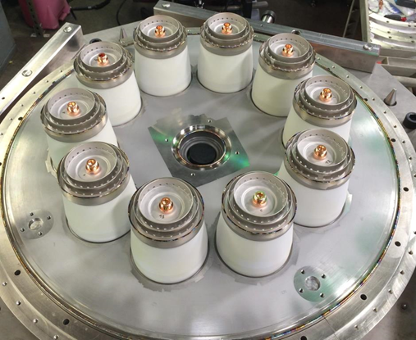


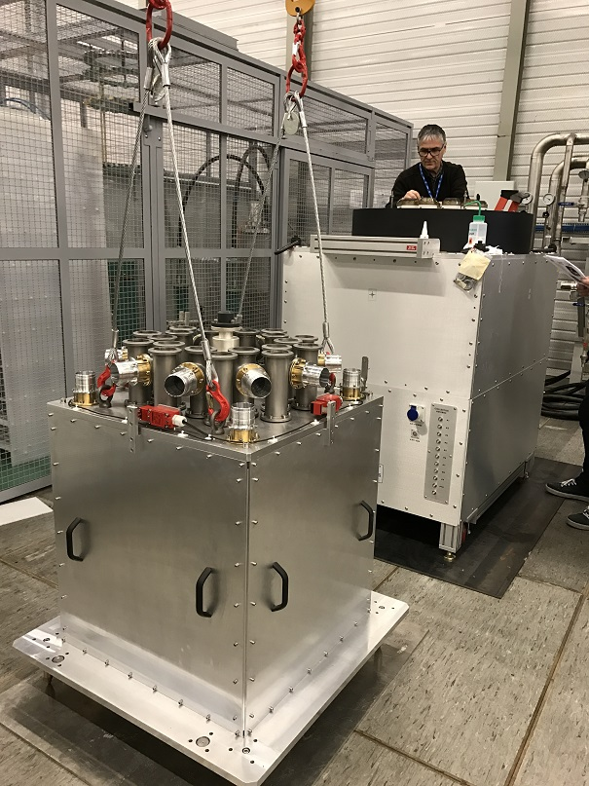
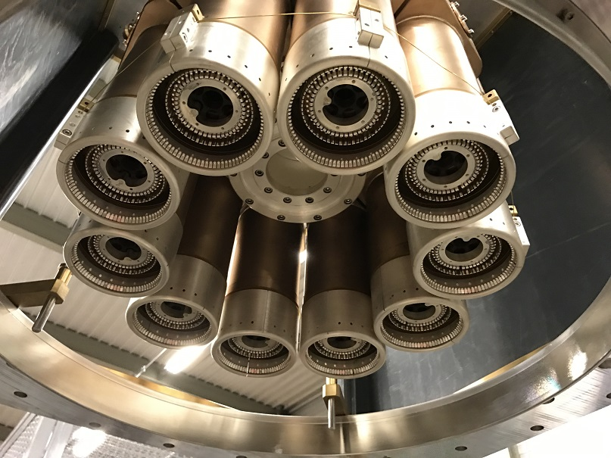
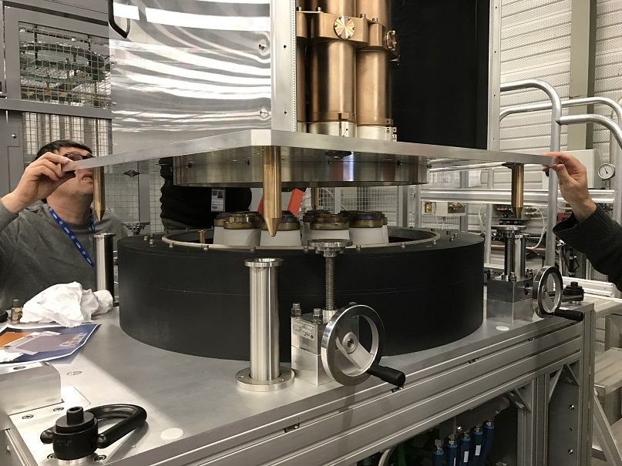
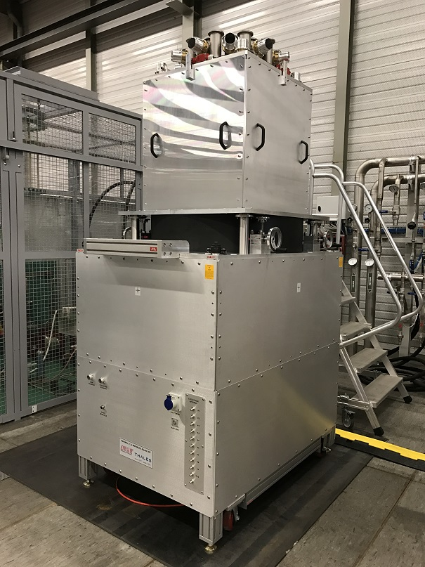
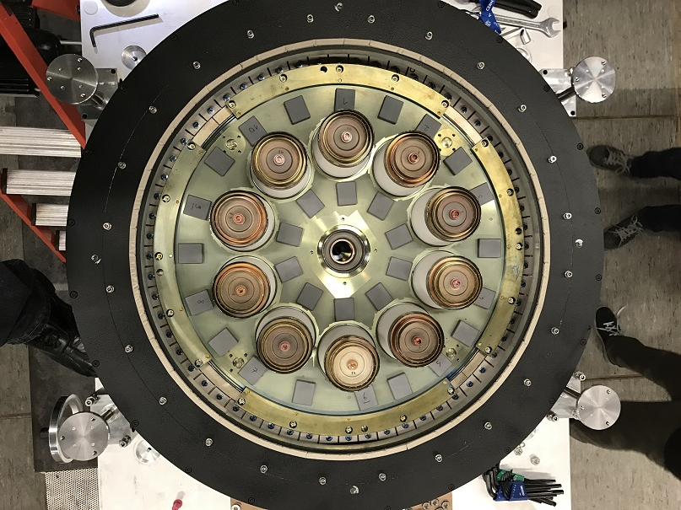
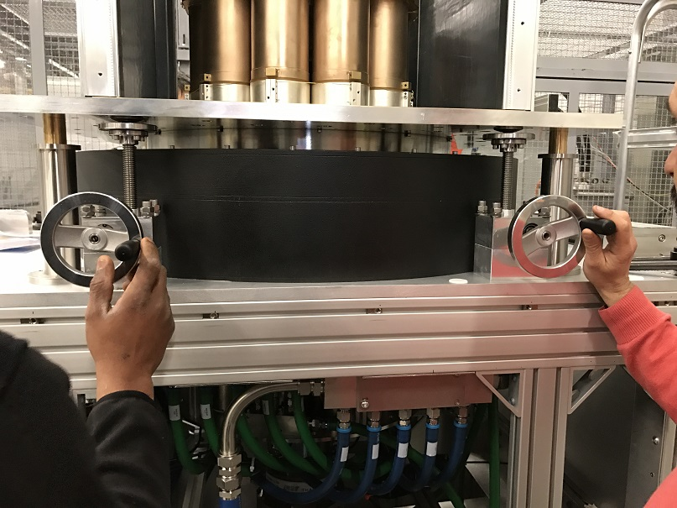
From Simulation to Reality: Thales and CPI
Assembly at CERN

Slide 18
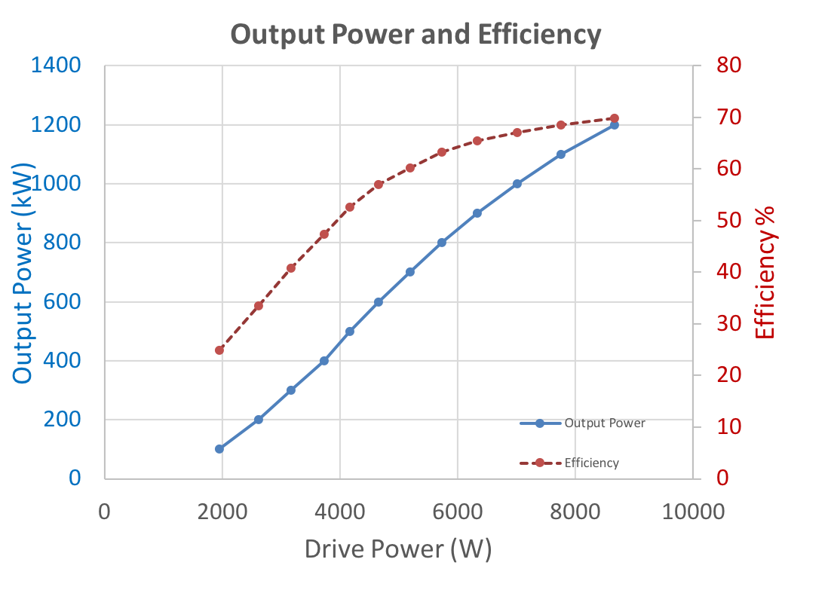
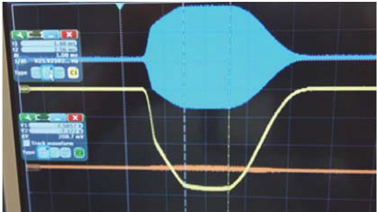
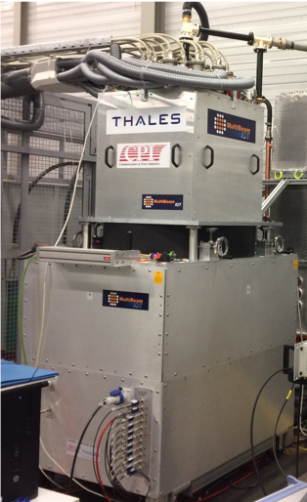
TED/CPI IOT Results
Transfer curve to 1.2 MW
Data obtained at 45 kV
1 ms flat top
1 ms leading and trailing edges
14 Hz rep. rate
Yellow: Total Collector current
Blue: RF output pulse
IOT installed at CERN

Slide 19
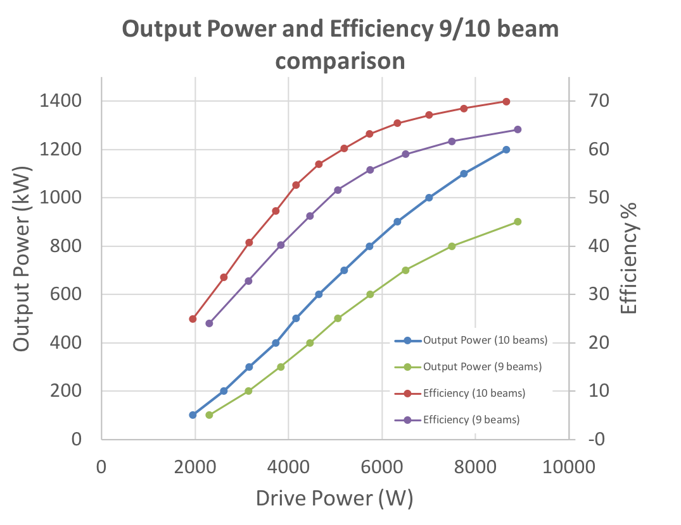
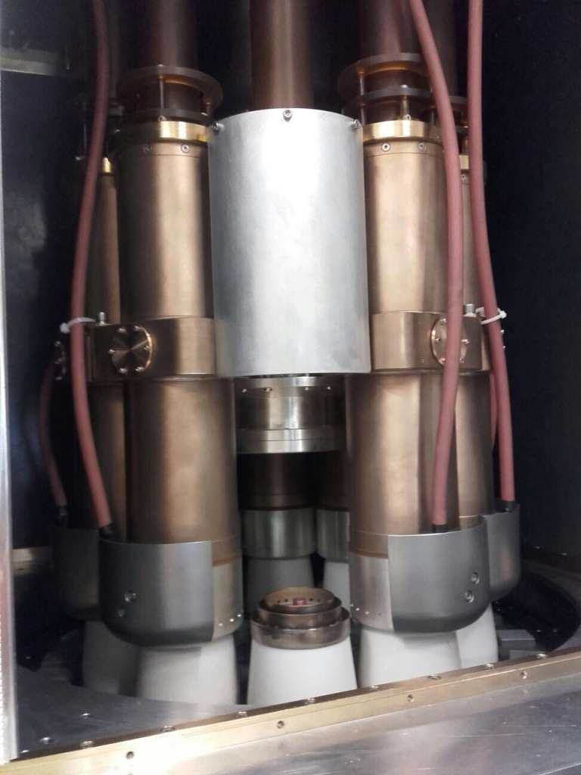
TED/CPI IOT Results
10 beams
Efficiency
9 beams
Pout 10 beams
Pout 9 beams
One gun off
Input cavity removed.
No signs of instability
Drive limited due to missing module
Pushing a single gun to higher current, equivalent to 1.4 MW, showed no sign of saturation

Slide 20
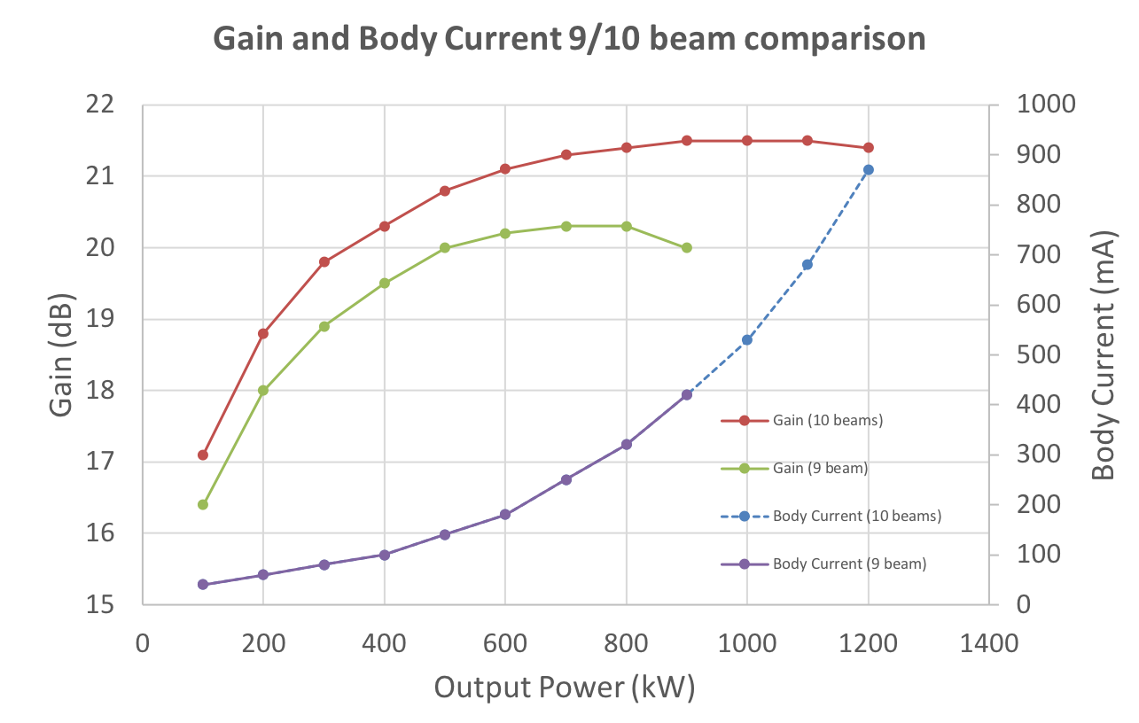
TED/CPI IOT Results

Slide 21
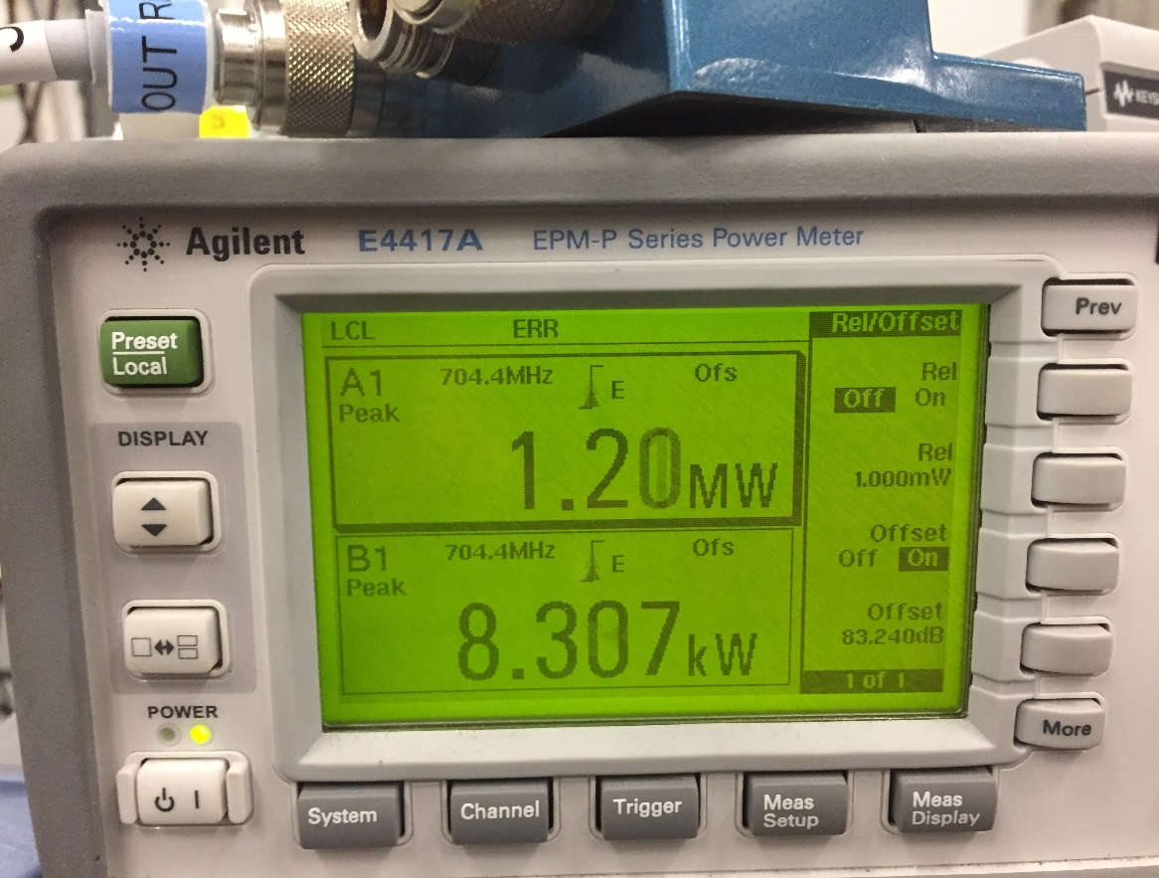
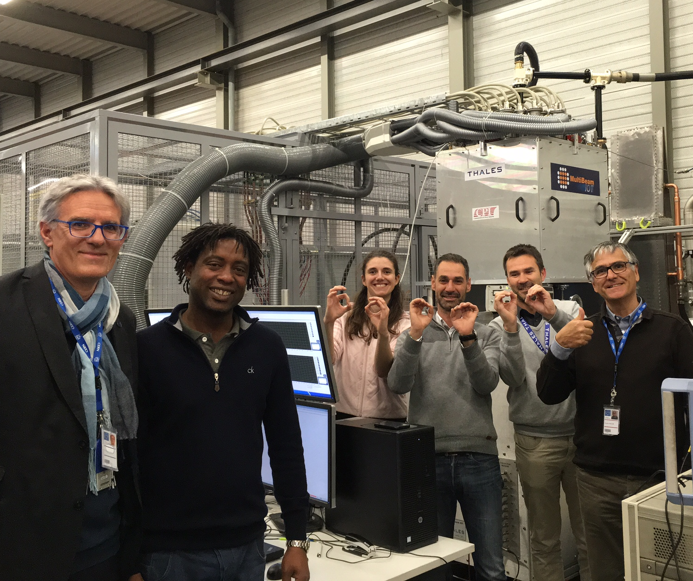
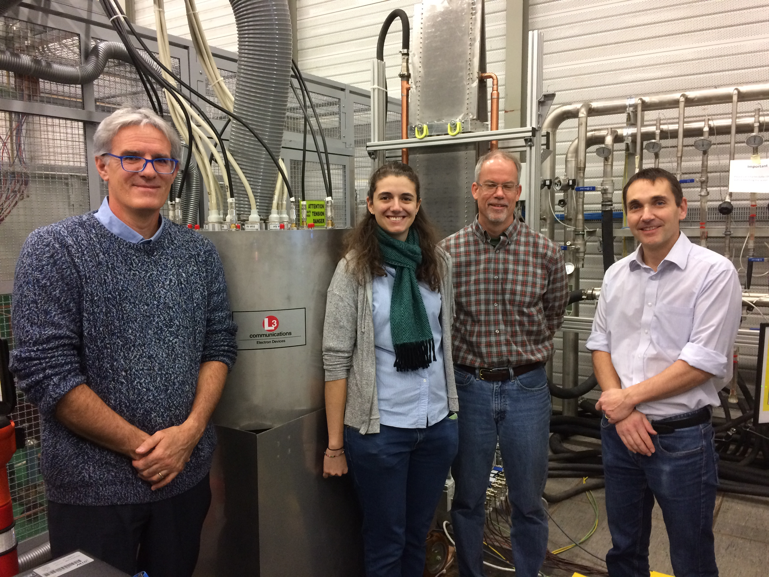
MBIOTs testing at Cern
MBIOTs delivered to CERN for testing
Both MBIOTs have delivered 1.2 MW
Overall Technical Specification achieved
World Record
Thales/CPI MBIOT
Testing at CERN
L3 MBIOT

Slide 22
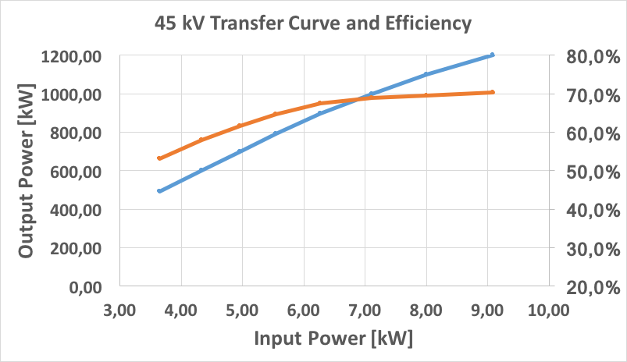
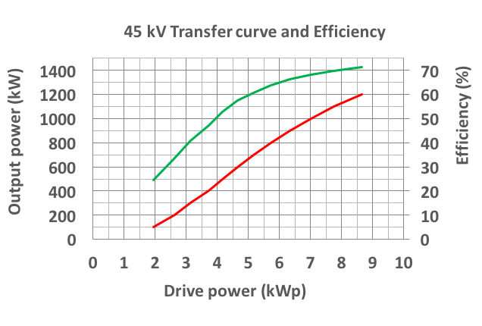
Results of the MBIOT testing
Summary
L3 MBIOT
Thales/CPI MBIOT
Efficiency
Efficiency
Output Power
Output Power
70 % efficient at 1.2 MW
Efficiency remains > 60% from 650 kW
Further optimisation possible by optimising HV and Q
High efficiency at point of operation even when overhead is required

Slide 23
Auxiliary systems
Overall the auxiliary power consumption is similar between IOTs and Klystrons
 | Klystron | MBIOT
Magnetic Focusing | < 3 kW typ | 0 (PPM) - < 200 W
Filament | 250 - 300 W typ | 10 guns = 2-2.5 kW typ
Blower | None | TBD > 2 kW expected
Driver | < 300 W typ | < 5 kW expected during pulse
HV Power Supply
- Klystron requires pulsed HV; up to 110 kV typical
- MBIOT constant HV, gated current; up to 50 kV typical

Slide 24
Comments after some operational experience
Initial test setup was not trivial
Care needed with configuration and design of drivers and auxiliary devices incl. filament, focussing and ion pump supplies
Both IOTs delivered 1.2 MW
Both IOTs demonstrated possibility of operating with fewer guns in operation
Dedicated developments for HV PSU, auxiliary supplies are needed to optimise operation
Some industrialisation needed to reduce cost, ease operation and improve operational stability
The MB-IOT is particularly relevant for high duty and high power facilities where a power overhead is required for regulation

Slide 25
Calculated Cost Saving per IOT for ESS
Based on contracts for klystrons for medium beta and budgetary estimates for initial series IOTs the financial payback time is 10 years
Saving 10k EUR per year per IOT
because the ESS duty is only 5 %
Note
ESS duty is only 5 % and higher duty machine would see much shorter payback time
Final decision was to use klystrons also for high beta.
MBIOT technology is promising but needs more time to mature

Slide 26
Summary
Conclusion and future developments
IOT is an efficient power source, especially when considering the operational efficiency
High power limitation can be somehow overcome by the use of MB IOT
The MBIOT development for ESS was successful but not mature enough for the ESS timeline
The technology is however now available for other users!
Further improvements are possible: High efficiency klystron research can be applied to IOTs as well to increase
the efficiency even more.
High voltage, 1 MW, single cathode
10 MW MBIOT by combination of 1 MW tubes
Grid controlled emission with bunch forming cavities
HE-IOT (from 75% to…. 90% )
Grid controlled emission + “rotating” cavity + output cavity
What else could we achieve?
More power
Higher efficiency
Better reliability
Smaller footprint, etc.

Slide 27
Thank you for your attention!
And special thanks to:
Morten Jensen (from whom most of the presentation material comes from)
L3
Thales/CPI

