Slide 1
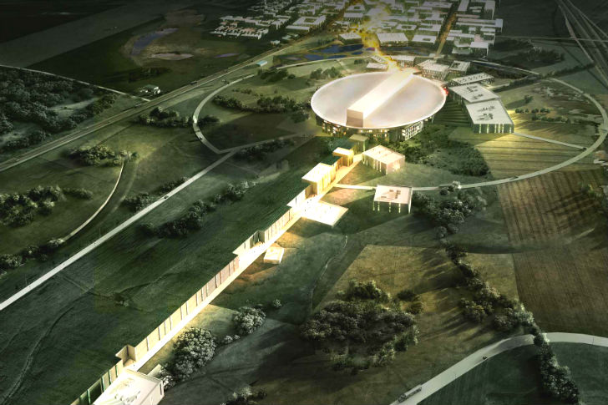



Klystron Modulators for ESS Accelerator
– Developments for Higher Efficiencies
Carlos A. Martins
ESS – Accelerator Division – Power Converters section leader
LTH – IEA Department - Invited Adjunct Professor in Power Electronics

Slide 2
Powering scheme of one RF cell
- Example of Medium Beta and High Beta sections of the ESS Linac
3-phase, 600V AC, 50Hz
RF cell #1
Electrical pulsed power
RF source A
SC cavity #A
RF power
RF source B
SC cavity #B
RF power
Modulator
(Power Supply)
AC Electrical Network
115 kV
100A
3.5 ms
14 Hz
RF source C
SC cavity #C
RF power
Beam
RF source D
SC cavity #D
RF power
RF cell #N
Similar to RF cell #1
Approximately 33 RF cells in total (Medium Beta and High Beta)

Slide 3
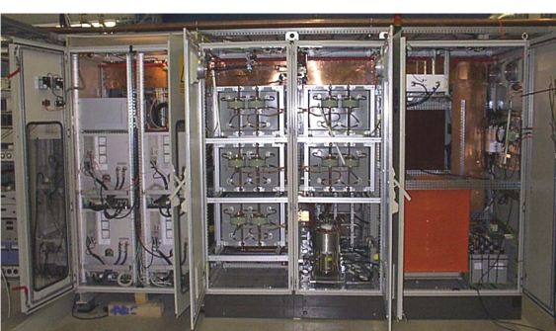
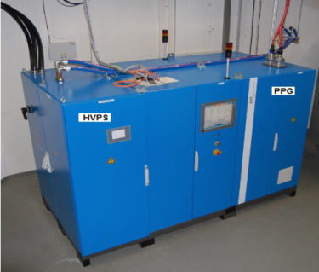
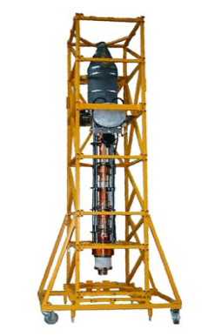
Pulsed Modulators for high power RF sources
– A machine challenging to design and procure
Sophisticated power electronic systems
1)- Multidisciplinary design:
Power Electronics; High Voltage; Mechanical;
Thermal and cooling;
Controls and software;
2)- Many different topologies possible;
Safety; Component’s availability;
Performance;
Availability / “Repairability”;
modulator
High Voltage pulse quality
Heavy and bulky
V
modulator
Vertical klystron
Rise time
Fall time
time
Flat-top
Pulse width
Reverse voltage
1.6m
3.8m
1m

Slide 4
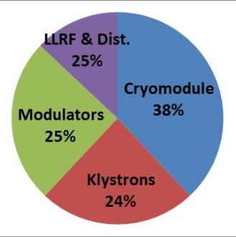
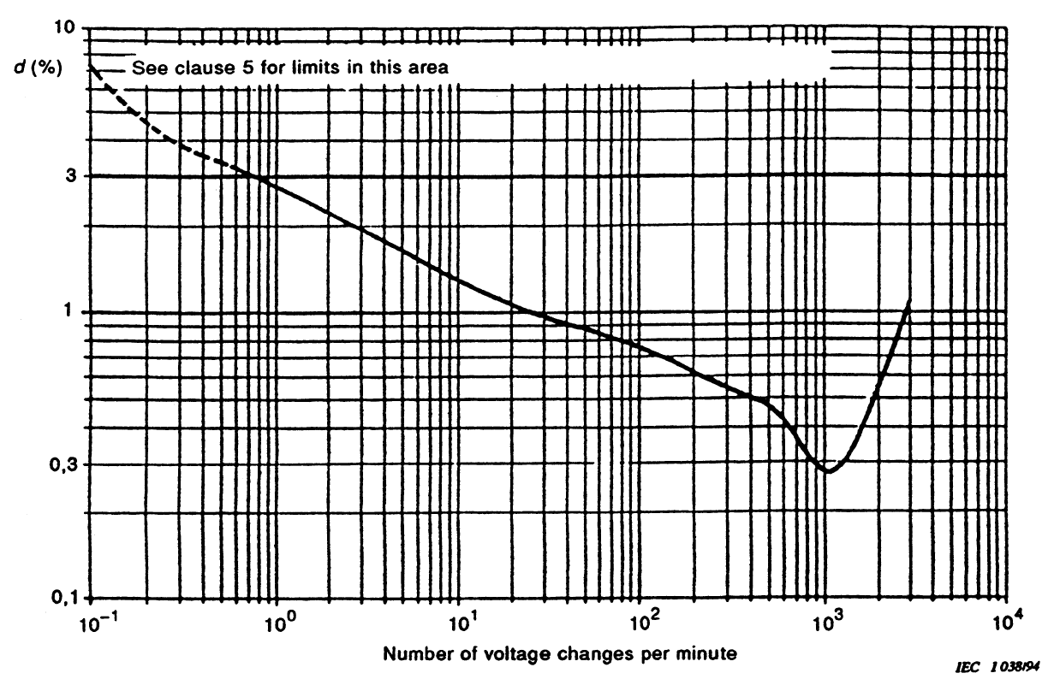
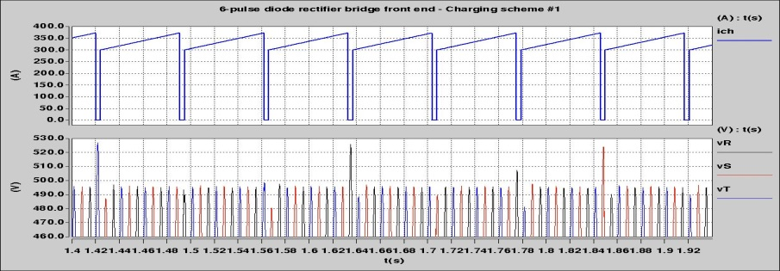
Pulsed Modulators for high power RF sources
– A machine challenging to design and procure
High cost impact in the whole accelerator
Few specialized companies worldwide, most of them SMB’s (Small Medium Business)
Engineering design capabilities;
Construction capacity and testing capabilities;
Quality Assurance and risk mitigation capacity;
Flicker standard IEC 61000-3-2 and IEC 61000-3-11 (low voltage public grids)
AC electrical grid power quality
Current harmonic distortion & Power factor
Flicker (if pulsed with 10mHz<PRR<20Hz)
(ΔV/V)_{max}=0.3%
14 Hz
If conventional charging adopted, then ~15MW of pulsed power at 14Hz in the ESS power line

Slide 5
Pulsed Modulators Efficiency
– Where are the power losses?
Internal to the power converter structures:
  Power Semiconductors, Power inductors, Power transformers, Snubbers (if existent);
Pulse rise time:
  Energy sent to klystron during rise time is lost in the klystron collector due to RF driver inhibit until V_{cathode} stabilizes within 99..100% band;
Current harmonic distortion & power factor:
  AC power lines, AC grid transformers;
High efficiency means:
High performant power semiconductors (1.7kV technology) & moderate switching frequencies;
Advanced materials and design in power inductors and transformers;
Reduced rise times (controls, compromise in the filters design);
Low current harmonic distortion & unitary power factor & no flicker;

Slide 6

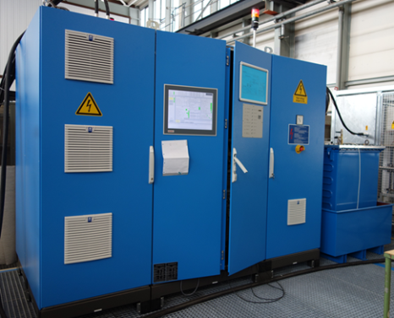
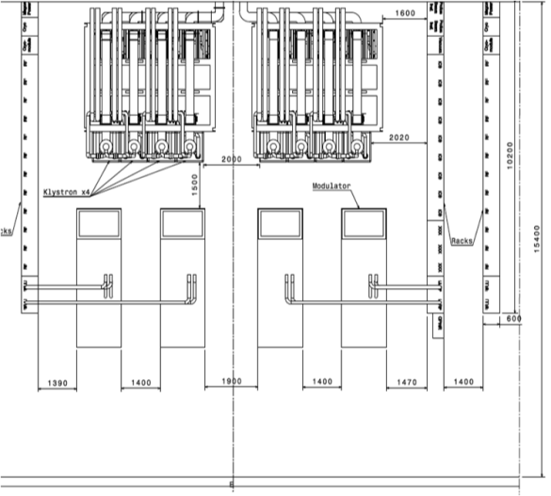
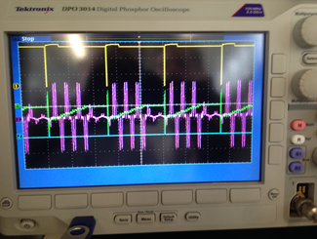
Strategies for developing modulators for ESS
– 1st strategy:
July
2011
ESS has launched an Invitation To Tender for the design and construction of one 180kVA modulator (turn-key, functional specification):
  Contract awarded in Dec. 2011; Delivery May 2014 (30 months delivery time);
1st ESS modulator (monolithic topology, pulse transformer based):
Rated 115kV/25A; 2.8ms/20Hz; 160kVA -> enough to power one 1.4MWpk klystron;
Limited performance:
Rise time = 350µs;
Flat-top droop = 3%;
Efficiency = 88%;
Power density = 22kVA/m² (no space in RF Gallery)
AC power quality issues (flicker, current harmonic distortion)
High capital cost:
- ~130 modulators needed
8 modulators per RF cell needed
One section of the RF Gallery (8x 704 MHz RF sources)
6
Purple: AC line current
Green: Capacitor bank voltage

Slide 7
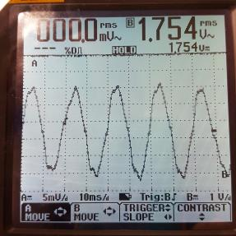
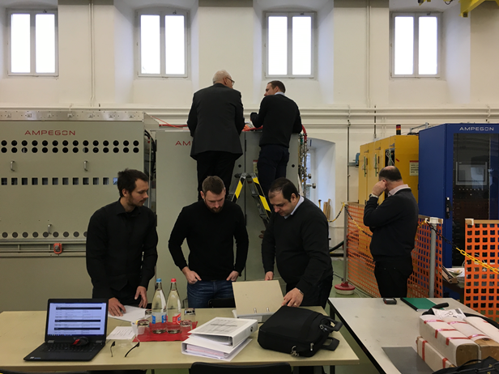
Strategies for developing modulators for ESS
– 2nd strategy:
Jan.
2014
ESS has launched an Invitation To Tender for the design and construction of one 330kVA modulator (turn-key, functional specification):
  Contract awarded in June 2014; Delivery June 2017 (36 months delivery time);
2st ESS modulator (modular topology, HF transformers based):
Rated 115kV/50A; 3.5ms/14Hz; 330kVA -> enough to power two 1.4MWpk klystrons;
Better but still limited performance:
Rise time = ~100µs;
Flat-top droop < 1%;
Efficiency = 89%;
Power density = 66kVA/m²
Better AC power quality: still high current distortion;
Reliability concerns due to huge number of components and limited design margins
Still high capital cost:
- ~65 modulators needed

Slide 8
Strategies for developing modulators for ESS
– 3rd strategy:
June
2013
ESS has decided to launch a collaboration with LTH / IEA Department, in view of designing and building a modulator prototype for ESS, following a novel topology:
3rd ESS modulator (Stacked Multi-Level topology)
Aimed at final ratings: 115kV/100A; 3.5ms/14Hz; 660kVA -> enough to power four 1.4MWpk klystrons;
Reduced scale prototype (easily scalable) rated at: 115kV/20A; 3.5ms/14Hz; 130kVA

Slide 9
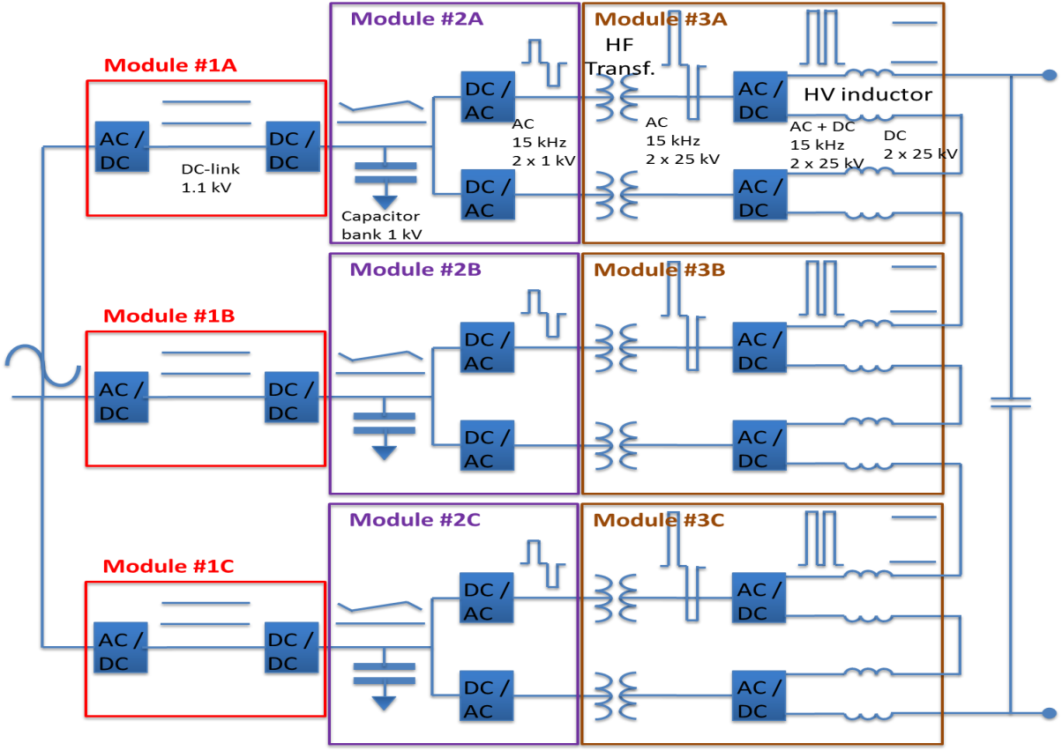
Pulsed modulators for klystrons
- Topology based on High Frequency transformers – Stacked Multi-Level (SML)
Modular topology, scalable to higher power levels;
Compact and cost effective;
High efficiency (92%);
Good pulse quality (low ripple, low rise-time);
Excellent grid power quality due to AFE’s (low flicker, low current THD);
High reliability (MTBF ~ 70’000 hours)

Slide 10
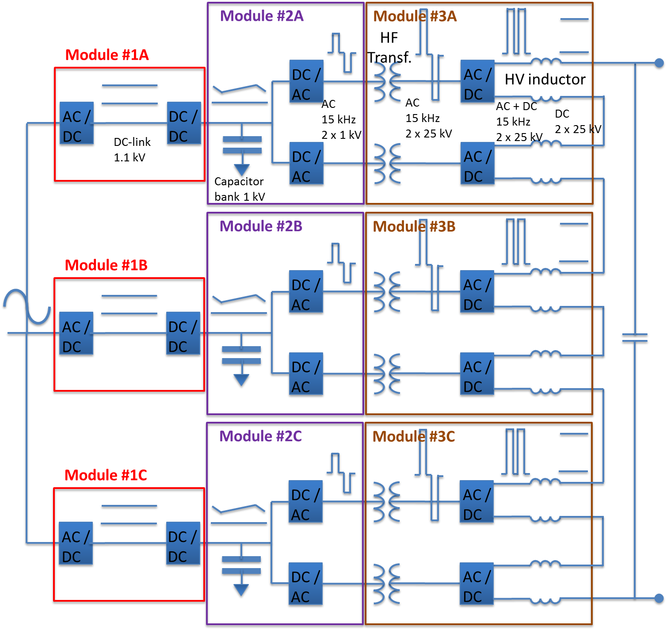
SML modulator development and validation strategy:- Initial Plan
LV stage (Part I)
Design studies, schematics, mechanical layout, BOM list, developed by ESS/LTH;
Construction subcontracted to a local company;
Signal cabling, controls software & hardware, and inspection held at LTH/IEA;
HV stage (Part II)
Turn-key system (design, construction, testing) outsourced to a another specialised company;
LV stage (Part I)
HV stage (Part II)
Feb.
2014
Study and design of LV stage completed. Contract placed for outsourcing LV stage assembly and cabling
June
2014
Contract placed for HV stage design, production & testing (requested delivery time: 9 months);
Sept.
2014
Delivery of LV stage to LTH Test Stand;

Slide 11
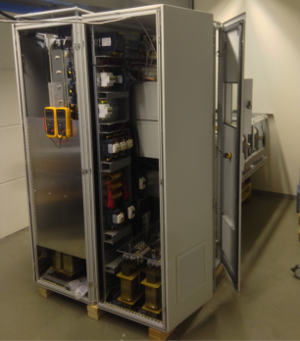
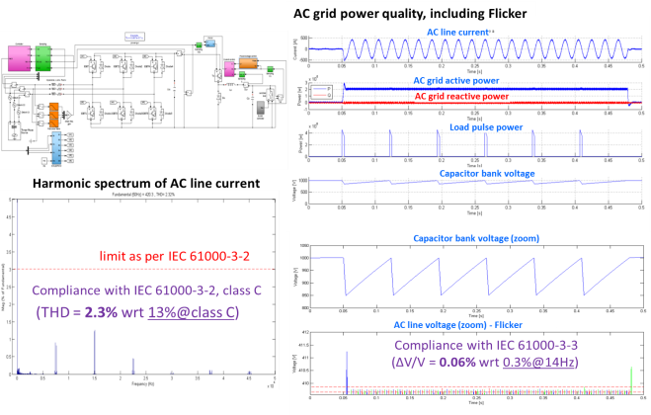
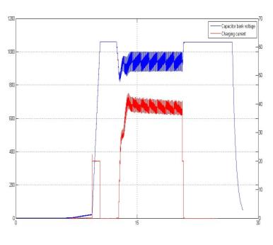
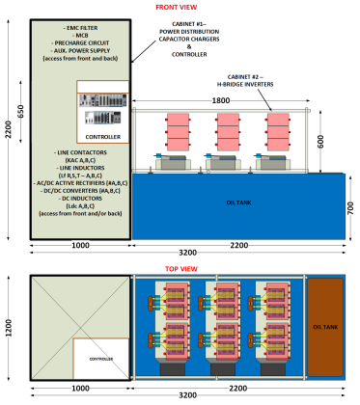
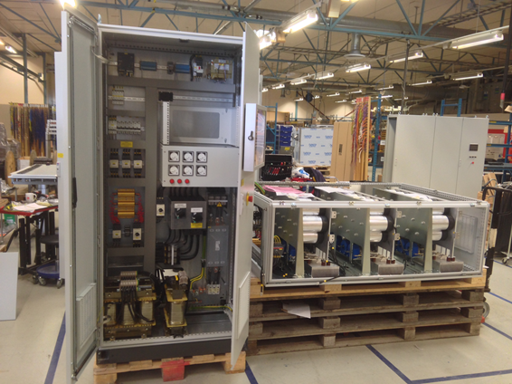
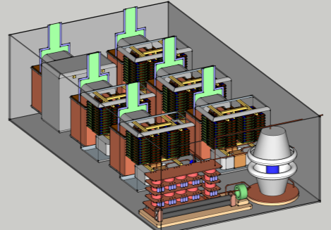
The SML modulator development roadmap
(LV stage)
Construction and testing of HV stage (oil tank assembly)
From Feb’15 …
Jun ’13
Experimental results, low voltage stage
Sept ’13 – May ’14
Jan ’15
Apr ’14
May ’14
Aug ’14
11

Slide 12
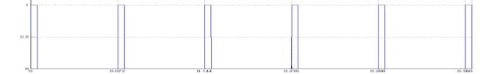
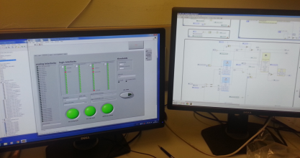
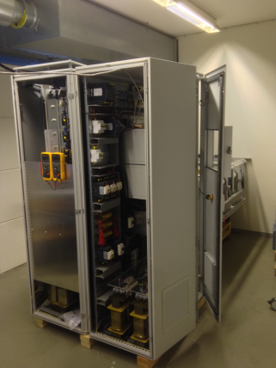
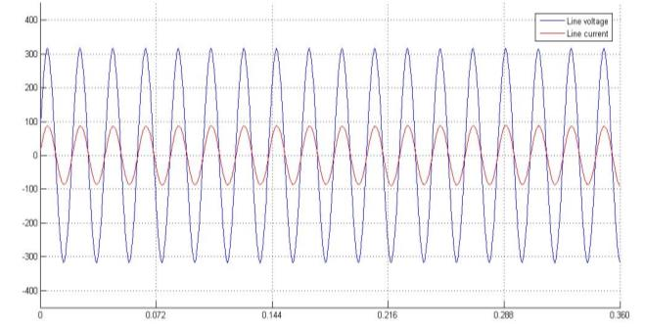
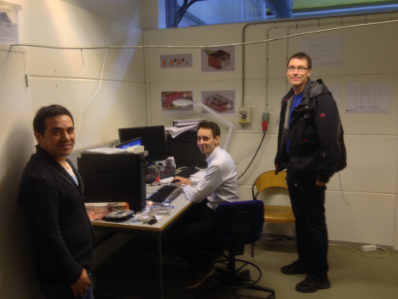
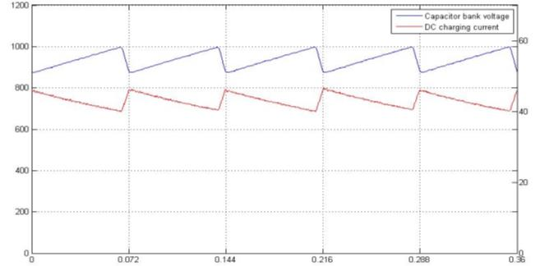
SML modulator, LV stage validation
- Experimental results
Jan.
2015
Initial experimental results of the LV stage on dummy loads
Pulse (1kV)
Controls & Human Machine Interface (Labview)
AC line voltage
AC line current
Unitary power factor;
Sinusoidal line current, constant amplitude -> No flicker
Capacitor bank voltage
Part I - Low voltage power converter stage
Capacitor bank charging current
Charging current adapted as an inversed function of the voltage;
Constant power flow
Active Front End (AFE) concept, well studied and developed at LTH / IEA

Slide 13
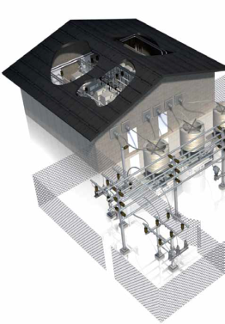
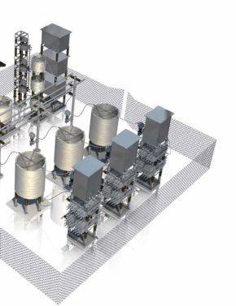
AC grid power quality:
– A classical approach with external grid compensators
140 kV
10 kV
10 kV
SVC
SVC
400V
400V
600V
400V
400V
600V
Not required thanks to SML topology
(AFE + cap. charger control)
Modulators
Modulators
Modulators
Cryo compressors
Modulators
Cryo compressors
Beam Instrumentation
Beam Instrumentation
Neutron Instruments
Neutron Instruments
- SVC footprint (outdoors): 2 x (10m x 15m) = 300 m²
- SVC estimated cost : 2 x ~6 M€ = ~12 M€

Slide 14
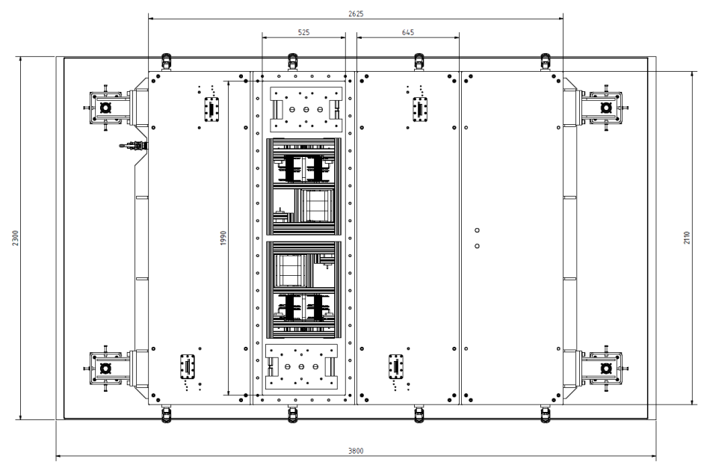
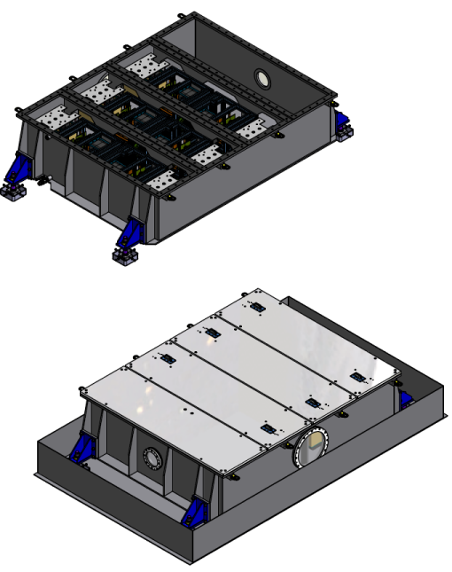
SML modulator development and validation strategy:- Initial Plan
Jan.
2015
HV stage design report from manufacturer showed prohibitive mechanical layout
ESS/LTH design footprint (660kVA full scale modulators
ESS/LTH design footprint (130kVA prototype)
Jan.
2015
ESS/LTH decided to take over the design, as built to print, of the HV stage.
Work has started immediately
July
2015
Contract with manufacturer cancelled

Slide 15
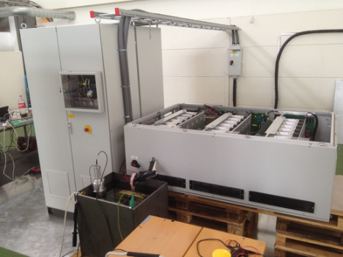
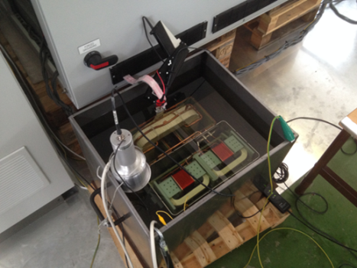
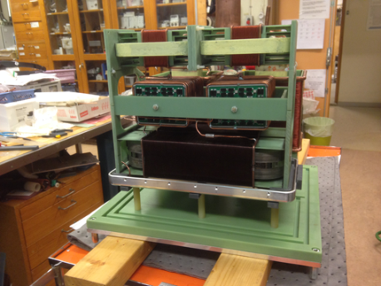
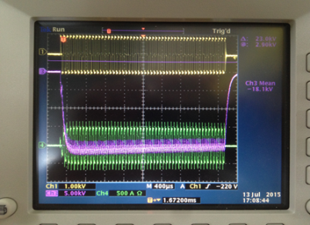
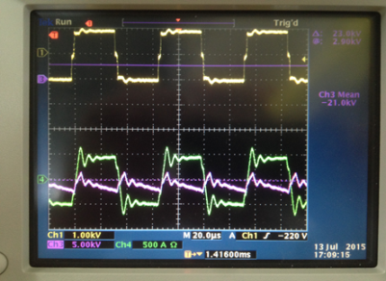
HV stage (oil tank assembly) design and testing
Jul.
2015
Complete integrated test of HV module prototype
Part I – LV stage
Part II – HV module #1 prototype in oil tank
HV module prototype in assembly workshop at LTH
Experimental results at full power: Pulsed at 20kV/20A, 3.5ms/14Hz
(Note: no output filter present; waveforms are as expected)
3.5ms pulse
zoom
Magenta: HV output pulse; Yellow: LV input voltage; Green: LV input current

Slide 16
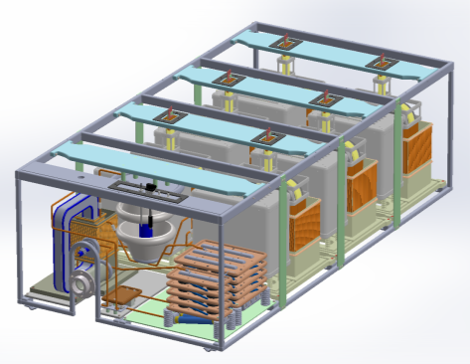
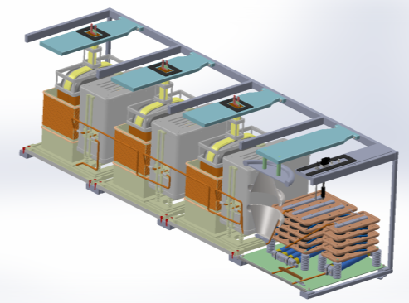
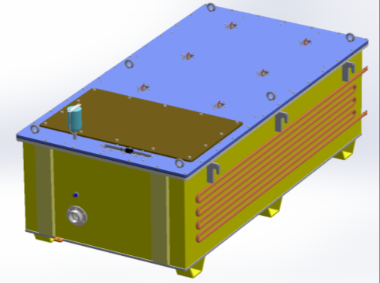
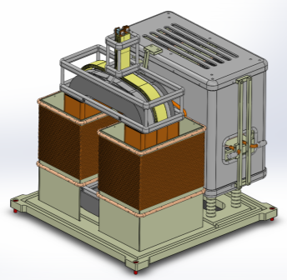
HV stage (oil tank assembly) design and testing
June
2015
Design of HV stage completed
Silica gel breather
Tank lid
Inspection lid
Water cooling serpentine
HV output connector
July
2015
ESS launched ITT for construction of HV stage on a “build to print” basis
HVHF transformer
HV rectifier box
Oct.
2015
HV stage construction contract awarded to AQ Elautomatik
Fiberglass insulation frame
HV module

Slide 17
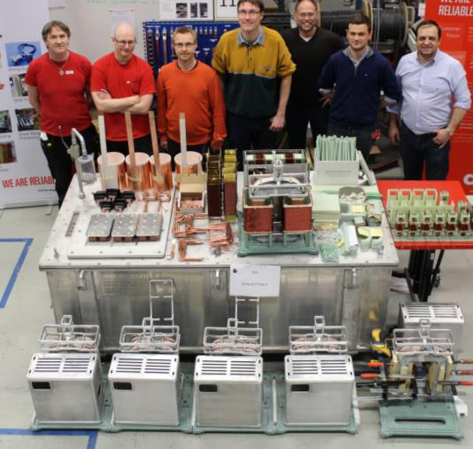
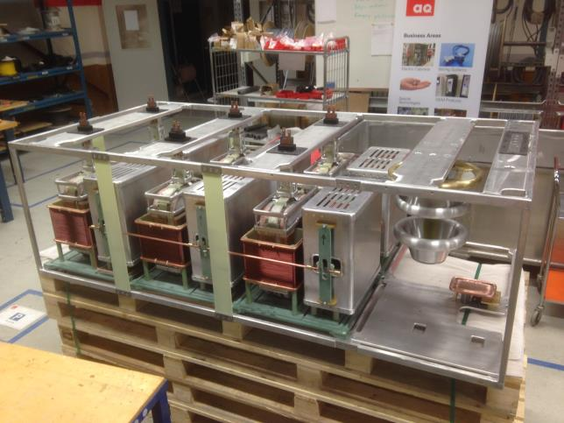
HV stage (oil tank assembly) construction
Jan.
2016
HV stage construction starts
Feb.
2016
Production of HV stage complete

Slide 18
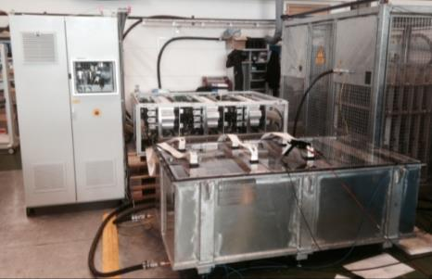
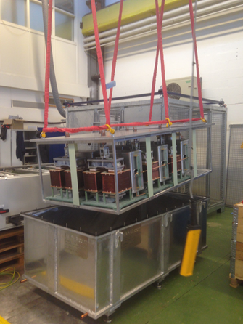
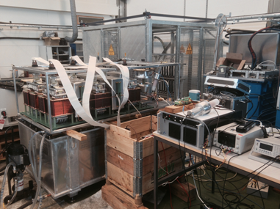
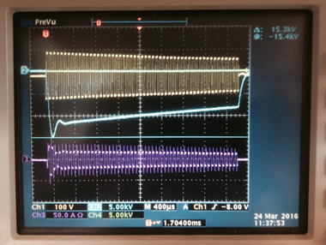
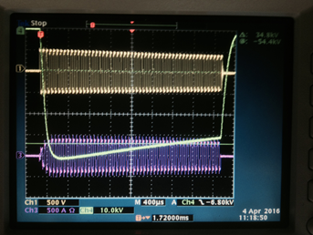
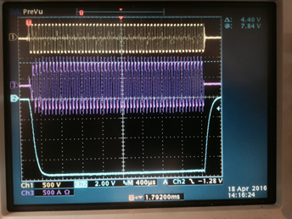
SML modulator prototype fully integrated tests
Apr.
2016
90kV achieved with full system (LV stage + HV stage)
HV oil tank assembly received at test stand - 4th March 2016
Preliminary testing of HV oil tank assembly at low voltage - 24th March 2016;
3 & 4 Testing of complete system
1st testing at High Voltage - 4th April 2016
90kV with droop comp. - 18th April 2016

Slide 19
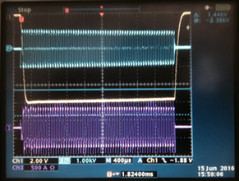
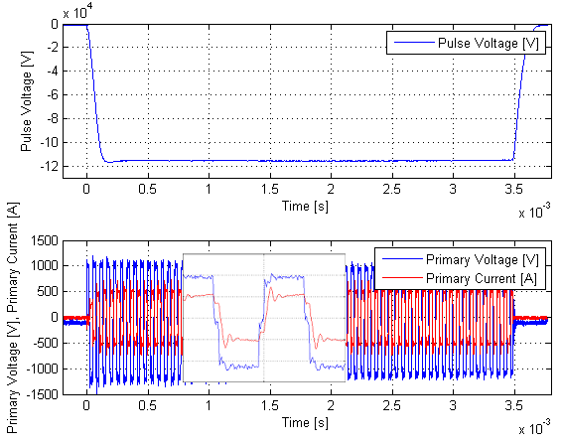
SML modulator prototype fully integrated tests
Apr.
2016
1st oil surprise: Ester MIDEL 7131 not suitable for >90 kV
June
2016
Change type of oil to mineral Shell Diala
July
2016
Nominal voltage and power successfully achieved for 12 hours of consecutive operation
→ Heat run test successfully performed at nominal (115kV, 20A, 3.5ms/14Hz) for 12 hours consecutively
Jan.
2017
Long term soak testing at nominal over >120 hours successfully achieved

Slide 20
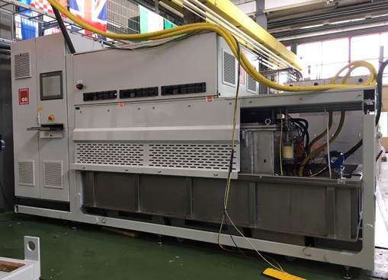
Mechanical integration.
Further testing on a real load (klystron)
Dec.
2017
200 hours of successful operation with real load (704Mhz Toshiba klystron)

Slide 21




SML modulator, Full Scale design (660kVA)
- Supply of 4x 1.4MW_{pk} klystrons in parallel
Sept.
2016
Design of full scale modulator nearly completed, ready for call for tender
3.8m
Compact
Retractable HV oil tank for easier access
2.4m
Integrated oil spill bin
1.4m
All in one frame with permanently mounted wheels for easy transportation
Total footprint: 3.8m x 1.4m
(planned was 5.5m x 1.6m, i.e. 40% less);
Total weight: < 5.5 tons (without oil);
Total volume of oil: ~ 2000 litters;
HV module

Slide 22


SML modulator, Full Scale design (660kVA)
- Supply of 4x 1.4MW_{pk} klystrons in parallel
Rated 115kV/100A; 3.5ms/14Hz; 660kVA -> enough to power four 1.4MWpk klystron in //;
Expect. performance:
Rise time = ~120µs;
Flat-top droop < 1%;
Efficiency = 91%;
Power density = 124kVA/m²
Excellent AC power quality: Active Front End;
(flicker free, sinusoidal current, unitary power factor)
Much improved reliability; minimal number of components (most are standard)
Effective capital cost (Mβ+Hβ):
33 modulators (~30 M€)
2 modulators per RF cell

Slide 23

Klystron modulators’ cost model vs
SML modulator real cost
Cost reduction due to SML concept
Example #5:
ESS/Ampegon modulator
Example #6:
ESS/SML modulators
Doubling the power,
with only ~20% increase in cost;
660

Slide 24


SML full scale modulator
- Initial test results on dummy load
SML Pulsed Klystron modulator rated 115kV/100A ; 3.5ms/14Hz.
The Low Voltage power electronics structure is hosted in the top section of the frame.
The oil tank and retention bin is placed in the bottom side of the frame for ease extraction to the side during maintenance and testing.
Experimental results at nominal condition.
Blue: Output pulse voltage (10V=115kV); Green: Transformer primary current of one HV module (2.5kA/div). Six HV modules are placed inside the tank.

Slide 25





SML modulator #1 delivery and installation at ESS TS3
Extensive test campaign of the 1st 660kVA SML klystron modulator (RFQ) in factory, from April to May 2019, led by ESS staff :
  FAT was held on 9th May, at full power;
  Delivery to ESS on 27th May;
  Installation in TS3 finished on 5th June;
  SAT campaign started on 11th June and will be continued over ~1 month in TS3, on a HV dummy load;
factory
factory
ESS, TS3

