Slide 1
IOT operation in the SPS Long term experience TWC 800 MHz

Slide 2
Project analysis slide 2
CONTENTS
SYSTEM PRESENTATION
OPERATION STATISTICS
800 MHZ OPERATION SCENARIO
IOTs LIFE TIME DATA
TRANSMITTERS FAULTS
IOT STARTUP MANAGEMENT
PREVENTIVE MAINTENANCE
EFFICIENCY
OTHER IOT INSTALLATION AT CERN
CONCLUSION

Slide 3
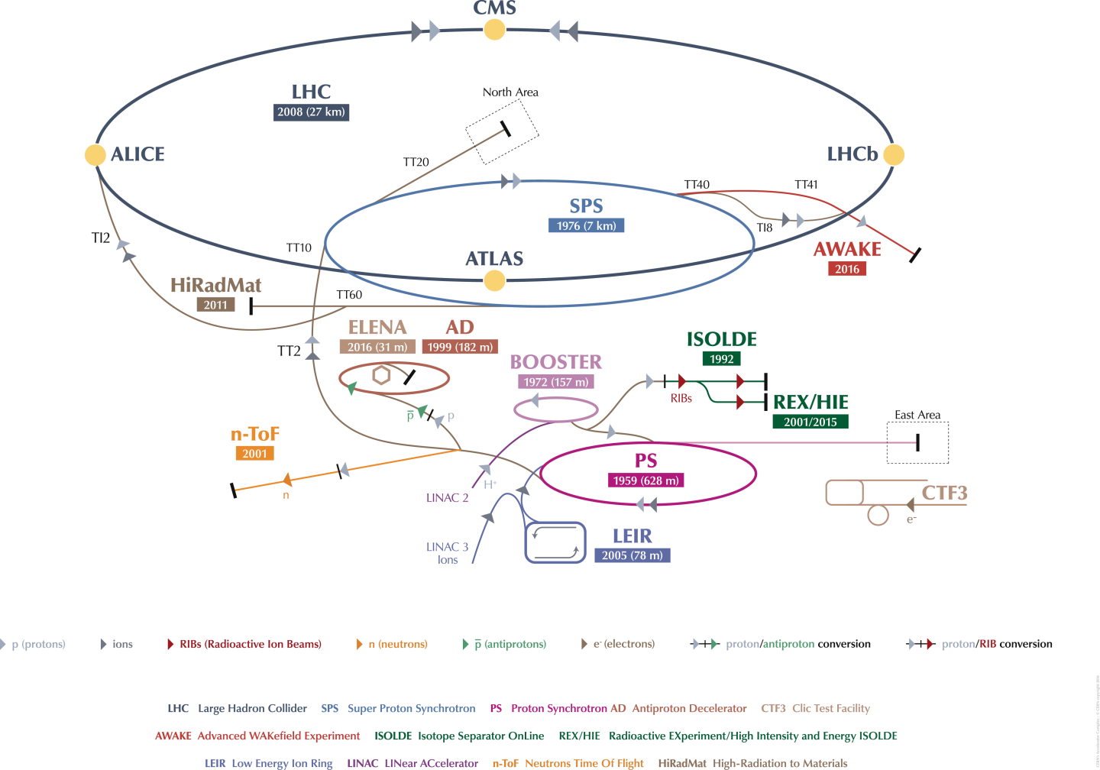
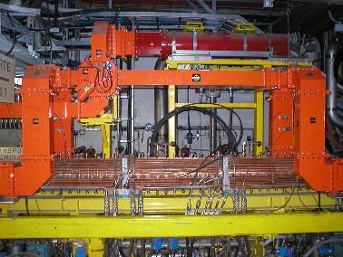
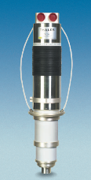
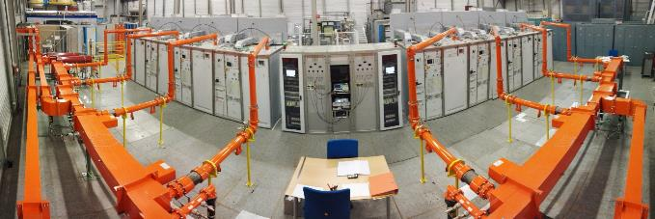
SYSTEM PRESENTATION
CERN Accelerator complex
2 x 800 MHz TW Cavity
TH795
160 KW CW per Cavity

Slide 4
OPERATION STATISTICS
Main objective
In average there was around 7 hours off operation per year.
The availability for beam in SPS was more than 99.9 %

Slide 5
800 MHZ OPERATION
SCENARIO
load
att
IOT
load
load
att
IOT
load
3 dB
3 dB
3 dB
3 dB
L.L.
drive
ph
att
IOT
CAVITY
L.L.
drive
ph
att
IOT
CAVITY
3 dB
3 dB
3 dB
3 dB
load
ph
att
IOT
load
load
ph
att
IOT
load
3 dB
3 dB
3 dB
3 dB
load
ph
att
IOT
load
load
ph
att
IOT
load
CAVITY 1
CAVITY 2
4 IOT combined for 1 cavity
The beam operation allows to have 1 IOT offline per cavity
And also, depending the users, the system allows to have 1 cavity off !

Slide 6
800 MHZ OPERATION
SCENARIO
load
att
IOT
load
load
att
IOT
load
3 dB
3 dB
3 dB
3 dB
L.L.
drive
ph
att
IOT
CAVITY
L.L.
drive
ph
att
IOT
CAVITY
3 dB
3 dB
3 dB
3 dB
load
ph
att
IOT
load
load
ph
att
IOT
load
3 dB
3 dB
3 dB
3 dB
load
ph
att
IOT
load
load
ph
att
IOT
load
CAVITY 1
CAVITY 2
4 IOT combined for 1 cavity
The beam operation allows to have 1 IOT offline per cavity
And also, depending the users, the system allows to have 1 cavity off !

Slide 7
800 MHZ OPERATION
SCENARIO
load
att
IOT
load
load
att
IOT
load
3 dB
3 dB
3 dB
3 dB
L.L.
drive
ph
att
IOT
CAVITY
L.L.
drive
ph
att
IOT
CAVITY
3 dB
3 dB
3 dB
3 dB
load
ph
att
IOT
load
load
ph
att
IOT
load
3 dB
3 dB
3 dB
3 dB
load
ph
att
IOT
load
load
ph
att
IOT
load
CAVITY 1
CAVITY 2
4 IOT combined for 1 cavity
The beam operation allows to have 1 IOT offline per cavity
And also, depending the users, the system allows to have 1 cavity off !

Slide 8
800 MHZ OPERATION
SCENARIO
load
att
IOT
load
load
att
IOT
load
3 dB
3 dB
3 dB
3 dB
L.L.
drive
ph
att
IOT
CAVITY
L.L.
drive
ph
att
IOT
CAVITY
3 dB
3 dB
3 dB
3 dB
load
ph
att
IOT
load
load
ph
att
IOT
load
3 dB
3 dB
3 dB
3 dB
load
ph
att
IOT
load
load
ph
att
IOT
load
CAVITY 1
CAVITY 2
4 IOT combined for 1 cavity
The beam operation allows to have 1 IOT offline per cavity
And also, depending the users, the system allows to have 1 cavity off !

Slide 9
LIFE TIME DATA
4 years of operation
6 tubes have now more than 30’000 hours filament
Only one had to be replaced current of 2018 with a ‘possible’ arc failure (still to be confirmed, the tube could be ok)

Slide 10
FAULTS

Slide 11
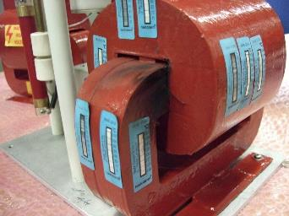
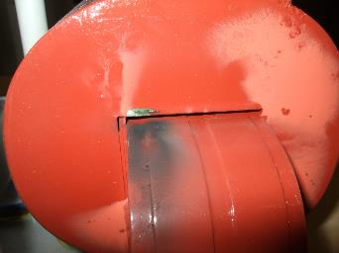
FAULTS
Isolation Transformer :
Resin transformer isolated up to 60 kV DC
All first transformers installed come from a bad series
During the two first years of operation, it was difficult to identify that the problem was the transformer
New transformers were bought with an improved isolation
Interventions were always necessary to fix the trouble, main circuit breaker tripped
Not a thermal cause !
But a HV arc!

Slide 12
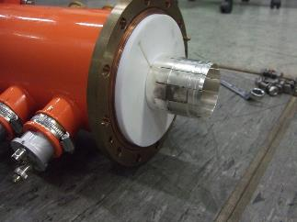
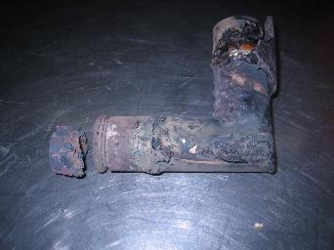
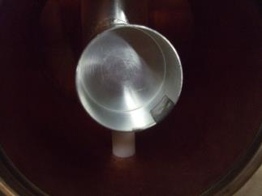
FAULTS
Coaxial lines :
Some difficulties on the assemblies of the coaxial lines were experimented
It was only human errors
Can appear several days after the mistake was made.
The time of intervention for repair is several hours
4-1/2’’ coaxial line
Inner elbow burned
Bad contact from the inner clamp

Slide 13
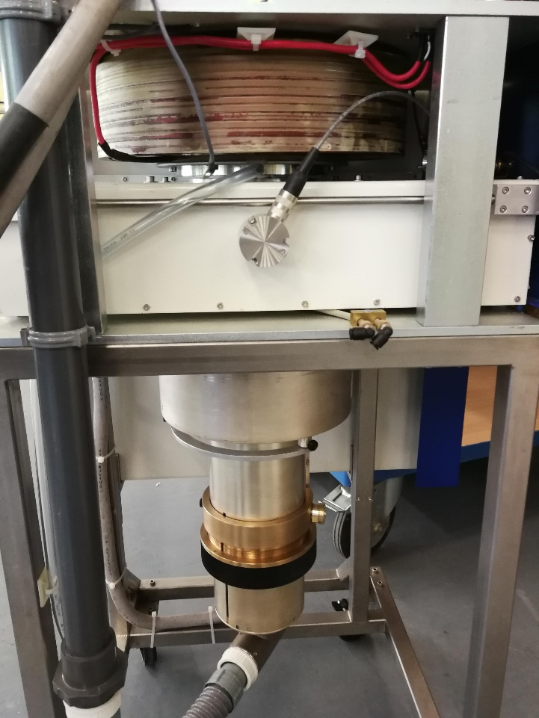
FAULTS
Ion pump isolation piece
Trolleys :
The pieces between Ion pump et cathode melted due to a bad soldering.
A second default was found, a water leak on the anode contact due to also a bad brazing
The time to replace a trolley from the transmitter is as well several hours
Anode cooling pipes

Slide 14
FAULTS
800.8 MHz
Low Level and PLC :
Following the LL upgrade done two years ago, the new ‘Switch & Limit’ system generated strange injections to the power system.
Concerning the PLC and controls, we fixed some initial problems linked with the start-up, and later troubles linked with the ‘S&L” system.
776 MHz
825 MHz
Δ
‘Switch & Limit’ system generated harmonics (- 25 MHz / + 25 MHz) even higher than the fundamental !

Slide 15
IOT STARTING UP
MANAGEMENT
Short stop (minutes)
IonPump & Filament : 10 min
HV (35 kV / 0.15 A) : 0 min
Long stop (hours or days)
IonPump & Filament : 2 hours
First start (at reception of the tube before storage or after a long (years) storage)
IonPump & Filament : 24 hours
RF (CW full power) : 0 min
Second start (after storage, less than a year)
HV ( 20 kV / 0.2 A) : 30 min
RF (CW half power) : 30 min
RF (CW full power) : 30 min
HV ( 30 kV / 0.2 A) : 30 min
HV ( 35 kV / 0.6 A) : 30 min
HV ( 35 kV / 0.15 A) : 30 min
HV ( 20 kV / 0.2 A) : 1 hour
HV ( 30 kV / 0.2 A) : 1 hour
HV ( 35 kV / 0.6 A) : 1 hour
HV ( 35 kV / 0.15 A) : 1 hour
RF (CW half power) : 30 min
RF (CW full power) : 30 min
IonPump & Filament : 2 hours
HV ( 20 kV / 0.2 A) : 30 min
HV ( 30 kV / 0.2 A) : 30 min
HV ( 35 kV / 0.6 A) : 30 min
HV ( 35 kV / 0.15 A) : 30 min
RF (CW half power) : 30 min
RF (CW full power) : 30 min
In case of more difficulties for the start up of an IOT, we do a conditioning on table up to 45 kV (35 kV in operation).
In addition we also reduce the filament current with respect to ageing given Thales indications.

Slide 16
PREVENTIVE MAINTENANCE
Daily
Noise
Monthly
Air filter
Water inspection
Technical stop (4x1w/y)
Air pressure switch
IOT tunning
End year stop (10 w)
Long shutdown (1-2y/5y)
Electrical tightening
Smell
Reflected levels
Body current
Grid current
HV visual control
Combining IOT tunning
Tank water level
Soldering control
Smoke detector
Water flow
HV cleaning
Crowbar test
Drivers gain
Plunger control
Fans replacement
HV cleanig
Trolley cleaning
Motor servicing
Capacitors exchange
A good preventive maintenance get rid of troubles linked to HV

Slide 17
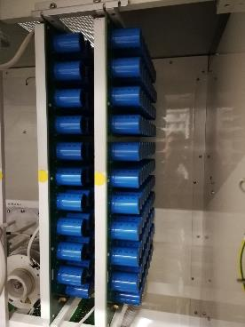
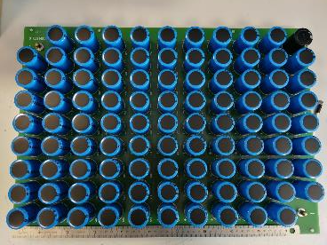
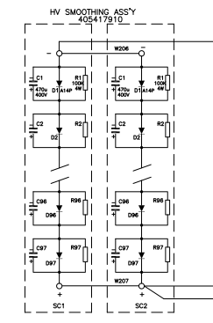
PREVENTIVE MAINTENANCE
Smoothing capacitors :
The Low Voltage capacitors (400 VAC) for the HV smoothing in Electrosys cubicle is an important point for the maintenance and operation
The lifetime in operation is rated 20’000 hours
Off the shelf lifetime is 500 hours only !!!
This implies a daily accurate management of the spares
97 capacitors on 1 card
1,552 capacitors at 8 €/unit for 8 transmitters every 5 years !
Total cost = 2’500 €/year

Slide 18
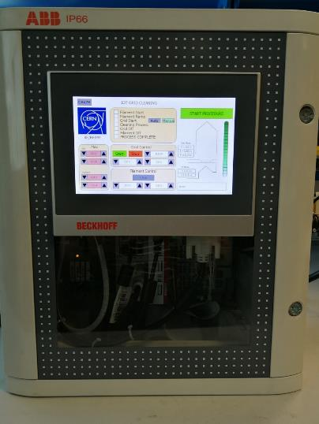
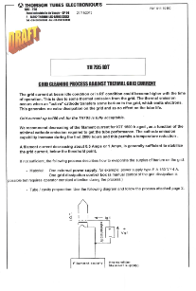
PREVENTIVE MAINTENANCE
Grid cleaning process :
Following the recommendation from Thales, we do a grid cleaning
The initial excess of barium from the cathode moves to the grid, and after around 5’000 hours this starts to induce thermal grid current
We implemented our own system, and after our process the complete thermal grid current disappears by removing this excess of barium from the grid
The cleaning was for the moment necessary only one time for each IOT

Slide 19
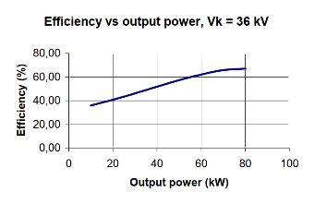
EFFICIENCY
40 KW CW operation point
160 KW CW operation point
In order to guaranty availability for the beams, and include margin requested by the LLRF, we decided to operate the tubes at a lower point of operation than the maximum available.
We demonstrated that this is very efficient for the availability of the system.
However, this has a cost in the DC to RF efficiency, we pay almost – 15 % efficiency.

Slide 20
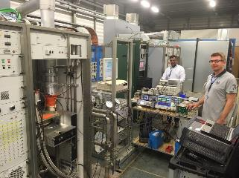
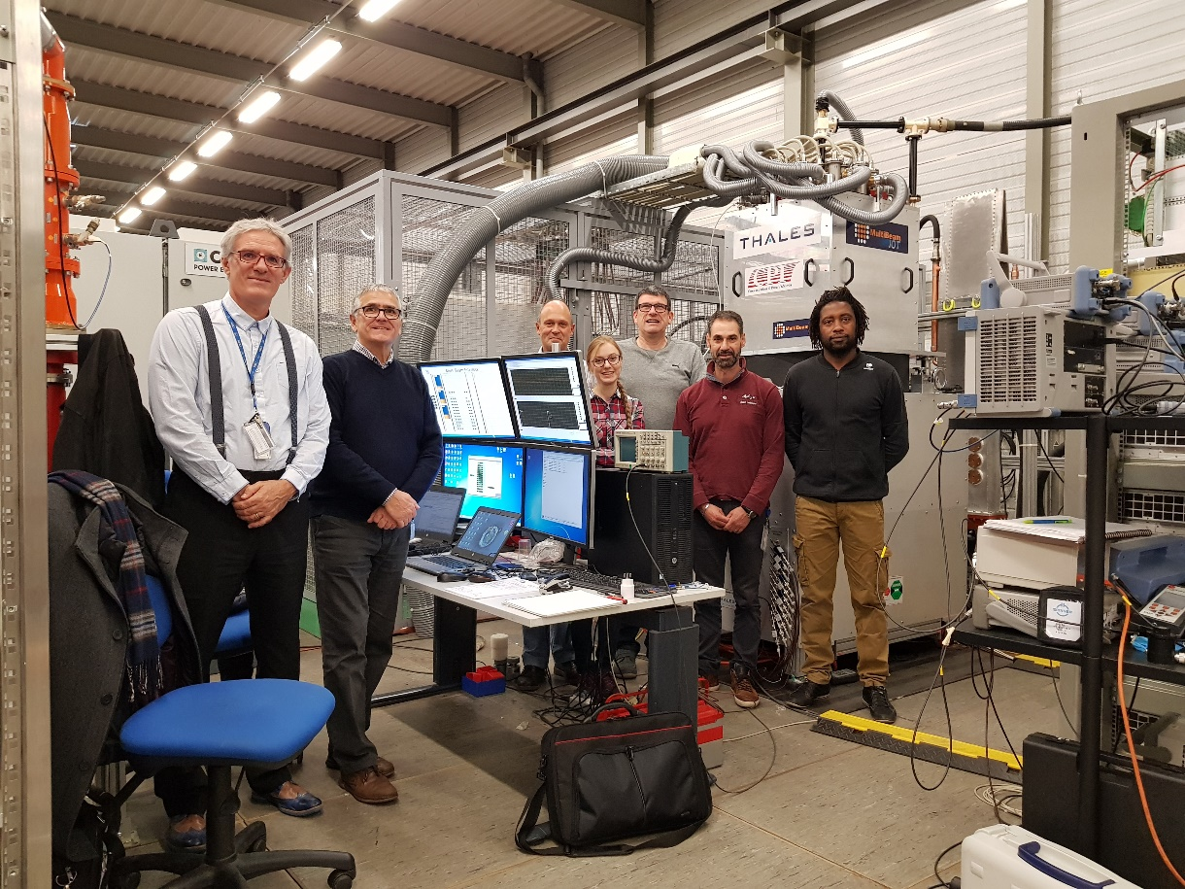
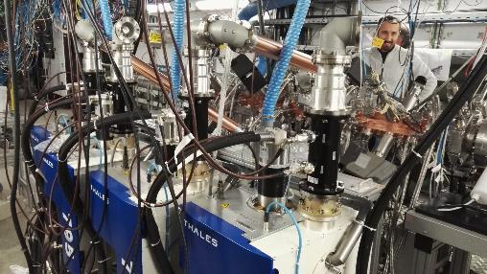
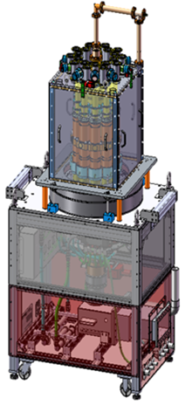
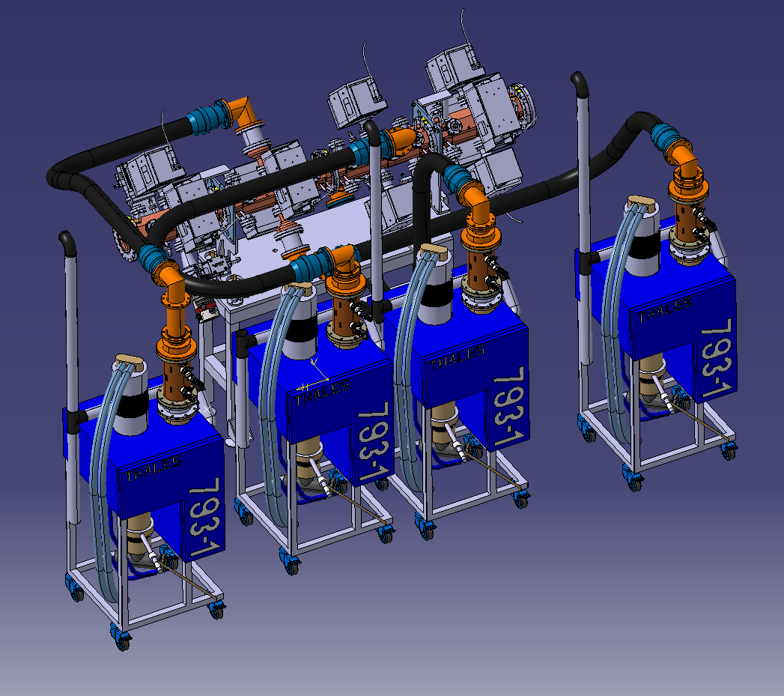
OTHER IOT INSTALLATION
@CERN
SPS Crab cavity
400 MHz
40 KW CW
MB IOT
704 MHz
1.2 MW Pulsed
Medical RFQ
750 MHz
100 KW Pulsed

Slide 21
CONCLUSION
Our IOT system is now mature and has proven to be very reliable, ensuring a high availability for the beams
IOT itself demonstrated to be very robust and easy to operate
IOT has the advantage of a high gain, needing only a few hundreds of Watt driver
IOT offers a high power density (HVPS can be aside and quite far away)
Given the LLRF requirements of margin, IOT offers a very good DC to RF efficiency
IOT are absolutely fantastic !
IOT should always be considered for RF systems for accelerators !
Thank you for your attention

