Slide 1
Panel Discussion: Future of Vacuum Tubes
Plenary Discussion: Future of Vacuum Tubes
ARIES Workshop on Energy Efficient RF
Ångström Laboratory, Uppsala universitet
18 – 20 June 2019 – Uppsala, Sweden

Slide 2
Tetrodes – didn’t talk much about them, but we’ll continue to rely on them for the next decades. Hope for SSPAs to eventually take over …
IOT/MB-IOT
Klystron
Magnetron
Other?

Slide 3
IOTs
MB-IOT successful, but no solid data for lifetime. How to make it “mature”?
Thales: someone must fully validate technical choices. Who?
CERN IOT experience (& Alba, RAL, …)
Requires very systematic procedures and preventive maintenance, but the IOT itself seems to have acceptable lifetime (35kh+)
Smoothing capacitors: lifetime in operation>>lifetime on shelf (?!)

Slide 4
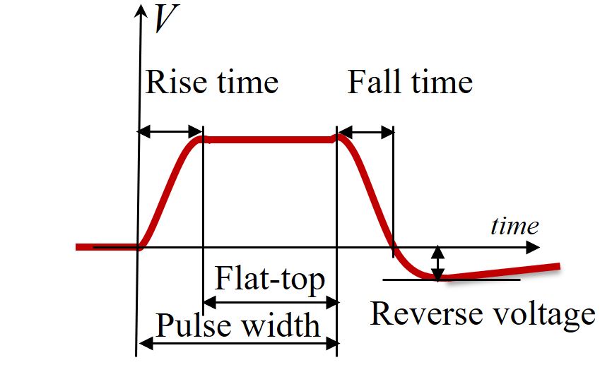
Klystrons & modulators
What about the LLRF request to work well below saturation?
Rise time losses in pulsed operation: can we switch RF on when voltage is at (say) 90%? With additional phase FF, e.g. …
Beautiful SML modulator 660 kVA! (Jema)

Slide 5
High-efficiency klystrons
Where do we stand?
What should we concentrate on ? …
How to best include industry – win/win…
What method for which application? (COM, BAC, CSM, kladistron…)
Multi-gap output cavity – advantages and disadvantages. How to proceed to fully validate?
Superconducting solenoid vs permanent magnet focussing?
Spurious oscillations in “EuCARD-2” tube – understood?
All these simulation codes – benchmarking them against each other.
Efficiency limits: have we included everything?
(bunch saturation, bunch congregation, space charge power, radial stratification, asymmetry, beam rotation)

Slide 6
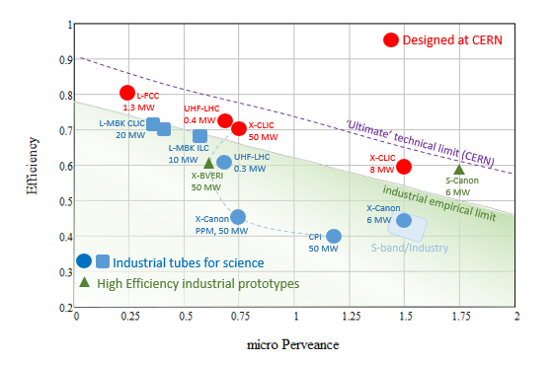
ESS-8

Slide 7
What about magnetrons?
What should the community (we) do?
Discard the idea, or validate it? But not do nothing about it
What are the relevant tests to be conducted?

