Slide 1
Technical limits of vacuum tubes efficiency
Chiara Marrelli
European Spallation Source ERIC
ARIES workshop on Energy Efficient RF
19/06/2019

Slide 2
Disclaimer
“vacuum tubes” is a VERY wide term
The talk will be limited to linear beam devices (Klystrons, IOTs, TWTs)
Main focus will be klystrons
(almost all concepts are applicable to other linear beam devices)

Slide 3
Outline
High efficiency basic concepts
Methods to achieve high efficiency (short recap)
Bunching and deceleration issues
  1D (bunch saturation, bunch congregation, space charge power)
  2D (bunch stratification)
  3D (symmetry of output coupler, beam rotation due to cathode emission)
“Real life” issues
  Ohmic losses
  Power dissipated by the auxiliary power supplies
  Non-ideal output match
  HV risetime in pulsed systems
  Power overhead for regulation

Slide 4


High efficiency basic concepts
Recipe for the very high efficiency tube
Ingredients:
RF beam current optimization
Short bunches
Bunch saturation
Velocity spread optimization
Bunch congregation
Bunch internal
“structure”
Methods to achieve high efficiency (klystrons):
Core Oscillations Method (COM)
BAC method
Harmonic bunching (CSM)

Slide 5
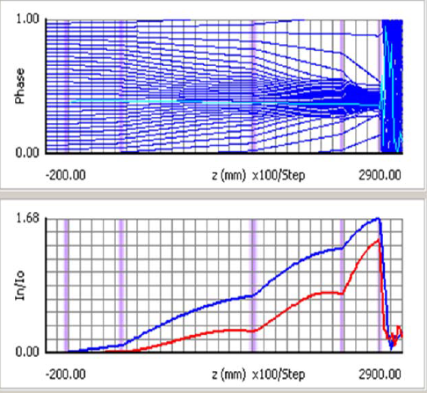
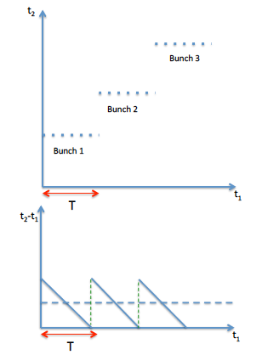
How do we achieve high efficiency?
The RF beam current induces RF voltage in the output cavity
In general high induced voltage in the output cavity means high output power -> high efficiency
The RF beam current is high when the bunches are very short and “dense” .
Ideally all electrons should be arriving at the output cavity at the same time: the transit time should be sawtooth-like
Main Problems:
Infinitely short bunch does not exist because of space charge
Space charge elongates the bunch while decelerating
Some electrons will be in the antibunch
For klystrons -> low microperveance helps because it means lower space charge

Slide 6
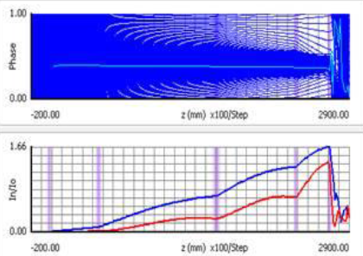
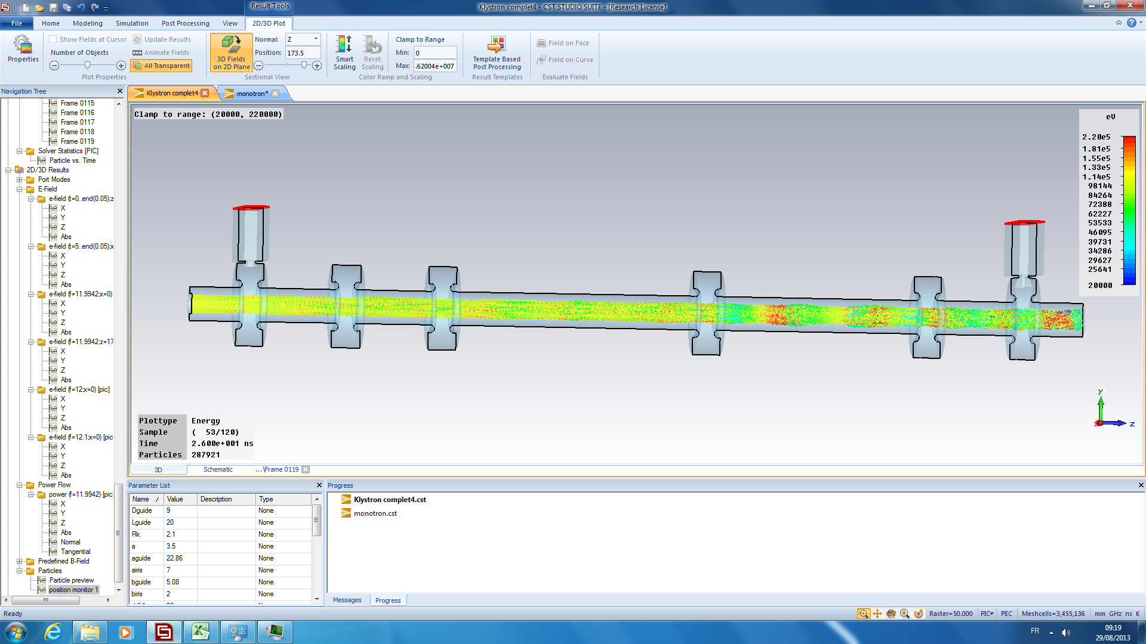
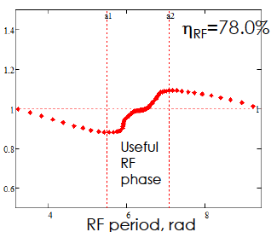
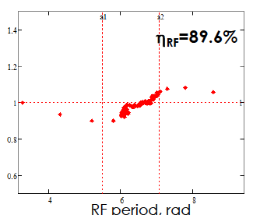
Optimization of RF current and bunch saturation
antibunch
bunch
bunch
antibunch
Particles in the antibunch are an obstacle to high efficiency:
1.They reduce the maximum beam current
2. They are out of phase and are re-accelerated by the fields in the output gap
2. Collect the outsiders in the bunch (bunch saturation) will increase efficiency

Slide 7
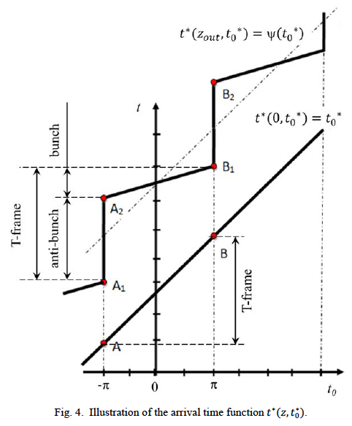
Optimization of RF current and bunch saturation
Another way to look at things…
Ideally, the RF current in the output cavity is maximum when the red lines are horizontal (short bunches)
Also, the antibunch is empty when the green lines are strictly vertical
Arrival time
Eff=78.5%
Eff=86.5%
Departing time (phase)

Slide 8
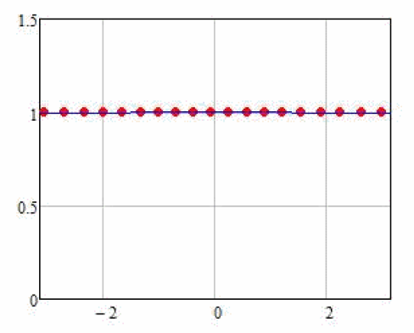
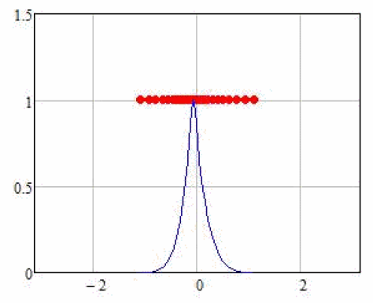
Velocity spread
In the output cavity the bunches have to slow down and give all their kinetic energy to the electric field
But klystrons are velocity modulated tubes.
So when we decelerate the slowest particle to zero, there will still be some energy left in the rest of the bunch
If we want high efficiency we have to:
Reduce velocity spread at the output: ideally monocromatic bunch
In the ideal klystron world….
Phase space @ output cavity entrance
Initial phase space
Normalized velocity
Normalized velocity
ϕ
ϕ

Slide 9
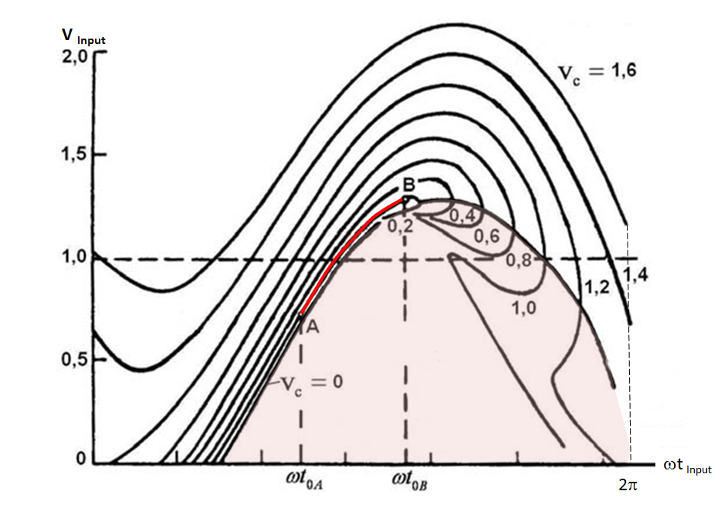
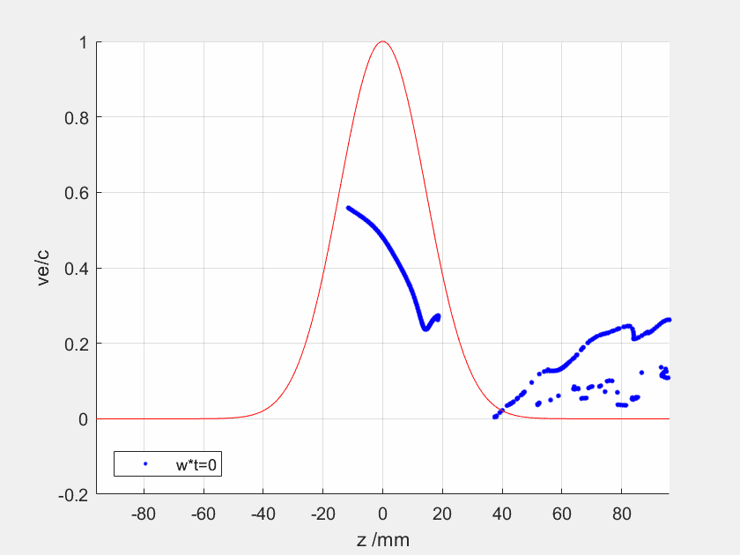
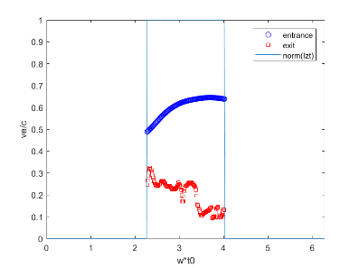

Bunch congregation
Monocromatic bunch would work only with a infinitely short bunch (delta bunch).
In reality, during deceleration, the bunch will be elongated by debunching forces. It is essential that peripheral particles will not migrate to the anti-bunch. For the “long bunch”, this will be fulfilled if there is some velocity dispersion along the bunch BEFORE it enters in the output cavity
To avoid migration of the electrons from bunch to anti-bunch during deceleration in the output cavity, the incoming bunch with non-zero length should have optimal velocity dispersion: Congregated Bunch, when the leading electrons are slower than the tailing ones (Kochetova et al., Radio-technic and Electronics, Moscow, 1981).
Congregated bunch should be gradually transformed at the cavity exit into monochromatic bunch with least velocity.
The concept of congregated bunch relaxes the demands on the strong bunching
Fully saturated bunch with optimal congregation.
FCC CSM output cavity, drift channel and beam.
Each line in the plot corresponds to an output speed for particles in the last cavity: red line -> 90% extraction efficiency
90.1%
Fully saturated bunch with optimal congregation can deliver 90(+)% RF power production efficiency (in simulations!).
I. Syratchev, 7th Low Emittance Rings Workshop, Jan 2018

Slide 10
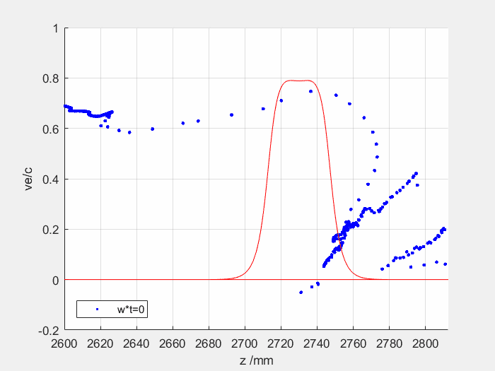
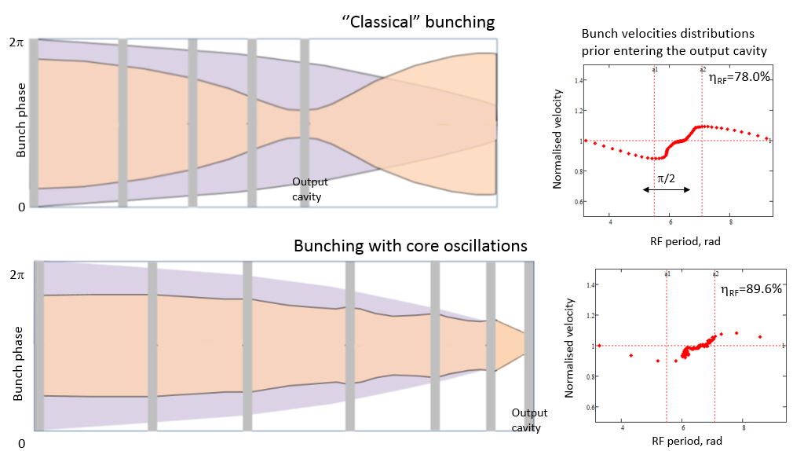
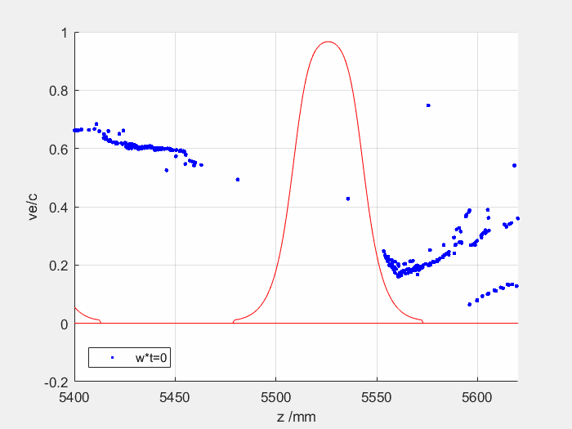
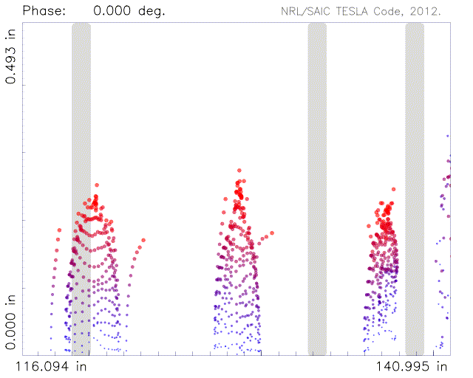
Optimum bunching
Core oscillation method
Example of fully saturated bunch
Core oscillation method tube (COM): A. Baikov, 2013
Bunching split into two distinct regimes:
  non-monotonic: core of the bunch periodically contracts and expands (in time) around the center of the bunch (space charge guided process)
  outsiders monotonically go to the center of the bunch
77.5%
Example of the ‘fully’ saturated bunch in COM tube (Tesla 2D code)
83.5%
I. Syratchev, 7th Low Emittance Rings Workshop, Jan 2018

Slide 11
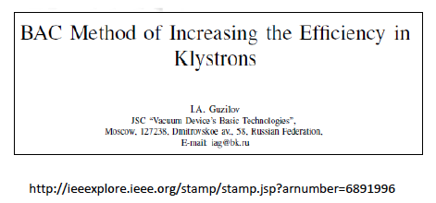
Optimum bunching
BAC method
COM method gives very efficient tubes but TOO LONG, especially at lower frequencies, because we have to wait for the oscillations to happen under the effect of space charge.
In the BAC method, introduced by I. Guzilov, we use the tuning of the cavities to create “artificial” oscillations.
Inductive detuning
Capacitive detuning
Second harmonic cavities
The impedance of the cavities allows to reduce the spatial wavelength of the core oscillations. The tube efficiency is maintained, but the length of the tube is dramatically reduced.
The number of cavities increases.

Slide 12
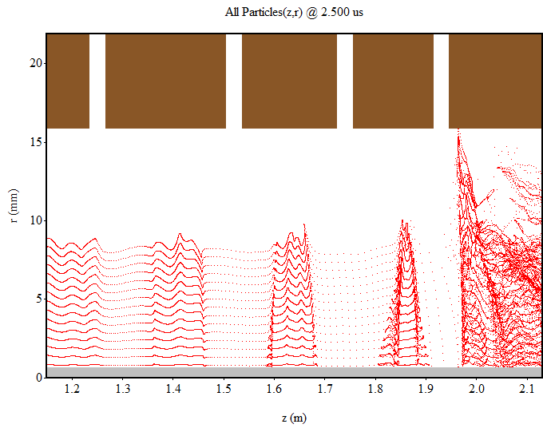
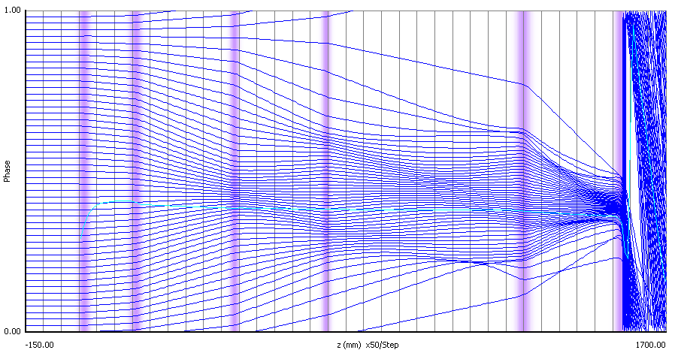
Optimum bunching
Core Stabilization Method
Core Stabilization Method (CSM), Cern 2013 (C. Marrelli, E. Jensen)
Rough idea:
Harmonic cavities can be used as a way to introduce non-linear components in the electron transit time from input cavity to output; 2nd harmonic cavities have been used since the 70s (E. L. Lien), but higher harmonics had never been used.
The harmonic cavities (2,3) push peripheral particles towards the center of the bunch, while the core forms sub-bunches (depending on the number of harmonics used). For high harmonic number the core is stabilized around the center.
This process allows to get very good bunch saturation over a short interaction distance.
3rd Harmonic
CSM-223: very good bunch saturation (Magic RF eff: 81%)
2nd Harmonic

Slide 13
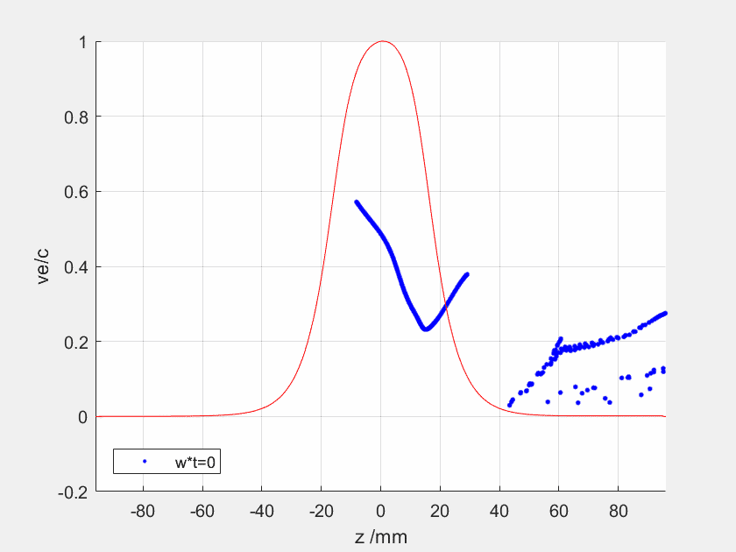
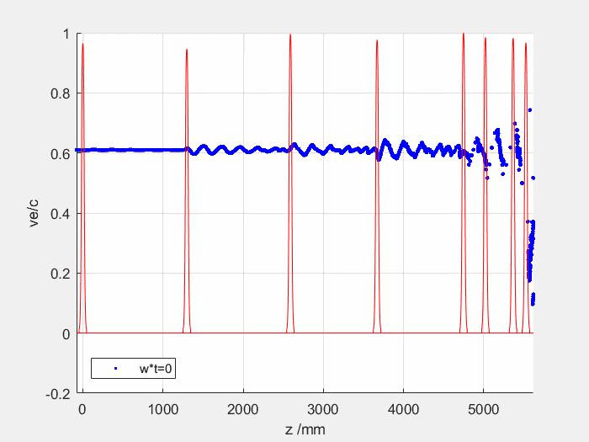
Ultimate efficiency reach
90% efficiency would be possible with the perfectly saturated and congregated bunch
Optimised congregation
Linear congregation (usually the case in real tubes)
90.1%
88.70%
Reflected electrons as
ultimate limiting factor
In “real life” obtaining such a perfect bunch is not always possible:
FCC COM tube example:
bunch saturation (-1%)
bunch congregation ‘as received’ (-3.8%)
I. Syratchev, 7th Low Emittance Rings Workshop, Jan 2018

Slide 14
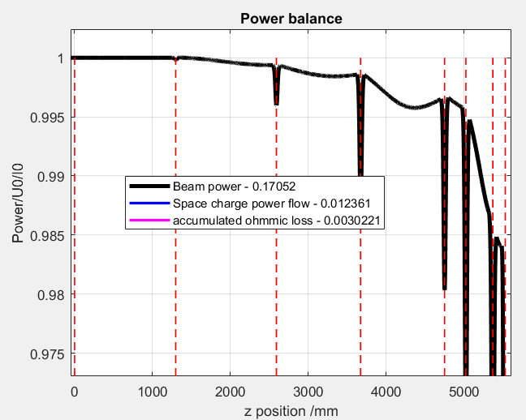
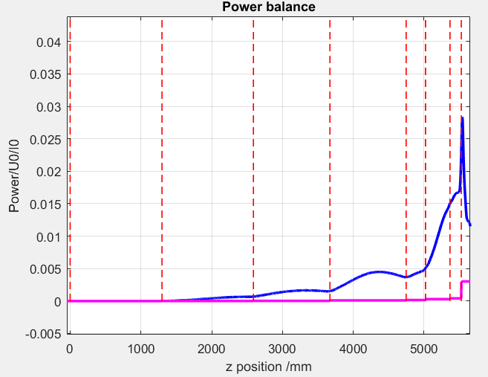
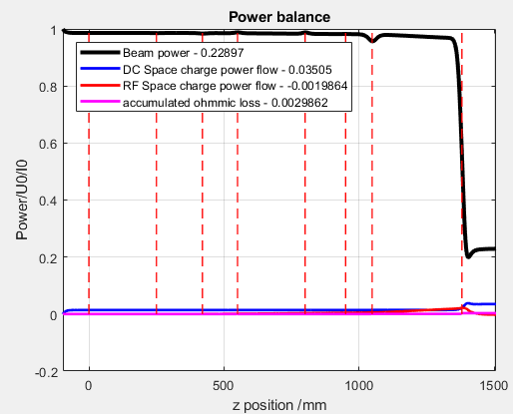
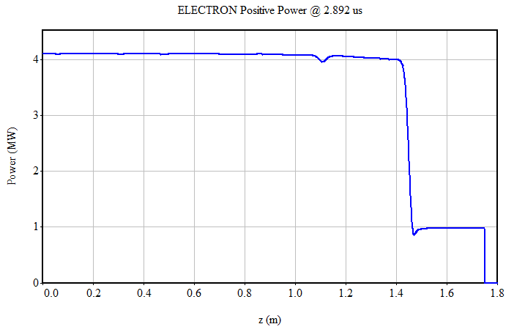

Space charge power
Even with very good saturation and congregation we have to deal with space charge related effects:
While bunching is progressing along the tube, some kinetic energy is converted into potential energy (DC and RF)
This effect is more evident in high perveance tubes
Example from FCC COM tube
(-1.75%)
KlyC simulation
83.5%
I. Syratchev, 7th Low Emittance Rings Workshop, Jan 2018
ESS-8 CSM tube
(-3.7%)
uK=0.46
KlyC simulation
MAGIC simulation
ESS-8
Output
power

Slide 15
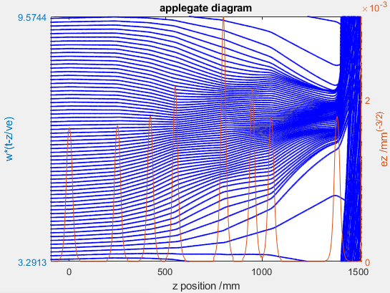
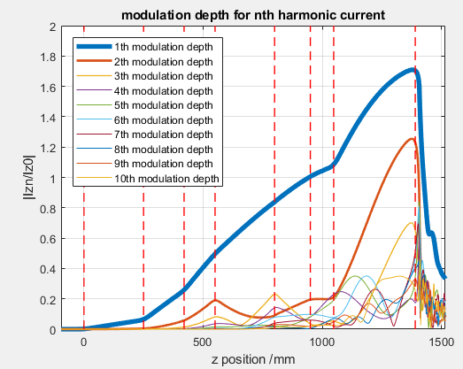
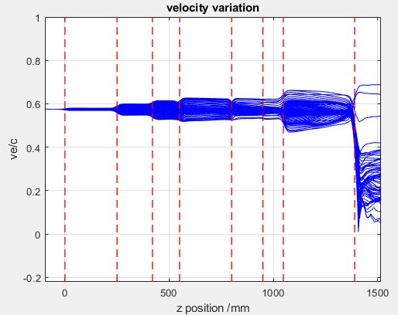
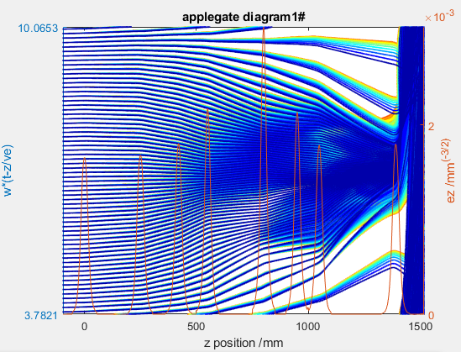
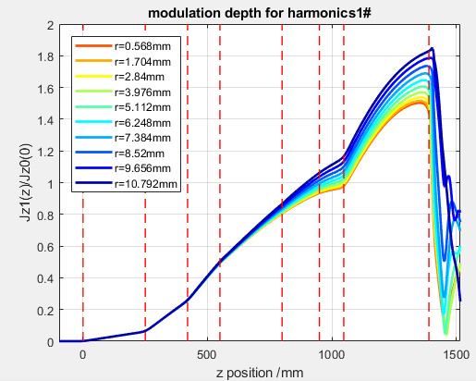
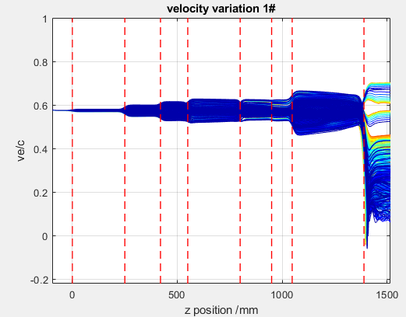
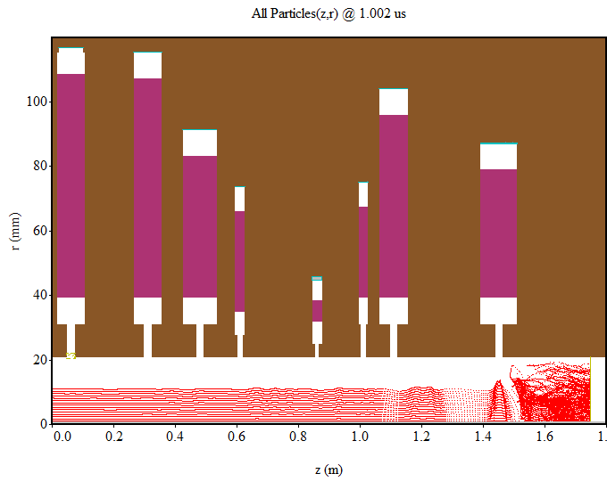
2D effects: radial bunch stratification
ESS-8
75.66% (KlyC simulation, 1 Layer)
ESS-8
73.53% (KlyC simulation, 10 layers)
ESS-8 Magic 2D simulation
The electromagnetic fields (cavity + space charge) acting on the beam during the bunching process are not uniform across the beam section: as a result, bunching happens “differently” for particles on axis with respect to particles off-axis.

Slide 16
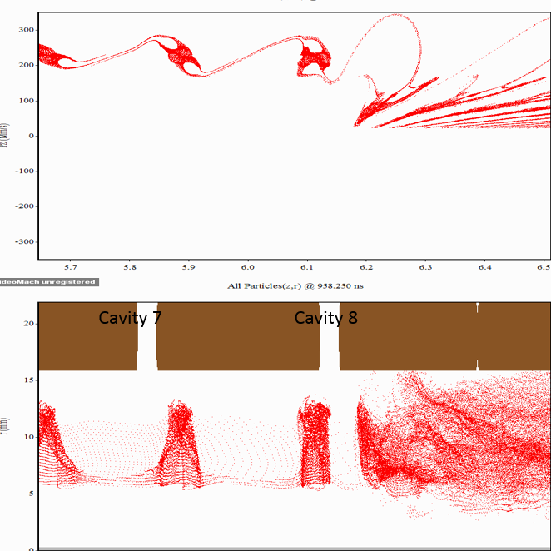
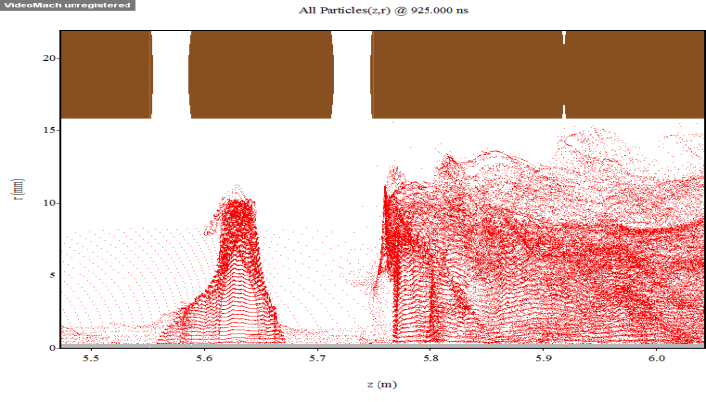
2D effects: radial bunch stratification
Radial bunch stratification can be mitigated with hollow beam configuration
Example:
Study for FCC tube development:
Bunch velocity varies with radial position. On-axis bunch is less saturated

Slide 17
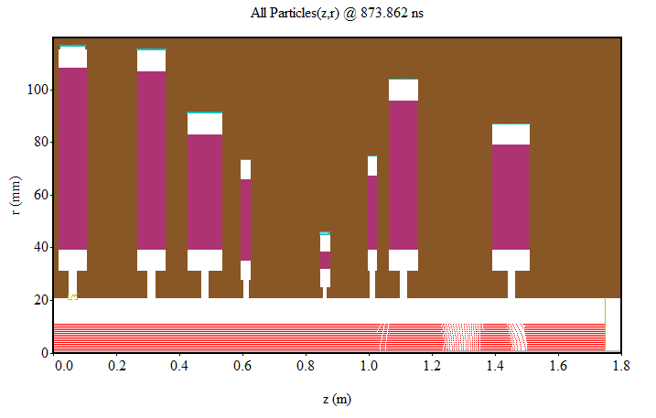
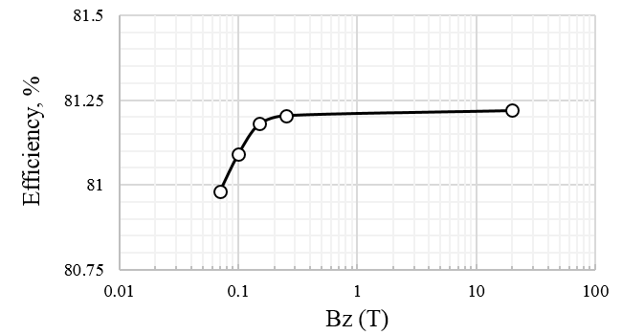
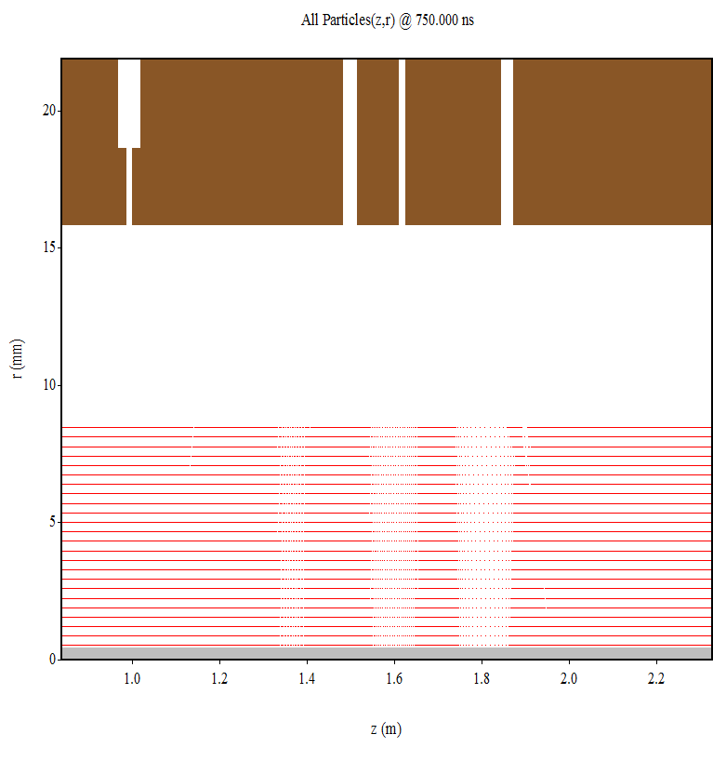
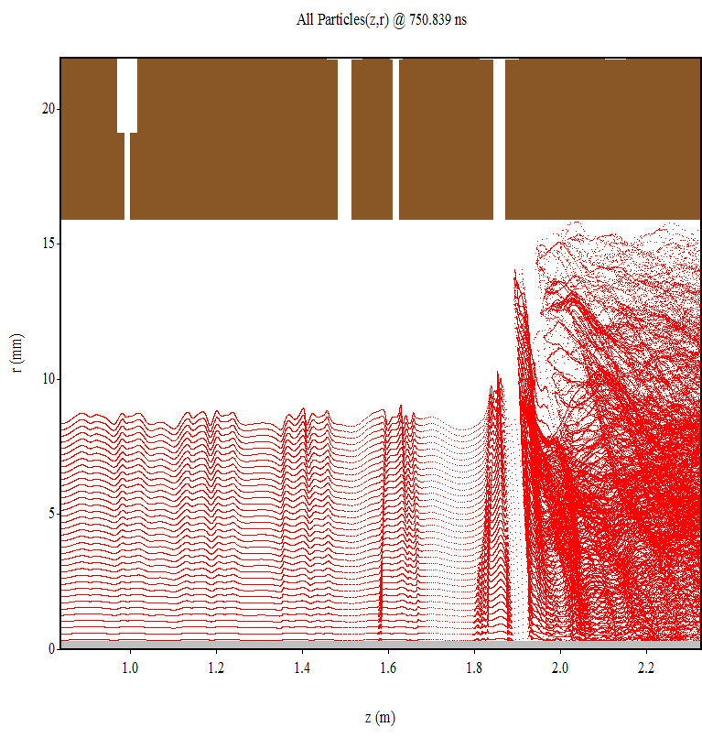
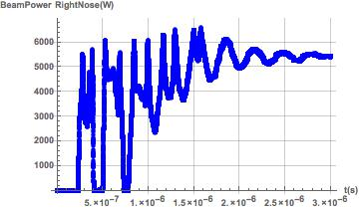
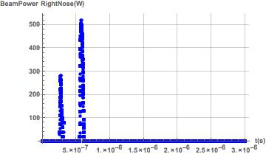
2D effects: magnetic field
ESS-8
Radial beam expansion has a very little effect on efficiency
Bz=1.1 T
Eff 73.2%
FCC COM tube
20 T
0.07 T
Bz=0.055 T
Eff 73.1%
Bz=0.062 T
Eff 73.2%
Syratchev, 7th Low Emittance Rings Workshop, Jan 2018

Slide 18
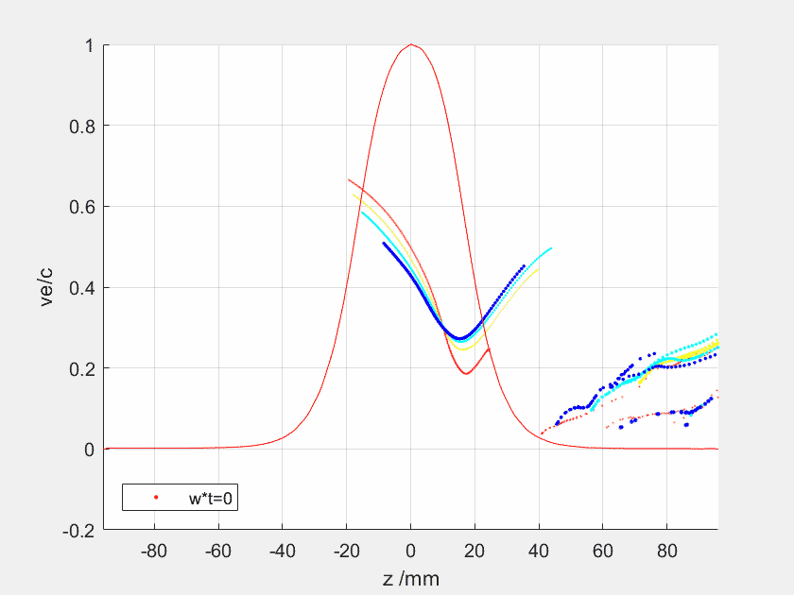
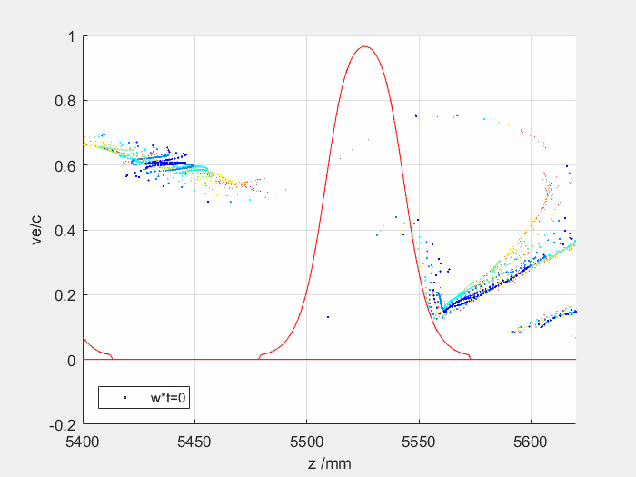
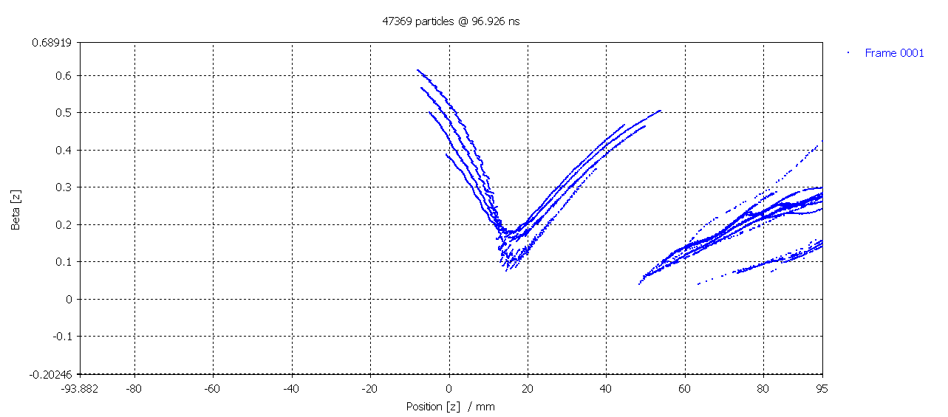
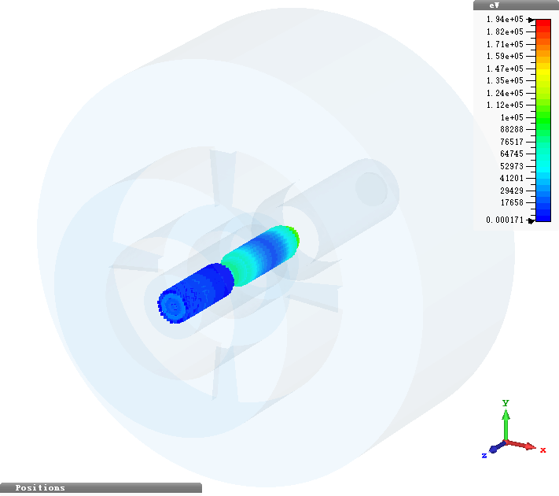
Summary example: bunching and deceleration effects
Optimised congregation
Linear congregation
Stratified bunch with linear congregation
Work From Z.N. Liu
Fully saturated bunch
90.1%
88.70%
84.20%
FCC COM tube
80.1%
CST MWS
82.6%
J. Cai, FCC week 2018

Slide 19
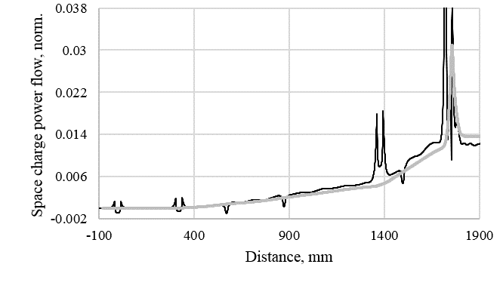
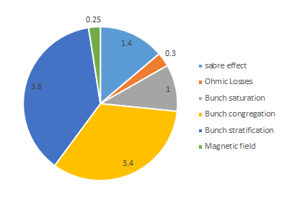
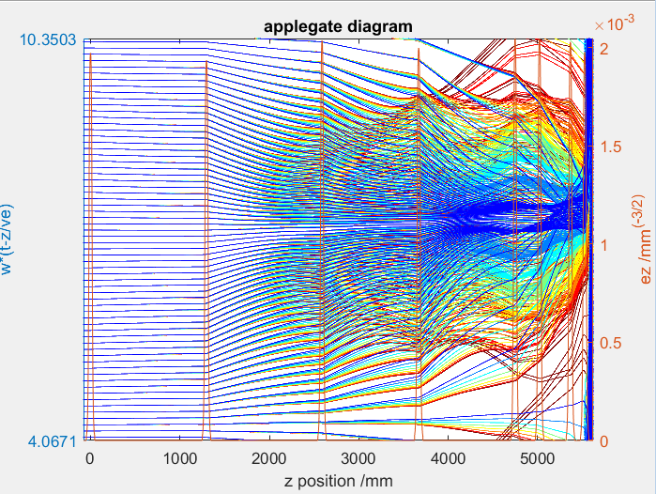
Summary example: bunching and deceleration effects
90%
Summary example (FCC tube)
The accumulated effect of all the limiting factors that are inherent to the bunching and deceleration processes results in 10% efficiency reduction (from 90% to 80%).
80%
FCC CSM
Syratchev, 7th Low Emittance Rings Workshop, Jan 2018

Slide 20
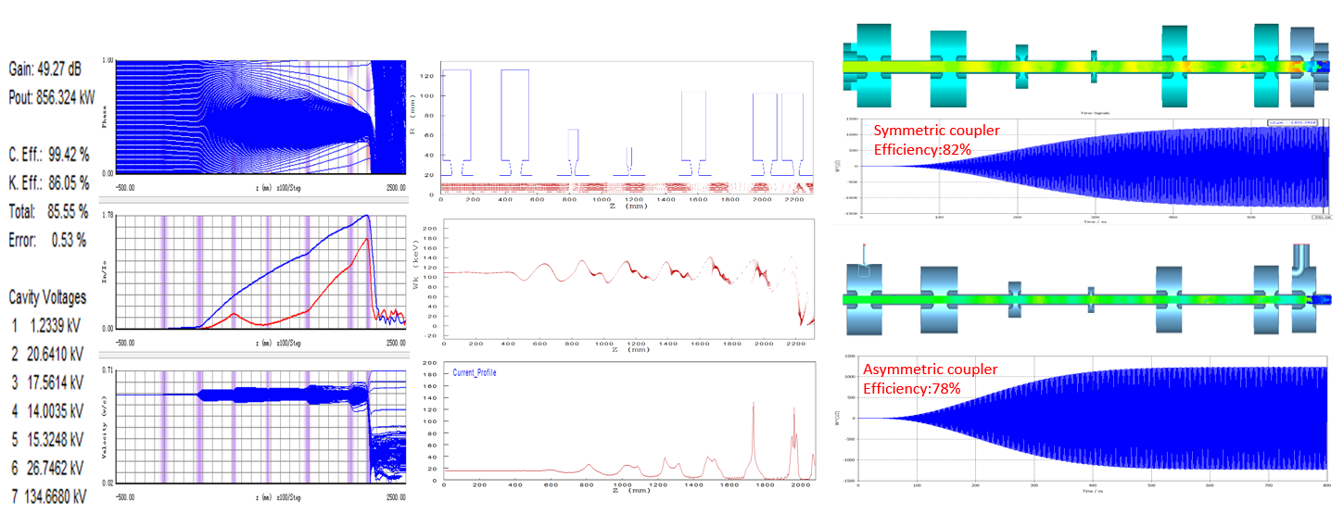
3D effects
Coupler asymmetry
Coupler asymmetry produces non uniform fields in the output cavity reducing the efficiency
Example:
High efficiency klystron developed for CEPC (CSM tube):
4% efficiency reduction due (probably) to coupler asymmetry -> to be further investigated
Can be mitigated with double coupler
O. Xiao, IVEC 2019

Slide 21
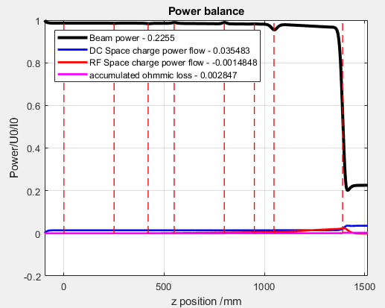

“Real life” issues (1)
Ohmic losses
They can be evaluated in simulations
KlyC takes them into account in the balanced efficiency calculation
They are introduced in Magic cavity by cavity and in CST using lossy material
Usually the impact on efficiency is quite small (<0.5% for copper interaction structures)
ESS-8
Magic 2D
Lossy material:
σ can be adjusted

Slide 22
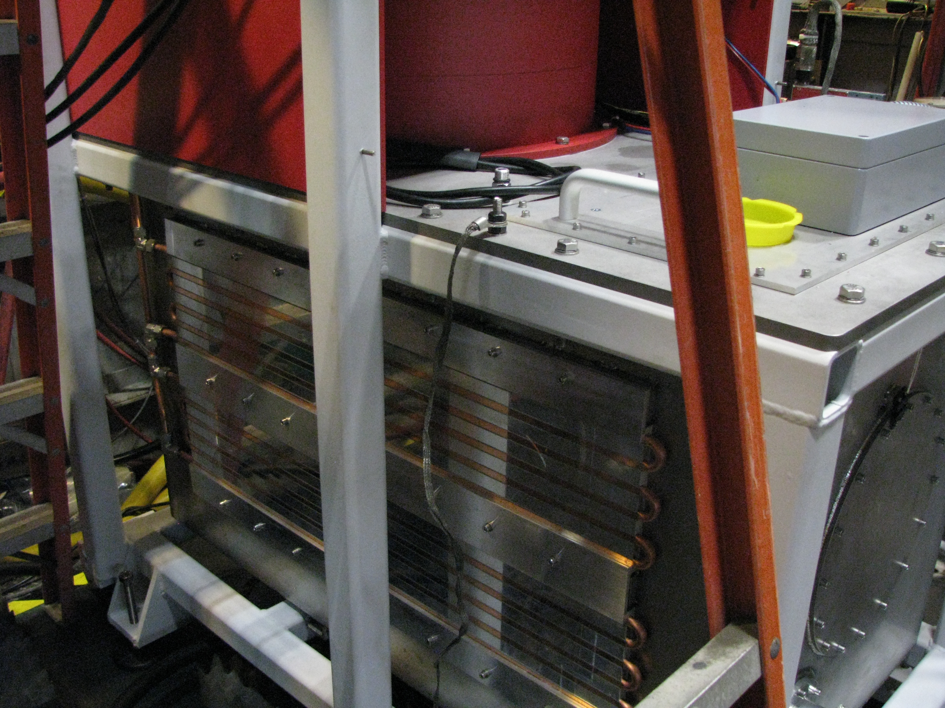


“Real life” issues (2)
Power dissipated in the auxiliary power supplies
Filament power supply
<300 W for the ESS medium beta klystrons
But it is DC power: 0.4% of klystron average output power
<3000 W for ESS medium beta klystrons
But it is DC power: up to 4% of klystron average output power
Solenoid power supply (if present)
Ion pump power supplies
Negligible as the current is usually below 1 uA

Slide 23

“Real life” issues (3)
Mismatched load
Non – ideal output match and possible instabilities
Non-ideal behavior of the RF distribution chain after the klystron changes the effective external Q of the klystron output cavity and it can:
Have an influence on performances
In worst cases give rise to reflected electrons and instabilities
ESS-8
Operation on mismatched load
(VSWR 1.2, variable phase)
Simulation of the klystron behavior on mismatched load is important
Example:
ESS Medium Beta klystron
Non-monotonous phase observed during Acceptance Test due to electrons “bouncing” in the output cavity: observed in simulations only for higher values of Qext
Problem solved by reducing Qext of output cavity (and slightly reducing the tube efficiency)

Slide 24

“Real life” issues (4)
HV rise and fall time in pulsed systems
RF can be applied only after HV pulse is up and stable.
Some DC power is dissipated at the beginning and end of the pulse: tube efficiency is not affected but the system efficiency is reduced
Very small effect on efficiency
High Voltage
(Negative polarity)
3.5 ms
Time
4 ms
If t_{rise}=t_{fall}=250 us, HV=109 kV, I=21.5 A
Efficiency is reduced by 0.2%

Slide 25


“Real life” issues (5)
Power overhead for LLRF regulation
Klystrons reach maximum efficiency at saturation
Due to need of overhead for regulation purposes we can’t operate them in saturation but we need to stay in the linear region; this will reduce the efficiency
At ESS, the current overhead for LLRF is 25% (+5% to take into account power dissipation in the RFDS)
Saturation
With present klystrons (Efficiency at saturation 65%):
Operational efficiency: 52%
Example:
Power to the cavity = 950 kW
Overhead = 25%
Klystron saturated power = 1.18 MW
Courtesy of Thales ED
With HE klystrons (Efficiency at saturation 80%):
Operational efficiency: 64% (more if less overhead is required)
BIG impact on
efficiency in operation!
A possible solution is to act on high voltage instead than drive power (see R. Yogi’s presentation at IVEC 2019)
Mitigation: reduce overhead as much as possible!

Slide 26

Summary
In the example with low perveance case about 10% reduction in efficiency can be expected due to effects related to bunching and deceleration processes. Can be mitigated (low perveance, hollow beam, high efficiency bunching methods, etc.) but not eliminated.
Other factors limiting the overall system efficiency have to be considered (auxiliary power supplies, regulation overhead, non-ideal load, etc). These can be difficult to quantify and depend on the particular system considered.
ESS-8
Thanks to I. Syratchev and J. Cai whose material has been widely used in this presentation and for the efforts put in the High Efficiency Klystron collaboration and the development of the KlyC code!

