Slide 1






The new CERN solid state Amplifier for the sps / 200 MHz
ARIES, Uppsala University, and CEA organize an international workshop on concepts for energy efficient RF power generation for accelerators. Experienced researchers and leading companies in the field of RF power generation and related technologies will explore the technical challenges emerging from the design of new accelerators and to match them with state-of-the-art industrial solutions for RF power generation.
The workshop will focus on methods, technologies and experiences in energy efficient electron tube devices and solid-state amplifiers.
Through knowledge exchange between research institutes and commercial partners, the workshop will address technical challenges shared by European research institutes collaborating in TIARA.
Erk.Jensen@cern.ch reporting for
Eric.Montesinos@cern.ch
19 June 2019

Slide 2
outlook
Brief description of the project
New building
Solid State Power Amplifier design
Fantastic Cavity Combiners
Efficiency
Conclusion

Slide 3
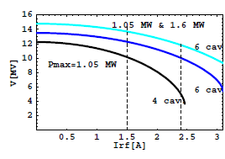
Brief Description of the project
First definition of the project (2011)
  Four to become six Travelling Wave Cavities
  Four existing amplifiers upgraded to 1.05 MW* feeding four cavities
  Two new power amplifiers delivering 1.4 MW* to two cavities (became 1.6 MW* in 2015)
  A new building
  A new SPS-LSS3 layout
  *All RF power levels being peak power operating with a duty cycle at 50% at 42 kHz or 172 kHz
Courtesy Elena Chapochnikova
Available RF voltage as a function of Irf

Slide 4
First definition of the project (2011)
One line
(input cavity ~120 to 180 m away)
Three contracts
Drivers :
  2 x 16 x SSPA
Finals :
  Tetrode : 2 x 16 x 110 kW
  IOT : 2 x 16 x 110 kW
  SSPA : 2 x 16 x (110 x 1 kW)
  Diacrode : 2 x 2 x 850 kW
  No klystron at 200 MHz
Combiners + lines :
  3 dB hybrids
  850 kW power loads
From Beam Control
1/16 splitter
2 x
1.6 MW at cavity input
4 stages of 3 dB combiners = - 0.6 dB
120 to 180 m Coaxial lines = - 0.2 dB
Final Amplifier output = 1.6 MW + 0.8 dB = 2.0 MW / 16 = 125 kW

Slide 5
Purchasing strategy
Two contracts
  1/ Drivers
  2/ Finals
A first contract for the Drivers
  SSPA only (best technology for a few kW amplifier)
  Will be a first input for a predefined cost for the Finals
Combining systems
  Done in house or subcontracted
  Will be a second input for a predefined cost for the Finals
Once Drivers contract adjudicated, a second
contract for the Finals.
  Drivers cost
  + Combiner cost (defined by CERN)
  + Finals offer
  _______________________________________
  Adjudication to the lowest compliant offer

Slide 6
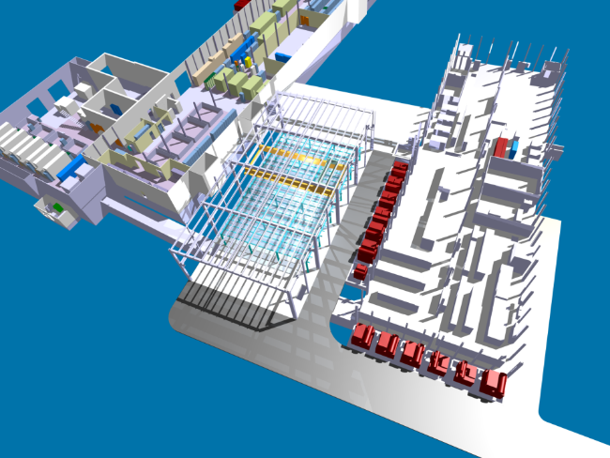
Pre-requisite : New building
Bare building
2011
2012
2013
2014
2015
2016
2017
2018
2019
2020
Design completed by end of October 2011 to allow Civil Engineering studies and authorisation requests to be launched.
Goal to have the bare building completed by end 2014 (taking advantage of LS1 to minimize accident impacting SPS operation during construction).
Even if we did not know what amplifier technology will be selected !

Slide 7
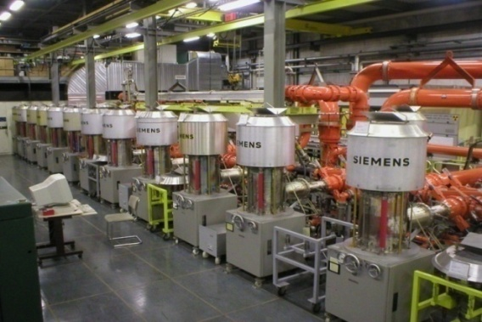
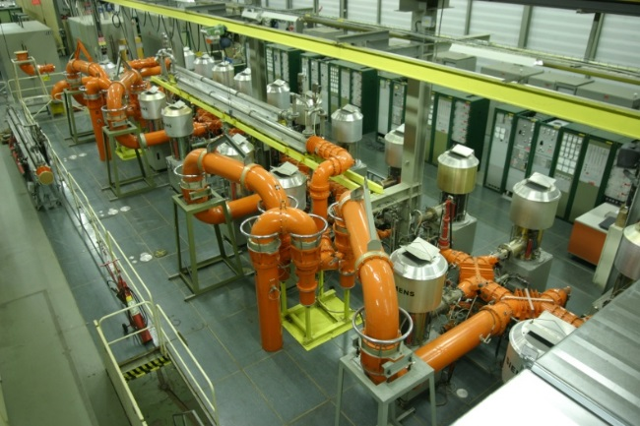
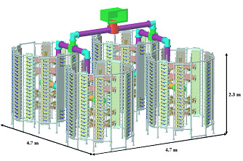
New building
Total combiners = 200 m²
Amplifier tendering process opened to several technologies
  2 x 16 tetrodes (well-known)
  2 x 2048 SSPA (Solid State Power Amplifiers)
  4 x Diacrodes (new tube)
  4 x IOT (Inductive Output Tube, almost new)
Answer of the selected technology (knowledge of volume needed) after the building approval
Hybrid combiners and coaxial lines will be similar to the ones in use with existing tetrode systems already in the SPS
1 tube (160 kW) = 4 m²
HVPS = 192 m²
Total 32 tubes = 320 m²
4 tours (320 kW) = 33 m²
LVPS = 72 m²
total 64 towers = 600 m²
Total combiners = 200 m²
Courtesy
Patrick Marchand
(SOLEIL)
2.3 m
4.7 m
4.7 m

Slide 8
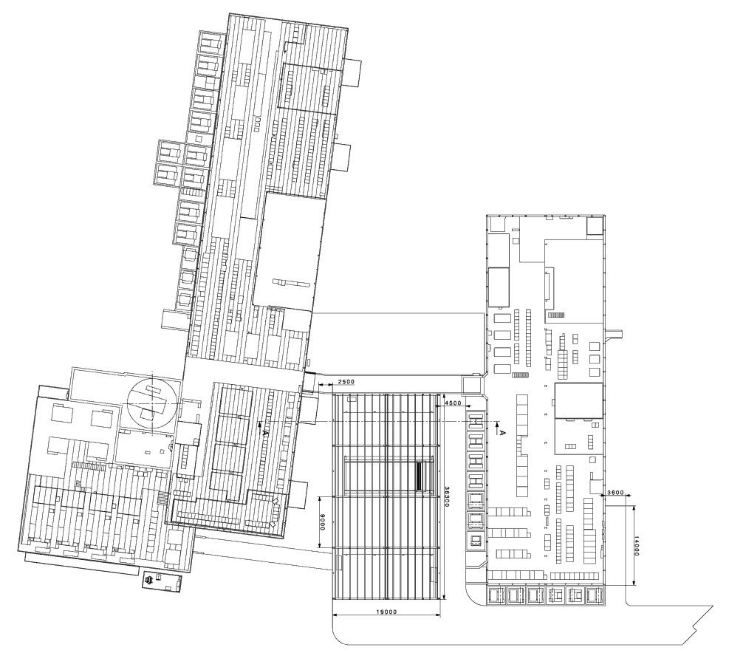
New building
Total surfaces:
  Basement : 19.5 m x 36.5 m = 710 m2
  Mezzanine : 475 m2
  Total = 1185 m2
Total surfaces for RF:
  Basement = 550 m2
  Mezzanine = 475 m2
  Total = 1025 m2
36.5 m
19.5 m

Slide 9
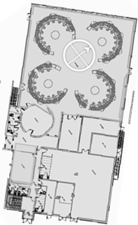
Future power systems in the SPS
BA3
Siemens
2 x 1.1 MW
CCC
BB3
Electrosys
2 x 240 kW
BAE3
Philips
2 x 1.1 MW
BAF3
New
2 x 2.0 MW

Slide 10
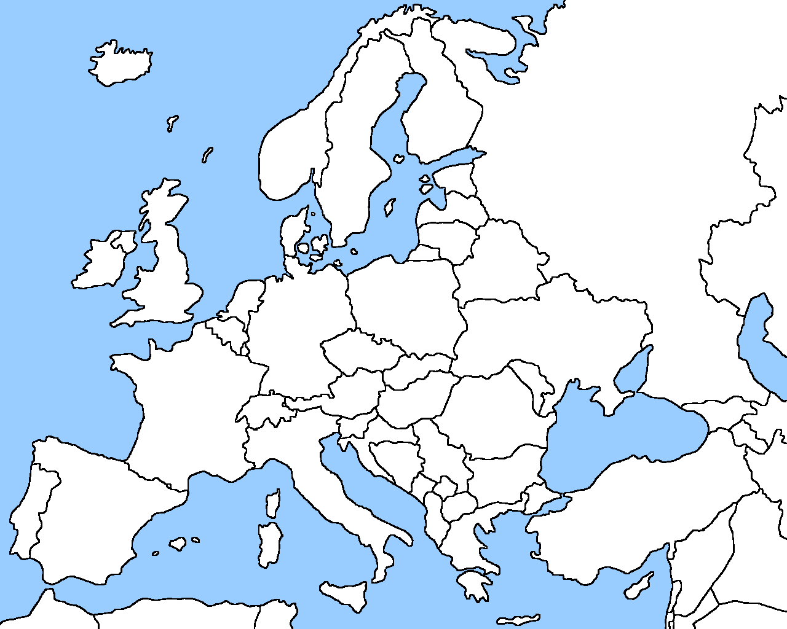
dRIVERS
Consulted
Selected
November 2011
March 2014
2011
2012
2013
2014
2015
2016
2017
2018
2019
2020
72 companies consulted
20 selected
10 offers
Defined a 1.25 kW unit
  Compatible with all Finals technologies
    32 for SSPA & IOTS, 256 for Tetrodes, 192 for Diacrodes
  12 pre-series for qualification (end of contract clause in case of any failure without any payment)
  One to six batches of 50 (total 62 to 312) regarding result of future Finals IT-3841
TTI Norte, Spain, awarded the contract (3.7 €/Wp)

Slide 11
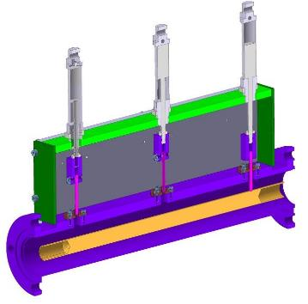
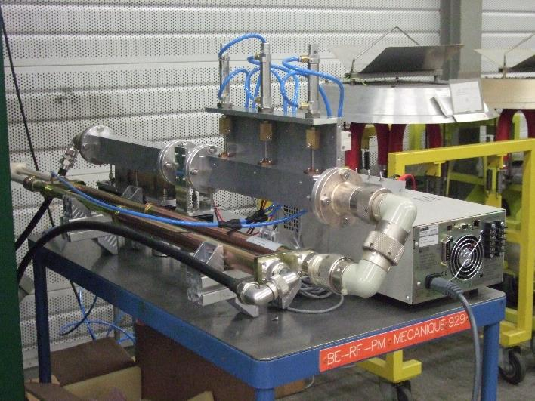
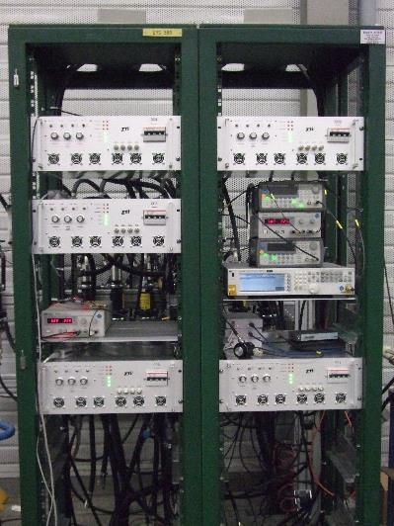
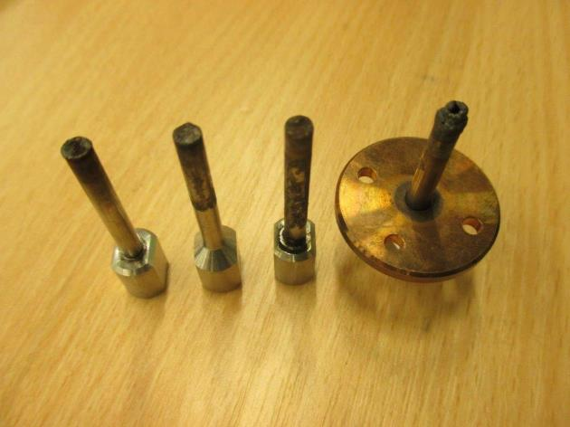
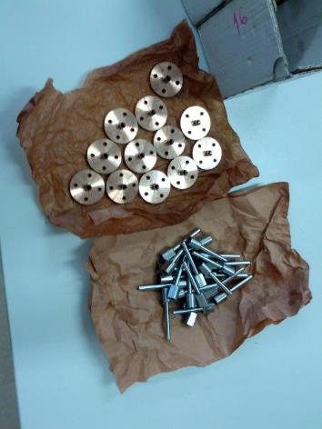
DRIVERS
Stable since September 2017
Upgrade from 64 x 1 kW tube to 64 x 1.25 kW SSPA, January 2017
12 Prototypes, March 2014
2011
2012
2013
2014
2015
2016
2017
2018
2019
2020
RF design is impressively robust.
Double circulators !
Sustained the CERN Fast Short-Circuit test !
Successfully performed the 1000 hours test with five units (not a single failure)
Many broken transistors after 6 months of operation (first half 2017)
Very quick reaction of the company (TTi Norte, Spain), who repaired at no cost all the already produced units.
64 units in operation since mid-2017 with very few failures ! (normal with all new systems)
In total, 300 units delivered and successfully tested.

Slide 12
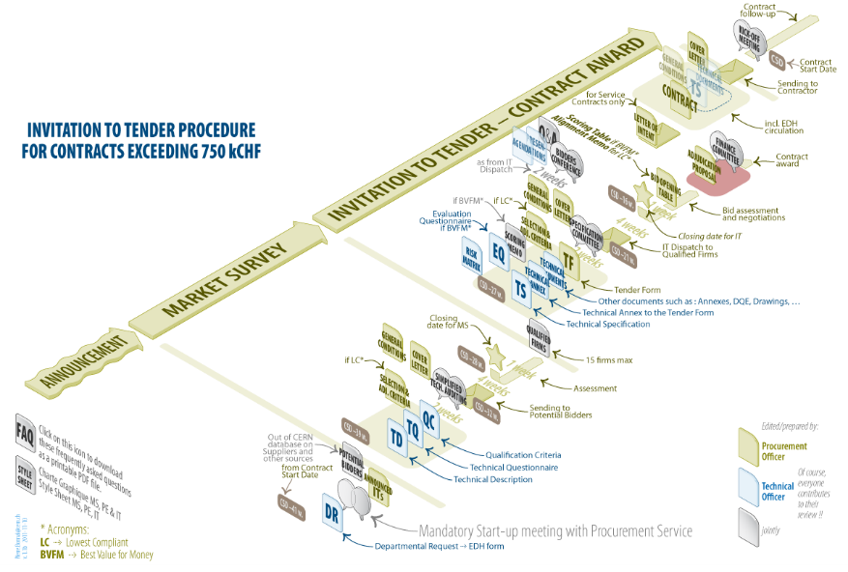
FINALS
Drivers prototypes validated, March 2015
2011
2012
2013
2014
2015
2016
2017
2018
2019
2020
Invitation to tender for Finals, November 2014
Technical Specification to be finalized taking into account Drivers outcome
(even before full qualification of the Drivers, as purchasing process is extremely long at CERN)
Power level request increased
  Cavity 1.4 to 1.6 MW
  Amplifier from 1.6 to 2.0 MW !
Minimum 41 weeks
(in real life 1.5 year)

Slide 13
Finals Additional costs
Drivers cost (5’500 CHF per 1.25 kW unit)
  SSPA & IOT 176 kCHF
  Tetrodes 1’408 kCHF
  Diacrodes 1’056 kCHF
Combiner cost (defined by CERN)
  SSPA & IOT 2’760 kCHF
  Tetrode 3’160 kCHF
  Diacrode 800 kCHF
Total additional cost per technology
  SSPA & IOT 2’936 kCHF
  Tetrode 4’568 kCHF
  Diacrode 1’856 kCHF

Slide 14
Bidders conference
20 January 2015
2011
2012
2013
2014
2015
2016
2017
2018
2019
2020
Defined the scope of the contract
  being as fair as possible regarding the technology,
  Defining a quite costly demonstrator in order to disqualify ‘non serious’ companies (we do not want to be R&D at low cost),
  Not a single CHF paid in case of failure of the demonstrator!
  Taking into account tubes on an as long as possible period (over 5 years),
  Including spares in order to operate during 20 years.
Answered 102 questions from the
suppliers

Slide 15
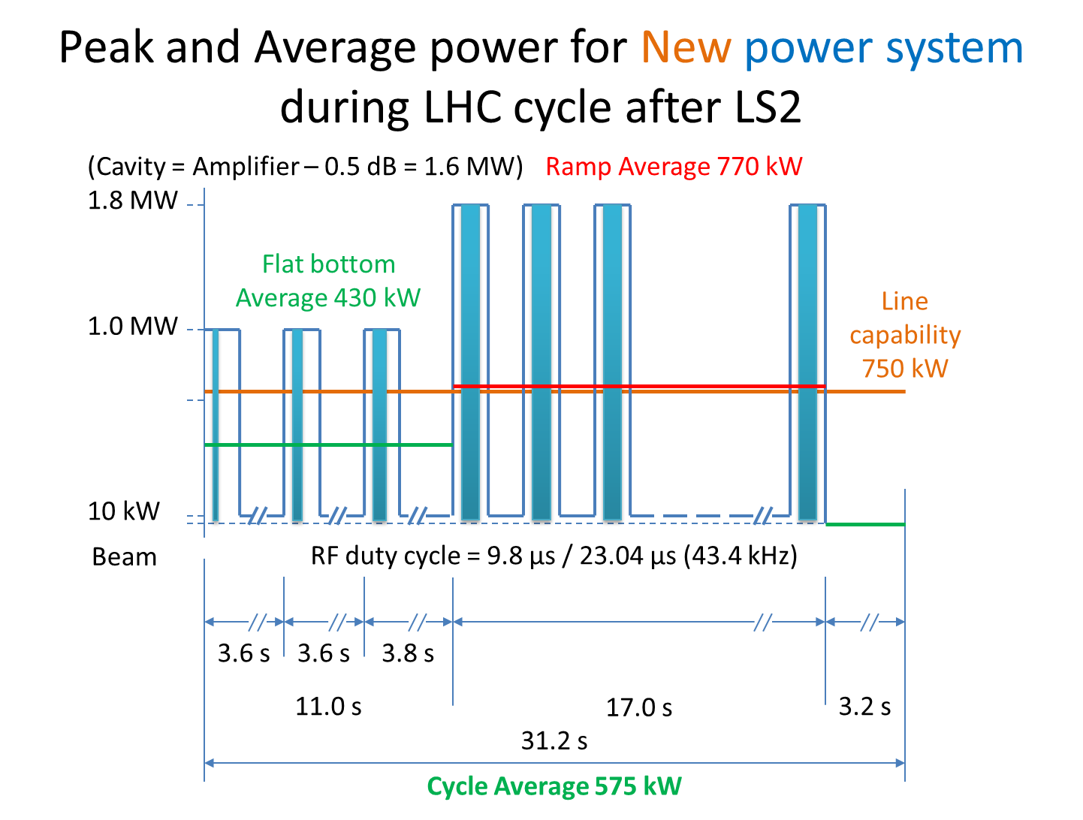
Technical specification
Requirements
  Integration within the given building,
  Repetition rate 0.1 Hz to 500 kHz (require a CW and a pulsed amplifier),
  Full reflection all phases during 100 ms (equivalent to 4 x the power level along the lines),
  Non conventional way to measure the BW (required by LLRF and TWC),
  Very good linearity,
  Very specific RF cycle as being an injector for the LHC, repeating the cycle every ~ 30 seconds,
  This was known to be very stressing for the tetrodes.

Slide 16
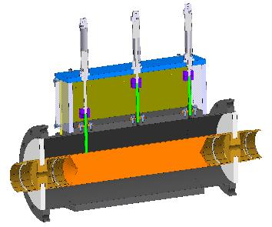
Technical specification
A lot of tests to qualify the Finals:
  Supercycle test, short circuit test, BW, linearity, …
  Short duration tests to qualify an Amplifier within one week,
  Long duration tests to check reliability within one month.
Nota for this (high efficiency) workshop
  As being an injector,
  As being only ~ 600 kW average compared to the 225 MW consumed by the CERN complex,
  As being requested to always be available,
  Efficiency was not one of the key criteria
  We agreed to accept 25% AC to RF.

Slide 17
Finals
Consulted
Selected
13 March 2015, bids opening
2011
2012
2013
2014
2015
2016
2017
2018
2019
2020
74 companies consulted
19 selected
8 declined
7 offered
No discussion about the Drivers neither the combiners costs
(we were very proud, as showing our estimates were correct)
Unable to submit a competitive bid due to quantity being beyond our production capacity and we could not provide installation support
Dear all, We are sorry but we are not able to finish every documents within deadline. So we must decline to participate with our offer. Thank you for your opportunity. Best regards
We are not on time with the documents required
We believe that the chances are too low to get the contract by bidding Solid State Amplifier solutions. Additionally, the known dumping price structure of competitors in the field of Solid State Amplifiers, which get development provided free of costs by public institutes (already known due to the preceding call for tender for preamplifiers of the same frequency) also makes the chance to win the bid too small for the required work load for bid preparation

Slide 18
finals
Consulted
Selected
17 September 2015, FC approval
Offered
13 March 2015, bids opening
2011
2012
2013
2014
2015
2016
2017
2018
2019
2020
74 companies consulted
19 selected
8 declined
7 offers
March 2015 lowest bid is Thales
Communication & Security for 8 MCHF
Very careful verification of the offer
September 2015 CERN FC approval
1.75 €/Wp
lowest compliant bid – but!!!

Slide 19
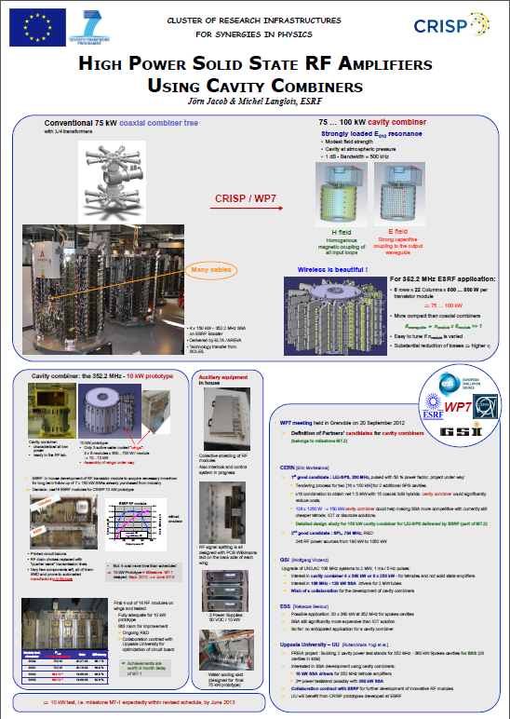
Cavity combiner
CRISP (Sept 2010)
  Jörn Jacob (ESRF) asked for support to the development of cavity combiners receiving funding from the EU as work package WP7 in the framework of the FP7/ESFRI/CRISP program,
  CERN immediately supported it.
CRISP, 2nd yearly meeting, PSI 18-19 March 2013
  ESRF cavity combiner,
  144:1 Cavity combiner for CERN-LIU-SPS
In addition, please refer to two excellent papers from ESRF at IPAC 2019:
  MOPC005-IPAC11, 352.2 MHZ – 150 kW Solid State Amplifiers at the ESRF
  WEPFI004-IPAC13, Commissioning of first 352.2 MHz - 150 kW Solid state amplifiers at the ESRF and status of R&D

Slide 20
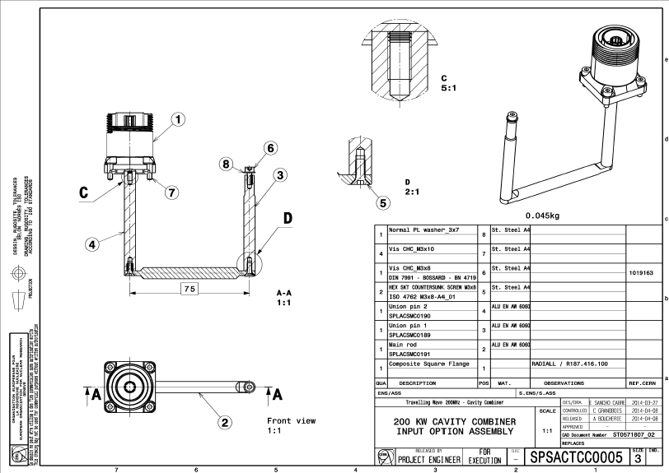
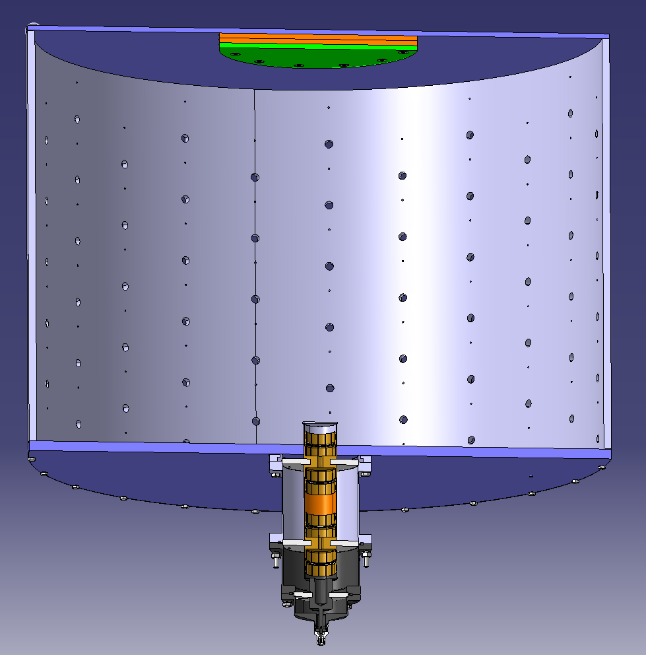
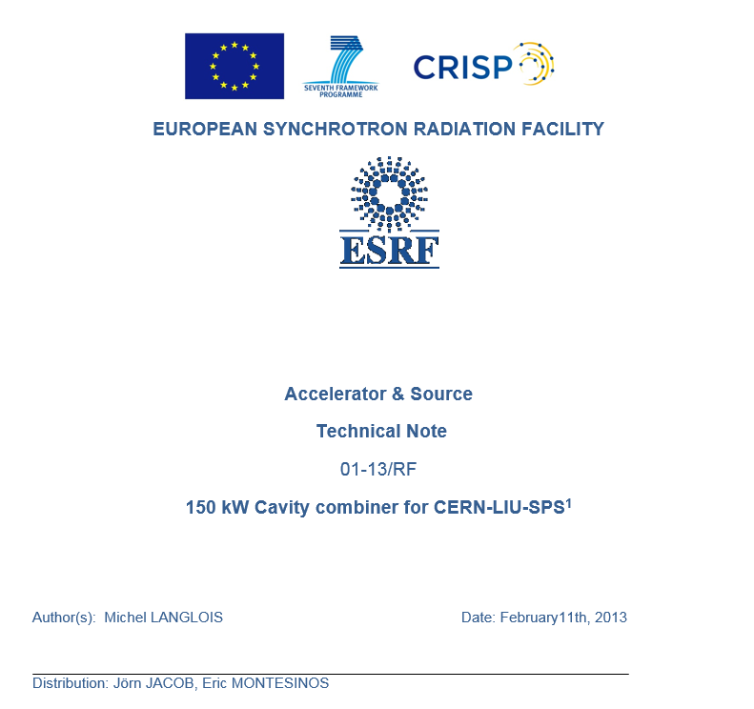
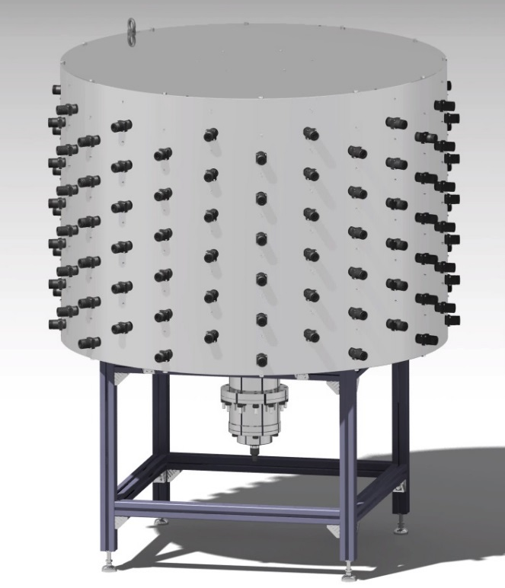
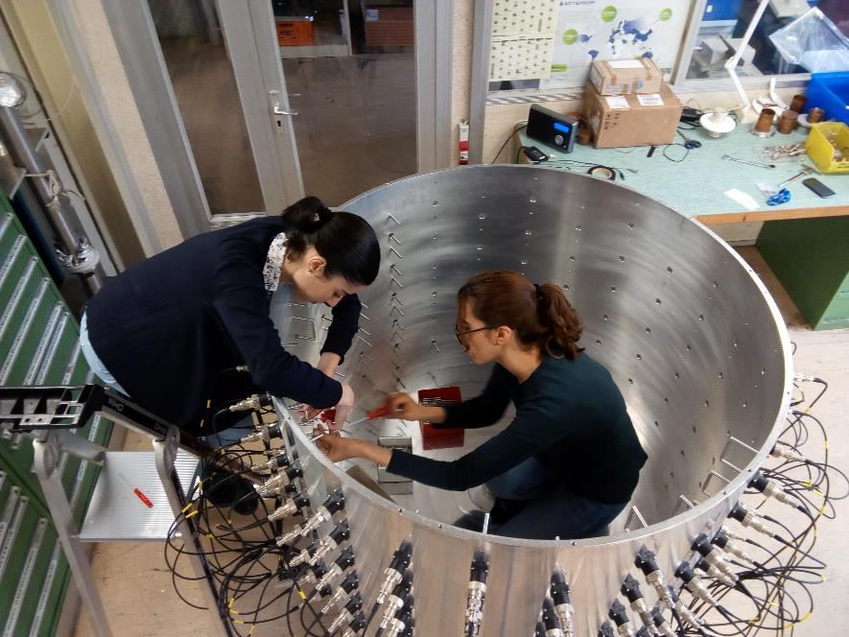
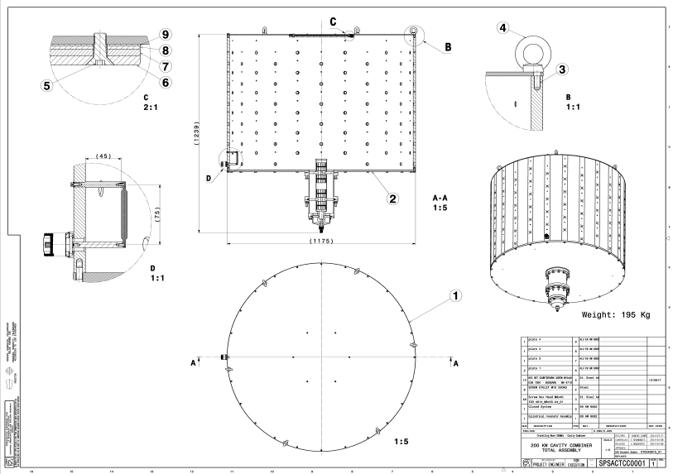
Cavity Combiner
We firmly believe that power combination is key for an SSPA of this size, specifications, power and efficiency. Based on ESRF Technical Note for CERN-LIU-SPS under CRISP in Feb 2013 (thanks, Jörn!), we built our own 144:1 cavity combiner.

Slide 21
Proposal from thales
One Transmitter will be composed of
  16 x 144 kW RF amplifiers
One RF amplifier (tower) will be composed of
  1:80 cavity splitter,
  80:1 cavity combiner,
  80 x 2 kW RF modules, i.e. 160 transistors.
In total:
  Two systems,
  32 towers,
  2560 RF modules,
  5120 transistors.
Thales proposal was fully in line with our own R&D programs.
  Small RF units based on 1 kW LDMOS transistors,
  Cavity combiners,
  New very interesting features still covered by a NDA
Illustration,
not exactly as the choosen option, still under NDA
2 x 16 x 144 kW
RF Towers

Slide 22
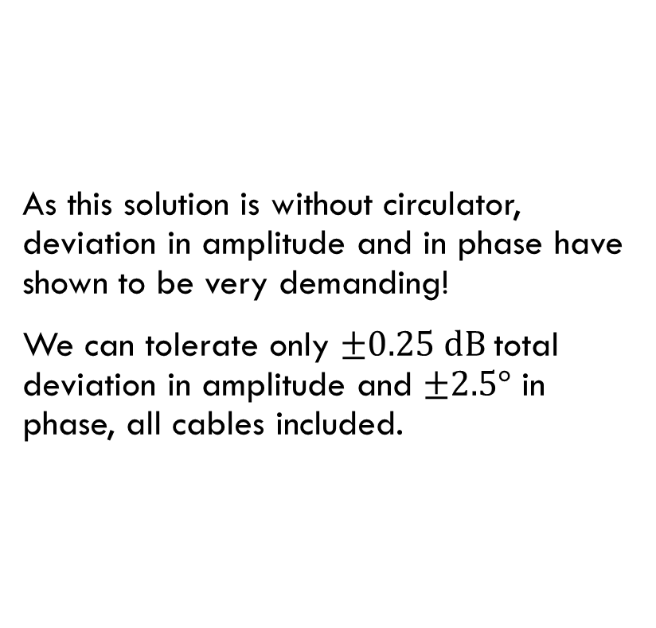
Advantages of a cavity combiner system
Thanks to the design of the module, if one module fails, we can switch it offline, showing a short circuit at the cavity wall plane, and continue with the remainder.
This allows us to get full advantage of the modularity at the transistor level as we will then lose only one module in power.
Oversizing of 10 % was requested, such that the tower still deliver full power with 72/80 modules.
Altogether, these advantages allows us to calculate a 99.99 % availability for the beams.
As this solution is without circulator, deviation in amplitude and in phase have shown to be very demanding!
We can tolerate only $±0.25 dB$total deviation in amplitude and $±2.5°$ in phase, all cables included.
very difficult!

Slide 23
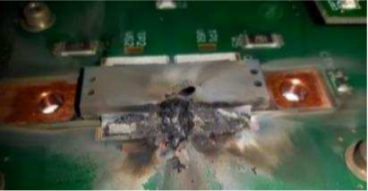
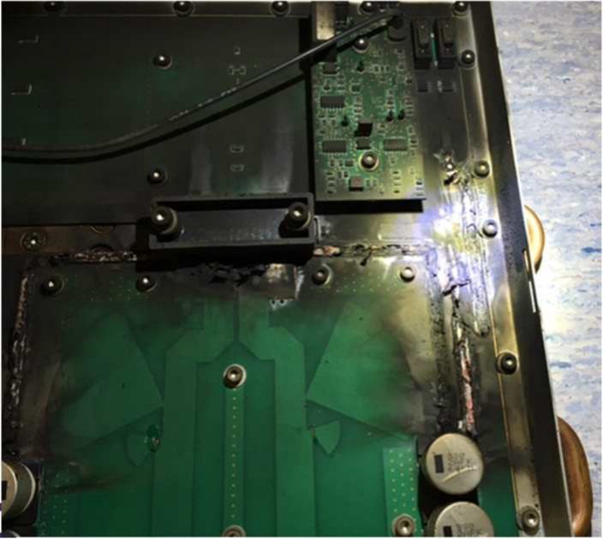
Difficult to move from theory to real life
Main difficulties were:
  Correct design of the RF board, getting rid of all parasitic frequencies,
  Brazing of the transistor to their heatsinks,
  Robust water cooling design of the tower,
  Best heatsink design to guaranty a correct cool down of the transistors,
  Others… where Thales like to keep some confidentiality…

Slide 24
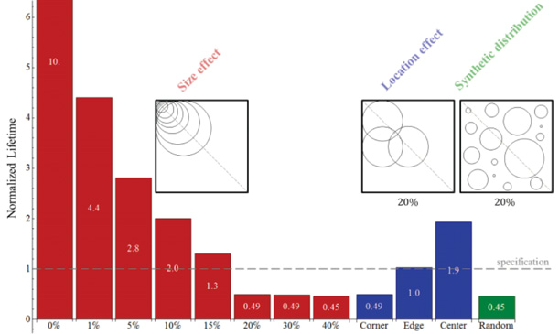
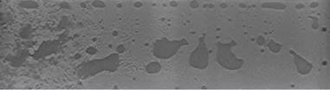

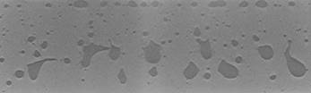

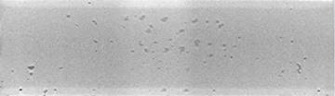

Difficult to move from theory to real life
Main difficulties were:
  Correct design of the RF board, getting rid of all parasitic frequencies,
  Brazing of the transistor to their heatsinks,
  Robust water cooling design of the tower,
  Best heatsink design to guaranty a correct cool down of the transistors
  Others… where Thales like to keep some confidentiality…
Micro-tomography showing voids after brazing
Lifetime can be improved by a factor up to 20 between a very bad brazing process versus a very good one !
Very bad 25 % voids
Bad 15 % voids
Very good 2 % voids

Slide 25
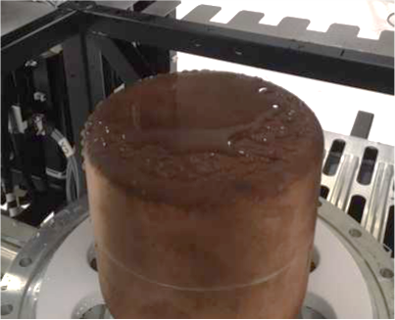
Difficult to move from theory to real life
Main difficulties were:
  Correct design of the RF board, getting rid of all parasitic frequencies,
  Brazing of the transistor to their heatsinks
  Robust water cooling design of the tower,
  Best heatsink design to guaranty a correct cool down of the transistors,
  Others… where Thales like to keep some confidentiality…

Slide 26
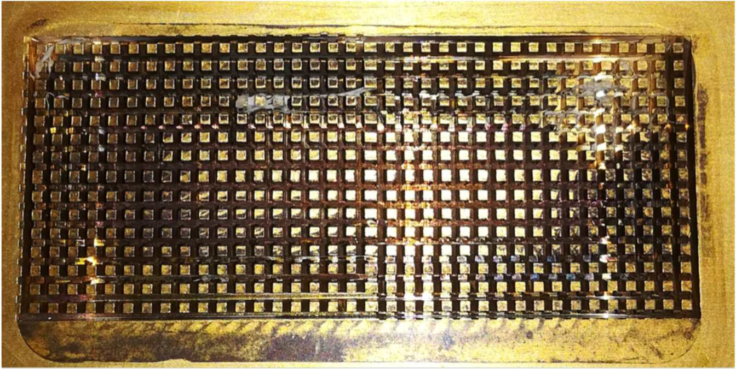
Difficult to move from theory to real life
Caused by teflon residues?
Main difficulties were:
  Correct design of the RF board, getting rid of all parasitic frequencies,
  Brazing of the transistor to their heatsinks,
  Robust water cooling design of the tower,
  Best heatsink design to guaranty a correct cool down of the transistors,
  Others… where Thales like to keep some confidentiality…

Slide 27
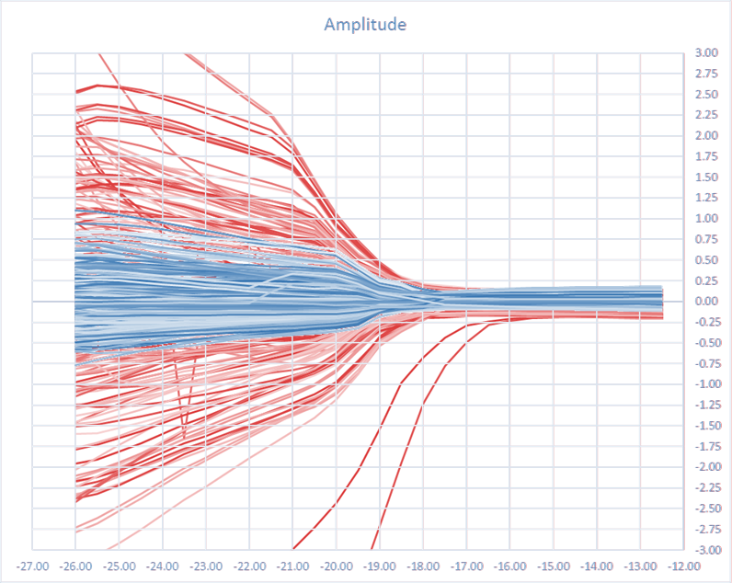
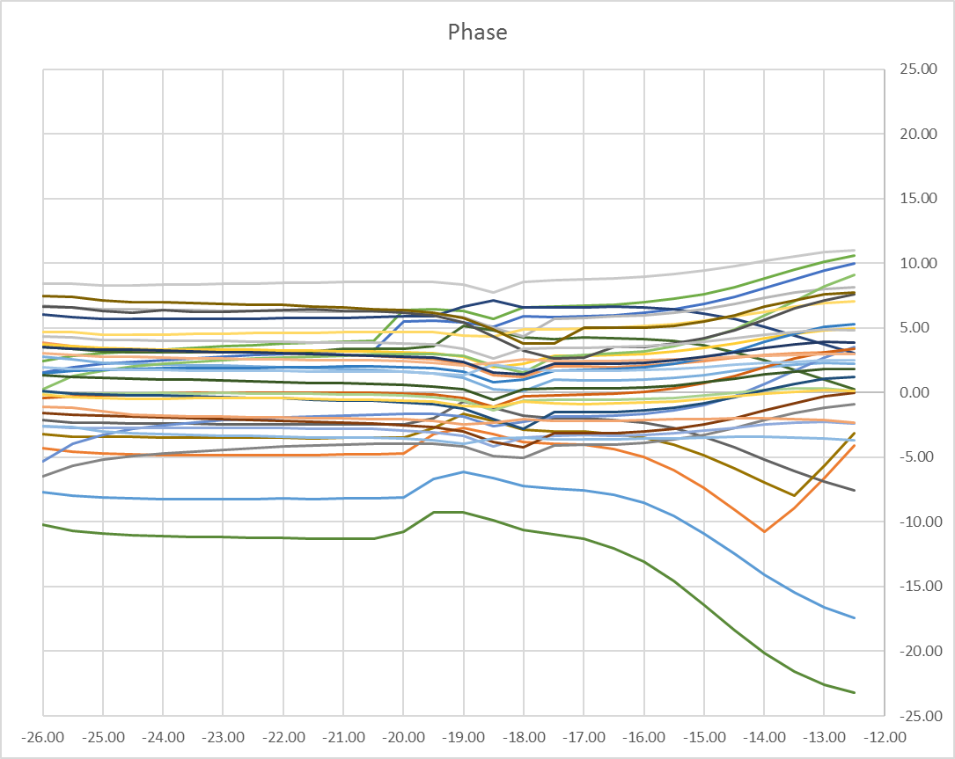
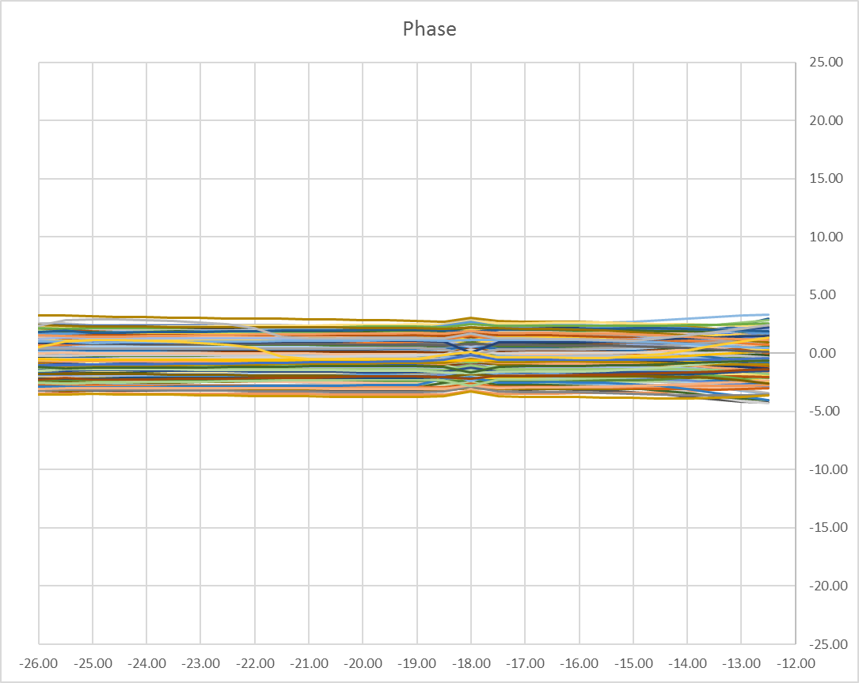
RF dispersion
First test total amplitude 7.2 [dB] total phase 51 [deg]
After strict adjustment total amplitude 1.7 [dB] total phase 15 [deg]
Module amplitude
+3 [dB]
First test > 6 dB
After strict
adjustment < 1 dB
Amplitude dispersion [dB]
-3 [dB]
Input power [dBm]
Module phase
+25 [deg]
Phase dispersion [deg]
First test (> 35 deg)
After strict adjustment (< 8 deg)
-25 [deg]
Input power [dBm]

Slide 28
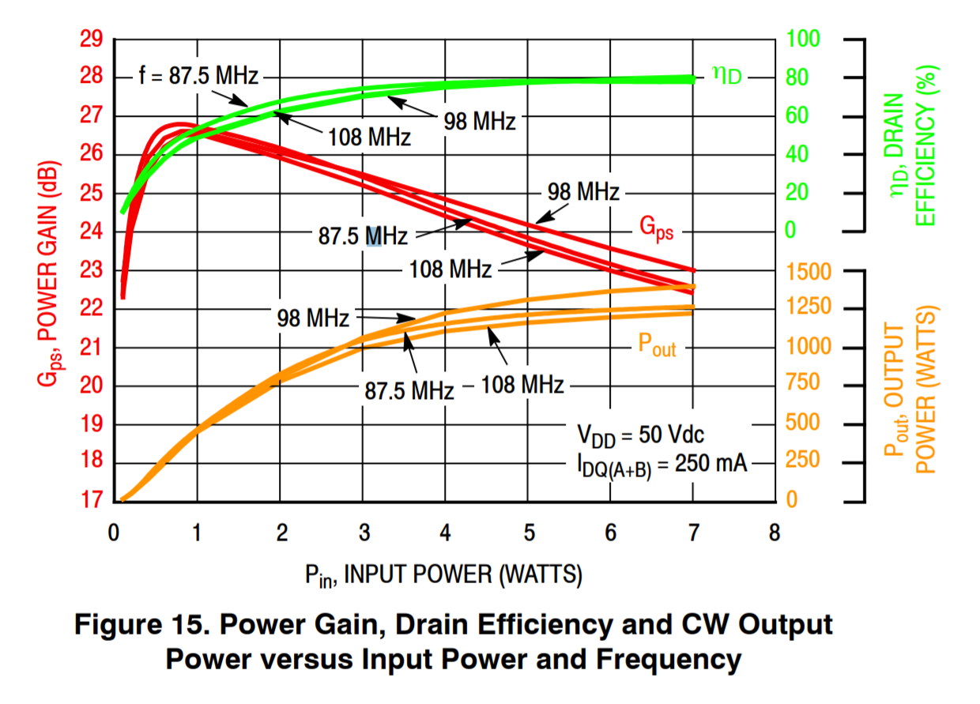
Thermal effects
Case temperature
20ºC
40ºC
60ºC
With a pulsed (seconds) system, two parameters affect the lifetime:
  Case Temperature,
  Delta Temperature over the cycle.,
Operating at the best efficient point will then help to reduce the electrical bill, and also help to increase the lifetime,
Operating at a too low power is counter-productive, as efficiency reduces, case thermal temp will increase,
… but we have to operate at sub-optimum efficiency ( ) to assure availability!
Once we will master the operation of the system, thanks to our possibility to switch offline modules without affecting the global performance (thanks to cavity combiner!), we intend to operate with a minimum number of modules in order to increase efficiency, redundancy (availability for beams) and lifetime!
80ºC
100ºC
72/80
80/80

Slide 29
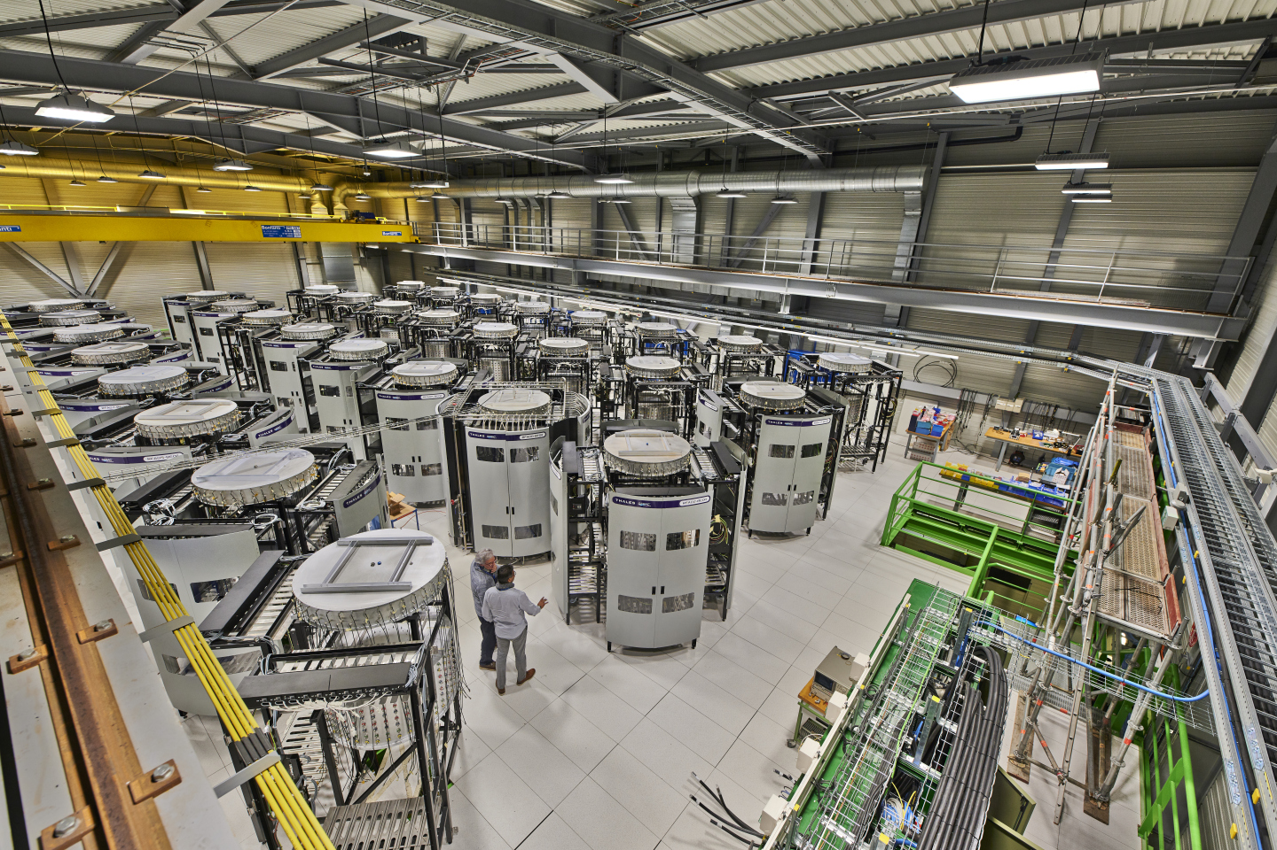
To date
After 10 trials, one Demonstrator (one full tower) has successfully qualified at full performances and under full stress
12 modules have performed ageing tests providing expected lifetime longer than 500’000 hours of operation (100 years), that allows us to apply MTBF calculations with confidence
Almost all other devices than modules have been delivered, installed and commissioned
Modules are being delivered from this week at a rate of 120+ per week, with all modules delivered before end 2019 (spares in 2020)

Slide 30
Conclusion
After a very difficult design, industrialisation and test phase, we now entered the production phase.
Brazing of the transistors to their heatsink was very complex to achieve, this is very particular to the 30 seconds multi thermal cycles needed as being an injector for the LHC, and Thales did a fantastic job to provide a high tech solution.
Cavity combiner is a key solution in order to take full advantage of the granularity, it also helps increasing the efficiency of a SSPA system, discrepancy must be very well managed.

