Slide 1
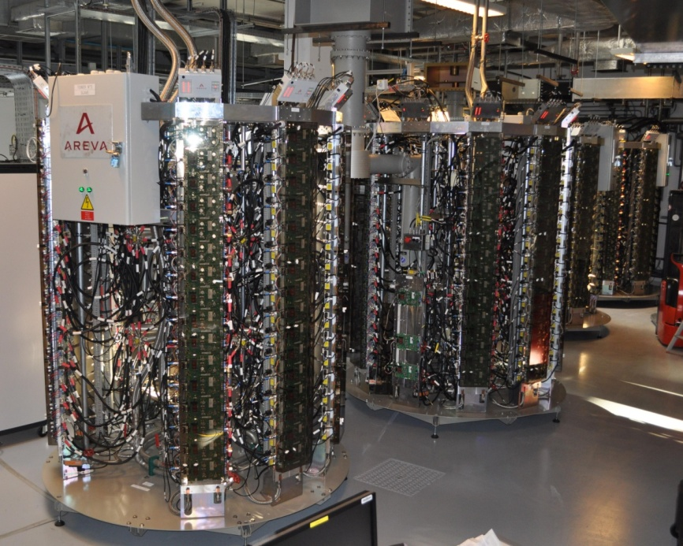
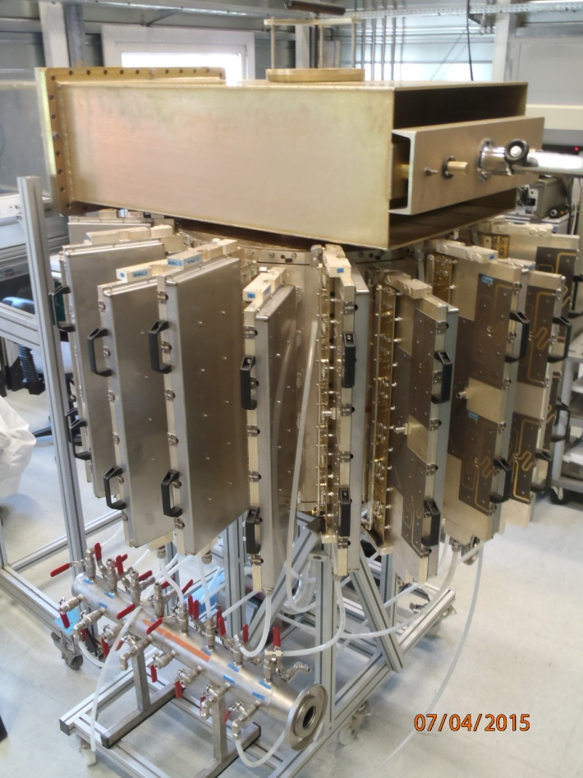
ARIES Workshop on Energy Efficient RF
Ångström Laboratory, Uppsala, 18-20 June 2019
ESRF Experience with Solid State Amplifiers and Combiners
Jörn Jacob
on behalf of ESRF RF Group
SOLEIL – ELTA/AREVA SSA at ESRF
ESRF Design
with cavity combiner

Slide 2
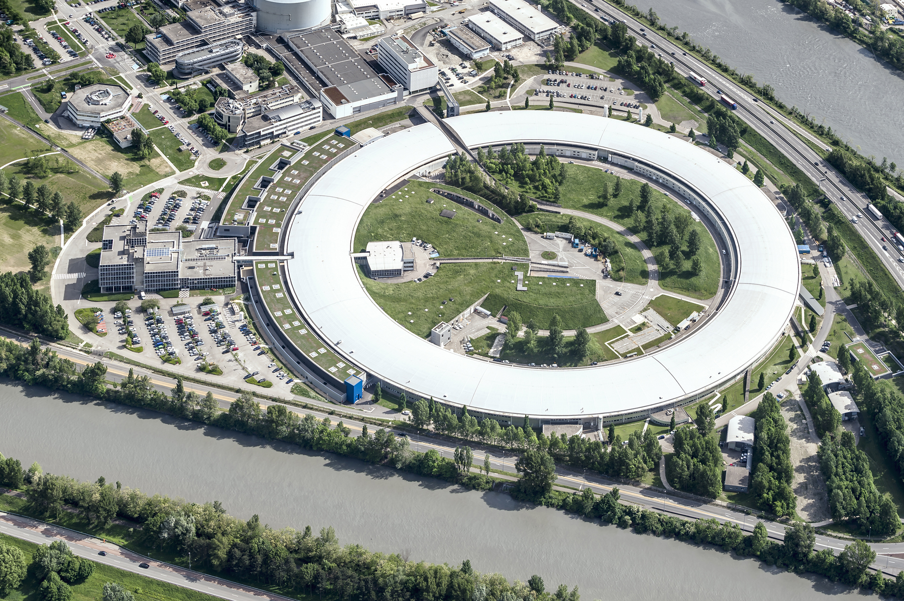

ESRF: First 3rd generation, becomes 4th generation light source
Up to 100 keV X-rays
Circ = 844 m
6 GeV Booster
200 MeV Linac
6 GeV Storage Ring
200 mA
Existing Storage Ring
1992: commissioning
1994: external users
since then:
many upgrades
brilliance increase by about a factor 1000
New Extremely Brilliant Source: EBS
Further brilliance increase by a factor 100
2019: installation well advanced, start up in Dec.
2020: commissioning and resume user service

Slide 3
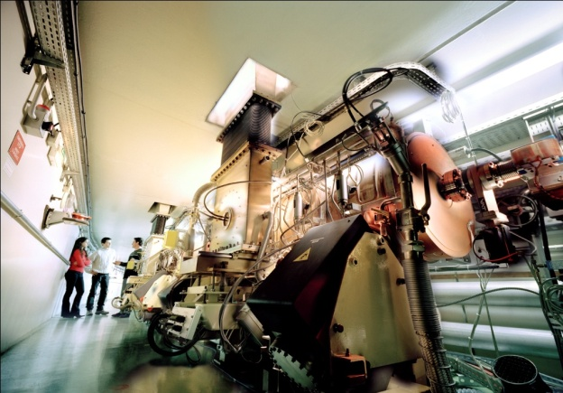
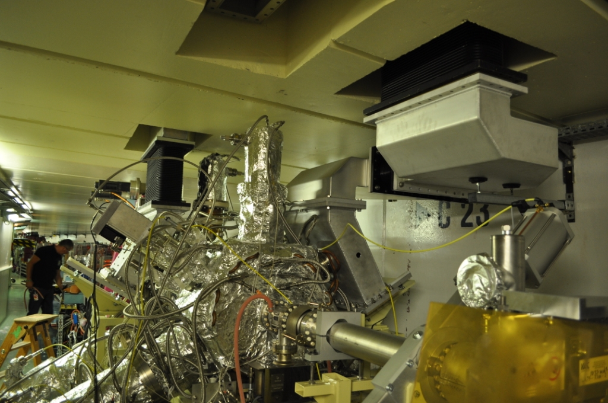
RF Layout → until December 2018
Cell 5
Cell 7
6 GeV
Storage Ring
5-cell cavities: strong HOM
Klys1
Klys2
6 GeV
Booster
Teststand
150 kW
4 x 150 kW SSA [ELTA/SOLEIL]
in operation since April 2012
SY Cav 1 & 2
150 kW
pulsed
150 kW
150 kW
3 x 150 kW SSA [ELTA/SOLEIL]
in operation since 2013
150 kW
3 prototype HOM damped cavities
  In operation since 2013
  One cavity removed due to a micro leak
Klys3
150 kW
150 kW
ID
ID
Cell 25
Cell 23

Slide 4
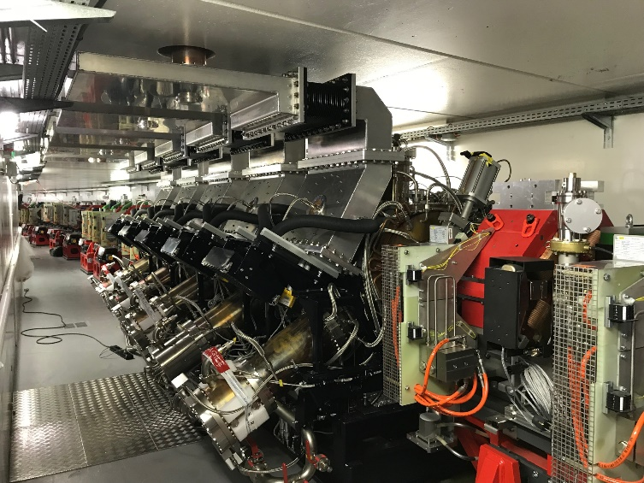
EBS RF system Layout – Start up December 2019
Cell 5
Cell 7
EBS Storage Ring
Symmetric 3dB splitting using existing magic T’s
-7 dB
-7 dB
KLYS 1
KLYS 2
NEW RF power Teststand
75 kW
tower
75 kW
tower
75 kW
tower
75 kW
tower
75 kW
tower
75 kW
tower
Space for 3rd or 4th harmonic RF system
  Still under study:
    5 to 7 active (?) NC cavities
    or passive Super3HC type
  ≈ 40 kW per NC cavity from SSA
3x existing 150 kW SSAs
Cell 25

Slide 5
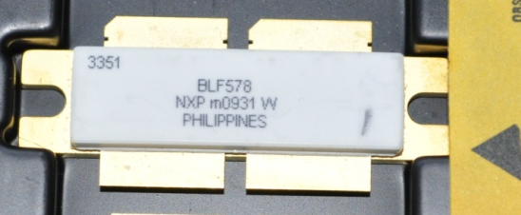
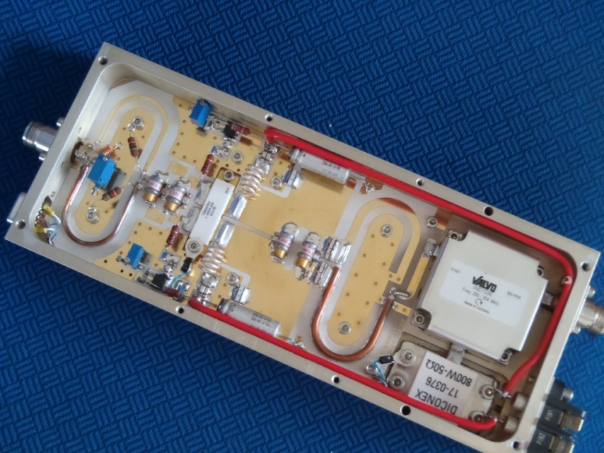
150 kW – 352 MHz SSA at ESRF
Pair of transistors in push-pull
(BLF578 from NXP, now produced by Ampleon)
x 128
x 2
75 kW coaxial power combiner tree
150 kW - 352.2 MHz SSA
DC to RF: η = 58 %, G = 63.3 dB at P_{nom}
☞ 7 such SSAs in operation at the ESRF!
650 W RF module
DC to RF: η = 68 to 70 %
Tolerates failures: no trip even at maximum power with up to 6 faulty modules
High redundancy
Initially developed by SOLEIL
Transfer of technology to ELTA / AREVA
RF modules & coaxial lines built by BBEF (PRC)

Slide 6
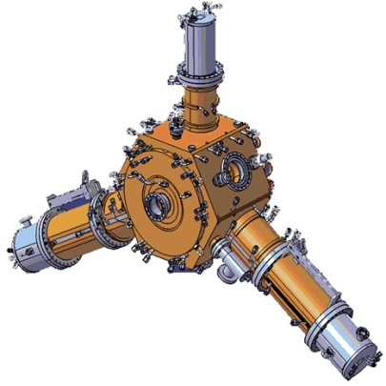
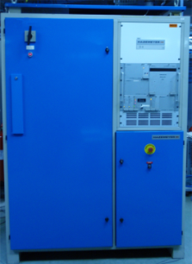





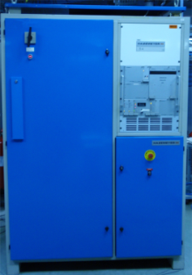
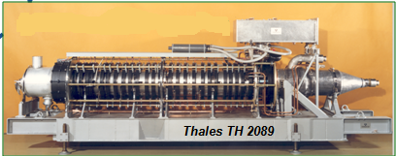
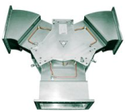
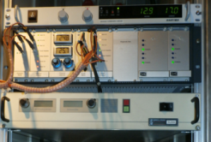
COMPARISION SSA versus klystron in operation
What we compare
RF 352MHz
Lo
Power Amplifier
Low Level RF
Load
Driver RF 100W
2 Focusing Power Supplies 2 X 130V/8A
95kV/18A
IP Power Supply
HVPS 100kV
5kV
Filament 25V/25A
Power IN
Power OUT
AC/DC Converter
460kVA / 280VDC
CIRCULATOR
ELTA/SOLEIL
Solid State Amplifier
Modulating Anode 60kV/2mA
1.3 MW KLYSTRON

Slide 7
SSA versus klystron – TRIP RATE
Including auxiliaries and Power supplies
KLYSTRON average failure: 4 trips / year
SSA average failure: 0.9 trips/ year
*
* When a klystron begins to be sick it can generate several beam interruptions in a short time lapse
0.5 year

Slide 8
Operation experience with 7 x 150 kW SSA
Booster → 4 x 150 kW SSA, since January 2012 (6,400 hr), Top-up since April 2016
SR → 3 x 150 kW SSA, since October 2013 (32,000 hr), 1 stopped after a few months due to cavity
So far not a single transistor failure !
Nominal Power Efficiency DC→RF: 58%, Gain 63.3 dB – No variation in time detected so far
Component | Event count | Disturb Operation ? | Comment
HPA 650W (filter) | SR 22 SY 9 | No No | CMS filters stressed when soldering on the PCB. Youth problem, now fixed with time. Last failure: February 2018.
DC/DC Converter 280V/50V | SR 12 SY 3 | No No | Primary filter capacitors (C12 & C24).
Pre-Driver | SR 0 SY 5 | Yes 1 | Conception problems, which have been fixed: Gain loss, bad soldering, bad logic circuitry …
MUXBOX Control Interface | SR 3 SY 4 | Yes 3 No | The SSA trips when the fuse blows because the relays for cooling interlocks are fed by this interface. This is a weakness of the system, which can be improved.
Water Cooling | SR 1 SY 2 | No Yes 1 | Fortunately it happened outside of machine operation
TOTAL | SR 38 SY 23 | 3 2 | 1 in 2014 + 1 in 2015 + 1 in 2016 → Beam loss 2 in 2012 → Refill postponed

Slide 9
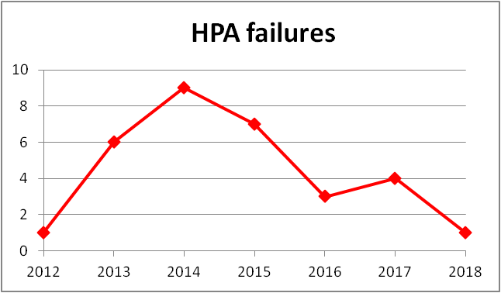
SSA : 650 W - HPA Failures
Year | SY | SR | Total
2012 | 1 |  | 1
2013 | 3 | 3 | 6
2014 | 2 | 7 | 9
2015 | 3 | 4 | 7
2016 | 0 | 3 | 3
2017 | 0 | 4 | 4
2018 | 0 | 1 | 1
Average 5 HPA failures per year for a total of 1820 HPA (128+2 / tower)

Slide 10
ELTA/SOLEIL SSA TEsts - OVERDRIVE
Avoid overdrive conditions
  High peak drain voltage can damage the transistor [according to NXP]
  Explains gain and efficiency degradation observed on first 75 kW tower under test at the ESRF, according to ELTA *⁾
  Taken into account by ELTA for the fabrication of the 2nd batch of 3 x 150 kW SSA for the ESRF storage ring:
    No degradation observed after 3500 hours of fatigue test with 8 amplifier modules at maximum power *⁾
    Paid with 1 to 2 % less efficiency of the RF modules and about 1 % less efficiency at nominal power for a complete SSA
Short pulses (20 μs)
  Transient gain increase up to ≈1.3 dB
  Risk of overdrive
  Overdrive protection needs to be adjusted carefully
* [J.-P. Abadie & A. Cauhepe, ELTA / AREVA]

Slide 11
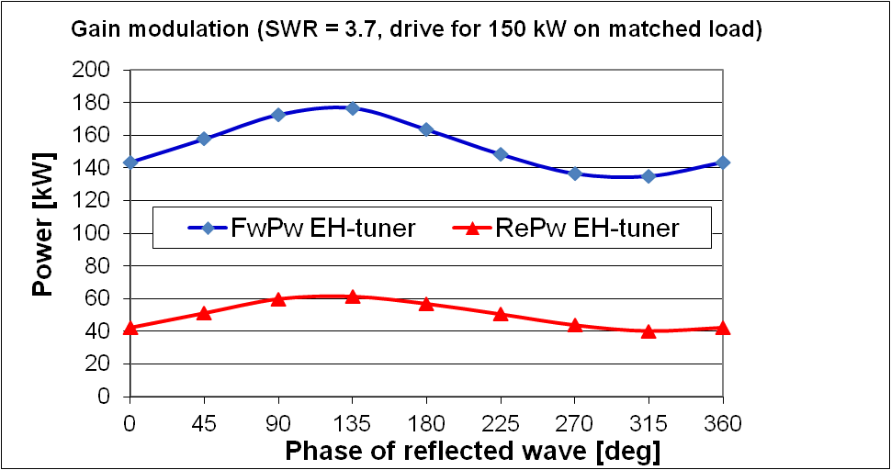
ELTA/SOLEIL SSA TEsts – gain modulation for mismatched load
Measurement with constant RF input power level, giving 150 kW on matched load:
± 20 kW on FwPw, i.e. gain modulation
Partially intrinsic to non directive coaxial combiner tree (confirmed by simulation)
Partially due to imperfect circulators on RF modules:
⇒ modulation of load impedance
⇒ RF module gain modulation
Specification:
SWR = 3.7 → P_{refl} / P_{fwd} = 50 kW / 150 kW, all phases ( EH – tuner)
Full reflection at all phases specified and tested for 80 kW (movable short circuit)
Test results:
Reflected power well absorbed by circulator loads on RF modules
Despite one circulator per RF module: gain modulation
⇒ for some phases: SWR=3.7 test limited to 140 kW and short circuit test limited to 60 kW by overdrive protection

Slide 12
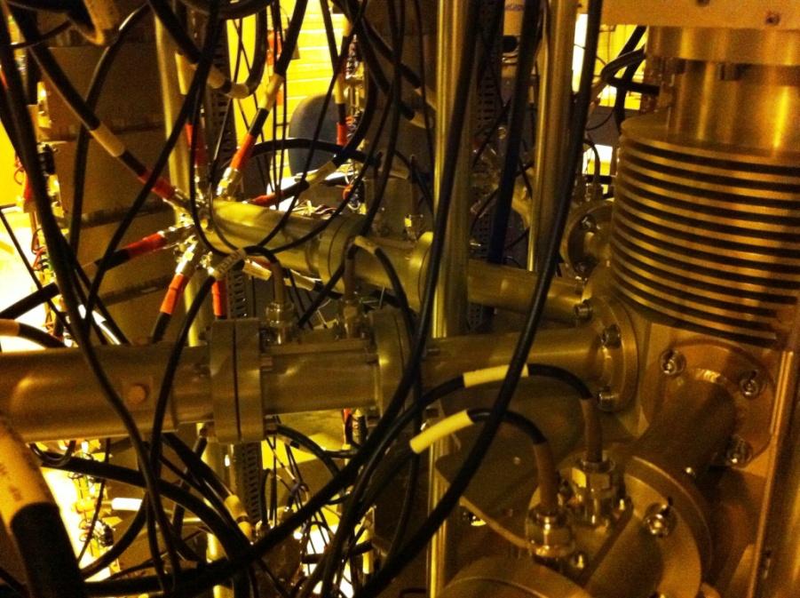
ELTA/SOLEIL SSA TEsts – overload of unpowered RF modules
SWR = 3.7 (Spec) → P_{refl} / P_{fwd} = 50 kW / 150 kW, all phases ( EH – tuner)
  Operation with up to 6 unpowered modules (redundancy in case of defect)
  But: overpower on circulator load depending on phase of mismatch: up to 1700 W
170 mm
Adjusting the length of the 2nd stage in the combiner tree by +170 mm
⇒
Limit of peak reverse power to 1200 W = capacity of circulator load

Slide 13
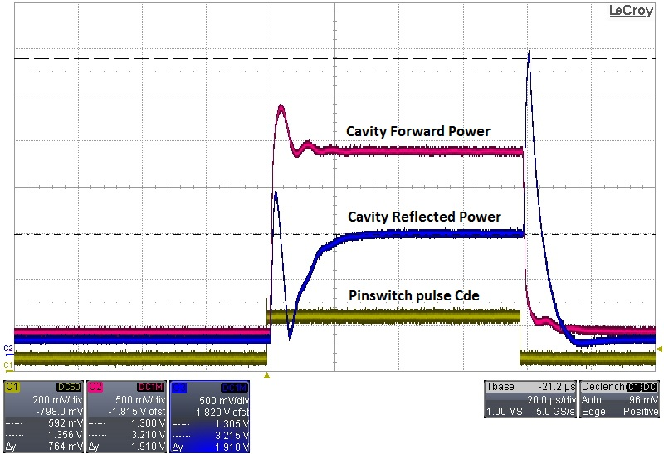
Transient Reflections for pulsed cavity conditioning
Measurement: P = |amplitude|²
Computation: amplitude
HOM damped cavity at f_{res}
R/Q = 145 Ω
Qo = 32500
β = 3.8
|r| = 1.5
Incident wave amplitude
Reflected
wave
amplitude
Amplitude [a.u.]
Filtered reflection signal
[RC=10μs]
t [μs]
ESRF SSPA from ELTA tested with 20 μs /150 kW pulses at full reflection (spec)
Fast interlock for P_{refl} > 150 kW
Interlock on low pass filtered signal for P_{refl} > 50 kW (spec)

Slide 14
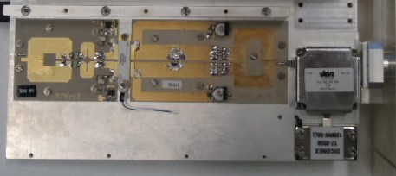
RF amplifier module: ESRF in house development
Motorola patent
unbalanced
balanced
ESRF fully planer design:
Printed circuit baluns
RF drain chokes replaced with “quarter wave” transmission lines.
Very few components left, all of them SMD and prone to automated manufacturing
Reduced fabrication costs
18 modules incl. output circulator | Average Gain | Average Efficiency
at P_{RF}^{out} = 400 W | 20.6 dB | 50.8 %
at P_{RF}^{out} = 700 W | 20.0 dB | 64.1 %
[M. Langlois, ESRF]

Slide 15
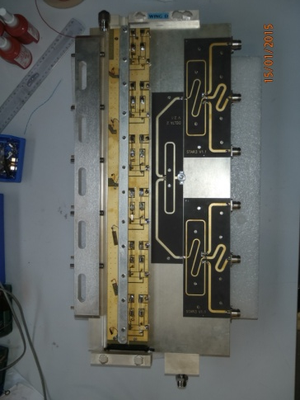
Wilkinson splitter for the RF drive distribution
50 Ω
R = 50 Ω
50 Ω
50 Ω
R = 50 Ω
3 x splitter:
Length = λ/4
Z = √3 x 50 Ω
R = 50 Ω
50 Ω
Resistors absorb differential signals without perturbing the common mode, thereby decoupling the connected outputs from each other
50 Vdc distribution
RF splitters
Water cooled wing with 6 RF modules, developed at ESRF
[M. Langlois, ESRF]

Slide 16



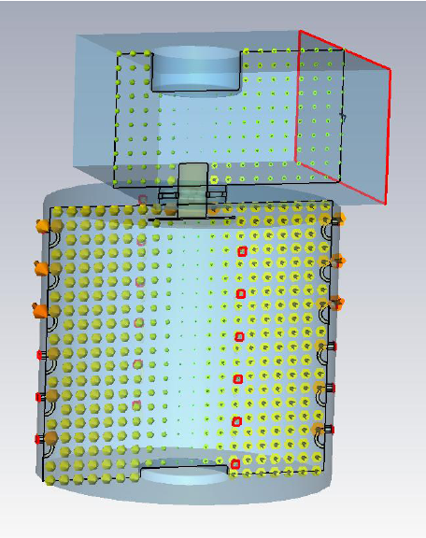
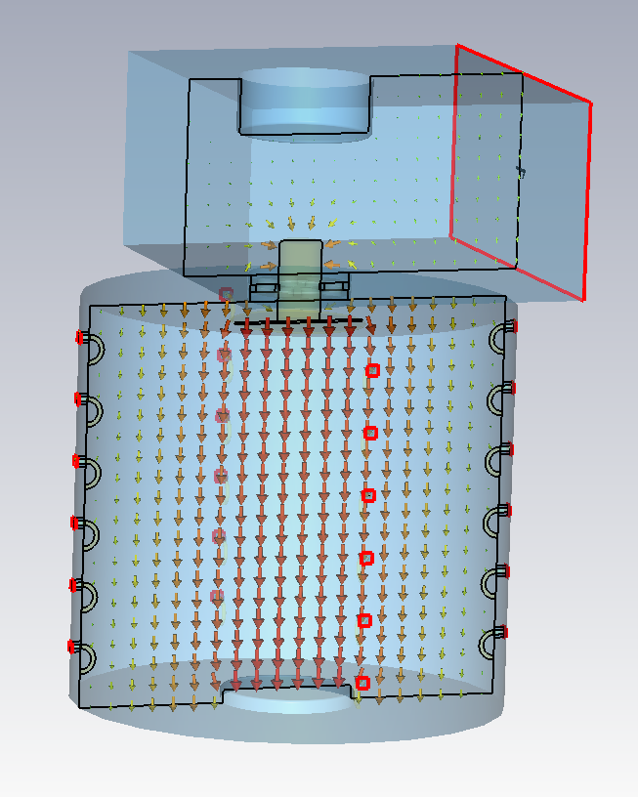
ESRF design using a cavity combiner *
For 352.2 MHz ESRF application:
6 rows x 22 Columns x 700 W per transistor module
85 kW nominal
More compact than coaxial combiners
ß_{waveguide} ≈ n_{module} x ß_{module} >> 1
Easy to tune if n_{module} is varied
Substantial reduction of losses ⇒ higher η
H field
Homogenous magnetic coupling of all input loops
E field
Strong capacitive coupling to the output waveguide
Strongly loaded E₀₁₀ resonance
Modest field strength
Cavity at atmospheric pressure
1 dB - Bandwidth ≈ 0.5 … 1 MHz
* Received funding from the EU as work package WP7 of the FP7/ ESRFI/CRISP project

Slide 17
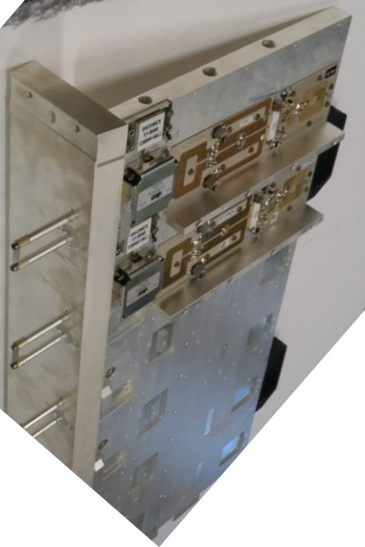
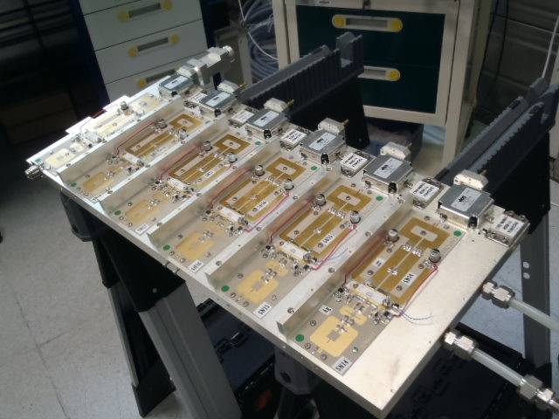
ESRF design using a cavity combiner
Direct coupling of RF modules to the cavity combiner:
No coaxial RF power line
Very few, sound connections
6 RF modules are supported by a water cooled “wing”
The end plate of the wing is part of the cavity wall with built on coupling loops
One collective shielding per wing
Less than half the size of a 75 kW tower with coaxial combiner tree
η_{RF/DC} = 62 % at P_{nom} = 85 kW
P_{test} = 90 kW
P_{nom} obtained with 1 wing off
[M. Langlois, ESRF]

Slide 18
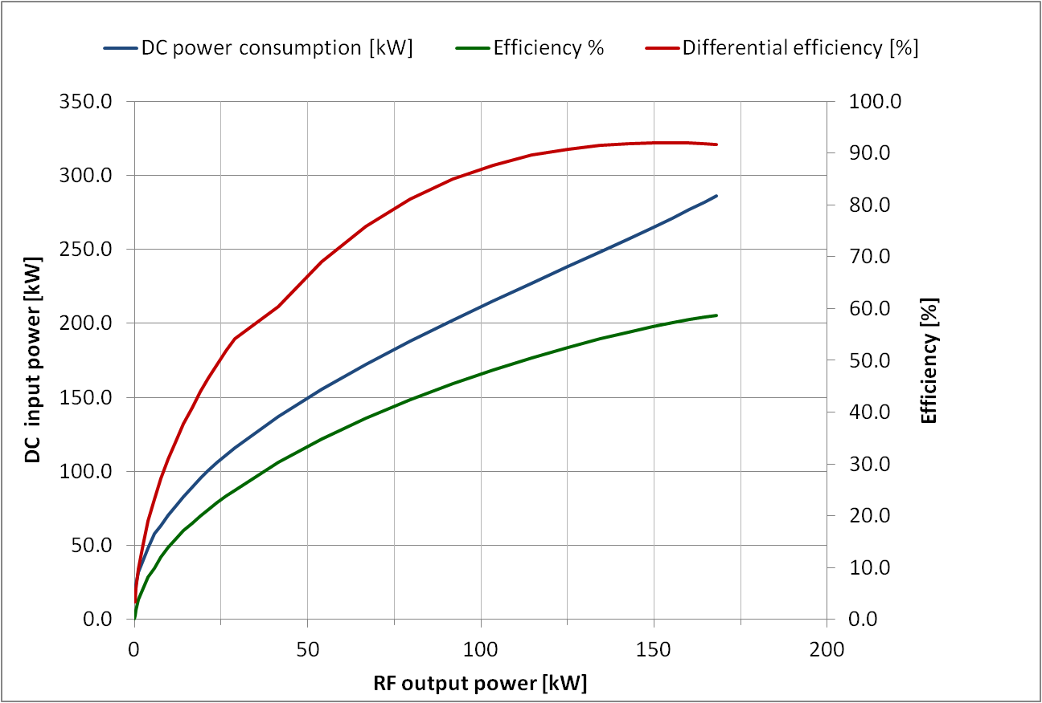
DC power requirement for ESRF 150 kW SSPA from ELTA
≈ 90 % !
η_{diff} = dP_{rf}/dP_{dc}
P_{dc}
η = P_{rf}/P_{dc}
400 Vac / 280 Vdc - 360 kW Power Converters

Slide 19
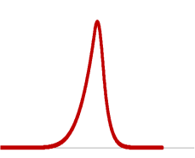
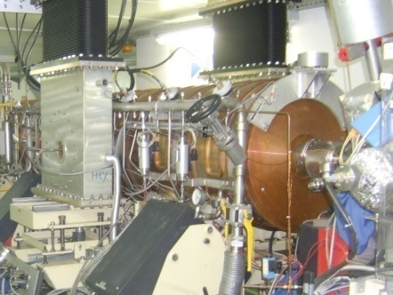
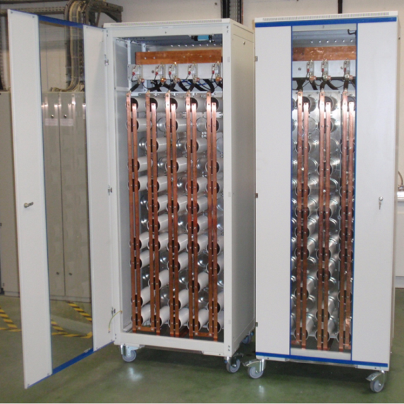
DC supply of 4x 150 kW SSPA on ESRF booster
Constant AC power 300…400 kW
Average power consumption
Peak DC power 1000…1200 kW
4 Hz
Mains 400 V ac
600 kW RF
280 V dc
280 Vdc Supply
400 kW average
Anti-flicker
C = 4.4 F
4 SSPA incl. 280V / 50V dc/dc converter boards
4 booster cavities
Single 280 V dc / 400 kW PS for the 4 SSPA of the ESRF booster and one back up 360 kW PS
Three 280 V dc / 360 kW PS: for the 3 SR SSPA
Capacitor cabinets

Slide 20
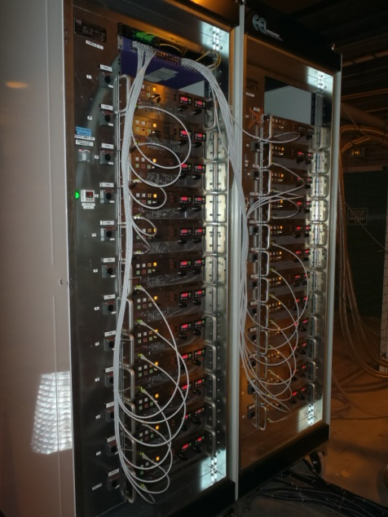
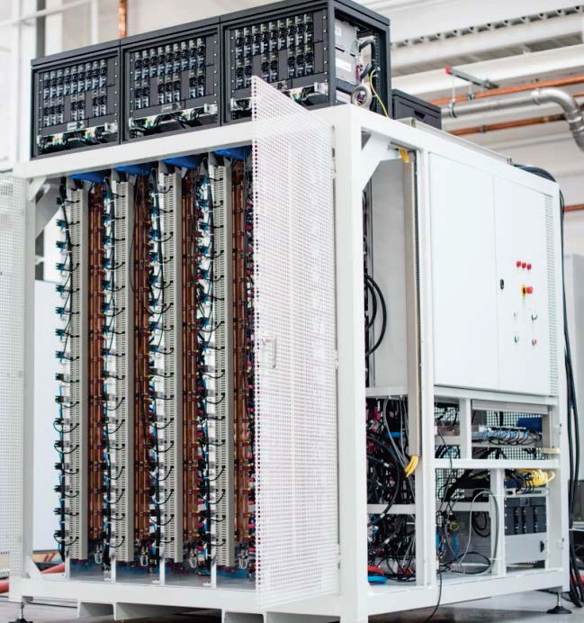
DC supplies with increased efficiency, modularity and redundancy
ESRF 352 MHz - 85 kW SSPA:
Direct 400 Vac / 50 Vdc converters from EEI
  Higher efficiency than 2 stages
  OK for CW, but antiflicker capacitances for pulsed operation 6x higher at 50 Vdc
One 160 A / 8 kW PS per wing = 6 RF modules
  Redundancy: can tolerate 1 PS failure at P_{nom} without tripping the SSPA
Recent SOLEIL developments:
Highly efficient (η = 96 %), modular 2 kW - 240 Vac / 50 Vdc converters, feeding 50 Vdc busses
High redundancy, tolerates converter failures
Remote voltage control: allows optimising SSPA efficiency for large range of output power:
  η_{RF/AC} = 56 % at P_{max} and 50 % at ½ P_{max}
Architecture changed from tower to cabinet
Example:
500 MHz -80 kW SSPA at SESAME:
1st one built by SOLEIL
2nd- 4th under SOLEIL licence by Sigmaphi Electronics
[P. Marchand, SOLEIL]

Slide 21
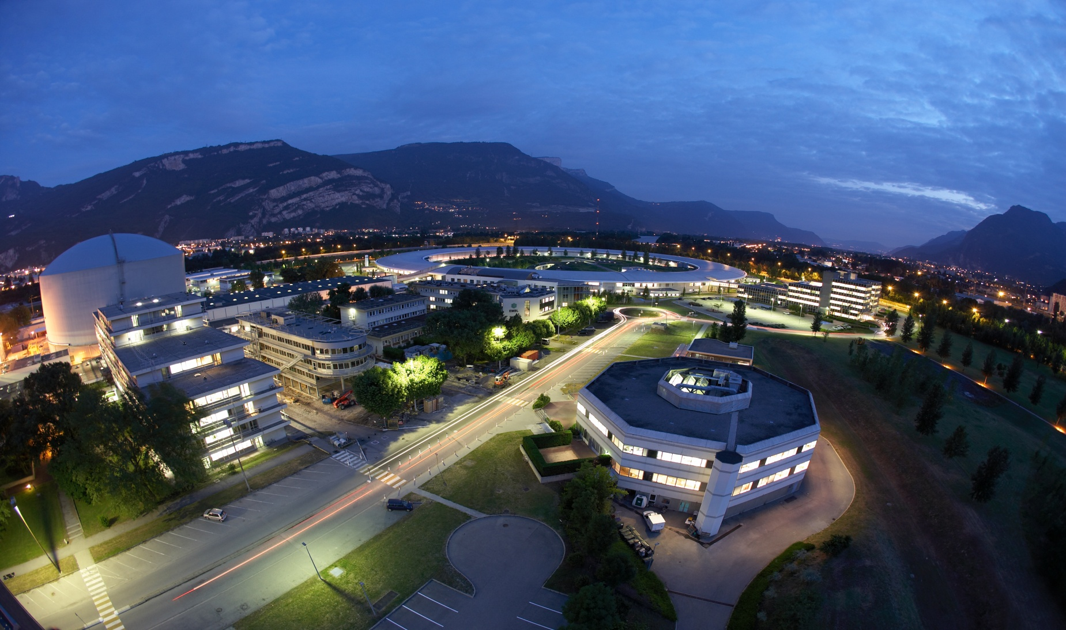
Thank you !!!

