Slide 1
SOLEIL Long Term SSPA
Operational Experience
ARIES Workshop on Energy Efficient RF
Ångström Laboratory, 18-20 June 2018
Massamba DIOP
On Behalf of the RF & LINAC Group

Slide 2

SSPA Principle
Combining in // a number of elementary amplifier modules (or pallets) of a few 100 W (up to ~ 1 kW)
- MOSFET (V_{d} = 30 - 50 V) → No HV & Low phase ripple
- Circulator & its load to ensure a good isolation (even a small residual VSWR can affect the MOSFET power capability !!)
1:n₁
n₁:1
≈
≈
1:n₂
n₂:1
1:n₃
n₃:1
Pre-
ampli
x 10 kW
n₁ Ampli modules
x kW
≈
≈
≈
≈
≈
≈
Pre-
ampli
Driver
ampli
x n₂
⇔
x 10 kW
x n₃
≈
≈
≈
≈
Few kW unit
x kW
x 10 kW
⇔
The number of pre-ampli depends on the module gain
x kW
Few 10 kW unit
Few 100 kW unit
SOLEIL Booster first SSPA (P_{nom} = 35 kW @ 352 MHz) :
P_{mod} ≈ 300 W ; n₁ = 8 → 2.4 kW ; n₂ = 8 → 19 kW ; n₃ = 2 → 146 RF modules (128 Ampli + 18 Pre-A) → P_{out} ≈ 38 kW
→ Modularity & Redundancy inherent to such a design

Slide 3
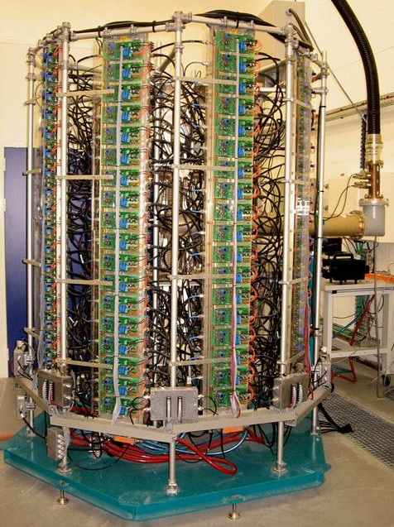
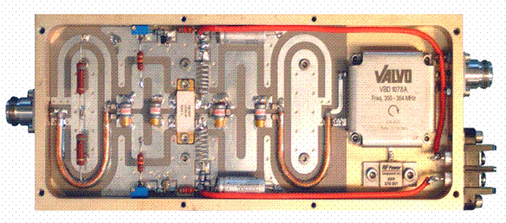

Booster Original 35 kW SSPA
300 W CW - 352 MHz amplifier module
VDMOS D1029UK05 from SEMELAB
(G = 11 dB, ƞ = 62 %)
Circulator
600 W - 280 / 28 V dc
power converter
Power combiner
(8 x 8 x 2)
8 dissipaters of
16 + 2* modules
* Pre-amplifiers
35 kW
8 x 300 W
All amplifier components were designed in house and the mass production contracted to industry
In 2005, world record for a SSPA
~ 77 000 running hours over 14 years and only one single trip from the SSPA, in August 2016,
due to a loose connection on a monitoring cable (down time ~ 2.10⁻⁵ and MTBF ~ 38 000 hours)
~ 1 module failure / year, without impact on the operation, thanks to the modularity and redundancy
Notes:
146 modules of 300 W @ 352 MHz & individual power supplies, mounted on 8 water cooled dissipaters

Slide 4
A new 60 kW SSPA for the Booster
Booster RF system was originally designed for standard operation
The 35 kW amplifier drives a 5-cell copper cavity => V_{RF} = 1 MV (P_{diss} = 20 kW ; P_{beam} = 5 kW → P_{tot} = 25 kW)
But low-ɑ operating mode suffered from a low injection efficiency (15-20%) due to the long BO bunches
→ Heavy safety radiation constraints
→ Prevents more beam lines to join this operating mode
2nd RF station installed to increase V_{RF} from 1 MV up to 3 MV in winter 2017-2018
Shorter bunch length → SR injection efficiency improved by a factor of ~ 2 in low-ɑ operation
Upgrade plan :
Former spare cavity installed in one straight section of the Bo ring and powered with 60 kW (V_{RF} = 1.8 MV)
New 60 kW - 352 MHz SSPA, identical to a standard tower of our SR amplifiers
(10 dissipaters of 16 modules, built from 160 RF modules of 400 W with BLF574XR transistors and their dc-dc converters made available by the SR SSPA refurbishment)
SSPA and its associated LLRF & control (replica of the actual one) inside the Bo RF room
Increase V_{RF} of the existing plant from 1 MV up to 1.2 MV → P_{RF} ~ 30 kW (P_{beam} ~ 0)
‘Upgraded’ Low-ɑ operating mode available for users since October 2018
with V_{RF} = 3 MV (SR injection efficiency = 35% instead of 18% before).
+ power savings and redundancy in all other operating modes

Slide 5
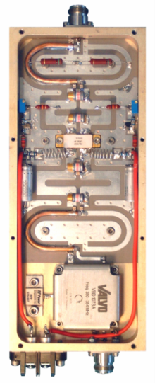
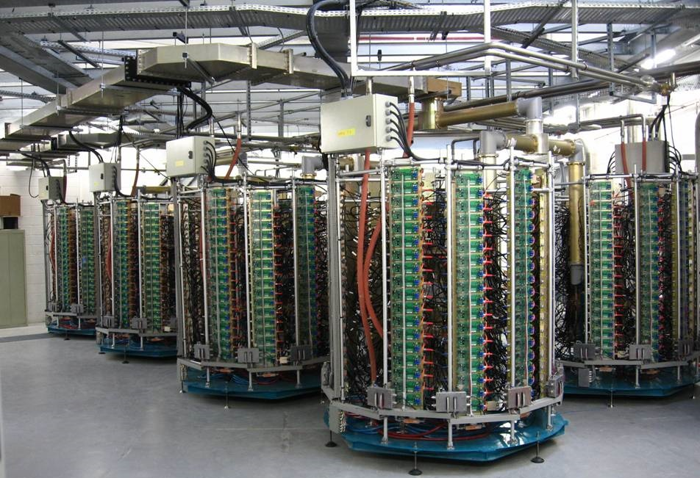
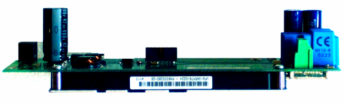
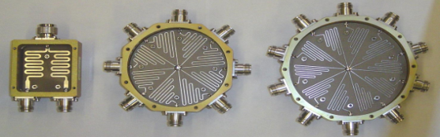
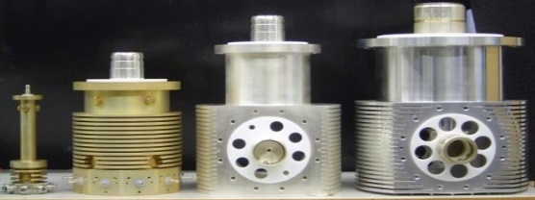
Soleil SR 180 kW SSPA’s
Same principle as the BO one but extended to 4 towers of 45 kW:
  10 dissipaters of 18 modules per tower
  726 modules / amplifier x 4 cavities → 16 towers & ~ 3000 modules
LDMOS LR301 from POLYFET
G : 13 dB, η : 62 %
600 W - 280 Vdc / 28 Vdc
Still a world record for SSPA?
Splitters
A1
Amplifiers 1 & 2 (2 x 4 towers)
powering the 2 cavities of
Cryomodule 1
Combiners
A2

Slide 6
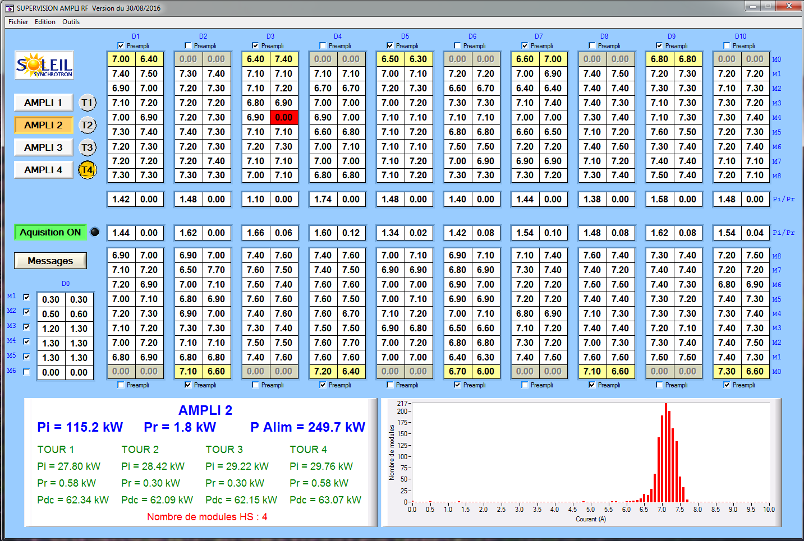
SR SSPA Control
Multiplexing (I x 2 x 680 mod. + P_{i} & P_{r} x 80) → single µcontroller for 1 complete amplifier (4 towers)
Tower T4 of
Amplifier 2
Top transistor currents
Pi & Pr
2.5 kW combiner
Bottom transistor currents

Slide 7
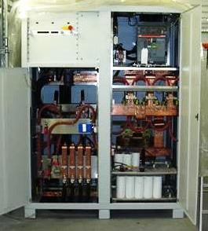
SR SSPA’s Operational Results
MTBF & beam downtime, cumulated by the 4 SR SSPA’s over ~ 70 000 running hours in ~ 13 years
Equipment | MTBF | Downtime | Comments
a) 4 x RF amplifiers | ~ 12 500 h | ~ 1 10⁻⁴ | Failures from preamplifiers and 1st stage combiners
b) 4 x 500 kVA thyristor-based 230 Vac / 270 Vdc rectifiers | ~ 8 000 h | ~ 4 10⁻⁴ | Single rectifier per amplifier
a) + b) 4 x RF transmitters | ~ 5 000 h | ~ 5 10⁻⁴
Already excellent MTBF and operational avaibility
  But still perfectible
  - providing some more redundancy
  1) in the ac-dc power conversion, which originally
  consists in a single 500 kW rectifier per SSPA
  2) in the preamplifier stage, a failure of one of them
  switching the RF off automatically
  - improving the power capability of the 1st stage combiners
  → Cures for these “weaknesses” in our new design

Slide 8
180 kW SSPA’s Refurbishement
The failure rate of our original LR301 transistors remains significant, stabilized ~ 2% a year from 2012-2013.
2 types of failures identified: - Transistor breakdown
- Damaged soldering due to thermal fatigue
→ Since 2013, on going refurbishment
LR301 replacement by 6th generation BLF574XR (V_{d} = 50V instead of 30V with better performances)
More robust transistor and lower thermal stress → longer lifetime → less maintenance
→ failure of a single « new » transistor (~ 6 years of operation)
+ 7 dB transistor gain → 160 modules & their dc PS are got back for the new BO SSA
P_{mod} increased : 315 W → 450 W
Electrical power savings (efficiency : 50 % → 60%) compensate the investment cost in < 3 years

Slide 9
180 kW SSPA’s Refurbishement
80
Cure the lack of redundancy in the pre-amplification stage → develop a “combiner-divider”
1
1
80
24W
3W
3W
Pre-ampli
300W
300W
24W
190kW
2.4kW
Upgrade
300W
24kW
24kW
Present config : each pre-ampli drives 80 modules; if one of them fails the amplifier is stopped
190kW
Thanks to the combiner-divider, the failure of a pre-ampli does not affect the functioning anymore
Modification of the 2.5 kW combiners (welded → screwed connections) to increase their power capability

Slide 10
180 kW SSPA’s Refurbishement
12 of the 16 towers already refurbished (~ 2400 modules) → rate of 5 towers a year until 2020 with SOLEIL and external resources
Storage Ring RF upgrade Status
Present : Now we can store 450 mA with 3 running SSPA’s or 500 mA with 3 running cavities
In 2020 (end of refurbishment) : Possibility to store 500 mA with 3 running SSPA’s / cavities or 450 mA with a single cryomodule, combining 2 SSPA’s per cavity

Slide 11
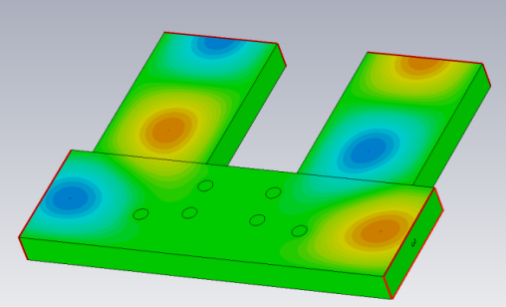
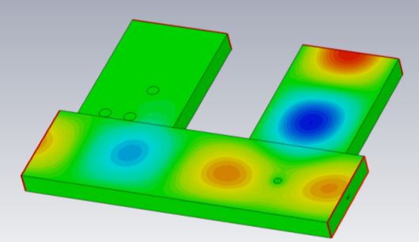
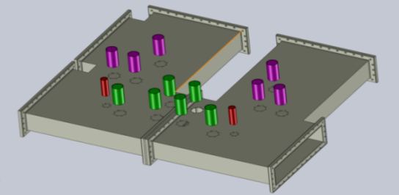
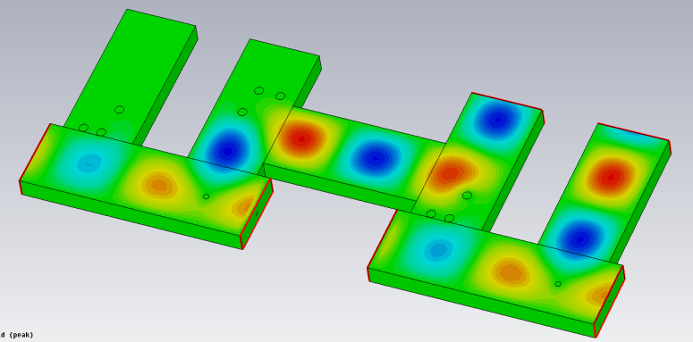
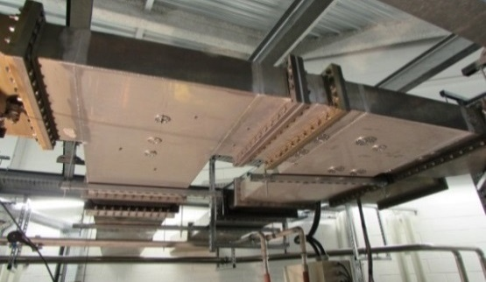
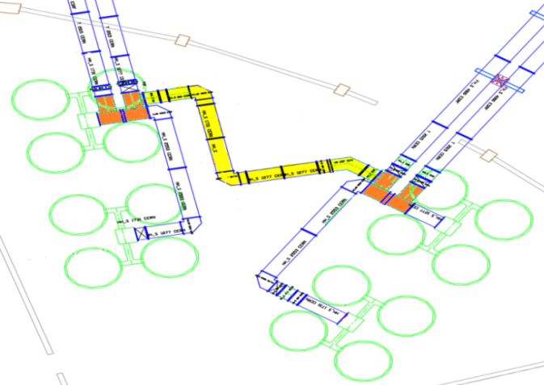
Toward storing 450 mA using a single CM
Modification of the waveguide network to combine the power from two amplifiers into one cavity → Possibility of storing the full beam current using a single CM
« Magic Switch »
P1
P2
P1+P2
OR
depending on the post configuration
P1
P1
P2
P2
P1+P2
CM2
CM1
P3+P4
P1
P2
P3
P4
Waveguide network layout to power one or the other CM with 300 kW / cav from the 4 SSPA’s, combined by pairs
Connecting 2 Magic Switches
The 2 Magic Switches implemented and waveguide distribution completed in end-2018

Slide 12
SOLEIL SSPA R&D
Scientific Collaborations
and Technology Transfers

Slide 13
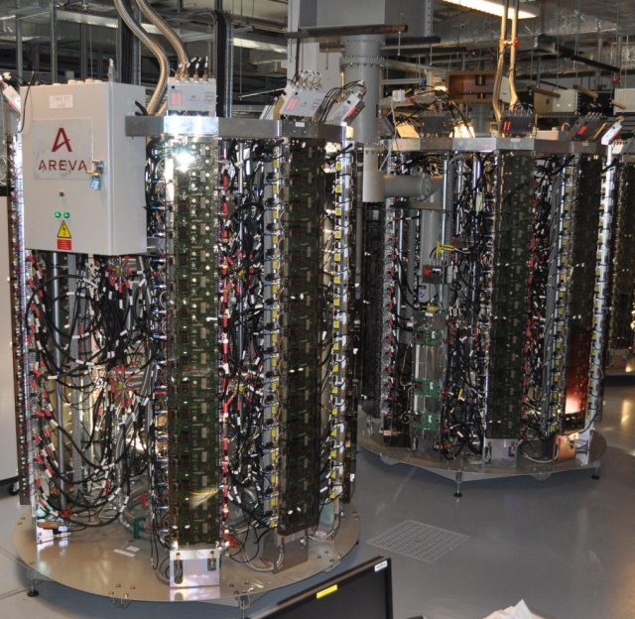
SOLEIL R&D with 352 MHz SSPA’s
Development of new RF modules, based on 6th generation LDMOS (Vd = 50V)
P_{mod} ~ 700 W, G ~ 20 dB, η > 70% at 352 MHz
[ With original LR301 (28V), P_{mod} = 315 W, G = 13 dB, η = 62 % @ 352 MHz ]
→ Huge improvement : P_{mod} x 2.2 , better performance (G , η , linearity) & strong reduction in thermal stress (ΔT : - 60 °C) → longer lifetime
ESRF project of partly replacing its 1 MW klystrons by 150 kW SSPA’s (1 per cavity)
→ 2009, SOLEIL transfer of technology with ELTA-AREVA
→ 7 SSPA’s of 150 kW, built by ELTA under SOLEIL license
ESRF 150 kW 352 MHz SSPA from ELTA/SOLEIL
2 towers of 75 kW ↔ 260 RF modules of 700 W
BO : 4 x 150 kW SSPA’s in use since January 2012
2 trips in 7 years of operation → refill postponed
SR : 2 x 150 kW SSPA’s in use since October 2013
(3rd one stopped after few months due to cavity leak)
3 trips in 5 years of operation → beam loss (youth problems fixed)
BO + SR : ~ 1 820 transistors and not a single failure !
DC-to-RF efficiency of 58%, dc-dc converters included
With new ac-dc converters → η (overall ac to RF) > 60%

Slide 14
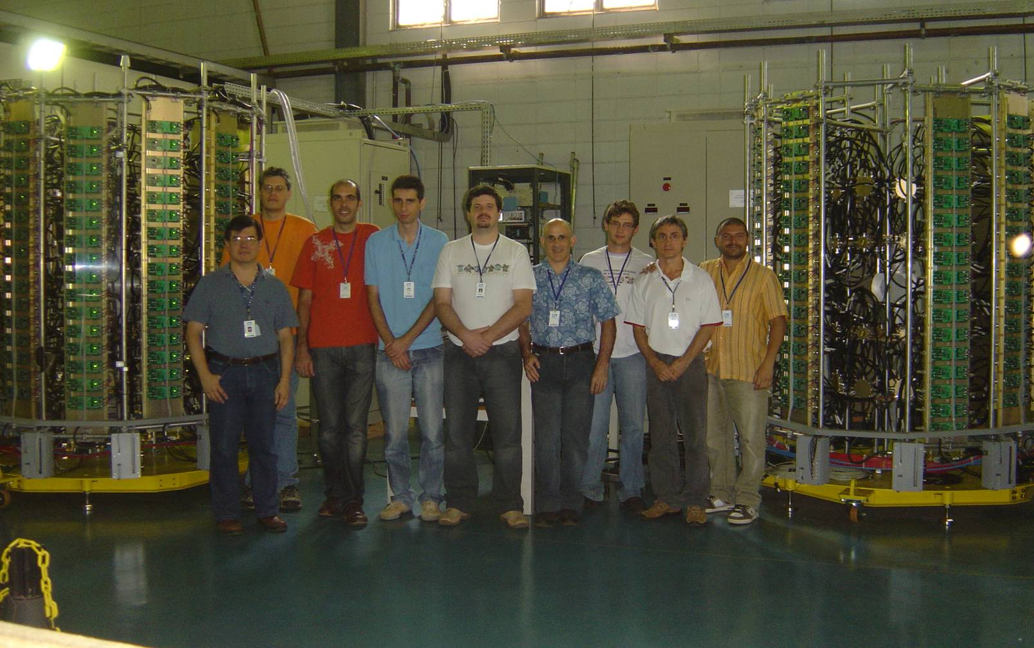
LNLS – SOLEIL Collaboration
Two SSPA’s of 50 kW @ 476 MHz for LNLS (Brazilian LS) SR * with components designed by SOLEIL (400 W modules with BLF574)
April 2010 in Campinas-Brazil : the SOLEIL - LNLS team, after successful tests of the amplifiers
* A 2.5 kW 476 MHz SSA had already been built for the LNLS Booster

Slide 15
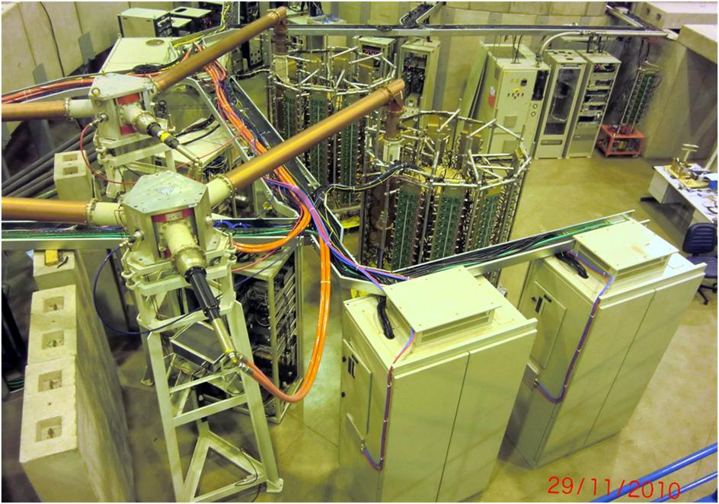
LNLS 50 kW RF plants
The two 50 kW SSPA’s of the LNLS SR have run satisfactorily for > 8 years
→ Use of SSPA’s @ 500 MHz in SIRIUS, the new LS under construction

Slide 16
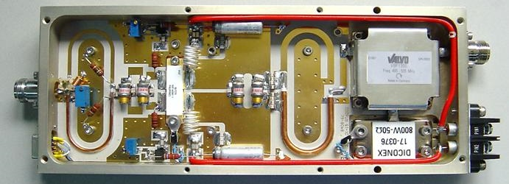
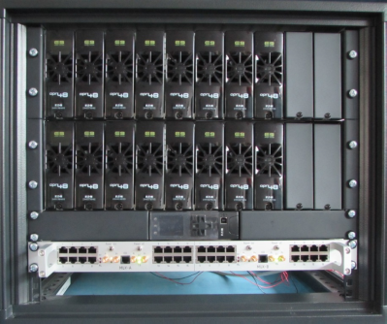
R&D with 500 MHz SSPA at SOLEIL
Experience feedback →
Increase effort on the modularity/redundancy and the efficiency *
Moderate power for long lifetime (thermal stress → soldering degradation)
* + 10 pts in efficiency lead to electrical power savings over 10 years of operation ≈ full amplifier cost
New 650 W - 500 MHz modules using 6th generation (Vd : 50V) LDMOS BLF578 from NXP
RF output power, P_{n} : 650 W CW
Input return loss : - 40 dB at P_{n}
Unconditional stability (K >10 dB)
Gain : 17 dB at P_{n} (1 dB compression)
Efficiency ≈ 62 % at P_{n}
Gain dispersion : +/- 0.2 dB at P_{n}
Phase dispersion : +/- 5° at P_{n}
Mandatory for good combining efficiency → Components for gain and phase adjustments
  Modular dc-dc converters + single power rectifier replaced by modular 230 V_{ac} / 50 V_{dc} converters, in 2 kW units, 96% efficiency, voltage remote control
  → optimized efficiency for any operating power :
  56% (overall) @ P_{max} and 50% @ 0.6 P_{max}
2 kW unit
controller
Modularity brought in the preamplification stage by inserting the « divider-combiner »

Slide 17
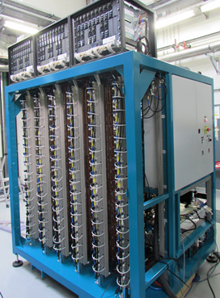
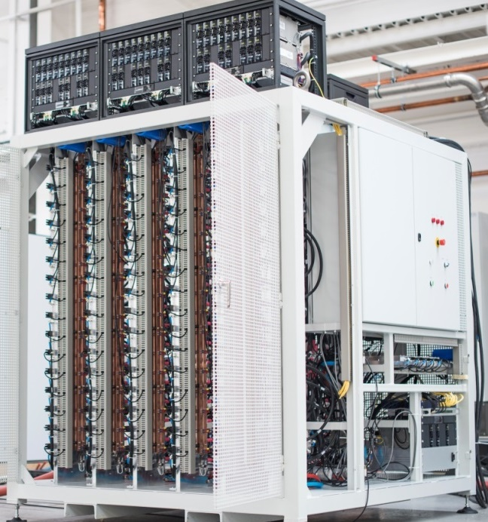
500 MHz SSPA for ThomX⁽¹⁾ & SESAME⁽²⁾
⁽¹⁾ ThomX : Compton X-ray source under construction in Orsay, France
⁽²⁾ SESAME : Jordan Synchrotron light source
  Fully modular 50V power supplies
  230 V_{ac} / 50 V_{dc} converters,
  in 2 kW units, 96% efficiency, with voltage remote control for efficiency optimization
  Change from the tower to cabinet assembly, better suited with the new power supplies
Control upgrade → stand-alone, self-protected and more modular
(1 µcontroler per dissipater)
ThomX 50 kW SSPA
(6 x 16 RF modules + 3 x 15 PS)
SESAME 80 kW SSPA
(10 x 16 RF modules + 5 x 16 PS)
For SESAME SR : 4 x 80 kW SSPA → 1st one built by SOLEIL as a demonstrator
→ 3 others on the same model by SigmaPhi Electronics (SPE), SOLEIL licensee since 2014
Status : all in operation (first pair since end 2016 and 2nd one since May 2017)
The ThomX 50 kW SSPA is also completed ; it is now being commissioned on site

Slide 18
1.3 GHz SSPA for LUCRECE*
* RF R&D program for the French FEL project LUNEX5
RF Power Source requirements for LUCRECE: 20 kW CW SSPA @ 1.3 GHz (SOLEIL - SPE collaboration)
Comparison between GaN and LDMOS technology
Transistor performance measurements
 | Old Gen GaN | New Gen GaN | New Gen LDMOS
V_{d} (V) | 50 | 50 | 42
P_{out} (W @ 1 dB comp.) | 71.2 | 150.2 | 459.7
P_{out} (W @ 3 dB comp.) | 425.9 | 430.9 | X
Gain (dB) | 14.11 | 18.33 | 18.16
Efficiency (%) | 55.6 | 65 | 59.6
Efficiency (%)
X: not measured

Slide 19
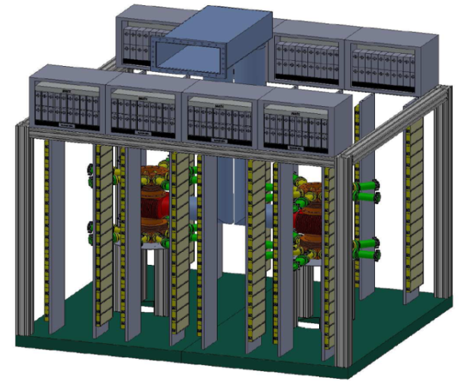
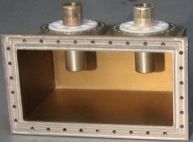
Other SOLEIL activities on SSPA’s
The 150 kW-500 MHz SSPA is already in the SPE catalogue
→ 2 x 75 kW (2 x 8 dissipaters of 16 modules) combined by
means of a wave guide to coaxial combiner, the WaCCo
R&D on VHF e-gun for LUNEX5
2 SSPA of 60 kW @ 176 MHz
800 W - 176 MHz RF modules
(compact 800 W - 176 MHz circulators developed
in collaboration with VALVO Bauelemente )
SOLEIL upgrade towards DLSR
6 & 7 BA / cell lattice → ε_{z} < 100 pm
Main RF: P_{beam} = 250 kW at 352 MHz → Re-use of our actual refurbished 180 kW SSPA’s (or part of them) + converter and control upgrade?
Harmonic system (n=4): adaptation of LUCRECE SSPA if the system is active
WaCCo
2 x 80 kW
WaCCo

Slide 20
Summary & Conclusions
SOLEIL has pioneered the use of SSPA’s in particle accelerators
35 kW + new 60 kW in the BO and 4 x 180 kW in the SR with outstanding operational MTBF >> 1 year
BO RF upgrade → redundancy + SR injection efficiency improvement in low-ɑ operating mode (~ factor of 2)
2013: start of original transistor replacement by 6th generation LDMOS (V_{d} = 50 V instead of 30 V), much more robust and with higher gain and efficiency → Drastic reduction in module failures, higher power capabilities and efficiency + available components for the new 60 kW BO SSPA
SR SSPA refurbishment + “Magic switches” (+ Upgraded cavity couplers) → Additional redundancy
Possibility to store full I_{beam} using either a single CM or 2 CMs with only 3 running amplifiers/cavities
SOLEIL R&D on SSPA → improvement of the original design in compactness, reliability and efficiency
Overall (plug to RF) efficiency ~ 65% at 352 MHz or lower frequencies, ~ 56% at 500 MHz and ~ 50% at 1.3 GHz
Scientific collaborations & technology transfers to the industry (ESRF, LNLS, ThomX, SESAME, LUCRECE, ...)

Slide 21
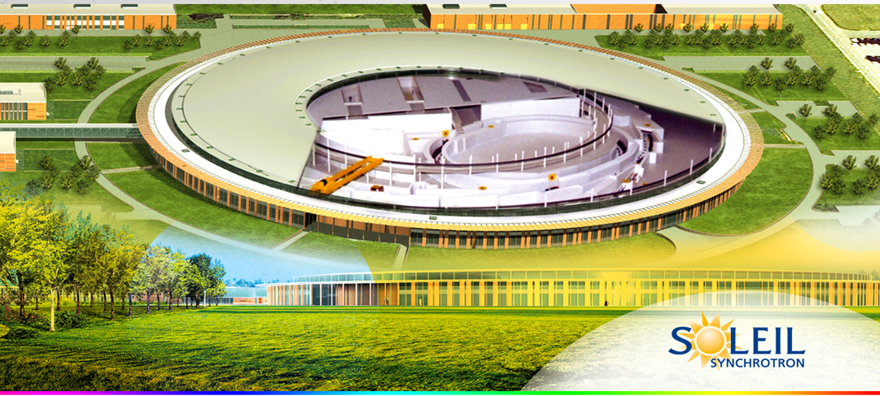
Thank you for your attention

