Slide 1













Neutron Scattering Instruments and Detectors at the ESS
Anton Khaplanov
On behalf of ESS Detector Group and Collaborators
Amongst others…
www.europeanspallationsource.se
SKS-KF, 2018 10 17, Uppsala

Slide 2
Outline
Why neutrons?
ESS construction
Detector Development
Neutron scattering Instruments
Spectroscopy
Reflectometry
SANS
Multi-Grid Detector
Multi-Blade Detector
SoNDe
Beyond initial instruments

Slide 3
Outline
Why neutrons?
ESS construction
Detector Development
Neutron scattering Instruments
Spectroscopy
Reflectometry
SANS
Multi-Grid Detector
Multi-Blade Detector
SoNDe
Beyond initial instruments

Slide 4
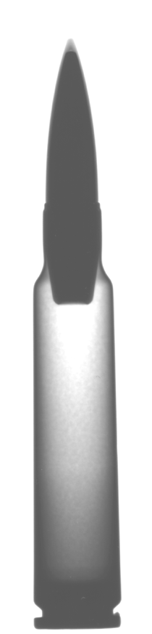
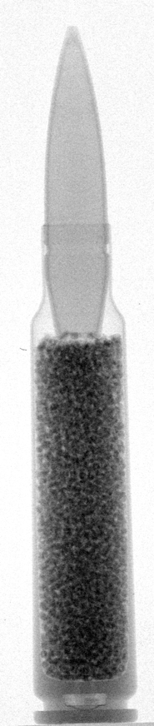
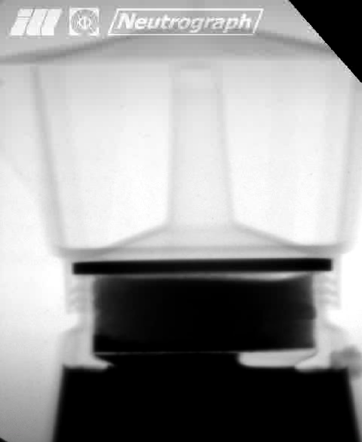
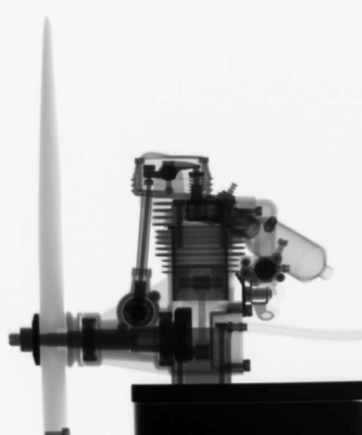
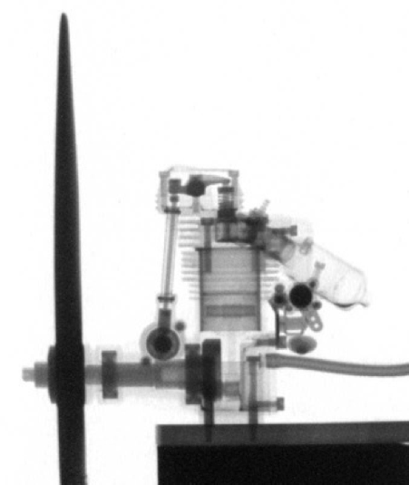
Why Neutron scattering?
Neutron and x-ray complementarity
x-ray cross section
H
D
C
O
Al
Si
Fe
Gd
neutron cross section
x-ray
neutron
x-ray
neutron

Slide 5

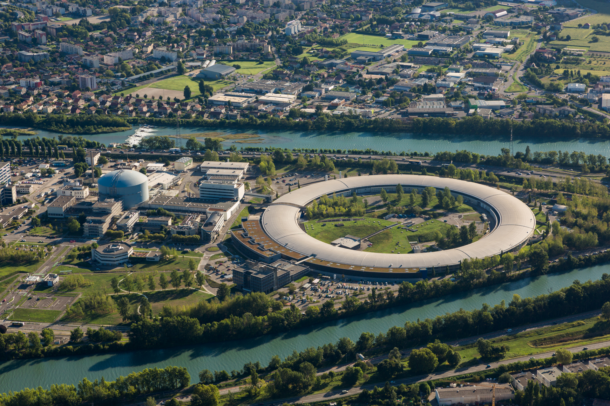
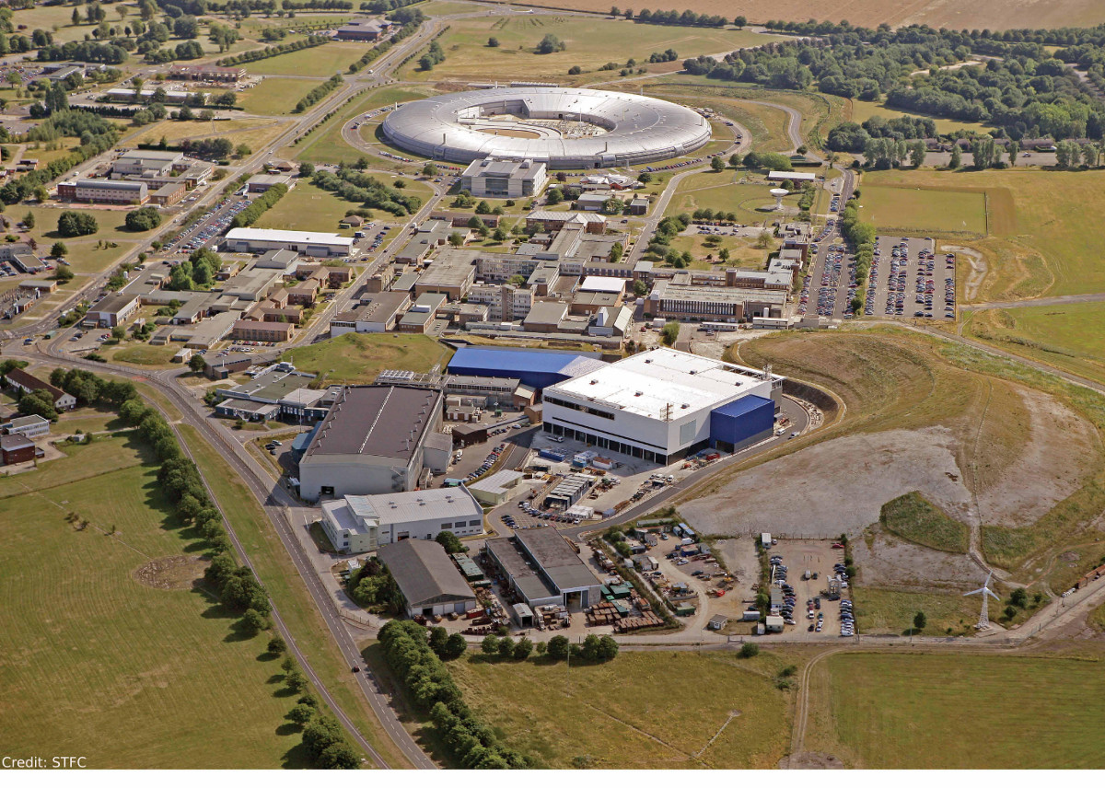
Neutron and X-ray sources
Often built close to each other
ILL neutron source and
ESRF synchrotron
Grenoble, France
ISIS neutrons source and
Diamond synchrotron
Didcot, UK

Slide 6
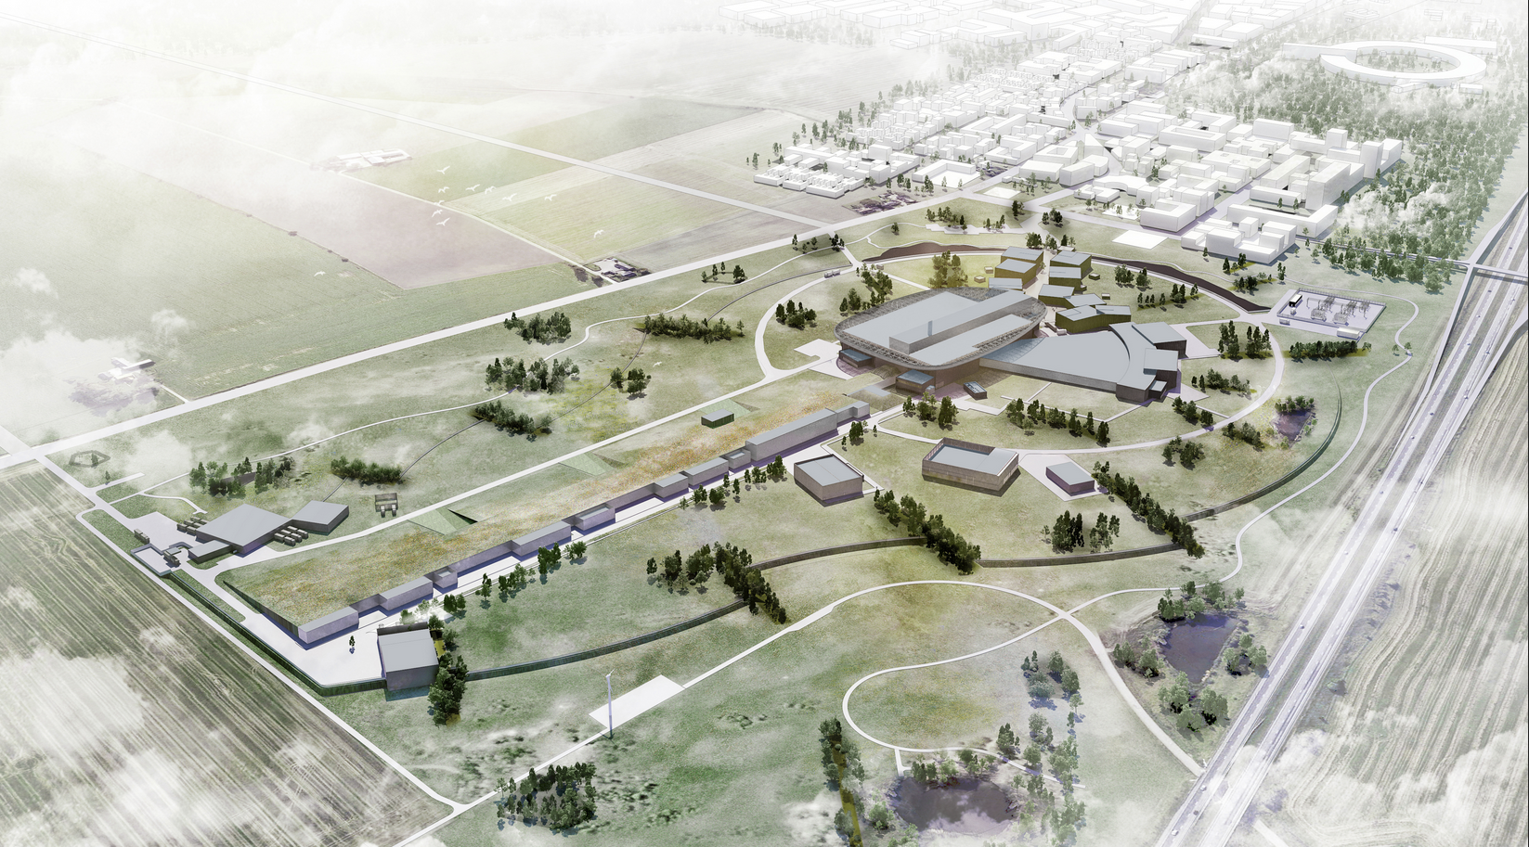
Neutron and X-ray sources
Often built close to each other
Lund
MAX IV
Target
ESS
Instruments
Proton Beam
E 22
6

Slide 7
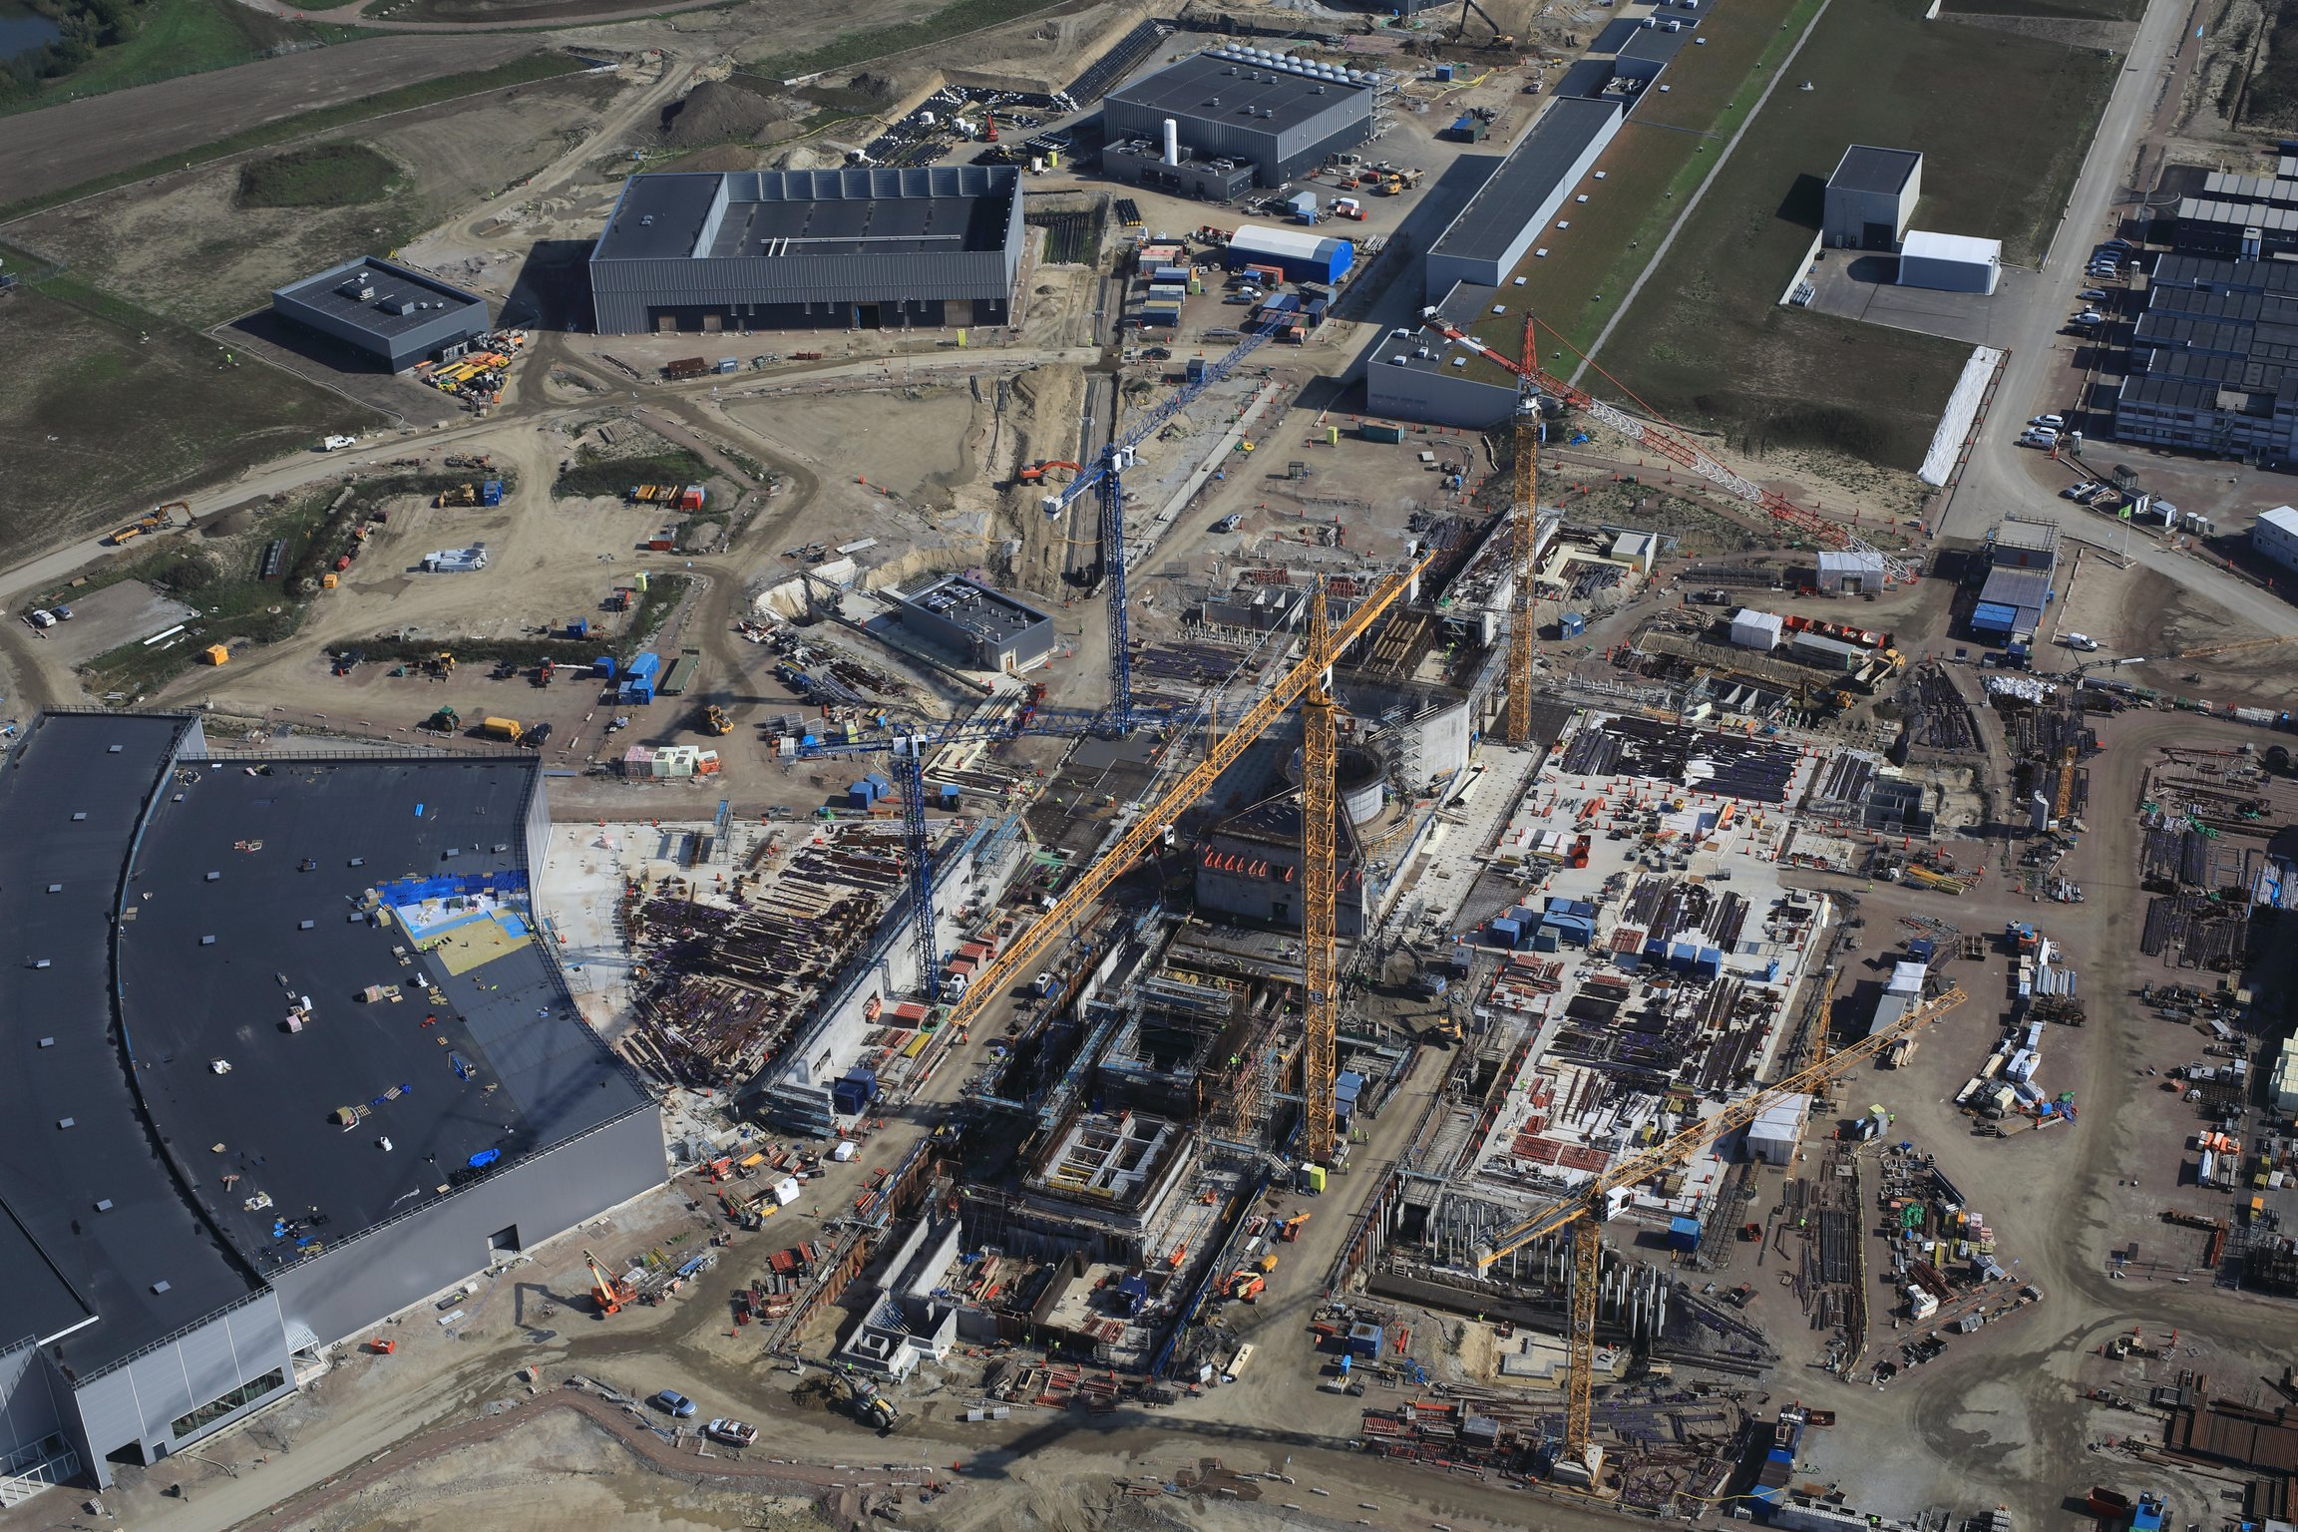
ESS, October 2018
www.europeanspallationsource.se

Slide 8
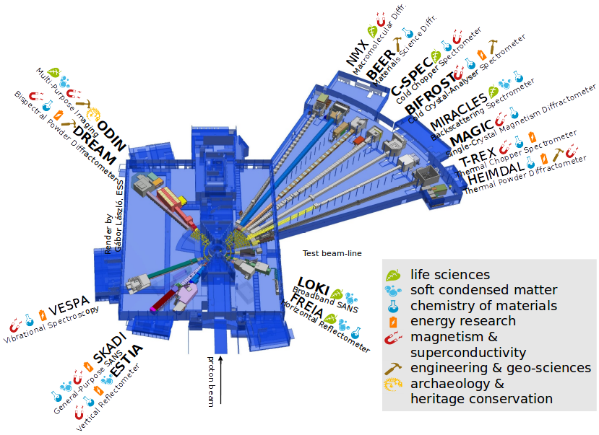
Instruments at the ESS
15 instruments
in construction scope
8 instruments operational
for start of user program
(August 2023).
22 instruments in full scope
42 beam ports in total – further instruments possible (some ports will not be accessible)

Slide 9
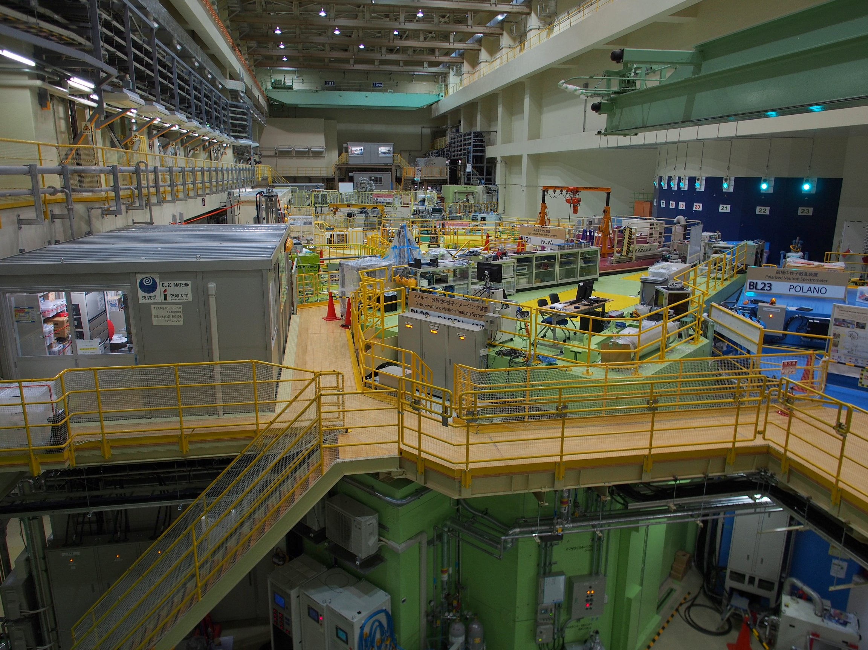
What will it look like?
Example: the Japanese spallation source at J-PARC

Slide 10
Outline
Why neutrons?
ESS construction
Detector Development
Neutron scattering Instruments
Spectroscopy
Reflectometry
SANS
Multi-Grid Detector
Multi-Blade Detector
SoNDe

Slide 11
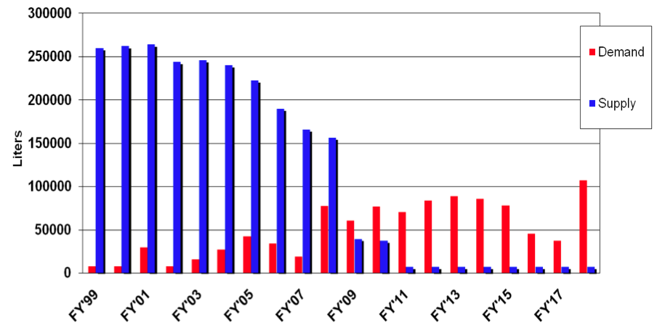
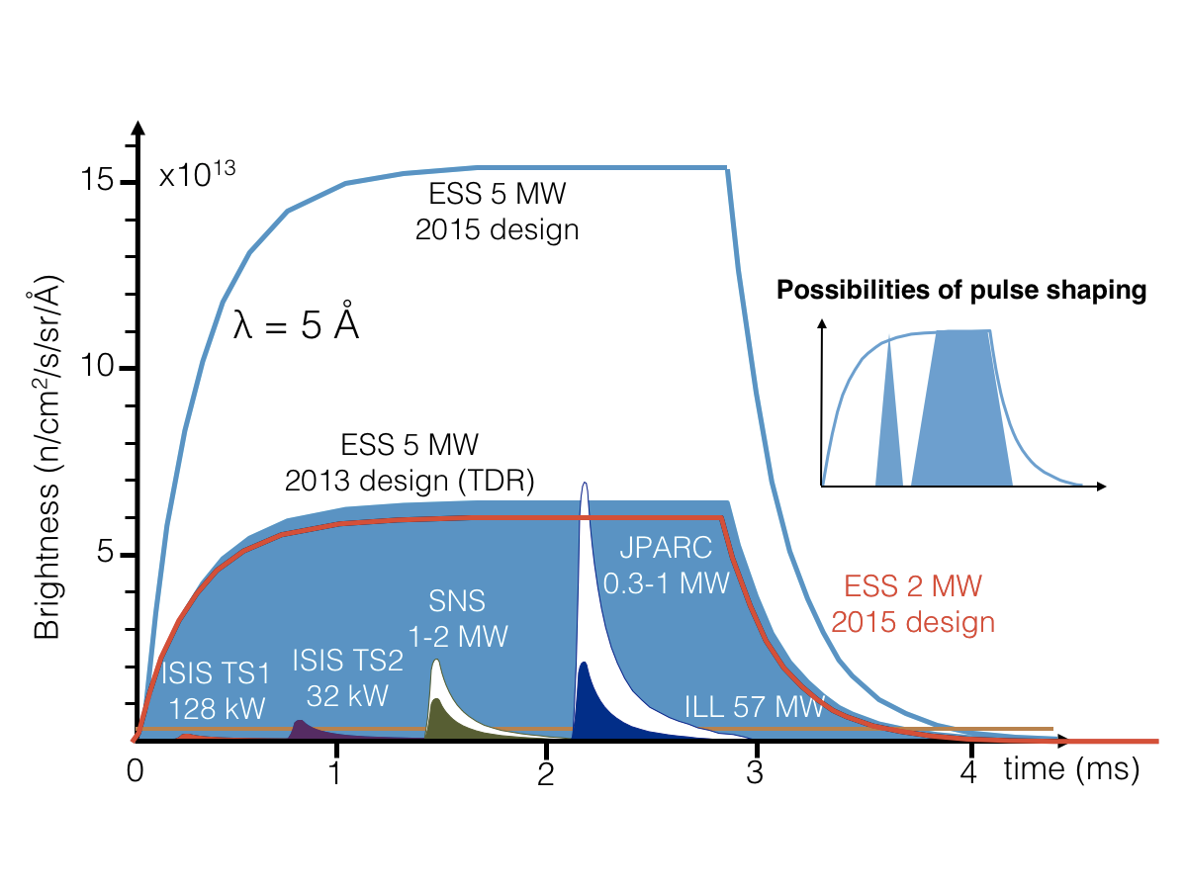
Detector Development at ESS
B10 Detectors as Alternative to He3
³He crisis, demand vs. supply:
Several isotopes have capture reactions that allow thermal neutron detection.
n + ³He → ³H + p + 0.764 MeV
n +¹⁰B → α + ⁷Li + 2.31 MeV
n + ⁶Li → t + α + 4.78 MeV
n + ^{155/157}Gd → ^{156/158}Gd + γ/c.e⁻
n + ²³⁵U → f.f. + xn + ~80 MeV
Increased flux – increase counting rate:
Challenge, but also a new opportunity:
In addition to lower cost,
Improve rate performance
Improve position resolution
No requirement for gas purification
No high pressure gas

Slide 12

Detector Development at ESS
B10 Detectors as Alternative to He3
Multi-Grid:
Multiple layers at normal incidence
³He detector
¹⁰B detector
³He gas
gas
n
conversion
⁷Li or α
n
³H or p
n
fragment 2
⁷Li or α
fragment 1
³H or p
conversion
B-10 film
pressure vessel
~5% efficiency
in 1 layer
substrate
Anode wires
For gas detectors, we use:
¹⁰B + n → ⁷Li + α + 2.97MeV
^{NAT}B contains ~20% ¹⁰B – a relatively inexpensive isotope.
Still working with gas detectors, but now the converter is solid
B-10 film
on 1 side
fragment 2
Anode wires
n
fragment 1
Multi-Blade:
Single layers at ~5° incidence

Slide 13
Outline
Why neutrons?
ESS construction
Detector Development
Neutron scattering Instruments
Spectroscopy
Reflectometry
SANS
Multi-Grid Detector
Multi-Blade Detector
SoNDe
Beyond initial instruments

Slide 14
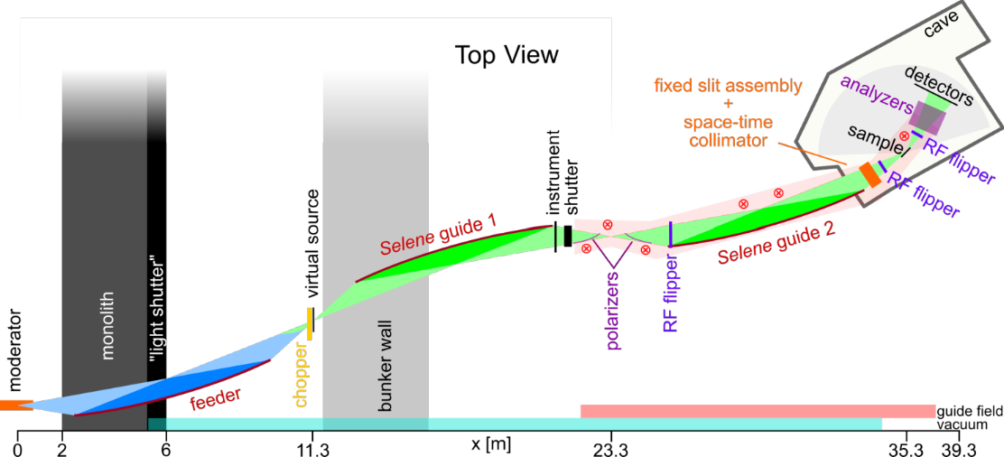
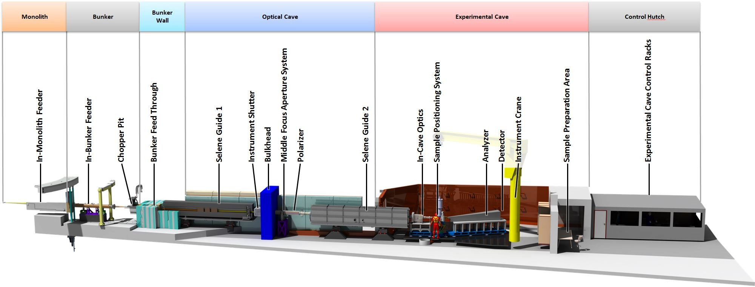
ESTIA reflectometer instrument
Slides courtesy of
Artur Glavic <artur.glavic@psi.ch>

Slide 15
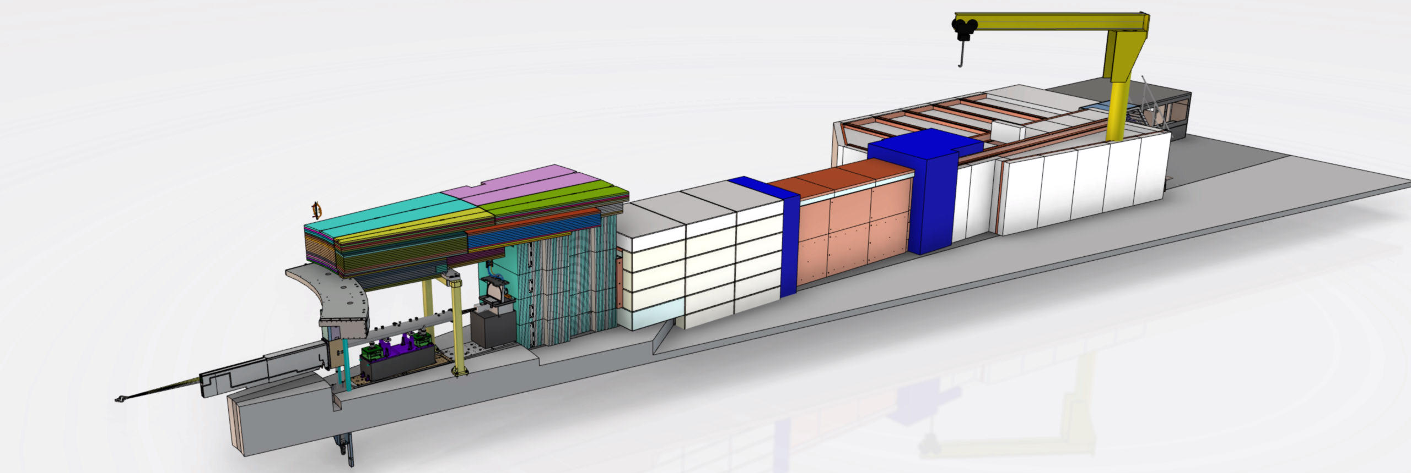
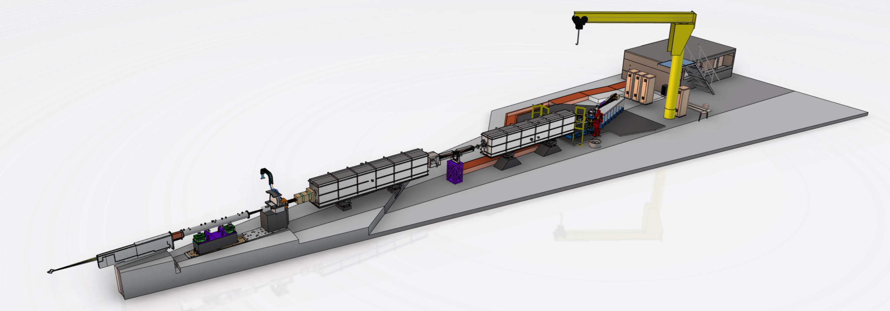
ESTIA instrument design
NBOA
optical / experimental
cave
chopper
pit
Selene 2
Selene 1
feeder
sample
position
middle
focus
Slides courtesy of
Artur Glavic <artur.glavic@psi.ch>

Slide 16
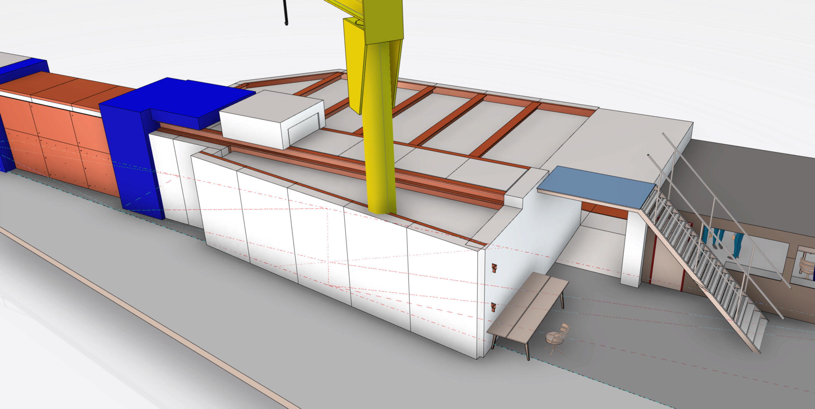
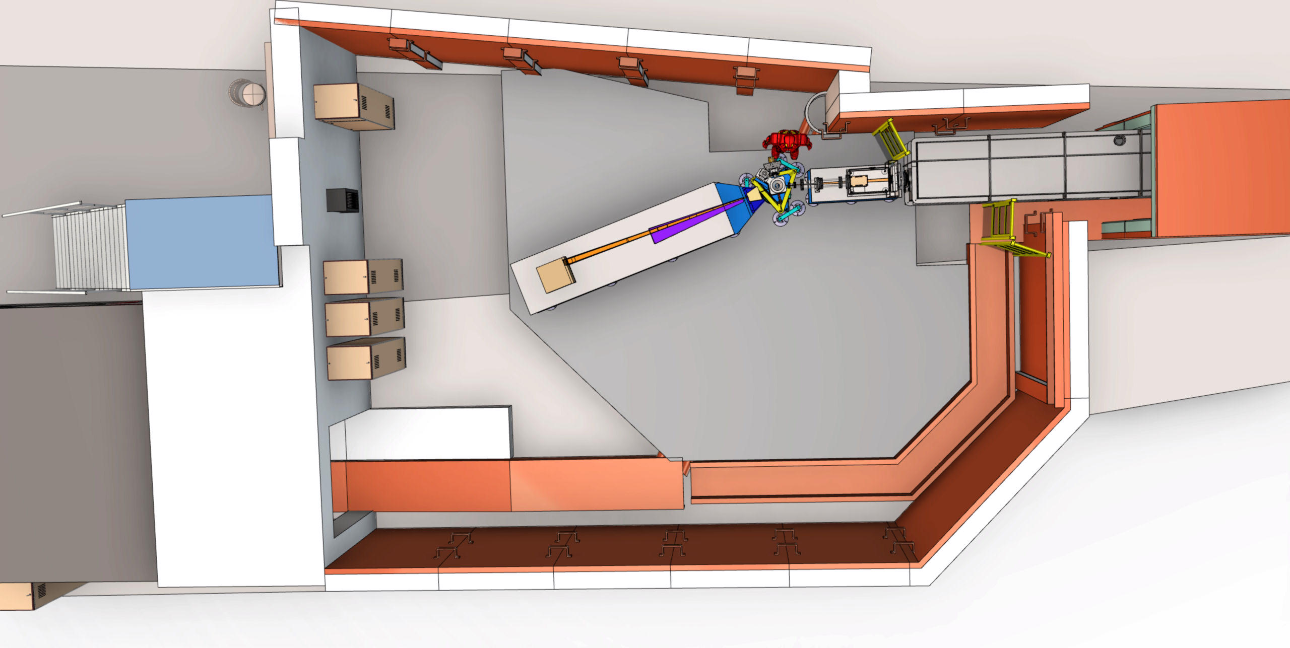
ESTIA cave design
Slides courtesy of
Artur Glavic <artur.glavic@psi.ch>

Slide 17
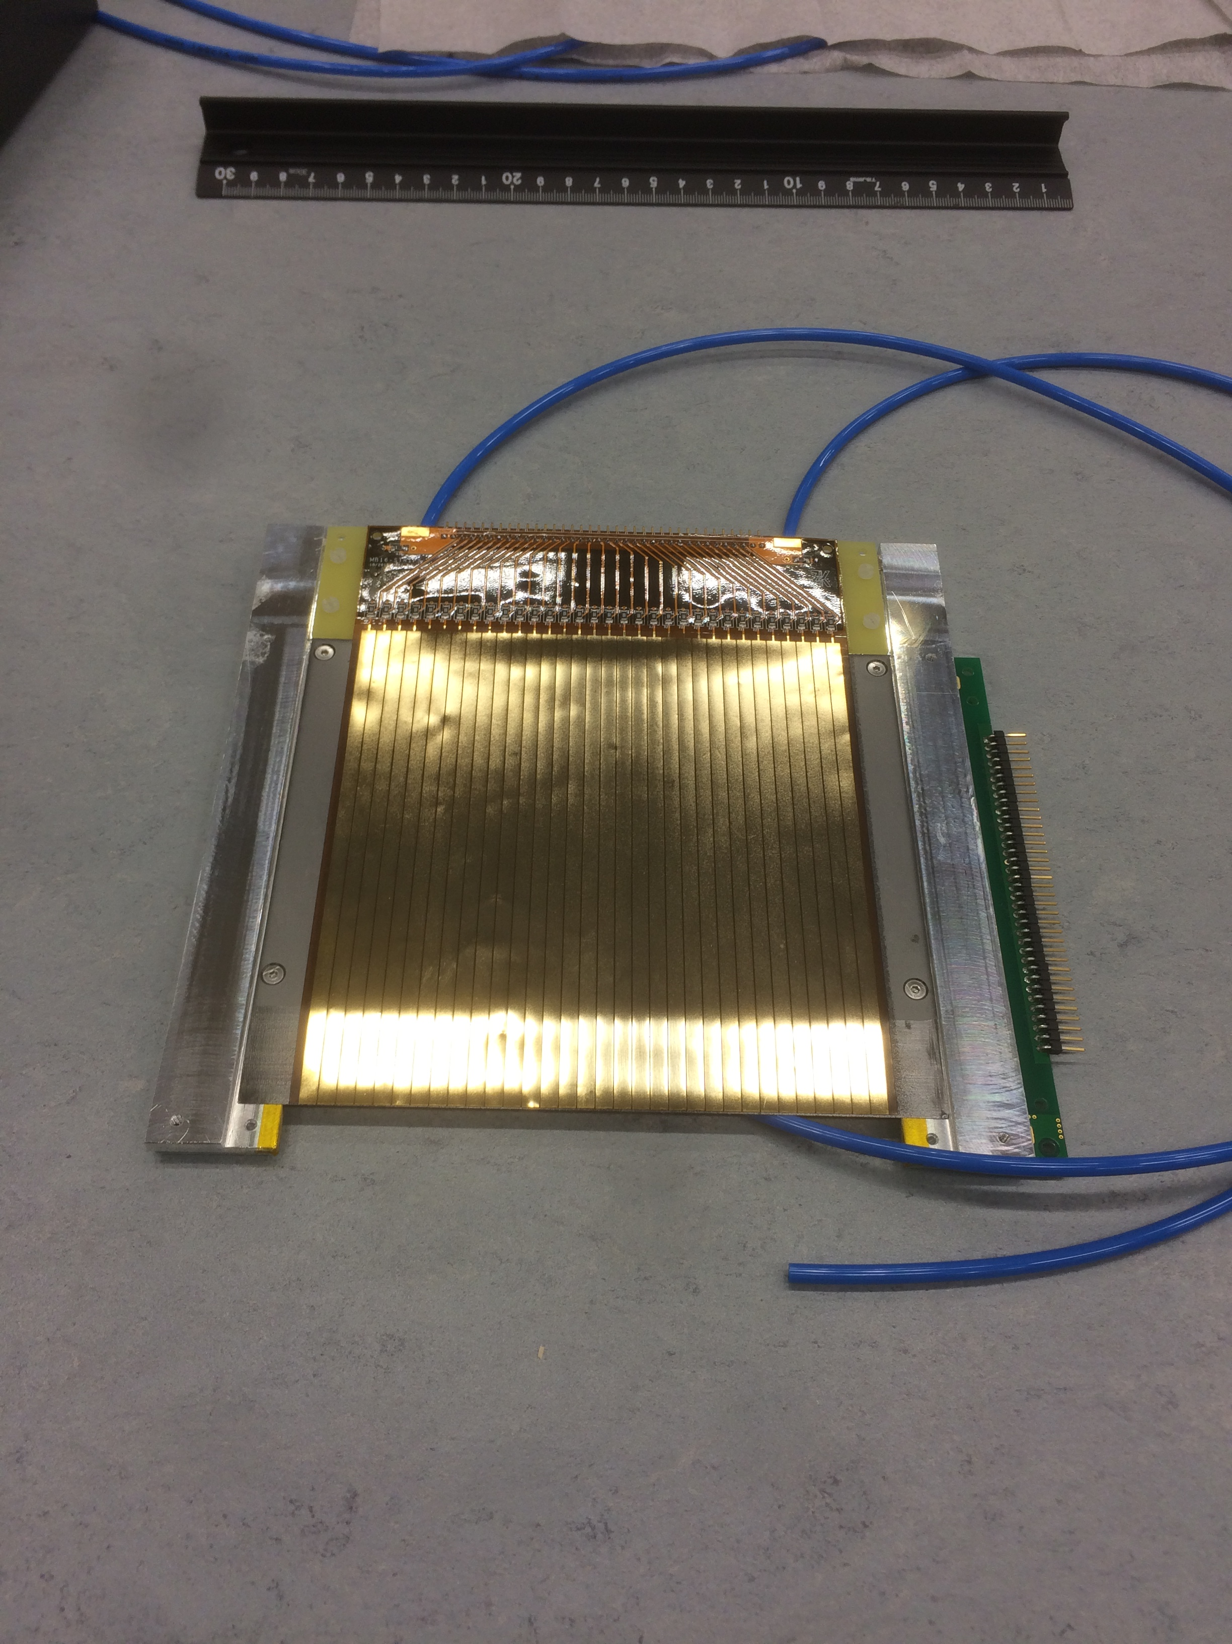
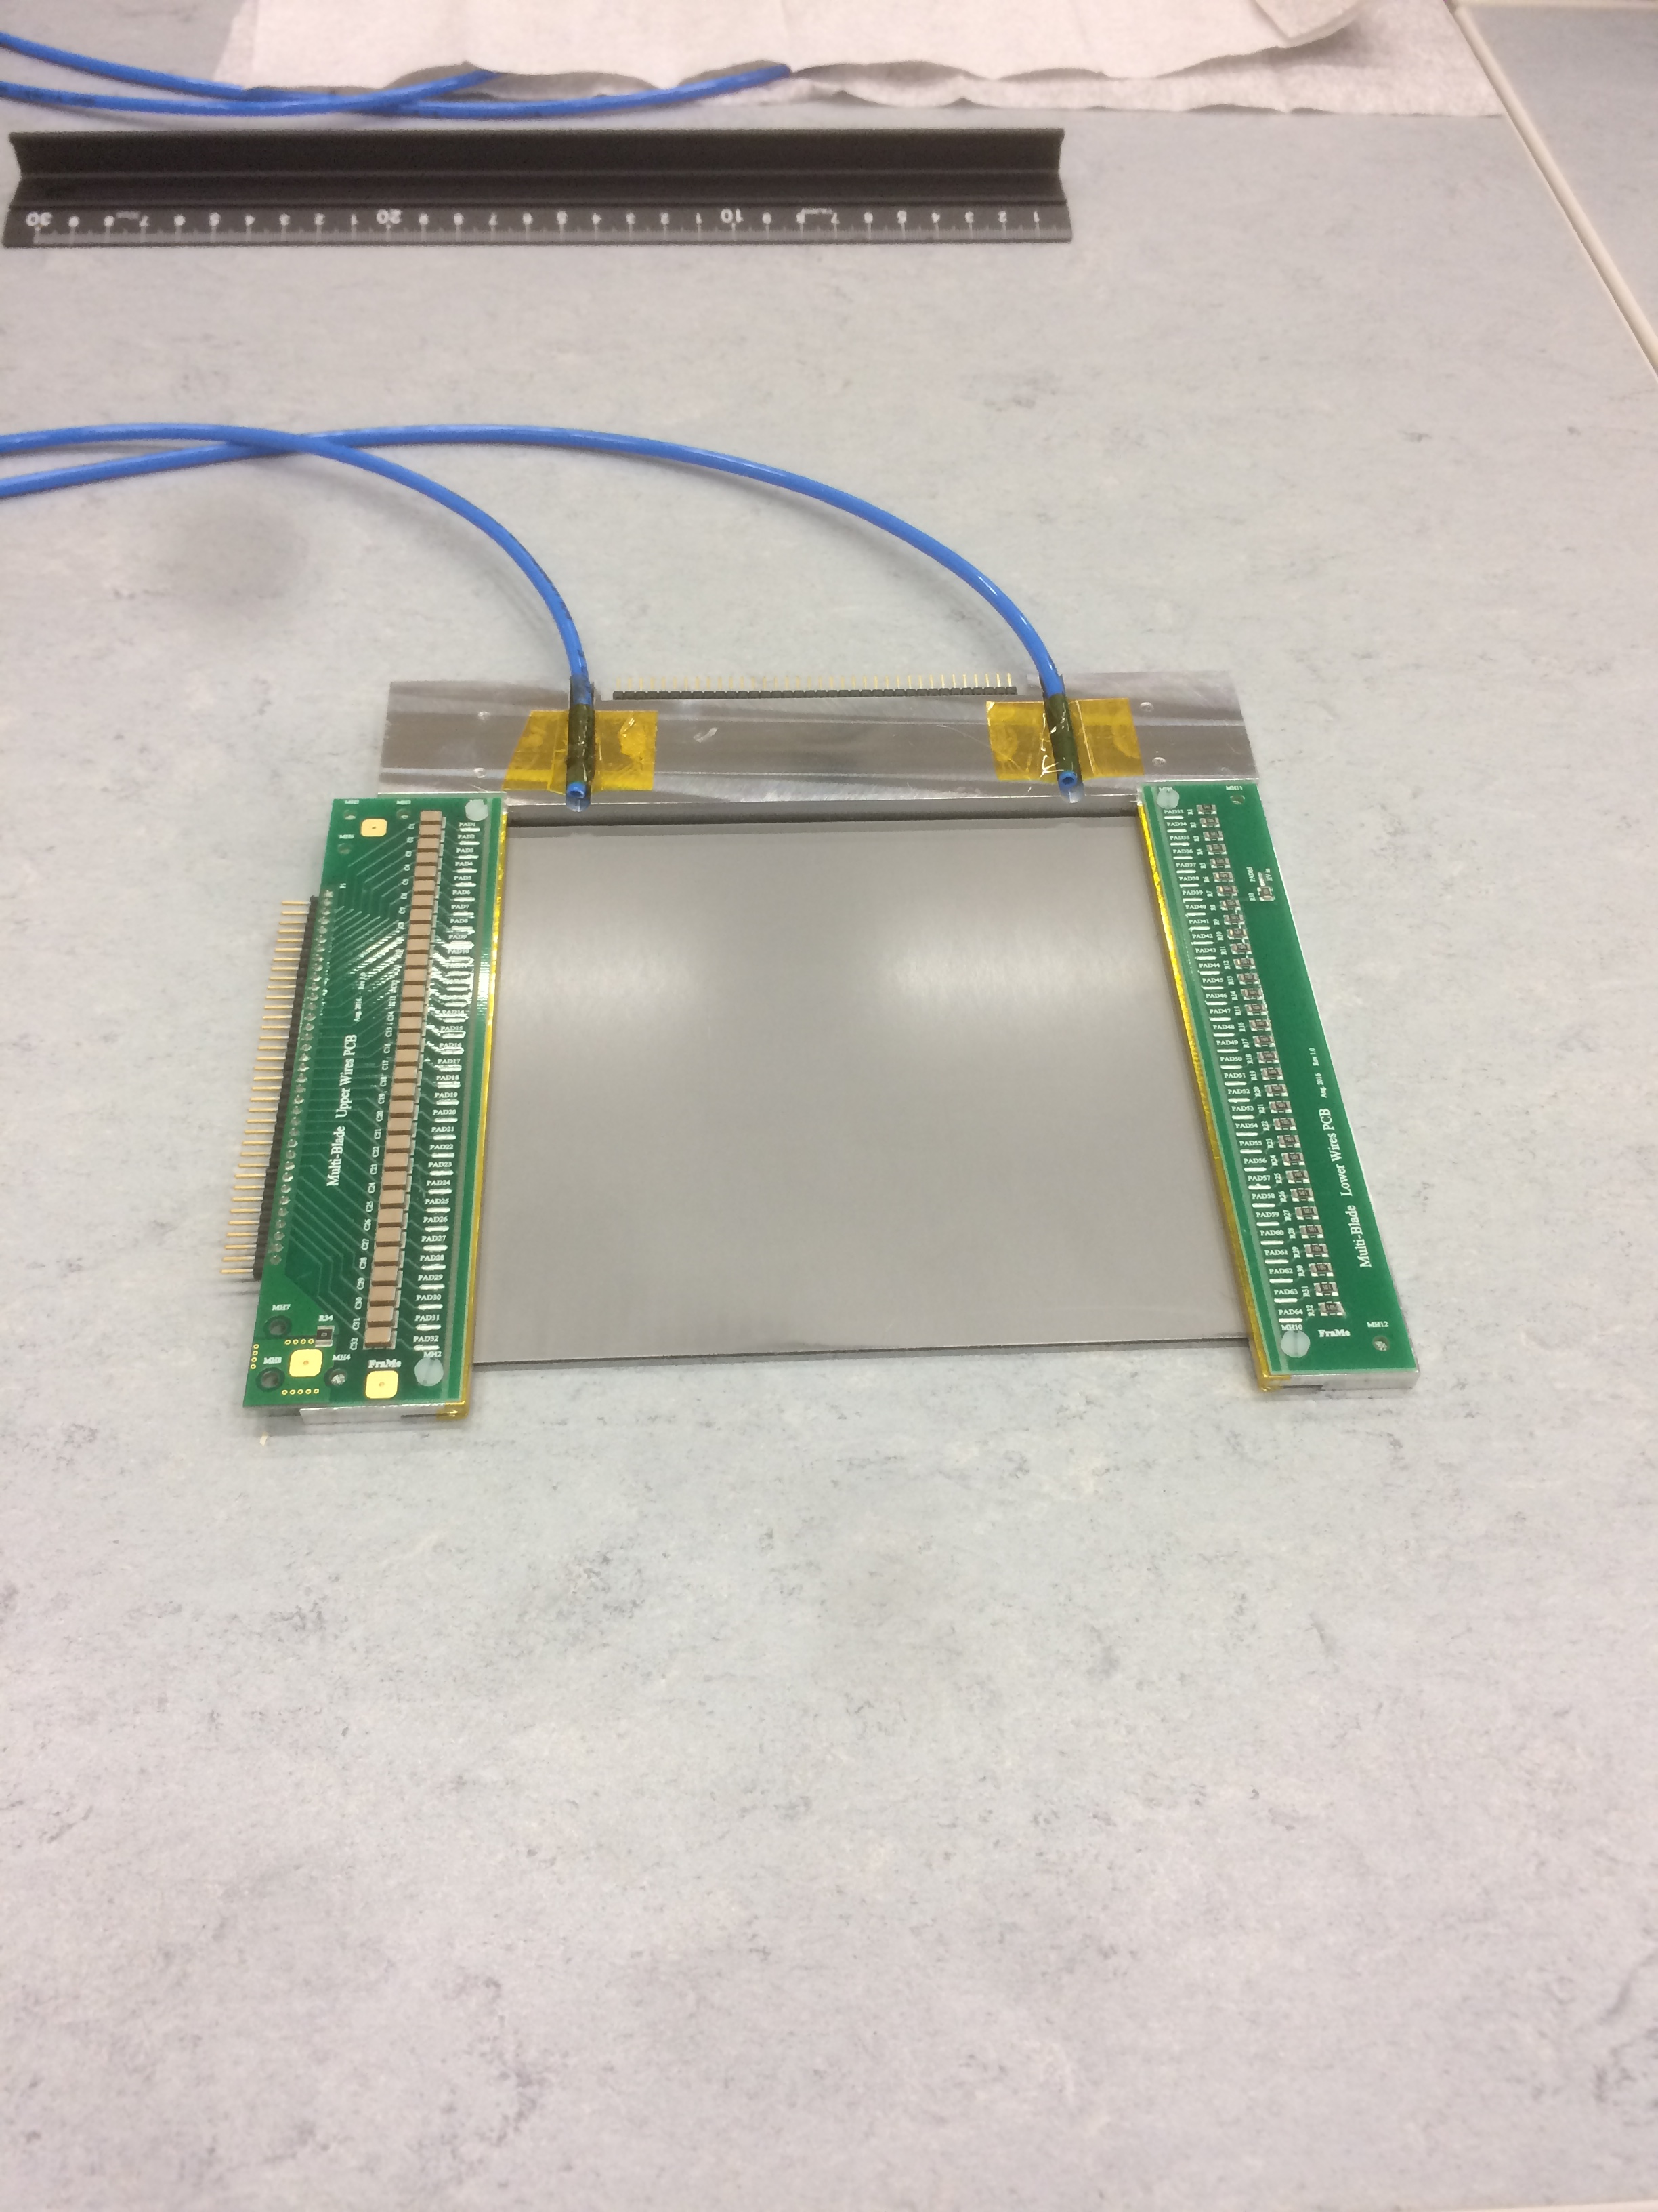
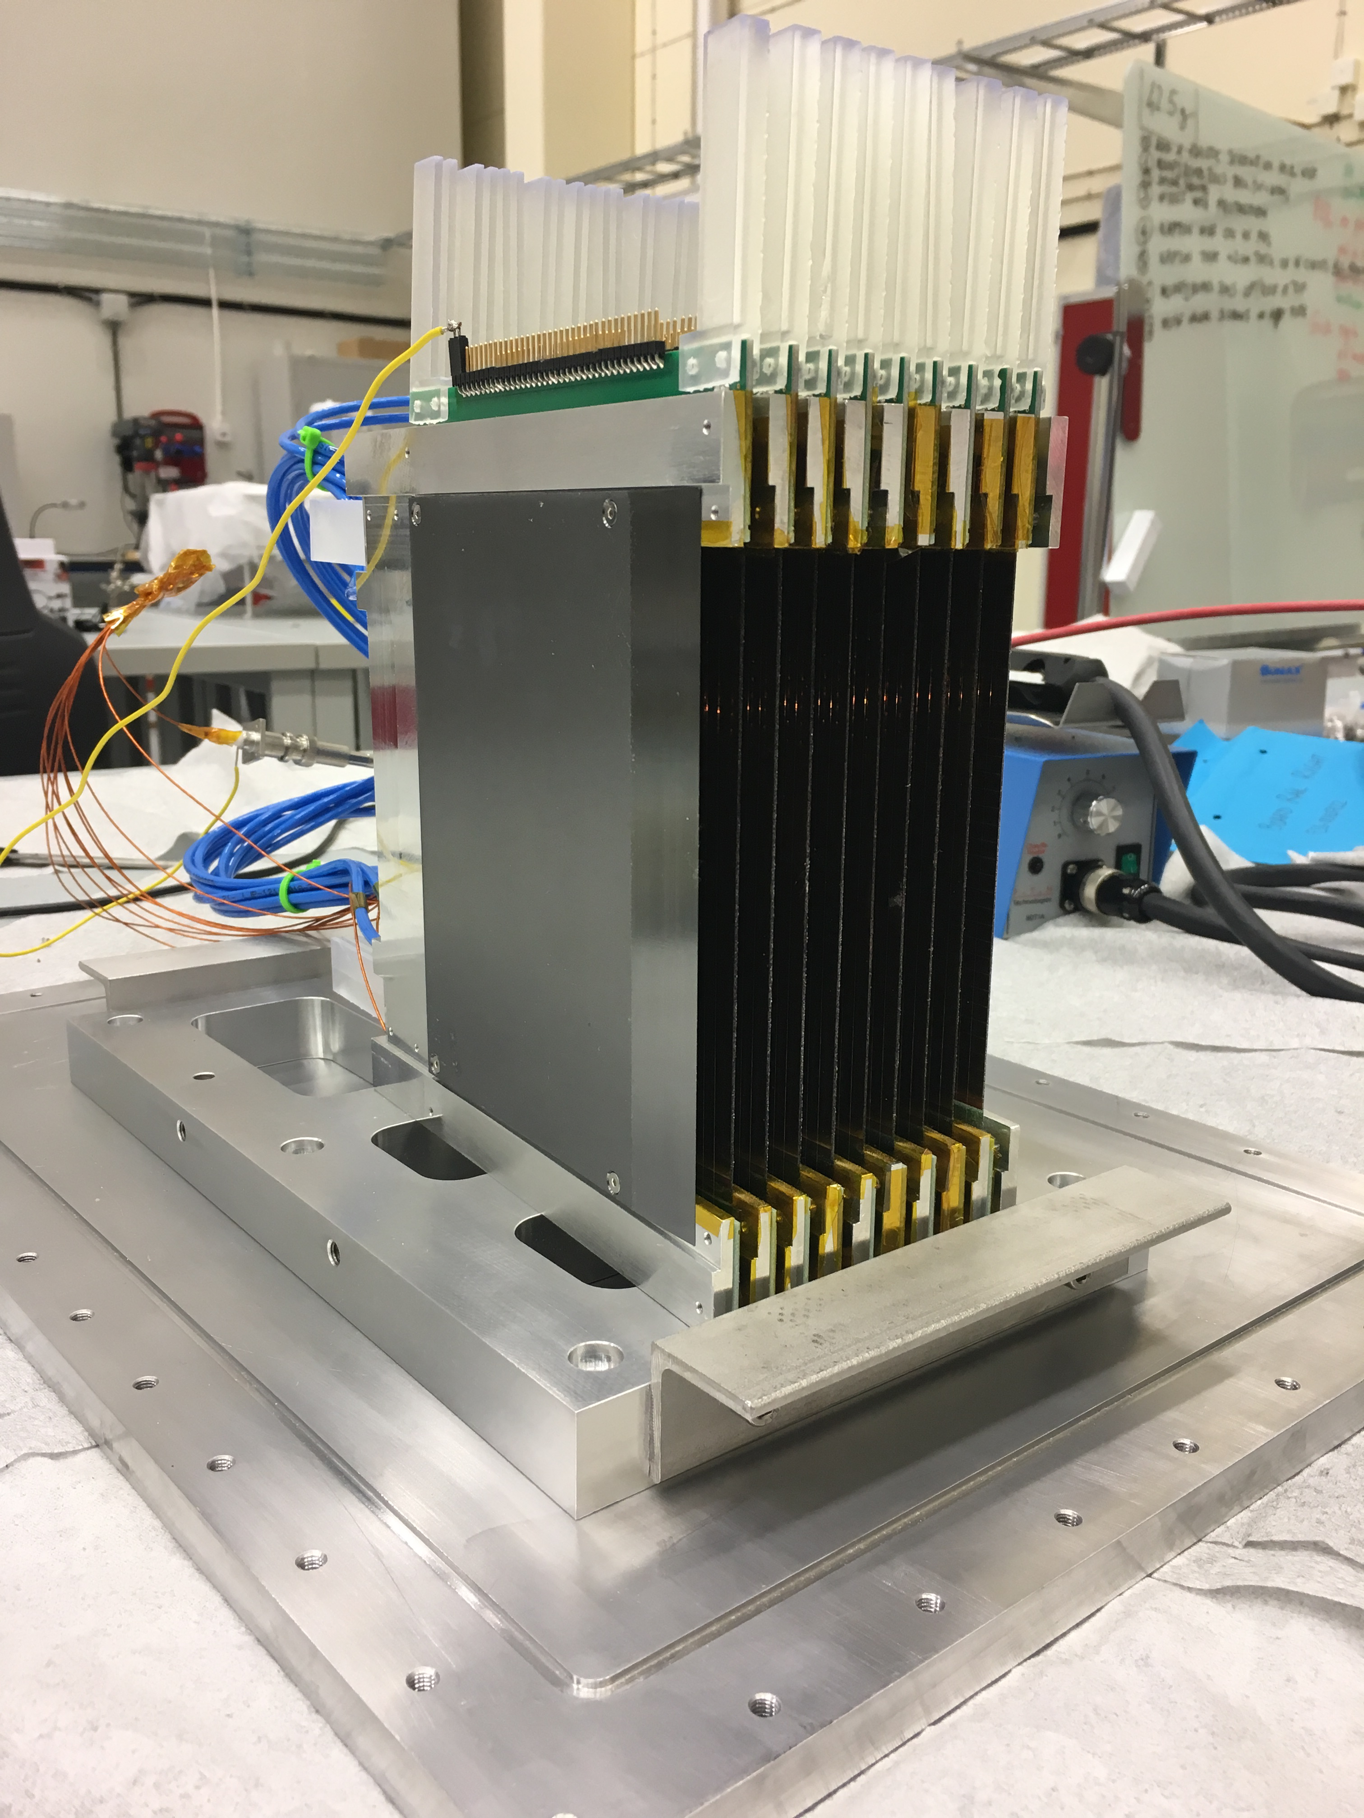
Multi-Blade prototype for ESTIA
High-rate and -resolution detector
32 Strips
(back)
32 wires
(front)
9 units
130mm
neutrons
wires X
100mm
substrate
¹⁰B₄C
strips Y
neutrons
θ
A cassette (unit)
θ = 5 degrees
F. Piscitelli et al., Characterization of the Multi-Blade 10B-based detector at the CRISP reflectometer at ISIS, JINST 13 P05009 (2018).

Slide 18
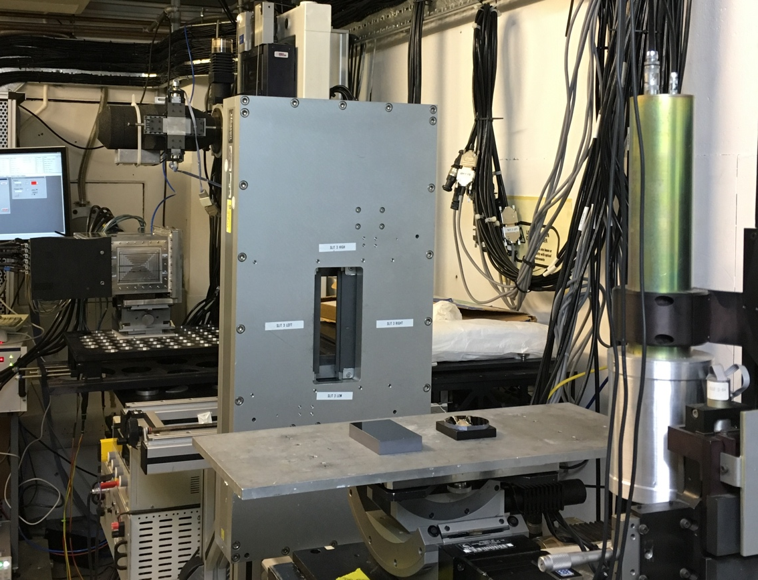
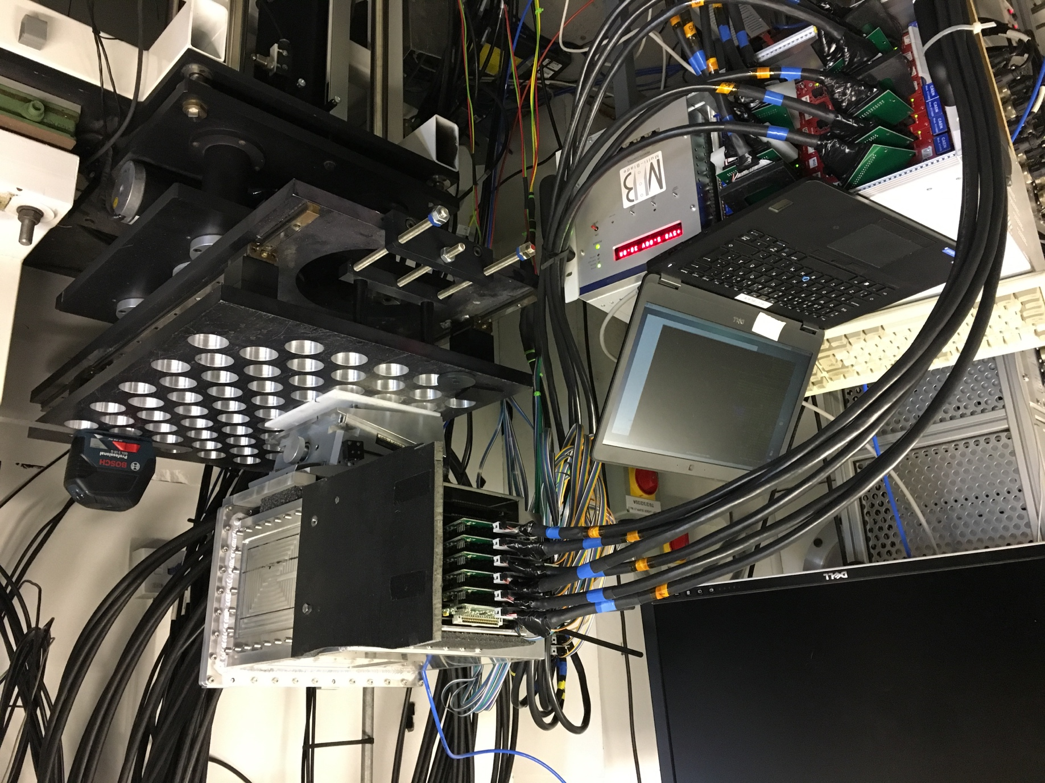
Multi-Blade prototype for ESTIA
Test at CRISP reflectometer
MB detector
2.3m
FEE
MB detector
DAQ CAEN
sample
F. Piscitelli et al., Characterization of the Multi-Blade 10B-based detector at the CRISP reflectometer at ISIS, JINST 13 P05009 (2018).

Slide 19
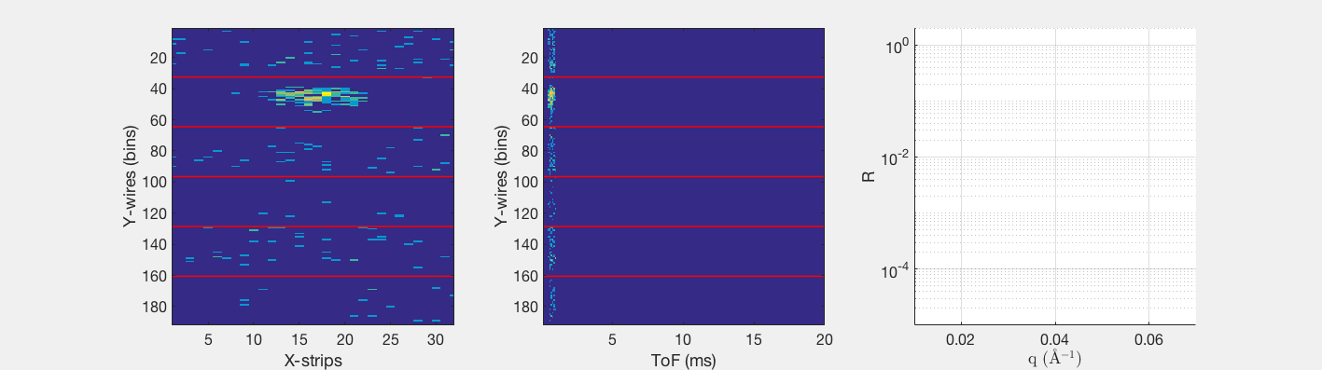
Multi-Blade prototype for ESTIA
Results from CRISP reflectometer
G. Mauri et al., Neutron reflectometry with the Multi-Blade 10B-based detector, Proc. R. Soc. A 474: 20180266 (2018).
Multi-Blade
sample
θ
θ

Slide 20
Outline
Why neutrons?
ESS construction
Detector Development
Neutron scattering Instruments
Spectroscopy
Reflectometry
SANS
Multi-Grid Detector
Multi-Blade Detector
SoNDe
Beyond initial instruments

Slide 21
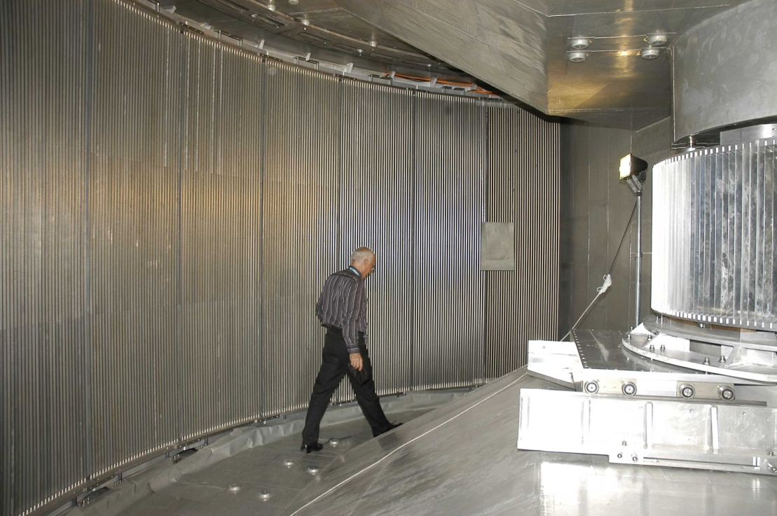
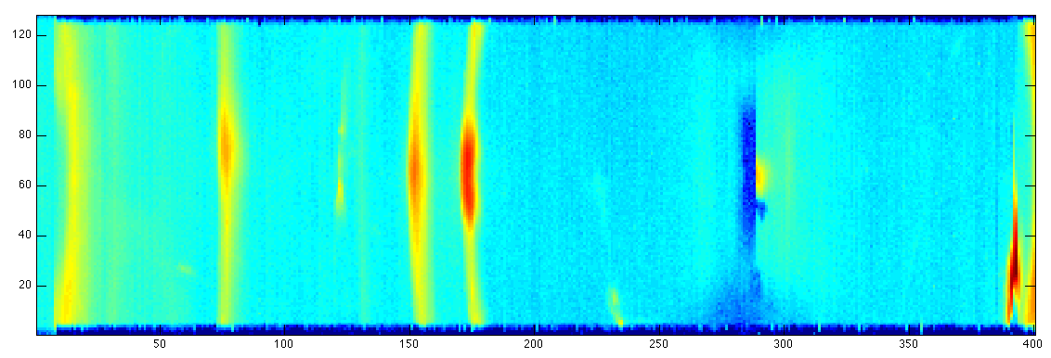
Neutron Spectroscopy:
Time-of-Flight Spectrometers
IN5 at ILL
Few meV to few eV energy range
Time-of-flight information
2-5 m sample to detector distance
→ Energy transfer
20-40 m² detector area
Position resolution O(1inch)
Momentum transfer
High dynamic range
Low background
Detected image
Incident beam
n E_{i}, Q_{i}
n E_{f}, Q_{f}
Detected ToF spectrum
Sample

Slide 22
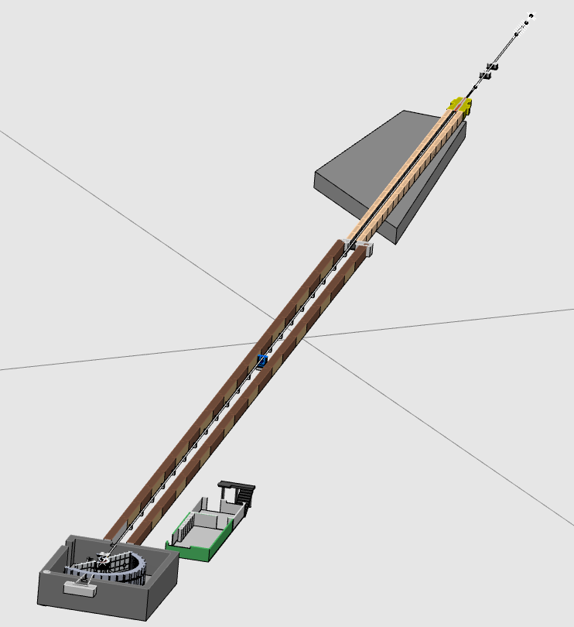
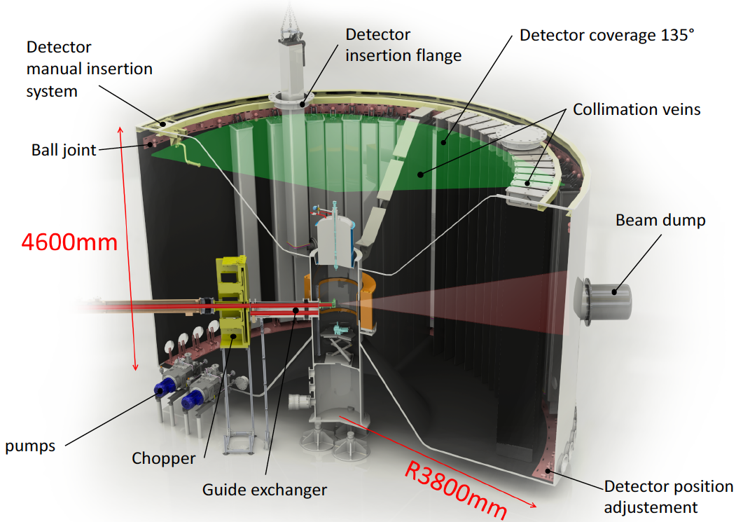
CSPEC instrument design
ToF vacuum tank with Multi-Grid detectors

Slide 23
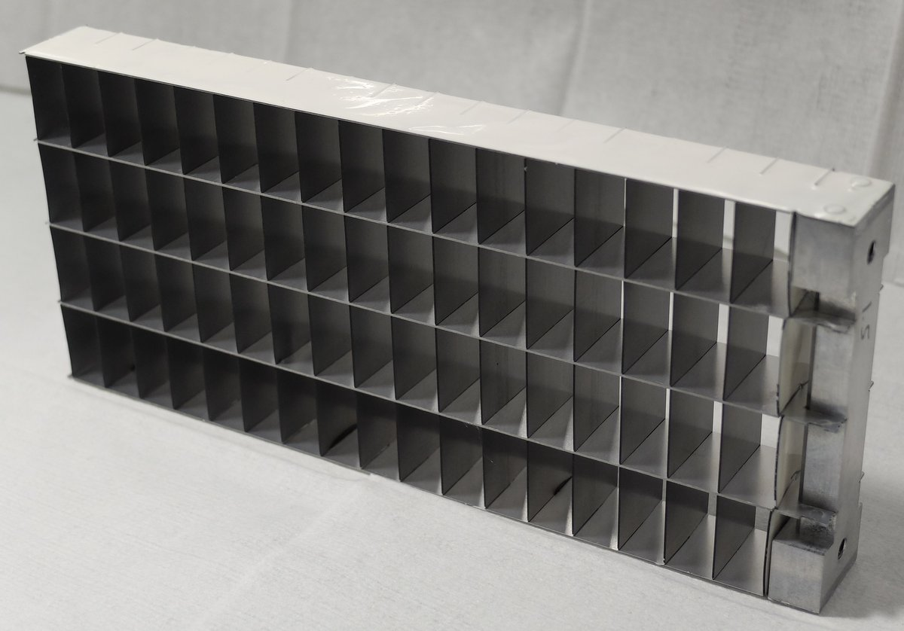
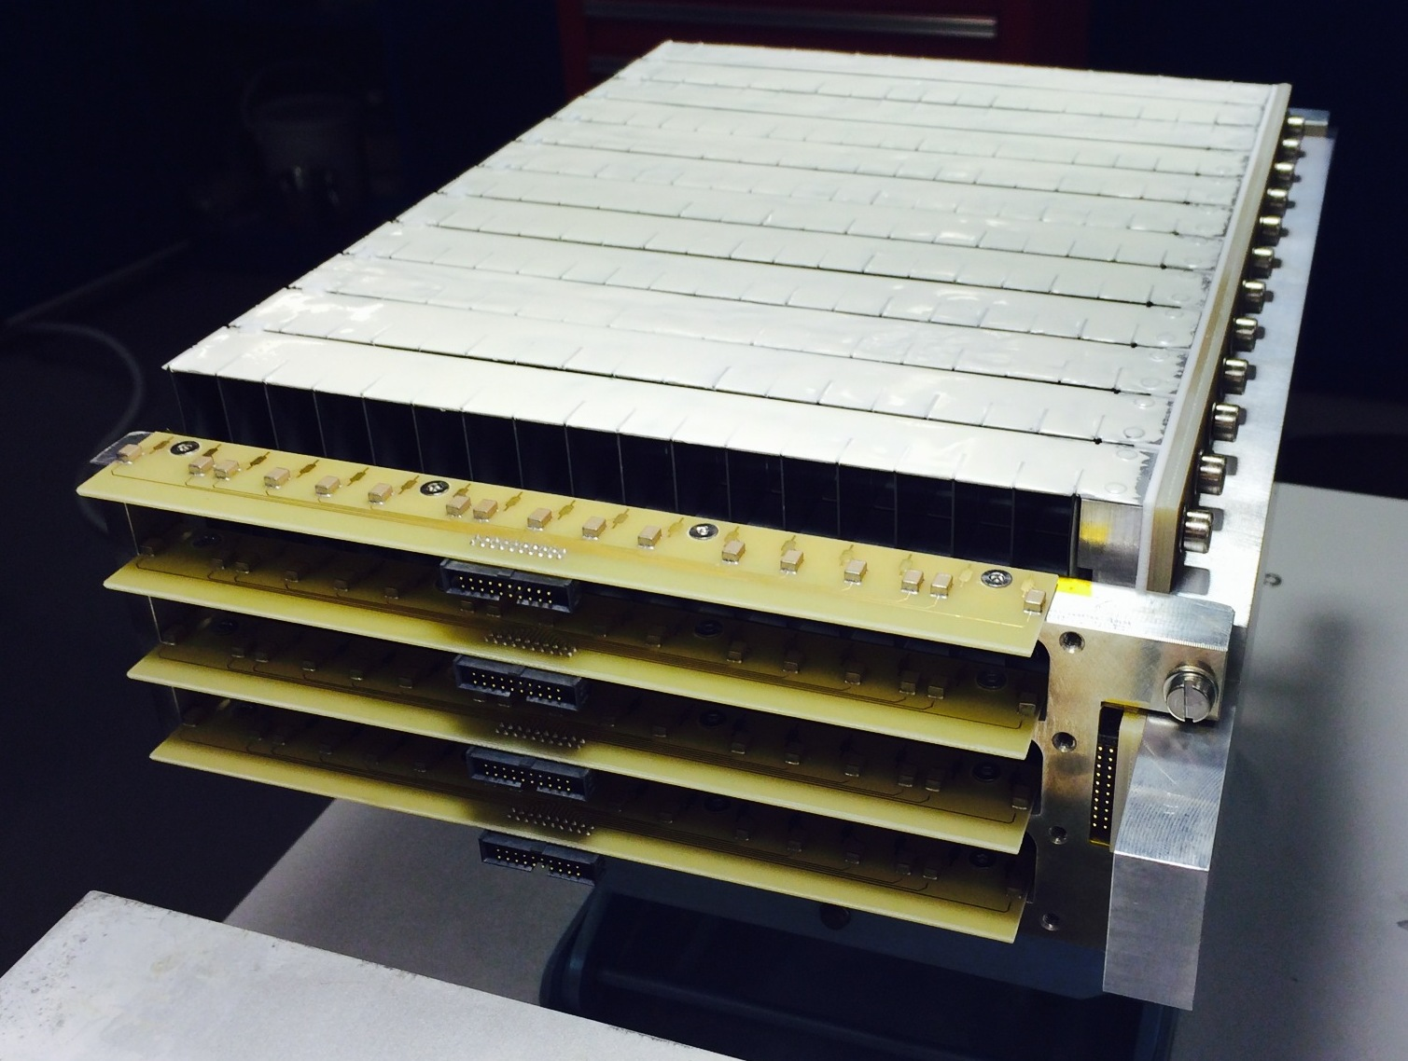
Multi-Grid: How it Works
n
n
n
Low cost for large area
Modular
High total efficiency
Many layers – lower local rate
No need for resistive readout – low gain
Introduced at ILL, jointly developed by ILL and ESS under CRISP project,
now under BrightnESS

Slide 24
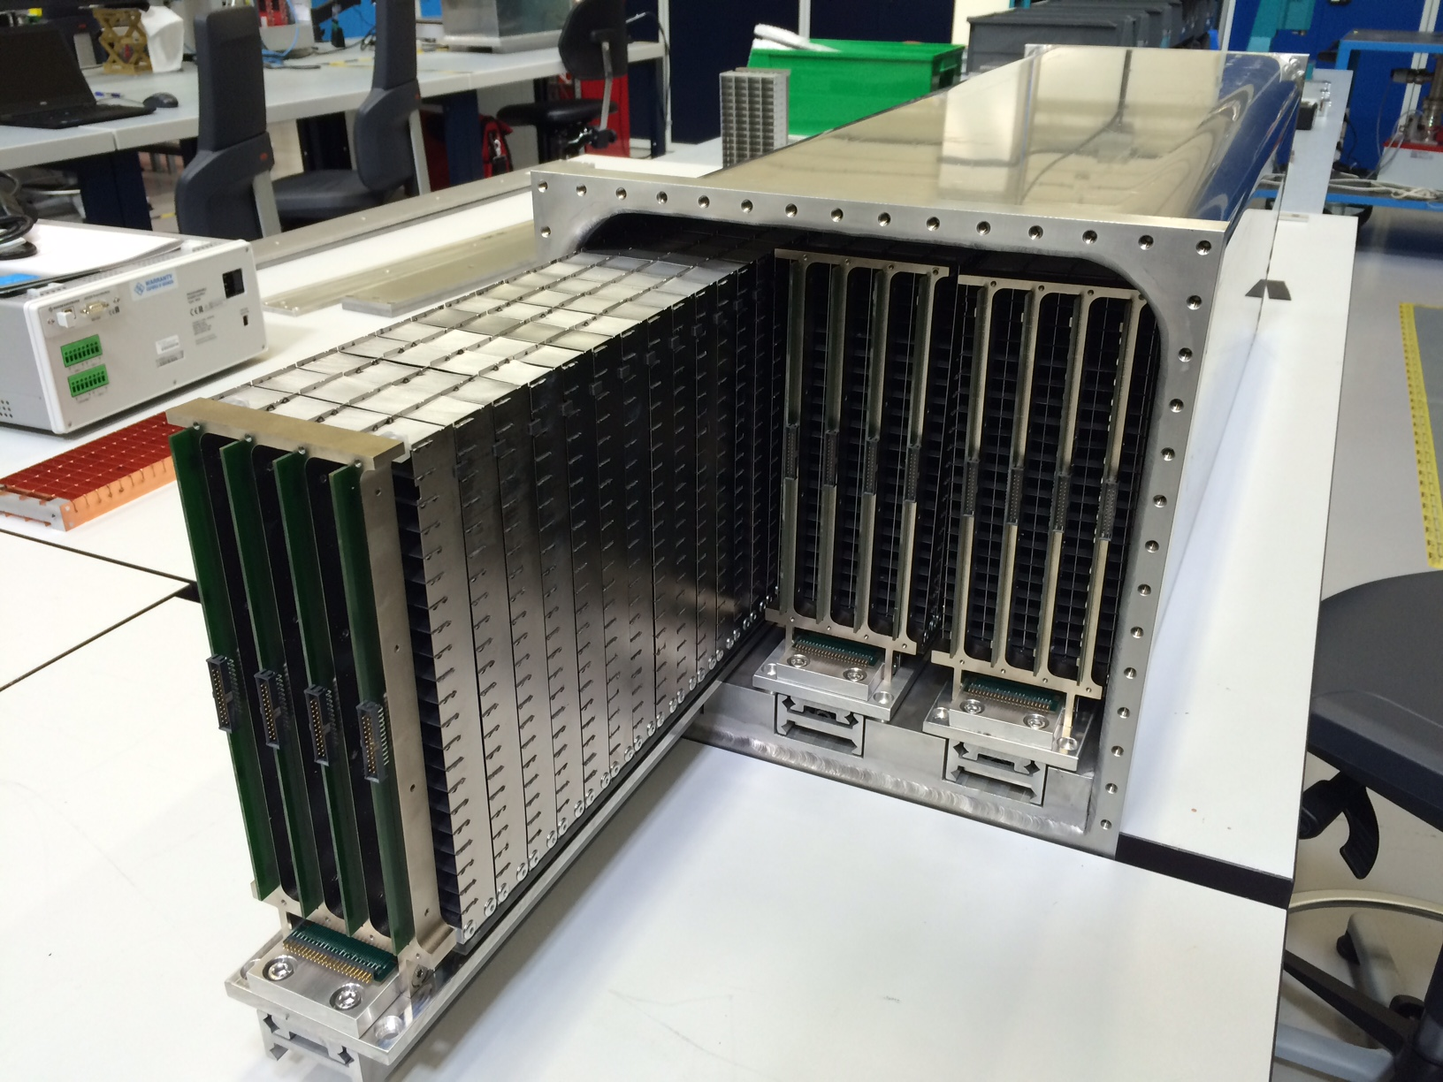
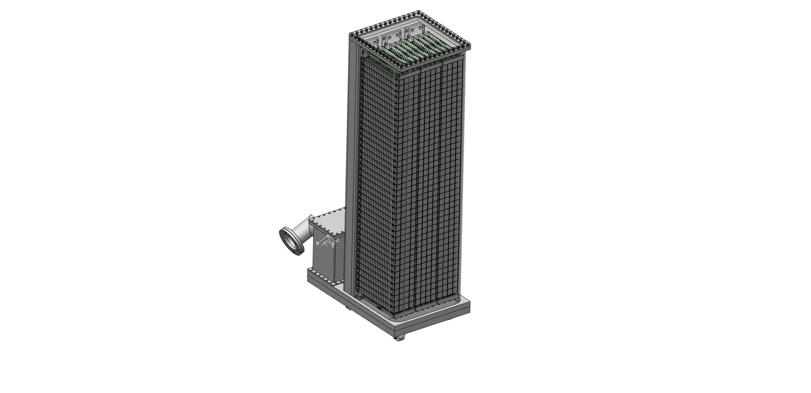
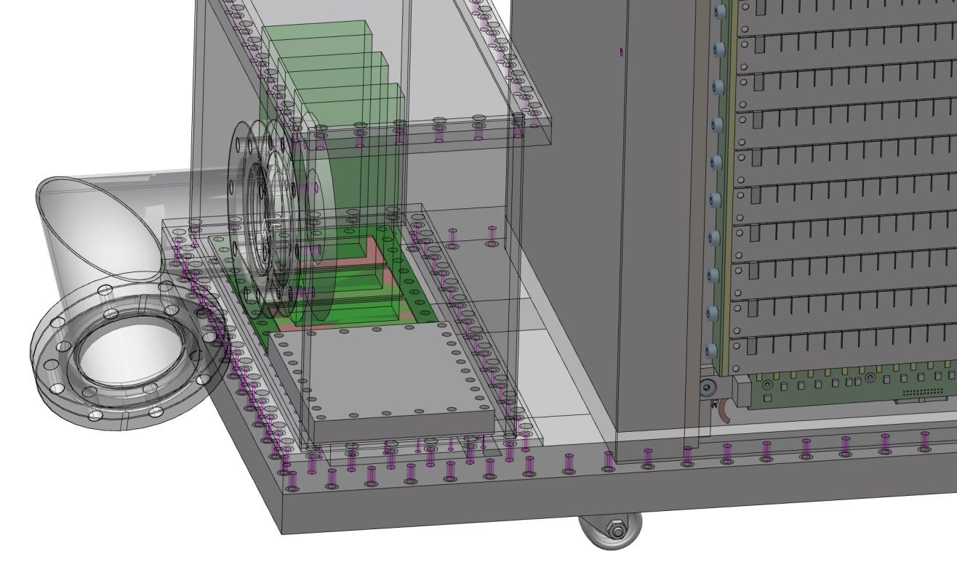
MG.SEQ prototype
Design of the detector
3 detectors + 1 spare
3 modules per detector
40 grids per module
20 cell layers per grid
1 m

Slide 25
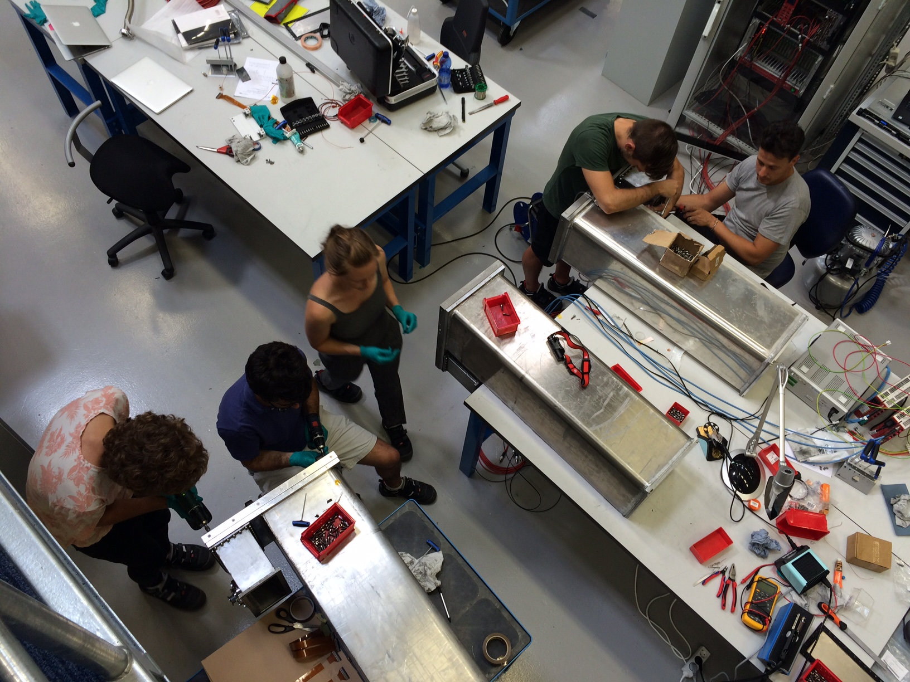
MG.SEQ prototype
Building 3 detectors in Utgård in Lund

Slide 26
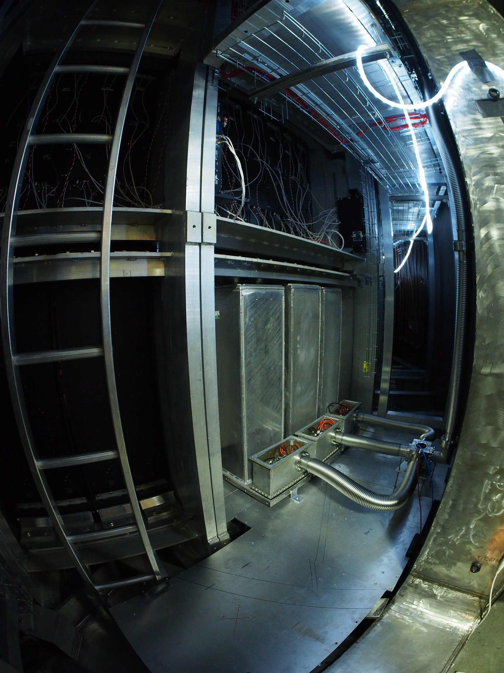
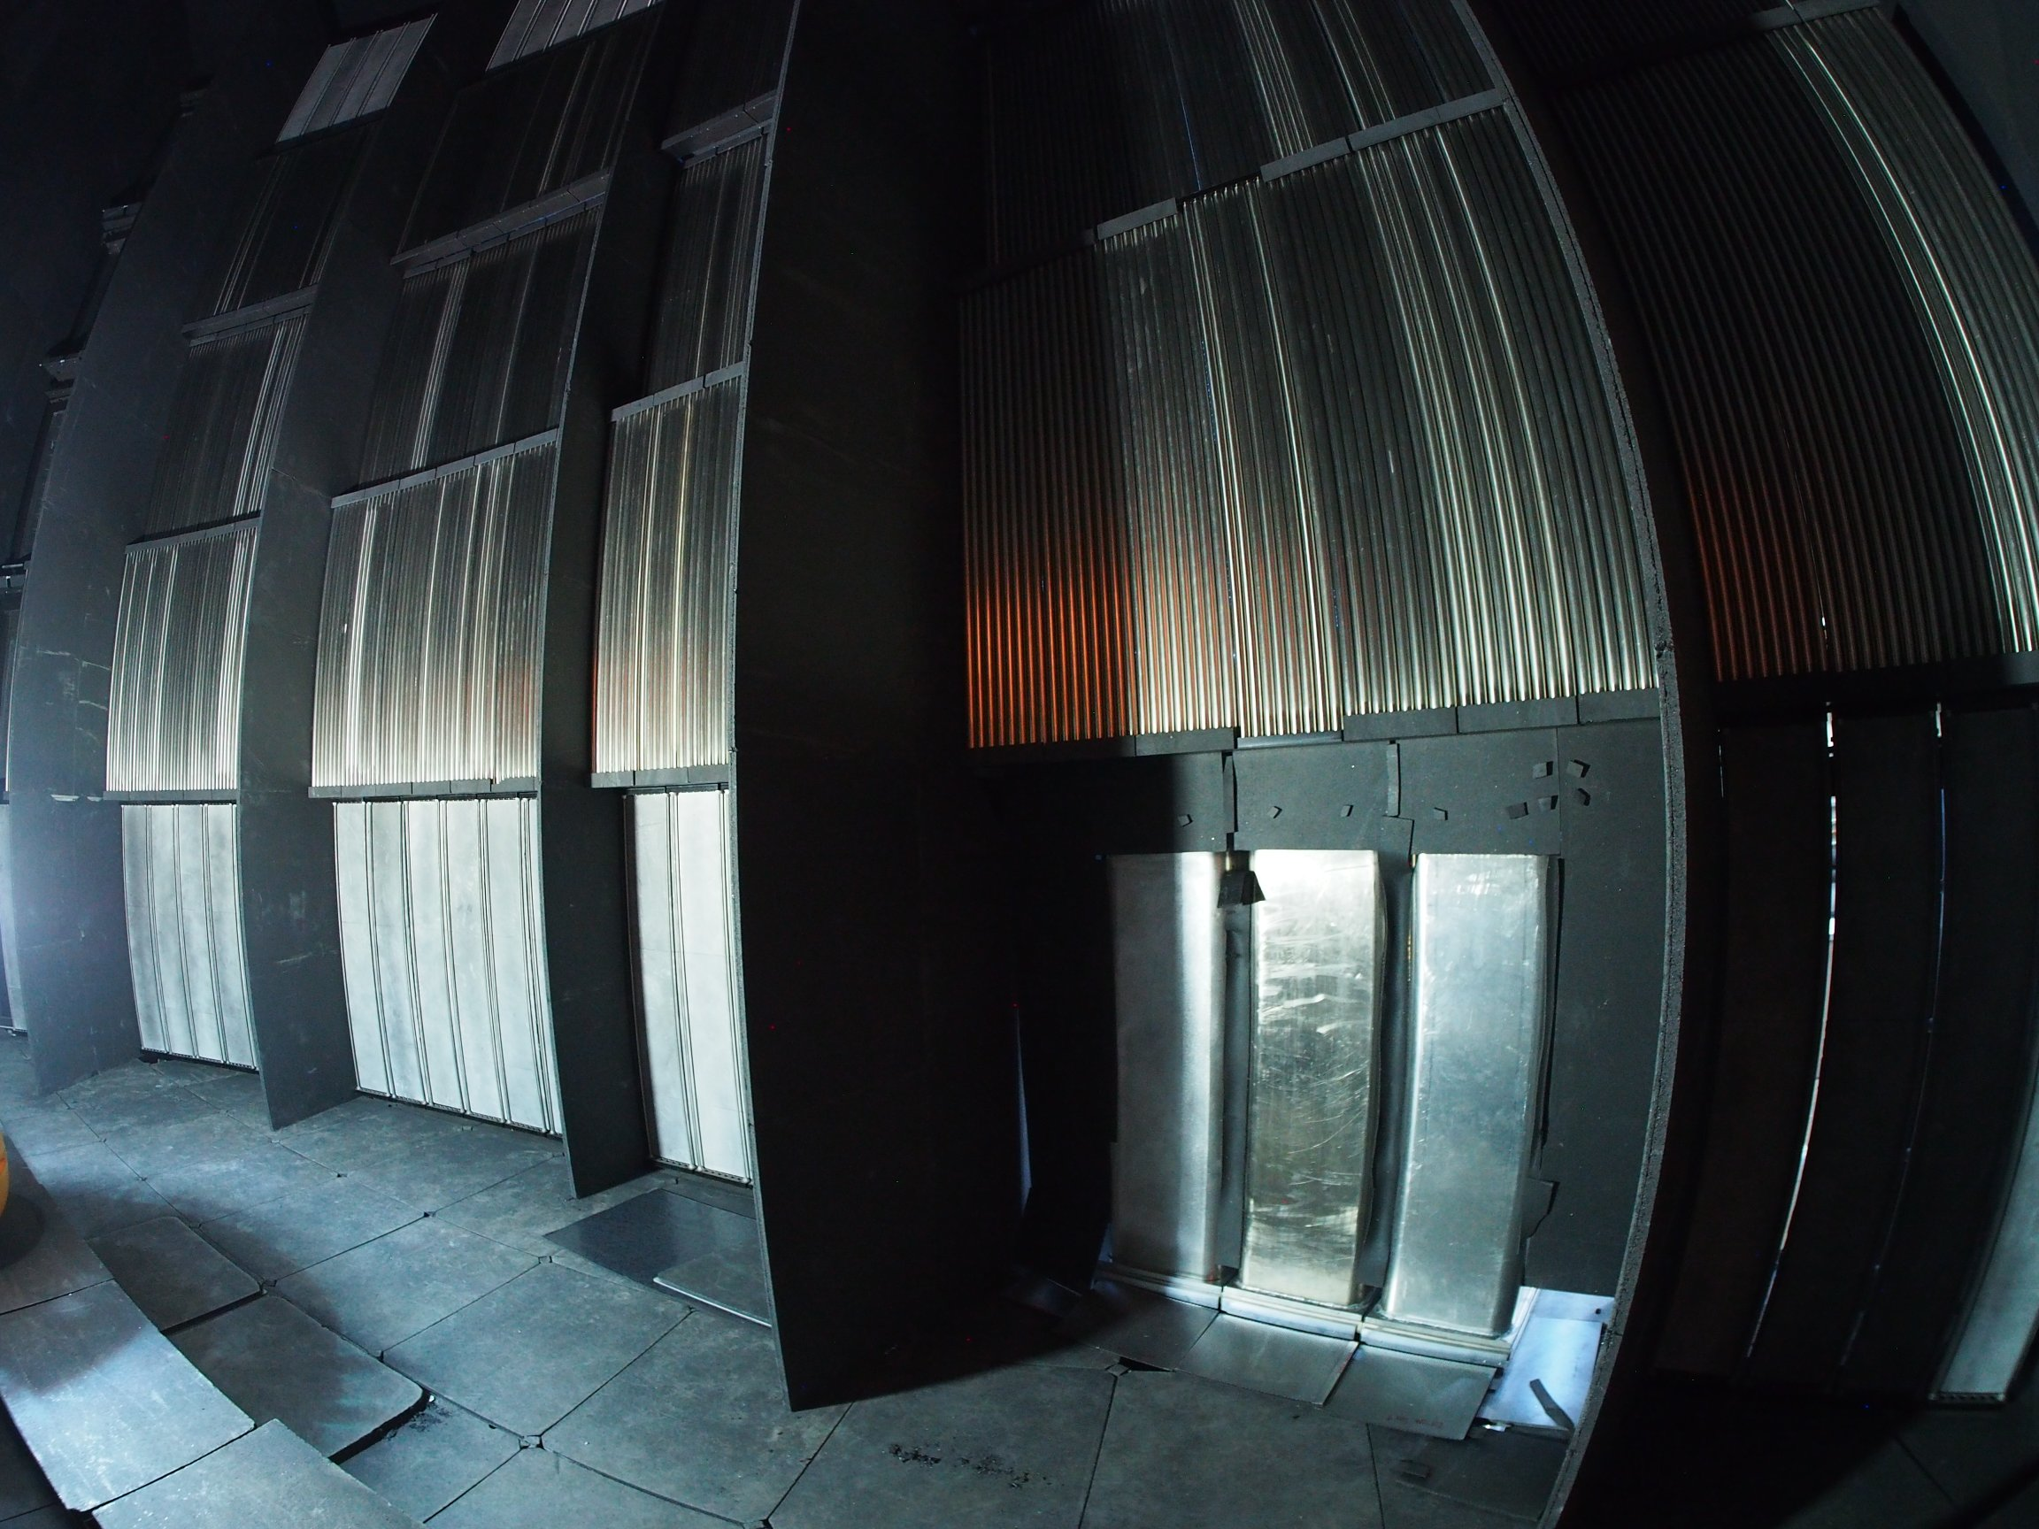
MG.SEQ prototype
Installed in SEQUOIA at SNS, Oak Ridge National Lab

Slide 27
MG.SEQ prototype
Spectroscopy measurement
PRELIMINARY RESULTS

Slide 28
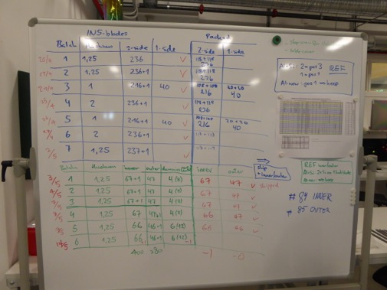
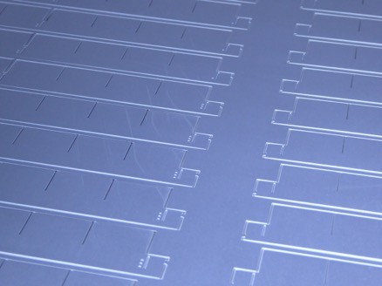
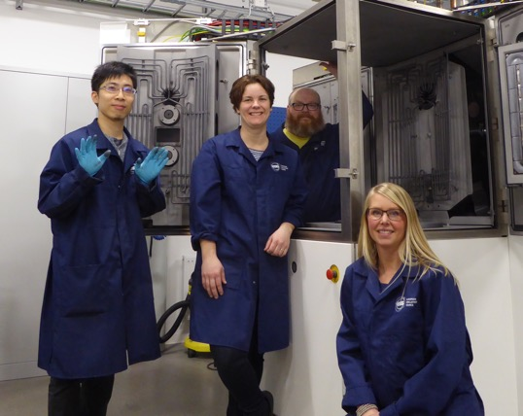
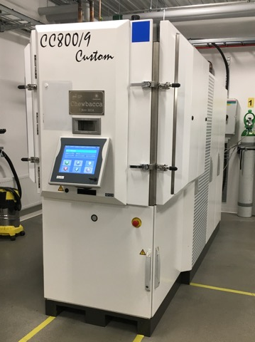
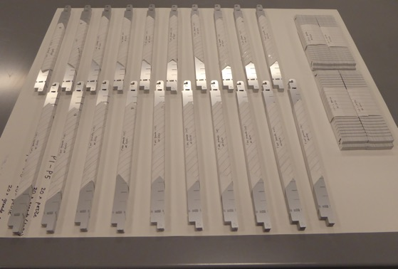
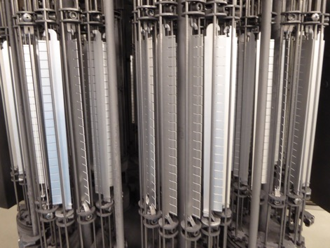
¹⁰B₄C layer production
Coating workshop in Linköping
Dedicated coating workshop in Linköping
Capacity to coat up to 400 blades per run (8-12 hours)
C. Höglund et al, J of Appl. Phys. 111, 104908 (2012)

Slide 29
Outline
Why neutrons?
ESS construction
Detector Development
Neutron scattering Instruments
Spectroscopy
Reflectometry
SANS
Multi-Grid Detector
Multi-Blade Detector
SoNDe
Beyond initial instruments

Slide 30
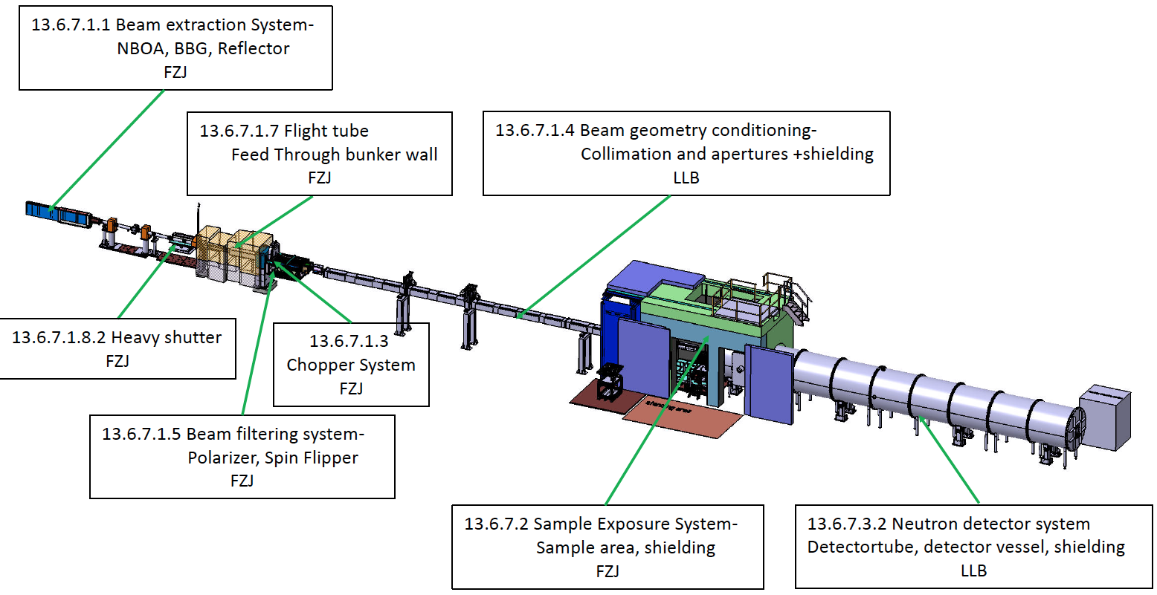
Small Angle Neutron Scattering, SANS
SKADI instrument at ESS

Slide 31
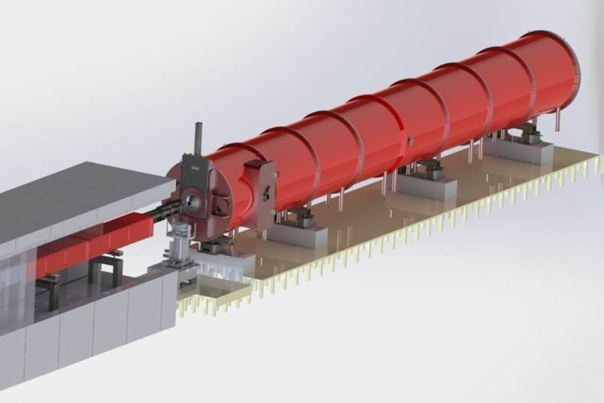
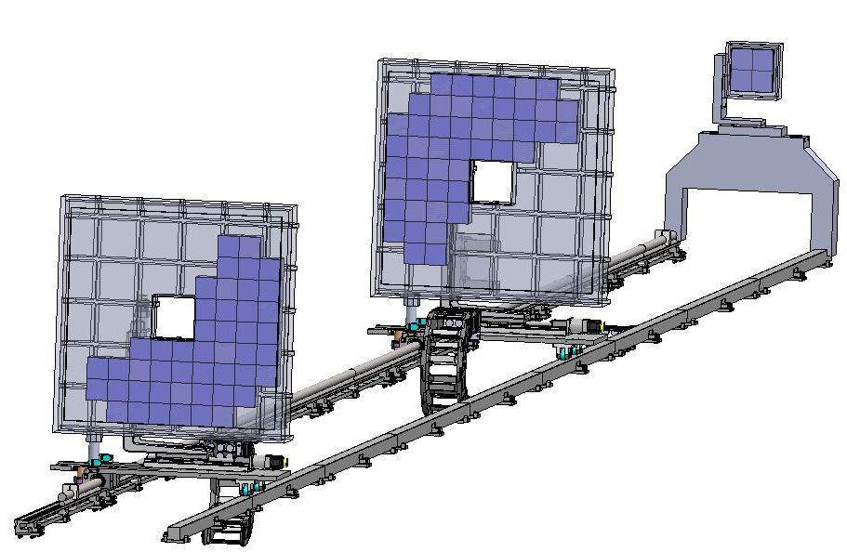
Detector system for SKADI
Develop a high-resolution neutron detector technique for enabling the construction of position-sensitive neutron detectors for high flux sources.
Detector for the SKADI instrument Requirements:
Count-rate rate capability of up to 20 MHz@10% dead time
Detection efficiency of 80% @ 5Å with a gamma suppression of 10 -5
Position resolution of 6 mm 2 , 3 mm 2 , 1 μs time resolution for TOF
Operation in vacuum, adaptable shape

Slide 32
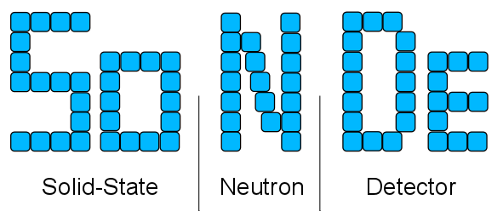



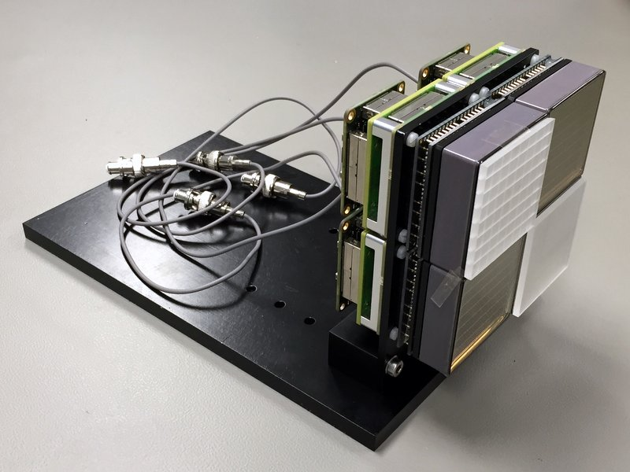
Detector for SKADI
SoNDe detector
n + ⁶Li → t + α + 4.78 MeV
50x50mm 8x8 pixels
64 pixels
IDEAS IDE3465
+FPGA
+
+
Grooved Li glass (GS20)
MA-PMT (H9500 or H12700)

Slide 33
Outline
Why neutrons?
ESS construction
Detector Development
Neutron scattering Instruments
Spectroscopy
Reflectometry
SANS
Multi-Grid Detector
Multi-Blade Detector
SoNDe
Beyond initial instruments

Slide 34
Fundamental & Particle Physics @ ESS
Standard Model of particle physics (SM)
Precision experiments
Beyond SM
New interactions
Neutron antineutron oscillation beamline (NNbar)
Baryon asymmetry of the Universe
Cold neutron
beamline (ANNI)
Neutron beta decay
Hadronic parity violation
Electromagnetic properties of the neutron
UCN beamline
Gravity resonance spectroscopy
Neutron interferometry
Neutron beta decay
Full ESS Proposal, public user beamline, strong support by SAC, but not prioritized among first 15 instruments: instruments 16-22
Letter of intent,
cost ~ x 10 higher than
ESS instruments 1-22,
requires external funding
Letter of intent, public user beamline, after or alternatively to NNbar

Slide 35
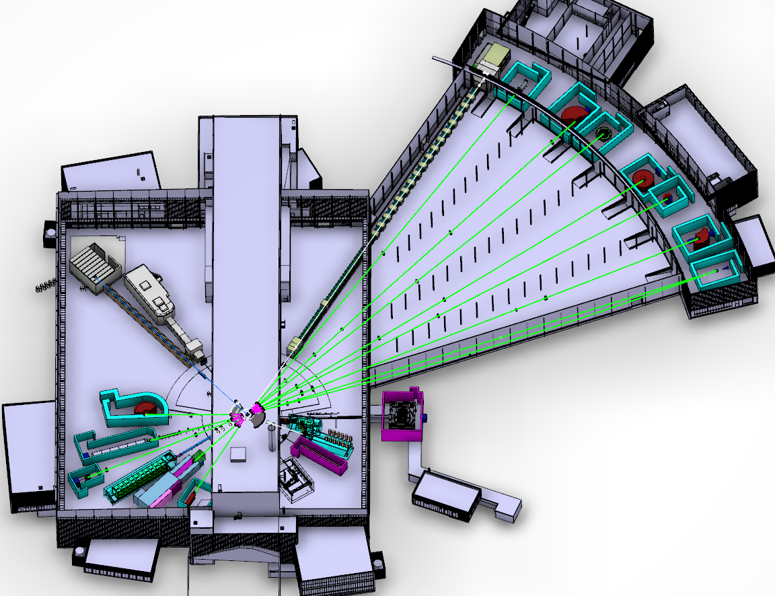
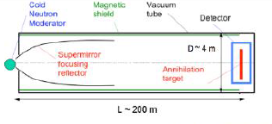
Fundamental & Particle Physics @ ESS
Instruments 1-15; funded by NSS construction project (-2025)
Instruments 16-22; to be funded by initial operations (2019-2025), should include ANNI
NMX
BEER
C-SPEC
BIFROST
MIRACLES
Space for ANNI reserved (cold neutron fundamental physics beamline), cost similar to other instruments
NNbar (letter of intent, significant additional funding required): possible
MAGIC
T-REX
ODIN
DREAM
HEIMDAL
VOR
NNbar, UCN
LoKI
VESPA
FREIA
NNbar
SKADI
HR-NSE
15 (+1) Neutron Instruments (2025)
ANNI
ESTIA
Proton beam
50 m
100 m
150 m

Slide 36
Thank you!

Slide 37


Multi-Blade prototype for ESTIA
Test at CRISP reflectometer
Multi-Blade
Side view
upgrade
262mm
70mm
262mm

Slide 38



MG.SEQ prototype
Readout
Detector signal connected with flex PCBs
Analogue + Digital Front-end: Mesytec MMR
Back-end:
Mesytec VMMR, Struck SIS3153

Slide 39




Multi-Grid detector for CSPEC
Neutrons

Slide 40

MG.SEQ prototype
Time-of-Flight measurement

Slide 41
Time-of-Flight instruments
Using choppers to select neutron energies
162m <336 Hz
108m <252 Hz
40 m
32 m
+Provision of T0 at 19 m

