Slide 1
FREIA Laboratory for Accelerator and Instrumentation Development at Uppsala University
Brief presentation of the FREIA Laboratory at the UU-CERN-RFR meeting for the DFH collaboration project for HL-LHC Wednesday 20 June 2018

Slide 2
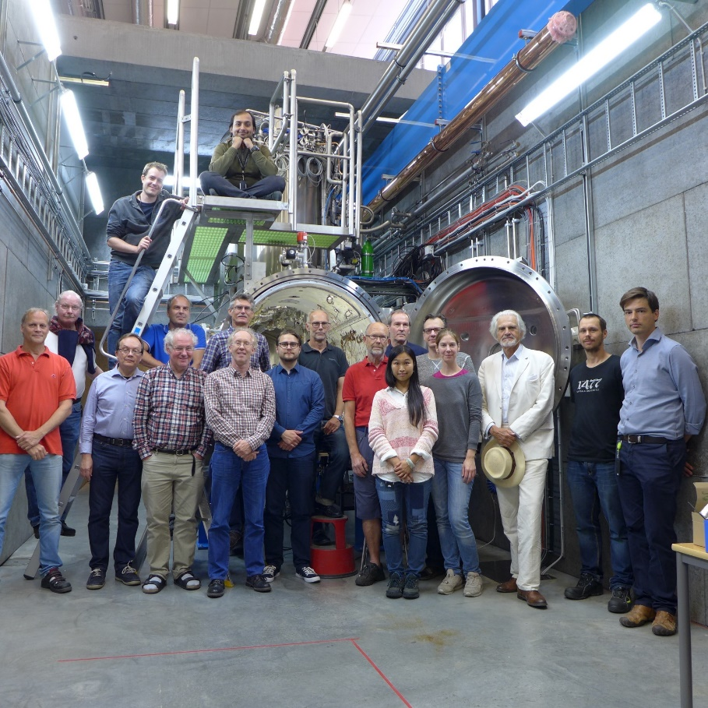
Personnel
8 senior staff have been recruited from the former National Uppsala Accelerator Laboratory TSL.
New recruitments of mostly younger members of the personnel have been made through wide international announcements.
Two out of the currently three recruitments made from outside Sweden (from China, Spain and Ukraine) are women.

Slide 3

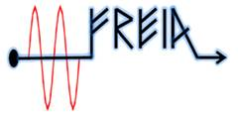
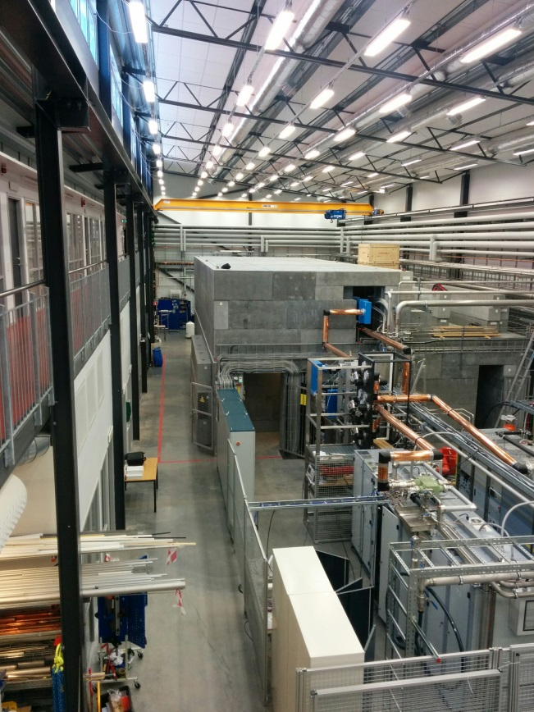
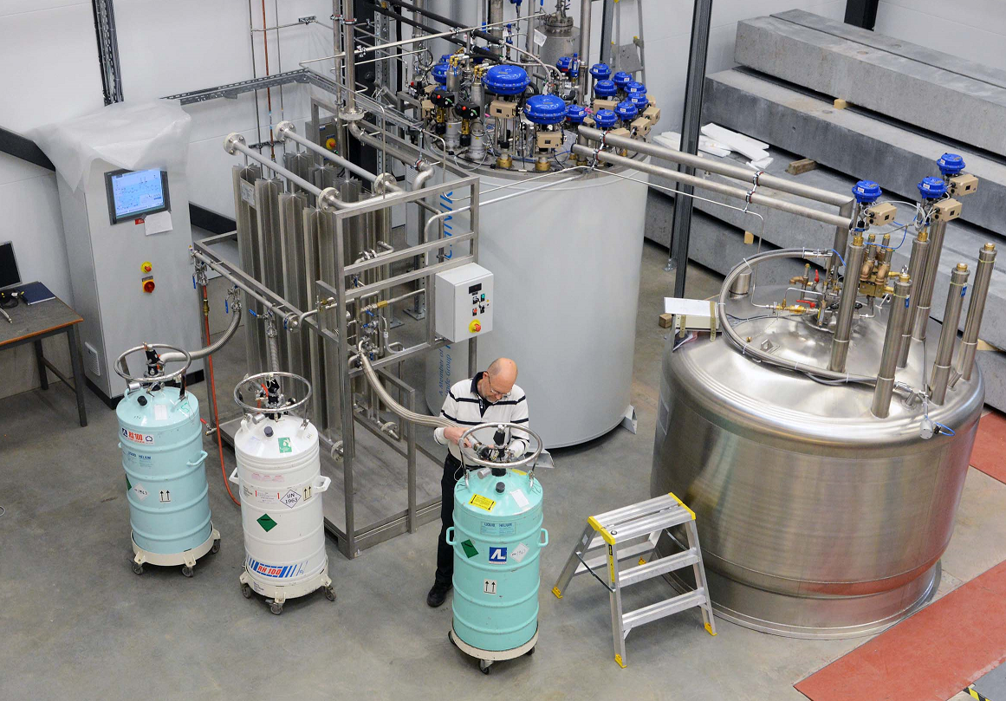
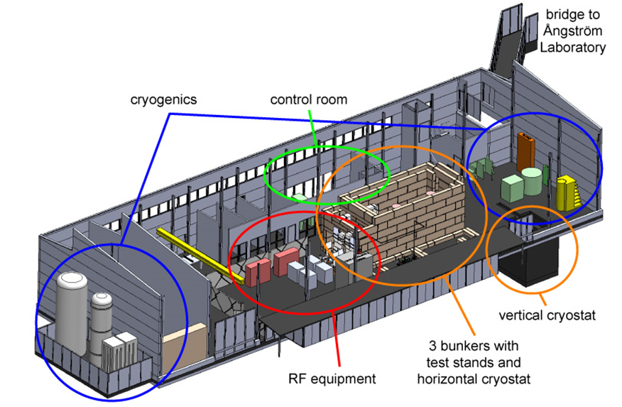
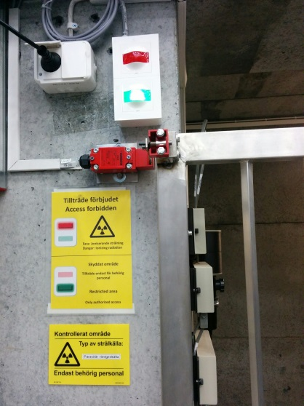
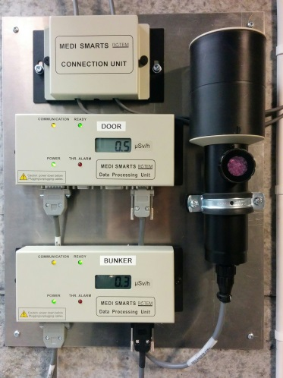
Infrastructure
Major high-tech infrastructure for accelerator and instrumentation development and tests.
The nearby Ångström Mechnical Workshop with its highly qualified workshop personnel and large set-up of modern numerical workshop machines is a significant asset for FREIA.
The FREIA laboratory will have to continuously develop and complement its infrastructure when collaborations on new projects will be added to the current activities.
Funding will be needed in future not only to cover the operational costs but also for investments in new infrastructure.
FREIA stands for "Facility for Research Instrumentation and Accelerator Development". The FREIA Laboratory was established in 2011 within the department of Physics and Astronomy at Uppsala University, to develop and test new particle accelerator and detector instrumentation. Freia is located at the Ångström Laboratory campus and was inaugurated in 2013.
Cryo Plant
The Hall
1000 m² large, 10 m high. Has a 6.3-ton movable crane and other mechanical equipment, office space for ~15 people, small workshops for mechanics and electronics and 50 m² control room.
Cryogen Distribution
The cryogenic facility produces and distributes liquid helium and provides liquid nitrogen to the test cryostats in the FREIA Laboratory
In addition it provides these cryogens to all other research departments at the University.
Bunkers
Three concrete bunkers for equipment producing ionizing radiation.
1 bunker, 10.4 m x 4.0 m x 4.8 m high, with cryostat
2 bunkers, dimension 4.0 m x 2.8 m x 2.4 m high
Monitoring systems for ionizing radiation and oxygen deficiency
Helium Liquefier
Helium liquefier 140 l/h at 1.15 bar.
Liquid helium storage dewar 2’000 l.
Liquid nitrogen storage dewar 20’000 l at 3 bar.
High pressure helium gas storage, 11 m³ at 200 bar.
High pressure helium gas recovery compressor station, 75 m³/h at 200 bar.
Impure helium recovery gas storage balloon 100 m³.
Helium gas sub-atmospheric pumping system, 3 g/s at 10 mbar
Radiation Safety
Interlock system prevents entry into the experimental bunker
Area monitoring detectors outside and inside the bunker
FREIA stands for "Facility for Research Instrumentation and Accelerator Development". The FREIA Laboratory was established in 2011 within the department of Physics and Astronomy at Uppsala University, to develop and test new particle accelerator and detector instrumentation. Freia is located at the Ångström Laboratory campus and was inaugurated in 2013.
Cryo Plant
The Hall
1000 m² large, 10 m high. Has a 6.3-ton movable crane and other mechanical equipment, office space for ~15 people, small workshops for mechanics and electronics and 50 m² control room.
Cryogen Distribution
The cryogenic facility produces and distributes liquid helium and provides liquid nitrogen to the test cryostats in the FREIA Laboratory
In addition it provides these cryogens to all other research departments at the University.
Bunkers
Three concrete bunkers for equipment producing ionizing radiation.
1 bunker, 10.4 m x 4.0 m x 4.8 m high, with cryostat
2 bunkers, dimension 4.0 m x 2.8 m x 2.4 m high
Monitoring systems for ionizing radiation and oxygen deficiency
Helium Liquefier
Helium liquefier 140 l/h at 1.15 bar.
Liquid helium storage dewar 2’000 l.
Liquid nitrogen storage dewar 20’000 l at 3 bar.
High pressure helium gas storage, 11 m³ at 200 bar.
High pressure helium gas recovery compressor station, 75 m³/h at 200 bar.
Impure helium recovery gas storage balloon 100 m³.
Helium gas sub-atmospheric pumping system, 3 g/s at 10 mbar
Radiation Safety
Interlock system prevents entry into the experimental bunker
Area monitoring detectors outside and inside the bunker

Slide 4
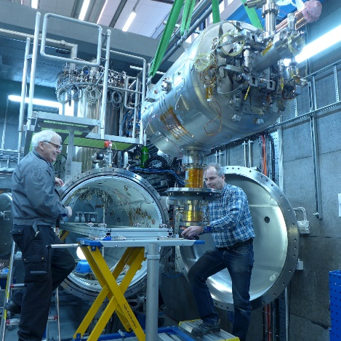
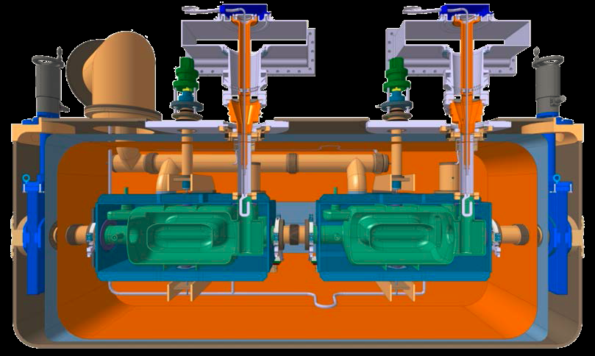
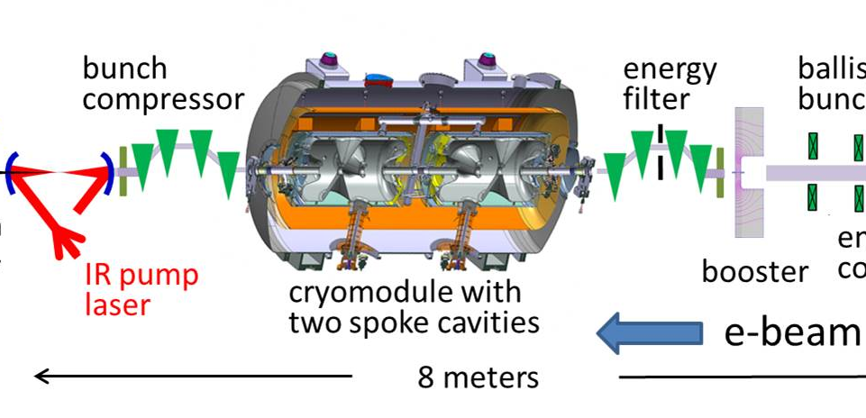
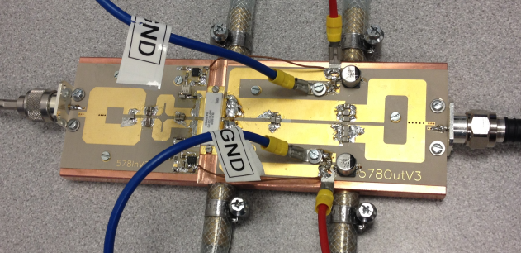
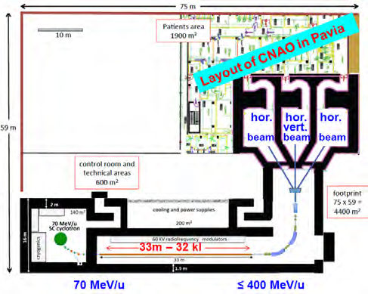
Research profiles
Characterization of
superconducting
cavities for the ESS
Linear Accelerator
Test and development of
Crab cavities for the CERN
LHC Luminosity Upgrade
Development of
Control system for
ESS modulators
Doubling of the linac power
and compression of the proton
pulse for the ESS Neutrino
Super-Beam (ESSnuSB) project
Commission the Laser
Heater for X-FEL
Enabling technology
of generation of
single-cycle light-beams
High-power microwave
sources for scientific
and industrial accelerators
Superconducting Light Ion
Haron Therapy Cyclinac

Slide 5
Finances
There are also contributions coming from several EU-projects in which FREIA is a partner:
EUCARD2 40 kEURO,
ARIES 337 kEURO,
EuroNuNet 16 kEURO and
AMICI 100 kEURO.
§
The regular operations budget from the Faculty to FREIA is 0.1 MEUR/year.

Slide 6
Academic culture
The FREIA research and development results are presented by FREIA scientists at seminars and international conferences and published in refereed journals, conference proceedings and internal reports.
FREIA staff are contributing to the teaching to a variety of undergraduate and graduate courses at the University
FREIA is inviting external scientists to give seminars at the Department of Physics and Astronomy (Carlo Rubbia of CERN, Ken Long of Imperial College and John Womersley of ESS are examples of renowned scientists recently invited to give FREIA seminars).
The FREIA activities regularly reviewed at the weekly meetings of the FREIA Division.

Slide 7
Teaching
8 FREIA lecturers
giving
lecture hours
and
158 laboratory instruction
hours

Slide 8
FREIA Vision
Pursue physics research and development on the national and international level in collaboration with large research infrastructure and industry of accelerators and instrumentation for the development of new research instruments for Neutron Physics, Particle Physics, Synchrotron Radiation Physics, Medical Physics, Nuclear physics, Fusion Physics, Astronomy and Space Physics.

