Slide 1
FREIA Laboratory
Facility for Research Instrumentation and Accelerator Development
Overview of R&D Activities
Roger Ruber for the FREIA Team
CERN, 20 June 2018

Slide 2
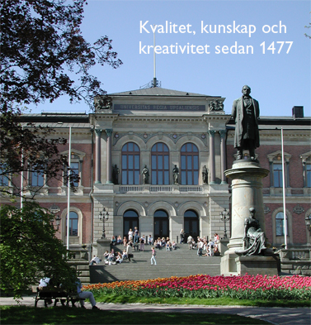
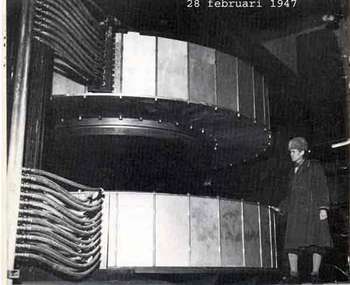
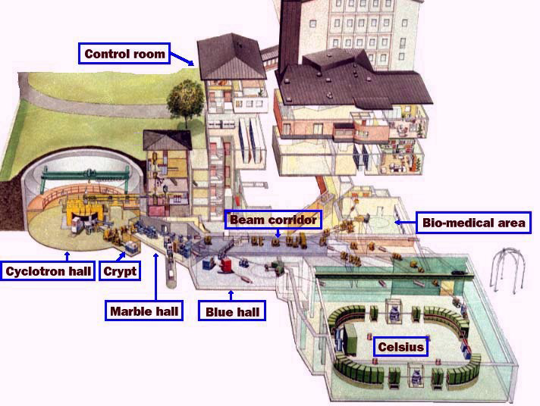
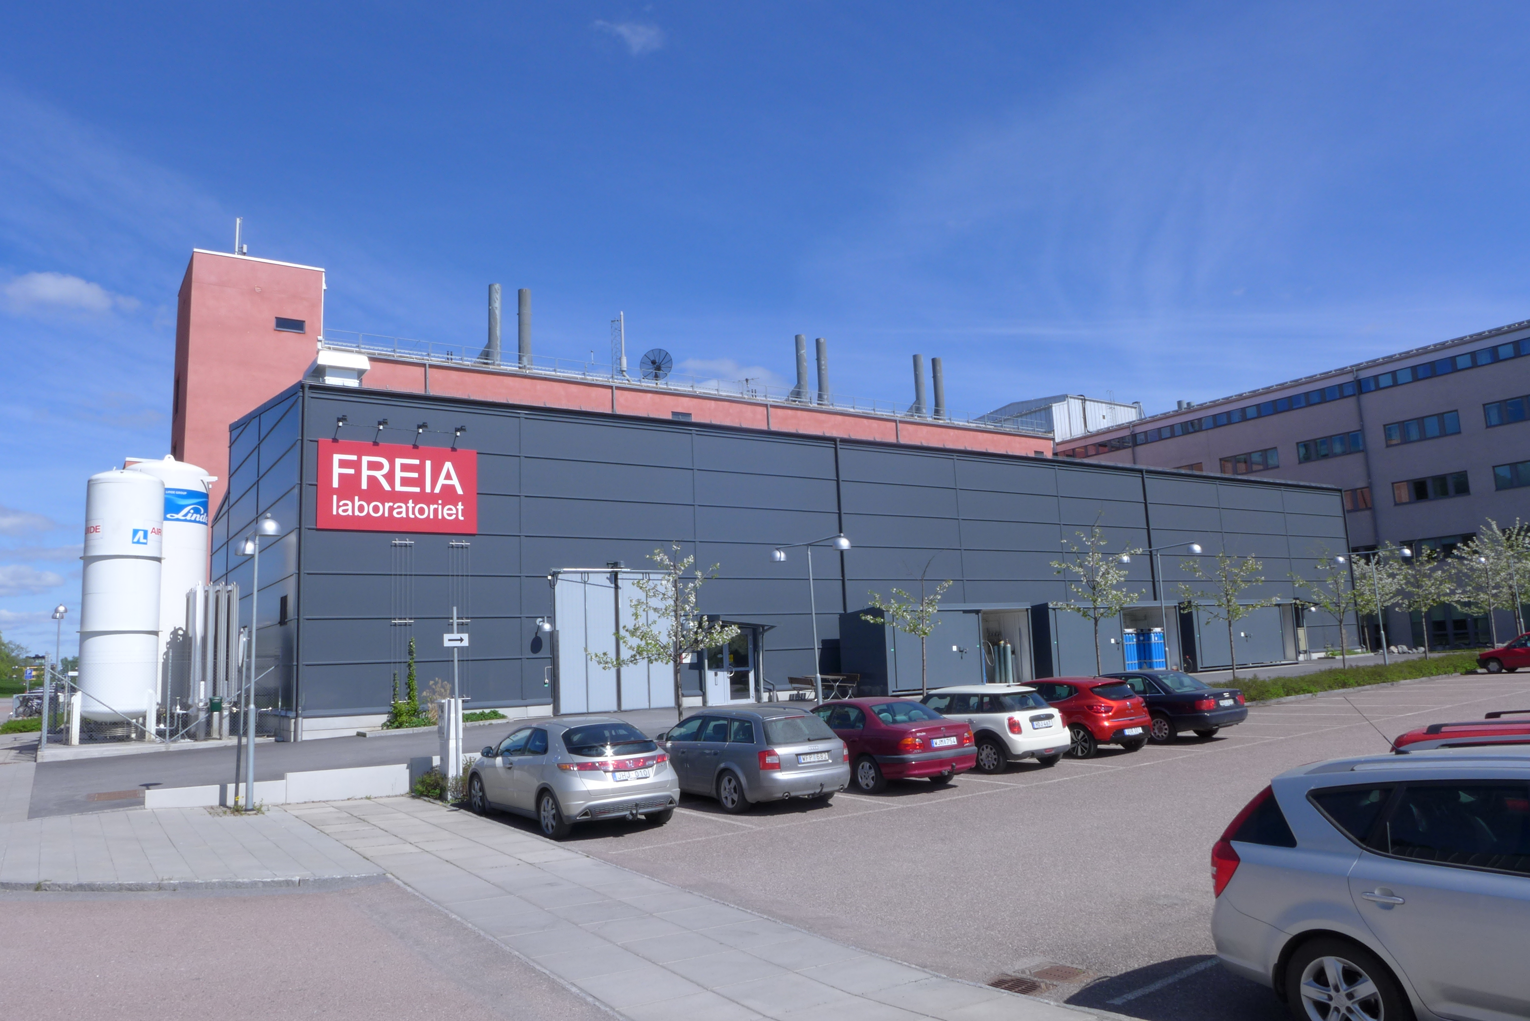
Uppsala Accelerator History
1477: Uppsala University, oldest in Scandinavia
25'000 students, 7'000 staff
historical profiles: Linné, Rudbeck, Celsius, Ångström, Svedberg
1940's: The(odore) Svedberg builds a cyclotron
Gustaf Werner synchro-cyclotron (1947 - 2016)
  nuclear physics & oncology
CELSIUS ring (1984 - 2005)
  nuclear & particle physics
2000's: External projects
CTF3/CLIC (since 2005)
FLASH/XFEL (since 2006)
ESS (since 2009)
2010's: New ventures
FREIA laboratory (est. 2011)
Skandion clinic (est. 2015)

Slide 3
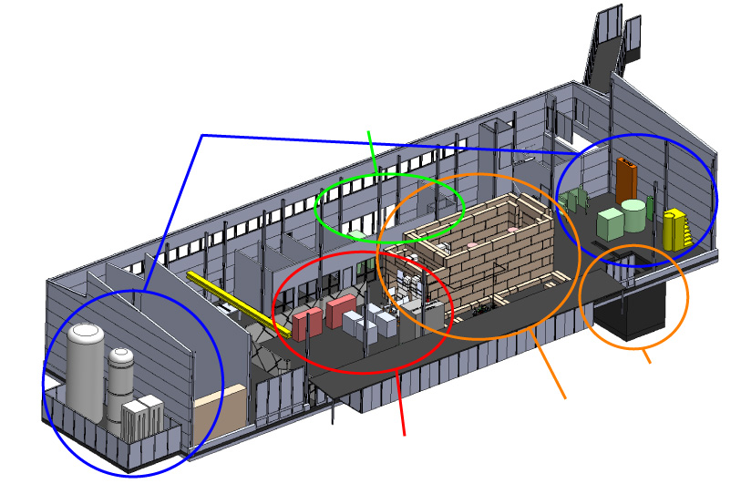
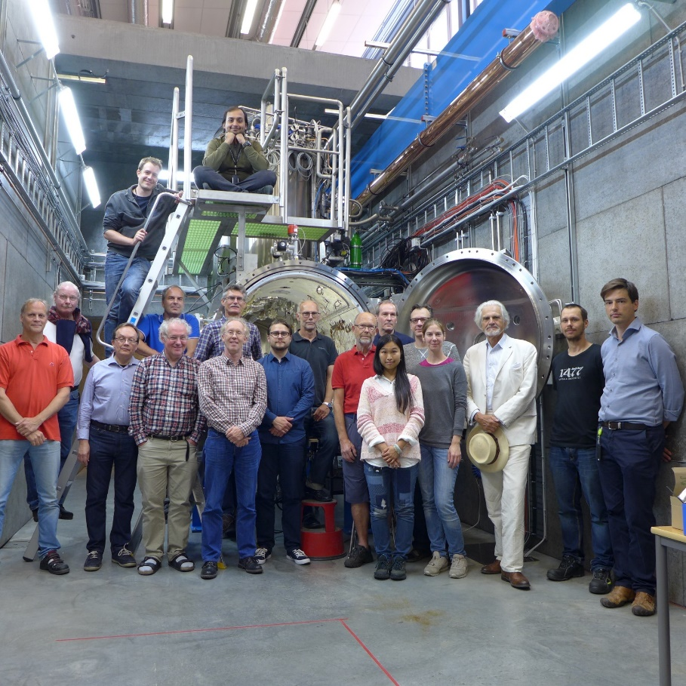
FREIA
Facility for Research Instrumentation and Accelerator Development
Funded by
KAWS, Government, Uppsala Univ.
State-of-the-art Equipment
cryogenics
- liquid helium
- liquid nitrogen
control room
- equipment controls
- data acquisition
Competent and motivated staff
collaboration of physics (IFA)
and engineering (Teknikum).
vertical cryostat
3 bunkers
with test stands
horizontal cryostat
radio-frequency (RF) power sources

Slide 4
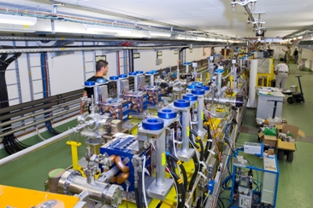
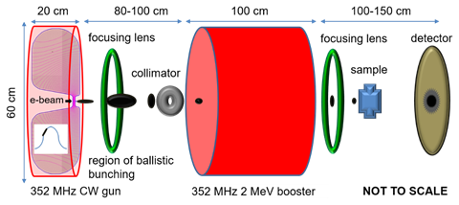
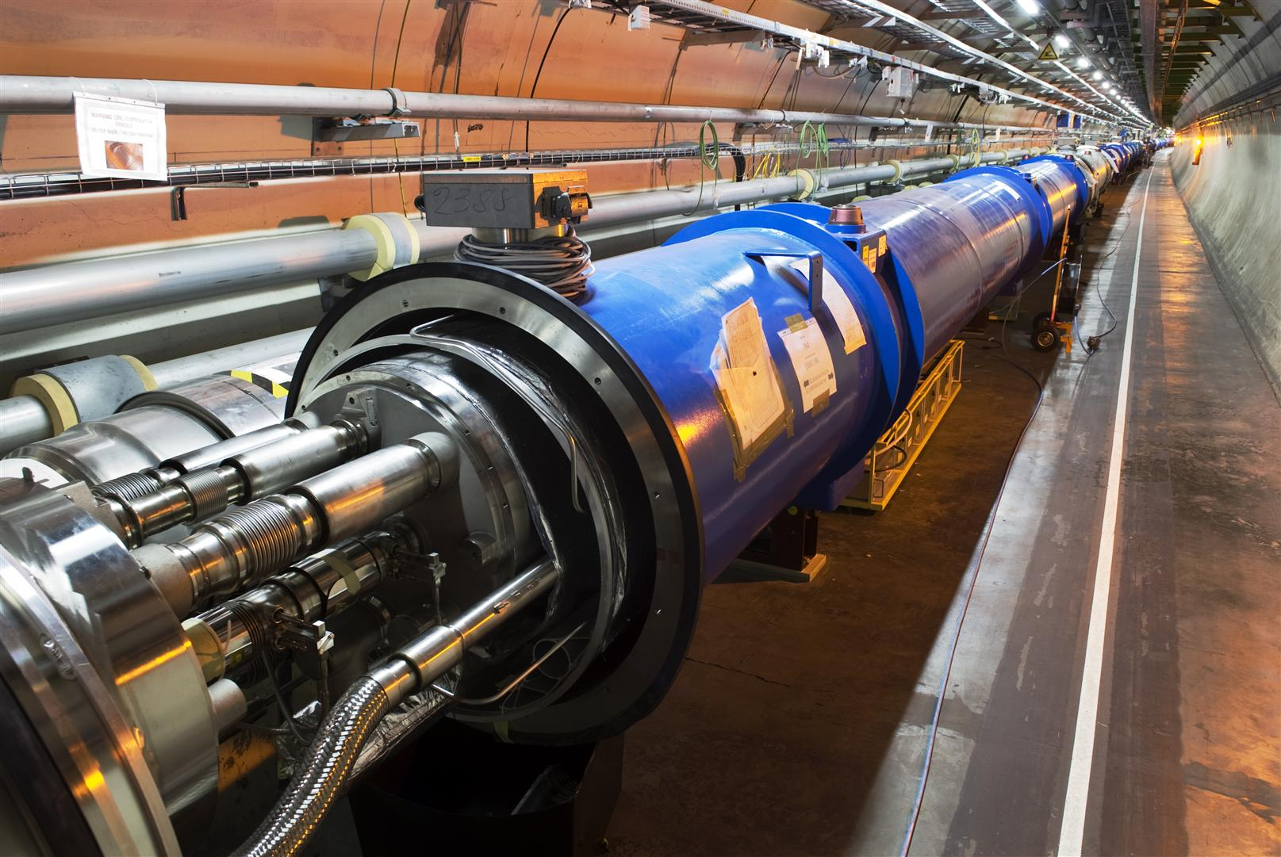
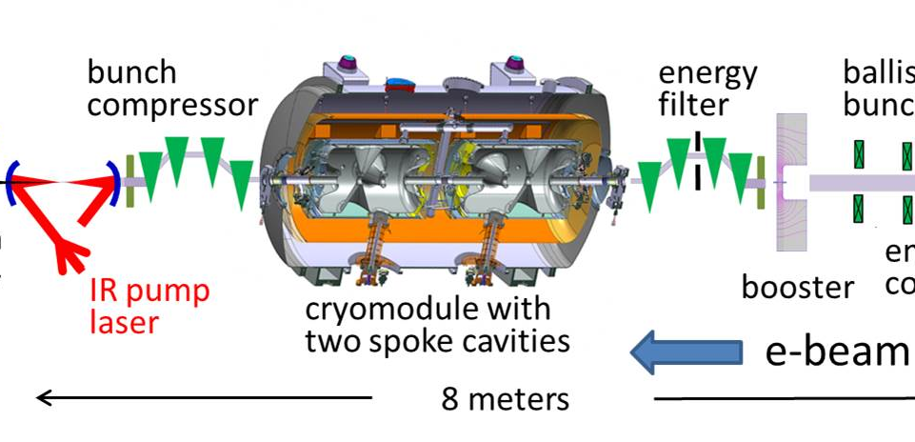
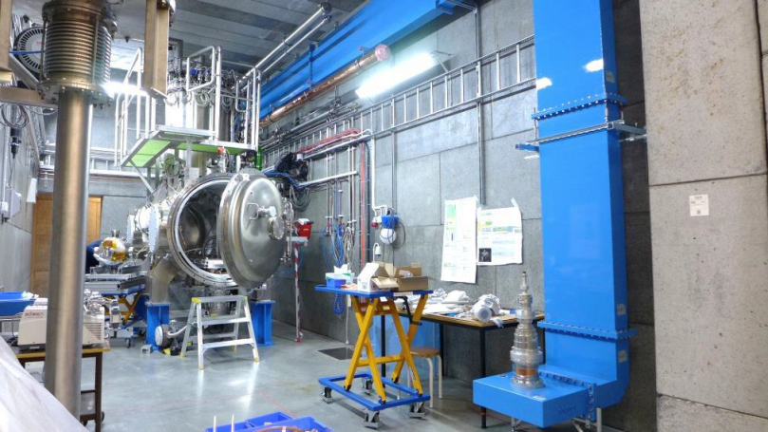
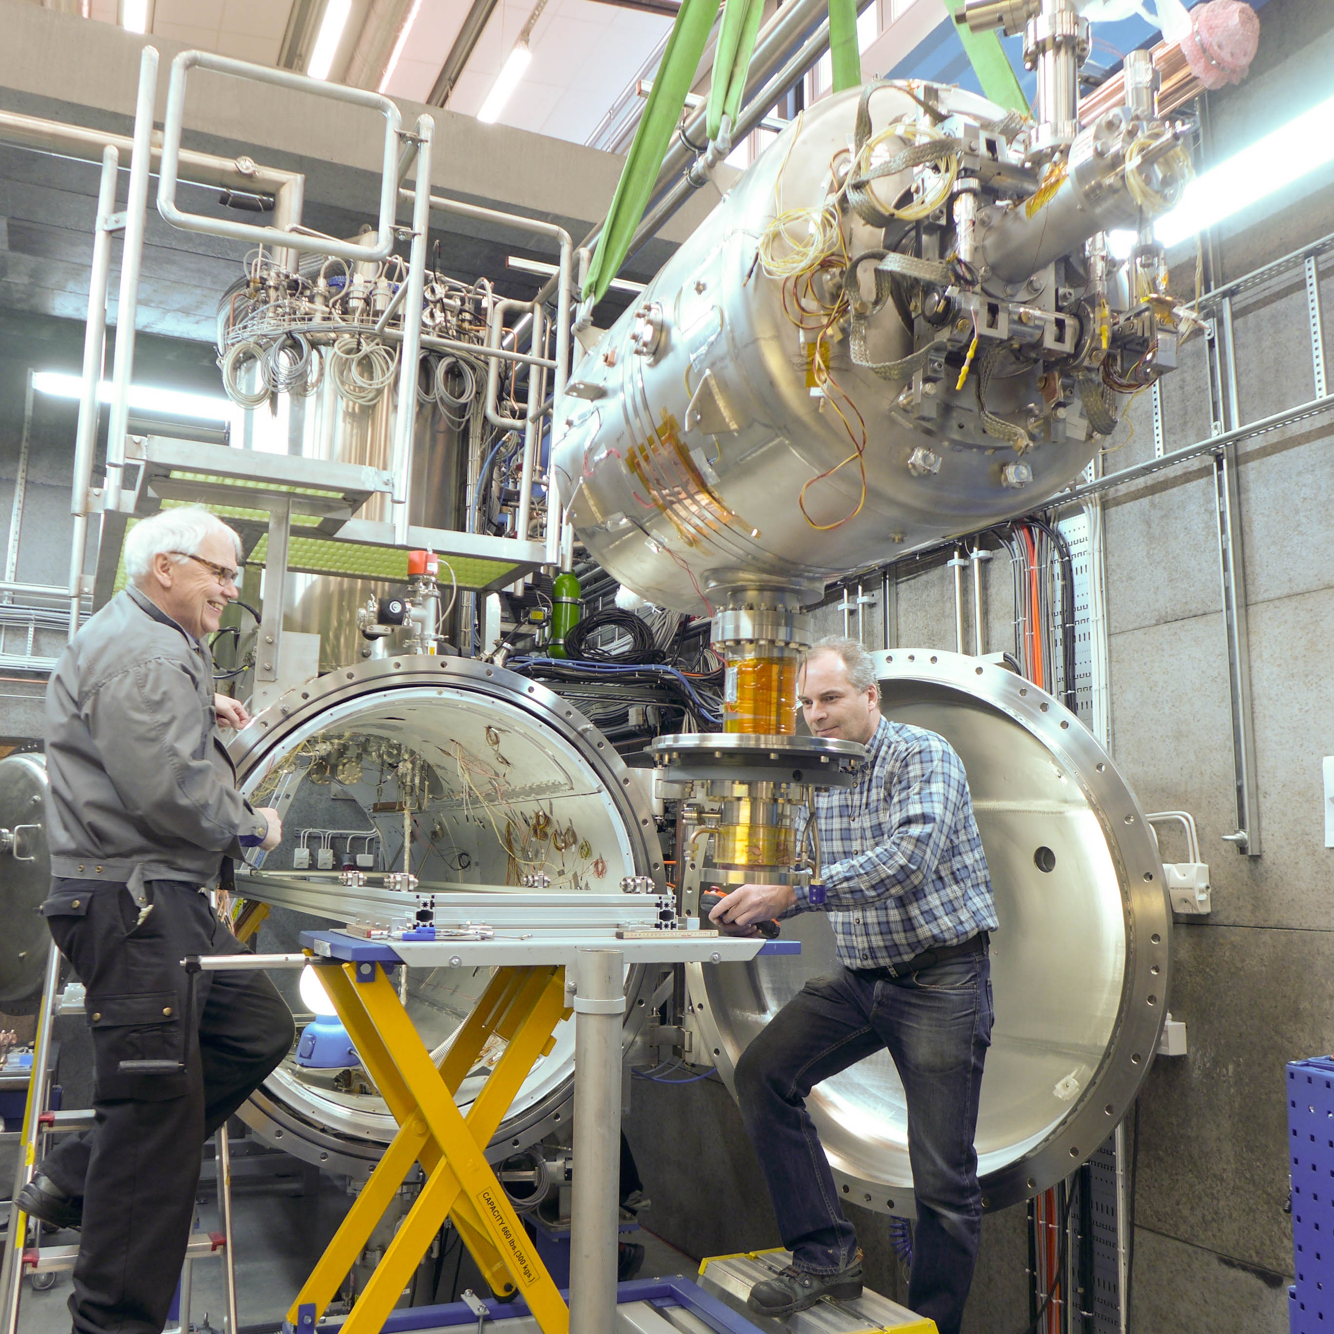
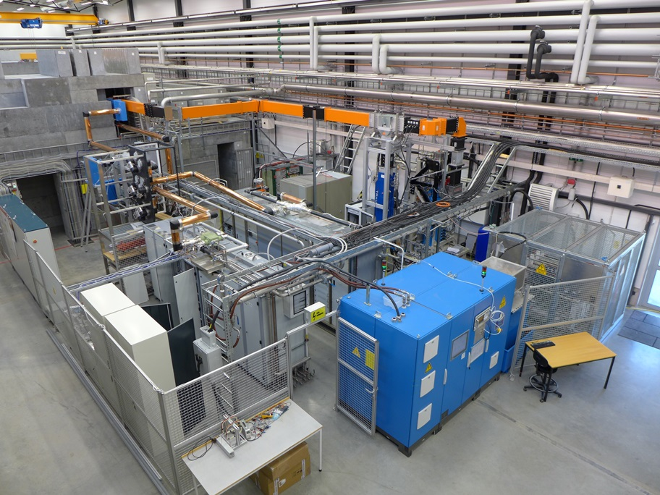
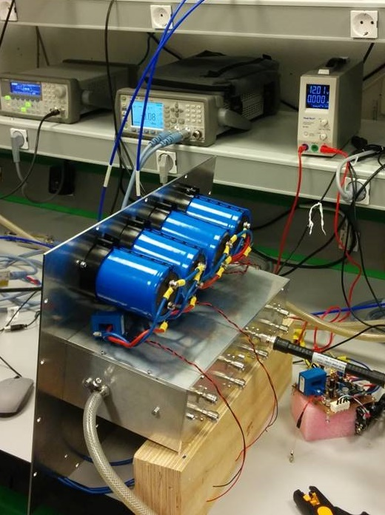
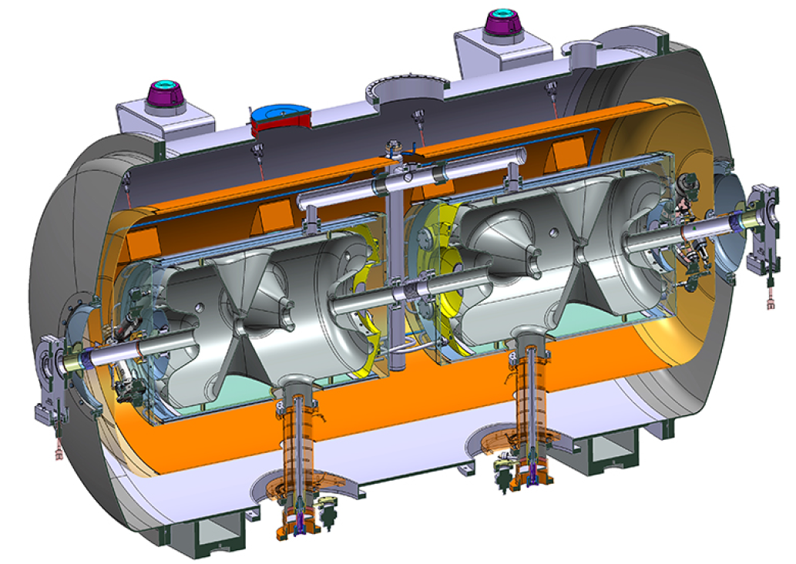
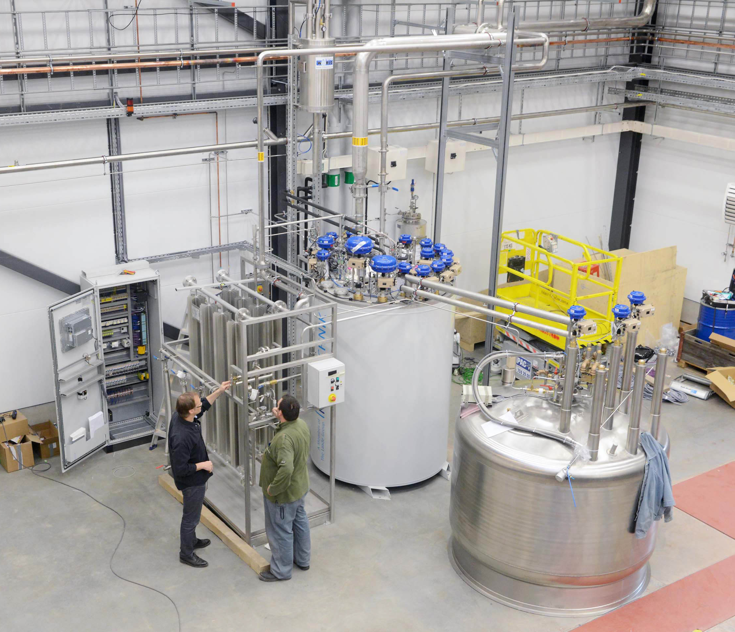
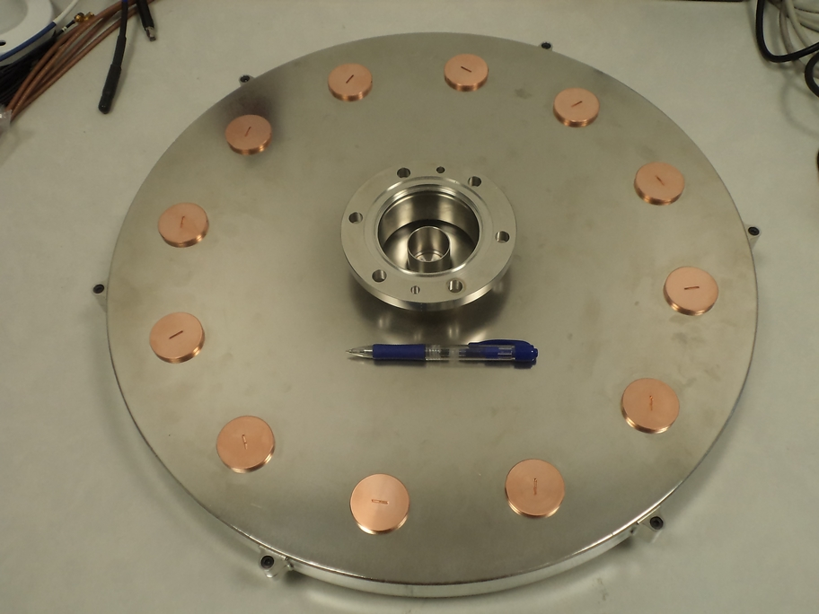
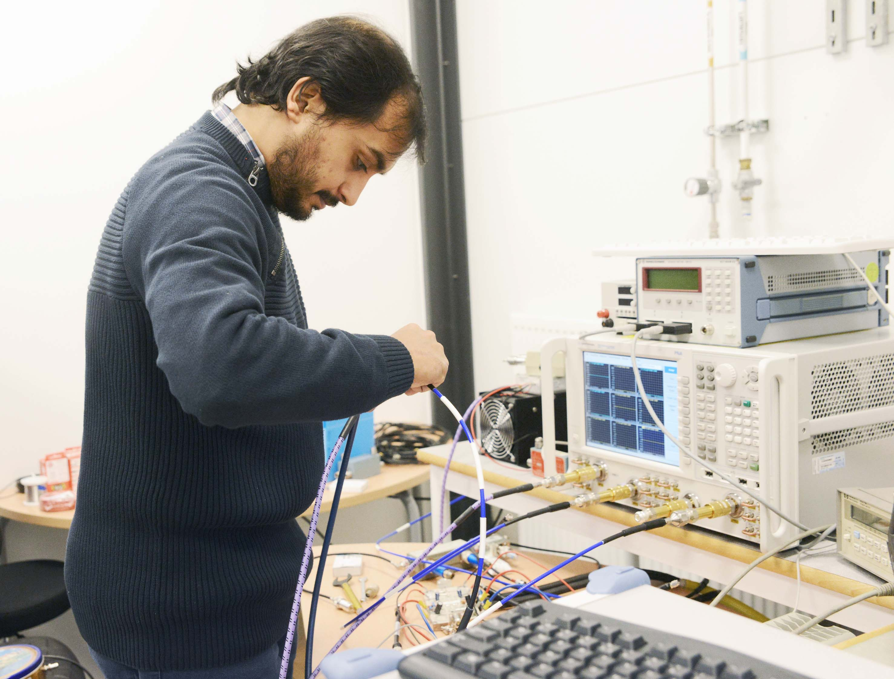
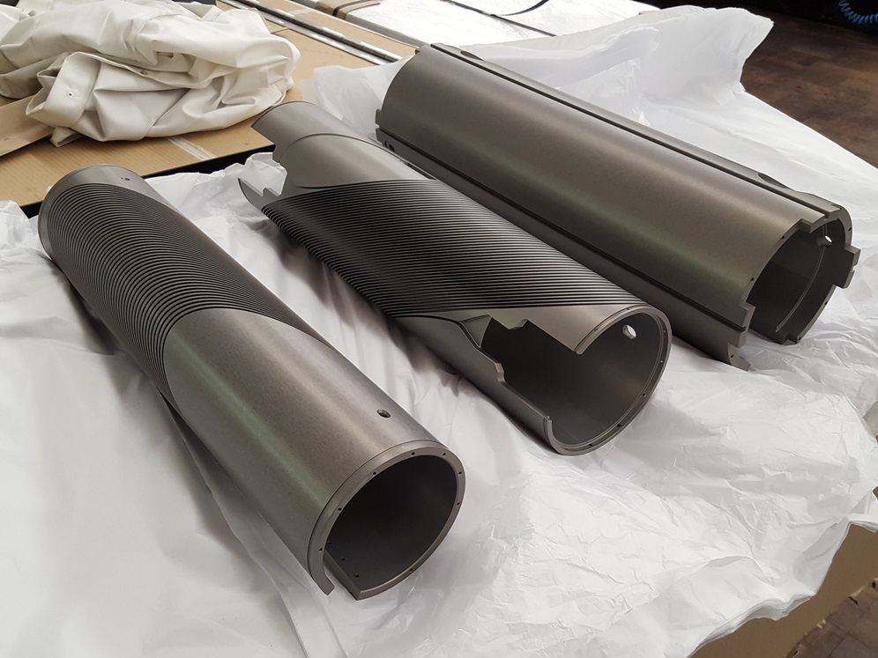
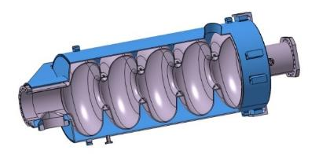
Accelerators & Instrumentation
Ultra Bright Electron Beams
High Intensity Proton Beams
Advanced Instrumentation
SC Cavities & Magnets
RF Generation & Control
Cryogenics

Slide 5
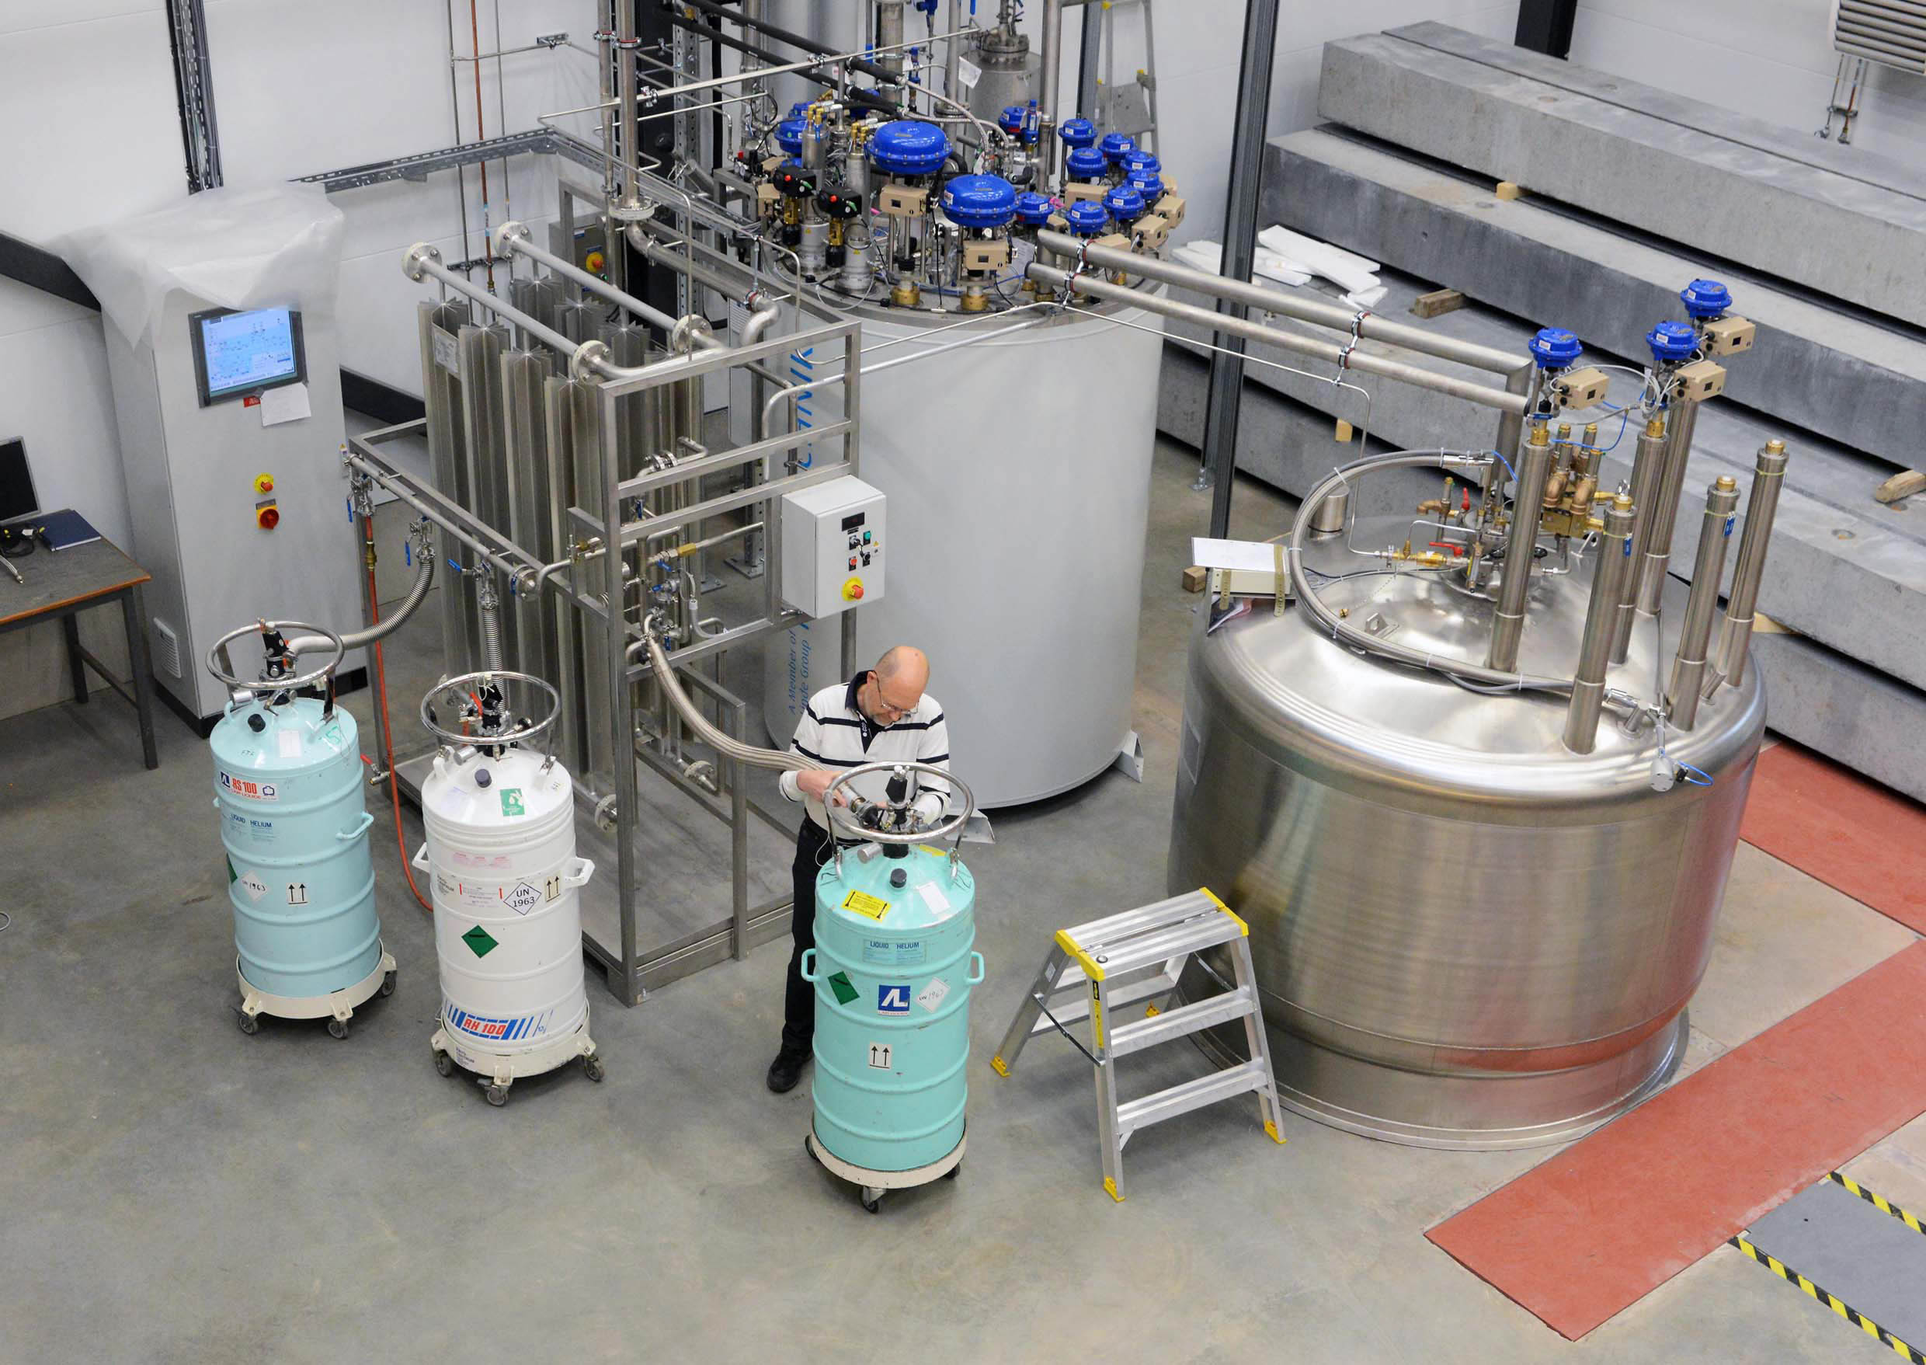
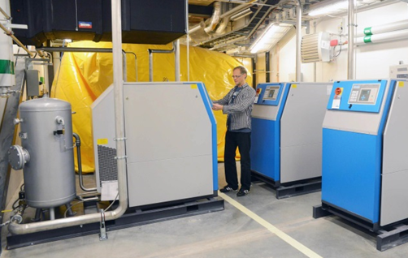
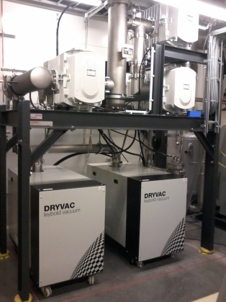
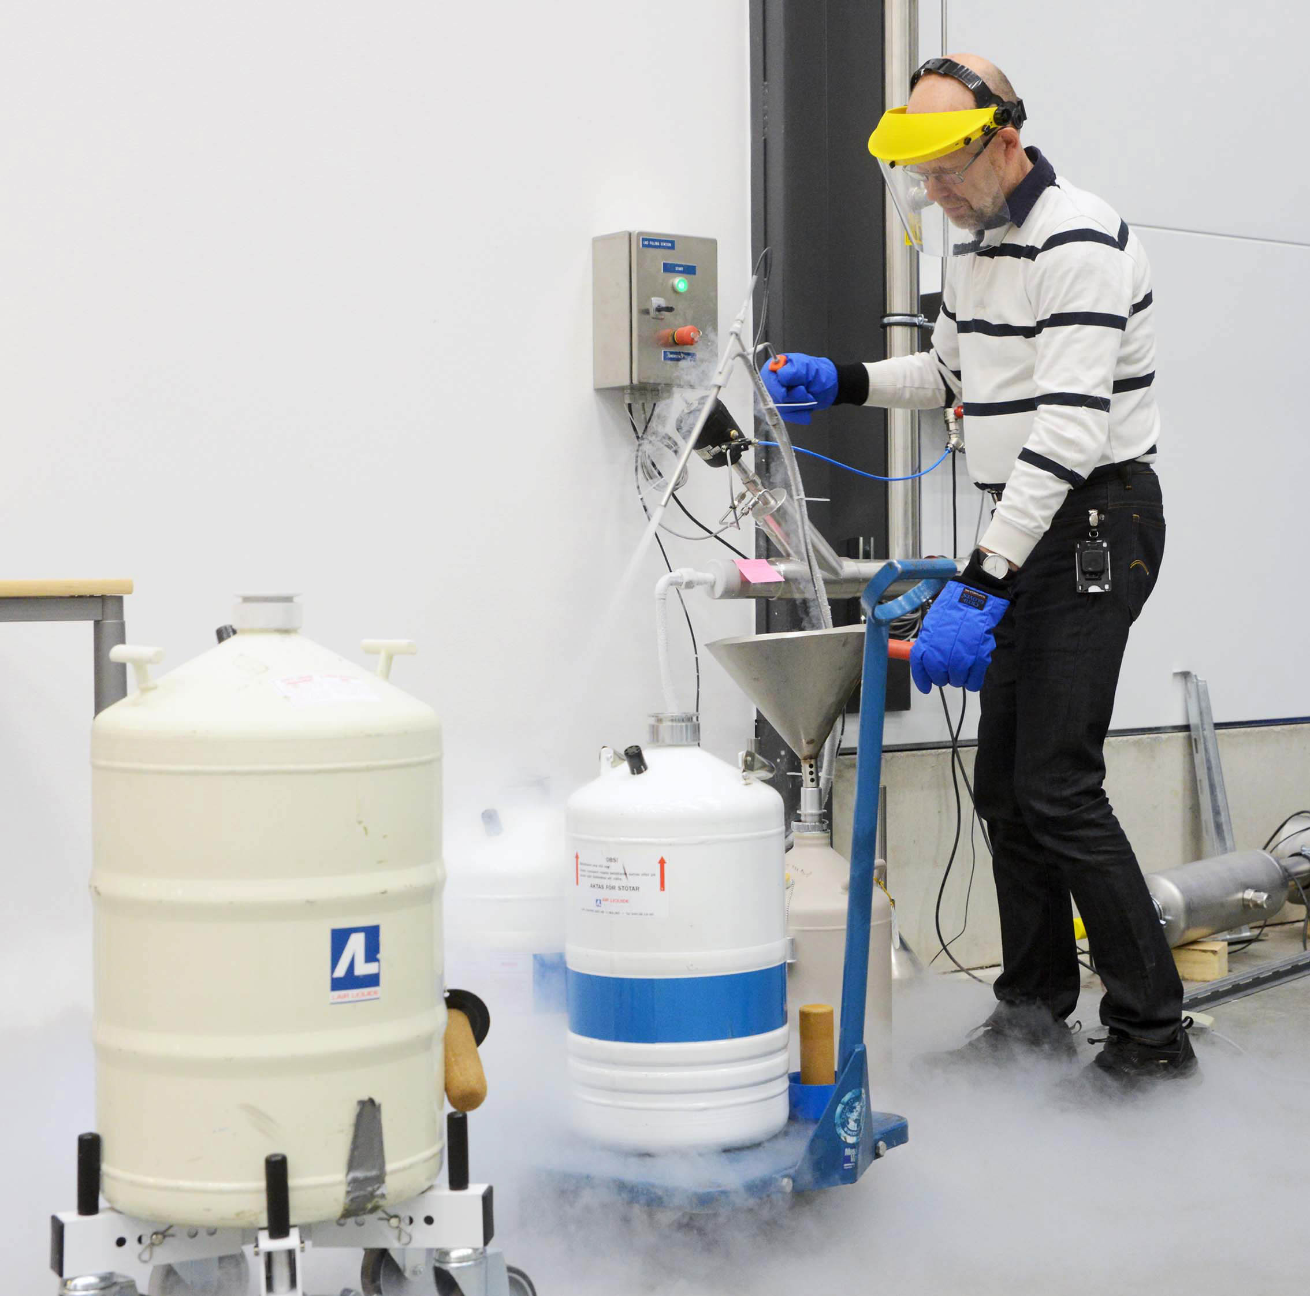
Cryogenics
Helium liquefaction
  150 l/h at 4.5K (LN2 pre-cooling)
  2000 l LHe dewar/buffer, 3+1 outlets
  cryostats connected in closed loop
Gas recovery
  100 m³ gasbag
  3x 25 m³/h compressor
  10 m³ 200 bar storage
2K Pumping
  ~3.2 g/s at 10 mbar
  ~4.3 g/s at 15 mbar
  110(90)W at 2.0(1.8)K
Liquid nitrogen
  20 m³ LN2 tank
Helium gas recovery system
Sub-atmospheric pumping station

Slide 6
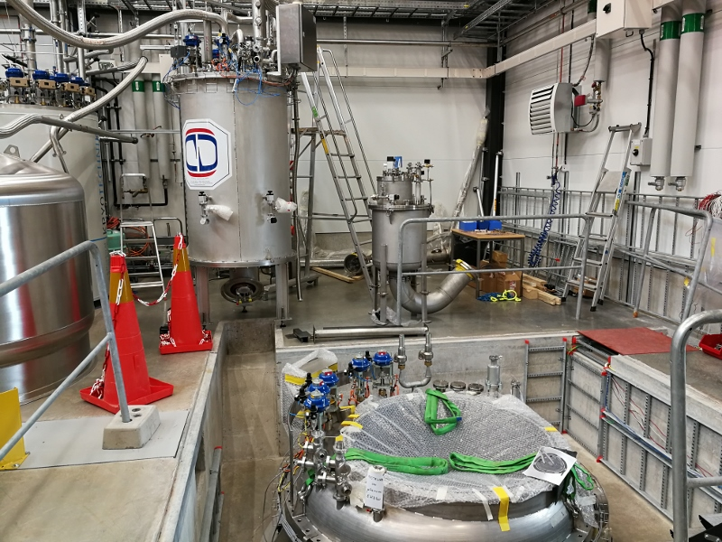
Cryostats
"HNOSS" Horizontal Cryostat
"Gersemi" Vertical Cryostat
test of SRF cavities
  3240 x ø1200mm inner volume
  up to two cavities simultaneously,
  each equipped with helium tank,
low or high power RF testing
  power coupler (top, bottom, side)
  (cold) tuning system
operation range 1.8 to 4.5K.
test of SC magnets or SRF cavities
  3.2m x ø1.1m total volume
  2.65m x ø1.1m below lambda plate
  design includes joint for lambda plate
operation modes 1.8 to 4.5 K
  vacuum
  saturated bath
  pressurized bath (2K heat exchanger)
Available as ARIES
Trans National Access Facility

Slide 7
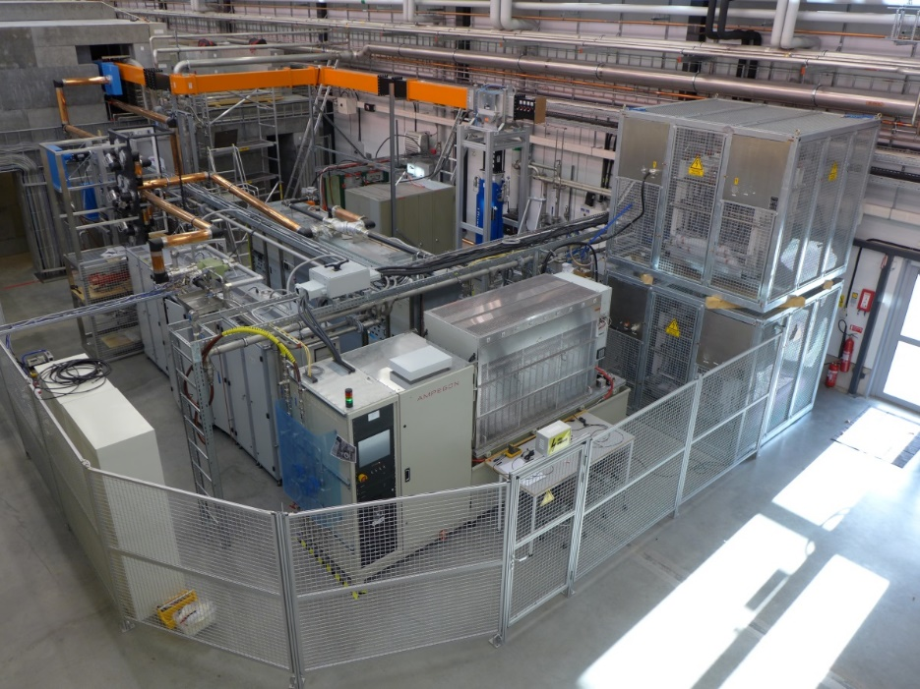
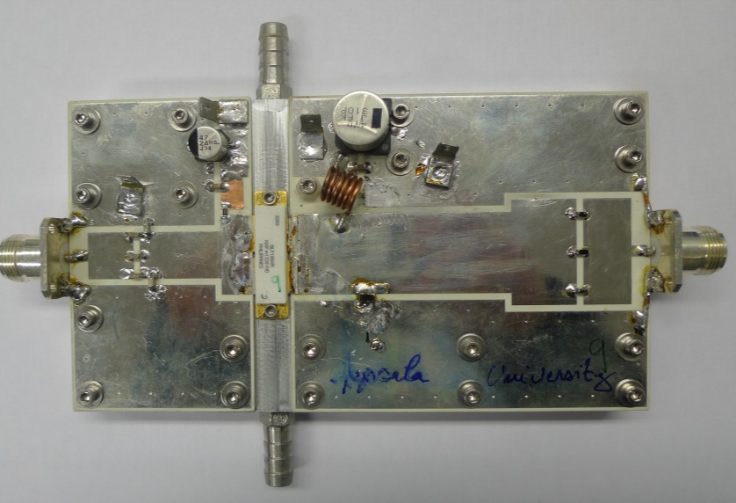
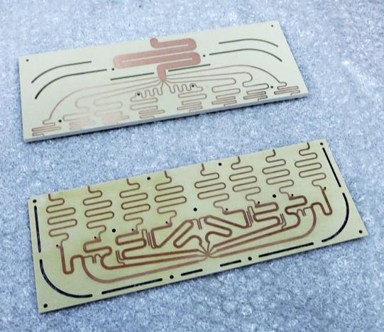
High Power RF Amplifiers
Vacuum Tube
Solid State R&D
352 Dual-tetrode
  2x 400 kW, 3.5 ms, 14-28 Hz
352 / 400 MHz
  50 kW CW (loan from CERN)
704 MHz Klystron
  1.1 MW, 3 ms, 14 Hz (loan from ESS)
single transistor
  1250 W and 70% efficiency
8 transistor demonstrator
  10 kW with ~70% efficiency
compact low-loss combiners
  200 kW 12-to-1 cavity combiner
  10 kW 8-to-1 planar gysel combiner
  20 kW 2-to-1 planar gysel combiner

Slide 8
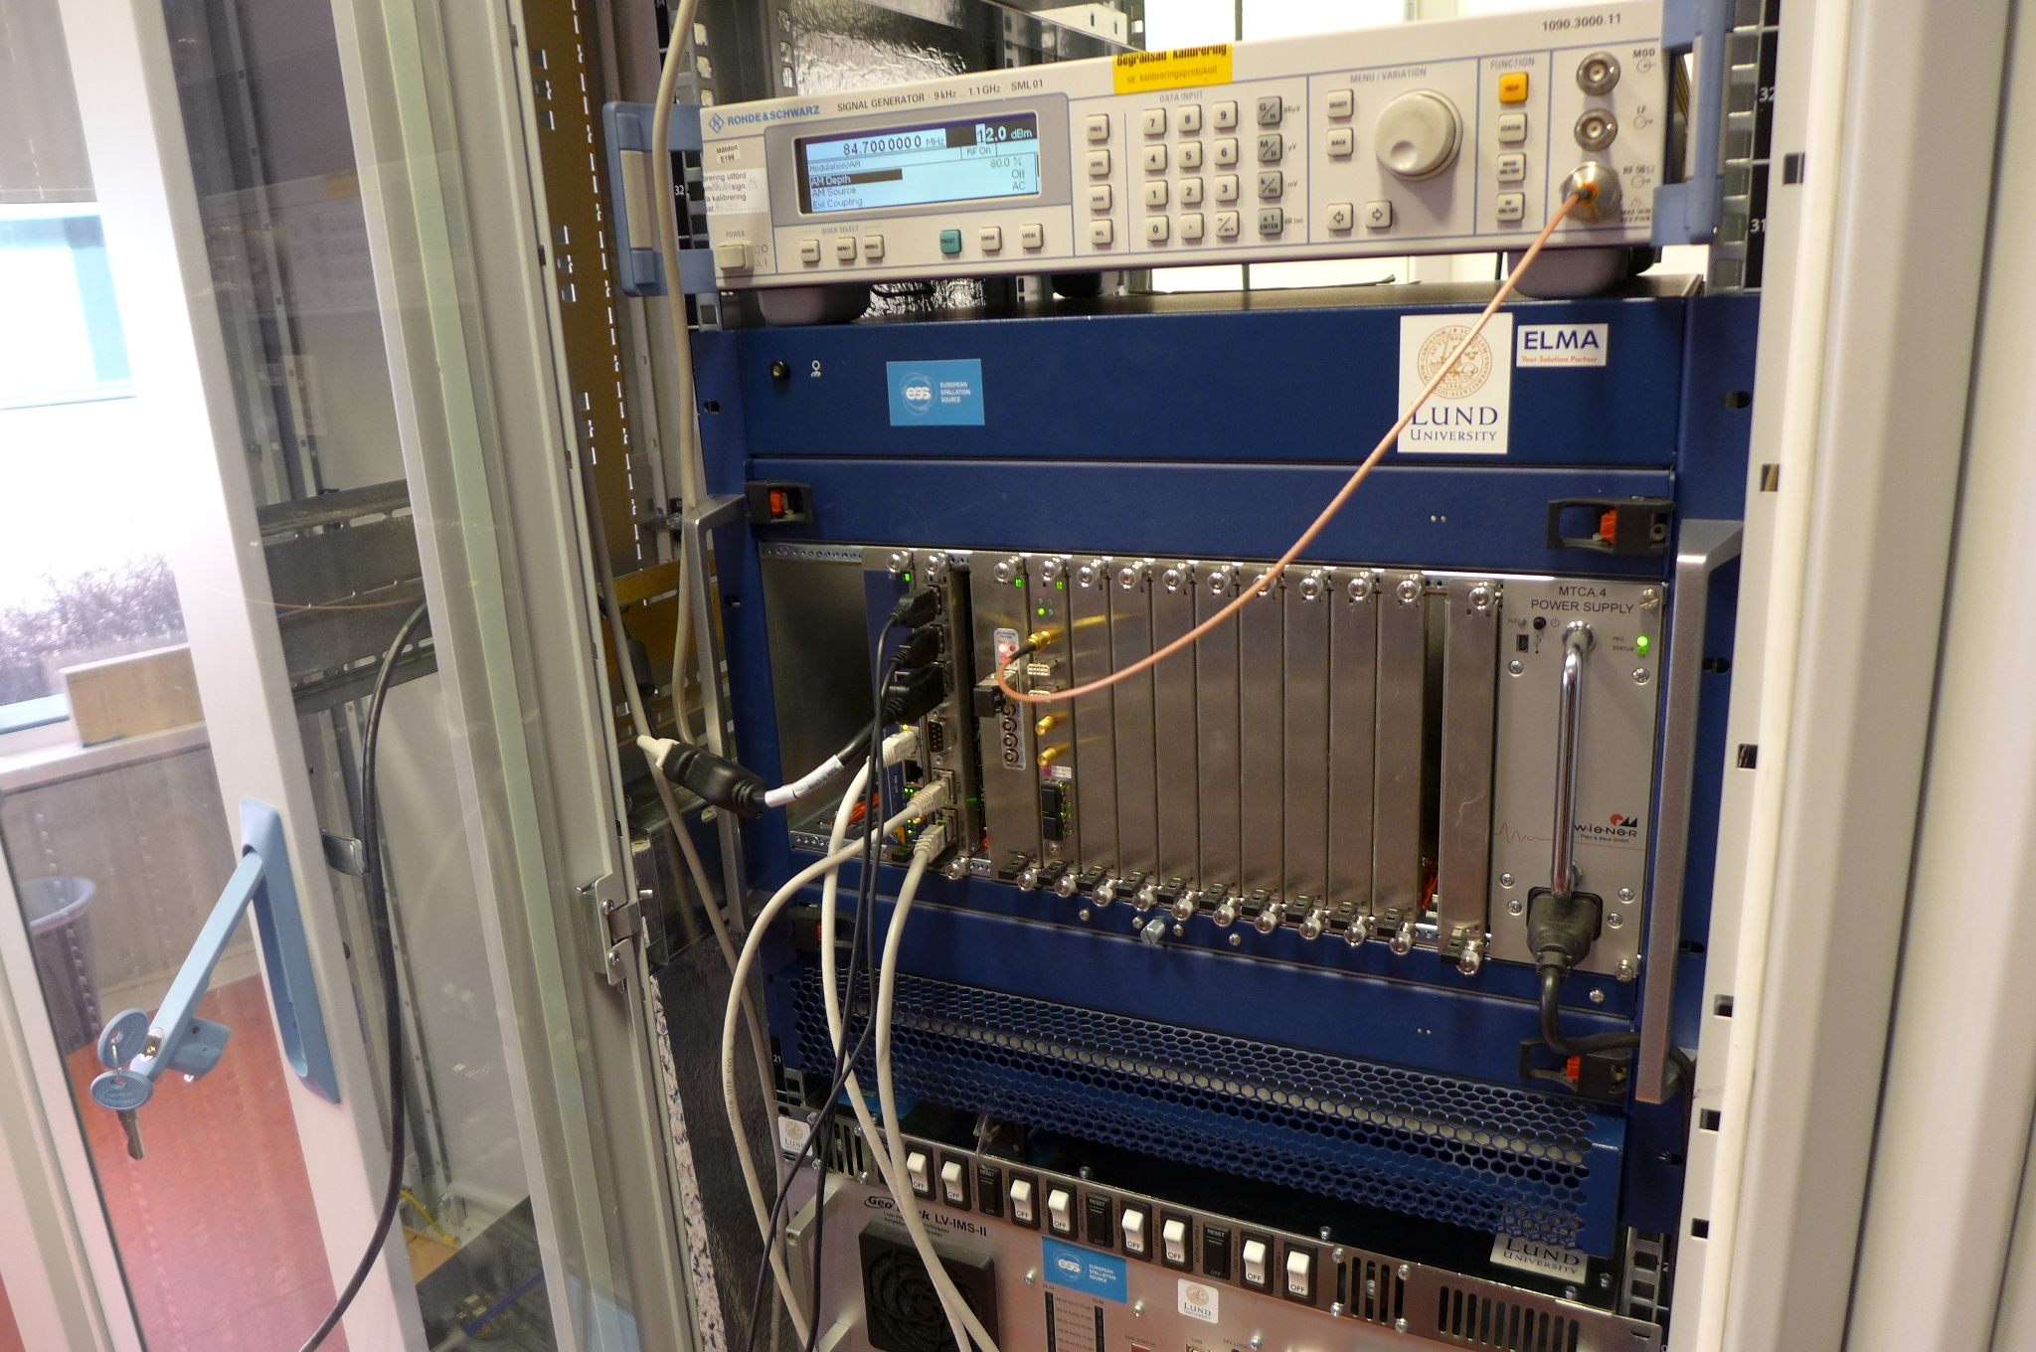
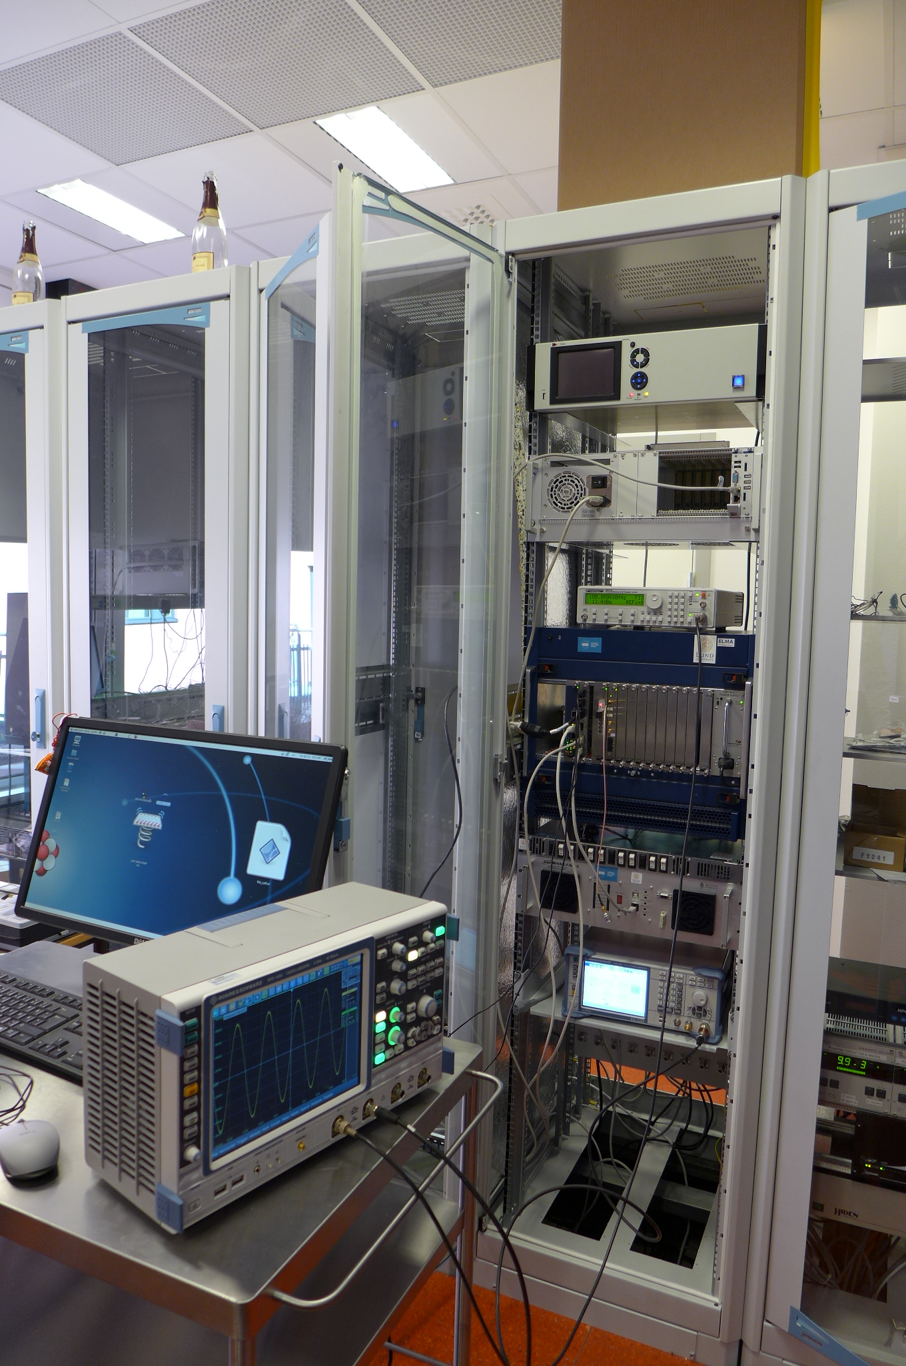
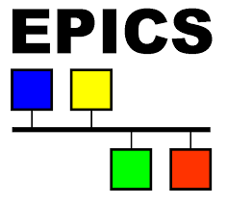
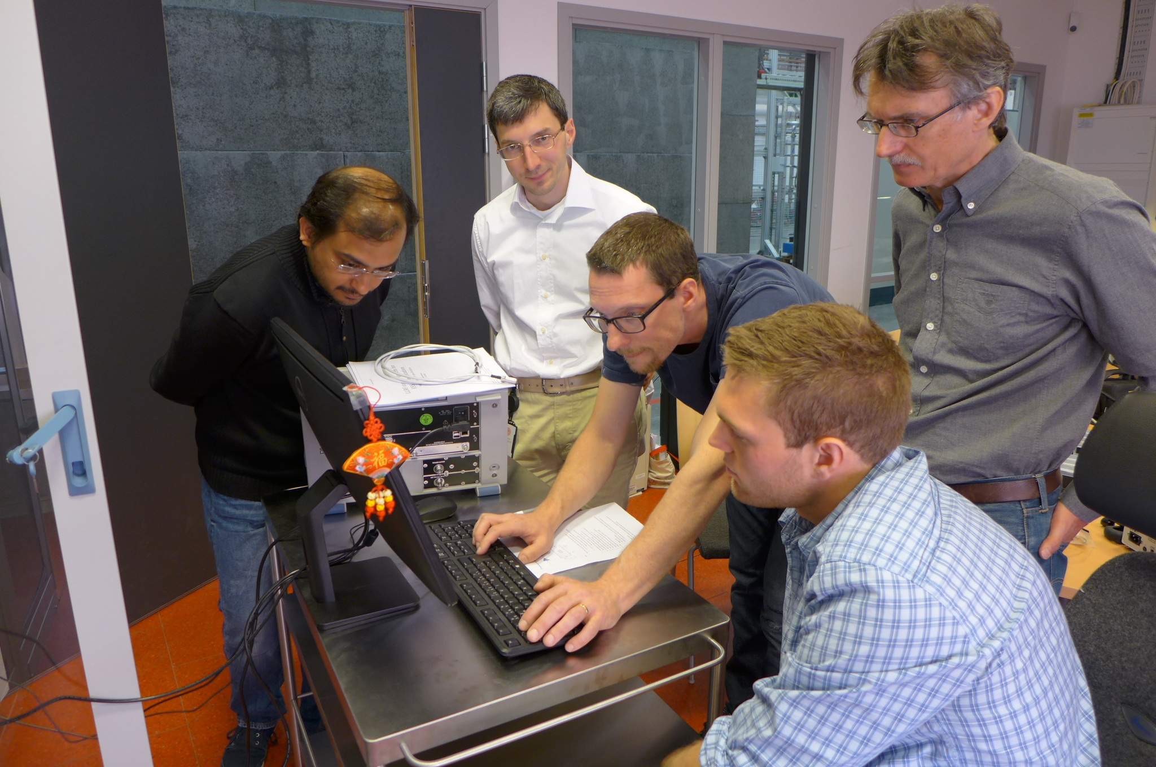
Controls and Measurement
Uppsala LLRF
  Self excited loop 352/704 MHz
    pulsed or CW operation
  Nat. Instr. PXI and LabVIEW
    digital phase control for SEL
    extended RF measurements
Lund Univ./ESS LLRF
  µTCA includes timing system
  external signal generators
Controls and Safety Interlock
  Siemens PLC, NI cRIO
  EPICS interface with data archiver
  connecting different sub-systems:
  cryogenics, cryostats, ...

Slide 9
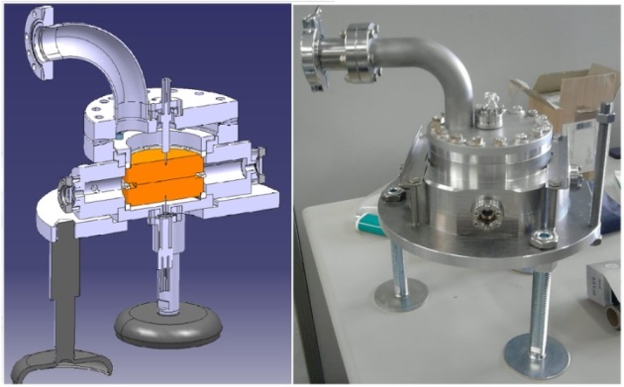
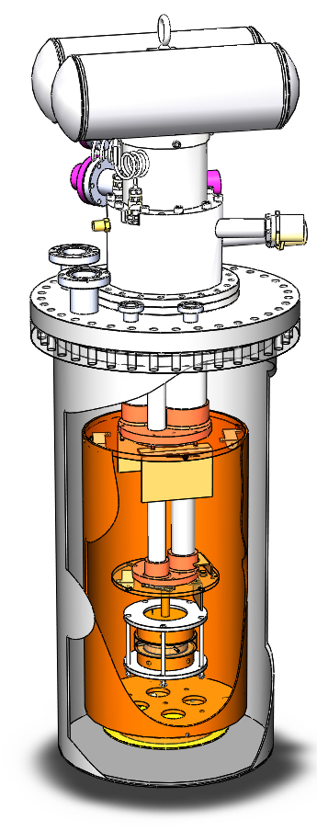
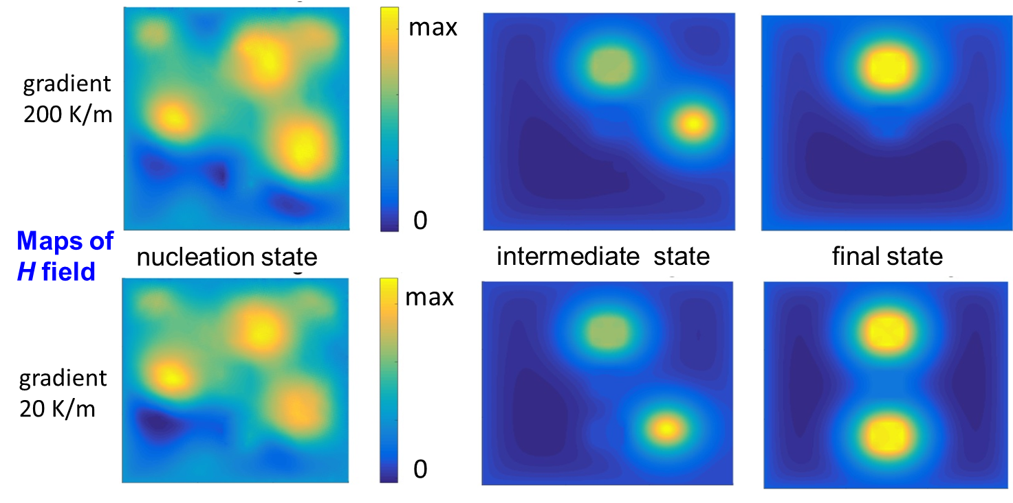
SRF Research
Time-dependent GL Model
Cold DCspark
Impact of spatial gradients on Q0 upon cooldown
  trapped ambient magnetic field leads to the residual resistance
developing a simulation environment based on the first-principle model to study different scenarios of cooldown
  time-dependent Ginzburg-Landau
  supports that the flux expulsion is temperature gradient dependent
field emission and BDR as a function of temperature
complement to RF tests
  allows in depth studies of the fundamental physics of high-fields (e.g. material and surface science)
  possibility to find new and potentially important connections between the high-gradient NC and SC fields

Slide 10
Summary
Uppsala University & FREIA Laboratory
actively supporting accelerator and instrumentation R&D

