Slide 1
Introduction to the Cold Powering Project for HL-LHC
A. Ballarino
Leader of WP6a (Cold Powering)
CERN, 20/06/2018
UU-CERN-RFR Meeting for the DFH Collaboration Protect

Slide 2
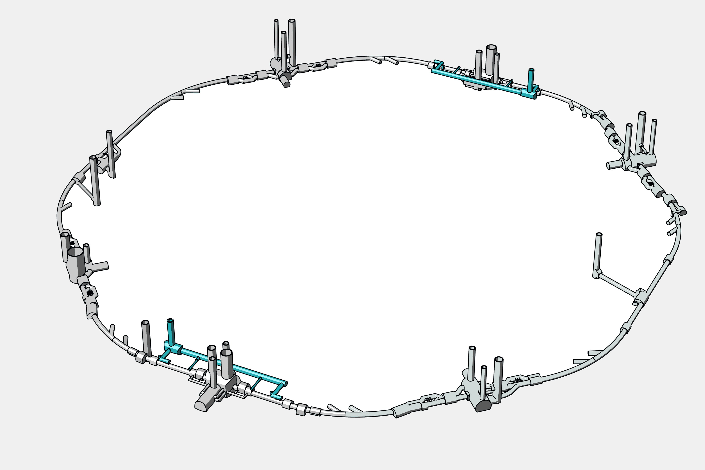
The project
P5 CMS
Powering the HL-LHC SC Magnets
at LHC Point 5 and Point 5
Powering of LHC High Luminosity
magnets at LHC Point 1 and Point 5
P1 ATLAS

Slide 3
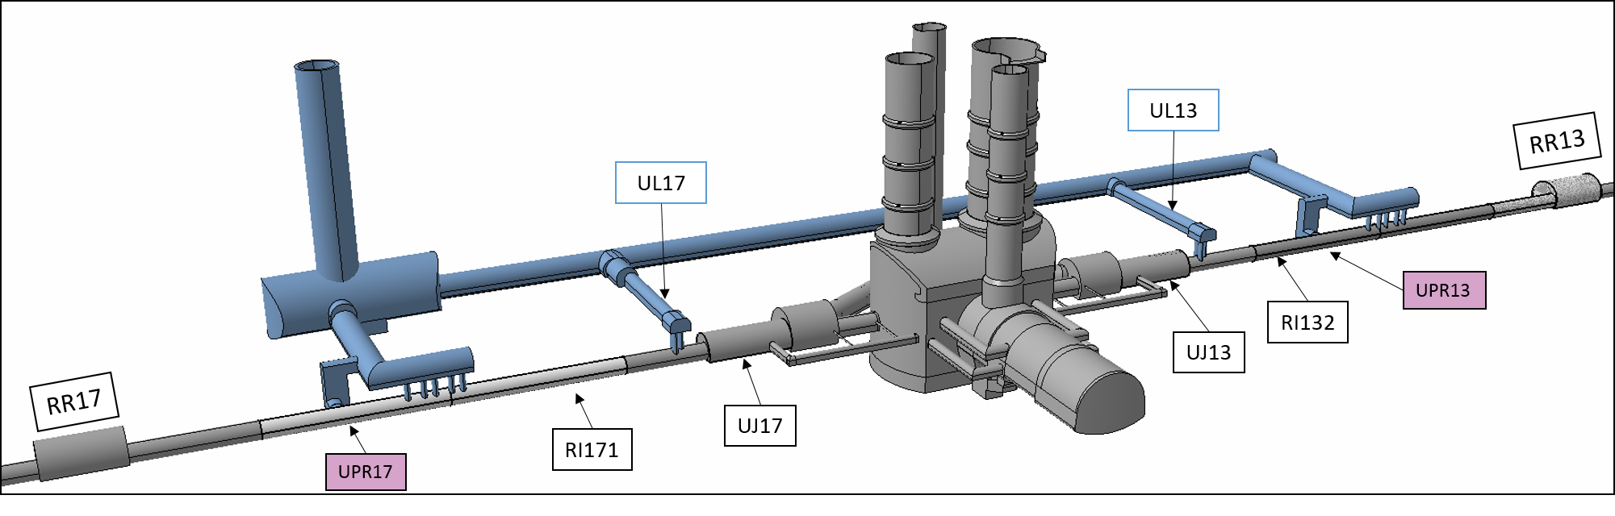
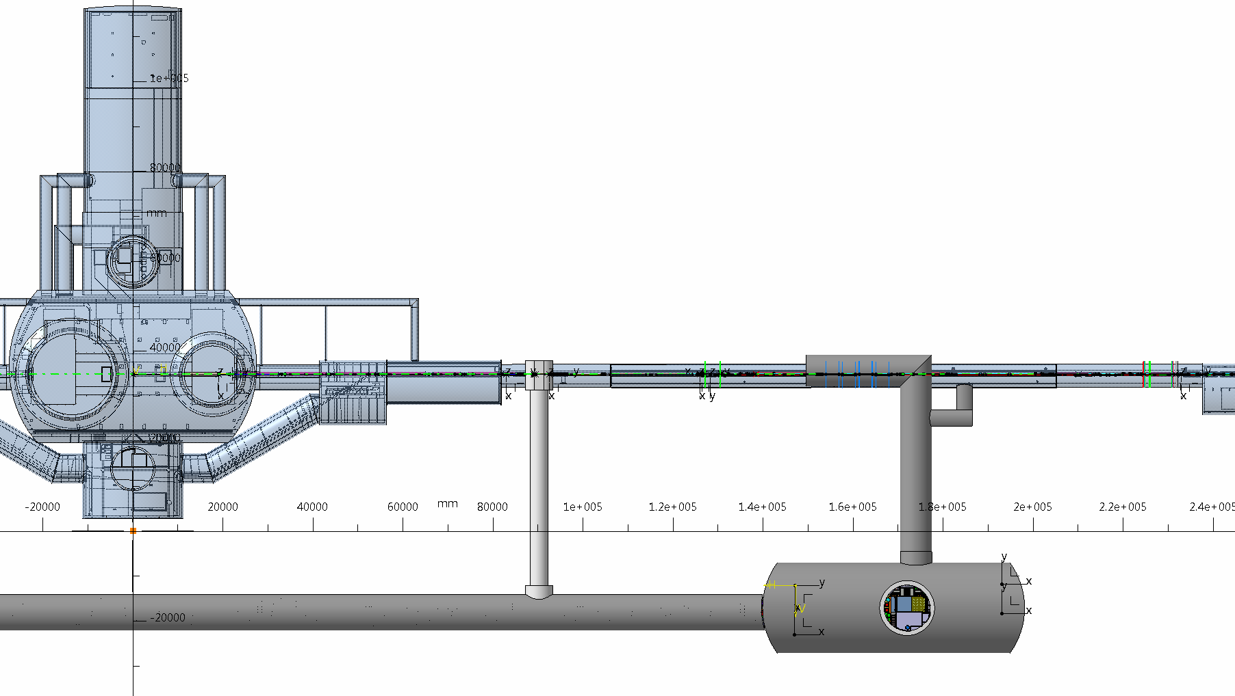
The HL-LHC Tunnel
Triplets
Matching Section
Q1
Q2A
Q2B
Q3
CP
D1
D2
Q4
Q5
Q6
Atlas

Slide 4
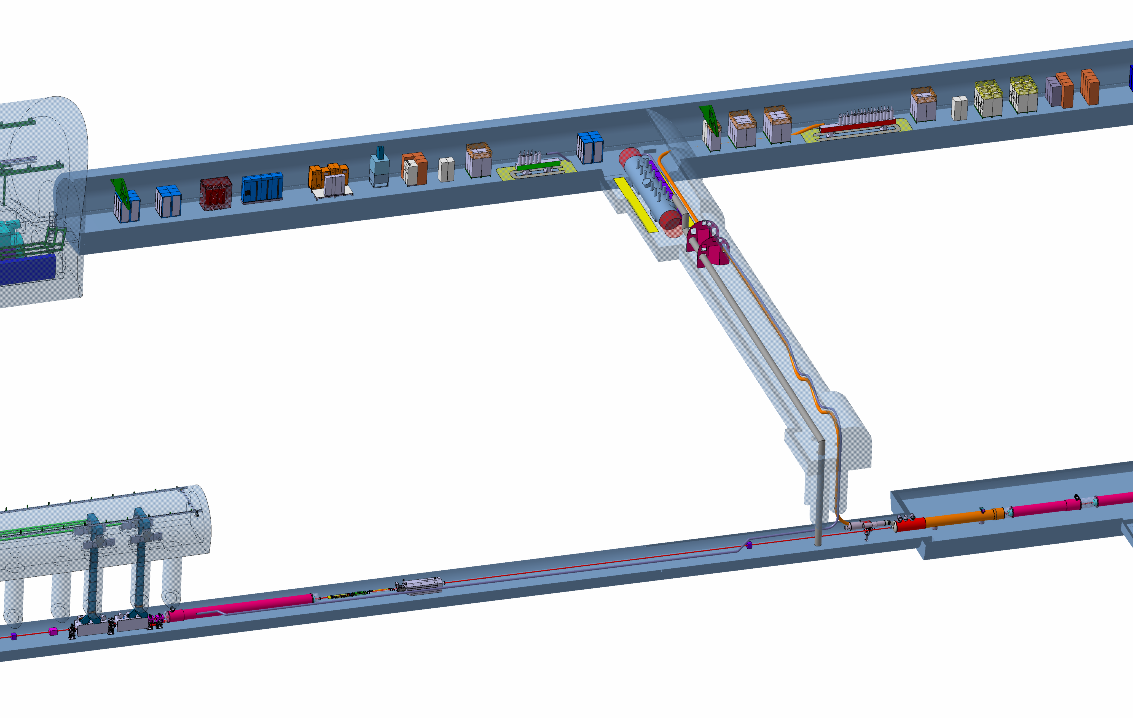
LHC Tunnel and equipment
Cryostat and leads
Cryostat and leads
DFHX
Power converters
DFHM
Power converters
VALVES BOX
SC Link for Triplets
≈ 100 m
SC Link for
Matching Sections
≈ 130 m
SCLINK 120<Ø< 200
DFX
D1
Cryostat
(connection to magnets bus-bar)
D2 (DFM)
Cryostat (connection to magnets bus-bar)

Slide 5
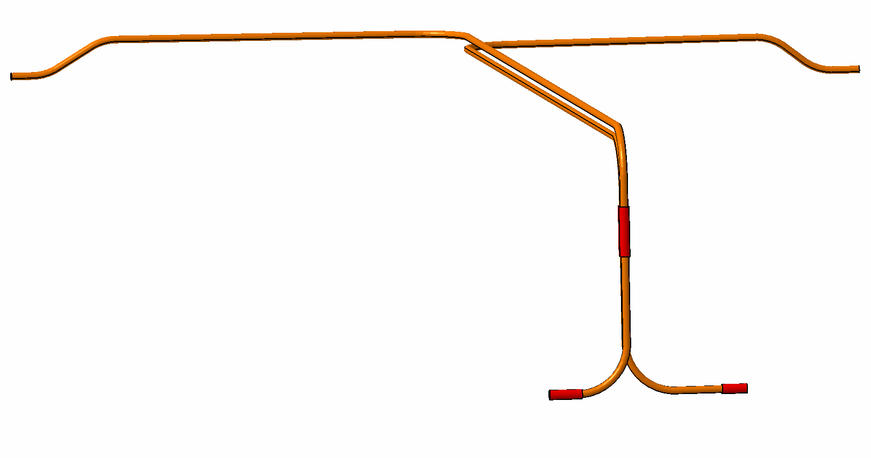
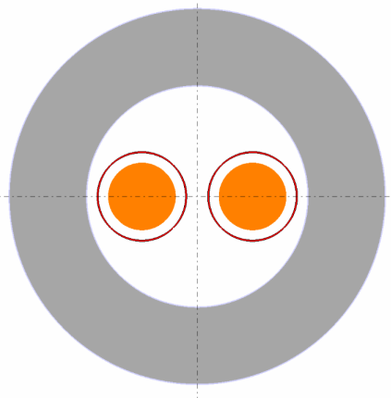
LHC Tunnel Configuration
L ∼ 100 m
L ∼ 130 m
∼ 8 m
Ø 1000

Slide 6
Cold Powering System (WP6a) Schematic representation
4
Current Leads (DFLH)
T2≤50 K
HTS
T1≤17 K
MgB₂ to HTS
3
DFH
1
DFX
λ-Plate
2
SC Link (DSL)
4.2 K
MgB₂
MgB₂ to Nb-Ti
Nb-Ti – 1.9 K
Nb-Ti to Nb-Ti
A. Ballarino
6

Slide 7
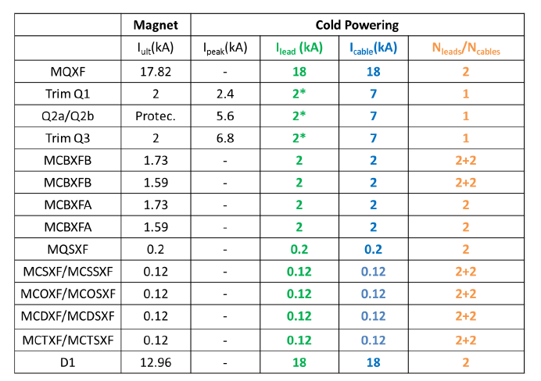
Requirements for the powering of the Triplets
Trim Q1a (35 A) → Local powering
EDMS N. 1821907
* Able to cope with over-currents without excessive over-heating

Slide 8
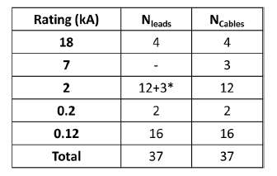
Requirements for the powering of the Triplets
Number and type of components per system
Leads rated at 0.12 kA and 0.2 kA (18 in total)
proposed for local powering (as in the LHC)
Updated in order to take into account recent changes on the magnets circuits
(HL-LHC Magnets Circuits Internal Review, EDMS N. 1807471, May 2017)
EDMS N. 1821907

Slide 9
DFH - Concept
CERN supply
DFH

Slide 10
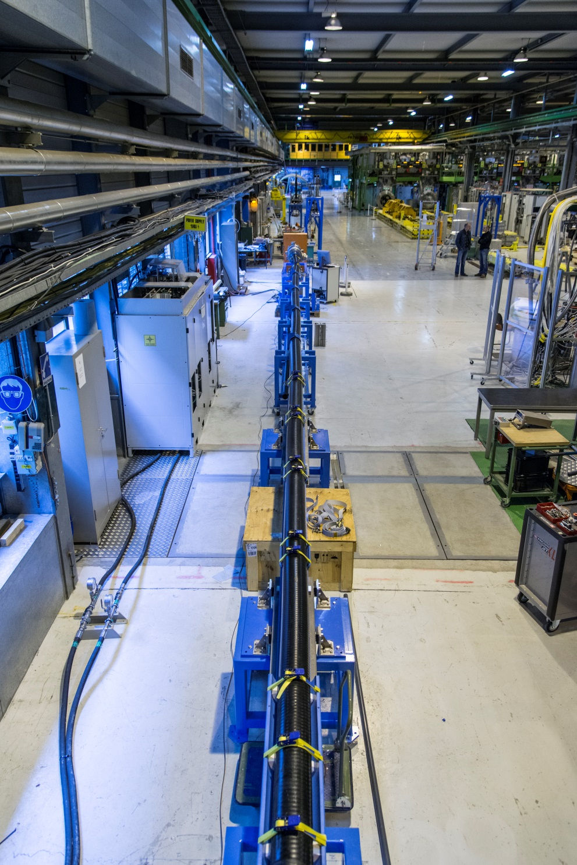
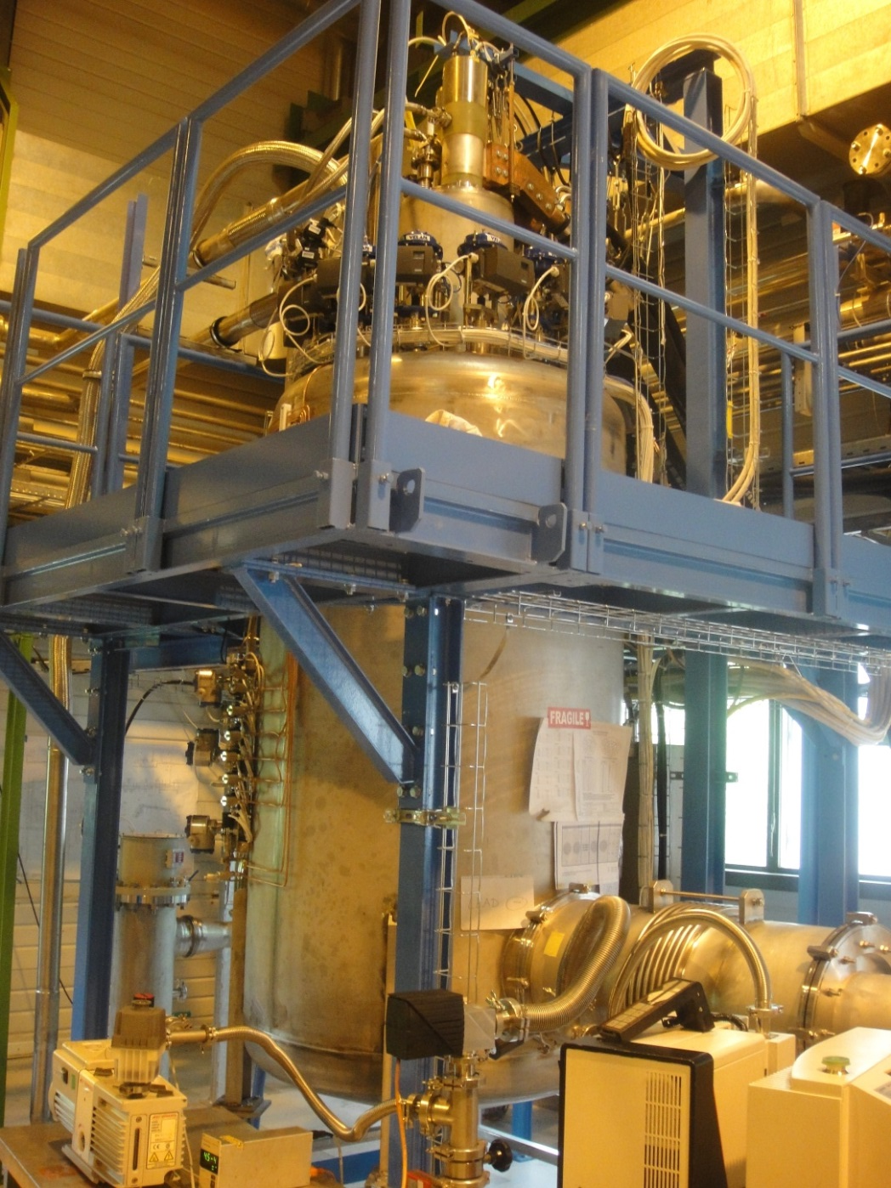
Development activity at CERN
Test station operational from 2014 until end 2016 – now being upgraded
L test station = 20 m/ 60 m
H ∼ 4 m
GHe
5 K- 70 K
± 1 K

Slide 11
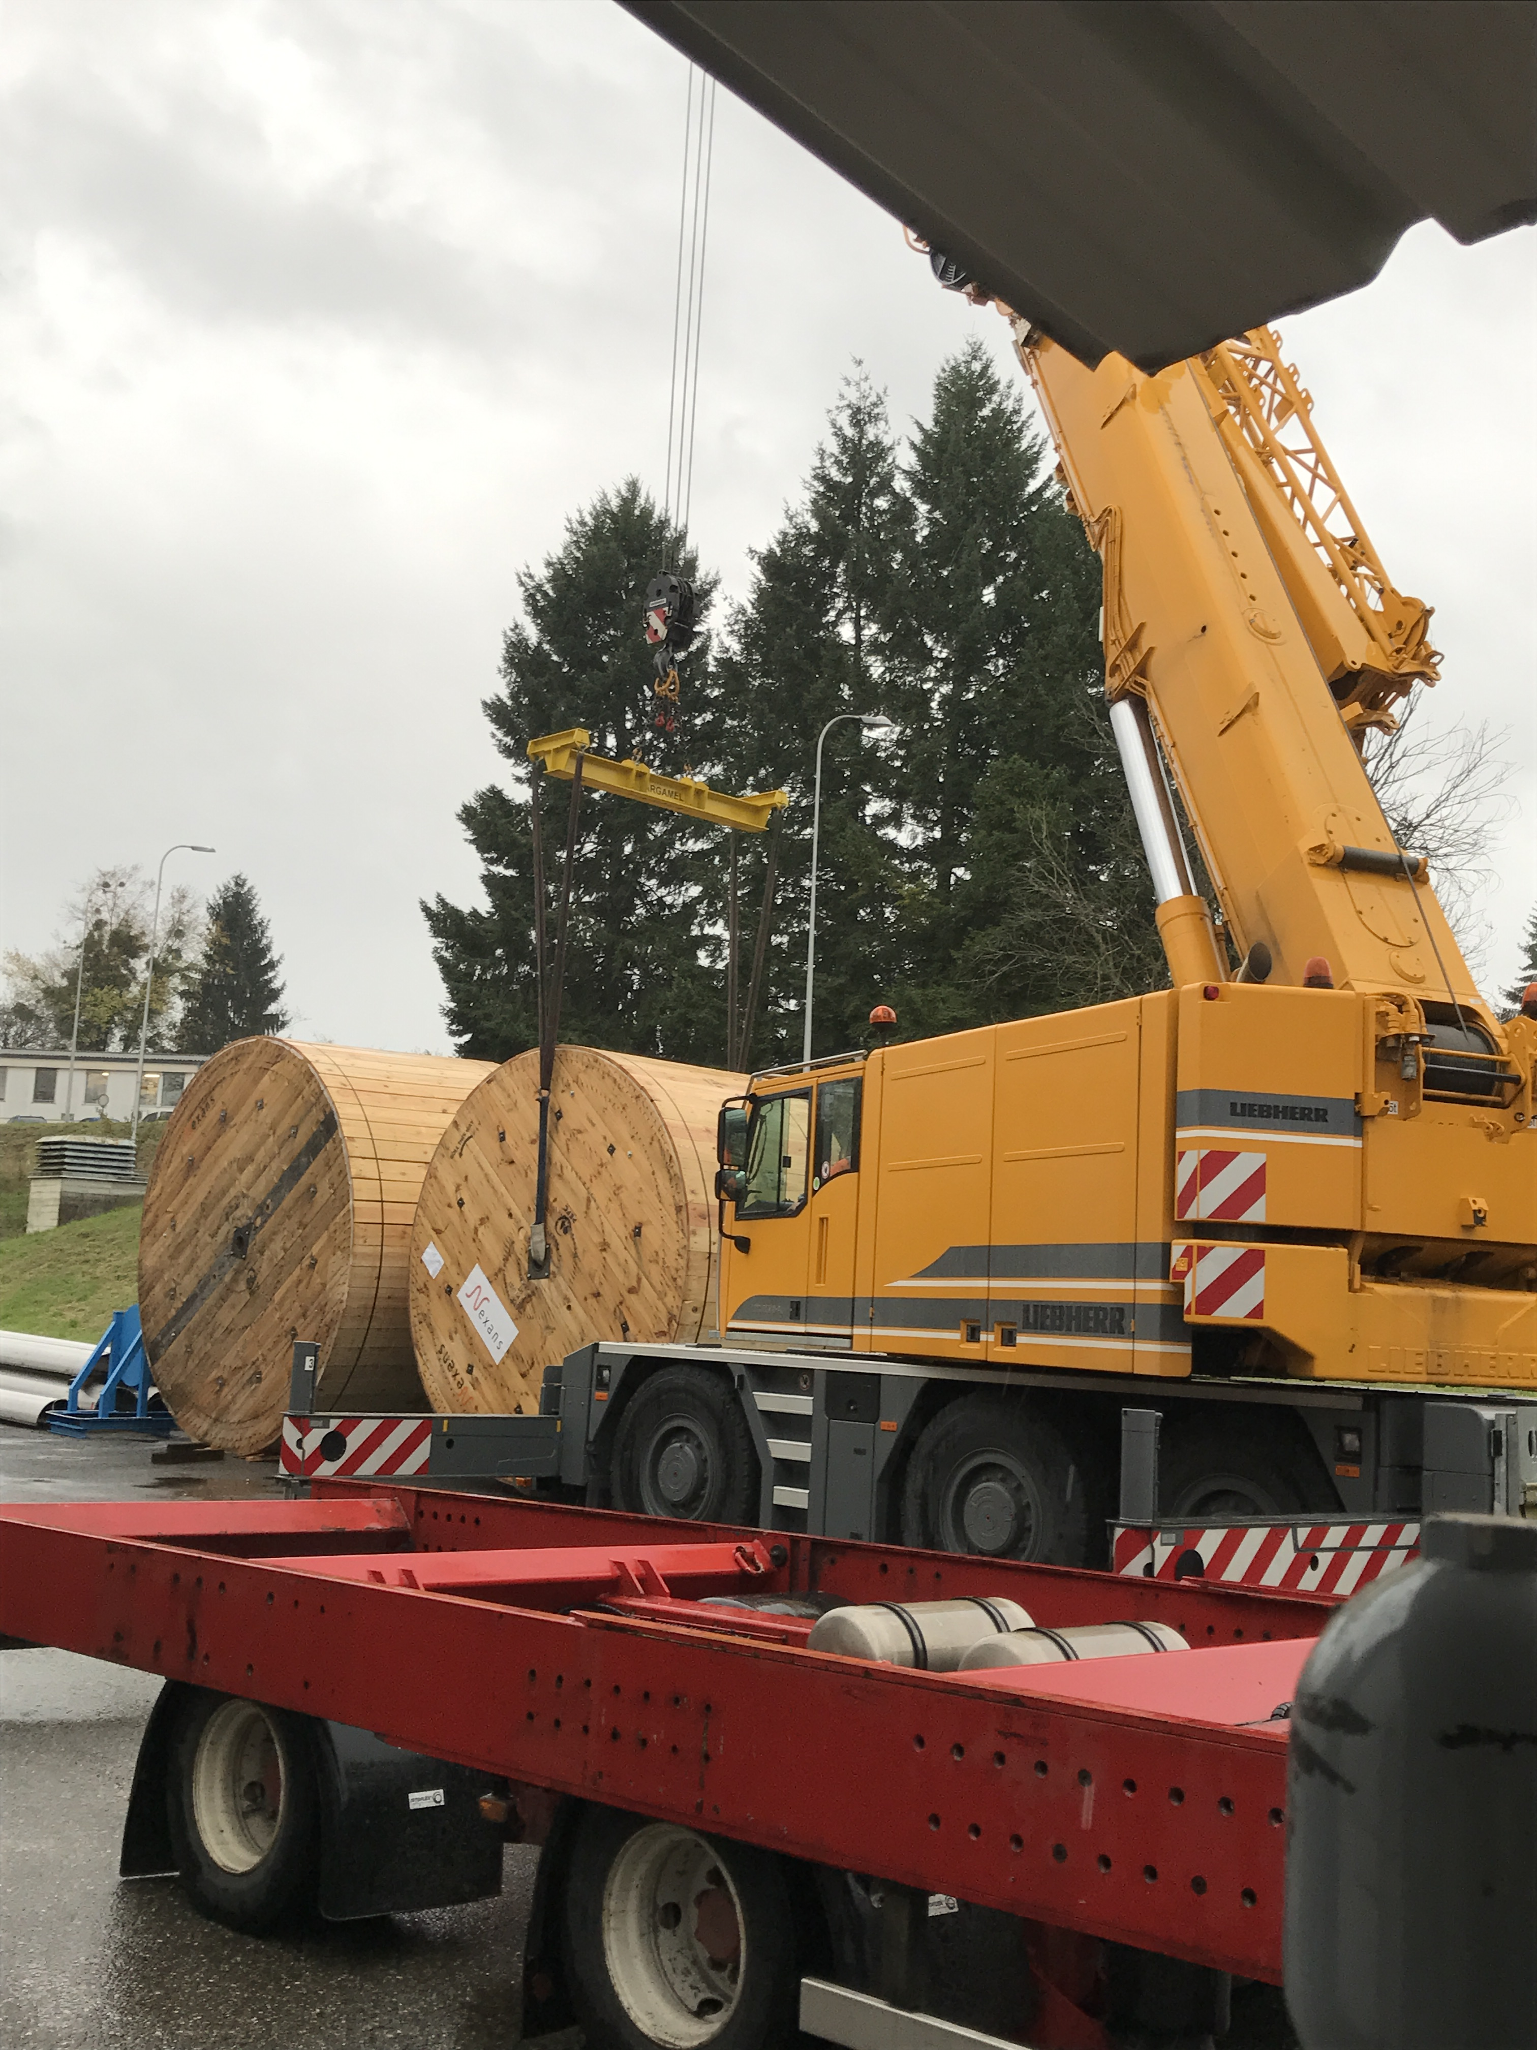
Industrial procurement of long cryostats
SC Link cryostats @ CERN

Slide 12
R&D Development
SC Link
MgB₂ wire: developed with industry. Being procured
MgB₂ cable: prototyping on-going in industry
HTS Current leads
Prototypes at CERN (internal design/construction)
DFX
Small scale demonstrator being constructed
DFH
Clear baseline – changed in 2018 for simplifying cooling

Slide 13
DFH Functionalities
4
Current Leads (DFLH)
T2≤50 K
HTS
T1≤17 K
MgB₂ to HTS
3
DFH
1
DFX
λ-Plate
2
SC Link (DSL)
4.2 K
MgB₂
MgB₂ to Nb-Ti
Nb-Ti – 1.9 K
Nb-Ti to Nb-Ti
A. Ballarino
A. Ballarino
6
6

Slide 14
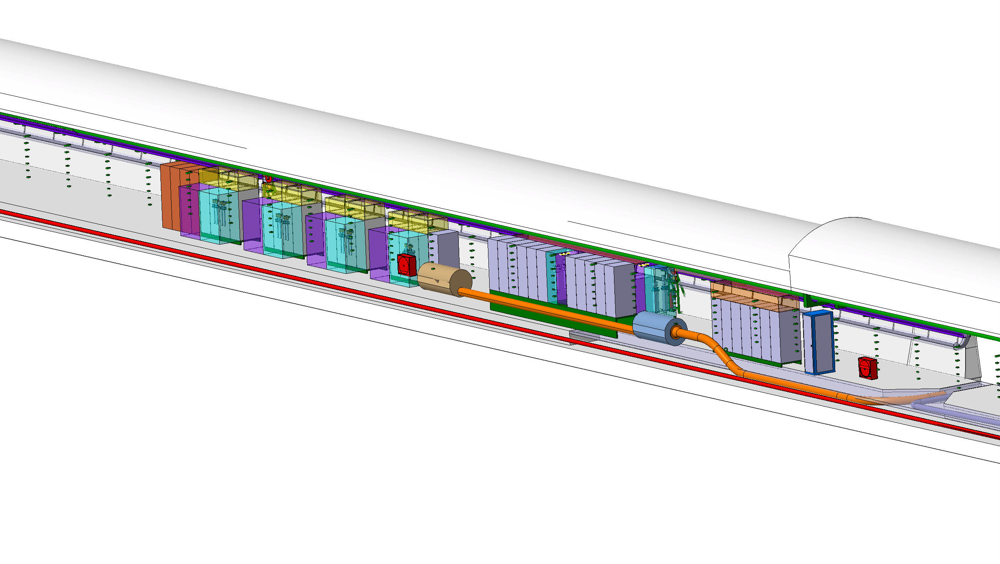
DFH Integration in the tunnel

Slide 15
HL-LHC Timeline
Today
Integration in LHC Tunnel in 2024
All large procurements of WP6a components launched in 2018 and 2019

Slide 16
Looking forward to starting the collaboration
Questions ?

