Slide 1
Interconnection boxes : DFH Concept overview and quality assurance UU-CERN-RFR meeting
20 June 2018
Y.Leclercq and V.Parma on behalf of the DF cryostats design team (WP6a)
WP6a workpackage leader : A. Ballarino

Slide 2
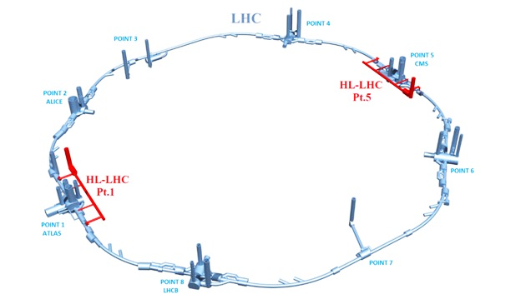
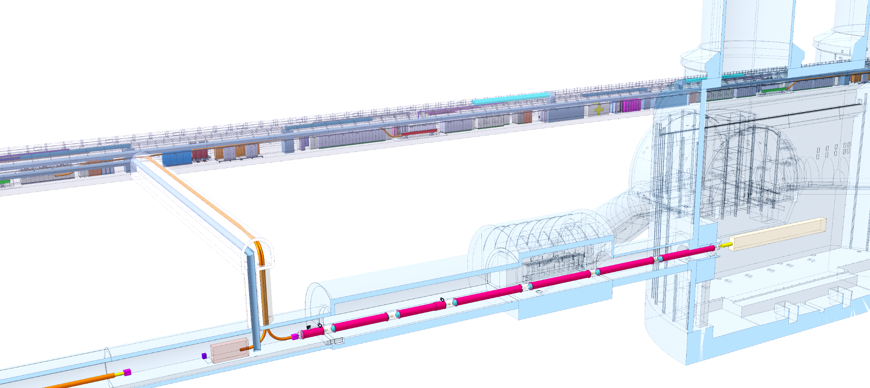
Context
DFXI
DFXJ
DFMJ
DFMI
Each IP1 and IP5 sides equipped with 2 cold powering chains of cryostats
Triplet insertion : DFH – SC Link (DSH) – DFX
Matching sections : DFH – SC Link - DFM
DFH basic functions:
Electrical interface between SC Link (20K) and power converters (300K)
DFMJ
DFXG
DFXF
DFMI
DFHX
Power converters area
DFHM
Service tunnel
SCLink
Transverse tunnel
≈50m
IP
Q1
≈8m
Q2a
Illustration of the position of the DFH
(not latest version for details)
Q2b
Q3
DFX
D1
CP
DFM
≈80m
LHC tunnel

Slide 3
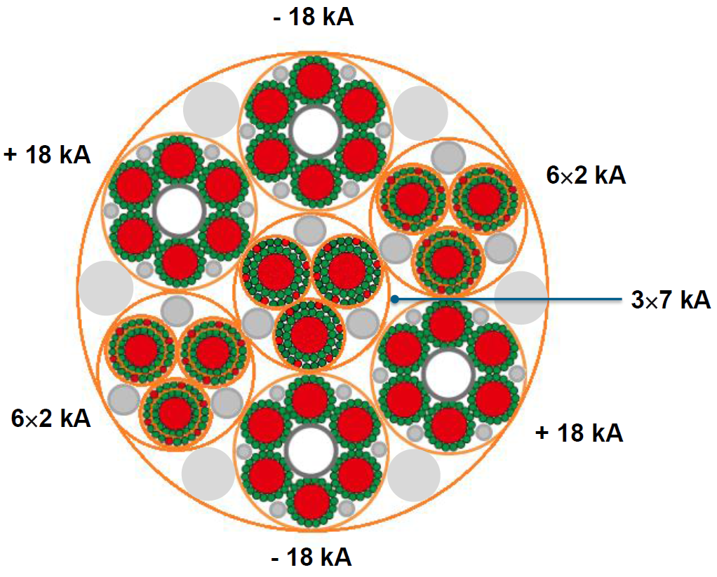
DFH concept
DFH objectives :
Connect the 37 electrical leads from the SCLink side to the current leads interfaces
Monitor the electrical connection performance
Ensure the cooling of electrical connections and cables
Overview of the DFH:
37 (19) leads from 0.12 kA to 18 kA in a flow of gaseous helium below 20K.
T operation = 5 to 20 K
Design pressure : PS≈4 bara
Cryogenic lines
300 K
Current
Leads
Courtesy A. Ballarino
DFH envelope
Current
Leads
20 K
PT
TT
TT
T< 20K
T< 20K
VT
SCLink
Layout of DFH electrical boxes

Slide 4
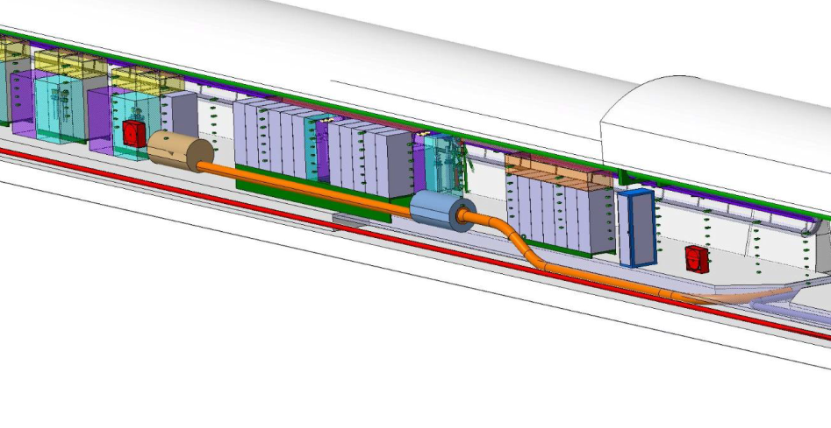
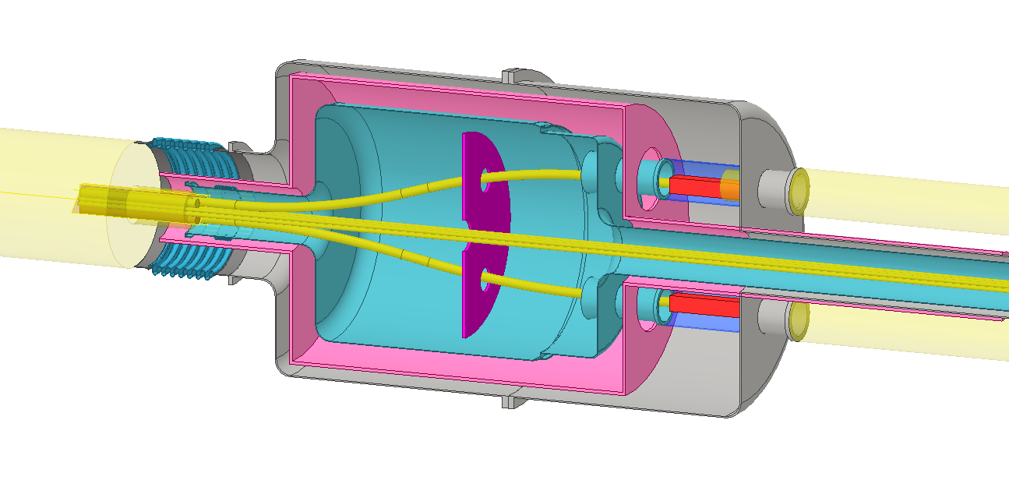
Overview of manufacturing and qualification
Pre-study of DFH integration in the tunnel
Courtesy S. Maridor
CERN safety rules : GSI-M4
“The manufacture […] by collaborating institutions, of all new cryogenic equipment shall comply with the applicable CERN Safety Rules, European directives and harmonised standards”
Pressure European Directive 2014/68/EU (PED)
HL-LHC QA specific requirements
Bellows & flexibles
EN14917+A1
Vacuum vessel
Thermal shield + MLI
Al / Actively cooled
Helium vessel
EN1.4435 - PED
≈Ø1m
Ports
SCLink
Current leads
Composite supports
Helium volume
4bara / 20K
Leak tightness : <1.10⁻¹⁰mbar.l.s⁻¹
Insulation vacuum
P<1.10⁻⁵mbar
Leak tightness : <1.10⁻¹⁰mbar.l.s⁻¹
≈2m
Artist view of one DFH box (illustrative)

Slide 5
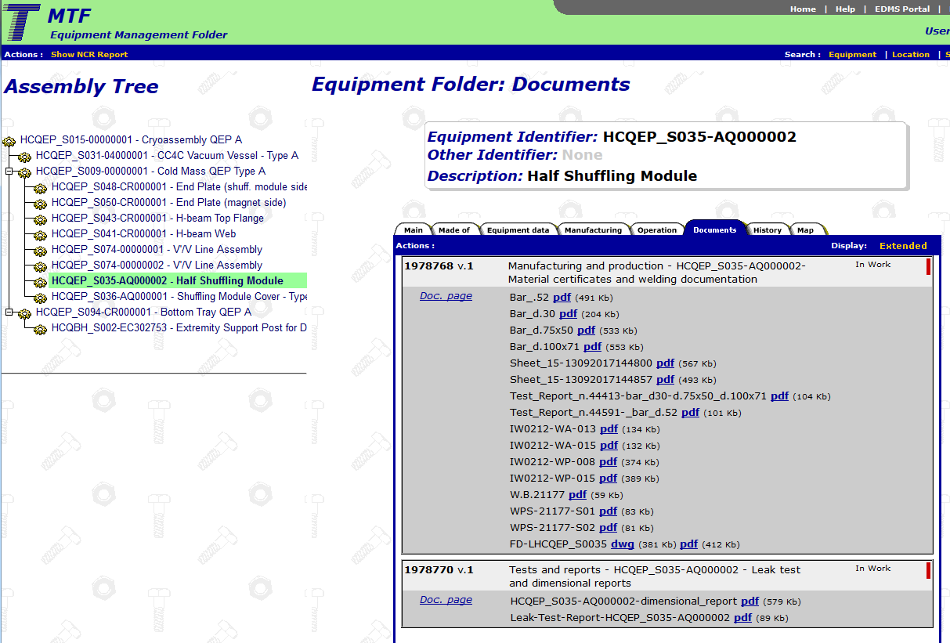
Manufacturing, qualification and QA
Design phase : CERN supply specification drawings acc. ISO-GPS
Procurement
Design, calculation reports, Technical specifications (PED, HL-LHC QA spec., CE certif.)
➔ CERN approval before release
Manufacturing
MIP, welding book, cleaning, inspection procedures.
Manufacturing drawings produced from CERN specification dwg
➔ CERN approval
Manufacturing process ➔ Inspection reports (including certifications)
➔ CERN reports approval
Assembly & qualification phase
Assembly procedures / Inspection and qualification plan
➔ CERN assembly approval
Assembly process ➔ Inspection reports
QA follow-up
Upload documentation to MTF
Detailed installation and maintenance procedures
➔ CERN approval
Delivery to CERN
Packing and shipping to CERN
CERN database MTF for manufactured products
Non exhaustive list of QA requirements for illustration

Slide 6
Additional information

Slide 7
Standards usually specified for HL-LHC cryostats procurement
 | Procurement |  |  |  | Manufacturing & assembly |  |  |  |  |  |  |  |  |  |  | QA
 | Manufacturing drawings | CE certif. | Calculations reports | Pressure test procedure |  |  | Welding |  | Weld inspection |  |  |  | Leak test |  | Cleaning
 |  |  |  |  | Material certificate | Dimensional report | Welder | Procedure | NDT personnel | Visual inspection | X-ray proc. | X-ray result | Procedure | Operator | Procedure | MTF archiving
Standard | ISO-GPS | PED | EN13445 EN14917+A1 | EN13458-2 | EN10028 HL-LHC_QA | NA | ISO 9606-1 ISO14732 | EN ISO 15614-1 | ISO 9712 NDT level2 | ISO 17637 | ISO 17636 | ISO 5817 Quality B | EN1779A1 EN13185 | ISO 9712 Level2 | EN12300
Qualification by notified body |  | if needed | If needed |  |  |  | X | X | X |  |  |  |  | X
Components
Vacuum vessel | X |  | X |  | X | X | X | X | X | X | X | X | X | X |  | X
Helium vessels | X | X | X | X | X | X | X | X | X | X | X | X | X | X | X | X
Thermal shield | X |  |  | X | X | X | X | X | X | X | X | X | X | X |  | X
MLI | X |  |  |  | X | X |  |  |  |  |  |  |  |  |  | X
Structural supports | X |  |  |  | X | X |  |  |  |  |  |  |  |  |  | X
Pressure vessels : general Pressure Equipment Directive (PED) 2014/68/EU; EN 13445 Unfired pressure vessels; EN 13458 Static vacuum insulated vessels;
Materials EN 10204 Metallic products – Types of inspection documents; EN 10028-7 Flat products made of stainless steels for pressure purposes; EN 10216 Seamless steel tubes for pressure purposes; EN 10217 Welded steel tubes for pressure purposes; EN 10222 Steel forging for pressure purposes; EN 10213 Steel casting for pressure purposes; EN 10253 Butt-welding pipe fitting; EN 10272 Stainless steel bars for pressure purposes; EN 12392 Aluminium and aluminium, alloys – Wrought products – special requirements for products intended for the production of pressure equipment;
Brazing EN 13134 Brazing – Procedure approval EN 13133 Brazing – Brazer approval EN 12799 Brazing – Non-destructive examination of brazed joints
Bellows EN 14917+A1 Metal bellows expansion joints for pressure applications; EN 13445-3 §14 Expansion bellows
Leak testing EN 13185 Non-destructive testing – Leak testing – tracer gas method; EN 1779-A1 Non-destructive testing : leak testing : criteria for method and technique selection;
Cleaning EN 12300 Cryogenic vessels – Cleanliness for cryogenic services
Welding ISO 5817 Welding – Fusion-welded joints in steel, nickel, titanium and their alloys (beam welding excluded) – Quality levels for imperfections (Requirement: Level B); ISO 9606-1 Qualification testing of welders – Fusion welding – Steels; ISO 14732 Welding personnel – Qualification testing of welding operators EN ISO 15609-1 Specification and qualification of welding procedures for metallic materials - Welding procedure specification - Part 1: Arc welding; EN ISO 9712 Non-destructive testing – Qualification and certification of NDT personnel. Requirement: Level 2; EN ISO 17637 Non-destructive testing of welds – Visual testing of fusion-welded joints; ISO 17636-1 Non-destructive testing of welds – Radiographic testing. X- and gamma-ray techniques with film; ISO 17636-2 Non-destructive testing of welds – Radiographic testing. X- and gamma-ray techniques with digital detectors;

Slide 8
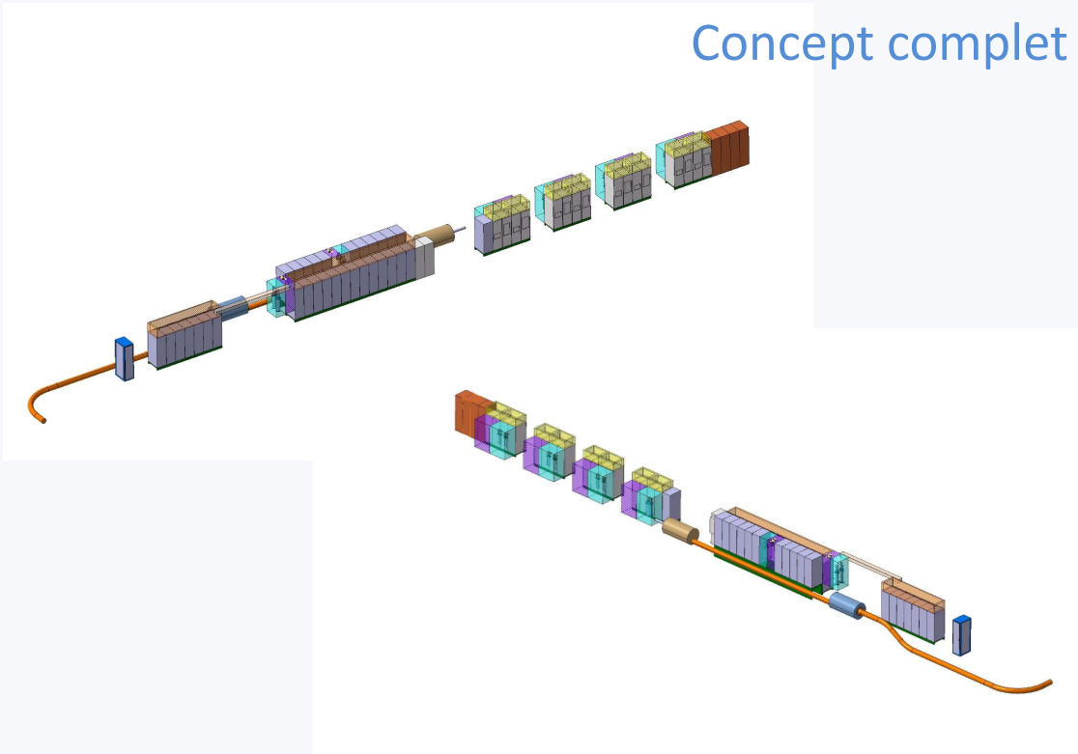
Preliminary concept of integration
Pre-study of DFH & PC integration in the tunnel
Courtesy S. Maridor

