Slide 1

CLIC / AWAKE
electron sources
Kévin PEPITONE
August 27, 2018

Slide 2




Outline
  AWAKE (Layout)
    Electron source
    Electron line
  CLIC (Layout)
    LEETCHI
      Layout
      Electron source
      Experimental results
      Simulations

Slide 3

AWAKE

Slide 4
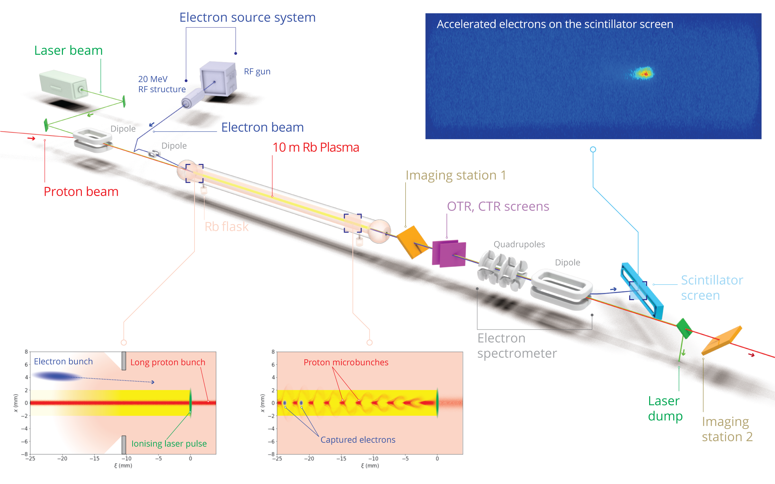
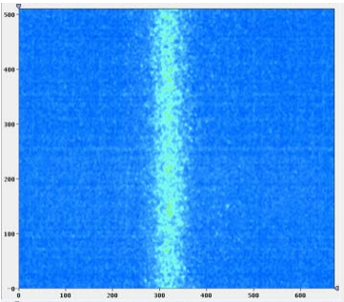
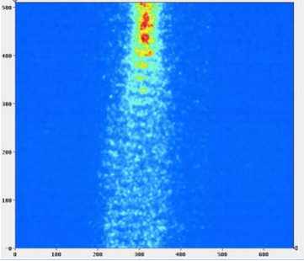
AWAKE – Introduction
Comparison to the proton bunch longitudinal profile (top, no plasma) with the profile for a bunch passing through the plasma (bottom).
The strong modulation of the bunch is clearly seen

Slide 5
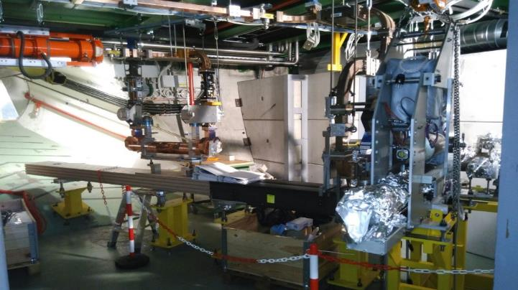
AWAKE – Electron source
Parameters | Phase 1
Beam energy | 16 MeV
Relative energy spread | Dp/p = 0.5%
Bunch Length | σ_{z} = 4 ps
Bunch size at focus | σ*_{x,y} = 250 um
Normalized Emittance | 2 mm.mrad
Electrons/bunch (bunch charge) | 1.25E9 (0.2 nC)

Slide 6
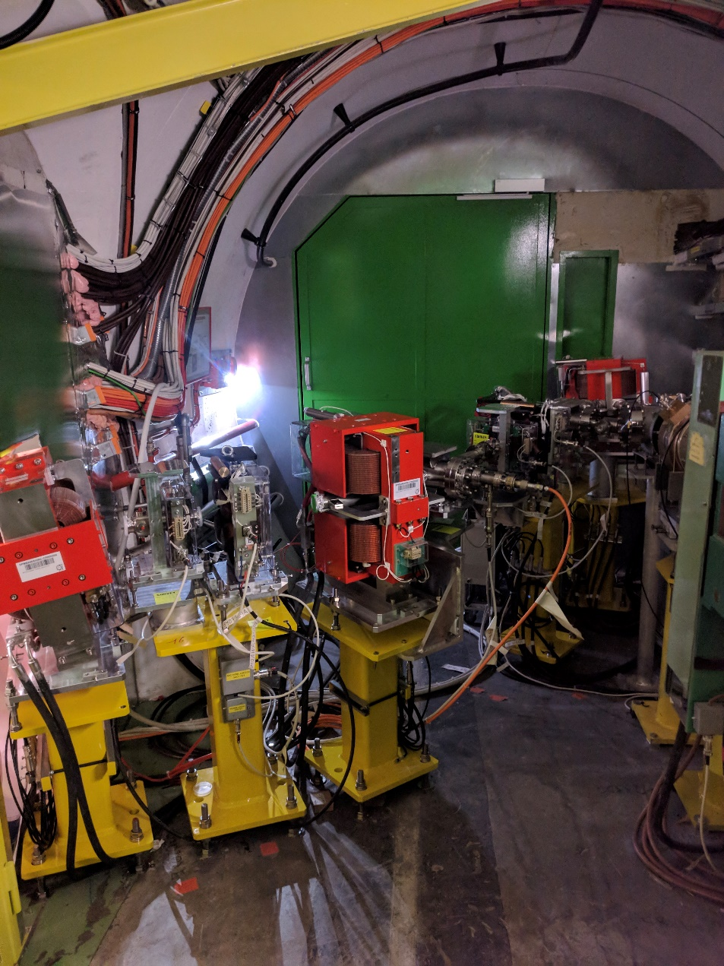
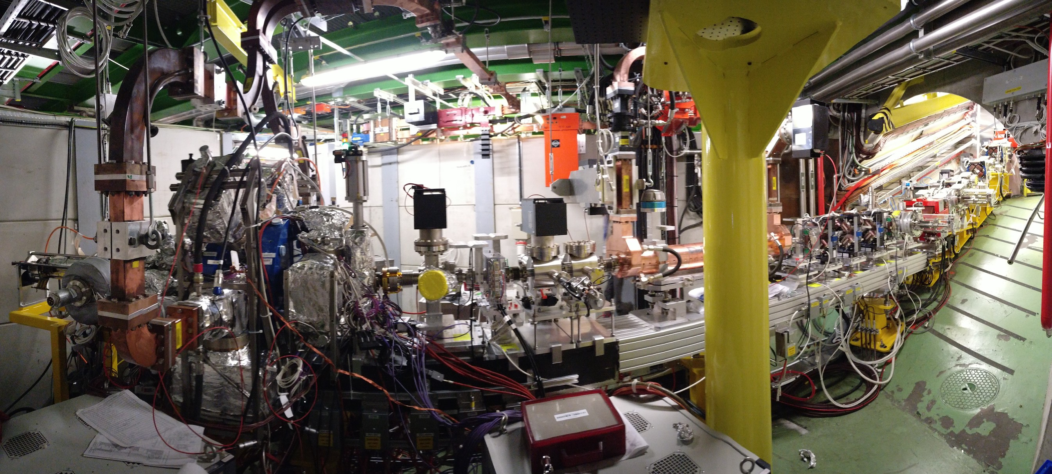
AWAKE – Electron Line

Slide 7
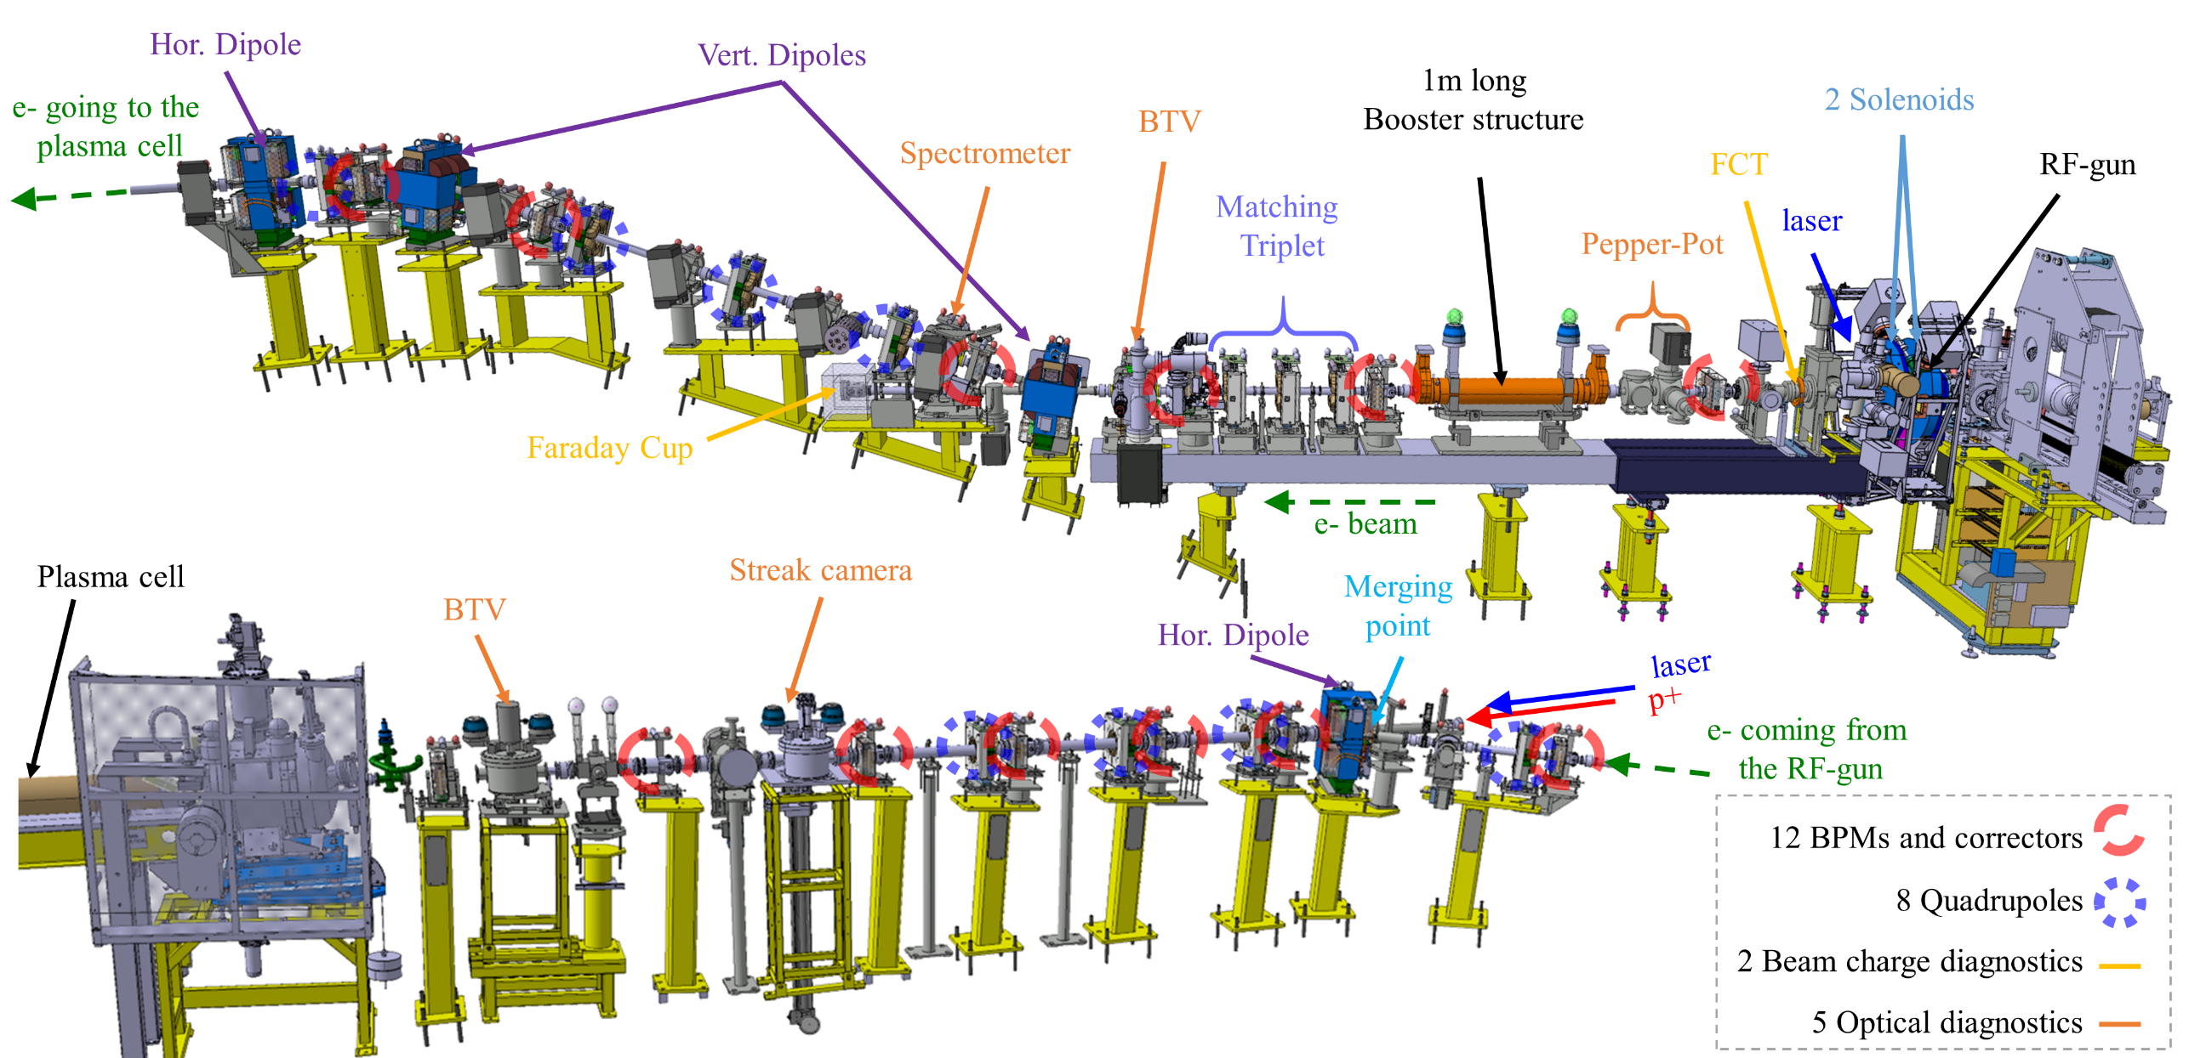
AWAKE – Electron Layout

Slide 8
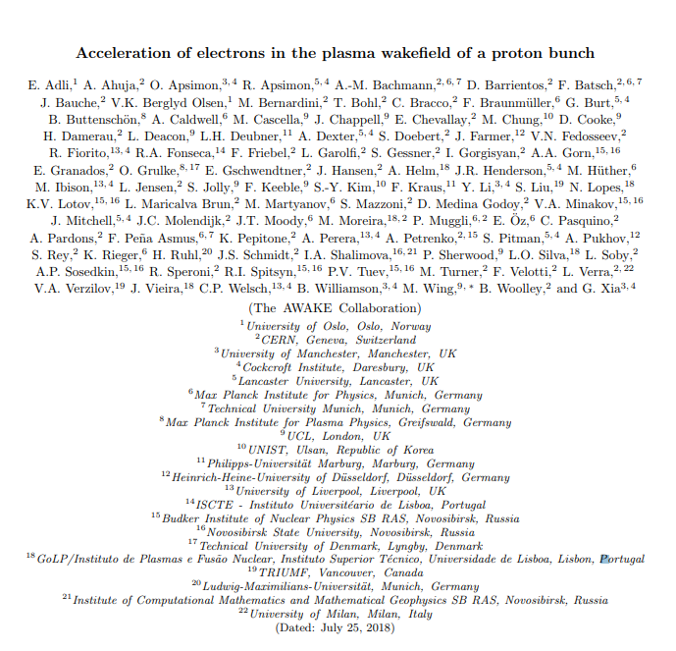
Accelerated electron beam
Acceleration of electrons in the plasma wakefield of a proton bunch
The AWAKE Collaboration
Nature paper published online on 29 August and then appear in print in the 20 September issue

Slide 9
CLIC

Slide 10
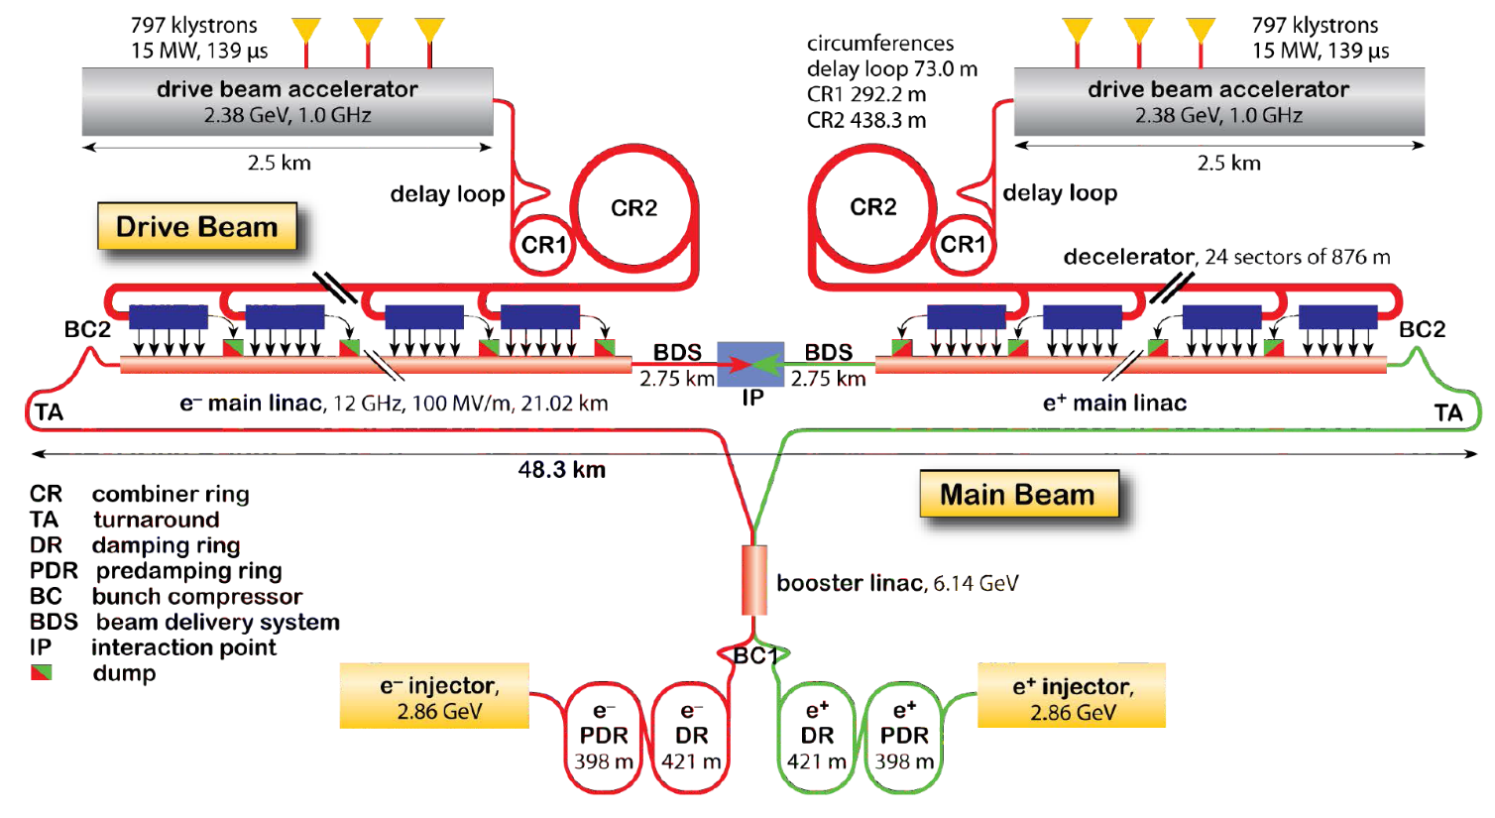
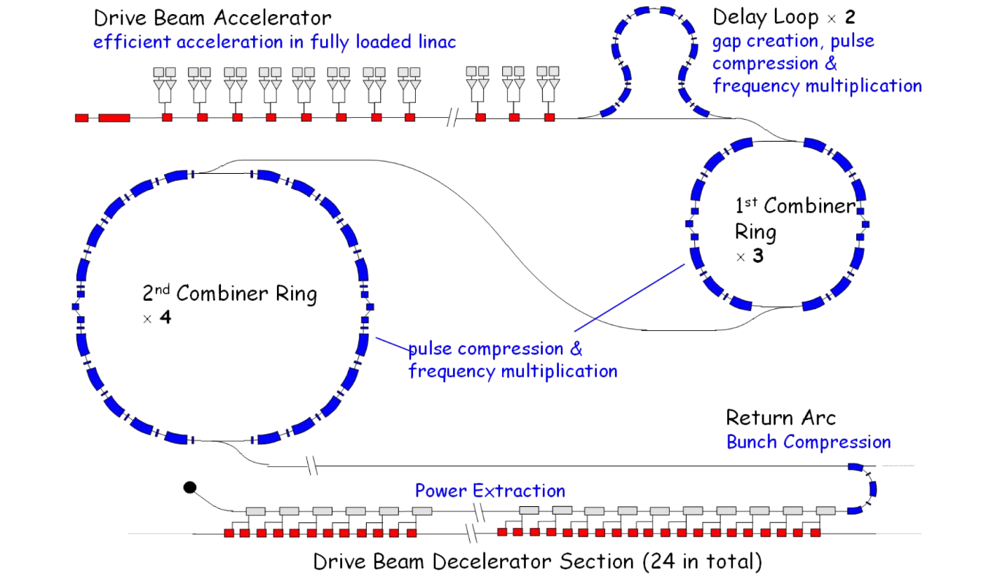
CLIC – Layout
Conceptual design report (EDMS 1234244)

Slide 11
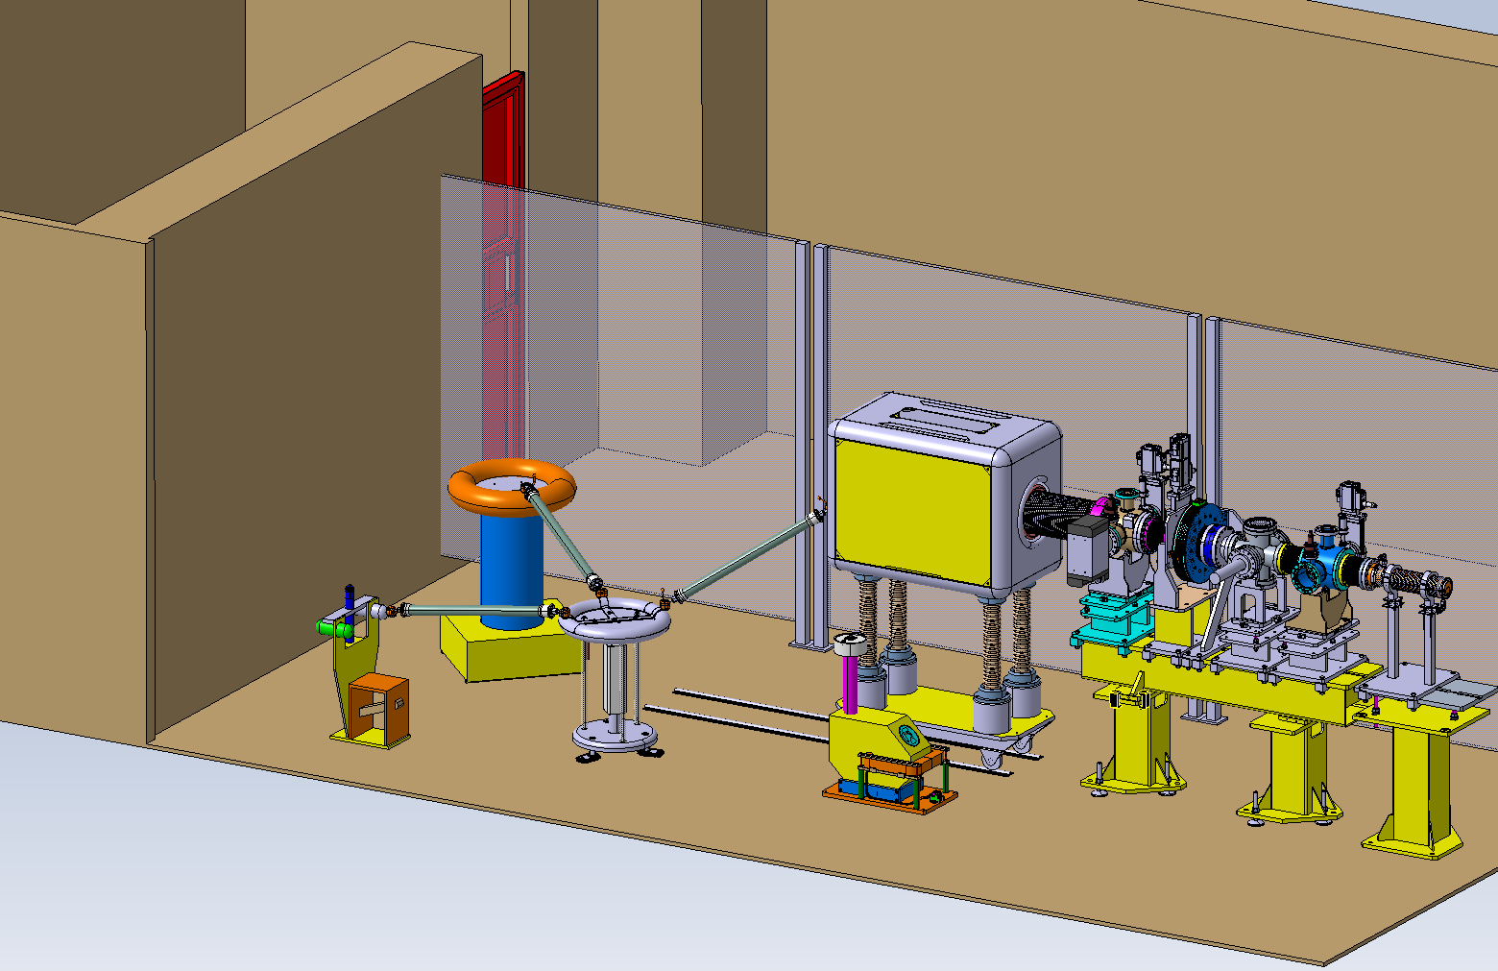
LEETCHI
Low Energy Electrons from a Thermionic Cathode at High Intensity
Parameters | Baseline
Beam energy | 140 keV
Beam current | Up to 7 A
Pulse length | 140 µs
Emittance (RMS) | < 20 mm mrad
Repetition rate | 50 Hz
Beam power | Up to 6.9 kW
Shot to shot charge variation | 0.1 %
Flat top charge variation | 0.1 % after correction

Slide 12
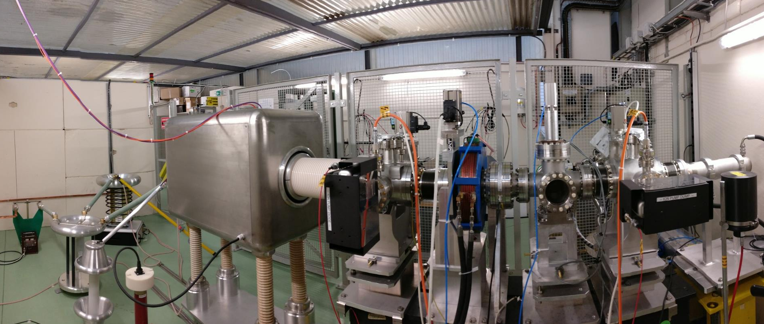
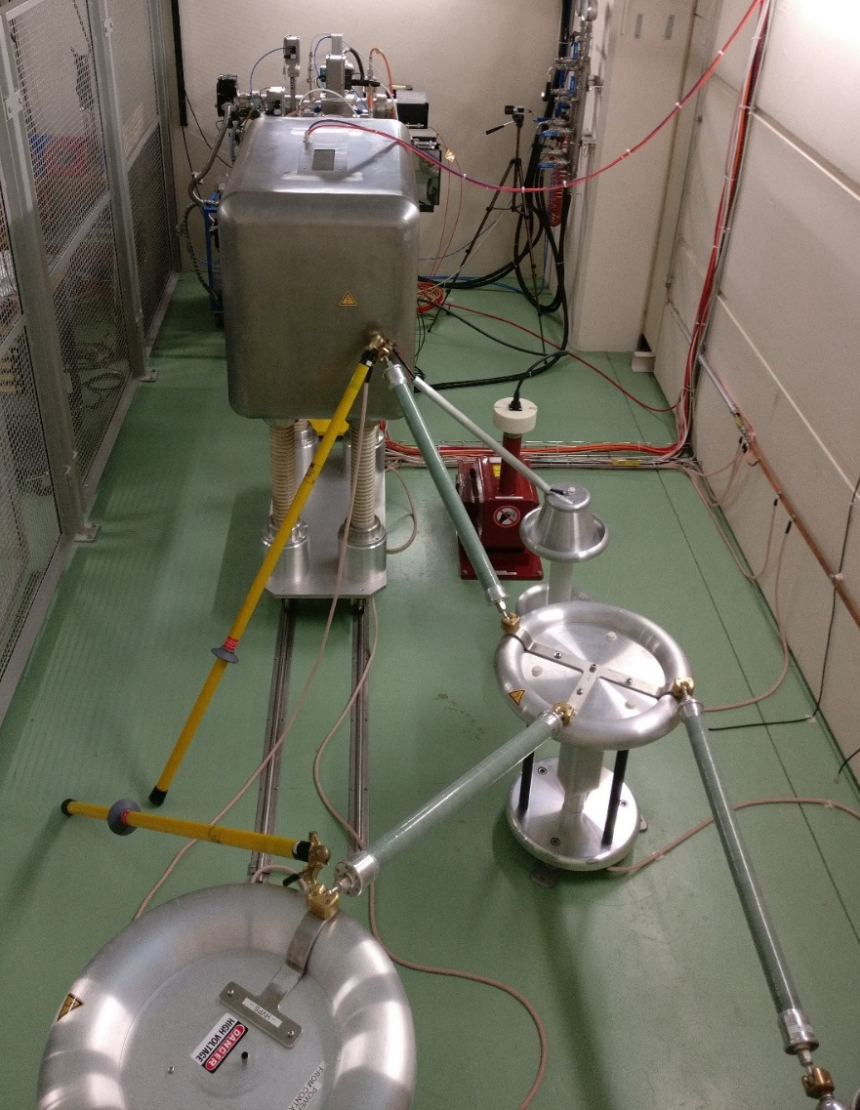
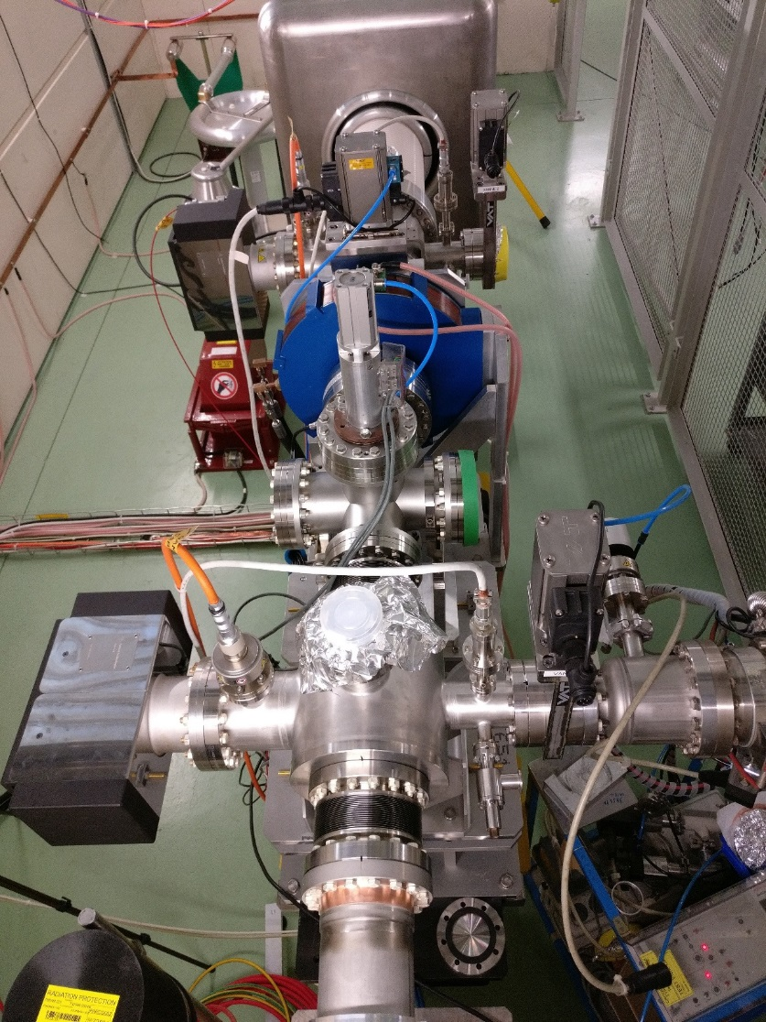
LEETCHI
Low Energy Electrons from a Thermionic Cathode at High Intensity
Current transformer
Gun
HV deck
Dump
HVPS
Capacitor
Voltage
divider
OTR
window
Solenoid

Slide 13
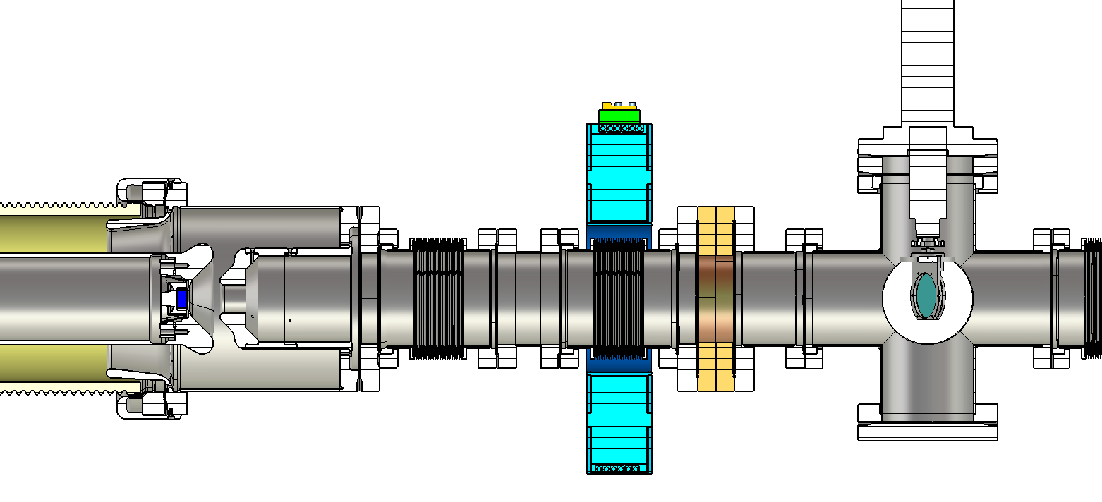
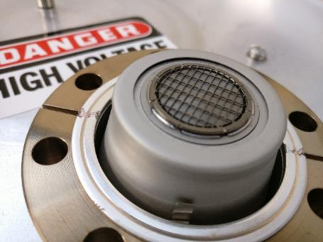
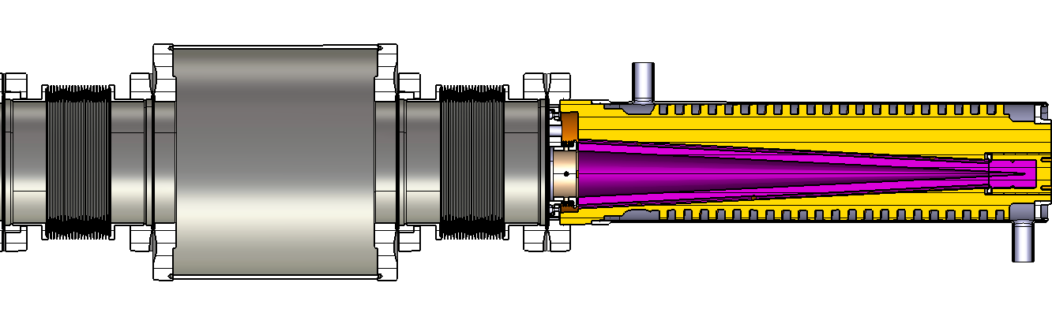

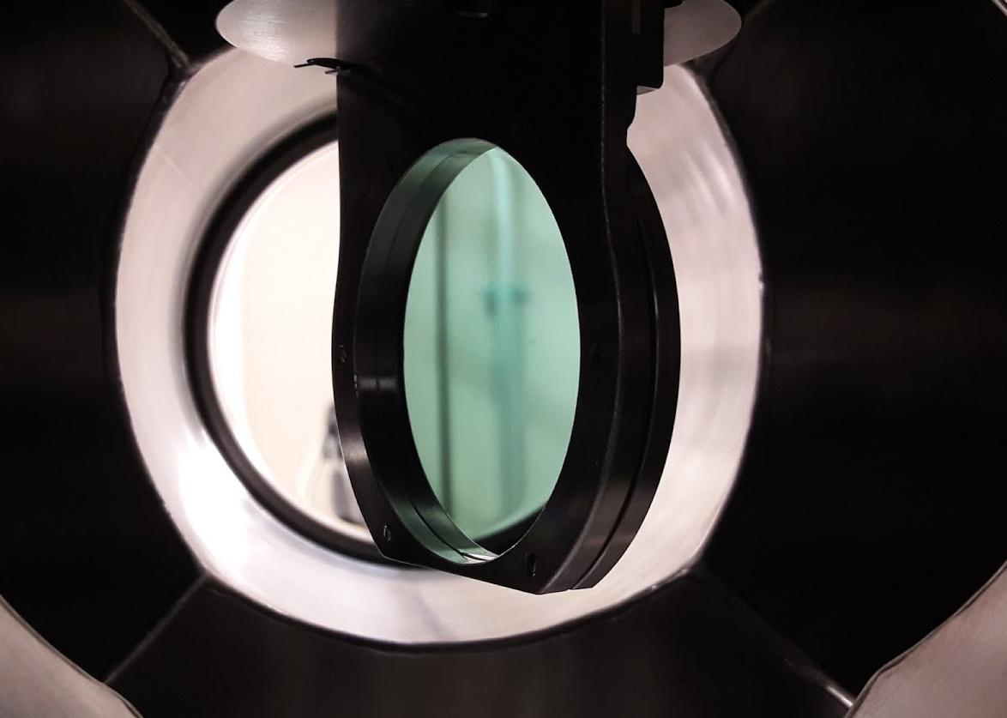
LEETCHI – Layout
Current transformer
Diode
Solenoid
1300 mm
CPI Eimac YU-156
CPI Eimac YU-156
Beam dump
OTR
412 mm
95 mm
320 mm
45 mm
119 mm
270 mm
430 mm
SiC target for OTR measurement
Vacuum chamber
Adjustable parameters in order to study beam transport and beam characteristics under different conditions:
  I_{beam} from 0 to 4.5 A
  Magnetic field from 120 to 240 G
  d_{AK} by changing the spacer
  Cathodes: 2 cm² or 3 cm² area
  V_{HV} from 0 to 140 kV
Beam dump
330 µm SiC

Slide 14
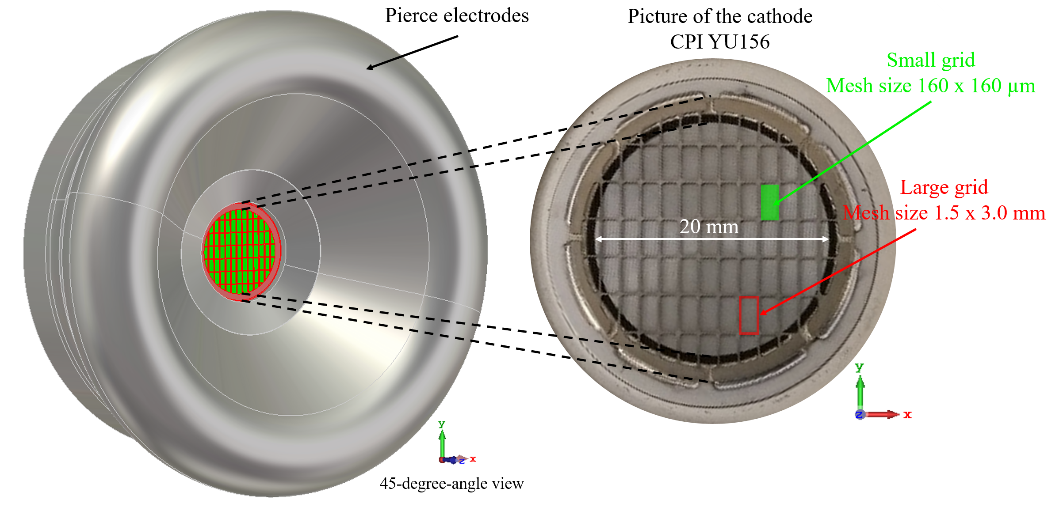
LEETCHI – Cathode grid effects

Slide 15
LEETCHI – Experimental results
20 shots:
V_{HV} = 140 kV
t = 155 µs
I = 4.5 A
Good stability

Slide 16
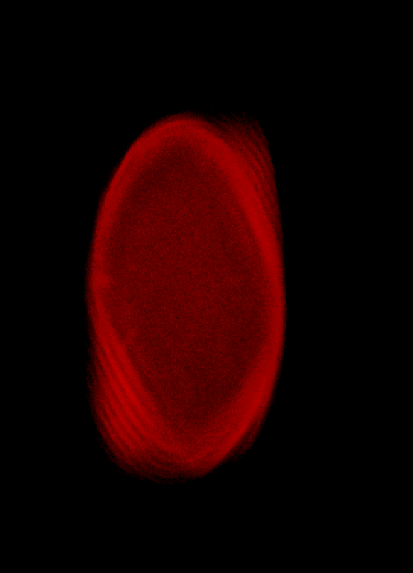
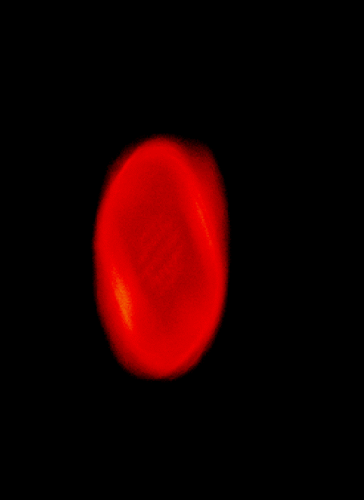
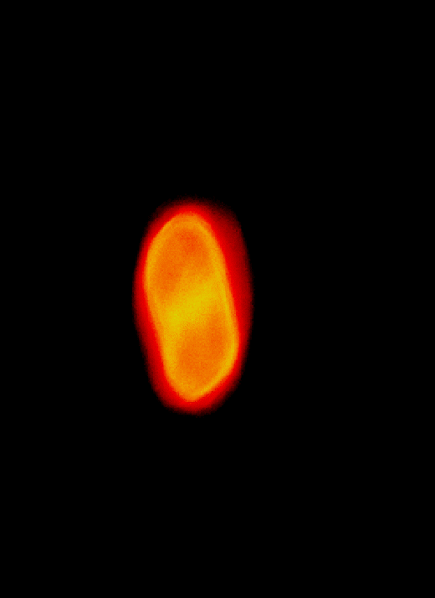
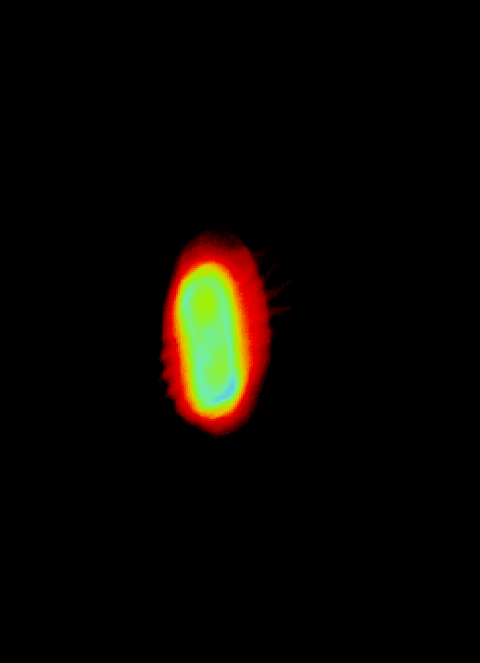

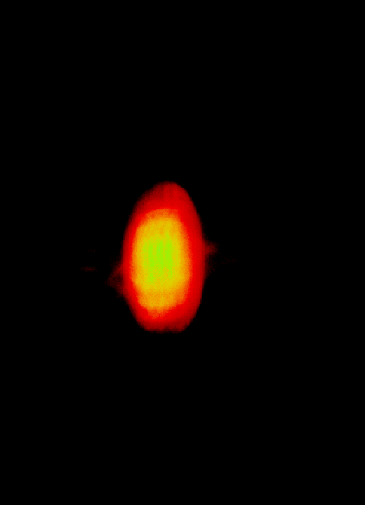
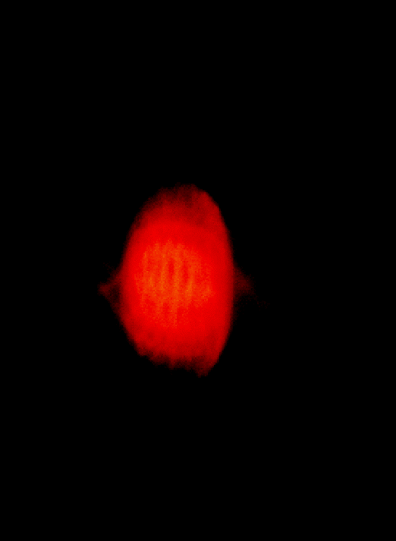
LEETCHI – Experimental results
RMS radius with OTR
t = 5 µs, I_{beam} = 4.5 A, E = 140 keV
r_{rms} = 9.8 mm
r_{rms} = 5.9 mm
r_{rms} = 11.3 mm
r_{rms} = 13.5 mm
r_{rms} = 6.8 mm
r_{rms} = 8.2 mm
r_{rms} = 12.6 mm
I_{solenoid} = 5.0 A
I_{solenoid} = 6.0 A
I_{solenoid} = 7.0 A
I_{solenoid} = 8.0 A
I_{solenoid} = 5.5 A
I_{solenoid} = 6.5 A
I_{solenoid} = 7.5 A
Magnetic
field
: 175 G
240 G

Slide 17
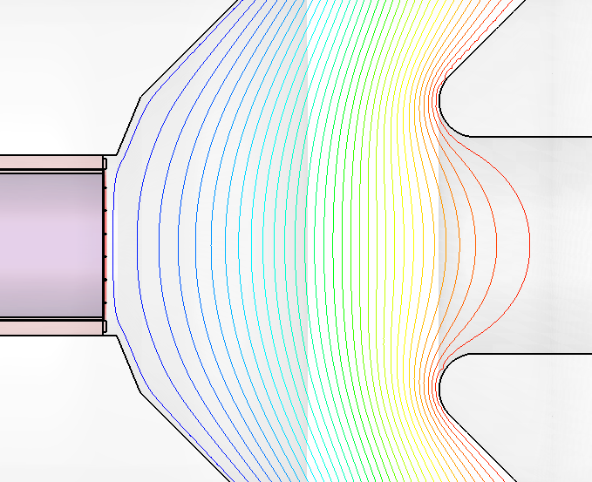
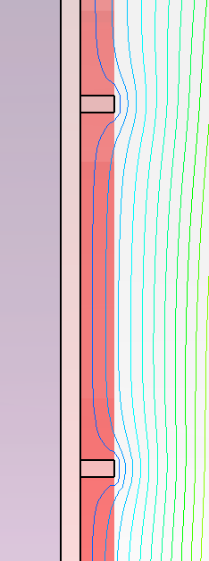
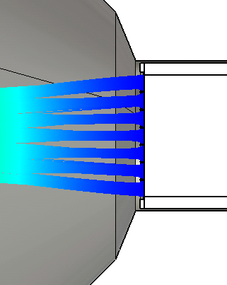
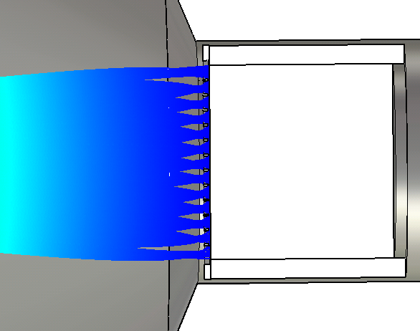

LEETCHI – Cathode grid effects
Pierce electrode
Small grid
Electron beam
Equipotential
lines
Cathode
Anode
Large grid
X-Z plane
Y-Z plane

Slide 18
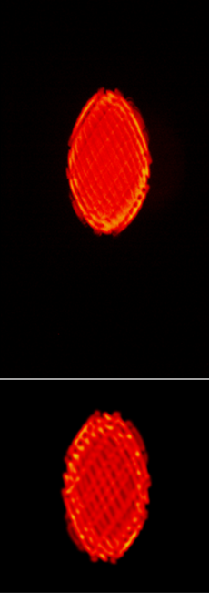
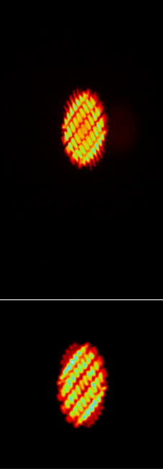
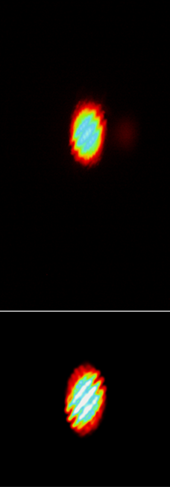
LEETCHI – Comparison between experimental results and simulations @ 0.5 A
I_{s} = 5.4 A
I_{s} = 5.6 A
I_{s} = 5.8 A
Experiment
CST Tracking
simulations

Slide 19
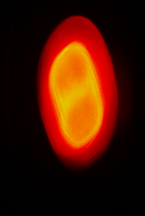
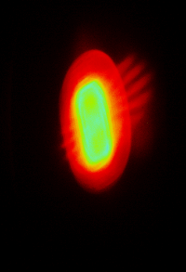
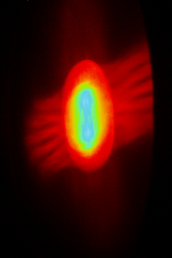
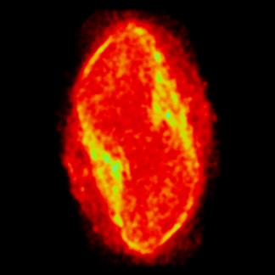
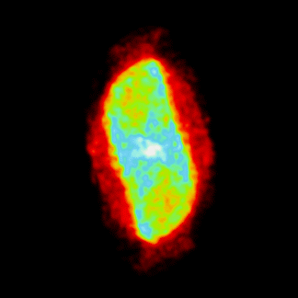
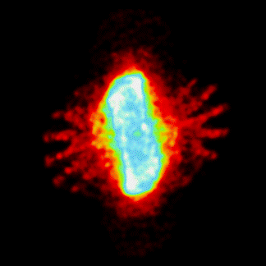
LEETCHI – Comparison between experimental results and simulations @ 4.5 A
I_{s} = 6 A
I_{s} = 6.5 A
I_{s} = 7 A
Experiment
CST Tracking
simulations

Slide 20


Thank you for your attention
Questions

