Slide 1
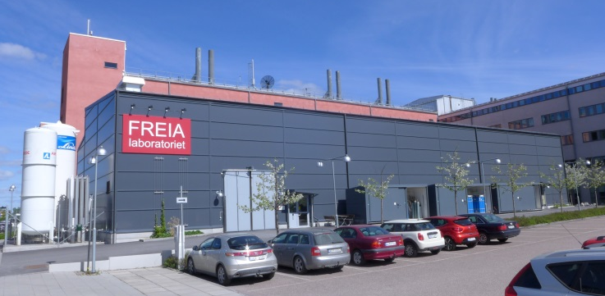
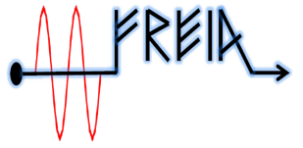
Contribution Possibilities to the
Development of ESS Instruments
Roger Ruber,
for the FREIA Team
ESS, 14 September 2018

Slide 2
Presentation Layout
Some examples of what Freia lab has delivered and the experience of their staff
How could the FREIA lab contribute in terms of
  Design engineering
    how many senior / junior engineers and their physical location
  Development of technology
  Machining & fabrication

Slide 3
personnel

Slide 4
Organization Overview
Uppsala University
Humanities &
Social Science
Science & Technology
Medicine & Pharmacy
Engineering
Physics & Astronomy
Chemistry, Biology, Math & Comp, Geo
Ångström Workshop
FREIA Laboratory
9 other
research divisions
11 staff
27 staff
5 PhD students
260 staff
140 PhD students

Slide 5
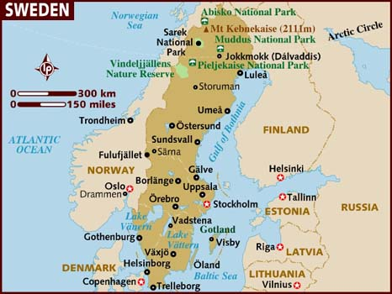
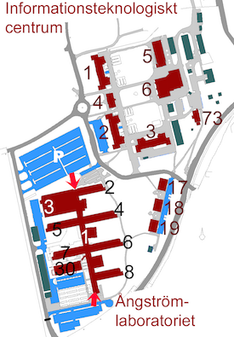
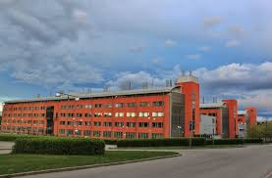
Location
Mechanical workshop
FREIA Laboratory

Slide 6
Competences Inventory
 | FREIA | Workshop | HEP/NP | Cond. Matter
Controls & data acquisition | 2.2 |  | 1.2
Radio-frequency | 2
Beam dynamics & ray tracing | 5
Accelerator technology | 2
Applied superconductivity | 2
Cryogenics and cryostats | 2 |  | 0.5
Mechanics design, construction | 2.2 | 10 |  | 0.9
Electronics design, construction | 2 |  | 0.9 | 0.5
Optics & lasers | 1 |  |  | 1.5
Diagnostics: sensors & detectors | 1 |  | 0.4 | 0.5
Project management | 2 | 1 |  | 1
 | 23.4 | 11 | 3 | 3.4

Slide 7
FREIA Laboratory
Academic: 17
Technical/Administrative: 10
Lecturer/professors
  3 experimental physics
  1 accelerator physics
Senior researchers
  3 experimental physics
  5 accelerator physics/engineering
  3 microwave engineering
Post-doctoral researchers
  2 accelerator physics
Senior research engineers
  1 project leader
  2 controls, data acquisition
  1 LLRF
Engineers
  1 cryogenics & vacuum
  1 power converters, cooling
  1 mechanics, construction
  1 mechanics, design
Technicians
  1 analogue electronics
  1 mechanics, construction

Slide 8
Ångström Mechanical Workshop
Academic: 0
Technical/Administrative: 11
Research engineers
  1 project leader
  1 mechanics design
Technicians
  9 fine mechanics

Slide 9
Machining & fabrication

Slide 10
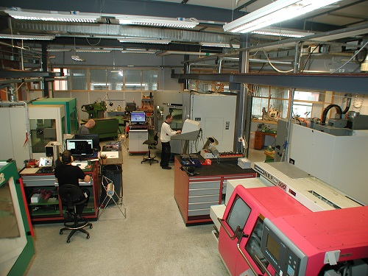
Machining
Ångström Mechanical Workshop
  http://www.physics.uu.se/research/angstrom-workshop/
  fine mechanical works with small tolerances
    stainless steel, aluminium, brass, copper, ceramics, various plastics
  3x CNC milling, 5-axis, largest object ~500x500x400mm
  5x CNC milling, 3-axis, largest object ~1000x600mm
  2x CNC lathe
  3D printer, 100mm(Φ) x 80mm(h)
    aluminium, steel 316L, inconel,
    glass-metal achieved in R&D-project
External workshops
  in and around Uppsala

Slide 11
Assembly and Testing
Ångström Mechanical Workshop
  UHV-compatible
    ultra-sonic bath cleaning, largest object ~500x400x370mm
  welding of most materials
    TIG, MIG, electrode, gas
    TIG for vacuum (aluminium and steel)
  helium leak detection
  mechanical design
    SolidWorks CAD software
FREIA Laboratory
  UHV vacuum
  portable clean room
  thermal shock
  helium leak detection
  mechanical design
    SolidWorks CAD software

Slide 12
technology development

Slide 13
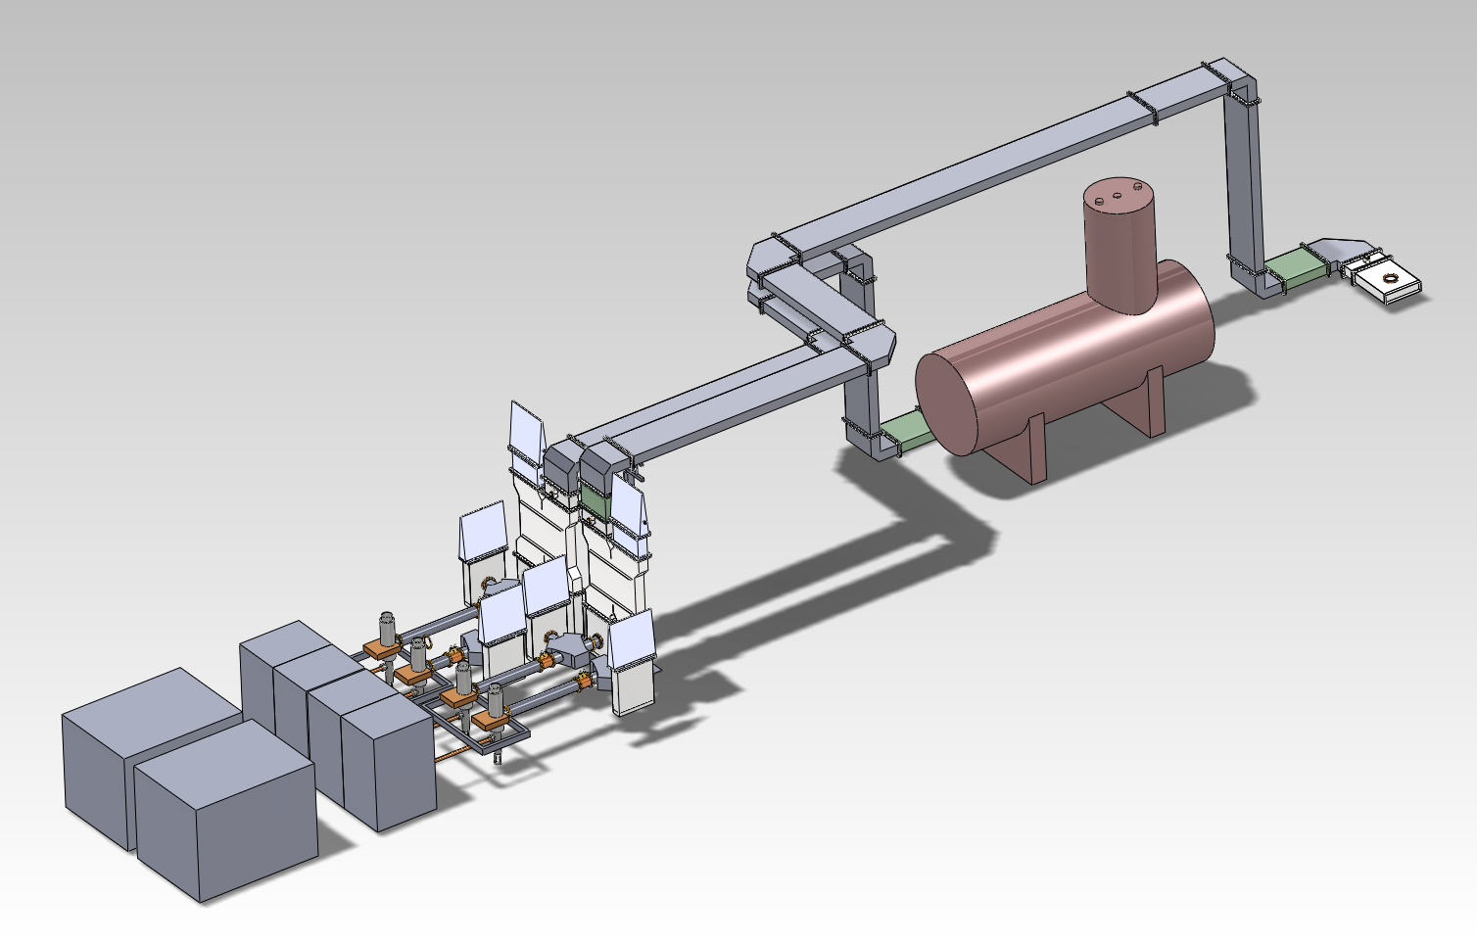
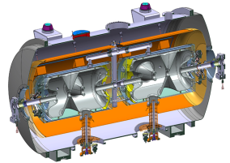
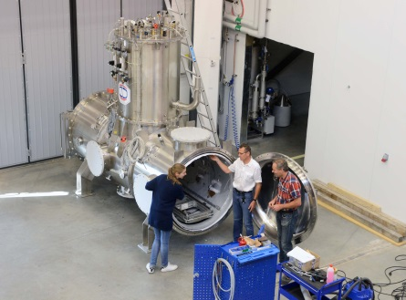
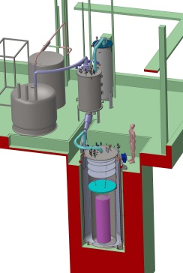
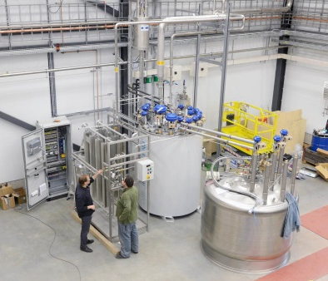
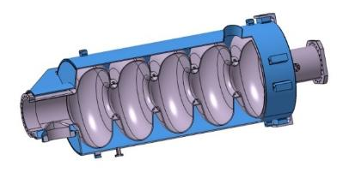
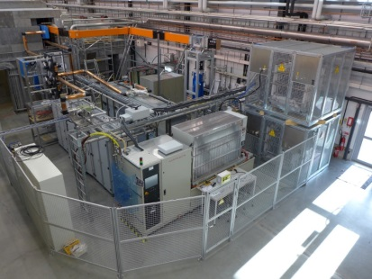
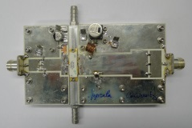
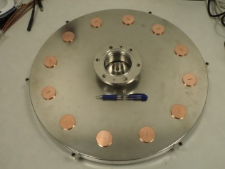
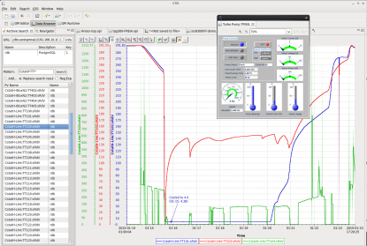
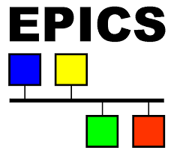
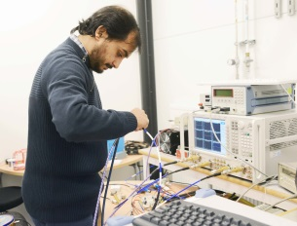
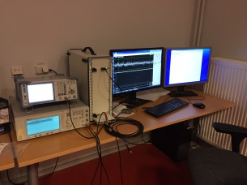
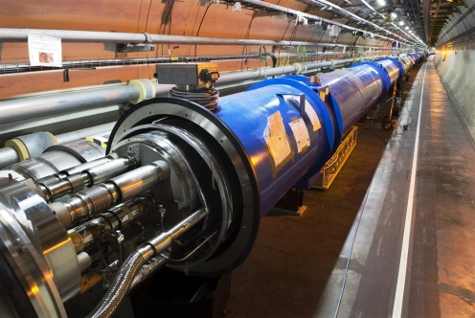
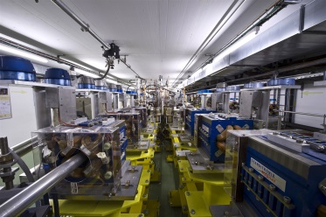
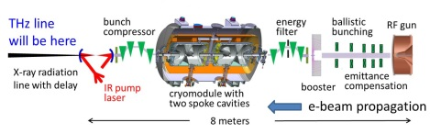
RF = Radio Frequency
FEL = Free Electron Laser
ESS Superconducting Linac
Cryostat Test Stands
Cryogenics
High Power RF
Solid State RF
Controls & Data Acquisition
HiLumi LHC
CLIC & FELs
ESS Neutrino Super Beam

Slide 14
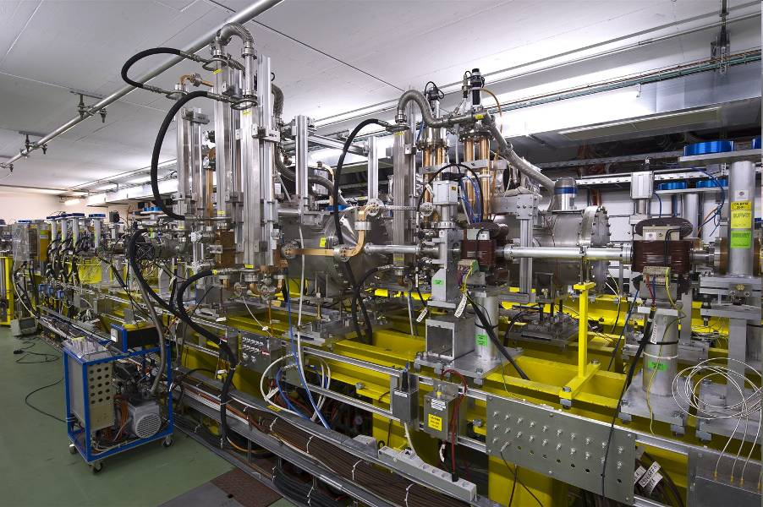
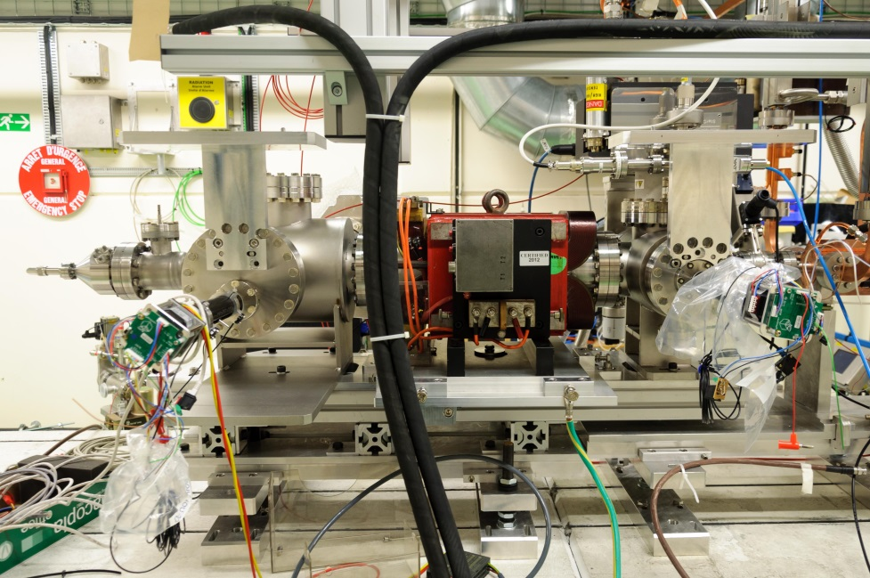
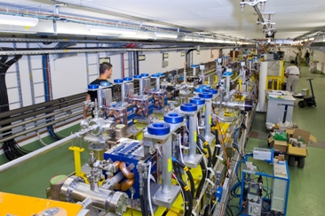
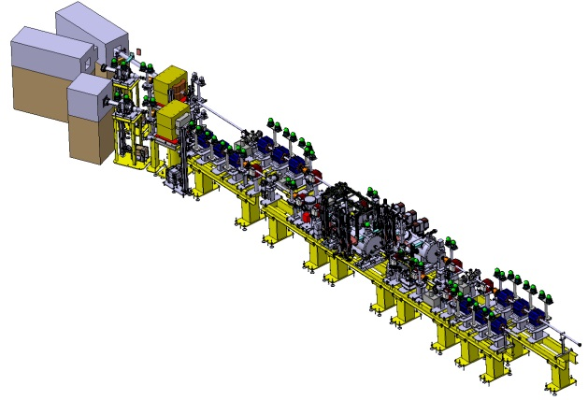
CTF3 / CLIC Project
Two-Beam Test Stand
Uppsala X-band Spectrometer

Slide 15
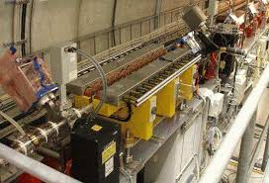
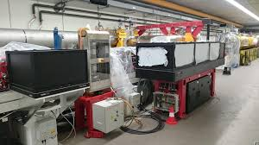
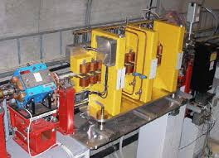
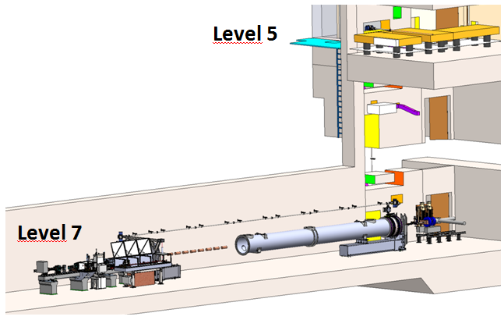
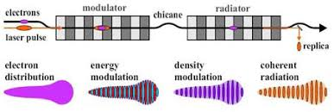
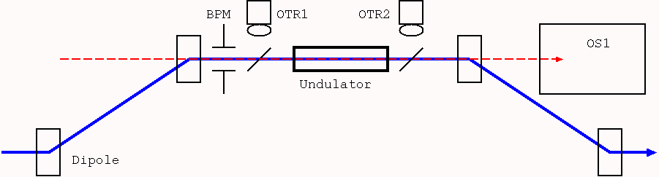
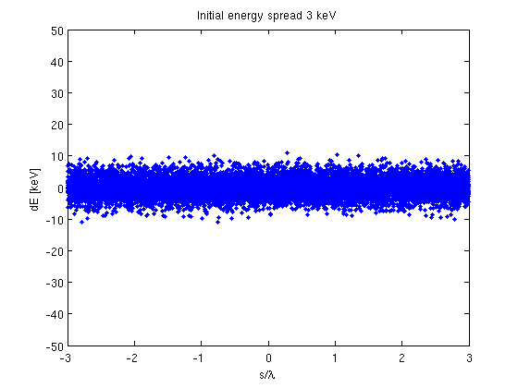
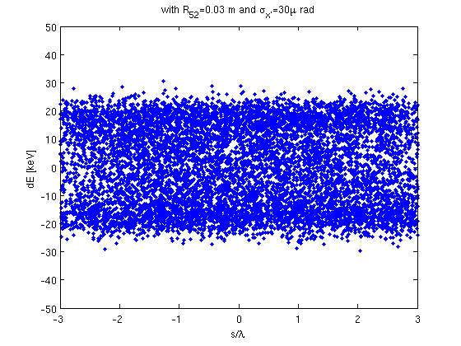
FLASH & EuXFEL Projects
Optical Replica Synthesizer
Laser Heater

Slide 16
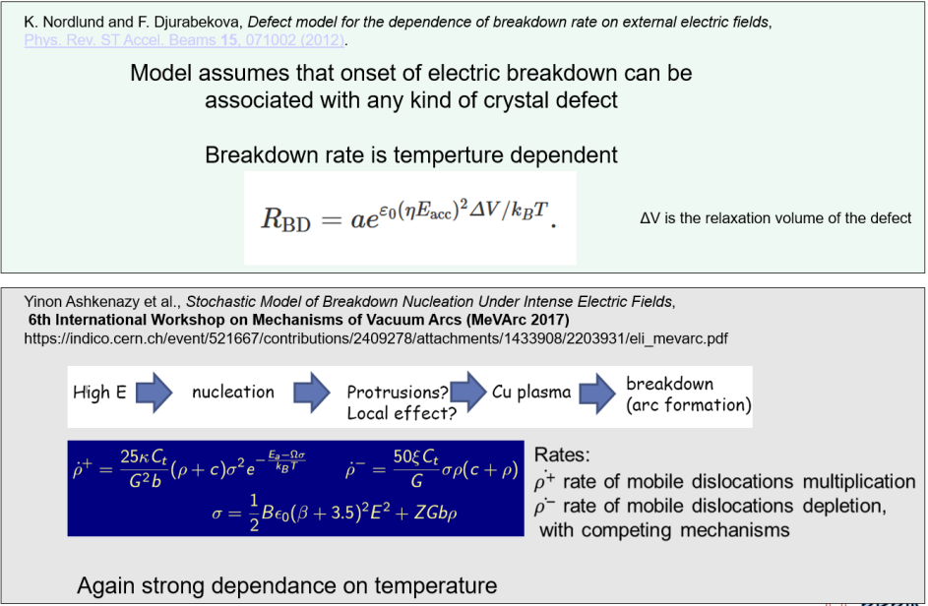
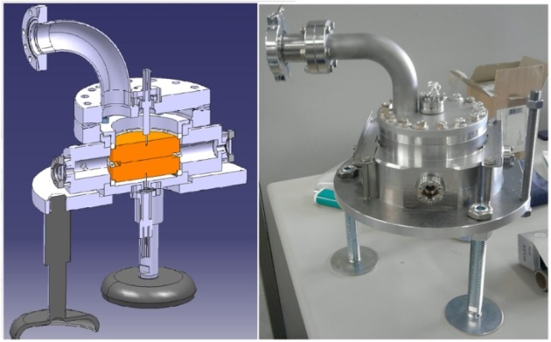
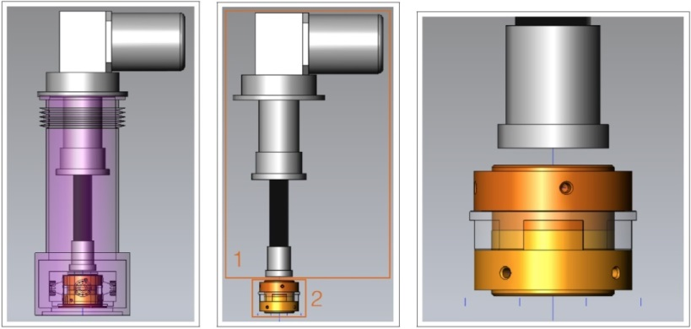
Cryogenic DC-spark System
Field emission & vacuum breakdown
rate as function of temp.
  complement to RF tests
    in-depth studies of the high-fields physics
    (e.g. material and surface science)
    possibility to find new and potentially
    important connections between the
    high-gradient NC and SC fields.
  very high repetition rate, pulsed DC
  simple geometry (large planar electrodes)
  similar high-field behavior in RF and pulsed DC
Modern vacuum breakdown models – T dependent

Slide 17
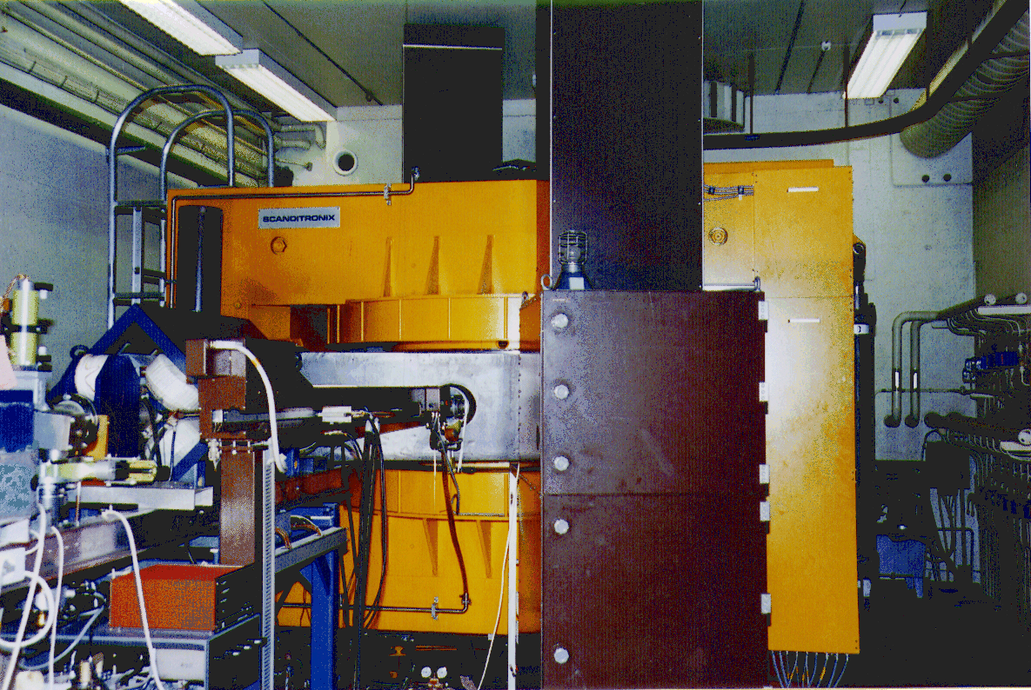

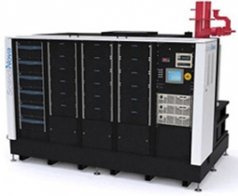

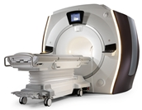
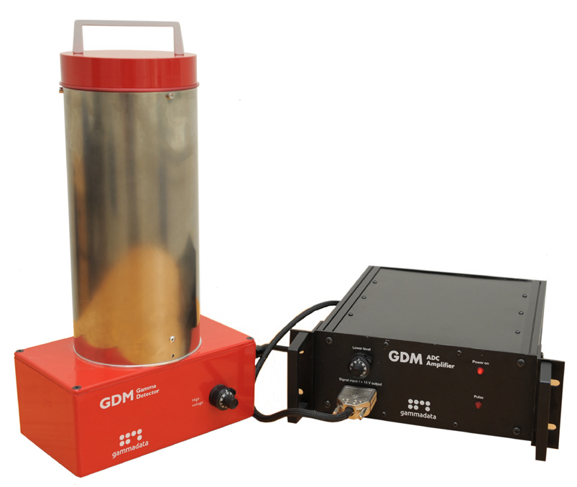

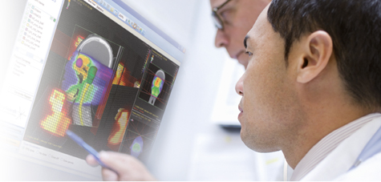




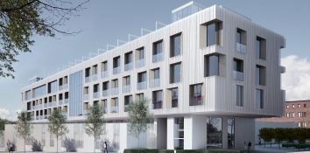
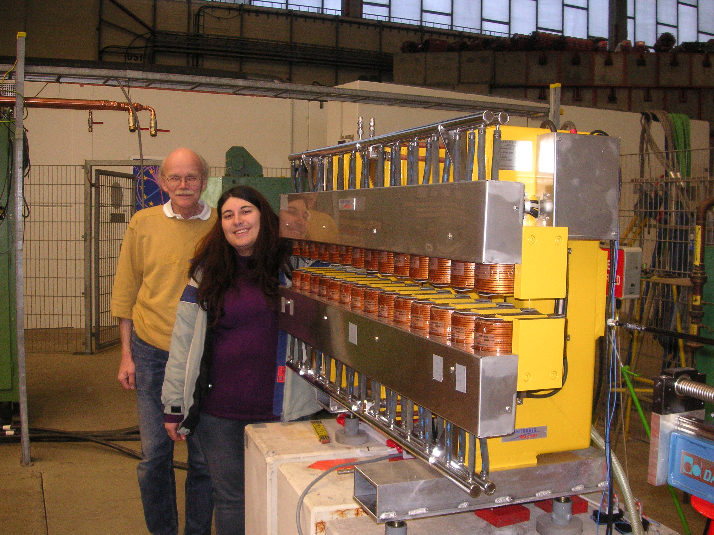
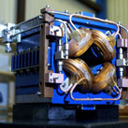
Offshoots from Uppsala Accelerator R&D
Scanditronix
  major supplier
    cyclotrons 1970-80’s
    PETs 1980’s
GE Medical Systems
PET and cyclotrons
  former Scanditronix
IBA Dosimetry
  former Scanditronix Wellhöfer
Scanditronix Magnets
  magnets
ScandiNova
  high voltage
  pulse modulators
Gammadata
  physics tools
  education,
  research,
  industry
Skandionkliniken
  proton therapy centre

