Slide 1
FREIA Laboratory
Facility for Research Instrumentation and Accelerator Development
Overview of Activities
Roger Ruber for the FREIA Team
ESS, 14 September 2018

Slide 2
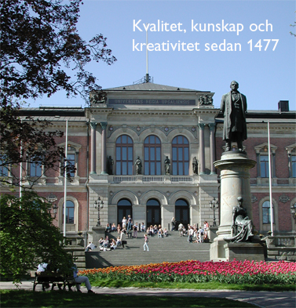
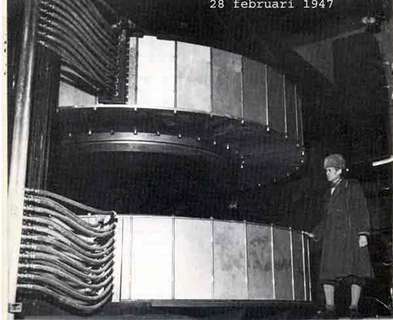
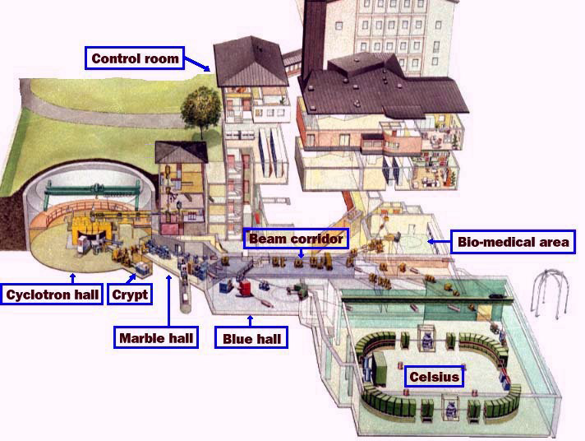
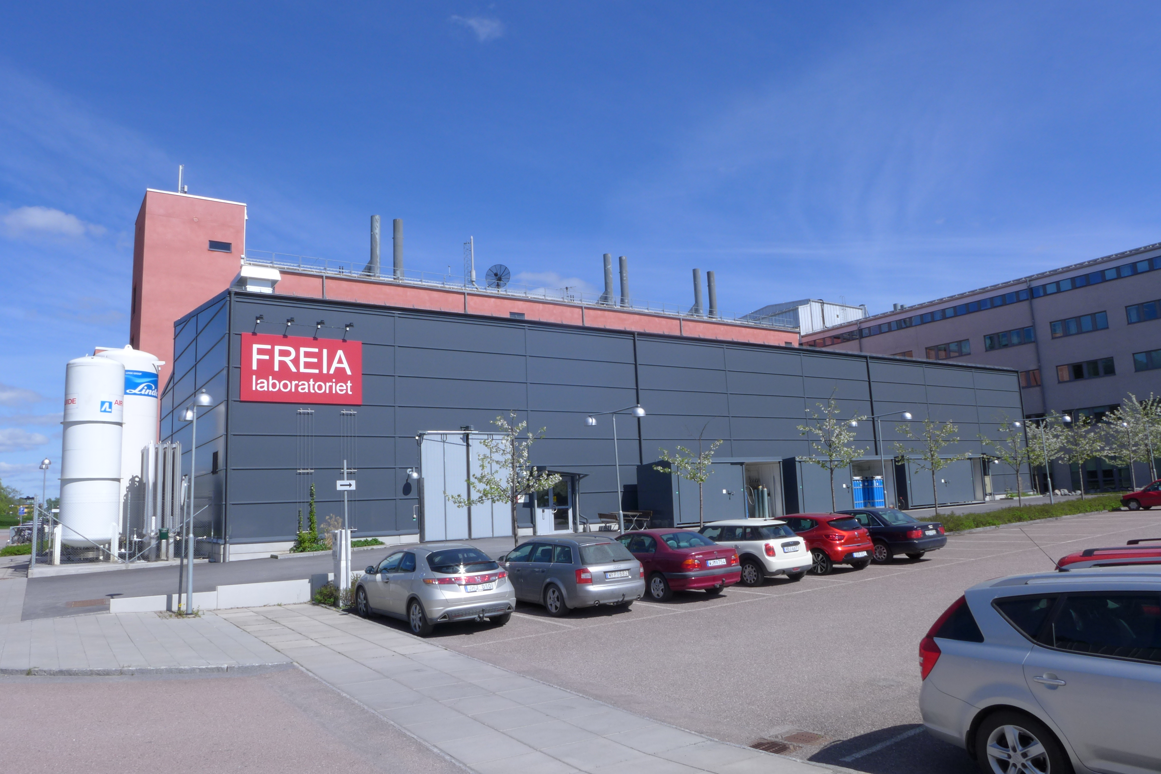
Uppsala Accelerator History
1477: Uppsala University, oldest in Scandinavia
25'000 students, 7'000 staff
historical profiles: Linné, Rudbeck, Celsius, Ångström, Svedberg
1940's: The(odore) Svedberg builds a cyclotron
Gustaf Werner synchro-cyclotron (1947 - 2016)
  nuclear physics & oncology
CELSIUS ring (1984 - 2005)
  nuclear & particle physics
2000's: External projects
CTF3/CLIC (since 2005)
FLASH/XFEL (since 2006)
ESS (since 2009)
2010's: New ventures
FREIA laboratory (est. 2011)
Skandion clinic (est. 2015)

Slide 3
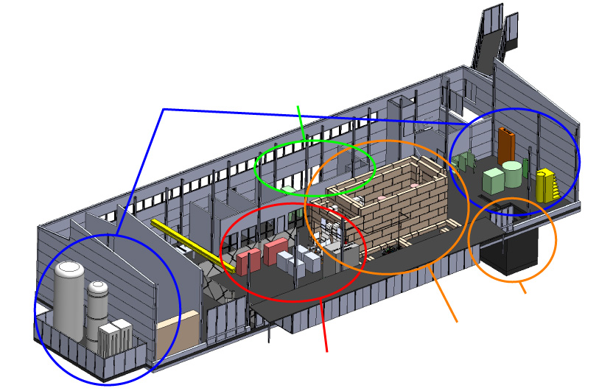
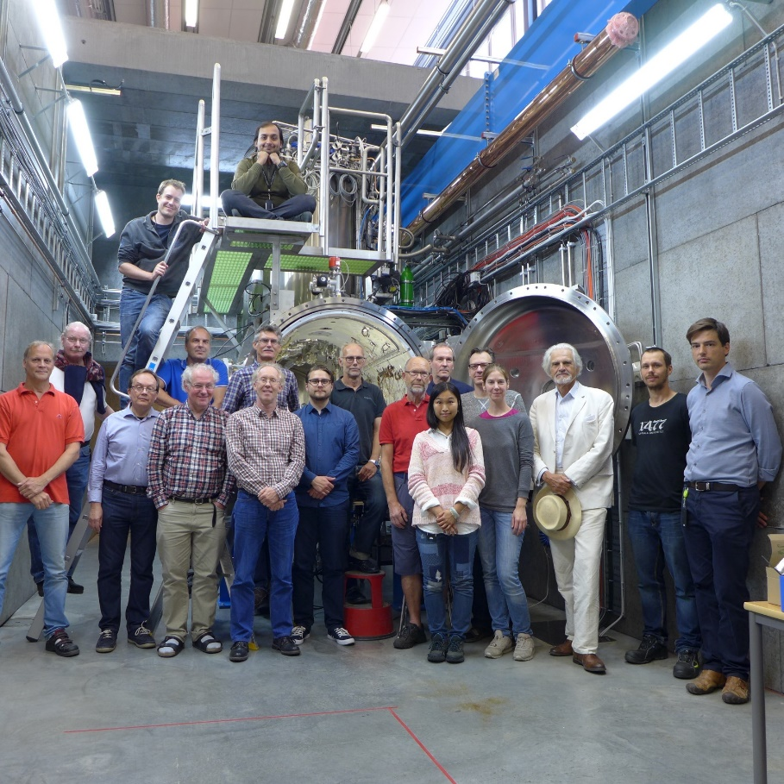
FREIA
Facility for Research Instrumentation and Accelerator Development
Funded by
KAWS, Government, Uppsala Univ.
State-of-the-art Equipment
cryogenics
- liquid helium
- liquid nitrogen
control room
- equipment controls
- data acquisition
Competent and motivated staff
collaboration of physics (IFA)
and engineering (Teknikum).
vertical cryostat
3 bunkers
with test stands
horizontal cryostat
radio-frequency (RF) power sources

Slide 4
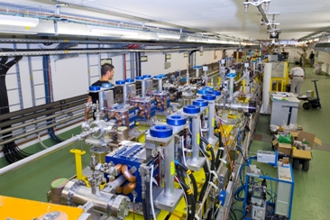
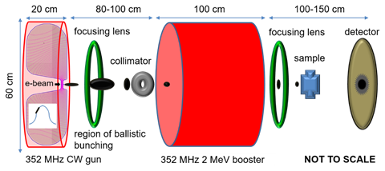
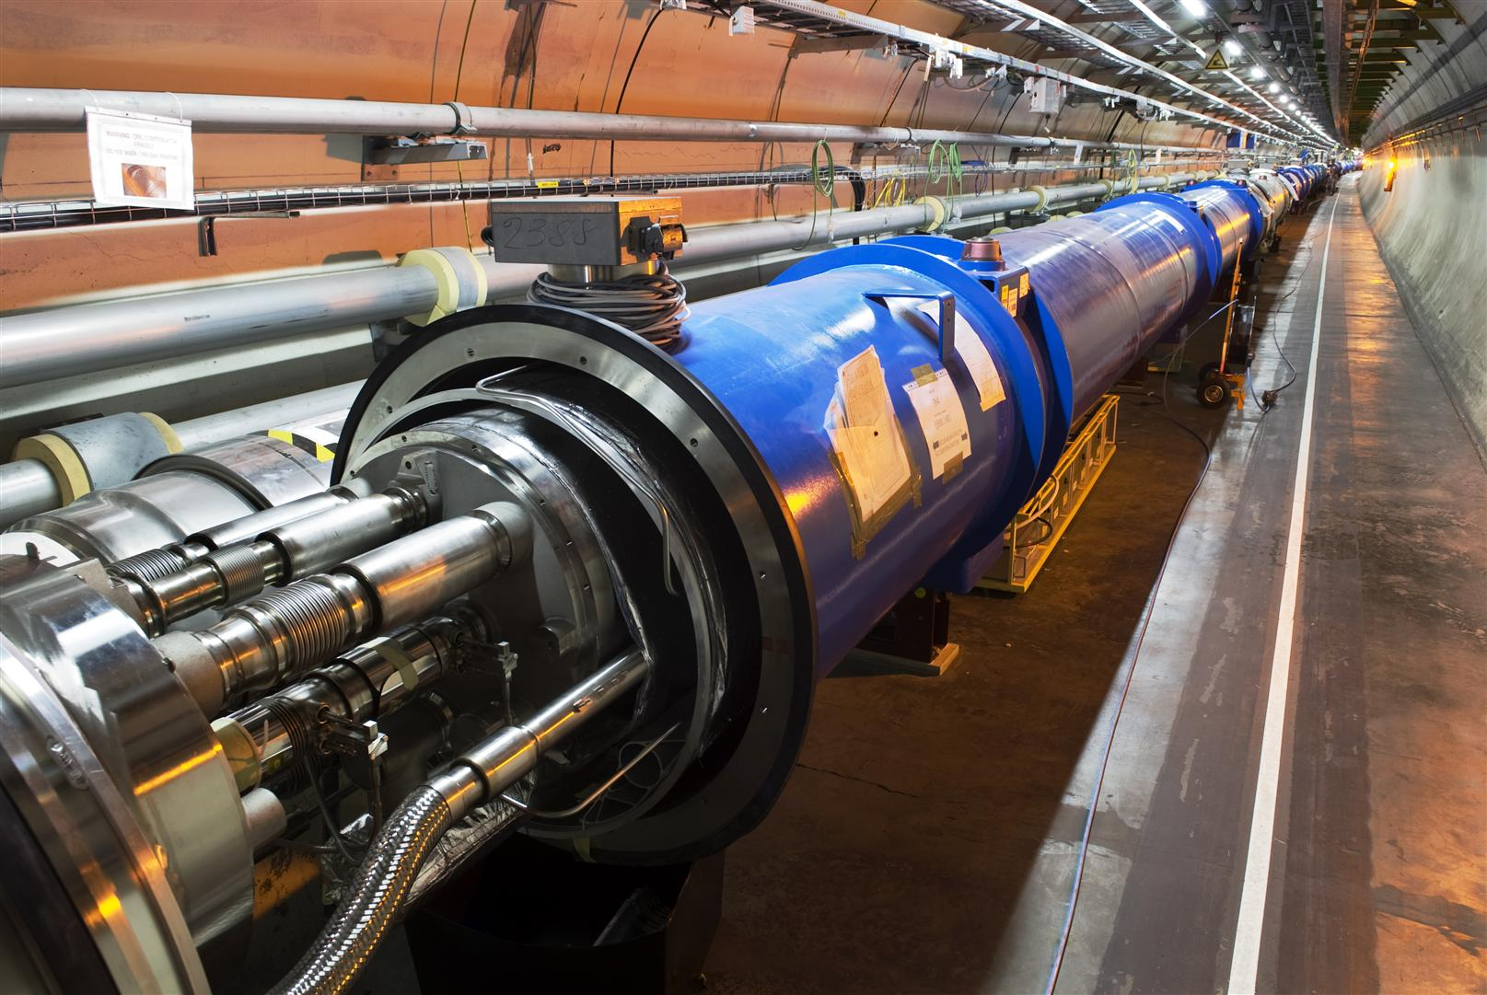
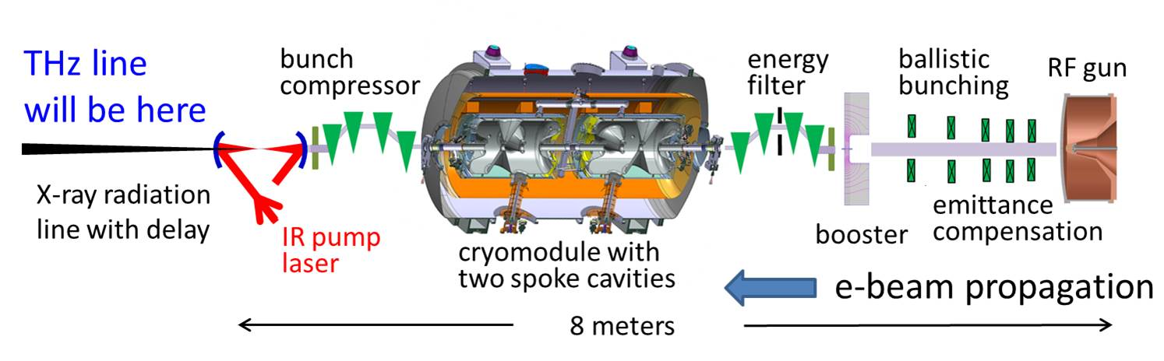
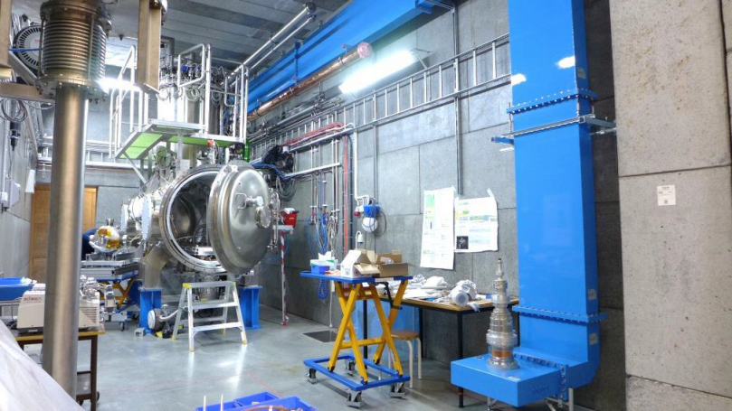
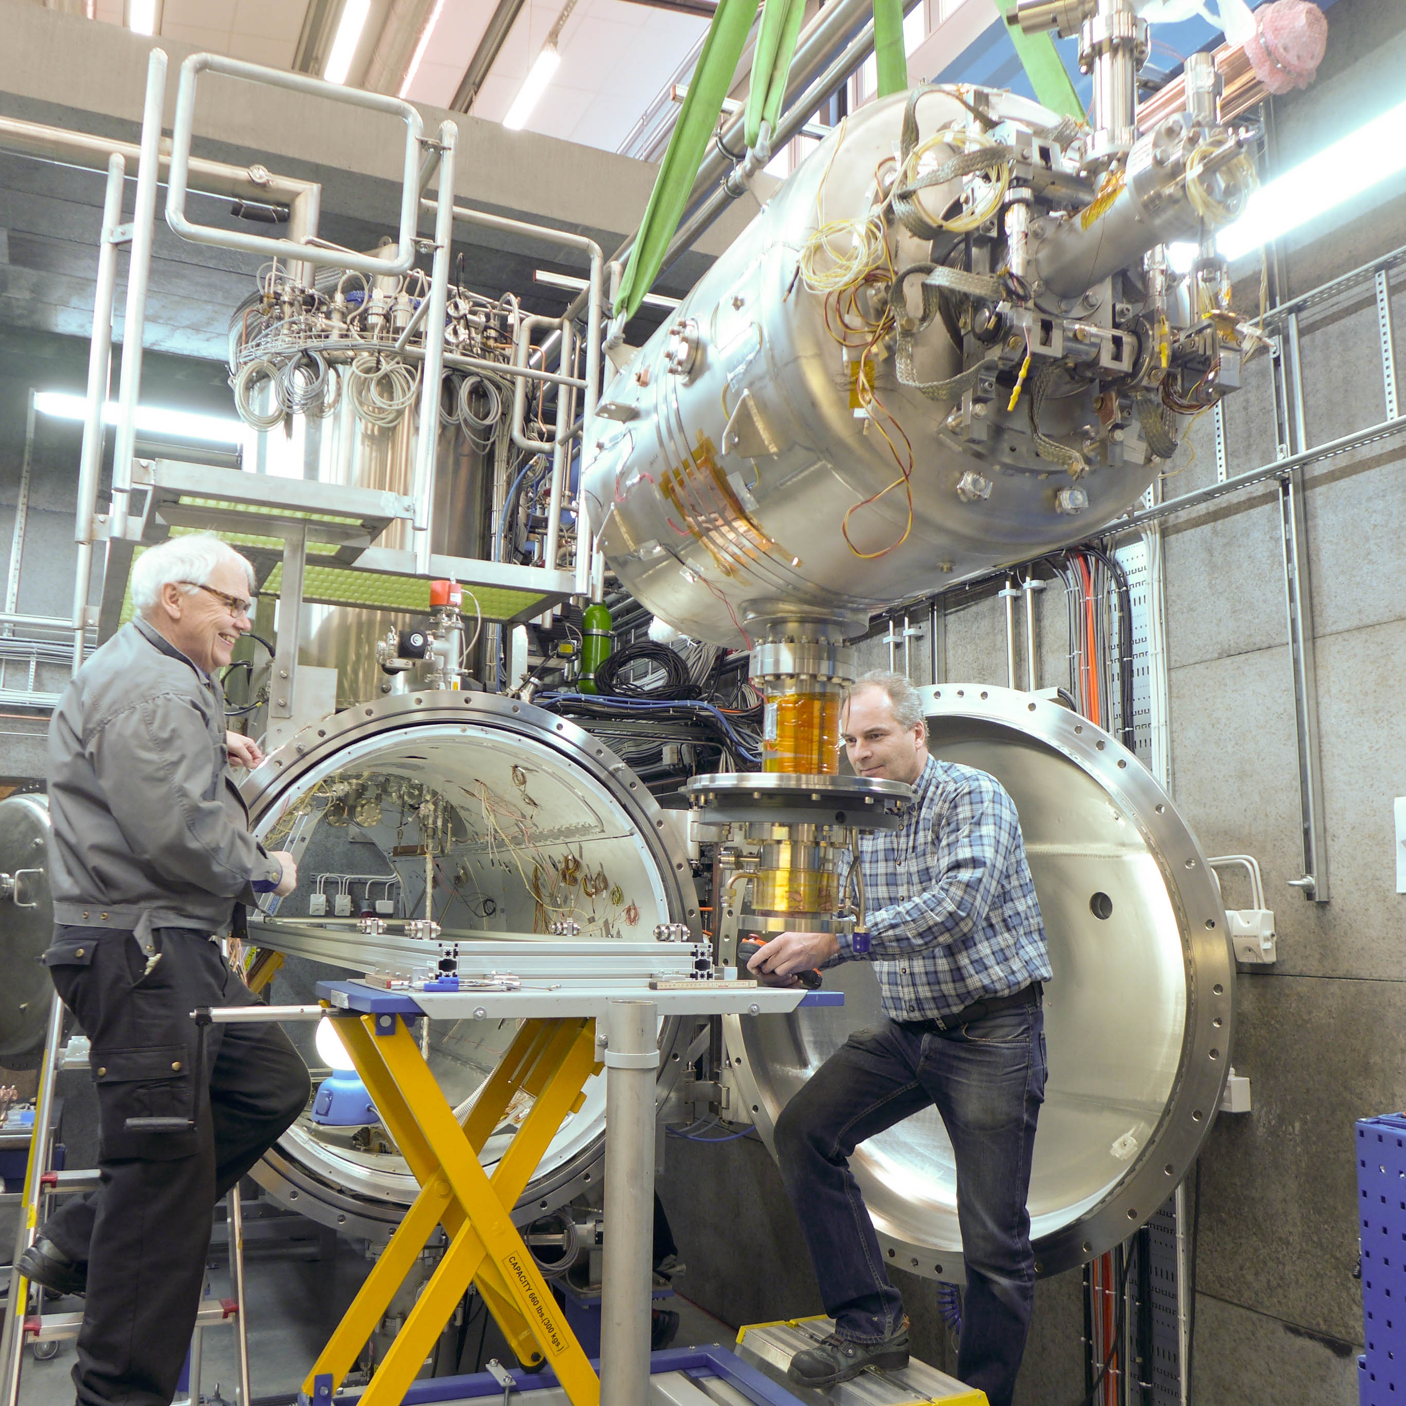
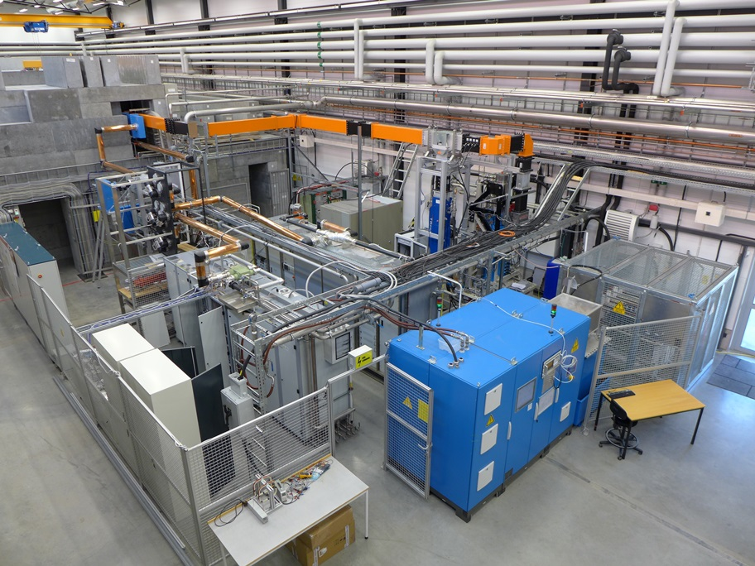
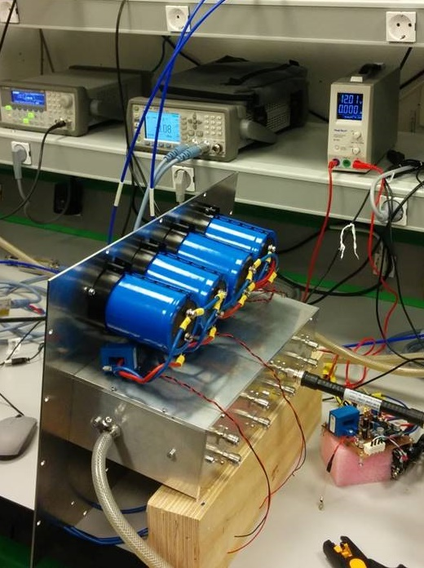
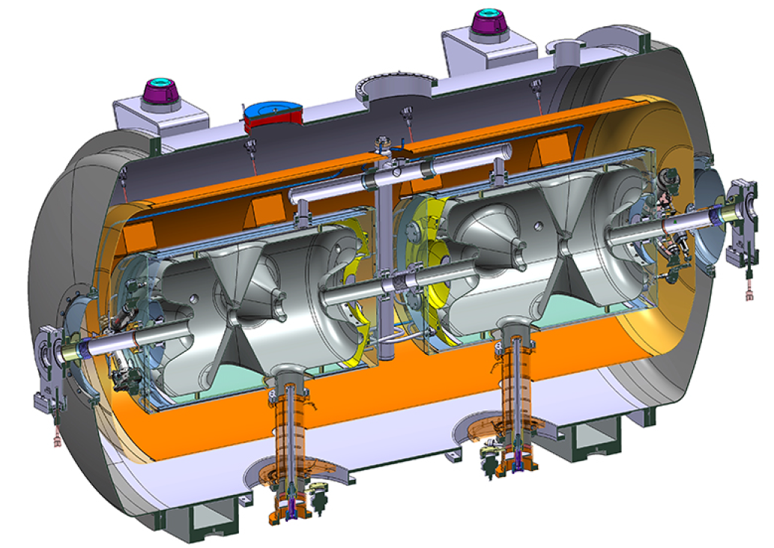
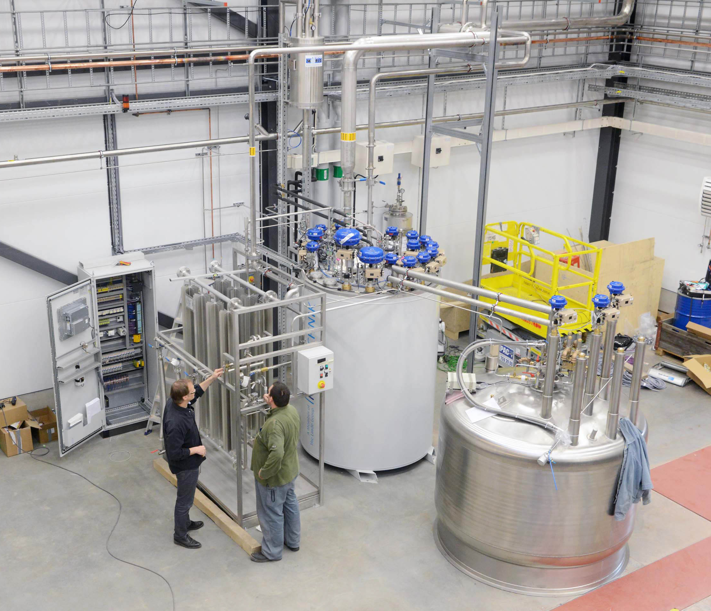
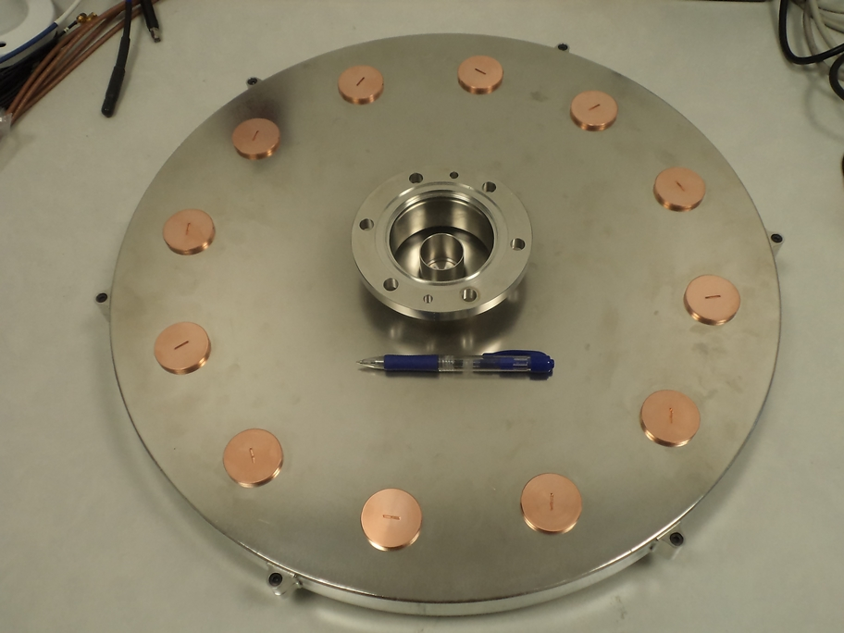
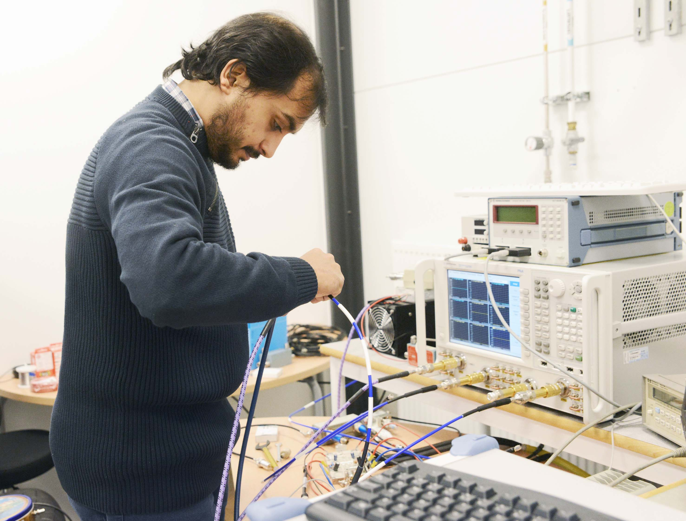
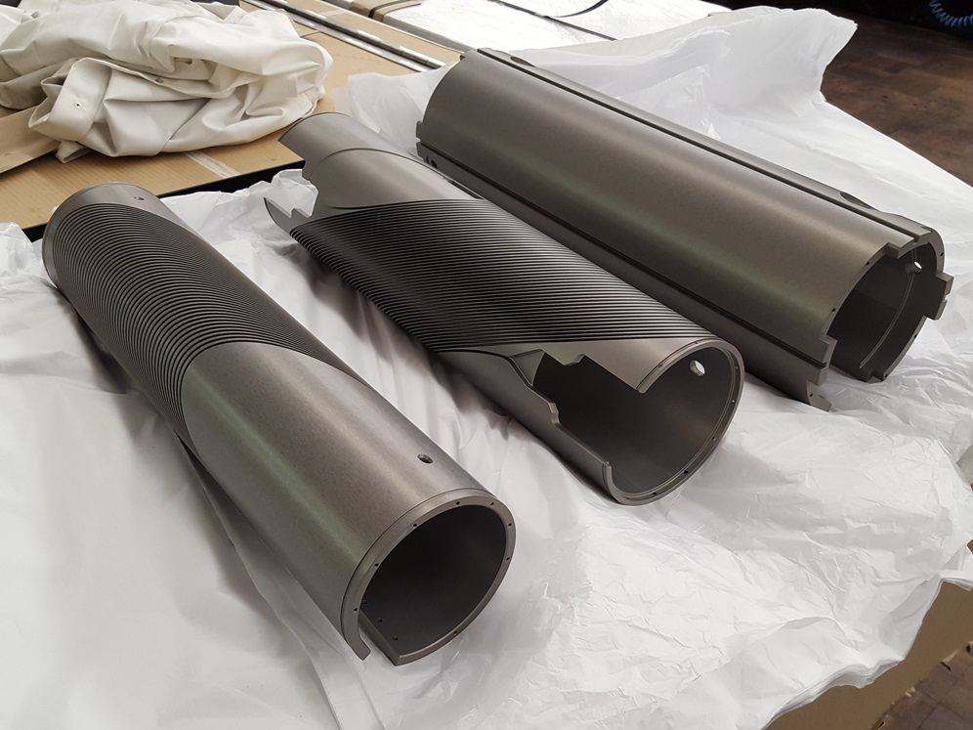
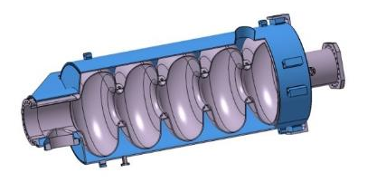
Accelerators & Instrumentation
Ultra Bright Electron Beams
High Intensity Proton Beams
Advanced Instrumentation
SC Cavities & Magnets
RF Generation & Control
Cryogenics

Slide 5
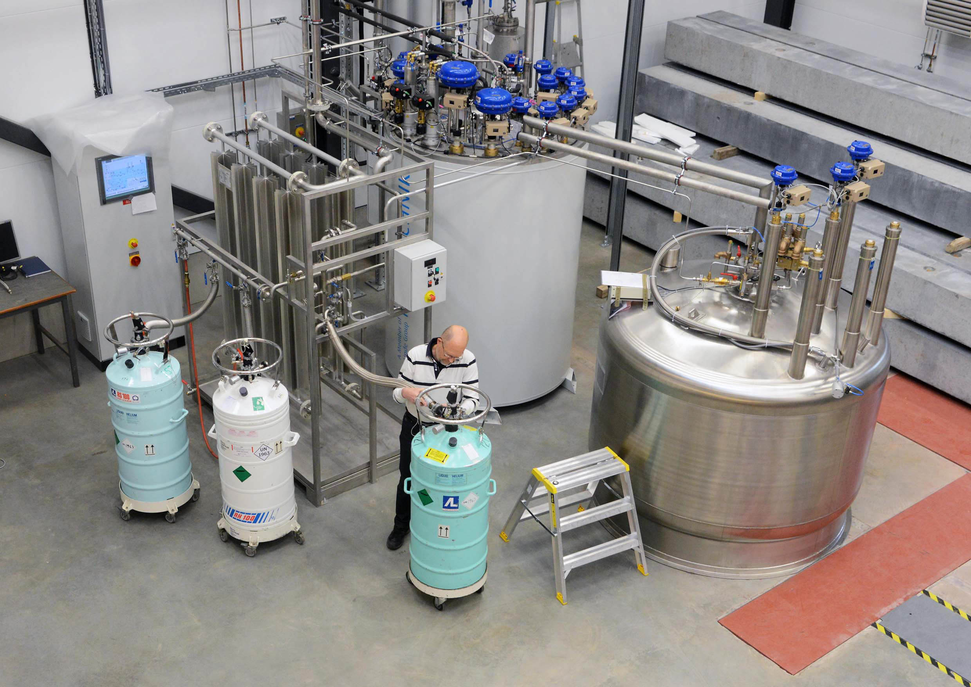
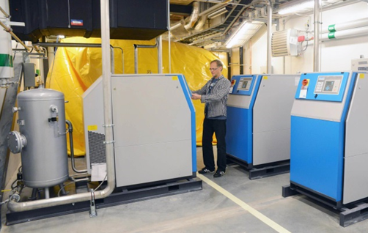
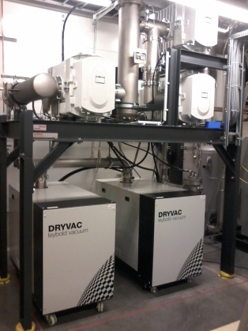
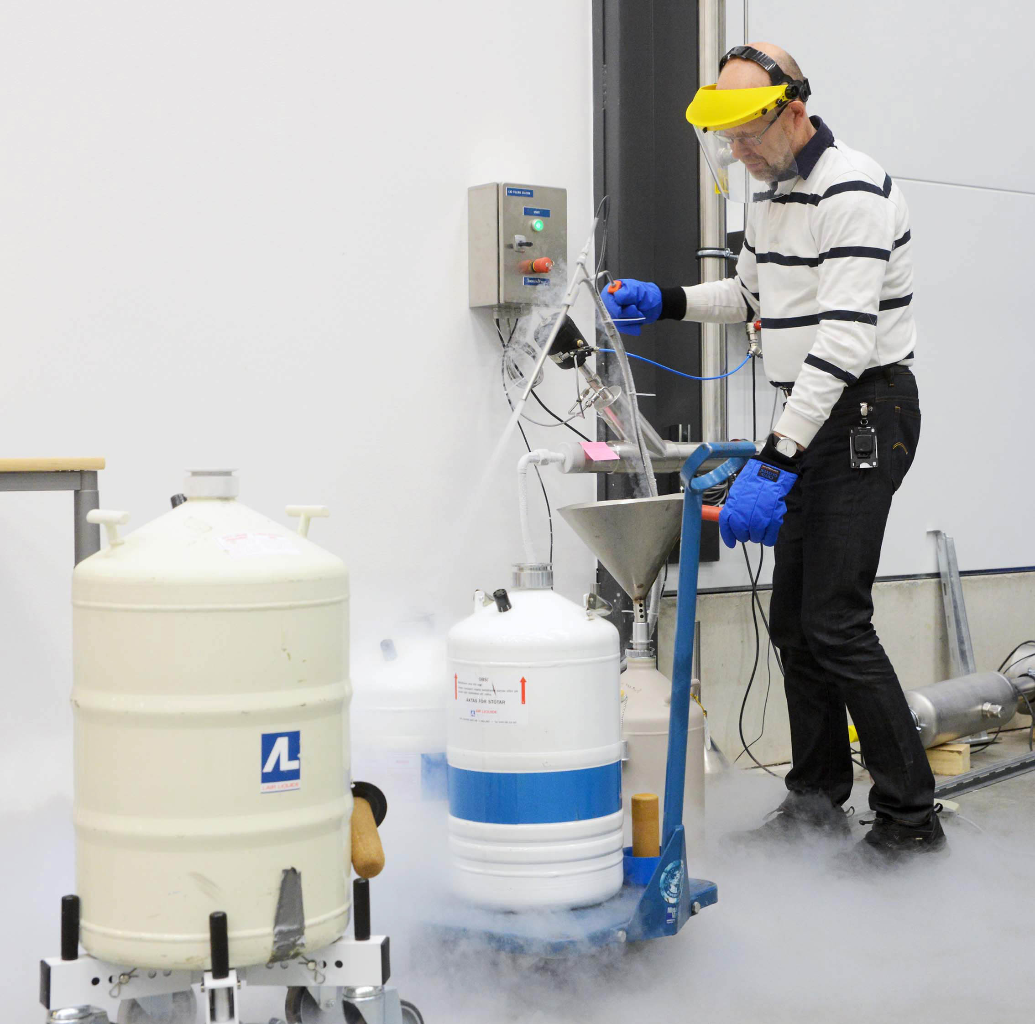
Cryogenics
Helium liquefaction
  150 l/h at 4.5K (LN2 pre-cooling)
  2000 l LHe dewar/buffer, 3+1 outlets
  cryostats connected in closed loop
Gas recovery
  100 m³ gasbag
  3x 25 m³/h compressor
  10 m³ 200 bar storage
2K Pumping
  ~3.2 g/s at 10 mbar
  ~4.3 g/s at 15 mbar
  110(90)W at 2.0(1.8)K
Liquid nitrogen
  20 m³ LN2 tank
Helium gas recovery system
Sub-atmospheric pumping station

Slide 6

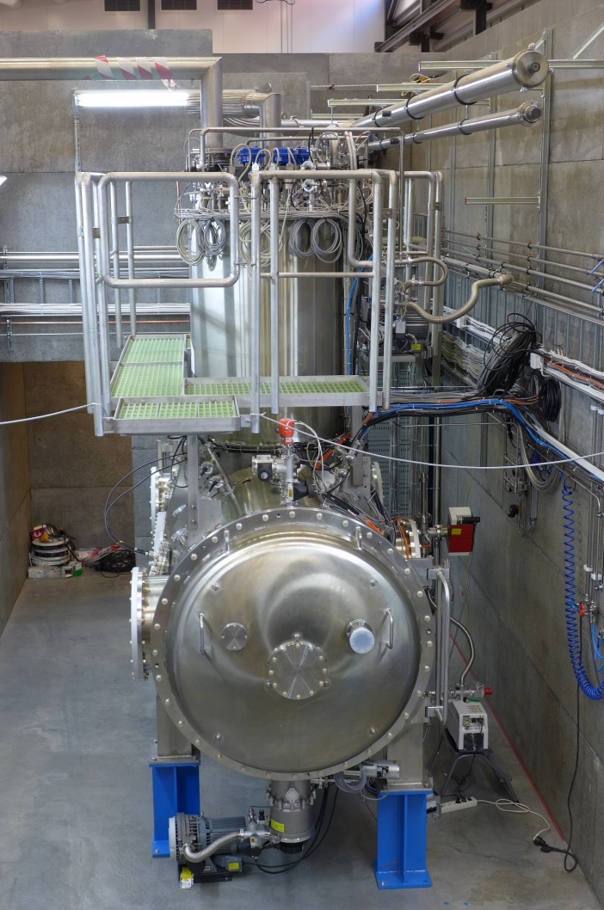
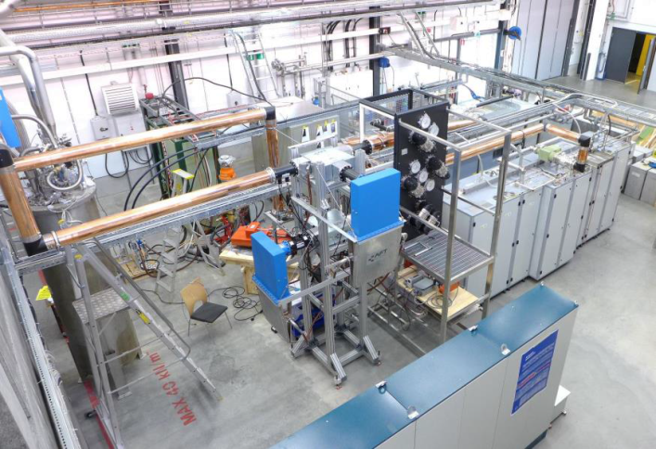
“HNOSS” Horizontal Cryostat
HNOSS = Horizontal Nugget for Operation of Superconducting Systems
Test of superconducting cavities/devices
  3240 x ø1200mm inner volume
  up to two cavities simultaneously,
  each equipped with helium tank,
Low or High power RF testing
  fundamental power coupler (top, bottom, side)
  (cold) tuning system
Operation in the range 1.8 to 4.5K.
Available as ARIES
Trans National Access Facility

Slide 7
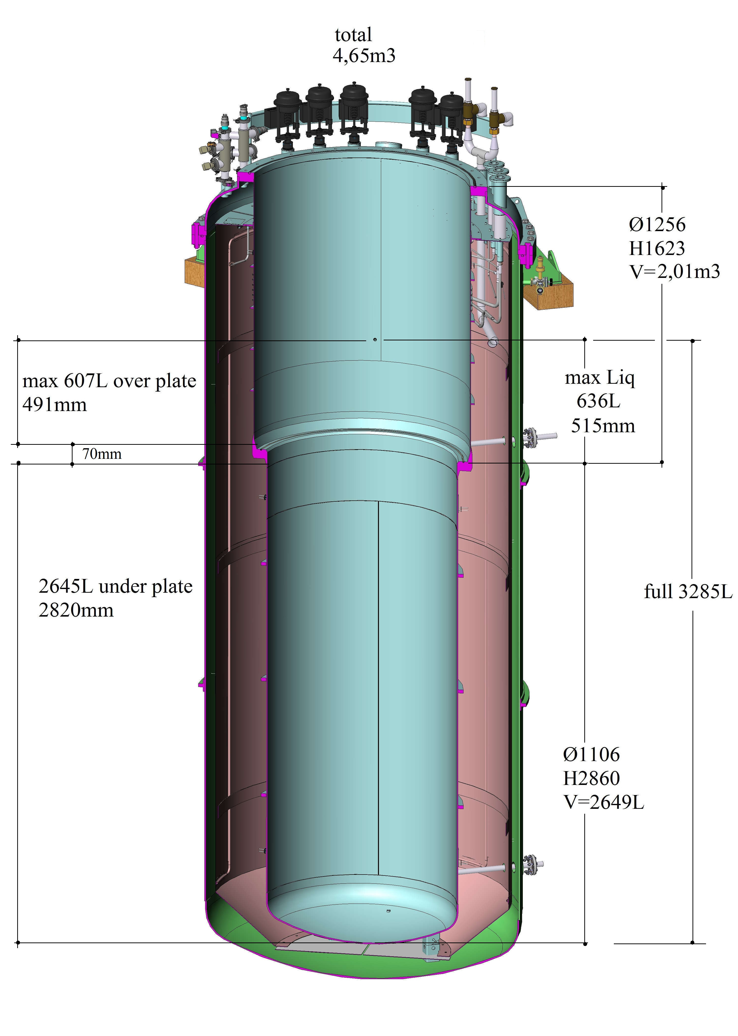
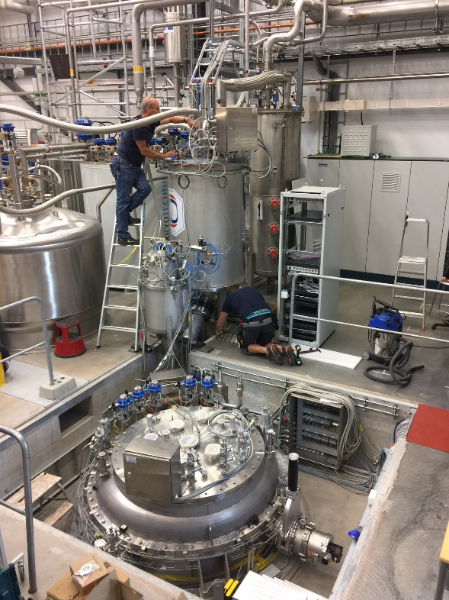
“Gersemi” Vertical Cryostat
Under commissioning
Test of SC cavities & magnets
  3.2m x ø1.1m total volume
  2.65m x ø1.1m below lambda plate
    design includes joint for lambda plate
Operation in the range 1.8 to 4.5K
Three operation modes
  vacuum
  liquid bath
  pressurized bath with 2K heat exchanger
Available as ARIES
Trans National Access Facility

Slide 8
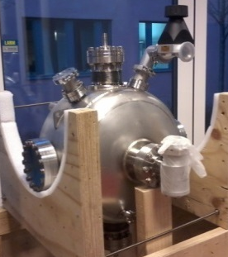
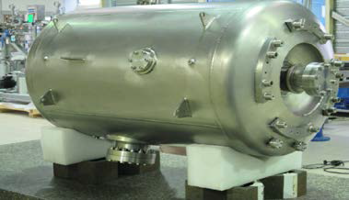
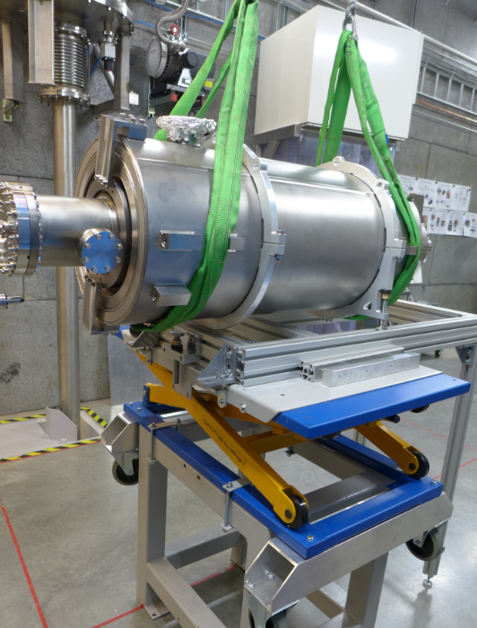
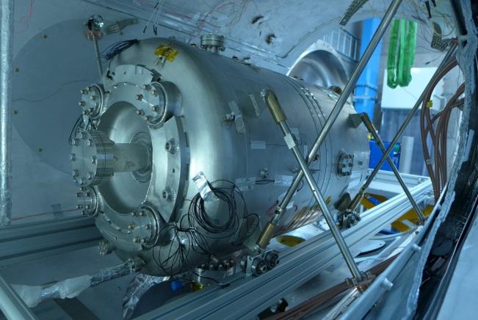
Test Activities
Hélène single spoke cavity (IPNO)
  antenna, low power
  self-excited loop (SEL)
  RF calibration procedures
Germaine double spoke (IPNO)
  antenna and cold tuner, low power
  cryogenics: cooling, heat load
  LLRF, SEL
  Q₀, gradient, microphonics
Romea cavity package (IPNO)
  power coupler and tuner, nominal gradient
  Q₀ and gradient, microphonics, fill time, Lorentz force detuning
  tuner operation
RF Station 352 MHz (2x)
  acceptance and functional test
    including RF distribution components
  soak test
  pulsed and CW operation on cavity
RF Station 704 MHz
  acceptance & operation of modulator
High-β elliptical cavity package (CEA)
  FPC conditioning ok
  under test
ESS Cryomodules
  prototype,
  arrived August 2018
  13 series during
  2019 - 2020

Slide 9
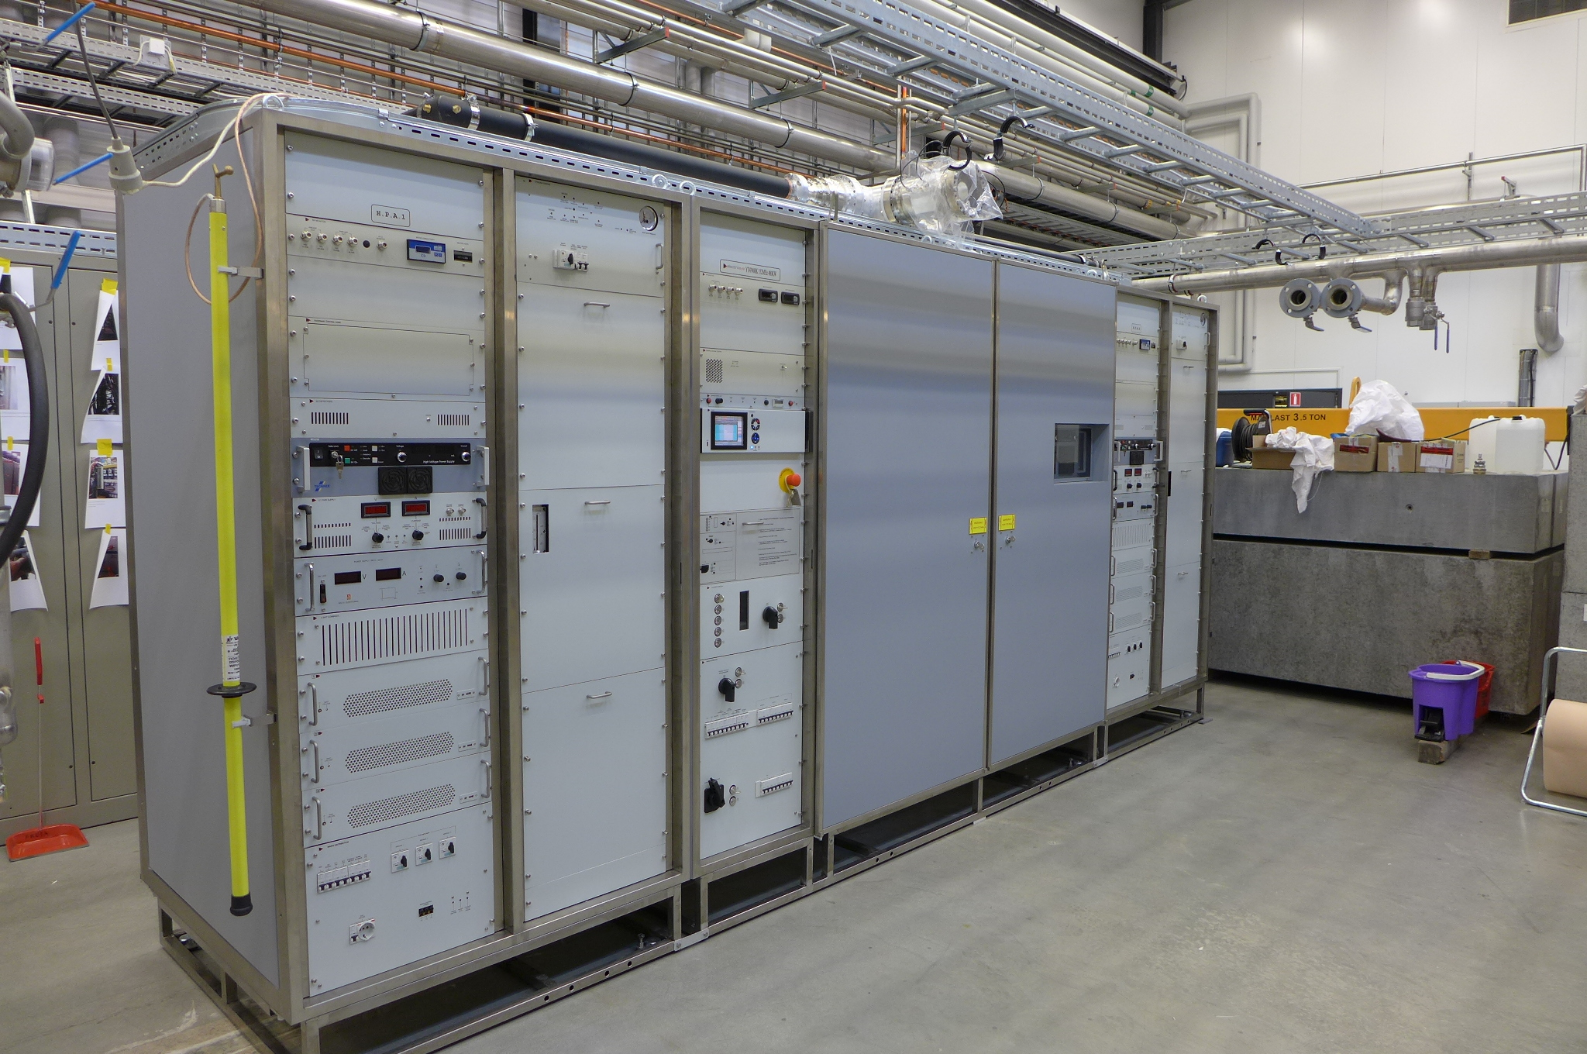
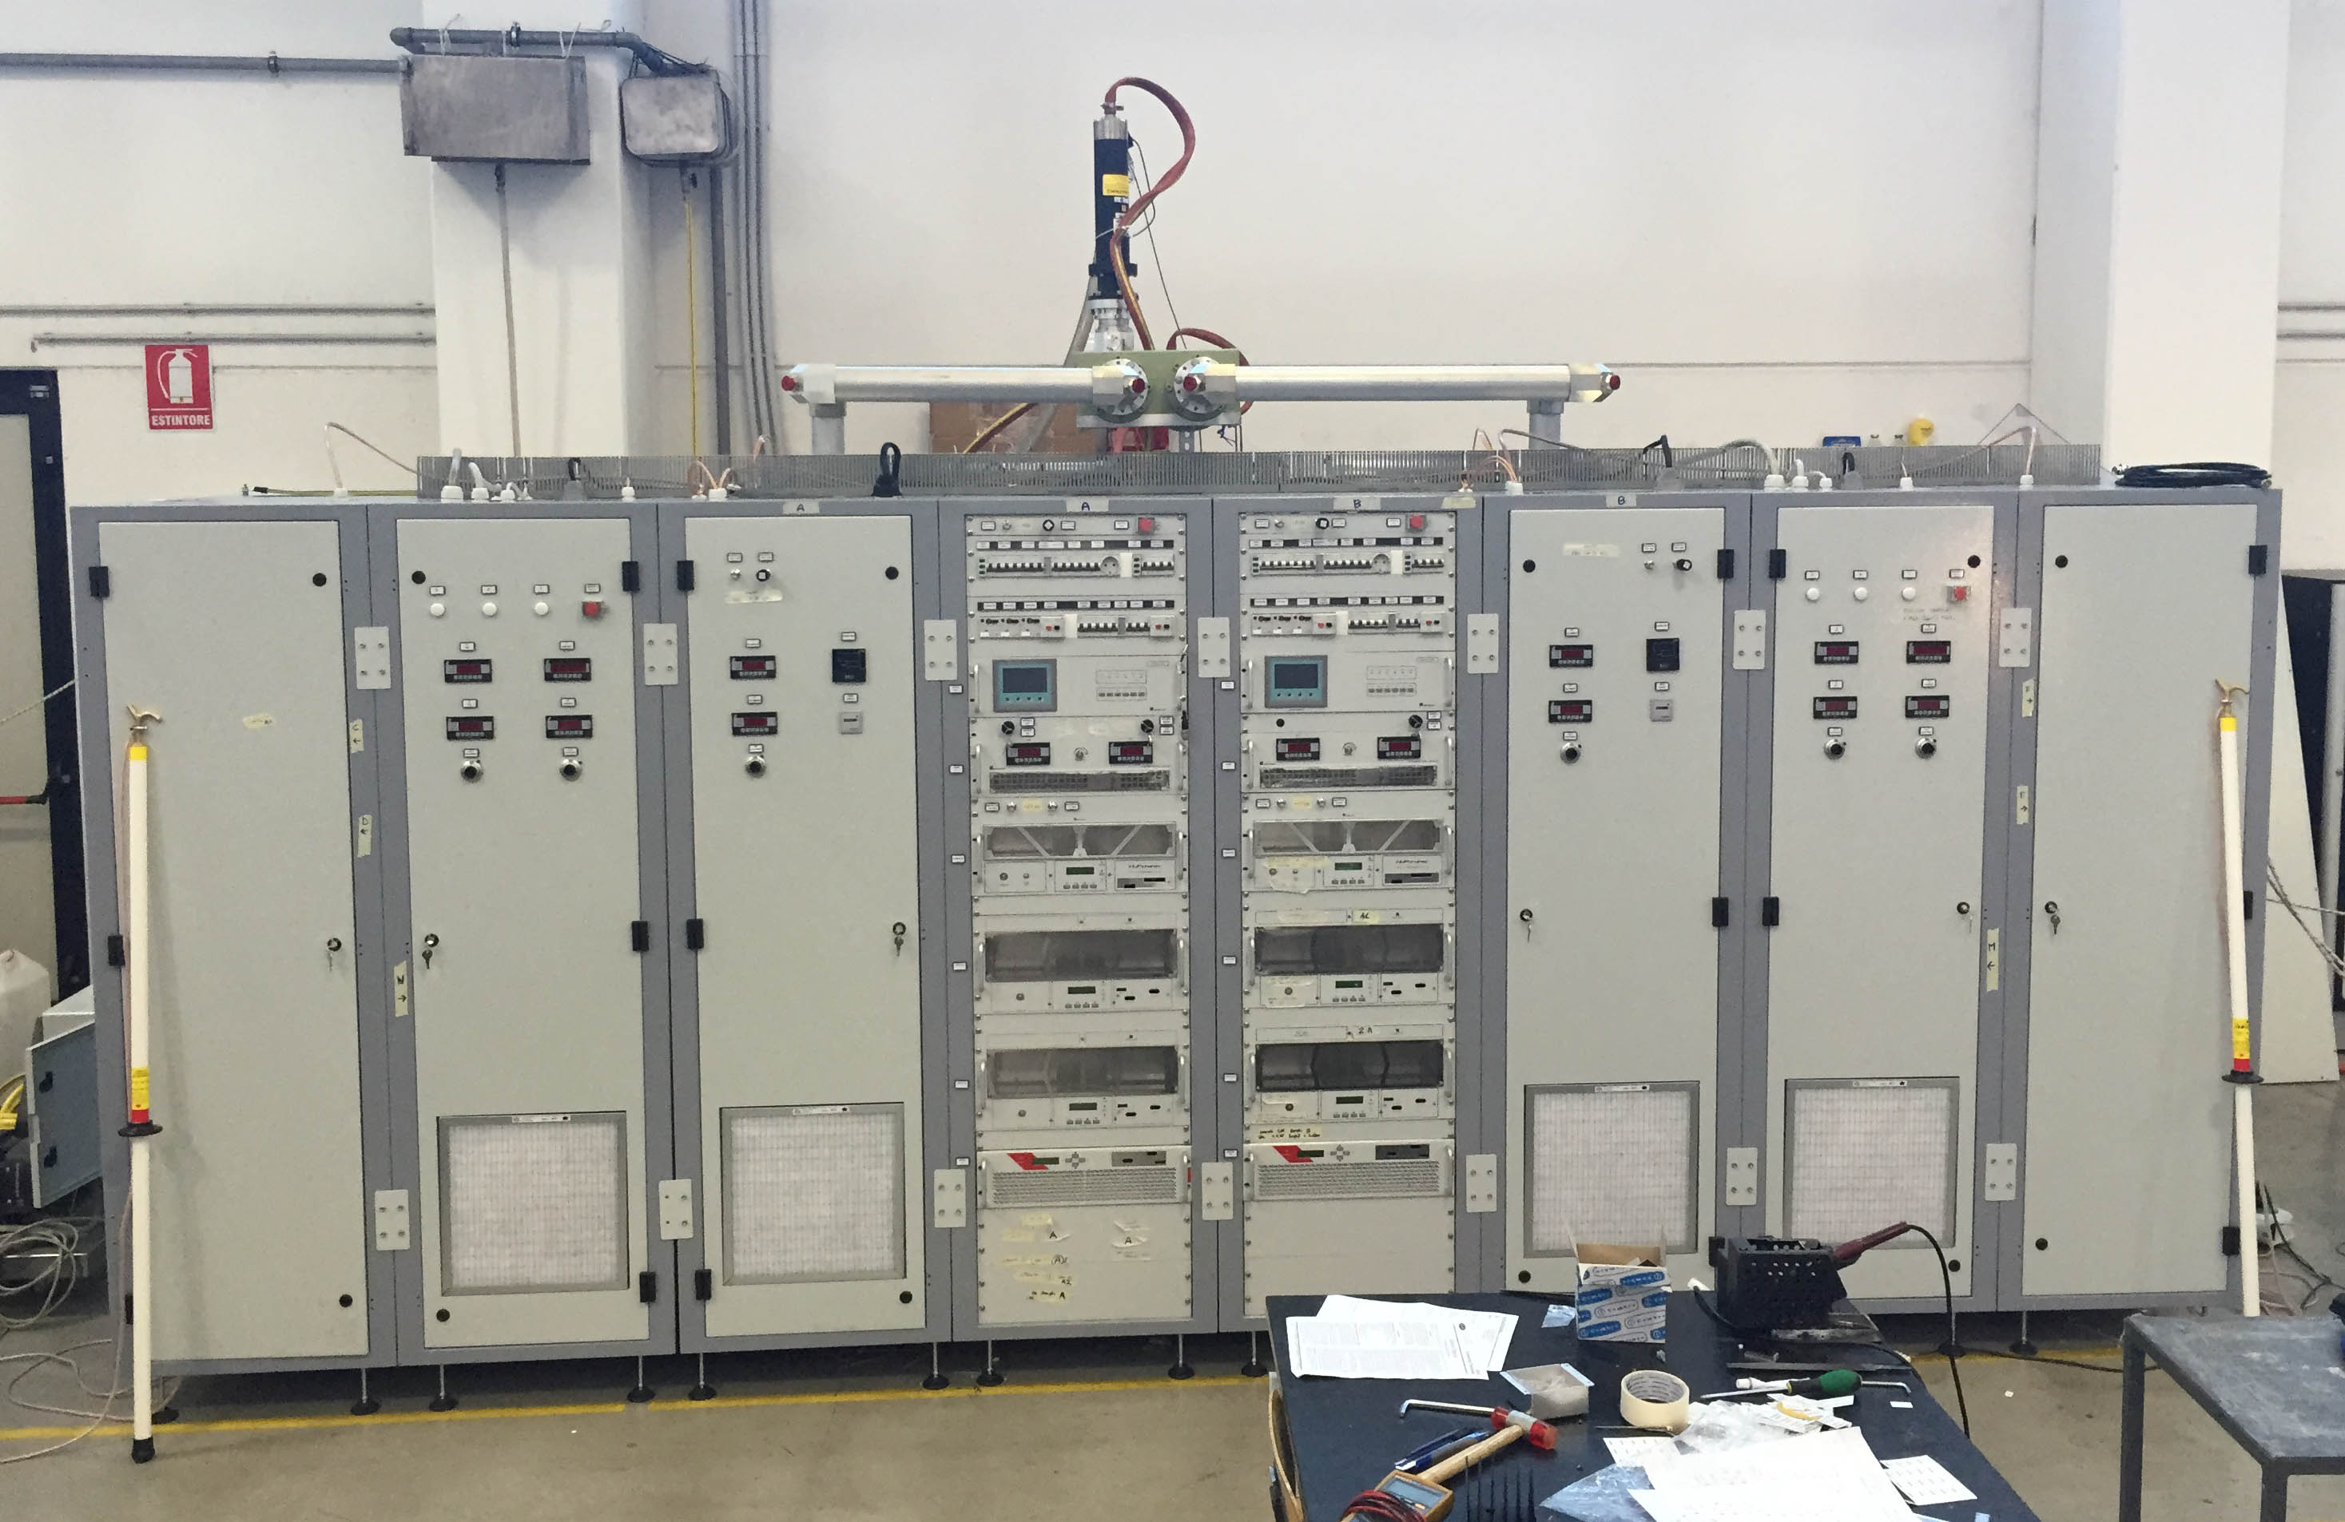
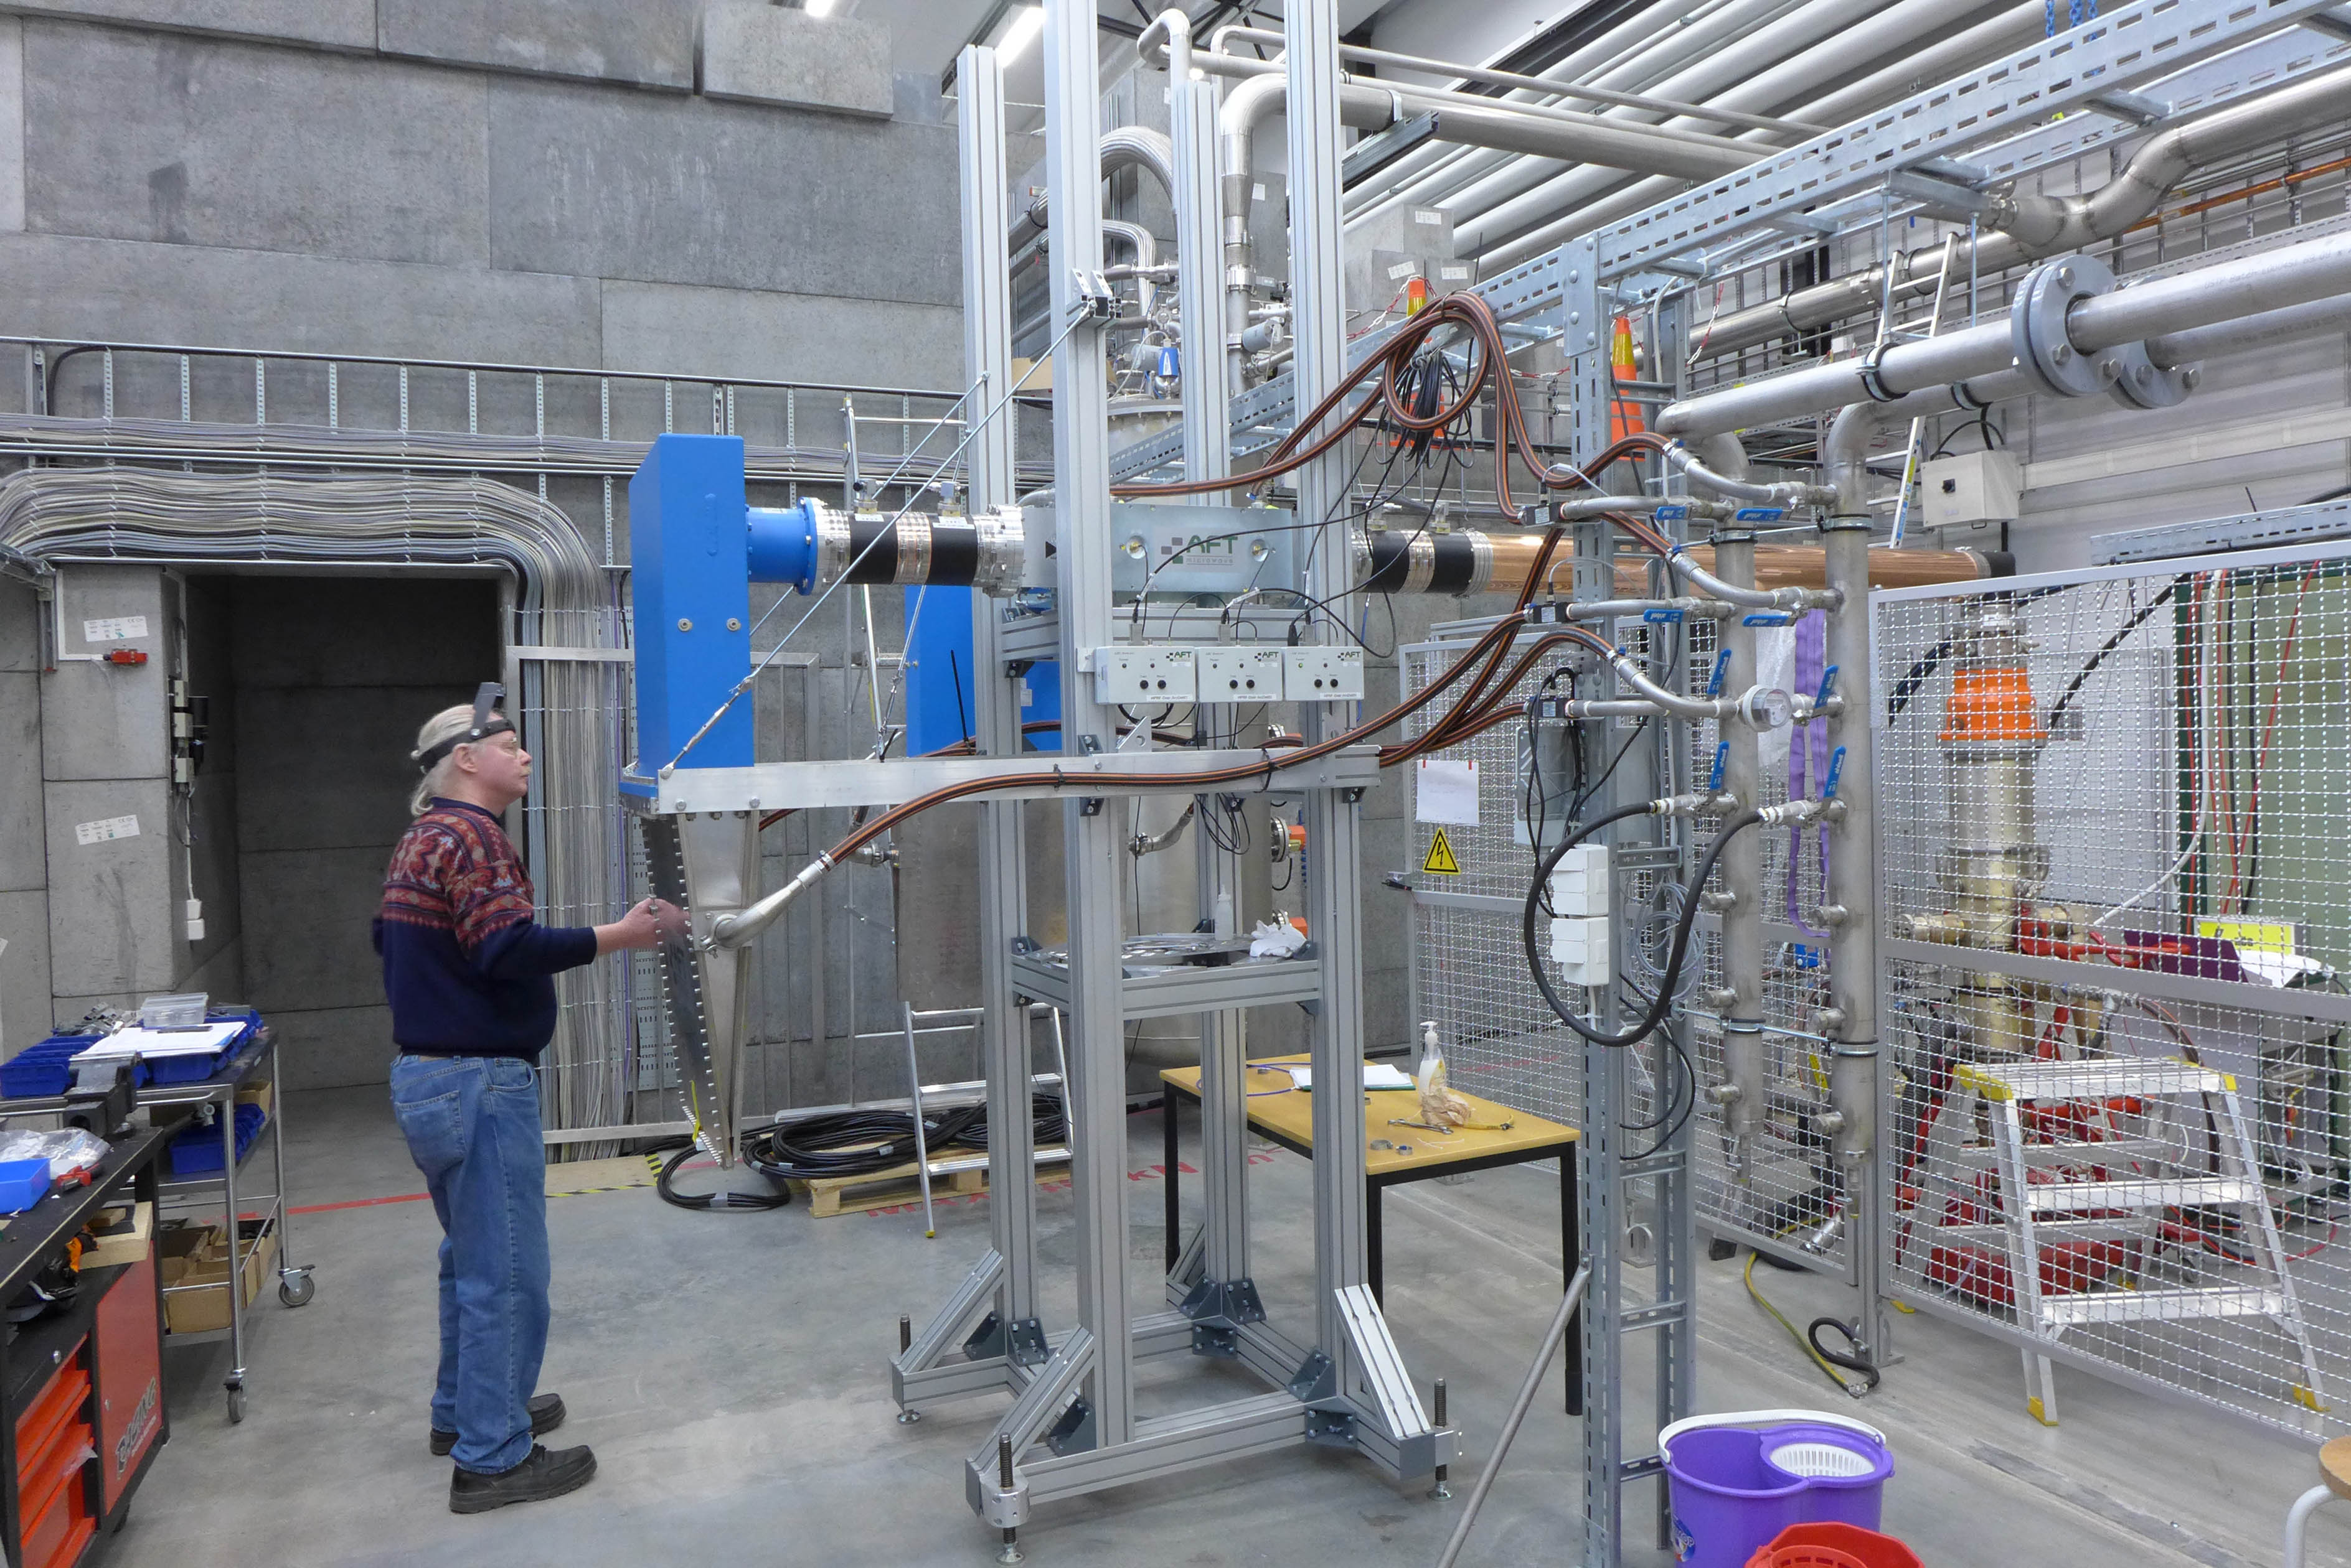
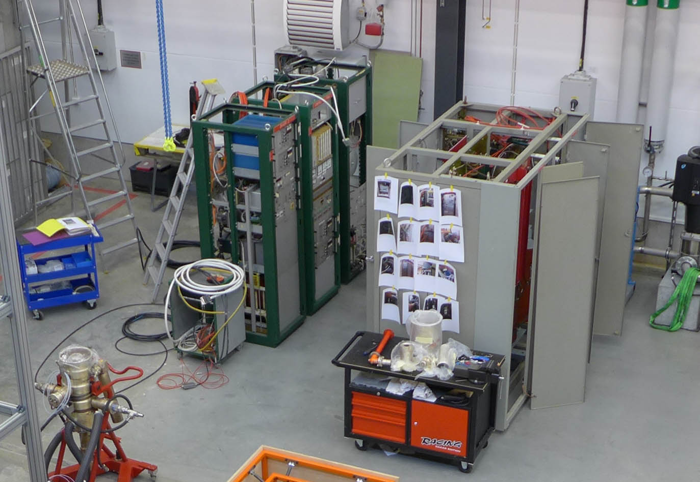
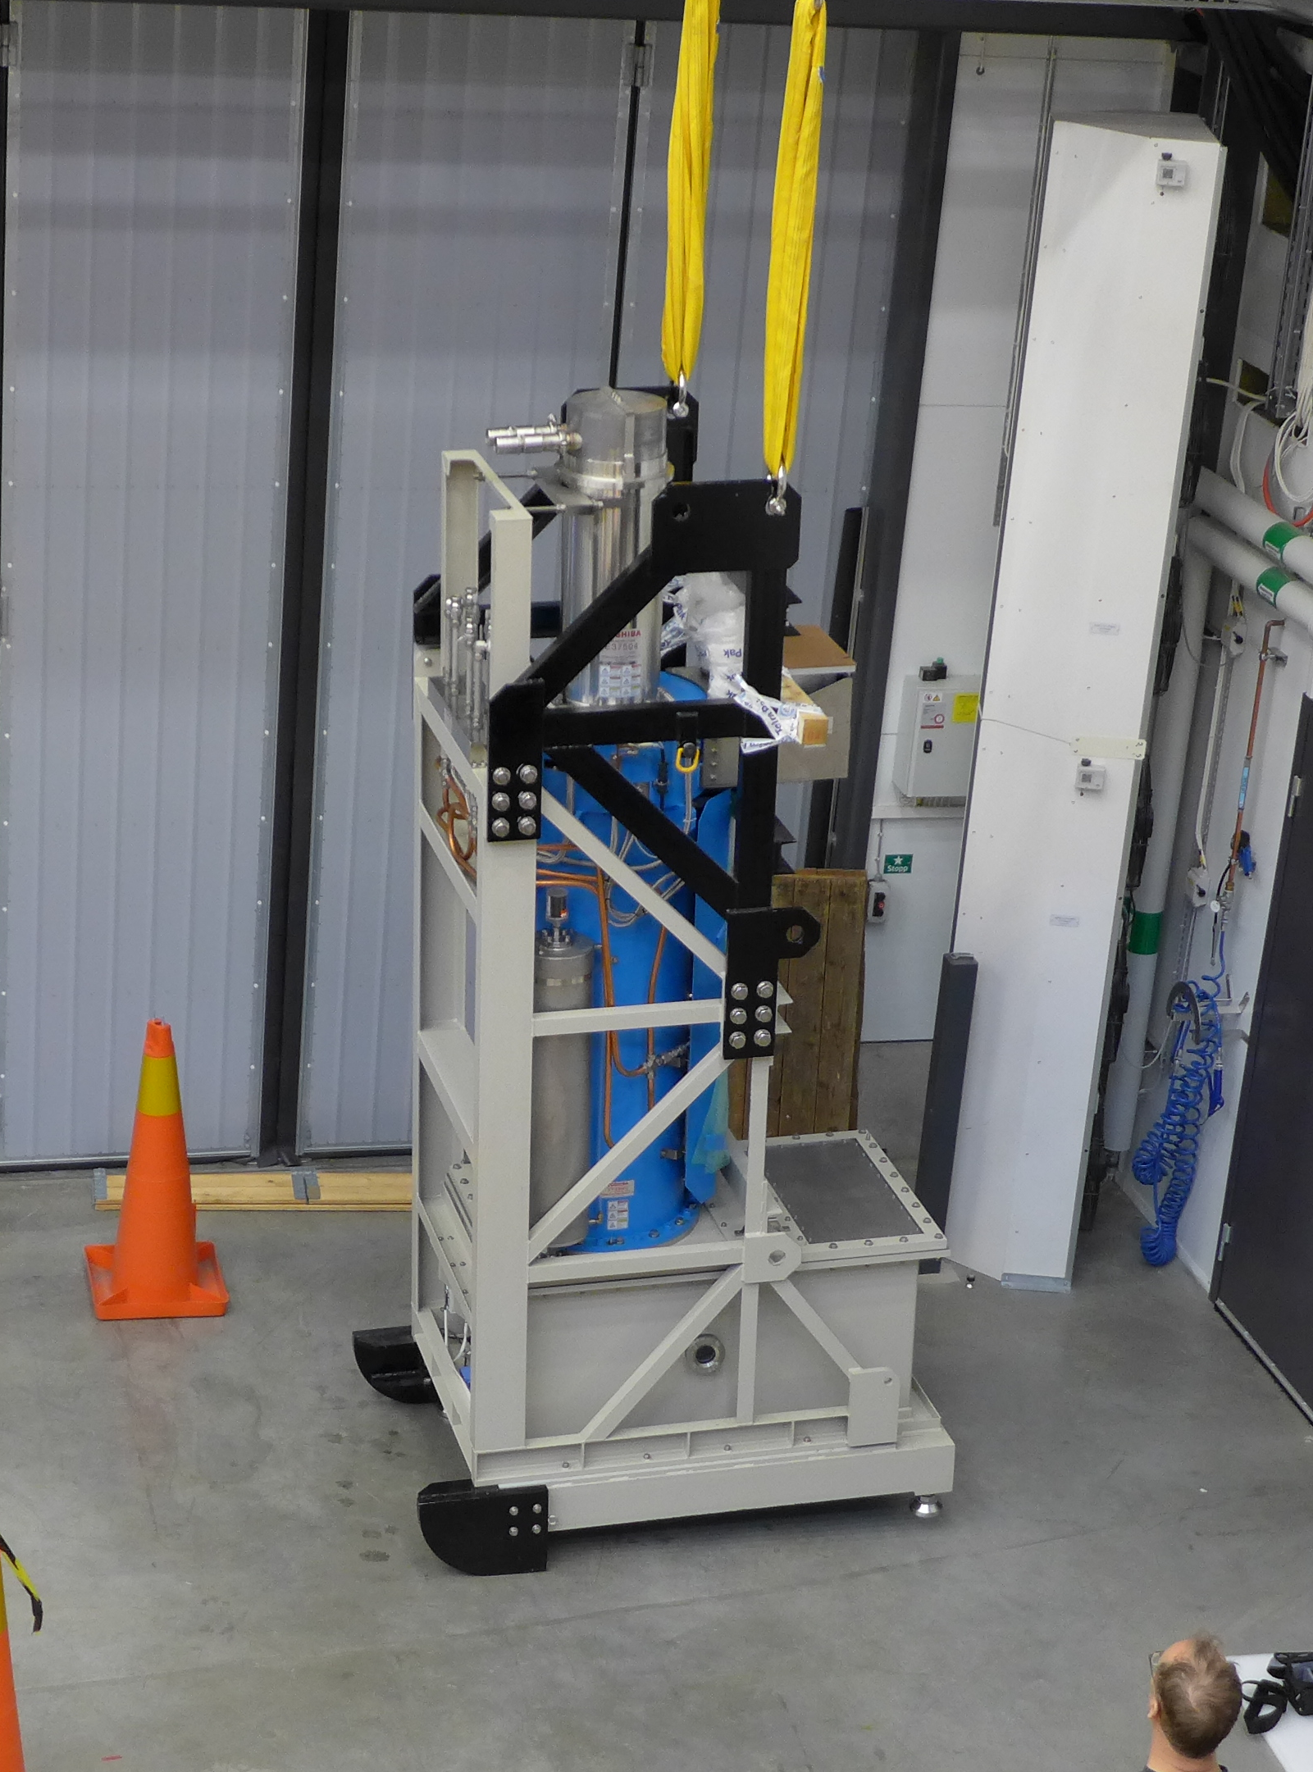
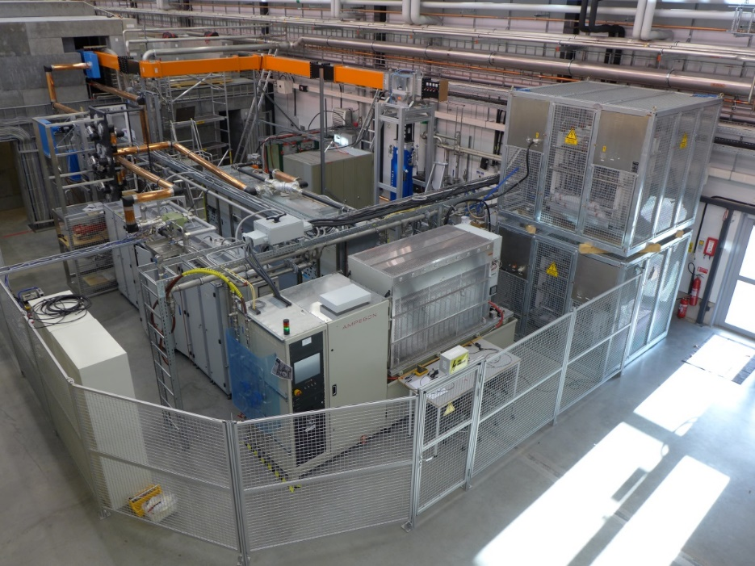
High Power RF Amplifiers
704 MHz Klystron
1.1 MW, 3 ms, 14 Hz
  on loan from ESS
  Ampegon/PPT modulator
  Toshiba klystron
CERN 50 kW CW
352 MHz Tetrodes
2x 400 kW, 3.5 ms, 14-28 Hz
  combined output 2 tetrodes TH595
50 kW CW
  on loan from CERN
  tetrode TH571b
  352 or 400 MHz output cavity

Slide 10
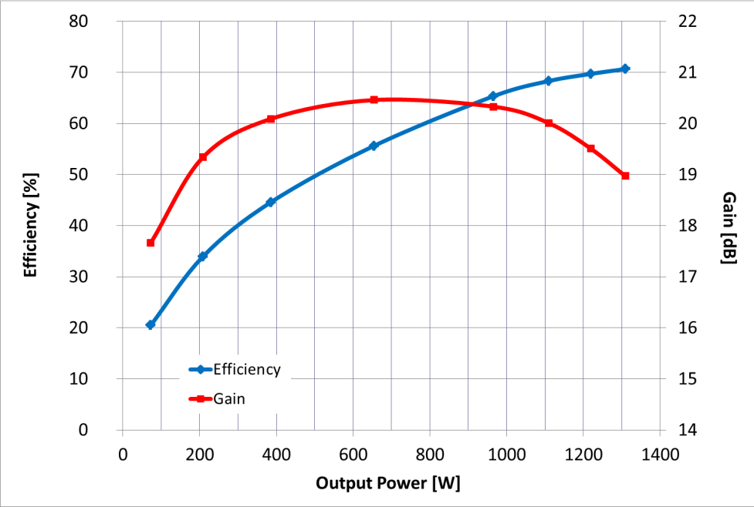
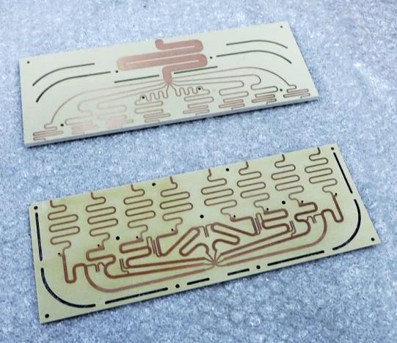
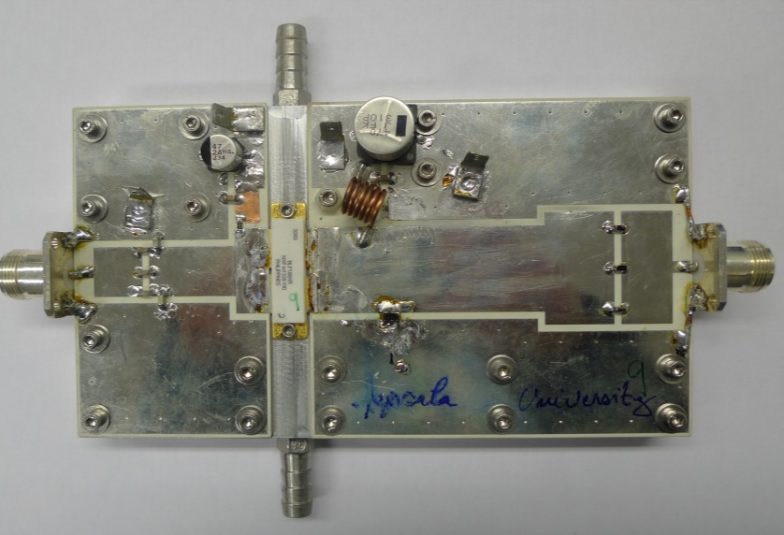
Solid State RF Development
SSA development
  single ended RF power amplifier
  based on BLF188XR
  1250 W and 70% efficiency
SSA demonstrator
  10 kW, 8 modules
Compact Combiners
  compact cavity combiner 100 kW
  planar Gysel combiner 10 kW

Slide 11
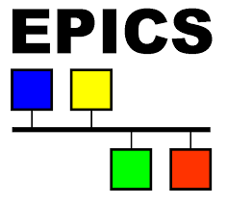
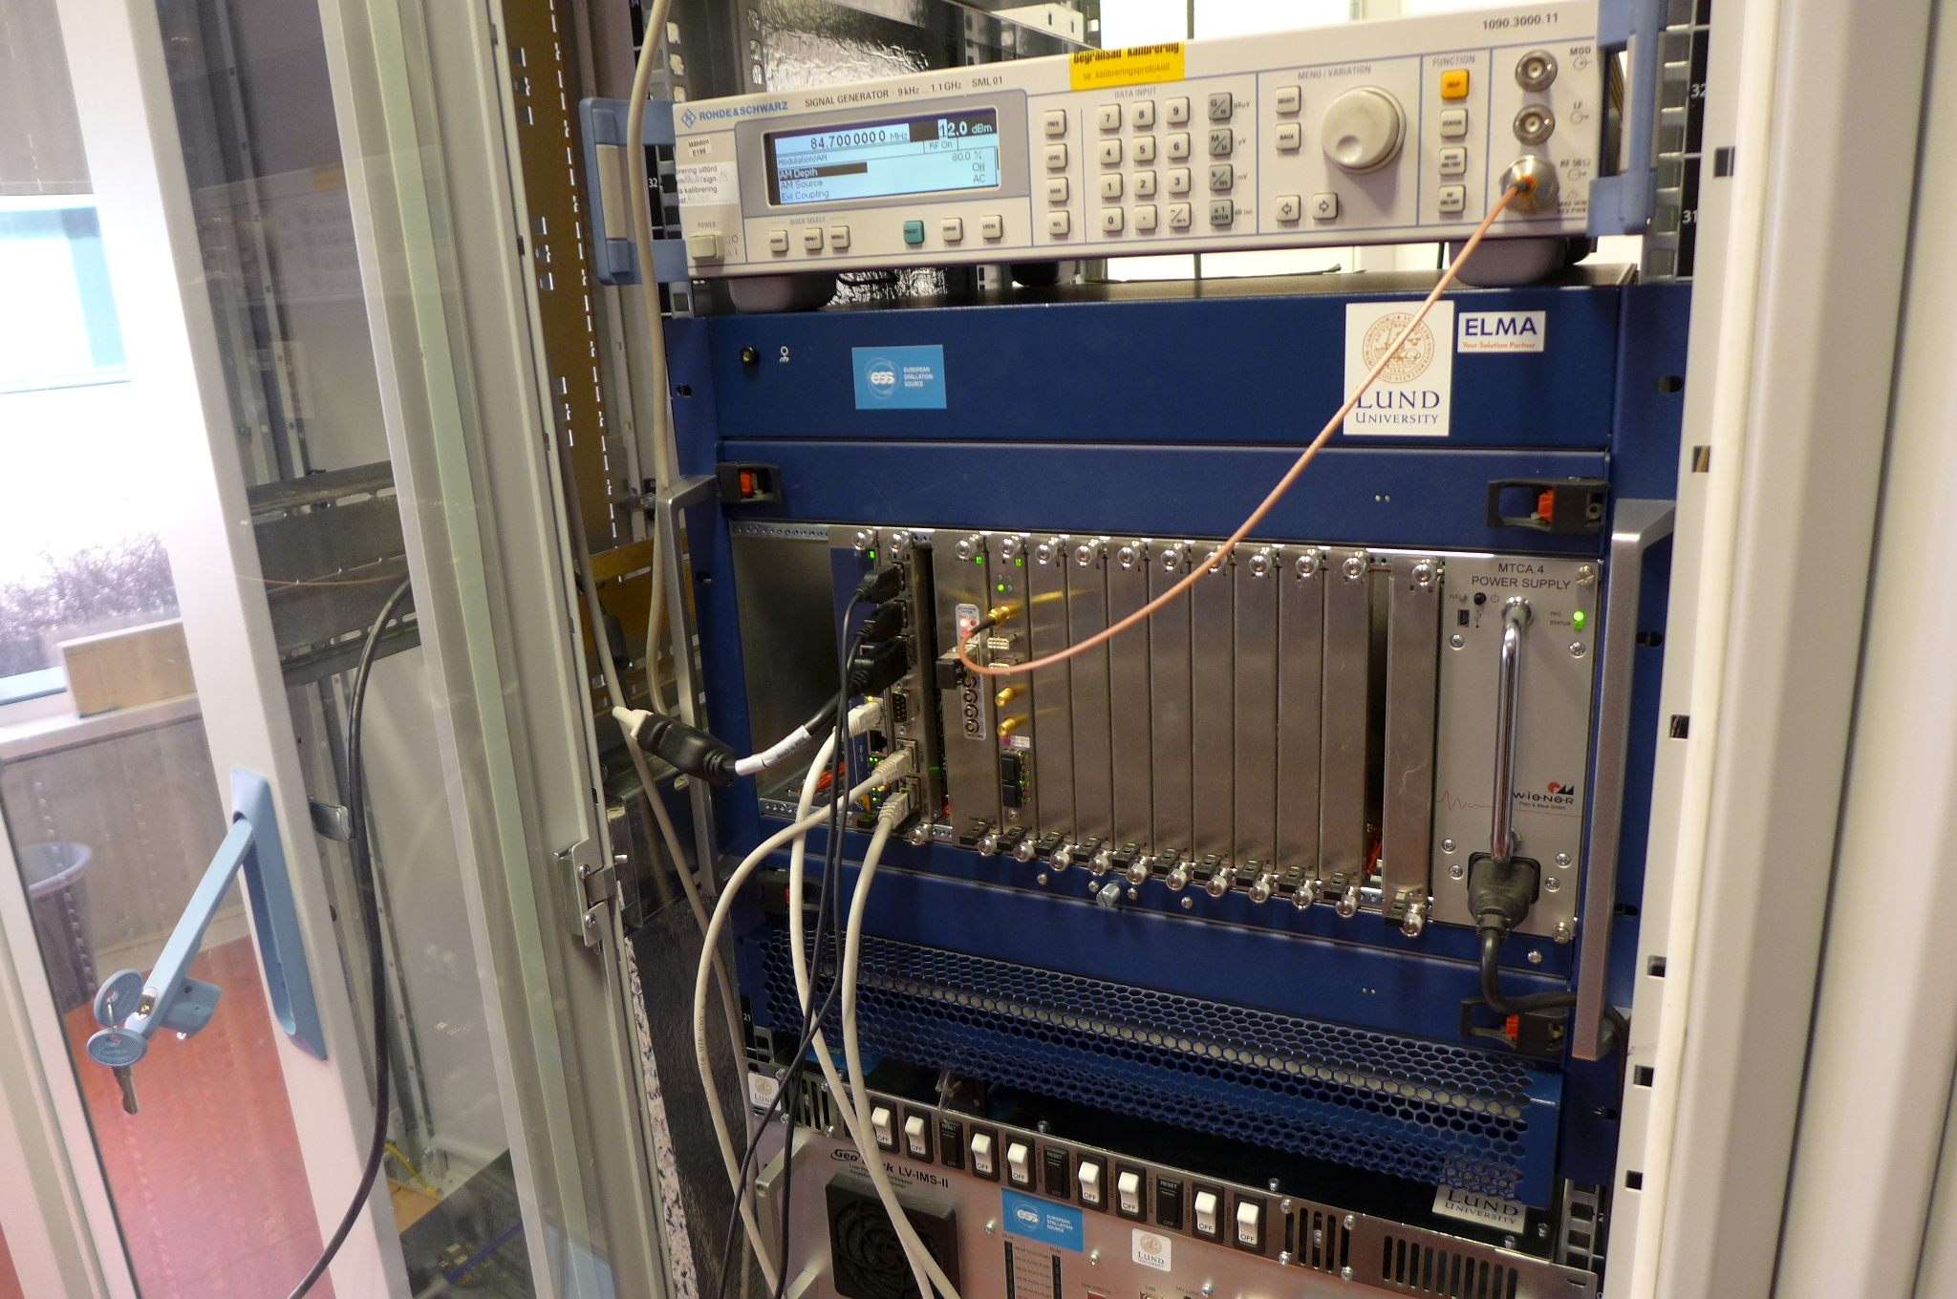
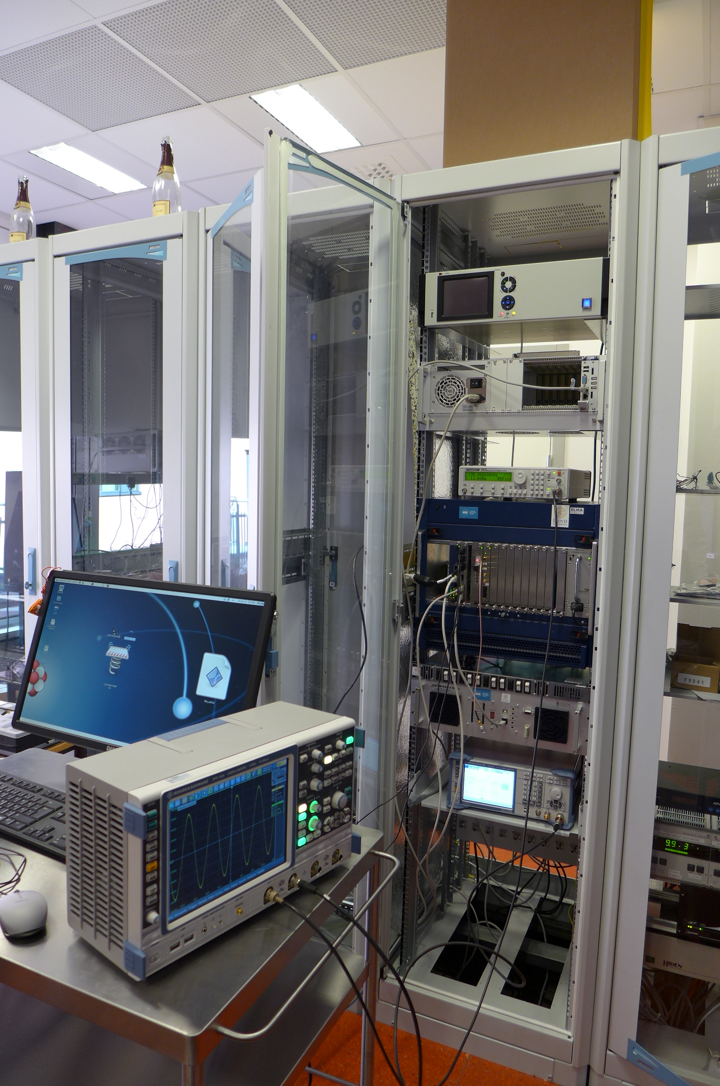
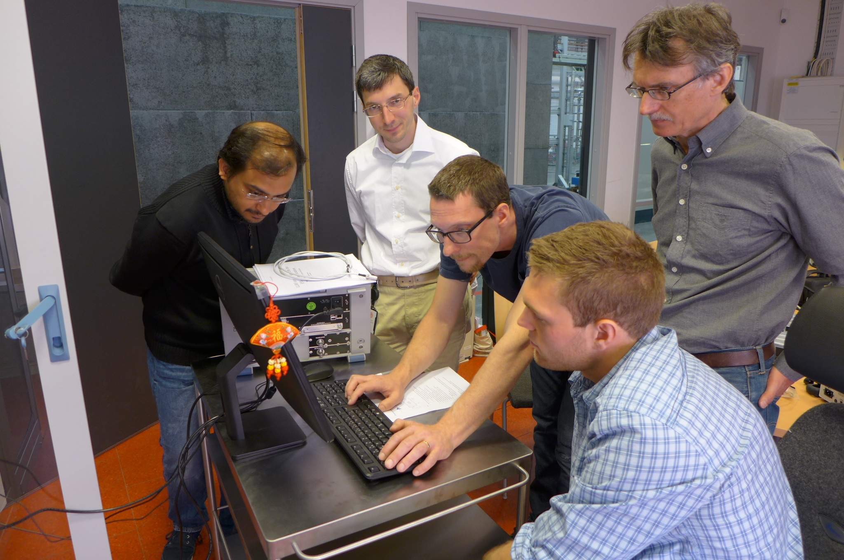
Controls and Measurement
Slow Controls & Safety Interlock
  connecting different sub-systems:
  cryogenics, cryostats, powering, ...
  Siemens PLC, Nat.Instr. cRIO
  EPICS interface with data archiver
LLRF
  Self excited loop 352/704 MHz
    pulsed or CW operation
  Nat. Instr. PXI and LabVIEW
    digital phase control for SEL
    extended RF measurements
  Lund Univ/ESS µTCA system
    timing, external signal generators
Fast Magnet Quench Monitoring
  Nat.Instr. PXI and LabVIEW
    based on CERN developments
Software
  EPICS and archiver
  LabVIEW code
    klystron auto conditioning
    power coupler auto conditioning
      pulse length, power level, repetition rates
    SEL control and data acquisition
    cavity frequency shift tracing
    dynamic Lorentz force detuning

Slide 12
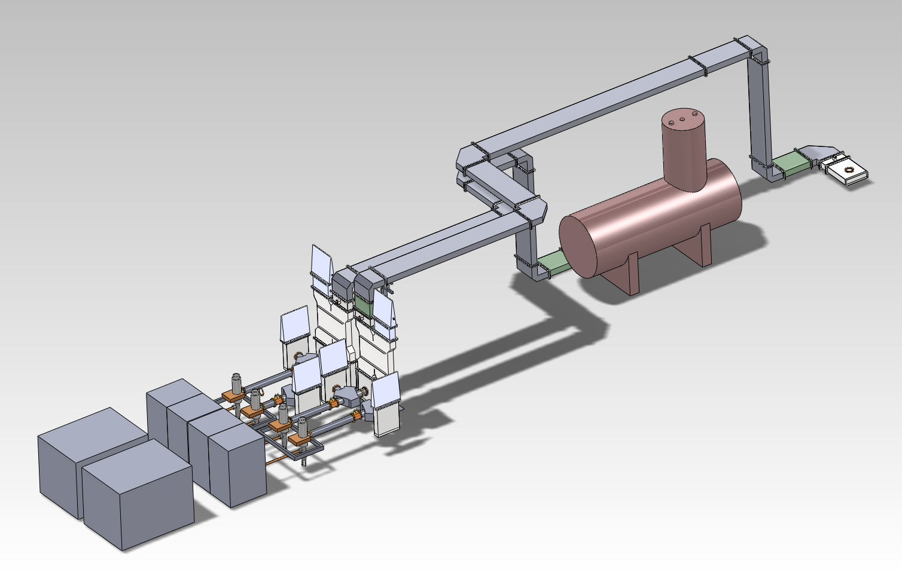
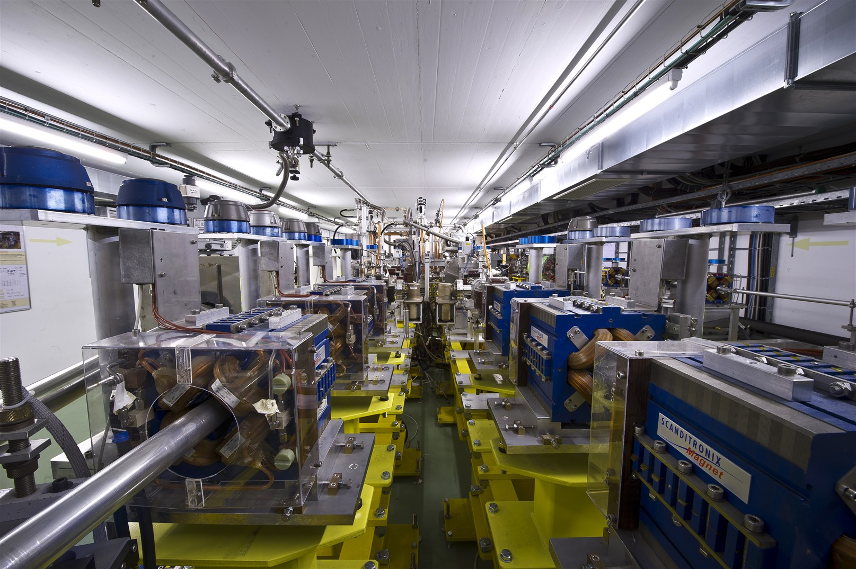
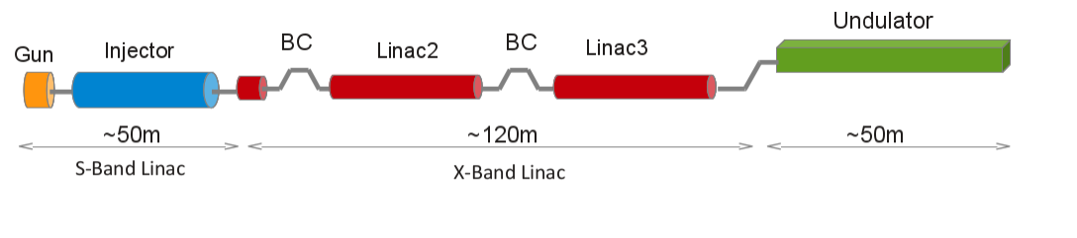
Research Projects
High Brilliance Proton Beams
ESS Superconducting Linac
ESS Neutrino Super Beam
HiLumi LHC
High Brilliance Electron Beams
FELs
CLIC
Ultrafast Electron Diffraction
*) FEL = Free Electron Laser

Slide 13
Summary
Uppsala University & FREIA Laboratory actively developing accelerator and instrumentation technology
Development, verification, and testing
cavity (package)
high power RF
RF solid-state and power combiners
LLRF
Controls
Research
high brilliance beams
superconducting RF
vacuum/RF breakdown
Academic Teaching

