Slide 1

(Micro Accelerator Structure center) i Uppsala
FREIA Seminar 2018-12-17

Slide 2

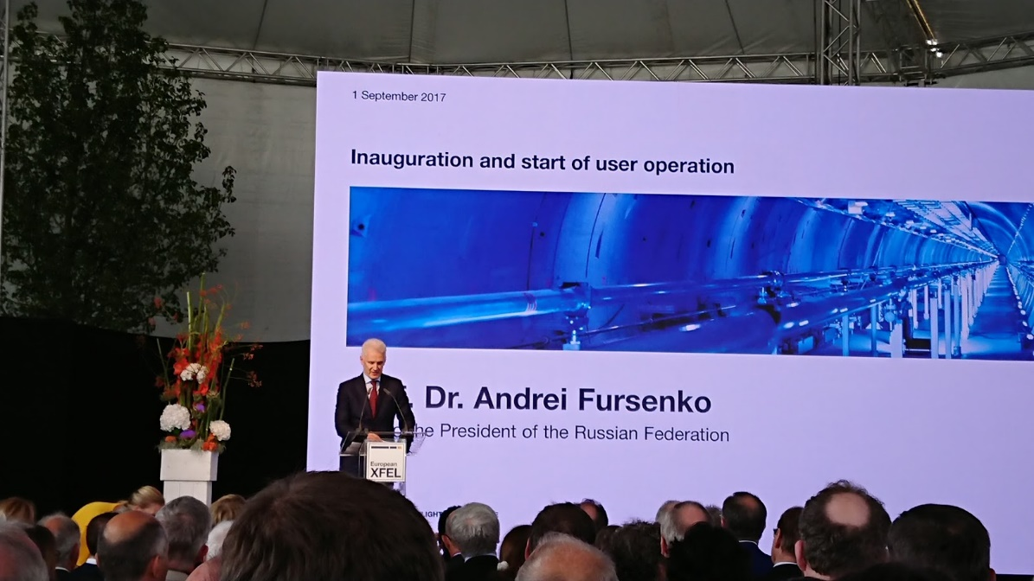
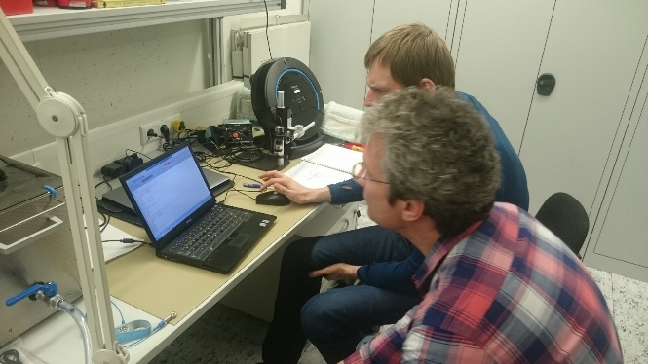
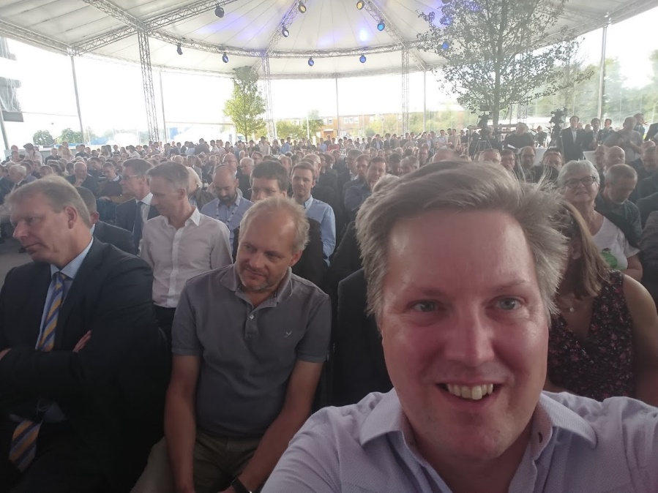
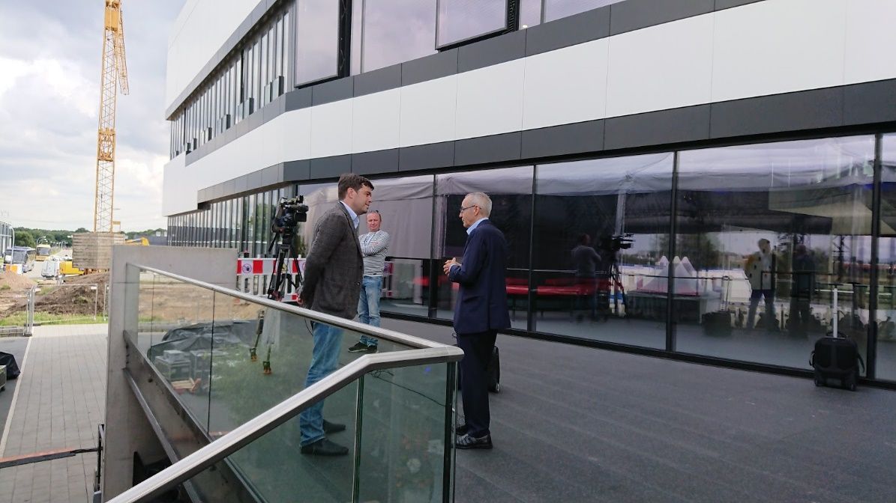
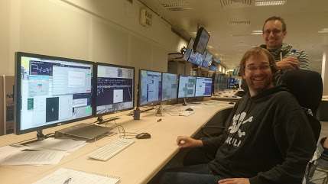
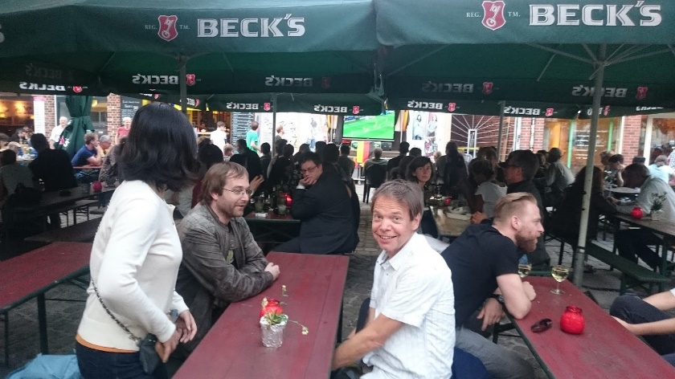
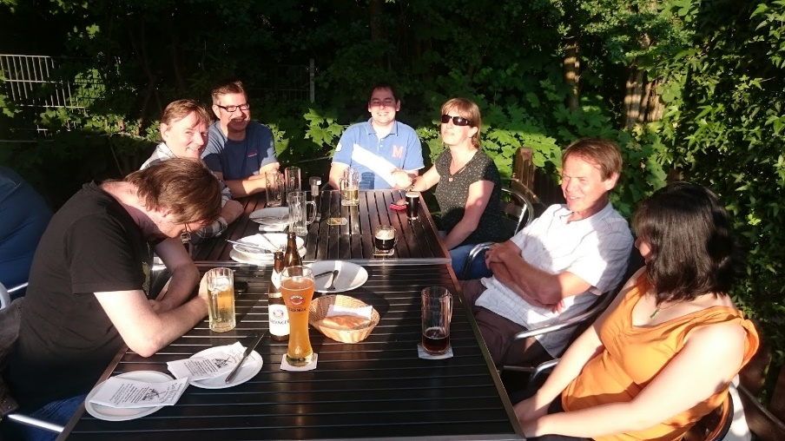
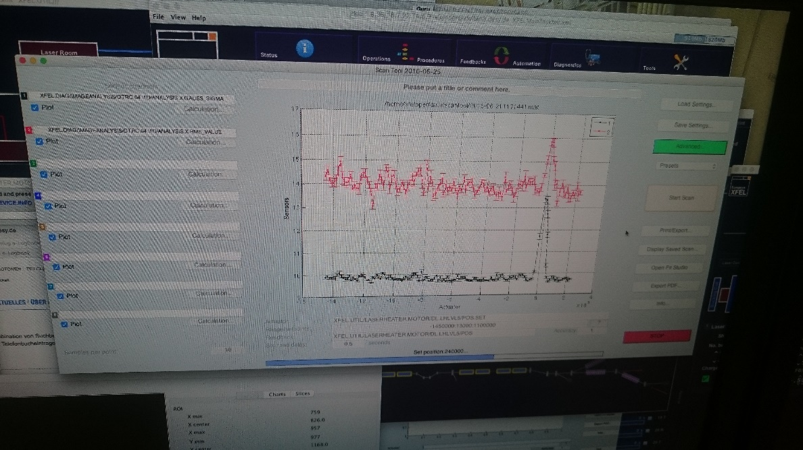
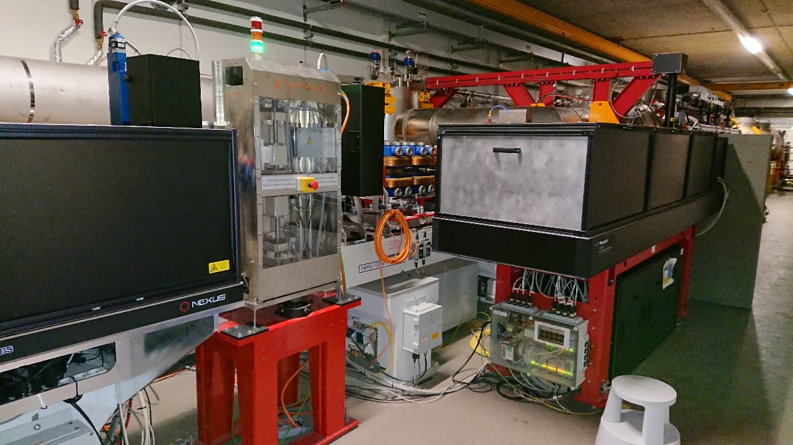
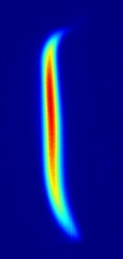
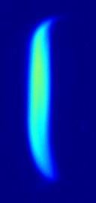
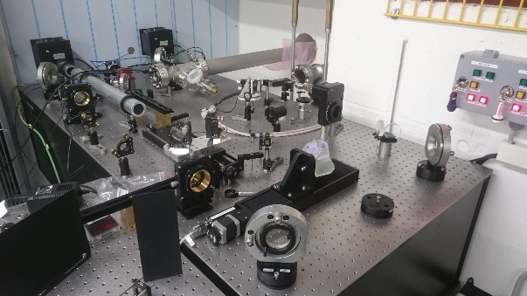
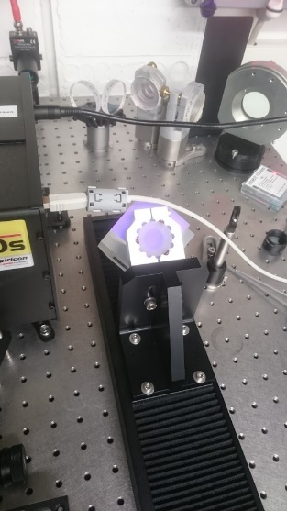
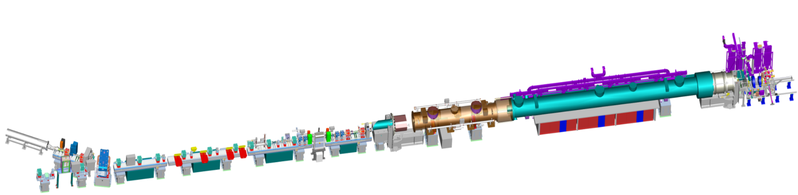
MY BACKGROUND = INSTRUMENT DESIGN
Laser Heater
Several Subsystems
Extreme Specifications
Heating 2016-06-21
Doubling XFEL Output 2018-03-27
ASKED TO LEAD ARIES LH WG
OFF
ON
Laser heater
Photocathode gun
Accelerator modules
OS1
OS0

Slide 3
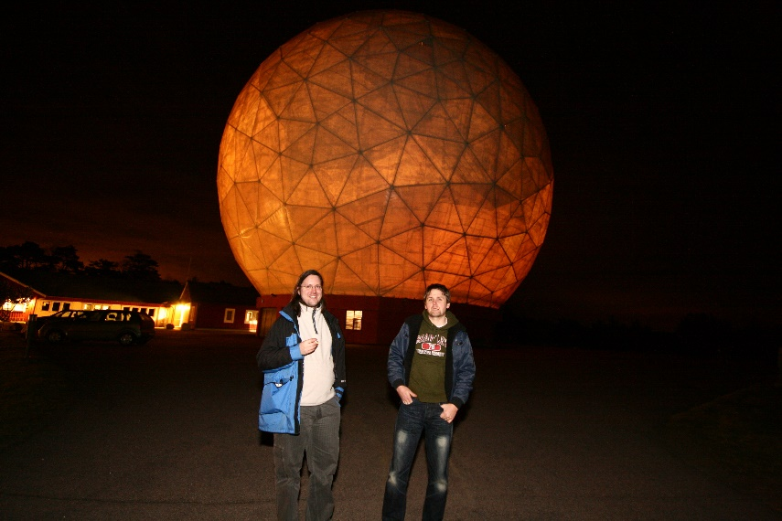
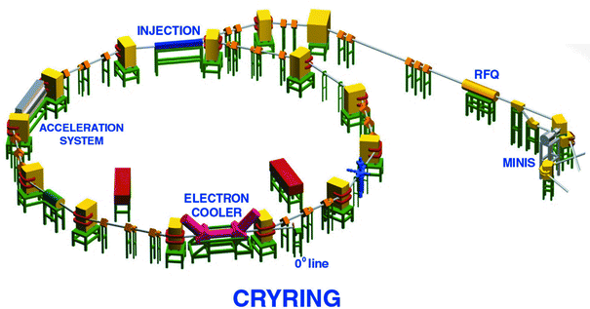
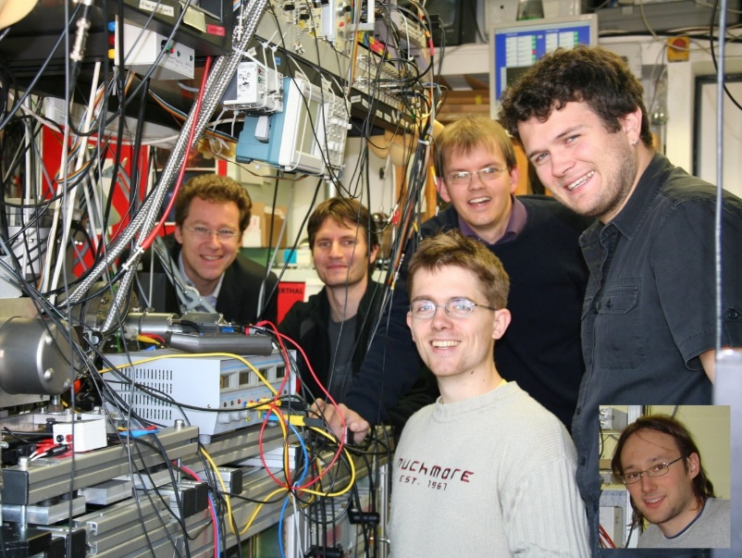
MY BACKGROUND = EXPERIMENTALIST
STOCKHOLM UNIVERSITY
CHEMICAL PHYSICS
ACCELERATOR PHYSICS
ION SOURCE & DETECTOR RESPONSIBLE
Dissociative Recombination
Cooled Trap
FLASH ORS
(Crossed Beams)
(Radio Astronomy)
35 ARTICLES

Slide 4

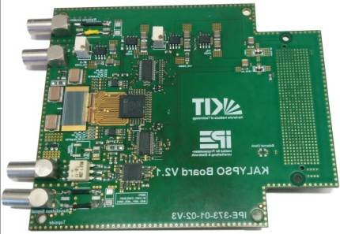

CURRENT ACTIVITIES
CLASSIFIED
SPECTROMETER AT EU-XFEL
GOAL: INVESTIGATE LASER HEATER IMPACT ON SPECTRA ➔ LONGITUDINAL DISTRIBUTION ➔ INSTABILITY SUPPRESION
NIR (800-1500 nm)
DIPLOMA WORK: Simon Fahlström
Christopher Gerth, Nils Lockmann
INSTALLATION JANUARY 2019
MEASUREMENTS MARCH 2019
KALYPSO BASED
WORLDS FASTEST >4 MHz @ 14bit
CAN BE USED ELSEWHERE
Sensor
KALYPSO board
with 16 channel ADC
ASICs
Accelerator
Photon Beamline
User Experiment
Courtesy of C. Gerth

Slide 5
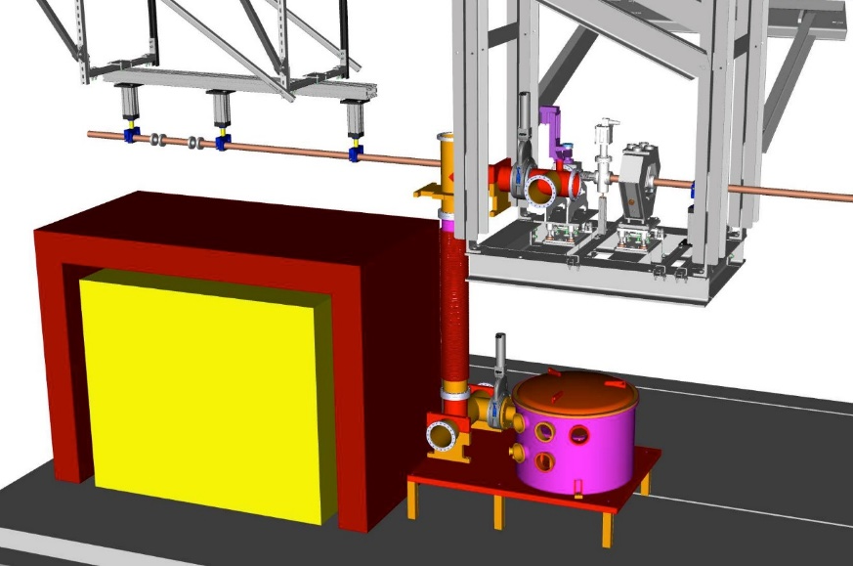
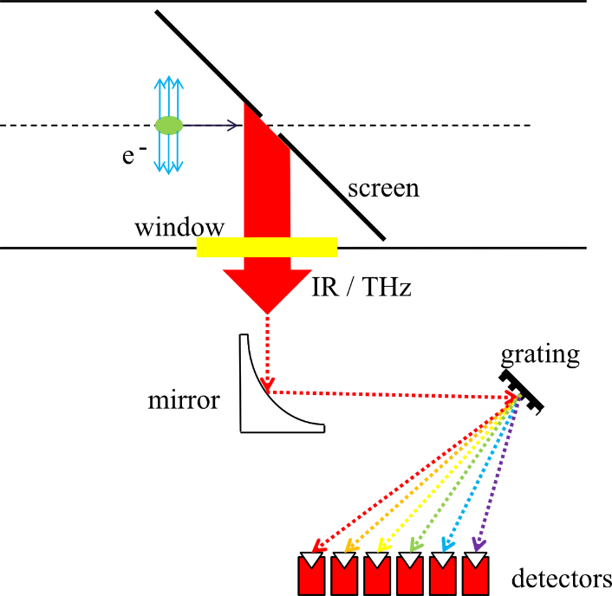
Near Infrared Spectrometer (NISP)
CLASSIFIED
Translation stage:
Camera and 2nd mirror move on stage
1st Flat mirror:
Beam coming
from the top
Goal: Record NIR part of diffraction radiation emitted by electron bunches as a measure of the impact of the laser heater on the charge profile of the bunch (e.g. suppression of micro-bunching instabilities)
Use existing THz spectrometer setup to couple visible/NIR part of radiation
CLASSIFIED
CCD camera park position
2nd Flat mirror
MTCA readout
Motor controls
Power supplies
Prism
KALYPSO
sensor
SPECTROMETER INSTALLATION SPACE
➔ NEEDS TO BE COMPACT.
Lens 1
DIFRACCTION RADIATION FROM NON-INVASIVE SCREEN
COURTESY OF C. GERTH

Slide 6
BACKGROUND ➔ FUTURE
INSTRUMENT DESIGN
EXPERIMENTAL APPROACH
ACCELERATOR PHYSICS
PASSION

Slide 7
BACKGROUND ➔ FUTURE
ACCELERATOR PHYSICS = LUND
LARGE ACCELERATOR IN MÄLARDALEN?
COST LIMITED RESEARCH
➔ SLOW SCIENTIFIC PROGRESS
ONE BOTTLE NECK IS ACCELERATOR CAVITIES
What can we expect from future technologies and how do we create them?

Slide 8
BACKGROUND ➔ FUTURE
NEW ACCELERATION METHODS
PLASMA ACCELERATION
DIELECTRIC LASER ACCELERATION
THz ACCELERATION
APPLICATIONS
LIGHT SOURCES?
ONCOLOGY?

Slide 9
STRATEGY
NO (KNOWN) GROUP DEDICATED TO MICROACCELERATOR STRUCTURE DEVELOPMENT
MAKE THE DISADVANTEGES AN ADVANTAGE
USE WHAT WE HAVE IN UPPSALA
EXTREMELY MULTIDISCIPLINARY !!!
COLLABORATE WITH THE BEST
BE BOLD

Slide 10

MICRO ACCELERATOR STRUCTURE CENTER IN UPPSALA
MAS: WHEN GROW SOME BALLS IS TAKEN LITERALLY!

Slide 11
MAS GROUP
Local Group at Ångström Laboratory Formed in 2015
Mathias Hamberg
Mikael Karlsson
Pontus Forsberg
Ernesto Vargas Catalan
Dragos Dancilo
Anders Rydberg
Janos Haidu
Finnish Colleagues Joensuu
DESY Collegues
ERLANGEN and Max-Planck Quantum Optics

Slide 12
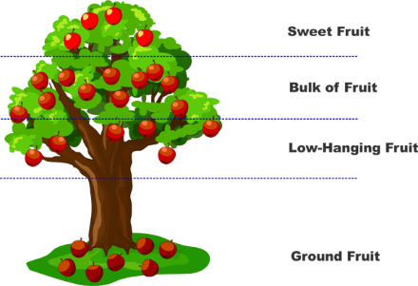
GRANTS AIM
Σ9 MSEK
Local Swedish Setup at Ångström Laboratory
Two PhD´s and one Postdoc
Instrument Design
PhD1: DLA Focus
PhD2: THz Focus
Material Physics
Postdoc: Manufacturing
Career Possibilites???

Slide 13
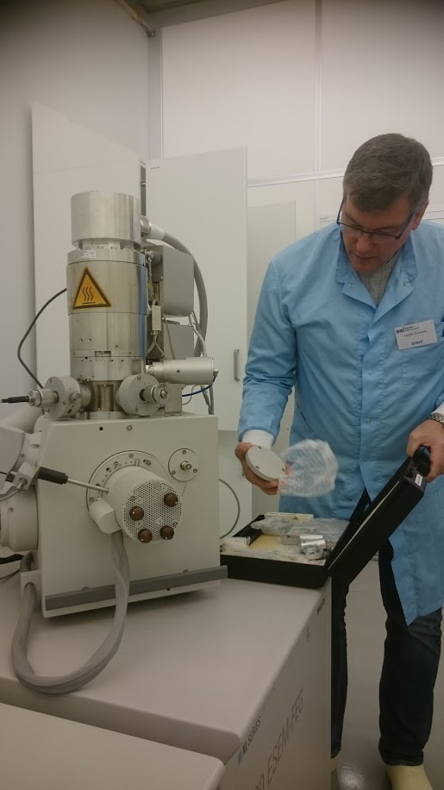
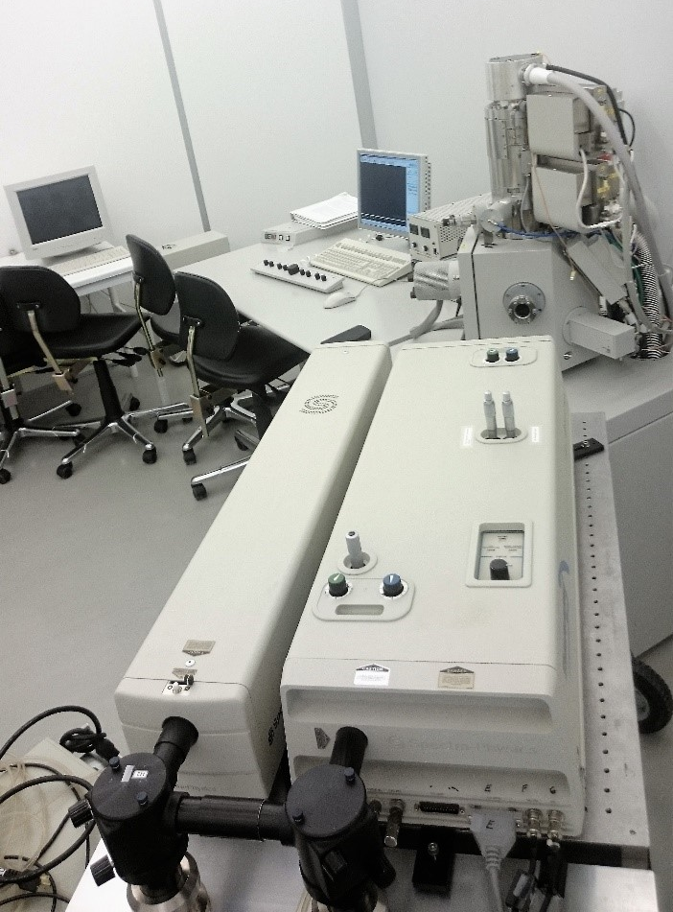
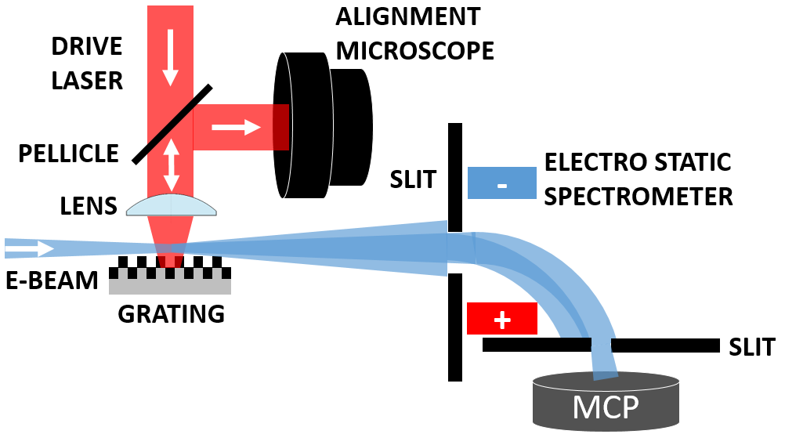
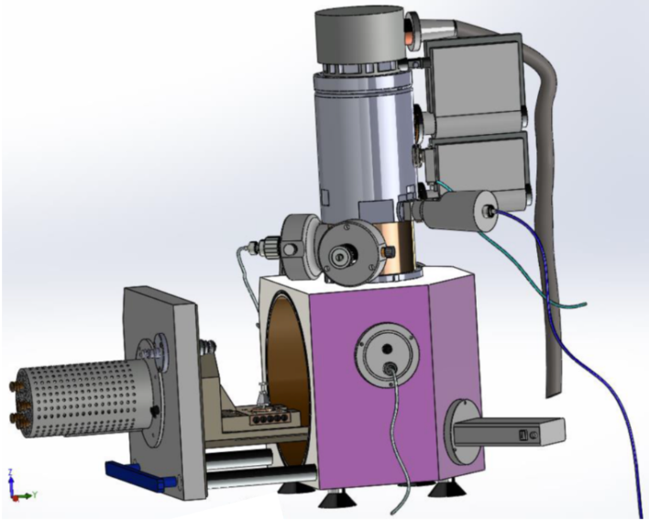
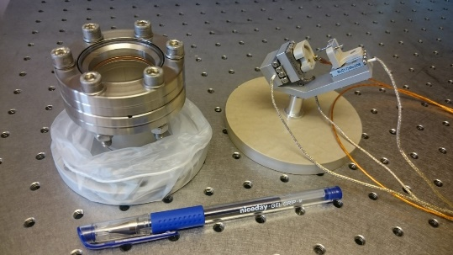
UPPSALA DLA SETUP
SEM DLA SETUP
DIPLOMA WORK UPSTARTING
SIMILAR TO ERLANGEN SETUP

Slide 14
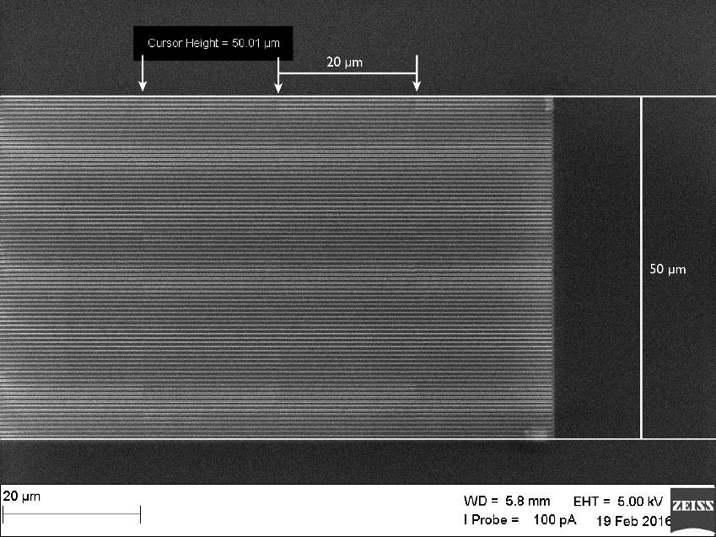
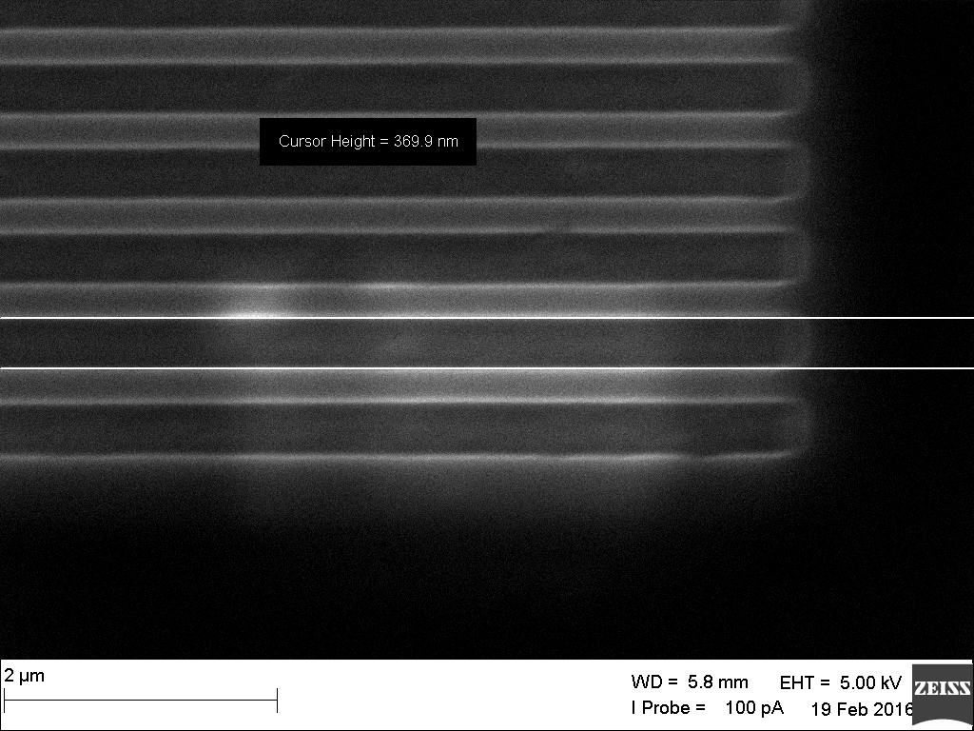
MYFAB
Polycrystalline diamond substrates Ø10 mm, 300 µm thick used for grating fabrication. Improved method was demonstrated by Karlsson et al. Nano-replication using SAMIM, and ICP-RIE of Al, Si and diamond.
Diminishable line width differences compared to master pattern. A lower sidewall angle was demonstrated by collaborators. The diamond gratings will be tested at the DLA setup at FAU, Erlangen, Germany.
MICROFABRICATION
LITOGRAPHY METHODS
DIAMOND
NEW MATERIALS
VARIOUS STRUCTURES
SEM image of PDMS etching
LASER DAMAGE TESTS
Unprocessed polycrystalline diamond substrates was irradiated by a laser with λ=1.93 µm, pulse duration of 600 fs and repetition rate of 1 MHz in at FAU Erlangen, Germany. The laser pulses with peak field of E=4 GVm⁻¹ were not causing any visible damage to the diamond sample as opposed to Silicon samples.

Slide 15
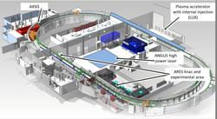
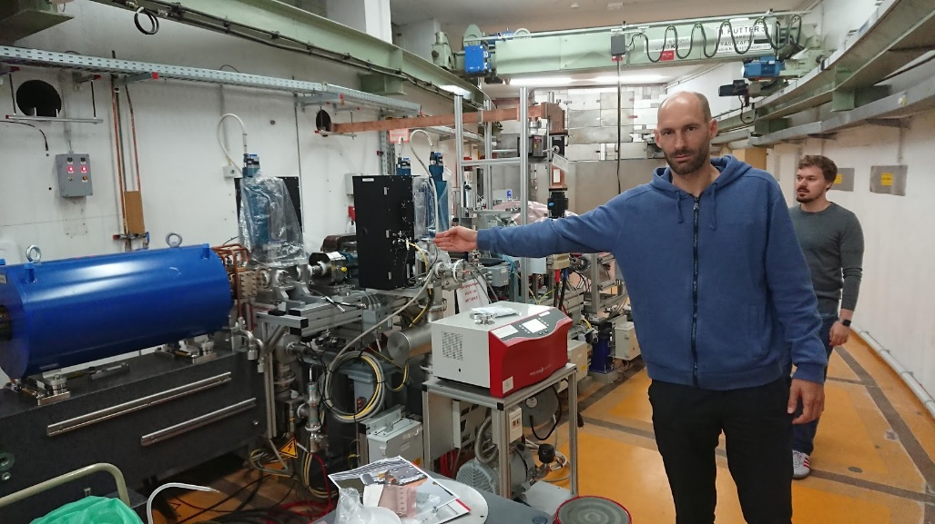
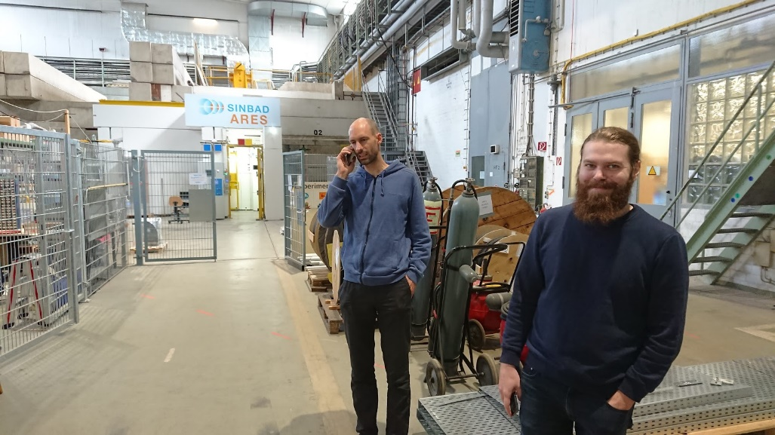
SINBAD
SINBAD
300 m RACE TRACK
ARES
100 MeV
pC CHARGES
<10 fs RMS ELECTRON BUNCH JITTER
50 Hz
WE PROVIDE GRATINGS
AXSIS
DESY CFEL ARIZONA ERC COLLABORATION
THz ACCELERATION
XRAY CREATION

Slide 16
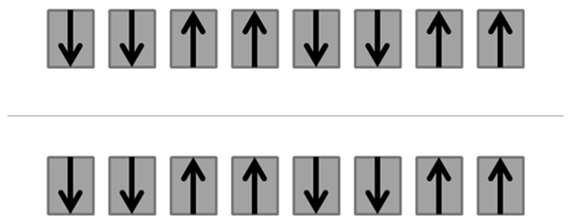
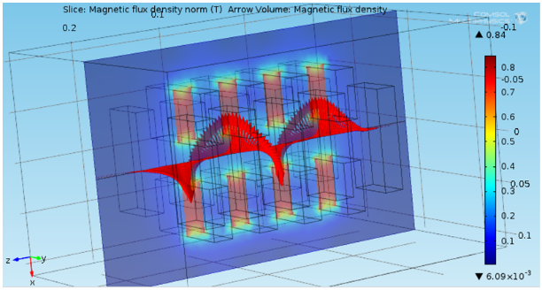
SINBAD
ARES
MICROBUNCH CREATION
COULD BE AN OPTION FOR THE HAM-UNDULATOR
MY SIMULATIONS
SIMONS SIMULATIONS
DIPLOMA WORK MECHANICAL ENGINEER
DESY+KYMA COLLABORATION

Slide 17
BPM
MM SIZE
SUPERIOR RESOLUTION
SPECTROMETER BASED
COLOR CHANGE ➔ POSITION CHANGE
SPECTRAL BROADENING ➔ BEAM BROADENING

Slide 18
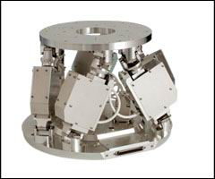
OPTIONS ARE AVAILABLE
DISCUSSIONS ARE ONGOING
HARDWARE DESIGN
VACUUM CHAMBER
HEXAPOD IMPLEMENTATION
LASER INCOUPLING
GRATING CONTROL

Slide 19
WHAT IS POSSIBLE?
CLASSIFIED

Slide 20

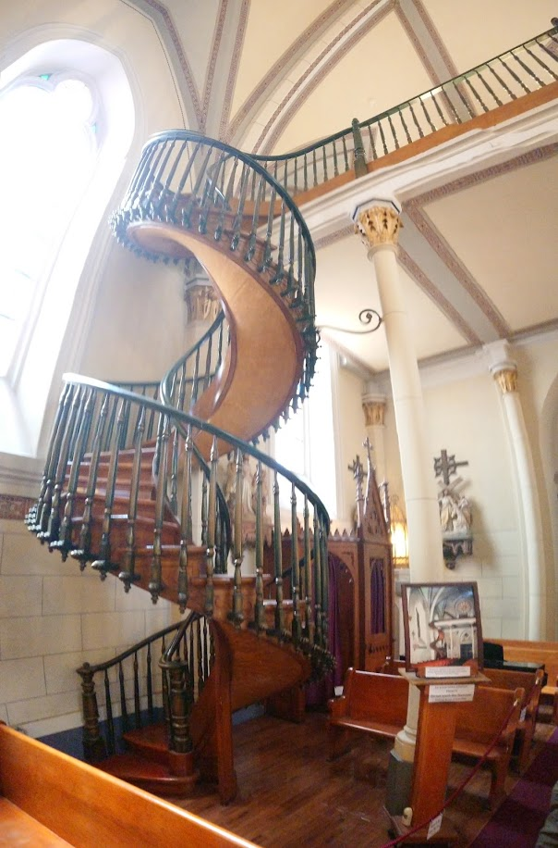
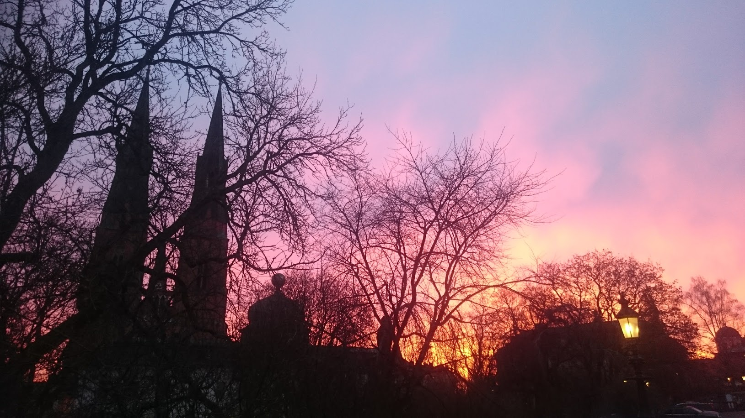

THANK YOU FOR YOUR ATTENTION!

Slide 21

QUESTIONS?

