Slide 1
Formation of femtosecond electron bunches for ultrafast electron diffraction
Carlos GARCERA
Under the supervision of Vitaliy GORYASHKO
1

Slide 2
Contents
Ultrafast electron diffraction (UED) : introduction and outlines
Electron diffraction
Modern ultrafast diffractometers
Transverse coherence and beam quality
Transverse coherence
Beam quality
FREIA’s UED design
Layout
Requirements on the beam
Preliminary results
Parametric study
Discussion about low-emittance beam results
Summary
2

Slide 3
Contents
Ultrafast electron diffraction (UED) : introduction and outlines
Electron diffraction
Ultrafast diffractometers
Transverse coherence and beam quality
Transverse coherence
Beam quality
FREIA’s UED design
Layout
Requirements on the beam
Preliminary results
Parametric study
Discussion about low-emittance beam results
Summary
3

Slide 4
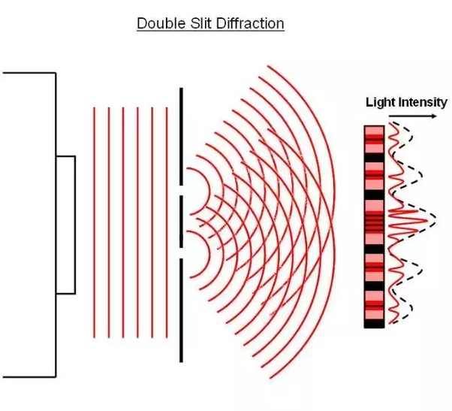
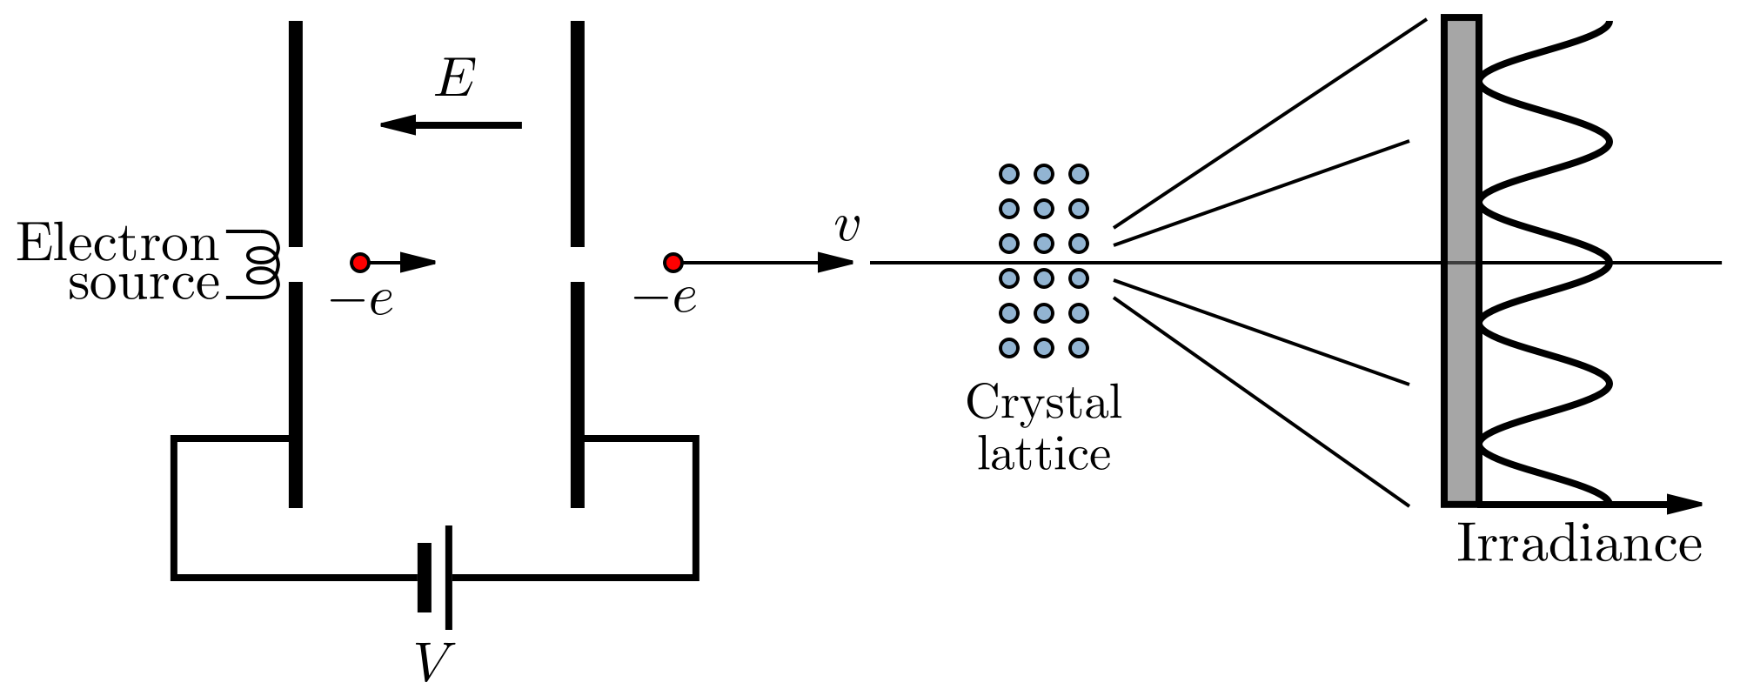
Electron diffraction
4

Slide 5
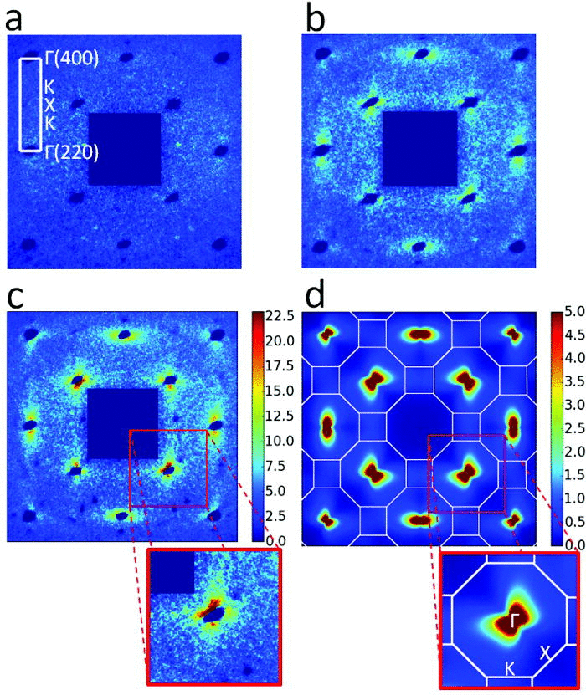
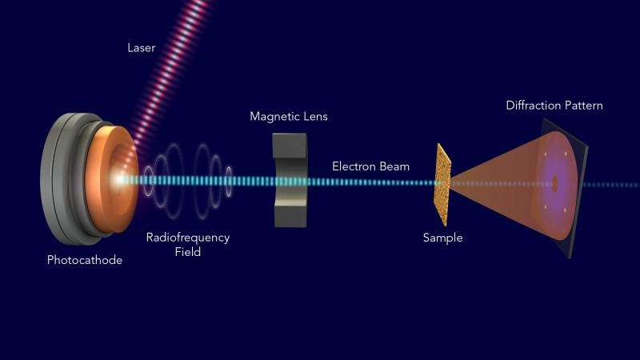
Modern ultrafast diffractometers
diffraction from transient phonons in 20 nm thin single-crystalline Au films
T. Chase. APL. 108, 041909 (2016)
SLAC UED’s design
5

Slide 6
Contents
Ultrafast electron diffraction (UED) : introduction and outlines
Electron diffraction
Ultrafast diffractometers
Transverse coherence and beam quality
Transverse coherence length
Emittance
FREIA’s UED design
Layout
Requirements on the beam
Preliminary results
Parametric study
Discussion about low-emittance beam results
Summary
6

Slide 7
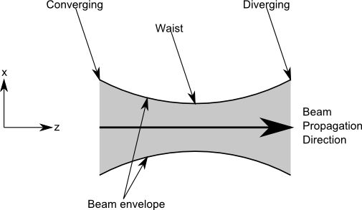
Transverse coherence length
Transverse coherence at the beam waist
$L_{c}=\frac{ℏ}{mc}\frac{σ_{b}}{ε_{n}}$ [m]
$$σ_{b}$$
normalized rms emittance $ε_{n}$ [$π$ mrad mm]
initial bunch size $σ_{b}$[mm]
reduced Planck constant $ℏ$ [J s]
7

Slide 8
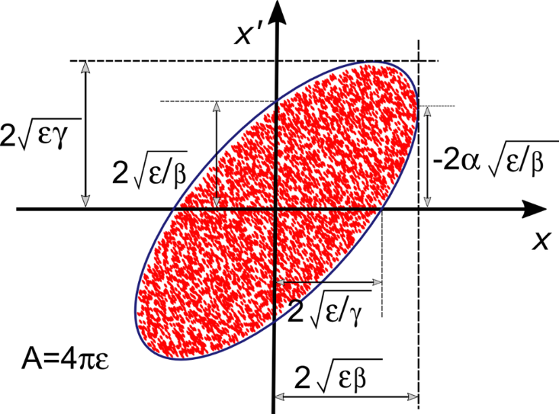
Emittance
Emittance at beam waist
$$ε_{n}=\frac{σ_{b}σ_{p}}{mc}$$
Rms momentum spread $σ_{p}$
8

Slide 9
Contents
Ultrafast electron diffraction (UED) : introduction and outlines
Electron diffraction
Ultrafast diffractometers
Transverse coherence and beam quality
Transverse coherence
Beam quality
FREIA’s UED design
Layout
Requirements on the beam
Preliminary results
Parametric study
Discussion about low-emittance beam results
Summary
9

Slide 10
FREIA’s UED design proposal
10

Slide 11
Requirements on the beam
Information before entering the booster
Cathode
Solenoid lens
Booster
Initial pulse duration $σ_{t}$
Initial bunch size $σ_{b}$
$$L_{c}≥10 nm$$
$$Energy spread$$
$$∆E<1\%$$
$$ε_{trans}≤0.04$$
$$π mrad mm$$
$$ε_{long}≤0.03$$
$$π keV mm$$
Maximum solenoid field MaxB
ASTRA
11

Slide 12
Contents
Ultrafast electron diffraction (UED) : introduction and outlines
Electron diffraction
Ultrafast diffractometers
Transverse coherence and beam quality
Transverse coherence
Beam quality
FREIA’s UED design
Layout
Requirements on the beam
Preliminary results
Parametric study
Discussion about low-emittance beam results
Summary
12

Slide 13
Parametric study
Initial pulse duration $σ_{t}∈\left[0.5;3\right] picoseconds$
Initial bunch size $σ_{b}∈\left[5;15\right] microns$
Maximum solenoid field $MaxB∈\left[240;270\right] gauss$

Slide 14
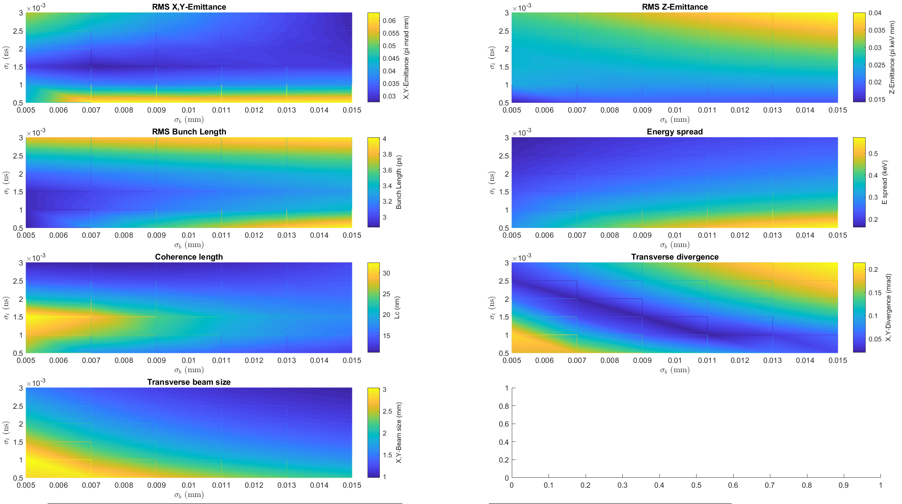
Preliminary results
MaxB = 240 G
14

Slide 15
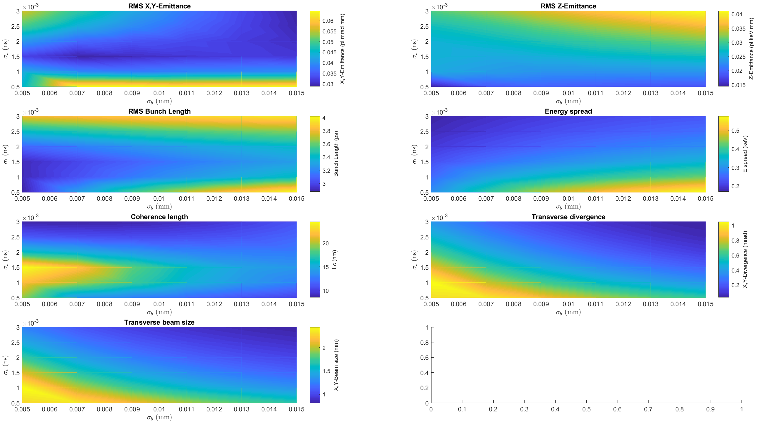
Preliminary results
MaxB = 250 G
15

Slide 16
Preliminary results
MaxB = 260 G
16

Slide 17
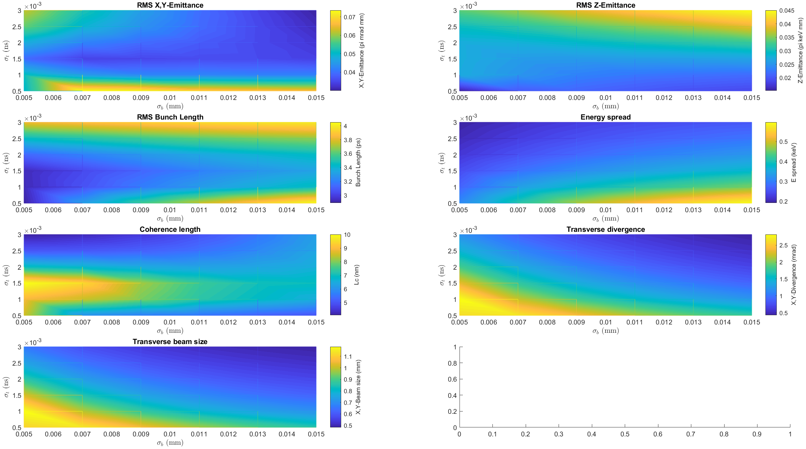
Preliminary results
MaxB = 270 G
17

Slide 18
Contents
Ultrafast electron diffraction (UED) : introduction and outlines
Electron diffraction
Ultrafast diffractometers
Transverse coherence and beam quality
Transverse coherence
Beam quality
FREIA’s UED design
Layout
Requirements on the beam
Preliminary results
Parametric study
Discussion about low-emittance beam results
Summary
18

Slide 19
Summary
MaxB $∈$ [260;270] gauss
$σ_{t}∈$ [5;8] microns
$σ_{b}∈$ [2;3] picoseconds
Next objective
→ work with a different phase to see the effects of longitudinal focusing on the electron beam
19

Slide 20
Thank you for your attention
Acknowledgements : Special thanks to Vitaliy GORYASHKO and Kevin PEPITONE for their help with the simulations and for their advices all along the project
20

