Slide 1
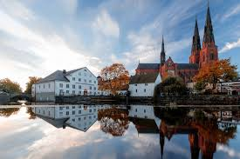
https://indico.uu.se/event/596/overview
photo from turismsuede.fr.
31 talks in 2 days
News from 13 test facilities
44 participants
Special thanks for KEVIN PEPITONE for the local organisation and for ARIES ( EU grant agreement 730871 ) project for supporting the workshop

