Slide 1

On the significant role played by the
AMICI European Technology Infrastructure
for the development and build-up of
the Large Research Infrastructures
Report by the AMICI Task 2.3 on “Sustainability”
June 2019

Slide 2
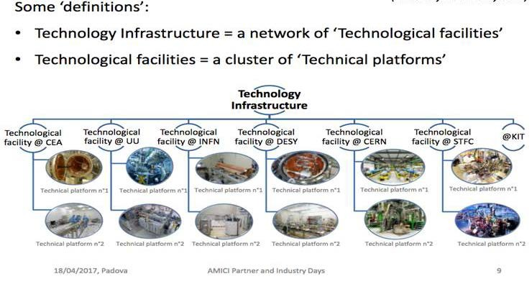
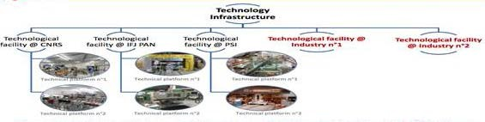
The AMICI European Technology Infrastructure

Slide 3
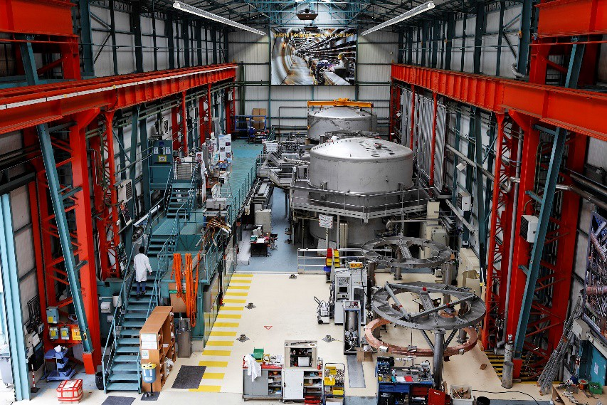
Many of the current Technological Facilities in AMICI: CEA, CERN, CNRS, DESY, FREIA, IFJ PAN, INFN, KIT, PSI and STFC were created as High Energy Physics labs with their own accelerators and High Energy Physics user communities. Modern High Energy Physics is constantly requiring larger and larger accelerators and many of the former smaller High Energy Physics accelerators have been shut down during the last few decades. During the same time several other sciences have also developed very large accelerator and magnet system based research infrastructures.
The host laboratories of these very large accelerator based laboratories
in the world do not have enough Technical Platform capacity to develop and build their own planned accelerators and magnet systems and the European Technological Infrastructure therefore constitutes a necessary contributor to the technical development for, and build-up of, the future accelerators and magnet systems for the large international and national infrastructures for research in High Energy Physics, Nuclear Physics, Synchrotron Radiation Science, Spallation Neutron Science, New Energy Sources, Environmental Research and others.
Test stations for sc magnets and large cryogenic components at CEA Saclay

Slide 4
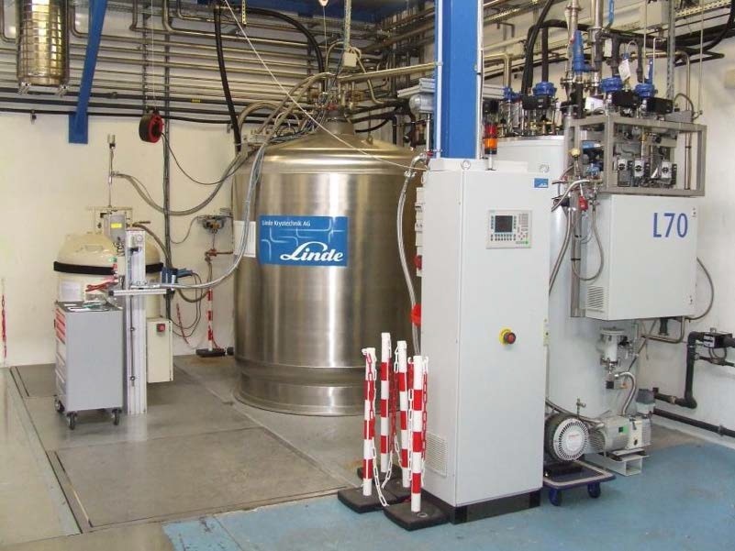
A particularly illustrative example of the above is ESS for which practically all components of its Research Infrastructure currently are being built up and tested at a large number of European Technological Facilities. An estimate has been made of the extra time and extra cost that would have been required for the ESS accelerator if one would have had to employ and train all the physicists, engineers and technicians needed for the build up on the ESS site in Lund the laboratory premises and technical infrastructure required for the design, prototyping, test and industrial ordering for the accelerator project. The result of the estimate is that this would have required about 7 additional years and about 77 MEUR additional funding for its completion. The estimated 77 MEUR includes the funding for the additional manpower. The nominal total construction time and total nominal cost of the current ESS accelerator project is ca 10 years and 570 MEUR, respectively.
Liquid helium is produced at CNRS IPN Orsay using a commercial helium liquefier

Slide 5
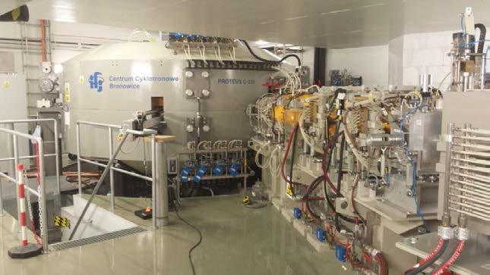
From a census made by the AMICI Task 2.3 among the 10 AMICI Technological Facilities one may conclude that there are three categories of such Facilities :
1. Technological Facilities in the form of a single laboratory with a large accelerator facility having a wide research user community. The large accelerator facility requires a technical program of development, production and tests of new equipment to be maintained in order to keep the accelerator facility competitive. This technical program in the host lab is used to serve also other major Research Infrastructures,. Labs in this category are: CERN, DESY, PSI, INFN Frascati and STFC RAL.
2. Technological Facilities in the form of national clusters of a number of smaller laboratories which have smaller accelerator facilities mostly for accelerator and magnet technology developments and in some cases for research and test beams which also have, taken together, a major program of development, production and tests of equipment for large Research Infrastructures. Labs in this category are most of the national laboratories of INFN, STFC and CNRS-IN2P3.
Test beam facility at IFJ PAN

Slide 6
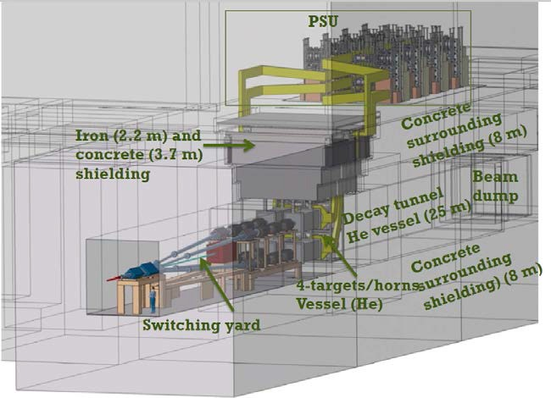
3. T echnological Facilities in the form of a single laboratory with no major research accelerator but a major program of development, production and tests of equipment for Research Infrastructures. Labs in this category are CEA-Saclay, FREIA and IFJ PAN.
These three categories have different sustainability boundary conditions. One clear tendency is that the Technological Facilities having an accelerator Research Infrastructure with an associated scientific user community have less problems with sustainability owing to the support to the Facility provided by its accelerator user community.
A trial was made to estimate through the census how much governmental support the Technological Facility function is receiving. This however turned out to be too complex a goal to achieve, in particular for the first of the three categories where it seems to be nearly impossible to separate the cost for the operation of the own Research Facility from the task of providing development, production and tests of equipment for the own Research Infrastructures, on the one hand, and to other Research Infrastructures, on the other.
Layout of the 4 magnetic Hardon Collector Horns with their 350 ‘000 A pulsed current sources for ESSnuSB

Slide 7
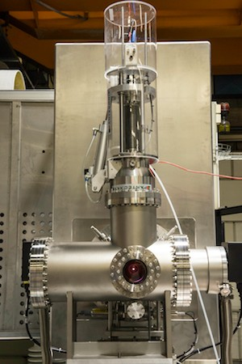
The census gave a picture of how the co-operation between the Technological Facilities and the Research Infrastructures are regulated. As a rule, the co-operation agreement is in the form of a detailed written contract. Normally the Technological Facility will demand the Research Infrastructure to cover the full costs of all purchased equipment components, industrial orders and consumables needed for the work at the Research Infrastructure and in some cases also for the personnel costs. On the other hand, the Research Infrastructure is not asked to pay for rental costs, overheads or for the depreciation of existing technical infrastructure at the Research Infrastructure. There is also no provision for a profit to be made by the Technological Facility.
As both parties to such an agreement are contributing to the financing of the common project, the co-operation has more a character of a collaboration of mutual interest and benefit than that of a commercial agreement. This is natural as the Technological Facility, like any public research institution, operates as a public service institution having its basic operation costs covered by public funding an does not claim exclusive Intellectual Properties rights for what it produces. To achieve the same goals operating under fully commercial appears as impossible.
Ion source from INFN Catania
Being installed at ESS

Slide 8
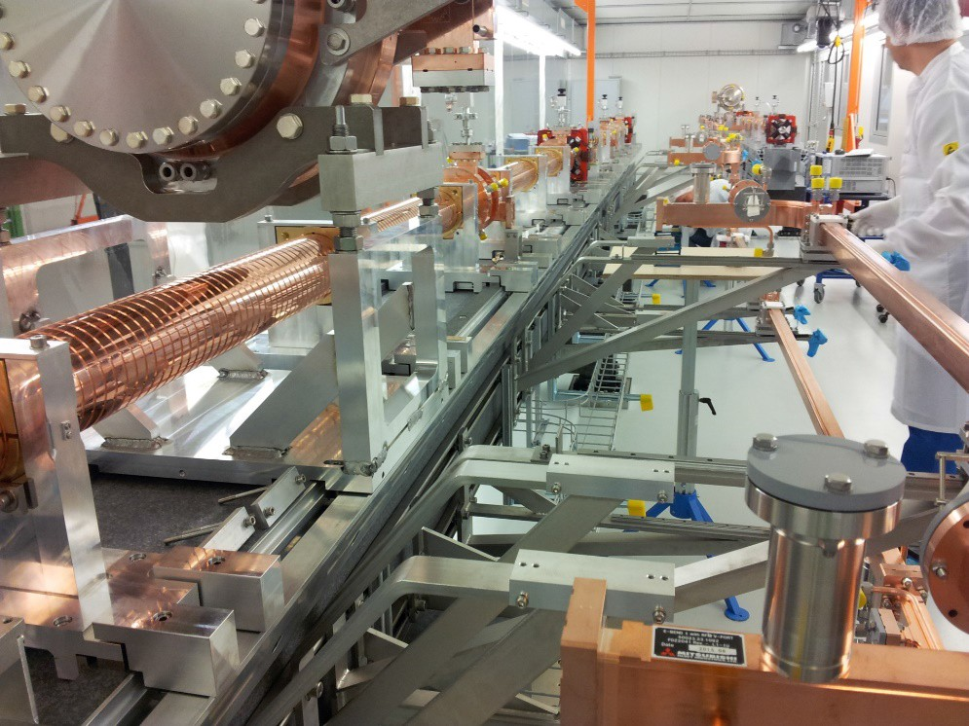
This new paradigm for how the very large new Research Infrastructures are developed, build and maintained in Europe is not well known by the general public, who usually have the understanding that, e.g., the CERN LHC and its upgrade, DESY's XFEL and ESS's neutron spallation source are build by CERN, XFEL and ESS, respectively, and that is all. The extensive and intensive interplay required between all the European Technological Facilities in collaboration with European High-Tech Industry is to a varying degree unknown on the political level. This implies a problem for motivating public support towards the operation costs of the Technical Facilities and thus for their sustainability.
It is essential for the future of European fundamental science, as well as for the development of European high-tech industry, that the new and important role played by the European Technological Facilities be understood by the national science and technology funding sources such that the sustainability of the Technical Facilities can be guaranteed
C-band accelerating structures test stand at PSI

Slide 9
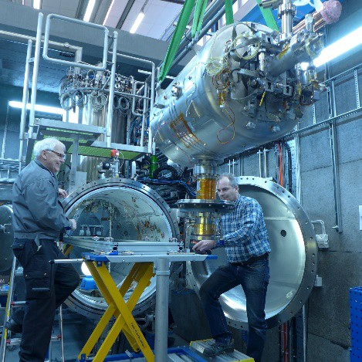
One example of this situation is that in Sweden, where the FREIA Laboratory was created in Uppsala as a Technological Facility in 2012 after the shut down of the TSL national accelerator laboratory there. The build-up and operation till now of FREIA was made possible by a one-off initial investment grant of ca 20 MEUR provided directly from the Government, from ESS, from the University and from the Wallenberg Foundation.
FREIA now operates as one of the Technical Facilities in Europe, currently with programs of tests of superconducting accelerator cavities for ESS and of superconducting orbit corrector dipoles and crab cavities for the CERNs HighLumi Upgrade. FREIA has till now received only minor financial support from the Swedish National Research Council and the Swedish Industrial Innovation Agency that is on a level insufficient to cover the basic operation costs for FREIA of ca 1.8 MEUR/year.
Insertion of the ESS spoke cavity protoype for tests in the FREIA horizontal cryostat
.

Slide 10
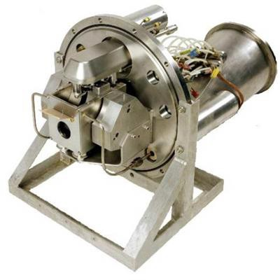
This situation implies that FREIA will have to cease all operations in less than 2 years time unless these two agencies, or some other governmental agencies can be made aware of the new situation for the development and build-up of future large Research Infrastructures in Europe and the need for involving high-tech industry as described here and agree to provide the funding required.
FREIA may constitute an special example but many of the 10 AMICI Research Facilities report stagnant or slightly decreasing governmental support to their basic operations costs.
What needs to be made clear to the national science and technology funding agencies in Europe is:
that experimental fundamental science, which has since the Renaissance been the long-term driver of technological, and therefore also economical, development in Europe, has now reached a level where the research infrastructures have become so large and so complex that they require the active support of all European Technological Facilities and High-Tech Industry, calling for international coordination and cooperation between the Technological Facilities and sustained support for their operation.
Multi-purpose test stand for high power proton accelerator front end technologies at STFC

Slide 11
that such co-operation is needed in order to keep the leading position in fundamental scientific research as well as in technological development that the Western World has had until now, but which is now seriously challenged by other upcoming major regions in the world like China and India and this on a time scale that is much shorter than we may currently think.
that the Technological Facilities has the important function to educate and train young researchers, engineers and technicians in the field of accelerator and magnet technology. There is currently a generally testified and acute lack of competent personnel in these fields at the Research Infrastructures which constitutes a threat against the timely realization of any new advanced Research Infrastructure.
Winding of a CCT orbit corrector dipole prototype for HL-LHC at the Scanditronix AB company

Slide 12
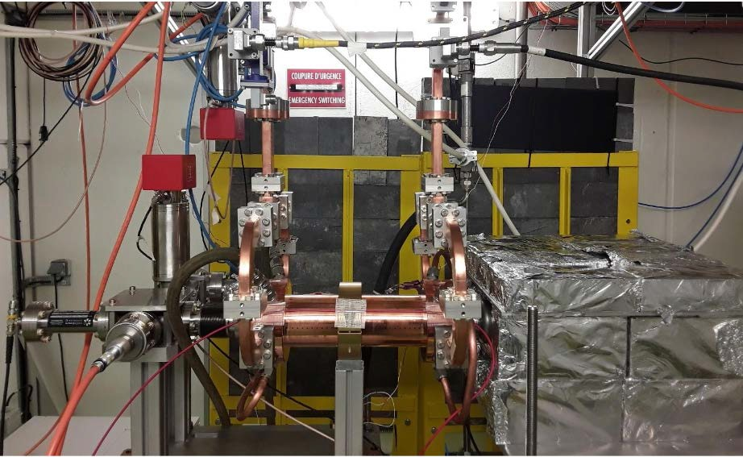
There is general agreement on that it is important to have a number of national Industrial Liaison Officers and to organize regular international information meetings with Industry, like the Big Science Business Forums, in order to facilitate contacts between industrial companies and the large Research Infrastructures under construction. And this is also sufficient when it comes to mediating the provision from industry of raw materials and already existing technical products.
But providing information and organize forums is not sufficient when it comes to requesting industry to develop new technology for the Research Infrastructures. Such technical development must be done in tight technical collaboration between the Technological Infrastructures and high-tech industrial companies.
It is both time-consuming, risky and costly for an Small or Middle Sized company (SME) to spend the time and the resources needed to explore the possibility and commercial interest of developing a brand new technology proposed by a Research Infrastructure.
Test stand for X-band accelerating structures for CLIC at CERN

Slide 13
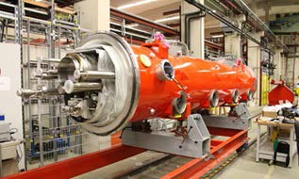
At that stage is therefore necessary to involve local scientists and engineers that have experience of working with the specific type of Research Infrastructure, having at their disposal an adequately equipped Technological Facility for developing and testing the new technology, operating in collaboration with the Research Infrastructure and SMEs as a partners.
The Technological Facility offering this type of service must have its basic operations costs covered by public funding – if it were to have to ask the SME to cover the costs for all services offered in the co-operation, this again will normally represent too big a cost and risk for the SME. The co-operation would thus not come about and Technology Facility could not sustain its activity if the co-operation would be required to built on completely commercial conditions.
An almost finished European XFEL
3.9 GHz module after assembly at DESY

Slide 14
In conclusion, the motivation for Society to provide the required public support to the Technological Facilities in Europe and thereby guarantee their sustainability, is
that most of the advanced scientific research in Europe, on which the further technical and economical development of our Society is critically dependent, is based on the use of large international Research Facilities and that the European Technological Facilities have nowadays become absolutely vital actors for the build-up and upgrade of these Research Facilities
that the European Technological Facilities make it possible for modern European industry to meet the demand from the Research Infrastructures to develop qualitatively new technologies that soon constitute the basis also for many new practical applications in Society and
that by federating and specializing the different Technological Facilities in Europe through a coordinating AMICI consortium, thereby rendering the competences and Technical Platforms of the TFs complementary, large synergetic gains can be achieved.
.

