Slide 1
BNL Magnet Test Facility
3rd International Workshop of the Superconducting Magnets Test Stands
Piyush N Joshi
Superconducting Magnet Division
Brookhaven National Laboratory. NY
June 11, 2019

Slide 2
Outline
SC Magnet Test Facility-Introduction
Upgrades for Hi-Lumi project
Systems and components
Recent improvements
Performance and validation
Future upgrades

Slide 3
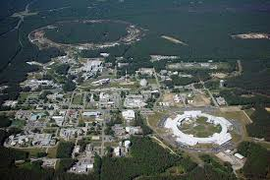
Brookhaven is a multidisciplinary lab supporting big facilities like
RHIC
NSLS II
NASA Space Radiation Laboratory (NSRL)

Slide 4
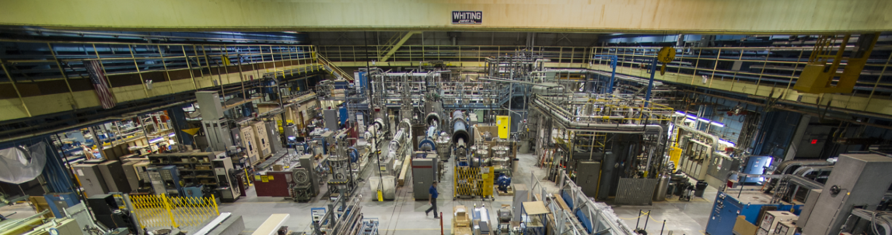
Magnet Test Facility
Five Horizontal test bay: 10kA PS and SCR energy extraction switch (RHIC)
Five vertical test dewars with 30kA PS and 24kA IGBT energy extraction switch
30 ton crane with hook height of 8m
Cryo plant with He liquefaction capacity around 260L/Hr
Vacuum pumps for 1.8K operation

Slide 5
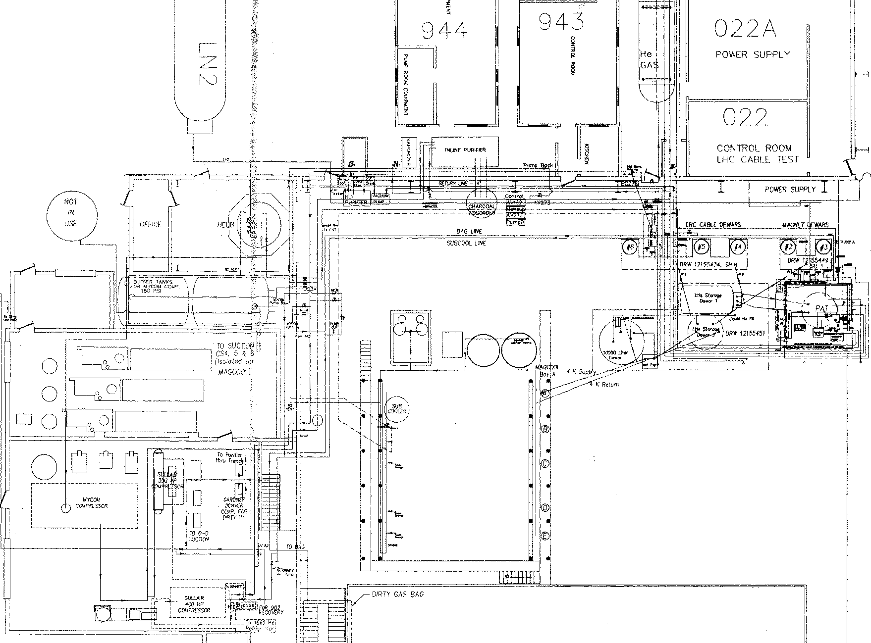
Building 902 Test Facility Floor Plan
Vertical Test Dewars 2-6
Horizontal
Test
Stands A - E

Slide 6
Assortment of Power supplies
(1) 30kA (2 x 15 kA) @ 14VDC connected to vertical test facility (VTF)
(2) 10kA @ 20VDC connected to horizontal test facility (HTF)
(3) 8.5kA @30VDC for VTF
(4) 8kA @ 12VDC “Short sample test facility magnets”
(5) 1kA @1kVDC
(6) 7.5kA @ 25VDC “Fast Ramp”, 50VDC, 100VDC (GSI ramp rates to 7800 A/s)
(7) Dual Acme 5500A @ 125V “Room temperature field measurements and calibration magnets for measuring coils”
(8) Variety of trim power supplies (bipolar and unipolar)
All power supplies can be configured for a wide range of magnet tests.
Energy extraction is available with few of them

Slide 7
Dual 15kA (30kA) Power Supply System

Slide 8
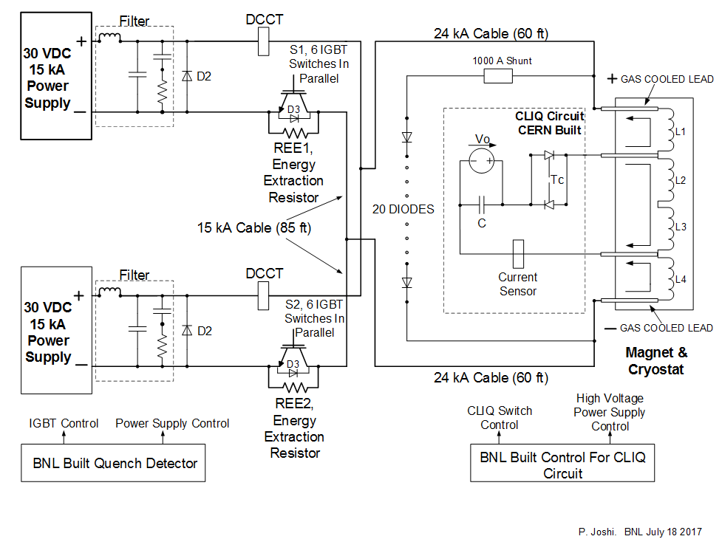

CLIQ integration in protection system
2nd International Workshop on Magnet Test Facilities BNL May 8-9 2018

Slide 9
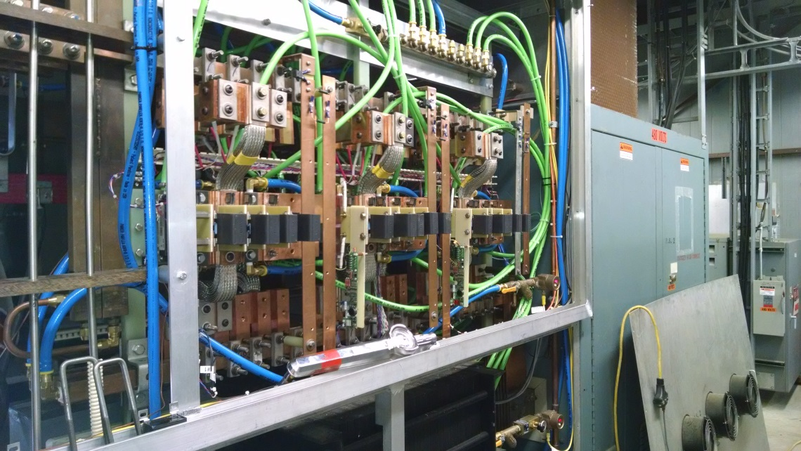
24kA IGBT Switch
  Switch consists of 2 modules, each with six high power IGBTs in parallel. (One module of 6 for each 15 kA power supply.)
  Infineon make IGBT rated for 3600 A, 1700V
  IGBT current & C-E voltage will be limited 2000 A and 1000 V.
  Each IGBT has been equipped with a snubber circuit designed to limit high voltage switching transients.
  40 channel IGBT Switch data monitoring and logging system for each module.
15 kA power supply switch cabinet with IGBT and snubber circuits. Each power supply is configured for 12 kA with 6 water-cooled IGBT and snubber circuits, allowing 24 kA magnet operation.

Slide 10
Quench Detection and Data Acquisition

Slide 11
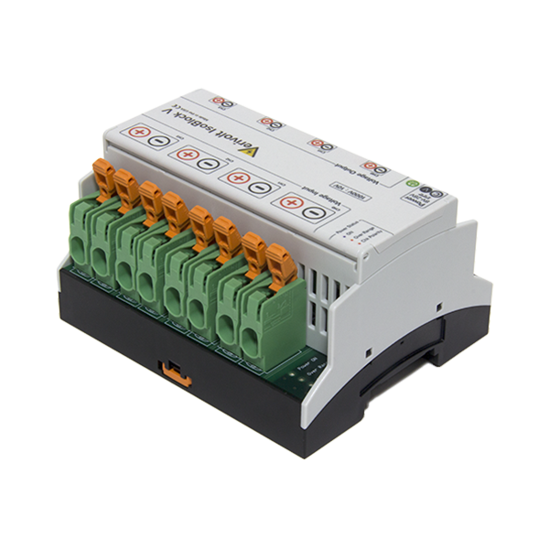
Signal Isolation
Off the Self item: from VeriVolt
Reasonably priced (we have about 240 channels)
Two flavor: Fixed gain and jumper selectable
  Input Output
  2V 10V
  10V 10V
  1000V 10V
Input to Output isolation:2500V
Ch to Ch and Ch to Gnd:1200V sustained, 4200V surge
BW: 100kHz

Slide 12
Magnet protection systems
Magnet is protected using four systems operating in co-ordination.
  Quench detector
  Energy extraction
  Quench heater activation
  CLIQ
Quench detector: Two National Instrument CRIO FPGA chassis with 24 channels of differential analog input, 24 bit simultaneous sampling (50kHz) and 24 channel digital output lines.
Adjustable validation time and thresholds as a function of current
Adjustable energy extraction dump resistor. (30mΩ, 37.5mΩ, 50mΩ, 75mΩ, 150mΩ) can absorb up to 10MJ maximum.
Solid state switch based on 12 parallel IGBTs divert magnet current in to non inductive dump resistor in less than 10µs
Quench heater power supply controlled by an independent CRIO chassis with adjustable charge voltages and discharge delay time.
12 capacitor banks chargeable to 900V
2nd International Workshop on Magnet Test Facilities BNL May 8-9 2018

Slide 13
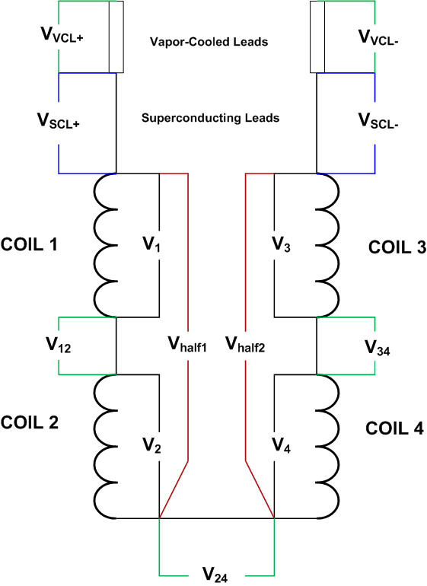
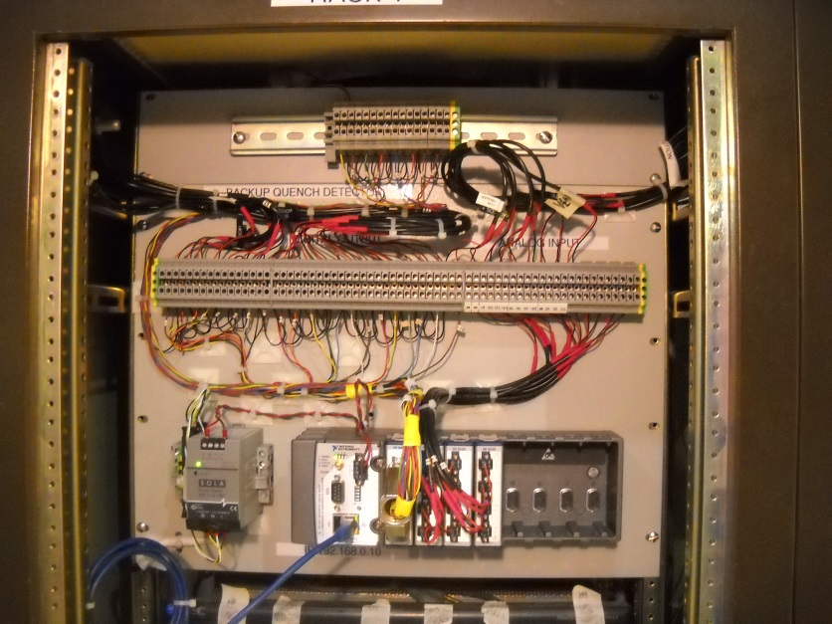
Quench Detection
The quench detection system is based on two (for redundancy) NI FPGA systems. When any one of the following signals reaches its specified threshold voltage after a specified validation time, a fast discharge is instigated (current decays through dump resistor). Typical threshold voltages and validation times are listed here.
Half coil voltage V_{half1} - V_{half2} 50-150 mV 5 ms
Quarter coil voltage V₁ – V₂ 50-150 mV 5 ms
Quarter coil voltage V₃ – V₄ 50-150 mV 5 ms
V_{total} – L dI/dt 1-2V 5 ms
SC lead voltages V_{SCL+} and V_{SCL-} 10-50 mV 5 ms
Splice voltages V₁₂, V₃₄, V₂₄ 8-10 mV 5 ms
Local data capture for all input channels
Note: In Nb₃Sn magnets, current-dependent thresholds as high as several volts at low currents are necessary and are set in the software. This is to avoid false QD trips due to flux jump spikes.

Slide 14
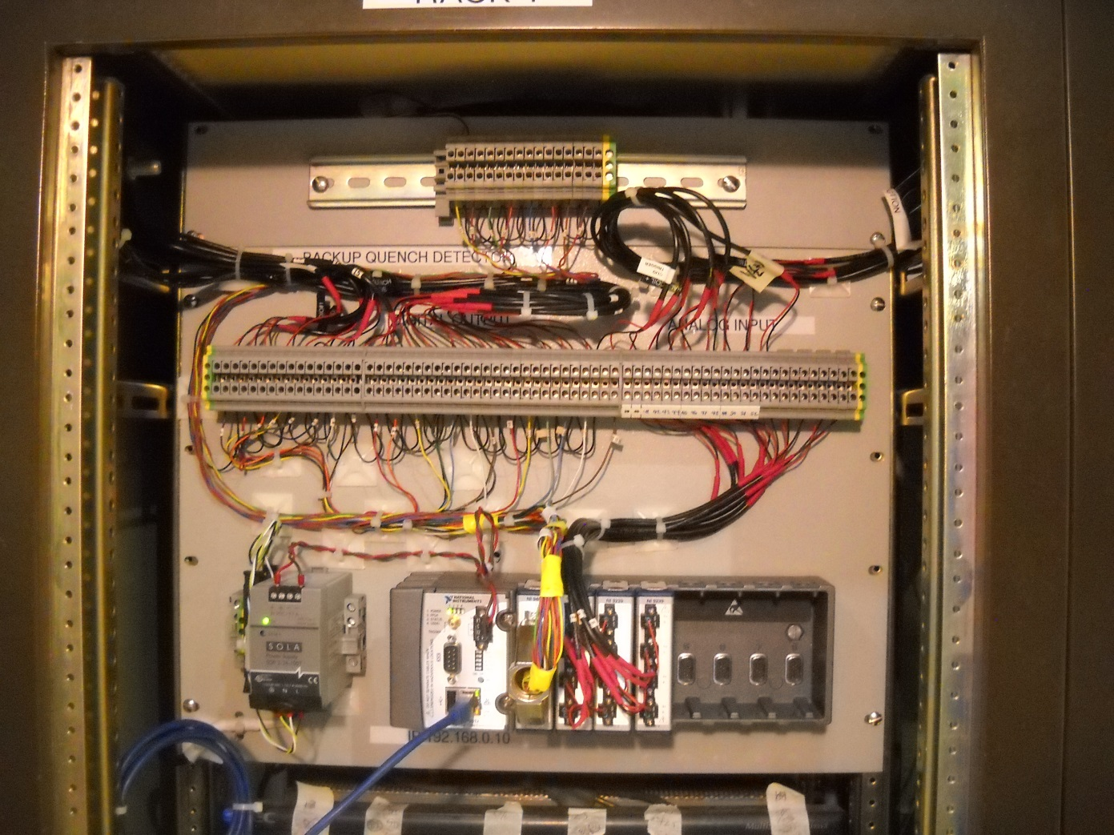
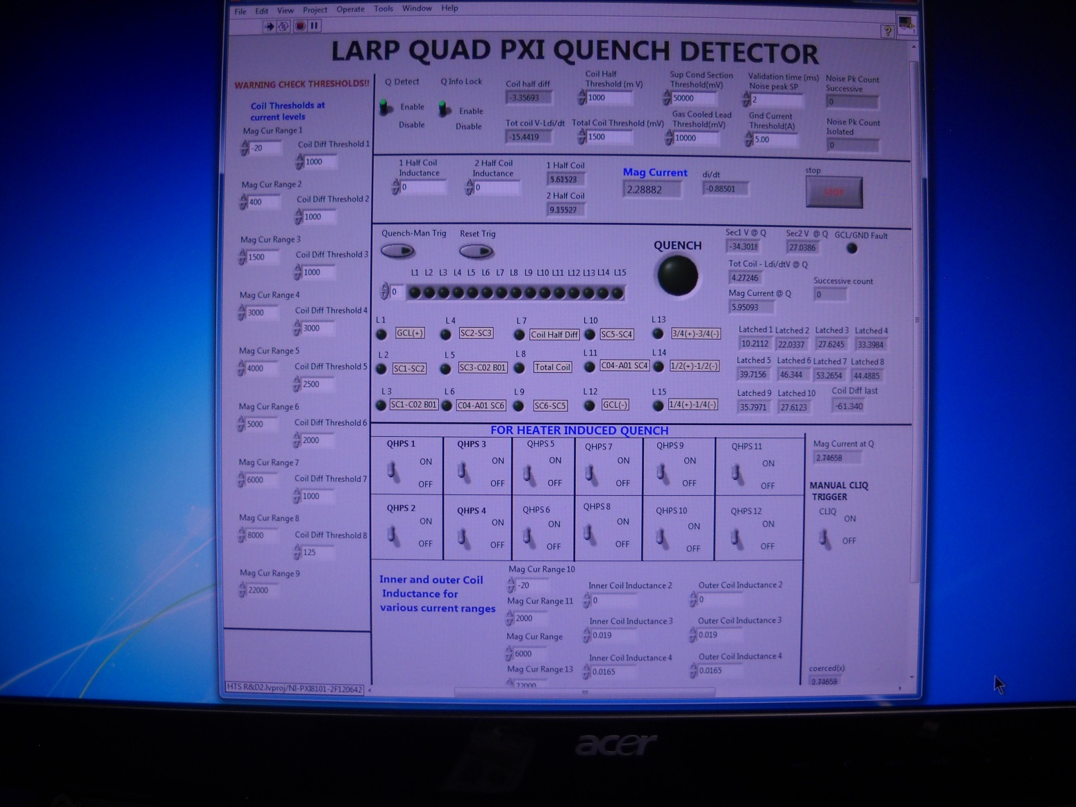
Quench Detection Hardware and Software

Slide 15
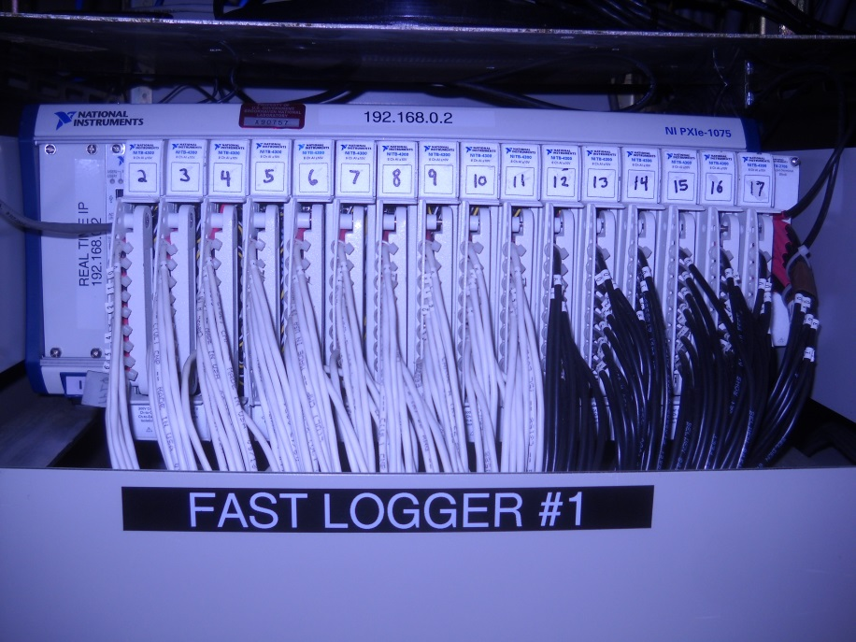
Fast Logger
FAST DATA LOGGER DAQ
28 National Instruments DAQ cards PXIe-4300 plugged in two PXIe chassis
Number of channels per card = 8 differential, simultaneous sampling
Analog input = ±10 V, ±5 V, ±2 V, ±1 V
ADC resolution = 16 bit
Sampling rate = 10kHz to 100 kHz
TOTAL CHANNELS = 224 differential, simultaneous sampling
Usage: Fixed (main) voltage taps and configurable (auxiliary) voltage taps,
quench antenna signals

Slide 16
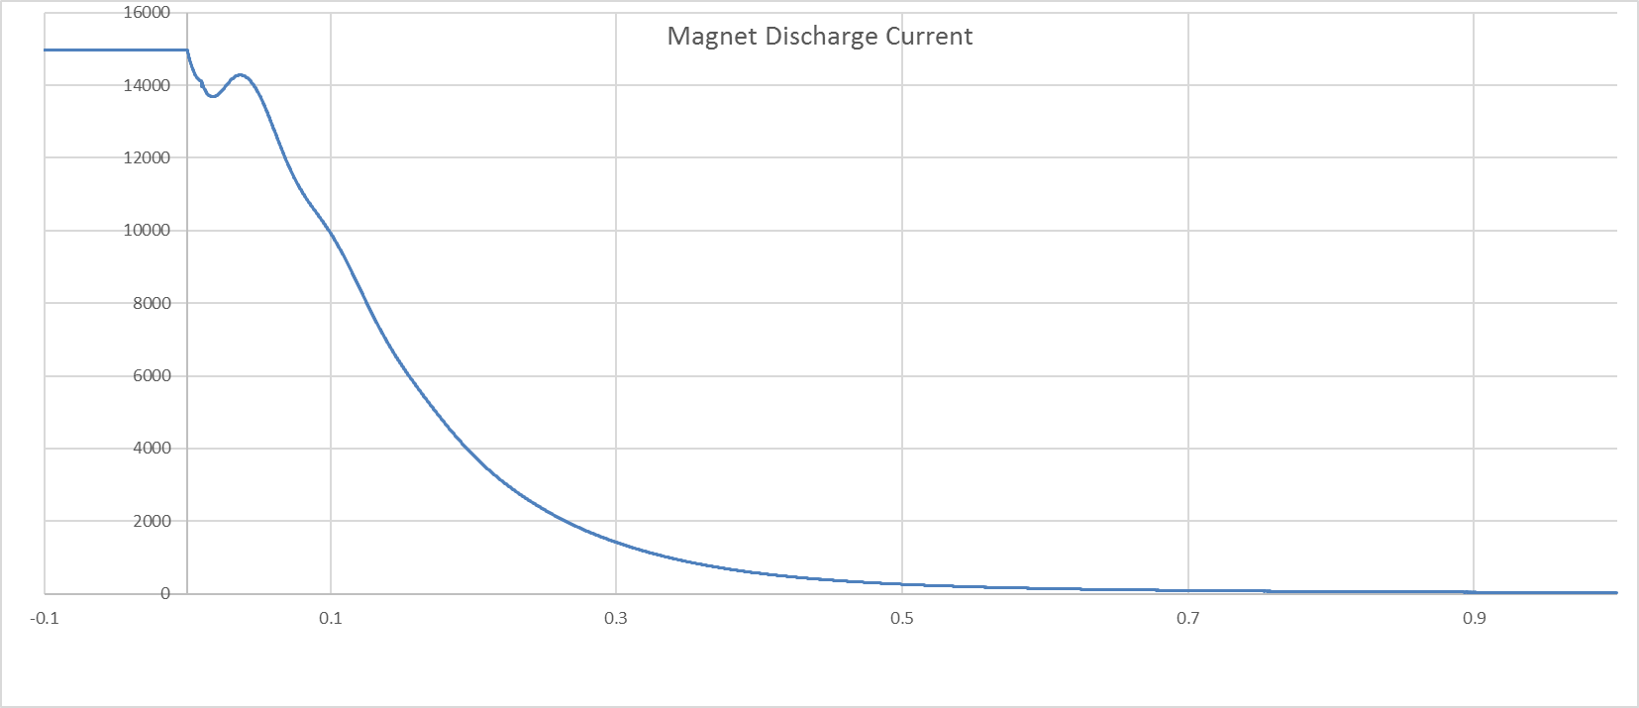
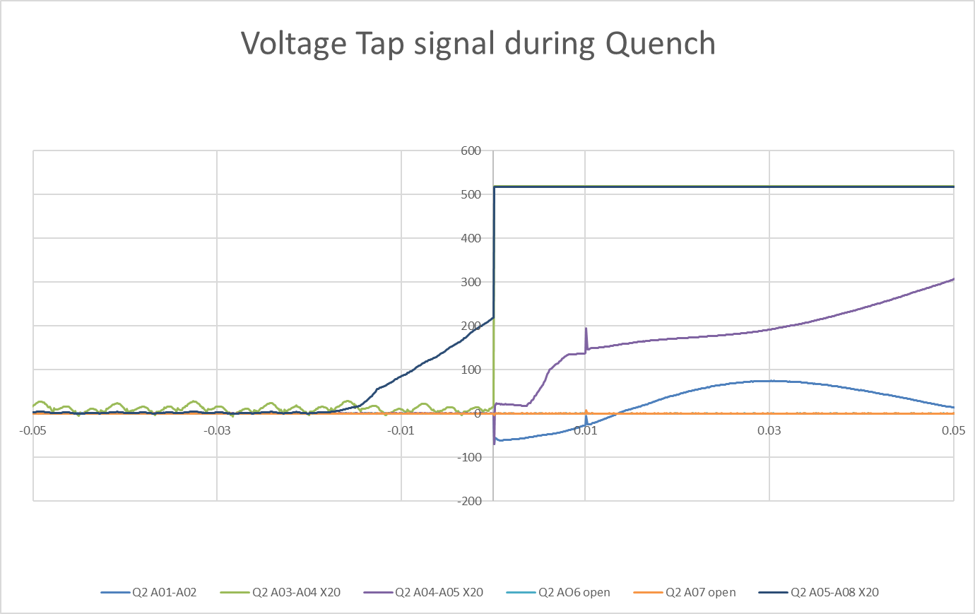
Quench Plots

Slide 17
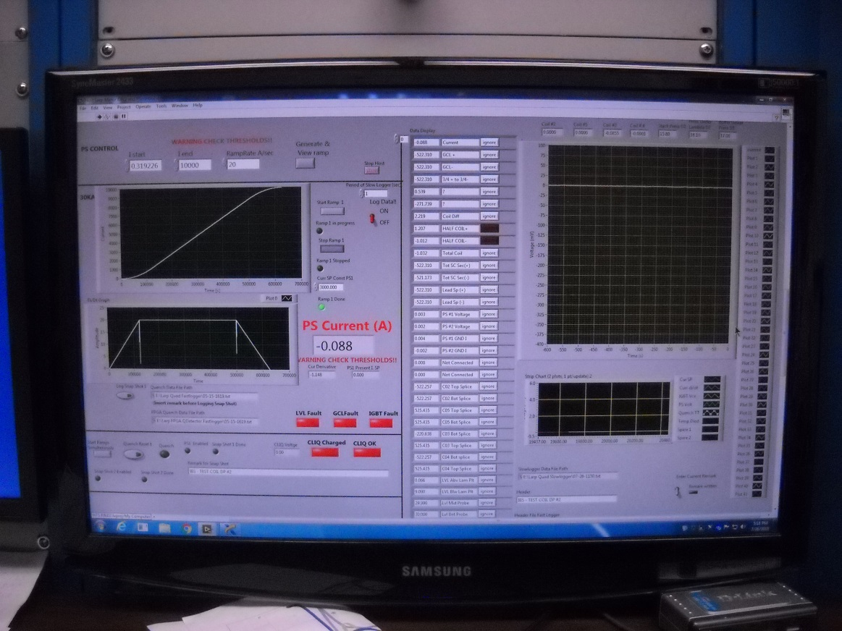
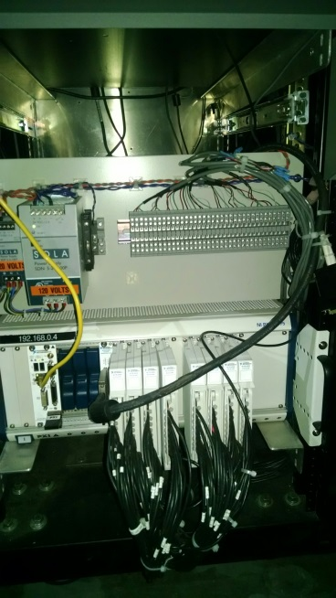
Slow Logger
Four National Instruments PXI-6289 DAQ cards
Number of channels/card = 16 differential
Analog input ranges: ±10 V, ±5 V, ±2 V, ±1 V, ±0.5 V, ±0.2 V, ±0.1 V
ADC resolution = 18 bit
Three power line cycle filtering
TOTAL CHANNELS = 64 differential
Usage : Monitoring of vapor-cooled lead voltages, splice voltages, SC lead voltages, temperatures, LHe levels, and other instrumentation

Slide 18
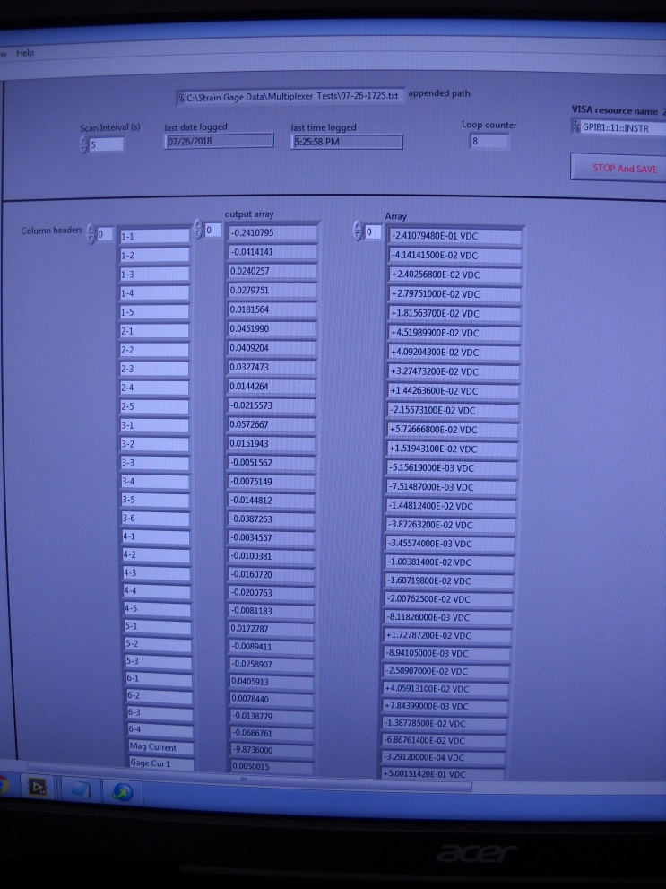
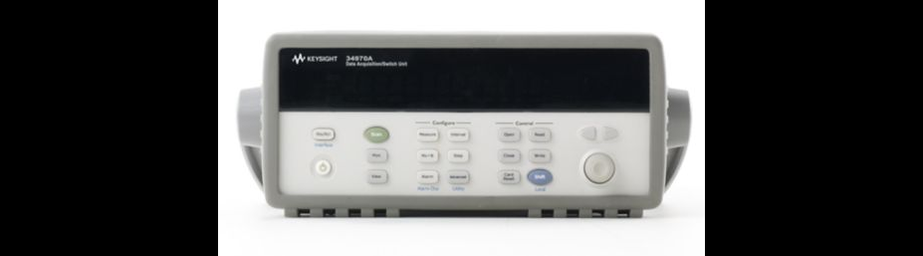
STRAIN GAUGE LOGGER DAQ
Agilent 34970A DMM with multiplexer
Number of channels = 60 differential
ADC resolution = 22 bit max
Scan rate = 20 ch/s max
Total channels = 60 differential
Usage = strain gauges

Slide 19
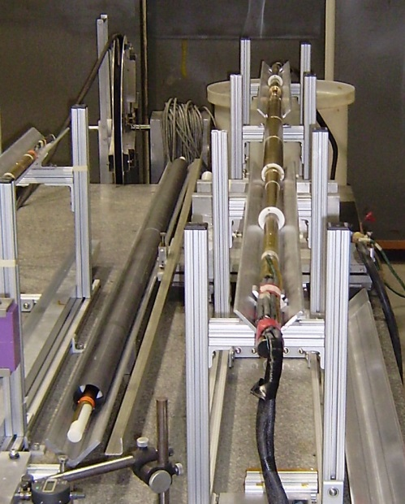
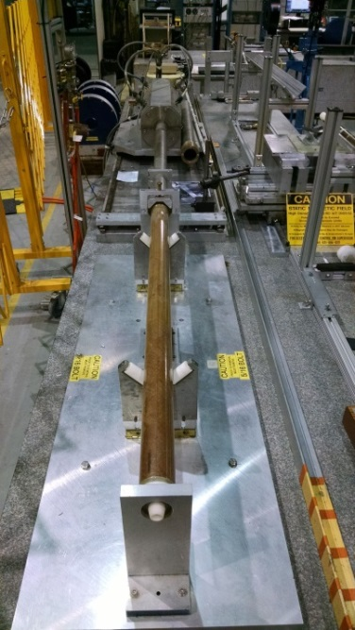
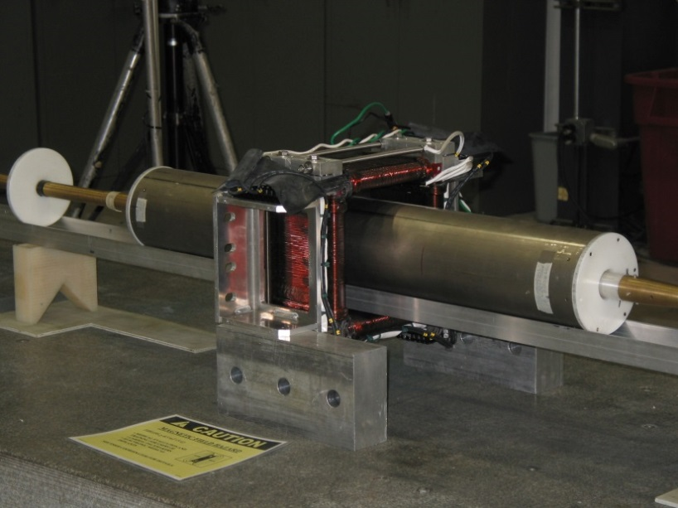
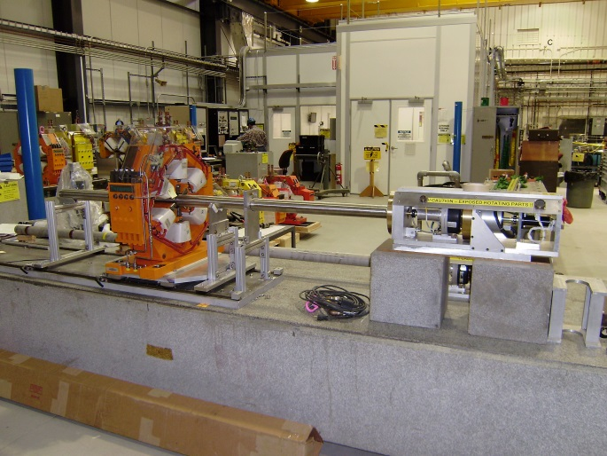
Magnetic Field Measurement Systems
Existing inventory of over 60 magnetic field measuring coils, with variety of lengths and radii:
External drive coils, various radii and lengths, some with warm bore tubes
Moles, 1 m long and smaller, various radii, with electric (warm) or gas-driven (cold) motors
Other devices: Hall probes, fluxgate magnetometers, vibrating wire
Magnetic field measuring probe designed for MQXF will not be needed for the upcoming mirror test but will be available for the testing of the prototypes starting in Feb 2017.

Slide 20
New Upgrades
Digital current control loop for 30kA PS using NI CRIO FPGA hardware and LabView software: Implemented and tested
1.8K heat exchanger with increased surface area: Implemented and tested
Upgrade of Dewar 6 with 10kA magnet PS and 30kA SC cable sample PS : Design stage
Development of Dewar 1 for testing of cables for Fusion program:: 30kA magnet PS and 100kA current transformer as sample PS. Dewar diameter=2m and depth =3.5m

Slide 21
THANK YOU FOR YOUR ATTENTION
Acknowledgements for contributions to this presentation: Sebastian Dimaiuta, Bill McKeon, Dan Sullivan, Joe D’Ambra, Joe Muratore

Slide 23
Backup slides

Slide 24
RECENTLY UPGRADED WITH ALL NEW SOFTWARE
  POWER SUPPLY CONTROL PROGRAMS (LABVIEW)
  INSTRUMENTATION CONTROL PROGRAMS (LABVIEW)
  DATA ANALYSIS PROGRAMS (LABVIEW / DIADEM)
    DATA HANDLING, PLOTTING, AND ANALYSIS
    MULTIPLE SIGNALS DISPLAYED
    WAVEFORM CALCULATOR
    ∫(I² dt) CALCULATION

Slide 25
Data Acquisition, Quench Detection and Protection
FAST Logger
Two National Instrument PXIe-1075, 18 slot chassis with real time controller
200 channels, 25 DAQ modules each with 8 differential input, 16bit, simultaneous sampling. Max sampling rate of 250KHz, Data capture window of 6 seconds
SLOW Logger
One National Instrument PXI-1050, 8 slot chassis with real time controller
DAQ modules are differential input, 16bit, multiplexed sampling. 56 channels sampled at 1KHz. Each signal processes through 3 power line cycle averaging filter.
QUENCH DETECTORS
Two Quench detectors with redundancy to protect magnet and sample
National Instrument make state of the art CRIO FPGA chassis with 16 channels of differential analog input, 24 bit simultaneous sampling (10kHz) and 24 channel digital output lines
Adjustable validation time and thresholds for quench detection on each channel
Energy extraction is achieved by solid state switch based on 12 parallel IGBTs diverting magnet current in to a dump resistor in less than 10µs
12 Quench heater power supply controlled by an independent Real Time CRIO chassis with adjustable charge voltages and discharge delay time for each PS.
8

Slide 26
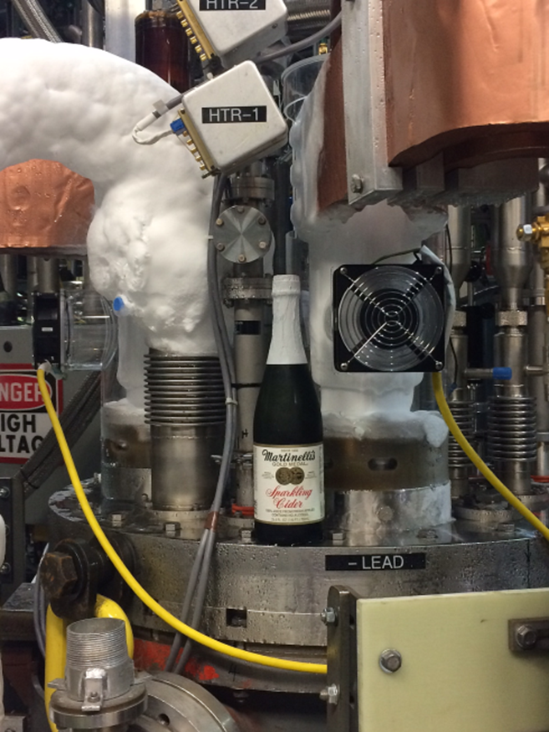

Slide 27
Quench Detection and Data Acquisition

