Slide 1
3nd International Magnet Test Stand Workshop
Magnet Test Facility at LBNL
Marcos Turqueti
US Magnet Development Program
Lawrence Berkeley National Laboratory

Slide 2
Outline
Facility Overview
CLIQ
Extraction
Power Supply
CryoDAQ
MTF team:
Maxim Marchevsky – Physicist
Marcos Turqueti – Electrical Engineer
Jordan Taylor – Electrical Technician
Jim Swanson – Cryo Technician
Daniel Davis – Ph.D Student

Slide 3
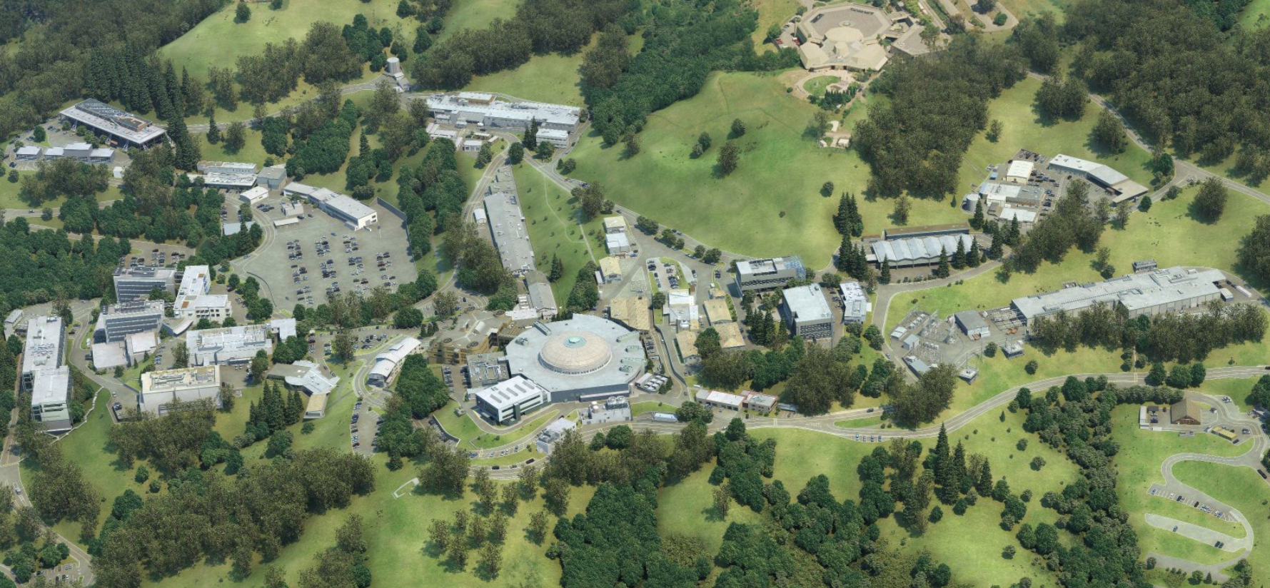
The Facility
It is located in the Berkeley Hills near Berkeley, California;
Magnet Test Facilities

Slide 4
The Facility
The Magnet Test Facility (MTF) at LBNL has the mission of testing and characterizing prototype high field superconducting magnets;
Several magnet parameters, such as current, training behavior, and field quality are tested and characterized at MTF;
The facility is capable of adapting to an wide variety of magnets and provide unique instrumentation capabilities;
Several upgrades are current ongoing at LBNL to further improve the Magnet Test Facility capabilities.
Current scheduled for testing (July):
  Gantry, CCT5, C2B

Slide 5

Upgrades - Coupling-Loss Induced Quench system (CLIQ)
Max: 9.9 kJ, 800 V, 45 mF

Slide 6
Upgrades - CLIQ
Normally closed relay
IGBT switching on/off capacitor banks.
IGBT gate control
Capacitor bank charging
Capacitor bank
voltage measurement
Bleed resistor for each capacitor.
6

Slide 7
Energy Extraction System
Silicon Controlled Rectifier (SCR) based extraction system. Four SCRs capable of switching 6kA (55 ºC) each.
  Maximum tested current rise 500A/s
  Maximum voltage of 1350V
  Maximum SCR operating temperature of 125C, with interlocks set to 90C
  Turn off time of 0.5ms
9kJ capacitor bank necessary to disengage SCR’s during energy extraction with energy proportional to maximum extraction current.

Slide 8
Upgrades - Energy Extraction
IGBT Based System
Dump resistor unit – specifications next page.
Scenerio | Resistance (ohm) | Energy rating (kJ)
1 | 0.1 | 400
2 | 0.05 | 500
3 | 0.0333 | 600
4 | 0.025 | 700
5 | 0.02 | 800
IGBT assembly with cooling
Dripping pan
IGBT, 2.4 kA, 1.7 kV
Bus bars
Current transducer LF 2010-S, I_{PN}=2 kA
By J. Taylor
Four Soresen (10 V, 1.2 kA)

Slide 9
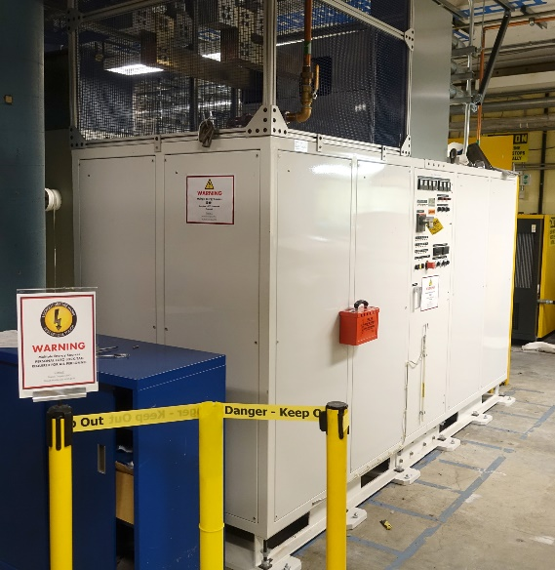
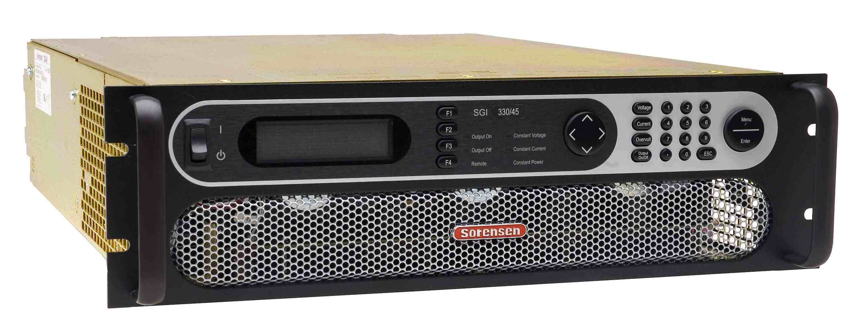
Main Power Supply
New 25kA power supply (Transferred; Los Alamos)
Maximum current: 25 kA (limited to 23.5 kA by voltage drop on the lines + SCRs balance resistors)
Maximum voltage: 20 V
Remotely controlled from the MTF control room via Ethernet interface (dedicated network line)
SGI Series DC
5kA secondary magnet power supply is now in operation

Slide 10
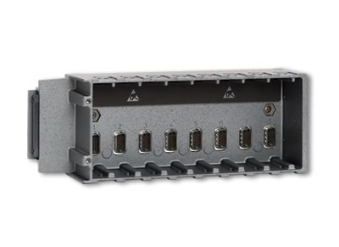
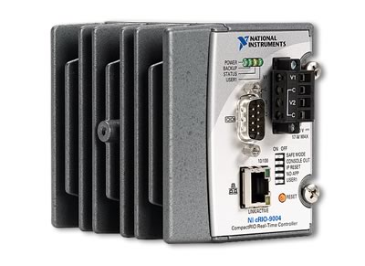
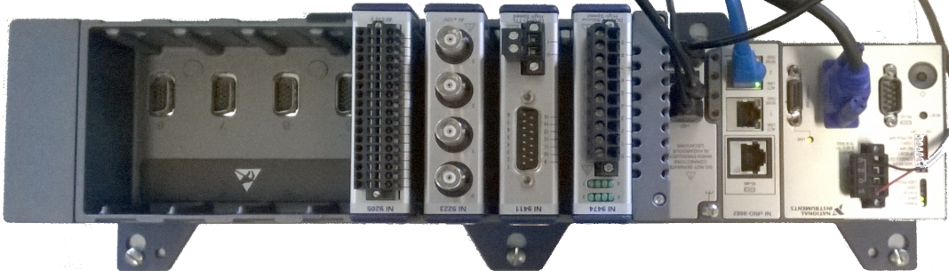
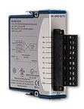
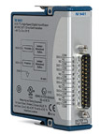
Quench Detection System
LabVIEW
LabWindows/CVI
LabVIEW RT
LabWindows/CVI RT
LabVIEW FPGA
Custom VHDL
Win/Linux
VxWorks
NI-RIO
Controller
Chassis
PowerPC
FPGA
Modules
NI-9215
4 ch 100kS/s 16bit
NI-9401
8ch 100ns TTL
LBNL QUENCH DETECTION SYSTEM

Slide 11
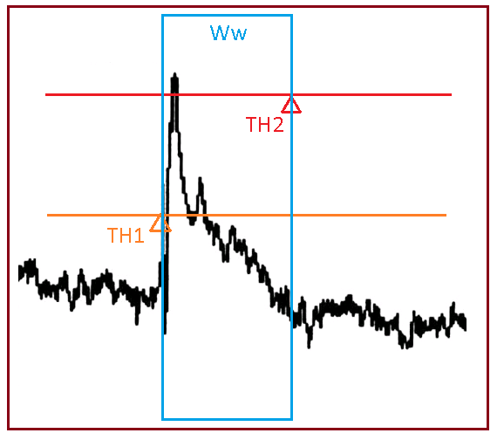
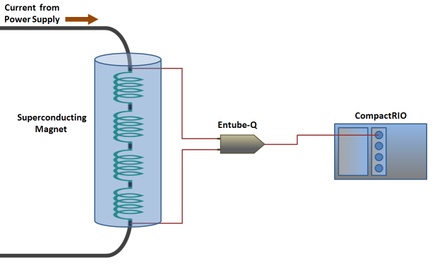
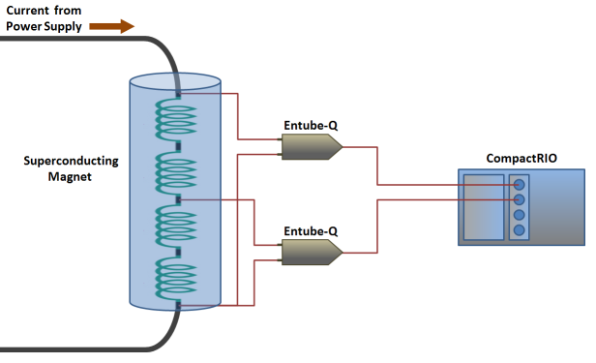
Quench Detection System
SIGNAL ORIGIN
Ww – Window width 2us- 100ms
TH1 – Trigger Threshold
TH2 – Action Threshold

Slide 12
New Activities : CryoDAQ R&D
Active Cryogenic Electronic Envelope (2013)
  U.S. Patent No. 10,240,875 (Supercon)
Commercial off-the-shelf cryogenic components (4k-77k)
ADCs, Amplifiers, Diodes, FPGAs, Laser Diodes, Optical Isolators , Voltage Regulators, Transistors and Passives
Field Programmable Gate Array (FPGA) on Cryogenic Environments
FPGA operating with COTS ADC
FPGA based ADC
Cryogenic Magnetic Sensors
  Acoustic Sensors (Maxim)
  Electron Beam Sensor (LDRD)
160nm Cryogenic ASIC
16 channels 12b 10MSPS ADC, 1 MSPS 10b ADC, Charge Amplifier, Voltage Regulator, Strain Gauge, Sea-of-Transistors, Memory (C.Grace, D.Gnani)

Slide 13
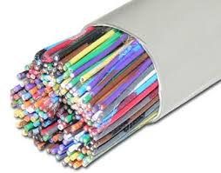
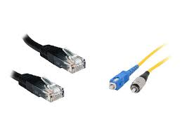
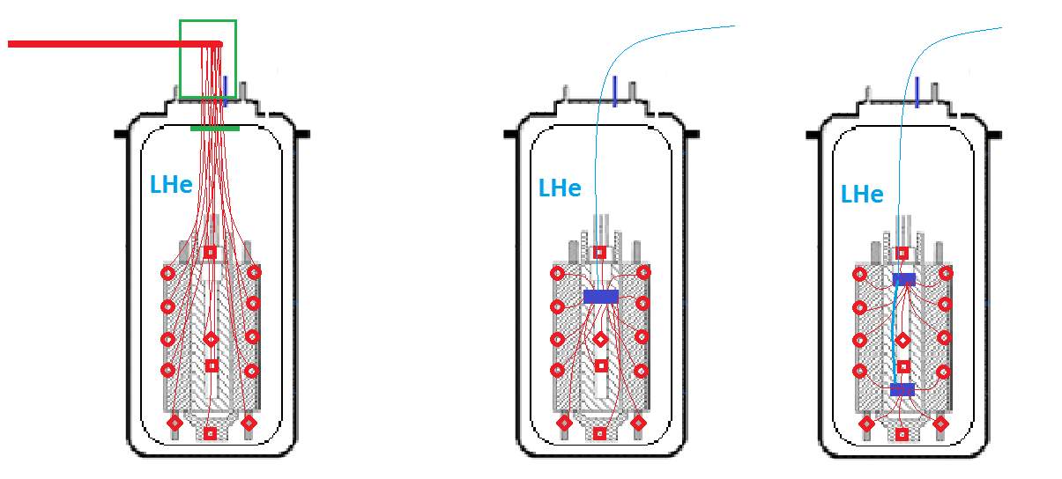
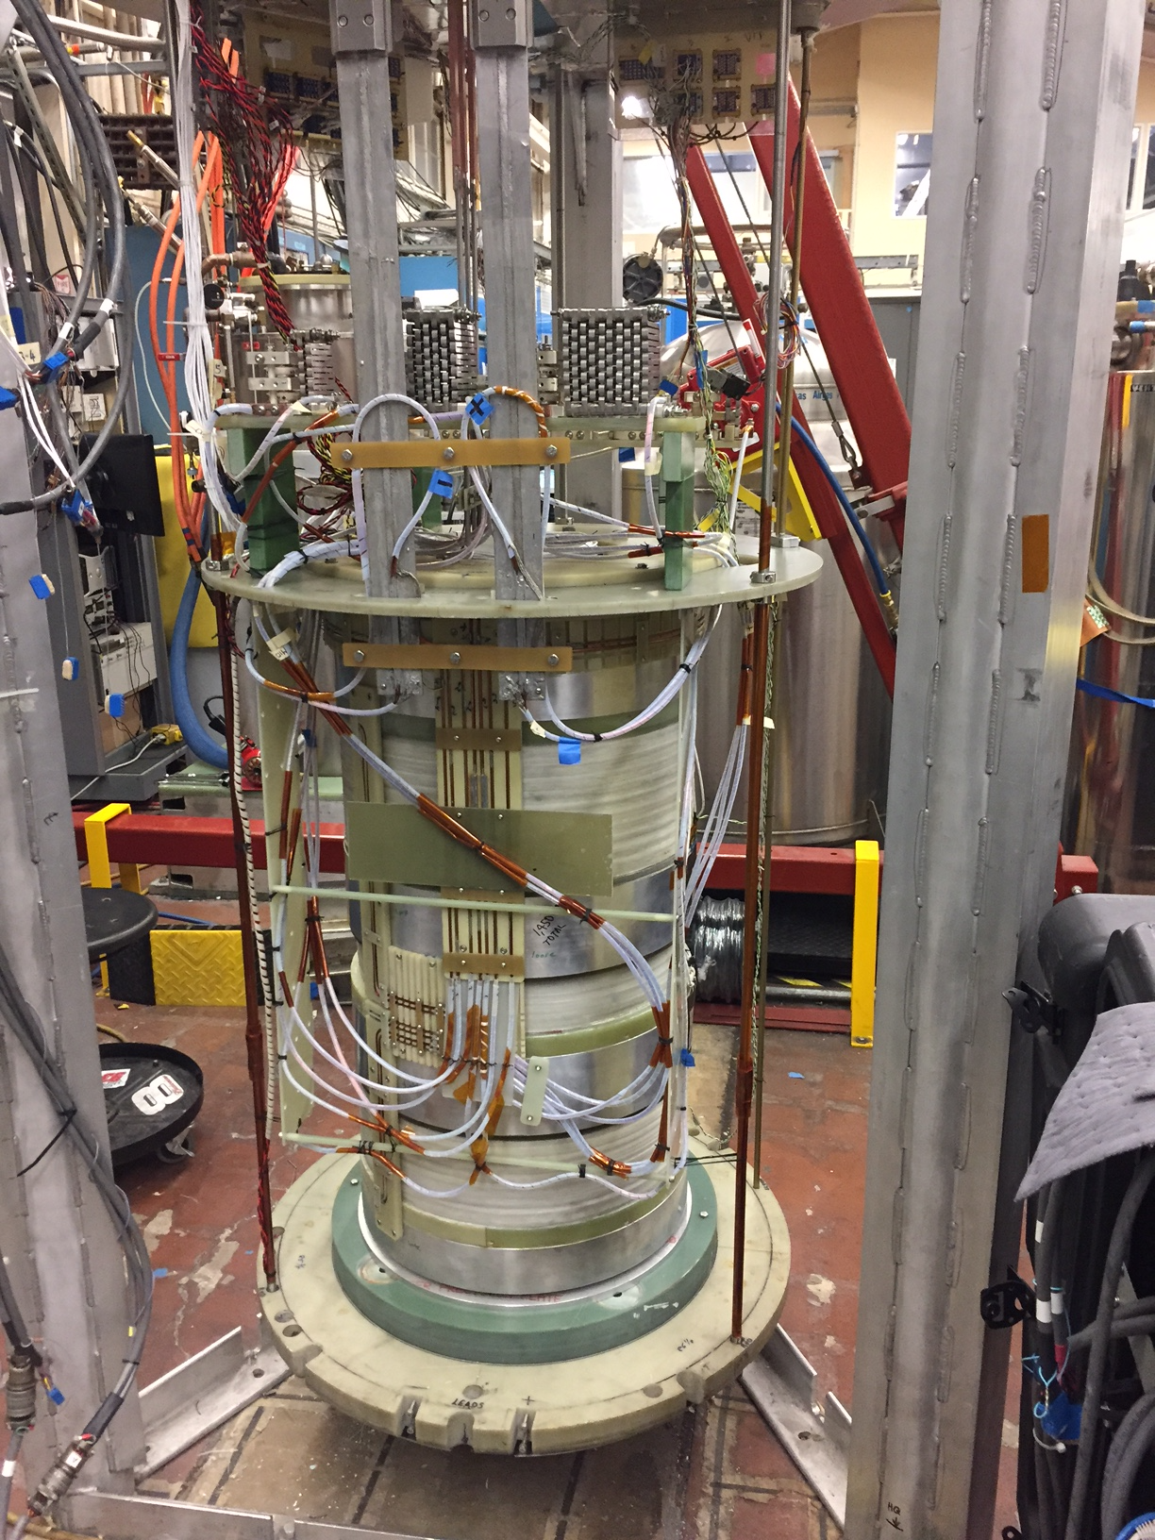

New Activities : CryoDAQ R&D
Strain Gauge
Voltage Taps
Temperature Sensor

Slide 14
Architectures for cryogenic DAQ
TX/RX line
TX/RX line
OPTO
Power Reg
Power Reg
Power:
Switched Capacitor+LDO
Power over Fiber
LED supply
Communications:
JESD
LVDS
CMOS
Ethernet (PHY?)
Over copper or fiber
Single or multiple lanes.
Typically one lane provides 300Mbps
Isolation:
Opto or capacitive
FPGA
FPGA
ADC
ADC
ADC
ADC
AMP
AMP
MUX
Sensors
Sensors

Slide 15
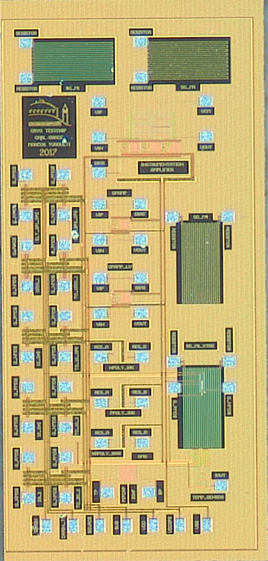
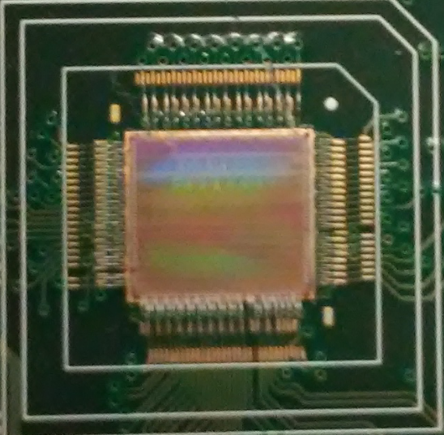
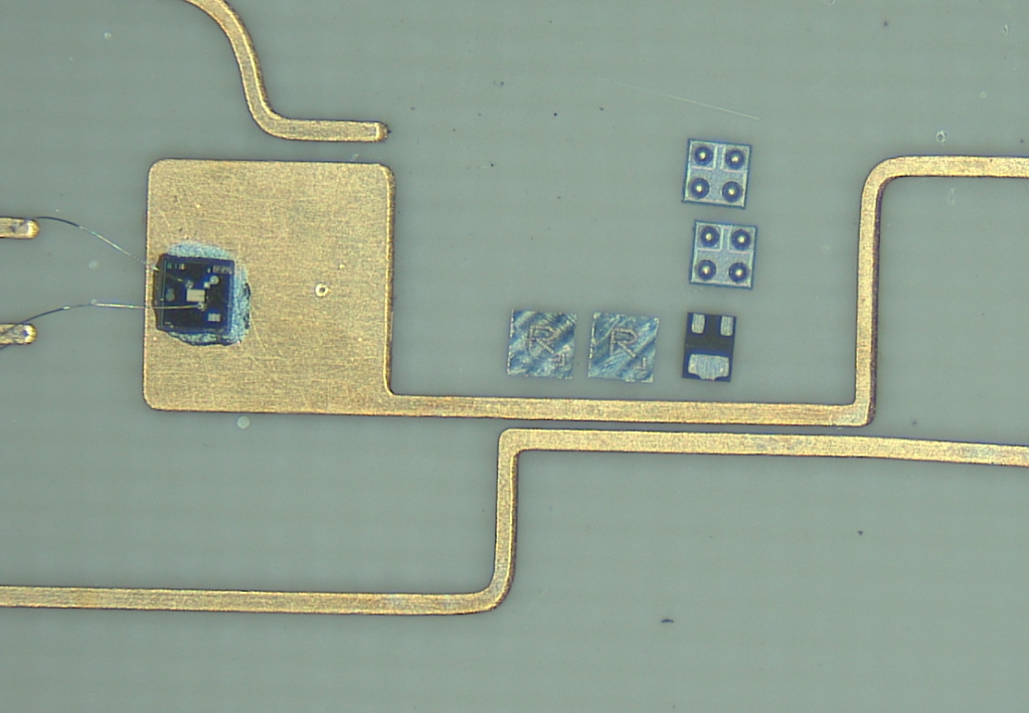
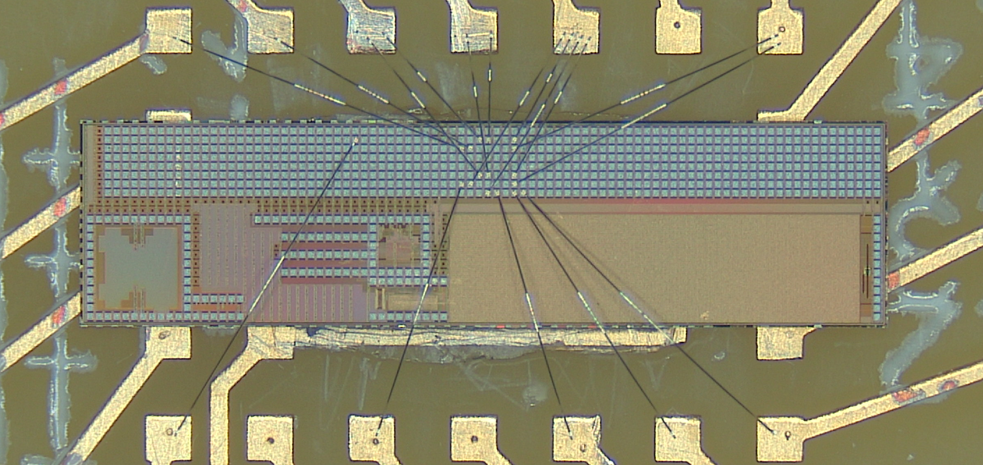
ASICs for Cryogenics Design by LBNL

Slide 16
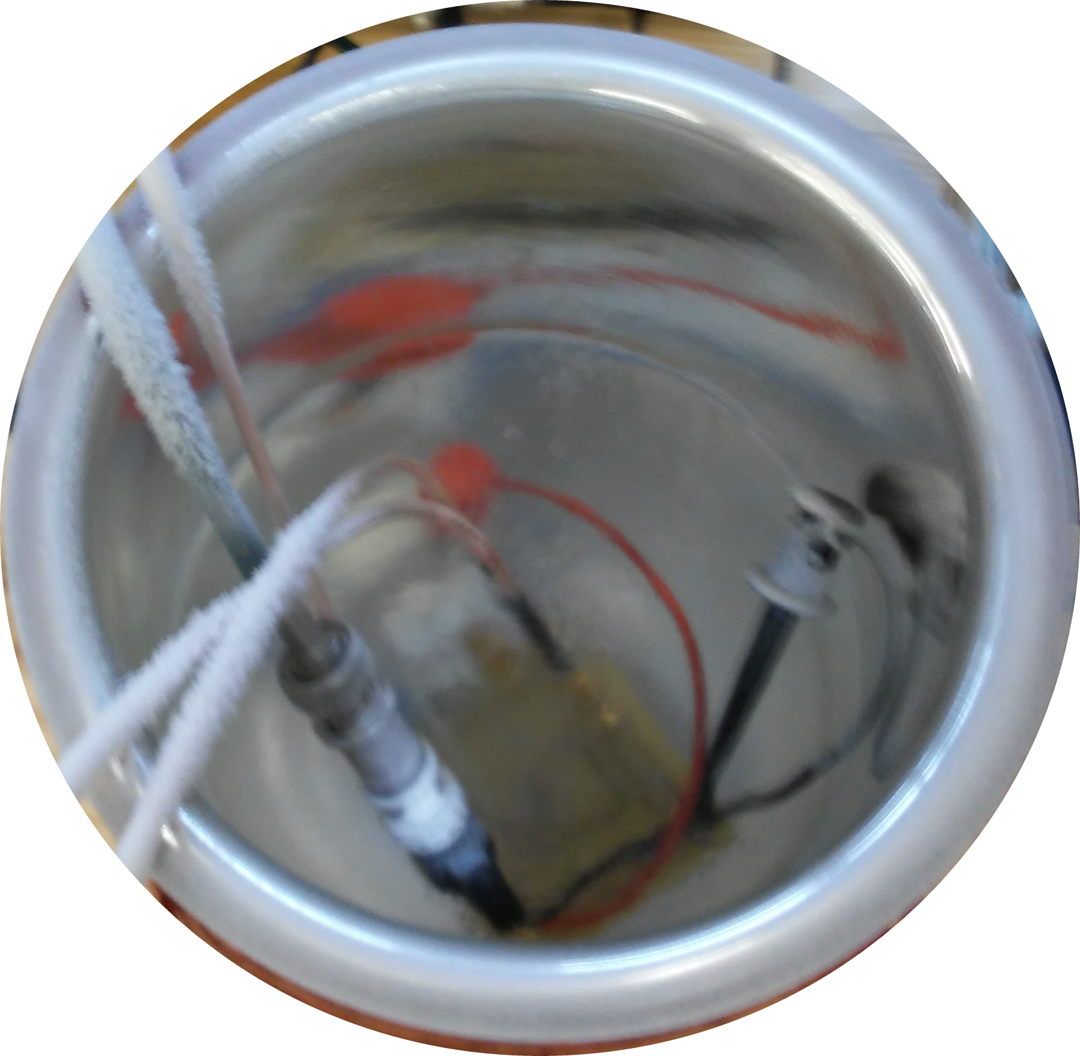
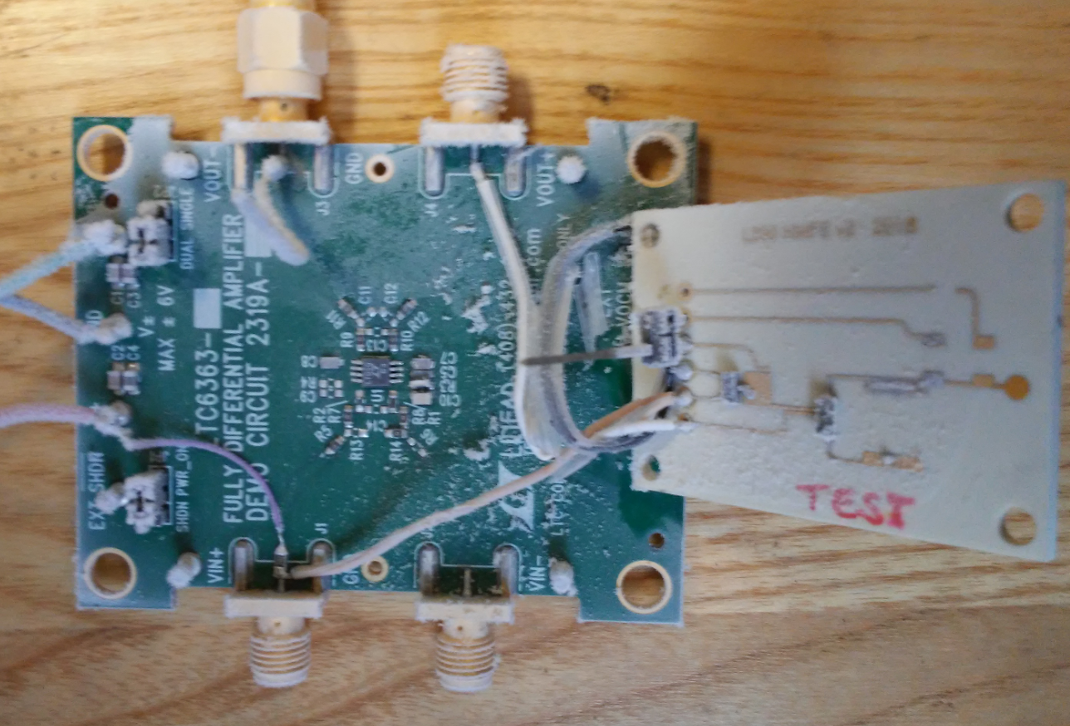
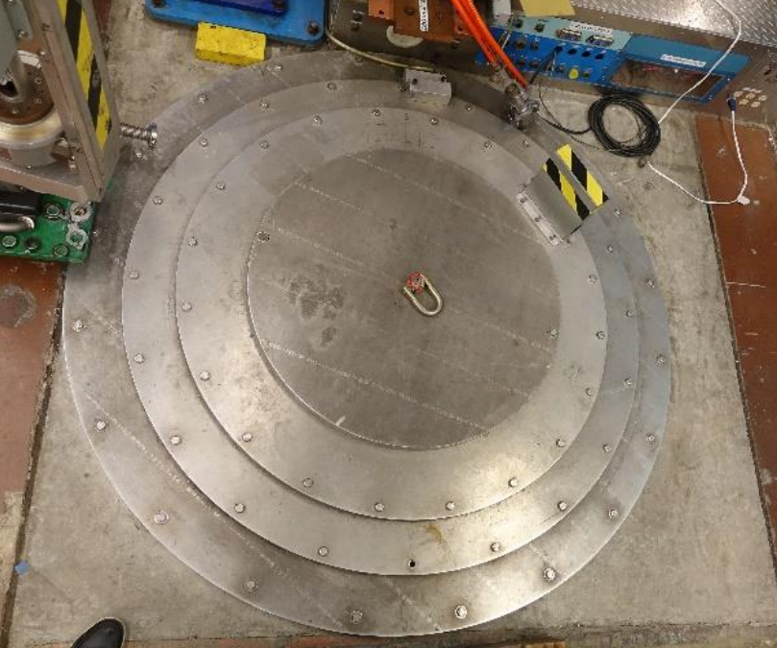
Systems with COTS cryogenic components
LN Test
ADCs
  24b / 20kSPS
  12b / 10MSPS
  4b / 500MSPS
Amplifiers (up to 500MHz)
Diodes (HV protection 1A)
FPGAs (28nm- 45nm)
Laser Diodes Optical Isolators
Voltage Regulators
  LDO and SW capacitor
Transistors
  JFET
  HEMT
  MOSFET
Passives
  Capacitors and resistors
Slow Amplifier
(Acoustic Instrumentation)
LHe Test
Fast Amplifier -500MHz
Basic COTS component

Slide 17
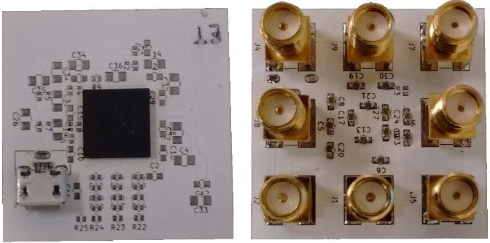
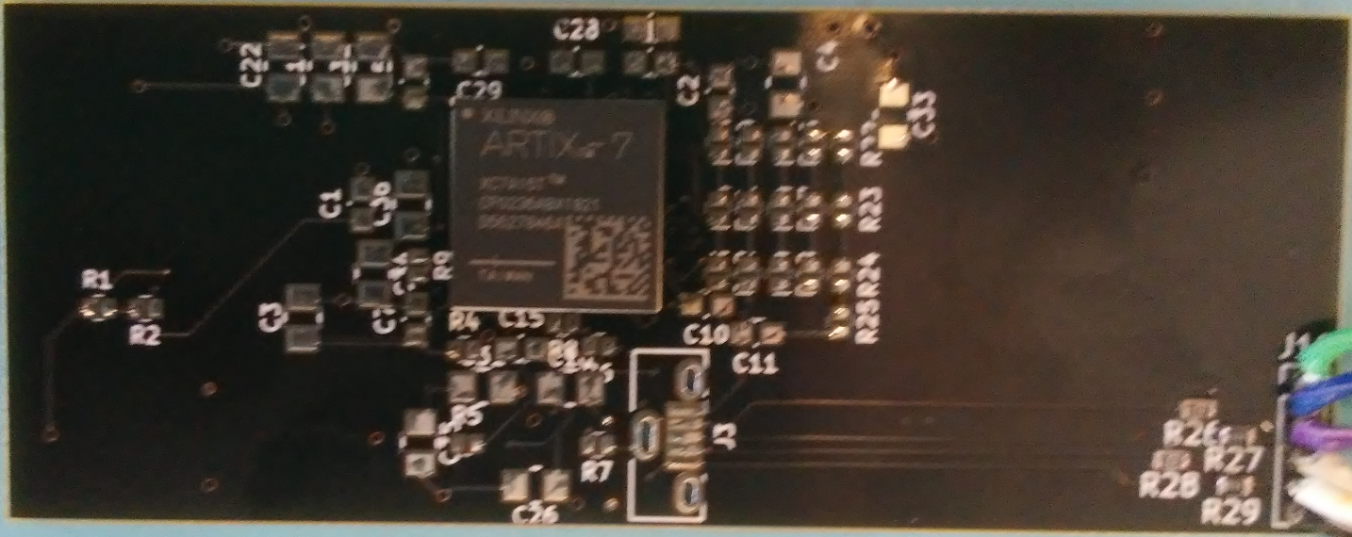
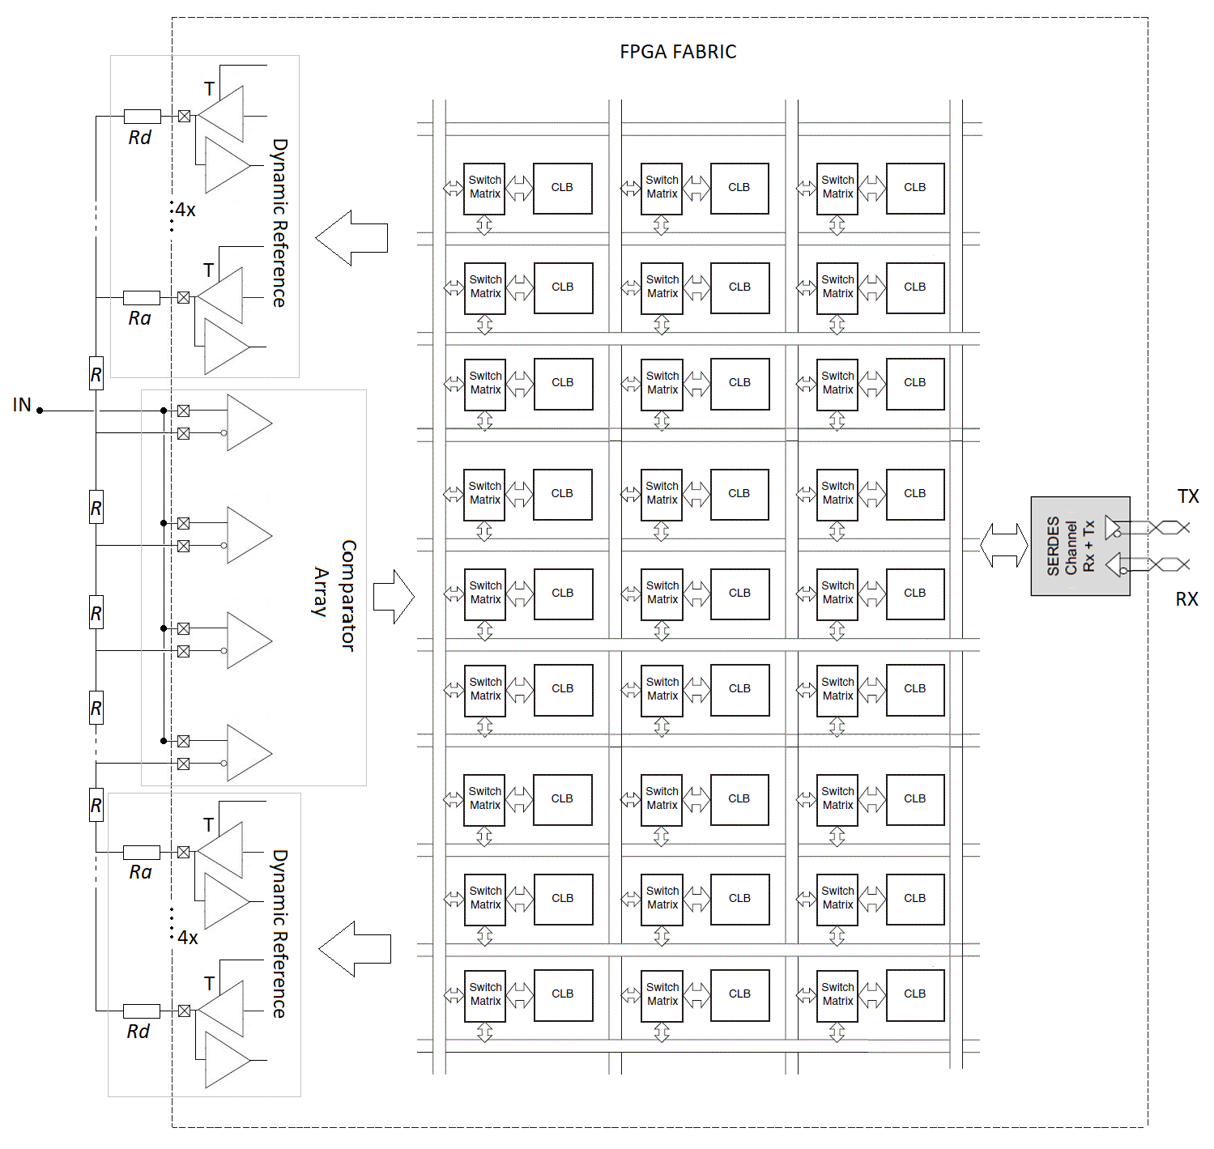
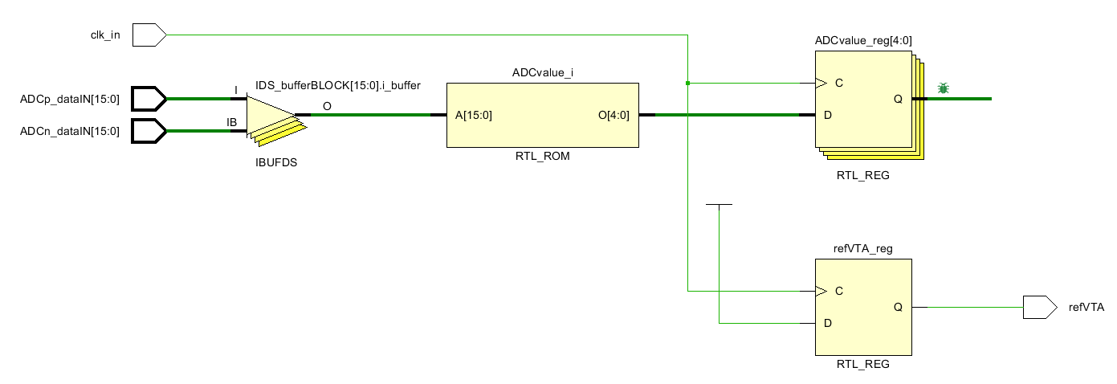
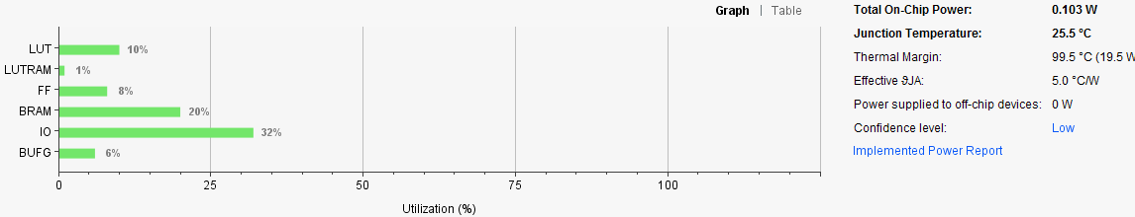
FPGA Based n-bit Analog to Digital Converter
Reconfigurable Flash Folding Architecture. With this architecture it is possible to change the ADC resolution on the fly.

