Slide 1
CERN SM18 test stand news
Marta Bajko, CERN
June 2019

Slide 2
Content of my talk
SM18 test facility development for HL-LHC
Road Map of construction work
Testing at CERN in SM18
TNA ARIES
Summary

Slide 3
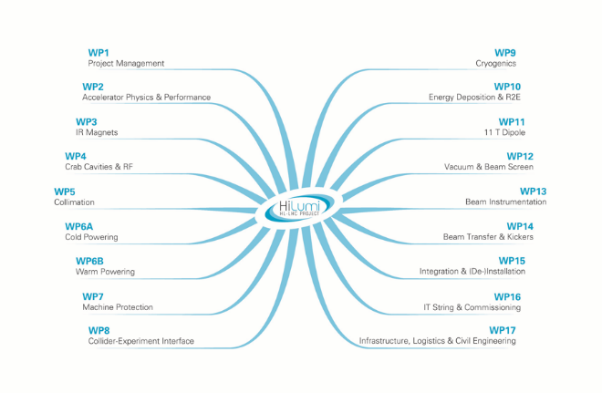
Summary of testing for the HL-LHC
WP3: Test stands are operational for model magnets ( Cluster D and HFM) and ready for prototypes ( Cluster A),
Yet to be built on both the HFM and Cluster D the secondary low current circuits with EE for correctors ; upgrade Cl A with low current and CL for 2 kA, build a second test stand (Cluster F) to insure redundancy and reduce risk needed for 2020. Interfaces with mechanical and hydraulically connections are needed for D1, D2 also!
WP11: Test stand is operational for model magnets and the modifications are ongoing for the prototype and series measurements. To be completed this year.
WP6A: Test stands for SC Link demonstrator ( 60 m) is operational for cryostat testing.
Identified test stations for measurement of series component (leads and SC Links). Conceptual work started. Detailed and design work to follow - 2018 and 2019
WP16: Test stand for HL-LHC IT STRING is in preparation.
WP7: QPS system implemented for parallel working conditions with present protection system on cluster D.
Is planned to be implemented this year on Cluster C in the same way before implementing for 2020 exclusively that system on Cluster F.
Demineralised water, new overhead crane and new control room are operational.
Primary water, cryogenic cooling and the upgrade of the whole electrical distribution is ongoing. Operation foreseen 2019.
Pumping capacity upgrade is proven that is needed. Strategy is in place.

Slide 4
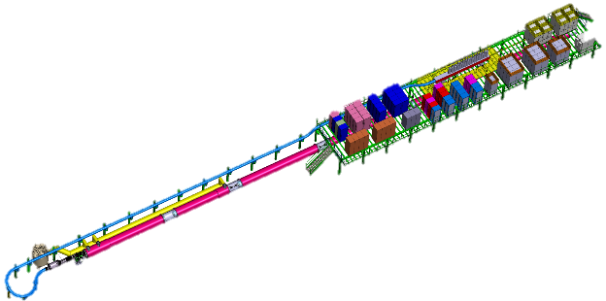
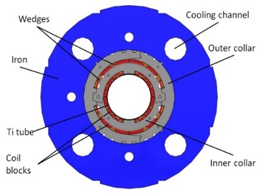
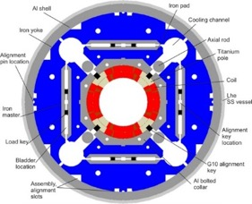
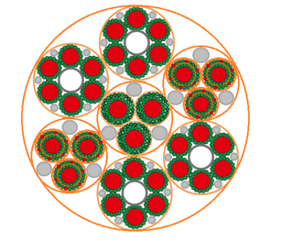
Road Map of SM18 test benches: 2018-2020
HFM and Cluster D for Q2 and D2 corrector magnets with two circuits (WP3)
Bench A1 for Q2 type cryo magnets
( WP3)
Cluster J for HL-LHC IT STRING ( WP16)
Cluster G
Cluster D
Cluster J
Cluster A
Feed Box for CL test on Cluster G (WP6A)
Modify for CL
Install secondary circuit (structure, WCC, EE)
Install secondary circuits for 2 kA
(CC, PC, EE, CL)
Change CL in the feed box, install CC and PC of 2 kA
Service upgrade:
He Liquefier
Transformer
Water cooling
Install 20 kA, 2kA PC, WCC, CC, EE, structure, DFX, DFH, QDS
Modify QDS ( WP11)
Cluster F
Bench F1 for Q2 type cryo magnets and nQDS
(WP3/ WP7)
Bench F2 for Sc link and nQDS
( WP6A/WP7)
Safety improvement
Metallic structures for magnet preparation zone Cluster D and G
Secondary circuit for HFM ( metallic structure , WCC, Switch and Dump), Cluster C modification for 11T
Secondary circuit for Cluster D for proto MCBXFA/B (CC, PC, Switch and Dump)
Cluster G Feed Box and diode cryostat modification for CL test
Cluster A, F, B,E for Q2,D2 magnets: PC, CL, WCC,EE
Cluster F for Sc link series
HL-LHC IT STRING
June 2018
Summer 2018
Mid 2019
Mid 2019
February 2020
End 2020
January 2021

Slide 5
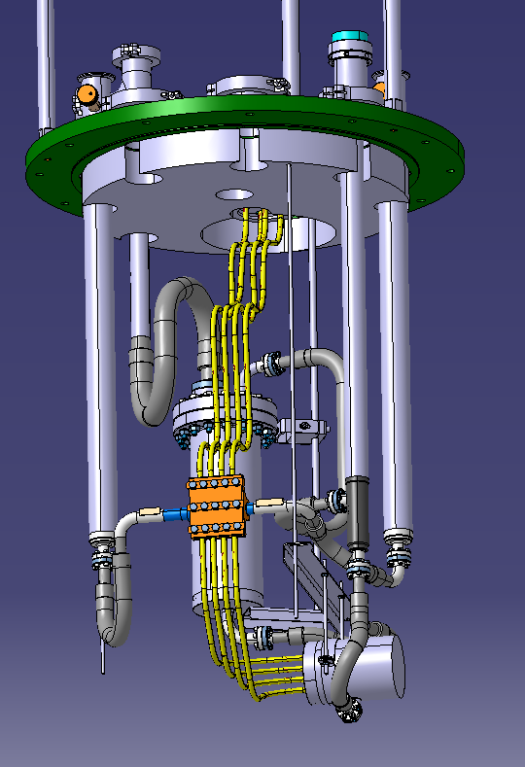
Cluster G development
HFM and Cluster D for Q2 and D2 corrector magnets with two circuits (WP3)
Cluster G
Cluster D
Cluster J
Cluster A
Feed Box for CL test on Cluster G (WP6A)
Modify for CL
Install secondary circuit (structure, WCC, EE)
Install secondary circuits for 2 kA
(CC, PC, EE, CL)
Change CL in the feed box, install CC and PC of 2 kA
Install 20 kA, 2kA PC, WCC, CC, EE, structure, DFX, DFH, QDS
Modify QDS ( WP11)
Cluster F
Metallic structures for magnet preparation zone Cluster D and G
Secondary circuit for HFM ( metallic structure , WCC, Switch and Dump), Cluster C modification for 11T
Secondary circuit for Cluster D for proto MCBXFA/B (CC, PC, Switch and Dump)
Cluster G Feed Box and diode cryostat modification for CL test
Cluster A, F, B,E for Q2,D2 magnets: PC, CL, WCC,EE
Cluster F for Sc link series
HL-LHC IT STRING
June 2018
Summer 2018
Mid 2019
Mid 2019
February 2020
End 2020
January 2021

Slide 6
Cluster A and F development for magnets
Bench A1 for Q2 type cryo magnets
( WP3)
Cluster G
Cluster D
Cluster J
Cluster A
Modify for CL
Install secondary circuit (structure, WCC, EE)
Install secondary circuits for 2 kA
(CC, PC, EE, CL)
Change CL in the feed box, install CC and PC of 2 kA
Install 20 kA, 2kA PC, WCC, CC, EE, structure, DFX, DFH, QDS
Modify QDS ( WP11)
Cluster F
Bench F1 for Q2 type cryo magnets and nQDS
(WP3/ WP7)
Metallic structures for magnet preparation zone Cluster D and G
Secondary circuit for HFM ( metallic structure , WCC, Switch and Dump), Cluster C modification for 11T
Secondary circuit for Cluster D for proto MCBXFA/B (CC, PC, Switch and Dump)
Cluster G Feed Box and diode cryostat modification for CL test
Cluster A, F, B,E for Q2,D2 magnets: PC, CL, WCC,EE
Cluster F for Sc link series
HL-LHC IT STRING
June 2018
Summer 2018
Mid 2019
Mid 2019
February 2020
End 2020
January 2021

Slide 7
Cluster F development for superconducting links
Cluster G
Cluster D
Cluster J
Cluster A
Modify for CL
Install secondary circuit (structure, WCC, EE)
Install secondary circuits for 2 kA
(CC, PC, EE, CL)
Change CL in the feed box, install CC and PC of 2 kA
Install 20 kA, 2kA PC, WCC, CC, EE, structure, DFX, DFH, QDS
Modify QDS ( WP11)
Cluster F
Bench F2 for Sc link and nQDS
( WP6A/WP7)
Metallic structures for magnet preparation zone Cluster D and G
Secondary circuit for HFM ( metallic structure , WCC, Switch and Dump), Cluster C modification for 11T
Secondary circuit for Cluster D for proto MCBXFA/B (CC, PC, Switch and Dump)
Cluster G Feed Box and diode cryostat modification for CL test
Cluster A, F, B,E for Q2,D2 magnets: PC, CL, WCC,EE
Cluster F for Sc link series
HL-LHC IT STRING
June 2018
Summer 2018
Mid 2019
Mid 2019
February 2020
End 2020
January 2021

Slide 8
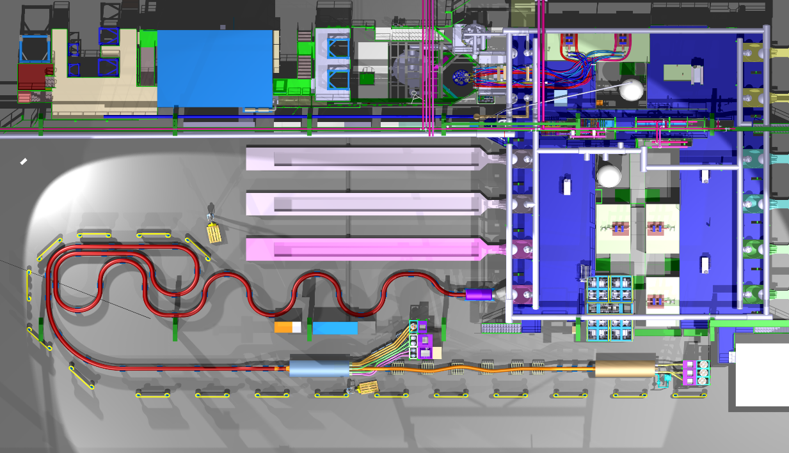
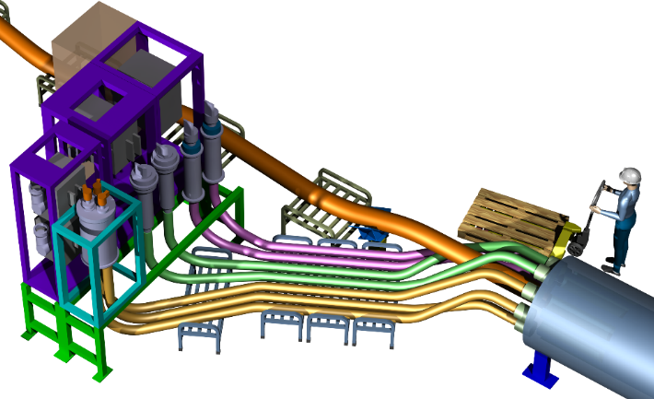
Cluster F development for superconducting links
Cluster G
Cluster D
Cluster J
Cluster A
Cluster D
Modify for CL
Install secondary circuit (structure, WCC, EE)
Cluster E
Install secondary circuits for 2 kA
(CC, PC, EE, CL)
Change CL in the feed box, install CC and PC of 2 kA
SC Link
Alim 13 kA
Cluster E
Cluster F
DFX
Alim 13 kA
Cluster C
Install 20 kA, 2kA PC, WCC, CC, EE, structure, DFX, DFH, QDS
Alim 20 kA
Cluster F
Modify QDS ( WP11)
Cluster F
6 x 2kA
Current leads
2 x 18kA
2 x 13kA
3 x 7kA
SC Link 17m
TOP VIEW
DFHx
Module 1
DFHx
Module 2
Réchauffeur
This will allow us to test the Sc Link systems
Metallic structures for magnet preparation zone Cluster D and G
Secondary circuit for HFM ( metallic structure , WCC, Switch and Dump), Cluster C modification for 11T
Secondary circuit for Cluster D for proto MCBXFA/B (CC, PC, Switch and Dump)
Cluster G Feed Box and diode cryostat modification for CL test
Cluster A, F, B,E for Q2,D2 magnets: PC, CL, WCC,EE
Cluster F for Sc link series
HL-LHC IT STRING
June 2018
Summer 2018
End 2018
Mid 2019
February 2020
End 2020
January 2021
Service UPG

Slide 9
HL-LHC IT STRING test stand and service upgare
Cluster J for HL-LHC IT STRING ( WP16)
Cluster G
Cluster D
Cluster J
Cluster A
Modify for CL
Install secondary circuit (structure, WCC, EE)
Install secondary circuits for 2 kA
(CC, PC, EE, CL)
Change CL in the feed box, install CC and PC of 2 kA
Service upgrade:
He Liquefier
Transformer
Water cooling
Install 20 kA, 2kA PC, WCC, CC, EE, structure, DFX, DFH, QDS
Modify QDS ( WP11)
Cluster F
See the dedicated presentation on this subject
Safety improvement
Metallic structures for magnet preparation zone Cluster D and G
Secondary circuit for HFM ( metallic structure , WCC, Switch and Dump), Cluster C modification for 11T
Secondary circuit for Cluster D for proto MCBXFA/B (CC, PC, Switch and Dump)
Cluster G Feed Box and diode cryostat modification for CL test
Cluster A, F, B,E for Q2,D2 magnets: PC, CL, WCC,EE
Cluster F for Sc link series
HL-LHC IT STRING
June 2018
Summer 2018
Mid 2019
Mid 2019
February 2020
End 2020
January 2021

Slide 10
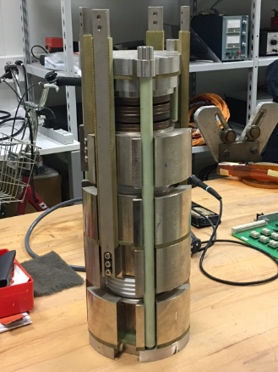
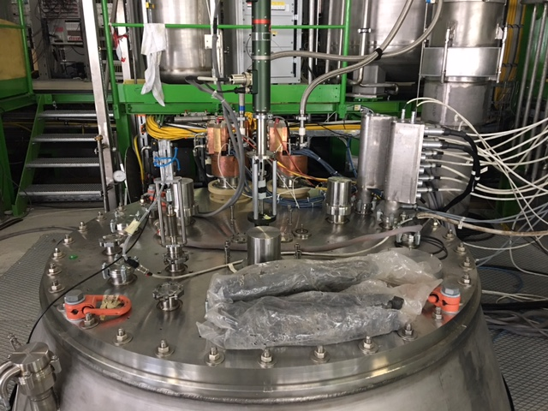
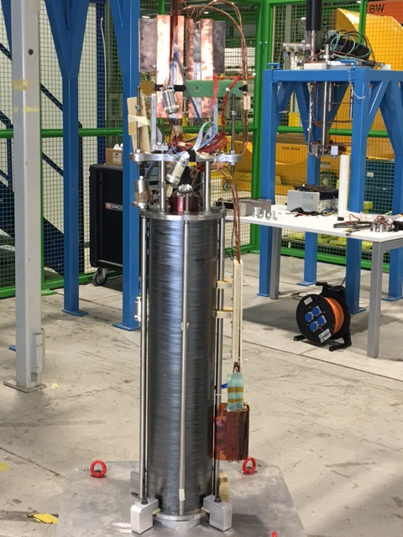
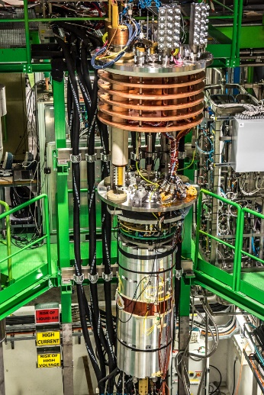
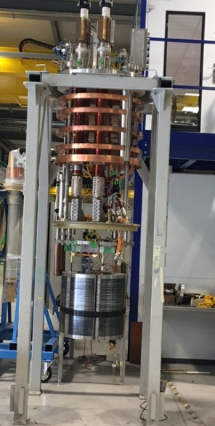
Testing in SM18
We do in average 40 test per year with an increase in capacity of up to 20-30% per year
LONG
Diodes and Leads
Siegtal
HFM
Cluster D

Slide 11
Trans National Access @ CERN MagNet within ARIES

Slide 12
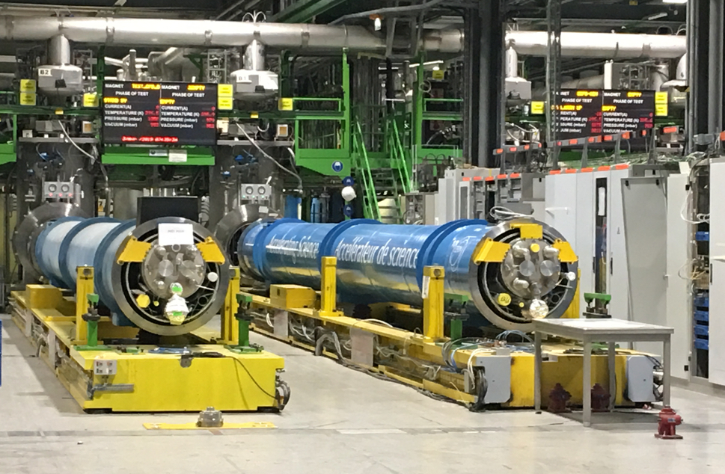
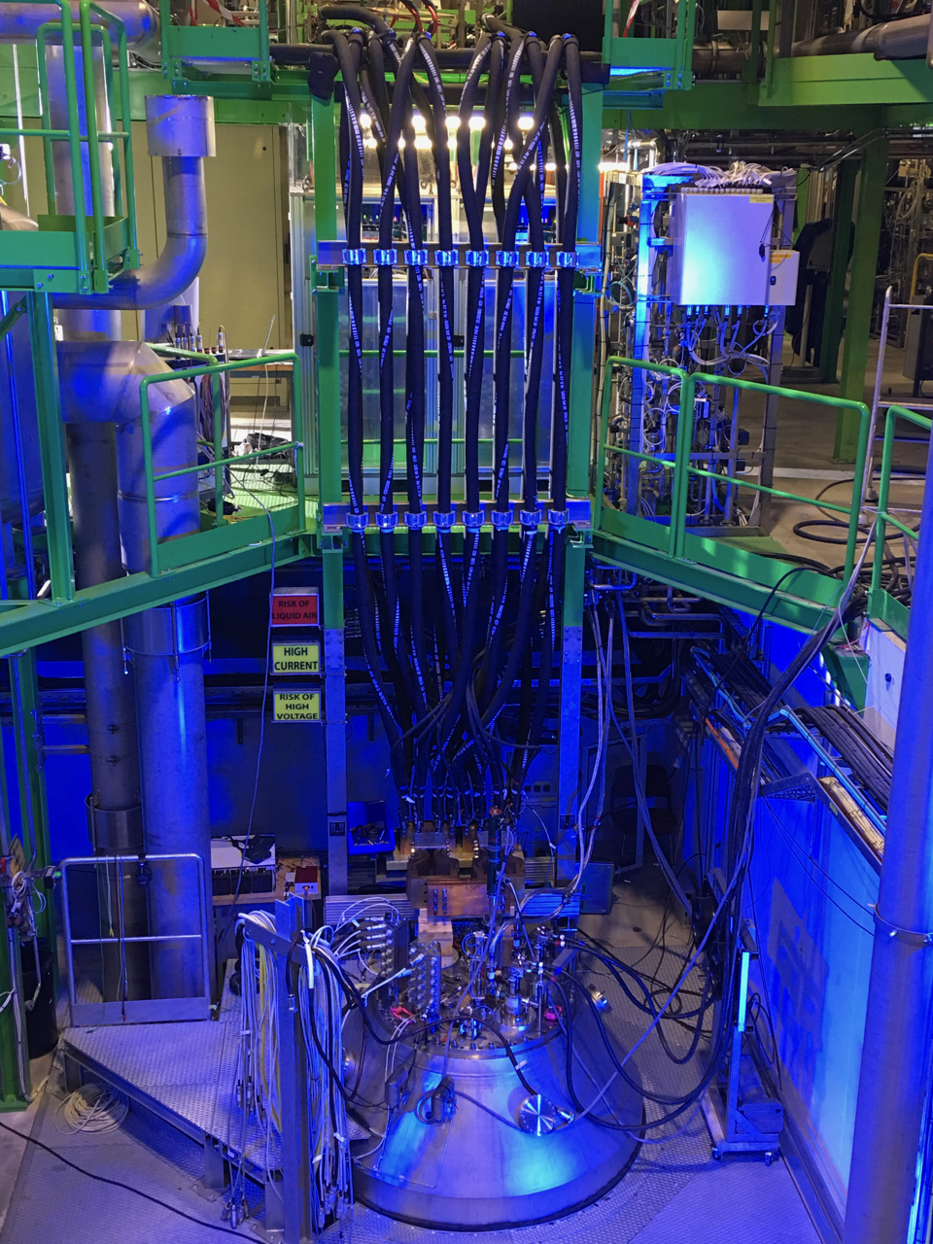
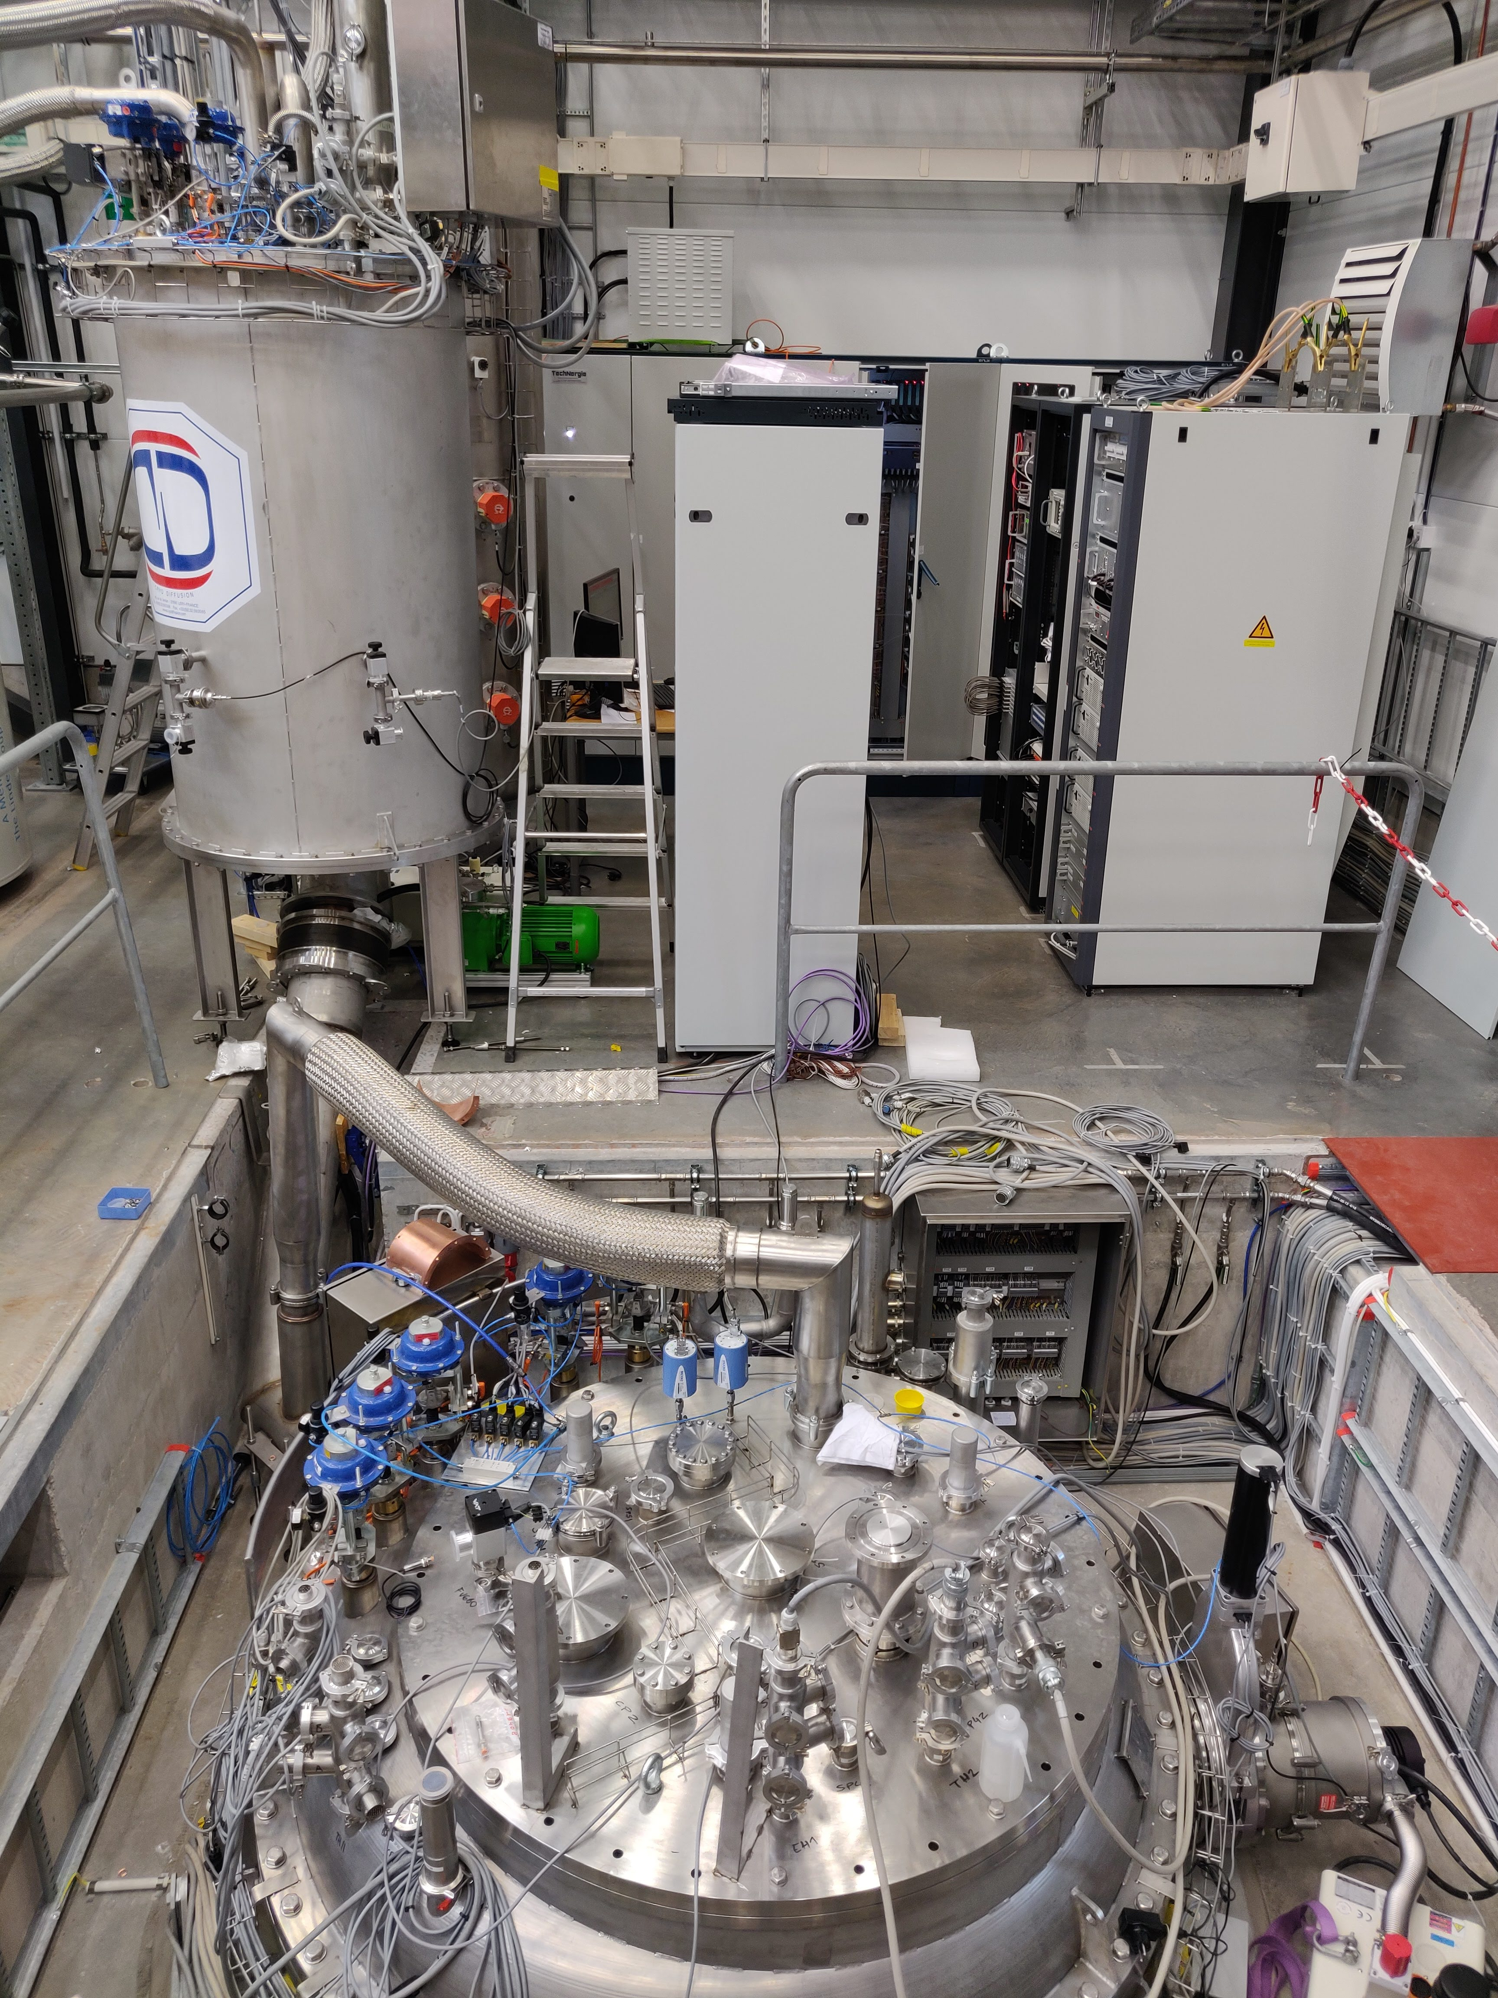
WP9 – TNA : MagNet
5 projects were submitted for approval
4 approved and 1 in evaluation process
4 of them has been already performed tests
TNA is composed by two laboratories: CERN ( CH) and FREIA (S).
MagNet (@CERN) is operational
GERSEMI (@FREIA) is starting Hardware Commissioning with possible testing by the end of the year.
Facility | No. of projects Y1 | Total no. of projects Annex 1 | No. of users Y1 | Total no. of users Annex 1 | No. of access units Y1 | Total no. of access units Annex 1
MagNet | 4 | 8 | 27 | 40 | 944 | 1,920
Gersemi | 0 | 8 | 0 | 56 | 0 | 2,880

Slide 13
Summary
CERN SM18 test facility is essentially developed for the HL –LHC project but
We do test for ATIRES TNA project for external members also
Our installations covers test stand for :
Superconducting magnets
Superconducting and normal conducting current leads
Superconducting links
HL-LHC IT STRING
Construction work is still ongoing till end 2020 in SM18
Today 5 vertical test stands, 8 horizontal benches and 1 feed box is operational
A cryogenic liquid production is under upgrade and we expect 35 g/s extra wrt 25 g/s we have today from 2020
The operation is ongoing in parallel with the upgrade and construction work

