Slide 1
News from the FREIA Test Facility
3rd International Workshop of the Superconducting Magnets Test Stand
Kévin Pepitone
Uppsala, June 11-12, 2019

Slide 2
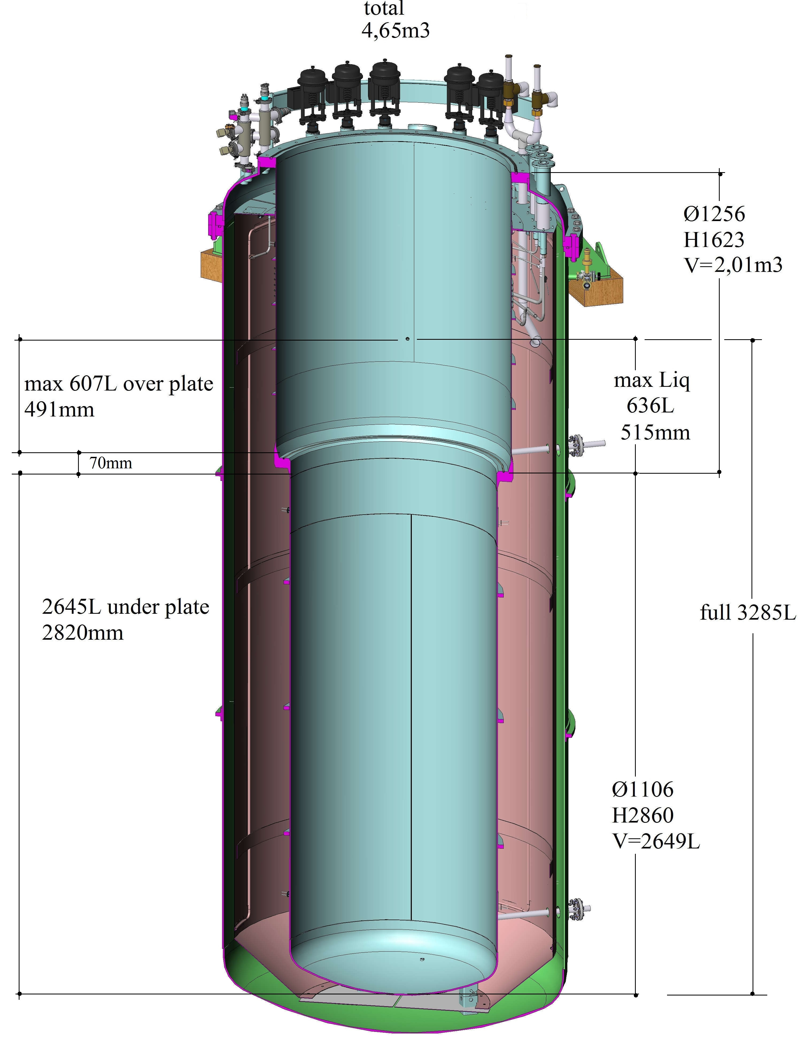
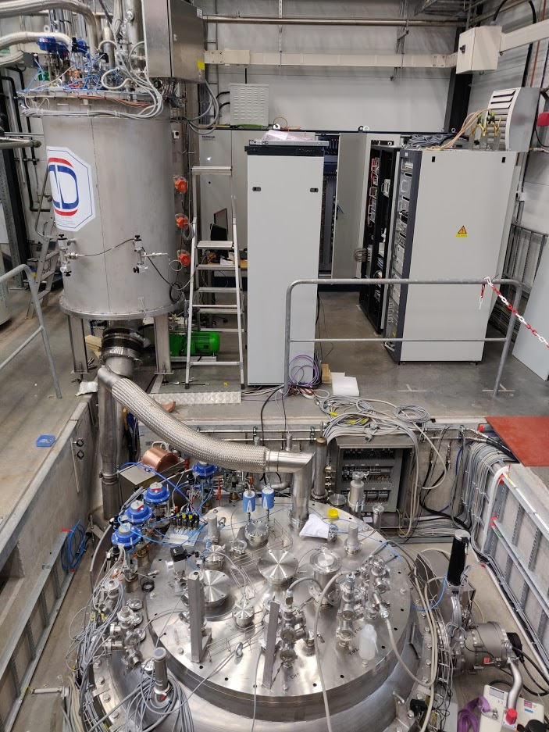
GERSEMI – Vertical cryostat
Test of SC cavities & magnets
  3.2m x ø1.1m total volume
  2.65m x ø1.1m below lambda plate
    design includes joint for lambda plate
Three operation modes
  vacuum
  liquid (saturated) bath
  pressurized bath
  with 2K heat exchanger

Slide 3
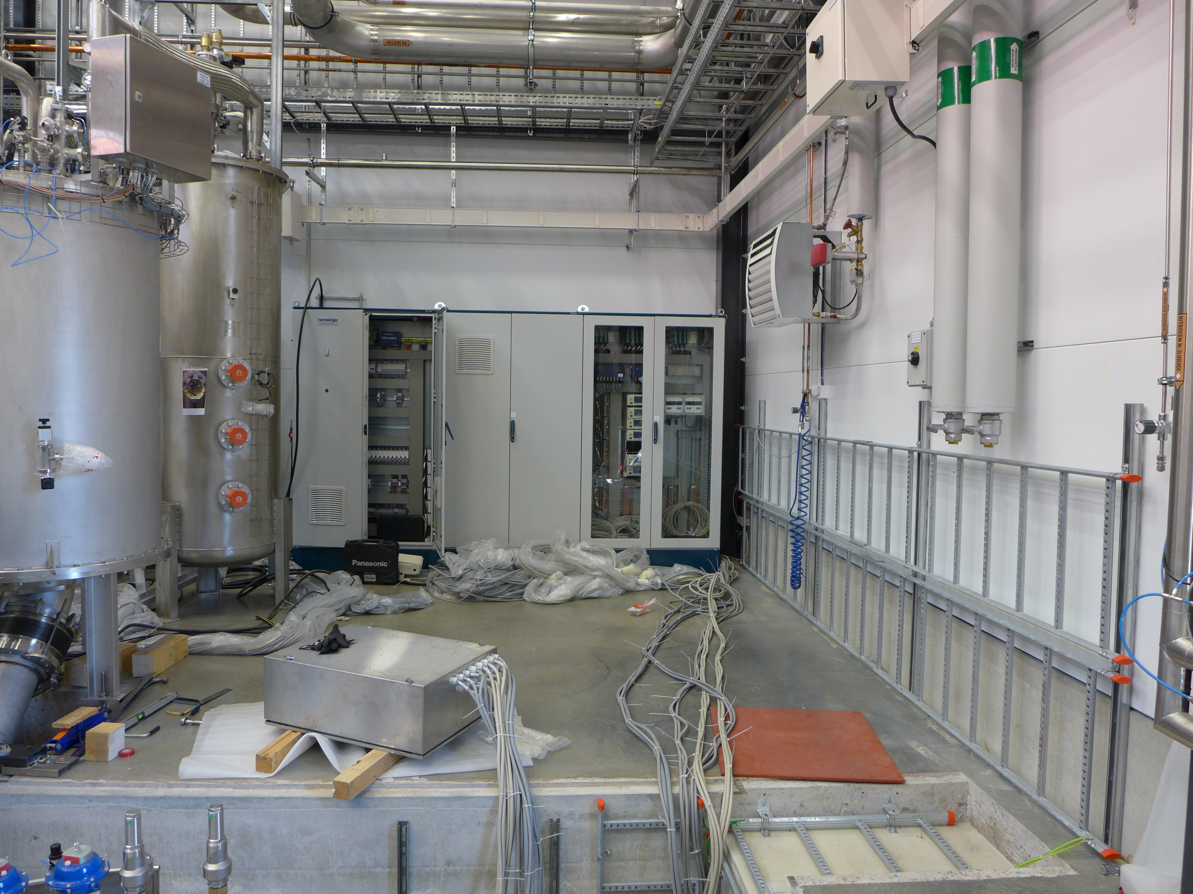
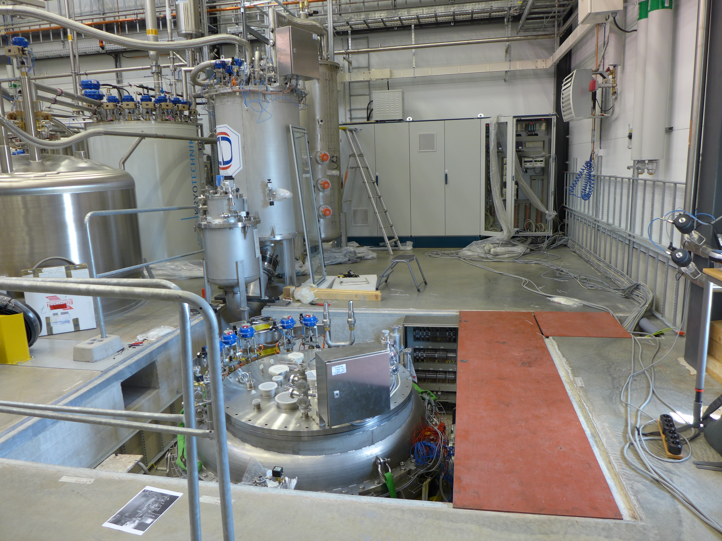
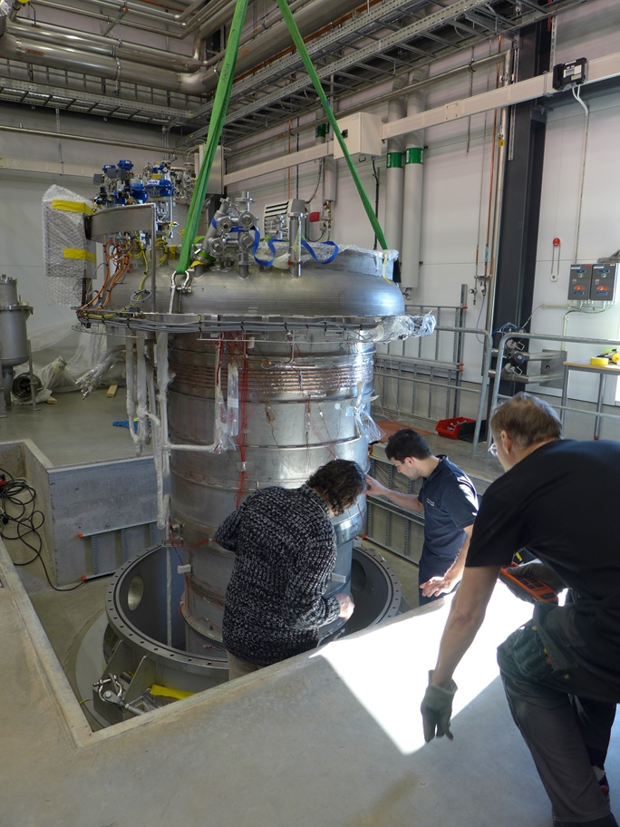
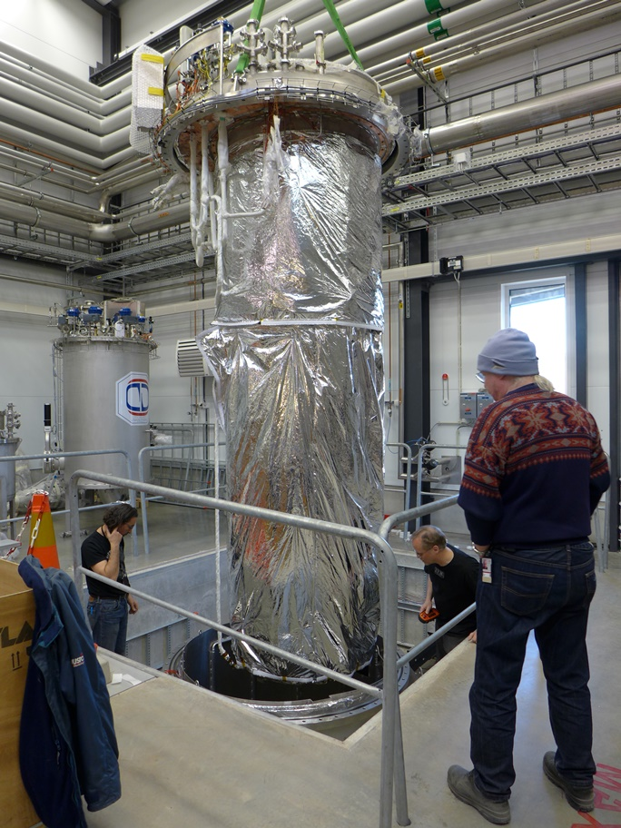
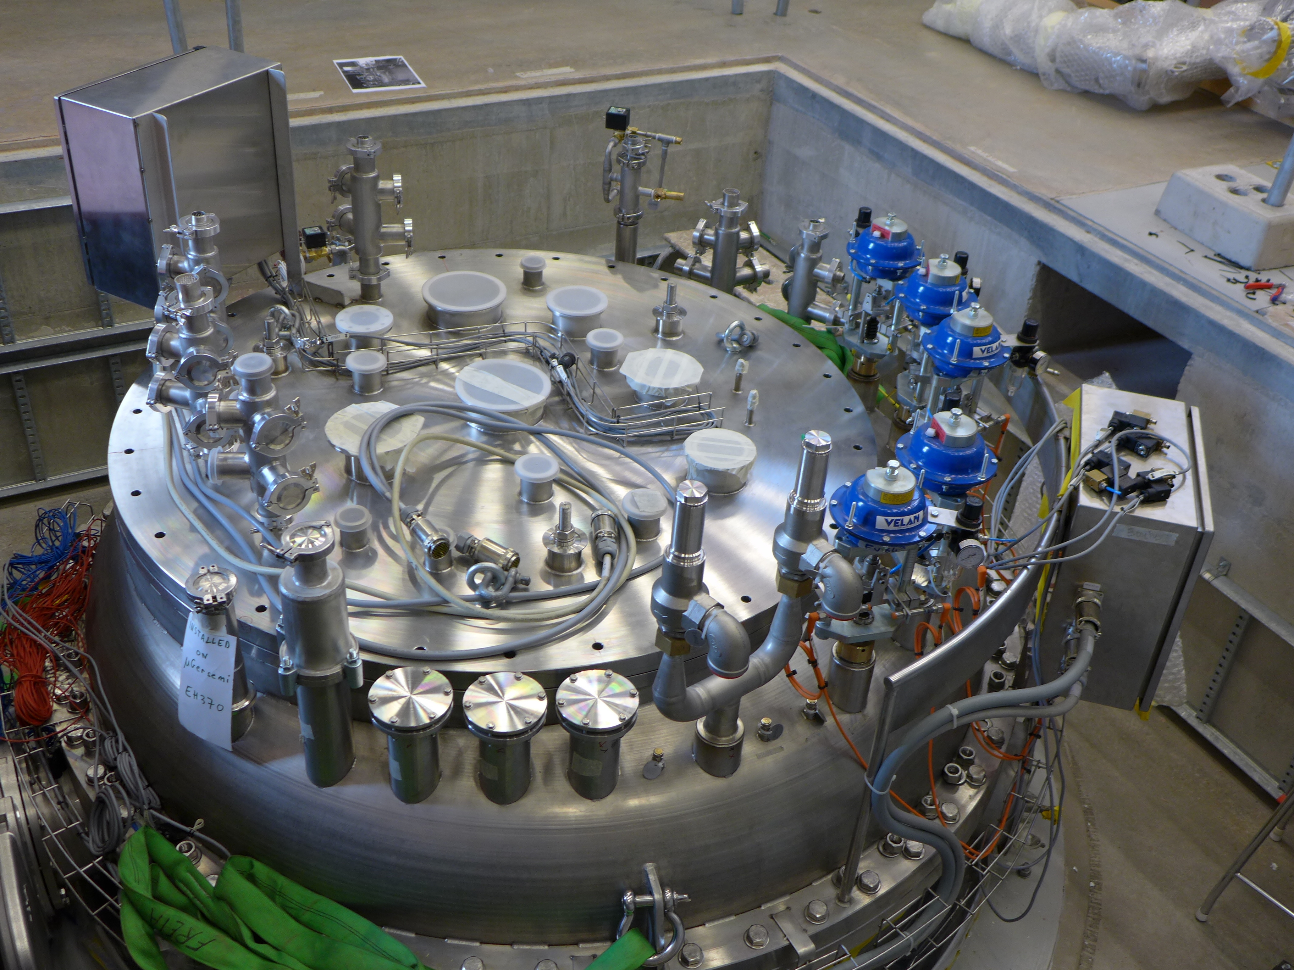
GERSEMI - Cryostat re-assembly
24-May-2018 (P1040864)
29-May-2018 (P1040868)
21-Mar-2018 (P1040559)
28-Mar-2018
(P1040611)
29-May-2018 (P1040869)

Slide 4
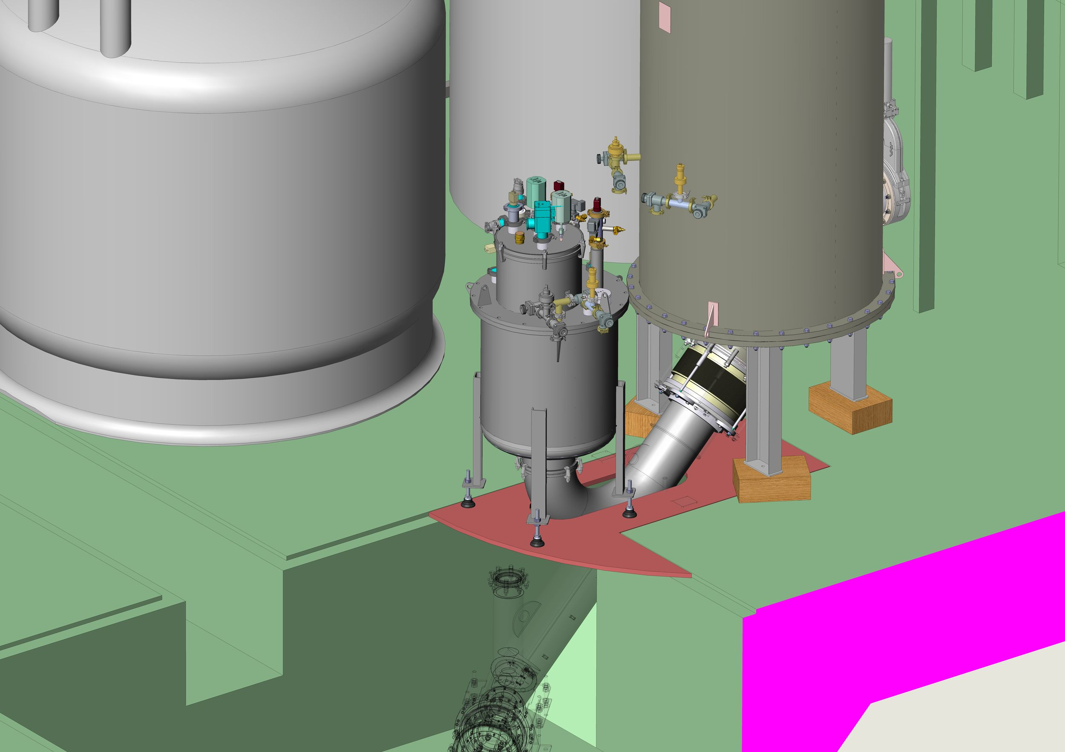
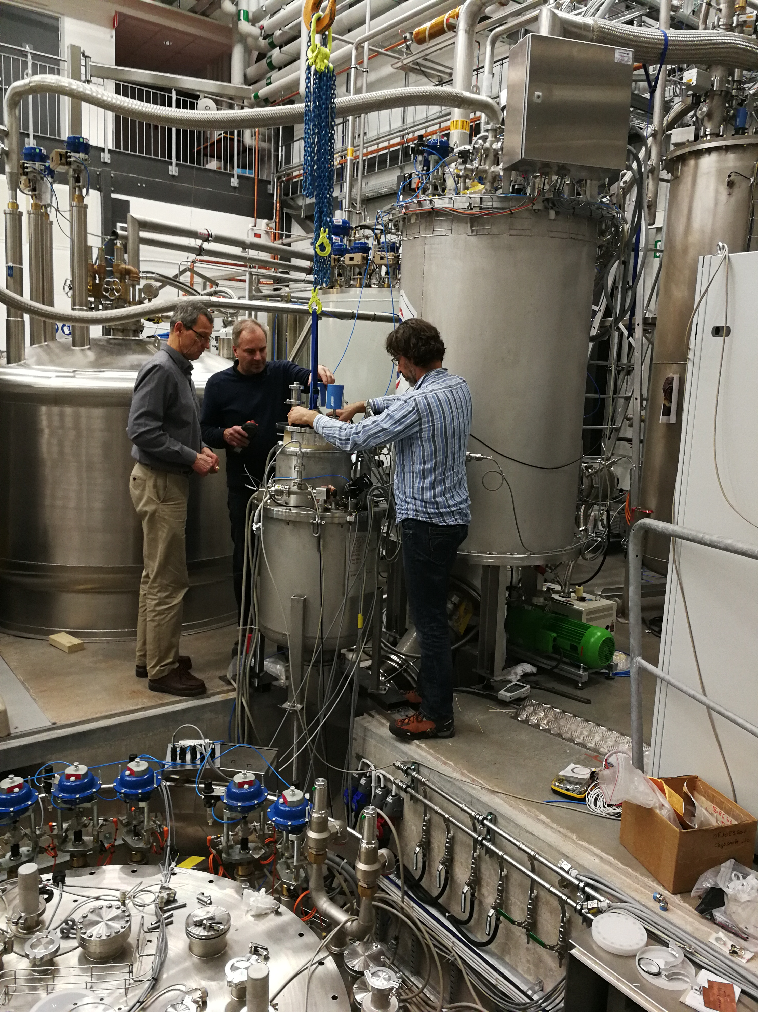
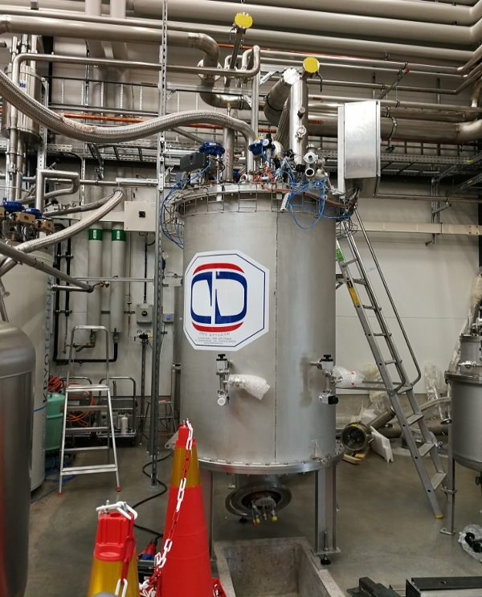
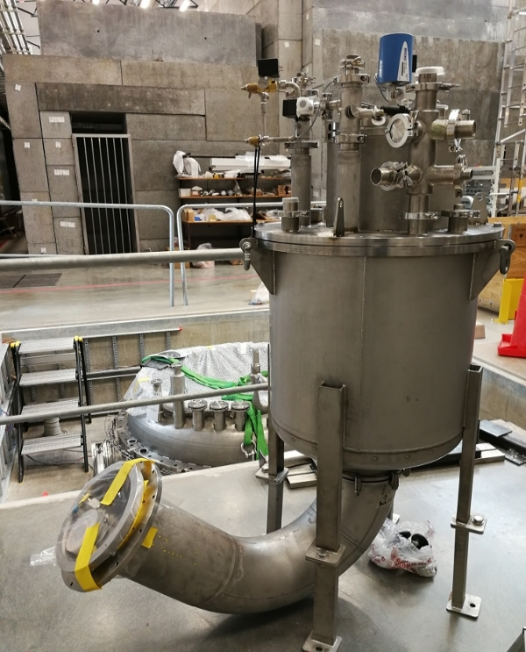
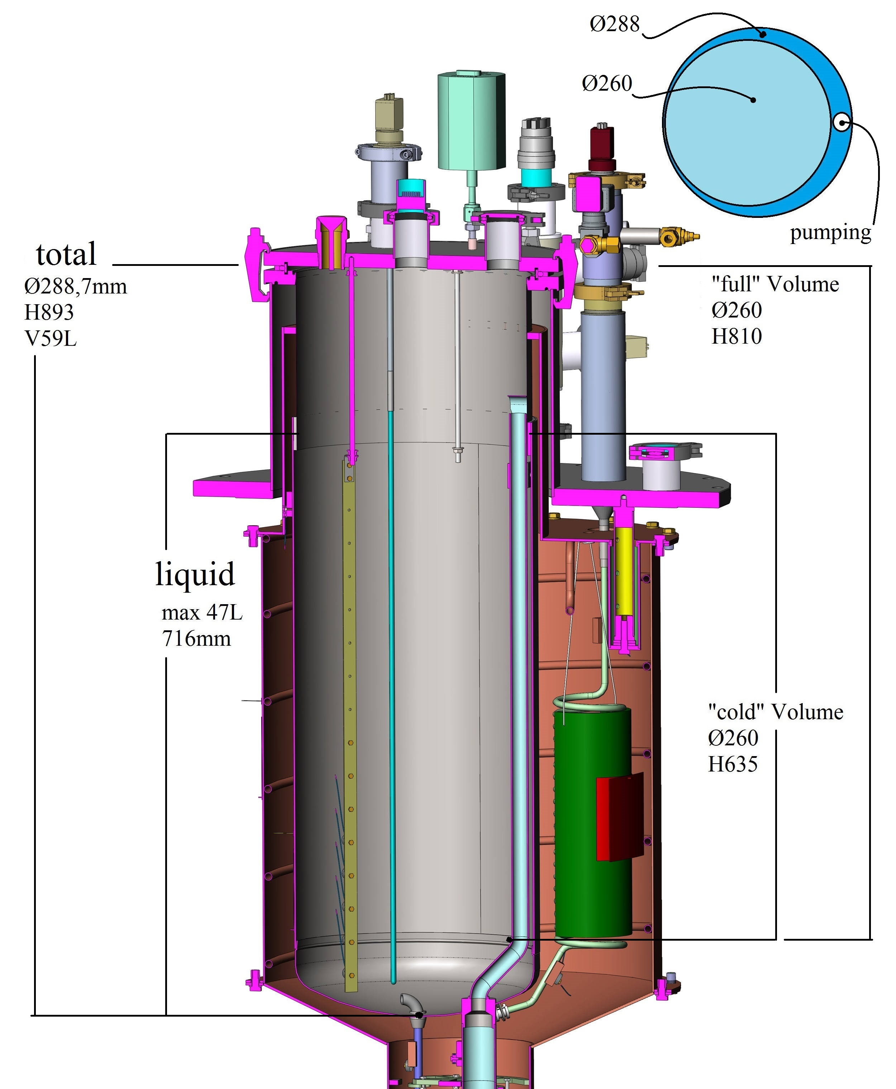
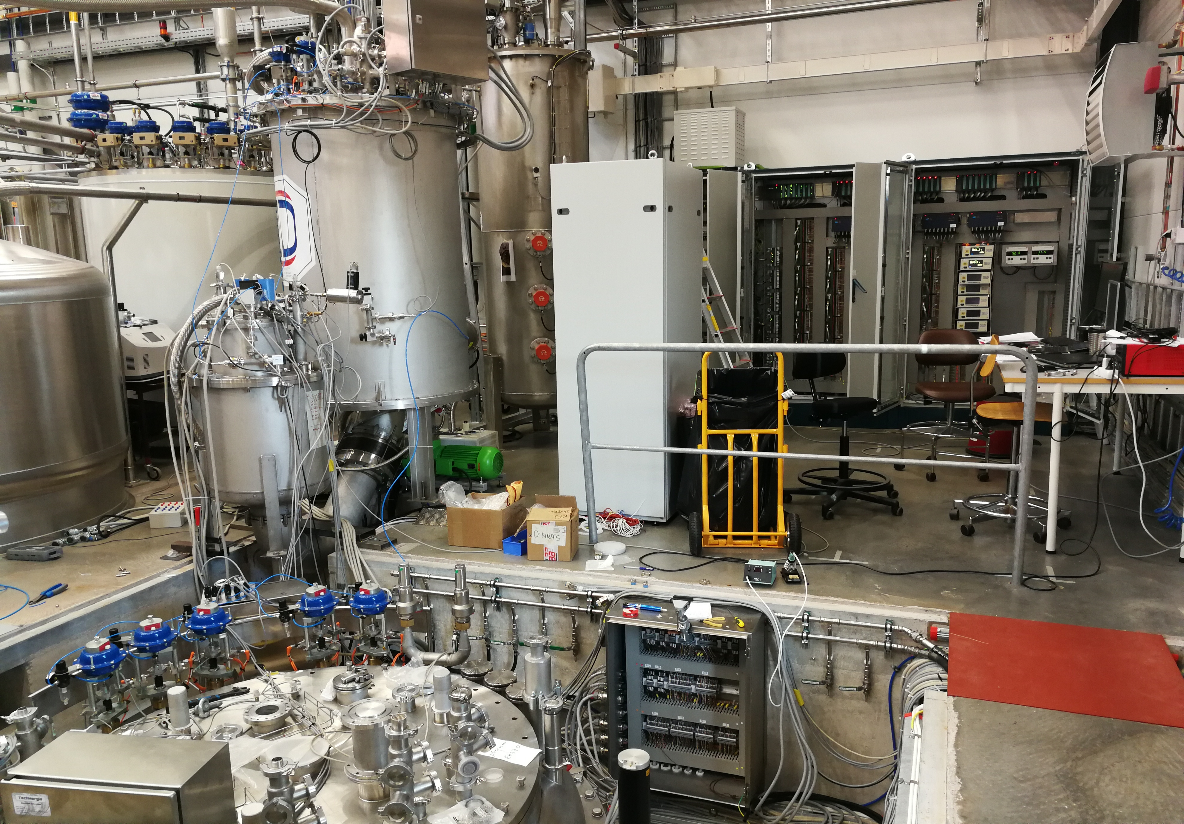
μGERSEMI simulator and valve box
The cryogenic commissioning of the valve box with the simulator was conducted during the period from September 2018 to March 2019.
“µGersemi” simulator
60 l cryostat for system test
“µGersemi” simulator
10-Dec-2018 (151453)
2-May-2018 (100425)
helium distribution
cold box
2-May-2018 (100442)
26-Sept-2018 (160359)

Slide 5
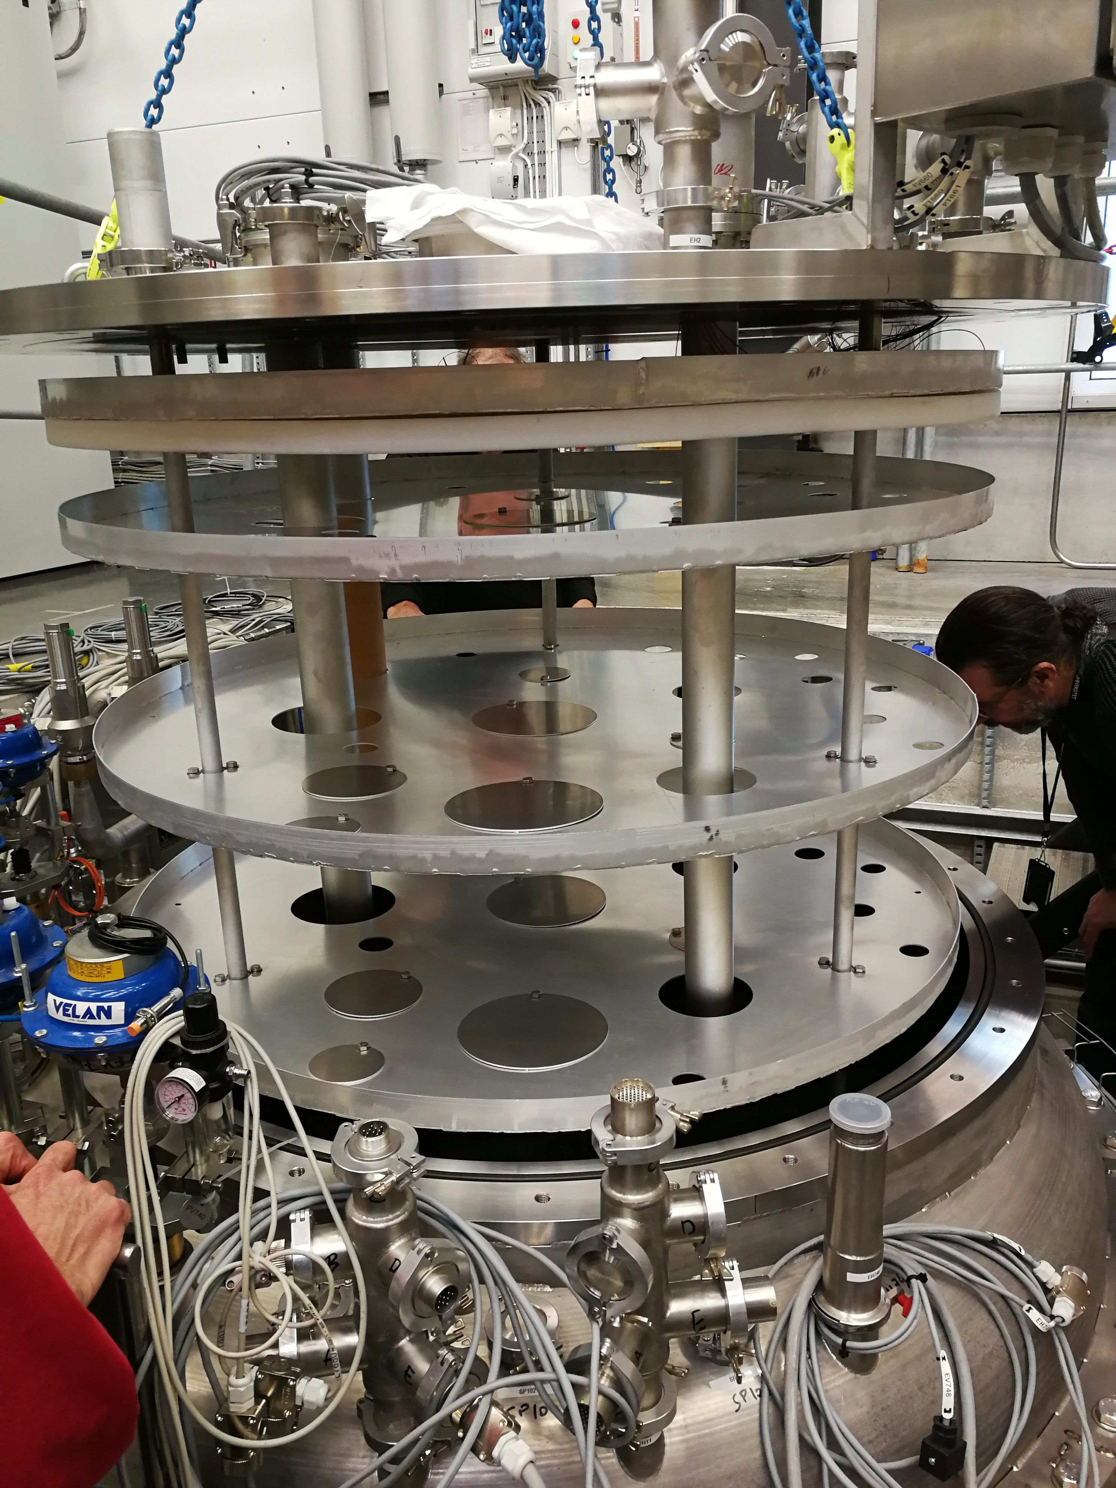
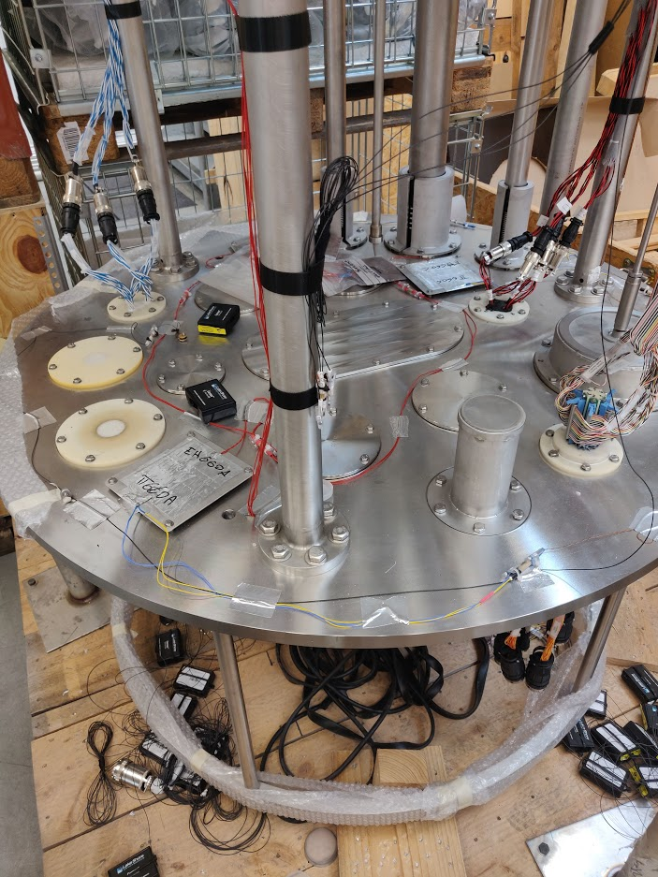
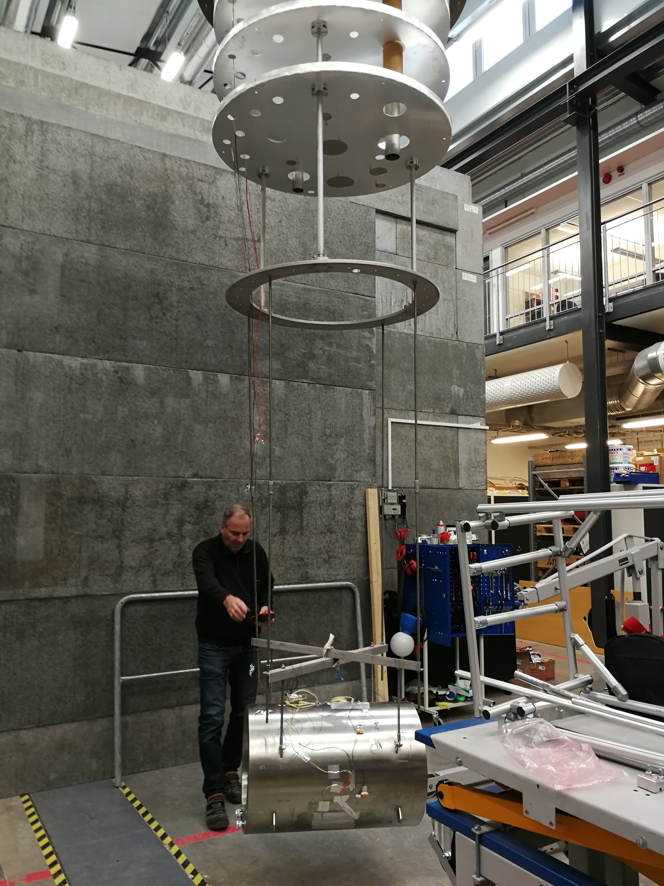
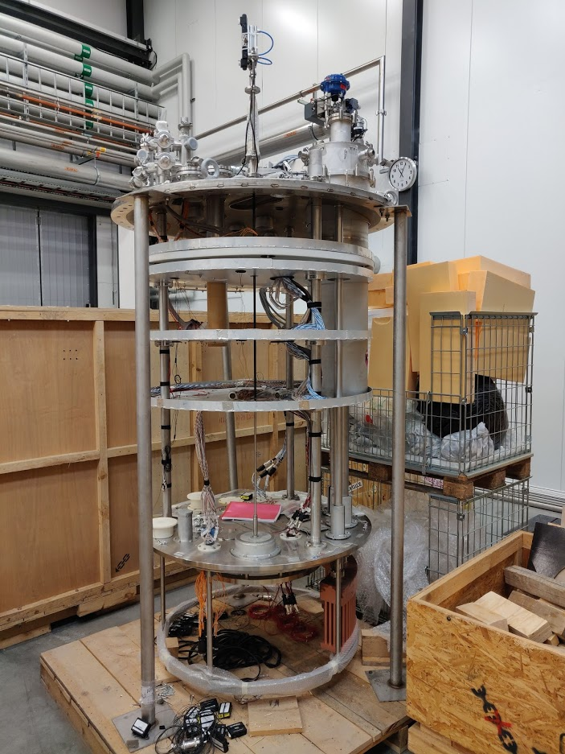
Inserts
Liquid insert
Magnetic insert
19-Mar-19 (135545)
70 sensors (level sensor, CERNOX, Pt100)
2000 connections
5 km of cable
19-Mar-19 (083558)

Slide 6
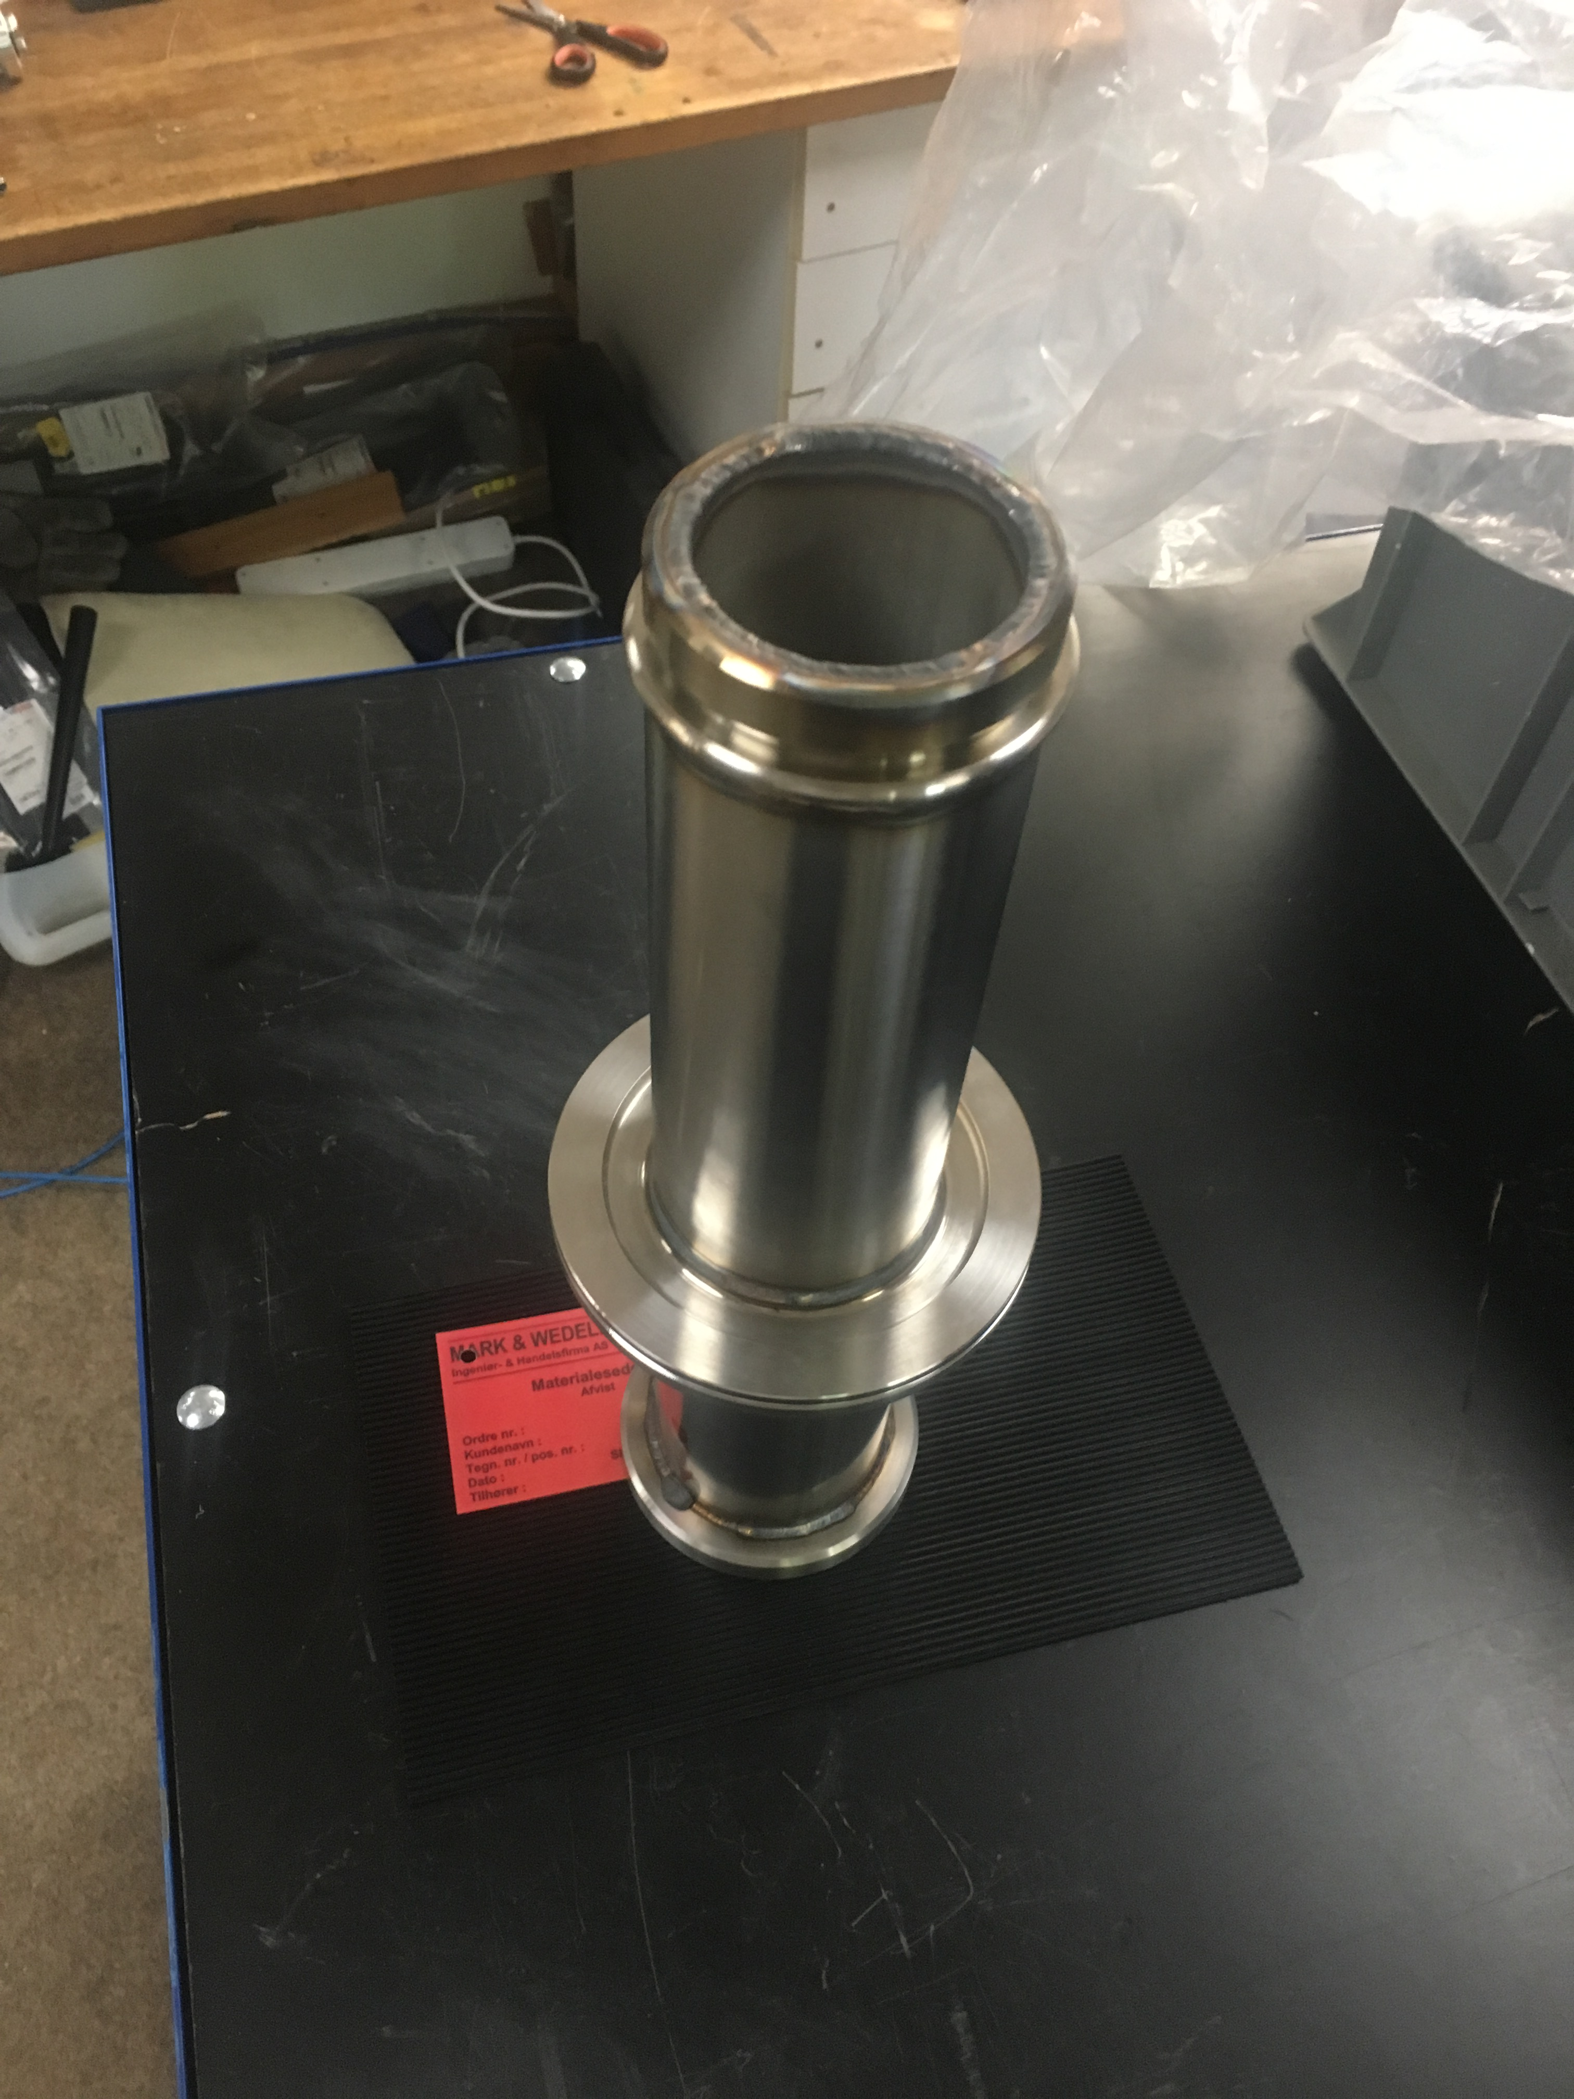
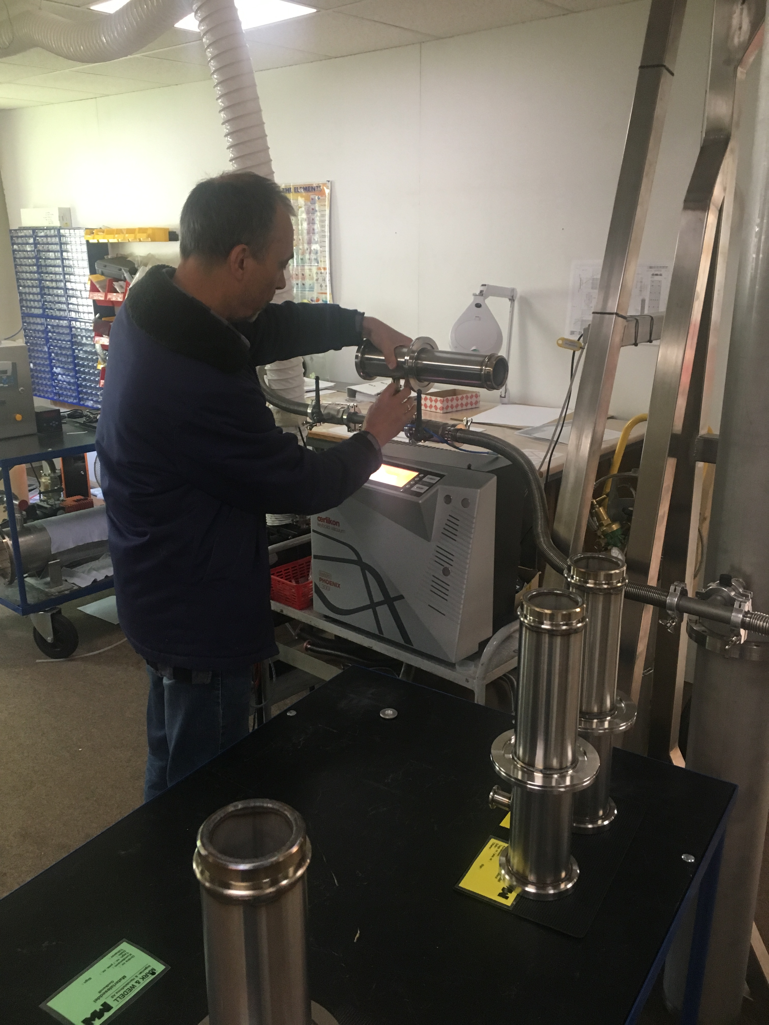
Inserts
Liquid Insert
Magnetic Insert
19-Mar-19 (135545)
70 sensors (level sensor, CERNOX, Pt100)
2000 connections
5 km of cable
19-Mar-19 (083558)

Slide 7

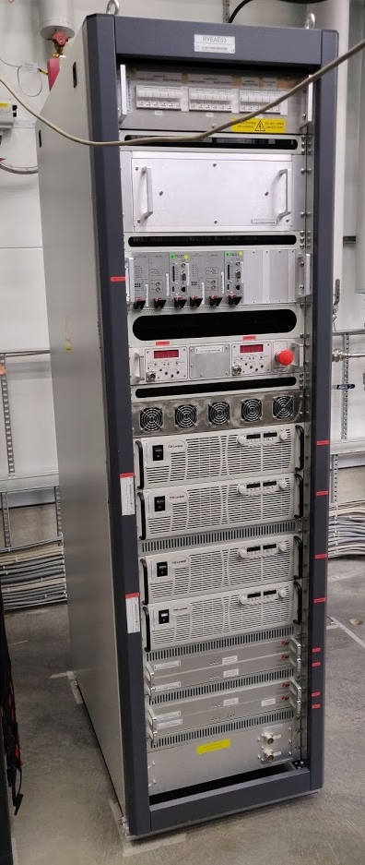
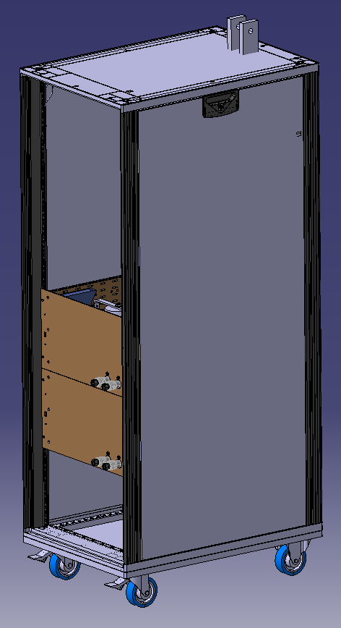
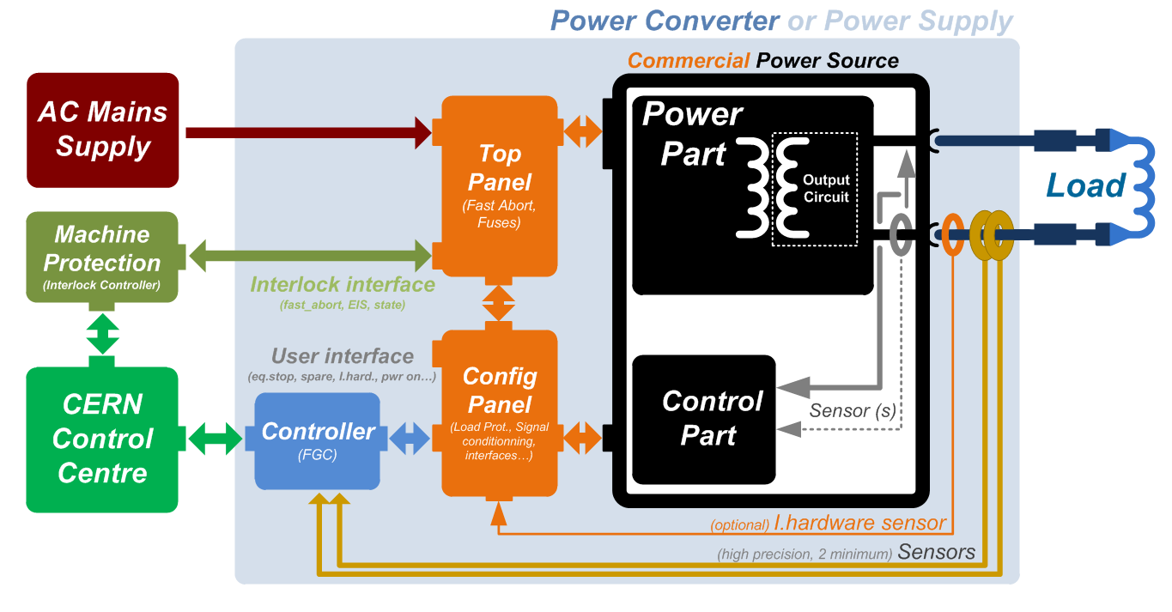
Power converters and Energy extraction
Combo (COMmercial Based cOnverter) Power converter
IGBT based energy extraction
Later this year
Samer Yammine
14:50 Today
Bozhidar Panev
15:15 Today
2 x 2000 A

Slide 8
DAQ and magnet protection
Kévin Pepitone
16:30 Today

Slide 9
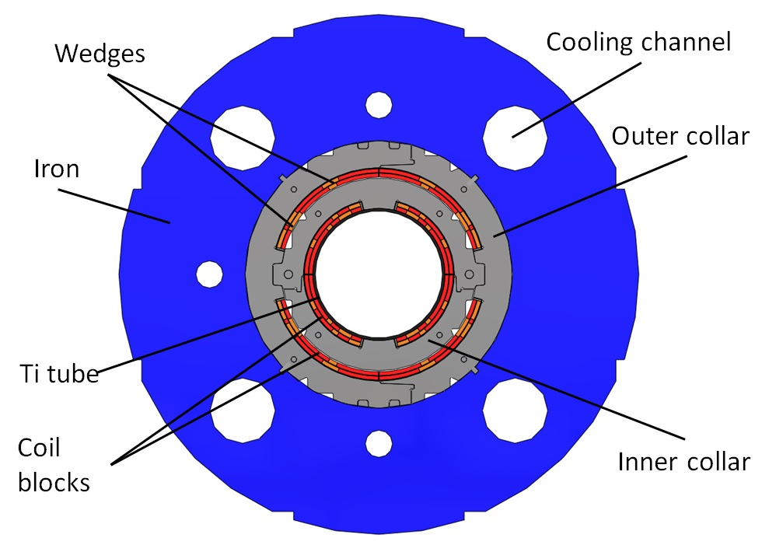
Planning
MCBXF
Delivery of the current leads in the coming weeks
DAQ – DMM delivered in July
Commissioning of the, cryostat, current leads, PC and EE in September / October at warm and with a magnet
First magnet test
Training of the MCBXF magnets in 2020

Slide 10
Thank you for your attention
Thank you to FREIA team to make GERSEMI possible

