Slide 1
Testing of Series Superconducting Dipole Magnets for the SIS100 Synchrotron
P. Aguar Bartolome et al.
GSI Helmholtzzentrun für Schwerionenforschung GmbH, Darmstadt, Germany
3rd International Workshop of the Superconducting Magnets Test Stands, 11th-12th June

Slide 2
Outline
Introduction
- FAIR @ GSI
- Heavy Ion Synchrotron SIS100
SIS100 Dipole Magnets
- Design
- Testing Strategy
GSI Test Facilities for SIS100 Magnets
- Infrastructure
- Measurement Systems
Test Status for SIS100 Series Dipoles
Summary and Outlook

Slide 3
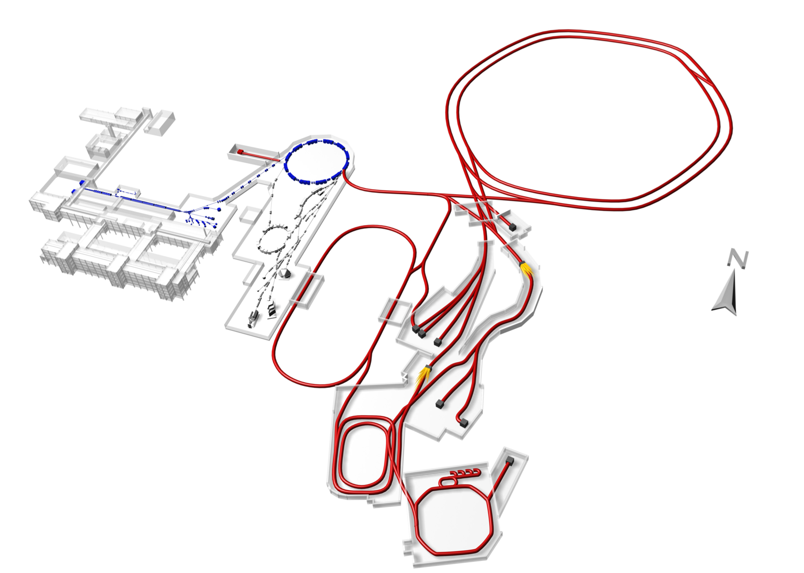
Facility for Antiproton and Ion Research
Existing GSI facility
FAIR facility
International project
SIS100
p-LINAC
SIS18
UNILAC
High intensity ion and antiproton beams for experiments in nuclear, atomic, plasma physics and material science.
Existing facility UNILAC/SIS18 will provide ion-beam source and injector for FAIR.

Slide 4
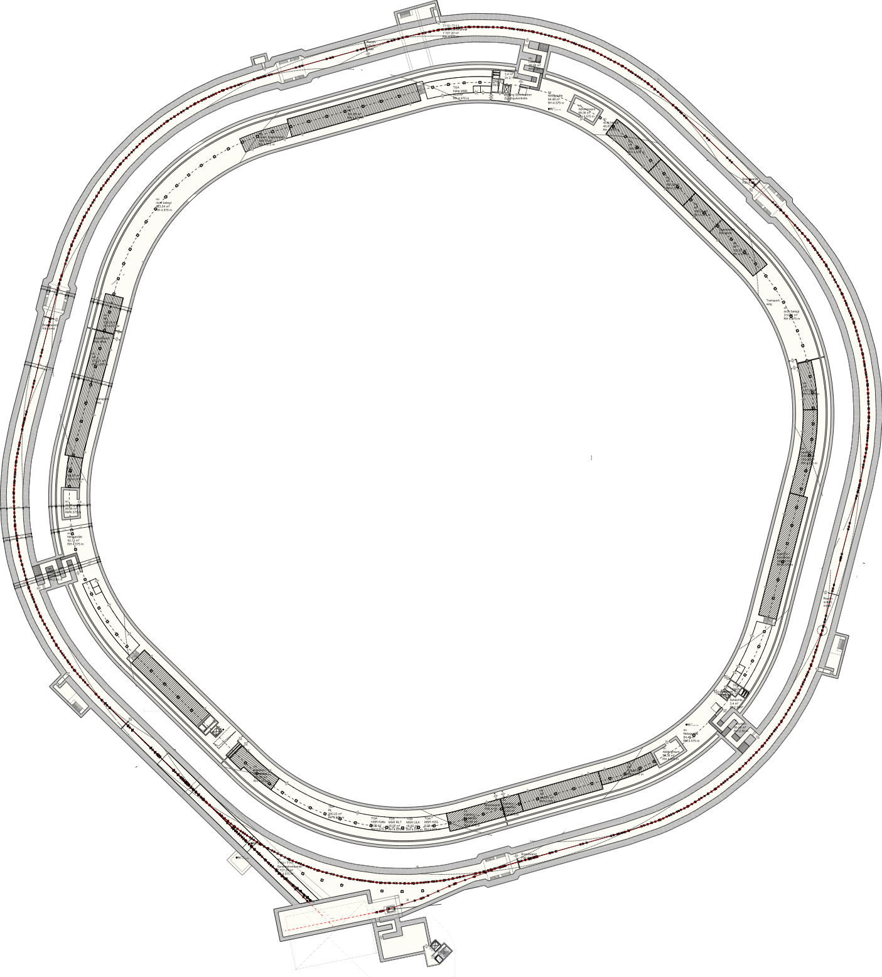
Heavy Ion Synchrotron SIS100
SIS100 = Schwerionensynchrotron 100 [Tm] = Heavy ion synchrotron (beam rigidity 100 [Tm]*)
Hexagonal, circumference 1083.60 m
Operational modes:
Ultra High Vacuum (10⁻¹¹ mbar)
- Adsorption by cold vacuum chamber (10 - 15K)
- Superconducting (magnet) accelerator
Fast-ramp machine ~0.5 sec. to maximum field
Accelerator tunnel SIS100
Service tunnel
*Beam rigidity 100 [Tm] = Bending dipole field 1.9 [T] × Bending radius 52.632 [m]

Slide 5
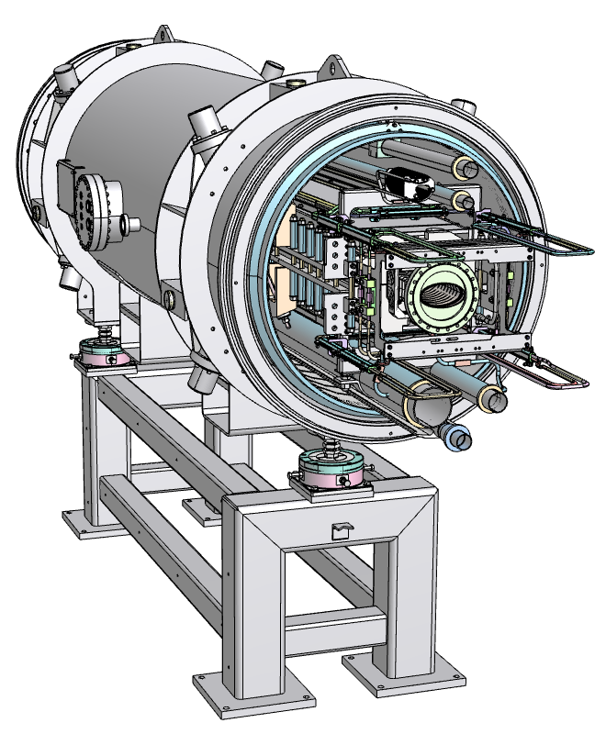
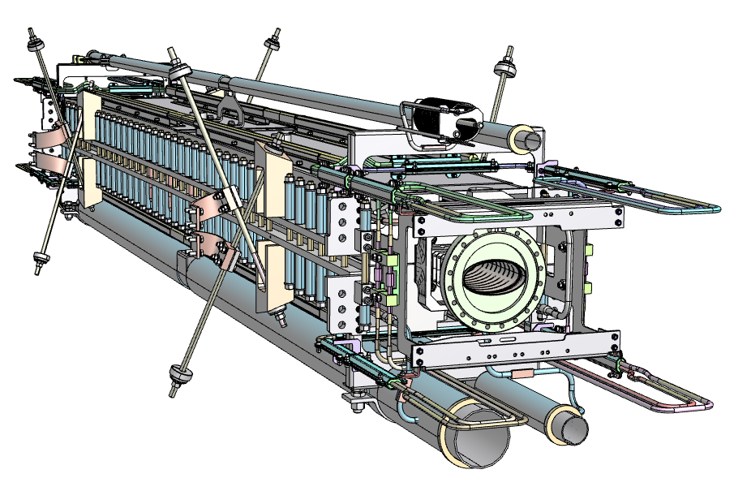
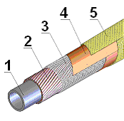
SIS100 Dipole Magnets: Design
Cryo-dipole module
Main parameters
Number of the magnets in SIS100 | 110
Effective length L_{eff} | 3.062 | m
Usable aperture | 60 x 120 | mm x mm
Bending angle | 3 1/3 | deg.
Bending radius | 52.632 | m
Nominal Field | 1.9 | T
Field homogeneity ∆B/B_{main} x10⁴ | < ± 6 | units
Ramp rate | 4 @1Hz | T/s
Super ferric magnets
Curved magnet
SC coil (4 turn per pole)
Nuclotron type cable
Cooling with 2-phase He @ 4.5K
Cold mass with beam chamber
Magnet cross section
Nuclotron cable
266 mm
68
1 - Cooling tube CuNi
2 - SC wire NbTi
3 - CrNi wire
4 - Kapton tape
≈ 3000 mm
140.1 mm
350 mm

Slide 6
SIS100 Dipole Magnets: Testing Strategy
Series dipoles are manufactured at Bilfinger Noell GmbH, Germany
At contractor site:
At GSI site:
Quality inspections on different production steps
(e.g. yoke geometry for half yokes before and after welding, after assembly with the coil)
Functionality tests @ 300K
components of assembly
assembled magnet
Factory Acceptance Test (FAT)
measurement protocols
quality certificate (summary of single tests)
Standard Test Program for 100% of magnets:
documents control
quality controls
functionality tests @ 300K (after delivery, after cold tests)
functionality tests @ 4.5K including magnetic field measurements (DC, AC mode)

Slide 7
Site Acceptance Test (SAT): Scope
Quality assurance (including safety)
Machine control
Yoke geometry
Process lines
Instrumentation check
Electrical integrity
Quench performance
Static heat load and AC losses
Integral B-field
Harmonics
Load line
aperture height (precise)
sag and twist
positioning
pressure and leak
massflow rate
positioning
For each dipole magnet:
HV
continuity
turn-to-turn insulation
About 30 parameters to control
About 110 steps to follow
Duration ~ 3 weeks

Slide 8
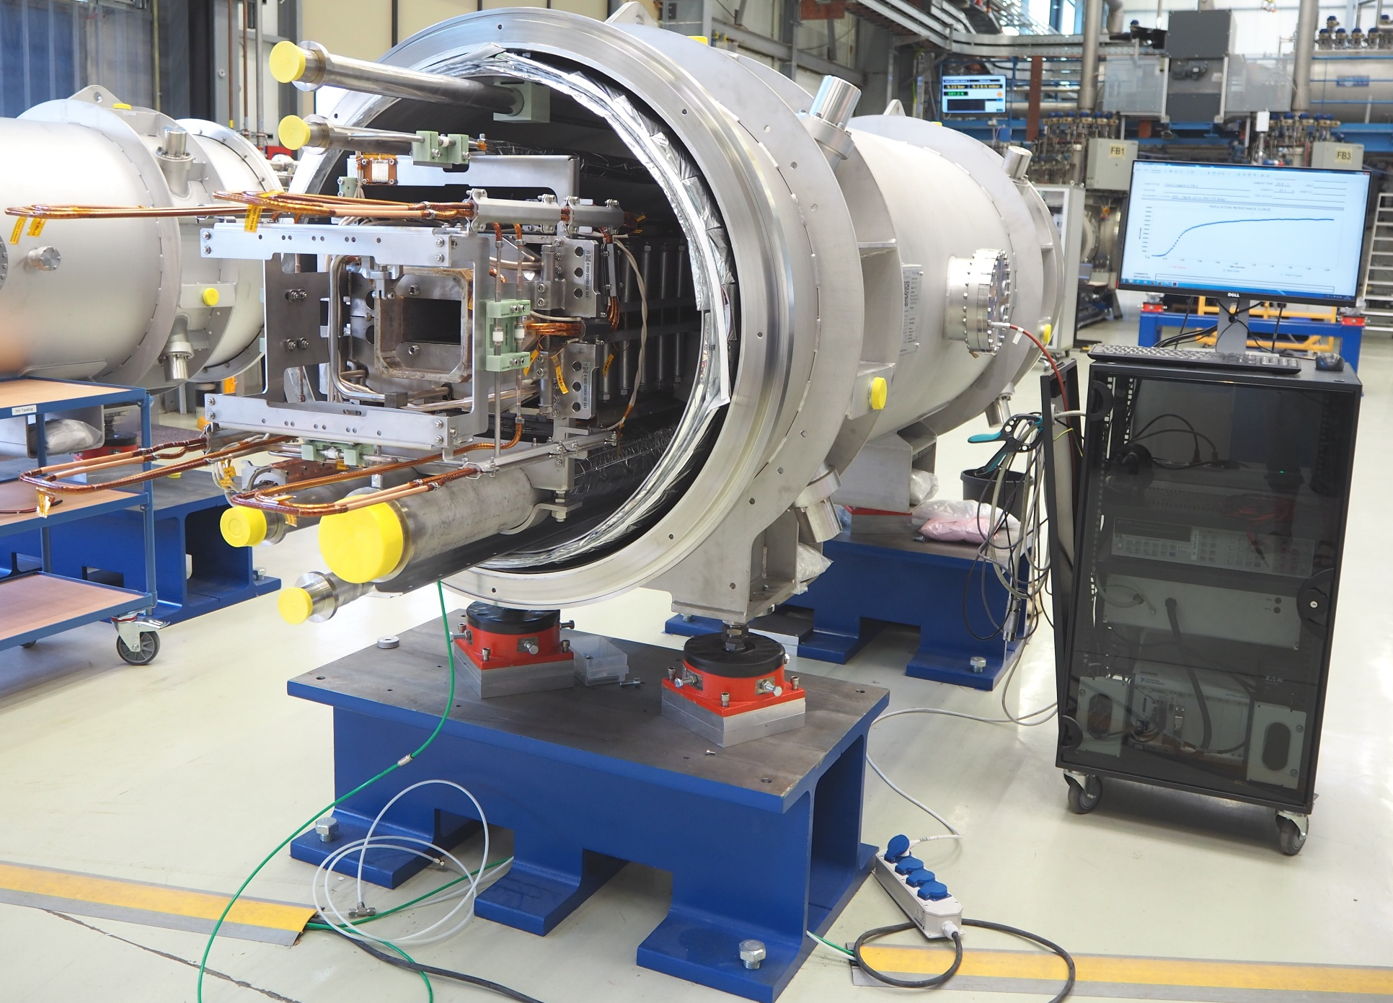
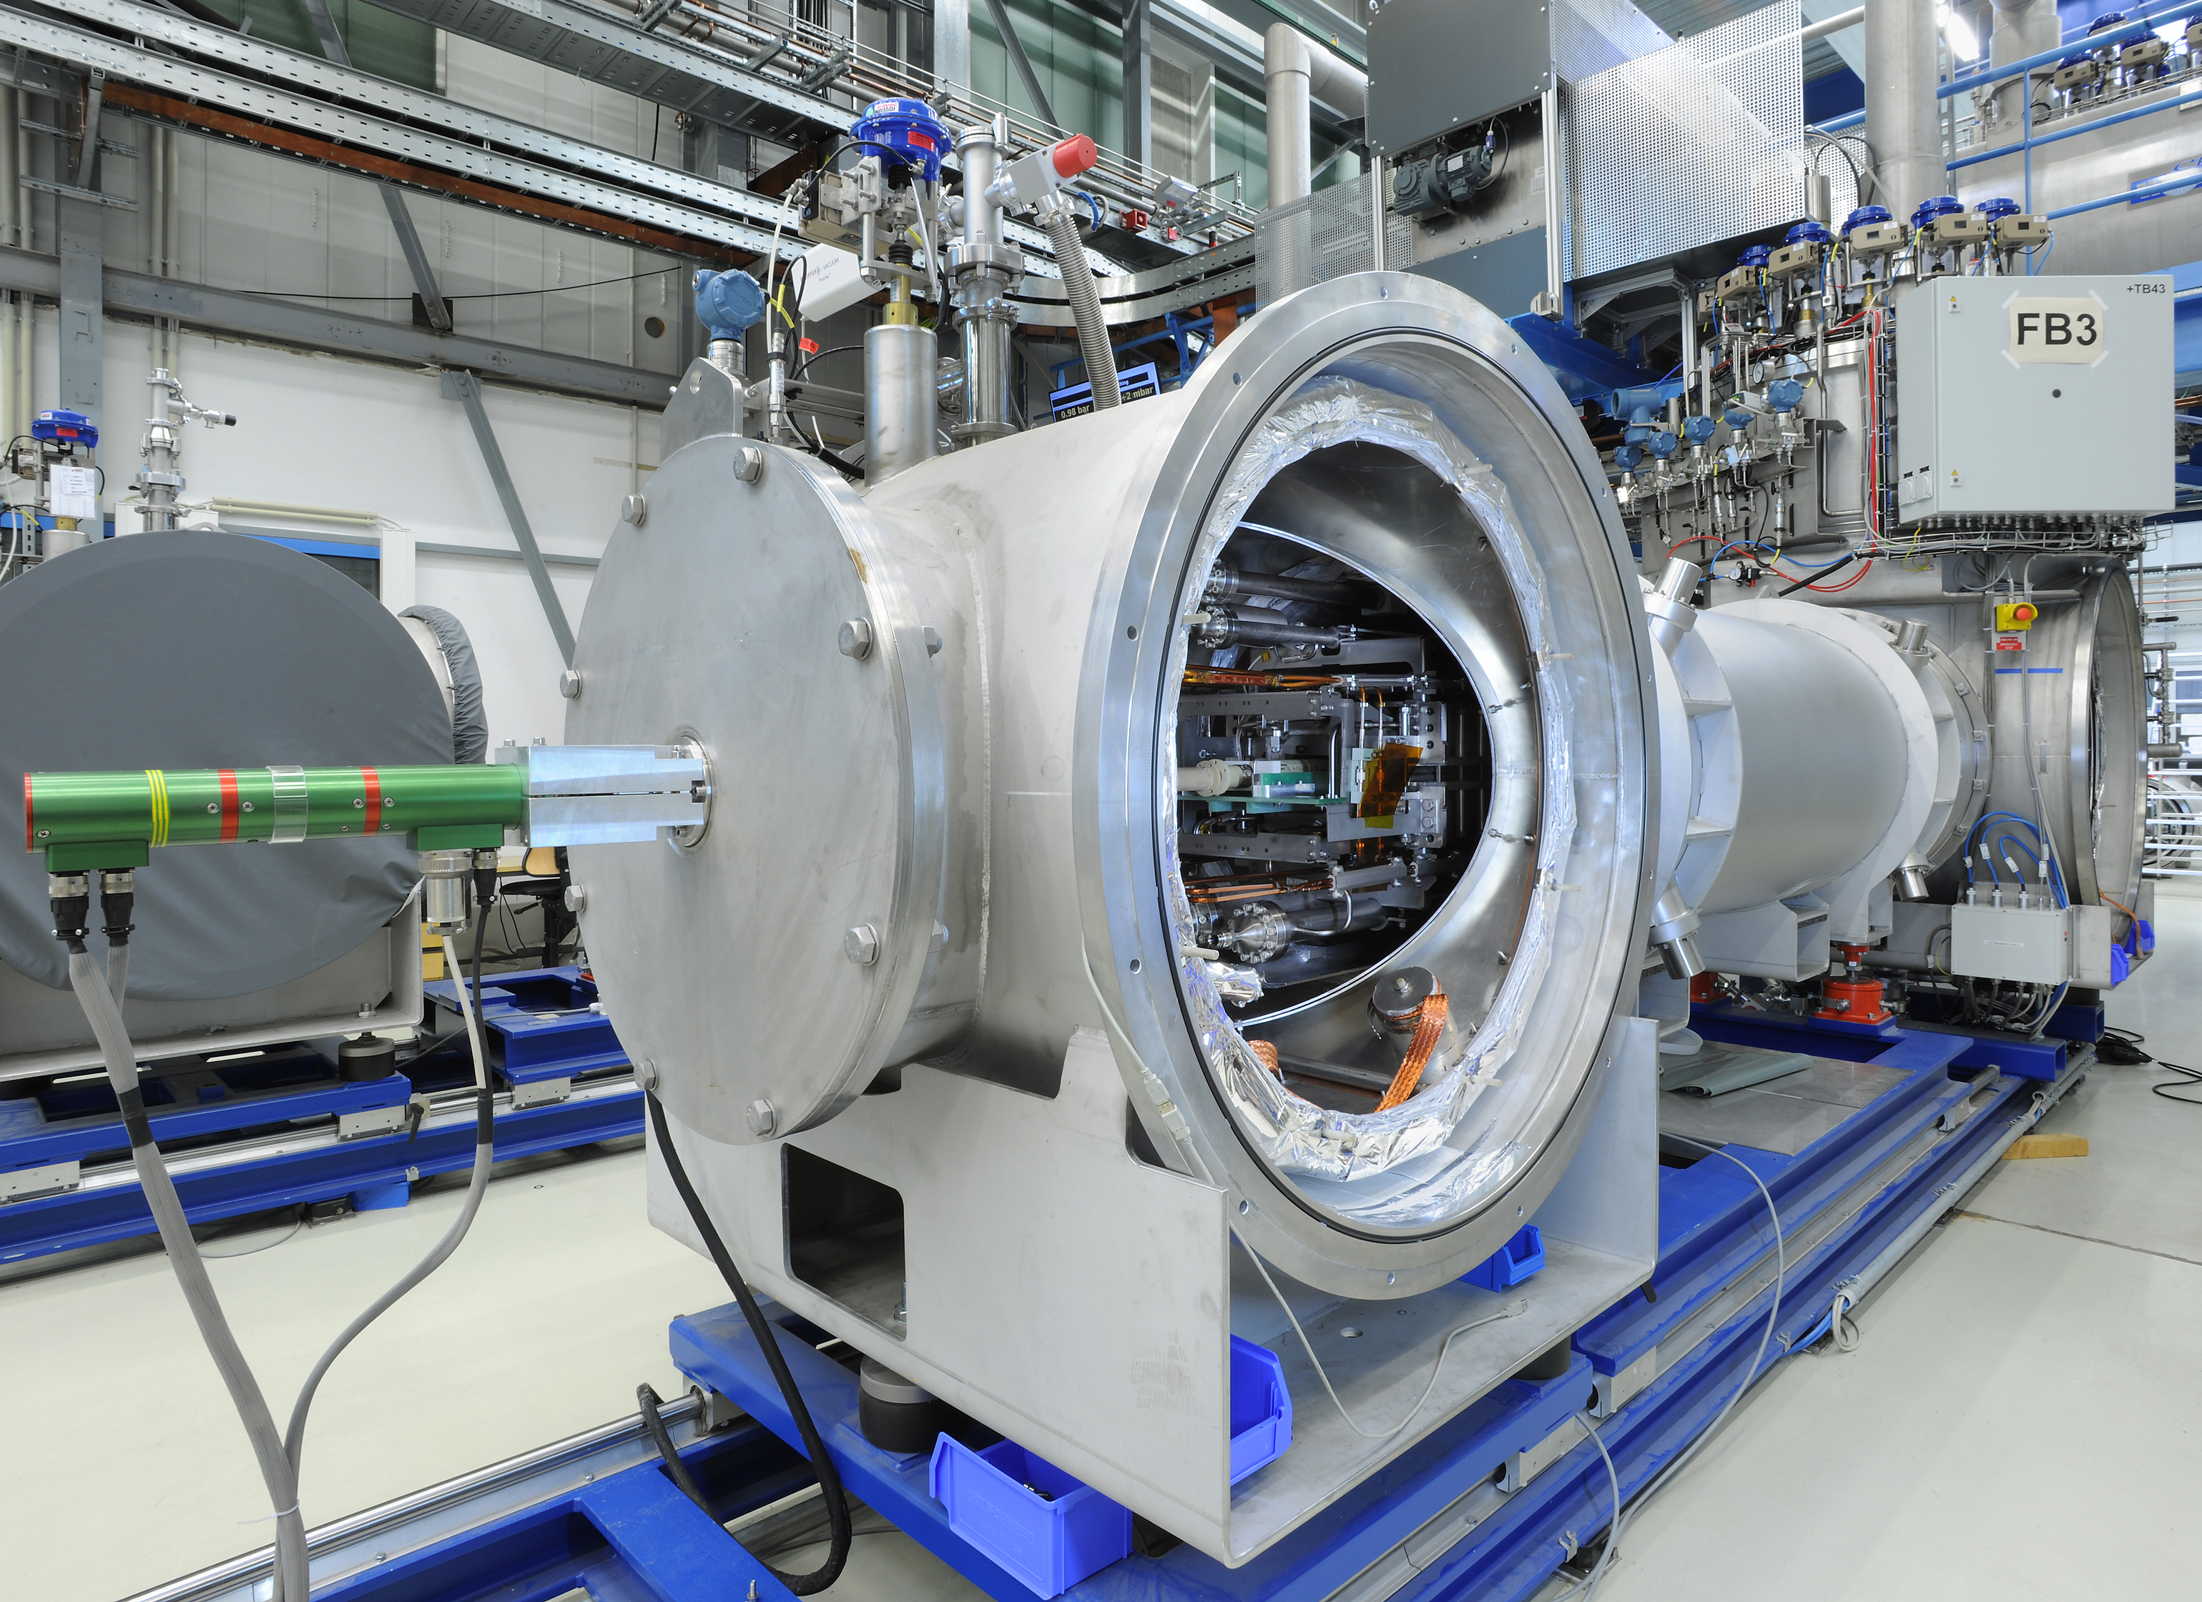
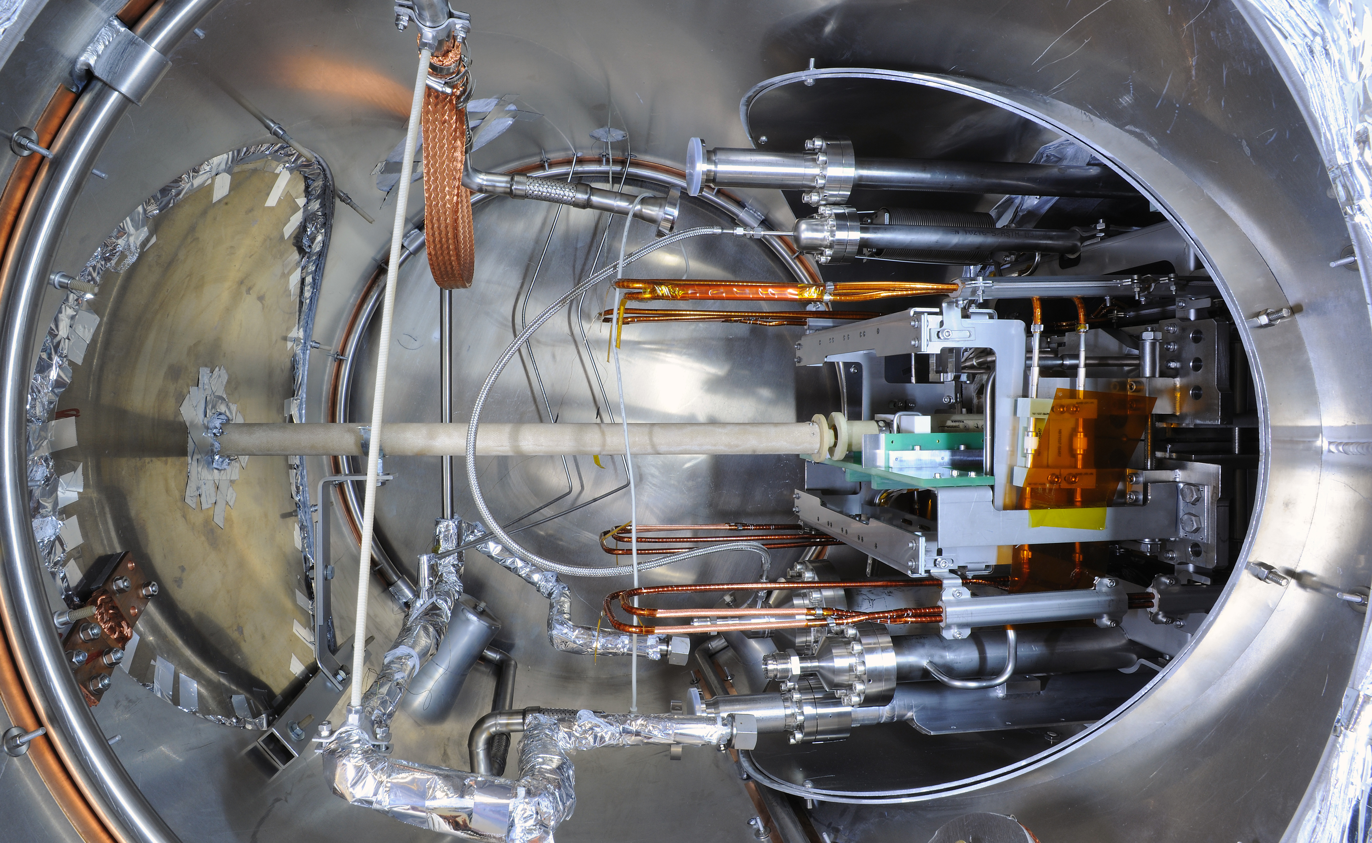
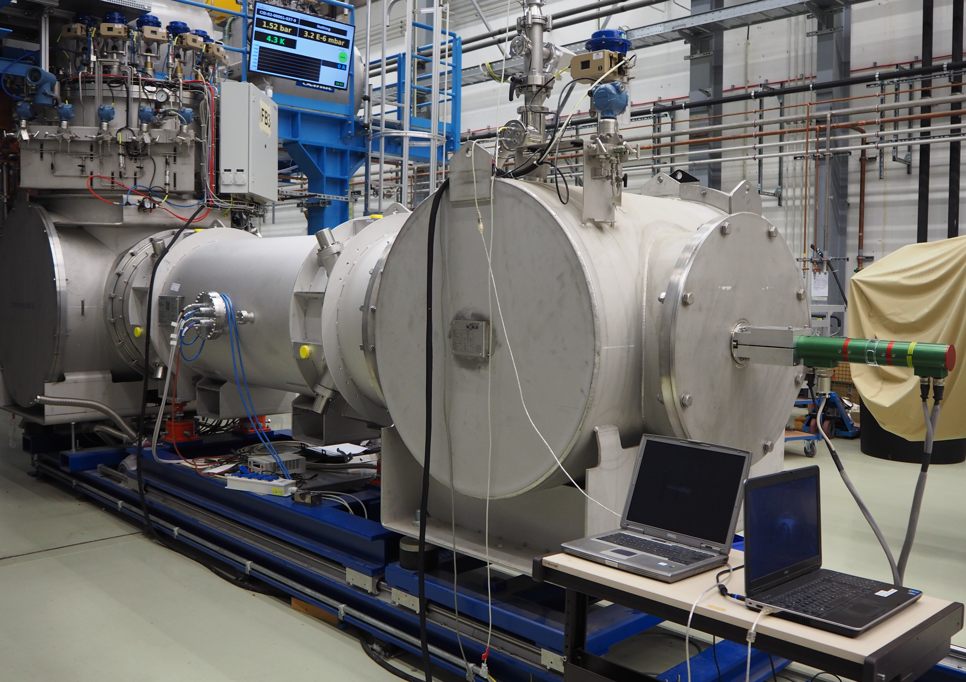
Site Acceptance Test (SAT): Sequence
Reception
visual inspection
document check
SAT @300 K (Incoming)
instrumentation
electrical insulation
geometry
pressure and leaks, massflow rate
Mounting on the test bench
Installation of the MF-probe
electrical integrity magnet+current leads
pumping 24 h
cool down 76 - 90h
SAT @ 4.5K
electrical integrity and insulation
magnet training
inductance
magnetic field
static and AC losses
Warming up and dismounting
SAT @ 300K (Outgoing) 1- 2 days
~ 5 days
2 - 3 days
3 - 4 days
4 - 5 days

Slide 9
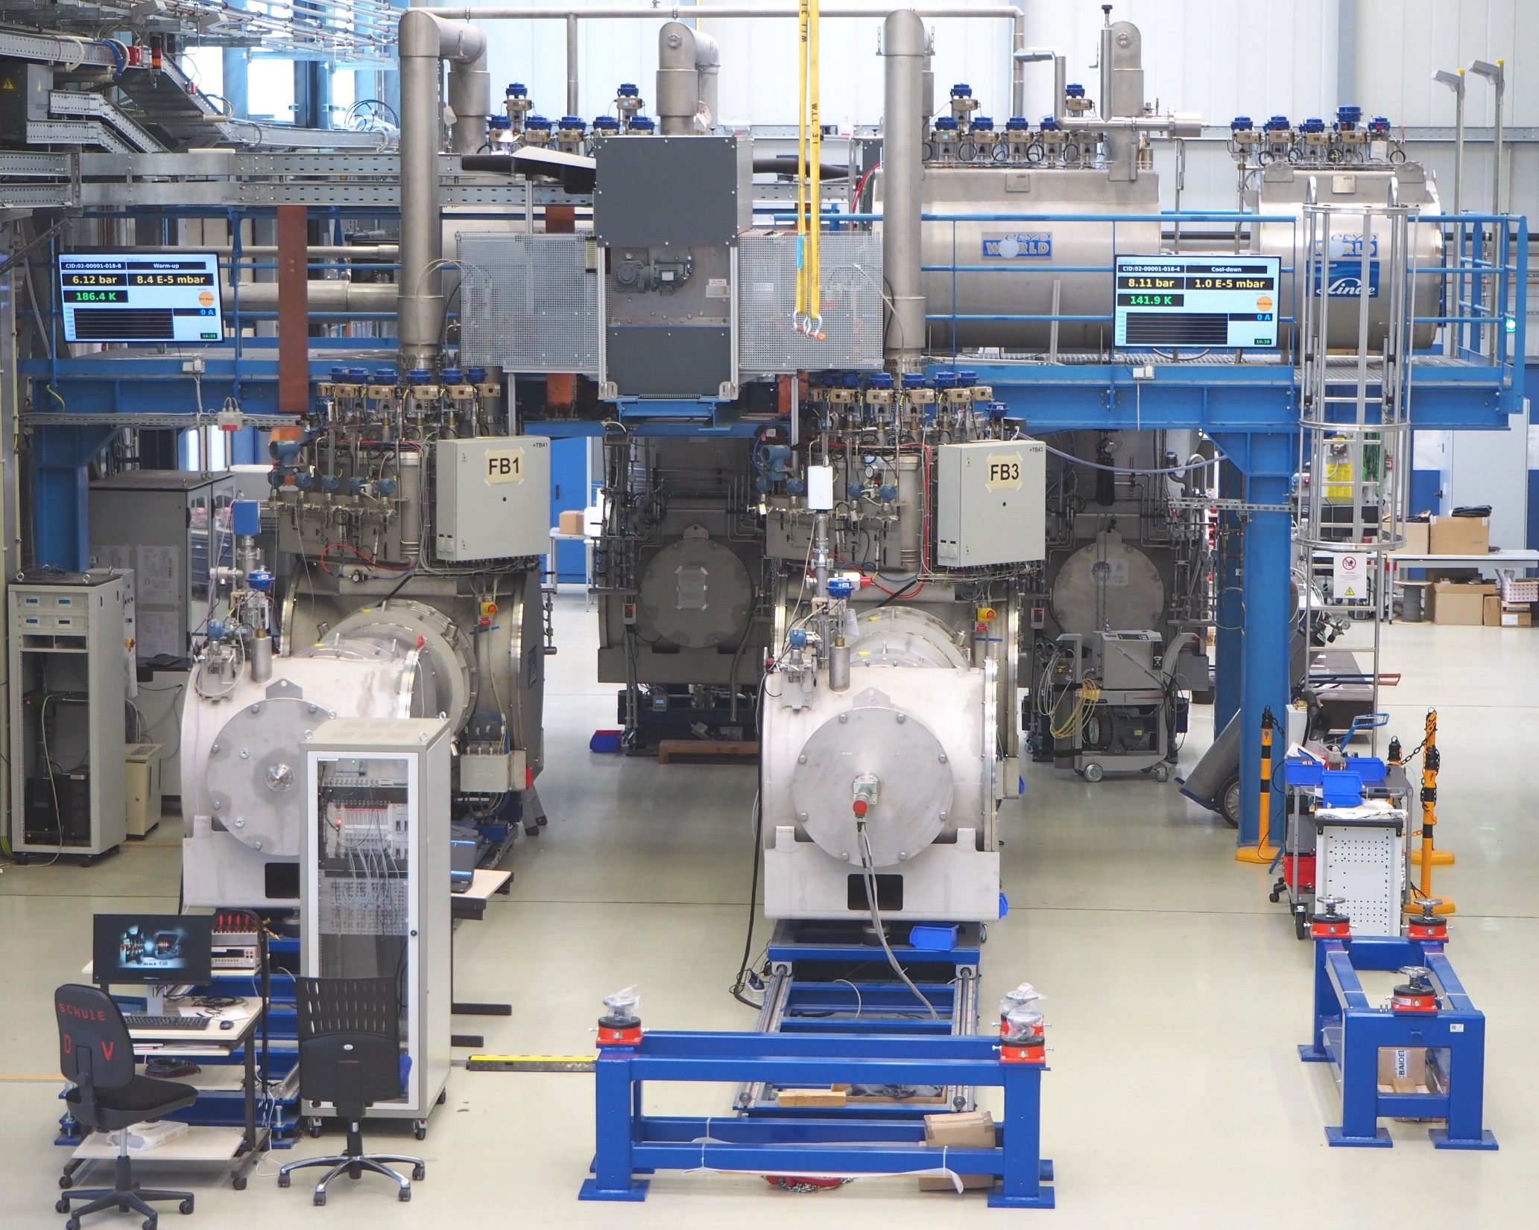
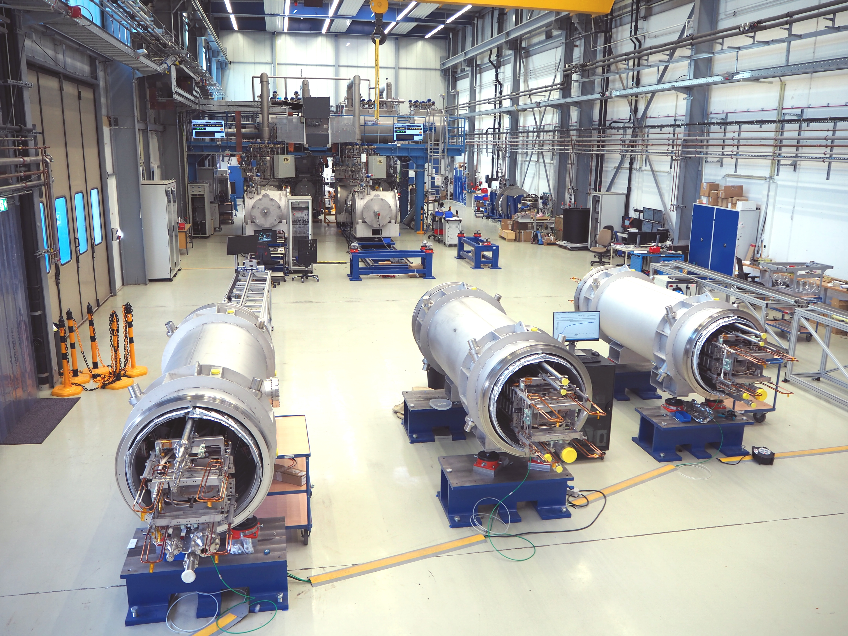
GSI Test Facilities for SIS100 Magnets
Series Test Facility (STF)
Cryo-plant 1.5 kW – commissioned Q2/2015
Power converters 2 x 20 kA (66 V) –commissioned Q1 & Q3/2016
14 kA DC HTS Current Leads (CL) – commissioning Q3/2015 – Q1/2017
QD / Magnet protection system
687m² total area
4 test benches for cold tests
6 preparation benches
Calibration chain for MF-probe
3
4
2
1
5
Full readiness for operation August 2017
5
Test benches for superconducting magnets: 1 - end box, 2 - feed box, 3 - distribution box, 4 - power switch, 5 - preparation bench

Slide 10
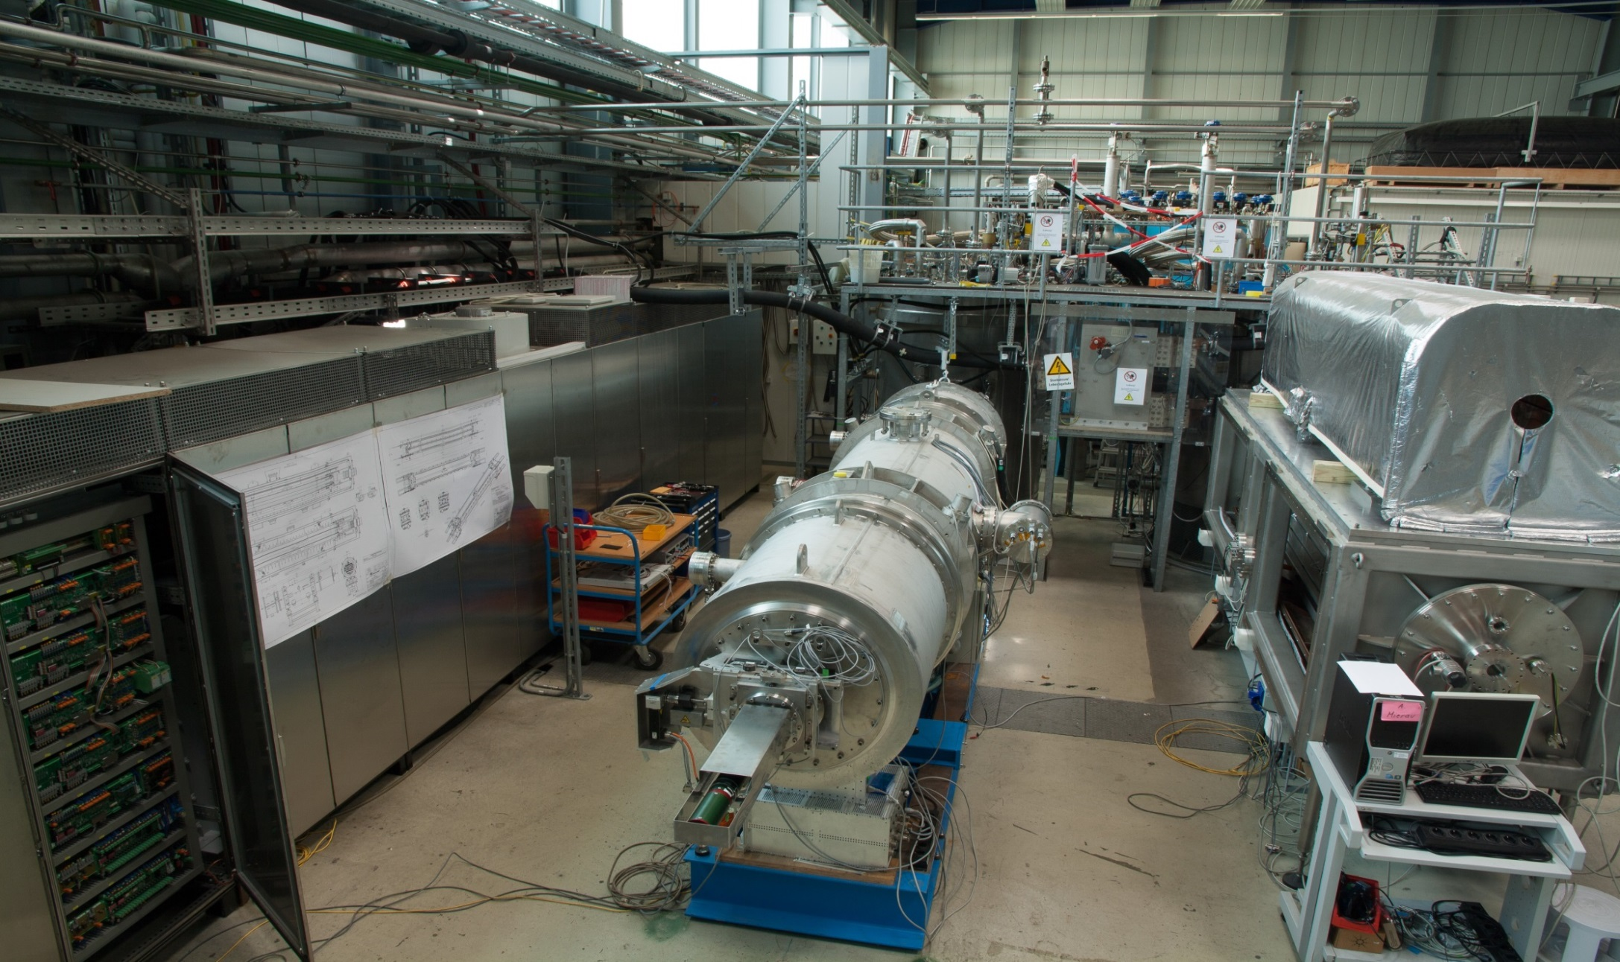
GSI Test Facilities for SIS100 Magnets
Prototype Test Facility
Cryo-plant 0,6 kW – commissioned 2007
Power converters 20 kA (66 V) – commissioned Q3/2013
14 kA DC HTS Current Leads (CL) – commissioning Q3/2013, Q4/2014
QD / Magnet protection system
150 m² total area
1 test benches for cold tests SIS100 dipole
1 universal cryostat
2
1
4
3
5
1
1 - power converter, 2 - feed box for testing of SIS100 magnets, 3 - First of series dipole for SIS100, 4 - power switch, 5 - Universal cryostat for cryogenic tests of small components.

Slide 11
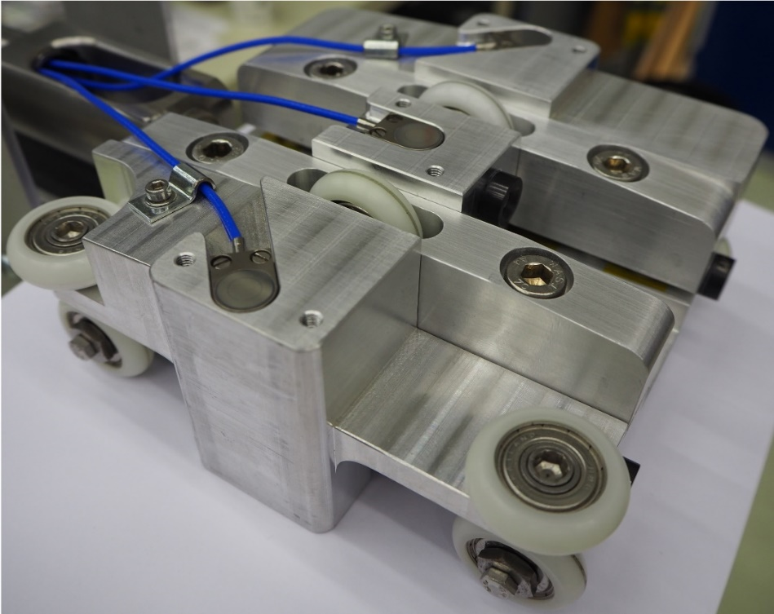
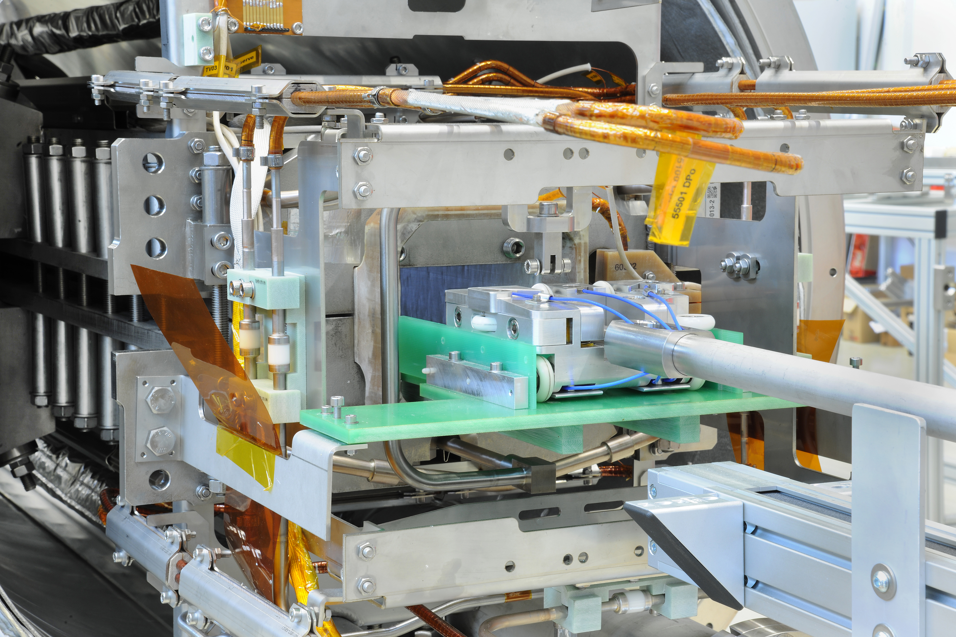
Main Measurement Systems
System for high precision gap height measurement
2
6 capacitive sensors CSH1,2FL(20)-CRm 4,0 from Micro - Epsilon GmbH& Co.KG
4
2
Linear encoder WDS-100-P 115-CR
from Micro-Epsilon GmbH& Co for reproducible
positioning of the carriage along the magnet
1
3
absolute precision 15µm
relative precision < ± 3µm
1 - carriage, 2 - capacitive sensors, 3 - wheels,
4 - holder for spherically mounted retroreflectors.
@ 300K
In combination with a laser tracker, the
system provides data regarding the yoke’s sag and twist.

Slide 12
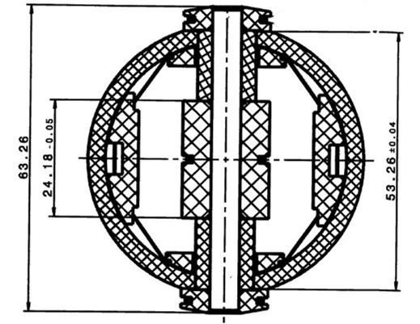
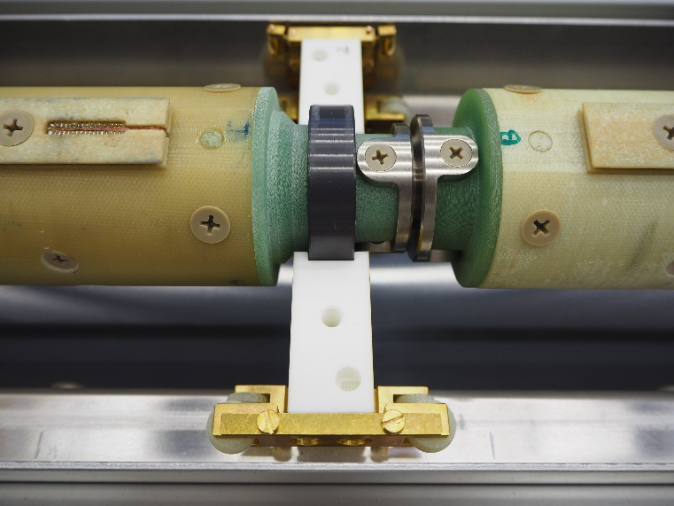
Main Measurement Systems
System for magnetic field measurements
The measuring probe is designed and built in collaboration with CERN
rotated ferro fluidic feed througth
motor unit
3600 mm
5 measuring heads – tangential coils
3 pick up coils per head, 600 mm length
Effective surface 1.67 m²
Ti-alloy bellows – interconnection between segments and to align the heads along the beam axis
SiN ball bearings for rotation motion
Ceramic supporting blocks for transverse positioning in the gap
measuring head
supporting block
620 mm
SiN ball bearing
Ti bellow
Field measurements in vacuum @ 4.5K
Cross section of the measuring head (3 tangentinal coils)

Slide 13
Test Status for SIS100 Series Dipoles
The measurement results reveal an excellent performance of the chosen design and high production quality.
The magnetic field shows very low variation in terms of the field integral and the low harmonic content is satisfactory for the beam physics requirements.
Quench performance verifies a high stability of the coil structure in the yoke.
46 | 42
Dipole magnets delivered
Dipole magnets tested

Slide 14
Summary and Outlook
The series production of the SIS 100 dipole magnets started in August 2016
The first series dipole was delivered to GSI at the end of September 2017
Quality control and functionality tests at contractor and GSI site are defined
High precision measurement systems were developed for magnet evaluation
Excellent performance of the chosen design and high production quality.
Almost 50% of the series dipoles successfully tested.
Dipole series production is ongoing with a delivery rate of approx. one magnet per week.

Slide 15
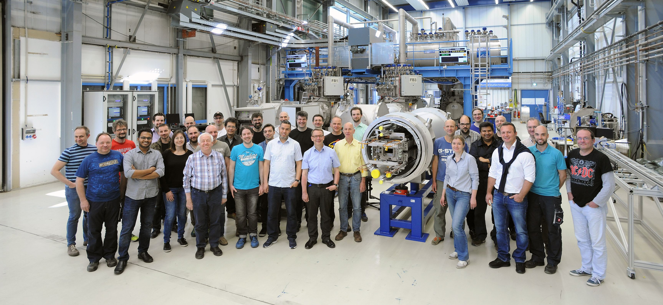
SAT Team
Test coordinators
Survey & alignment
Electrical integrity
Field measurement
Quench detection
Cryoplant operators
Transport and installation
Quality assurance
DAQ, control and software
GSI departments
SCM, QA, TRI, CRY, EN-MG, EPS, VAC, BB, RHV
Support on demand – MEWE, KB, ENG

Slide 16
Thank you for your attention

Slide 17
Backup 1

Slide 18
 | unit | Main Dipole | Main Quadrupole | Chromaticity sextupole (h/v) | Steerer (nested h/v) |  | Multipole corrector (nested)
 |  |  |  |  |  |  | Quadrupole | Sext.(skew) | Octupole
Design |  | Super-Ferric | Super-Ferric | Super-Ferric | Cosθ |  | Cosθ | Cosθ | Cosθ
Number of Magnets |  | 108 | 166 | 42 | 83 |  | 12 | 12 | 12
Magnetic field strength | T/m^{n-1} | 1.9 | 27.77 | 232 | 0.372 | 0.366 | 0.91 | 31.8 | 446
Effective length | m | 3.062 | 1.264 | 0.383 | 0.403 | 0.410 | 0.62 | 0.59 | 0.56
Usable aperture | mm | 133x65 | 133x65 | 135x65 | 135x65 |  | 133x65
Ramp time to Max. | sec. | 0.5 | 0.5 | 0.175 | 0.2 |  | 0.175

Slide 19
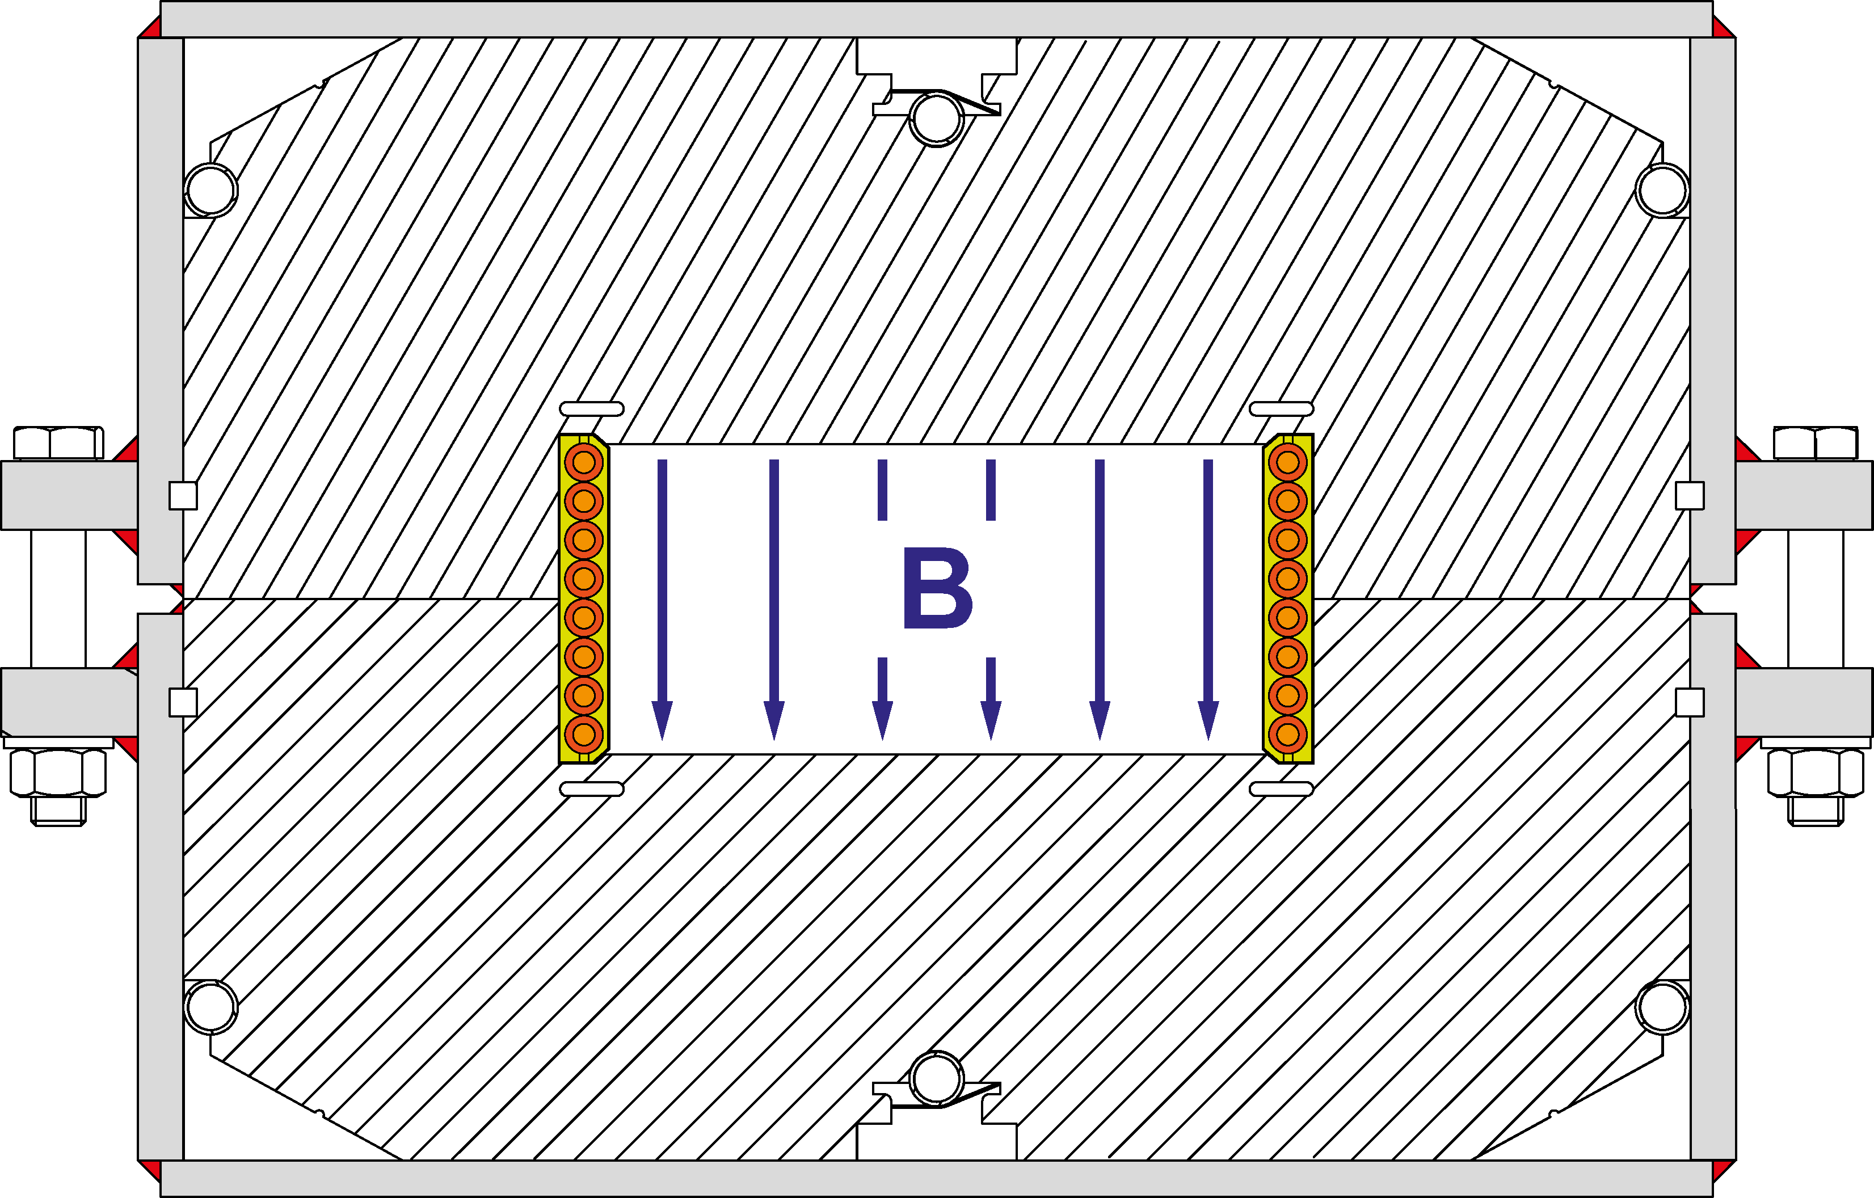
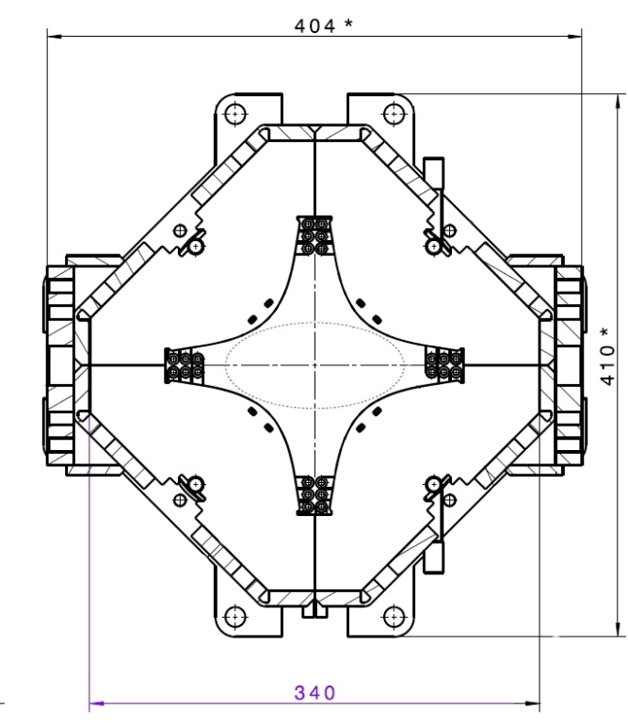
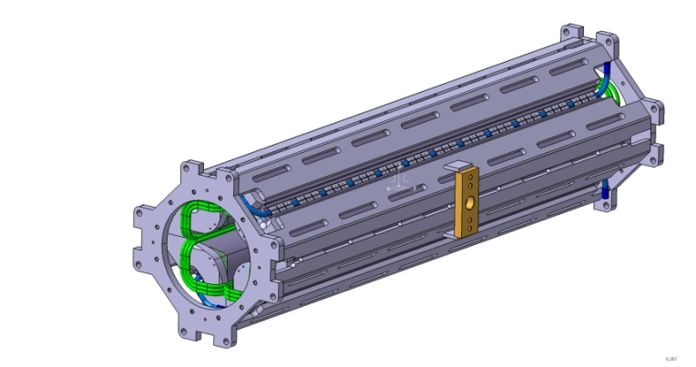
SIS100 Superconducting Magnet System
Main Dipole Magnets
Super-Ferric 1.9T @ 13.2 kA
Window frame, curved magnet R 52.632 m
Nuclotron cable
fast ramped
cooling with 2 phase He
108 Magnets
yoke cross section
with coil
cold mass
with beam chamber
Nuclotron cable:
1 - Cooling tube CuNi
2 - SC wire NbTi
3 - CrNi wire
4 - Kapton tape
5 - Glasfiber tape
Main Quadrupole Magnets
Super-Ferric 10 kA , 27.7 T/m
Nuclotron cable
cooling with 2 phase He
166 Magnets

Slide 20
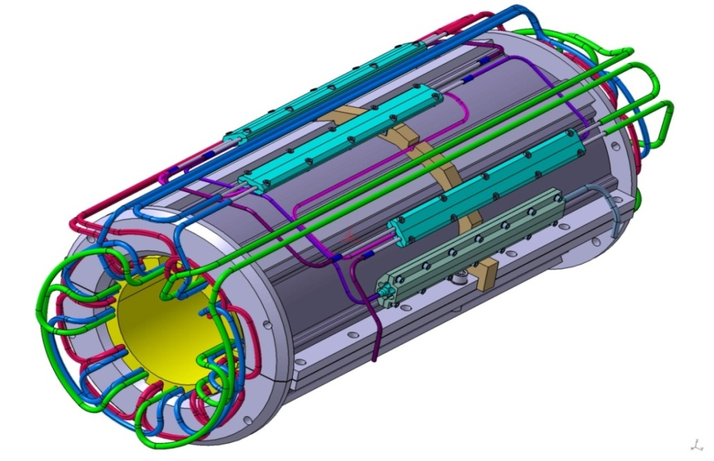
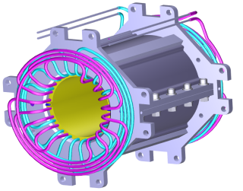
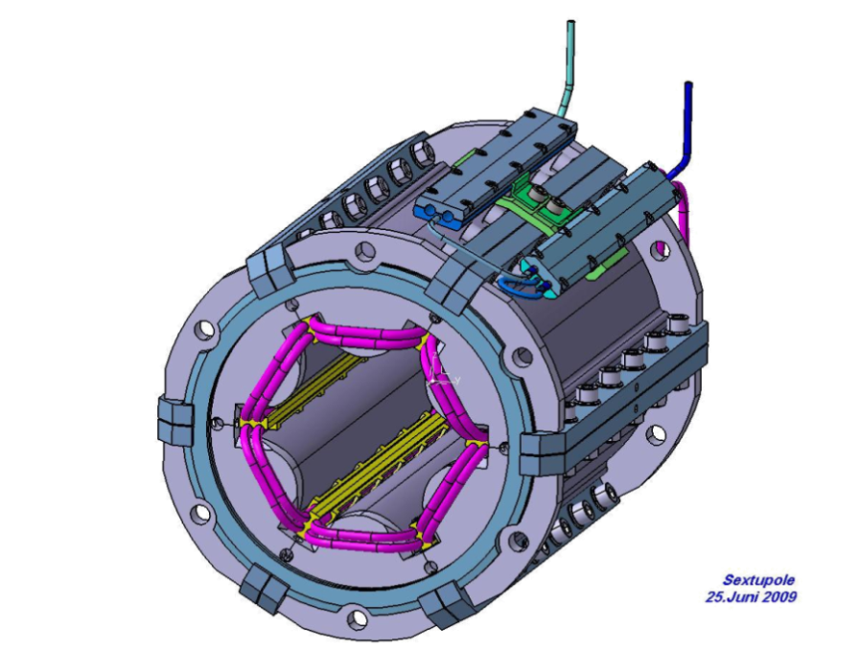
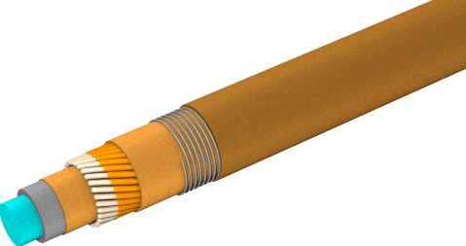
SIS100 Superconducting Magnet System – Corrector Magnets
Chromaticity sextupole:
Super-Ferric 232 T/m²
Nuclotron cable
Nested (horisontal and vertical correction)
42 Magnets
Steering magnet:
Cos-Θ
Nuclotron cable
with insulated strands
Nested (horizontal and vertical correction)
83 Magnets
Multipole corrector magnet:
Cos-Θ
Nuclotron cable
with insulated strands
Nested (B2, A3, B4) correction
12 Magnets
Insulated Sc. strands connected in series
250A × 27 Strands = 6.75kA

Slide 21
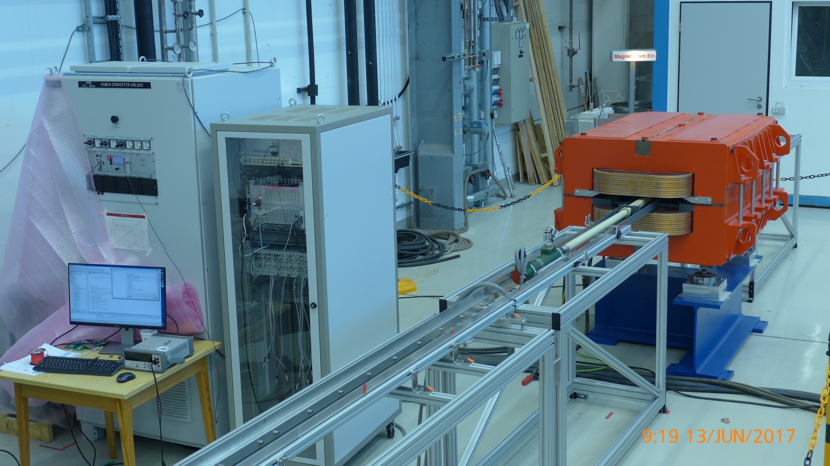
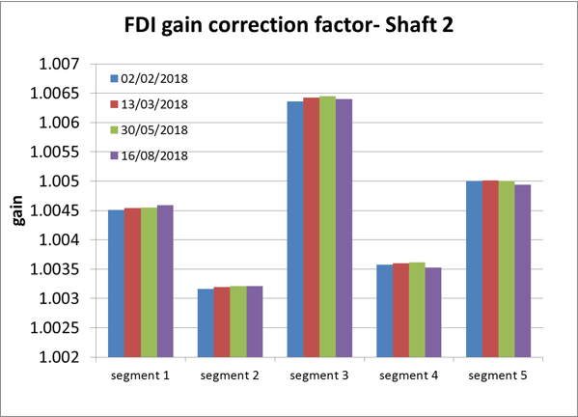
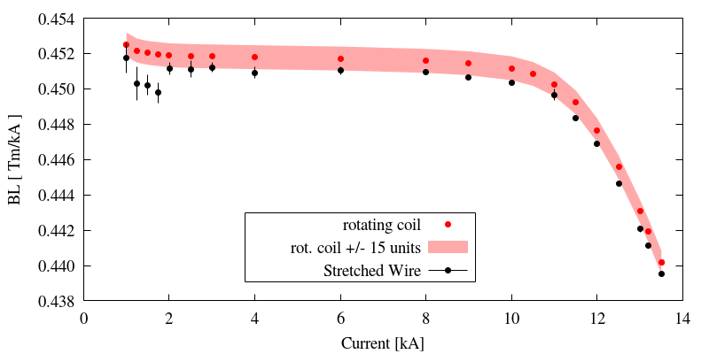
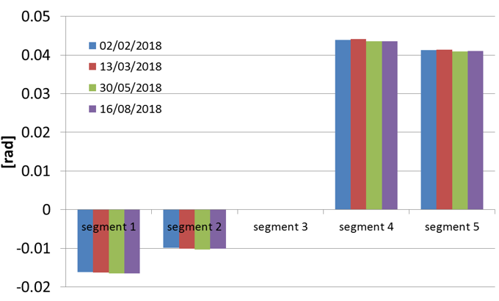
Main Measurement Systems
Calibration of the magnetic field measuring probe
calibration @ 300K in NC dipole
surface calibration –> precise measurement B₁,$\int{Bdl}$
angular displacement of the head relative to the reference one i.e., the middle segment –> direction B₁, higher order harmonics
lengths of the interconnection areas between the segments –> precise measurement $\int{Bdl}$
1.007
02/02/2018
13/03/2018
30/05/2018
16/08/2018
1.006
dose the warm calibration work for the cold measurements?
1.005
gain
1.004
1.003
yes, it works and is precise enough for qualifying of the SIS100 dipoles.
Required precision < 4×10⁻³
1.002
segm.1
segm.2
segm.3
segm.4
segm.5
0.05
0.04
02/02/2018
13/03/2018
30/05/2018
16/08/2018
0.03
Angle [rad]
0.02
mechanic of the MF-probe is not affected by thermal cycles. The calibration stays stable
0.01
segm.1
segm. 2
0
segm.3
segm.4
segm.5
-0.01
-0.02

Slide 22
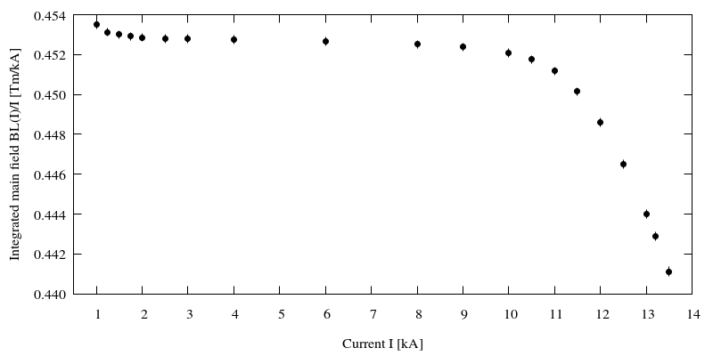
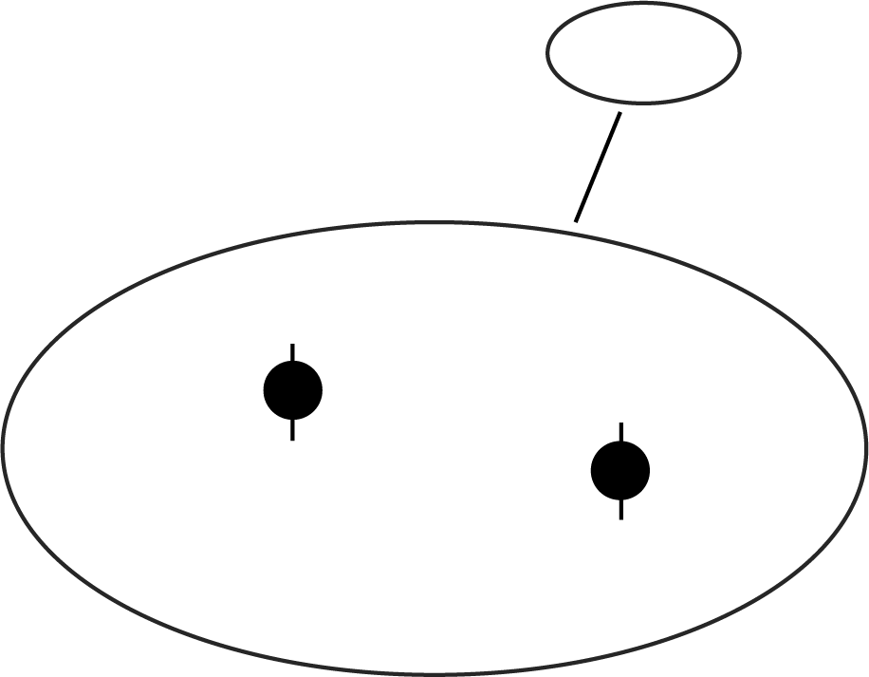
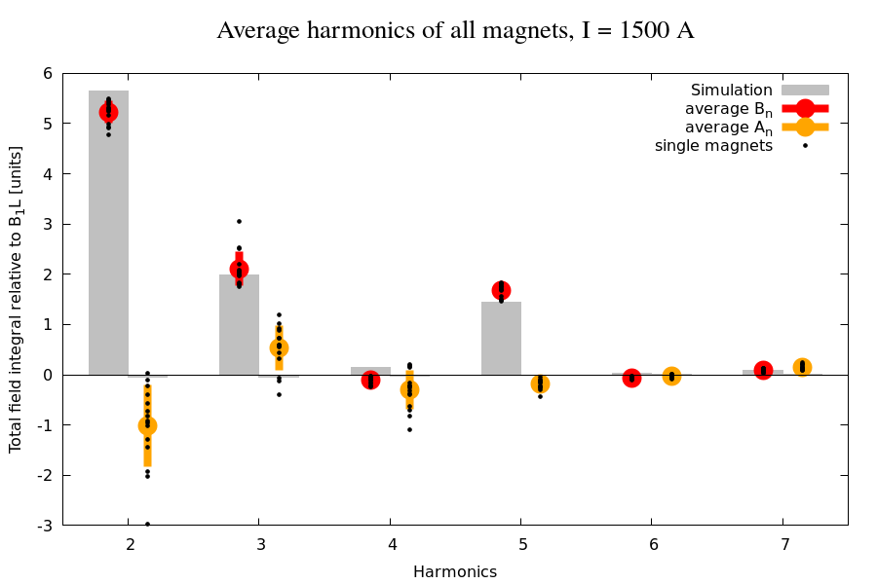
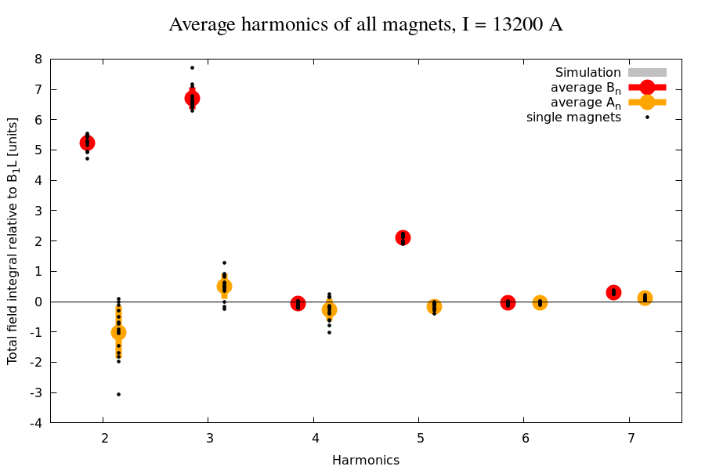
Test Results for SIS100 Series Dipoles
Integral Field
acceptance criteria from SIS100:
$${∆ BL}/{BL}≤ {4×10}^{−3}$$
with $BL= \int{B\left(l\right)dl}$
measured on 15 magnets:
measured on 15 magnets:
ΔBL/BL = 4.1 ×10⁻⁴
ΔBL/BL = 4.1 ×10⁻⁴
Field homogeneity
acceptance criteria:
$B\left(z=x+iy\right)=\sum_{n}{C_{n}{\left(\frac{z}{R_{ref}}\right)}^{n−1}}$ with $C_{n}{=B}_{n}+{iA}_{n}$
$\sum_{n}{C_{n}/B_{1}}$ < ± 6 units @ $R_{ref}$= 30mm
6
8
measured on 15 magnets:
5
I = 1500 A
Simulation
average b_{n}
average a_{n}
single magnets
I = 13200 A
Simulation
average b_{n}
average a_{n}
single magnets
7
4
6
5
magnet data acceptable for synchrotron operation
good agreement with expectation exept:
- b₃ systematic → correctable
- a₂ under investigation
high repruducibility ( except …)
3
4
2
3
[units]
2
1
1
0
0
-1
-1
-2
-2
-3
-3
2
3
4
5
6
7
2
3
4
5
6
7
-4
Harmonic Nr.
Harmonic Nr.

Slide 23
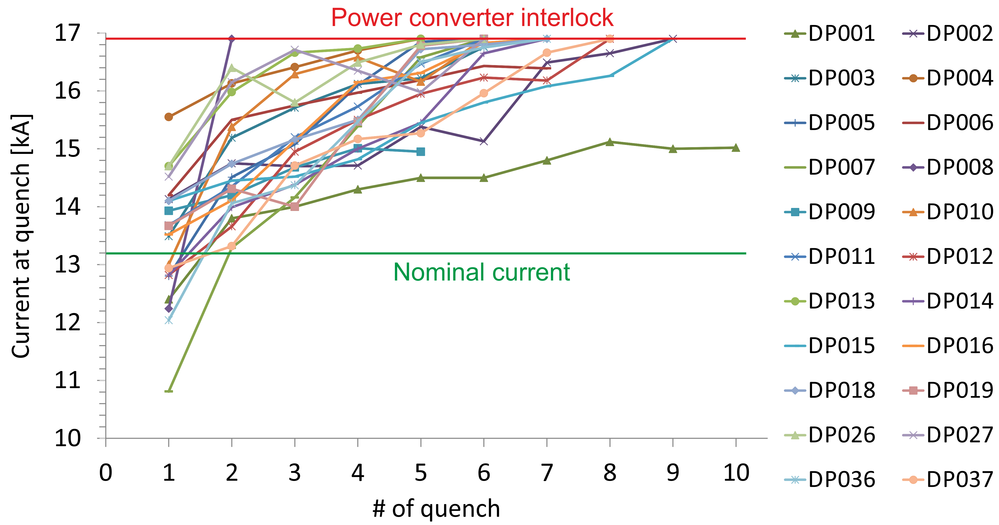
Test Results for SIS100 Series Dipoles
Magnet training
short sample limit of the cable 17.8 kA
specified:
nominal current (nc) to be reached:
at 3rd quench in first cycle
at 1st quench in further
de-training limited to 5 % of nc (compared to previous quench)
quench current has to stabilize at 110 % of nc at least (14.5 kA)
results for 22 magnets
stable operation for all tested magnets
nc reached at 2nd quench at least
no significant de-training observed
Outstanding quench performance!
Training close to the short sample limit of the cable (17.8 kA) -> high stability of the coil structure in the yoke.

Slide 24
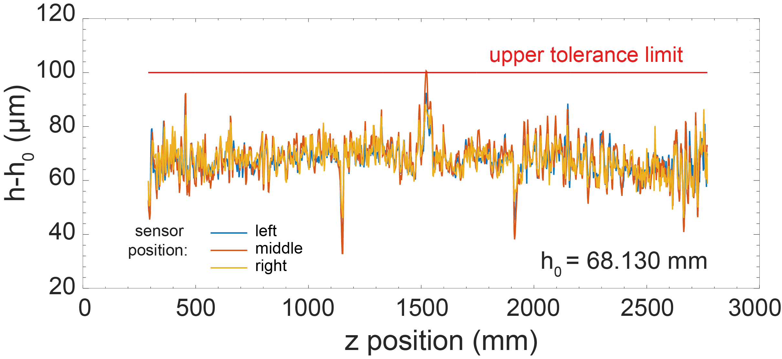
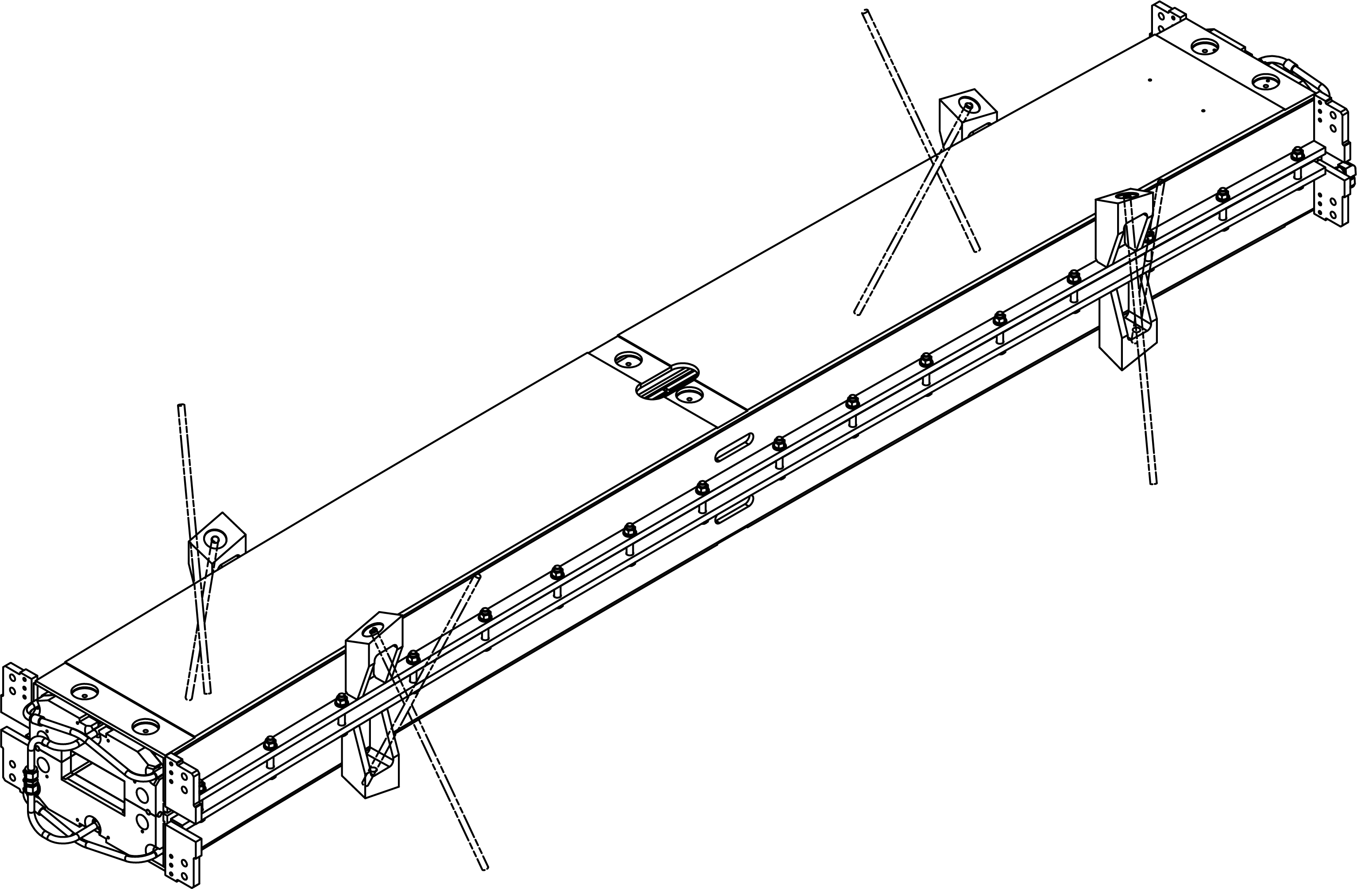
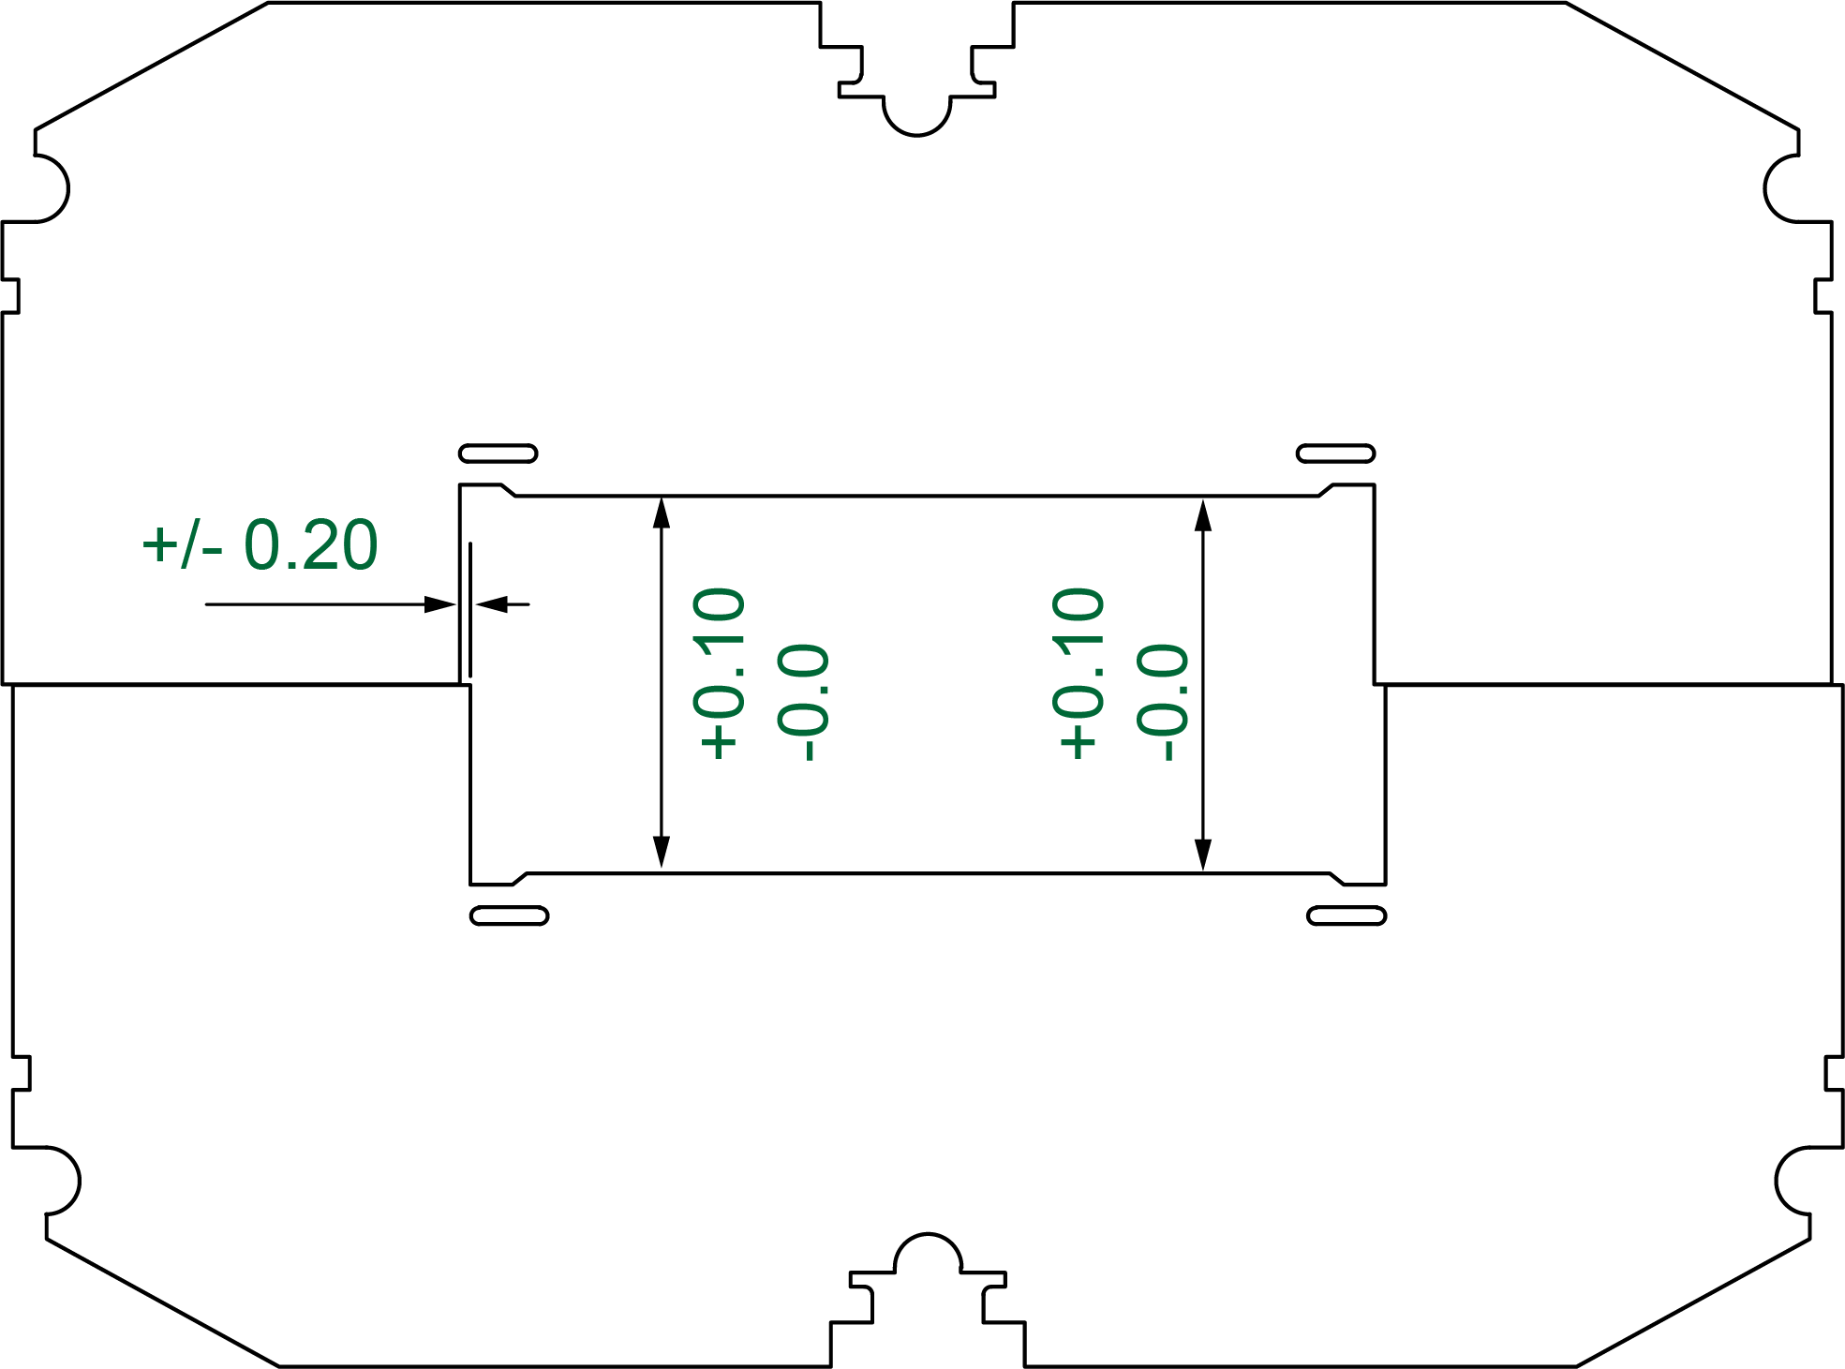
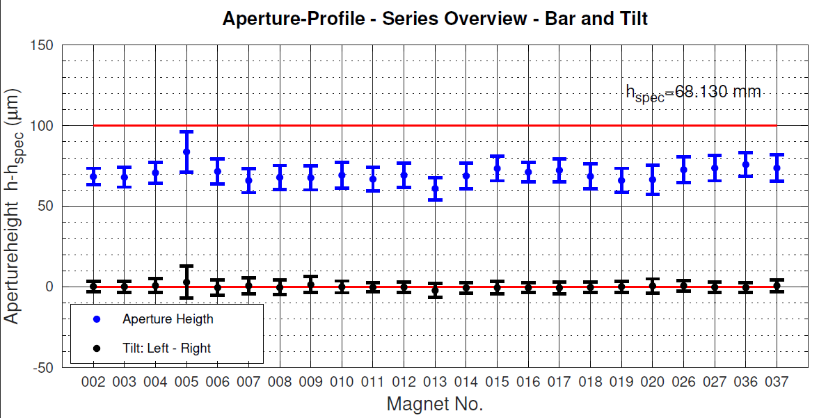
Test Results for SIS100 Series Dipoles
Gap geometry
spot welding of lamination to outer frame
required:
example
Z
aperture height
150
(→BL)
h_{spec} = 68.13 mm
well within specification on average for each magnet
very good reproducibility
100
Aperture heigth h – h_{spec} (µm)
50
tilt
0
(→ a_{n}, b_{n})
• Aperture heigth
• Tilt
negligible
-50
02
03
04
05
06
07
08
09
10
11
12
13
14
15
16
17
18
19
20
26
27
36
37
Magnet Nr.

