Slide 1
News from the GSI test Facility @ CERN
Antonella Chiuchiolo on behalf of GSI-CERN collaboration on Super-FRS testing
3rd International Workshop of the Superconducting Magnets Test Stands,
Uppsala 11-12 June, 2019

Slide 2
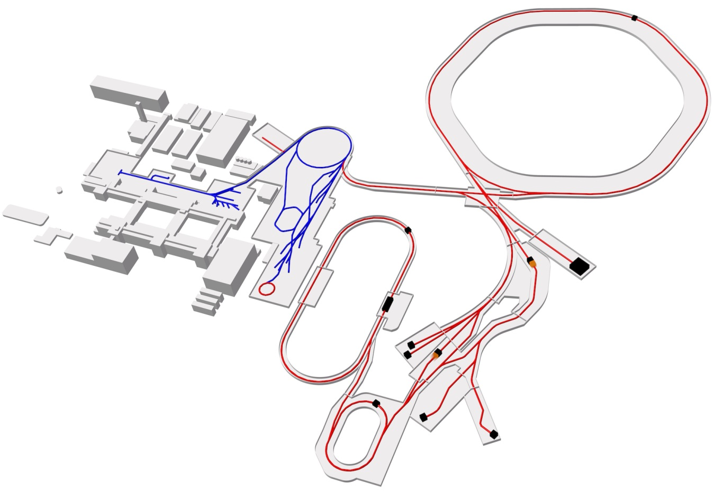
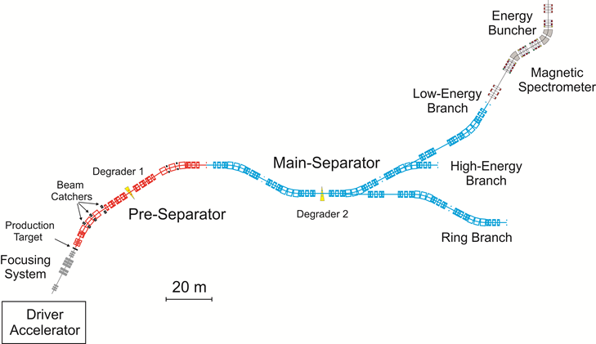
GSI accelerators complex
SIS18
SIS100
Super-FRS

Slide 3
Outline
Super-FRS superconducting magnets
GSI Test Stand layout @ CERN
Facility infrastructures
Facility status today

Slide 4
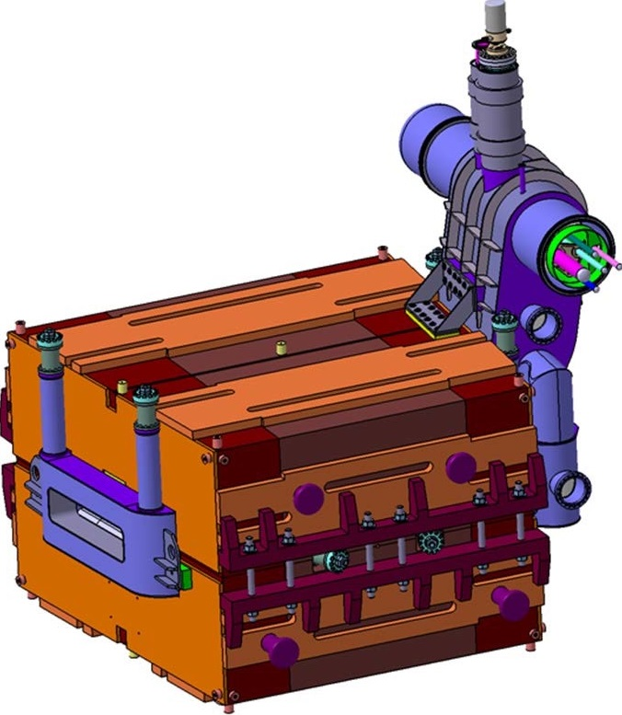
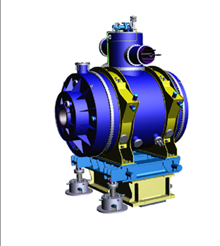
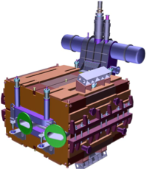
Super-FRS superconducting magnets
# | Type | Mass | Cold mass | LHe volume | Operation current | Stored energy | Inductance | Aperture | Peak field
 |  | (kg) | (kg) | (m³) | (A) | (MJ) | (H) | (mm) | (T)
21 | Dipoles | 50000 | 2000 | 0.025 | 236 | 0.45 | 26 | 70 x 190 | 1.6
7 | Short Multiplet | 28000 | 20000 | 0.8 | 300 | 1 | 21 (Quad) | 380 | 2.5
24 | Long Multiplet | 60000 | 45000 | 1.5 | 300 | 2.7 | 21 (Quad) | 380 | 2.5
Standard Dipoles
Short Multiplets
Long Multiplets
Branch dipoles
4 m
7 m
2.7 m
2.5 m
From 2 up to 9 magnets in the same cold mass
2019-06-11

Slide 5
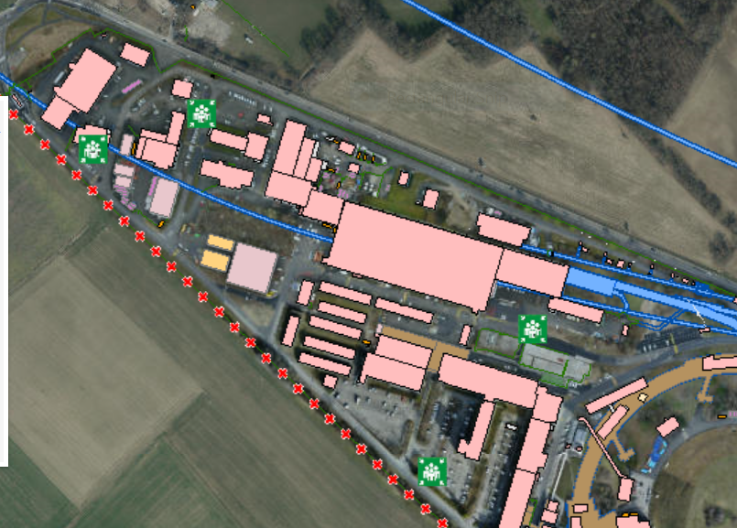
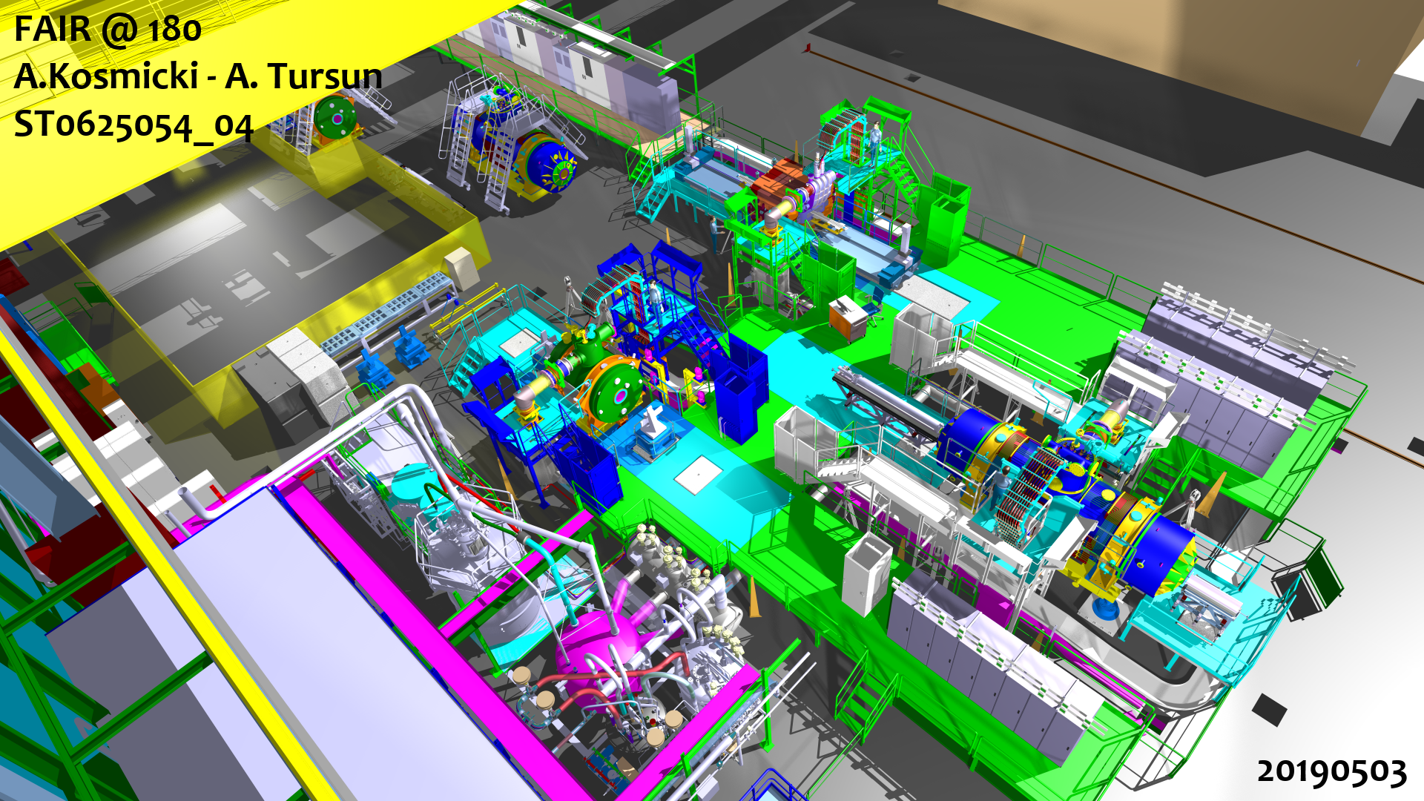
Super-FRS magnets test stand @ CERN
CERN’s building 180
Facility Construction
2012-2018 → CERN contribution
180
Power converters
Preparation area
Control racks
Test area
Cold Box
Dewar
Control racks
2019-06-11

Slide 6
Super-FRS magnets test stand @ CERN
CERN’s building 180
Facility Construction
2012-2018 → CERN contribution
180
Power converters
Preparation area
INFRASTRUCTURE
3 test benches
3 cryogenic distribution systems
9 power converters circuits
3 energy extraction systems
2 over-head cranes (40T and 60T)
OPERATION
I_{max} = 330 A
T_{op} = 4.5 K
Control racks
Test area
Cold Box
Dewar
Control racks
2019-06-11

Slide 7
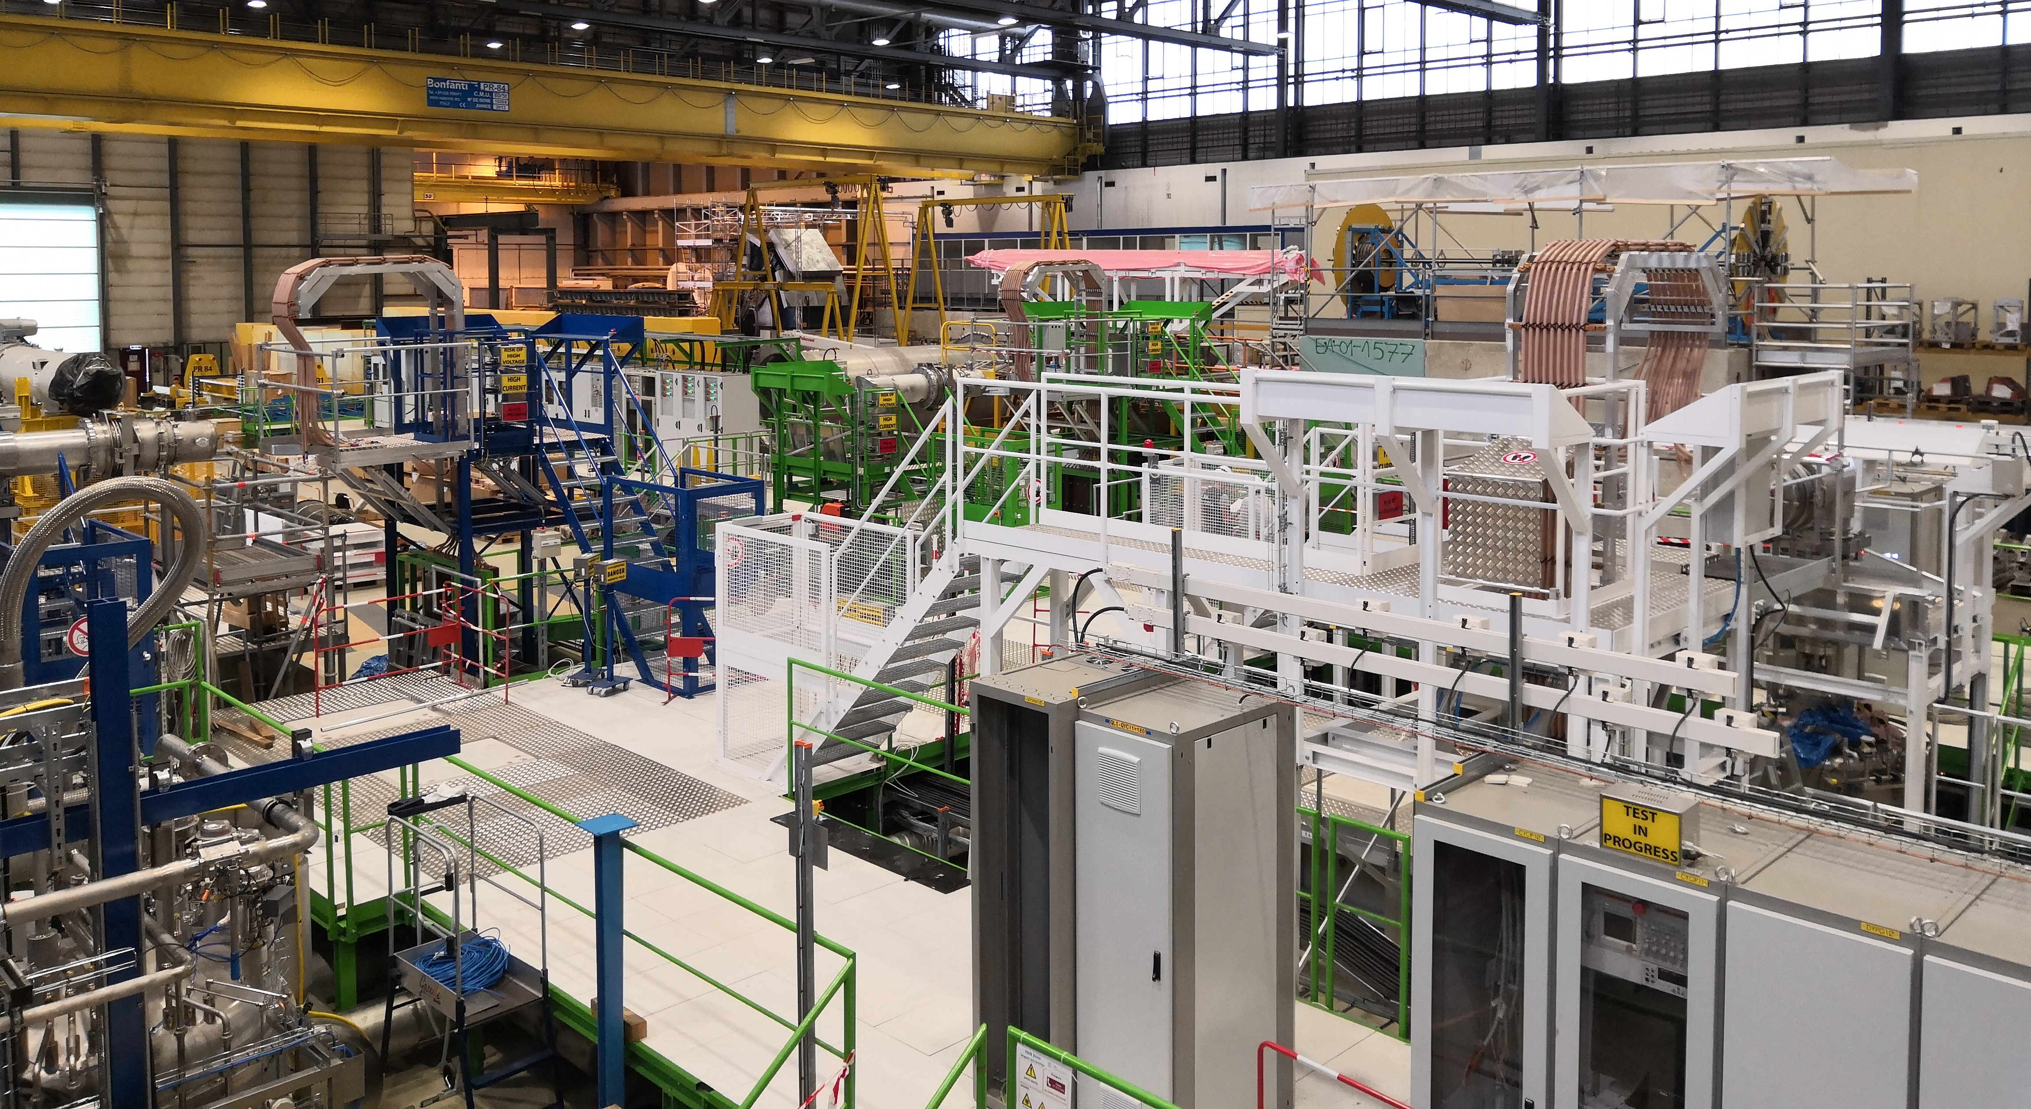
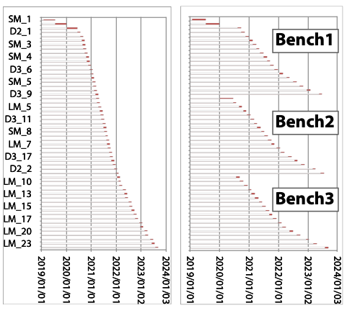
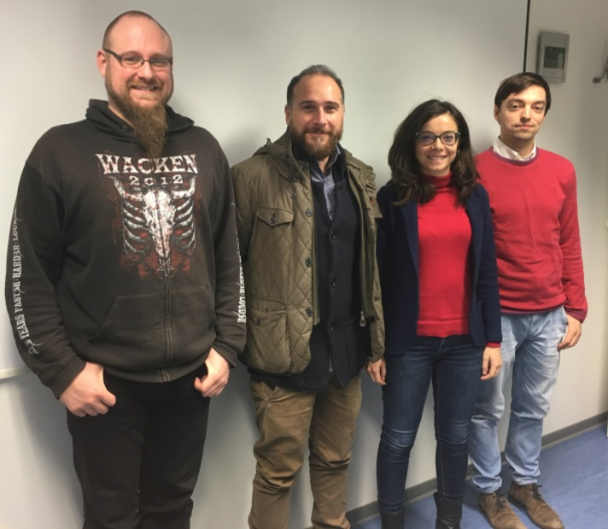
Testing team and plan
Facility Commissioning: 2018-2019 with the first magnet
Facility Operation: 2018-2023 GSI team + CERN Cryo OP
2019-06-11

Slide 8
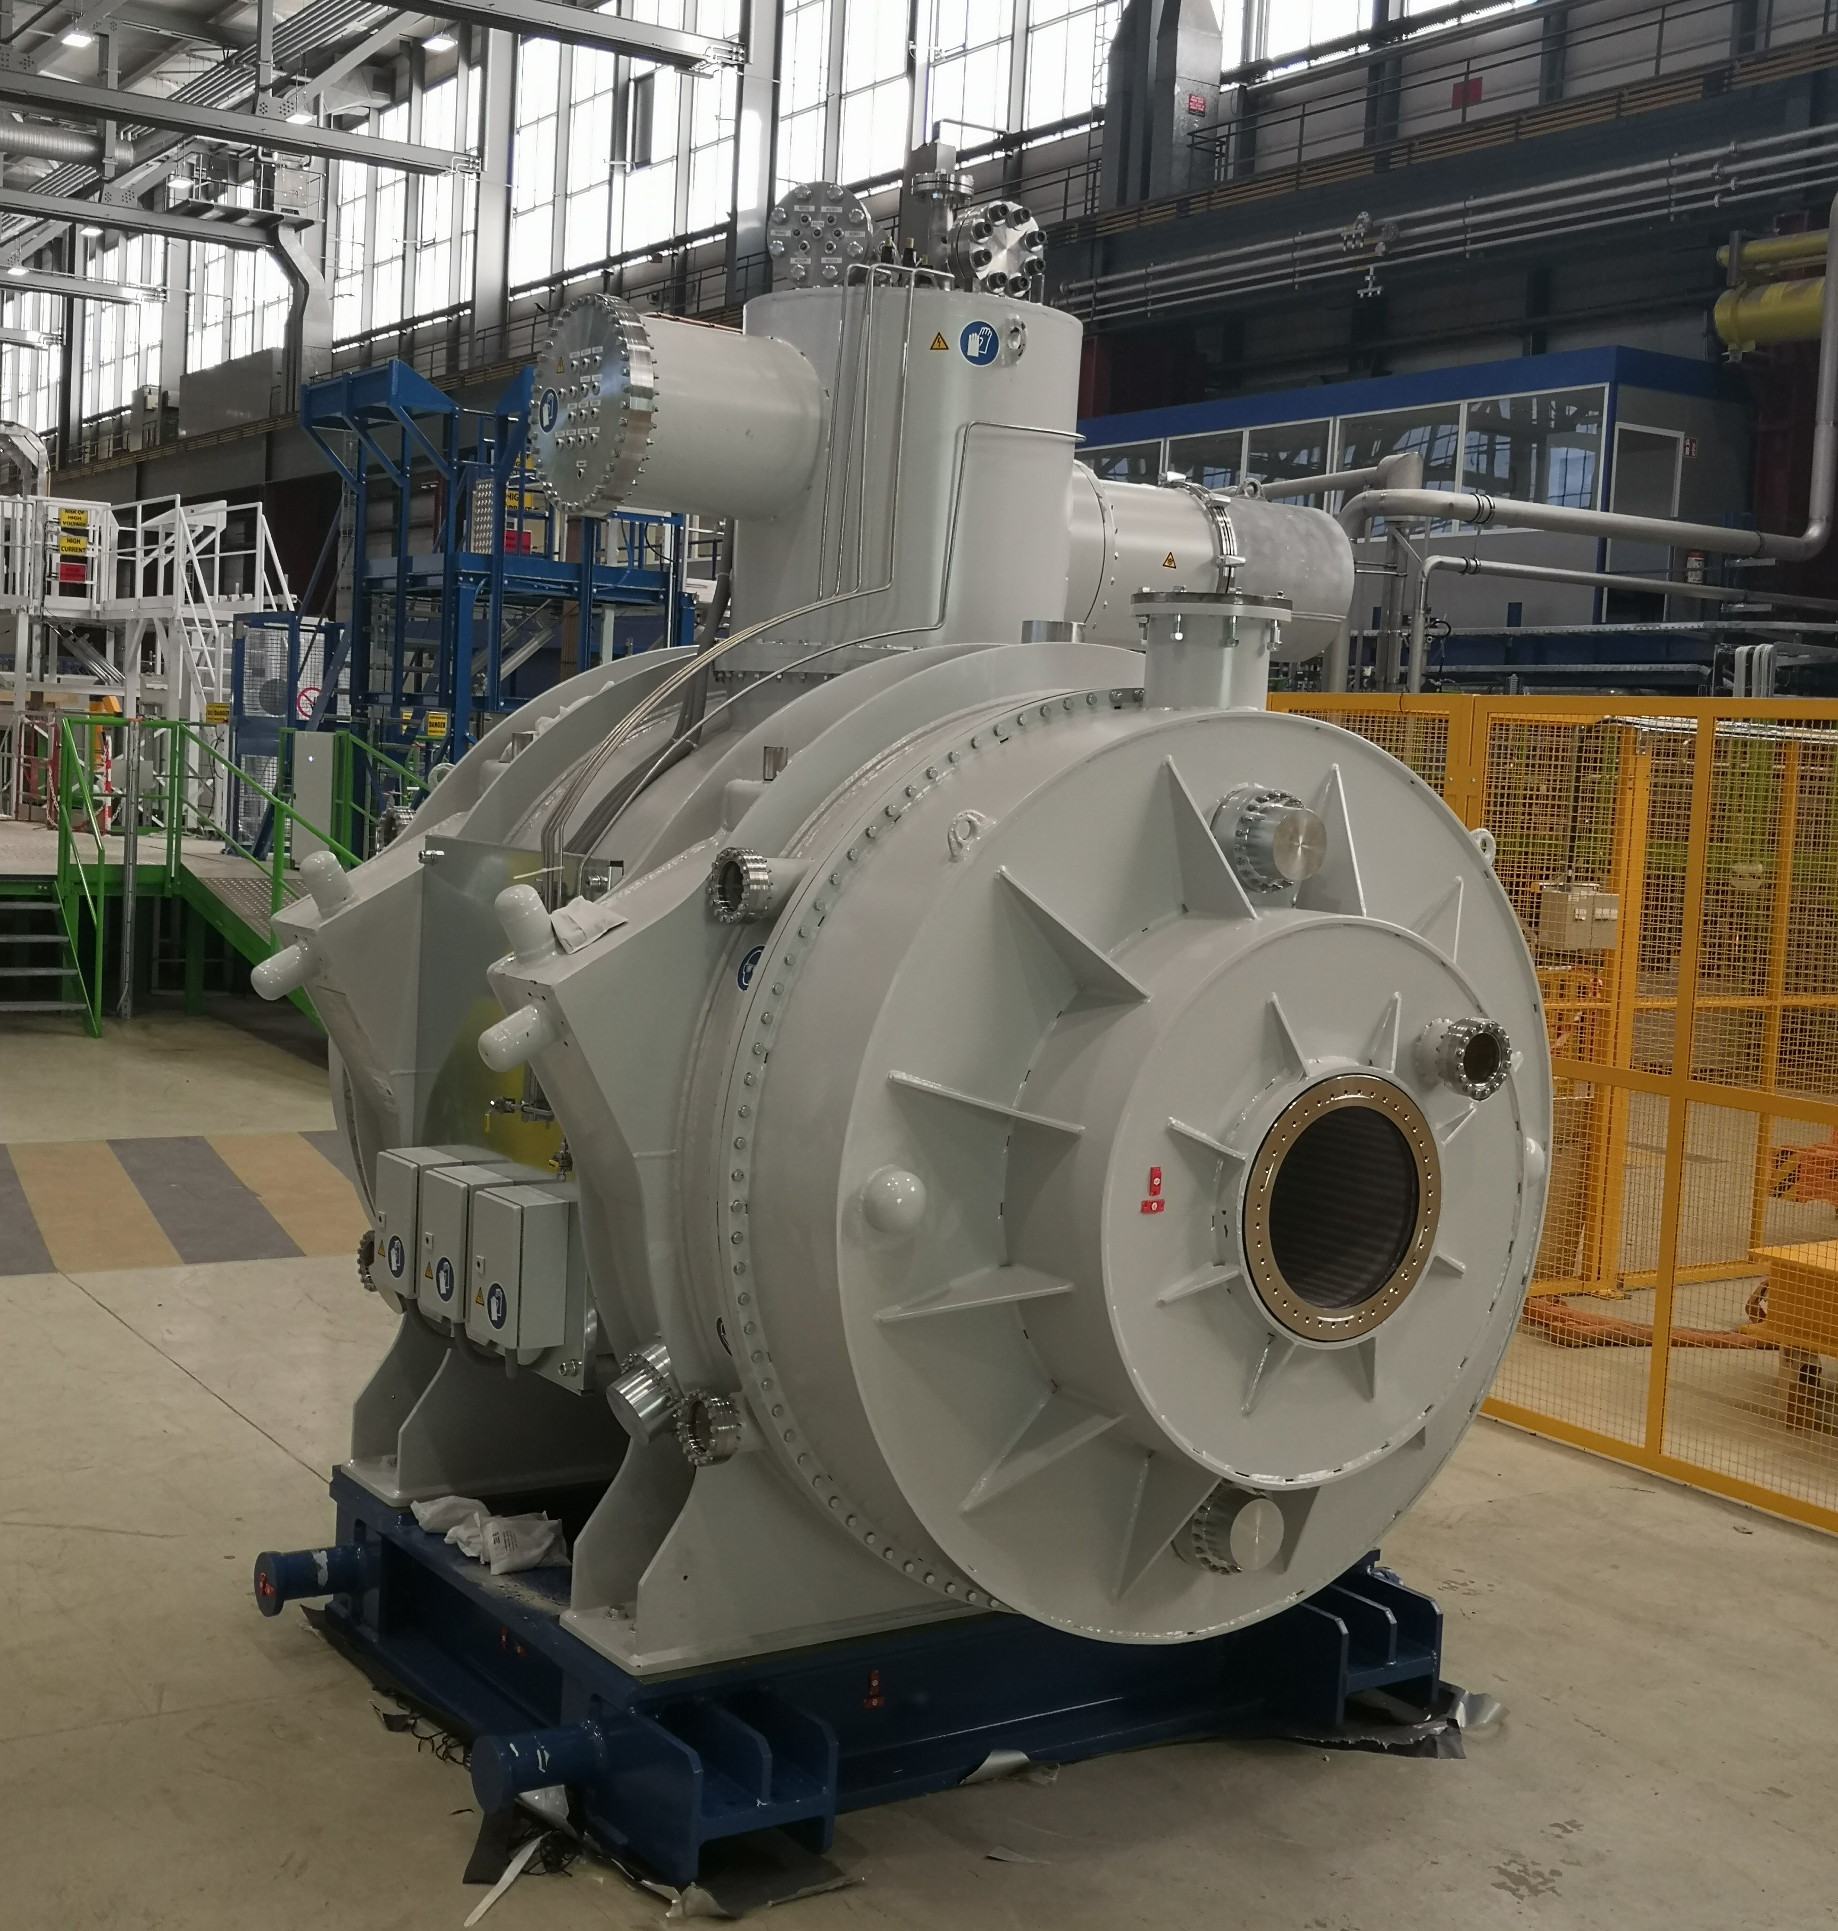
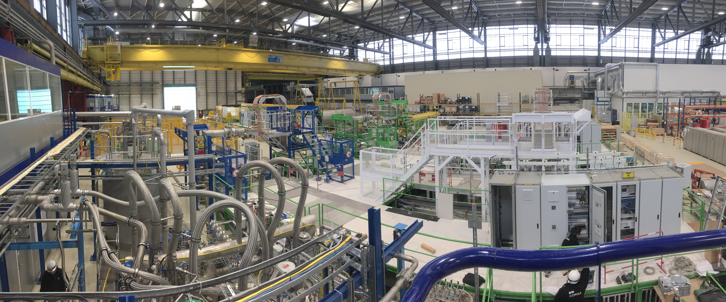
Test facility interfaces
Facility
Interface | GSI | CERN
Electric | Current lead warm terminal | Cable from power converter
Mechanic | Magnet feet | Spacer on the floor
Cooling | Cryogenic jumper line | Satellite valve box
(Helium return) | Instrumentation panel | Helium return line
Vacuum | Cryostat vacuum pump port | Vacuum pump
Alignment | Fiducial targets on cryostat | Fiducialization
Instrumentation | Cabinet for sensor signals | Control system
Magnetic | Magnet | Magnetic measurement systems
2019-06-11

Slide 9
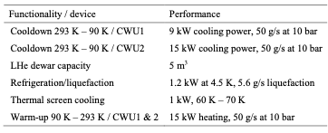
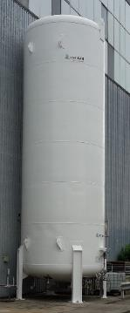
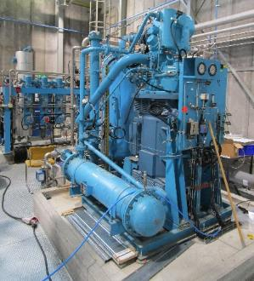
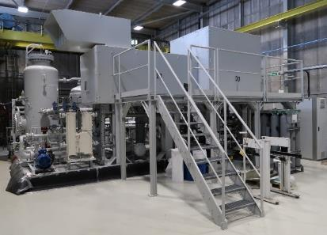
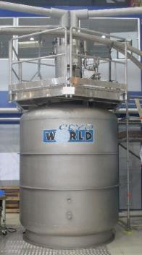
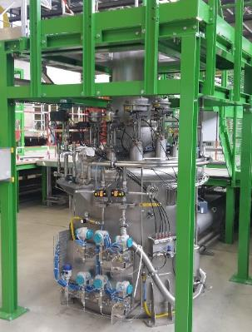
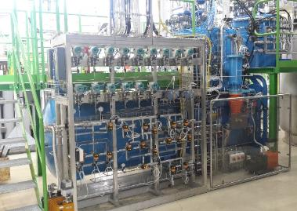
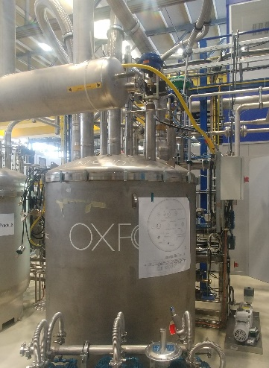
Cryogenics
Cryogenic main sub-systems
Pre-cooling system
LHe system
Cryogenic distribution system
50 g/s at 17 bar
150 g/s at 18 bar
Courtesy of G. Rolando (TE-CRG-ME)
2019-06-11

Slide 10
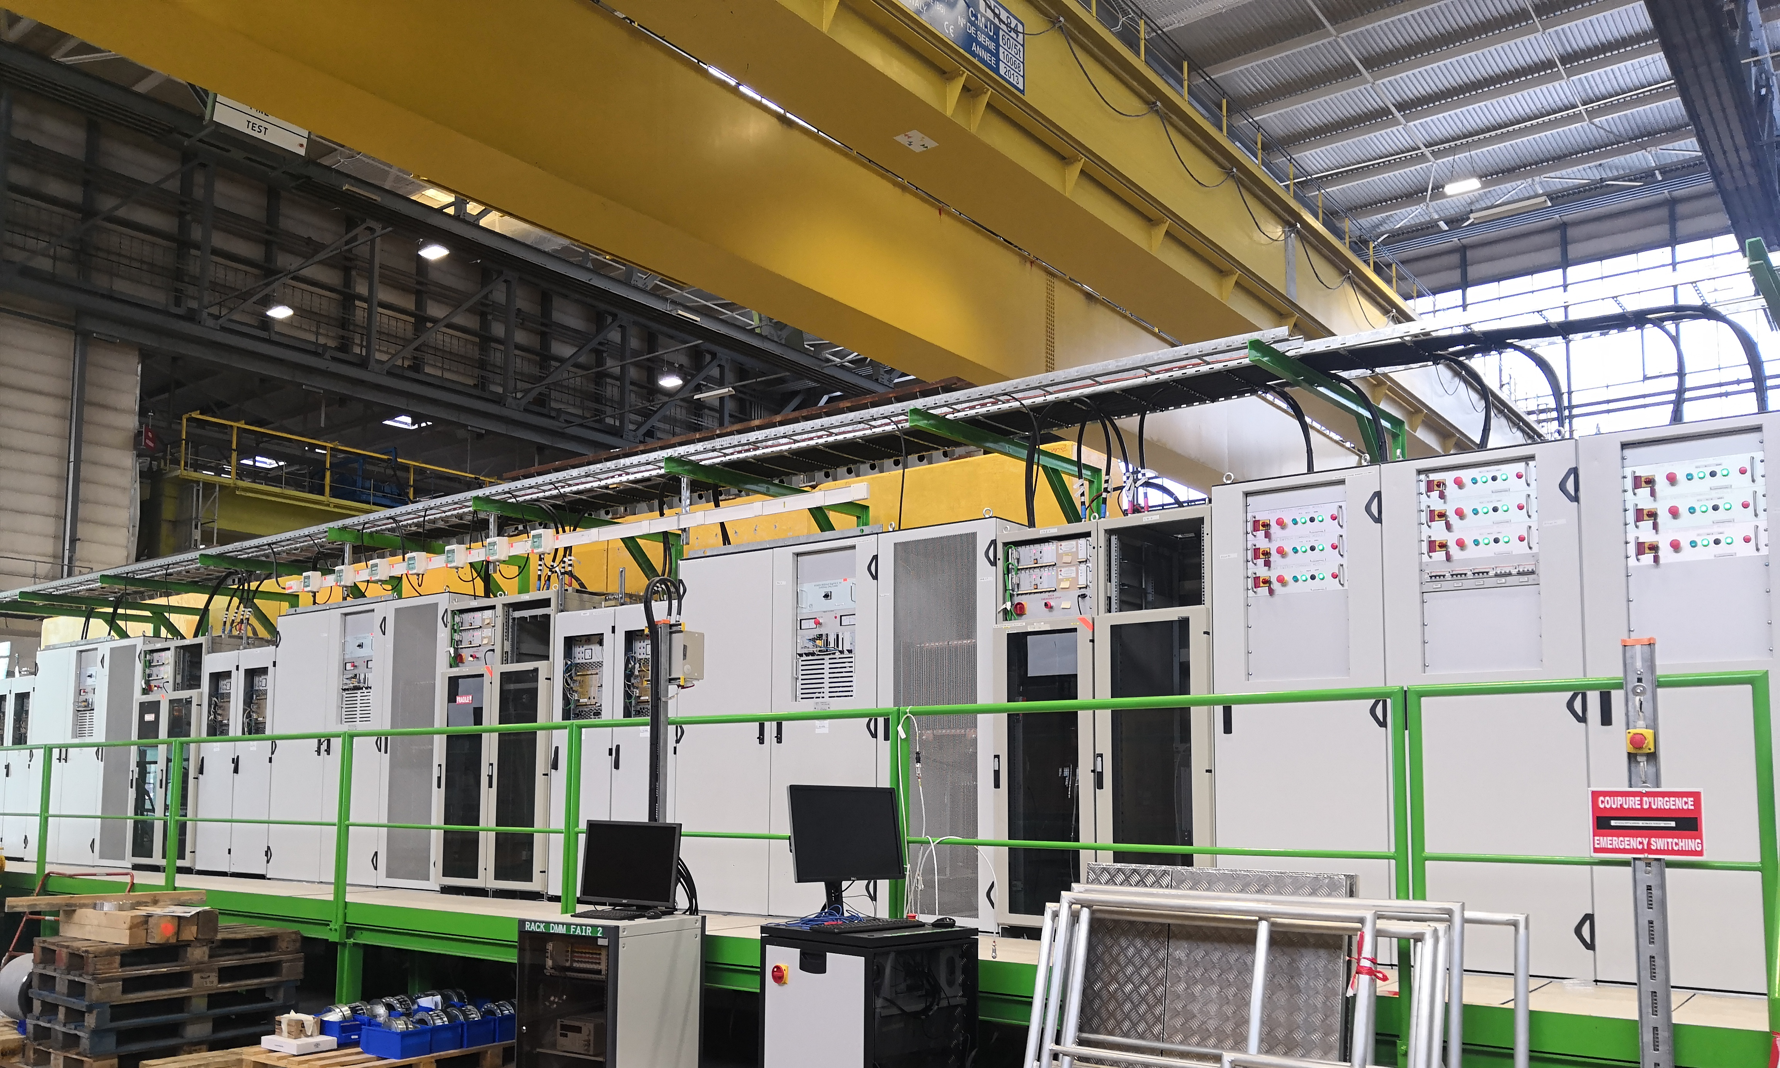
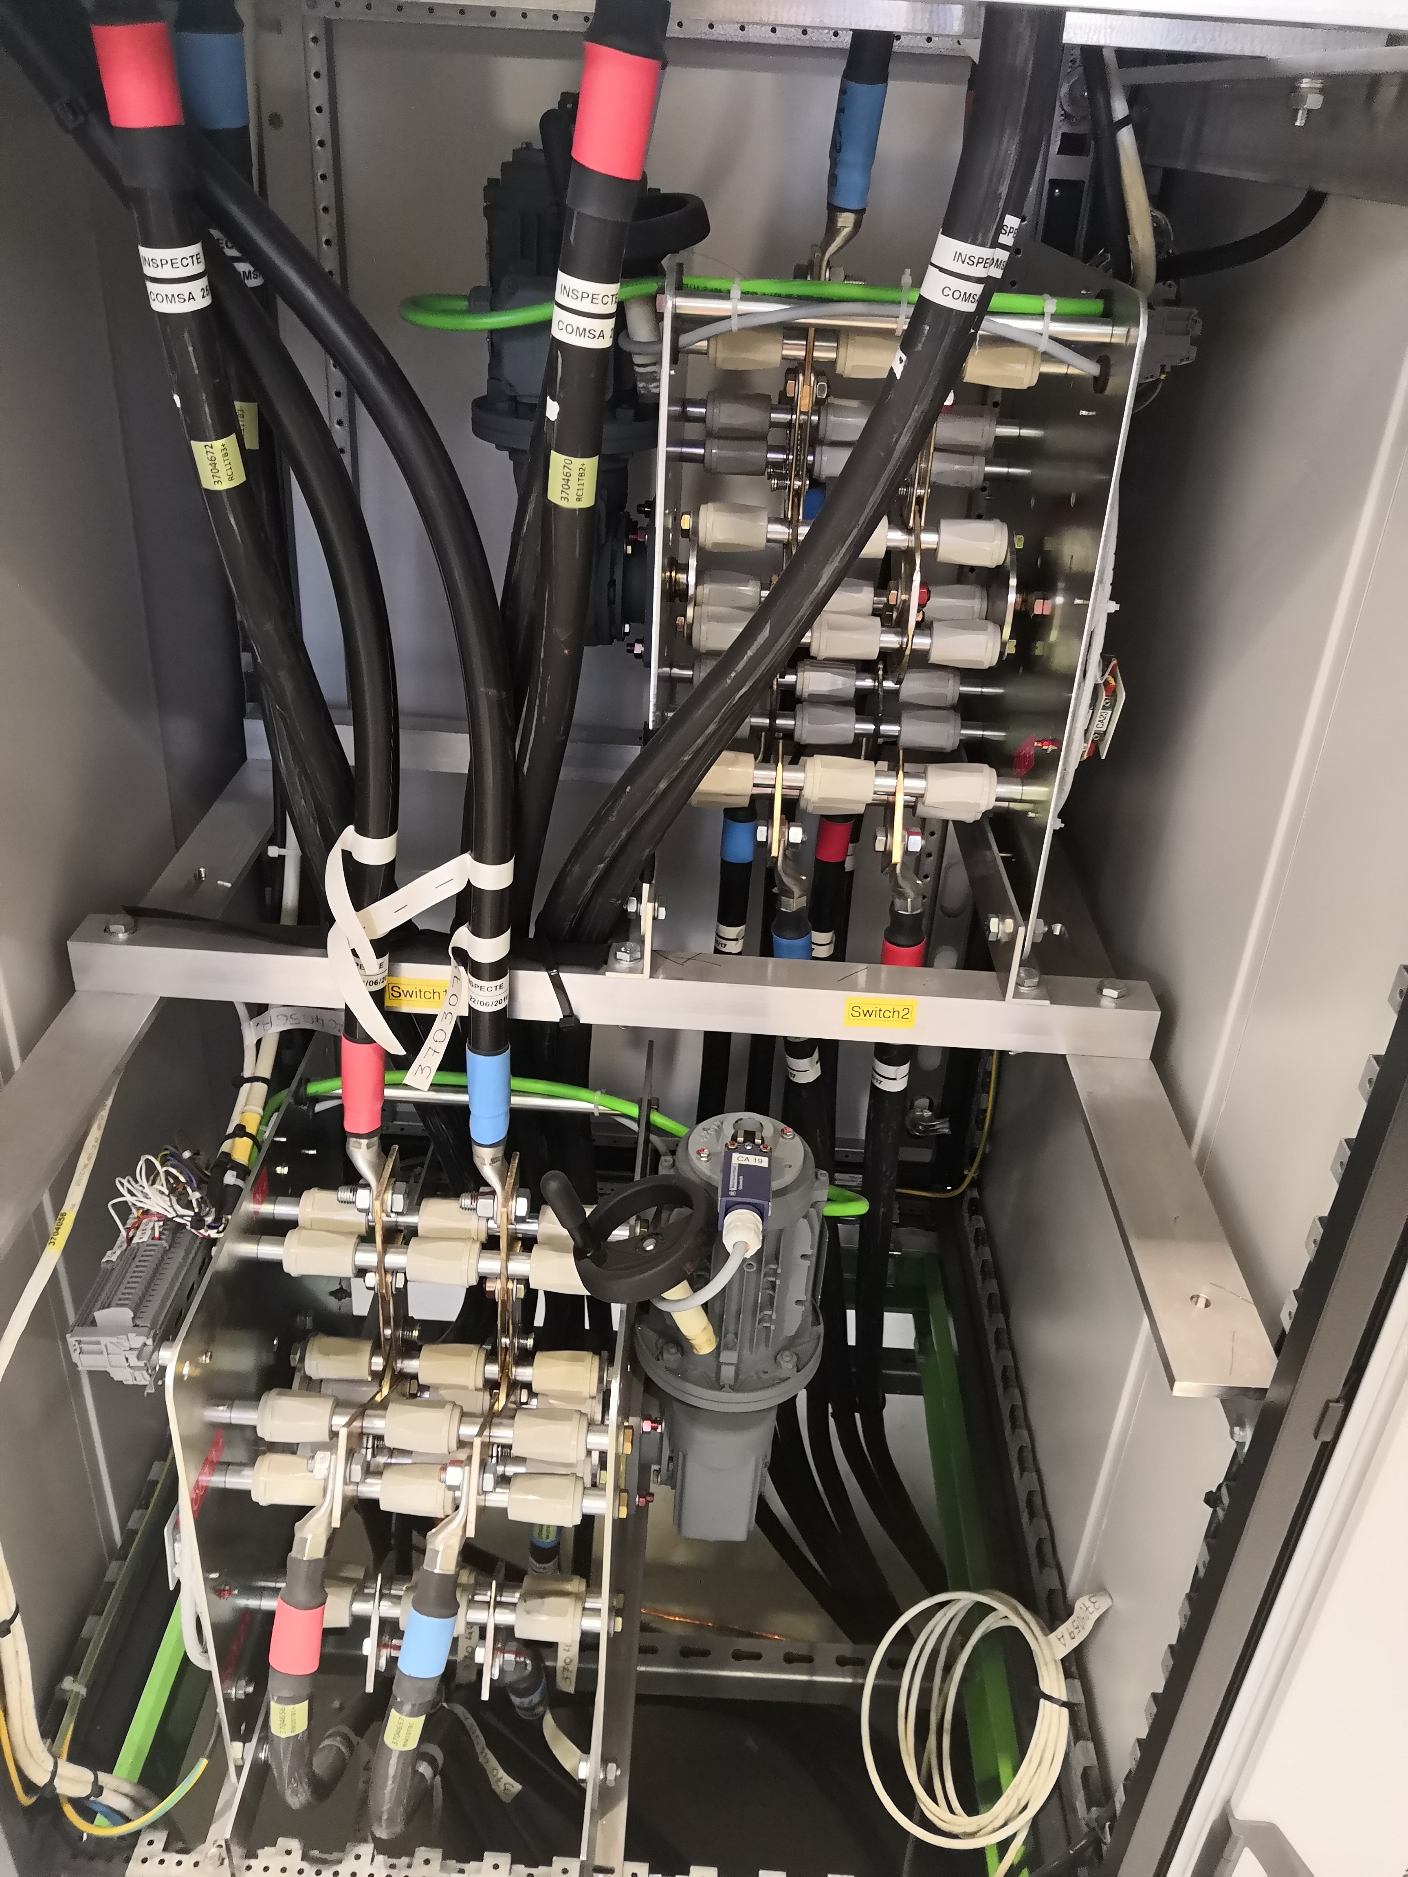
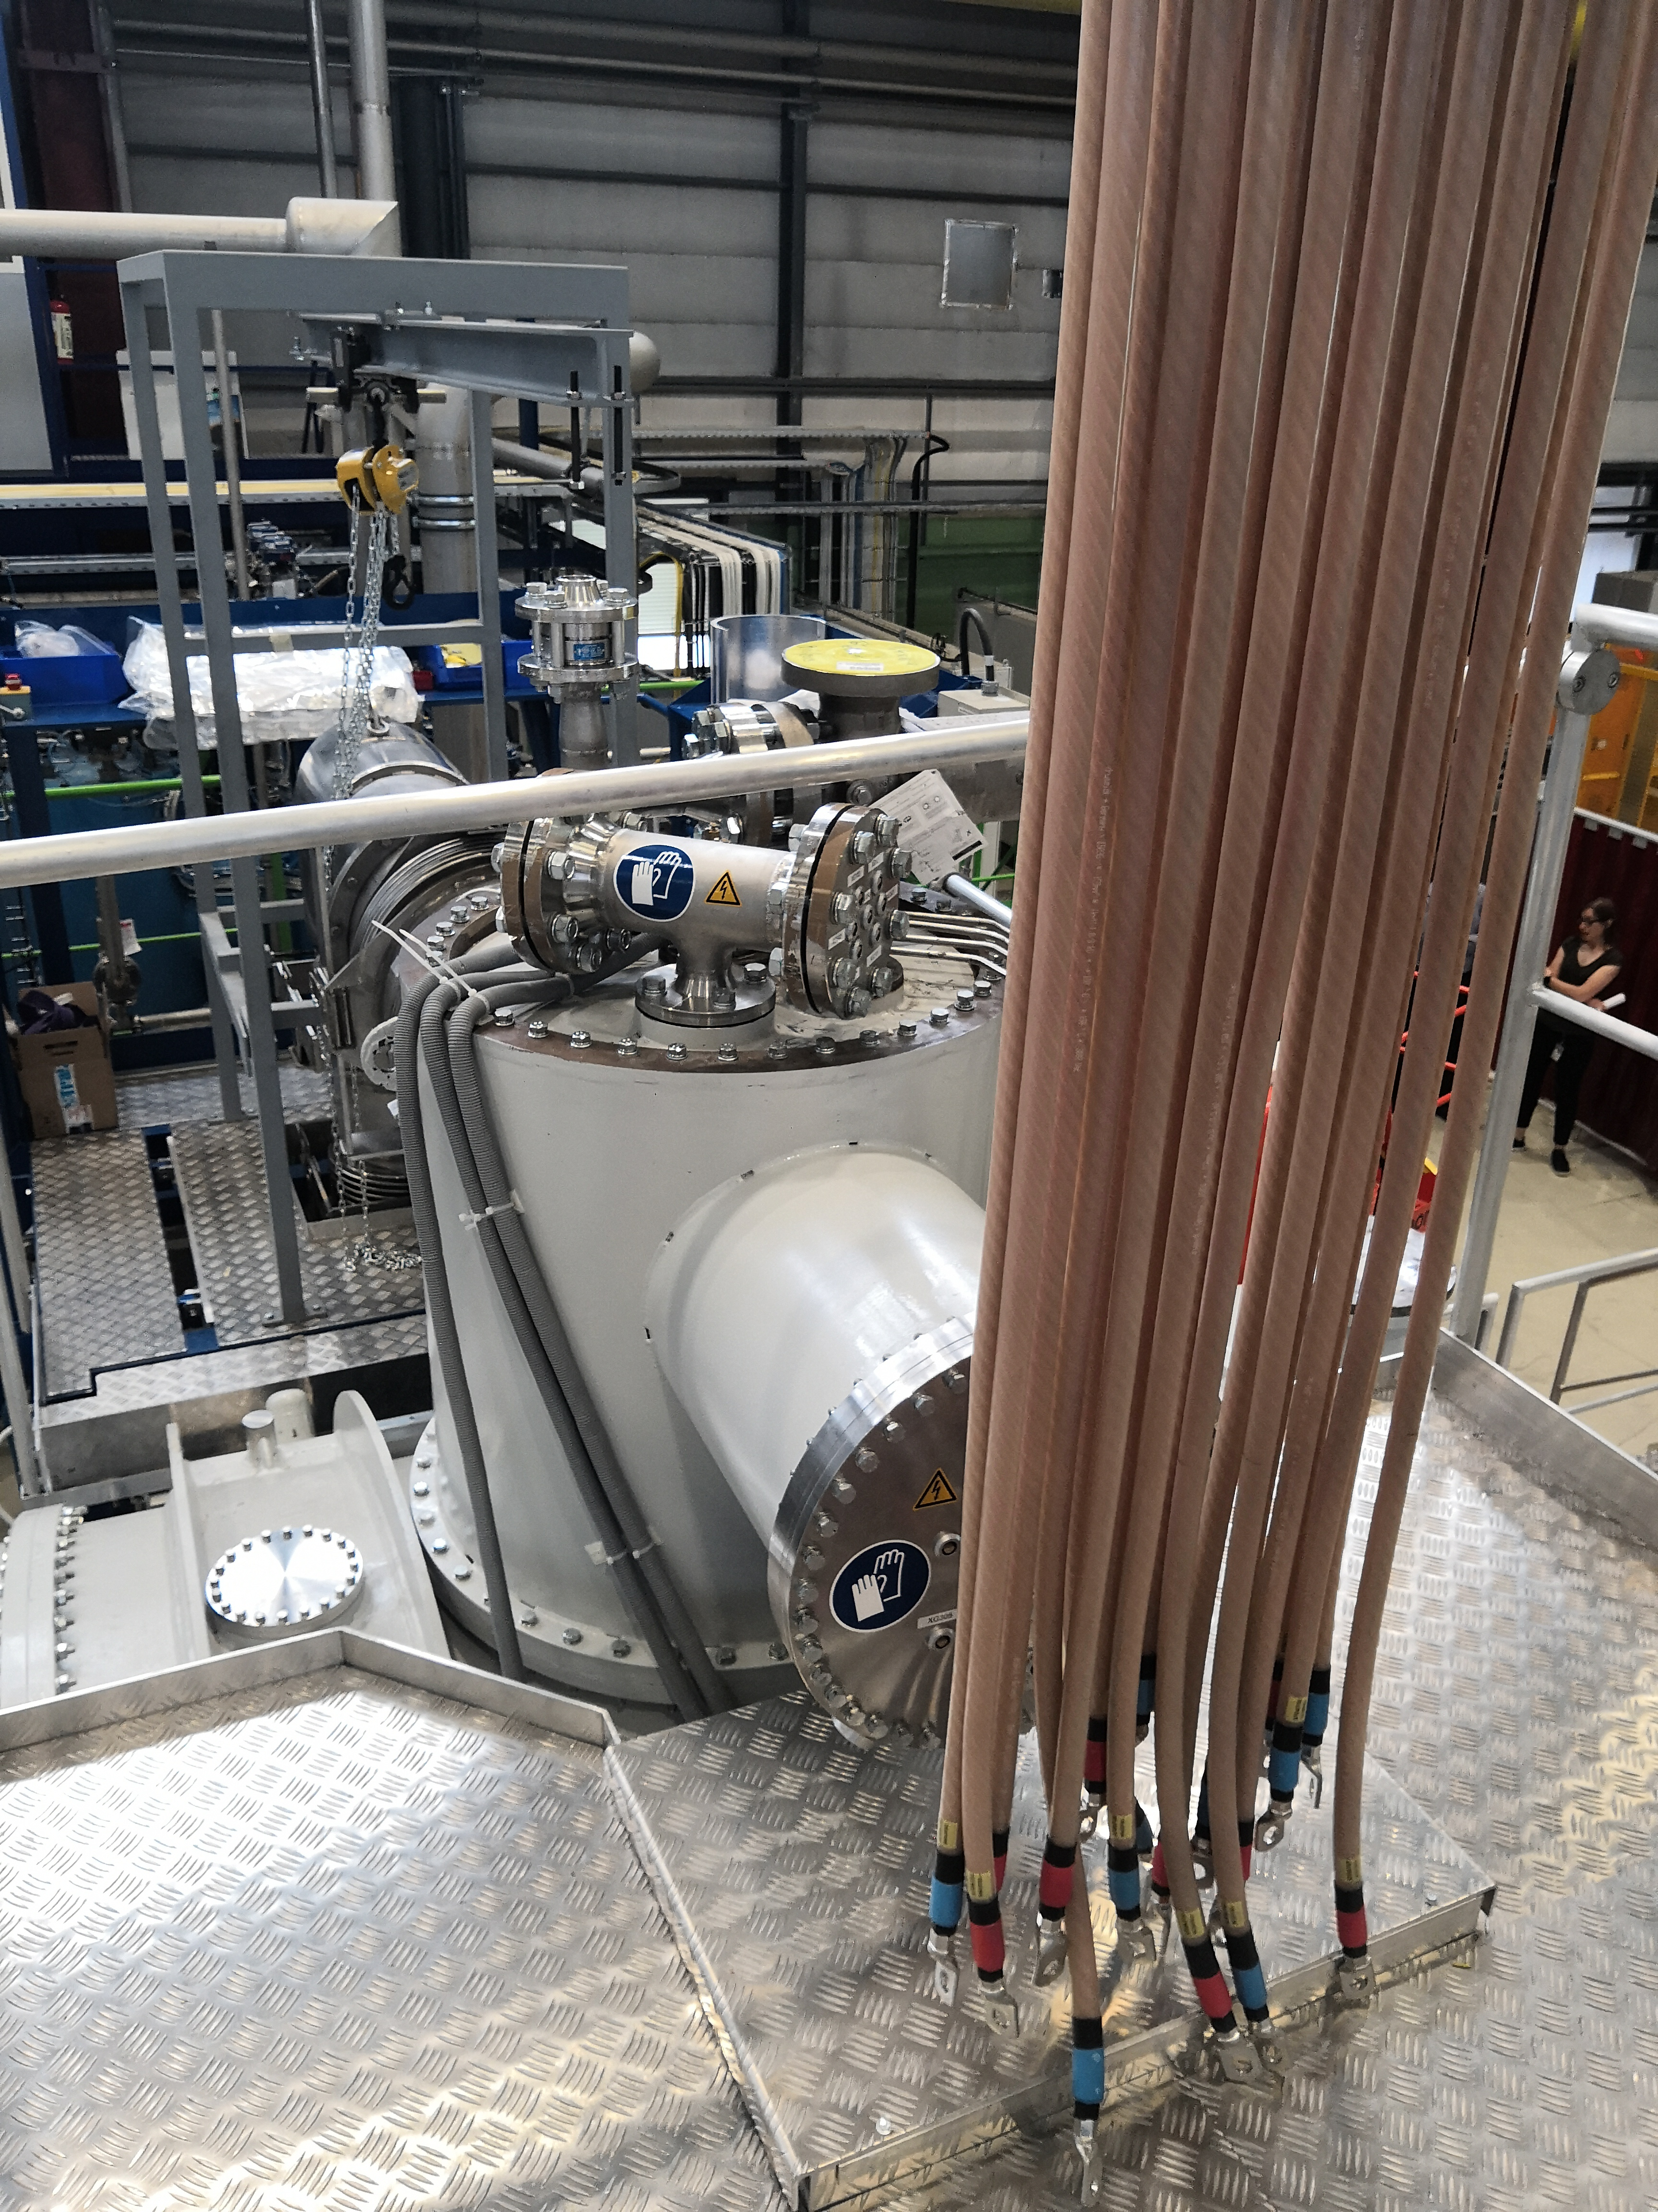
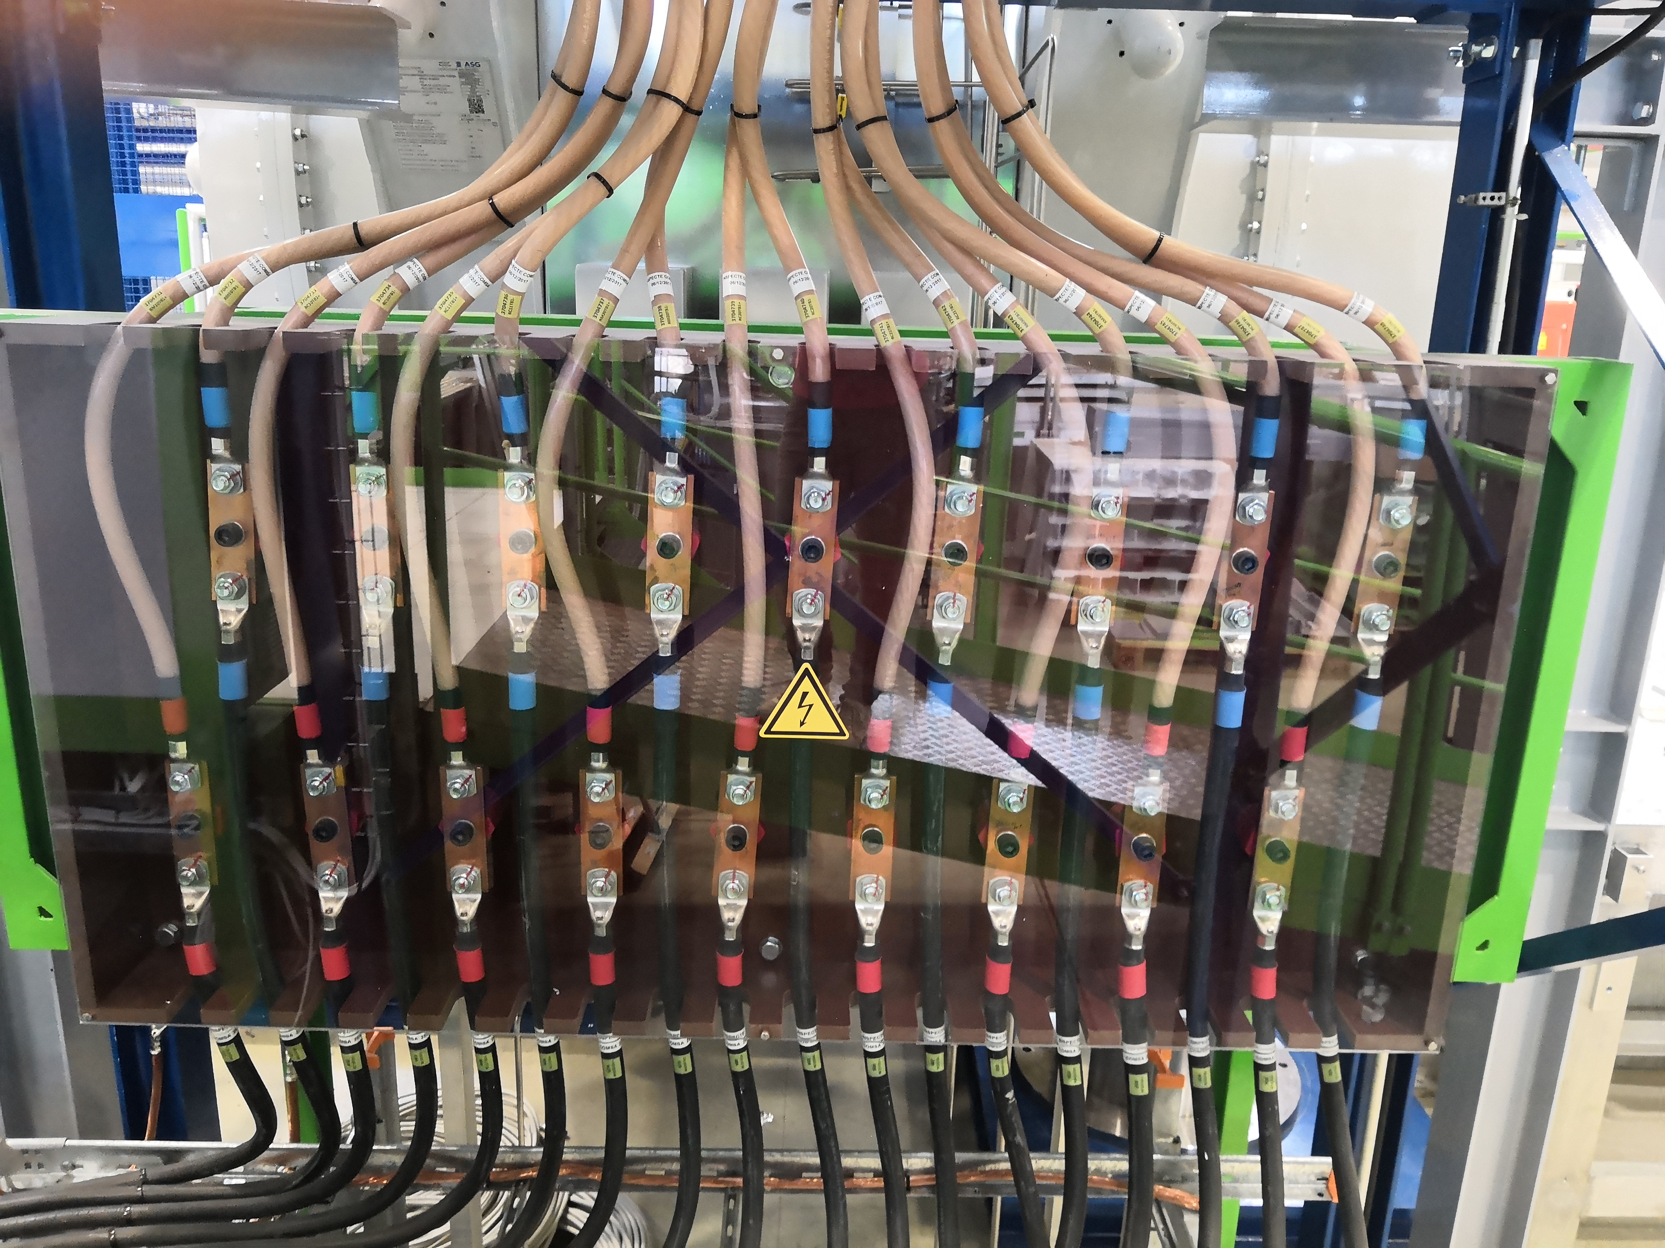
Power Converter, Energy Extraction, Power Cables
Power converters Racks
Load Switches
Power Cables
3 x [±500A/±120V] for the main circuits + EE system with 2.8 Ohm resistance for the quadrupoles
6 x [±600A/±40V] for the corrector circuits
9 load switches interlocked
78 DC powering cables, with a combined total length of about 2900 m
2019-06-11

Slide 11
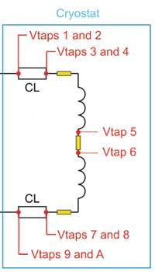
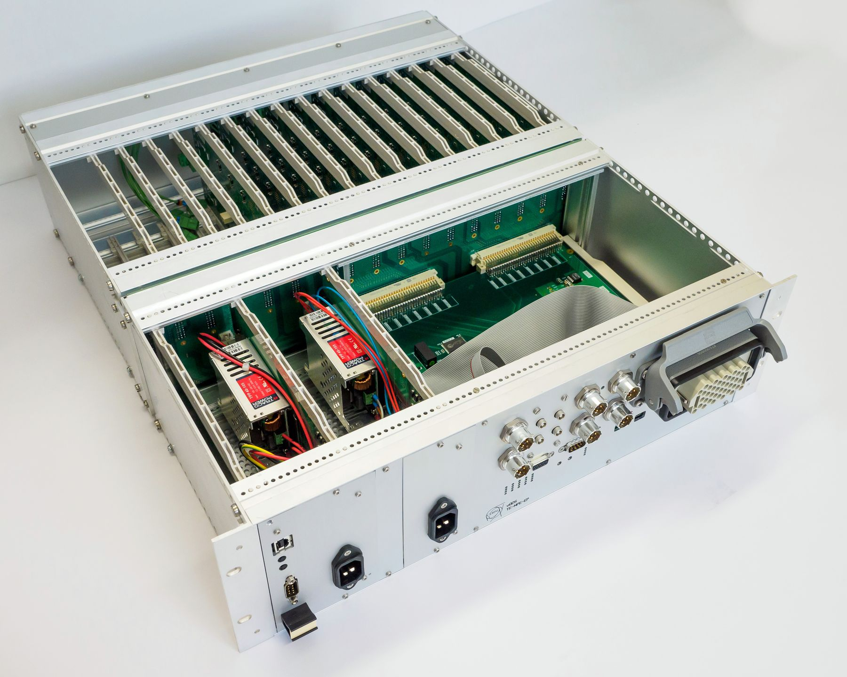
Universal Quench Detection System
Integrated data acquisition system oﬀers high sampling rates
Front-end channels
(up to 16)
Backplane with signal connector(s)
Galvanic insulation
2.5kV
Digital mid-plane
Redundant power supplies
(monitored)
Interlocks & communication
Redundancy on the level of crate
Enhanced availability of supervision
Qualified in radiation
Radiation tolerant up to 100 Gy
Field Bus
base line prototype for the HL-LHC quench detection system
Courtesy of M. Zerlauth (TE-MPE-MS)
2019-06-11

Slide 12
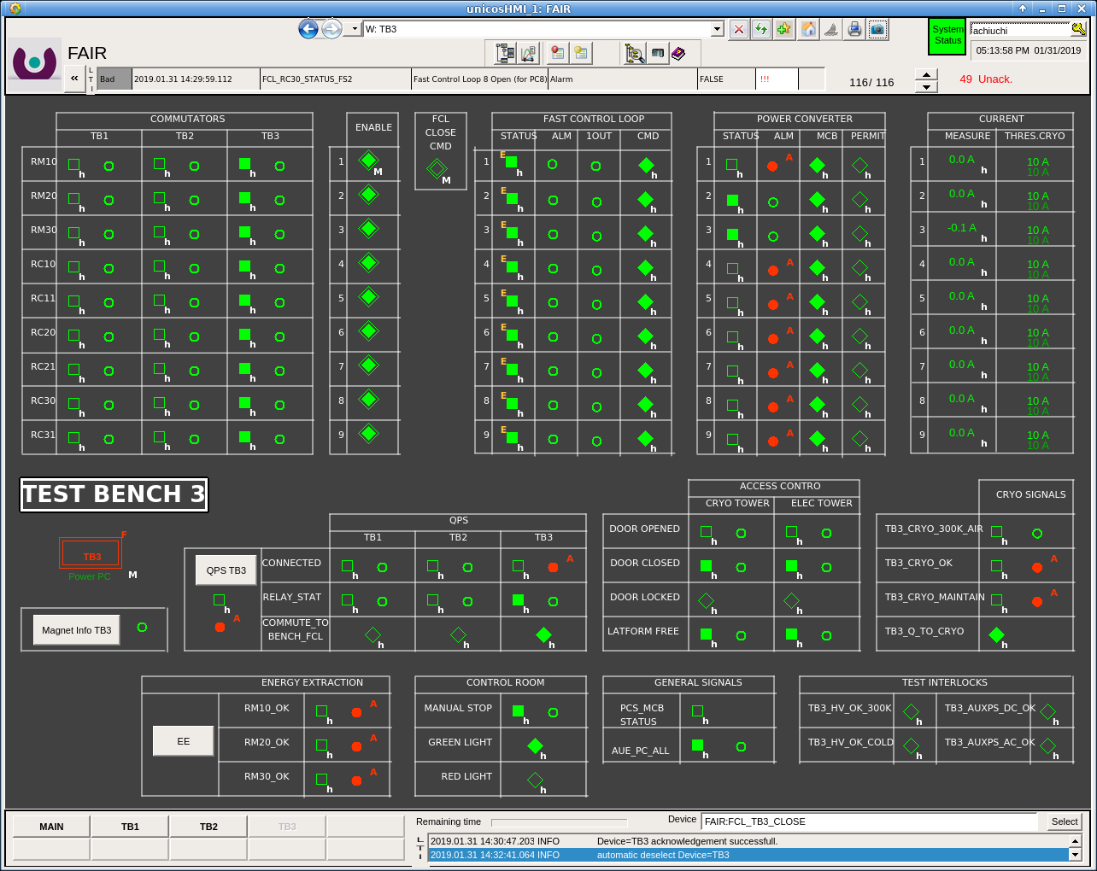
Interlock PLC
Power commutators
Power converters
EE switches
QDS
Platform access
Cryogenic PLC
2019-06-11

Slide 13
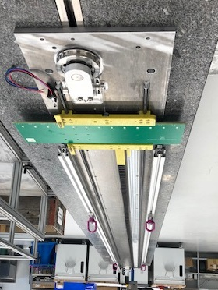
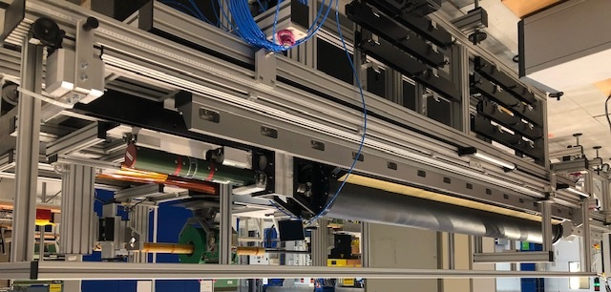
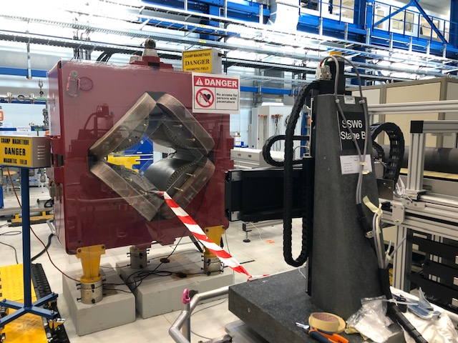
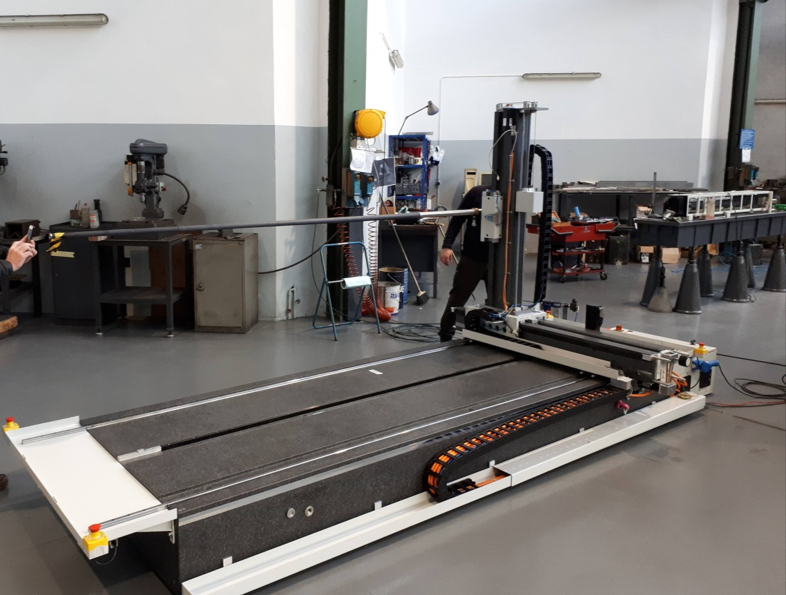
Magnetic measurements
Magnetic field measurements for magnet acceptance
4 measurements devices
Giancarlo Golluccio’s talk: Magnetic measurements techniques for Super FRS Today at 17:55
2019-06-11

Slide 14
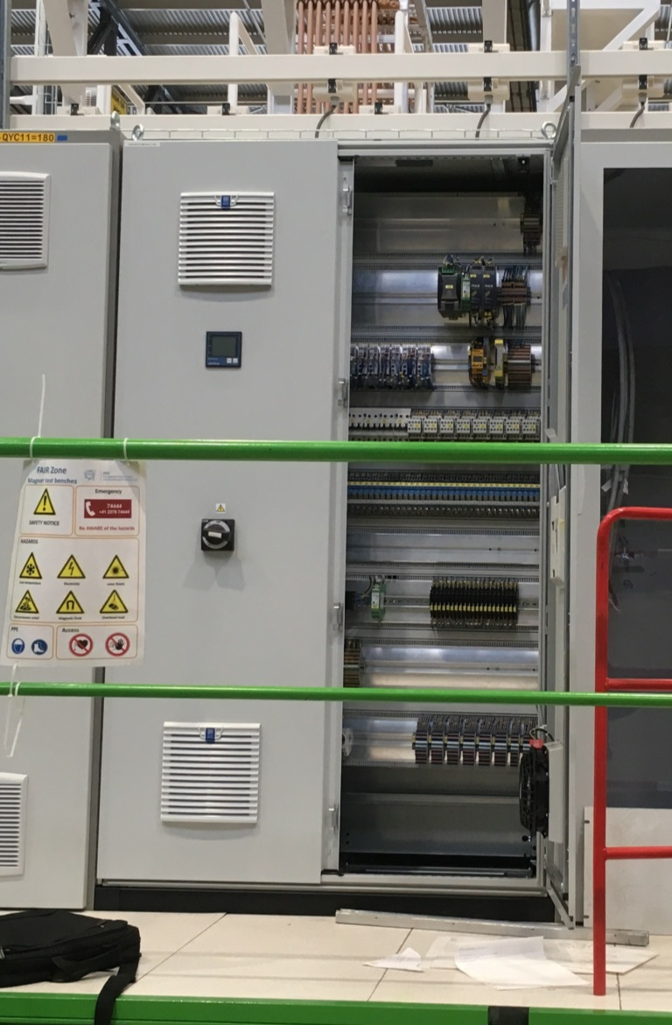
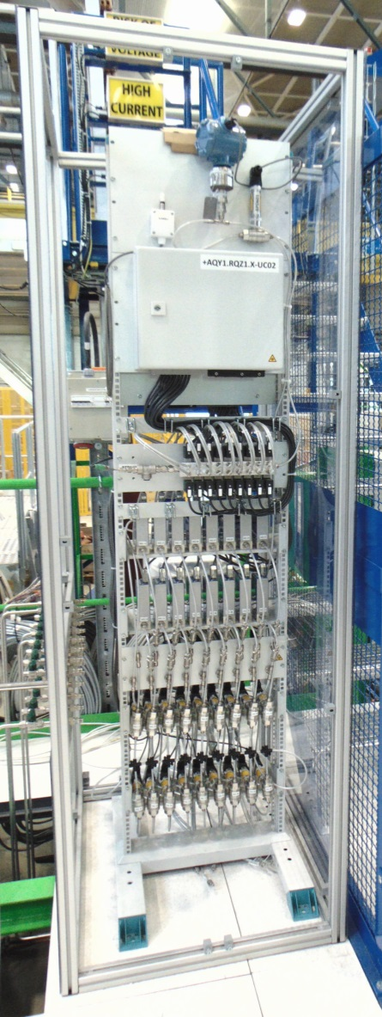
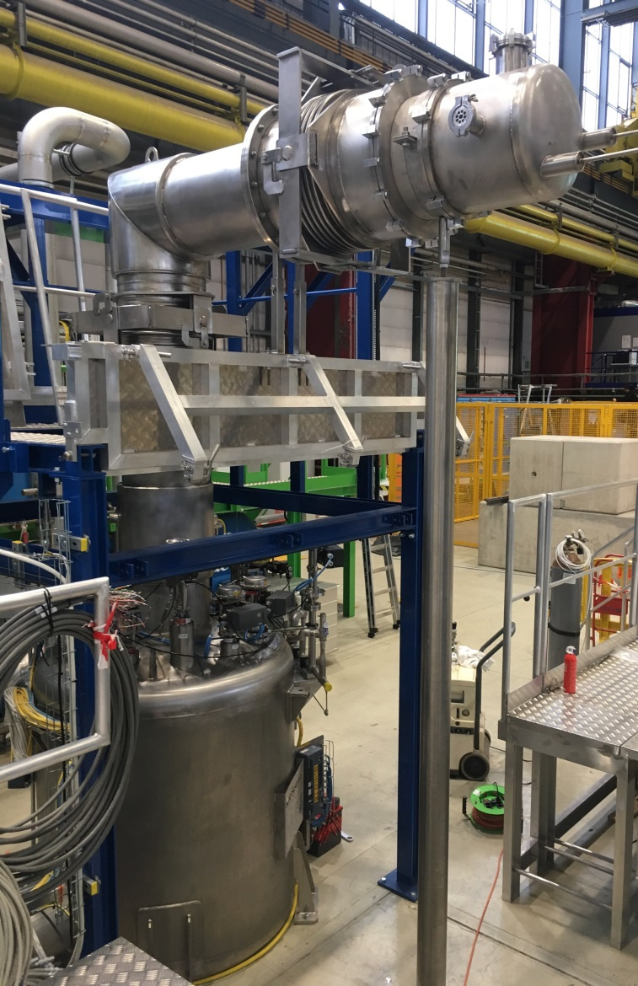
GSI contribution
Electrical Cabinet
Jumpler line
(GSI)
Satellite valve box
(CERN)
Instrumentation panel
2019-06-11

Slide 15
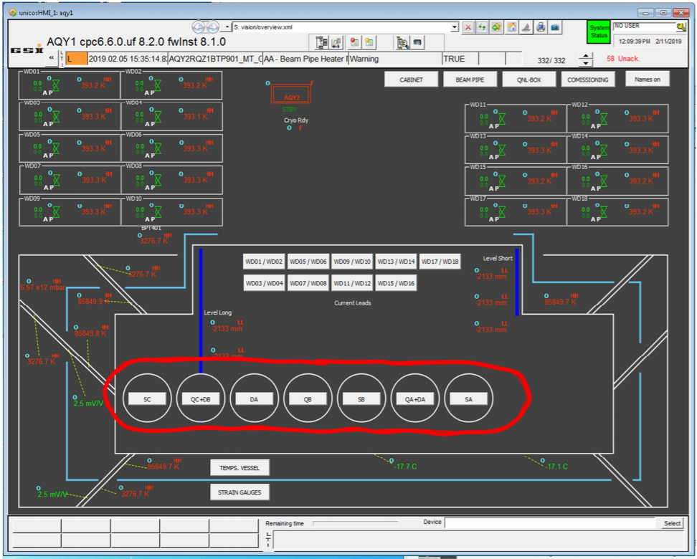
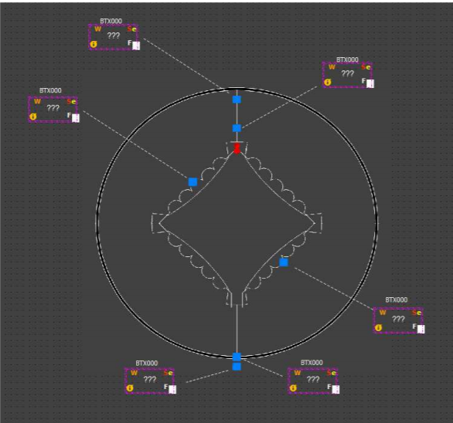
GSI contribution
SCADA software based on the UNICOS-framework: monitoring and control of magnet and current leads instrumentation
Configuration of the different panel types for each magnet
2019-06-11

Slide 16
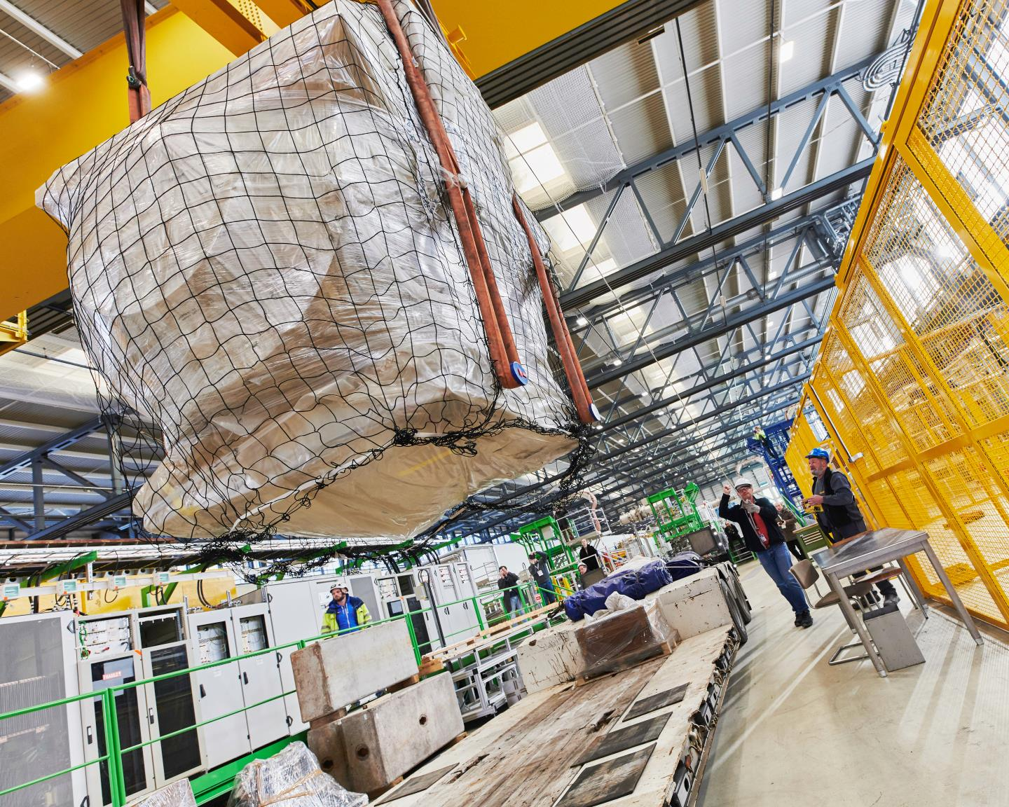
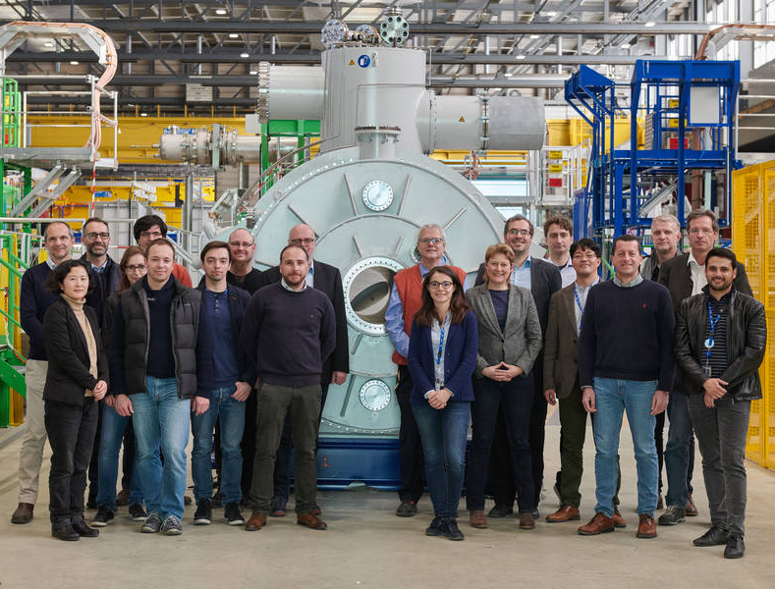
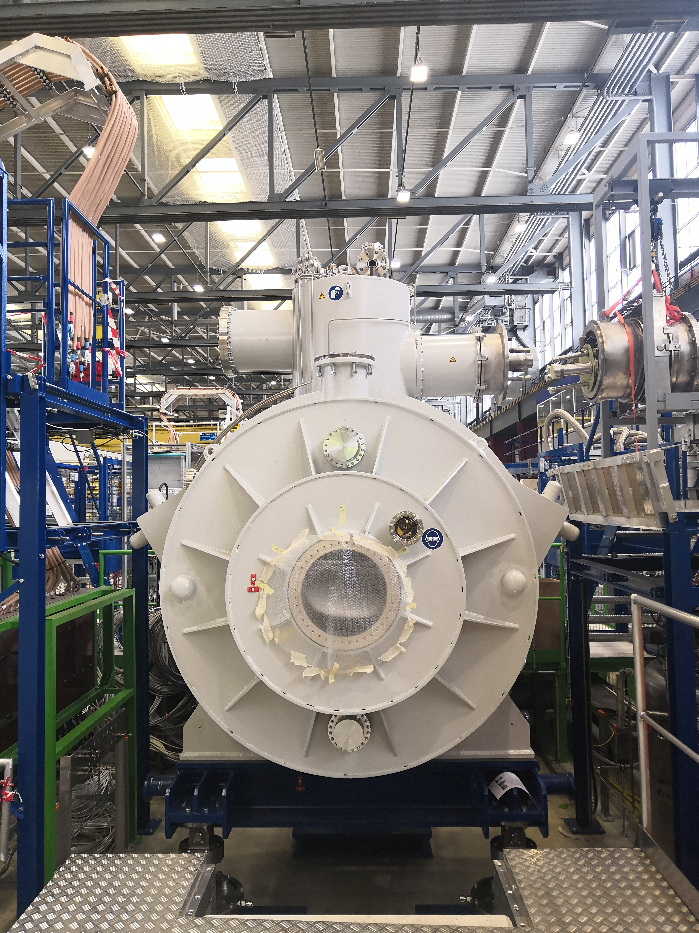
Status Today
First SM arrived on Feb 7th, 2019
Electrical integrity Tests done
SM preparation for the bench done
Installation on the test bench May 7th, 2019
Cold mass survey measurements
Insulation vacuum and leak test on going
1st Cooldown 25th June, 2019
2019-06-11

Slide 17
Thank you for your attention

Slide 18
Back up

Slide 19
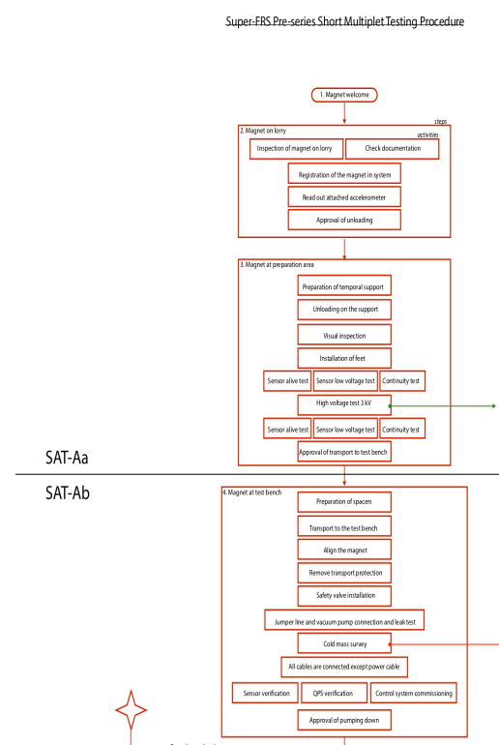
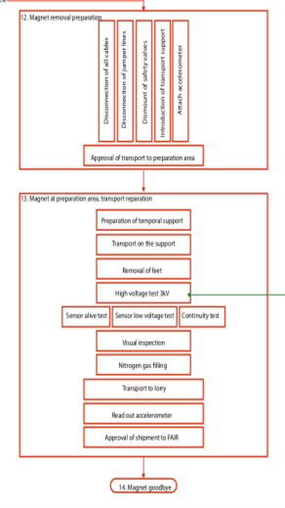
Test plan for FoS short multiplet
Steps
magnet welcome
magnet on lorry
magnet at preparation area
magnet at test bench
isolation vacuum pumping
cool down
cold test without excitation
cold test wit excitation
Magnetic measurements
warm up
warm test under vacuum
warm test at atmosphere
magnet removal preparation
magnet at preparation area, transport preparation
magnet goodbye
(Delivery at CERN, 7th Feb. 2019)
Now
2 times
(thermal cycle)
(Shipment to FAIR, end of 2019)

